Slide 1

Perspectives on Causal Inference
Epidemiology 207 - Epidemiology Methods II
June M. Chan, ScD
Professor, Epidemiology & Biostatistics and Urology
Steven & Christine Burd Safeway Distinguished Professor

Slide 2

Brief Overview of Causal Models and Heuristics
Causal guidelines (B. Hill)
Sufficient cause & Causal Pies (Rothman, Ch. 2)
Counterfactual model and causation vs. association (Hernan & Robbins Ch. 2)

Slide 3

Sufficient & Component Cause Model and Causal Pies
-K. Rothman
https://www.youtube.com/watch?v=zSuEm4CUa6Y
~25 min, John Snow lecture, May 2013
Notes:
Sound goes out a little around minute 4, fyi

Slide 4
Overview – Perspectives on “Cause” from K. Rothman
What is a cause?
Causal Pie Model & terms
  Sufficient cause
  Component cause
  Necessary cause
  Strong component cause
Limitations of Causal Pie Model

Slide 5


What is a cause?
A cause of a specific disease event [is] an antecedent event, condition or characteristic that…
  was necessary for the disease at the moment it occurred, given that other conditions are fixed.
  preceded the disease event and without which the disease event would not have occurred at all or would not have occurred until some later time.
Kenneth Rothman

Slide 6
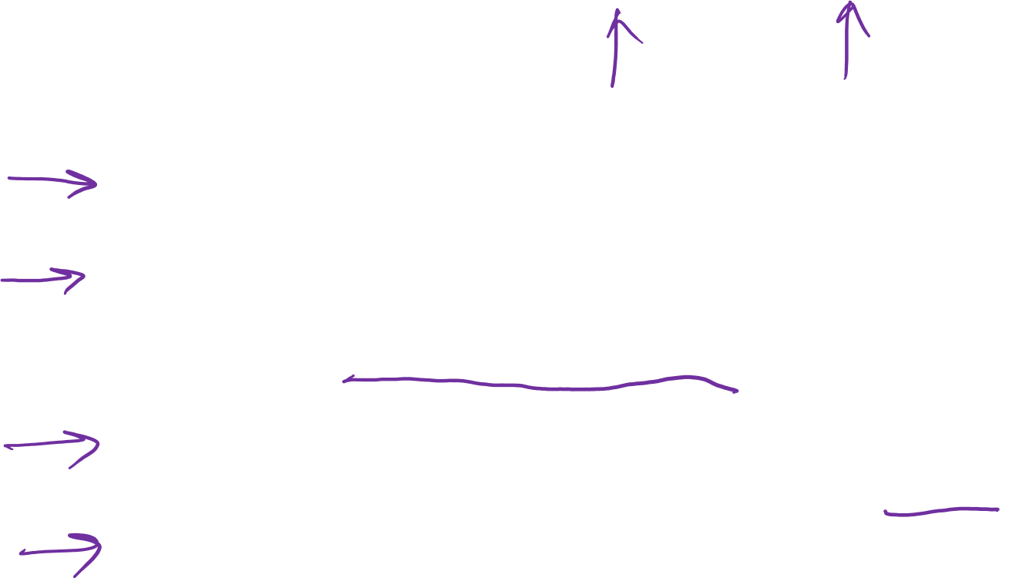
Types of causal relationships - “Necessary” vs. “Sufficient"
A Cause can be…
  Necessary and sufficient
    E.g., genetic mutation for Tay-Sachs disease
  Necessary but not sufficient
    Multiple factors acting in a specific temporal sequence
    E.g., Infection with M.tuberculosis is necessary but not always sufficient to cause symptomatic, full-blown TB
  Sufficient but not necessary
    E.g., both ionizing radiation and benzene exposure cause leukemia
  Neither sufficient nor necessary
    Many different pathways of getting the same disease
    E.g., Obesity and MI
Notes:
Another set of explanations:
http://sphweb.bumc.bu.edu/otlt/mph-modules/ep/ep713_causality/ep713_causality4.html

Slide 7

“An event, condition, or characteristic is not a cause by itself as an intrinsic property it possesses in isolation, but as a part of a causal contrast with an alternative event, condition, or characteristic.”
IMPORTANT to always specify the reference or control group
RGL, 2008, p. 8

Slide 8

The causal pie model
(sufficient component model)
Each pie is a theoretical causal mechanism for a given disease (“sufficient cause”)
Each individual instance of disease occurs through a single sufficient cause
U
A
B
T
X
B
RGL, 2008, Ch 2

Slide 9
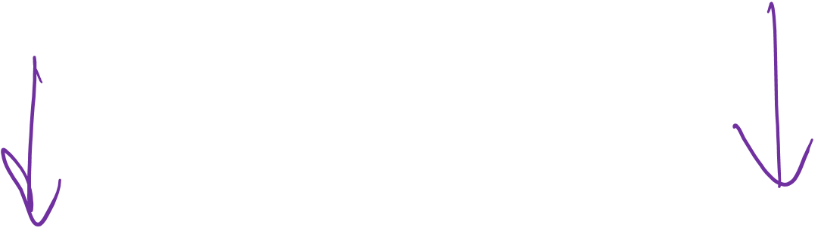
Sufficient and component causes
U
T
A
B
X
B
Sufficient Cause 1
Sufficient Cause 2
A sufficient cause is a set of minimal conditions or events that inevitably produce disease

Slide 10
Sufficient and component causes
Component causes
U
T
A
B
X
B
Sufficient Cause 1
Sufficient Cause 2
A sufficient cause is a set of minimal conditions or events that inevitably produce disease

Slide 11
Sufficient and component causes
Component causes
A component cause is any one of a set of conditions which are necessary for the completion of a sufficient cause
U
T
A
B
X
B
Sufficient Cause 1
Sufficient Cause 2
A sufficient cause is a set of minimal conditions or events that inevitably produce disease

Slide 12

Sufficient and component causes
A necessary component cause is a component cause that is a member of every sufficient cause
U
T
A
B
X
B
Sufficient Cause 1
Sufficient Cause 2

Slide 13
Sufficient and component causes
A strong component cause is a component cause that plays a causal role in a high proportion of cases in the population
U
T
A
B
X
B
Sufficient Cause 1
Sufficient Cause 2

Slide 14
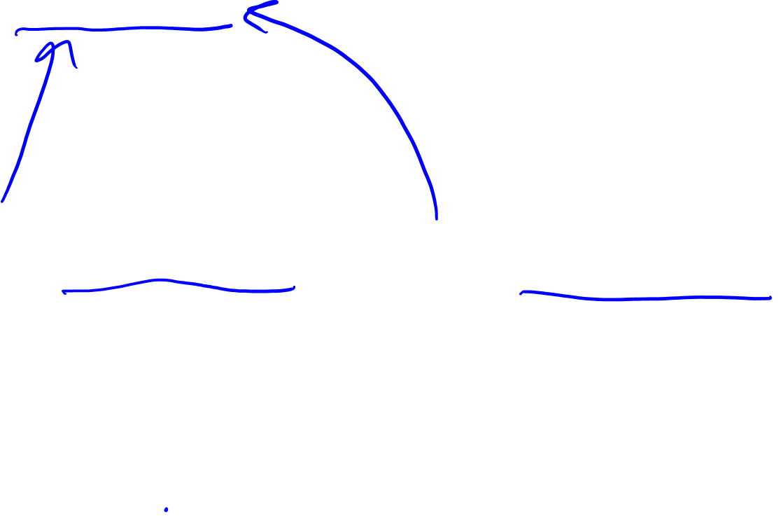
Example: Tuberculosis
Necessary but not sufficient
M. tuberculosis
M. tuberculosis
Poor
nutrition
Immuno-
suppression
Sufficient Cause 1
Sufficient Cause 2
Neither necessary nor sufficient
Notes:
“Mycobacterium tuberculosis”

Slide 15

Insights from Causal Pies
An effect has more than one cause
Component causes interact to form a sufficient cause
If we sum the proportions of disease attributable to each component cause, there is not an upper limit
  Each case of disease is due to every component cause of the completed sufficient cause
  Attributable fraction added across component causes of the same disease do not sum to 1
  Only the fraction of disease attributable to a single cause cannot exceed 100%
  P.14-15, RGL, 2008
Notes:
Covered in first 11 minutes of https://www.youtube.com/watch?v=zSuEm4CUa6Y

Slide 16
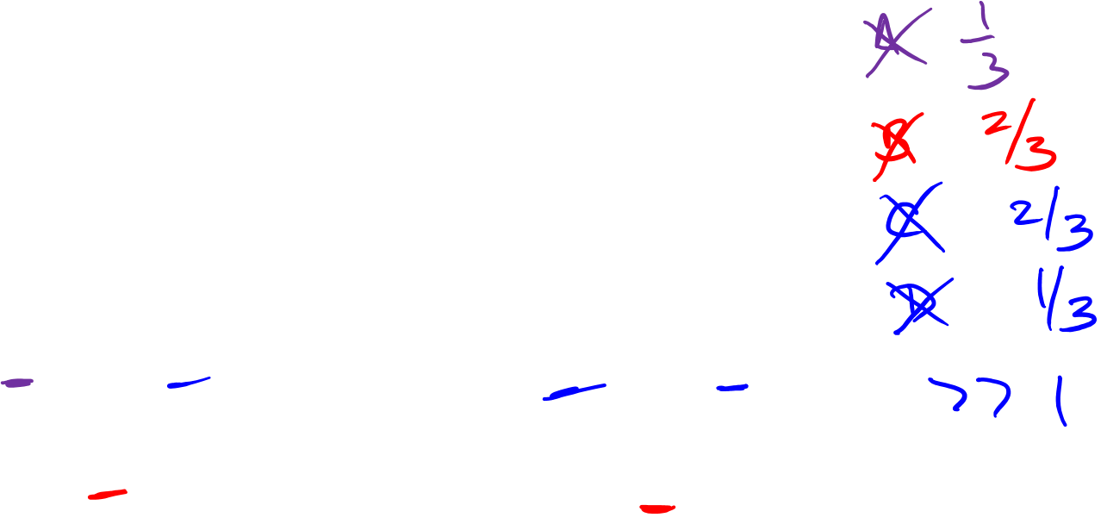
Imagine there are 3 Cases of Disease that came about due to these 3 different Sufficient Causes….
A
C
D
C
B
B
Sufficient Cause 1
Sufficient Cause 2
E
F
G
Sufficient Cause 3
Notes:
If I take away A, I prevent one case out of these 3, or 33%
If I take away B, then I prevent 2 out of the three cases, or 67%
If I take away E, then I prevent 1 out of three cases or 33%
If I take away C, then I prevent 2 cases of disease, or 67%..
And so forth… so one can see that very easily, the attributable fraction of the component causes is greater than 1…
This stems from the premise that component causes work in concert sto form a sufficient cause.

Slide 17

“Causing” a myocardial infarction
Y
Poor diet quality
W
Obesity
No exercise
High cholesterol
A
C
T
Genes
X
B
Smoking
Stress

Slide 18
Advantages of the Rothman’s model
Simple way to organize thinking about multi-factorial disease process
Naturally acknowledges that typically a disease is the result of several factors acting in concert, over time
  E.g., multistage carcinogenesis model, where initiators, promoters and catalysts could be conceptualized as component causes

Slide 19

Limitations of Rothman’s Causal Pie model
Pies do not specify reference groups
Focuses on proximal causes, less on origin of causes
Does not naturally reflect induction periods for different component causes
Causes of disease in individuals but not in populations
Specifies components but not linkages among them
  Ignores indirect effects (effects of some component causes mediated by other component causes in the model)
Does not easily reflect dynamic non-linear relations
Notes:
First 14 min of Rothman you tube lecture
Several of these limitations are pointed out by Rothman himself.

Slide 20
“Causing” a myocardial infarction
Poor diet quality
Y
W
Obesity
No exercise
High cholesterol
A
C
T
Genes
X
B
Smoking
Stress

Slide 21

In Summary…
Rothman’s ”causal pie” model provides a simple way to organize thinking about multi-factorial disease process
Several of the terms and definitions can be helpful to organize thinking
  Component cause
  Sufficient cause
  Necessary cause
  Strong component cause
Sum of proportions of disease attributable to each component cause is not bound by 1 or 100%
Important aspects not captured by the model
  timing (induction)
  reference groups
  Non-linear relationships

