Slide 1
Lecture 6: The Effects of Social Policies on Health Disparities
Epi 222
Rita Hamad, MD, PhD
Acknowledgement: Maria Glymour

Slide 2
Big Picture
Economic & social
opportunities and resources
Policies to reduce poverty, promote employment,
and reduce segregation
Policies to promote child
development, education
Conditions in
homes and communities
Policies to promote healthier homes, neighborhoods,
schools, workplaces
Behaviors
Medical care
Biology; interaction of biology with experiences
Health

Slide 3
Policies and Health Disparities
Reasons to research policies
Types of policies that may affect disparities
Examples of evaluating health effects of policies
  Moving to Opportunity: a randomized trial
  Regression discontinuity and related methods: hospital desegregation, educational policies
  Pseudo-randomization: juvenile judges
Distinguishing effects on average outcomes versus disparities: GI Bill
Major controversies and uncertainties

Slide 4
Policies and Health Disparities
Reasons to research policies
Types of policies that may affect disparities
Examples of evaluating health effects of policies
  Moving to Opportunity: a randomized trial
  Regression discontinuity and related methods: hospital desegregation, educational policies
  Pseudo-randomization: juvenile judges
Distinguishing effects on average outcomes versus disparities: GI Bill
Major controversies and uncertainties

Slide 5
Why Study Social Policies & Health?
Policies may be the most powerful health interventions.
Evaluating health impact of policies can inform the design and implementation of such policies.
Policies may provide “natural experiments” to understand the origins of health disparities.
Evaluating policies as natural experiments can clarify whether social factors are causal.

Slide 6
Social Factors and Health:
Hypothesized Pathways
Employment/
Occupation
Income
Wealth
Social Networks
Knowledge
Cognitive Skills
Self-efficacy
Toxic/Dangerous
Environments
(housing, work,
Infections, lead)
Behaviors
(diet, medical care,
sex, violence)
Psychological
Experiences
(stress, shame)
Education
Disease
Onset, Progression, Consequences
Race,
Ethnicity

Slide 7
Pathways Affected by Healthcare
Employment/
Occupation
Income
Wealth
Social Networks
Knowledge
Cognitive Skills
Self-efficacy
Toxic/Dangerous
Environments
(housing, work,
Infections, lead)
Behaviors
(diet, medical care,
sex, violence)
Psychological
Experiences
(stress, shame)
Education
Disease
Onset, Progression, Consequences
Race,
Ethnicity

Slide 8
Pathways Affected by Policies
Employment/
Occupation
Income
Wealth
Social Networks
Knowledge
Cognitive Skills
Self-efficacy
Toxic/Dangerous
Environments
(housing, work,
Infections, lead)
Behaviors
(diet, medical care,
sex, violence)
Psychological
Experiences
(stress, shame)
Education
Disease
Onset, Progression, Consequences
Race,
Ethnicity

Slide 9
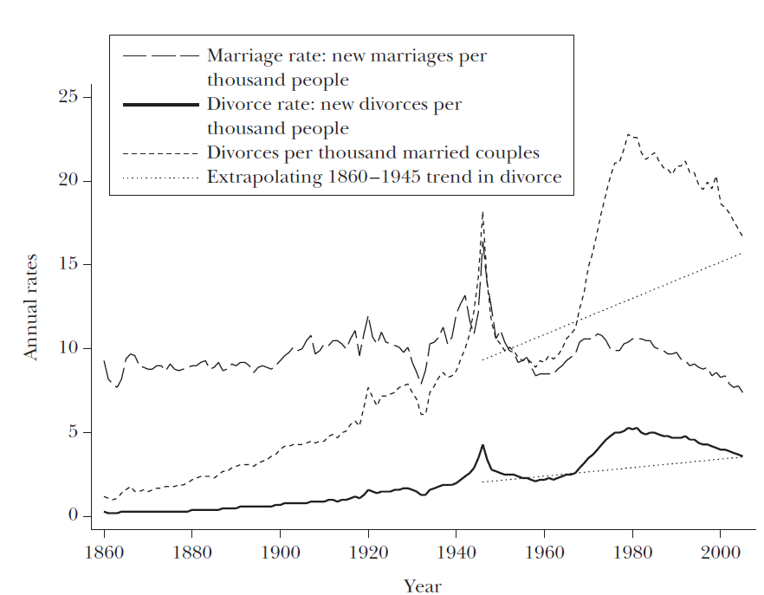
Even Very Personal Exposures are Shaped by Policies
U.S. Marriage and Divorce Rates, 1860-2005
Stevenson and Wolfers, JEP 2007
Notes:
Elimination of requirement that there had to be a specific reason like adultery for divorce.

Slide 10
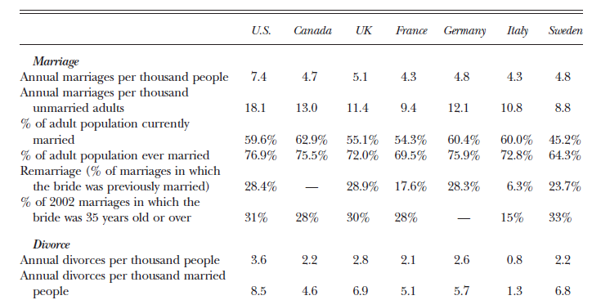
Even Very Personal Exposures are Shaped by Policies
International Marriage and Divorce Rates, 2003
Marriage/divorce rates differ by time and across countries.
Probably dynamic feedback between social policies and social norms
Stevenson and Wolfers, JEP 2007

Slide 11
Even Very Personal Exposures are Shaped by Policies
Marriage, divorce, children:
  Affect core social networks
  Affect marriage → household resources
  Affect fertility → labor market participation, resources
  Affect stigma → mental health
Notes:
Beyond this, CT at one point had law that made contraception illegal, which resulted in a Supreme Court case brought by Griswold (head of Planned Parenthood) that defined a “right to marital privacy,” which was later extended to unmarried couples. Another Supreme Court case overturned state laws that exempted men from paying child support for children they had out of wedlock. Living v Virginia allowing interracial marriage in 1967. The list goes on.
Point here is simply that something that seems fundamentally personal and individual level – who you love, have sex with, and marry – is deeply shaped by social policies. These factors (who you love, have sex with, and marry) in turn shape a whole host of downstream health risk factors – health behaviors, medical access, exposures.

Slide 12
Pathways Affected by Policies
Employment/
Occupation
Income
Wealth
Social Networks
Knowledge
Cognitive Skills
Self-efficacy
Toxic/Dangerous
Environments
(housing, work,
Infections, lead)
Behaviors
(diet, medical care,
sex, violence)
Psychological
Experiences
(stress, shame)
Education
Disease
Onset, Progression, Consequences
Race,
Ethnicity

Slide 13
Policies and Health Disparities
Reasons to research policies
Types of policies that may affect disparities
Examples of evaluating health effects of policies
  Moving to Opportunity: a randomized trial
  Regression discontinuity and related methods: hospital desegregation, educational policies
  Pseudo-randomization: juvenile judges
Distinguishing effects on average outcomes versus disparities: GI Bill
Major controversies and uncertainties

Slide 14

Policies regulating fundamental social causes
Social inequalities in health risk factors
Social inequalities in morbidity and mortality
Education/Schooling
Availability
Quality
Content
Age of attendance
Behaviors
Healthcare access
Toxic environment
Housing
Occupational health
Neighborhood safety
Stress
Social networks/ integration
Social norms
Mental and physical health
Financial Resources
Taxation
Safety net programs
Retirement pensions
Work anti-discrimination
Minimum wages
Employment security
Notes:
One way to organize thinking about categories of policies relevant to health. Policy mechanisms influencing social determinants of health and socially patterned risk factors. Some social policies directly influence “fundamental social determinants of health”, such as education and income, but many social policies also target inequalities in health risk factors. Policies that eliminate social inequalities in health risk factors, for example by guaranteeing healthy housing in safe neighborhoods, can also reduce social inequalities in health.

Slide 15
Types of Policies
Helpful to classify by “proximity” to health outcome
  Social determinants of health
  Recognized health risk factors
  Receipt of high quality medical care
Alternatively, classify by stage of disease process
  Primordial prevention: prevent development of risk factors
  Primary prevention: prevent disease incidence
  Secondary prevention: reduce the impact of existing disease
  Tertiary prevention: reduce long-term impact of ongoing illness

Slide 16
Social Epidemiology Translation (SET) model
Interventions within the Medical Care System
Identify populations likely to be underdiagnosed to improve screening and preventive treatment
Identify vulnerable people and vulnerable periods to improve quality of care delivery systems
Identify modifiers of treatment effects/personalize treatment
Risk Factors
Disease Incidence
Disease Diagnosis
Disease Management
Morbidity, Mortality
Prevent development of risk factors (e.g., unhealthy behaviors). Modify risk factors for disease incidence, e.g., smoking, lead exposure
Modifiable risk factors for non-adherence to treatment, e.g., low literacy, lack of transportation
Modifiable risk factors for poor outcomes even with good treatment adherence. e.g., psychological stressors
Interventions for Individual or Community/Environment
Patton & Glymour, 2014
Notes:
Figure: Conceptual model for strategies to use social epidemiology research to reduce morbidity and mortality: the social epidemiology translation (SET) framework.

Slide 17
Stages of Policy Evaluation
What are the causes of health and illness?
Theoretical understanding, including biology and social theory
How important are the various causes?
Heterogeneity/subgroup analyses
Population attributable fractions
How do we alter these health determinants?
Collaborations with experts in the “determinants of social determinants” to define interventions
Policy analyses
Simulation studies
Quasi- or natural-experiments
Implementation expertise
Observational epidemiology
Randomized trials
Evidence feedback: intervention results inform theoretical understanding of causal determinants of health.

Slide 18
Policies and Health Disparities
Reasons to research policies
Types of policies that may affect disparities
Examples of evaluating health effects of policies
  Moving to Opportunity: a randomized trial
  Regression discontinuity and related methods: hospital desegregation, educational policies
  Pseudo-randomization: juvenile judges
Distinguishing effects on average outcomes versus disparities: GI Bill
Major controversies and uncertainties

Slide 19
How Do You Study the Health Effects of Policies?
Randomize: generally preferable, but rare.
Some other possible sources of exogenous variation:
  Geographic variation
  Temporal variation
  Institutional variation (bank policies, loan guarantees)
  Evidence on the effects of the target of the policy.
    Hypothesis: Policy → “Resource” → Health
    Prove “resource” affects health
Notes:
19

Slide 20
Policies and Health Disparities
Reasons to research policies
Types of policies that may affect disparities
Examples of evaluating health effects of policies
  Moving to Opportunity: a randomized trial
  Regression discontinuity and related methods: hospital desegregation, educational policies
  Pseudo-randomization: juvenile judges
Distinguishing effects on average outcomes versus disparities: GI Bill
Major controversies and uncertainties

Slide 21
Study Design
Families with public housing randomized to:
  No intervention
  Section 8
  “Low poverty” section 8
Once randomized:
  60% of section 8 group moved
  47% of low poverty group moved
Compare to Women’s Health Initiative:
  “At the time the trial was stopped, 54.0% of study participants assigned to receive estrogens and 53.5% of those assigned to receive placebo had discontinued study medication.” (Hsia 2006)

Slide 22
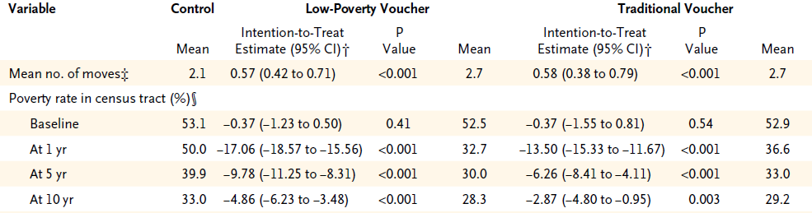
Effects on Neighborhood Poverty
Ludwig 2011

Slide 23
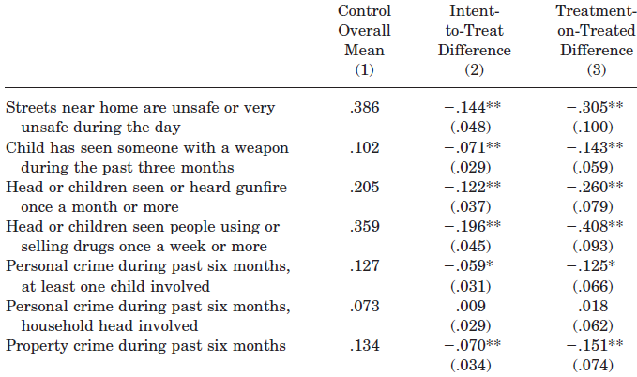
Effects on Neighborhood
Boston, 2-year Follow-up
Katz 2001

Slide 24
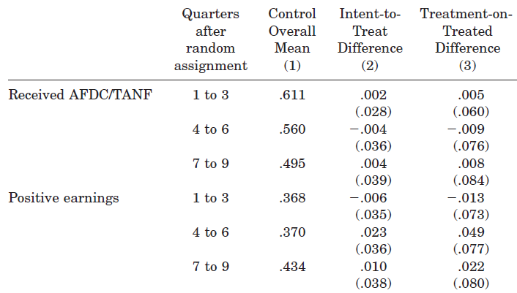
Effects on Labor Outcomes
Boston, 2-year Follow-up
Katz 2001

Slide 25
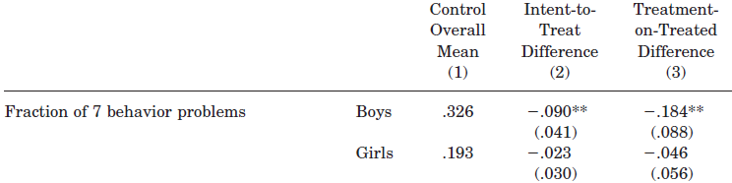
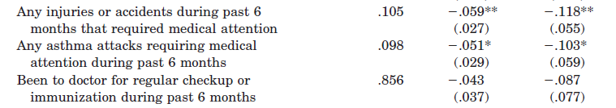
Low Poverty Effects on Health
Boston, 2-year Follow-up
Katz 2001

Slide 26
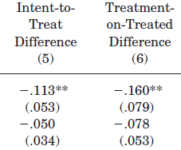
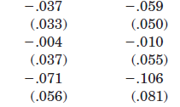
Section 8 Effects on Health
Boston, 2-year Follow-up
Katz 2001

Slide 27
Effects at 5- to 7-year Follow-up
No effects on economic self-sufficiency
Reduction in adult obesity
Improvements in adult mental health

Slide 28
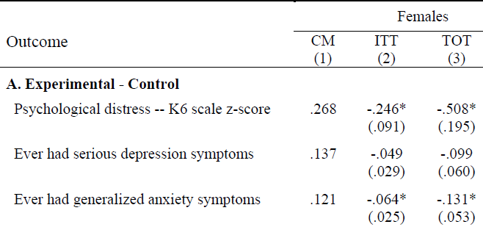
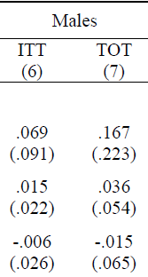

Effects on Children’s Mental Health
5- to 7-year Follow-up

Slide 29
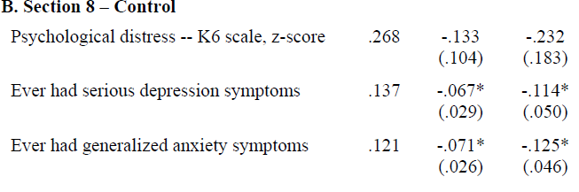
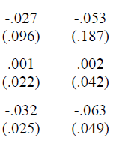
Effects on Children’s Mental Health
5- to 7-year Follow-up
Girls ITT
Girls TOT
Boys ITT
Boys TOT

Slide 30
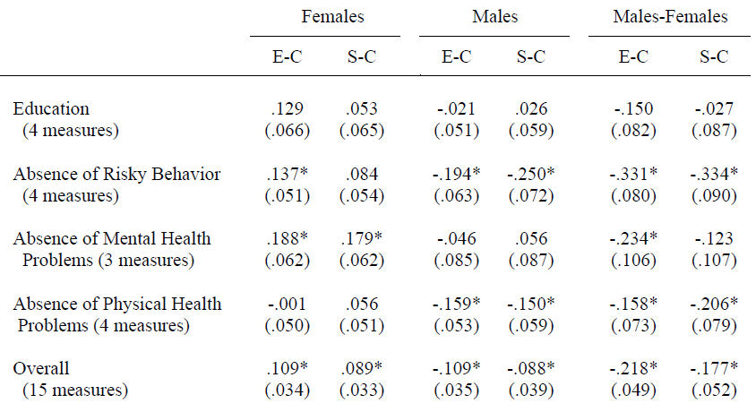
Effects on Children’s Mental Health
5- to 7-year Follow-up

Slide 31
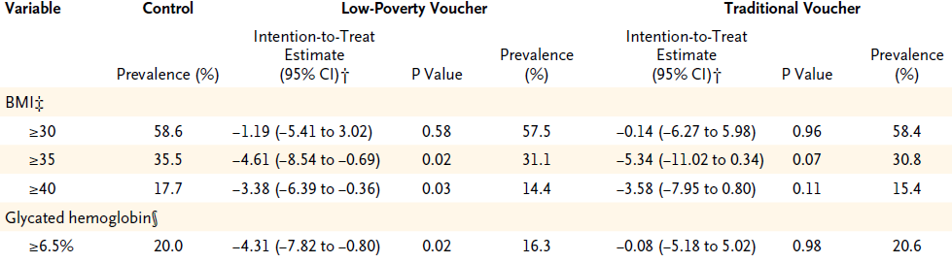
Effects on Adult Health
10-year Follow-up

Slide 32
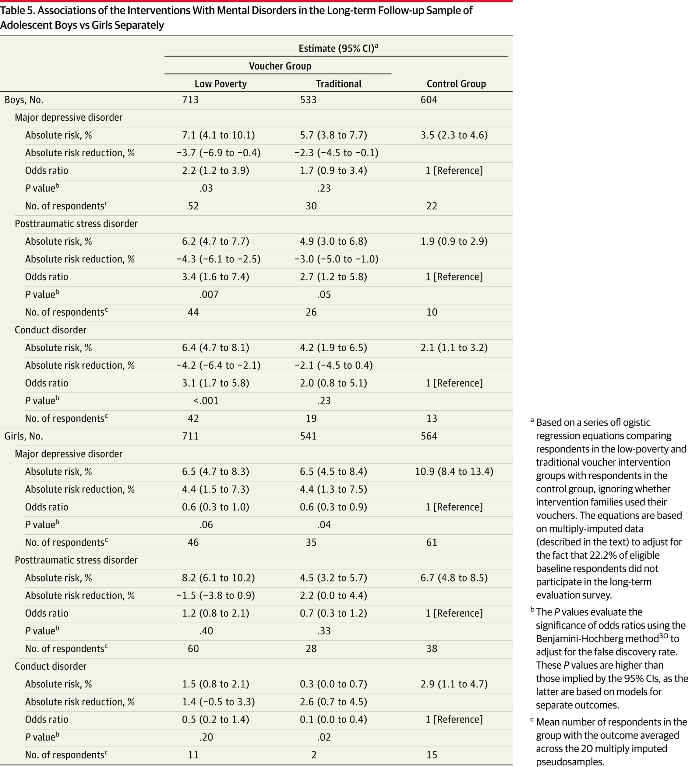
Effects on Children’s Mental Health
10-year Follow-up
Kessler 2014

Slide 33
Latest Results:
Earlier Exposure→ Benefits
Children who moved when < 13 years old had average annual income $3,477 (31%) higher in their mid-twenties relative to mean of $11,270 in the control group.
In contrast, the same moves have negative long-term impacts on children who are > 13 years old, perhaps because of disruption effects
Chetty 2015

Slide 34
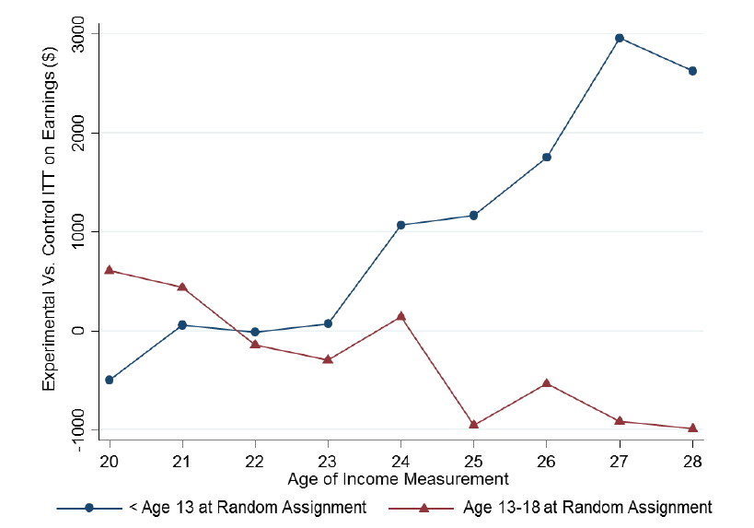
Effects on Earnings, by Age of Randomization
Chetty 2015

Slide 35
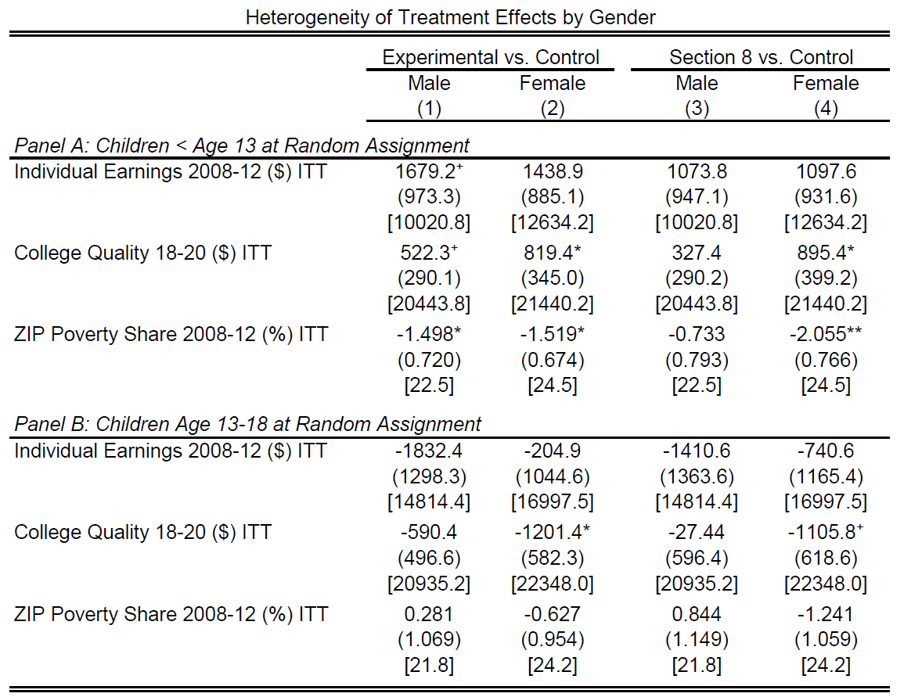
Effects on Earnings, by Age and Gender
Chetty 2015

Slide 36
New Neighborhood Results: Compare Children by Age When Parents Move
Outcomes of children who move converge to outcomes of permanent residents of destination at a rate of 3-4% per year.
Similar effects for college attendance, teenage employment, teenage birth, and marriage.
Chetty 2015

Slide 37
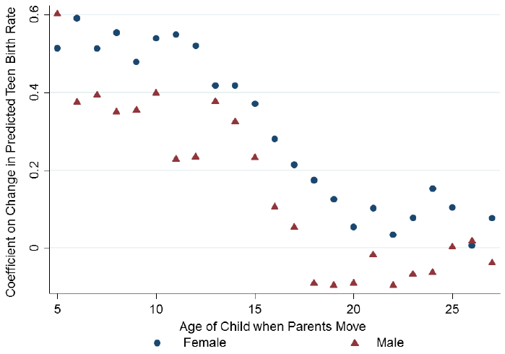
Different Study: Change in Teen Births When a Family Moves
N = over 16 million
Born 1980-1991
Chetty 2015

Slide 38
MTO Trial Challenges
Small samples?
Heterogeneous effects?
What was the salient component of the treatment?

Slide 39
Policies and Health Disparities
Reasons to research policies
Types of policies that may affect disparities
Examples of evaluating health effects of policies
  Moving to Opportunity: a randomized trial
  Regression discontinuity and related methods: hospital desegregation, educational policies
  Pseudo-randomization: juvenile judges
Distinguishing effects on average outcomes versus disparities: GI Bill
Major controversies and uncertainties

Slide 40
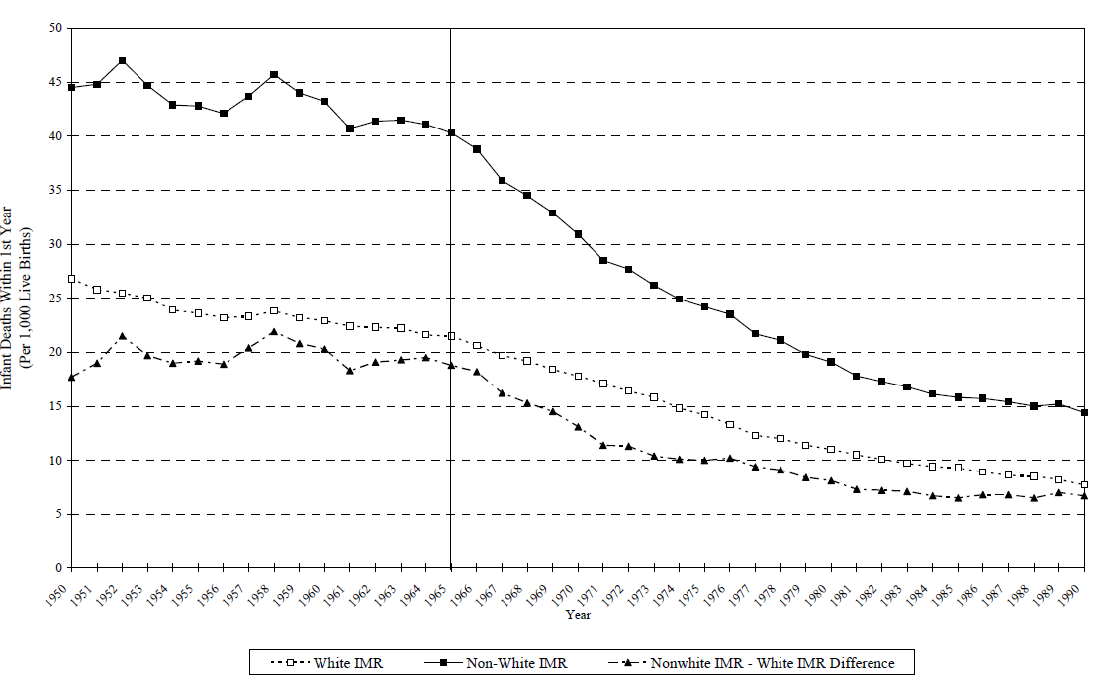
Trends in US Infant Mortality, by Race: 1950-1990
Non-white
White
1965
Notes:
Note dramatic declines over time, with fairly persistent *relative* disparity but markedly narrowing absolute disparity.
Note sharpness of black IMR declines increases in 1965

Slide 41
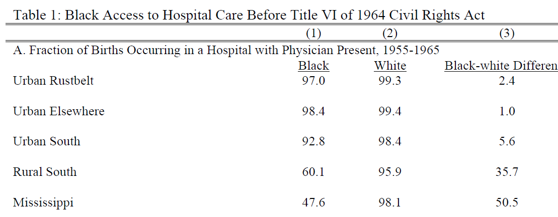
Pre-Civil Rights: Limited Access in Southern States

Slide 42
Did Hospital Desegregation Reduce Black Infant Mortality?
Hypotheses:
  Racial gap will decrease after 1965
  Gap will decrease more in areas where segregation and inadequate supply were more pervasive pre-1965
  Gap will decrease more among causes of death responsive to hospital access
  Among causes of death preventable with hospital access, gap will fall promptly and persistently upon integration.
Supported by the evidence?
Almond 2006

Slide 43
Did Hospital Desegregation Reduce Black Infant Mortality?
Data
  Individual mortality data for 1960-1975
  Natality data for each state by race and urban/rural
  Examine trends in mortality rates due to pneumonia and gasteroenteritis
  Separate analysis for Mississippi counties
Trend break in 1965
  Blacks in the rural south: -0.705
  Whites in the rural south: -0.076
  Blacks in the urban rustbelt: -0.205
  Whites in the urban rustbelt: -0.048

Slide 44
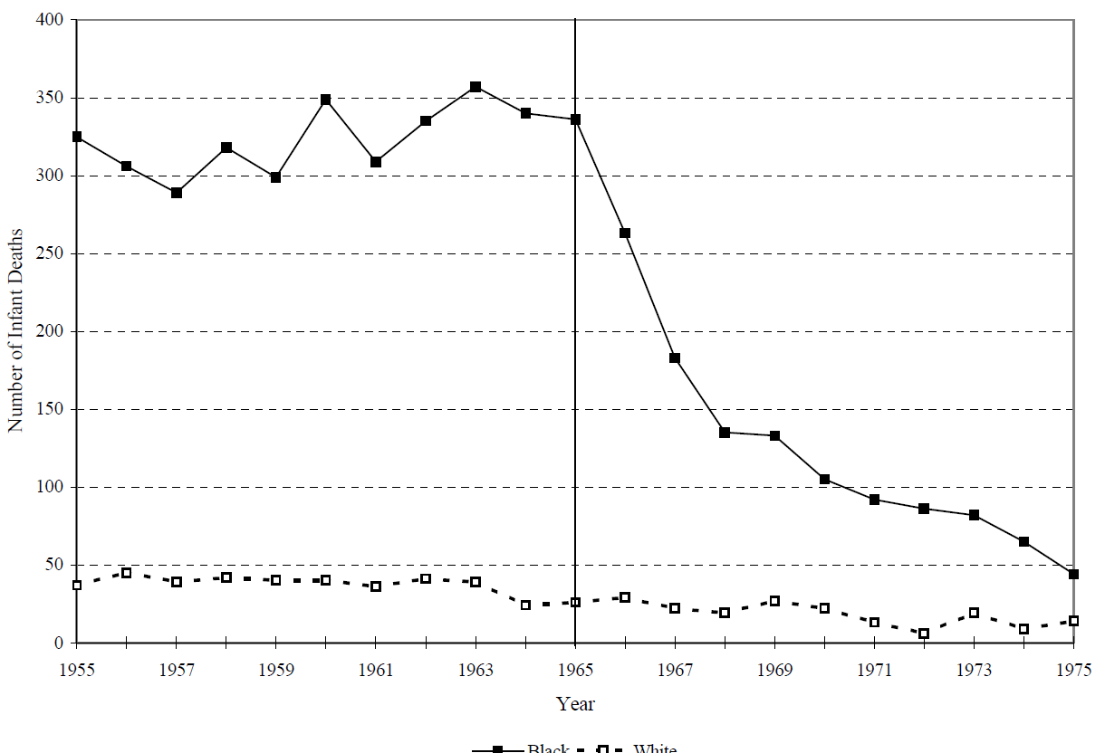
Post-Neonatal Infant Deaths Due to Diarrhea and Pneumonia, Mississippi 1955-1975
Black Infants
White Infants
1965

Slide 45
What Makes the Evidence Convincing?
This is basically a time trend… is the result credible?
A priori plausible
Specificity of population affected
  black infants, not white infants
Specificity of the outcome
  amenable to the exposure targeted by the policy
Specificity of the place
  segregated states in the South

Slide 46
Policies and Health Disparities
Reasons to research policies
Types of policies that may affect disparities
Examples of evaluating health effects of policies
  Moving to Opportunity: a randomized trial
  Regression discontinuity and related methods: hospital desegregation, educational policies
  Pseudo-randomization: juvenile judges
Distinguishing effects on average outcomes versus disparities: GI Bill
Major controversies and uncertainties

Slide 47
Research Question
Does increased years of education → reduced dementia risk?
Why education?
  Education modifiable via individual or policy actions (unlike ApoE gene)
  Likely few harmful side effects, possibly other benefits
  Generally politically feasible
  Revolutionary changes in years of education in 20th century U.S.
  Plausible mechanism: “use it or lose it” hypothesis
Challenge: Many confounders of education → dementia
  How to show that it was education itself that benefited kids?
Notes:
47

Slide 48
Example: Compulsory Schools Laws in South Carolina

Slide 49
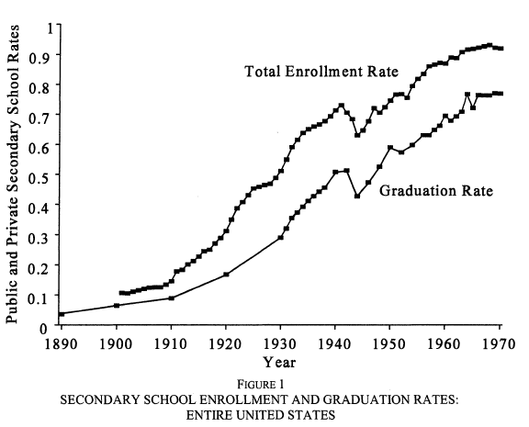
National Trends in High School Enrollment and Graduation
Goldin 1998

Slide 50
Natural Experiment: School Policy as an Instrumental Variable
Sample: U.S.-born whites with ≤12yrs of school
Compulsory schooling laws
  Minimum age to drop out or receive a work-permit
  Based on policy in state-of-birth when 14 yrs old
Exposure variable:
  Years of education (self-reported, confounded)
Outcome: Memory score in later adulthood
Two-sample instrumental variables analysis

Slide 51
Models with Different Covariates
1
Unadjusted
Sex
Birth year
State-of-birth indicators
State characteristics:
  age 6: % black, % urban, % foreign-born
  age 14: manufacturing jobs per capita, wages per manufacturing job
2
3
4

Slide 52
Sample:
Health & Retirement Survey

Slide 53
IV Results: Effect of Education on Memory Scores
Effect of 1 year of Education on Cognitive Test Scores
5. OLS estimates 0.09 (0.08, 0.10)

Slide 54
Schooling and Racial Disparities
Analyses restricted to whites because CSLs were not enforced for black children
Major historical differences in school quality for black and white children
De jure desegregation fairly recent and de facto segregation persists… do we know if it affects health?
Surprisingly limited evidence

Slide 55
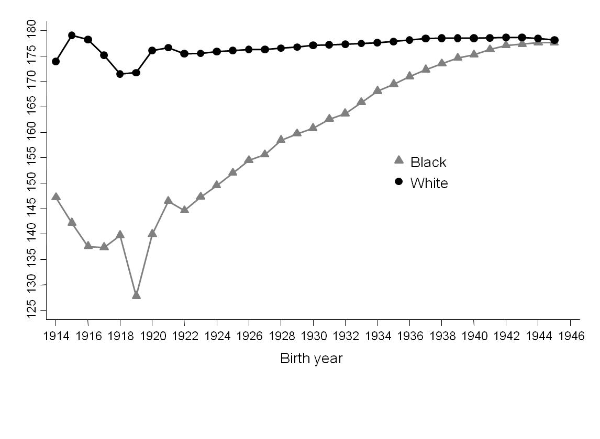
Variation in School Quality by Race
State-mandated school term length, by race
Liu 2015

Slide 56
Does This Affect Health Disparities?
Effect of state-level school term length on blood pressure
 | Change per 10% difference in school term length
 | Black |  | White
 | Female | Male | Female | Male
Systolic blood pressure (mm/Hg) | -5.9 (-8.7, -3.0) | -2.4 (-6.1, 1.3) | -0.3 (-2.3, 3.0) | 1.6 (-0.8, 4.0)
Liu 2015

Slide 57
Desegregating Schools and Reductions in Teen Pregnancy
1970-1980 Change in Teen Fertility by Race and Period of Desegregation
Liu 2012

Slide 58
Desegregating Schools and Reductions in Teen Pregnancy
Difference-in-difference-in-difference:
change in teen fertility during 1970-1980
among black versus white adolescents
in cities that desegregated in the 1970s vs in the 60s or 80s
Y = β₀ + β₁Census1980 + β₂Desegregated1970s + β₃Black + β₄Census1980*Desegregated1970s + β₅Census1980*Black + β₆Desegregated1970s*Black + β₇Desegregated1970s*Census1980*Black + ε_{istr}
“U.S. school desegregation policy in the 1970s was associated with a 3.2 percentage points in the prevalence of births among black female adolescents.”
Liu 2012

Slide 59
Conclusions:
School Policy and Health
Compulsory schooling laws predict years of education.
Effect of CSL-driven education on memory scores was statistically and clinically significant.
Other state characteristics may be confounders, but must change in tandem with CSLs and affect only those with <13 years of education.
School quality differences → persistent racial disparities in blood pressure, but effects may differ by sex
Desegregation → reduced adolescent births

Slide 60
Policies and Health Disparities
Reasons to research policies
Types of policies that may affect disparities
Examples of evaluating health effects of policies
  Moving to Opportunity: a randomized trial
  Regression discontinuity and related methods: hospital desegregation, educational policies
  Pseudo-randomization: juvenile judges
Distinguishing effects on average outcomes versus disparities: GI Bill
Major controversies and uncertainties

Slide 61
What are Effects of Juvenile Incarceration?
35,000 children in Chicago juvenile court
Linked to public school and adult incarceration data
Assigned to 1 of 62 judges essentially randomly
Judge decides whether the juvenile is:
  Placed on probation
  Incarcerated in Detention Center then placed on probation
Aizer 2015
Notes:
Placed on judge’s schedule based on order entered into system. Average age 14yrs. Average detention 42 days.

Slide 62
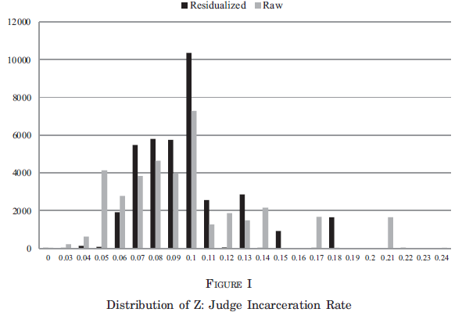
Chance of Incarceration Dependent on Judge
Number of cases assigned
Probability Judge Chooses to Incarcerate
(black bars adjusted for covariates such as child’s age)
Notes:
Range 6-18%, based on proclivities of that particular judge

Slide 63
Effects of Juvenile Incarceration
Results:
  Decreased high school graduation (13% points)
  Increased chance of imprisonment by age 25 (23% points)
  Increased chance of imprisonment as adult by age 25 for violent crime (15% points)
Effects largest for older children, ages 15-16 years
Estimates often different than those from conventional regression
Note: not for all kids, this is among kids on the margin who some judges incarcerated but others may not have.
Health effects unknown
Notes:
Effects for older children maybe because it leads them to drop out of school?

Slide 64
Policies and Health Disparities
Reasons to research policies
Types of policies that may affect disparities
Examples of evaluating health effects of policies
  Moving to Opportunity: a randomized trial
  Regression discontinuity and related methods: hospital desegregation, educational policies
  Pseudo-randomization: juvenile judges
Distinguishing effects on average outcomes versus disparities: GI Bill
Major controversies and uncertainties

Slide 65
GI Bill
  GI Bill implemented in 1944 under Roosevelt
  Components:
    Educational subsidy to cover college tuition
    Guarantees for loans for housing/business
    Job placement assistance
    Unemployment compensation
  Eligibility: 90+ days service, no dishonorable discharge
  Policy was race neutral
  Were effects race neutral?

Slide 66
Job Placement
Assistance administered by local offices, mostly staffed by whites:
“In trying to find a job, the veteran would visit the local U.S. Employment Service Office. If he’ll accept some laborer’s job, they’ll readily place him. If he knows some of the old-timey trades, they can get him placed…
But if he’s qualified in some of the new skills that Negros haven’t traditionally been doing, or has some kind of professional training, they just can’t find a place for him and he’ll be offered a job as a porter in the local hotel or the like.’”
Onkst 2001

Slide 67
GI Bill: Job Placement
In Mississippi in Oct 1945, job counselors filled 6,583 non-agricultural jobs
86% of professional, skilled, and semi-skilled positions went to whites
92% of the unskilled and service-oriented jobs went to blacks
Men who did not take a job deemed “suitable” by counselor were denied unemployment compensation

Slide 68
GI Bill: Loan Guarantees
Administered by local banks
  Loans require collateral
Survey of 13 Mississippi cities in 1947
  3,229 loans guaranteed by the VA
  2 were for blacks
Unclear how widespread, limited evidence, but likely that loan guarantees were essentially unavailable to blacks

Slide 69
GI Bill: Education
At the end of WWII, there were only ~100 small, under-resourced colleges in the South accepting blacks
Southern black colleges turned away ~55% of veterans
High school graduation rates lower among blacks, further reducing potential value of college tuition subsidy
How to estimate the effect of GI bill?
  Compare veterans to non-veterans?
Biased differentially for blacks and whites because of selection criteria for entry into the military (literacy, disability, discrimination)

Slide 70
Birth Cohort as a Natural Experiment
Don’t compare veterans to non-veterans
Equate birth cohort with chance of being a veteran
Compare outcomes by birth cohorts
Bound 2002

Slide 71
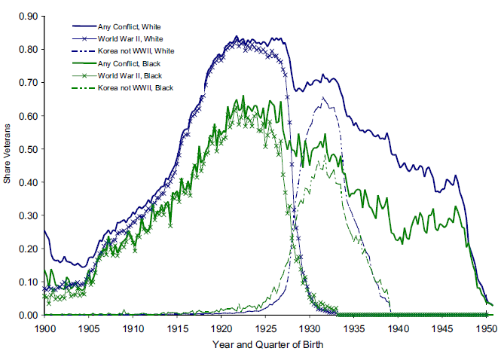
Birth Year → Chance of Military Service

Slide 72
How to Estimate Disparities in
GI Bill Benefits?
Assume that military participation differed by birth cohort not because of men’s characteristics
I.e., men in service cohorts were not smarter, richer, more educated, less likely to have kids...
Not quite credible, because there are secular trends in college enrollment and fertility.

Slide 73
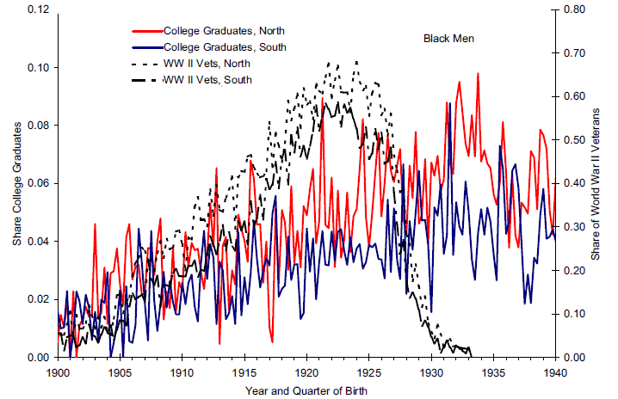
Temporal Trend in College Attendance: Black Men

Slide 74
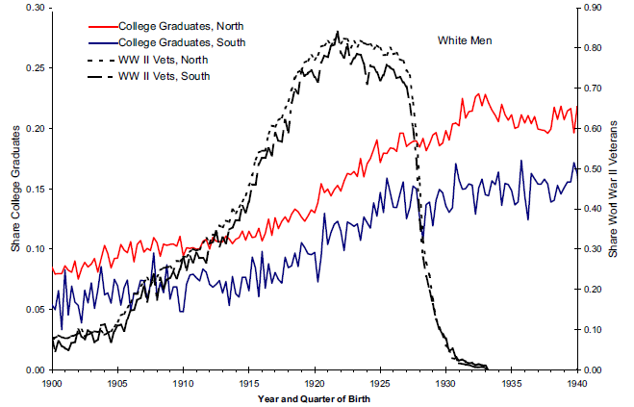
Temporal Trend in College Attendance: White Men

Slide 75
Estimated Effect of GI Bill
4% point increase in college completion
Large and positive benefits for white men
Negligible benefits for black men born in South
Positive benefits for black men outside South
Health effects??

Slide 76
Untargeted Resources Can Exacerbate Inequalities
Key lessons from GI Bill:
  Making a resource generally available without special consideration for least advantaged can exacerbate disparities even while helping the “average”
  Advantaged are best able to use the new resource
  This is one prediction of fundamental cause theory: new information, technological advances, and similar general progress can exacerbate inequalities
May depend on how inequality is measured
Notes:
Theory: SES embodies an array of resources, such as money, knowledge, prestige, power, and beneficial social connections that protect health no matter what mechanisms are relevant at any given time (Link and Phelan, 1995).

Slide 77
Policies and Health Disparities
Reasons to research policies
Types of policies that may affect disparities
Examples of evaluating health effects of policies
  Moving to Opportunity: a randomized trial
  Regression discontinuity and related methods: hospital desegregation, educational policies
  Pseudo-randomization: juvenile judges
Distinguishing effects on average outcomes versus disparities: GI Bill
Major controversies and uncertainties

Slide 78
Uncertainties and Controversies
Little rigorous research. Major social policies rarely evaluated for health impact: Social Security, home ownership subsidies, school quality, transportation, etc.
Results are often not what we expect.
What are details of intervention implementation?
  Additional education at age 4 versus age 17?
  Additional high- vs low-quality education?
  Education in the future similar to education in the past?
Results are often sensitive to model specification.
Studies are not powered adequately.

Slide 79
Homework
Identify a social or economic policy you think may have important health implications.
Describe why an evaluation of that policy is informative (e.g., primarily about the policy, or primarily a test of hypothesized mediators).
Specify the outcomes and populations you think most or least affected by the policy.
Propose a study design to evaluate the policy.
Describe biggest challenge to implementing and drawing inferences.

