Slide 1
Week 5 – Study Designs in Implementation Science
Elvin Geng
Epidemiology 245
Spring

Slide 2
Overview
“Design” refers to approach, strategy or methods to obtain inferences (generate knowledge)
There are no “study designs” that are in my view specific to implementation science
But implementation science means we need to reconsider all study designs, and consider “relevance” in the formulation
  Sampling
  Measuring
  Intervening
  Analysis
You want rigor at the end of the day, but also relevance
Has major implications

Slide 3
Objectives
What makes a designs that are correct and informative?
Observational
  Clinic or community based observational cohorts
  Natural experiments
    Regression discontinuity, difference in difference, and instruments
Experimental
  Implementation studies
  Hybrid studies
  Pragmatic randomized trials
  Stepped wedge trials
Qualitative work – another session

Slide 4
Reframing ”Implementation science designs”
We have established that the behavior of “real world” systems and individuals drives use of evidence-based interventions for health
Understanding those behaviors are important
What kinds of designs allow us to understand implementation in the “real world” and what kinds of designs get in the way?

Slide 5
Context for causal inference
More Control
Less Control
Clinical trials
Lab science
Implementation science

Slide 6
Strategy A (human subjects research): Conform reality to research needs
Research needs – what to do and when; what to measure and when
Traditional strategies “to understand” can be inimical to understanding when applied to implementation problems
Understand cause and effect through control
  Laboratory studies – Pearson’s correlation coefficient demonstrates causality
  Mimicked by “interval cohorts” and clinical trials – patient selection, intensive monitoring
Strengthens internal validity
  At the expense of external validity?

Slide 7
Strategy B (Human subjects research): Conform design to reality
Understand effects in the presence of incomplete control over the environment
Use analytic techniques to get at causal effects
Use opportunities that arise naturally (natural experiments)
Give up some control over measurements
Complicates analyses
  More difficult than a well conducted RCT

Slide 8


The Fisherman and the Hot Air Balloon
Attributed to Larry Green

Slide 9
Between a rock…
“GRADE”
Highest: Individual, double blinded, randomized trial
Downgraded: no blinding, cluster-randomized,
4. Rating the quality of evidence—risk of bias
5. Rating the quality of evidence—publication bias
6. Rating the quality of evidence—imprecision (random error)
7. Rating the quality of evidence—inconsistency
8. Rating the quality of evidence—indirectness
9. Rating up the quality of evidence
10. Rating the quality of evidence for resource use

Slide 10
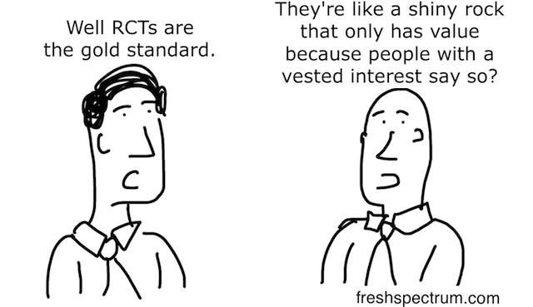
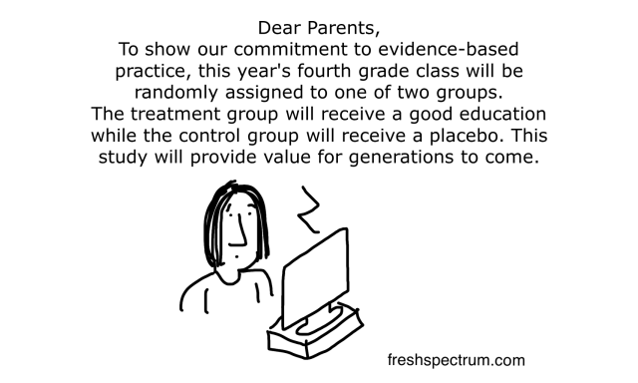
…and a Hard Place
http://www.ictworks.org/2016/06/24/randomized-control-trials-feed-our-fetish-for-single-focus-interventions/
Notes:
http://blogs.sciencemag.org/pipeline/archives/2016/06/15/the-nejm-and-clinical-trials-whats-going-on

Slide 11
Observational Studies: Cohorts
“Interval cohort” vs. “clinic-based cohort” (Lau ARHR 2007)
Interval
  Researcher controls timing and nature of the measurements
  Patients “recruited” and assembled specifically for the purposes of research
Clinic based
  Uses a population enumerated by program or practice (EHR)
  Researcher does not control nature nor timing of measurements
    For example - loss to follow-up maybe common and more “informative”
  Missing or misclassified information is the common
  But… more “real world”

Slide 12
Interval cohort
http://aidscohortstudy.org/
“THE MACS STUDY IS CONDUCTED by sites located in Baltimore, Chicago, Pittsburgh and Los Angeles, and includes over 7000 men with and without HIV infection.”
“Study visits include detailed questions covering HIV-related symptoms and utilization of health services, demographic and psychosocial characteristics, a quality of life survey, a physical examination, a detailed form on medications used as prophylaxis and/or treatment, a neuropsychological screening and examination, blood samples to measure hematologic variables including enumeration of T-cell subsets and HIV viral load, and the allocation of samples to be sent to the National Repository. ”
Notes:
The only they they don’t have are biopsies!

Slide 13
Clinic-based cohort
http://www.iedea.org/
Pools data collected in routine HIV clinical care from sites all over the world
  Patients come for care (enumerated through care)
  Paper forms – data entered into open source database
  Minimal intrusion into clinical practice
  Seven regions globally
  NIAID funded
1,700,000 patients globally

Slide 14
A MACS – type publication
Molsberry, Samantha A., et al. "Mixed membership trajectory models of cognitive impairment in the multicenter AIDS cohort study." AIDS (London, England) 29.6 (2015): 713-721.

Slide 15
An IeDEA Type Publication
International Epidemiological Databases to Evaluate AIDS
Data come from “blue sheet” standardized clinical form
  Minimum data
Pools clinic-based cohorts regionally
  Seven regions
  East Africa
  Does not influence care delivery
  Install database and data entrants at the site
Want to understand barriers to care among HIV patients

Slide 16
18,081 Current Clinic Population
3,250 (18%) Lost to follow-up
579 (18%) Sampled
82 (14%) No outcome found
497 (86%) Outcome found
157 (32%) Dead
340 (69%) Alive
62 (18%) Updated Retention Status Not Possible
278 (82%)
Updated Retention Status Possible
90 (32%)
Not in care
188 (68%)
In care
Figure 1
Geng CID 2015
Notes:
215 and 149

Slide 17
Unweighted “naïve” analysis (N=18,081)
Weighted “corrected” analysis (N=18,081)
Proportion
Proportion
Days since ART initiation
Days since ART initiation

Slide 18
Clinic-based cohort vs. Interval cohort
Clinic based enumeration (+10 relevance)
Measurement error (-5 rigor)
Loss to follow-up (-5 rigor)
Analytic recovery (ie., multiple imputation etc.,) (+5 rigor)
Supplemental data (+10 rigor)
Geng AJE 2012

Slide 20
Observational:
Natural experiments

Slide 21
Bolstering Rigor?
Many dimensions….
But causal inference is central
Causal relationships are the key to improvement
Counterfactual

Slide 22
True or False?
“Randomized trials are only thing that can give causality (or observational studies only give you correlation not causation)”
“In observational studies, you cannot estimate causal effects if there are unmeasured confounders”

Slide 23
Randomized trials?
Not true…
…but need some assumptions*
RCT’s (traditionally) control the context…
…but we want effects in context**
*Also some things you can’t randomize (e.g., air pollution)
**Some things get distorted when you randomize them
Notes:
Many of these assumptions are very plausible in the real world
But clinical effects are likely to be very different
Does behavior of patients change
Does behavior of health systems change
Sacrifice a little rigor…
…gain a lot
Cost, feasibility
etc

Slide 24
Natural experiments
A condition or exposure not under the control of researchers is plausibly randomly assigned
Can be used to learn about causal effects (in the real world)
Examples
  1854 Cholera outbreak – water supply by two companies essentially randomly distributed in London (John Snow ~ 1854)
  Draft lottery for Vietnam (Hearst, Newman and Hully NEJM 1986)

Slide 25
Regression discontinuity
Takes advantage of a practice that is assigned at an arbitrary threshold of some continuous characteristic
People just on either side are “exchangeable”
Not fully random, but “as if”
  The effect of getting an award of scholastic achievement (Thistlethwaite J Educational Psychology 1960)
  Exposure to air pollution on life expectancy from China’s Huai River policy (Chen PNAS 2013)
  Eligibility on retention using CD4 treatment threshold of 350/ul (Bor PLOS Med 2017)

Slide 26
Application to HIV: Effect of treatment expansion on retention
Offering treatment to all persons improves clinical outcomes (START, TEMPRANO)
What will be the real world effects?
  Retention? Crowding out?
Use shift from 350/ul to 500/ul in Zambia to foreshadow effects of further expansion
Compare people who presented just before and just after guideline change
23,000 patients in Zambia in 2014
Assume those who present shortly before and after are “exchangeable”
Mody IAS 2017
Notes:
Bor

Slide 27
Mody IAS 2017

Slide 28
Other tools: Instrumental variable
Treatment eligibility
(instrumental variable)
?
Start treatment
(treatment)
Retention
Unmeasured factors (e.g., SES, education, etc.) or counfounders
Notes:
Eligibility only effects retention through the treatment, then the causal effect of the treatment on retention is the effect of eligibility on retention more or less minus the effect of eligibility on starting treatmnet
Causal inference without randomized trials

Slide 29
Instrumental Variable Analysis:
Effect of ART Initiation on Retention in Care
Actually initiating ART led to a 37.9% increase in retention in care (95% CI 28.8, 46.9%, p<0.001)
2.6 patients need to be initiated on ART to prevent one episode of LTFU (95% CI 2.1, 3.5)
Mody IAS 2017

Slide 30
Of note…both not worse (rigor) and sometimes better (relevance)
Better than a randomized trial?
More relevant
  The behavioral effects of offering and starting treatment are not seen in RCT’s of expanding treatment
  In START and TEMPRANO the deferred were retained
Give up very little rigor, gain a lot of relevance

Slide 31
Experimental Trails: Phased Implementation

Slide 32
Stepped Wedge Cluster Randomized Trial
Rationale
  Reconciles policy maker constraints with rigorous evaluation
  There is not equipoise scientifically or politically
  Or you can’t implement every where at once
  Finally when you have numerous potential comparators is when you want to match to obtain power

Slide 33
Evaluation: Phased implementation
4
3
Wave
2
1
Period
Notes:
Primary outcomes
Also provider attitudes
Specific provider behaviors
Assess implementabiilty as well as effectiveness
Potential evaluations
Comparative implementability
Roll out visit spacing only in 10 districts vs. all models in 10 districts
Assess the fraction of stable patients in different care models
Assess health care workers
Comparative effectiveness
Examine changes in retention and viral load
Among all patients (whether or not they got the intervention)

Slide 34
Stepped Wedge
Rigor
Relevance
Pluses: Randomized
Minuses:
  But susceptible to secular trends
  Even more susceptible to time by group trends
  Missing data? Data systems
  Secular trends for non absorbing outcomes
Pluses
  Usually all persons – unselected
  Usually implemented by real world health workers and systems
Minuses
  Is the environment representative?

Slide 35
Is a RCT a good way to study implementation problems….?
…it depends

Slide 36
Design of studies (vs. study designs) for implementation science
“Randomized trials are not good for ISR”
Within any particular design (such as randomized trials)
Decisions can influence what the trial tells us
  More nuanced decision within a larger “study design” typology

Slide 37
Emerging literature on how to do a trial
Clarify what you want to know
  Pragmatic – what does X do in the real world
  Explanatory – what can X do under idealized settings
Implementation science usually but not always is focuses on latter

Slide 38
Another way to look at the point of a trial
Effectiveness – understand the effect of some intervention on clinical outcomes (in real world)
Implementation – understand the effect of some intervention on implementation

Slide 40
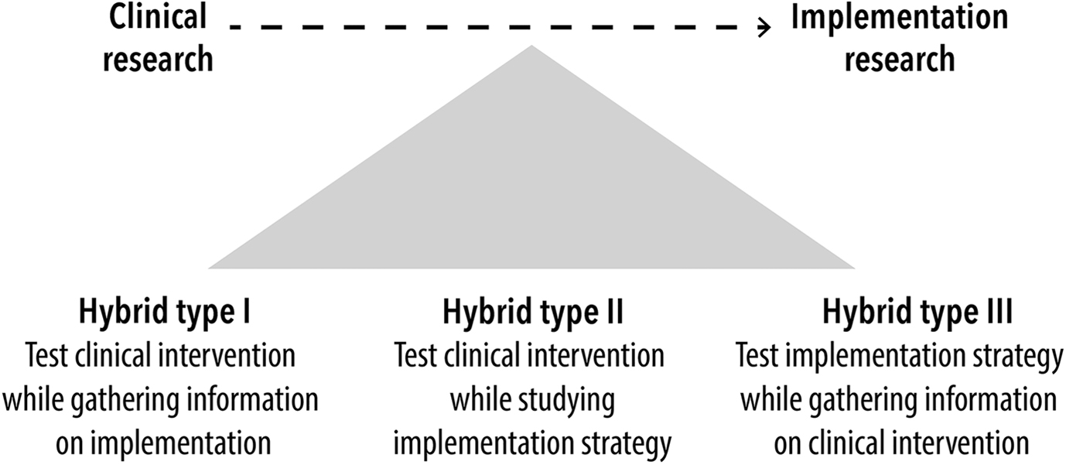
Implementation – Effectiveness Designs
Curran

Slide 41
PRECIS -2
Eligibility—To what extent are the participants in the trial similar to those who would receive this intervention if it was part of usual care?
  TB trial includes all those with clinically suspected TB or those with culture or smear positive TB?
Recruitment—How much extra effort is made to recruit participants over and above what would be used in the usual care setting to engage with patients?
  Pay people to participate
Setting—How different are the settings of the trial from the usual care setting?
  Predisone for ART IRIS carried out at university hospital in Africa
Follow-up—How different is the intensity of measurement and follow-up of participants in the trial from the typical follow-up in usual care?
Primary analysis—To what extent are all data included in the analysis of the primary outcome?

Slide 42
Precis - 2
Organization
  How different are the resources, provider expertise, and the organization of care delivery in the intervention arm of the trial from those available in usual care
Flexibility (delivery)
  How different is the flexibility in how the intervention is delivered and the flexibility anticipated in usual care?
  “The most pragmatic design approach to delivery flexibility would leave the details of how to implement the intervention up to providers, in other words, what happens in usual care.”
Flexibility (adherence)
  How different is the flexibility in how participants are monitored and encouraged to adhere to the intervention from the flexibility anticipated in usual care?
Primary outcome—To what extent is the trial’s primary outcome directly relevant to participants?

Slide 43
Wrap-up
Observational and interventional studies can be used for implementation science
Their utility, it the objective is for implementation science, depends on
  Clarifying the intention
  Nuances of design
Emerging thinking which is evolving

Slide 44
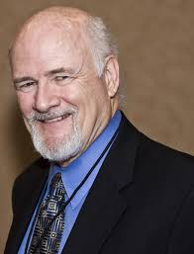
Program-based Evidence
“If you want more evidence-based practice, you need more practice-based evidence”
                Larry W. Green

Slide 45
From “Lab” and “System” Gap to…
“Lab”
“System”
Will it be the same?

Slide 46
…Learning Systems for Health
Learning
System

