Slide 1
From Evidence to Policy and Practice
Spring 2018
Epi 245
Elvin Geng MD MPH

Slide 2
Overview
How does evidence influence policy and practice?
The “benevolent despot” model
But how do things really work?
Usual approaches: not bad, but naïve?
Case study in reality – the lifecycle of evidence
What’s a scientist to do?

Slide 3
Make evidence, influence policy
What’s the problem?
Frustration with the translation of evidence to policy a symptom of an immature understanding of how decisions are made?

Slide 4
Guidance on how to make implementation science usable…
Engage stakeholders
Ask relevant questions (through engaging stakeholders)
Community engagement
Work closely with implementers
Co-produce science

Slide 5

Jon Kudelka.

Slide 6

"Everything for the people, nothing by the people"
-Joseph II
13 March 1741 – 20 February 1790
Emperor of Habsburg lands

Slide 7


Slide 8
Research’s role
Not linear
Not nihilism
Enlightenment
  Warning
  Guidance
  Reconceptualization
  Mobilization of support
Unintended consequences

Slide 9
The role of research: examples from the HIV response

Slide 10
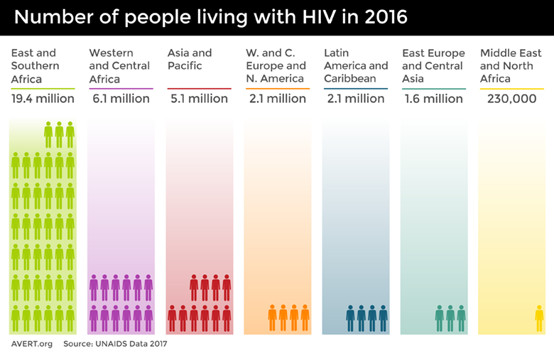

Slide 11
Science: Mobilization

Slide 12


Slide 13
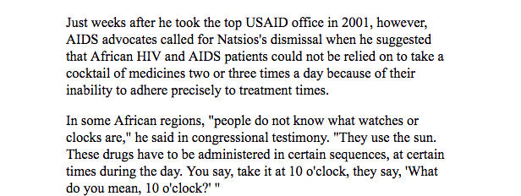

Slide 14
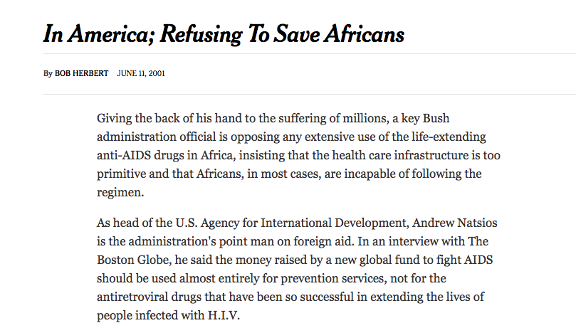

Slide 15


Slide 16
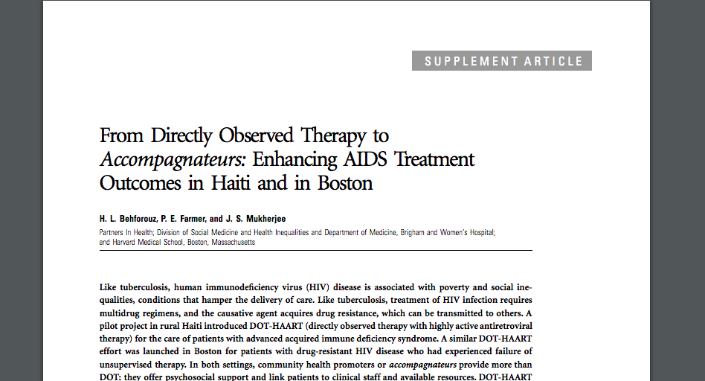

Slide 17
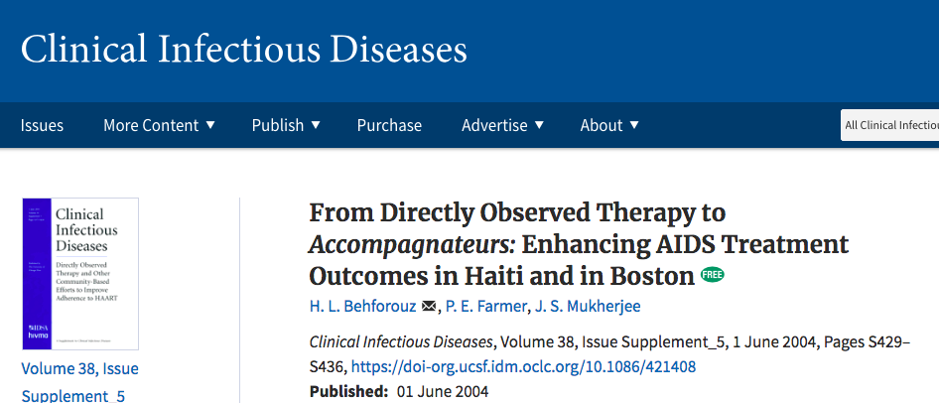

Slide 18
“Combination antiretroviral therapy, remarkably efficacious when used as prescribed, may stand as the most complicated and demanding regimen for a condition requiring continuous open-ended treatment [2].”
“It is estimated that adherence levels of >95% are required to achieve durable suppression of HIV load [3].”

Slide 19
The accompagnateurs are the structural backbone of the HIV Equity Initiative. Although we used the term DOT to describe what they do, it was clear from the outset that far more complex social processes were occurring.
The accompagnateurs are respected in their home communities and serve as the essential link between the villages and the clinic. When a patient from the catchment area is given the diagnosis of advanced HIV disease requiring HAART, an accompagnateur is either selected from the current staff or hired from the community at the patient's request.
The majority of these village-based health workers are peasant farmers or market women. Accompagnateurs receive training on the importance of confidentiality and emotional support for the patients. In addition, they are educated about the clinical presentation and management of HIV infection and tuberculosis, including proper use of medications, management of side effects, and prevention of HIV infection.
During daily visits, accompagnateurs are asked to directly observe the ingestion of at least 1 dose of HAART and are permitted to leave the second treatment dose with the patient at that time. In most cases, however, accompagnateurs visit their patients more than once a day, to observe the ingestion of the second dose.

Slide 20
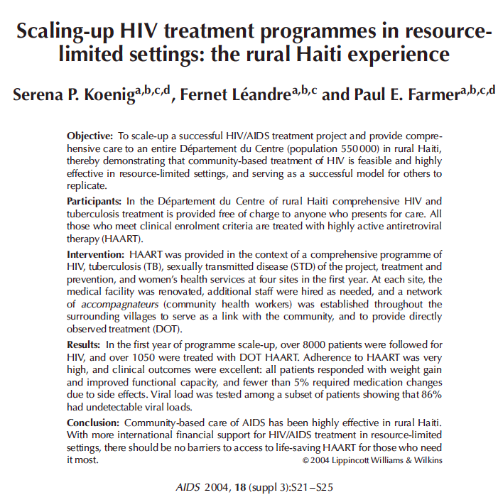

Slide 21
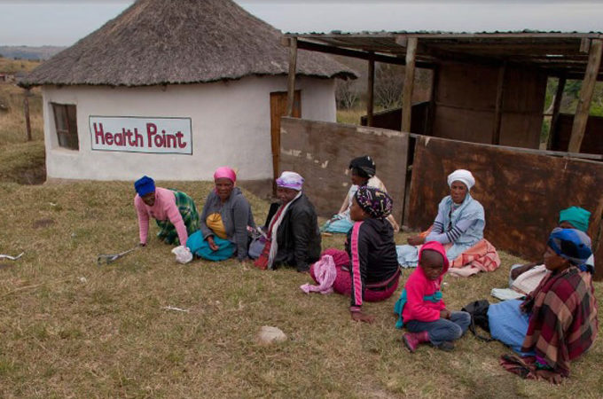
Credit: http://www.aljazeera.com/mritems/Images/2013/11/28/2013112855453306580_20.jpg

Slide 22
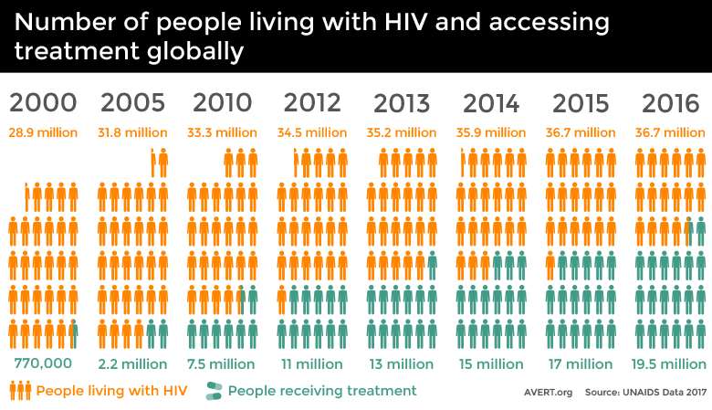

Slide 23
Warning

Slide 24
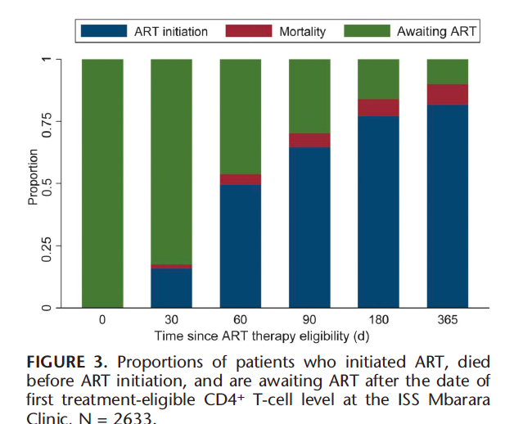
Failure to Initiate?

Slide 25
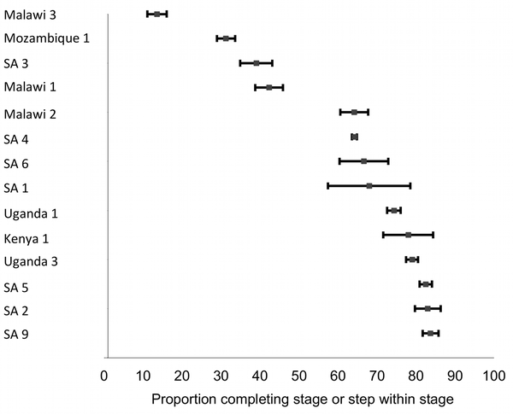
ART Initiation among Eligible Patients
Fox PLoS Medicine 2011

Slide 26
Unintended consequences

Slide 27
Guidance

Slide 28
Delays in Antiretroviral Therapy Initiation among ART Eligible Patients
ART Initiation among Eligible Patients
Fox PLoS Medicine 2011
Systems Barriers to ART Initiation
Providers
  Perception that “ART is not an emergency” slow diffusion of new research (Zolopa PLoS One 2009, Havlir NEJM 2011)
  Unaware of loss to follow-up between eligibility and initiation
Structural
  Overnight CD4 processing - failure to return for second visit
Organizational
  Standard three pre-ART adherence and “treatment supporters”
Median 68%
(range 14%–84%)
Notes:
Although the scale up of antiretroviral therapy has saved countless lives globally, the cascade of care is not optimally efficient nor effective
Early epidemiologic studies found sub-optimal levels of ART initiation even among patients known to be eligible for treatment
In a systematic review using in 14 cohorts in six countries, 68% of ART eligible patients actually started ART
Both programmatic experience and literature suggested to us three supply-side drivers of sub-optimal ART initiation among eligible patients.
First, front line health care workers do not think of ART as an emergency. Findings from studies such as ACTG 5221 and 5164 that found delays in ART initiation of even a few weeks increased the risk of AIDS progression and death, had not diffused through the health system. Also not fully aware of epidemiologic studies showing loss to follow up after eligibility and before ART start
standard overnight CD4 processing meant that patients with CD4-based indications for ART would not know about eligibility until the second visit – thus at risk for loss to follow-up during a period of uncertainty about treatment.
Second, standard counseling practices to prepare patients for ART often require two to three pre-treatment adherence counseling sessions that start after eligibility is established and requirements for a “treatment supporter” were widespread. Both practices can act as a barrier to ART initiation in some patients and incur risk for loss to follow up
Third,
28

Slide 29
Intervention Development
Notes:
We applied the PRECEDE framework to design an intervention targeting these barriers.
The PRECEDE framework which emerged from the health promotion movement and is authored by Larry Green posits that sustained behavior change requires three processes: a “predisposing factor” which can be knowledge that inclines and individual to a particular behavior, an “enabling factor” that makes it easy for that behavior and an “reinforcing factor” that motivates the desired behavior.
We therefore used
An opinion leader led education sessions about the risks of loss to follow up or clinical progression with delays (to predispose),
We introduced a PIMA point of care CD4 as well as an alternative counseling approach that allowed concomitant start and adherence counseling and removed a treatment supporter as a requirement to make it easier for providers to stage and initiate patients
Instituted feedback cards to the clinics which would allow clinics to see their performance in relation to other facilities and therefore “reinforce” desired behavior.

Slide 30
Approach
“Real world” population:
  ART eligible adults in network of clinics in Uganda operated by MOH and supported by NGO
Pragmatic design:
  Stepped wedge, cluster randomized trial
Measurements within existing program information systems:
  Routine program clinical information system
Analysis:
  ART initiation 2 weeks overall and in pre-specified subgroups (CD4, sex, etc.)
  HIV RNA and retention in care
  Adjustment for clustering using mixed effects logistic regression
START intervention
No intervention
Wave 4
Wave 3
Wave 2
Wave 1
0
6
12
18
24
30
36
Notes:
The study population included all treatment naïve adults eligible for ART during the study period at 20 clinic facilities in Uganda – we applied no other selection criteria and thus the population was highly “representative” of real world population.
Rural Urban
We used a pragmatic cluster randomized design in which facilities were randomized to receive the intervention in four groups of five clinics at approximately six month intervals
Randomization was stratified by facility size
A stepped wedge design was selected because all elements of the intervention were supported by the MOH and equipoise was not present
All measurements were made using existing program data systems – no parallel “research database” was created
The primary endpoint was ART initiation by 14 days after eligibility
A secondary endpoint was HIV RNA suppression one year after eligibility in a random sample from wave 1 and 4. These waves were the only ones in which one year of observation in either the treatment or control condition was possible.
We also examined retention through visit adherence (the fraction of appointments that were made within 7 days)
Secondary outcomes are adjusted for patient characteristics including CD4, sex, age, calendar time
Clustering by clinic in all analysis was handled using mixed effects
Power
For the primary endpoint, “The size of the study population was determined as the anticipated patient population thatwould become eligible for antiretroviral therapy in the clinic sites supported by the MJAP organization. Assuming proportion with the outcome in the control condition of 25%, proportion with the outcome in the intervention condition of 50%, 20 total clinics with 5 clinics randomized to the intervention in each of four waves, a harmonic mean of 50 individuals in each clinic during each period, and a coefficient of variation of 0.2, the study is powered at >99%.”
For HIV RNA outcomes, given assumption of coefficient of variation of 0.10, a control condition suppression proportion of 80% and a intervention condition suppression proportion of 92% (a 12% absolute risk difference), we calculated a power of 77% using a harmonic mean of 50 patients in each clinic were tested.

Slide 31
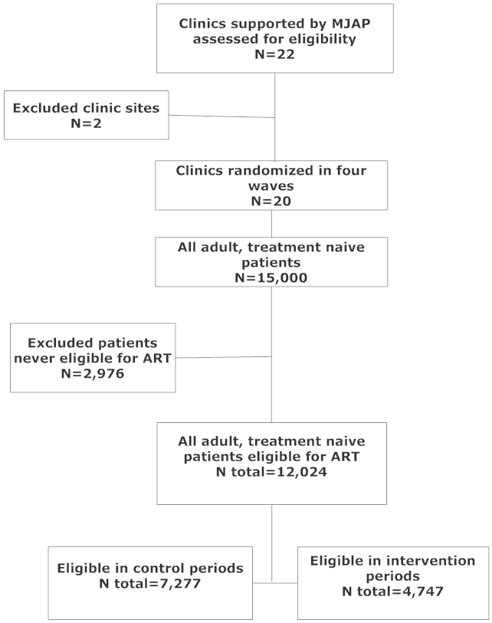
CONSORT
Notes:
We approached 22 clinics supported for participation and 2 refused
A total of 15,000 treatment naïve patients made a visit during the study period
2976 never had documented ART eligibility criteria and were excluded from the study population, resulting in a study population of 12,024
31

Slide 32
Patient Characteristics (N=12,024)
 |  | Total Control Periods | Total Intervention Periods
Patients, n (%) |  | 7277 (60.5%) | 4747 (39.5%)
Sex | Men, n (%) | 2562 (35.2%) | 1917 (40.4%)
 | Female, n (%) | 4715 (64.8%) | 2830 (59.6%)
Age at eligibility | <35 years, n (%) | 4596 (63.2%) | 3179 (67.0%)
 | >= 35 years, n (%) | 2681 (36.8%) | 1568 (33.0%)
Health facility size | Large, n (%) | 5374 (73.8%) | 3242 (68.3%)
 | Medium, n (%) | 919 (12.6%) | 501 (10.6%)
 | Small, n (%) | 322 (4.4%) | 472 (9.9%)
 | New, n (%) | 662 (9.1%) | 532 (11.2%)
ART eligibility | Incident, n (%) | 5335 (73.3%) | 4583 (96.5%)
 | Prevalent, n (%) | 1942 (26.7%) | 164 (3.5%)
ART eligibility date (Median (Q1-Q3)) |  | 08/14/13 (05/13/13-01/27/14) | 06/02/14 (02/25/14-10/16/14)
Notes:
7277 patients were exposed to the control condition at the time of eligibility and 4747 in the intervention
Patients eligible in the intervention period were more likely to be men, younger in age, at non-large health facilities, and, as expected, later in calendar time
32

Slide 33
Patient Characteristics (N=12,024)
 | Total Control Periods | Total Intervention Periods
Eligibility CD4+ T cells/µl | <= 50 | 615 (9.0%) | 332 (7.5%)
 | > 50 | 6186 (91.0%) | 4119 (92.5%)
Pregnancy status at eligibility | Pregnant, n (%) | 1272 (27.0%) | 635 (22.4%)
 | Not pregnant, n (%) | 3443 (73.0%) | 2195 (77.6%)
Eligibility WHO Stage | Stage 1 and 2, n (%) | 3170 (59.8%) | 2920 (80.5%)
 | Stage 3 and 4, n (%) | 2133 (40.2%) | 708 (19.5%)
Tuberculosis at eligibility, n (%) |  | 715 (9.8%) | 281 (5.9%)
ART initiation date (Median (Q1-Q3)) |  | 11/30/13 (07/17/13-04/11/14) | 06/16/14 (03/11/14-10/31/14)
Ever Initiated ART, n (%) |  | 5601 (77.0%) | 4543 (95.7%)
Regimen contained EFV, n (%) |  | 5462 (83.0%) | 4207 (92.2%)
Regimen contained TDF, n (%) |  | 5465 (83.0%) | 4279 (93.8%)
Notes:
In addition, the intervention those with very low CD4 levels were slightly lower, higher lower WHO stage (because the treatment thresholds were changed) and more likely to receive regimens with EFV or TDF

Slide 34
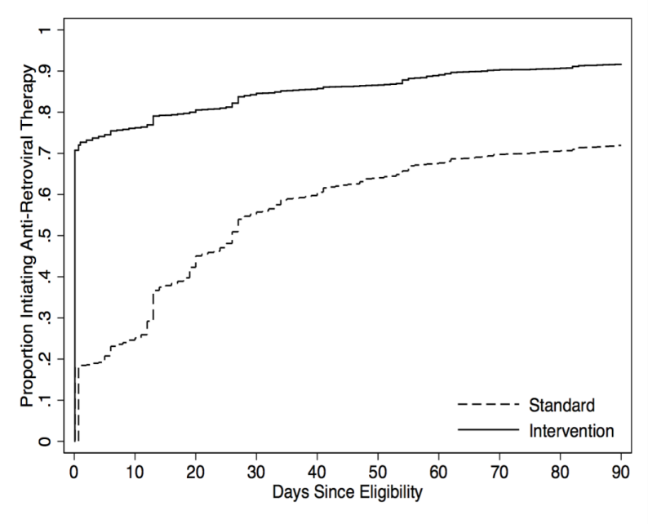
ART Initiation 14 days after ART eligibility (N=12,024)
Probability of primary outcome |  | Risk Ratio (95% CI) | Risk Difference (95% CI) | P-value
Control | Intervention
37.70% | 79.60% | 2.11 (2.03 - 2.20) | 41.9 (40.1 - 43.8) | <0.0001
Subgroup Analysis
Cumulative Incidence of ART Initiation
Notes:
Among 12,024 treatment eligible patients 79.6% met the primary outcome of ART initiation two weeks after eligibility in the intervention condition vs. 37.7% in the control condition (risk ratio of 2.11 (95% CI of 2.03 to 2.20) and a risk difference of 41.9%, (95% CI: 40.1%-43.8%). The p value was less than 0.0001
Subgroup analysis found this effect to be consistent across sex, age, although an attenuation in effect over each intervention wave was observed.
The full distribution of ART initiation times shows that the probability of initiation on the same day as eligibility rose from 18.30% to 70.80%, for a risk ratio of 3.87 (95% CI: 3.64 - 4.11, P < 0.0001).
At 90 days, 70.40% had started in the control condition and 89.70% in the intervention condition, for a risk ratio of 1.27 (1.25 - 1.30), p value <0.0001
The cumulative incidence was estimated with the Aalen-Johansen competing risk method

Slide 35
HIV RNA Suppression
Proportion HIV RNA < 200 c/ml in all patients sampled for viral load testing (missing = failure) N=437
Control | Intervention | Risk Difference (95% CI) | Risk Ratio (95% CI) | P-value
57.70% | 65.60% | 7.9 (-4.2 - 20.0) | 1.14 (0.93 - 1.38) | 0.2003
Proportion HIV RNA < 200 c/ml among patients successfully measured (N=335)
Control | Intervention | Risk Difference (95% CI) | Risk Ratio (95% CI) | P-value
70.60% | 86.20% | 15.6 (4.4 - 26.7) | 1.22 (1.05 - 1.41) | 0.0078
Notes:
We attempted to obtain HIV RNA levels random sample of patients one year after eligibility.
437 patients were selected based and HIV RNA levels were obtained in 335 or 77% overall with 75% in the intervention and 79% in the control condition
In the primary analysis where missing was equal to failure, 65.6% of patients in the intervention condition were suppressed compared to 57.7% in the control condition, for a non-statistically significant risk difference of 7.9% and a risk ratio of 1.14
In a pre-specified analysis of viral loads among those where specimen was ascertained, 86.2% of individuals in the intervention conditions were suppressed compared to 70.6% in the control condition, a difference of 15.6% and a risk ratio of 1.22, differences that were statistically significant

Slide 36
Retention
 |  | Control (95% CI) | Intervention (95% CI) | Rate Ratio (95% CI) | P-value
Visit Adherence: (appointment made within 7 days) | Overall | 0.84 (0.83 - 0.85) | 0.84 (0.83 - 0.85) | 1.00 (0.99 - 1.01) | 0.93
 | ART Starters | 0.83 (0.82 - 0.83) | 0.84 (0.84 - 0.85) | 1.02 (1.01 - 1.03) | 0.0069
Adjusted incident or prevalent eligible, sex, age (3 knot cubic spline), cd4 value at eligibility (3 knot cubic spline), time since eligibility and period of eligibility
Notes:
We compared retention through the visit adherence (defined as the fraction of assigned visits made w/i 7 days)
In all study patients in the control condition, patients made 1.44 visits per 90 days, whereas in the intervention the visit rate was 1.39, which was 4% lower.
Among ART starters, however, the visits rate was 6% higher in the intervention condition, a difference that was statistically significant
Visit adherence was not different between treatment groups overall
But when looking only at observation time after ART initiation, however, the visit adherence was 2% higher in the intervention condition – a statistically significant but clinically insignificant difference.
Notes
CONSTANCY: Visit rate per 90 days
Row 1: Among all, adjusted incident or prevalent eligible, sex, age (3 knot cubic spline), cd4 value at eligibility (3 knot cubic spline), time since eligibility and period of eligibility
Row 2: Among those we started ARVs, adjusted for incident or prevalent eligible, sex, age (3 knot cubic spline), cd4 value at eligibility (3 knot cubic spline), time since eligibility and period of eligibility no start
ADHERENCE: Proportion visiting in 7 day window of assigned appointment
Row 1: Among all, adjusted incident or prevalent eligible, sex, age (3 knot cubic spline), cd4 value at eligibility (3 knot cubic spline), time since eligibility and period of eligibility
Row 2: Among those we started ARVs, adjusted for incident or prevalent eligible, sex, age (3 knot cubic spline), cd4 value at eligibility (3 knot cubic spline), time since eligibility and period of eligibility no start

Slide 37
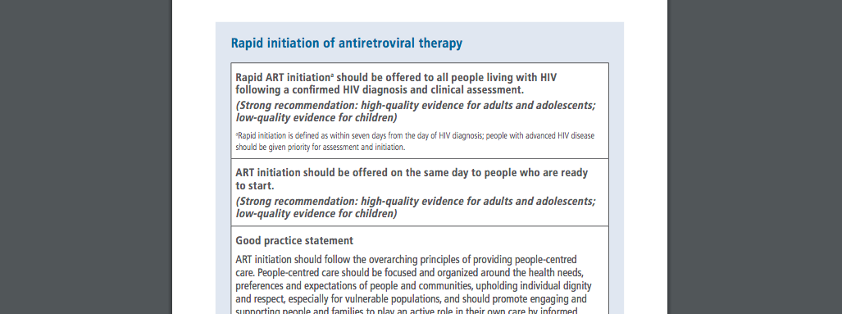
WHO Guidelines

Slide 38
Epilouge
Recent trip to Kisumu

Slide 39
Reconceptualization

Slide 40
The Effectiveness of the Response: a Leaky Cascade?
70%
59%
68%
65%
HIV Infected
Diagnosed
Linked
Initiated
Retained
Rosen et al, 2013 PLoS Med 8(7): e1001056.
Notes:
Given efficacious medications and global resource commitments, where does the public health response to this epidemic stand today?
First, the scale and scope of the response has been enormous – 13 million persons in RLS have started ART, 10 million in Africa. The resources to set up supply chains, systems, and human resources to delivery this therapy have been a revolution.
But despite this massive effort, there are signs that the response if far from optimally effective.
The cascade of care is widely used to represent the effectiveness of HIV services: the steps on the X axis represent the macroscopic processes in the implementation of HIV public health services and the bars represent the fraction of patients who complete each step.
Dozens of studies from program settings, synthesized in a number of systematic reviews, suggest that the cascade is leaky: testing coverage must increase, linkages between testing and care must be strengthened, not all patients eligible for ART start and of those who start, lapses in retention are not rare.

Slide 41
Retention in HIV Care: a Critical Step in the Cascade of Care
Weighted Retention at 2 years: 60-70%
Setting
Rosen PLoS Med 2007 DOI: 10.1371/journal.pmed.0040298
Fox TMIH 2010 doi:10.1111/j.1365-3156.2010.02508.x
Notes:
Although I’ve done research on engagement in other steps, I will focus on retention on ART care today.
Retention on ART care is defined conceptually as continuous and appropriate contact with the health system – operationally its usually defined by some index of visits to a health facility
Five years into the global response in 2007 and again in 2011, researchers summarized dozens of studies summarizing outcomes after HIV treatment were summarized in a systematic review in PLoS Medicine and then in Tropical Medicine and International Health.
As suggested in this figure, adapted from actual data in the published study, the study suggested that two years after ART initiation, only 60 to 70% of patients were retained in care.

Slide 42
Understanding Retention in the Cascade of HIV Care
Setting
Notes:
These data were widely interpreted as showing poor retention.
When the complement, however, is examined more closely, those who are considered to fail this particular step in the cascade actually includes a large fraction, from 10% to 30% lost to follow up.
In the setting of the global scale up of HIV several factors make high losses not surprising:
Lifelong treatment – time horizons for follow up are long and many are involved in livelihoods that require mobility.
Decentralization of services than patients access care in a widening network of sites and hence
Weak and fragment health systems and health information systems
The objective, therefore, of a first series of studies was therefore to understand true outcomes – which is could influence the estimates of mortality, retention in care and factors associated with retention

Slide 43
A Sampling-based Solution?
All Patients in a Health Unit
Patients lost to follow-up (B)
Patients with outcome ascertained by tracking (D)
Patients sought by tracking (C)
Patients who Continue to be Observed
Patients Lost to Follow-up (B)
P_{w}=
Patients Successfully Tracked (D)
Notes:
To address this problem, we have proposed a sampling based approach. Consider a cohort of patients who have started ART in a given program or district or even country, some proportion will become lost to follow-up, because in many settings, there are too many patients to trace all,
We identify a numerically small sample of the lost to trace, making the task tracable and efficient.
The sample is randomly selected so that their outcomes can be an unbiased estimate of outcomes in all the lost
The outcomes found among this random sample can be incorporated into underlying estimates using a probability weight to essentially “fill in the blanks.”

Slide 44
Sampling-based Estimates of Mortality in Mbarara, Uganda (N=3,628)
0.20
Sampling-based Estimate
12.2
corrected
0.15
10.3
7.5
Proportion deceased
0.10
Naïve estimate
2.3
naive
2.1
0.05
1.7
0.00
0
.5
1
1.5
2
2.5
3
3.5
Time since ARV initiation (years)
Geng et al., JAMA 2008; 300(5):506-507
Notes:
Incorporating the outcomes among the 111 successfully tracked lost patients through a probability weight which is inverse to the sampling probability - we revised our estimates of mortality after ART initiation – which rose by approximately 4-5 fold over the first 3 years after ART initiation as compared to mortality estimates using only outcomes as passively observed.

Slide 45
Sampling-based Estimates of Retention in Care (N=3,628)
86.2% (95%CI: 82.9–89.5)
78.9% (95%CI: 75.2–82.6)
68.9% (95%CI: 67.1–70.8)
Geng et al., PLoS One 2011 6(7): e217972011
Notes:
We also applied this sampling approach to revise estimates of retention using current care status ascertained in patients who tracked.
The black line indicates retention after ART initiation under the prevailing definitions where patients lost to follow-up are considered not retained. The estimate is 69% at two years, virtually the same as 70% figure cited in a 2010 systematic review using reports from 39 cohorts in Africa.
Since we could only ask about current care status among those alive and interviewed in person, we conducted two revised estimates of retention.
The red line represents a revised, sampling based, estimate of retention assuming all those alive as reported by an informant (and therefore in whom we could not ask about current care status) to be out of care.
The blue line represents revised retention estimate if we assumed all person alive but not interviewed in person were indeed in care.
In either the pessimistic or optimistic assumptions, the revised estimate of retention – somewhere between 79% and 86 % at two years – were both substantially higher than the uncorrected estimate of 69%.

Slide 46
Sampling-based Estimate of Connection to Care after Accounting for Deaths in Care (N=3,628)
93.2% (95% CI: 90.9–95.1)
85.8% (95% CI: 81.9–89.8)
70.8% (95% CI: 68.9–72.6)
Geng, Glidden, Bwana, MB., PLoS One 6(7): e217972011
Notes:
Ascertaining mortality and retention in care among lost patients also allowed us to distinguish deaths in care (i.e., shortly after a clinic visit) from lapses in care and late deaths.
There was two causal relationships between retention and death. One is the non-retention leads to death. This is where patients disengaged from care, interrupt therapy, have virologic rebound, immunologic deterioration and death. Second death in a retained patient can lead to non-retention. A patient who make appropriates and continuous visit to clinic might still die, within days or weeks of a clinic visit. Distinguishing these two is important because they would require different solutions – the first patient needs outreach, the second needs medical intervention at the last clinic visit.
We used a competing risk approach where we considered death within 90 days of the last clinic visit to be a “death in care” in order to estimate the cumulative probability of being alive and ceasing care. We termed this quantity connection to care (as opposed to retention). We found connection to care to be 86% to 93% at two years.
This implies that deaths in care accounted for almost half of non-retention while the other half was due to disengagement and late deaths.
These findings suggest that to maximize retention efforts to improve access to care as well clinical effectiveness of the care itself are both needed.

Slide 47
Sampling-weighted Factors Associated with Mortality (N=3,628)
Un-weighted
(outcomes as observed)
Sample-weighted
(resampled outcomes)
Geng et al., TMIH (15) s1:63–69 2010
Notes:
It is sometimes less well recognized that loss to follow up can lead to bias in analyses to identify factors associated with those outcomes.
In this analyses we conducted multi-variable regression among patients on ART to find factors associated with mortality.
The first column shows results using the deaths known to the clinic without tracking. The second set of results shows the findings of the same analysis, after incorporating outcomes from the tracked sample of lost patients.
Sampling allowed identification of associations which were missed (with age, entry weight and year of ART initiation) as well as spurious associations, most importantly between male sex and mortality in this case.
These findings provide proof of concept that loss to follow-up can fundamentally distort even the most basic epidemiologic analyses.

Slide 48
Structural Approach to Managing the Effects of Loss to Follow-up
Sex
Loss to follow-up
Time updated CD4
Clinical visit
Pre-therapy CD4
Vital status
Geng, Am J Epi 2012 DOI: 10.1093/aje/kwr444
Notes:
Based on this work, I also published a methods paper that extends the lessons learned from the sampling work to “real world” cohorts more generally.
There is substantial interest in knowing whether newer statistical approaches can “correct” mortality estimates – if so it would be simpler than “resampling” outcomes among the lost.
We therefore compared inverse probability of censoring weights to unweighted and sample-weighted analysis and indeed found that statistical tools alone – either traditional regression models as well as more advanced techniques such as inverse probability of censoring weights – failed to correct estimates.
DAG theory uses simple semiotics to qualitatively examine the implication of causal knowledge on statistical associations to suggest why these techniques fail. By applying the contextual knowledge that death is a cause of being classified as lost to follow up in this setting, DAG theory shows that this fundamental undermines assumptions common to both traditional and advanced approaches in statistics that enable valid estimates.
We argued that sampling based approach could be widely applied in cohort epidemiology to deal with any setting where the outcome could influence the ascertainment of the outcome.

Slide 49
Sampling-based Estimates in a Network of Clinics in Eastern Africa
34,277 Current Clinic Population
5,780 (17%) Lost to follow-up
991 (17%) Sampled
131 (13%) No outcome found
860 (87%) Outcome found
233 (27%) Dead
627 (73%) Alive
150 (24%) Interviewed proxy
477 (76%)
Updated Retention Status Possible
208 (44%) Not in care
269 (56%) In care
Notes:
Building on this, I obtained a grant to expand this work into 14 clinics in five programs within the East Africa IeDEA Consortium – an NIH sponsored network of clinics that pool and harmonize data collected in the course of routine care – these clinic sites provide the same underlying public health package of care: moh staffed, NNRTI based, no individual providers, no routine HIV
We extended this in several ways
Scope – generalizability of the method and its importance
Survey among those lost to better understand reasons for non-return – theory based
Mixed methods: in depth interviews in a select few
Among 30K, we identified 5700 lost, took a random sample of 991

Slide 50
Variable Effectiveness: Mortality Estimates Across Settings (N=34,277)
Uncorrected
Sample weighted
24%
Risk difference=17%
Number needed to treat=6
Risk difference=1.1%
Number needed to teat=91
2.7%
1.6%
7%
Mbarara
Eldoret
Kisumu
Kampala
Morogoro
Notes:
First, we achieved a 90% outcomes ascertainment at all sites – widely feasible
Second, the sampling changed both the total (raising it more than 4 fold) and the rank order – widely important
Revealed unwarranted and unexpected heterogeneity in mortality – these sites are nominally implementing the same package of clinical services: NNRTI based ART.

Slide 51
Variable Engagement Estimates Across Settings (N=34,277)
Mbarara
Eldoret
Kisumu
Kampala
Morogoro
Uncorrected
Sample weighted
40%
21%
4%
9%
Notes:
And like mortality we also found revised estimates of disengagement to be highly varied from site to site.
This variability in mortality and engagement are a clarion call for better understanding of the means through with care is delivered: patient education, satisfaction, treatment literacy,

Slide 52
Conclusions
Research produces findings
Findings are used (or not) in a complex policy making environment
Lots of actors, different agendas
Evidence is best through of as enlightening the policy environment
Specific functions….

