Slide 1
Designing Clinical Research
An Introduction
Mark Pletcher, MD MPH
Dept of Epidemiology and Biostatistics, and Medicine
July 31, 2018
Notes:
Good morning, and welcome to Designing Clinical Research! Let me congratulate you on finding our Training in Clinical Research Program, and for enrolling in this course. I believe this course is the longest continuously-running Epidemiology course in the University, and the first of it’s type in the country. If you are thinking about embarking on a career in clinical research, you are in the right place.

Slide 2
Outline
History of this course
Approach and philosophy
Course logistics
Anatomy and physiology of research
Choosing a good research question
Overview of study design options
Lessons and examples from my own career

Slide 3
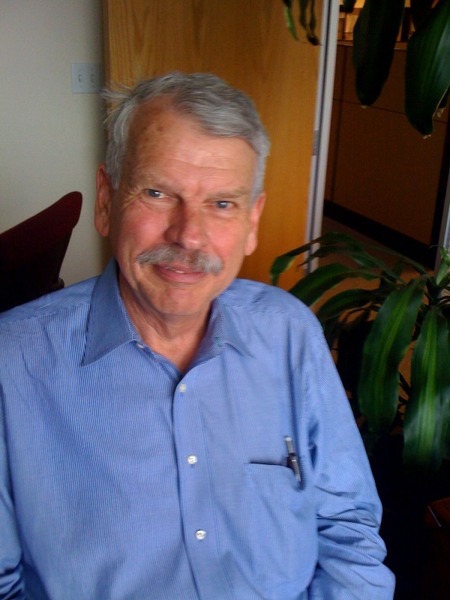
History of the Course
Started >30 years ago by Steve Hulley
  Steve wrote the book
  Designed the course, with focus on building a Study Protocol for a real study
  Led course for over 20 years (through Summer 2008)

Slide 4
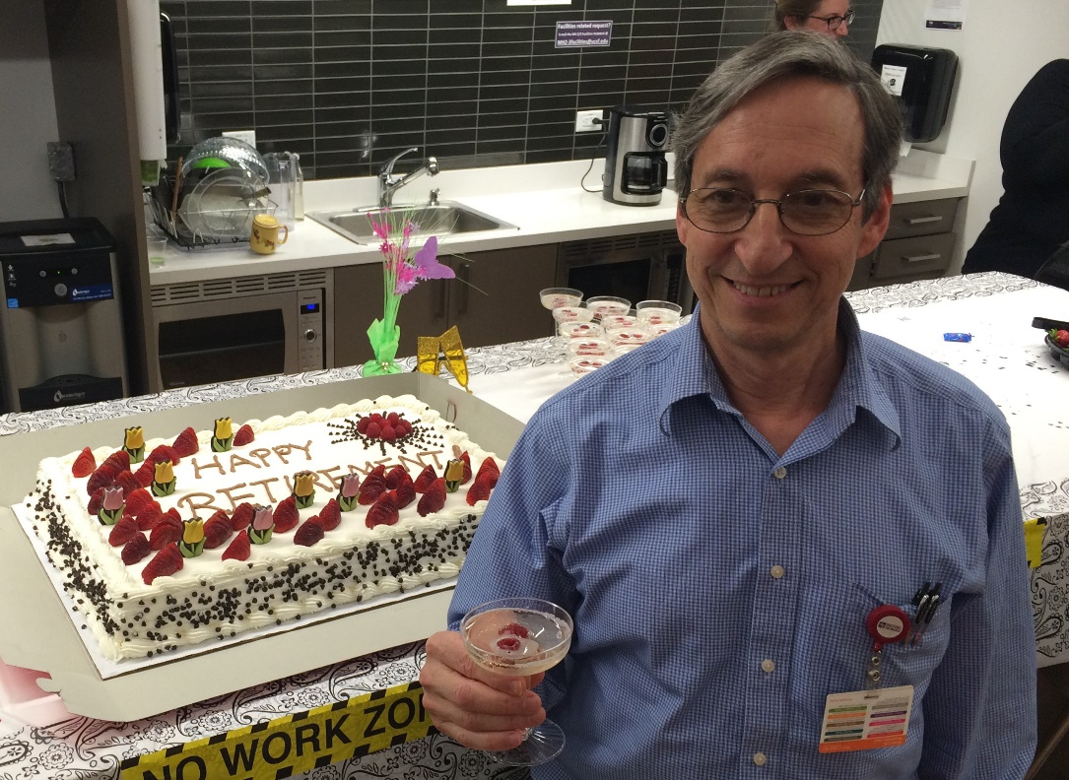
History of the Course
Led by Tom Newman 2009-2015
  Clinical Epidemiology Division Chief → retired this year
  Co-Author of the Book
  Will give Lecture 2

Slide 5
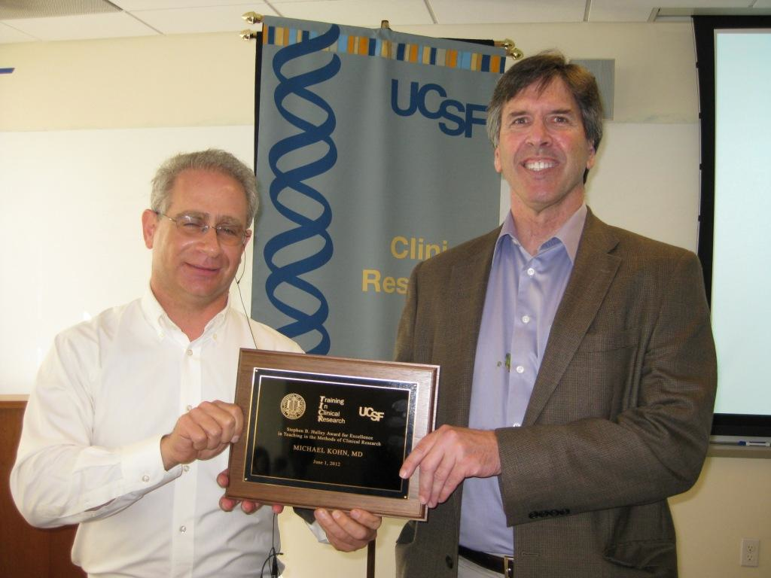
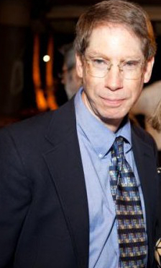
History of the Course
Michael Kohn
  Course Co-Director 2004-2011
  Online sample size calculators
  Will be giving Lecture 6
Joel Simon, Course Co-Director
  Small Group Leader since 1992
  Course Co-Director since 2012
Both have played instrumental roles refining and honing DCR materials over the years

Slide 6
History of the Course
My third year teaching the course
  UCSF Medical School 1993-98
  MPH at UC Berkeley 1997
  UCSF Medical Intern → Resident 1998-2001
  UCSF General Internal Medicine Fellow 2001-2003
    Took this course in 2001
  Joined Epidemiology Department Faculty 2003
  Developed Stata Course and directed TICR Seminar for years
Trying some new things this year…

Slide 7
Approach and Philosophy
Research is the art of the possible
  Inherently opportunistic
  No study is perfect
  From theory → reality → theory
  Feasibility trumps all
  Can you add a “brick”?
    Understand what’s already there
    Find a gap
    Design something feasible to fill the gap
    Execute
    Interpret and publish

Slide 8
Approach and Philosophy
Research is the art of the possible
  Inherently opportunistic
  No study is perfect
  From theory → reality → theory
  Feasibility trumps all
  Can you add a brick in the wall?
    Understand what’s already there
    Find a gap
    Design something feasible to fill the gap
    Execute
    Interpret and publish
Epi 202:
Designing Clinical Research

Slide 9
Approach and Philosophy
Learn by doing
  Design a study and compose a 5-page study protocol
    A practical and usable product!
  MAKE IT REAL
    If it’s only theoretical, you won’t really learn theory→practical
    Ideal: You will submit IRB and start recruitment in Sept!
  The challenge
    Your means are limited
    Do your best, design for feasibility in the near future
    Design at least 2 studies this Summer
      At least 1 with primary data collection
      At least 1 that is feasible to start within the coming year

Slide 10
Course Logistics
Weekly Schedule
  1 hour Full Class Session every Tuesday morning
  2 hour Small Group Sessions
  Bring paper copy of homework on Tuesdays
  Turn in revised homework Wednesday by Midnight
  You’ll get comments back by Friday night
    Different schedule for online students

Slide 11
Course Logistics
Experimenting this year
Weekly Schedule
  1 hour Full Class Session every Tuesday morning
  2 hour Small Group Sessions
  Bring paper copy of homework on Tuesdays
  Turn in revised homework Wednesday by Midnight
  You’ll get comments back by Friday night
    Different schedule for online students and dental students

Slide 12
Course Logistics
1 hour Full Class Sessions, by week
  1 – My lecture (Introduction)
  2 – Tom Newman lecture (Subjects, Variables)
  3 – Sample size “Quiz” format! (watch lecture before)
  4 – Warren Browner lecture (Observational Studies)
  5 – Deborah Grady lecture (Clinical Trials, Confounding)
  6 – Mike Kohn lecture (Survey Design, Data)
  7 – My lecture (The Learning Healthcare System)

Slide 13
Course Logistics
1 hour Full Class Sessions, by week
  1 – My lecture (Introduction)
  2 – Tom Newman lecture (Subjects, Variables)
  3 – Sample size “Quiz” format! (watch lecture before)
  4 – Warren Browner lecture (Observational Studies)
  5 – Deborah Grady lecture (Clinical Trials, Confounding)
  6 – Mike Kohn lecture (Survey Design, Data)
  7 – My lecture (The Learning Healthcare System)

Slide 14
Course Logistics
Weekly Assignments
  Reading
    Chapters in Designing Clinical Research, 4th Edition
    Do exercises in book - optional
    Other miscellaneous articles
  Watching recorded lectures
    Try 1.5-2x speed...
  Writing assignments
    Mostly developing your 5-page protocol
    Optional problem sets

Slide 15
Course Logistics
Small Group Sessions
  Heterogeneous student backgrounds
    The methods are universal!
    Learn from each other
    Learn by critiquing (constructively, of course)
  Attendance is critical
  Outstanding set of Small Group Leaders
    Affiliated faculty, practicing researchers, former trainees

Slide 16
Course Logistics
Small Group Leaders
Meyeon Park
Ingrid Chen
Jacqueline Torres
Megie Okumura
Joel Simon
Farzad Moazed
Jason Flatt
Cassie Kline
Jennifer Smith
Christian Apfel
Matt Cooperberg - Online
Laura Jelliffe
Helen Byakwaga - Uganda

Slide 17
Course Logistics
Small Group Leaders
Meyeon Park
Ingrid Chen
Jacqueline Torres
Megie Okumura
Joel Simon
Farzad Moazed
Jason Flatt
Cassie Kline
Jennifer Smith
Christian Apfel
Matt Cooperberg - Online
Laura Jelliffe
Helen Byakwaga - Uganda
See DCR Roster 2018 link on the website for your Small Group Assignment and Room number

Slide 18
Course Logistics
Final Project: 5-page protocol
  Develop over 7 weeks of course
  Template provided in syllabus
  Feedback along the way from Small Group Leader and colleagues
  Due Monday Sept 17th at 5 pm

Slide 19
Course Logistics
Grading - To get an “A” in the course:
  Excellent attendance (body and mind)
    1 excused absence is allowed
  No missing homework
  Very high quality (and tidy) 5-page Protocol

Slide 20
Course Logistics
Agnes Ng
  Enrollment issues, email changes, logistics
  ANg@psg.ucsf.edu, 514-6399
Clair Dunne
  Website/Syllabus issues, GoToMeeting/Zoom support for online Small Group
  Cdunne@epi.ucsf.edu, 514-8135

Slide 21
Course Logistics
Any questions?

Slide 22
Anatomy and Physiology of Clinical Research
Anatomy: What it’s made of
Physiology: How it works

Slide 23
Anatomy of Clinical Research
What is research made of?
Written products!
Including descriptions of:
  Research question(s)
  Background and significance
  Study design
  Study sample
  Measurements
  Statistical issues (including sample size justification)
  Implementation plans

Slide 24
Anatomy of Clinical Research
Formats:
  1-Sentence Summary
  1-Page Outline
  5-Page Protocol

Slide 25
Anatomy of Clinical Research
Formats:
  1-Sentence Summary
  1-Page Outline
  5-Page Protocol
  Examples
    Grant application*
    Methods section for a publication
    ClinicalTrials.gov submission*
    Manuscript proposal for analysis of existing study data*
    UCSF IRB’s Protocol for a Clinical Trial*
    Operations Manual
* - Example files on the CLE Syllabus

Slide 26
Anatomy of Clinical Research
1-Sentence Summary example:
  The Prevention of Premature Atherosclerosis in Young Adults (POPAYA) Trial is a randomized controlled trial designed to estimate the effect of 10 mg atorvastatin for 5 years versus placebo on coronary calcification in young adults age 30-40 with LDL 130-190 mg/dl

Slide 27
Anatomy of Clinical Research
NAME of the study
1-Sentence Summary example:
  The Prevention of Premature Atherosclerosis in Young Adults (POPAYA) Trial is a randomized controlled trial designed to estimate the effect of 10 mg atorvastatin for 5 years versus placebo on coronary calcification in young adults age 30-40 with LDL 130-190 mg/dl

Slide 28
Anatomy of Clinical Research
DESIGN of the study
1-Sentence Summary example:
  The Prevention of Premature Atherosclerosis in Young Adults (POPAYA) Trial is a randomized controlled trial designed to estimate the effect of 10 mg atorvastatin for 5 years versus placebo on coronary calcification in young adults age 30-40 with LDL 130-190 mg/dl

Slide 29
Anatomy of Clinical Research
Primary PREDICTOR variable
1-Sentence Summary example:
  The Prevention of Premature Atherosclerosis in Young Adults (POPAYA) Trial is a randomized controlled trial designed to estimate the effect of 10 mg atorvastatin for 5 years versus placebo on coronary calcification in young adults age 30-40 with LDL 130-190 mg/dl

Slide 30
Anatomy of Clinical Research
Primary OUTCOME variable
1-Sentence Summary example:
  The Prevention of Premature Atherosclerosis in Young Adults (POPAYA) Trial is a randomized controlled trial designed to estimate the effect of 10 mg atorvastatin for 5 years versus placebo on coronary calcification in young adults age 30-40 with LDL 130-190 mg/dl

Slide 31
Anatomy of Clinical Research
Study population
1-Sentence Summary example:
  The Prevention of Premature Atherosclerosis in Young Adults (POPAYA) Trial is a randomized controlled trial designed to estimate the effect of 10 mg atorvastatin for 5 years versus placebo on coronary calcification in young adults age 30-40 with LDL 130-190 mg/dl

Slide 32
Anatomy of Clinical Research
1-Sentence Summary “MADLIB”:
  The [study name] is a [study design] designed to estimate the effect of [intervention] versus [comparator] on [outcome] in [study sample]

Slide 33
Anatomy of Clinical Research
1-Sentence Summary “MADLIB”:
for trials:
  The [study name] is a [study design] designed to estimate the effect of [intervention] versus [comparator] on [outcome] in [study sample]
for observational studies:
  The [study name] is a [study design] designed to examine the association between [primary predictor] and [outcome] in [study sample]

Slide 34
Anatomy of Clinical Research
1-Sentence Summary “MADLIB”:
for trials:
  The [study name] is a [study design] designed to estimate the effect of [intervention] versus [comparator] on [outcome] in [study sample]
for observational studies:
  The [study name] is a [study design] designed to examine the association between [primary predictor] and [outcome] in [study sample]
There are extremely important advantages to fitting into this framework (e.g., power calculations)

Slide 35
Physiology of Clinical Research
How does research work?
We use measurements in a sample to draw inferences about phenomena in a population

Slide 36
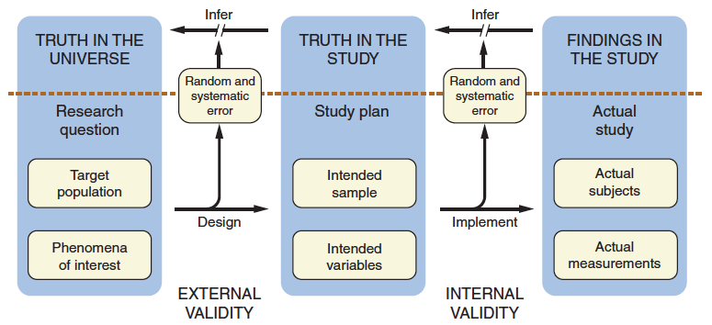
DCR-4 Figure 1.4
Goal: Use actual measurements in an actual sample to draw inferences about phenomena in a population

Slide 37
DCR-4 Figure 1.4
Step 1) What do you actually want to know?

Slide 38
DCR-4 Figure 1.4
Step 2) Can we theoretically access a relevant sample of participants and get required measurements?

Slide 39
DCR-4 Figure 1.4
Step 3) Can we actually recruit the intended study subjects and make the measurements without bias?

Slide 40
DCR-4 Figure 1.4
Good design reduces random and systematic error, and allows better inference

Slide 41
Choosing a research question
What “truth” do you want to know?
  As per our course philosophy, MAKE IT REAL
  Where are the real gaps and opportunities?
Tension between feasibility and importance…

Slide 42
Choosing a research question
The FINER Criteria
Feasible
Interesting
Novel
Ethical
Relevant

Slide 43
Choosing a research question
The FINGER Criteria
Feasible
Interesting
Novel
Good for your career
Ethical
Relevant

Slide 44
Choosing a research question
Some FINER projects aren’t ideal choices for this course:
  Qualitative research
  Data synthesis like decision analysis, cost-effectiveness analysis, meta-analysis
  Animals/molecules without humans

Slide 45
Choosing a research question
Some FINER projects aren’t ideal choices for this course:
  Qualitative research
  Data synthesis like decision analysis, cost-effectiveness analysis, meta-analysis
  Animals/molecules without humans
Humans are a primary source of many feasibility issues...☺

Slide 46
Choosing a research question
Some FINER projects aren’t ideal choices for this course:
  Qualitative research
  Data synthesis like decision analysis, cost-effectiveness analysis, meta-analysis
  Animals/molecules without humans
Design at least one quantitative study with human subjects

Slide 47
Choosing a research question
Secondary data analyses are great for career-building
Pro’s:
  Feasible
  Often use high-quality/high-impact data sources and leverage $millions invested in study execution
  Can lead to quick, high-quality publications
Con’s:
  Some already did the hard work of design and implementation
  You won’t learn as much from this course

Slide 48
Choosing a research question
Bottom line:
  Design at least 1 study with primary data collection
  Design at least 1 study you definitely plan to do (near-term feasibility)
  Do at least a 1-page outline for both
  Your Small Group Leader/Colleagues can help you decide which to turn into a 5-page protocol as your Final Project

Slide 49
Choosing a study design
Choosing a study DESIGN is hard too…
You probably already know something, and you’ll probably continue learning for the rest of your career
Chicken-egg problem
  Teach it now before you need it
  Ask you to guess, then teach after you beg for it?

Slide 50
Choosing a study design
Compromise for this course:
  Quick “refresher” right now
  16 minute mini-lecture posted (week 2 on syllabus)
  Dive in and guess!
  Discuss throughout course in Small Group Sessions
  More knowledge coming soon
    Chapters 7-13, Lectures 4 and 5
  Modify, refine during the course

Slide 51
Choosing a study design
Randomized controlled trial
  INTERVENTION (with random assignment to control)
Cross-sectional study
  Take a look at a given population (sample) right now
Cohort study
  Choose a sample and follow over time
Case-control study
  Choose two samples (cases and controls) with and without the outcome, compare exposures

Slide 52
Simple rubric for choosing a study design
No
Do you want to compare groups?
Descriptive study
Is the outcome rare? (Sample based on outcome)
Yes
Case-control study
No
Cross-sectional study
Will you follow the subjects over time?
Is the exposure rare? (Sample based on exposure)
Yes
Double-cohort study
Will you TREAT the subjects?
No
Cohort study
Can you randomly assign treatment?
Yes
Randomized trial
Yes
Compare subjects only with themselves?
Before-after study
Compare subjects with others?
Yes
Nonrandomized trial (historical control)
Clinical Anecdote
From Warren Browner
52

Slide 53
Choosing a study design
Advice: “Try out” different study designs for your research question

Slide 54
Examples from my own research
Three different studies
  VEST
  The Health eHeart Study
  POPAYA
Practice doing 1-sentence summaries
Trials and tribulations of real-world research
Illustration of feasibility-importance tradeoffs

Slide 55
VEST
The Vest prevention of Early Sudden death Trial (VEST)
  Rationale:
    500,000 sudden deaths in US/year
    High risk in low ejection fraction patients immediately post-MI
    Implantable defibrillators work, but NOT immediately post-MI
      First 2-3 months RCTs have shown no benefit and possible harm
    Could a wearable defibrillator provide “gap” protection during those 2-3 months?

Slide 56
VEST
Here’s our plan: Find immediately post-MI patients with EF < 35%, randomize 2:1 to LifeVest or usual care, follow for 3 months, primary outcome sudden death
Fill in the Madlib:
  [study name] is a [study design] designed to estimate the effect of [intervention] compared with [control] on [outcome] in [study sample].

Slide 57
VEST
Here’s our plan: Find immediately post-MI patients with EF < 35%, randomize 2:1 to LifeVest or usual care, follow for 3 months, primary outcome sudden death
ANSWER:
  VEST is a randomized controlled trial designed to estimate the effect of a wearable LifeVest defibrillator compared with usual care on sudden death in immediately post-MI patients with low ejection fraction (<35%).

Slide 58
VEST
Trials and tribulations
  We wanted to use all-cause mortality as our primary outcome, but could not afford to do so (much larger sample size required)
  MUCH harder than anticipated finding study subjects
  Study finally finishing up, but LifeVest already becoming de facto standard of care in some communities

Slide 59

Health eHeart Study

Slide 60
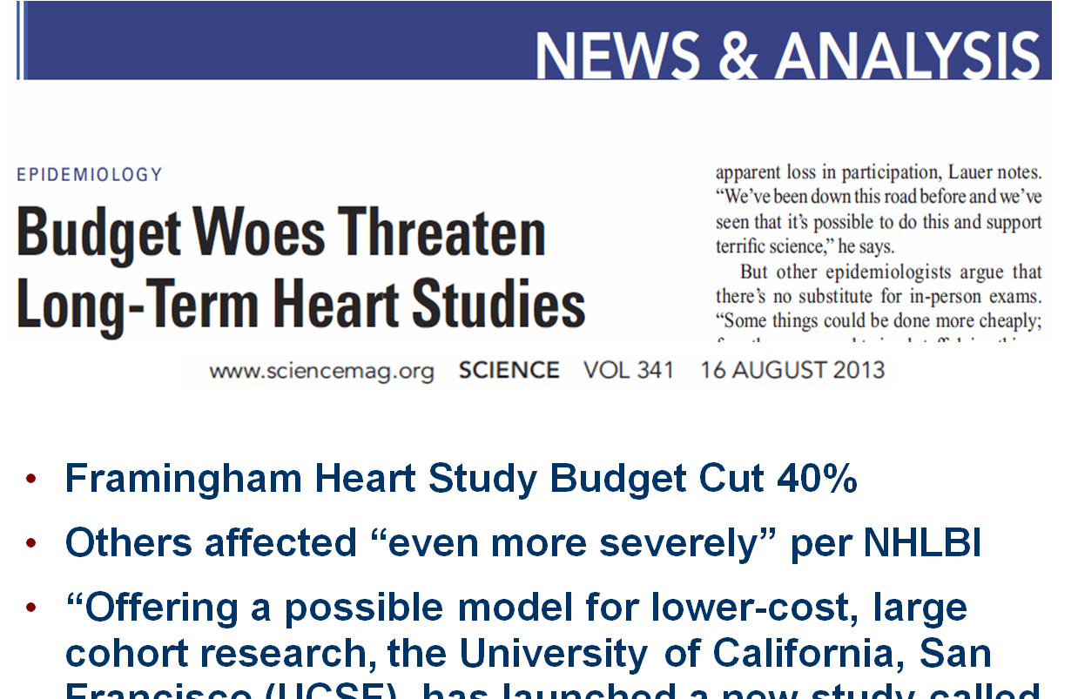
Notes:
This is a big deal. These cohort studies have been the scientific engine that has driven a lot of the new knowledge generation over the years, and scaling back support could really hamper progress in our field. We need to figure out ways to do the same type of research for less money.

Slide 61
US Technology use

Slide 62
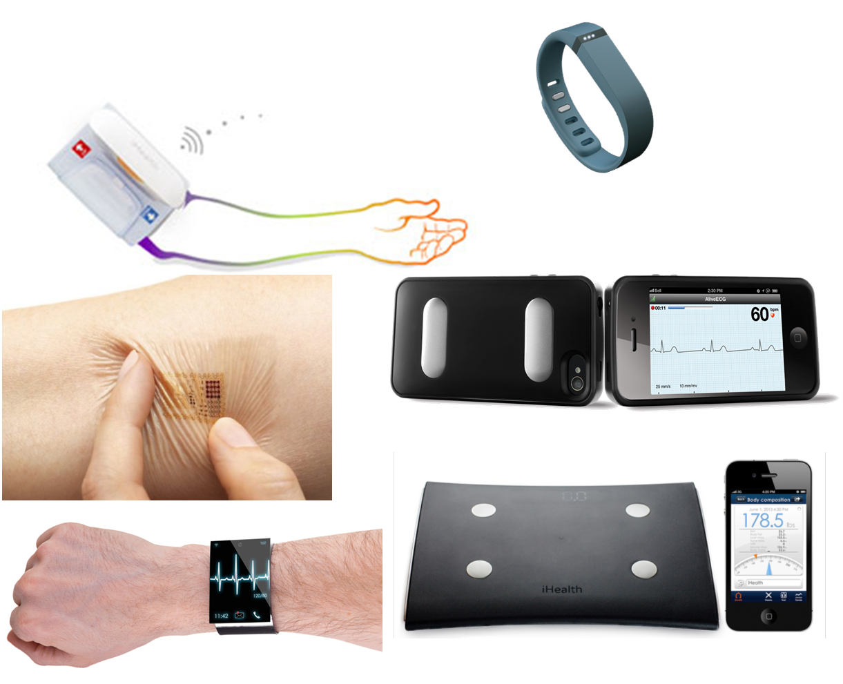
Wearable sensors

Slide 63
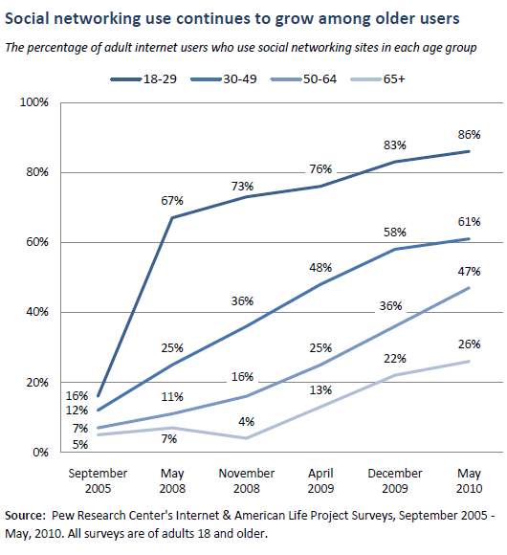
Online social networks
1.3 billion Facebook users
50% log in on any given day

Slide 64
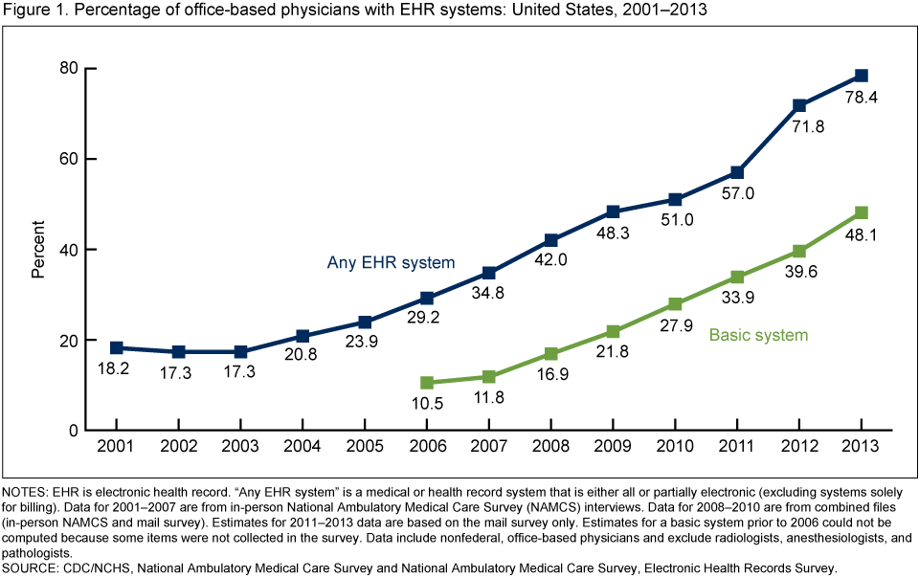
Electronic health records

Slide 65
Health eHeart Study
Basic Question: Can we use emerging technology to improve health?
Do research more efficiency
Collect new types of measurements
Design and test new interventions

Slide 66
Health eHeart Study
Here’s our plan: Build a web portal, enroll adults≥20 with email addresses, and collect survey data and sensor/device data (e.g, Fitbit)
Get partners to help us enroll (e.g., AHA)

Slide 67
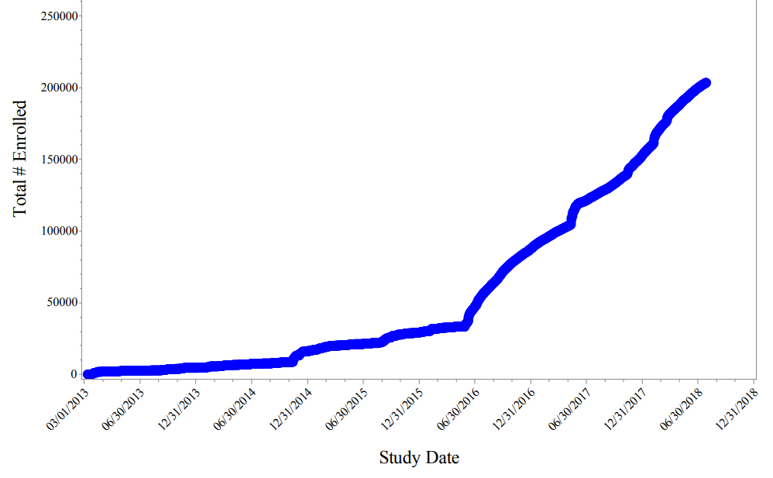
Health eHeart Study
>200,000 consented participants

Slide 68
Health eHeart Study
Here’s our plan: Build a web portal, enroll adults≥20 with email addresses, and collect survey data and sensor/device data (e.g, Fitbit)
Fill in the Madlib:
  The [study name] is a [observational study design] designed to examine the association between [primary predictor] and [outcome] in [study population].

Slide 69
Health eHeart Study
Here’s our plan: Build a web portal, enroll adults≥20 with email addresses, and collect survey data and sensor/device data (e.g, Fitbit)
ANSWER: We have not yet specified enough!
  The Health eHeart Study is an ”eCohort” Study designed to examine the association between [primary predictor] and [outcome] in adults≥20 on the internet with an email address.

Slide 70
Health eHeart Study
Trials and tribulations
  Exciting general concept, but research questions not well-specified up front
    Slow to publish
    Inadequate attention and resources for MI detection, etc
  Enrollment brisk, but not representative!
    Self-selection, word of mouth
    73% women, 4% African-American, 73% college grad
  Better as a platform and registry than cohort study

Slide 71
MS-FIT
A Health eHeart Ancillary Study
MS-FIT Study – Here’s what we did:
We enrolled MS patients from the UCSF MS Clinic into Health eHeart, measured EDSS (disability) at baseline, and gathered Fitbit daily step counts over 4 weeks
  The MS-Fit Study is a cohort study designed to examine the association between average daily step count measured by a Fitbit over 4 weeks and disability measured by the EDSS score at baseline in MS patients recruited in the UCSF Multiple Sclerosis Clinic.

Slide 72
MS-FIT
Now we can get an answer!
Block, Gelfand et al. Preliminary

Slide 73
CVD risk factor Tx in young adults
Does treatment of high cholesterol during young adulthood improve cardiovascular health?
Rationale:
  Atherosclerosis starts during young adulthood or earlier
  Cumulative exposure to LDL associated with:
    Coronary calcification
    Coronary heart disease events
  We treat high blood pressure >140 early in life, why not high cholesterol?

Slide 74
CVD risk factor Tx in young adults
Does treatment of high cholesterol during young adulthood improve cardiovascular health?
Study Design #1: POPAYA
  The Prevention of Premature Atherosclerosis in Young Adults (POPAYA) Trial is a randomized controlled trial designed to estimate the effect of 10 mg atorvastatin for 5 years versus placebo on coronary calcification in young adults age 30-40 with LDL 130-190 mg/dl

Slide 75
Study Design: Importance vs. Feasibility
Must be very clever…
Importance
Don’t bother
Usual tradeoff zone
0 --
Don’t bother
|
0
Feasibility

Slide 76
Study Design: Importance vs. Feasibility
How do increase importance?
What would be more feasible?
Any opportunities for “cleverness”?
Ideas??
Importance
POPAYA
0 --
|
0
Feasibility

Slide 77
CVD risk factor Tx in young adults
Study Design #2: RCT→Events
This is a randomized controlled trial designed to estimate the effect of 10 mg atorvastatin versus placebo for 20+ years on coronary heart disease events after initiation of therapy in young adults age 30-40 with LDL 130-190 mg/dl

Slide 78
Study Design: Importance vs. Feasibility
How do increase importance?
What would be more feasible?
Any opportunities for “cleverness”?
RCT→Events
Importance
POPAYA
0 --
|
0
Feasibility

Slide 79
CVD risk factor Tx in young adults
Study Design Option #3: Cross-sectional
This is a cross-sectional study designed to examine the association between statins and coronary calcification in young adults with high cholesterol undergoing a coronary calcium scan.

Slide 80
Study Design: Importance vs. Feasibility
How do increase importance?
What would be more feasible?
Any opportunities for “cleverness”?
RCT→Events
Importance
POPAYA
X-sectional
0 --
|
0
Feasibility

Slide 81
CVD risk factor Tx in young adults
Study Design Option #4: Cohort Study
This is a retrospective cohort study designed to examine the association between statin therapy started during young adulthood and coronary heart disease events in young adults with high cholesterol.

Slide 82
Study Design: Importance vs. Feasibility
How do increase importance?
What would be more feasible?
Any opportunities for “cleverness”?
RCT→Events
Importance
POPAYA
Cohort
X-sectional
0 --
|
0
Feasibility

Slide 83
CVD risk factor Tx in young adults
Study Design Option #5: Case-Control Study
The Statin Duration Study is a case-control study designed to examine the association between self-reported prior duration of statin therapy and coronary heart disease events in adults with and without coronary heart disease events on a statin and matched on age and estimated pre-statin LDL levels and CHD risk.

Slide 84
Study Design: Importance vs. Feasibility
How do increase importance?
What would be more feasible?
Any opportunities for “cleverness”?
RCT→Events
Importance
POPAYA
Case-control
Cohort
X-sectional
0 --
|
0
Feasibility

Slide 85
Study Design: Importance vs. Feasibility
Focus in on feasible studies with reasonable “value”
RCT→Events
Importance
POPAYA
Case-control
Cohort
X-sectional
0 --
|
0
Feasibility

Slide 86
Critical Points
You can’t contribute to science without a carefully crafted and specified research question
  A description of your Goal and What You Will Do, are not enough
  Primary objective of DCR is to help you specify your study design
Consider all of your study design options
  All research has flaws and limitations
  Design multiple studies
  Discard if completely infeasible or “fatally” flawed
  Role of opportunism and cleverness

Slide 87
Upcoming Lectures
 | Lecture title | Lecturer
1 | Introduction to the Course, Clinical Research, and Research Questions | Mark Pletcher
2 | Subjects and Variables | Tom Newman
3 | Sample size, P-values and Confidence Intervals | Mark Pletcher /Steve Cummings
4 | Observational Designs and Studies of Diagnostic Tests | Warren Browner
5 | Causal Inference and Randomized Trials | Deborah Grady
6 | Questionnaires, Data Collection Forms and Data management | Michael Kohn
7 | Technology-Enabled Research at UCSF | Mark Pletcher

Slide 88
Upcoming assignments
DCR-4 Reading | Written Assignments
Chapters 1 and 2 | 1-sentence Research Question Significance section with references
Chapters 3 and 4 | 1-page protocol outline Flesh out Study Subjects section
Chapters 5 and 6 | 1) Sample size justification
Chapters 7,8 and 12 or 13 | Flesh out Study Design and Measurements 2nd 1-page protocol outline
Chapters 9-11 | 1) Flesh out a) Confounder approach; b) Randomization/Blinding approach; c) Gold standard/Test eval approach
Chapters 12 or 13, and 15 and 16 | 1-page data collection form excerpt (or critique of one?) Data dictionary Data collection/management plan
 | Final Project

Slide 89
Have fun in section!
Questions → Small Group Leaders

