Slide 1
Biostat 202: Opportunities and Challenges of “Big Data”.
Machine Learning 2:
Classification
David Glidden
Division of Biostatistics
Department of Epidemiology and Biostatistics
08/16/2018

Slide 2
Overview
Auto-numeric node Modeler Demo
Classification
Model evaluation
Training-test
Classification methods
  Logistic Regression
  K-nearest neighbors
IBM SPSS Data Modeler examples left for todays lab

Slide 3
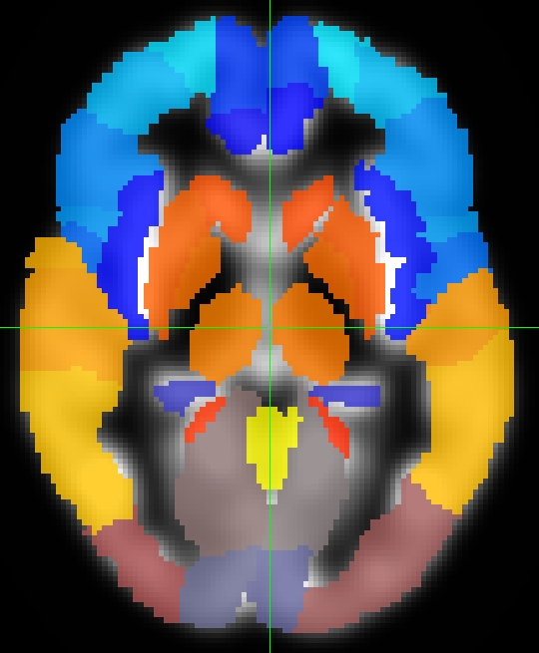
Brain volumes dataset Modeler demo
Use regional brain volumes to predict age of subject in healthy controls with a range of ages – Target = Age, Predictors = regional volumes + demographic variables
ROI volumes are the main predictors: Extract 136 ROIs as predictors for each subject – big data?
ROIs are defined in terms of anatomical regions and landmarks in the human brain that are common to all individuals – often have specific functional roles

Slide 4
Classification

Slide 5
Supervised vs. unsupervised
Machine Learning
Supervised
Regression (continuous outcome)
Classification (categorical outcome)
Unsupervised
Clustering
(grouping observations)
Data Reduction (transforming variables)

Slide 6
Supervised vs. unsupervised
Machine Learning
Supervised
Regression (continuous outcome)
Classification (categorical outcome)
Unsupervised
Clustering
(grouping observations)
Data Reduction (transforming variables)

Slide 7
Classification
Objective – given set of predictors and some training data, generate a rule (classifier) to predict which category a new instance/observation/subject belongs to
Training data with observed predictors and outcomes (target) used to develop a classifier
Classifier is applied to new data where the outcome (i.e. target group/class) is unknown
Let’s look at a toy example trying to classify 1st vs. 6th grade girls based on height and weight….

Slide 8
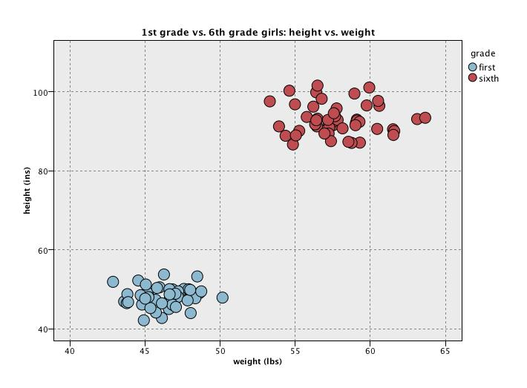
2D Classification example

Slide 9
2D Classification example

Slide 10
2D Classification example
Classification Rule is to predict new data points above the line to be 6th grade

Slide 11
2D Classification example

Slide 12
2D Classification example

Slide 13
But in real problems the separation is unlikely to be so neat
Consider 1st grade boys vs. 1st grade girls

Slide 14
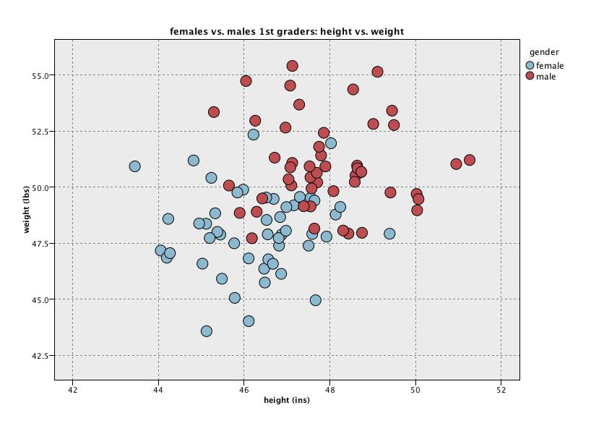
2D Classification example

Slide 15
2D Classification example
Tension: misclassifying many points

Slide 16
2D Classification example

Slide 17
2D Classification example
Tension: don’t believe real - overfitting

Slide 18
The trade-off
Want to find true predictive patterns in the data
But, want to avoid overfitting spurious detail: i.e. don’t want to make the model capture apparent patterns due to noise - we want results that are likely to be generalizable to future observations
Solution – independent testing – reserve some data that has not been used in model fitting for the purpose of model evaluation and comparison

Slide 19
Definitions
True Positive (TP) – observation is positive and was predicted as positive
True Negative (TN) – observation is negative and was predicted as negative
False Positive (FP) – observation is negative and was predicted as positive
False Negative (FN) – observation is positive and was predicted as negative
Classification accuracy – proportion of observations classified correctly = (#TP + #TN)/N

Slide 20
Evaluation
Possible evaluation measures:
  Classification Accuracy – or conversely, the classification error rate = 1 – classification accuracy
  Differential penalties – different errors may have different costs
  Area Under Receiver-Operating Characteristic (ROC) Curve (AUC)
How reliable are the predicted results ?

Slide 21
Classifier error rate
Natural performance measure for classification problems: error rate (or success rate)
  Success: instance’s class is predicted correctly
  Error: instance’s class is predicted incorrectly
  Error rate: proportion of errors made over the whole set of instances
  Success rate: proportion of errors made over the whole set of instances = 1 – Error rate

Slide 22
Cost-Benefit
Cost-benefit is similar to classification error, except that we might want to count some errors to be worse than others
Consider a disease where treatment involves taking a simple cheap and benign medicine to cure it (e.g. taking vitamin C), but if the disease is unchecked, the consequences are severe.
In that case, I would want to put much more weight on missing positives than missing negatives; i.e. consequences of false negatives are much worse than false positives.
For example, we might make the penalty (cost) for a false negative be 10 or 100 times that of a false positive

Slide 23
Sensitivity and Specificity
Test\Truth | Disease Free | Diseased | Total
Negative | TN | FN | FN+TN
Positive | FP | TP | TP+FP
Total | FP+TN | TP+FN | N

Slide 24
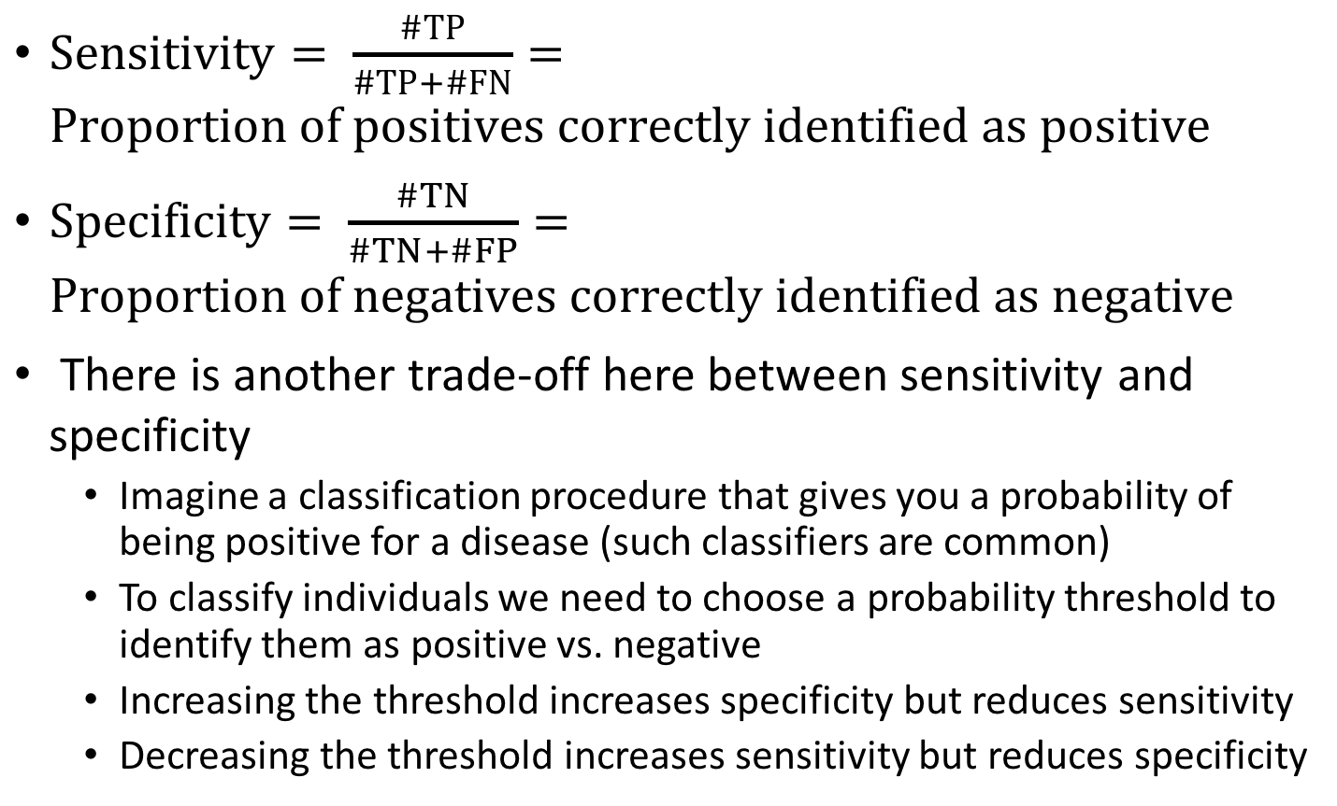
Sensitivity and Specificity
$Sensitivity= \frac{\#TP}{\#TP+\#FN}=Proportion of positives correctly identified as positive$
$Specificity= \frac{\#TN}{\#TN+\#FP}=Proportion of negatives correctly identified as negative$
There is another trade-off here between sensitivity and specificity
  Imagine a classification procedure that gives you a probability of being positive for a disease (such classifiers are common)
  To classify individuals we need to choose a probability threshold to identify them as positive vs. negative
  Increasing the threshold increases specificity but reduces sensitivity
  Decreasing the threshold increases sensitivity but reduces specificity

Slide 25
Receiver operating characteristic (ROC) curve
Sensitivity
1 - Specificity

Slide 26
Choosing threshold based on ROC
Many possible thresholds, each corresponding to one point on curve
Choosing a single one depends on context
Some studies say (for example) give me best specificity for a sensitivity of at least 0.8 (blue x)
General alternative – maximal perpendicular from diagonal (red x)
We will not be concerned with choosing thresholds, rather, we will use ROC to generate a metric
x
x
Sensitivity
1 - Specificity

Slide 27
Area under the (ROC) curve (AUC)
AUC gives a measure of how well the predictor does across all possible thresholds
Ideal AUC is 1
AUC for random predictor = 0.5
Objective is to find classifier that maximizes AUC
Sensitivity
1 - Specificity

Slide 28
Error rate vs. AUC
When should we choose error rate and when AUC?
Error rate (and cost-benefit) work well when your dataset is representative of the larger population (metric incorporates prevalence – e.g. proportion of people in population that have disease)
AUC works better when your dataset is not representative of larger population, e.g. in “case-control” studies (metric is independent of prevalence)

Slide 29
Training set error rate: is generally too optimistic!
You can find patterns even in random data
So we need to evaluate on separate independent (Test) set

Slide 30
When you have lots of “instances”
If many (>1000) instances are available, including >100 from each class
A simple evaluation training/test evaluation will work
  Randomly split data into training and test sets (often ~2/3 for train, 1/3 for test) – may want to stratify on outcome (have matching proportions of each class in each set)
Build a classifier using the training set and evaluate it using the test set
We will look at cross-validation later for when you do not have so many observations

Slide 31
When you have lots of “instances”
Results Known
+
Training set
+
-
-
Data
+
-
+
+
Testing set

Slide 32
When you have lots of “instances”
Results Known
+
Training set
+
-
-
Data
+
-
+
+
Model Builder
Testing set

Slide 33
When you have lots of “instances”
Results Known
+
Training set
+
-
-
Data
+
-
+
+
Model Builder
Evaluate
Predictions
+
-
+
-
Y
N
Testing set
At least greater than a few hundred instances and better >1000

Slide 34
When you have lots of “instances”
Results Known
+
Training set
+
-
-
Data
+
-
+
+
Model Builder
Evaluate
Predictions
+
-
+
-
Y
N
Testing set
At least greater than a few hundred instances and better >1000

Slide 35
Classification methods
Logistic regression
K-nearest neighbors
Classification trees
Support vector machines (SVMs)
Linear Discriminant Analysis (LDA)
Neural Networks

Slide 36
Logistic Regression

Slide 37
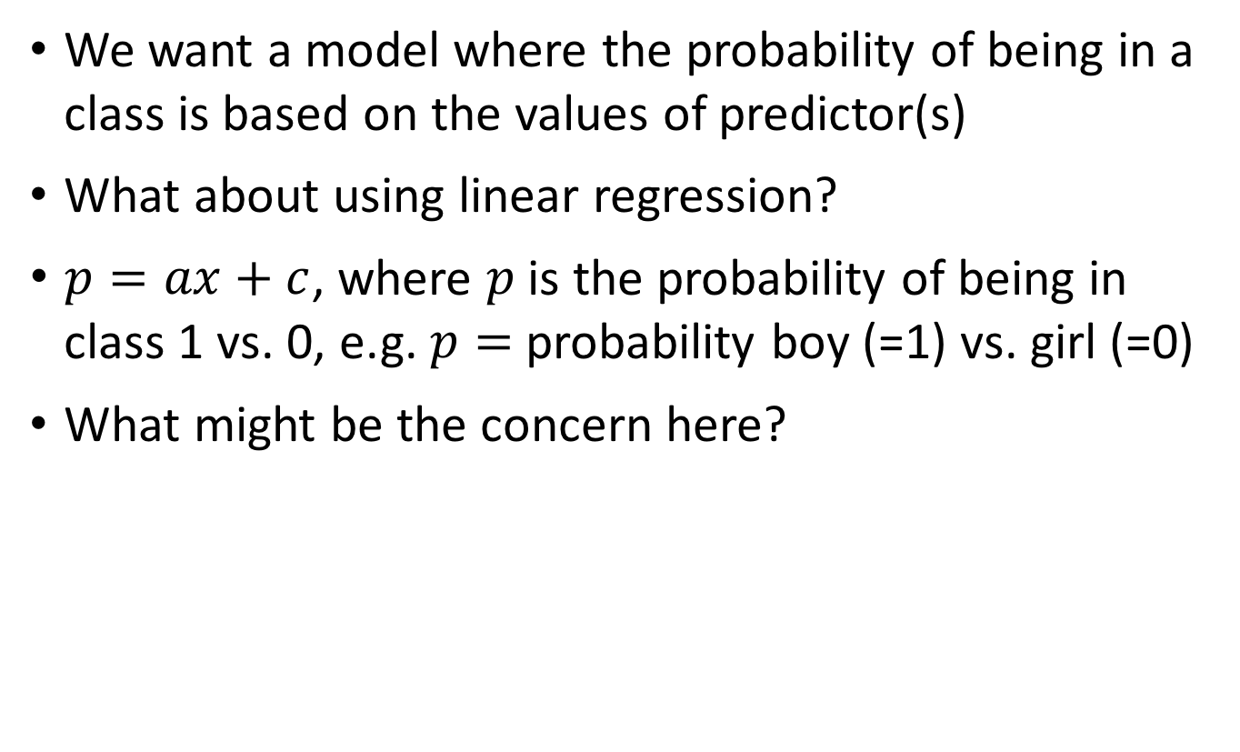
Binary/flag outcome regression modeling
We want a model where the probability of being in a class is based on the values of predictor(s)
What about using linear regression?
$p=ax+c$, where $p$ is the probability of being in class 1 vs. 0, e.g. $p=$probability boy (=1) vs. girl (=0)
What might be the concern here?

Slide 38

Linear regression?
$$p$$
1
0

Slide 39
Linear regression
Problem predictions – outside range 0 to 1
$$p$$
1
0

Slide 40
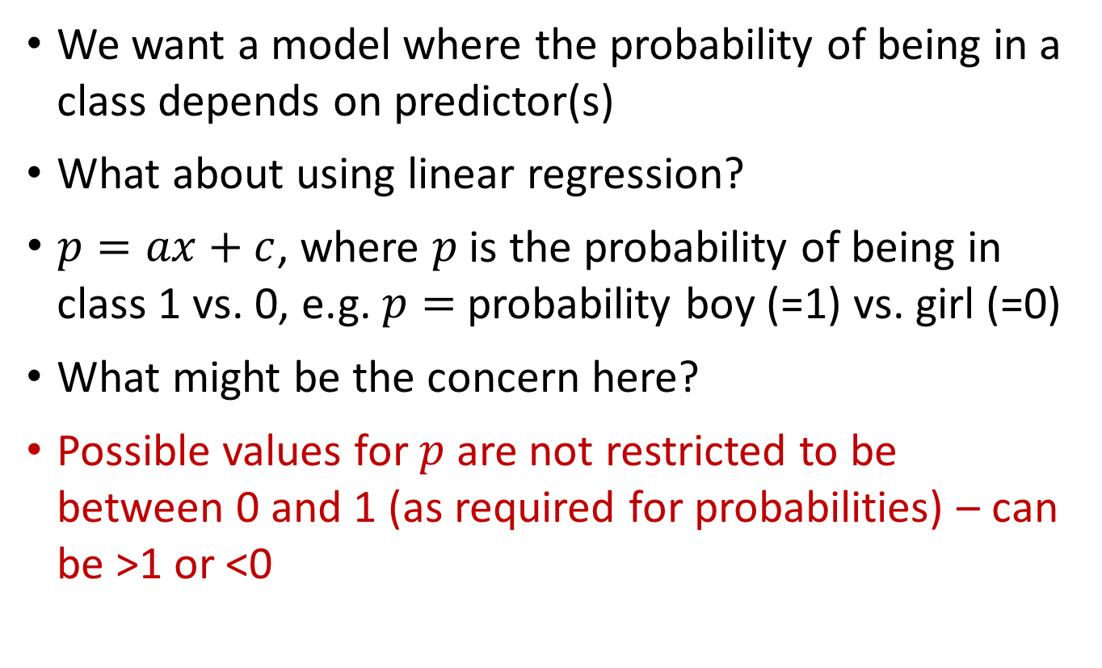
Binary/flag outcome regression modeling
We want a model where the probability of being in a class depends on predictor(s)
What about using linear regression?
$p=ax+c$, where $p$ is the probability of being in class 1 vs. 0, e.g. $p=$probability boy (=1) vs. girl (=0)
What might be the concern here?
Possible values for $p$ are not restricted to be between 0 and 1 (as required for probabilities) – can be >1 or <0

Slide 41
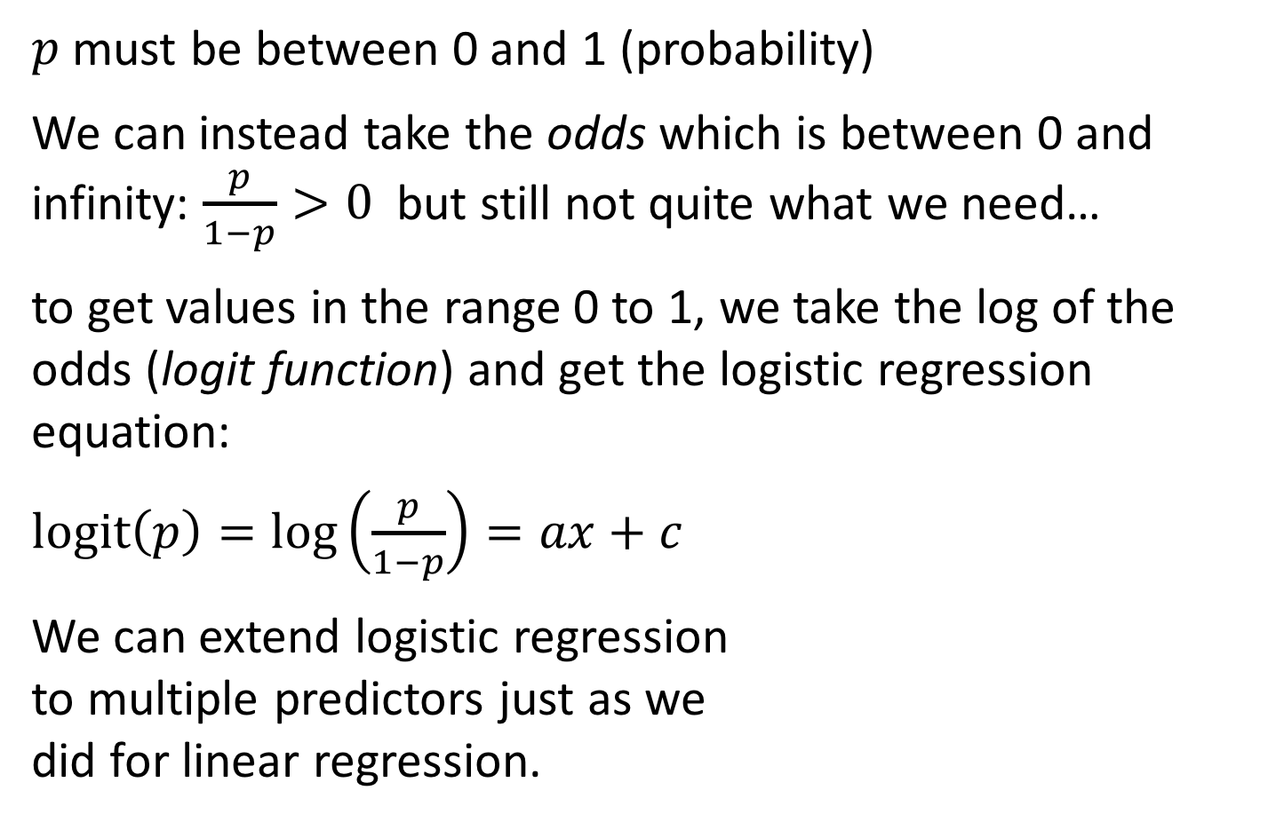
Logistic regression
$p$ must be between 0 and 1 (probability)
We can instead take the odds which is between 0 and infinity: $\frac{p}{1−p}>0$ but still not quite what we need…
to get values in the range 0 to 1, we take the log of the odds (logit function) and get the logistic regression equation:
$logit\left(p\right)=\log\left(\frac{p}{1−p}\right)=ax+c$
We can extend logistic regression
to multiple predictors just as we
did for linear regression.

Slide 42
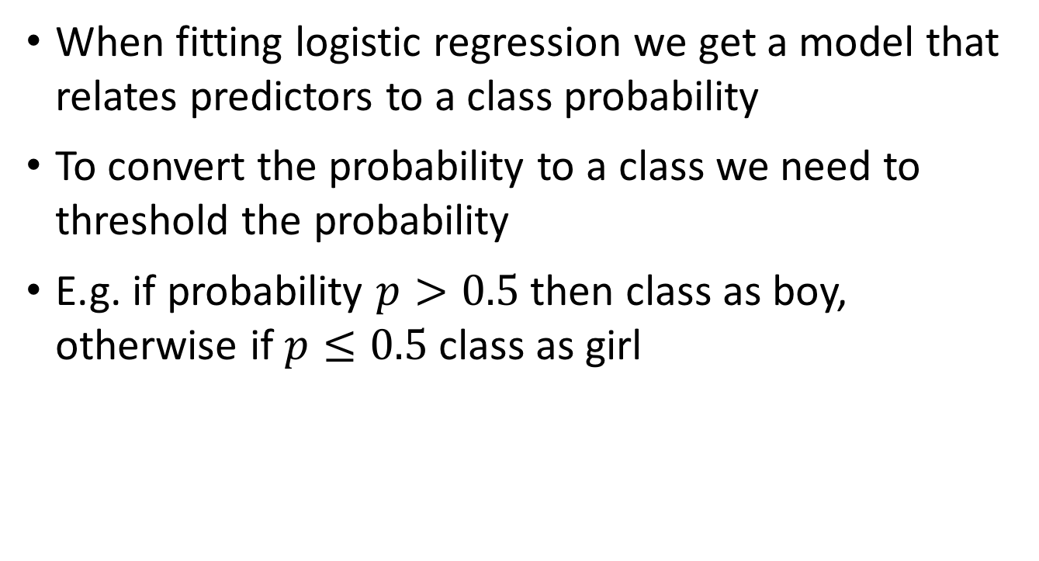
Logistic regression for classification
When fitting logistic regression we get a model that relates predictors to a class probability
To convert the probability to a class we need to threshold the probability
E.g. if probability $p>0.5$ then class as boy, otherwise if $p≤0.5$ class as girl

Slide 43
Logistic regression
A long history (relatively) – well known
Much statistical theory
Works well for many problems
Can be extended to multiple categories
Can use step-wise/subset selection techniques
Can provide interpretable models

Slide 44
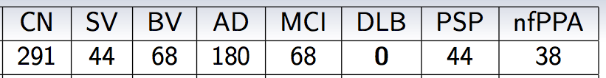
Running example: UCSF Memory and Aging Clinic (MAC) Dataset
Structural (volumetric) MRI – multiple dementia studies – but in same scanner and same protocol
Single time point
Gold standard Dx – autopsy (if dead) UCSF clinical expert joint decision (otherwise)
Objective is to classify patients as having or not having dementia (binary) and if yes, what type of dementia (multi-class)?

Slide 45
ROI predictors
ROI volumes are the main predictors: Extract 136 ROIs as predictors for each subject – big data?
ROIs are defined in terms of anatomical regions and landmarks in the human brain that are common to all individuals – often have specific functional roles

Slide 46
IBM Modeler analysis
Classification analysis – predicting dementia existence and type based on voxel-based-morphometry gray matter maps
Using region of interest (ROI) estimates as predictors
So let’s look at logistic regression predicting yes/no for dementia

Slide 47
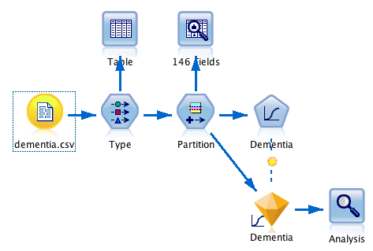
IBM Modeler stream

Slide 48

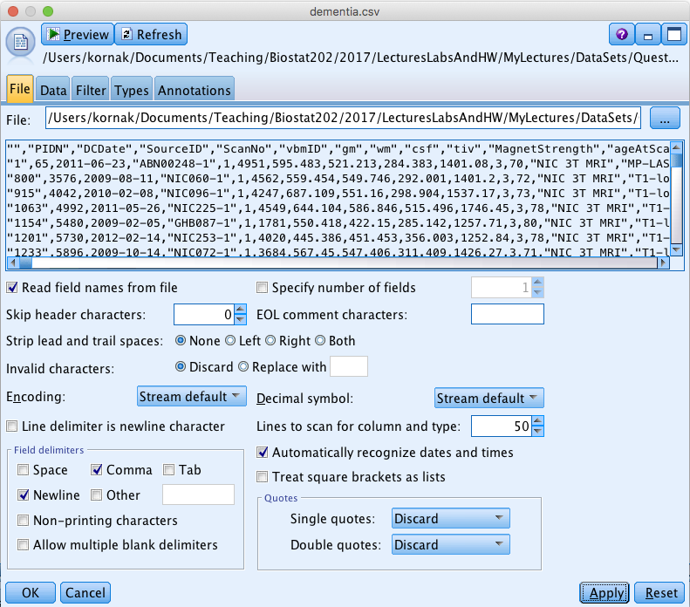
Var. File node

Slide 49
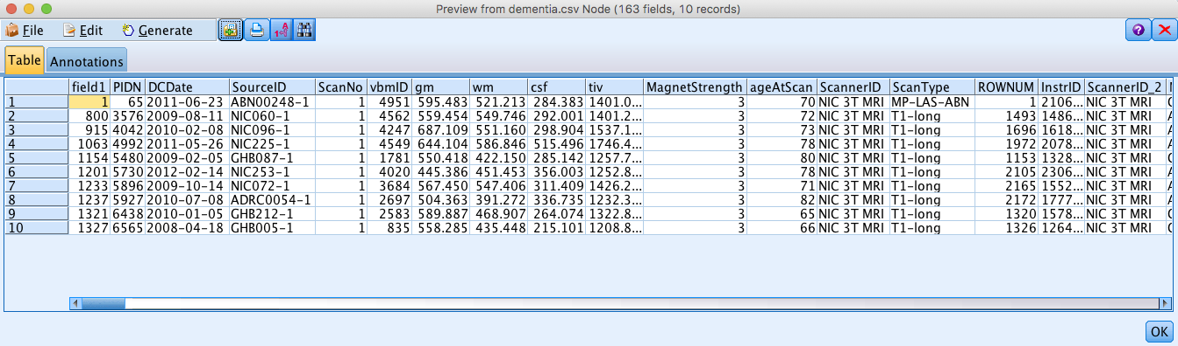
Var. File node – Preview

Slide 50

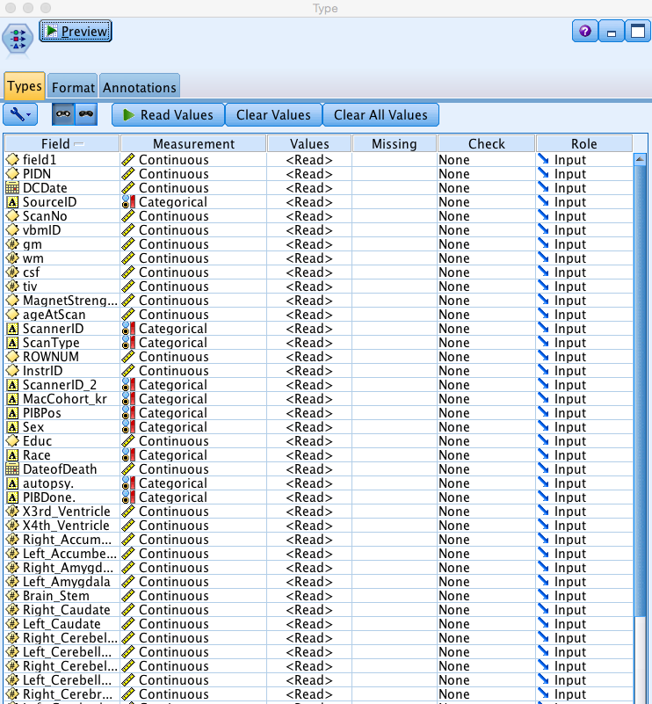
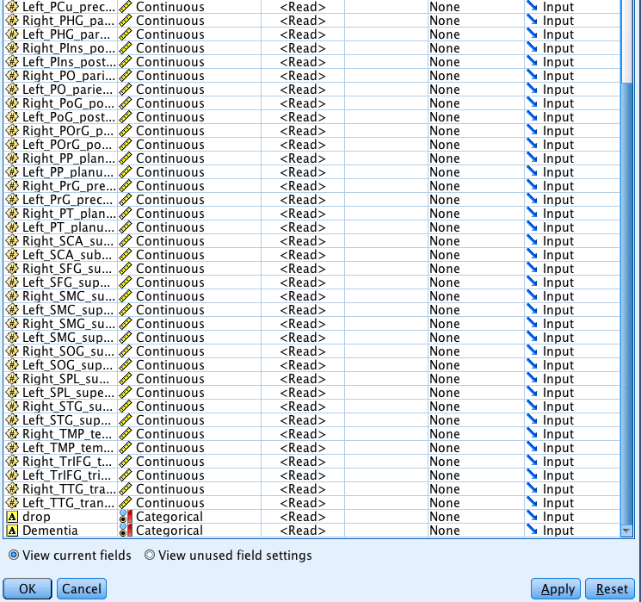
Type node – initial

Slide 51
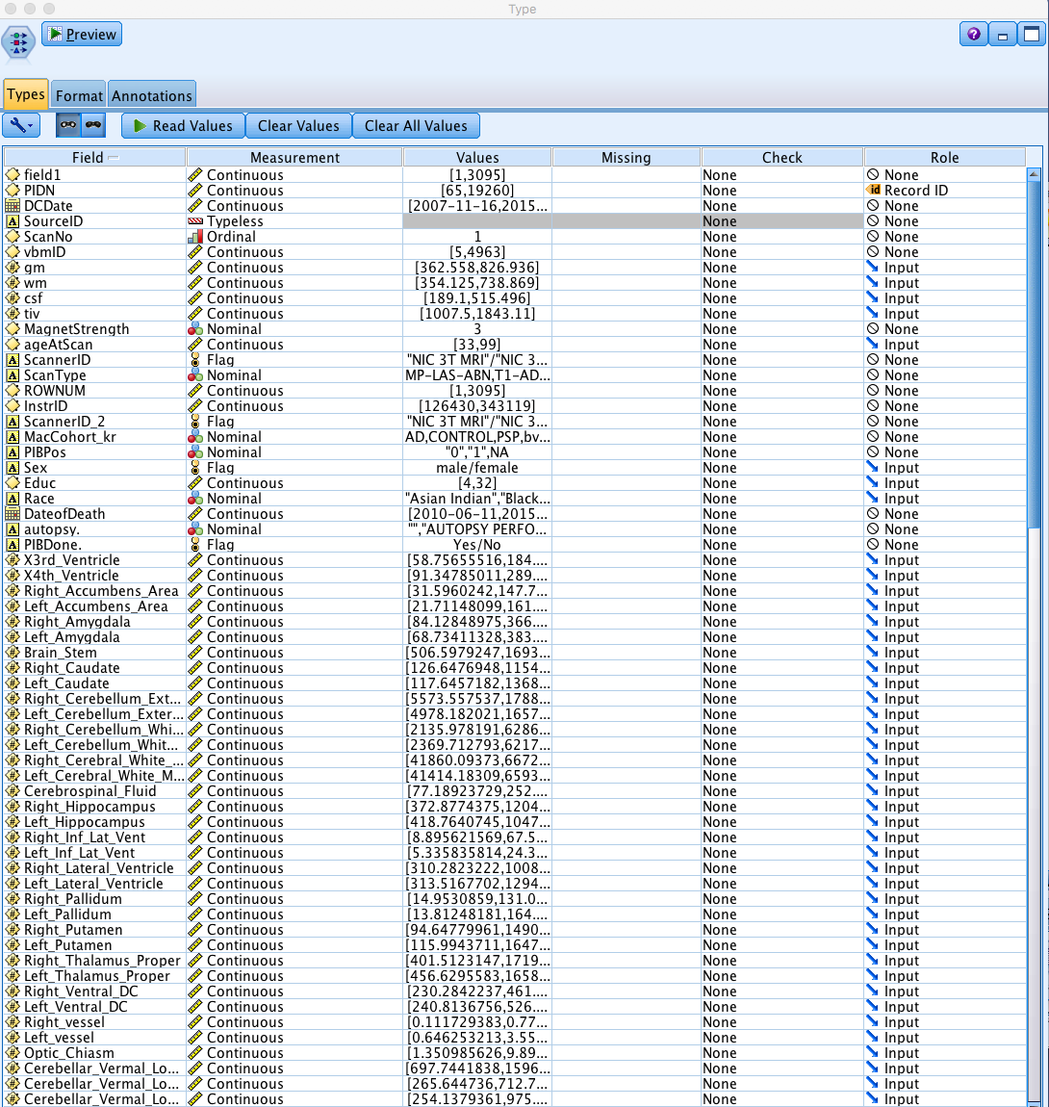
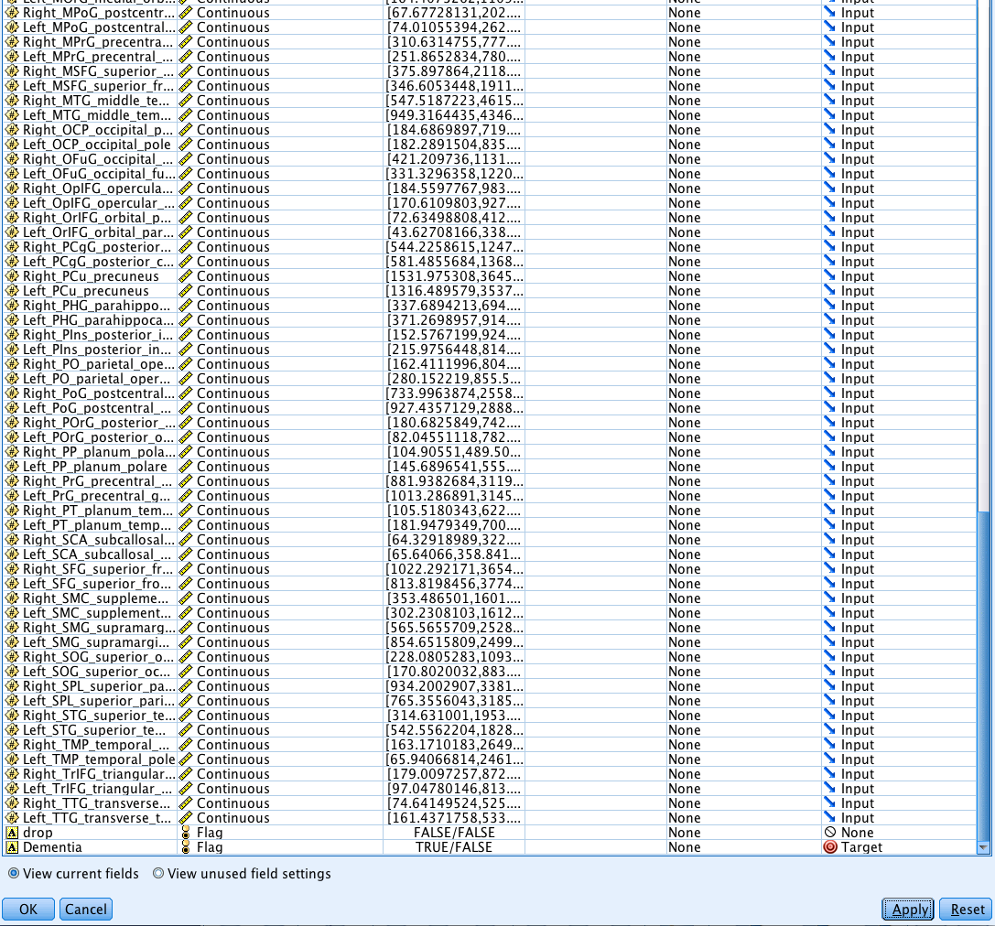
Type node – after correcting

Slide 52

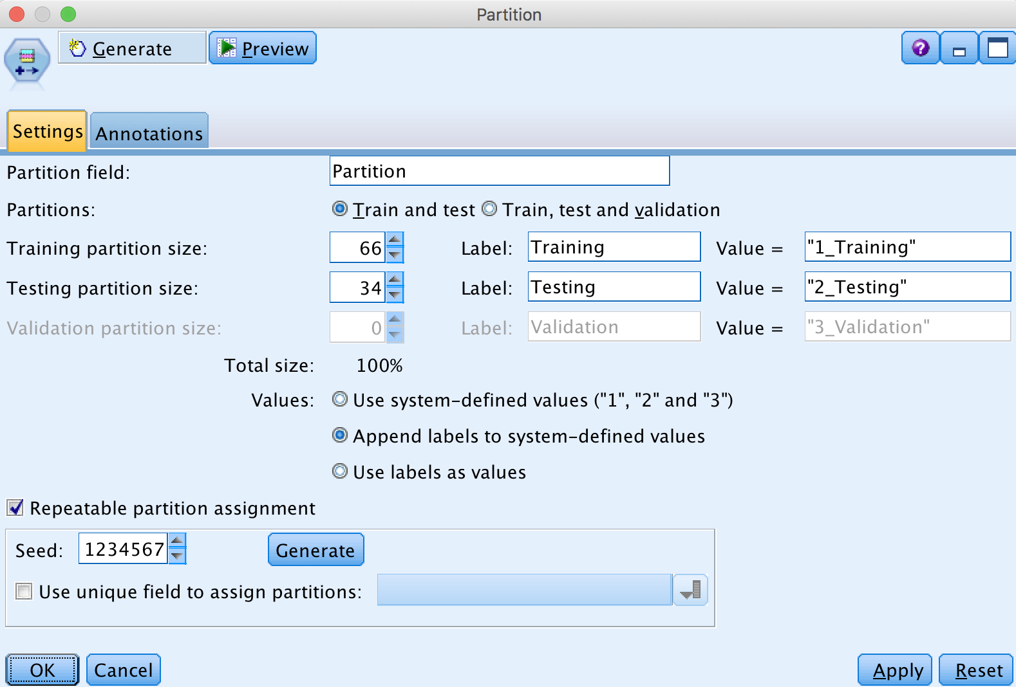
Partition node

Slide 53

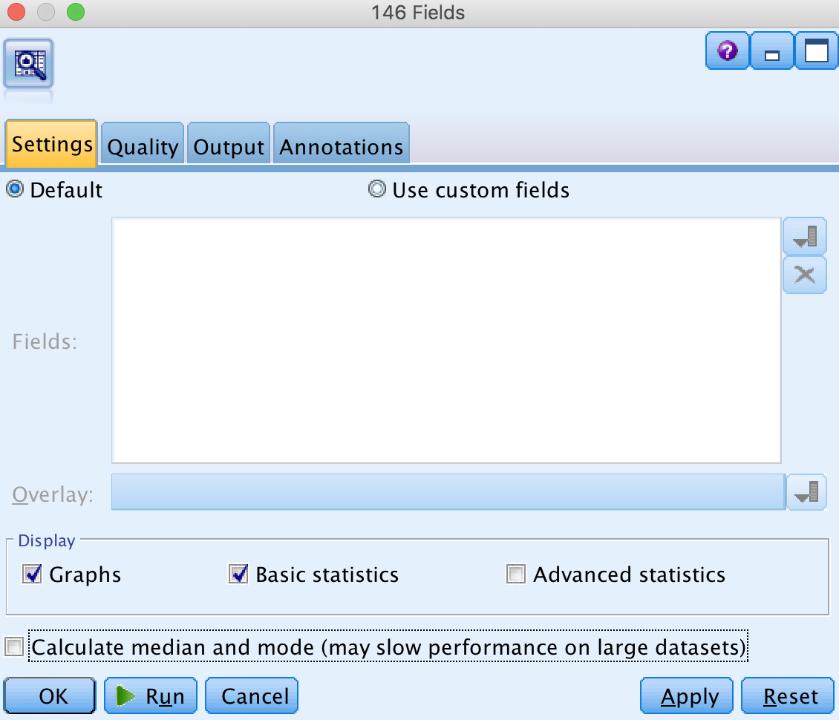
Audit node

Slide 54
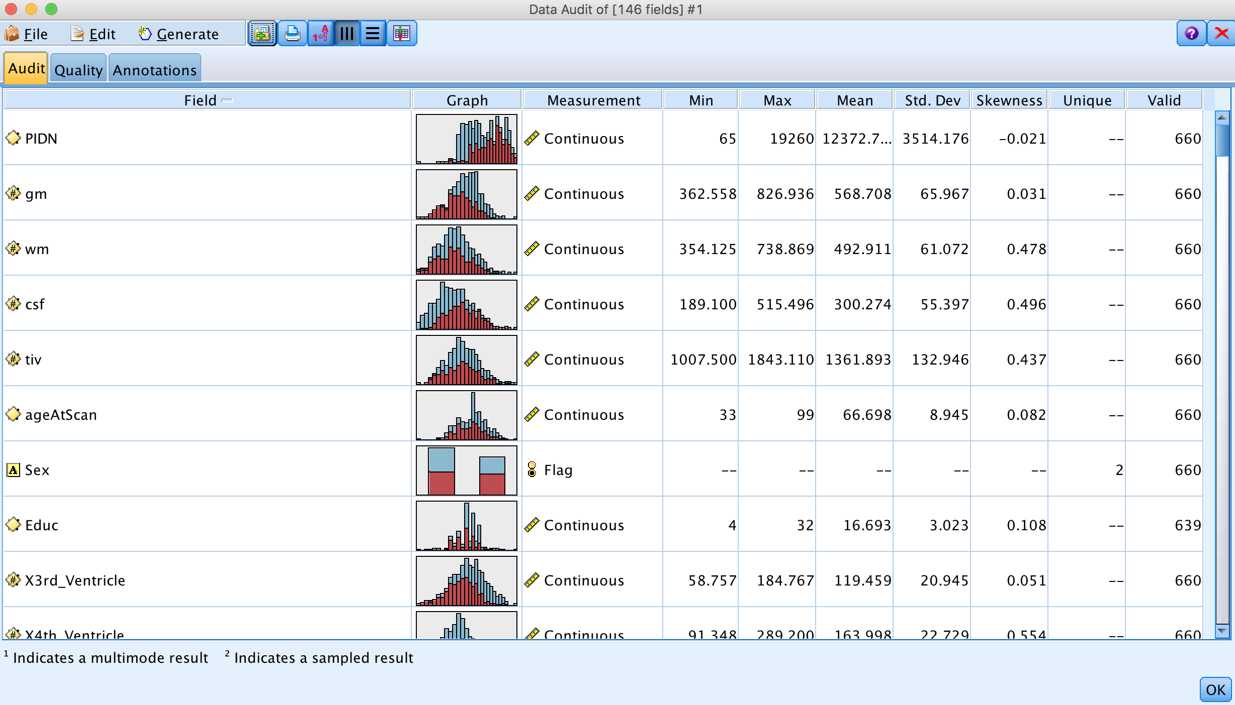
Audit node

Slide 55
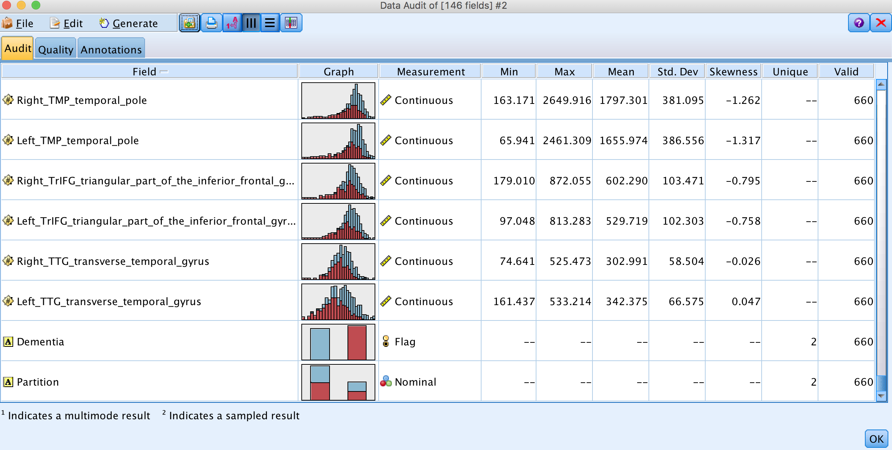
Audit node

Slide 56
Audit node

Slide 57
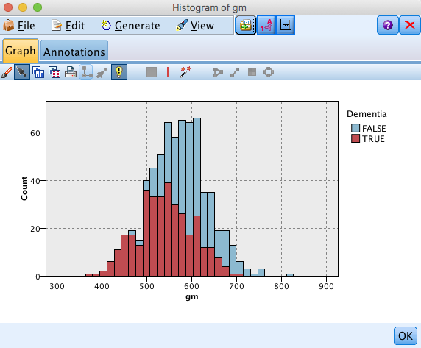
Audit node

Slide 58
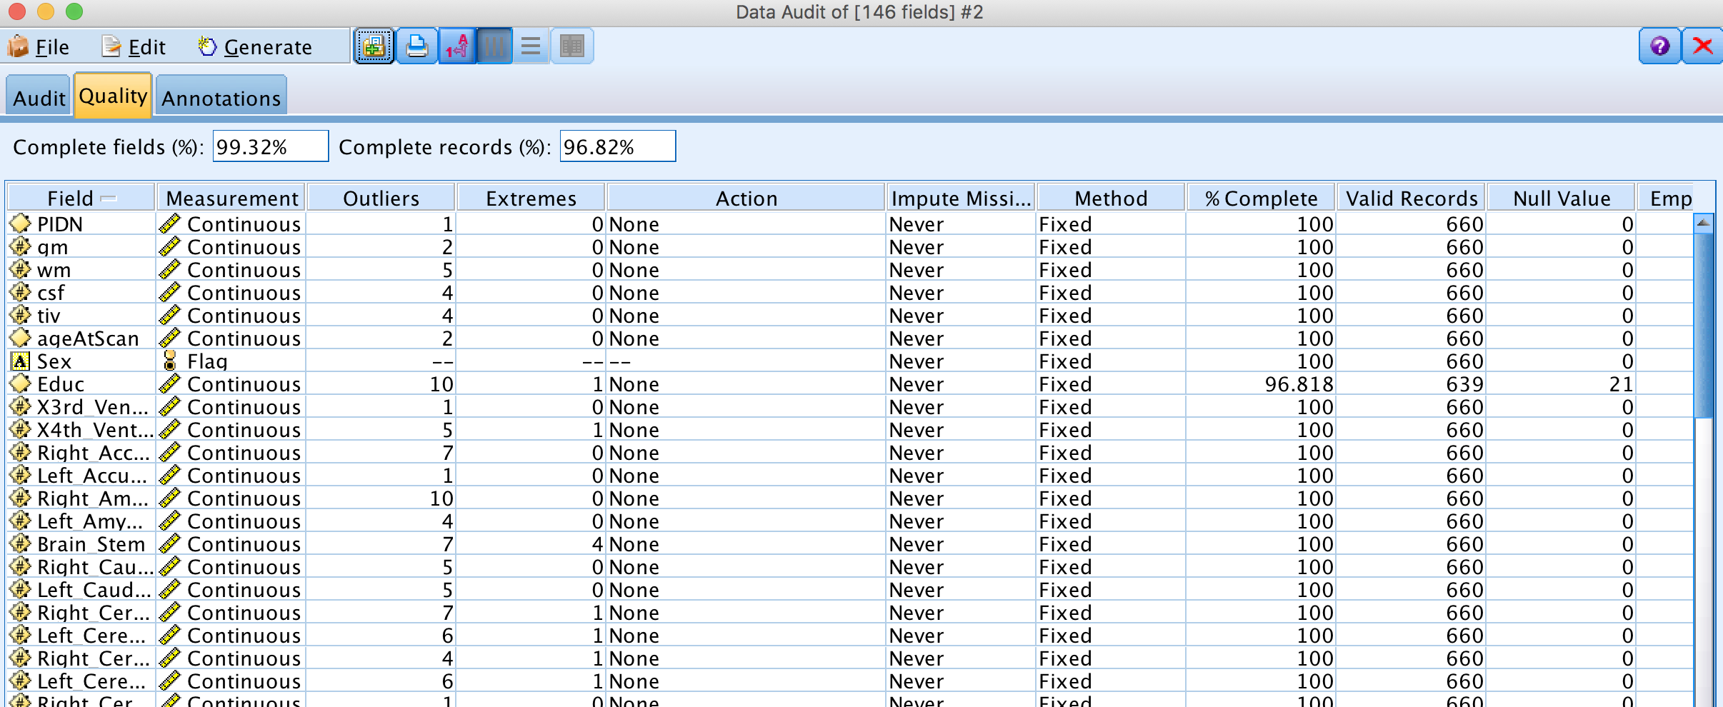
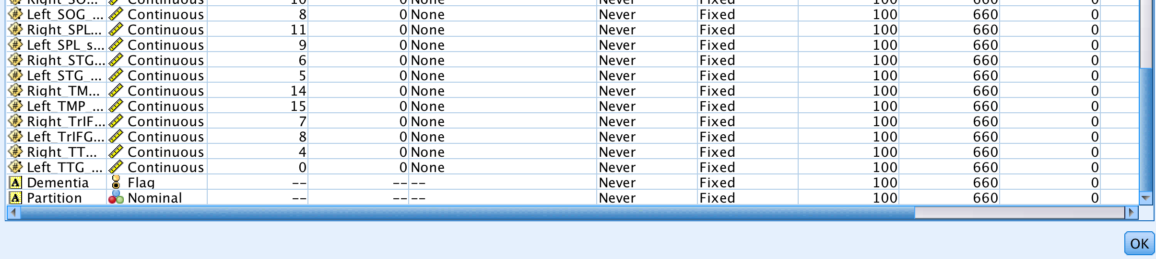
Audit node

Slide 59

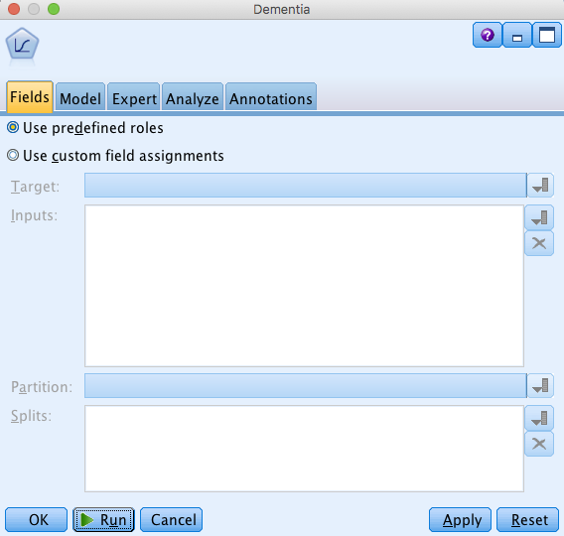
Logistic node

Slide 60
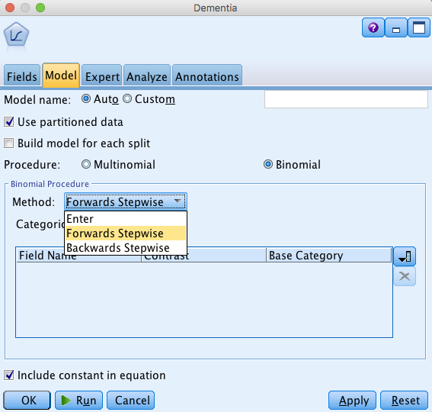
Logistic node

Slide 61
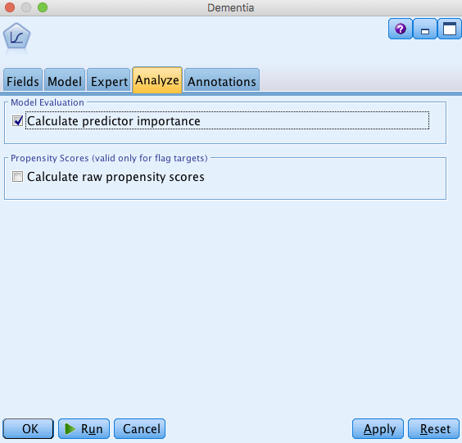
Logistic node

Slide 62

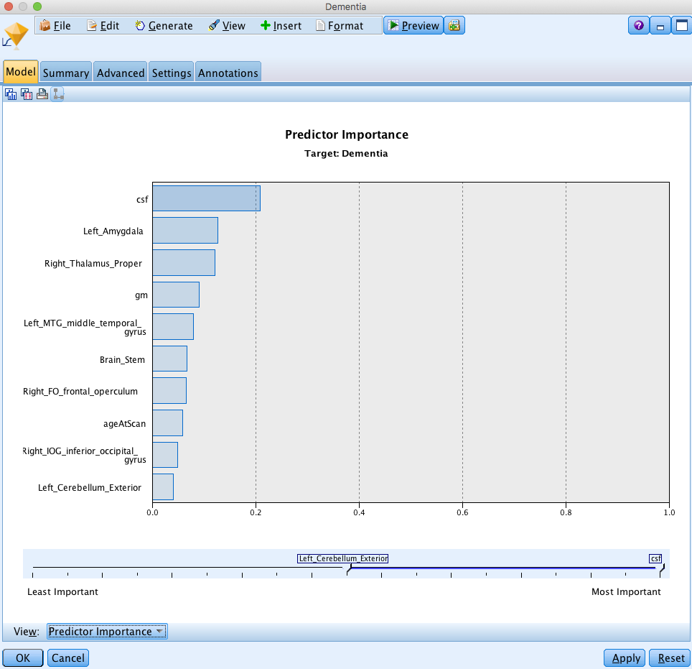
Golden Nugget

Slide 63
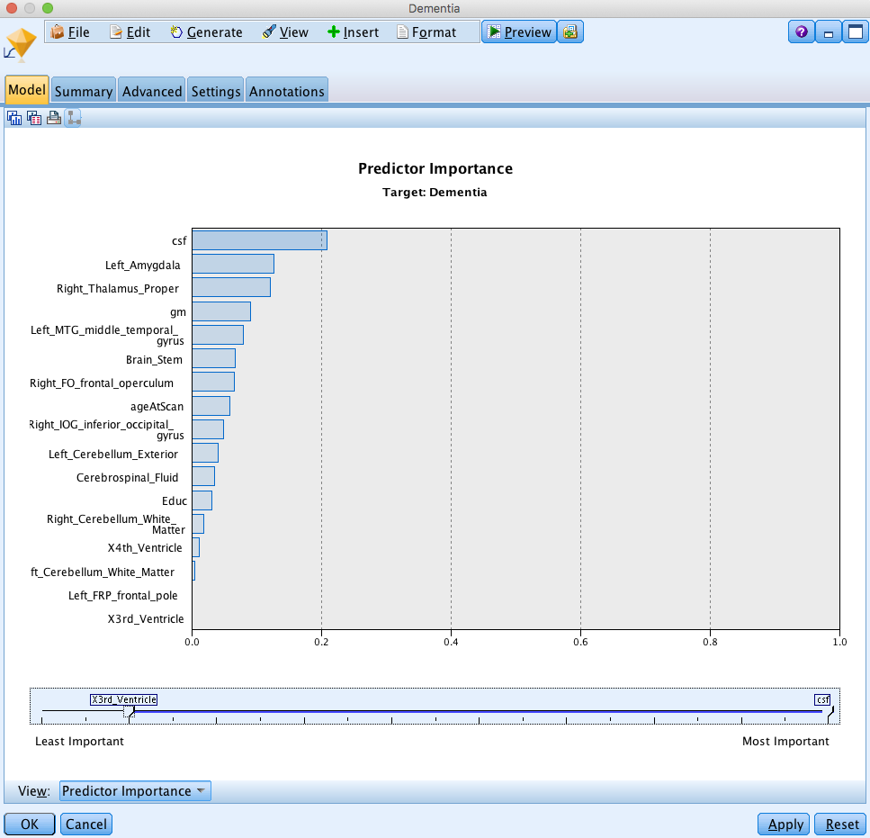
Golden Nugget
Also, the Advanced tab has a lot of information about what happened in the forward step-wise procedure, which predictors were retained etc.

Slide 64
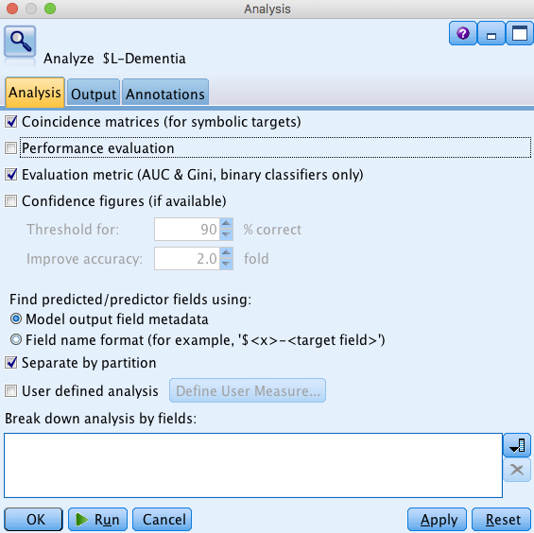
Analysis node

Slide 65
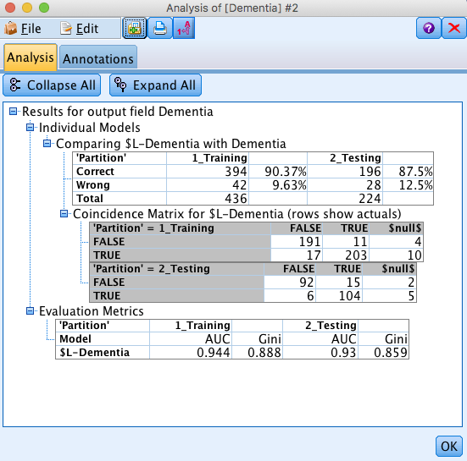
Analysis node

Slide 66
Monday’s lecture –
Machine Learning 3
K-nearest neighbors
Cross-validation
Classification Trees
Neural Networks (Neural Nets)
Note: HW #4 is on CLE
– due 11.55pm on Thursday August 23

