Slide 1
Biostat 202: Opportunities and Challenges of “Big Data”.
Machine Learning 3:
More Classification
David Glidden
Division of Biostatistics
Department of Epidemiology and Biostatistics
08/20/2018

Slide 2
Overview
More Classification methods
  K-nearest neighbors
  Classification/decision Trees (Recursive Partitioning)
  Support vector machines
Training-validation-test
Cross-validation
Comparison of classifiers

Slide 3
K-nearest neighbors classification

Slide 4
K-nearest neighbors classification
Training data – 2 classes
and 2
predictors
height
weight

Slide 5
K-nearest neighbors classification
k=1 – blue wins
height
New point – need to predict class
weight

Slide 6
K-nearest neighbors classification
k=1 – blue wins
height
weight

Slide 7
K-nearest neighbors classification
k=3 – red wins
height
weight

Slide 8
K-nearest neighbors classification
k=3 – red wins
height
Any concerns?
weight

Slide 9
K-nearest neighbors classification
Common to standardize predictors to have mean 0 and standard deviation of 1 (subtract mean and divide by standard deviation)
Take majority vote among k-nearest neighbors
Ties are broken at random (e.g. 1 red neighbor and 1 blue neighbor when k=2 – choose red or blue at random).
Works for problems with more than 2 classes

Slide 10
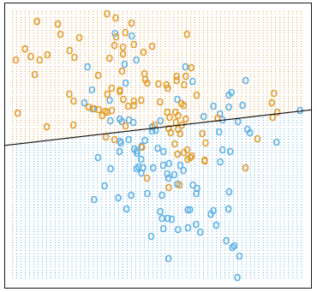
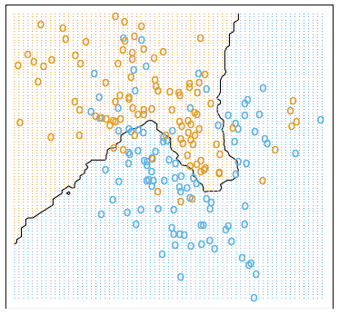
Choice of k
Example taken from Elements of Statistical Learning – Hastie et al. 2nd Ed. pp. 13-17
Linear decision boundary (LDA) 15 nearest-neighbor boundary

Slide 11
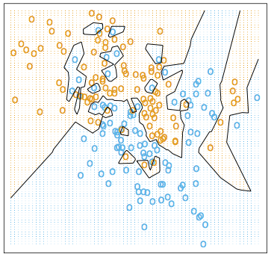
Choice of k
15 nearest-neighbor boundary 1-nearest neighbor boundary

Slide 12
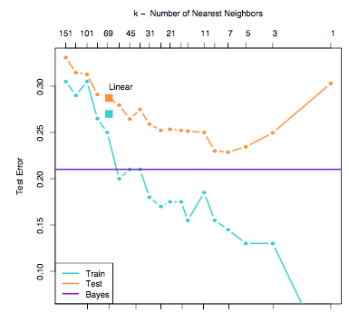
Choice of k
Fitting increased noise
Low to high complexity

Slide 13
Choice of k
Fitting increased noise
Low to high complexity
Training set error gets better with more complexity – fitting to noise helps

Slide 14
Choice of k
Fitting increased noise
Low to high complexity
Test error goes down then up again when overfitting
to training data
Training set error gets better with more complexity – fitting to noise helps

Slide 15
Choice of k
Best predictive
models
Fitting increased noise
Low to high complexity
Test error goes down then up again when overfitting
to training data
Training set error gets better with more complexity – fitting to noise helps

Slide 16
Choice of k
Best predictive
models
Theoretically best true predictive error level from this simulated data

Slide 17
Choice of k
Best linear separating line
Best predictive
models
Theoretically best true predictive error level from this simulated data

Slide 18
Nearest neighbors classifier
Simple technique
No modeling
Not good for a large number of predictors – suffers from the “curse of dimensionality”; but we can use unsupervised data reduction methods first to create new variables – e.g. Principle Components [see next lecture], or perform variable selection
Has been applied to many machine learning problems successfully

Slide 19
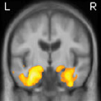
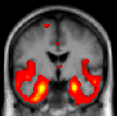
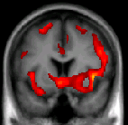
Running example: extend to differential diagnosis of multiple dementias
Dementias have different patterns of brain loss
Clinicians/radiologists often disagree on diagnosis of dementia type based on individual images
New treatments differential diagnosis important
Goal: automatically predict different dementias based on patterns of brain tissue loss
AD
svPPA
bvFTD

Slide 20
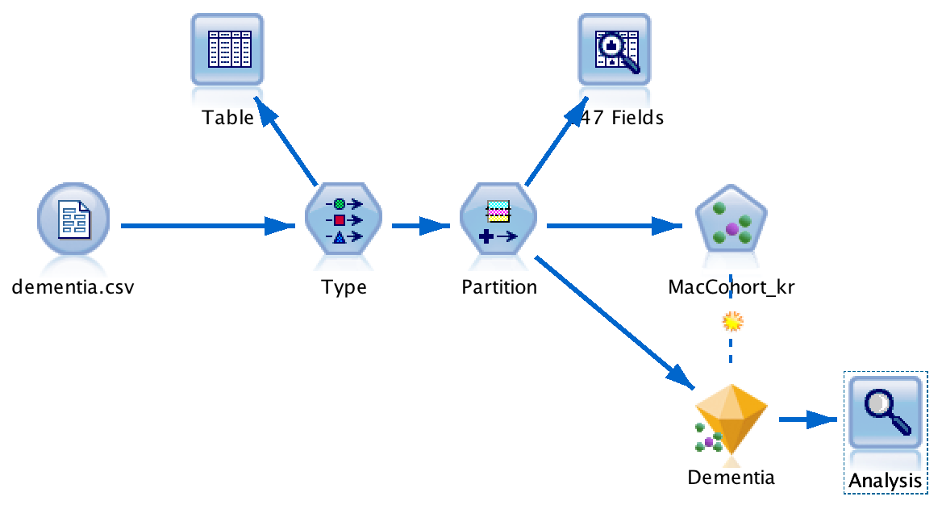
Modeler: K-Nearest Neighbors

Slide 21
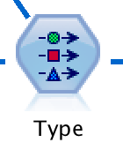
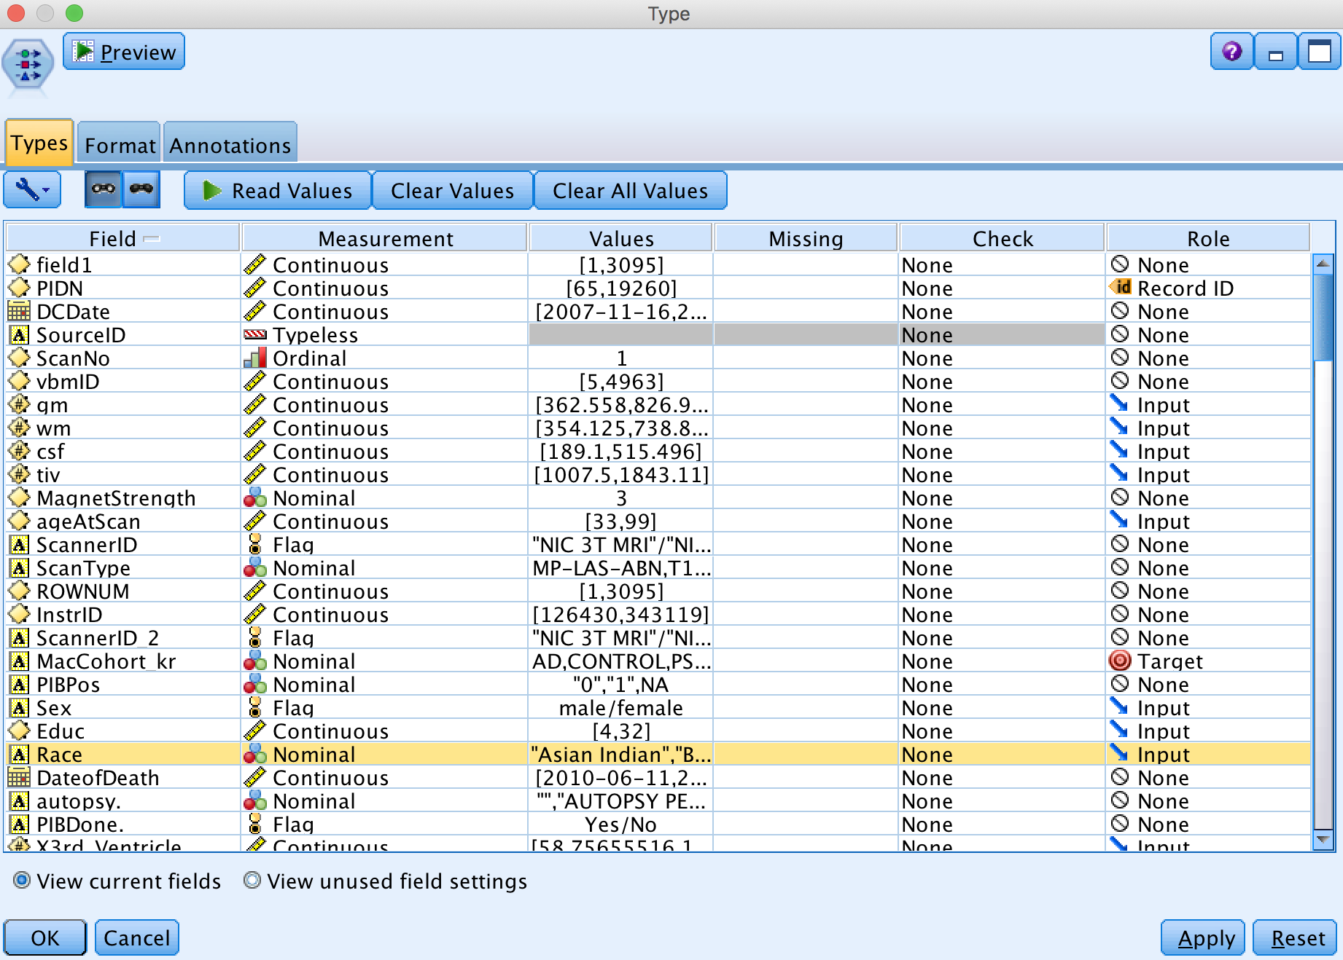
Type Node

Slide 22
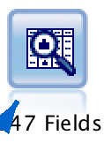
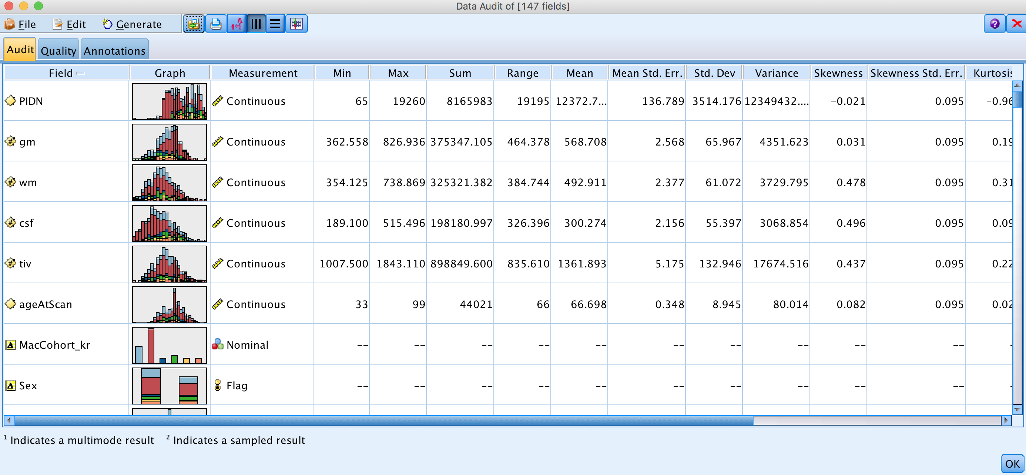
Audit Node (post-Type)

Slide 23
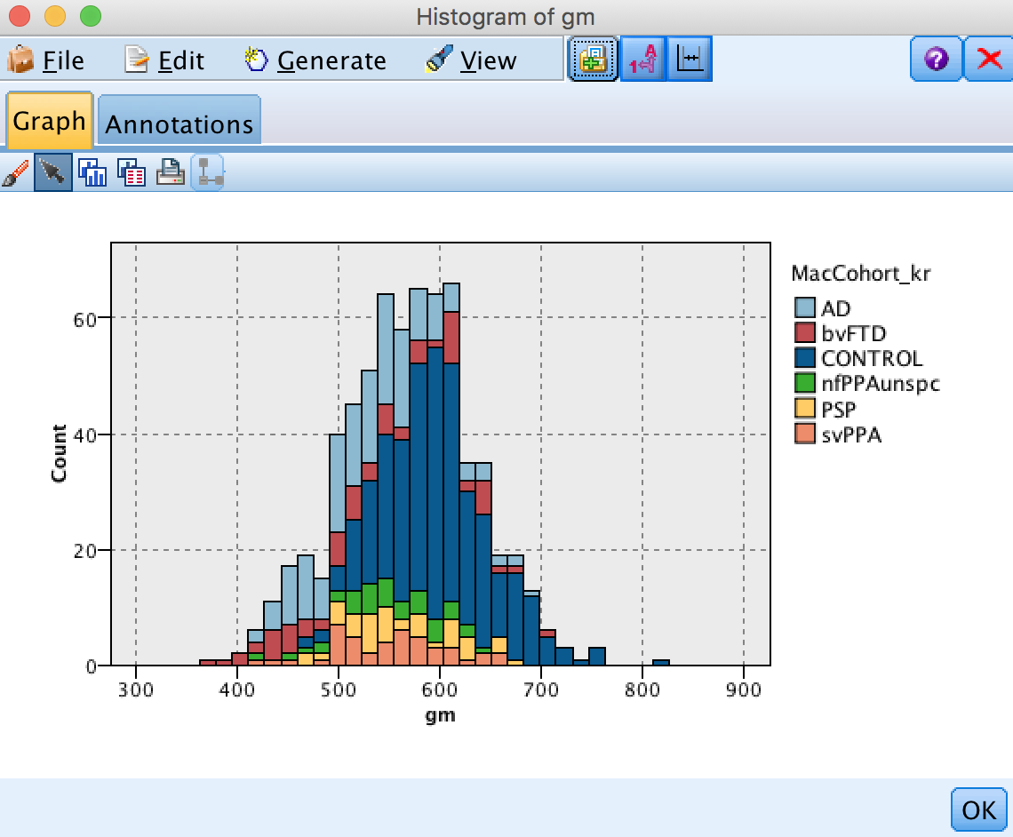
Audit Node (post-Type)

Slide 24
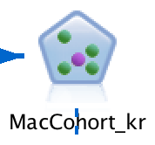
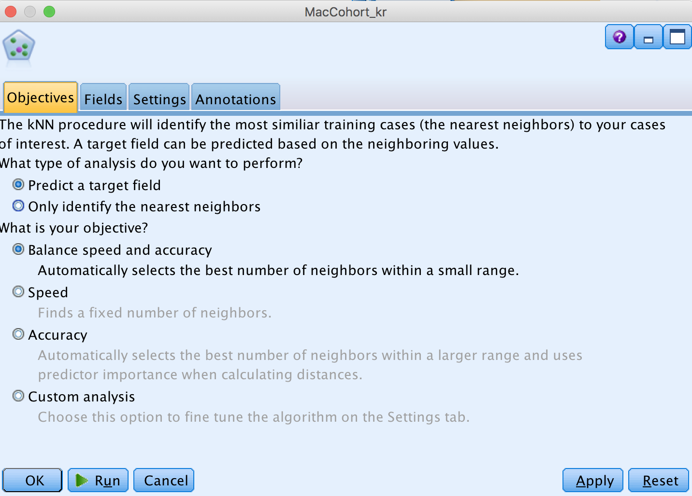
KNN node

Slide 25
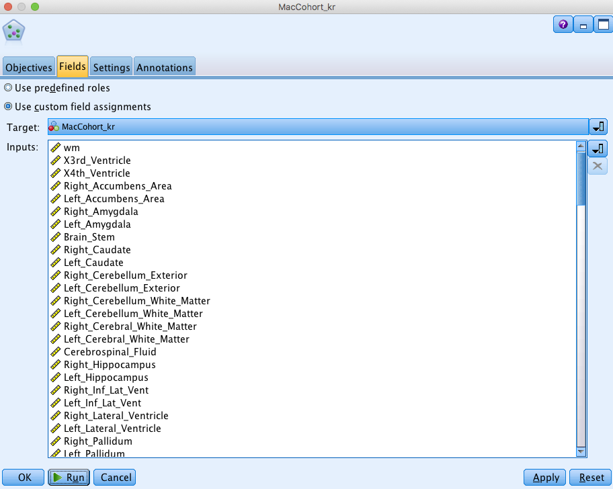
KNN node

Slide 26
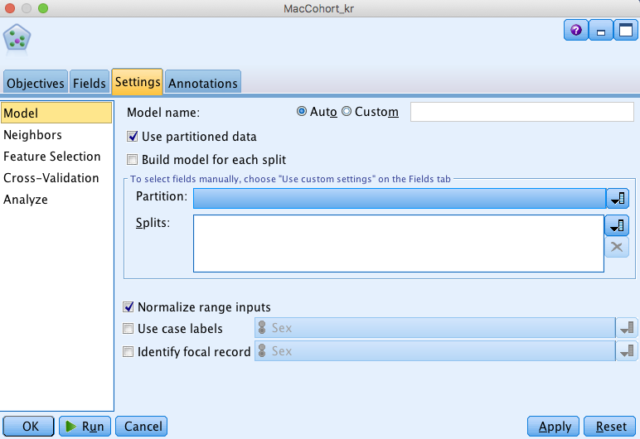
KNN node

Slide 27
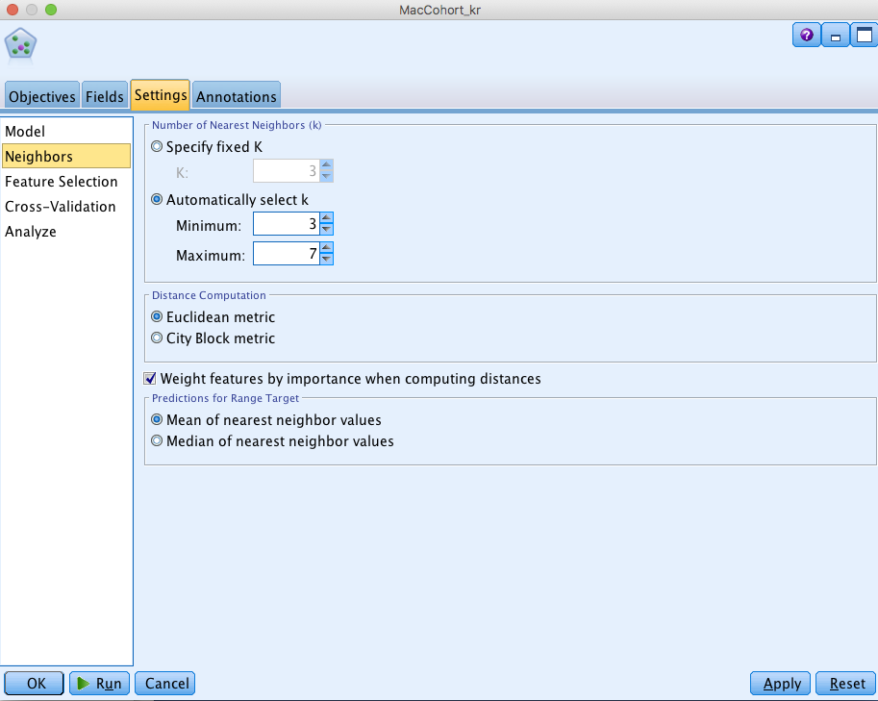
KNN node

Slide 28
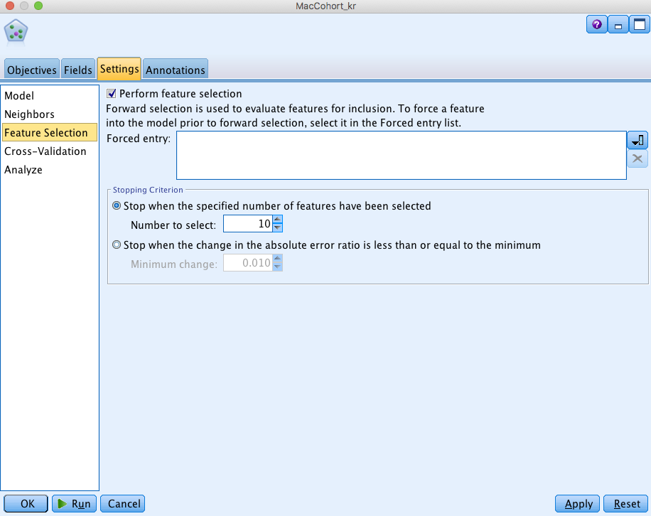
KNN node

Slide 29
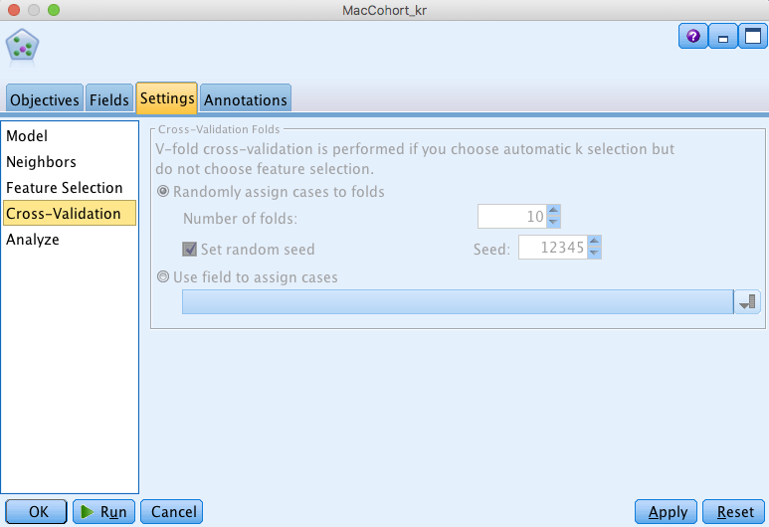
KNN node

Slide 30
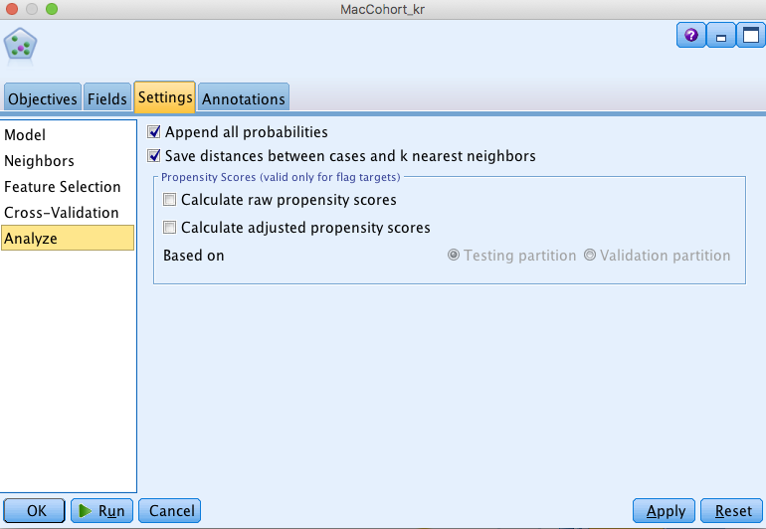
KNN node

Slide 31

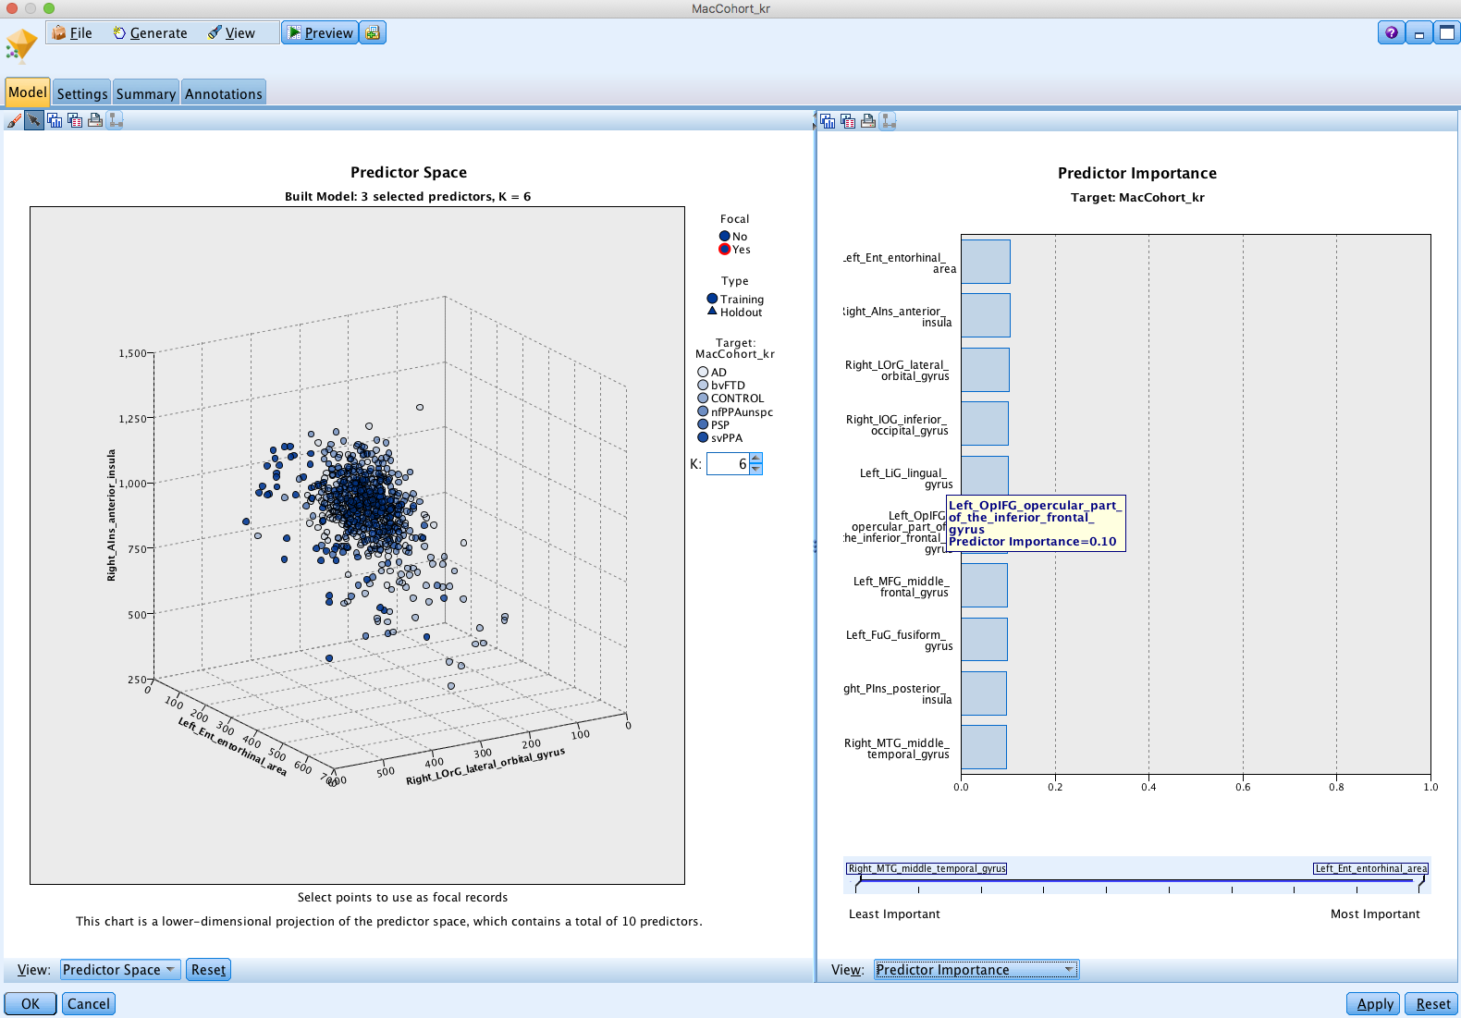
Golden nugget

Slide 32
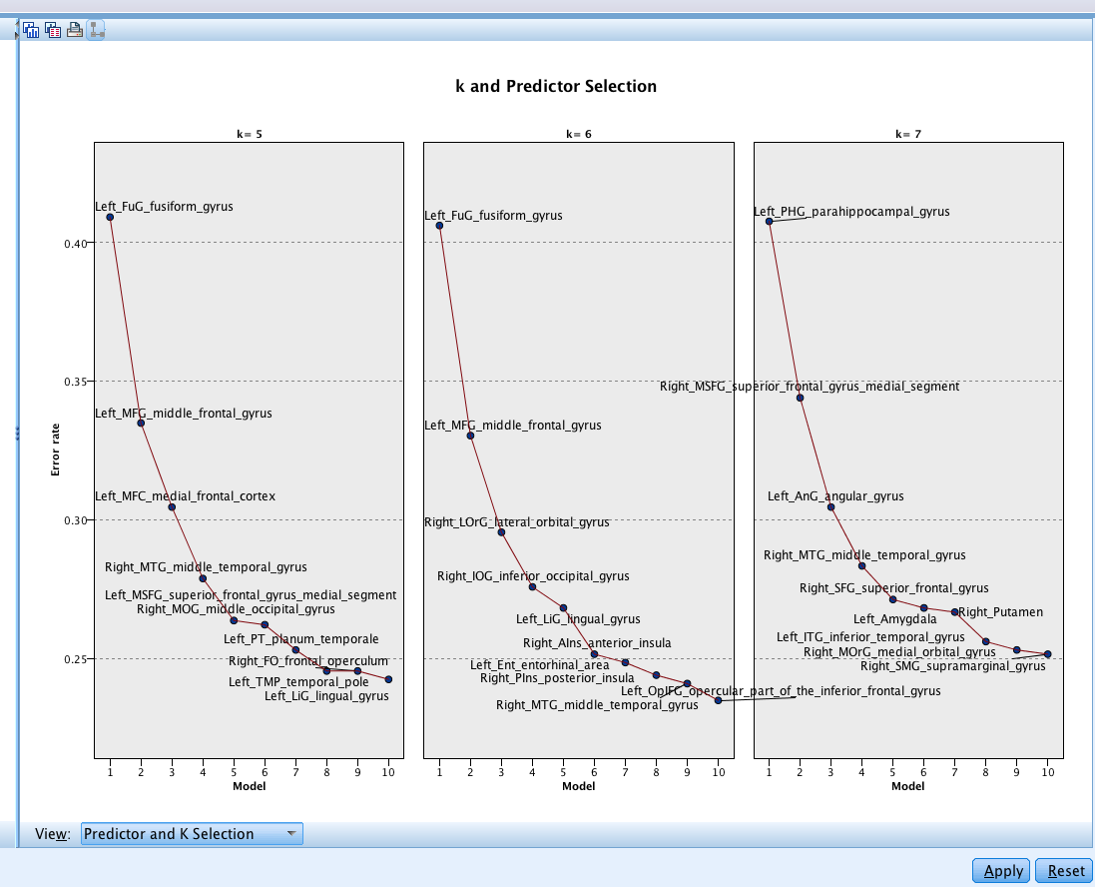
Golden nugget

Slide 33
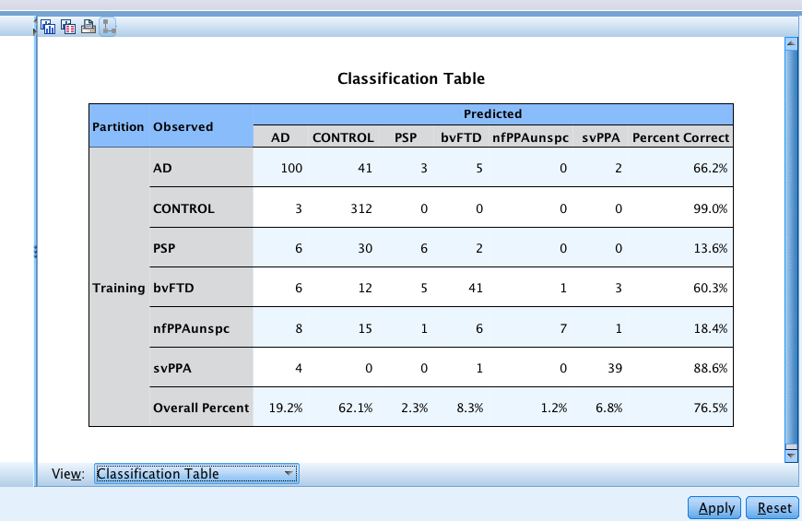
Golden nugget
Warning: this is based on training and test combined

Slide 34
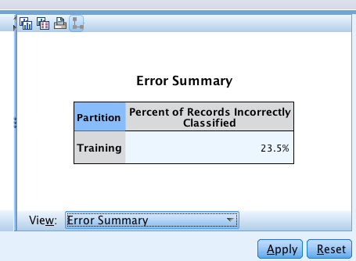
Golden nugget
Warning: this is based on training and test combined

Slide 35

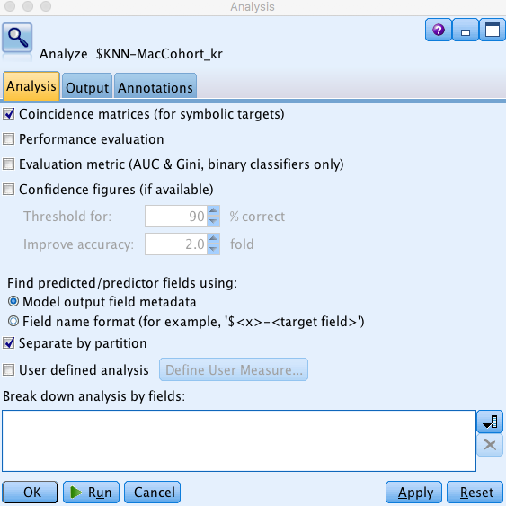
Analysis node

Slide 36
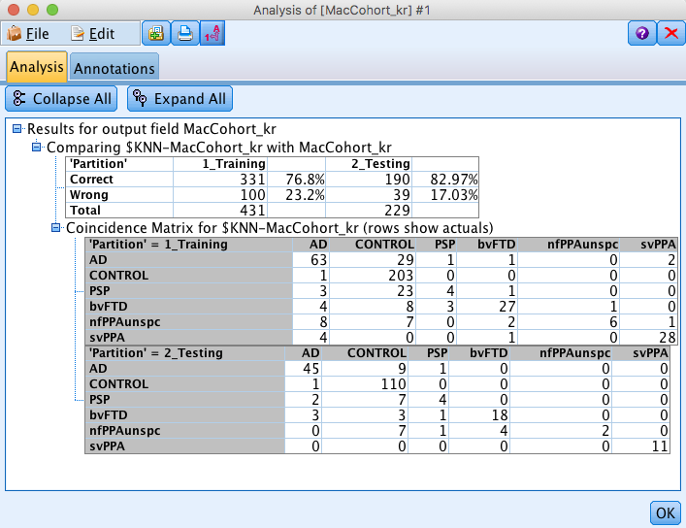
Analysis node

Slide 37
Analysis node
Anything unexpected?

Slide 38

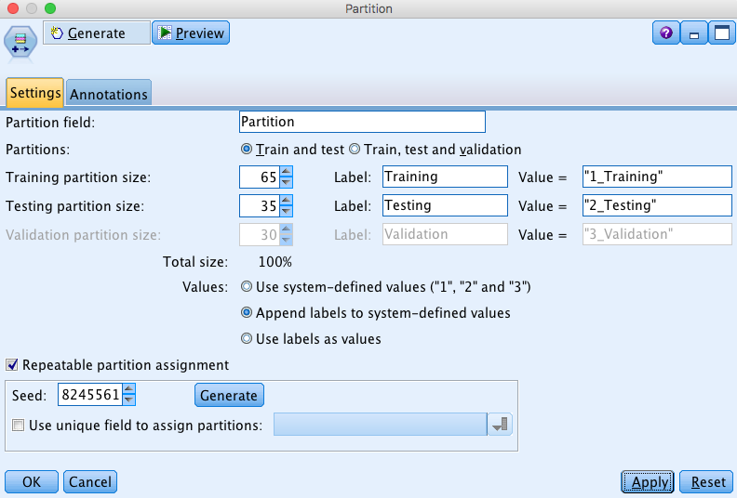
Different Partition?

Slide 39
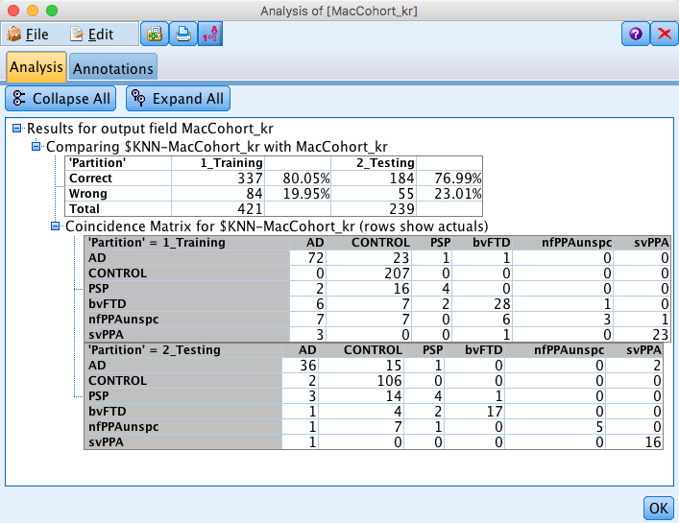
Analysis node

Slide 40
Parameter estimation
Many classifiers (and regression approaches) have inbuilt “tuning parameters” (like choosing k for nearest neighbors)
Some learning schemes operate in two stages:
  Stage 1: builds the basic structure
  Stage 2: optimizes parameter settings
  Note that instead of 2 stages for the KNN example, we did all model fitting and optimization in the training set, which risks overfitting for the best choice of k
The test data can’t be used for parameter tuning!
Proper procedure uses three sets: training data, validation data, and test data
  Validation data is used to optimize parameters
Once evaluation is complete, all the data can be used to build the final classifier

Slide 41
Training-test
Results Known
+
Training set
+
-
-
Data
+
-
+
+
Model Builder
Evaluate
Predictions
+
-
+
-
Y
N
Testing set

Slide 42
Train-validate-test
Do this green box for multiple values of the procedures parameter(s), e.g. K = 3, 4, 5, 6 for K-nearest neighbors
Results Known
+
Model
Builder
+
Training set
-
Data
-
+
Evaluate
-
Model Builder
+
Predictions
+
+
-
+
-
Y
N

Slide 43
Train-validate-test
Do this green box for multiple values of the procedures parameter(s), e.g. K = 3, 4, 5, 6 for K-nearest neighbors
Results Known
+
Model
Builder
+
Training set
-
Data
-
+
Evaluate
-
Model Builder
+
Predictions
+
+
-
+
-
Y
N
Each model based on training set has potentially been over-fitted… so utilize a validation set to determine best fitting model

Slide 44
Train-validate-test
Do this green box for multiple values of the procedures parameter(s), e.g. K = 3, 4, 5, 6 for K-nearest neighbors
Results Known
+
Model
Builder
+
Training set
-
Data
-
+
Evaluate
-
Model Builder
Choose best parameter values based on validation set results – evaluate model for each parameter value and choose the best
+
Predictions
+
+
-
+
-
Y
N
Validation set

Slide 45
Train-validate-test
Do this green box for multiple values of the procedures parameter(s), e.g. K = 3, 4, 5, 6 for K-nearest neighbors
Results Known
+
Model
Builder
+
Training set
-
Data
-
+
Evaluate
-
Model Builder
Choose best parameter values based on validation set results – evaluate model for each parameter value and choose the best
+
Predictions
+
+
-
+
-
Y
N
Validation set
But because we are choosing from many models we have again potentially over-fitted… so utilize a test set to determine accuracy of best fitting model

Slide 46
Train-validate-test
Do this green box for multiple values of the procedures parameter(s), e.g. K = 3, 4, 5, 6 for K-nearest neighbors
Results Known
+
Model
Builder
+
Training set
-
Data
-
+
Evaluate
-
Model Builder
Choose best parameter values based on validation set results – evaluate model for each parameter value and choose the best
+
Predictions
+
+
-
+
-
Y
N
Validation set
+
-
+
-
Final Test Set
Final Model with
optimized parameter(s) from validation set
Final Evaluation

Slide 47
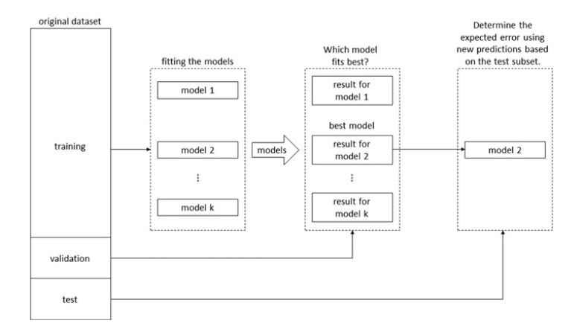
Train-validate-test
A different illustration from IBM Modeler text book (Wendler and Gröttrup)
k different parameter values

Slide 48
Warning: IBM Modeler goes against convention here:
IBM = training/test/validate convention = training/validate/test
We will use convention in the slides, but be careful to switch test and validate definitions when working in Modeler
Let’s see this applied to the dementia dataset using
K-nearest neighbors

Slide 49
Modeler: K-Nearest Neighbors

Slide 50
Modeler: K-Nearest Neighbors

Slide 51
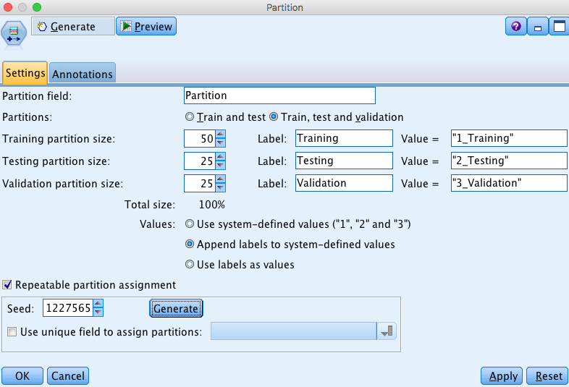
Revised Partition Node

Slide 52
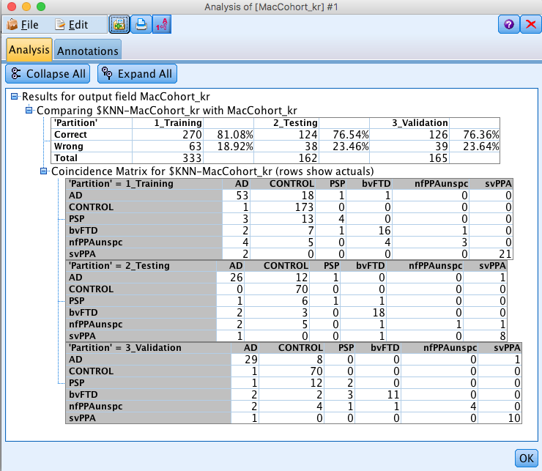
Analysis node
Best model was still for k = 6, so didn’t make much of a difference in this case

Slide 53
Analysis node
Best model was still for k = 6, so didn’t make much of a difference in this case

Slide 54
Cross-validation
What if you don’t have enough data to split 3 or even 2 ways? If data is expensive, it is a big sacrifice to reserve a large proportion of data for validation and testing

Slide 55
Cross-validation
Cross-validation
  First step: data is split into k subsets of equal size
  Second step: each subset is used in turn for validation and the remainder for training
This is called k-fold cross-validation (10-fold is common choice, also 5-fold for smaller datasets approx. <200 and even N-fold for very small datasets, called leave-one-out)
Often the subsets are stratified before the cross-validation is performed – e.g. same proportion of each diagnostic class in each fold
The error estimates are averaged across folds to yield an overall error estimate

Slide 56
E.g. 5-fold cross-validation
Break up data into 5 groups of the same size
Hold aside one group for testing and use the rest to build model
Repeat
When every group has had a turn at being the test set then you can estimate the classification accuracy based on the combined Test data (i.e. the 5 testsets)

Slide 57
Cross-validation
Notice that at no time is the classification accuracy based on data that was used to fit the model – so there is no over-fitting
And all of the data gets used in the process unlike Training-Test
As a final step you can then rebuild the classifier using all the data for predicting future observations – this model will (on average) be better than any of the individual models in the cross-validation because it uses more data
Cross-validation can be performed in 1) the validation step (i.e. for parameter estimation – easy for some algorithms in Modeler), or it can be performed in 2) the test step (i.e. for determining prediction quality – more difficult in Modeler)
Let’s look at cross-validation for the value of K in K-nearest neighbors (validation step)

Slide 58
Modeler: K-Nearest Neighbors

Slide 59
Partition Node
We are going to cross-validate within the Training set so don’t need a separate validation set

Slide 60
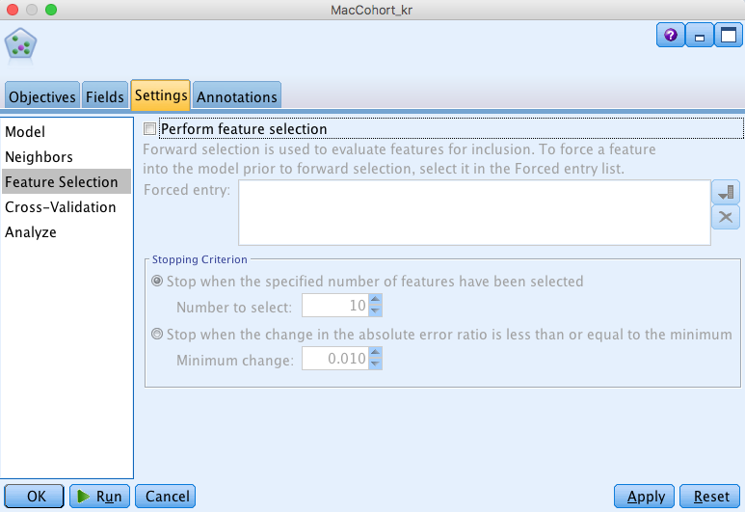
KNN Node

Slide 61
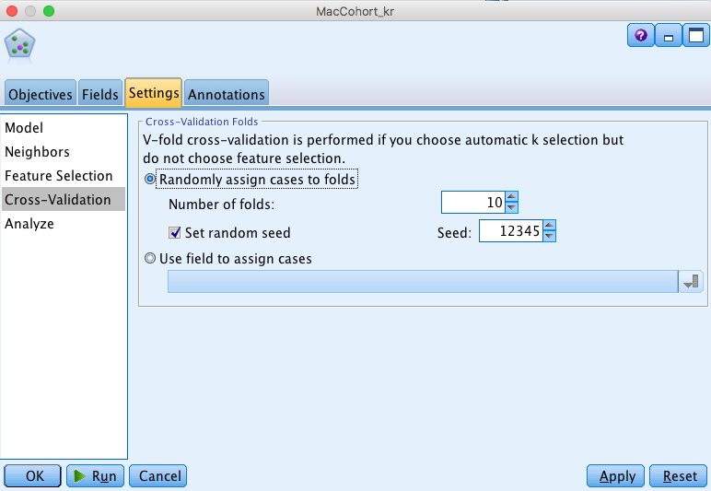
KNN Node

Slide 62
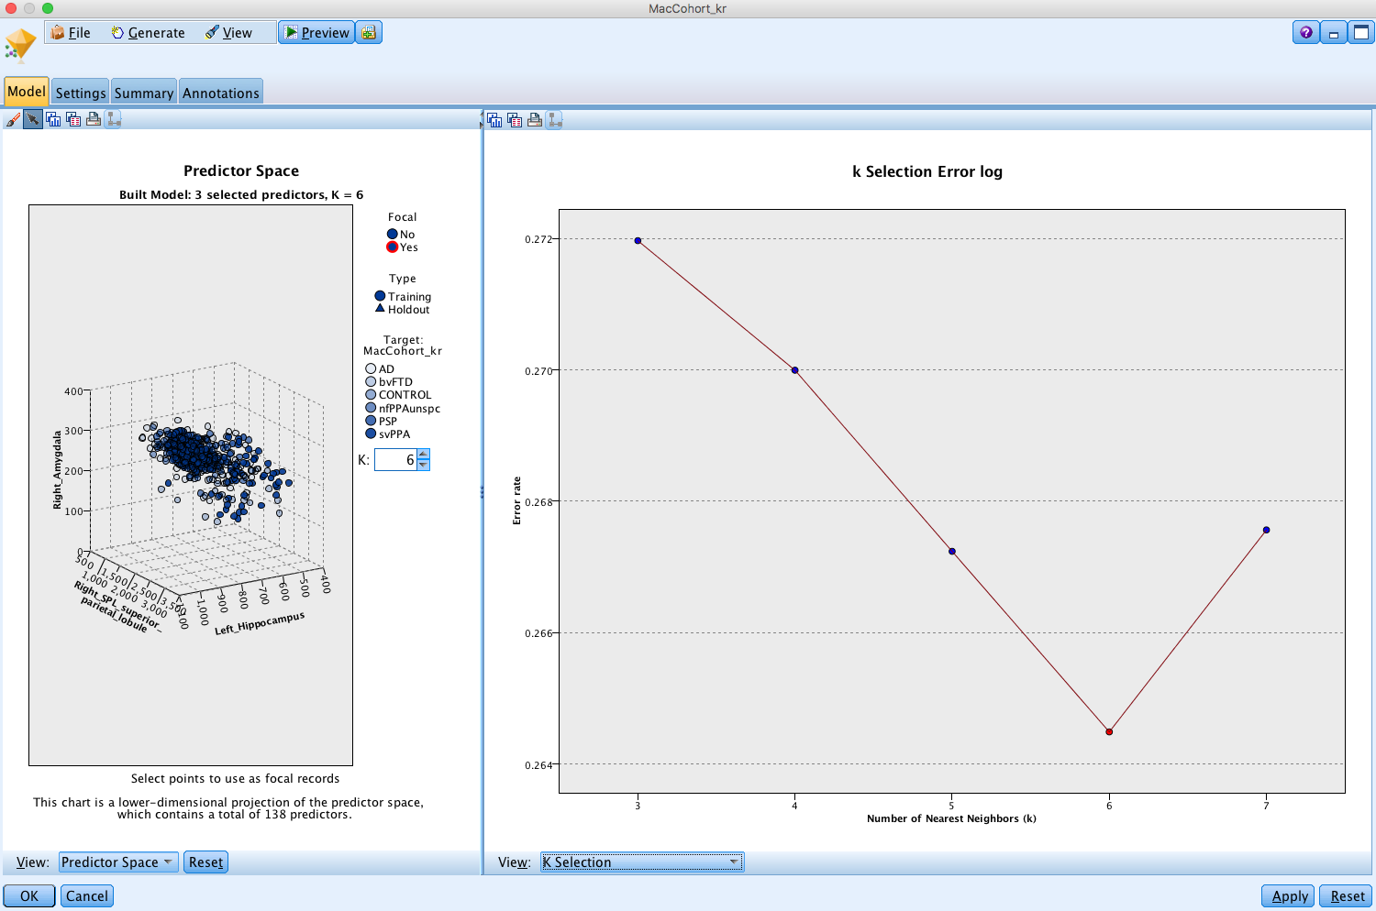
Golden nugget

Slide 63

Analysis node
Again, best model was still for k = 6, so didn’t make much of a difference in this case

Slide 64
Another Warning:
IBM text book (Wendler and Gröttrup) wrongly considers cross-validation to be a simple train-test-validate analysis
This flies in the face of the definition for cross-validation!
IBM Modeler gets it right though

Slide 65
Recursive Partitioning
(Decision Trees)

Slide 66
Recursive Partitioning
Classification based on a series of binary decision cut-points e.g.,
  Is systolic blood pressure greater that 140?
  If yes, is LDL Cholesterol greater than 190?
  If no, exercise > 2 times per week
At the end of the series of questions a decision node is reached (note that the series of questions may not be the same for every subject – it depends which branch of the tree you go down)

Slide 67
Risk of heart problem
Systolic BP > 140?
No Yes
Exercise < 2 times per week
LDL > 190?
Alcohol > 2 units/day?
monitor
intervention
monitor
monitor
intervention

Slide 68
Risk of heart problem
Systolic BP > 140?
No Yes
Exercise < 2 times per week
LDL > 190?
Exercise < 3 times per week
Alcohol > 2 units/day?
monitor
intervention
monitor
intervention
monitor
intervention

Slide 69
Growing Trees
Greedy algorithmic approach
Start with first best split on a single variable (e.g. based on Gini Index*)
  The Gini Index is related to classification error, but penalizes errors more as the proportion of observations in a node is further from 0.5 – favors pure nodes
  A pure node is a decision node where all of the observed data is of a single class
Then for each branch look for the best split on a single variable for the observations within that branch
Keep going until each branch is pure or has less than some number of observations (e.g. 5)
*Some algorithms, such as C5.0, use different criteria

Slide 70
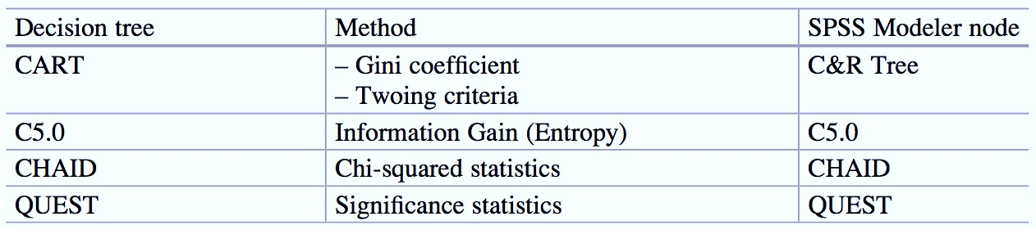
Modeler decision tree methods

Slide 71
Pruning Trees
Full tree after growing is typically too complex
Goal is to find the sub-tree (contained in the fully grown tree) that minimizes a cost-complexity criterion.
The cost-complexity criterion is a trade-off between the classification error rate and the complexity (size) of the tree
The best balance (weighting) for the trade-off is determined via cross-validation to minimize the classification error rate

Slide 72
Recursive Partitioning
Recursive partitioning methods are a very popular classification approach and come in many flavors: Classification and Regression Trees (CART), C5.0, and cutting-edge ensemble extensions like Random Forests (average over a bunch of trees – hence forest)
Partitioning on cut-points approach is very popular in medicine, because mimics decision approach of clinicians

Slide 73
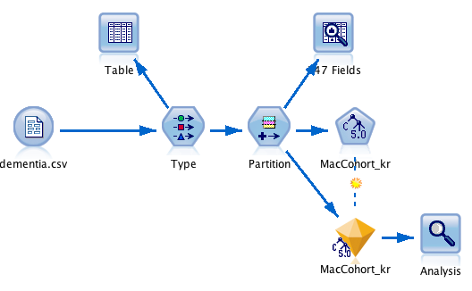
C5.0 Example Stream

Slide 74

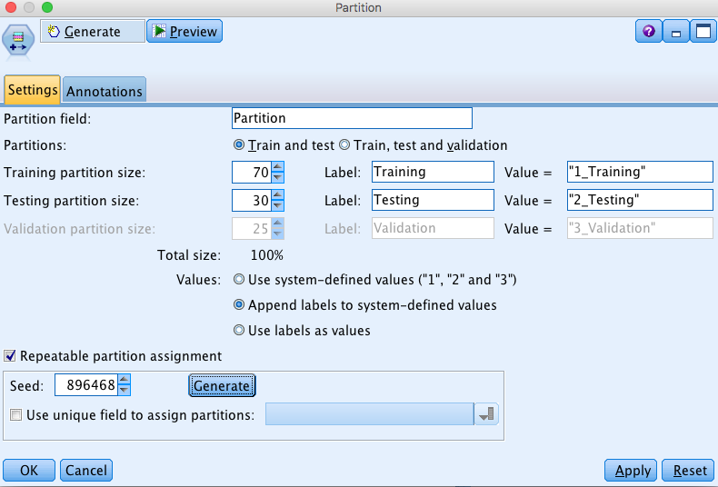
Partition Node

Slide 75

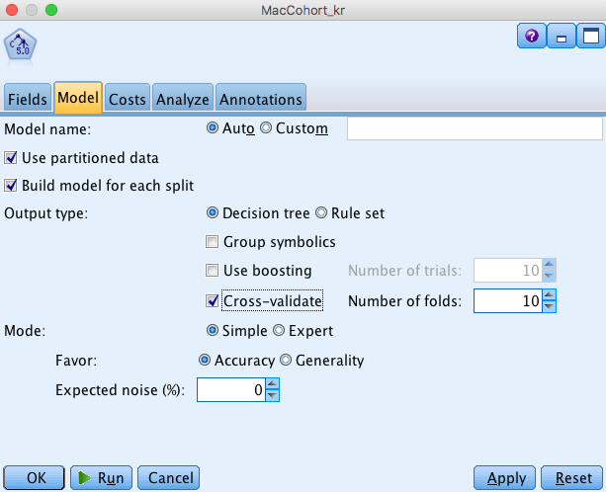
C5.0 Node

Slide 76
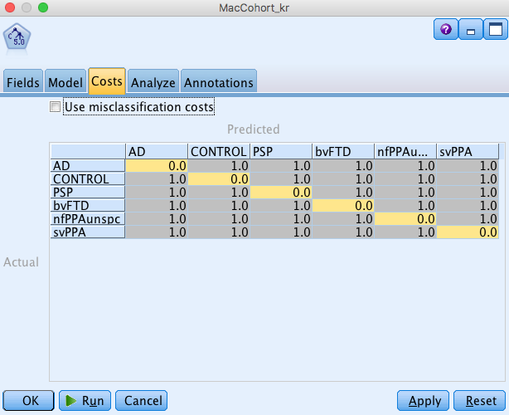
C5.0 Node

Slide 77

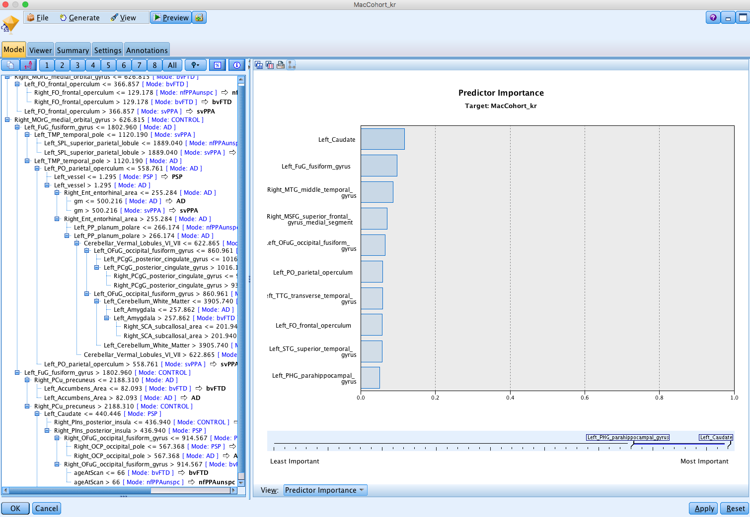
Golden Nugget

Slide 78
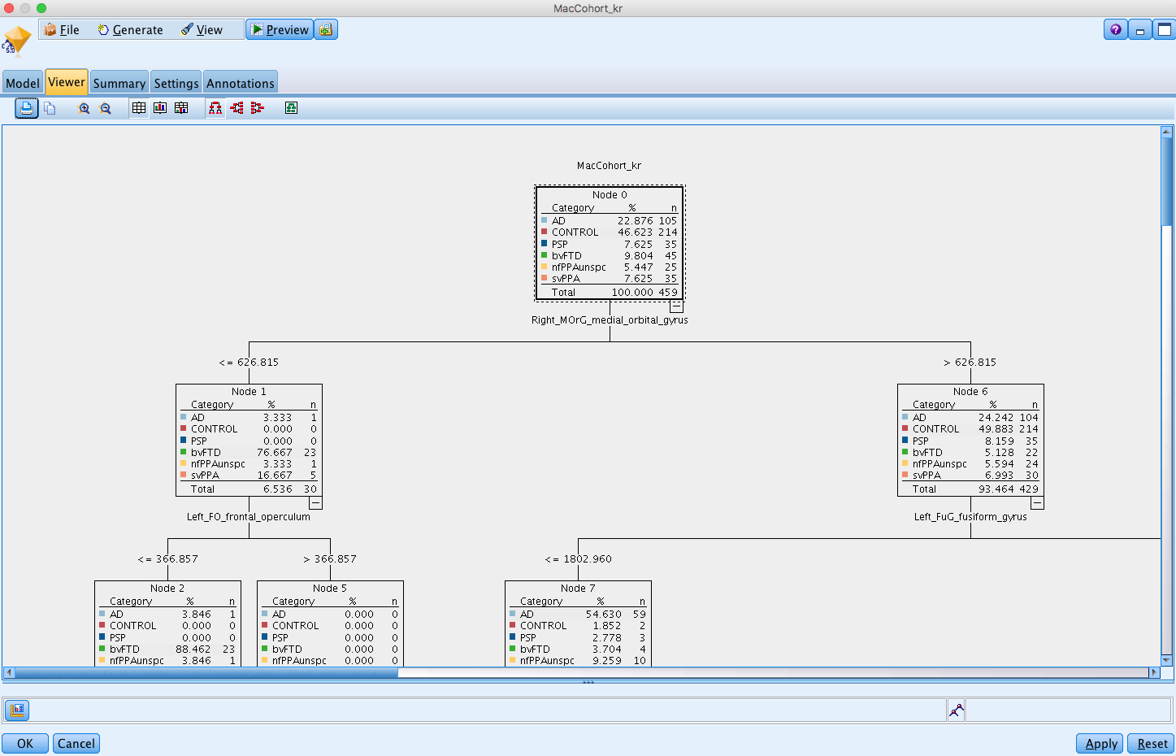
Golden Nugget

Slide 79

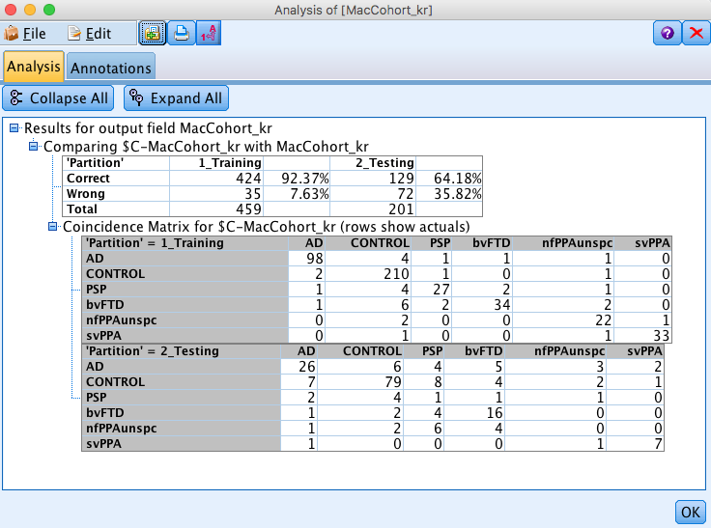
Analysis Node

Slide 80
Support vector machines

Slide 81
Support vector machines
Idea is to generate a (non-linear) hyper-plane that optimally separates points from different classes
Developed in computer science community in 1990s

Slide 82
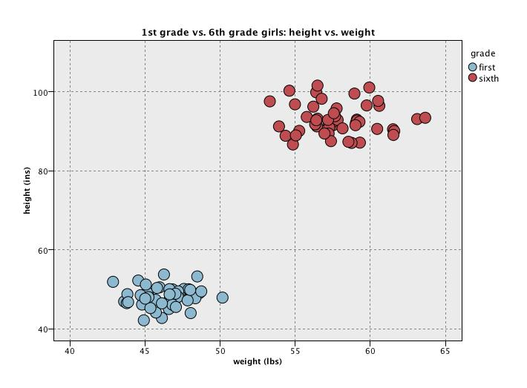
Maximizing margins

Slide 83
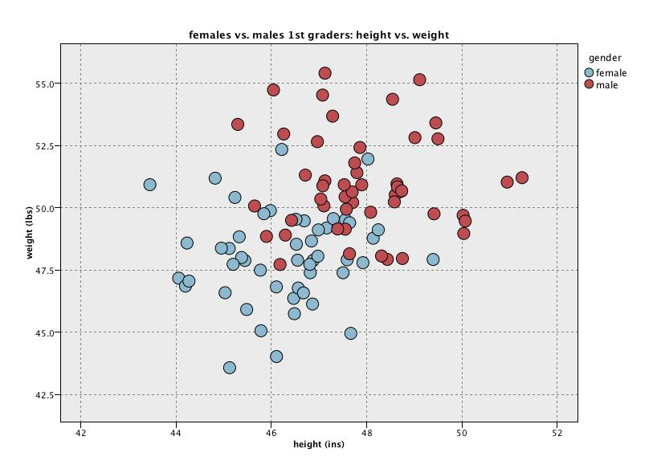
However, usually we have overlapping data…

Slide 84
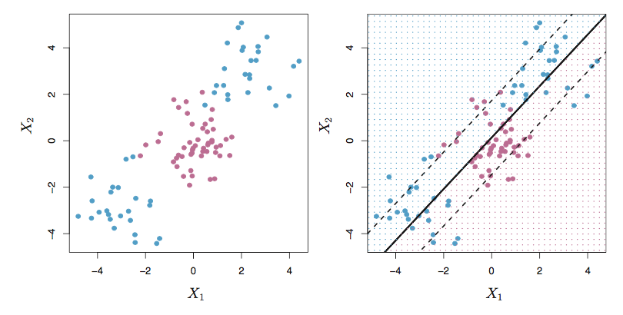
And linearity is limited
Example from ISLR

Slide 85
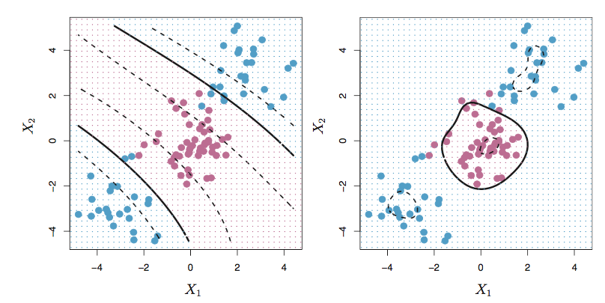
“Non-linear” decision boundary
The trick of SVM, is not to have non-linear models for the separation boundaries directly, but rather to warp the space that the data is in. That way, linear boundaries in the warped space become non-linear back in the original space.

Slide 86
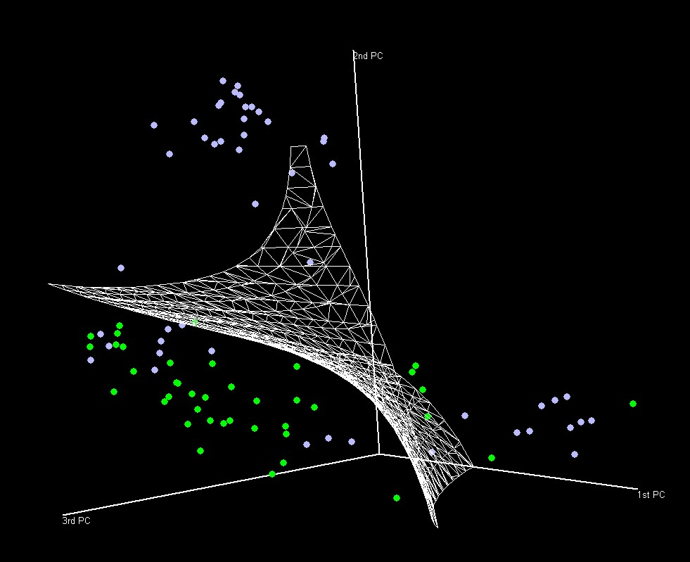
3 predictor – effective non-linear decision boundary

Slide 87
Support Vector Machine
Considered one of the best “out of the box” classifiers for complex big data problems
Has gained massive popularity
Solved a lot of tough problems
Great as a black box predictor, but not so good for interpretation

Slide 88
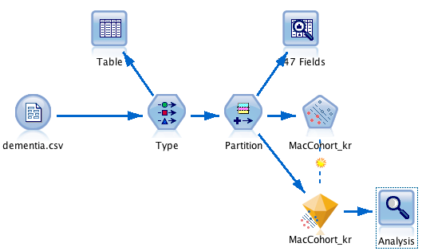
Modeler: Support Vector Machine

Slide 89

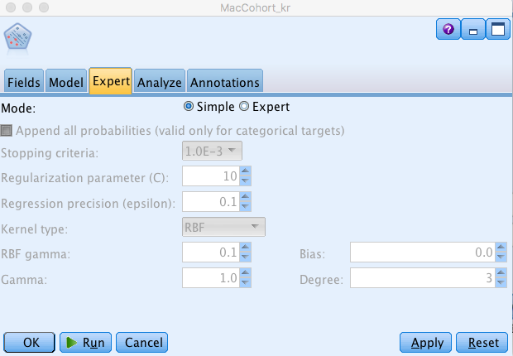
Support Vector Machine Node

Slide 90

Golden Nugget
Nothing much to see in here for multi-class problems

Slide 91


Analysis Node

Slide 92
Choosing a classifier
Logistic Regression
  Nice probabilistic interpretation
  Not highly flexible
K-nearest neighbors classification
  No “model” required – don’t have to worry about outliers
  Easy to understand rules
  Not so good for interpretation
  Not so good if you have very large number of predictors
Decision Trees
  Easy to interpret and explain
  No “model” required -- don’t have to worry about outliers
  Restricted to recursive partitioning of data to form classes
Support Vector Machines
  Often have high accuracy
  Can deal with highly non-linear separation of features
  Requires effort tuning and difficult to interpret
  Black box – difficult to interpret
However, if your primary goal is good prediction, then you can run multiple classifiers to find the best, or even combine them to get an even better model overall (ensemble techniques of boosting, bagging and stacking – hope to discuss Thursday)
If interested, take a look at last year’s Case Study lecture on the CLE. It performs an auto-classify node analysis of the dementia dataset using multiple classifiers

Slide 93
Monday’s lecture – clustering and data reduction
Clustering
  K-means clustering
  Kohonen
Data reduction
  Principal components analysis (PCA)
Guidance for choosing between Machine Learning methods
Ensemble methods
More classification techniques in brief (if time)

Slide 94
Note: HW #5 is up on CLE
– due 11.55pm on Thursday August 30

