Slide 1

Designing clinical research
Epi 150.03
Peter Chin-Hong, MD and
Miriam Kuppermann, PhD MPH
August 1, 2018

Slide 2
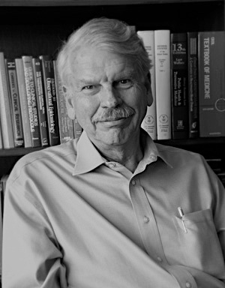
About the course
Began > 30 years ago
Also known as the “Hulley Course”
Steve was the leader for the text (DCR) and designed the course, homework, and instructions to section leaders
Steve Hulley

Slide 3
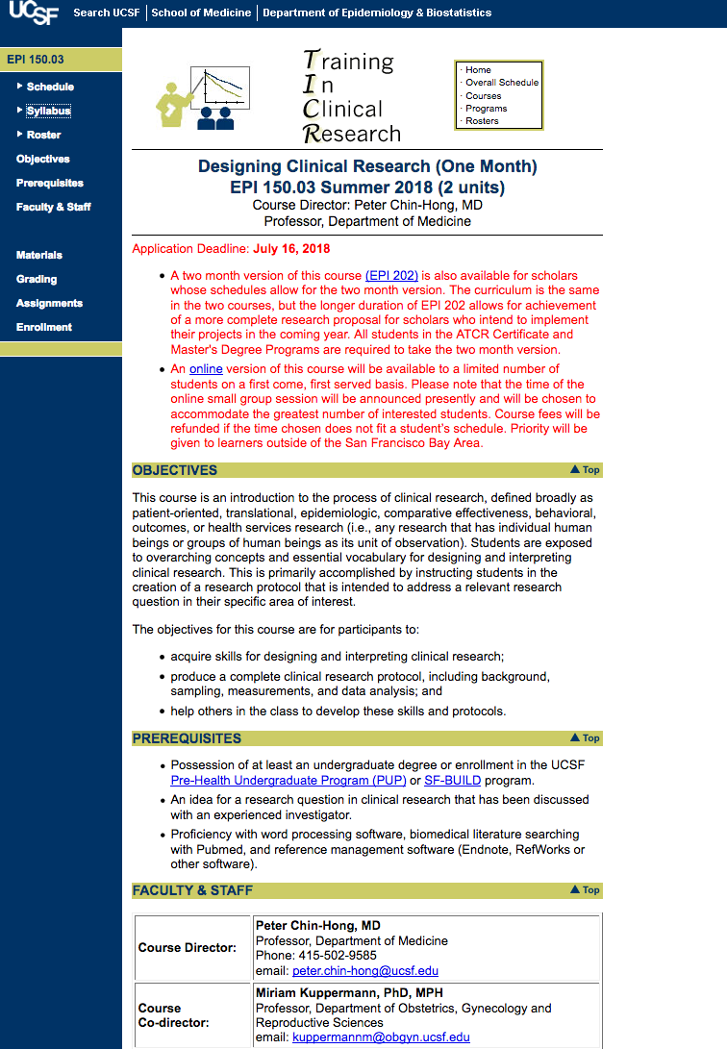
Website
Google “Epi 150.03” or “DCR UCSF 1 month” or find from TICR home page
Course roster, schedule, rooms, readings, PowerPoint files (when available)
Links to recordings of lectures

Slide 4
Website
Google “Epi 150.03” or “DCR UCSF 1 month” or find from TICR home page
Course roster, schedule, rooms, readings, PowerPoint files (when available)
Links to recordings of lectures

Slide 5
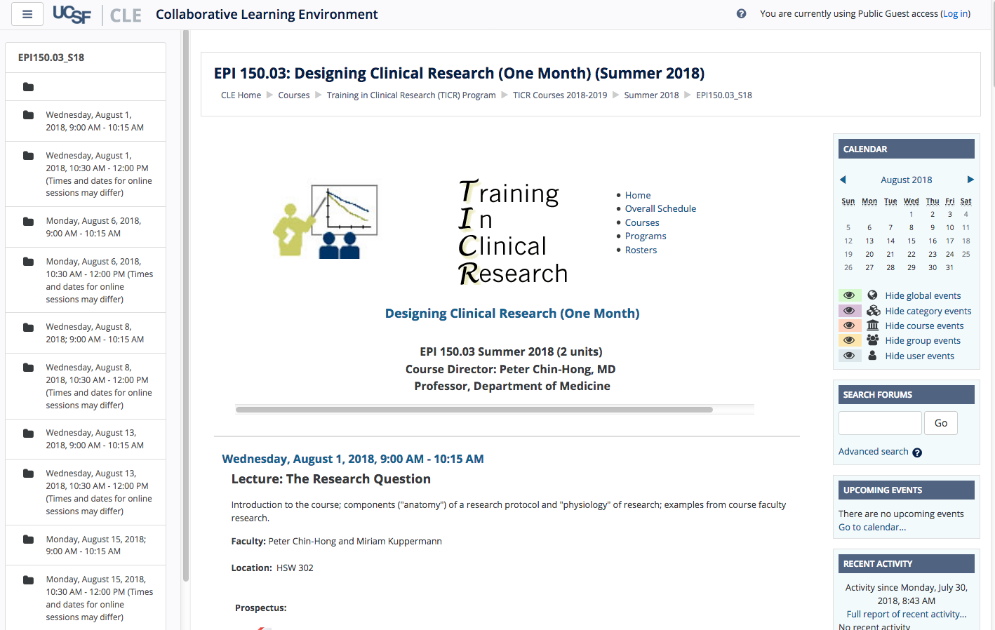

Slide 6

About the reading
DCR-4 includes exercises and answers at the end of the book
  We recommend jotting down answers before reading ours
  Can discuss in section but usually won’ t be turned in
Let us know your suggestions for improving the book
Notes:
Survival Guide for Generalist Physicians in Academic Fellowships.

Slide 7

About the reading
Recommended viewing this week
“How we know what we know”
Notes:
Survival Guide for Generalist Physicians in Academic Fellowships.

Slide 8
Course objectives
    1. Learn about how to design and do clinical research
    2. Produce a protocol for a study
    3. Help others in the workshop
    4. Provide feedback on the workshop
    5. Have a multiplier effect

Slide 9
Course ingredients
      Aug 1 − Lectures (9:00 – 10:15)
      Aug 22 * Selected issues from DCR 4 text and examples
      Sections (10:30 – 12:00)
      * Protocol components
      * More issues from the text
      * Helping and getting to know your classmates
      Aug 23 5-page protocols due
      Aug 27, TBA Protocol review sessions
      * In pairs and trios, new faculty

Slide 10
Grades, attendance, interruptions
5-page protocol must be turned in to pass
  Protocol review sessions on August 27
Gold star sticker
  No unexcused absences
  No more than 1 missing or late homework
  Help your colleagues with their protocols
Class time is sacred
  Do not answer cell phones or pages except emergencies
  If clinical responsibilities will interfere, please arrange coverage or take this class another time

Slide 11
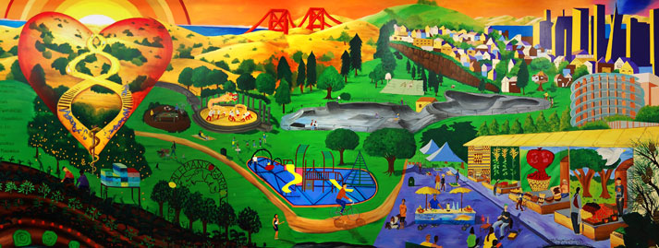
Faculty for sections 2018
Asa Clemenzi-Allen* (Medicine)
Beth Cohen (Medicine) – S-163
Giuseppe Cullaro (Medicine) – S-172
Felicia Chow (Neurology) – S-159
Jen Felder (Psychiatry) – U-506
Sam Goldman (Medicine) S-176
Diana Kwong (Medicine) – S-174
Brett Ley (Medicine) – S-180
Kala Mehta (Epidemiology) – S-168
Amy Padula (Obstetrics/Gynecology) – U-456
Neela Penumarthy – U-70 (Pediatrics)
Dan West (Pediatrics) – U-460
CVP Mural, UCSF
*E-section

Slide 12
Section assignments

Slide 13
Course coordinators
    Clair Dunne CDunne@psg.ucsf.edu
    (Please let her know if your email address changes by sending her an email from the new address)
    Agnes Ng

Slide 14
Questions?
Notes:
12.5 min to this point if few or no questions

