Slide 1

Biostat 202: Data Management & Storage
“It’s sink or swim as THE tidal wave of data approaches”
Nature 399:517 10 June 1999
Isabel Elaine Allen
Professor, Biostatistics & Epidemiology
isabel.allen@ucsf.edu

Slide 2
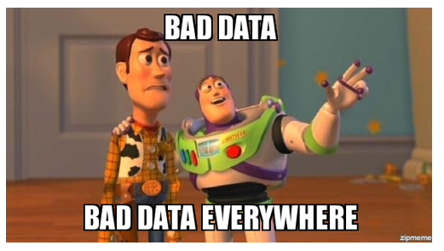
Why Data Management?
Data in the real world is dirty
  Incomplete: lacking attribute values, lacking certain attributes of interest, or containing only aggregate data
  Noisy: containing errors or outliers
  Inconsistent: containing discrepancies in codes or names
  Not well controlled: convenience samples
  Security: how will you protect the data?

Slide 3
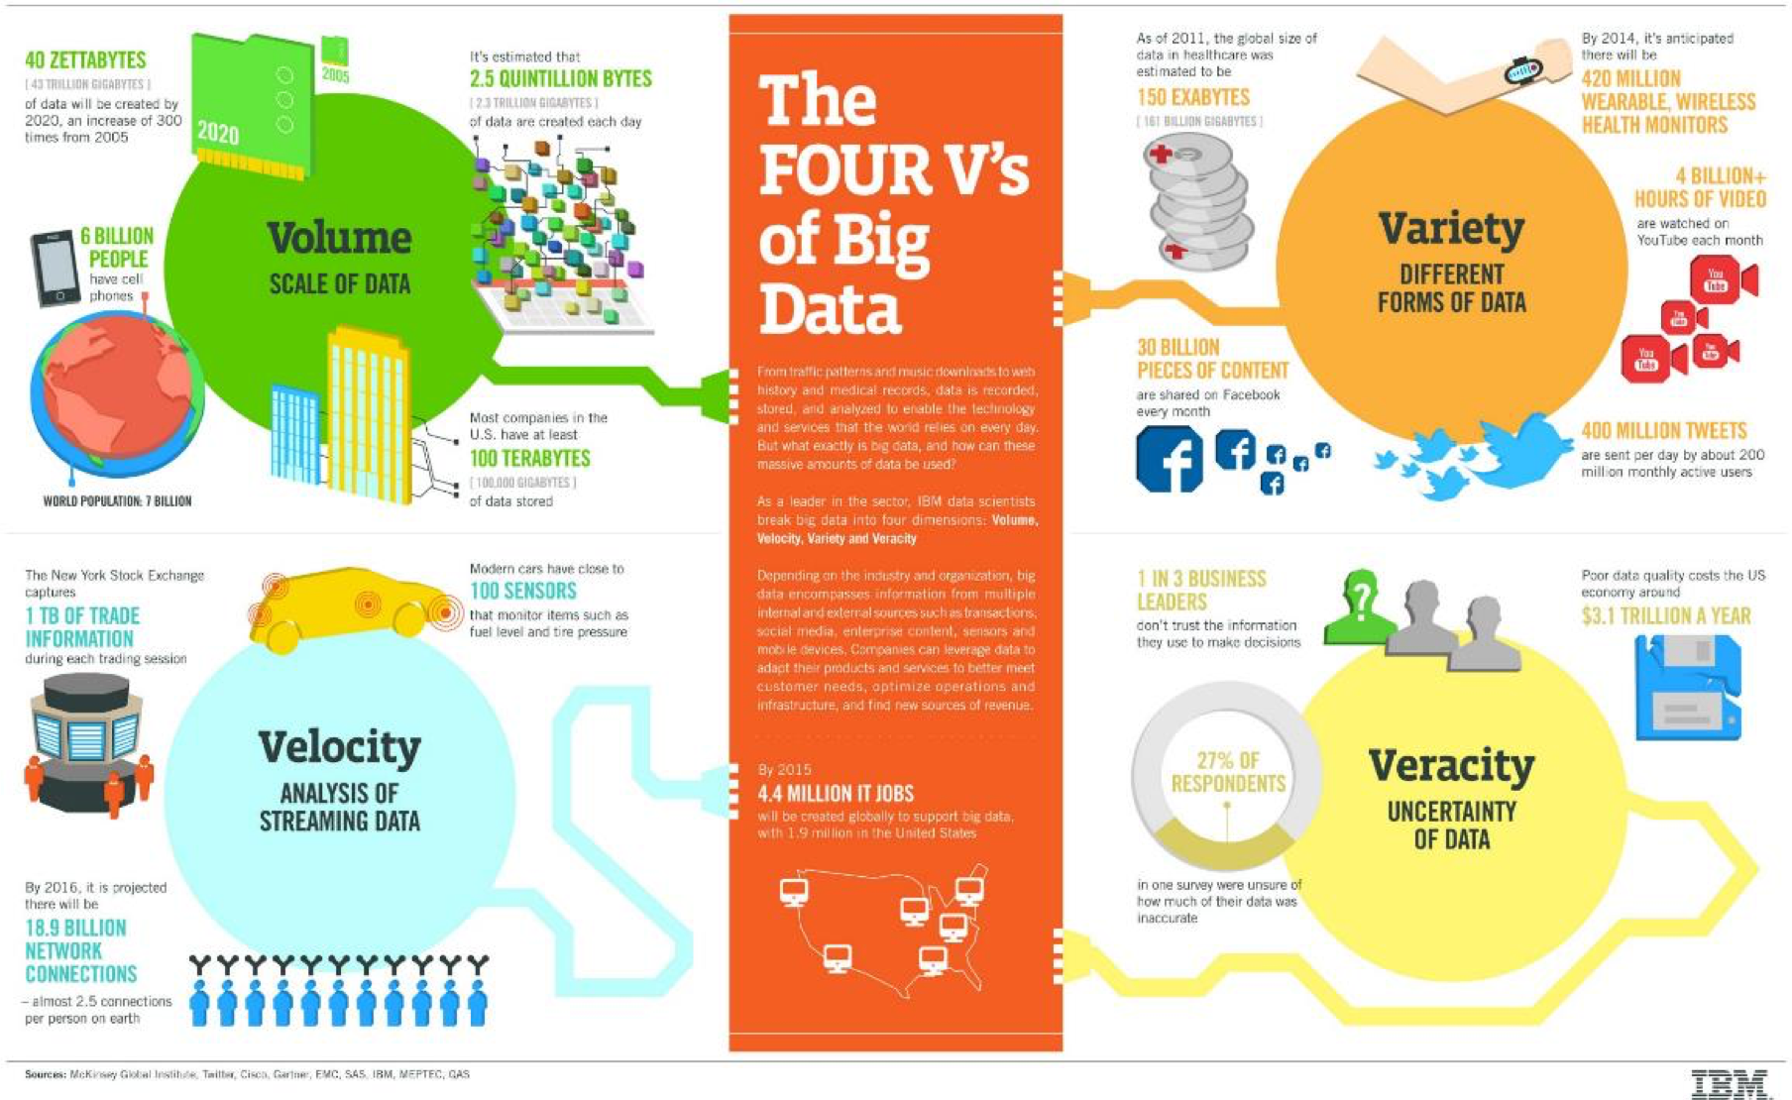

Slide 4
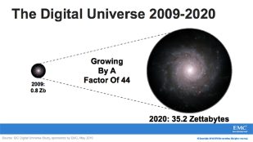
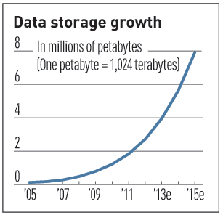

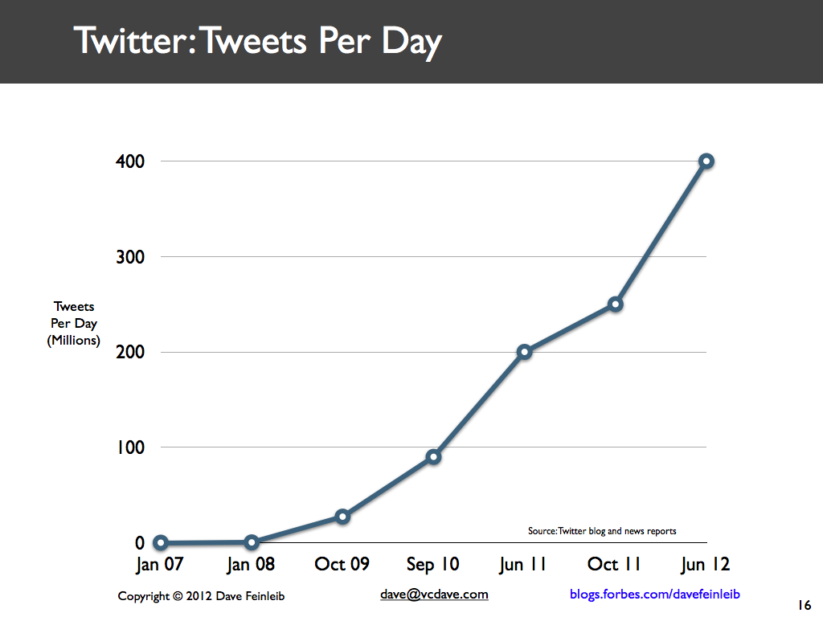
Characteristics of Big Data:
#1-Scale (Volume)
Data Volume
  44x increase from 2009 to 2020
  From 0.8 zettabytes to 35zb
Data volume is increasing exponentially
Exponential increase in collected/generated data

Slide 5
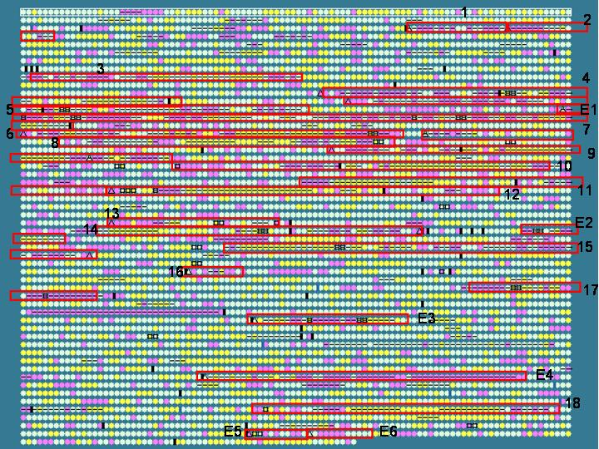
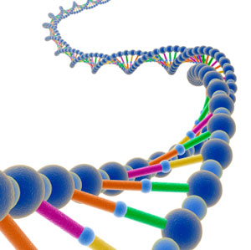
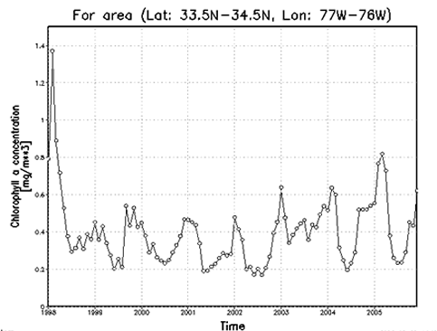
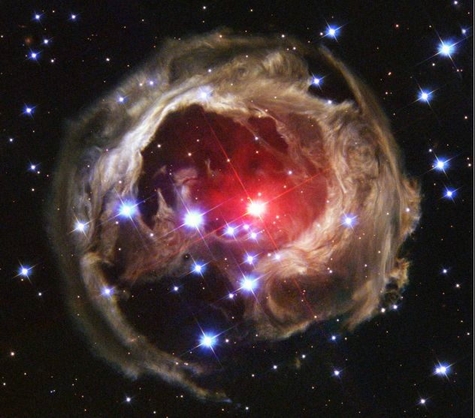
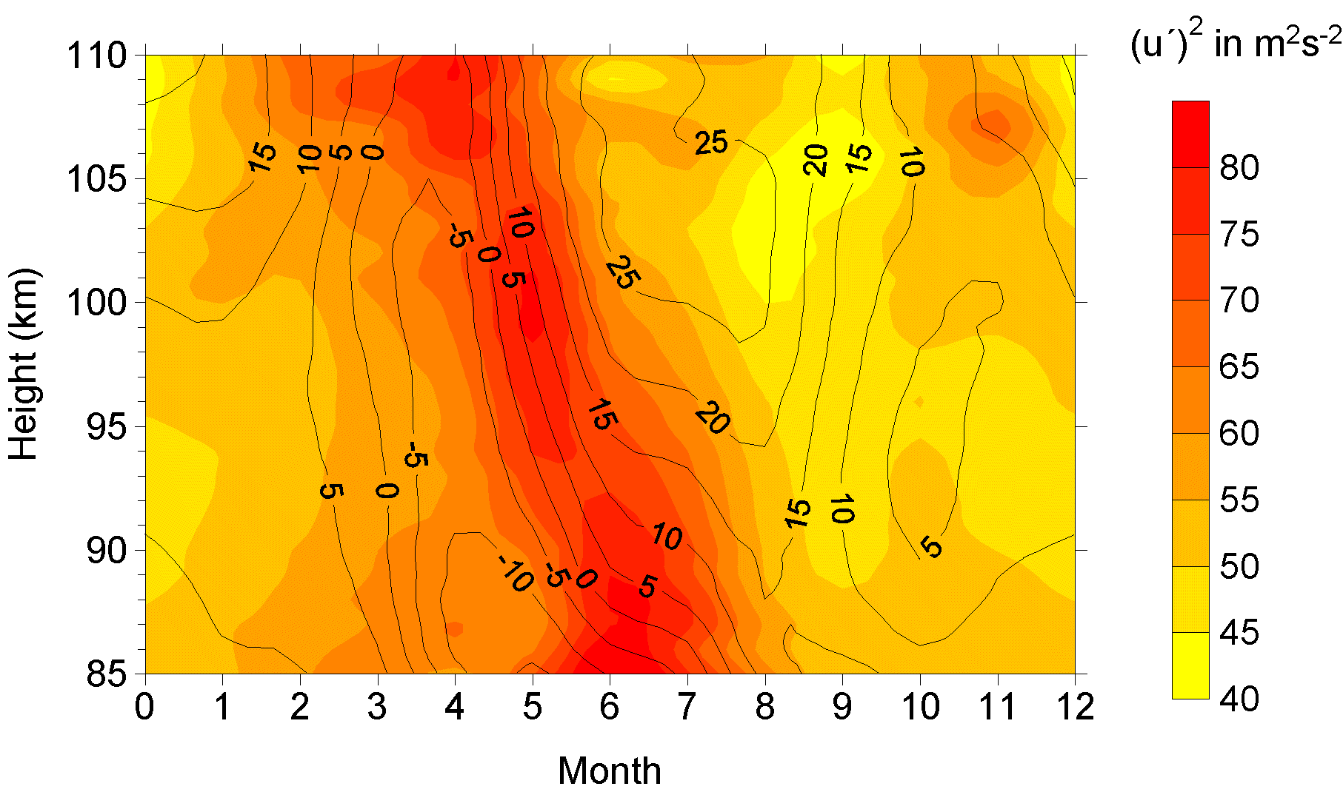

Characteristics of Big Data:
#2-Complexity (Variety)
Various formats, types, and structures
Text, numerical, images, audio, video, sequences, time series, social media data, multi-dim arrays, etc…
Static data vs. streaming data
A single application can be generating/collecting many types of data
To extract knowledge➔ all these types of data need to linked together

Slide 6

Characteristics of Big Data:
#3-Speed (Velocity)
Data is begin generated fast and need to be processed fast
Online Data Analytics
Late decisions ➔ missing opportunities
The bottlenecks are technology & skillsets
Examples
  E-Promotions: Based on your current location, your purchase history, what you like ➔ send promotions right now for store next to you
  Healthcare monitoring: sensors monitoring your activities and body ➔ any abnormal measurements require immediate reaction

Slide 7
In the Beginning, life was simple…

Slide 8
But…

Slide 9
Our information needs…

Slide 10
Kept growing. (The Spider web)
A type of database schema
SOURCE: William H. Inmon

Slide 11
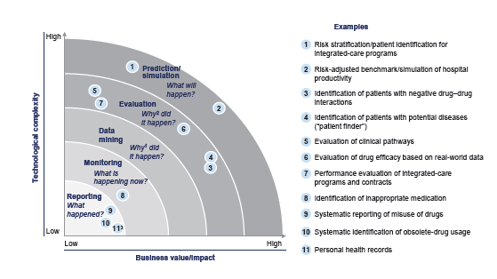
Mapping Value to Technology

Slide 12
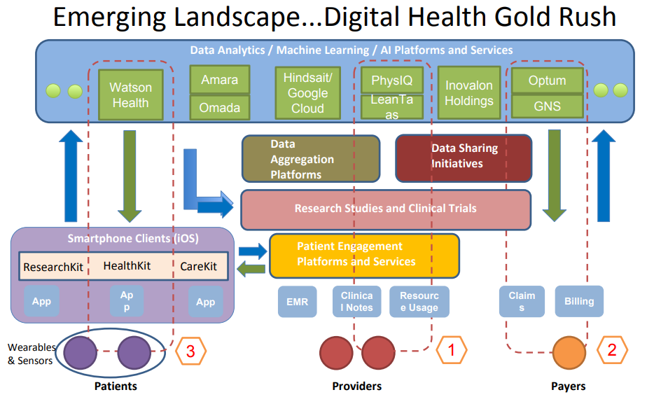

Slide 13
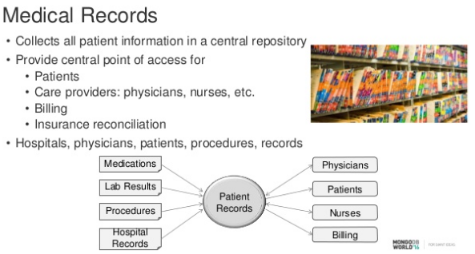
Database Schema
…time & effort to digitize this?

Slide 14
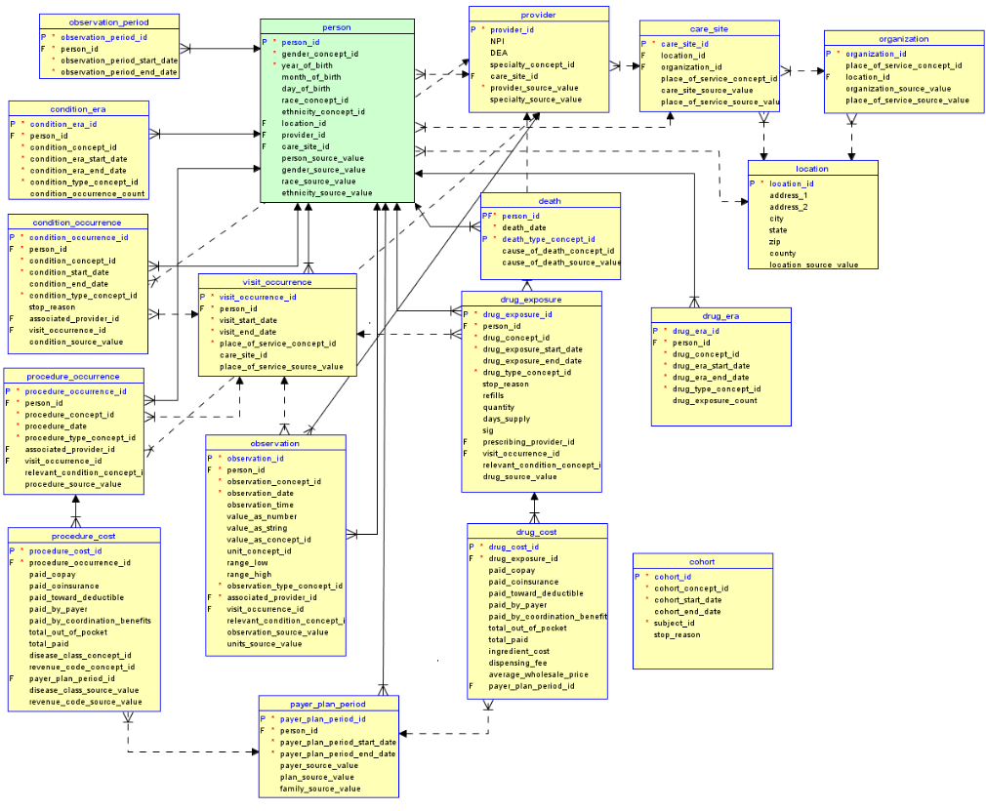

Slide 15
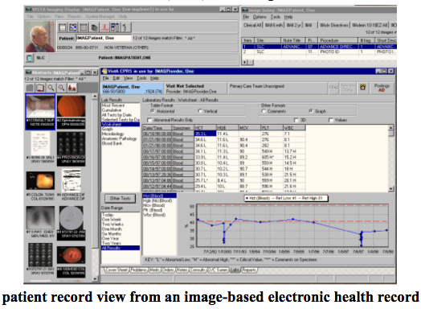
Traditional/Historical Database Design:

Slide 16
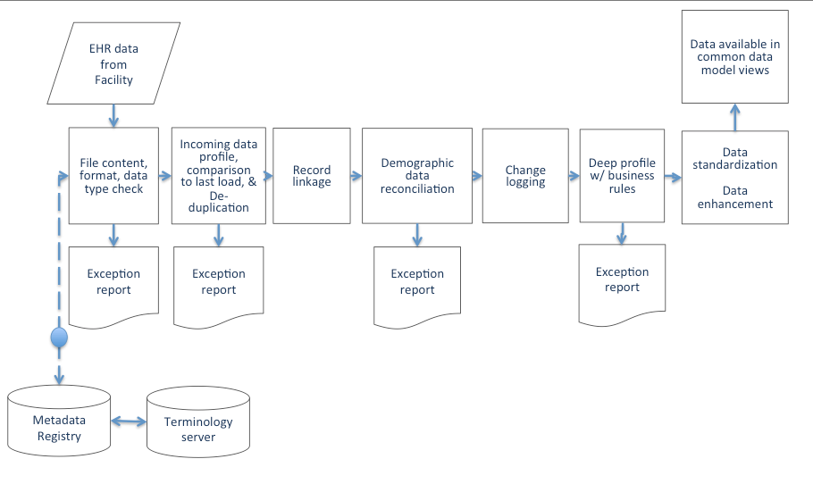
How does it get there?
…So now you want to put the data on your laptop

Slide 17
Do UCSF Databases Differ From Data On Your Laptop?
Size?
Goals?
Privacy?
  Anonymizing
  HIPPA
  Stored only on secure server
Structure & Merging & Analyzing?
  MyResearch & RedCap
  EMR’s (Epic vs. Apex vs. ??)
  Social media: Twitter & Google etc

Slide 18
Building your database:
Importing Data
Identify data sources
Extract the needed data from existing systems to a temporary data staging area
Merge, Append, Transform and Clean the data
  Resolve data type conflicts
  Resolve naming and key conflicts
  Remove, replace, correct, or flag bad data
  Conform Dimensions
Load the data
Pre-processing the data

Slide 19
An Example using APEX & Ambulance Transportation Company Records*
Identify all patients seen in SFGH ER between 1/2014 and 12/2014
Identify all transports to the ER in ambulances during the same period
Extract primary visit reason
Extract medical history
Extract demographics
Cross-code patient ID to link databases
Merge datasets
Anonymize data
Export data = 43,560 records
*2014 Hall, Rodriguez, Allen et al. EMS-STARS:Emergency Medical Services “Superuser” Transport Activations, a retrospective study Prehospital Emergency Care 19(1)L 61-67.

Slide 20
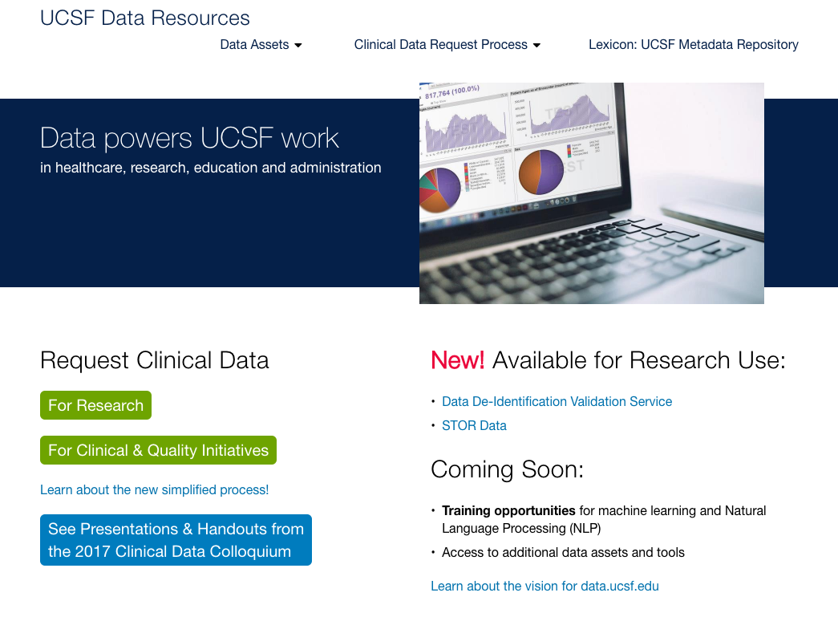
data.ucsf.edu

Slide 21
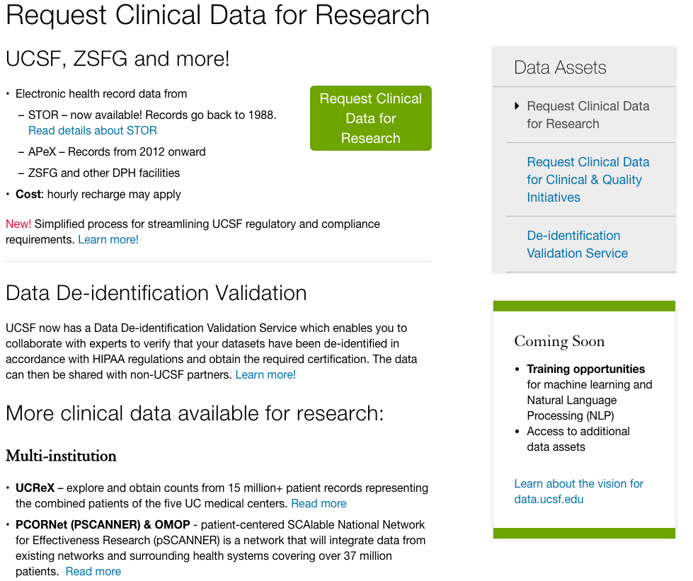

Slide 22
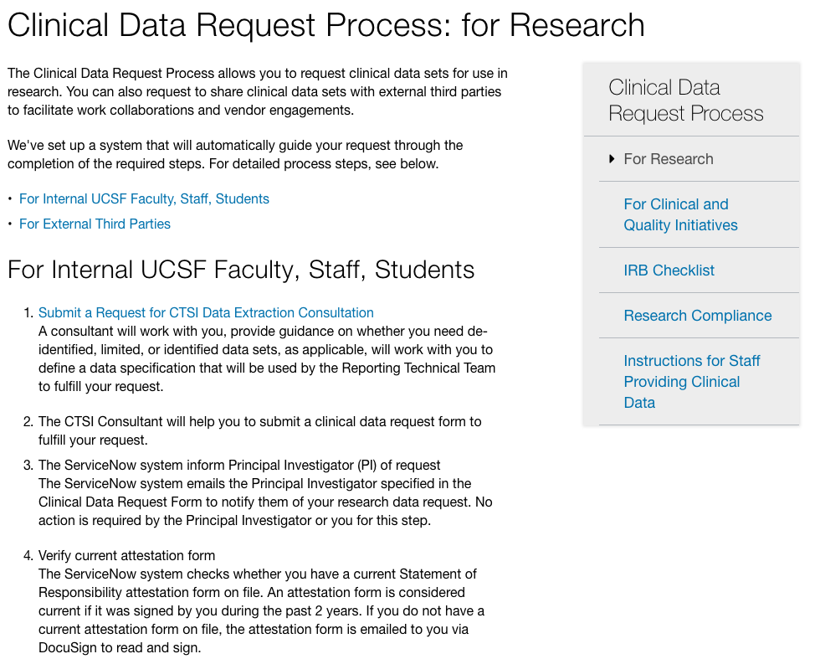
Next stop: data.ucsf.edu/lexicon

Slide 23
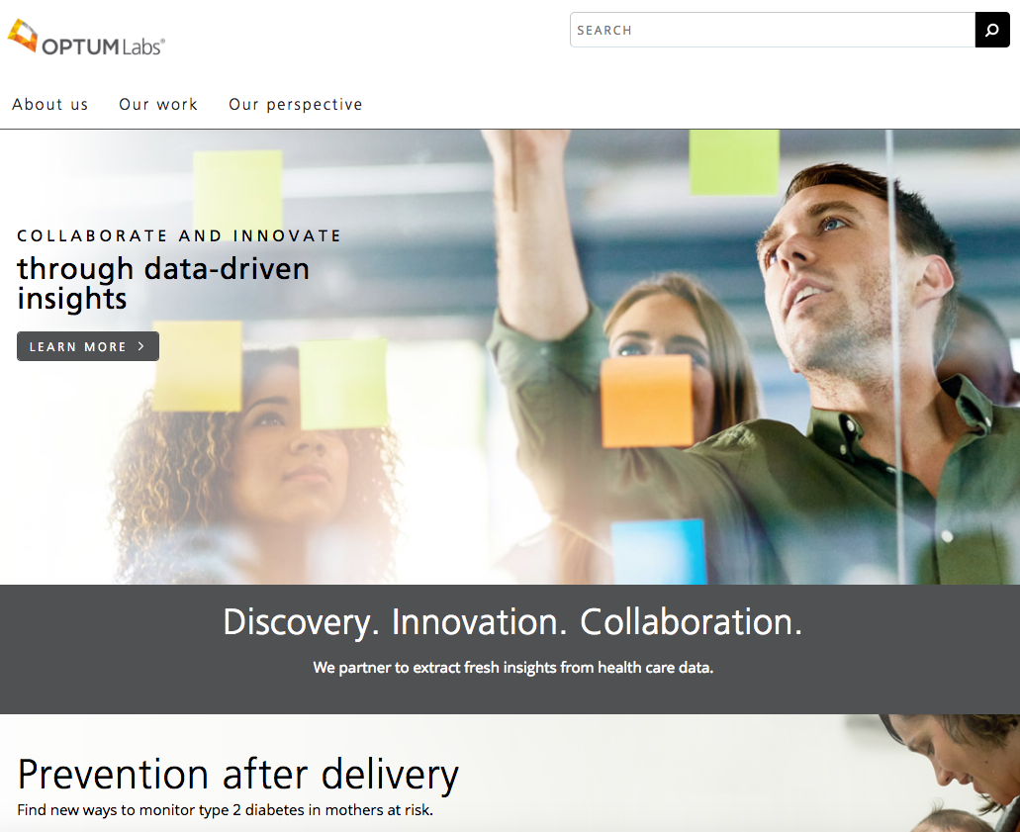
An alternative: optumlabs.com partnering with UCSF
https://sp.ucop.edu/sites/its/immediate/ciosupport/internal/optumlabs/default.aspx

Slide 24
Major Tasks in Data Management (1)
Data cleaning
  Fill in missing values, smooth noisy data, identify or remove outliers, and resolve inconsistencies (i.e. different units)
Data integration
  Integration of multiple databases, data cubes, or files
  Inner or outer merge, append

Slide 25
Major Tasks in Data Management (2)
Data transformation
  Normalization and aggregation
Data reduction
  Obtains reduced representation in volume but produces the same or similar analytical results
Data discretization
  Part of data reduction but with particular importance, especially for numerical data

Slide 26
Data Cleaning
Data cleaning tasks
  Fill in missing values
  Identify outliers and smooth out noisy data
  Correct inconsistent data*
*2005 Leff, Allen et al, Inside Employment Interventions: Effects of Job Development and Job Support on Competitive Employment of Persons with Severe Mental Illness, Psychiatric Services, 56(10): 1237-1245.

Slide 27

Missing Data (1)
Data is not always available
  eg, Many observations have no recorded value for several attributes (which may be linked), such as previous visit information or demographics

Slide 28

Missing Data (2)
Missing data may be due to
  Refuse/unable to answer/inconsistent answer
  Equipment malfunction
  Inconsistent with other recorded data and thus deleted
  Data not entered due to misunderstanding
  Certain data may not be considered important at the time of entry
  No register history or changes of the data
Missing data may need to be inferred and imputed

Slide 29
How to Handle Missing Data? (1)
Ignore the observation: usually done when class label is missing (assuming the tasks in classification—not effective when the percentage of missing values per attribute varies considerably)
Fill in the missing value manually: tedious + not feasible for any medium/large dataset
Use a global constant to fill in the missing value: e.g., “Unknown”, a new class, ‘999’?

Slide 30
How to Handle Missing Data? (2)
Use the mean to fill in the missing value (okay)
Use the mean for all samples belonging to the same class to fill in the missing value: (smart)
Use the most probable value to fill in the missing value: inference-based such as bayesian formula or decision tree or regression (smarter)
Multiple imputation techniques examining patterns of missingness (smartest?)
What can Modeler do for you? (Upcoming!)

Slide 31

Noisy Data (1)
Noise: random error or variance in a measured variable
Incorrect attribute values may be due to
  Faulty data collection instruments
  Data entry problems
  Data transmission problems
  Technology limitation
  Inconsistency in naming convention
  Identifiable bias?
…let’s measure the tables

Slide 32
Noisy Data* (2)
Other data problems which require data cleaning
  Duplicate records
  Incomplete data
  Inconsistent data

Slide 33
Data Integration (1)
Data integration:
  Combines data from multiple sources into a coherent store
  Merging vs. appending data
Database integration
  Integrate metadata from different sources
  Entity identification problem: identify real world entities from multiple data sources, e.g., A.Patient-id ≡ B.cust-#

Slide 34
Data Integration (2)
Detecting and resolving data value conflicts
  For the same real world entity, attribute values from different sources are different
  Possible reasons: different representations, different scales, e.g., Metric vs. British units

Slide 35

Redundant Data
Redundant data occur often when integrating of multiple databases
  The same attribute may have different names in different databases
  One attribute may be a “derived” attribute in another table, e.g., GFR or Creatinine Clearance

Slide 36
Data Integrity Problems: Examples
Same person, different spellings
  Agarwal, Agrawal, Aggarwal etc...
Multiple ways to denote company name
  Persistent Systems, PSPL, Persistent Pvt. LTD.
Use of different names
  Mumbai, Bombay
Different account numbers generated by different applications for the same customer
Required fields left blank
Invalid product codes collected*
  manual entry leads to mistakes
  “in case of a problem use 9999999”
*2016 Chu, Chi, Allen et al Durability of Flexible Ureteroscopy & Predictors of Repair: A prospective multicenter study (WIP)

Slide 37
SPSS Modeler for Data Management
Data audit
Variable derivation
Anonymizing
Merging & Appending
Missing Data
Examining small subgroups
…to the lab for today

