Slide 1
Epidemiologic Methods (EPI 203)
Notes:
Welcome to Epidemiologic Methods. Here is our roadmap for the quarter, the next three months. Ann Schwartz from our Department of Epidemiology and Biostatistics will start us off with a series of 5 lectures. The first is a lecture on study design in which the emphasis will be on a unifying concept – the study base -- that will hopefully make it easier, rather than harder, to understand the various options we have in designing our studies. Then, Ann will focus on the most basic parameters that we estimate in human subjects studies - the measurement of disease occurrence and the relationship between certain measurements (called “exposures” or predictor variables) to other measurements (called “outcomes”, “events’, or “disease”); we call these relationships measures of disease association. At that point, I will take over to give a series of 6 lectures about the various threats we face in getting the right answer in our work, in other words, selection bias, measurement bias, and confounding, with a major emphasis on confounding, because with the exception of randomized designs, confounding is generally our biggest threat.
Beginning in the 2nd week, we will have our weekly small group discussion session where we will review the prior week’s material by summarizing lecture and working through the weekly homework problem set. You will notice that on week 3, we begin to sprinkle in Journal Clubs where we apply what we have learned in lecture to the critical dissection of the contemporary literature. As you can see, we have several of these Journal Clubs because we feel it is critical for you to learn to read real life papers and apply the theory we learn in class to real problems.

Slide 2
Course Administration
Format
  Lectures: Live Tuesdays 8:45 – 10:15 am at Mission Hall at UCSF
    Video recording available on website later in the day
    Objective: Define the content for the week
  Small Group Sections: Begin in Week 2.
    Tuesdays 1:30 to 3 pm at UCSF. Other times internationally.
    Location: MH 2105, 2106, 2107, 2108 or internationally
    Every student assigned to a section (see Roster on website)
    Faculty: each section directed by experienced faculty or a recent former student (Teaching Assistant) accompanied by faculty
    Objective: Review lecture and weekly Problem Set. DISCUSS.
  Journal Clubs: Begin in Week 3.
    Tuesdays 3:15 to 4:15 pm at UCSF. Other times internationally.
    Same small group setting, led by experienced faculty
    Objective: Apply lecture concepts to contemporary literature
Notes:
A few housekeeping details, all of which are also listed on the course website.
All lectures will be given live at UCSF on Tuesdays at 8:45 am and will last 90 minutes. Note that we have a lot to cover and will start on time. Lecture videorecordings will be available later in the day on the course website. Occasionally (such as when the faculty are unavoidably out of town), we will just provide a taped lecture. The objective of the lecture is to define and describe the curricular content for the week.
Beginning in the second week of the course, we will have our weekly Small Groups Sections. In San Francisco, these occur at 1:30 PM at Mission Hall (second floor) and last 90 minutes. At our international venues, times will differ. Please note that each year we do have Small Group Sections ongoing at one or more international sites, making this a truly global course. Every enrolled student is assigned to a Small Group Section, and your assignment can be found in the Roster section of the course website. Our Small Group Section leaders are either experienced faculty or a recent former student (a teaching assistant) accompanied by a faculty member. These formers students are, to no surprise, chosen because of their exemplary performance in the course, and, indeed, each year we are looking for students who can assist us in the following year. One goal of the course is also to give these teaching assistants experience as they master their knowledge of the material. The objective of the Small Group Sections is to review the prior week’s lecture, review the weekly problem set, and have a dialogue about the material. A major goal of the Small Group Sections is to get your questions answers and your learning consolidated. The discussion in these sections is the critical aspect of the learning. We are not taking attendance but given that you took the time to enroll in the course, we would very much expect that you will attend because this is where you get the chance to discuss the concepts.
We will also have 6 Journal Clubs throughout the course. They will be from 3:15 to 4:15 pm in San Francisco in the same room as your Small Group sections, beginning in week 3 of the course. Times will vary in our international sites. As mentioned, the purpose of these sessions is to apply the concepts learned in class to understanding and critiquing the contemporary biomedical literature. This is a big part of the course because if you cannot apply what we have learned here to actual scientific practice, we have not achieved much. Hence, we are going to practice this application quite frequently in our Journal Clubs.

Slide 3
Resources for Learning
Curriculum represents our contemporary synthesis of the most fundamental and relevant concepts in epidemiology
This synthesis is described in our weekly 90 minute lecture and accompanying narrative slide notes (all posted on website)
  Lecture is therefore the single most important resource
    In view of the non-reproducibility in language and variable accuracy in concept coverage across sources, our lectures trump all else
  Designed to be the reference guide/document for the week more so than a light and breezy overview. As such, it is densely packed.
    To be most considerate of your time, we do not have a lecture and a separate reader. Instead, we have combined the two into one medium.
    At 90 minutes, some students prefer to view the video in several parts.
    Other students prefer to watch the live lecture and then review the video
    Because there are many learning styles, you will develop your own approach
    Sometimes the content extends beyond 90 minutes, in which case we provide you additional non-narrated slides and notes (but no less important)
Notes:
The curriculum represents our best contemporary synthesis of the most fundamental and relevant concepts in epidemiology. We stress that this is contemporary coverage in that there has been a revolution in the methods of epidemiology over the past 15 years, and it is our goal to depict this. Our synthesis of the material is described in our weekly lectures and accompanying slide notes, which are all posted on the course’s website. I will note that whenever there is a difference between our lectures or the text (or some other reading), our lectures trump everything else. For example, there is a lot of confusion and non-reproducibility in terminology and language in epidemiology (as well as in concepts). What we use in lecture trumps other terminology or other sources.
The weekly lecture and the accompanying narrative notes are designed to be the reference guide for the week. As such, the lecture is dense and is not designed to be a light and easy overview. To be considerate of students times, we don’t have a lecture and separate course reader. Instead, we have combined the two into one medium – a comprehensive lecture and accompanying set of narrative notes. What is true is that at 90 minutes and with dense coverage in the lecture, some students prefer to view the lecture video in several parts. That is, while some students can digest the entire lecture in one sitting, it is not easy for all students to do this and the recorded video allows them to break up their viewing into several parts. When we cannot cover everything in 90 minutes, we provide you with additional non-narrated slides and notes. Please do not view the non-narrated slides as being less important; they just could not be fit into the 90 minute lecture.

Slide 4
Resources – cont’d
Selected recommended & optional articles bolster our lectures
Textbook
  Epidemiology: Beyond the Basics by Szklo and Nieto. 3rd edition
    Of any textbook, we follow this one most closely (especially in the beginning) but we diverge often and especially towards the end of the course
    Lectures and accompanying notes are sufficient resources for many students
    Ultimately, a personal choice as to whether you will want your own copy
Software
  Statistical software: Stata version 13 or higher. Start in Week 2.
    We expect that you know how to load datasets and basic command syntax
  dagitty.net – free web-based software for DAGs
Notes:
In addition to our lectures, we have selected several other recommended and optional readings/passages, which are also posted on the website.
We do not follow any single textbook very closely, but of the available textbooks, the one we follow most closely is Epidemiology: Beyond the Basics by Szklo and Nieto, now in its 3rd edition. It is available from the publisher and the usual 3rd party commercial vendors (e.g., Amazon.com). The book is a fine resource, but it becomes less and less relevant as the course progresses. For many students, our lectures and the accompanying notes are sufficient resources to learn the material. For other students, their learning is enhanced by reading the recommended chapters from the textbook. Ultimately, it is a personal choice as to whether you will want to own your own copy of the book.
We will also be using statistical software, specifically Stata. Version 13 or higher will work. We expect that you understand the basics of working in Stata, namely how to load a dataset and basic command syntax. Completing our BIOSTAT 212 course easily suffices for this background.
Finally, later in the course, we will be using a web-based free software called dagitty.net, which is used to create and solve DAGs.

Slide 5
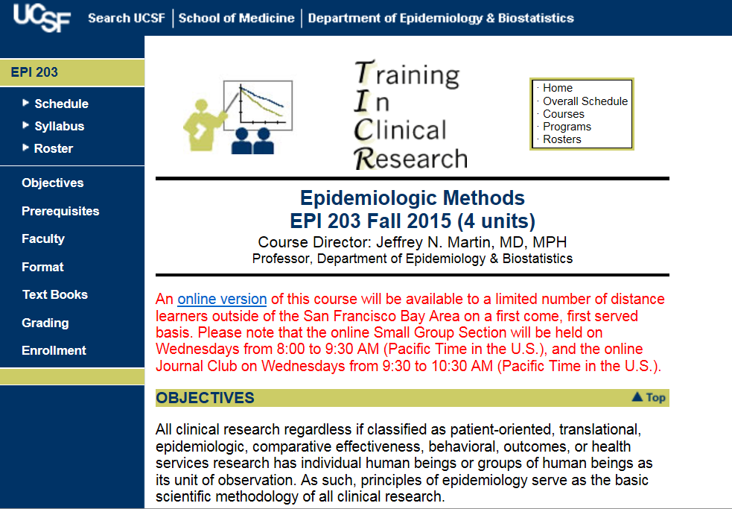
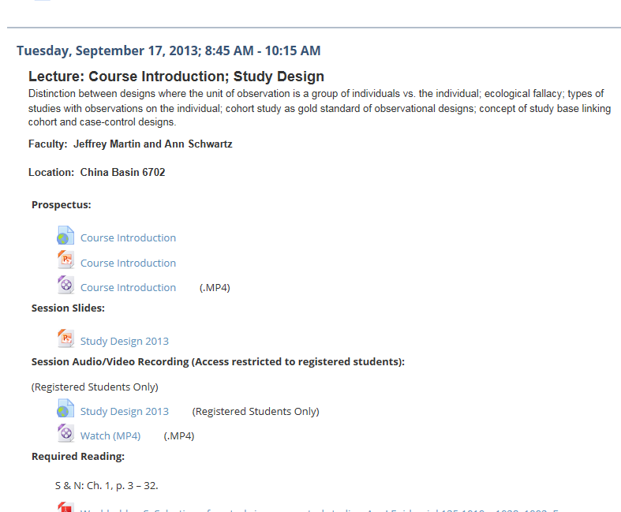
“CLE” (Syllabus)
Course Homepage
Notes:
When I say that the resources are available on the course website, what I really mean is what is called the Collaborative Learning Environment or CLE syllabus. As those of you whom have already taken one of our courses know, you can reach the this CLE site by clicking on Syllabus on the course’s main homepage. Or, you can go there through the campus CLE main website. All of our course materials will be placed on our CLE syllabus.

Slide 6
Grading
  Based on points achieved on weekly homework (~75%, after dropping lowest score) & final (~25%).
  Late assignments are not accepted (but plenty of pts + 1 drop)
  Weekly Problem Sets:
    files should be pulled from website
    word process your responses (OK to handwrite some equations)
    documents are all-inclusive; no need to lookup articles
    due at start of Small Group Section
    If absent, e-mail to section leader by start of session (eg,1:30 pm)
Attendance
  Lectures: Live attendance not required. Personal choice.
  Small Groups/J. Clubs: Not required, but highly recommended.
Notes:
Grades are based on homework and the final exam. The points breakdown is based approximately 75% on homework, after we allow you to drop your lowest weekly score, and 25% on the final. We have problem sets every week and they are due at the beginning of section the following week. For example, the problem sets that will be posted on the website after the first lecture will be due at 1:30 pm on the following Tuesday at the beginning of small group section. We do not accept late assignments, but because we have plenty of points in this course and we drop your lowest score, missing one or two homework assignments, won’t jeopardize your passing the course, assuming satisfactory performance on the rest of the material. If you are going to be absent from the small group section, then we expect you to email your assignment to your section leader by 1:30 pm.
Regarding attendance, we don’t formally require that you attend any of the sessions. Lectures in particular are a personal choice in terms of whether you want to attend in person or watch the video or both. The Small Groups and Journal Club, on the other hand, although not required, are highly recommended. This is because it is at these sessions where we will actively discuss the material, and this is where most people really learn the material.

Slide 7
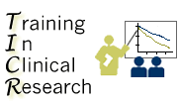
TICR Program
Professional Conduct Statement
Clarifications for this class
I will maintain the highest standards of academic honesty
I will not use answer keys from prior years
Problem Sets: I am permitted to consult with other classmates, but I will write final answers in my own words away from other classmates
Final Examination: I will neither give nor receive aid in examinations
Notes:
Regarding the weekly problem sets, this reminds me to clarify what we expect for professional conduct in this course. Following the overall tenets of the TICR Program Professional Conduct Statement, we ask that you maintain the highest standard of academic honesty and not use answer keys from prior years if you happen to come across them. It is fine and, in fact, we encourage you to work with other classmates on the problem sets, but please write the final answers in your own words. Finally, for the end of quarter final exam, please work on this entirely on your own without discussion with anyone else.

Slide 8
What We Do and Why We Do It
Spectrum of content
  Each week, new content described via lecture (& recommended reading)
Learning the material
  Listen to lectures; read slide annotations (& recommended reading)
  Work through the weekly problem sets (hands on keyboard) on your own or in student-run study groups
  (Visit us at weekly help sessions for content questions)
  Discuss the problem sets at Small Group section
  Read and discuss the Journal Club articles
Philosophy
  Steadily build a knowledge base over the course of quarter
  Time needed between each installment to optimize comprehension
  Learning is facilitated by engaging a variety of senses and motor functions (following “multiple intelligences” educational theory)
Problem Sets are the focal point; they facilitate “active learning”
Notes:
This brings us to a statement regarding our philosophy of teaching: what we do and why we do it?
Again, each week, the scope of the content is outlined in the lecture. If there is material in the reading that is not covered in the lecture, we try to let you know this.
We suggest that you learn the material by listening to the lectures and reading the accompanying narrative. If you can, read the recommended readings. Then, work through the weekly problem sets. It is not until a learner has applied the material can the learner be sure she/he really understands the material. We then strongly suggest that you attend and discuss the problem sets at the weekly Small Group Sections and also attend the Journal Clubs. While you might think you fully understand the problem sets by working through them on your own, it is likely you can learn even the material more deeply if you attend the Small Groups and Journal Clubs and listen to your classmates and discuss the material.
We feel strongly that you should take advantage the full 7 days between sessions in that time is needed between each installment of new material to optimize comprehension. Finally, we feel that learning is enhanced by engaging a variety of senses and motor functions (listening, seeing, speaking, writing, typing). This follows the “multiple intelligences” educational theory.
The main takeaway point from this is that our weekly problem sets are the focal point for learning. You can listen to lectures and do the reading and think you understand the material, but it is not until you work through problems do you develop a deep level of understanding and learning that sticks. This doing of problems is what as known as active learning and there is now ample empiric evidence that it is far preferable instruction that does not feature active learning. Most of the data for this teaching approach has been generated from the work of Carl Weiman at Stanford.

Slide 9
The Weekly Learning Cycle and Why We Do It
Spectrum of content
  Each week, new content described via lecture (& recommended reading)
Learning the material
  Listen to lectures; read slide annotations (& recommended reading)
  Work through the weekly problem sets (hands on keyboard) on your own and/or in student-run study groups
  (Visit us at weekly help sessions for content questions)
  Discuss the problem sets at Small Group section
  Read and discuss the Journal Club articles
Su | M | T Lecture available; Problem Set released | W | Th Drop-in Help Session | F | Sa
Su | M | T Small Group Section; Journal Club | W | Th | F | Sa
Work on
Problem Set on own
View lecture
Work on
Problem Set
in group
Turn in Problem Set
Notes:
This brings us to a statement regarding our philosophy of teaching: what we do and why we do it?
Again, each week, the scope of the content is outlined in the lecture. If there is material in the reading that is not covered in the lecture, we try to let you know this.
We suggest that you learn the material by listening to the lectures and reading the accompanying narrative. If you can, read the recommended readings. Then, work through the weekly problem sets. It is not until a learner has applied the material can the learner be sure she/he really understands the material. We then strongly suggest that you attend and discuss the problem sets at the weekly Small Group Sections and also attend the Journal Clubs. While you might think you fully understand the problem sets by working through them on your own, it is likely you can learn even the material more deeply if you attend the Small Groups and Journal Clubs and listen to your classmates and discuss the material.
This is what the weekly cycle looks like.

Slide 10
The Weekly Learning Cycle and Why We Do It
Philosophy
  We provide you with highly synthesized and annotated curricular material, but few can master it by just passive consumption
  Problem Sets are the focal point; they facilitate “active learning”, which is deeper and more persistent than by passive consumption
  Steadily build a knowledge base over the course of quarter
  Time needed between each installment to work on problems and optimize comprehension (i.e., the weekly cycle)
  Learning is facilitated by engaging a variety of senses and motor functions (following “multiple intelligences” educational theory)
Notes:
Our overall philosophy goes like this:
We provide with highly synthesized and annotated curricular material. We believe this is better than any book you could find on the topic at this level. However, very few learners can master the material by just passive consumption. Most people learning new material “”may be deceived by the illusion of knowing and the fallacy of understanding” (Schwartzstein NEJM 2017). That is, when learners hear or read material that is reasonably well-explained and apparently well-written or presented, it is common for them to believe they have now mastered the content of the material. Yet, when confronted with a problem in real life that requires application of that curricular material, the learners often come up very short suggesting that whatever learning had occurred was superficial. To prevent this from happening, we give you weekly real-world problem sets, and they indeed are the focal point for learning in the course. You can listen to lectures and do the reading and think you understand the material, but it is not until you work through problems do you develop a deep level of understanding and learning that sticks. This doing of problems is what as known as active learning and there is now ample empiric evidence that it is far preferable instruction that does not feature active learning. Most of the data for this teaching approach in the sciences at our level has been generated from the work of Carl Weiman at Stanford.
The rest of our philosophy includes the importance of time. We steadily build a knowledge base over the course of the quarter. We don’t think you could learn this material if it was all compressed over 2 weeks. As such, we feel strongly that you should take advantage the full 7 days between sessions in that time is needed between each installment of new material to optimize comprehension. Finally, we feel that learning is enhanced by engaging a variety of senses and motor functions (listening, seeing, speaking, writing, typing). This follows the “multiple intelligences” educational theory.

Slide 11
Definitions of Epidemiology
Traditional: The study of the distribution and determinants (causes) of disease
  e.g., cardiovascular epidemiology would study frequency and risk for various heart diseases
More inclusive contemporary: Method used to conduct human subject-based health-related research
  the methodologic foundation (“basic science”) of any research (experimental, observational, “translational”, etc.) where individual humans or groups of humans are the unit of observation
    This means everything that each of you are doing!
Notes:
Finally, what we really have not said is what is this course about. We should take a moment to define what we mean by epidemiology. These days, epidemiology really has two meanings. The first is the traditional definition where epidemiology means the study of the distribution or determinants of disease. For example, a cardiovascular epidemiologist would study patterns of occurrence of heart disease and the so-called “risk factors” for heart disease. This is now a dated and overly narrow definition. More broadly, the second definition is a more contemporary and inclusive definition that is more appropriate for these methods are used today. In this definition, epidemiology stands for the body of methods used to conduct any type of research where individual humans or groups of human are the unit of observation. In other words, epidemiology is the basic science, or basic foundation, for all human subjects research. I wish there was a better way to describe this basic science, but I don’t think there is one. Some people think this is what biostatistics is, but biostatistics is only a component of what I am talking about here. Our intent with this course is not to impart knowledge that is useful only for studies of the distribution or risk factors of disease. In other words, we don’t expect all of you will become epidemiologists in the traditional sense. Instead, we feel the material we teach in this course are the basic building blocks no matter if you think of yourself as a risk factor epidemiologist, clinical trialist, health services or policy researcher, or a meta-analyst.

Slide 12
Some Other Names
Epidemiologic principles are the basic science of a variety of human subject-based health-related research, which go by various names
  e.g., patient-oriented, clinical, translational, comparative effectiveness, behavioral, outcomes, or health services research
Epidemiology is agnostic to health or disease. It is the basic science to study health broadly, as defined by the WHO (1948):
  "Health is a state of complete physical, mental, and social well-being and not merely the absence of disease or infirmity.”
  In this class, we are not just studying the methods of understanding some physical medical illness
  Instead, we are teaching methods to understand a variety of physical, mental, or social conditions, including origins & outcomes
Notes:
Sometimes people are phobic to the term epidemiology or epidemiologist, thinking this is only done in foodborne illness epidemic outbreak investigations or public health departments. This is unfortunately a very narrow view because epidemiologic methodologic principles are the basic science of a variety of human subject-based health-related research, fields which go under a variety names such as patient-oriented research, clinical research,….
Also, epidemiology is agnostic to health or disease. It is the basic science to study health broadly, which, by the way, has been best defined by the WHO in 1948, when it was founded. Health is a state of complete physical, mental, and social well-being and not merely the absence of disease or infirmity. In other words, in this class we are not just studying the methods of understanding some physical medical illness. Instead, we are teaching the methods to understand a variety of physical, mental, or social conditions, including their origins and outcomes. Again, this should therefore apply to each of you.

Slide 13
What Kinds of Questions Does Clinical Research/Epidemiology Answer?
“Big 6”
Description
  How frequent/common are risk factors/exposures/conditions/diseases?
Causation (“Causal inference”)
  The science of establishing causal relationships among biological, behavioral, environmental (etc.) factors within humans. Does X cause (or prevent) Y?
  Will intervening upon X change occurrence of Y?
Attribution
  What fraction or how many cases of disease Y can be eliminated if a causal exposure X is eliminated or reduced?
Mediation
  Understanding the mechanisms of causation
  How does X cause Y?
Interaction
  When and for whom does X cause/predict Y?
Prediction
  Do A, B, and C predict concurrent presence/future occurrence of Y?
How often does Y occur?
e.g., diagnosis or prognosis
Notes:
Another way to think about our objectives is to think about the different kinds of questions that clinical researchers and epidemiologists answer. We call these the Big Six. Just what does clinical research and epidemiology do? What kinds of questions does clinical research and epidemiology answer? Most of what clinical research and epidemiology answer can be placed into one of these 6 categories, and each of them is highly relevant. The objective of this course is to make you aware of what these questions and how to methodogically address them.
First, is description….
Lastly, is prediction. Can we identify a factor or set of factors that predicts the occurrence of disease or some outcome in a diseased person. Doing this prediction concurrently is basically diagnosis. Using prediction to predict the future is prognosis.
I’m guessing that each of you is working at least one of these questions. If true, then this is course is for you.

Slide 14
The Big 6 are a Subset of the Larger Universe of Questions
Cluster/Pattern Identification
  How should various traits/characteristics (e.g., of persons/conditions) be grouped such that members or characteristics within groups are more similar to one another than to the membership of other groups?
Description
  How frequent/common are risk factors/exposures/conditions/diseases? How often does Y occur?
Causation
  Science of establishing causal relationships among biological, behavioral, environmental (etc.) factors within humans. Does X cause (or prevent) Y? Will intervening upon X change occurrence of Y?
Attribution
  What fraction or total cases of disease Y are eliminated if causal exposure X is eliminated or reduced?
Mediation
  Understanding the mechanisms of causation. How does X cause Y?
Interaction
  When and for whom does X cause/predict Y?
Prediction
  Do A, B, and C predict concurrent presence/future occurrence of Y? (diagnosis or prognosis)
Decision Analysis
  What are the consequences (often long-term), in terms of multi-dimensional and complex benefits and harms, of choosing one health-related course of action (diagnosis or intervention) over another?
Cost-Effectiveness
  What the financial implications (either costs or gains) associated with health-related actions?
Notes:
The Big 6 are actually subset of a slightly larger universe of questions, the extremes of which (cluster or pattern identification; decision analysis and cost effectiveness) won’t be covered in the course.
Even before the Big 6 questions, sometimes there is the need for cluster or pattern identification. Formally, this is called cluster analysis. A question in this realm asks how should various traits or characteristics (e.g., of persons or conditions or diseases) be coherently and meaningfully grouped. The goal of the grouping is for the members or characteristics within groups to be more similar to one another than to the membership of other groups. Examples of this include the defining of new disease entities, subgroups within diseases, or reduction of multi-dimensional data into a limited number of dimensions. This process is performed only with the information on hand and not in reference to any other concurrent or future outcomes or characteristics of the groups.
At the other end of the Big 6 are the questions that naturally arise with the information gleaned from the Big 6. Decision support refers to understanding the consequences of choosing one health-related action (a diagnostic maneuver or an intervention) over another. Decision support is required for complex situations, not simple ones for which a simple randomized trial can be performed. This means situations in which there are multiple outcomes, both in term of benefits and harms, which often occur over the long-term.
Finally, cost-effectiveness refers to understanding the financial implications (either cost or gains) associated with various health-related actions? Cost-effectiveness analysis recognizes that there are finite resources in any health care system and hence seeks to prioritize different health-related actions based on their financial consequences.

Slide 15
What Do (Good) Practicing Epidemiologists Know?
Research study design
Complex sampling
Measurement
Cluster/pattern recognition
Minimization of inferential bias
Subject matter and content knowledge
Advanced statistical analysis
Basic statistical analysis
Graphical representation
of data
Scientific dissemination
Research fieldwork implementation
Prediction
Generation of new research methods
Subject Matter Expert
(e.g., clinician or biologist)
Epidemiologist/
Clinical Researcher
Biostatistician
Notes:
From a domain and graphical perspective, what do practicing epidemiologists, or rather – good – practicing epidemiologists know? What are their skills and how is this differentiated from other professionals in the arena? In the green are the people who understand the subject matter and the facts. These people know the facts. Clinician or biologists are such persons. Statisticians, in the red, are experts in sampling of populations and advanced statistical analysis, generation of new analytic methods, as well as a variety of basic research domains. Where does this put epidemiologists? Here, in the blue. Epidemiologists do need to be subject matter experts for what they are studying but what sets them apart is their expertise in research study design, measurement, avoidance of bias, basic statistical analysis, scientific dissemination, and practical field implementation. In the blue boxes are what we are going to cover in this course. Of note, we will not turn you into subject matter experts; you need to get that elsewhere. This is also not a course in practical field implementation of projects, which we do not feel can be taught in class. It needs to be learned in a mentored hands-on field setting.

Slide 16
Distinctions Between the Disciplines
Measurement
Advanced
statistical analysis
Collection of complex data
Complex sampling
Extraction of complex data
Advanced research study design
Storage of complex data
Minimization of inferential bias
Cluster/pattern recognition
Basic research study design
Organization of complex data
Subject matter and content knowledge
Graphical representation
of data
Basic statistical analysis
Distributing
complex data
Cleaning of complex data
Research team leadership
Prediction
Scientific dissemination
Reporting of complex data
Manipulation of
complex data
Research fieldwork implementation
Generation of new research methods
Computing at speed
Subject Matter Expert
(e.g., clinician or biologist)
Epidemiologist/
Clinical Researcher
Informatician
(e.g., Bio/Clinical)
Biostatistician
Data Scientist
Notes:
For your reference, there are actually other professionals we work with to generate knowledge in clinical research and epidemiology. We won’t spend time distinguishing these now, but they are the data scientist and informatician.

Slide 17
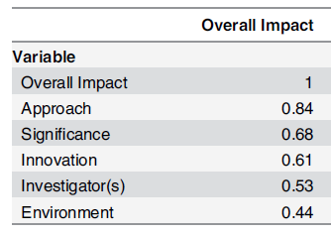
Why Should Knowing This Material Matter to You?
Usual intrinsic virtues
  You want your research to be valid (true) and impactful
Someone told you to take the course or it is a requirement
What is becoming increasingly relevant
  “Knowing what you are doing” in research matters in getting funding
  NIH’s “Rigor and Reproducibility” campaign
  Eblen et al. PLoS One, 2016
    123,707 submitted NIH grants 2010-2013, each scored on a 1 to 9 scale:
      5 individual element scores:
      Approach (i.e., methods), Significance, Innovation, Investigators, & Environment
      1 Overall Impact score, which is used to make final funding decision
Correlation between individual element & overall impact scores
Notes:
Now that we have discussed what we will cover, let’s finish with why this material should matter to you? Of course, for most of you, your intrinsic values of wanting your research to be valid (i.e. true) and impactful is all you need to motivate you. For others of you, you have been told or recommended to take the course or it is a requirement for you from someone or some program. This is all fine but what you may not have realized is that what is becoming increasingly relevant is that “knowing what you doing” in research, i.e., knowing your stuff, being a master at the methods matters in getting funding. The need for good work seems obvious but it is being spelled out in detail by the NIH in its rigor and reproducibility campaign. https://www.nih.gov/research-training/rigor-reproducibility
Moreover, this need for “knowing what you are doing” are not just idle threats. This is being borne out in reality. In a recent study of over 123,000 grants submitted to the NIH, each was scored by reviewers in the usual fashion on 5 individual elements and 1 overall impact score. Reviewers are told to score the individual elements separately and then come up with an overall impact score in any way they like, giving weight to the individual elements as they see fit. It is the overall impact score which is the one that is used to determine funding. When looking the correlation between individual elements scores and overall impact score, here by Pearson correlation, it was the approach score that far and way had the most influence. Approach is the NIH code word for the actual details of the scientific plan. In other words, the better your approach – the more you know what you are doing – the better the chance at funding. It is not good enough to just have a good idea.

Slide 18
Which of the following is the easiest to begin to perform?
Clinical practice (e.g., medicine, nursing, dentistry, pharmacy)
Epidemiologic/Clinical research (aka human subjects research)
Laboratory research
Notes:
Let’s end with having the first quiz of the course.
Which of the following is the easiest to begin to perform? Clinical practice? Epidemiologic or clinical research (in other words, any form of research where humans are the unit of observation)? Or, laboratory research?

Slide 19
Which of the following is the easiest to begin to perform?
Clinical practice
Epidemiologic/Clinical research (aka human subjects research)
Laboratory research
Need a degree and a license
Need idea, dataset from internet, and a calculator
Need physical lab space and equipment
Notes:
The answer: Well, it is not clinical practice. This takes a degree and a license to start. It is also not laboratory research. You need physical lab space and equipment; you just cannot start this in your garage on a weekend. So, the answer is clearly epidemiologic research: all you need is an idea, a dataset (which these days you can just pull down from the web), and a calculator and you could start your project. Today. This ease of start time often gives the impression that clinical/epidemiologic research is child’s play and that anyone can easily do it.

Slide 20
Which of the following is the easiest to perform well?
Clinical practice
Epidemiologic/Clinical research (aka human subjects research)
Laboratory research
Notes:
But, the more relevant question is which is the easiest to perform well?

Slide 21
Which of the following is the easiest to perform well?
Clinical practice
Epidemiologic/Clinical research (i.e., human subjects research)
Laboratory research
All of the above require extensive knowledge & experience to perform well and get right answers
Notes:
This is a bit of trick question, because, in fact, each of these require extensive knowledge and experience to perform well. In particular, epidemiologic or clinical research is not where you go if you thought clinical practice or laboratory research was too difficult. Indeed, what we hope to show you in this course (and for many of you, throughout our entire program) is despite how easy it is to get started in epidemiologic research, there is a quite a bit to know to do it well and to get what we want in the end – the right answer.

Slide 22
We look forward to working with everyone throughout the course on the journey towards performing epidemiologic/clinical research well.
Notes:
We look forward to working with everyone throughout the course for the next step on this journey.

