Slide 1
Introduction to Measurement Theory
Phenomena, conceptual frameworks and tools to capture them
Lydia B. Zablotska, MD, PhD
Professor, Department of Epidemiology and Biostatistics

Slide 2
Learning Objectives
Discuss how causal inference is central to the role of health research.
Define measurement, phenomena, domains, concepts/conceptual models/conceptual frameworks.
Learn how to operationalize theoretical constructs and concepts into measurable indicators.
Introduce classical measurement theory and give examples of modern measurement theories.
Discuss common measurement approaches: Scales.
Review statistical underpinnings of scale measurement.

Slide 3
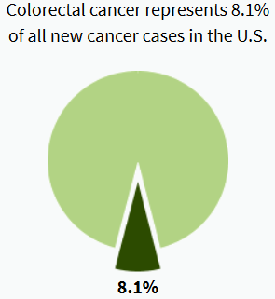
Example: “The Fiber Yarn”
Study of the association between fiber intake and risk of colorectal cancer
Incidence rates of colorectal cancer per year in the U.S.
 | SEER 2000 | SEER 2010 | SEER 2015
Males | 64 per 100,000 | 47 per 100,000 | 45 per 100,000
Females | 47 per 100,000 | 36 per 100,000 | 34 per 100,000
4.4% of men and women born today will be diagnosed with cancer of the colon and rectum at some time during their lifetime
4th leading cause of cancer (after breast, lung and prostate)
2nd leading cause of death from cancer (after lung)
Howlader et al. 2017
Notes:
This is an example of so-called “fiber yarn.” Billions of dollars have been spent on numerous studies of this association, from ecological to randomized controlled trial, but we are not any closer to the answer than we were at the time of the ecological study.

Slide 4

… but wait, this seems to be all about
measurement!
Knudsen MD et al. Am J Epidemiol.2014;179(10):1188-96. Self-reported whole-grain intake and plasma alkylresorcinol concentrations in combination in relation to the incidence of colorectal cancer.
RESULTS: We investigated this association using intakes of whole grains and whole-grain products measured via FFQs and plasma alkylresorcinol concentrations, a biomarker of whole-grain wheat and rye intake... Plasma alkylresorcinol concentration … (was) inversely associated with the incidence of distal colon cancer when the highest quartile was compared with the lowest (IRR= 0.34, 95% CI: 0.13, 0.92). No association was observed between whole-grain intake and any colorectal cancer when using an FFQ as the measure/ exposure variable for whole-grain intake.
CONCLUSIONS: … Assessing whole-grain intake using a combination of FFQs and biomarkers slightly increases the precision in estimating the risk of colon or rectal cancer...

Slide 5
… Saga Continues … a.k.a. “Untangling the fiber yarn”
Summary:
Changing definitions of “fiber consumption” have an effect on the findings of studies looking for causes of colorectal cancer
Questionable validity of some of the measures of “fiber consumption”
Study methods, i.e. “study design” and data collection instruments, have a profound effect on the study findings
Notes:
So, the main reason for the lack of clear answers on the association between fiber and colorectal cancer seems to be that most of the studies were poorly designed from the epi methods standpoint, they had poor exposure measurements, there could also have been a publication bias.

Slide 6
Back to basics:
What is measurement?
“Measurement of some attribute of a set of things is the process of assigning numbers or other symbols to the things in such a way that relationships of the numbers or symbols reflect relationships of the attributes of the things being measured. A particular way of assigning numbers or symbols to measure something is called a scale of measurement.”
Stevens, 1951
Notes:
“Measurement is a fundamental activity of science.” DeVellis
Measurement is the “assignment of numerals to objects or events according to rules” Stevens

Slide 7
Back to basics:
What is measurement theory?
“A branch of applied statistics that attempts to describe, categorize, and evaluate the quality of measurements, improve the usefulness, accuracy, and meaningfulness of measurements, and propose methods for developing new and better measurement instruments.”
Allen, Introduction to Measurement Theory, 2001
Origins in psychological measurements, i.e. psychometrics, in the early 1930s.
Notes:
Psychometrics is a field of study concerned with the theory and technique of psychological measurement. As defined by the National Council on Measurement in Education (NCME), psychometrics refers to psychological measurement. Generally, it refers to the field in psychology and education that is devoted to testing, measurement, assessment, and related activities.

Slide 8
Back to basics:
What are the building blocks of measurement?
Phenomenon ← domains ← concepts } conceptual framework
  “Phenomena” are observable facts or events.
  Concepts define the content of interest in measuring phenomena and systematically guide the measuring process. Concepts of interest in health research are usually difficult to operationalize, i.e. render measurable.
  Conceptual frameworks are models which are formed after a conceptualization or generalization process, they unify our understanding of how the concepts interact and help us organize our ideas. Sometimes, frameworks could be clearly subdivided into domains or spheres of knowledge, e.g., cognitive, affective and psychomotor domains of learning, each of which has its unique concepts and conceptual frameworks.
Notes:
A phenomenon is the term, description, or label given to describe an idea or responses about an event, a situation, a process, a group of events, or a group of situations (Meleis, 2012).
Logical connection between concept maps and DAGs.
Concept maps are for outcomes.

Slide 9
Back to basics:
What are the steps of measurement process?
A process of operationalizing concepts/ conceptual models/ conceptual frameworks through instrumentation
  Start with conceptualization (a.k.a., ‘theorization’, ‘generalization’ process): Determine what constitutes phenomenon of interest? What are the main concepts?
  “Operationalization” means translating an abstract concept into concrete observable events of phenomena, i.e., creating operational definitions.
  “Instrumentation” means selecting or developing tools and methods appropriate for measuring an attribute or characteristic of interest, e.g., standardized or study-specific questionnaires.
Notes:
#2. Special application to unobservable phenomena: the underlying phenomenon or construct that a scale is intended to reflect is often called the latent variable.
Additional notes:
In addition, it is important to assess whether the theoretical constructs we as researchers identify correspond with the actual perception and experiences of the people we plan to study. Focus groups and other qualitative approaches can be a means of determining whether ideas that underlie constructs of interest make sense to respondents. These methods would also help identify concepts that were not obvious to researchers and thus preclude a measurement strategy that would be doomed to failure.
Focus groups could also reveal the ‘natural’, everyday language that people use to talk about a concept.
Other qualitative approaches: cognitive interviewing or asking respondents what they understood an item to be about and how would they formulate a response to it.
E.g., OGTT test for children in the DESCRT study.

Slide 10
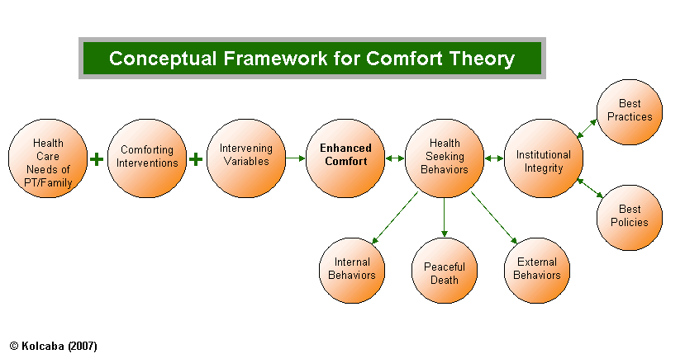
From Phenomenon to Conceptual Framework
Example 1:
We want to examine
  Comfort
  Conceptual framework developed by Kolcaba 2007

Slide 11
From Phenomenon to Concept to Instrumentation
Examples 2 & 3:
Phenomenon: Functional status covers both the individual carrying out activities of daily living and the individual participating in life situations and society.
  Concept: The Functional Health Status
  Instrumentation: Inventory of Functional Status in the Elderly Sickness Impact Profile
Phenomenon: Decreased physical activity and discomfort resulting from inadequate sleep
  Concept: Sleep Pattern Disturbance
  Instrumentation: Wrist actigraph with scoring of “sleep efficiency, time in bed, total sleep time, awake time, after sleep onset, and number of nocturnal awakenings”
Ulrich and Canale Nursing Care Planning Guides, 7th ed. 2010

Slide 12
From Research Question to Phenomenon to Domains to Concepts to Instrumentation
Example 4:
Research Question: Effects of introduction of EMR on patient safety
Phenomenon: Patient safety
Domains: Organizational and Individual (Patient safety culture has been described as a product of individual and organizational factors and includes individual and group values, attitudes, perceptions, competencies, and patterns of behavior)
Concepts: teamwork climate, organizational climate (including perceptions of management, working conditions, job satisfaction, and stress recognition ), communication/communication openness, and organizational learning .
Instrumentation: The AHRQ Hospital Survey on Patient Safety and the Safety Attitudes Questionnaire

Slide 13
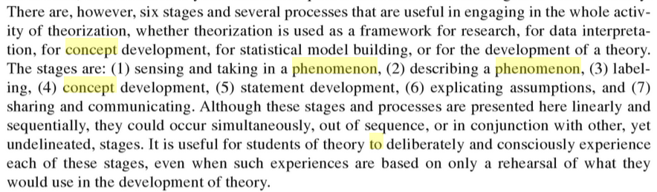
From Phenomenon to Concept to Operational Definition
Meleis A.I. 2011

Slide 14
Measurement theory
Phenomenon to be measured
Conceptual framework helps to determine what is to be measured and delineates how it will be operationalized
Study instrument
Measurement framework guides the design and interpretation of the measurement

Slide 15
Types of Measures
Direct – values of concrete factors such as weight, height, blood pressure, etc.
Indirect – measures or indicators of abstract ideas, characteristics or concepts such as pain, stress, caring, coping, etc.

Slide 16
Measurement Frameworks
Norm-referenced – evaluate a subject relative to other subjects in a well-defined norm or comparison group
  e.g., The Stress of Discharge Assessment Tool (SDAT-2) for patients with acute MI discharged from the hospital. Patient’s score is compared to the scores obtained by other patients who responded to the same tool.
Criterion-referenced – determine whether a subject has acquired a predetermined set of characteristics or behaviors
  e.g., standards defined by the Guidelines for the Management of Patients with Chronic Stable Angina, by the AHA
  Distribution has less variance and is typically skewed
Could be quantitative or qualitative

Slide 17
Types of quantitative measurement frameworks
Objective – construct the latitude of respondents and specify very clear criteria for scoring
  e.g., multiple-choice, physiologic measures
Subjective – allow respondents latitude in constructing responses and require individual judgment by scorers/ raters
  e.g., description of feelings and emotions; there is a high probability that different scorers apply different criteria; the same rater could assign different scores to the same response on different occasions

Slide 18
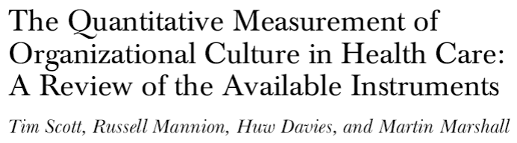
Example: Types of quantitative measurement frameworks of organizational culture in health care settings
Cognitive measures
Affective measures (to determine interests, values, and attitudes);

Slide 19
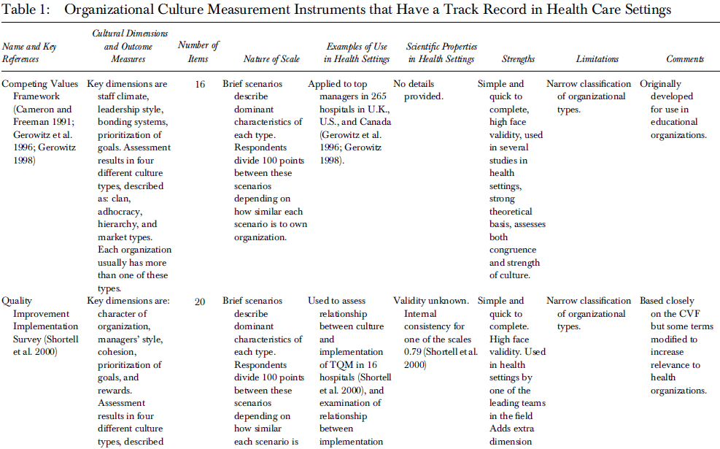
13 instruments that could be used to quantify culture in health care settings
Scott et al. 2003

Slide 20
Classical Measurement Theory
(‘Classical Test Theory’ (CTT))

Slide 21
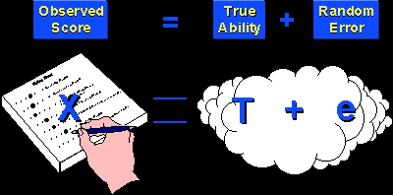
Classical measurement theory
Notes:
Up until now, you’ve been using and practicing CTT without even knowing it. Essentially, every time you used means and standard deviations for normal distributions, or distribution-free measures for non-normally distributed data, the so-called parametric measures, you were relying on the tenets of CTT. Your major concern was with how well observed scores reflect corresponding true scores.
In essence, you were always assuming that any error that happened in your measures is a sum of various errors due to the person doing the measurement, the subject providing responses, the instrument, etc. and that they could not be evaluated separately. There was only just one error term, irrespective of the number of various sources of error.

Slide 22
Classical measurement theory
Provides a model for assessing random measurement error
Describes ways in which errors of measurement (due to falliable measures) can influence observed scores
Describes unsystematic, or random, deviation of an individual’s observed score from a theoretically expected or “true” score
Effects of random error in the model are thought to cancel one another out if sample size is large

Slide 23
Classical measurement theory
If the assumptions are reasonable, and the model is useful, then we can assume that the conclusions we draw from it are likely to be valid.
Classical measurement theory is a relatively simple, quite useful method that describes ways in which errors of measurement (due to fallible measures) can influence observed scores.

Slide 24
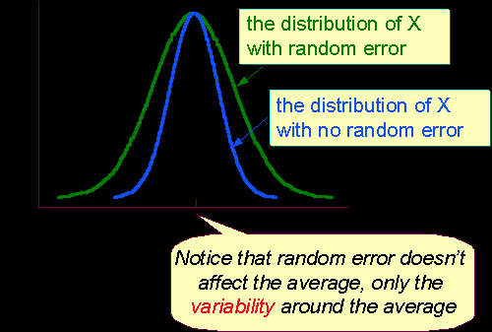
Type of error?
Notes:
Let’s briefly summarize the main principles of CTT you’ve been using all along.

Slide 25
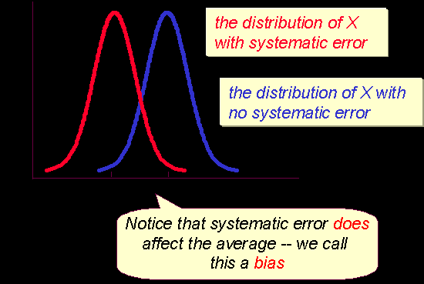
Type of error?

Slide 26
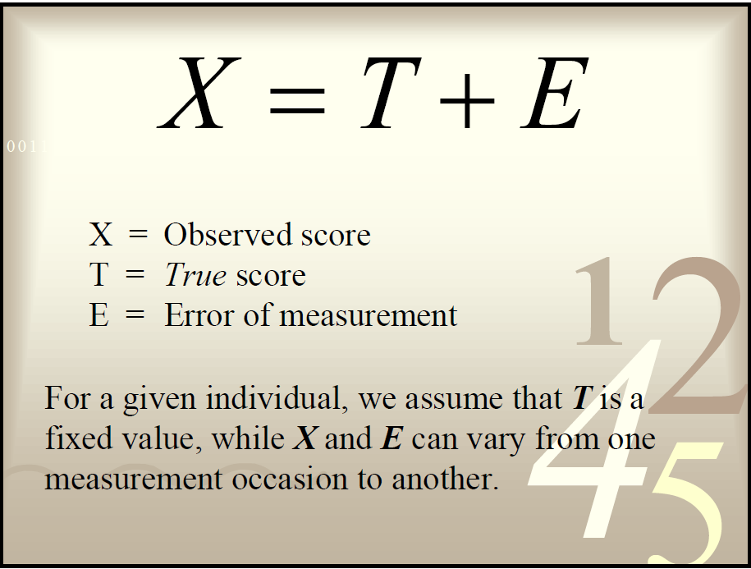
Classical measurement theory:
Assumptions
1.

Slide 27
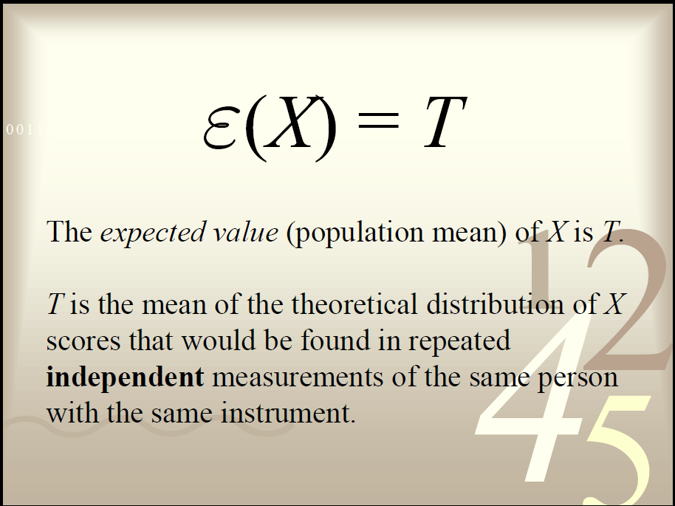
Classical measurement theory:
Assumptions
2.

Slide 28
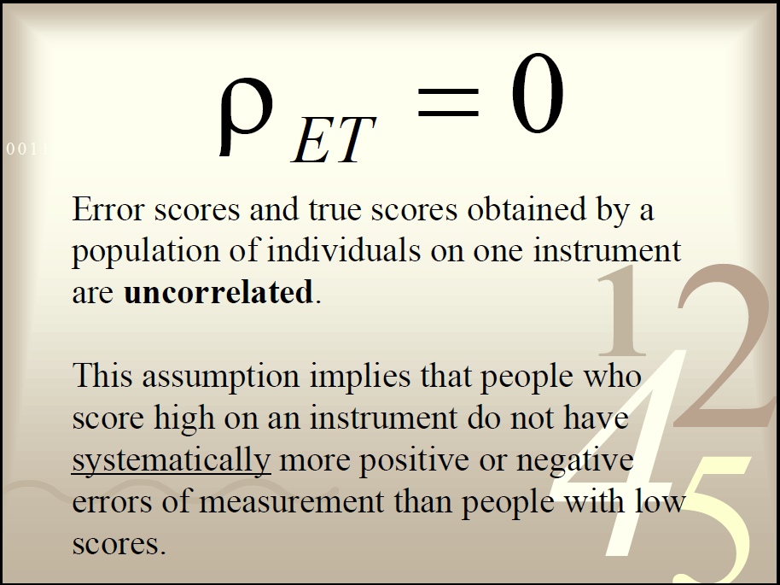
Classical measurement theory:
Assumptions
3.

Slide 29
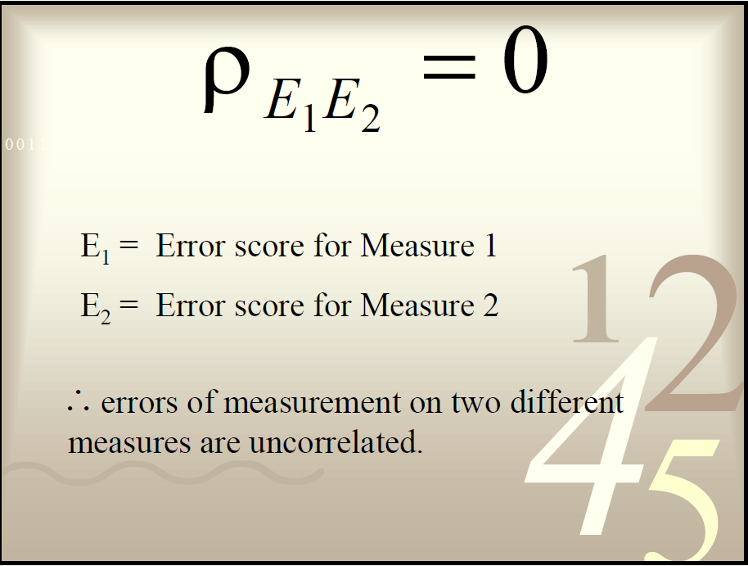
Classical measurement theory:
Assumptions
4.

Slide 30
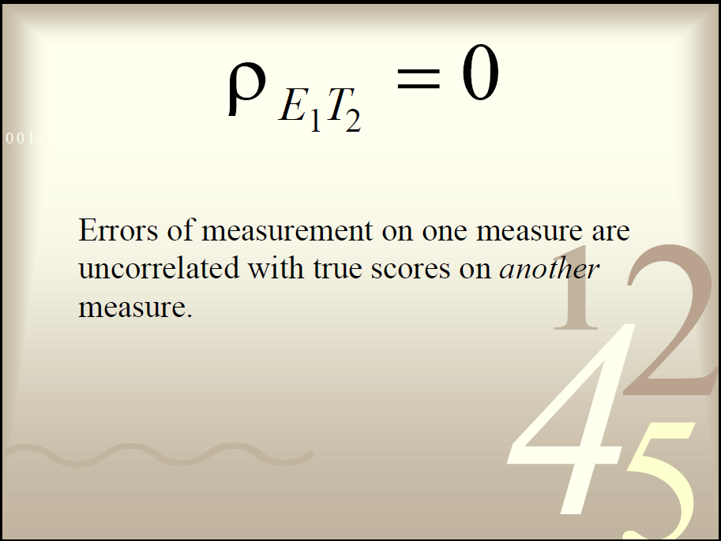
Classical measurement theory:
Assumptions
5.

Slide 31
Summary
Classical test theory (CTT) has been widely used in the development, characterization, and sometimes selection of outcome measures in health research. That is, qualities of outcomes, whether administered by clinicians or representing patient reports, are often describe in terms of “validity” and “reliability.”
The fundamental feature of CTT is the formulation of every observed score (X) as a function of the individual’s true score (T) and random measurement error (e)
CTT focuses on total test score – classical test theoretic constructs operate on the summary (sum of responses, average response) of items, individual items are not considered.
CTT-based characterizations are ‘best’ when a single factor underlies the total score (break up the whole assessment into unidimensional bits, each of which has some reliability estimate)

Slide 32
CTT’s limitations
X = T + E
Although E could represent many different types of error, CTT only permits the estimation of one general error term, which incorporates all sources of error but emphasizes certain types of error over others depending on the reliability study conducted:
    Inter–rater reliability focusing on rater error
    Test–retest reliability focusing on temporal error (occasion facet)
    Internal consistency reliability focusing on how well items fit together to measure the phenomenon consistently
Recognizes only two sources of variance
    Test -retest (stability over time)
    Parallel/ alternate forms (equivalence in item sampling)
Cannot adequately estimate individual sources of error influencing a measurement!

Slide 33
Sources of Error
Random
  Fluctuations in the measurement based purely on chance
  Scoring, rater drift, subject state, administration of measure, environment
  Primarily affects reliability (consistency or stability of measures)
Systematic
  Measurement error that affect a score because of some particular characteristic of the person or the test that has nothing to due with the construct being measured
  Characteristics of subject, measurement tool, measuring process, proxy response
  Primarily affects validity

Slide 34
Examples of modern measurement theories:
Generalizability Theory
SNC2015, Chs 9 & 12

Slide 35
Examples of modern measurement theories
Generalizability theory – acknowledges the multiple sources of measurement error by deriving estimates of each source separately
Item response theory – in contrast to classical measurement theory, which focuses on test performance, this theory focuses on item’s performance and the examinee’s ability; e.g., examinee’s performance could be predicted based on a set of factors referred to as traits, latent traits, abilities or proficiencies
Notes:
Modern measurement theories take a wider view of error structure and look a bit deeper by examining other factors that influence precision and accuracy of measurements:
Generalizability theory – acknowledges the multiple sources of measurement error by deriving estimates of each source separately. Accounts for the differences in measurement conditions that one is likely to encounter in applied measurement contexts (population characteristics, time, setting).
Item response theory – in contrast to classical measurement theory, which focuses on test performance, this theory focuses on item’s performance and the examinee’s ability; e.g., examinee’s performance could be predicted based on a set of factors referred to as traits, latent traits, abilities or proficiencies. IRT is used in Factor Analysis/ Principal Component Analysis and in Item Analysis.
If you are interested to learn more about these theories, we will be learning more about them in the second part of the course .
Also, Your textbook on health measurement scales by Streiner, Norman and Cairney 2015 has separate chapters on the two most well-known modern measurement theories, Ch. 9 on Generalizability Theory and Ch. 12 on Item Response Theory.

Slide 36
Generalizability theory (GT), Cronbach, 1963
Classical true score model considers only persons and items/scales
GT takes into account the various sources of error that affect measurement
  assumes that an observed score is a linear combination of true score and error
  error is multi-faceted and can be systematic
  Population, Time, Setting (ecology)
Acknowledges, but also accounts for, the differences in measurement conditions that one is likely to encounter in applied measurement contexts

Slide 37
GT vs. CTT
CTT – primarily concerned with reliability, i.e., how well observed scores reflect corresponding true scores
GT – attention focuses on dependability, or how well observed scores allow generalization about behavior in a defined universe of situations

Slide 38
Scales
Notes:
Next we are going to talk about a special section of measurement instruments which are used for unobservable phenomena. We develop scales when we want to measure phenomena that we believe to exist because of our theoretical understanding of the world but that we cannot assess directly.
Definition: Measurement instruments that are collections of items combined into a composite score and intended to reveal levels of theoretical variables not readily observable by direct means are often referred to as scales. (DeVellis)
The underlying phenomenon or construct that a scale is intended to reflect is often called the latent variable.

Slide 39
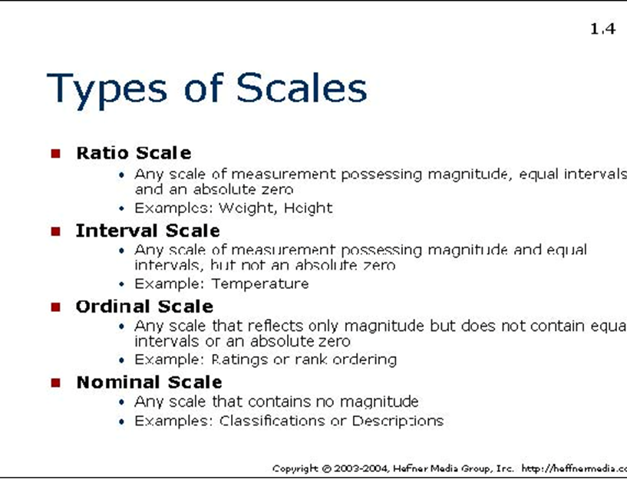
Smith Stevens 1951

Slide 40
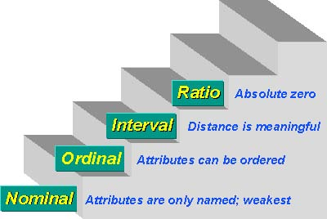
Types of scales

Slide 41
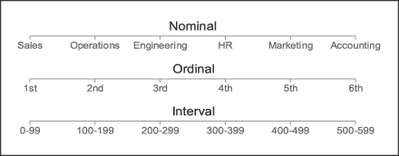
Scale examples

Slide 42
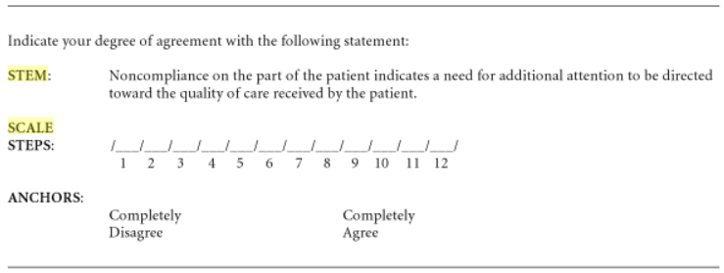
Common measurement approaches:
Scales
A measuring tool or method composed of
  A stem
  A series of scale steps
  Anchors that define the scale steps
Example:

Slide 43
Scaling approaches
Subject-centered
Stimulus-centered (e.g., quality of service offered by different clinical departments)
Response-centered (e.g., to assess the relative standings of individuals)
Types of scaling approaches:
    Thurstone scaling
      Summated ratings scales
        Likert scaling (1932) to measure opinions, beliefs and attitudes
      Semantic differential scales
    Guttman scaling
Notes:
Thurstone scaling: judges place a large pool of items into piles corresponding with equally spaced intervals of construct magnitude or strength. Subject’s choice indicates how much of the attribute the respondent possesses. Because of the equal intervals across items, scores from such scales are amenable to mathematical procedures based on interval scaling.
Guttman scaling: a series of items tapping progressively higher levels of attribute. Respondents have to endorse all preceding items before the amount of the attribute that the items tap exceeds that possessed by the subject.

Slide 44
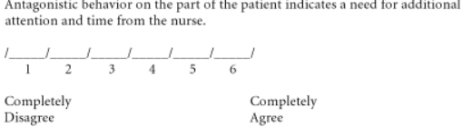
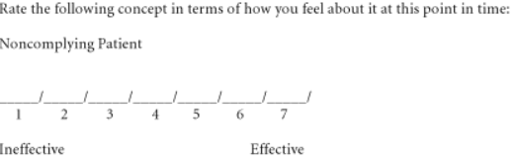
Scale variations
Summated rating scale – scores for all scales in a set are summed or averaged to place an individual somewhere on a continuum of the attitude in question - Rensis Likert (1932)
Semantic differential scale – a specific concept is rated on a scale with bipolar adjectives anchoring the scale
Subject-centered
a scale must contain multiple items
measure something that has a quantitative measurement continuum
each item has no "right" answer
each item in a scale is a statement
Response-centered
used for measuring the meaning of things and concepts

Slide 45
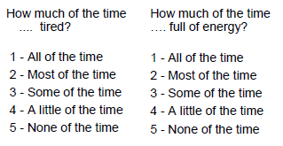
Example of a 2-item Summated
Ratings Scale

Slide 46
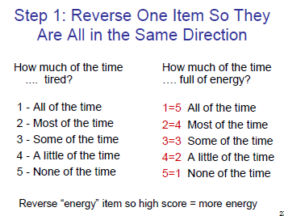
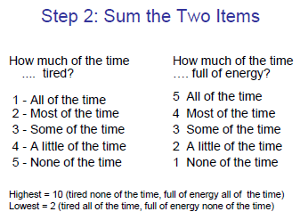
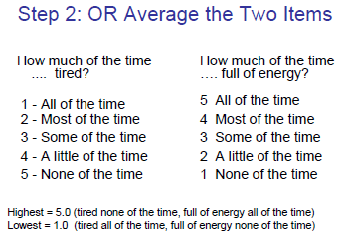
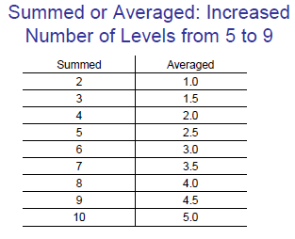

Slide 47
Example for Guttman Scales
Place a check‐mark against all statement’ with which you agree
  􀁹 I like eating out
  􀁹 I like going to restaurants
  􀁹 I like going to themed restaurants
  􀁹 I like going to Chinese restaurants
  􀁹 I like going to Beijing‐style Chinese restaurants
Notes:
Guttman scaling: a series of items tapping progressively higher levels of attribute. Respondents have to endorse all preceding items before the amount of the attribute that the items tap exceeds that possessed by the subject.

Slide 48
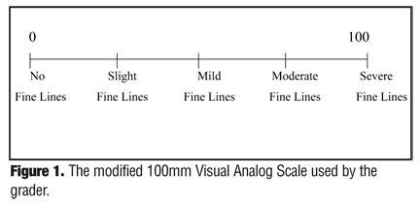
Visual analog scales
To measure intensity, strength, or magnitude of sensations and subjective feelings
Employ a drawn, printed or computer-generated straight line of a specific length, with verbal anchors
Subjects put a mark on the self-report of intensity, perception or sensation

Slide 49
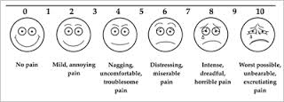
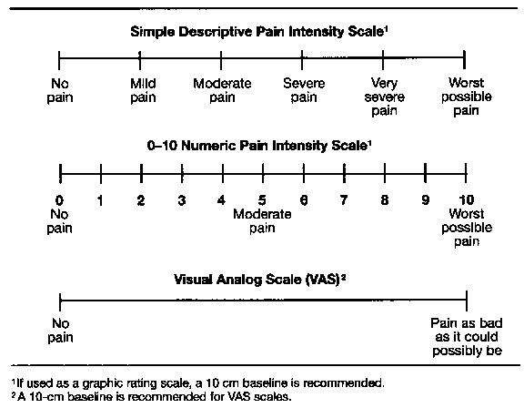
Visual analog scales
Example: Pain scales
Reliability could be assessed by test-retest, but would not be very accurate because phenomena are very dynamic
Validity could be assessed by comparing with other instruments (convergent validity)

Slide 50

Magnitude estimation scaling
Subjects rate the magnitude of a stimulus relative to one of standard strength
Not easy to use and requires abstract and complex thinking
Reliability assessed by test-retest
Validity is assessed by comparing MES with direct physical measurements of stimuli

Slide 51
Single items have more disadvantages than advantages
Advantages
  􀁹 Response choices are interpretable
Disadvantages
  􀁹 Numbers not easily interpretable
  􀁹 Limited variability
  􀁹 Easy to get skewed distributions
  􀁹 Reliability is usually low
  􀁹 Difficult to assess a complex concept

Slide 52
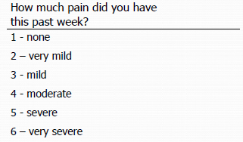
Although Responses of Single Items are Interpretable…

Slide 53
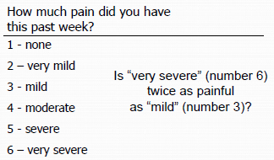
… the Numbers Are Not Easily
Interpretable

Slide 54
Multi‐Item Scales/Measures
Multi‐item scales are created by combining two or more items into an overall measure or scale score
Advantages of Multi‐item Scales Over Single Items:
  More scale values (enhances sensitivity)
  Improves distribution (more normal)
  Reduces number of variables needed to measure a concept
  Improves reliability (reduces random error)
  Can estimate score if some items missing
  Enriches concept (more valid)

Slide 55
Review statistical underpinnings of scale measurement

Slide 56
Statistical underpinnings of scale measurement
Distribution of scores could be described by:
  Shape
    Normal, symmetrical vs. asymmetrical, skewness and kurtosis
  Measures of central tendency
    Mean, median and mode
  Dispersion
    Amount of spread or scatter among the scores
    Measured by 3 indices: range, variance, & standard deviation
    Correlations summarize the relationship between scores within two separate distributions
Notes:
Frequency Distribution
How frequently various scores on a measure occur
The way in which they are spread out across the sample
Whether a symmetrical distribution – both halves are identical in shape

Slide 57
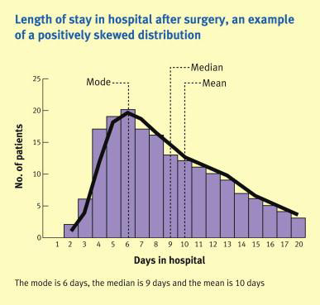
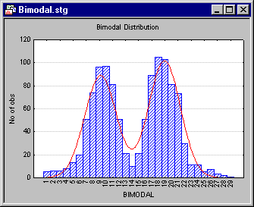
Examples:

Slide 58
Statistical underpinnings of scale measurement
Measures of Correlation
  Linear relationship of two sets of scores (e.g. 2 alternate sets of a scale)
  Most common is Pearson product-moment correlation coefficient (for normally distributed interval data)
  Also Spearman rho (variables are not assumed to be normally distributed and interval (but are assumed to be ordinal)), point biserial (for nominal and ordinal data)
  Lies between -1.00 and +1.00
  What does this range say about the correlation between 2 scores?

Slide 59
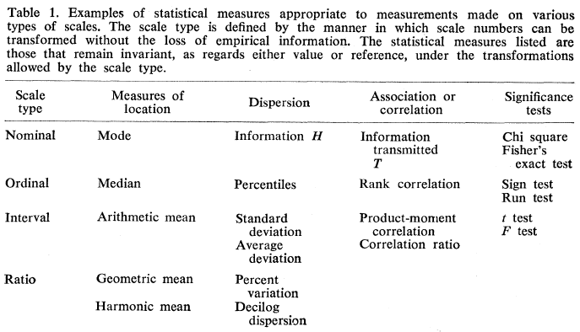
Relationship between Measurement and Statistics
Stevens 1968

Slide 60
Summary
“Measurement is a fundamental activity of science.” DeVellis
Classical test theory (CTT)
  has been widely used in the development, characterization, and sometimes selection of outcome measures in health research.
  qualities of outcomes, whether administered by clinicians or representing patient reports, are often describe in terms of “validity” and “reliability.”
  CTT focuses on total test score – classical test theoretic constructs operate on the summary (sum of responses, average response) of items, individual items are not considered.
Generalizability theory acknowledges the multiple sources of measurement error by deriving estimates of each source separately.
Scales are measurement instruments for unobservable phenomena.
Because of the equal intervals across items, scores from interval and ratio scales are amenable to mathematical procedures based on interval scaling.

