Slide 1
Demography and Demographic Methods for Public Health
Nadia Diamond-Smith, PhD, MSc
Assistant Professor
Institute for Global Health
Department of Epidemiology and Biostatistics,
UCSF

Slide 2
Introductions
A little about you (some demographics)
Area of focus
Area of interest within demography

Slide 3
Outline of Today’s Lecture
  Course information
  What is demography?
    Why is understanding demographic methods useful for epidemiologists/public health experts?
  Demographic theory and population growth
  Population pyramids!

Slide 4
Welcome: Class info
10 week course
Mondays 10:30am-12
No pre-requisites, assumed basic math skills, use of excel, knowledge of fundamentals of public health
Letter grade or pass/fail

Slide 5
General format
Short presentations about homework from the week before (~15 mins)
Lecture on topic of the week (me or guest lecturer) (~45 mins)
Discussion of reading (~30 mins)
  ~2-3 readings are listed in the syllabus to be read before each class.
  Everyone should post 2-3 questions about the reading by 5pm the night before class (Sunday evening) on the website
    These questions will be used to direct the discussion

Slide 6
Labs
5 labs
Everyone choose 2 countries that you will use for the 5 labs
Data on website
Labs are due by 5pm the night before class on the website
Each class will start with everyone briefly sharing their lab graphs
  Point out 1-2 interesting findings or comparisons between your countries

Slide 7
Final Project
Apply one of the methods learned in class to an existing data set to explore a question of interest to you
Potential types of projects:
Use life tables to look at people’s probability of migrating from Mexico to the US by age group, and expected number of years someone of each age group will spend living in Mexico or the US
Explore changes over time in total fertility rate and cohort childlessness by age group in a country of choice using Human Fertility Database Data
Project changes in population size of sub-groups in a population (for example, ethnic groups or women with asthma in the US) under different assumptions about future changes in fertility, mortality and migration
Use Demographic and Health Survey Data to explore if there is an urban penalty or advantage for child health outcomes in a country of choice

Slide 8
Final projects
Due: Friday Dec 7 via email to Nadia
8-10 pages, double spaced, mostly focus on methods, data analysis and findings
  Short background/intro, at least 5 references
Dec 3: 10 min powerpoint presentations of final project
Nov 19: Send Nadia a few sentence description of your project and the data you will use
  Have gotten access to that data source

Slide 9
Grading
Completion of each lab/homework (5% each x 5=25%)
Reading questions (25%)
A final paper (8-10 pages) (35%)
Presentation of the findings from labs and final project (15%)

Slide 10
Topics covered in the course
Intro to demography and theory, Population Growth (today)
Fertility, the impact of contraception and abortion on Population (Diana Greene Foster, UCSF)
Mortality
Data sources, quality of data and indirect methods; Aging
Disability and work: Guest lecturer Amal Harrati, Stanford University
Race and Health: Guest lecturer Robert Pickett (UC Berkeley)
Residential Segregation: Guest lecturer Joan Casey, UC Berkeley;
Migration and Urbanization
Gender and health (sex ratios), Family Demography
Final class is presentations

Slide 11
Outline of Today’s Lecture
  Course information
  What is demography?
    Why is understanding demographic methods useful for epidemiologists/public health experts?
  Demographic theory and population growth
  Population pyramids!

Slide 12
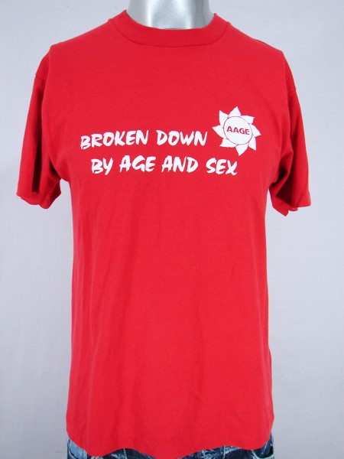
What is Demography?
  “Demography is the scientific study of human populations, primarily with respect to their size, their structure and their development”
  Demography =
  demos = people
  +
  graphos = study

Slide 13
“Principle in the study of mortality, then and now (Caldwell, 2001)”: applied to all of demography
Based on hard data: “The work depended on data having come into existence at the whim of others, usually governments, often for other purposes, […] less true today”
Attention to data quality: “Much of the labor was spent, not on making immediate deductions from the numbers, but on suspiciously testing the data and trying to improve them”
Awareness of potential biases: “Demographers were deeply sensitive to the fact that crude numbers of measures may be misleading […] and they were given to devising measures that overcame the distortions to allow valid comparisons”

Slide 14
Principle in the study of mortality, then a now (Caldwell, 2001): applied to all of demography (continued)
Concentration on large populations: “There was a concept of a population, a large body of people constituting some kind of definable unit to which the measurements pertain”
Searching for patterns: “Demographers look for regularities in populations or subpopulations and for contrasts between subpopulations: Graunt showed urban-rural differentials in mortality, as well as male-female differentials in both numbers born and subsequent mortality”
Early interest in causation: “From the beginning there was an interest in causation (Graunt examined the causes of death), but there was, at the same time, a suspicion that measures of causes were more likely to be in error than measures of population or death.”

Slide 15
Principle in the study of mortality, then a now (Caldwell, 2001): applied to all of demography (continued)
A mostly empirical discipline: “Most demographers have been happy to carry out analysis within a minimalist theoretical framework and have been deeply suspicious of disciplines that built theoretical structures upon unproven, theoretical bases. They have preferred intermediate or short-range theory to grand theory”
Less true now, and not true of Malthus

Slide 16
Why is demography important for health?
“The everyday activities of all human being, communities, and countries are interrelated with population change, patterns and levels of use of natural resources, the state of the environment, and the pace and quality of economic and social development”
  -Programme of Action of the UN International Conference on Population and Development, Cairo, 1994
  Demographic situation Health care supply and demand

Slide 17
Differences between Demography and Epidemiology (Wallace, 2001)
Epidemiology
Demography
Historically more clinical: medicine, basic science, pathology
Somewhat less global and comprehensive
More appropriate for clinical, individual and programmatic decision making
Uses randomized experiments, tests interventions
Common Areas: Sociology, Economics, psychology
More global and comprehensive, but topically narrower
More appropriate for population policy
Relies on natural experiments, large datasets (censuses, etc.)

Slide 18
Commonalities between demography and epidemiology
Quantitative
Appreciation of role of human behavior and social institutions
  Both often consider differences in health or health related factors based on wealth, SES, urban/rural, race/ethnicity, gender, vulnerable sub-groups, etc.
Look at relationship between vital events and health and disease
Concerned with prediction

Slide 19
How Demography is used in Public Health
Comparing the health of one population with that of another
Monitoring changes in the health of a given population
Identifying and quantifying the health inequalities within populations (e.g. across social groups and geography)
Provide projections that inform priorities for health service delivery and planning
Inform debates on priorities for research and development
Analyzing the benefits of health interventions for use in cost-effectiveness analyses

Slide 20
Outline of Today’s Lecture
  Course information
  What is demography?
    Why is understanding demographic methods useful for epidemiologists/public health experts?
  Demographic theory and population growth
  Population pyramids!

Slide 21
Origins of modern demography
First death records in renaissance Italy
Establishment of parish registers in the 16th c. that became common in the 17th c. in Western countries
  Motivated early work on mortality
British Royal Society founded in 1660 with two fathers of demography
  John Graunt
  William Petty

Slide 22
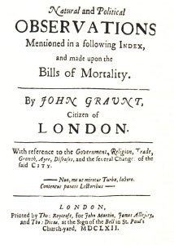

John Graunt (1620-1674)
  Natural and Political Observations Made upon the Bills of Mortality (1662)
  Laid the foundation for human statistical and census methods
  Developed first life tables
  Also a father of epidemiology

Slide 23
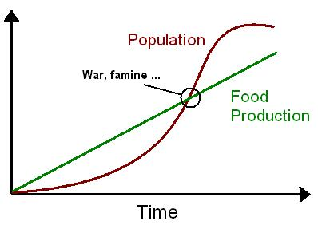
Demographic Theory
Thomas Robert Malthus
An Essay on the Principle of Population (1798)
  Population will grow geometrically
  Food production will grow arithmetically
  Famine and starvation
  UNLESS births are controlled!
    Delayed marriage

Slide 24
Malthus was very influential
Malthus’ work was well known in his time and later
Played a major role in Darwin’s development of the theory of evolution
Influenced David Ricardo in his Law of Diminishing Return
At the basis of the international family planning efforts of the 1960s, 1970s, and 1980s

Slide 25
Demographic Transition Theory
First proposed by Warren Thompson 1929
Formal theory proposed by Frank Notestein in 1940s and 50s
5 stages
  1. High births and death (Pre-industrial)
  2. Mortality drop, births high (most developing countries today)
  3. Fertility falls
  4. Low births and low deaths
  5. Below replacement level fertility

Slide 26
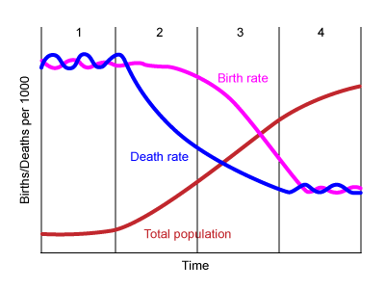
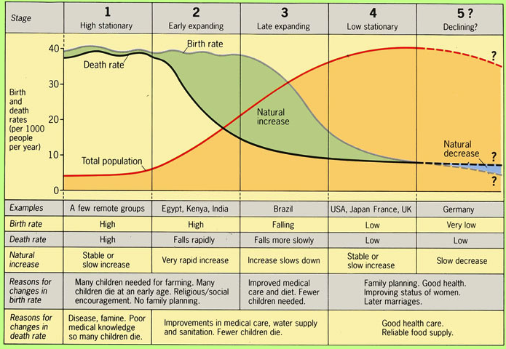
Demographic Transition Theory

Slide 27
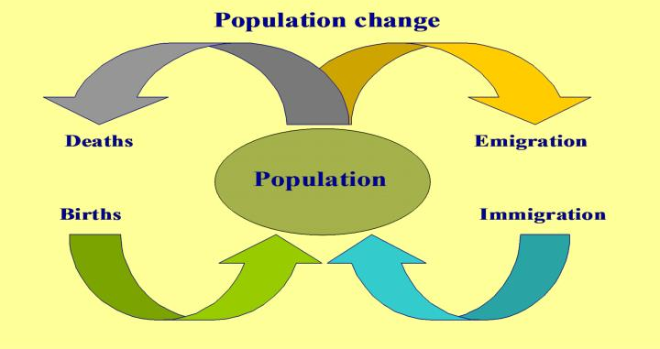
Population Growth: balancing equation
Demographic Balancing Equation
P=population
t=time
B=births
D=deaths
I=in migration
O=out
migration

Slide 28
Exponential population growth
r=rate of growth
t=time
P= population at each time period, P(0) is your starting population, and p(t) is your population at t years later

Slide 29
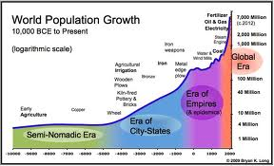
Historical Population Growth
Until about 1000 B=D
Then food supply, trade, etc. increased and B>D, slowly at first, then rapidly

Slide 30
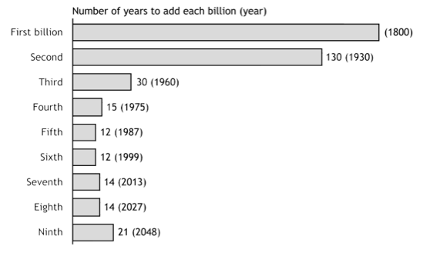
Number of years to add each billion
First and second billion: Population Reference Bureau; Third through ninth billion: United Nations.
(2005). World population prospects: the 2004 revision (medium scenario).

Slide 31
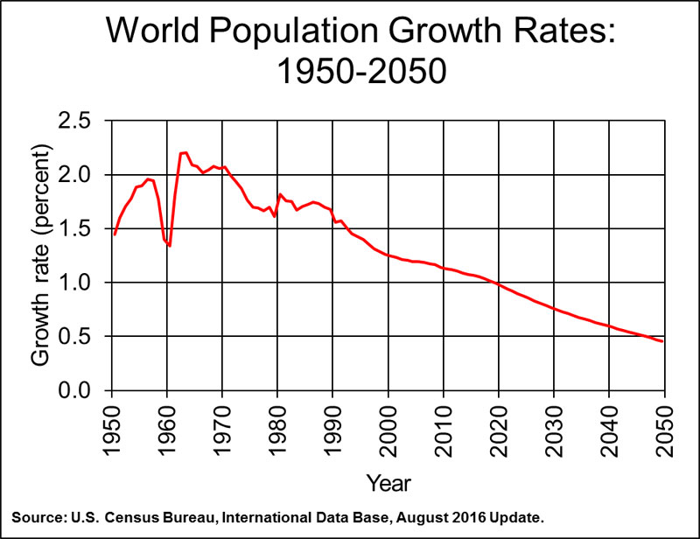

Slide 32
Outline of Today’s Lecture
  Course information
  What is demography?
    Why is understanding demographic methods useful for epidemiologists/public health experts?
  Demographic theory and population growth
  Population pyramids!

Slide 33
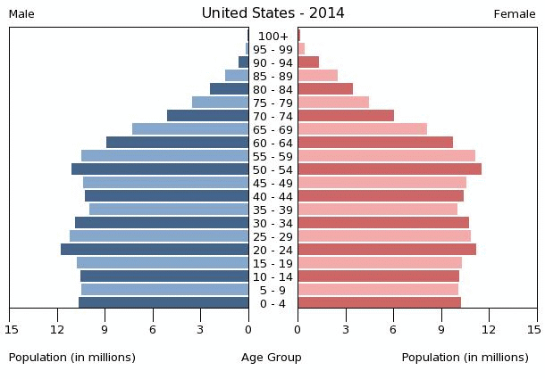
Population Pyramid: USA

Slide 34
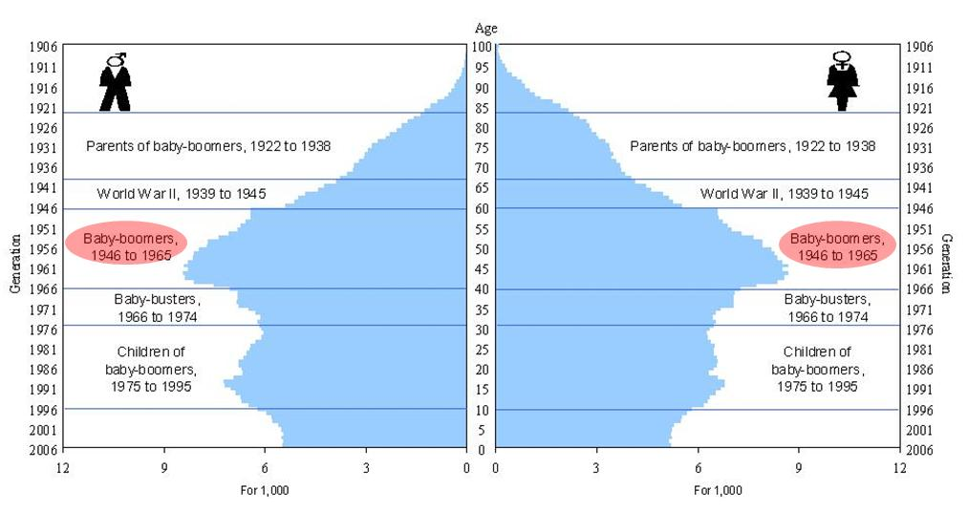
History in Pop Pyramids: US

Slide 35
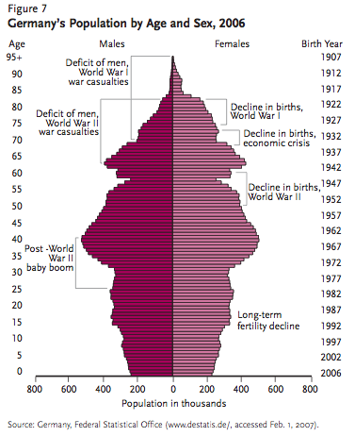
Notes:
Famine: 1866-68
15 months between two wars (1939-40 was the first one) between finland and soviet union.

Slide 36
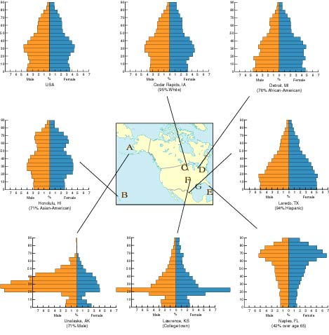
Guess the state
Alaska
Florida
Notes:
Lower right: florida
Middle bottom: kansas
Lower left: alaska
Middle right: texas
Top middle: iown
Left middle: hawaii

Slide 37
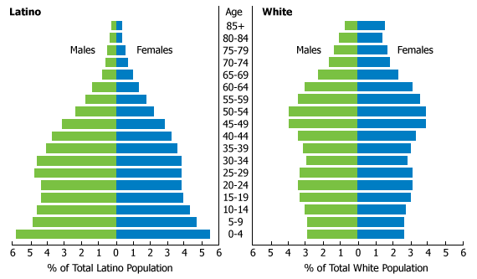
Difference by ethnic group: US

Slide 38
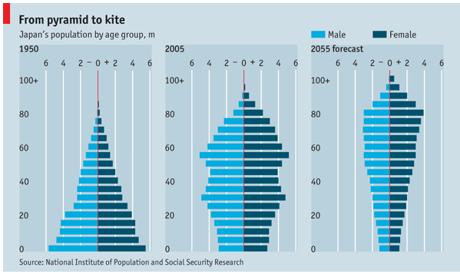
Change over time: Japan

Slide 39
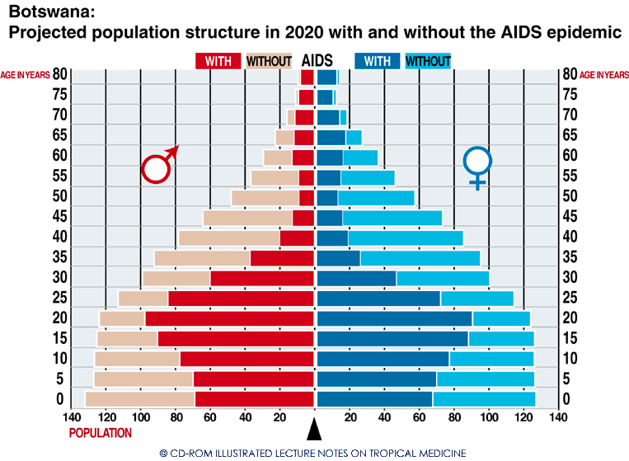
Botswana

Slide 40
Choose some countries!
For many lab assignments throughout the term, we will use data from 2 of the same countries to look at different demographic trends
Please choose two countries, on different continents, to use for the remainder of the course
Kristen: Australia, Ireland
Kristina: US, India
Andrew: China, Rwanda
Andrea: Mexico, Nigeria
Adrianne: Russia, Guinea
Nafeesa: Bangladesh, UAE
Teresa: Tanzania, South Africa
Ashley: Guatemala, England

Slide 41
Tips on graphs
Always label your axes
  Units, what it is
Always have a title that makes it clear without reading anything else what you are showing
If comparing two graphs, make sure the axes have the scale
Have a key
Think carefully about when a line graph vs bar graph might be useful
Use excel to do your graphs, always turn in the excel sheet. Can either paste the graphs into word and answer the questions there, or answer in excel.

Slide 42
Common Sources of Demographic Data
Vital Registration/Statistics
Population Registers (provides info about life events and population at risk)
Census
Sample Surveys
Record linkage
Other sources of demographic data
  Administrative Data: Medical claims, Hospital
  Qualitative sources
  Geographic Information Systems (GIS)
  Historical sources

Slide 43
Vital Registration Systems
Data:
  Mortality
  Fertility
  Nuptuality (marriage/divorce)
  Migration
US Vital registration/statistics:
  Death registration since 1900s (not for black population until 1968)
  Births since 1915
  1933: National Vital Statistics System started
Problems:
  Changes in cause of death classification over time
  Missing Populations
  Incomplete in many countries

Slide 44
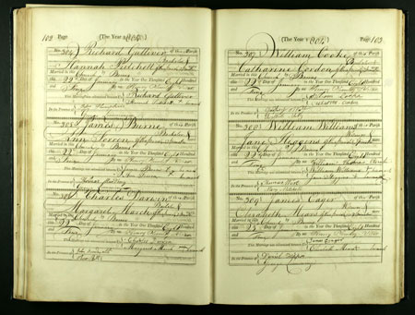
British Vital Registration:
Originally collected in church/parishes in Europe, then governments took over

Slide 45
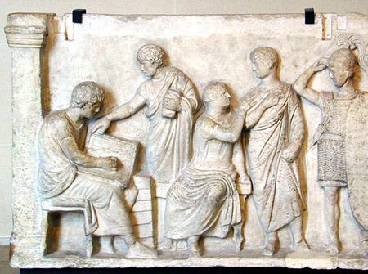
Censuses
Full count of a population at a certain point in time
  Age
  Sex
  Geographic locator
  Some have data on recent mortality
Pros: full country, most countries have them
  >90% of world population covered by census
  Cons: Only available at intervals, often 10 years

Slide 46
  Censuses: Types of errors
Sampling
Non-sampling
  Coverage
    Under enumeration; prone to missing data
      Recent births, migrants, homeless, hard to reach, minorities
      Ways to estimate using inter-censual projections
    Over enumeration: Kashmir and Jammu
  Content error:
    Prone to age-heaping
      Can use indirect estimation techniques to adjust for these
    Income notoriously hard to collet data on

Slide 47
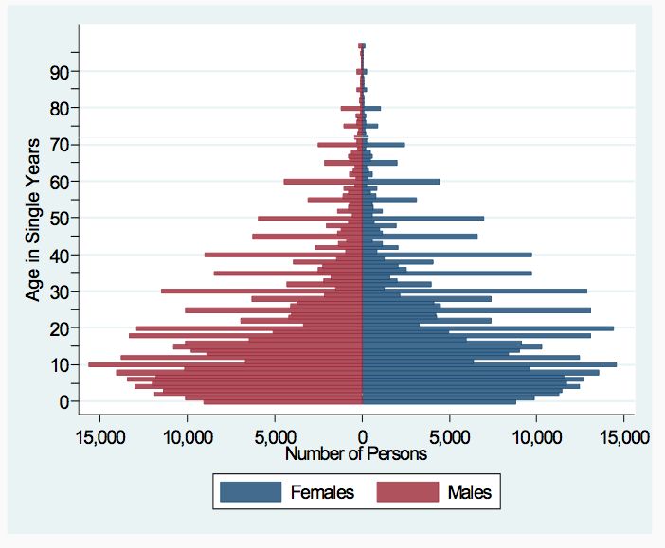
Ethiopia Census: 2007
Age attraction
Under reporting of children?

Slide 48
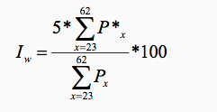

Detection and quantification of age attraction
Whipple’s Index (I_{w}):
Where Px is the population aged x, and P*x is the population of an age x ending in “0” or “5”

Slide 49

Other methods
Compare age ratios
  Ages in one 5 year group should be fairly similar (or smoothly related to) the ones before and after
Compare sex ratios
  Only works for some countries
UN: Age-sex accuracy index
Intercensal cohort comparisons

Slide 50
Sample Surveys
Used to validate vital statistics or Censuses, or provide information in inter-censual periods
Most focused on fertility and health
  Demographic and Health Surveys (International)
  Also general household surveys, labor force surveys, etc.
Pros
  Can be more in depth, ask different types of questions
  Can occur more frequently but still not continuous (compared to vital statistics)
Suffers from errors as well
  Sampling errors and biases: DHS and questionnaire length

Slide 51
Thank you!
Questions?
Notes:
Final boiler plate language: 2 versions
Through its singular focus on health, UCSF is leading revolutions in health.
UCSF is driven by the idea that great breakthroughs are achieved when the best research, the best education and the best patient care converge.

