Slide 1
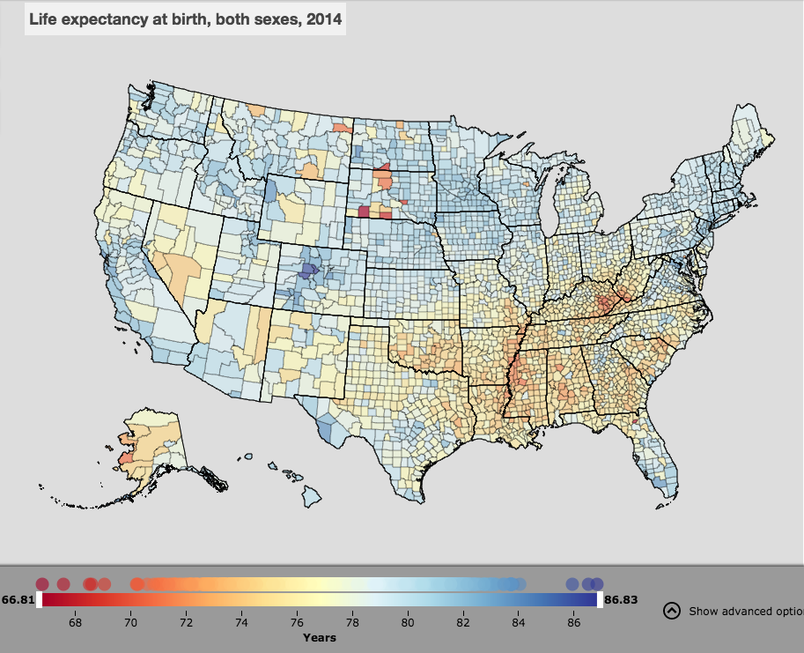
Spatial Epidemiology

Slide 2

Overview
Session | Date
Concepts of spatial epidemiology and R | September 19th
Using R for spatial analysis | September 26th
Spatial variation in risk | October 3rd

Slide 3

Overview
Session | Date
Concepts of spatial epidemiology and R | September 19th
Using R for spatial analysis | September 26th
Spatial variation in risk | October 3rd
Cluster analysis | October 10th
Jenny Smith

Slide 4

Overview
Session | Date
Concepts of spatial epidemiology and R | September 19th
Using R for spatial analysis | September 26th
Spatial variation in risk | October 3rd
Cluster analysis | October 10th
Intro to Remote Sensing | October 17th
Alemayehu Midekisa

Slide 5

Overview
Session | Date
Concepts of spatial epidemiology and R | September 19th
Using R for spatial analysis | September 26th
Spatial variation in risk | October 3rd
Cluster analysis | October 10th
Intro to Remote Sensing | October 17th
Intro to spatial regression analysis | October 24th
Adam Bennett

Slide 6
Overview
Session | Date
Concepts of spatial epidemiology and R | September 19th
Using R for spatial analysis | September 26th
Spatial variation in risk | October 3rd
Cluster analysis | October 10th
Intro to Remote Sensing | October 17th
Intro to spatial regression analysis | October 24th
Off | October 31st
Option A: Oct 31st off, class on Dec 4th
Option B: hold class Oct 29th or 30th, no class Dec 4th

Slide 7
Overview
Session | Date
Concepts of spatial epidemiology and R | September 19th
Using R for spatial analysis | September 26th
Spatial variation in risk | October 3rd
Cluster analysis | October 10th
Intro to Remote Sensing | October 17th
Intro to spatial regression analysis | October 24th
Off | October 31st
Spatial regression analysis (areal data) | November 7th
Adam Bennett

Slide 8
Overview
Session | Date
Concepts of spatial epidemiology and R | September 19th
Using R for spatial analysis | September 26th
Spatial variation in risk | October 3rd
Cluster analysis | October 10th
Intro to Remote Sensing | October 17th
Intro to spatial regression analysis | October 24th
Off | October 31st
Spatial regression analysis (areal data) | November 7th
Spatial regression analysis (point-level data) | November 14th
Ricardo Andrade

Slide 9
Overview
Session | Date
Concepts of spatial epidemiology and R | September 19th
Using R for spatial analysis | September 26th
Spatial variation in risk | October 3rd
Cluster analysis | October 10th
Intro to Remote Sensing | October 17th
Intro to spatial regression analysis | October 24th
Off | October 31st
Spatial regression analysis (areal data) | November 7th
Spatial regression analysis (point-level data) | November 14th
Thanksgiving | November 21st

Slide 10
Overview
Session | Date
Concepts of spatial epidemiology and R | September 19th
Using R for spatial analysis | September 26th
Spatial variation in risk | October 3rd
Cluster analysis | October 10th
Intro to Remote Sensing | October 17th
Intro to spatial regression analysis | October 24th
Off | October 31st
Spatial regression analysis (areal data) | November 7th
Spatial regression analysis (point-level data) | November 14th
Thanksgiving | November 21st
Spatial regression (review +) | November 28th
Ricardo Andrade

Slide 11
Overview
Session | Date
Concepts of spatial epidemiology and R | September 19th
Using R for spatial analysis | September 26th
Spatial variation in risk | October 3rd
Cluster analysis | October 10th
Intro to Remote Sensing | October 17th
Intro to spatial regression analysis | October 24th
Off | October 31st
Spatial regression analysis (areal data) | November 7th
Spatial regression analysis (point-level data) | November 14th
Thanksgiving | November 21st
Spatial regression (review +) | November 28th
Final project presentations | December 4th

Slide 12
Overview (Option A)
Session | Date
Concepts of spatial epidemiology and R | September 19th
Using R for spatial analysis | September 26th
Spatial variation in risk | October 3rd
Cluster analysis | October 10th
Intro to Remote Sensing | October 17th
Intro to spatial regression analysis | October 24th
Off | October 31st
Spatial regression analysis (areal data) | November 7th
Spatial regression analysis (point-level data) | November 14th
Thanksgiving | November 21st
Spatial regression (review +) | November 28th
Final project presentations | December 4th
Option B:
Hold class Oct 29th or 30th
Final project presentations November 28th
No class December 4th

Slide 13
Assessment
Final journal article-esque write up of spatial analyses + short presentation (80%)
Weekly assignments (20%)

Slide 14
Course objectives
Review types of spatial data you may handle
Explore tools/software to visualize, explore and analyze spatial data
Learn techniques available for visualising, exploring and analyzing data

Slide 15
Spatial epidemiology
Spatial epidemiology is the description and analysis of geographic variations in disease with respect to demographic, environmental, behavioral, socioeconomic, genetic, and infectious risk factors.

Slide 16
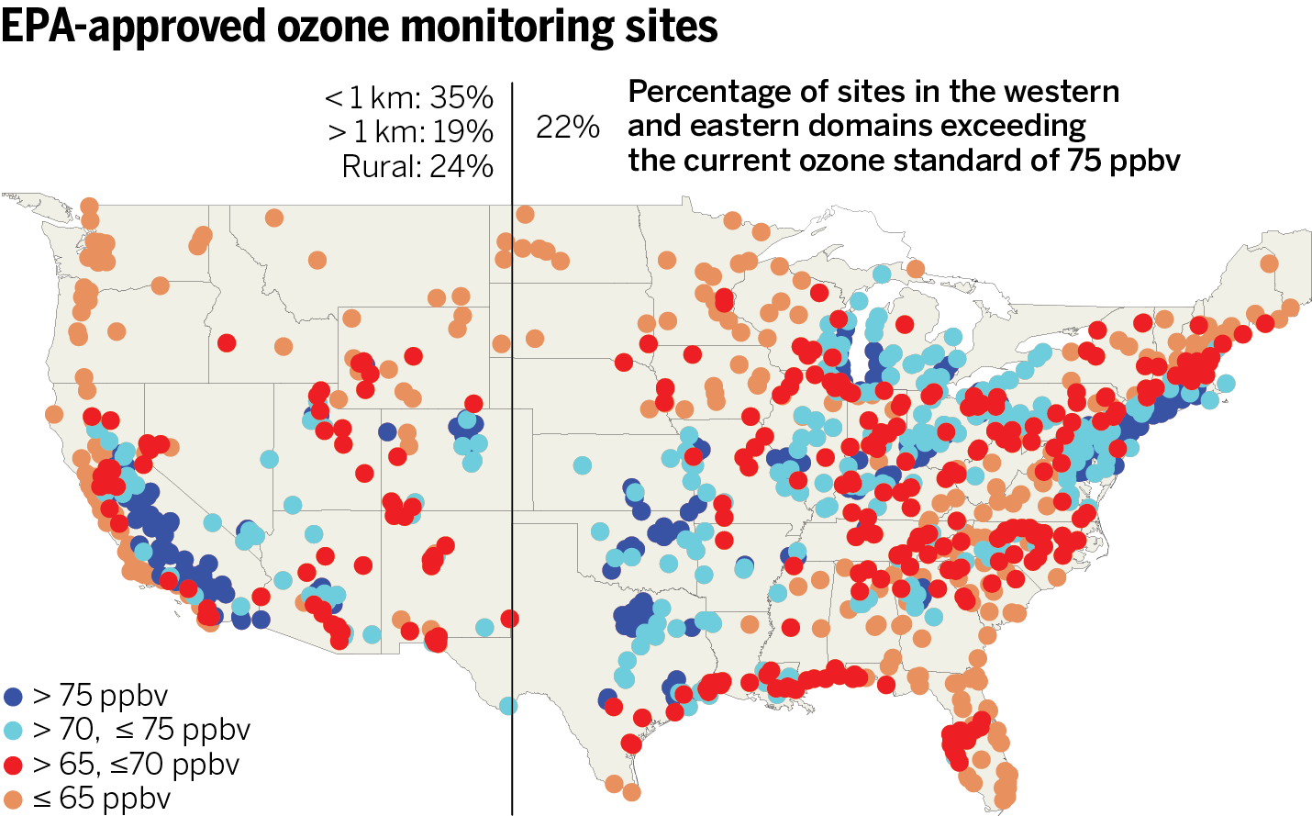
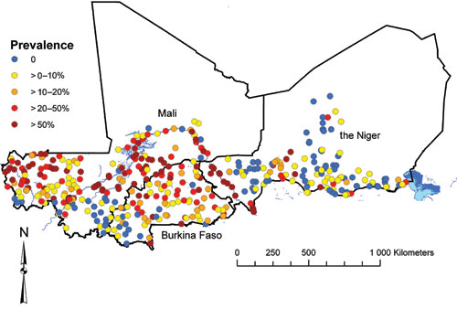
Spatial data types
Point level data
Schistosomiasis in Mali
Clements et al (2009) PLoS Negl Trop Dis 3(5): e431

Slide 17
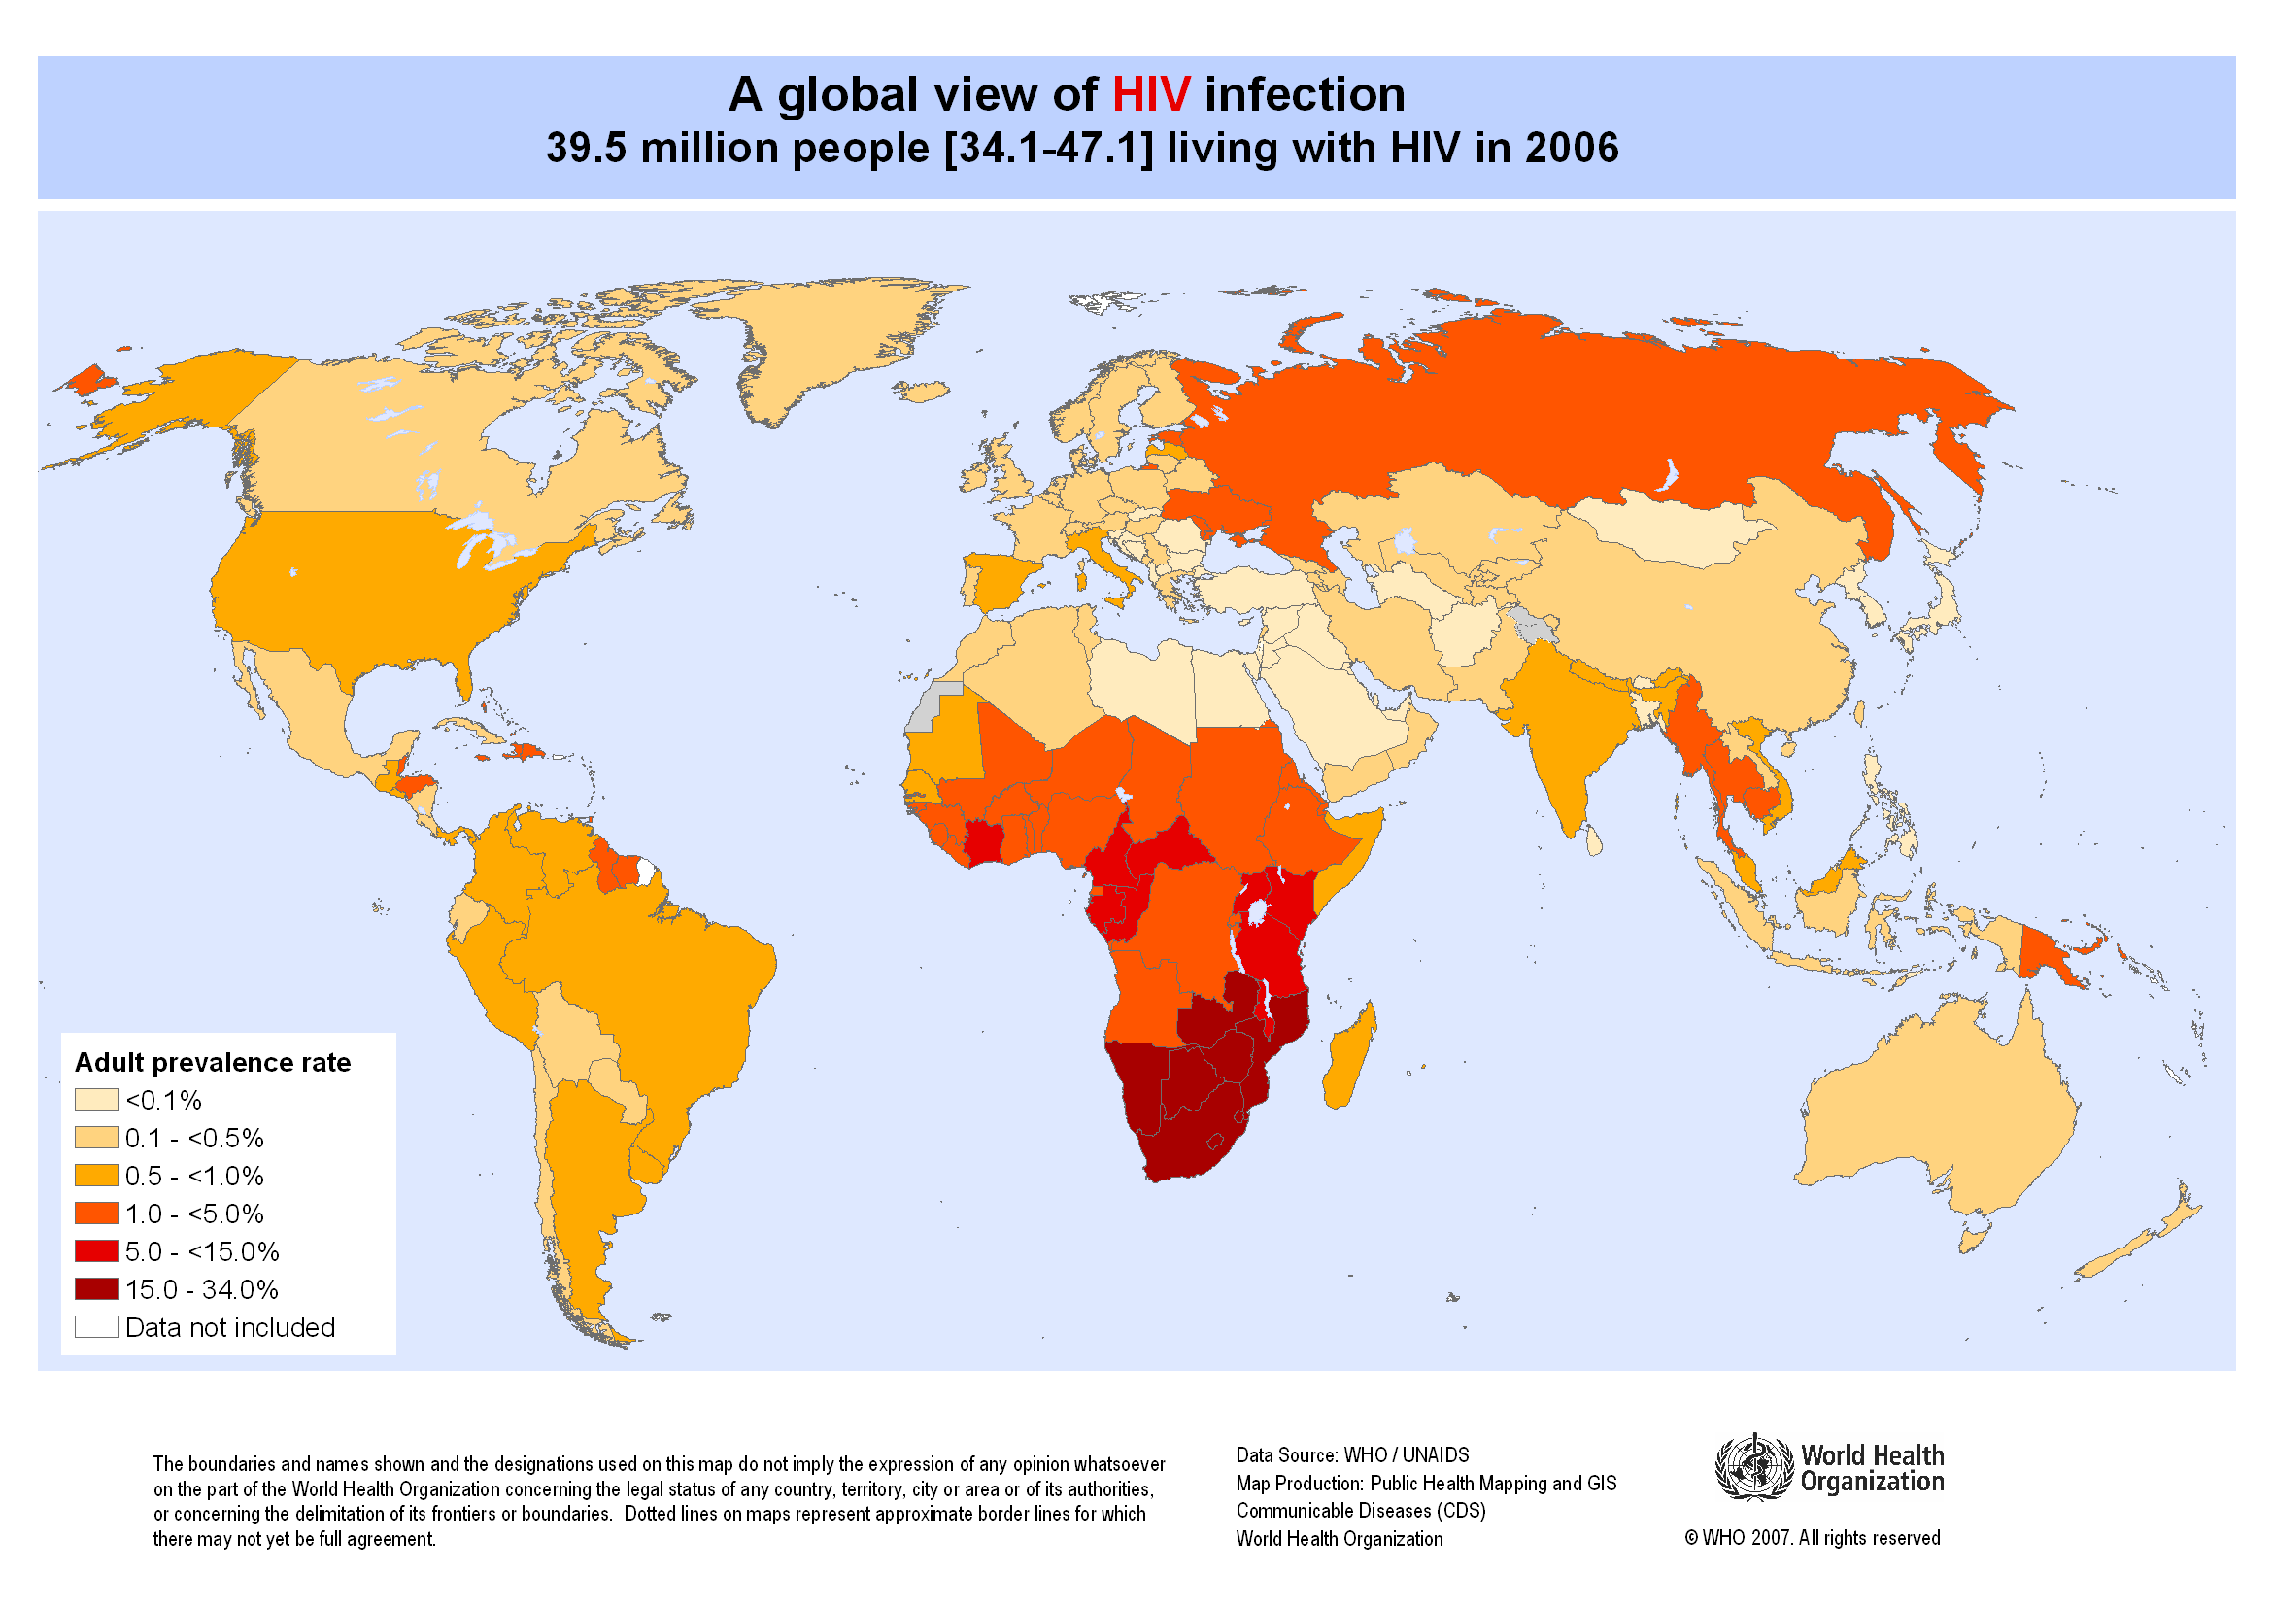
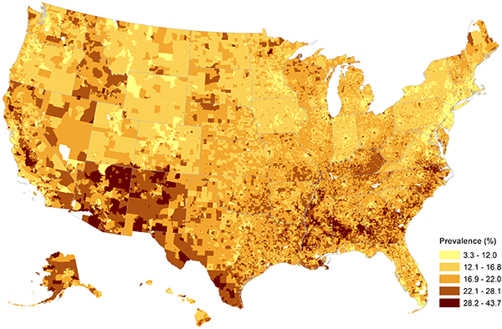
Spatial data types
Aggregate or ‘areal’ data
Childhood Obesity Prevalence at the Census Block-Group Level

Slide 18
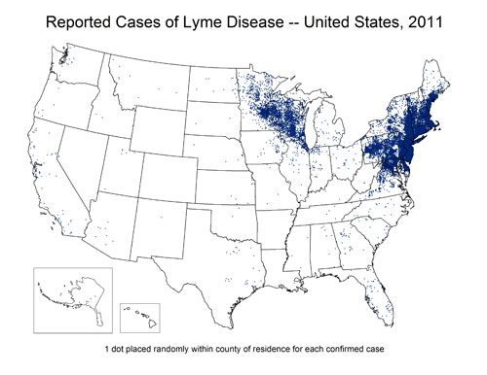
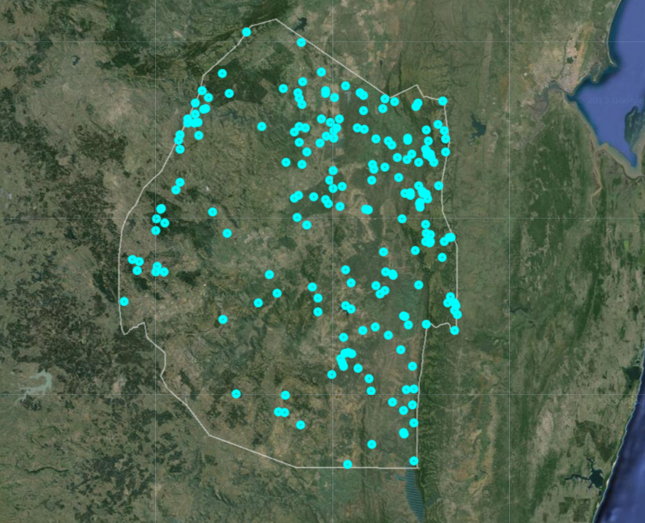
Spatial data types
Point process data
Malaria cases in Swaziland 2012-2014

Slide 19
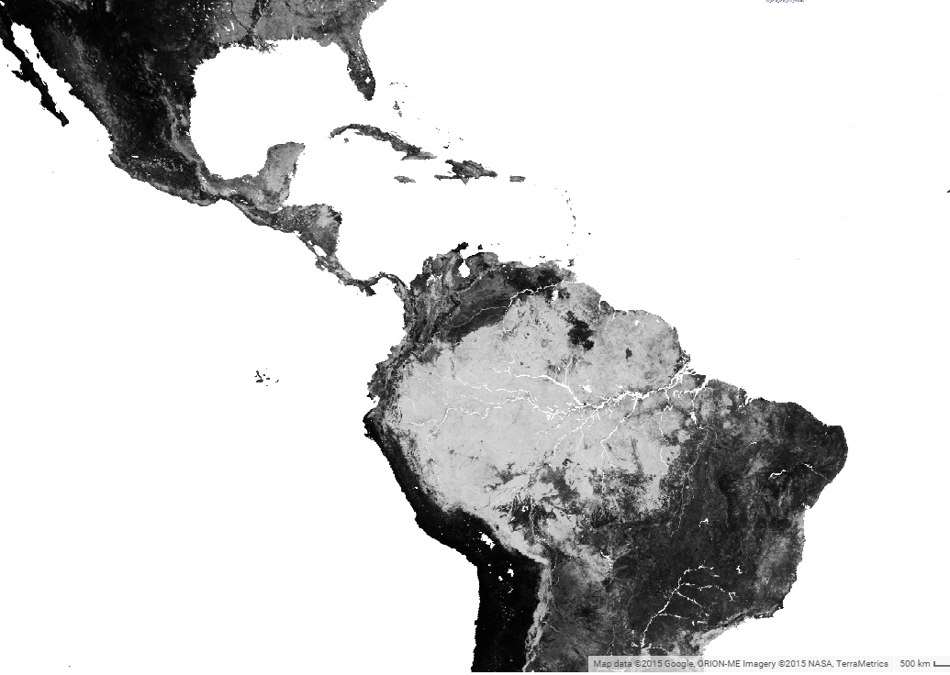
Spatial data types
Raster Data
For example, remotely sensed data – provide complete coverage at the spatial resolution of the sensor
Percentage tree cover

Slide 20
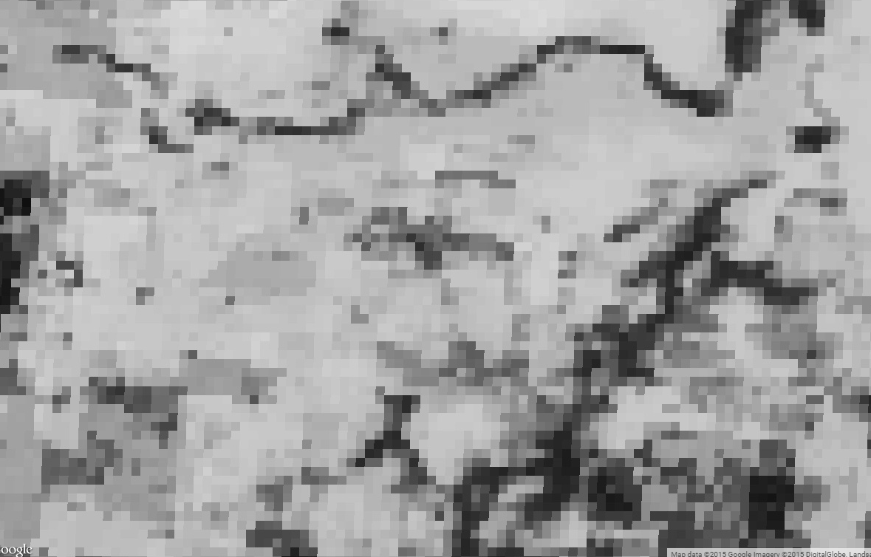
Spatial data types
Raster Data
For example, remotely sensed data – provide complete coverage at the spatial resolution of the sensor

Slide 21
Visualization
Exploration
Analysis

Slide 22
Visualization
Exploration
Analysis

Slide 23
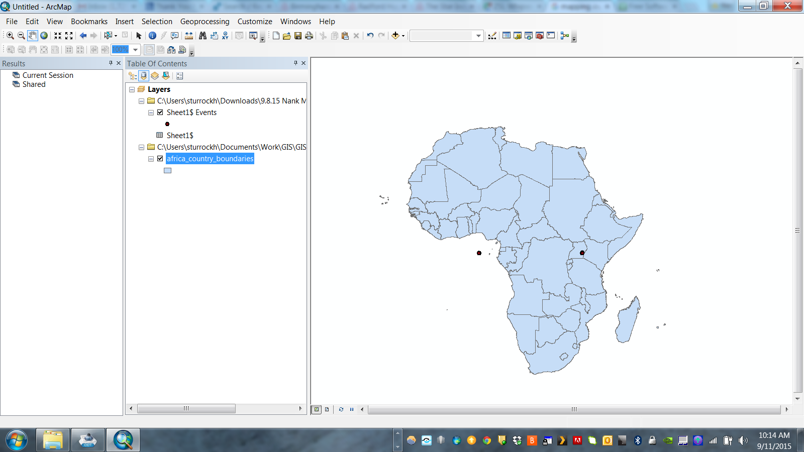
Identify errors/outliers

Slide 24
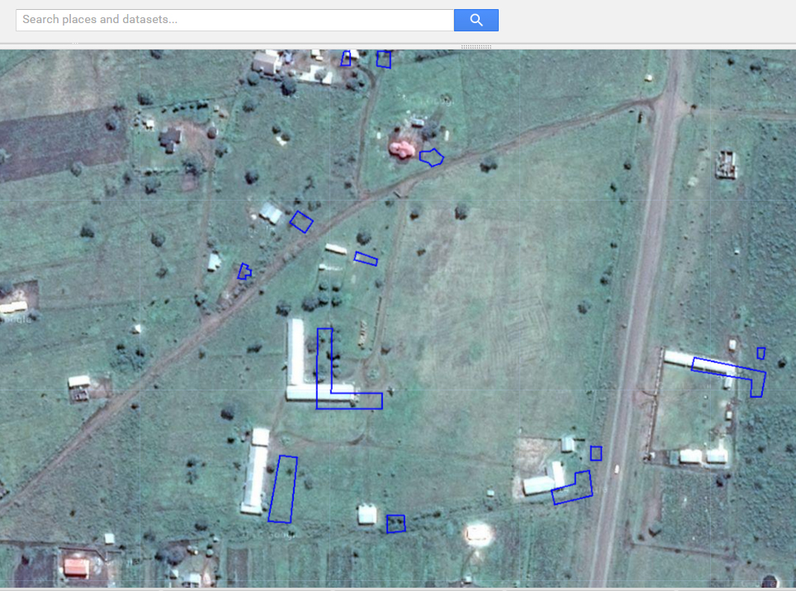
Identify errors/outliers

Slide 25
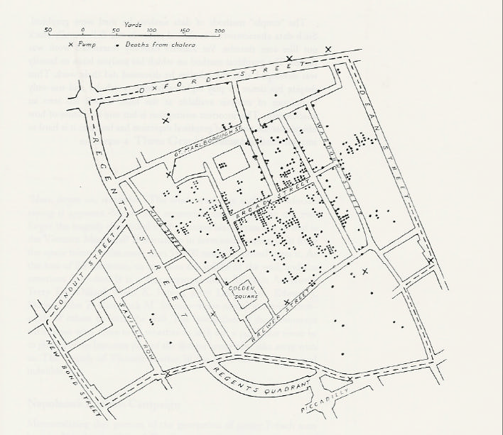
Identify trends

Slide 26
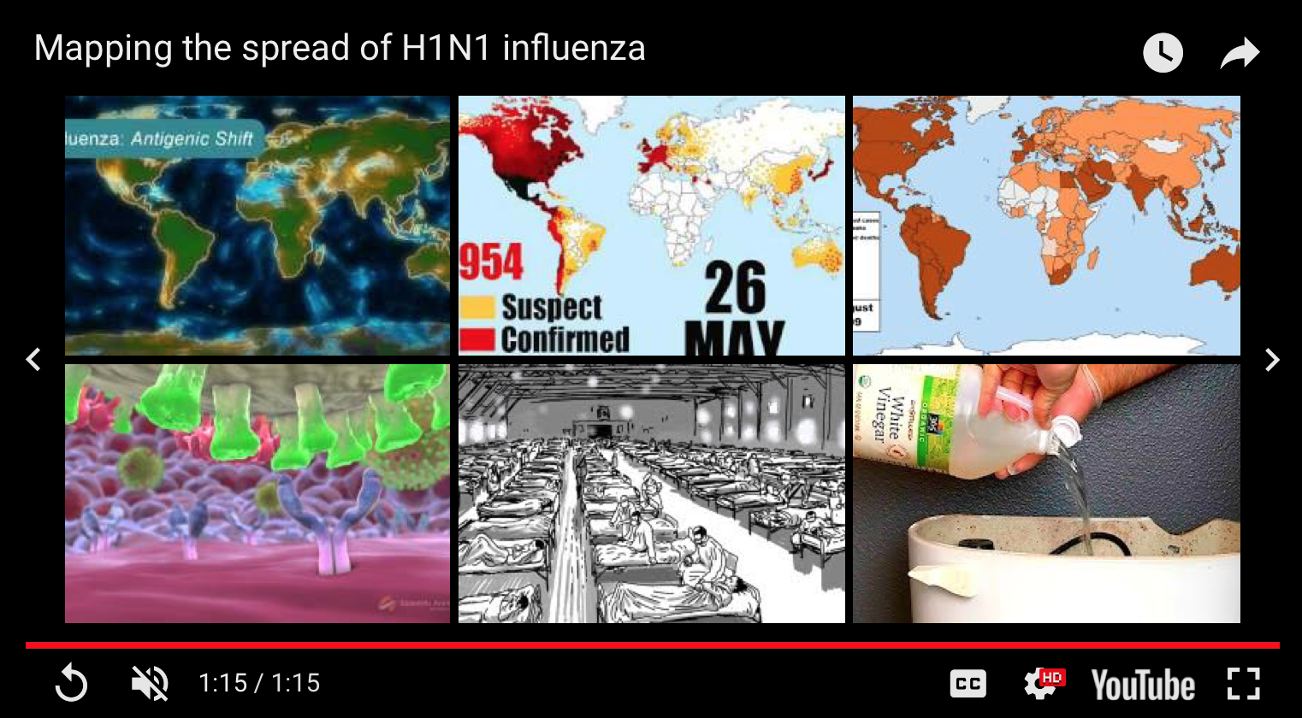
https://www.youtube.com/watch?v=2jOtehF01Kc

Slide 27
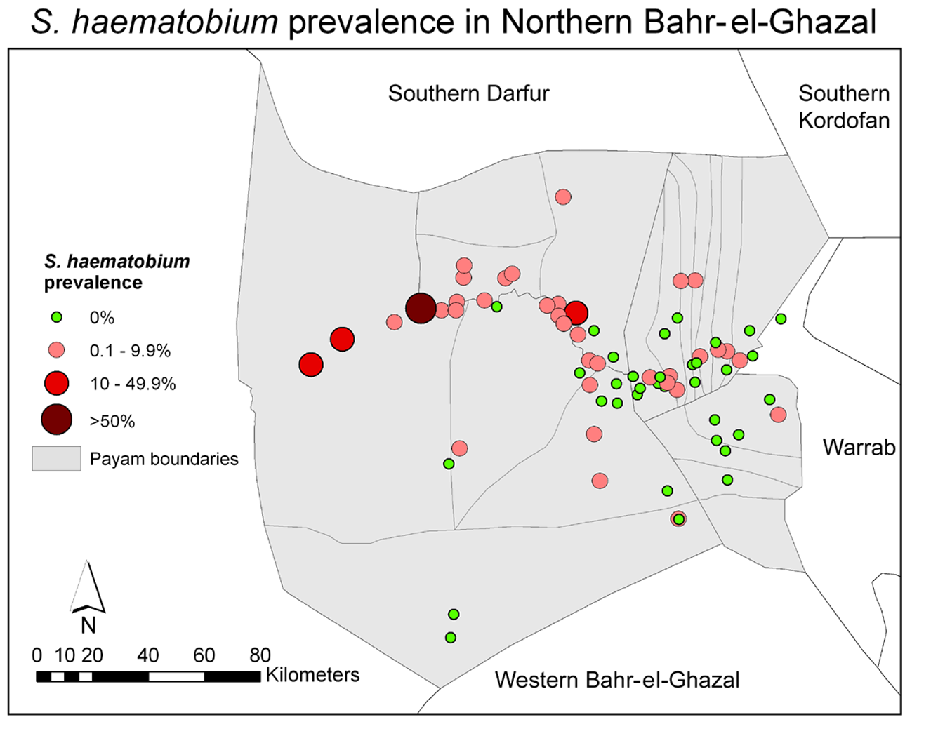
Spatial data-Point data
Sturrock et al (2010) PLoS Negl Trop Dis 3(10)

Slide 28
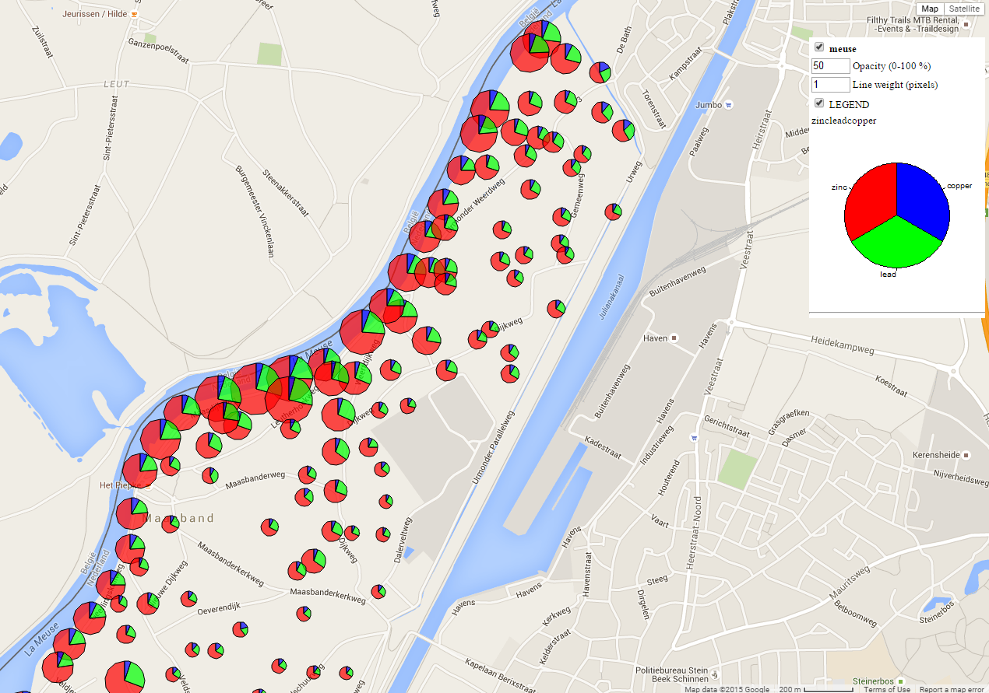
Spatial data-Point data

Slide 29
Spatial data-Areal data
Choropleth maps
Greek: choros (place) + plethos (filled)
These use polygonal enumeration units
e.g. census tract, counties, watersheds, etc. to visualize aggregated data
Data values are generally classified into ranges

Slide 30
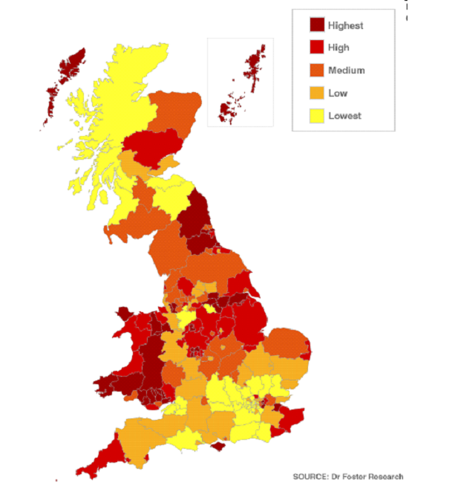
Obesity Prevalence by Primary Care Organisation

Slide 32
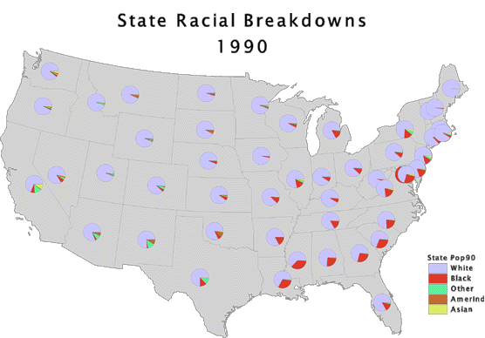

Slide 33
Disadvantages
Assumes mapped data are uniformly distributed in each unit – not usually true!

Slide 34
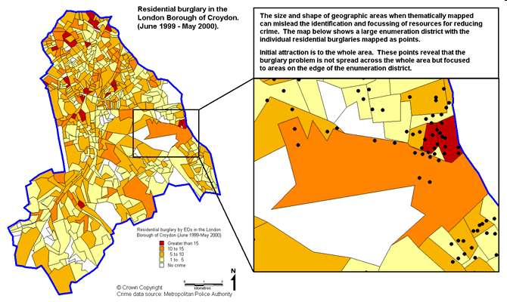
http://www.crimereduction.homeoffice.gov.uk/toolkits/fa020204-map1.htm
Notes:
The map below shows robbery data thematically shaded by enumeration districts across the London Borough of Croydon. A custom range has been used to present the distribution of this crime type. The map serves the purpose of identifying those enumeration districts that are grouped in the highest crime count categories. The map also makes use of natural colours that complement the central message of the map (i.e. where are the hotspots?), and a sensible number of ranges to represent the pattern of this crime across Croydon. When identifying hotspots from this map early attention is drawn to the large enumeration districts that are coloured in the darker orange shading, rather than the EDs of the same colouring but less than a tenth the size. This type of mapping can often mislead identifying and prioritising crime reduction resources to areas that appear as problems, but where the problem is exaggerated from a thematic map of areas of varying size and shapes

Slide 35
Disadvantages
Assumes mapped data are uniformly distributed in each unit – not usually true!
Political boundaries are frequently unrelated to the spatial distribution of the phenomena being mapped

Slide 36
Disadvantages
Assumes mapped data are uniformly distributed in each unit – not usually true!
Political boundaries are frequently unrelated to the spatial distribution of the phenomena being mapped
Large polygons tend to dominate the display

Slide 37
Disadvantages
Assumes mapped data are uniformly distributed in each unit – not usually true!
Political boundaries are frequently unrelated to the spatial distribution of the phenomena being mapped
Large polygons tend to dominate the display
Highly skewed data are difficult to display using a finite number of colour shades

Slide 38
Cartograms
Overcomes problem of physical dominance of large areas
Geometrically transforms the area of each polygon so that it is proportional to the corresponding attribute
Distort area and distance, forsaking spatial detail
See www.worldmapper.org

Slide 39
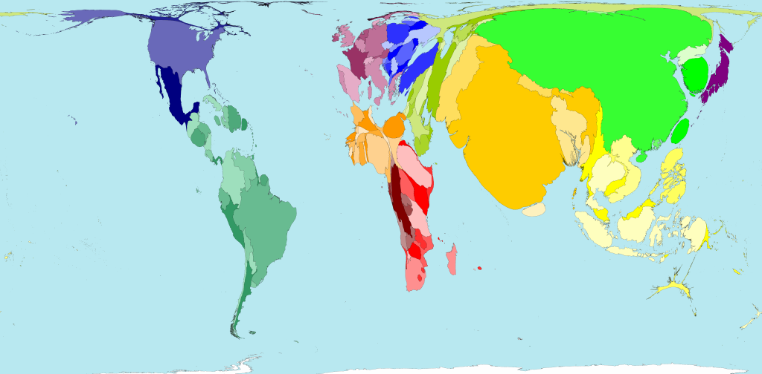
Road traffic accidents
Territory size shows the proportion of all road traffic accident deaths worldwide that occurred there.

Slide 40
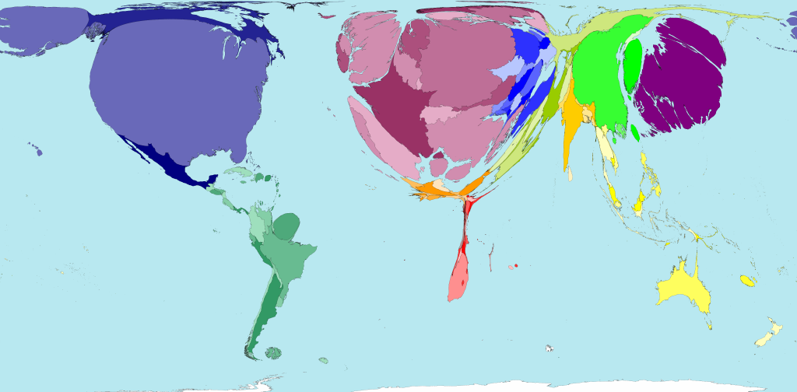
Public health spending
Territory size shows the proportion of worldwide spending on public health services that is spent there. This spending is measured in purchasing power parity.

Slide 41
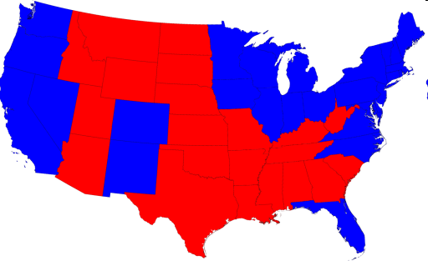
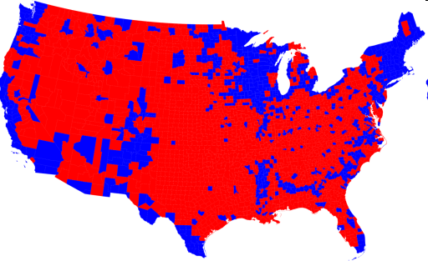
2008 Presidential Elections
Choropleths:
http://www-personal.umich.edu/~mejn/election/2008/

Slide 42
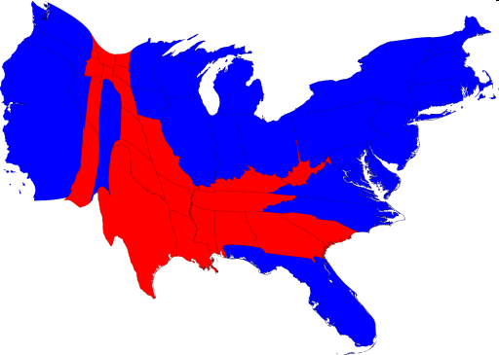
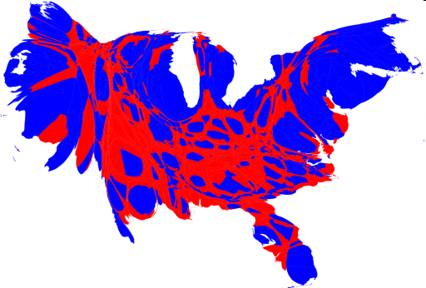
2008 Presidential Elections
Choropleths:
Cartograms:
http://www-personal.umich.edu/~mejn/election/2008/

Slide 43
Modifiable Areal Unit Problem (MAUP)
Observed patterns may be as much a function of the chosen zone boundaries as the underlying spatial distribution
Can cause problems later during analysis via:
Scale Effects
- variation in numerical results that occurs due to level of aggregation used in an analysis
(B) Zone Effects
- variation in numerical results that occurs due to regrouping of data into different configurations at the same scale

Slide 44
Modifiable Areal Unit Problem (MAUP)
10
15
5
5
10
15
6.66
11.66
6.66
Scale effect
5
10
5
x=8.88; n=9
x=8.33; n=3
12.5
7.5
11.25
8
Zone effect
6.66
7.5
x=8.47; n=3
x=9.33; n=3

Slide 45
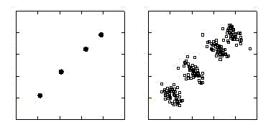
Ecological bias
Describes the difference between estimated associations based on aggregate- and individual-level data
Country
Individual
Outcome
Exposure

Slide 46
Spatial data - raster
For example, remotely sensed data – provide complete coverage at the spatial resolution of the sensor
Percentage tree cover

Slide 47
Spatial data - raster
For example, remotely sensed data – provide complete coverage at the spatial resolution of the sensor

Slide 48
Exploratory spatial data analysis
Visualization
Exploration
Analysis

Slide 49
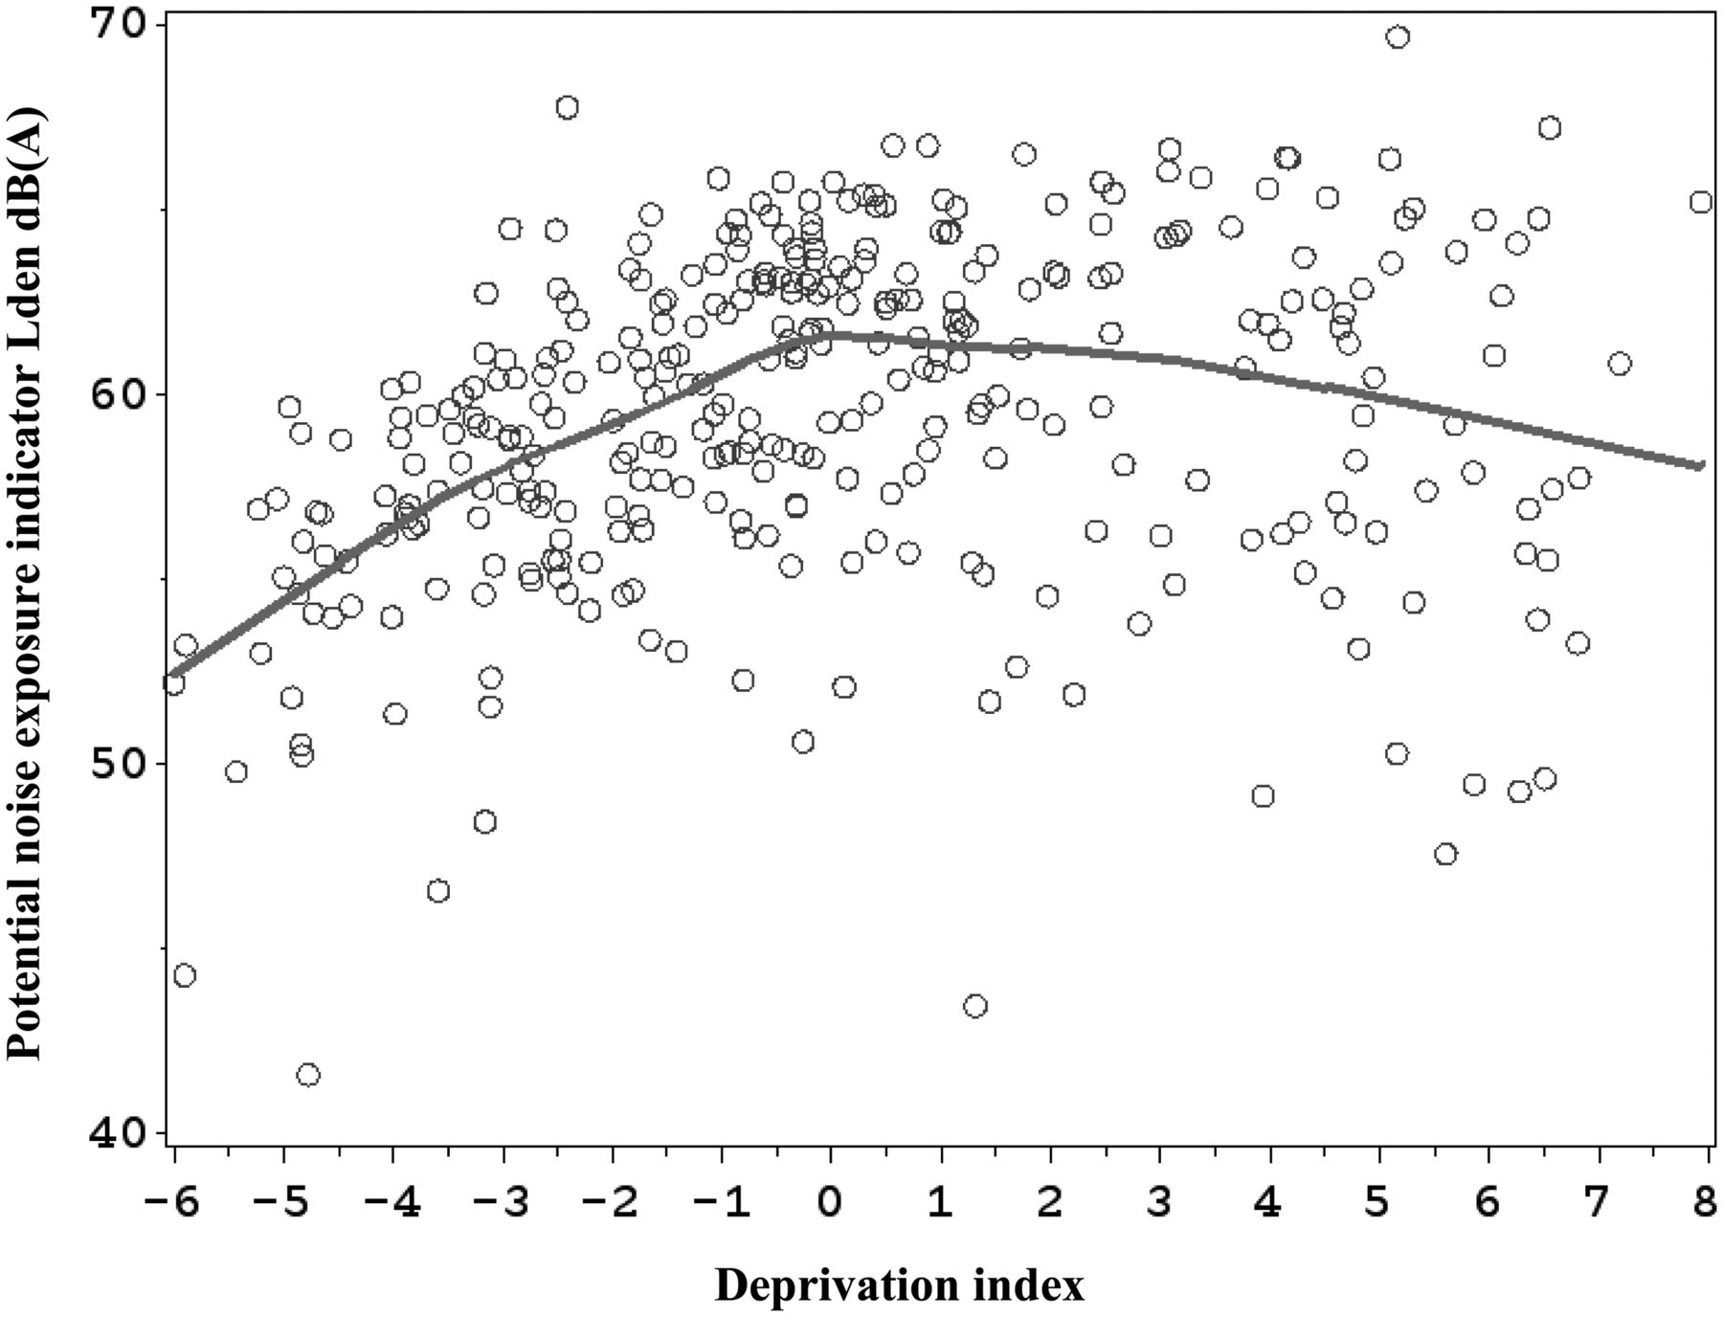
Exploring relationships
Prevalence of infection
Exposure

Slide 50
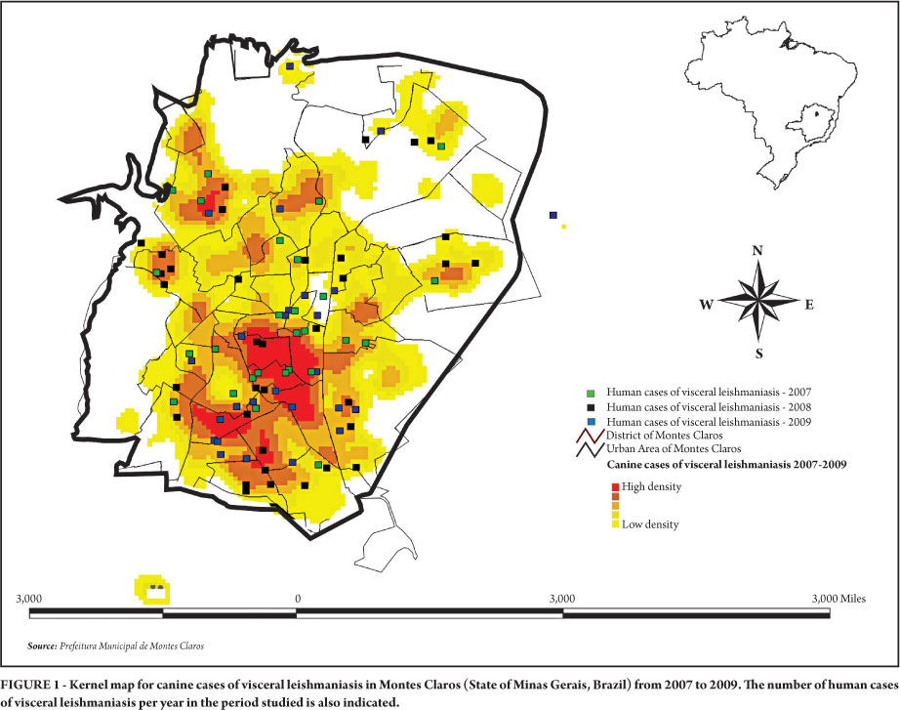
Density estimates
Fernandes do Prado et al 2011 Rev. Soc. Bras. Med. Trop. vol.44 no.5

Slide 51
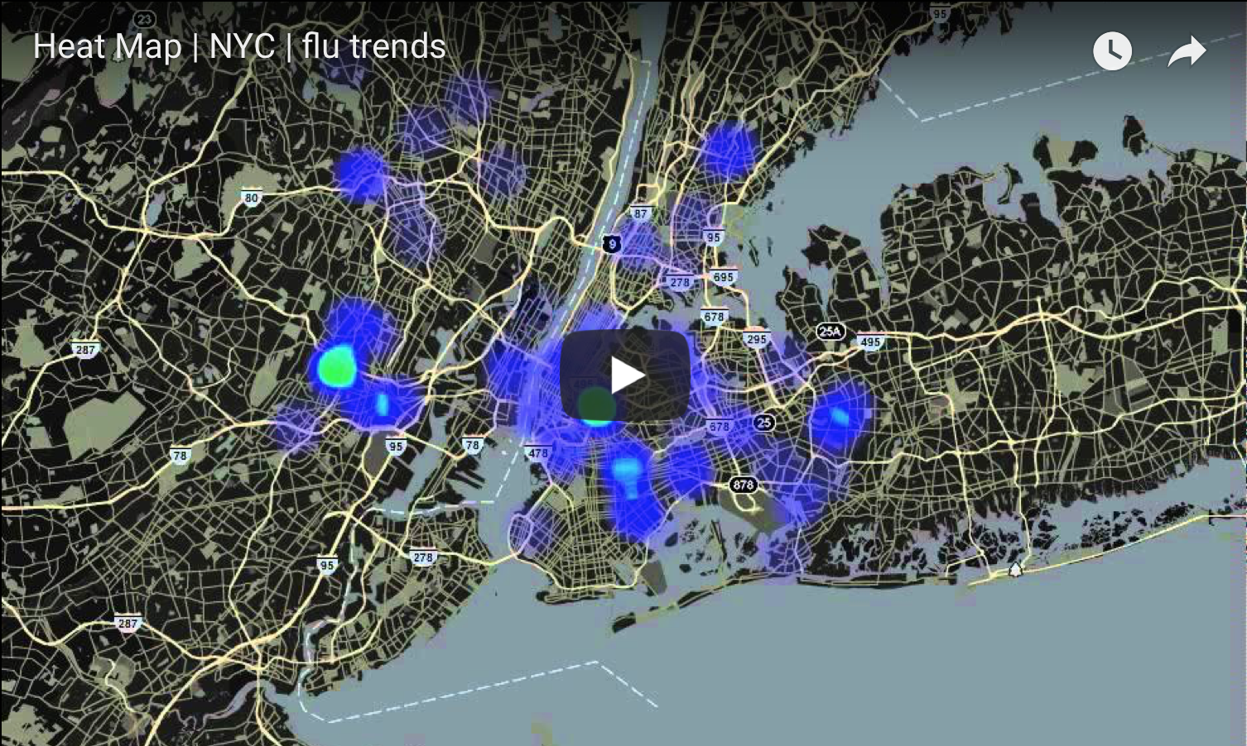
Density estimates

Slide 52
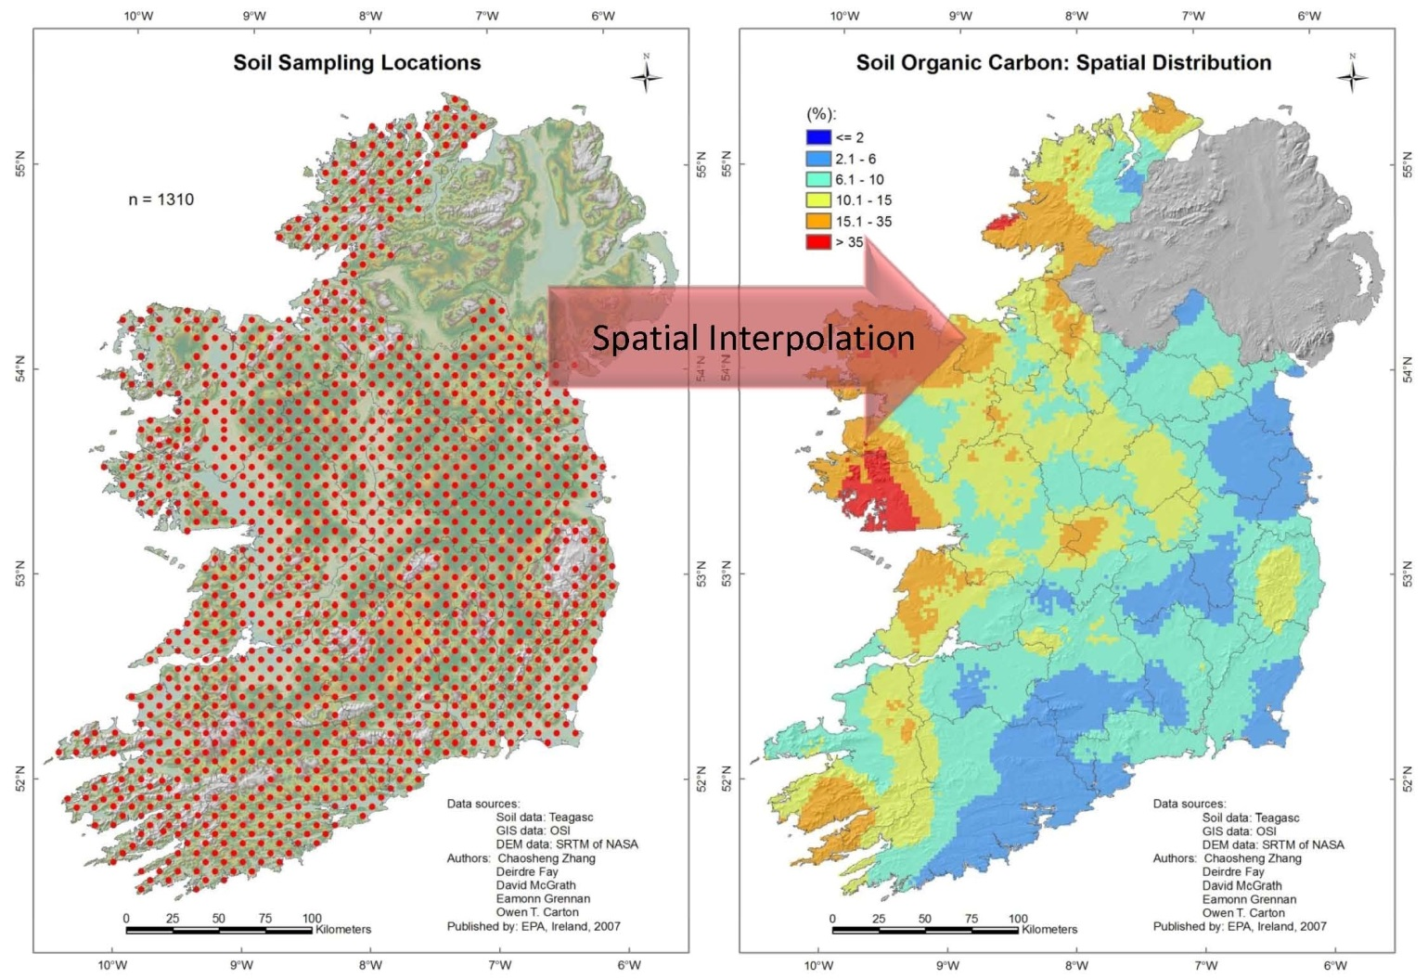
Interpolation

Slide 53
Visualization
Exploration
Analysis

Slide 54
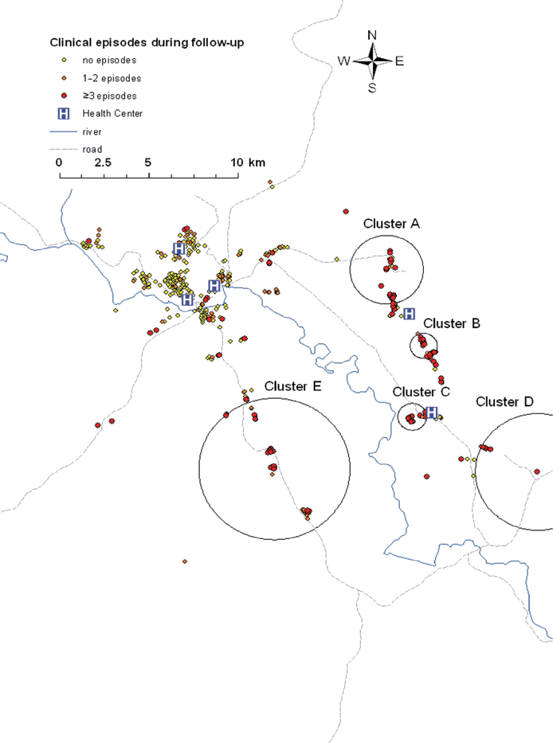
Cluster detection
Bousema et al Journal of Infectious Diseases 201.11 (2010): 1764-1774.

Slide 55
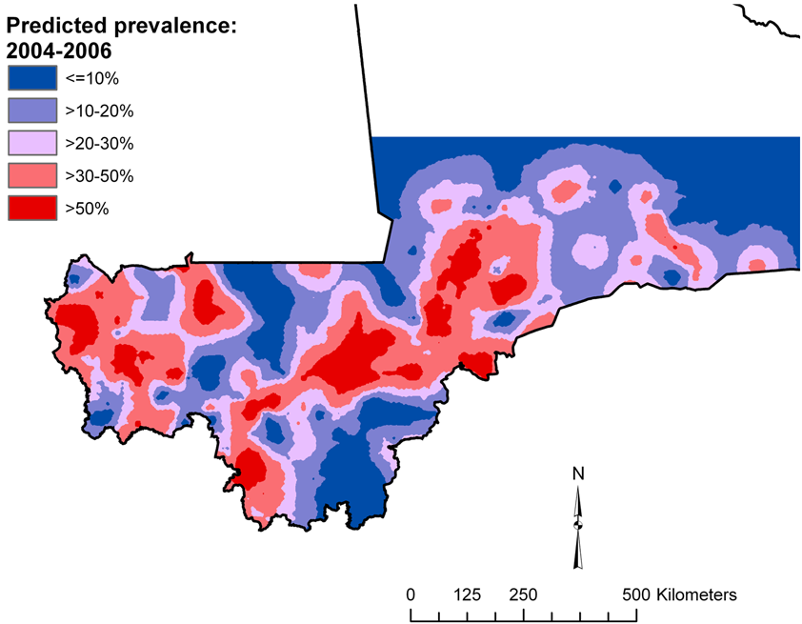
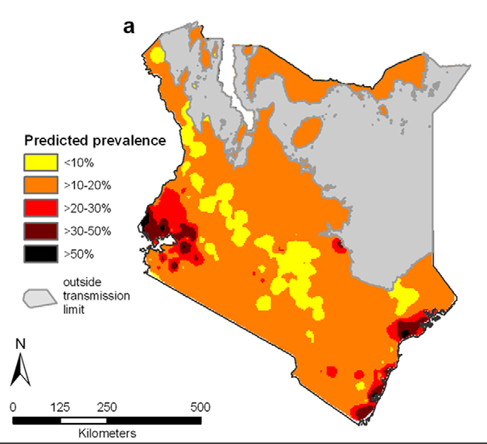
Risk mapping
Schistosomiasis in Mali
Clements et al (2009) PLoS Negl Trop Dis 3(5): e431
Intestinal worms in Kenya
Pullan et al (2011) PLoS Negl Trop Dis 5(2): e958

Slide 56
Questions?

Slide 57
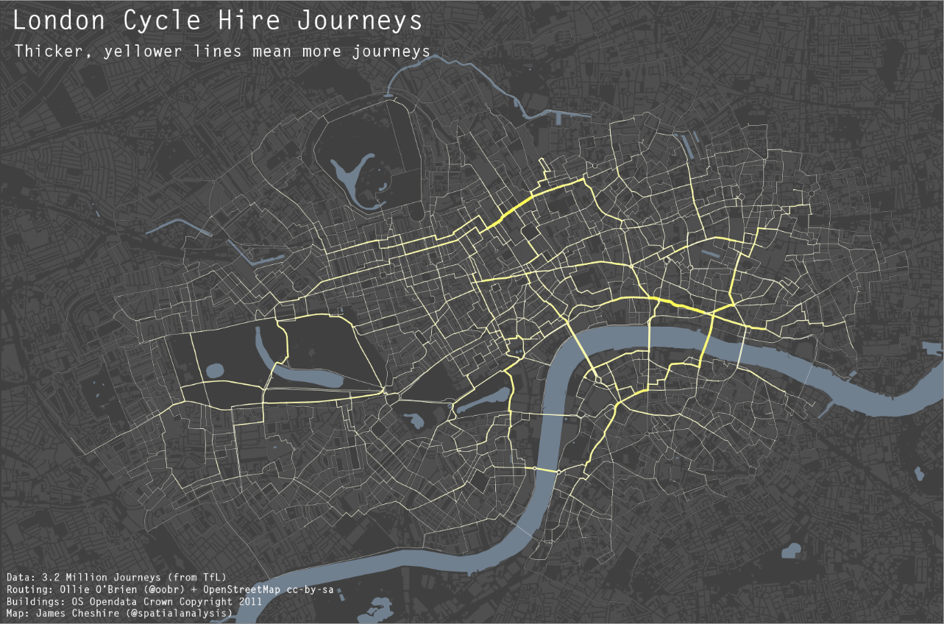
Visualizing data in R

Slide 58
Understanding coordinates reference systems….important for
Creating spatial data (collecting GPS data)
Importing into GIS and overlaying with other layers
Acquiring spatial data from other sources
Displaying your GPS data using maps

Slide 59
Coordinate Systems
There are 2 types of coordinate systems:
  Geographic Coordinate Systems
  Projected Coordinate Systems

Slide 60
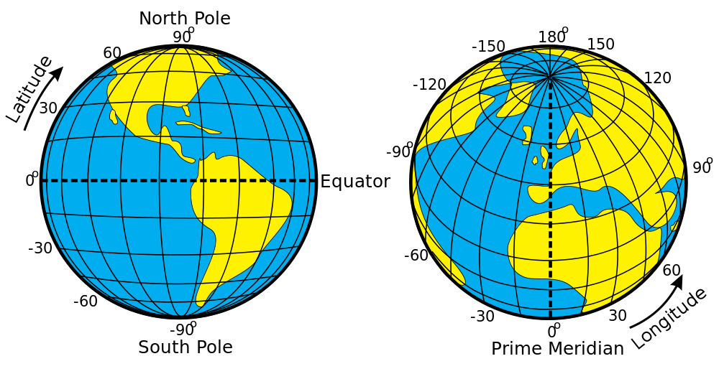
Geographic Coordinate System
A reference system using latitude and longitude to define the location of points on the surface of a sphere or spheroid
  decimal degrees (DD) -92.5
  degrees/minutes/seconds (DMS) 92° 30’ 00” W

Slide 61
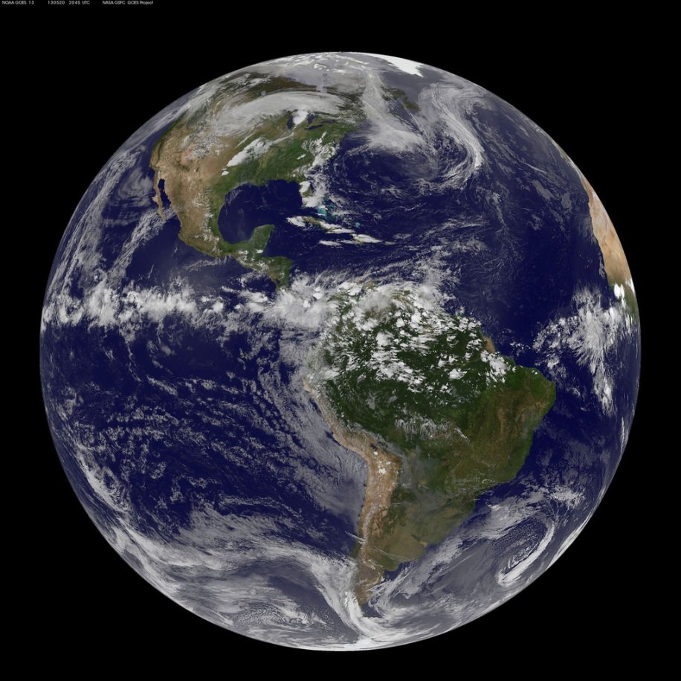
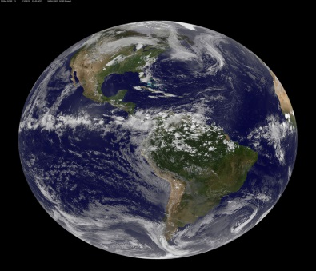
Geographic Coordinate Systems
- Earth is not a sphere
- Poles are flattened
- Bulges at equator
Earth is a spheroid……or ellipsoid
Notes:
USE GLOBE for PROP!
In order to transform Lat/Lon into these various projections. A model of the shape of the earth has to be developed so these computations can be performed.
A model to describe the shape of the earth is called the ellipsoid/spheroid.

Slide 62
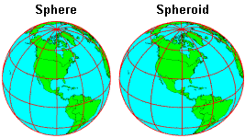
Geographic Coordinate Systems
Spheroid approximates the shape of the earth
  Model of the earth
  Also called an “ellipsoid”

Slide 63
Geographic Coordinate Systems
A datum defines the position of the spheroid relative to the center of the earth
  Origin and orientation of latitude and longitude lines are determined by the datum
  Hundreds of datums customized for different parts of the world.
  Most common GCS now is WGS84 (Google, GPS satellites)

Slide 64

Geographic Coordinate Systems
Universal Coordinate System (lat/lon)
Lat/lon good for locating positions on surface of a globe
Lat/lon is not efficient for measuring distances and areas!
  Latitude and longitude are not uniform units of measure
  One degree of longitude at equator = 111.321 km (Clarke 1866 spheroid)
  One degree of longitude at 60° latitude = 55.802 km (Clarke 1866 spheroid)

Slide 65
Projected Coordinate Systems
A map projection is the systematic transformation of locations on the earth (latitude/longitude) to planar coordinates
The basis for this transformation is the geographic coordinate system (which references a datum)
Map projections are designed for specific purposes

Slide 66
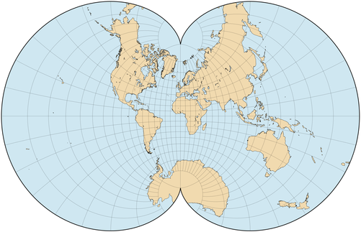
This process of flattening the earth will cause distortions in one or more of the following spatial properties:
Shape
  Conformal map projections preserve shape
Eisenlohr's projection
Notes:
All maps have errors. Something has to be sacrificed when choosing a projection.
These are the major characteristics which can be affected.
Maps that preserve Area are called Equal Area projections.
What type of map projection do you think would be used on maps used by sailors? Azimuthal/Equidistant

Slide 67
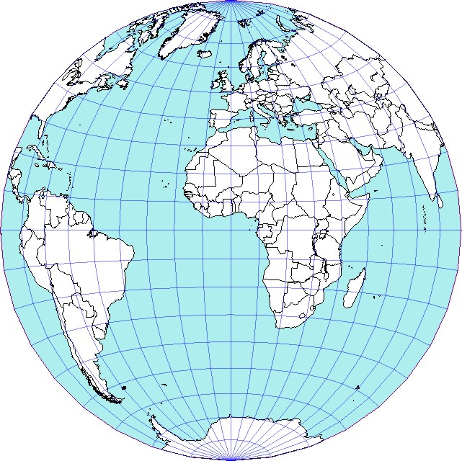
This process of flattening the earth will cause distortions in one or more of the following spatial properties:
Shape
  Conformal map projections preserve shape
Area
  Equal area map projections preserve area
Notes:
All maps have errors. Something has to be sacrificed when choosing a projection.
These are the major characteristics which can be affected.
Maps that preserve Area are called Equal Area projections.
What type of map projection do you think would be used on maps used by sailors? Azimuthal/Equidistant

Slide 68
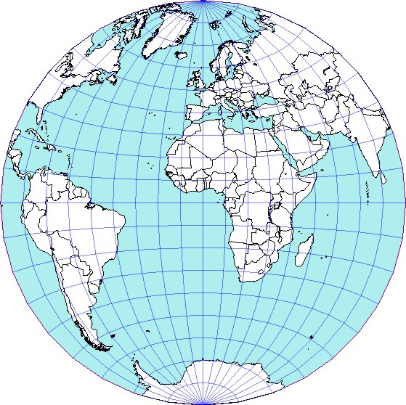
This process of flattening the earth will cause distortions in one or more of the following spatial properties:
Shape
  Conformal map projections preserve shape
Area
  Equal area map projections preserve area
Distance/Scale
  Equidistant map projections preserve distance
Notes:
All maps have errors. Something has to be sacrificed when choosing a projection.
These are the major characteristics which can be affected.
Maps that preserve Area are called Equal Area projections.
What type of map projection do you think would be used on maps used by sailors? Azimuthal/Equidistant

Slide 69
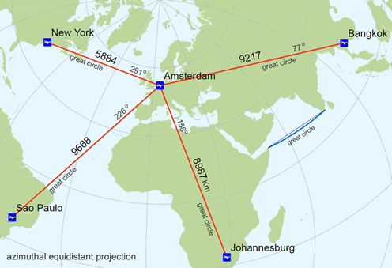
This process of flattening the earth will cause distortions in one or more of the following spatial properties:
Shape
  Conformal map projections preserve shape
Area
  Equal area map projections preserve area
Distance/Scale
  Equidistant map projections preserve distance
Direction/Angle
  Azimuthal map projections preserve true direction
https://en.wikipedia.org/wiki/List_of_map_projections

Slide 70
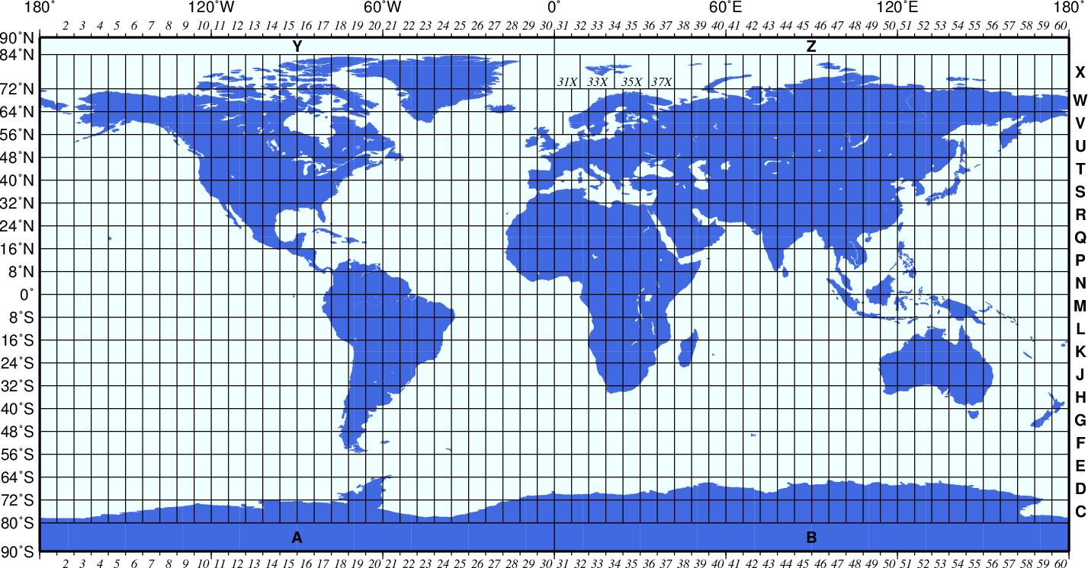
Universal Transverse Mercator (UTM)
Developed by military
Grid system (60 zones)
Coordinates refer to position within that zone
Great for small areas
  minimal map distortion
  distortion greater at edge of zones

