Slide 1
Epi 204, Lecture #1
Course overview, the diagnostic process, and measures of interobserver agreement
Michael Kohn
September 20, 2018

Slide 2
Overview of lecture
Administrative stuff
Chapter 1: Introduction
  Diagnosis: Naming the illness vs. testing to guide decisions
  Simplifying assumptions
Chapter 2: Reliability for categorical variables
  Concordance vs. Kappa
  “Expected” agreement
  Balanced and unbalanced disagreement
  Weighted Kappa

Slide 3
Administrative stuff -1
Introductions
  Faculty (Interest)
    Michael Kohn MD/MPP (Epi/EM)
    Tom Newman, MD, MPH (Epi/Peds)
    Martina Steurer-Mueller, MD, MAS (Neonatology and Pediatric Critical Care)
    Shabnam Peyvandi MD, MAS(Pediatric Cardiology)
    Miriam Laker MD, MAS (HIV Medicine)
  Section leaders
    Kerstin Kolodzie, MD (Anesthesiology)
    Kirk Fergus, MSIV
    Ryan McMahan, MS IV
    Sam Washington, MD (Urologic Oncology)
Notes:
Shab: My specialty is pediatric cardiology with a focus on fetal cardiology. My research interests are in Neurodevelopmental outcomes in patients with congenital heart disease,
Miriam: My specialty is HIV medicine and research area is HIV-associated malignancies specifically Kaposi's sarcoma.
I am passionate about mentoring young doctors and especially female doctors to help them navigate the work-life balance paradigm.

Slide 4
Administrative stuff -2
Basic structure of course
  New material each week in lecture
  Read text before lecture if possible
  HW on that material due the following week in section− bring PAPER copy
  Exceptions:
    No class on Thanksgiving (11/22)
    Penultimate class (11/19) – (Cognitive heuristics and biases, course review): no HW assigned on Chapter 12
    We will post the final no later than 6:00 pm Thursday 11/29, due 8:30 am 12/6.
    Last large group meeting 12/6: review of take-home exam; no section 12/6
Lecture recordings should be available later the day given.

Slide 5
SECTIONS
Section assignments: Click ROSTER on Epi 204 website
Section rooms: Click SCHEDULE on website
Faculty will rotate; students, rooms and TA's will be constant for the quarter
Section attendance is highly recommended but not required

Slide 6
Homework: 9 Problem Sets and Problem-Writing Assignment
Required – key way of learning material
PSet due in next Thursday’s section posted by 6 pm today.
Upload HW to CLE by 1 pm next Thursday
Try to also bring the HW to section on paper
Not graded if late, but can still be turned in; answers on CLE
Will be graded by section leaders before section on the following Thursday

Slide 7
Problem-writing Assignment
Write a homework or final exam problem
Ideally, based on a recent study (provide citation) from your field or of general interest
Problem should require understanding of material covered in this class
Due Thursday, Nov 8 by 1 pm. Upload to CLE.
May appear (probably altered) on final exam and/or in future homework sets!
Counts as one HW assignment
Details posted in a document at top of syllabus site.

Slide 8
Getting help
Classmates, then section leaders, then faculty
Post questions and answers on course Forum
Questions, ambiguous/confusing problems – post to the forum

Slide 9
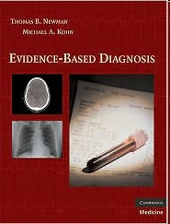
Books
We are working on the second edition of “Evidence-Based Diagnosis” (EBD-2). Required reading/problem sets posted on the syllabus site as Word documents.
EBD-1 (Cambridge University Press, 2009); print and e-version available in library and Agnes has copies to lend while you are at MH.
TBN’s royalties go to PSR. MAK’s royalties go to a cup of coffee at Starbuck’s.

Slide 11
Grading, honor code, etc.
Worst HW score dropped; all other HW count equally
HW/Exam question written by you counts as one homework
Grade based on HW (60%) and take-home final (40%)
Write out answers to problems in your own words.
Acknowledge help from others.
Do NOT collaborate on the final exam
Honor code taken seriously

Slide 12
TICR Professional Conduct Statement
I will maintain the highest standards of academic honesty
I will neither give nor receive aid in examinations or assignments unless such cooperation is expressly permitted by the instructor (HW—Yes, with attribution, Exam – No!)
I will conduct research in an unbiased manner, reports results truthfully, and credit ideas developed and work done by others
I will not use answer keys from prior years
I will write answers in my own words, and, when collaboration is permitted, acknowledge collaborators when answers are jointly formulated (HW)

Slide 13
Questions?

Slide 14
Clinical Epidemiology
“I hope that I may be excused for entering on these personal details, as I give them to show that I have not been hasty in coming to a decision.”
Charles Darwin, Introduction to “The Origin of Species” 1859
Notes:
TN created this course and started teaching it in 1989. I was an ED attending at SFGH when I took it in 1999. It was a revelation to someone frustrated with the lack of rigorous, quantitative thinking in clinical medicine.

Slide 15
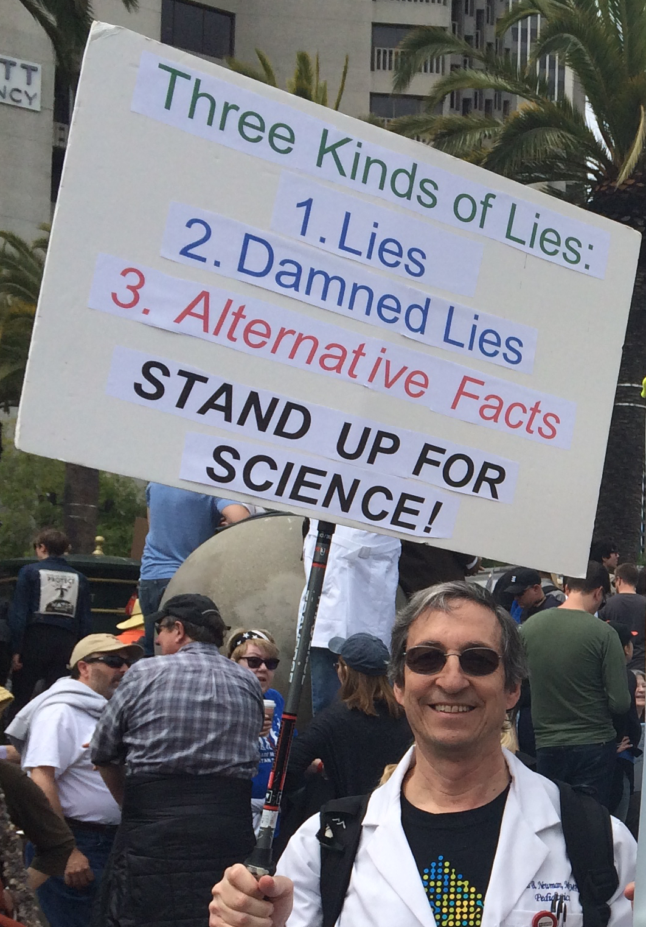
Notes:
TN created this course and started teaching it in 1989. I was an ED attending at SFGH when I took it in 1999. It was a revelation to someone frustrated with the lack of rigorous, quantitative thinking in clinical medicine.

Slide 16
Course: “Prediction 0”
Common speech
  Prediction: Using current information to estimate risk of future event.
Epidemiology
  Prediction: Using current information (e.g. test results) to estimate probability of a state that already exists*.
*but is too difficult or expensive to ascertain directly.
Notes:
In common speech, prediction involves using information that is available now to evaluate the likelihood of an uncertain event in the future. In epidemiology and biostatistics, “prediction” includes using available information not only to predict the future but also to estimate the probability of a state or condition that already exists but is difficult or expensive to measure by other means. In public health and clinical practice, diagnostic tests are used to estimate the probability of prevalent disease and risk prediction models (or “rules”) are used to evaluate the likelihood of some future event. In the first part of this course, we will cover how to interpret the metrics used to describe the performance of diagnostic tests and risk prediction models.

Slide 17
Course overview
Tests
  Theory (Using tests to guide decisions)
  Inter-rater reliability (Kappa)
  Dichotomous tests (Sensitivity, Specificity, PVs)
  Multilevel tests (ROC Curves, iLRs)
  Studies of tests (biases in test accuracy studies)
  Risk prediction (calibration, discrimination, NB)
  Combining tests (logistic regression, CART, …)
Treatments
  Randomized trials (ARR, NNT)
  Alternatives to randomized trials
Screening programs
P-values and confidence intervals
Cognitive process of diagnosis
Notes:
In common speech, prediction involves using information that is available now to evaluate the likelihood of an uncertain event in the future. In epidemiology and biostatistics, “prediction” includes using available information not only to predict the future but also to estimate the probability of a state or condition that already exists but is difficult or expensive to measure by other means. In public health and clinical practice, diagnostic tests are used to estimate the probability of prevalent disease and risk prediction models (or “rules”) are used to evaluate the likelihood of some future event. In the first part of this course, we will cover how to interpret the metrics used to describe the performance of diagnostic tests and risk prediction models.

Slide 18
Diagnosis
Identification of a disease by careful investigation of its symptoms and history.
The Oxford English Dictionary (2nd Edition 1989, accessed online)
Notes:
Diagnosis is naming a patient’s illness. We assign names to distinct illnesses, just as we name distinct animals, vegetables, minerals, cloud formations, personality types, …. So we can talk about them and maybe study them. Two distinct diseases can have the same treatment; other distinct diseases have no treatment; and yes, some distinct diseases have distinct treatments. But, assigning a disease name to a patient’s illness doesn’t necessarily imply a treatment decision.

Slide 19

Diagnosis: Complex cognitive process
Notes:
The cognitive process of diagnosis involves integrating information from history, observation, exam, and testing using an ill-defined combination of knowledge, experience, pattern recognition, and intuition to name a patient’s illness. We won’t be talking about this cognitive process and the errors to which it is prone until the last lecture.

Slide 20
Testing to refine probabilities and guide decisions (Ch 1 examples)
Rapid strep test to guide PCN treatment
WBC count and differential to determine NICU transfer and antibiotics
Screening mammography
Fetal 13-wk ultrasound to decide on chorionic villus sampling.
Notes:
Nothing special about clinical medicine. Need to make a decision, uncertainty about a current state or future outcome, can get additional information (at a cost) and refine probabilities. Should you test or just make the best decision you can without testing? Should an oil wildcatter pay for seismic soundings to help decide whether to drill before his option runs out? (Raiffa 1968)

Slide 21
Simplified Generic Decision Problem
Patient either has the disease or not
However, there is uncertainty, which we express as P(D+)
If D+, net benefit of treatment
If D−, better not to treat
  (“Treat” could just mean doing more tests)

Slide 22
Decision Analytic Framework
P(D+)
☺
Yes
D+ & Treated
No
Yes
D+?
😐
D- & Treated
No
Treat?
Yes
D+ & Untreated
☹
No
D+?
D- & Untreated
☺
Notes:
Next week, we will learn that the difference between 3 & 1 is “B”, and the difference between 2 & 4 is “C”.

Slide 23
Initial simplifying assumptions
1. Test results are dichotomous
2. Disease states are dichotomous
3. Test characteristics don’t depend on prior probability

Slide 24
Simplifying assumptions are often wrong because
Many tests have more than two possible results
Disease states are not really dichotomous
  Many diseases present along a spectrum of severity
  People who do not have the disease you are testing for may have one or more other diseases
History, physical findings, and laboratory data used to estimate the prior probability may also affect test characteristics

Slide 25
Nonetheless, these simplifying assumptions are often useful and can help clarify our thinking!
1. Test results are dichotomous
2. Disease states are dichotomous
3. Test characteristics don’t depend on prior probability

Slide 26
Questions about Chapter 1?

Slide 27
Test/Observer Reliability
Same or similar result in the same person (within a time period too short for real biological change to occur)
Results consistent whether repeated by the same observer (intra-rater reliability) or different observers (inter-rater reliability)

Slide 28
Why do we care about reproducibility?
Important to optimize quality of measurements/findings where there is no “gold standard”
  Clinical medicine
  Clinical research

Slide 29
Types of variables
Categorical
  Dichotomous – 2 values
  Nominal – no intrinsic ordering
  Ordinal – intrinsic ordering
Numerical
  Continuous -- infinite number of values
  Discrete -- limited number of values

Slide 30
Measuring interobserver agreement for categorical variables
What is the percent agreement (“concordance”)?
Notes:
Agreement is (15 +60)/ 100 = 75%

Slide 31
Concordance
What percent of the time do the two observers agree (exactly)?
Advantage: easy to understand
Disadvantage: may be misleading if observers agree on prevalence of abnormality and it is high or low
Example: presence or absence of gallop: 95% agreement

Slide 32
Concordance problem
95% agreement!
Why aren’t you impressed?
High concordance expected if observers agree on the marginals
“Marginals”
Notes:
Expected agreement is 98x99/100^2 = 95% + 2x3/100^2 =95.06%.
In this example there is a high level of agreement along the diagonal (95/100) because there is a lot of agreement on the MARGINALS, i.e., the observers agree that murmurs are rare, finding them 3% and 2% of subjects.

Slide 33
Definition of Kappa
The amount of agreement beyond what would be expected from the marginals (row and column totals)
This is often called agreement beyond that expected “by chance.”
Formula:
More precisely: the proportion of the difference between the agreement expected from the marginals and perfect agreement that was observed
Observed agreement – Expected agreement
1 – Expected agreement
Notes:
Draw picture like Figure 2.1 in the text.
We prefer “agreement based on the marginals” because this is the same as the agreement based on chance alone only under the unrealistic assumption that the marginals are fixed for both observers.

Slide 34
Practice calculating Kappa
Observed = 90%, Expected = 80%: K =
Observed = 70%, Expected = 60%: K =
Observed = 60%, Expected = 70%: K =

Slide 35
Calculation of Expected Agreement from Marginals
Row total × Column total
N
35×30/100 = 10.5
65×70/100 = 45.5
Notes:
30*35/100 = 10.5; 70*65/100 = 45.5; total = 56

Slide 36
Why does multiplying row total by column total and dividing by N give you the expected agreement?
It’s really (Row total/N) x (Column total/N) x N, but 1 set of N’s cancels out.
Example: if A thinks 35% of patients have a murmur and B thinks 30% do, then by chance alone we’d expect them both to agree that a murmur was present 35% x 30% =10.5% of the time. If total N= 100, this would be 10.5 patients.
Notes:
For expected counts, fractional patients is okay.

Slide 37
Why does multiplying row total by column total and dividing by N give you the expected agreement?
If P(A) and P(B) are independent, then P(A and B)=P(A) x P(B).
The R_{i}/N and C_{j}/N are probability estimates
So by chance alone the estimated probability of a subject being in cell_{ij} is R_{i}/N × C_{j}/N
This probability times the total N gives the expected number in each cell:
R_{i} × C_{j}/N

Slide 38
Calculation of Kappa
Obseved - Expected
1- Expected
75% – 56% = 19% = 0.43
1 – 56% 44%
35×30/100 = 10.5
65×70/100 = 45.5

Slide 39
Excel Demo
Lecture1.xls

Slide 40
Web Page Demo
https://www.graphpad.com/quickcalcs/kappa2/

Slide 41
Kappa for variables with more than two values
Calculate observed and expected agreement the same way
Calculate Kappa the same way
If the variable is ordinal use weighted kappa

Slide 42
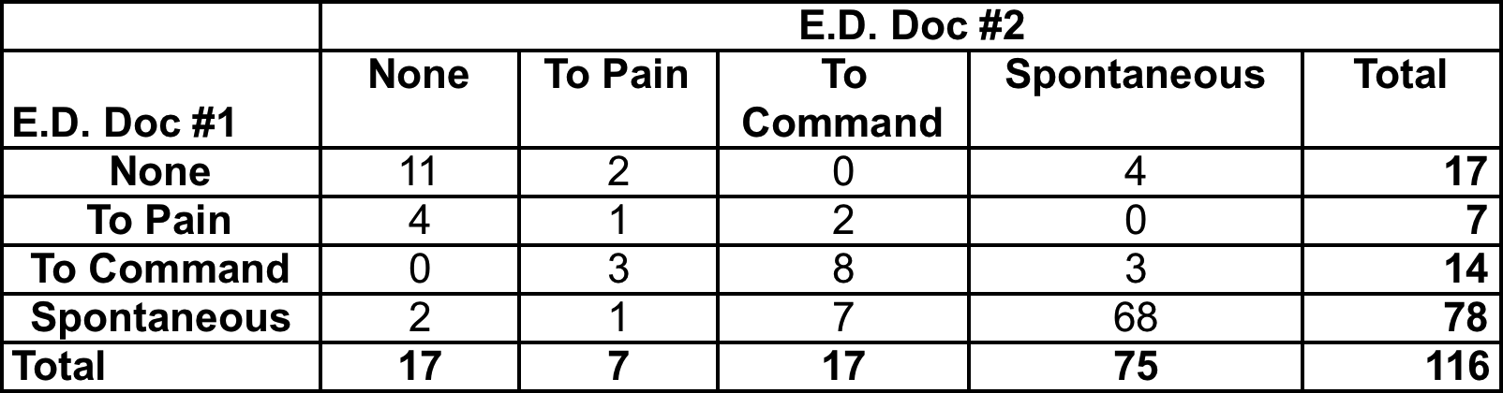
GCS Eye opening- Observed

Slide 43
Eye Opening: Expected
17× 14/116 = 2.1

Slide 44
Weighted Kappa
Weighted kappa
  Linear
  Quadratic – penalty for being wrong is squared (so more partial credit for being close)
  Custom
Notes:
Cover:

Slide 45
Unbalanced Disagreement
What is going on here?
Look for lack of balance above and below diagonal
Results when observers have different thresholds
Lesion # | Observer A | Observer B
1 | S | S
2 | S | S
3 | S | M
4 | S | M
5 | S | M
6 | M | M
7 | M | L
8 | L | L
9 | L | L
10 | L | L

Slide 46
Linear Weights
 | S | M | L
S | 1 | 1/2 | 0
M | 1/2 | 1 | 1/2
L | 0 | 1/2 | 1

Slide 47
 | ***** | **** | *** | ** | *
***** | 1 | 3/4 | 1/2 | 1/4 | 0
**** | 3/4 | 1 | 3/4 | 1/2 | 1/4
*** | 1/2 | 3/4 | 1 | 3/4 | 1/2
** | 1/4 | 1/2 | 3/4 | 1 | 3/4
* | 0 | 1/4 | 1/2 | 3/4 | 1

Slide 48
 | ***** | **** | *** | ** | *
***** | 1 | 3/4 | 1/2 | 1/4 | 0
**** |  | 1 | 3/4 | 1/2 | 1/4
*** |  |  | 1 | 3/4 | 1/2
** |  |  |  | 1 | 3/4
* |  |  |  |  | 1

Slide 49
Quadratic Weights
 | L | M | S
L | 1 | 0.75 | 0
M | 0.75 | 1 | 0.75
S | 0 | 0.75 | 1

Slide 50
 | ***** | **** | *** | ** | *
***** | 1 | 15/16 | 12/16 | 7/16 | 0
**** | 15/16 | 1 | 15/16 | 12/16 | 7/16
*** | 12/16 | 15/16 | 1 | 15/16 | 12/16
** | 7/16 | 12/16 | 15/16 | 1 | 15/16
* | 0 | 7/16 | 12/16 | 15/16 | 1

Slide 51
Unbalanced Disagreement
What is going on here?
Look for lack of balance above and below diagonal
Results when observers have different thresholds
Lesion # | Observer A | Observer B
1 | S | S
2 | S | S
3 | S | M
4 | S | M
5 | S | M
6 | M | M
7 | M | L
8 | L | L
9 | L | L
10 | L | L

Slide 52
Excel / Web /Stata
. tab ObsA ObsB
. kap ObsA ObsB
. kap ObsA ObsB, wgt(w)
. kap ObsA ObsB, wgt(w2)

Slide 53
What does observed Kappa depend upon?
How well people agree
SPECTRUM within classifications
  E.g., are the abnormal ones very abnormal?
  Difficult cases can be excluded or over-sampled
PREVALENCE estimates of each category by the various observers (and whether they agree)
Chance (random error; people can get lucky/unlucky)
Weighting scheme used

Slide 54
What’s a good Kappa?
Depends on weighting, number of categories
General guidance:

Slide 55
Interobserver Agreement Among Pathologists for Diagnosing Malignant Melanoma*
Eight expert dermatopathologists selected on the basis of their reputation and publications
Each selected 5 cases of melanomas or melanocytic nevi that shared histological features with melanoma
  Had to be "classic cases" that could be published as examples
  37 cases selected
*Farmer ER et al. Discordance in the histopathologic diagnosis of melanoma and melanocytic nevi between expert pathologists. Human Pathology 1996;27:528

Slide 56
Interobserver Agreement Among Pathologists for Malignant Melanoma: 13 cases with perfect agreement
Malignant
See Welch, GH. Should I Be Tested for Cancer?: Maybe Not and Here's Why. University of California Press. 2006.
Benign
Notes:
Farmer ER, Gonin R, Hanna MP. Discordance in the histopathologic diagnosis of melanoma and melanocytic nevi between expert pathologists. Hum Pathol. 1996 Jun;27(6):528-31. Review. PubMed PMID: 8666360.

Slide 57
Interobserver Agreement Among Pathologists for Malignant Melanoma: 24 cases with disagreement
Malignant
Call this “Benign”
Can’t tell
Benign
Notes:
Farmer ER, Gonin R, Hanna MP. Discordance in the histopathologic diagnosis of melanoma and melanocytic nevi between expert pathologists. Hum Pathol. 1996 Jun;27(6):528-31. Review. PubMed PMID: 8666360.

Slide 58

Interobserver Agreement Among Pathologists for Malignant Melanoma: 24 cases with disagreement
Malignant
Can’t tell
Overall Kappa = 0.5
Benign
Notes:
Farmer ER, Gonin R, Hanna MP. Discordance in the histopathologic diagnosis of melanoma and melanocytic nevi between expert pathologists. Hum Pathol. 1996 Jun;27(6):528-31. Review. PubMed PMID: 8666360.
This overall kappa is based on the number of each type of rating (Malignant, Can’t Tell, Benign) for each slide. It does not assume that the raters are the same for each slide, even though they were. It also does not require that the each slide have the same number of rating, although again each slide did have the same number of ratings (8). As with kappa for 2 raters, you lose any sense of systematic bias. For example, compare Pathologist F vs. G. F rated 21/37 (57%) Malignant G rated 10/27 (27%) Malignant. Would you consider that a systematic difference? And yet kappa simply counts the number of rating for each slide, so if you swapped F and G’s ratings on 5 of the 11 slides where F said Malignant of and G said benign, you would eliminate any systematic bias, but kappa would be exactly the same.

