Slide 1
Quantitative Approaches to Validity
Lydia B. Zablotska, MD, PhD
Professor, Department of Epidemiology and Biostatistics

Slide 2
Review of last week’s material (#1)
Discussed how causal inference is central to the role of health research
Defined measurement, concepts/conceptual models/conceptual frameworks and phenomena
  Phenomenon → domains → concepts } conceptual framework
Reviewed statistical underpinnings of scale measurement
  Structure
  types

Slide 3
Review of last week’s material (#2)
Introduced classical measurement theory
  Classical test theory (CTT) has been widely used in health research.
  The fundamental feature of CTT is the reliance on 5 key assumptions expressing every observed score (X) as a function of the individual’s true score (T) and random measurement error (e).
  CTT focuses on total test score – classical test theoretic constructs operate on the summary (sum of responses, average response) of items → individual items are not considered.
  Although E could represent many different types of error, CTT only permits the estimation of one general error term, which incorporates all sources of error but emphasizes certain types of error over others depending on the reliability study conducted → cannot adequately estimate individual sources of error → errors in measurement and causal inference

Slide 4
Review of last week’s material (#3)
Gave examples of modern measurement theories (more in lectures in weeks #6 and 8)
  Modern test theory, item response test (IRT), is a probabilistic (statistical, logistic) model of how/why examinees respond to any given item(s) – and independently, about the items themselves.
  IRT – in contrast to CTT, which focuses on test performance, focuses on item’s performance and the examinee’s ability; e.g., examinee’s performance could be predicted based on a set of factors referred to as traits, latent traits, abilities or proficiencies
  Generalizability theory – acknowledges the multiple sources of measurement error by deriving estimates of each source separately

Slide 5
Learning objectives
Discuss traditional definitions of validity (3 C’s: content, criterion and construct) and introduce new theories on validity of instruments.
Give examples of statistical methods for evaluation/ assessment of measurement validity.
Introduce consequential validity and discuss its importance for health research.
Notes:
Traditional definitions of validity (3 C’s: Content, Criterion and Construct validity) and statistical methods to assess them (Index and Rovinelli & Hambleton Index for Content validity; correlation coefficients and multiple regression for Criterion-related validity; Multitrait-Multhimethod Matrix, Spearman correlation coefficient, chi-square and ANOVA (Factor Analysis) for Construct validity);
new theories on validity of instruments (Goodman’s 24 types of validity); Consequential validity in health research.

Slide 6
Classical validity theory
Developed during World War II in the process of development of a wide array of measures, including personality screening tests for prospective fighter pilots, psychophysical measures to test reaction times, etc.
Cronbach and Meehl (1955) categorized validity into:
  Content
  Criterion (including concurrent and predictive)
  Construct

Slide 7
Criticism of the classical validity theory
Construct validity encompasses all other types of validity
Fractional approach to validity is not helpful in practice
Validity is not a property of the data collection instrument/ test, but of the data obtained using them when used for a specific study and with a particular population
Many different types of evidence is necessary to evaluate validity of the instrument for data collection

Slide 8
What do we mean when we talk about “Instrument Validity”?
A characteristic of an instrument that exemplifies the degree to which it measure what it purports to measure.
  Consequently…it is virtually impossible to state unequivocally that a measure is “valid”
  Instead, one can only build a case for a satisfactory degree of validity

Slide 9
What do we mean when we talk about “Instrument Validity”?
One does not assess the validity of a measure per se... rather, one validates the use of the measure for a given situation.
This distinction separates the characteristic of validity from the property of reliability
  Instrument could be reliable in and of itself in different broadly defined population groups while its validity needs to be tested in each population
9
Notes:
This distinction separates the characteristic of validity from the property of reliability
Instrument could be reliable in and of itself in different broadly defined population groups while its validity needs to be tested in each population

Slide 10
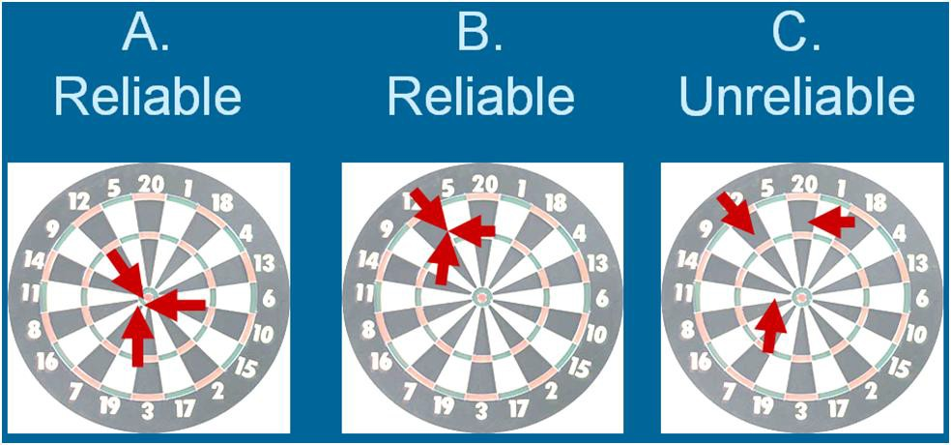
Reliability vs. Validity
Notes:
Quick recap of the differences between reliability and validity

Slide 11
Reliability vs. Validity
Conversely, validity is not assessed unequivocally…instead, one validates the use of a measure for a given situation. Consequently, if an instrument is felt to be valid for measuring certain phenomena, it might well not be valid for the measurement of related phenomena, or even the same phenomena under different circumstances.

Slide 12

Validation
Cronbach (1971) described validation as the process by which a test developer or test user collects evidence to support the type of inferences that are to be drawn from test score
“The correlation between a test score and some outside criterion.”

Slide 13
Main steps in the evaluation of validity
Requires empirical evidence - A measurement method cannot be declared valid or invalid before it has ever been used and the resulting scores have been thoroughly analyzed.
An ongoing process - The conclusion that a measurement method is valid depends on the results of many studies done over a period of years. Every new study using that measurement method provides additional evidence for or against its validity.
Is not an all-or-none property of a measurement method - It is possible for a measurement method to be judged "somewhat valid" or for one measure to be considered "more valid" than another. A measurement method might be valid for one subject population or in one context, but not in another.

Slide 14
Classical validity theory: 3C’s
Methods of evaluation/assessment of validity
Content
  Face validity
  Logical/Domain/Sampling-related Validity
Criterion-related
  Concurrent validity
  Predictive validity
Construct
  Convergent validity
  Discriminant validity

Slide 15
Content Validity –
  Established through the assessment of the actual content of a measure
  Could be evaluated through Face Validity and Logical/Domain/Sampling-related Validity

Slide 16
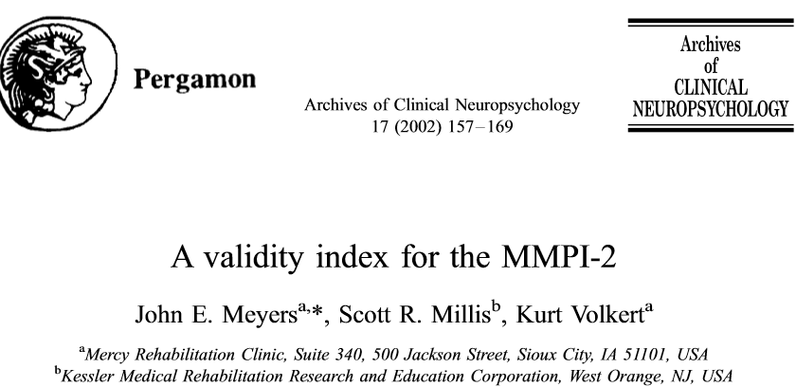
Content Validity –
Face Validity
  The degree to which a measure looks like it’s measuring the right thing
  In face validity, you look at the operationalization and see whether "on its face" it seems like a good translation of the construct.
  Often important, though not essential, face validity is usually assessed by "expert" consensus. Some very useful measures, however, have very little face validity (e.g., MMPI)
  Example: There have been numerous methods developed for the detection of valid profiles on the
  Minnesota Multiphasic Personality Inventory
  (MMPI) to assess malingering in chronic pain
  patients. Chronic pain patients in litigation produce
  a different validity profile than do non-litigants.

Slide 17
Content validity –
Logical/Domain/Sampling-related Validity
It addresses whether items on an instrument adequately measure a desired domain of content
The degree to which a measure was designed to contain a representative sample of the domain of items/questions/areas/etc., from the universe of content.

Slide 18
Content validity –
Steps for evaluation
Content validity consists of two stage process (Lynn, 1986)
  Development
      Domain identification
      Item generation
      Instrument construction
  Judgment-qualification
Notes:
1. a) Domain identification
The degree to which a measure was designed to contain a representative sample of the domain of items, questions, or areas from the universe of content. Sometimes referred to as blueprinting.
Much of the domain specification is done through a thorough search of the extant literature as well as some form of qualitative analysis of the phenomenon of interest.
1. b) Item generation
It is important to note that much of the domain specification is done through a thorough search of the extant literature as well as some form of qualitative analysis of the phenomenon of interest.
1. c) Instrument construction
Items are refined and organized in an appropriate sequence and format
2. Judgement-qualification
Ask a specific number of experts to evaluate the validity of items individually and as a set.
Content experts should have relevant training, experience, and qualifications.
May include 2-20 content experts

Slide 19
Content validity:
Steps for evaluation
1. a) Domain identification
  The degree to which a measure was designed to contain a representative sample of the domain of items, questions, or areas from the universe of content. Sometimes referred to as blueprinting.
  Much of the domain specification is done through a thorough search of the extant literature as well as some form of qualitative analysis of the phenomenon of interest.
1. b) Item generation
  It is important to note that much of the domain specification is done through a thorough search of the extant literature as well as some form of qualitative analysis of the phenomenon of interest.
1. c) Instrument construction
  Items are refined and organized in an appropriate sequence and format

Slide 20
Content validity:
Steps for evaluation
2. Judgment-qualification
Ask a specific number of experts to evaluate the validity of items individually and as a set.
Content experts should have necessity of relevant training, experience, and qualifications.
  May include 2-20 content experts

Slide 21
Content validity –
Structural elements in content reviews
Item content
  Judge how representative individual items are of the content domain and whether the content domain adequately measures all dimensions of the construct.
Item style
  Judge the clarity of item construction and wording
Comprehensiveness
  Judge whether the complete set of instrument items is sufficient to represent to total content domain

Slide 22
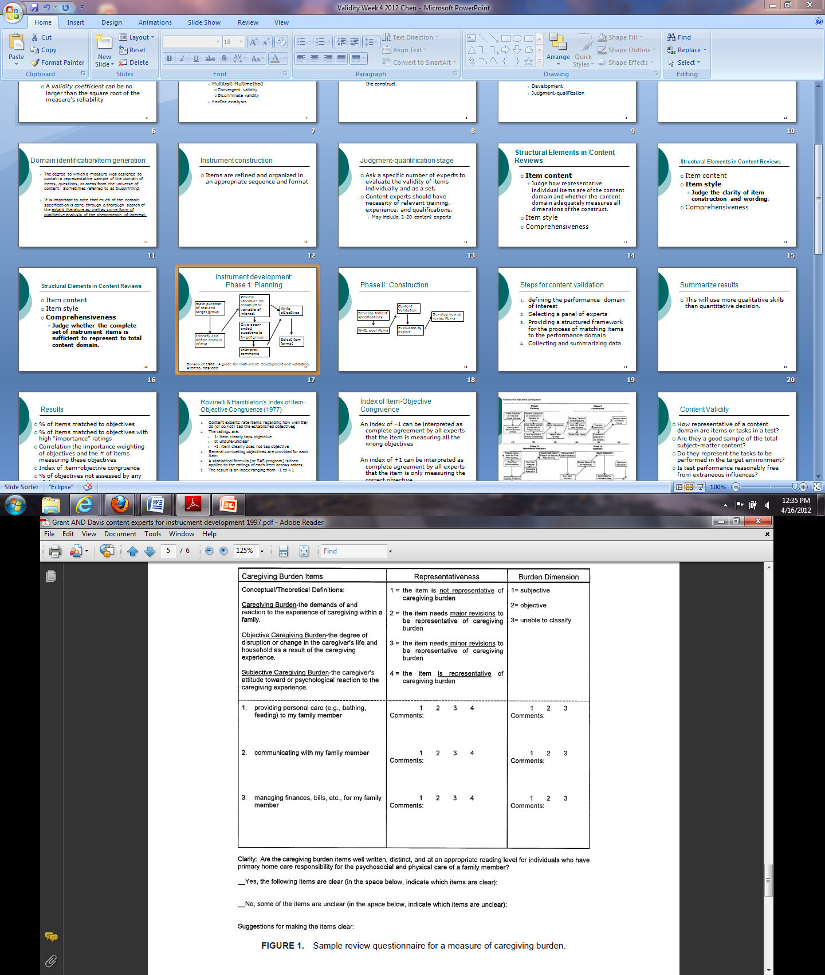
Notes:
In this example, experts are asked to:
Review 3 items (questions) in a questionnaire related to the concept of caregiver burden.
Evaluate whether these 3 items about caregiving burden fit into two main domains (dimensions) of the phenomenon: objective and subjective burden
Experts are also asked to comment on how well these items represent the two main dimensions and whether minor or major revisions of the items are warranted.
Lastly, experts are asked to comment on the clarity of the items and for suggestions to make them clearer.

Slide 23
Content validity:
Quantitative approach
Content validity index (CVI):
A CVI value can be computed for each item on a scale (I-CVI) as well as for the overall scale (S-CVI)
To calculate an item-level CVI (I-CVI), experts are asked to rate the relevance of each item, usually on a 4-point scale
  for each item, the I-CVI is computed as the number of experts giving a rating of either 3 or 4, divided by the number of experts—that is, the proportion in agreement about relevance.

Slide 24
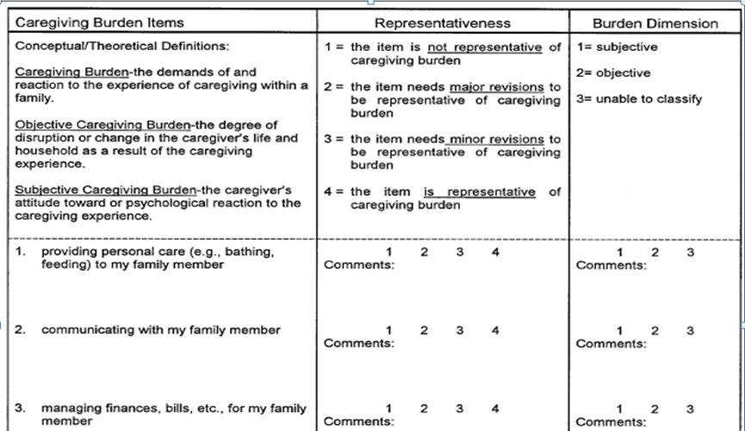
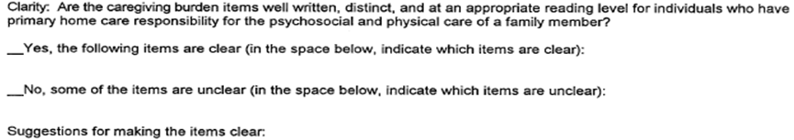
CVI, Example 1
Notes:
In this hypothetical example, there are 3 experts and they are asked to review a 10-item scale and state whether these items are relevant to the content of concepts identified by researchers. Experts say Yes or No about content validity. Their scores are then summarize using a 4-point assessment scale in the column titled Experts in Agreement.

Slide 25
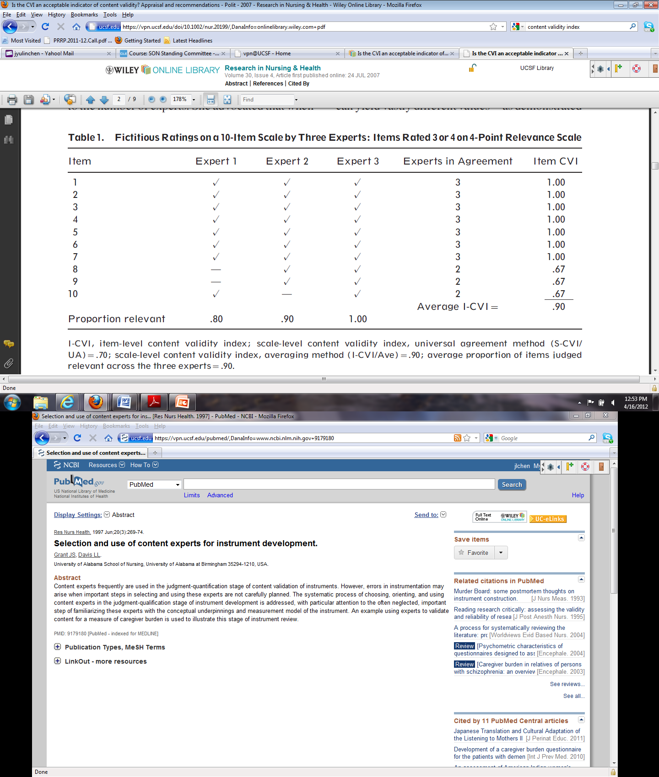
CVI, Example 1
Notes:
Expert scores are then converted into a numeric Content Validity Index.
1) Average item-level I-CVI is 90%, meaning that on average experts agree that items are relevant and good at representing the main content concepts.
2) Universal agreement = S-CVI/UA=0.70, meaning that all experts agree only on some items as being good at representing the main content concepts.
3) Average proportion of items judged relevant across the three experts: take proportion relevant by expert: (0.80+0.90+1.0)/3=2.7/3=0.90

Slide 26
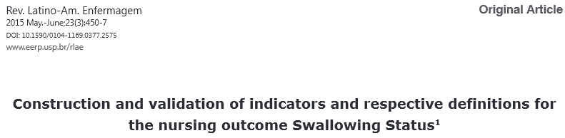
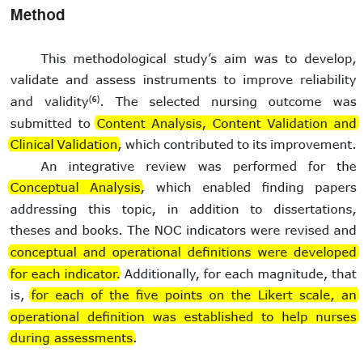
CVI, Example 2
Content validity:
Quantitative approach
11 judges examined the relevance and clarity of each indicator and respective definition according to the following: -1 (inappropriate definition/indicator), 0 (somewhat appropriate definition/indicator), and +1 (appropriate definition/indicator)
CVI were calculated

Slide 27
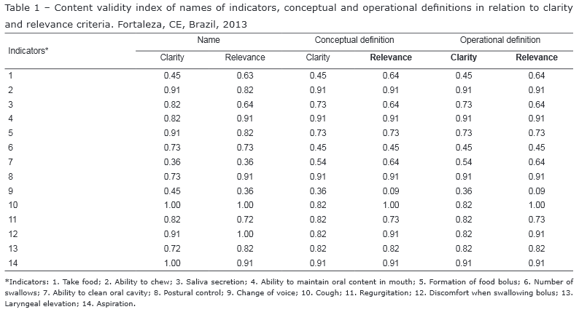
CVI, Example 2
Content validity:
Quantitative approach
Results: All the indicators, with the exception of the indicator “Ability to bring food to mouth”, presented CVI>0.80.
Clinical Validation: two pairs of nurses assessed 81 patients, one pair used an instrument with definitions and the other used an instrument without definitions
Result: greater
uniformity and accuracy
was achieved by the pair
of nurses using the
conceptual and
operational definitions for
the indicators of the
nursing outcome
Swallowing Status

Slide 28
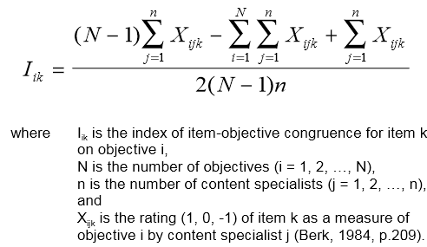
Content validity:
Quantitative approach
Index of Item-Objective Congruence (developed by Rovinelli & Hambleton (1977)
An index of –1 can be interpreted as complete agreement by all experts that the item is measuring all the wrong objectives
An index of +1 can be interpreted as complete agreement by all experts that the item is only measuring the correct objective

Slide 29
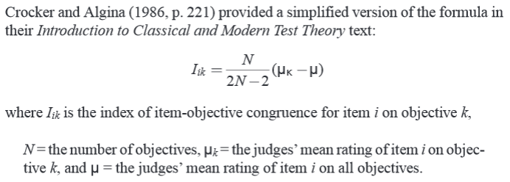
IOC, Example 1
Content validity:
Quantitative approach
Content experts rate items regarding how well they do (or do not) tap the established objectives
The ratings are:
  1: item clearly taps objective
  0: unsure/unclear
  -1: item clearly does not tap objective
Several competing objectives are provided for each item
A statistical formula is then applied to the ratings of each item across raters
The result is an index ranging from –1 to +1

Slide 30

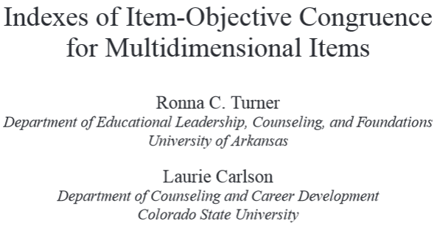
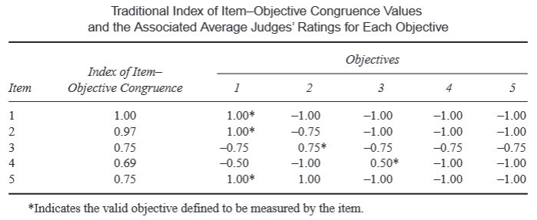
Content validity:
Quantitative approach
IOC, Example 2
Five items, five objectives, and ratings provided from four content experts
The experts agree that Item #2 is clearly measuring Objective 1 and not measuring Objectives 3, 4 and 5
Only one of four experts
believed that it is unclear whether the item is a measure of Objective 2
There are no statistical tests for assessing significance of the measure
One expert provided the rating of unsure for each of the 5 objectives of item #3
Item #4 has a lower index value than the other items (either 2 of the 4 experts are unsure or 1 of the 4 experts believes the item is clearly not measuring Objective 3
Items #1-3 would fall within the acceptable range of values using 4 content experts
Notes:
“-1” means that all four experts were sure that the items were clearly not measuring objectives
“-0.75” means that one out of four experts believed that it is unclear whether the item is a measure of specific objectives
“-0.50” means that two out of four experts believed that it is unclear whether the item is a measure of specific objectives
Q: Index of IOC is similar for items #3 and 5, so why do we say that item #5 falls outside the acceptable range of values using 4 content experts?

Slide 31
Content validity -
Steps for evaluation
Summary
Define the performance domain of interest
Select a panel of experts
Provide a structured framework for the process of matching items to the performance domain
Collect and summarize the data
Estimate numeric values for content validity measures

Slide 32
Types of validity
Content
Criterion-related
    Concurrent validity
    Predictive validity
Construct
  Convergent validity
  Discriminant validity

Slide 33
Criterion-related validity
  Refers to the extent that a test performance corresponds to an accurate measure of interest
  This type of validity is established by relating scores on the measure to some external criterion, and is usually expressed as a correlation coefficient of some sort, that is often referred to as the validity coefficient

Slide 34
Criterion-related validity:
Steps for evaluation
Identify a criterion and a method for measuring it
Identify an appropriate sample of examinees
Administer the test
Obtain data on the criterion
Determine the strength of the relationship between test scores and criterion performance

Slide 35
Criterion-related validity –
Concurrent validity
A correlation between a measure and a criterion when both measurements are obtained at the same point in time.
Q: Is the test effective in predicting performance on a simultaneously administered criterion measure?
This type of validity is established by relating scores on the measure to some external criterion, and is usually expressed as a correlation coefficient of some sort, that is often referred to as the validity coefficient.

Slide 36
Criterion-related validity –
Concurrent validity
In concurrent validity, we assess the operationalization's ability to distinguish between groups that it should theoretically be able to distinguish between.
    Example: if we come up with a way of assessing manic-depression, our measure should be able to distinguish between people who are diagnosed as manic-depression and those diagnosed paranoid schizophrenic.
  It is also demonstrated where a test correlates well with a measure that has previously been validated

Slide 37
Criterion-related validity –
Predictive validity
  A correlation between a measure and a criterion when there is a reasonable period of time between measurements.
  Is the test effective in forecasting future behavior?

Slide 38
Criterion-related validity –
Predictive validity
  In predictive validity, we assess the operationalization's ability to predict something it should theoretically be able to predict.
    Example: We might theorize that a measure of math ability should be able to predict how well a person will do in an science-based profession.

Slide 39
Criterion-related validity –
The Criterion Problem
The enigma
  If you have a good criterion, then why on earth are you developing a new measure!
The reality
  Most external criteria are inherently flawed… either they aren’t completely appropriate, or they have bad statistical properties like restriction of range

Slide 40
Criterion-related validity –
Quantitative approach
Concurrent validity
  Correlate a new instrument with an established one
    If outcomes are dichotomous
      use a two-by-two table to estimate sensitivity, specificity, PPV, NPV for new measure using the old one as a “gold standard”
      Phi (ϕ) coefficient for overall correlation
        Related to chi-square (χ²/N)
    If outcomes are continuous
      Use Pearson’s r
Predictive validity
  Need to wait a period of time between instrument #1 and #2
  Same stat methods as for Concurrent validity

Slide 41
Types of validity
Content
Criterion-related
Construct
    Convergent validity - measures that are theoretically supposed to be highly interrelated are, in practice, highly interrelated
    Discriminant validity - measures that shouldn't be related to each other in fact were not

Slide 42
Construct Validity –
The degree to which an instrument measures the theoretical construct or trait/characteristic it was designed to measure
In order to establish a measure's construct validity, the developer makes certain predictions that relate the measure to the theory that underlies it. These predictions can take a number of forms.

Slide 43
Convergent validity
To examine the degree to which the operationalization is similar to (converges on) other operationalizations that it theoretically should be similar to (high correlations)
    For instance, to show the convergent validity of a test of arithmetic skills, we might correlate the scores on our test with scores on other tests that purport to measure basic math ability, where high correlations would be evidence of convergent validity.

Slide 44
Discriminant Validity
  To examine the degree to which the operationalization is not similar to (diverges from) other operationalizations that it theoretically should be not be similar to (low correlations).

Slide 45
Construct validity:
Quantitative approach
Thorough and appropriate specification and sampling of the domain
Multitrait-Multimethod Matrix (MTMM)(Campbell and Fiske 1959)
Factor Analysis
  Allows one to examine the congruence between the empirical data and the theoretical domain
    WEEK #11!

Slide 46
Construct validity:
Quantitative approach
Multitrait-multimethod validation
(Cambell & Fiske, 1959)
In a multi-method, multi-trait validation strategy, the researcher not only uses multiple indicators per concept, but also gathers data for each indicator by multiple methods and/or from multiple sources.

Slide 47
Construct validity:
Quantitative approach
Multitrait-multimethod validation (MTMM)
Convergent validity
  Demonstrated by high correlations between scores on instruments measuring the same trait by different methods
  (Monotrait-Hetero method)
Divergent (or discriminant) validity
  Demonstrated by low correlations between scores on instruments measuring different traits by the same method (Heterotrait-Mono method)
  If correlations are as high or higher than Monotraint-Hetero method correlations, then the method of measurement is more important than the concepts being measured – not good!
Use reliability indices to assess validity!

Slide 48
MTMM Example 1:
A study of sixth grade students
We want to measure three traits or concepts:
  Self Esteem (SE)
  Self Disclosure (SD)
  Locus of Control (LC)
Measure each of these three different ways:
  Student self assessment via Paper-and-Pencil (P&P)
  Teacher rating
  Parent rating
Measure reliability by:
  test-retest, internal consistency
Look at correlations between these reliability indices to assess validity

Slide 49
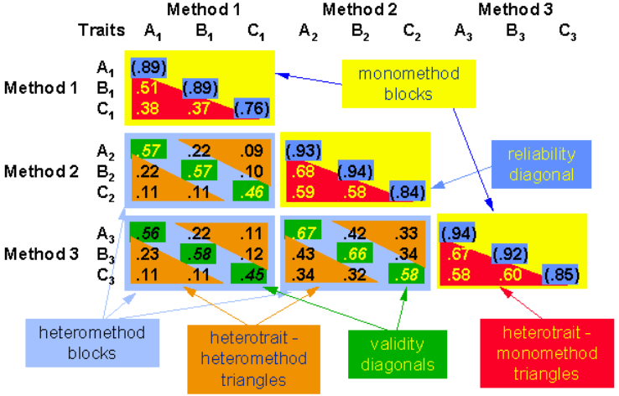
Multitrait-multimethod validation

Slide 50
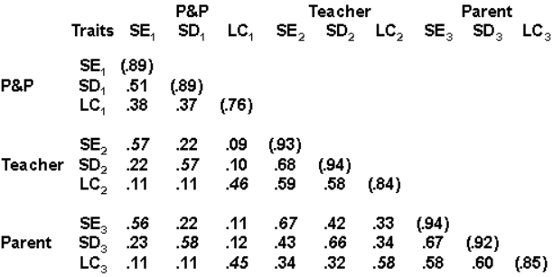
  Self Esteem (SE)
  Self Disclosure (SD)
  Locus of Control (LC)
  MTMM Example 1:
  Monotrait-Hetero method:
Construct validity demonstrated by high correlations between scores on instruments measuring the same trait by different method
monomethod
heteromethod
Notes:
0.89 on the reliability diagonal in the top left monomethod block: reliability of the Student self assessment via Paper-and-Pencil (P&P) taken on two different dates
0.51 from the same block: monomethod-heterotrait correlation, i.e., the correlation between scores for different traits evaluated by the same method, between SE and SD by P&P. Pretty morederate! Should be even lower.
0.57 from the block below: monotrait-heteromethod correlation, i.e., the correlation between scores for the same trait of self-esteem measured by two instruments, P&P and Parent. Pretty moderate! Should be higher.

Slide 51
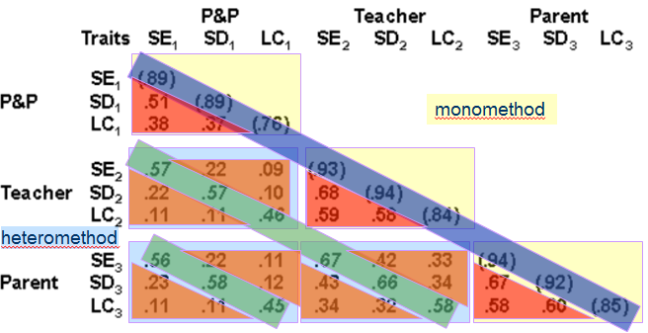
MTMM, Example 1:
A study of 6th grade students
Interpretation
Coefficients in the reliability diagonal
should consistently be the highest in the matrix (test-retest)
Coefficients in the validity diagonals should be significantly different from zero and high enough to warrant further investigation (→ convergent validity)
A validity coefficient should be higher than values lying in its column and row in the same heteromethod block
  (SE P&P)-(SE Teacher)=0.57 should be greater than (SE P&P)-(SD Teacher)=0.22, (SE P&P)-(LC Teacher)=0.11, (SE Teacher)-(SD P&P)=0.22 and (SE Teacher)-(LC P&P)=0.09
A validity coefficient should be higher than all coefficients in the heterotrait-monomethod triangles (trait factors should be stronger than methods factors)
  However, (LC P&P)-(LC Teacher)=0.46 is less than (SE Teacher)-(SD Teacher)=0.68, (SE Teacher)-(LC Teacher)=0.59, and (SD Teacher)-(LC Teacher)=0.58
The same pattern of trait interrelationship should be seen in all triangles
  in all triangles the SE-SD relationship is approximately twice as large as the relationships that involve LC
Conclusion: fairly strong construct validity!
  Self Esteem (SE)
  Self Disclosure (SD)
  Locus of Control (LC)

Slide 52
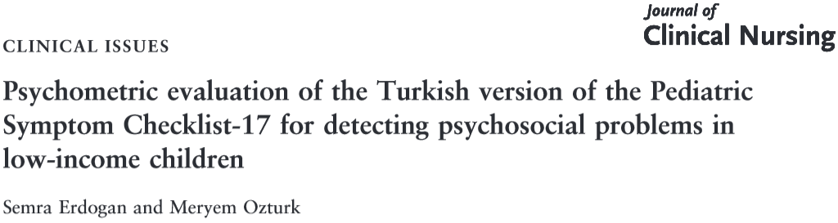
Construct
Validity
Example 2:
N= 306 parents with children between 6–16 years in Turkey
Parents completed PSC-17 and Child Behavior Checklist (CBCL)
Content validity was ascertained by an expert panel of 8 academicians specializing in child and adolescence psychiatry
The content validity index (CVI) score was computed by summing the percentage agreement scores of all items that were given by the experts a rating of ‘3’ or ‘4’. The criterion for retaining an item was at least 80% agreement among the experts at the agree or strongly agree level of relevance to the construct (CVI=98.5%)
The convergent validity was assessed by the Spearman correlation between PSC-17 and CBCL scores (r=0.82 for Total scores)
The discriminant validity of the PSC-17 was assessed by examining whether the PSC-17 could differentiate among the normal, borderline and clinical range groups using ANOVA test (p<0.001 between the groups)
The construct validity was assessed by factor analysis
CBCL was used to estimate the optimal cut-off score of PSC-17 by using a Receiver operating characteristic analysis

Slide 53
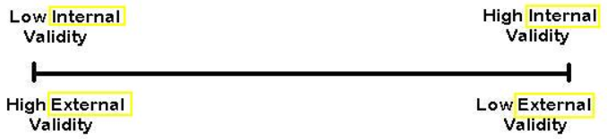
The Continuum of Validity

Slide 54
Types of validity evidence
(Goodwin 2002)
24 validity standards to evaluate 5 types of validity evidence:
  Evidence based on test content
  Evidence based on response process
  Evidence based on internal structure
  Evidence based on relations to other variables
  Evidence based on the consequences of testing
Notes:
In recent years, there have been attempts to enlarge the sphere of measurement validity from 3 C’s to a broader framework.
An article by Goodwin proposed to evaluate 5 types of measurement validity using 24 standards

Slide 55
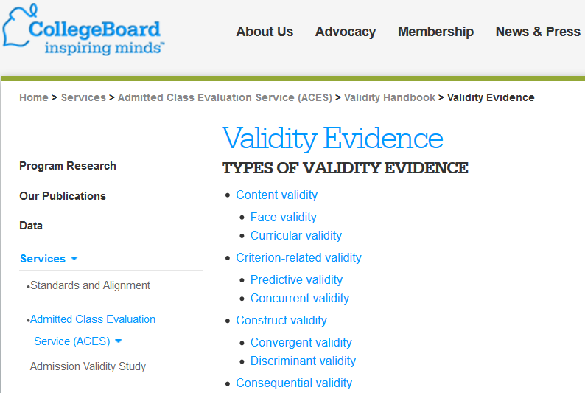
Notes:
Other researchers have advocated keeping the old system of 3 C’s and adding the 4th C: consequential validity.

Slide 56
What is Consequential Validity?
Messick (1989) originally introduced consequences to the validity argument. Later, Shepard (1993, 1997) broadened the definition by arguing one must investigate both positive/negative and intended/unintended consequences of score-based inferences to properly evaluate the validity of the assessment system.

Slide 57

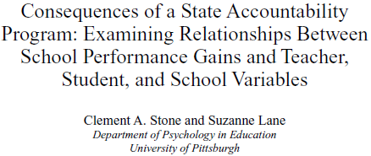
Consequential validity,
Example:
Objectives: Explore the relationship between (a) changes in the scores from the Maryland State Performance Assessment Program from 1993 to 1998 and (b) classroom instruction and assessment practices, student learning and motivation, students’ and teachers’ beliefs about and attitudes toward the assessment, and a school characteristic
Intended Consequences - state assessments are intended to impact:
  Student, teacher, and administrator motivation and effort;
  Curriculum and instructional content and strategies;
  Content and format of classroom assessments;
  Professional development support;
  Use and nature of test preparation activities; and
  Student, teacher, administrator, and public awareness and beliefs about the assessment, criteria for judging performance, and the use of assessment results.
Notes:
In this example, researchers developed a questionnaire to assess the relationship between …
They predicted that this assessment will have some consequences, namely: …

Slide 58
Consequential validity
Example:
At times, however, unintended consequences are possible such as:
  Narrowing of curriculum and instruction to focus only on the specific learning outcomes assessed;
  Use of test preparation materials that are closely linked to the assessment without making changes to the curriculum and instruction;
  Use of unethical test preparation materials; and
  Inappropriate use of test scores by administrators.

Slide 59
Consequential validity –
Impact on future research
Research questions on the consequential validity of alternate assessments from the perspective of:
  Students/Parents
      What benefits to students have accrued from the participation in AA-AAS?
      What is the relationship between student performance in AA-AAS and post-school life outcomes?
  Teachers
      What is the extent to which alternate assessments are a part of daily classroom routine?
  School
      Is there any relationship between student performance in the AA-AAS and student performance in the general assessment?
Notes:
In addition, consequential validity describes how one study has an impact on future research directions. For example, in the study of Alternate Assessments Based on Alternate Academic Achievement Standards (AA-AAS assessement), study results could have an effect on students, parents and teachers as individuals and on the schools as organizations. These effects could be explored in future studies using new research questions generated as a result of assessment of consequential validity.

Slide 60
Advantages of the new validity classification over the classical theory
Clearly defined validation activities
New emphasis on the consequences of testing
  social consequences of using a particular test for a particular purpose
  How are the scores really being used?
  Does this testing lead to benefits for participants?
  Are there negative spin-offs?
  Kreiter et al. 2013: Testing within medical education makes a strong positive contribution to learning
Better understanding of the meaning of ‘valid instrument’ and ‘validity of measure’
So, what happened in practice?
Both continue to co-exist!

Slide 61
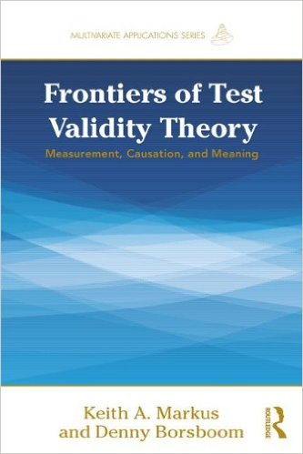
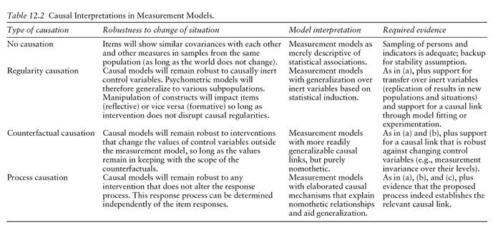
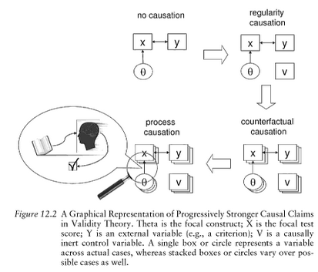
New Validity Theories
Notes:
Epidemiologists have also recently started to try to integrate causal theories into assessment of validity. For example, this book on Frontiers of Test Validity Theory proposes to evaluate validity of measurement methods using various types of causation, including regularity, counterfactual and process causation. The authors define regularity causation as “theory which analyzes causation in terms of nothing but regular sequence.” You are familiar with counterfactual causation and process causation refers to the situation when “some interactions are more readily defined as processes rather than as a series of events.” I encourage you to review this book to find out more about new validity theories and how this methodological work could be helpful in your own research when you are trying to establish causal links between exposures and outcomes.

Slide 62
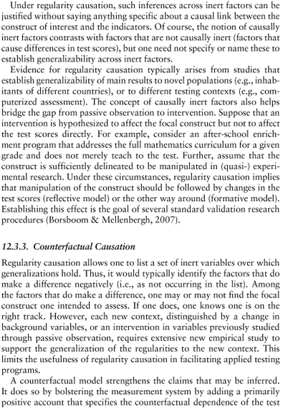
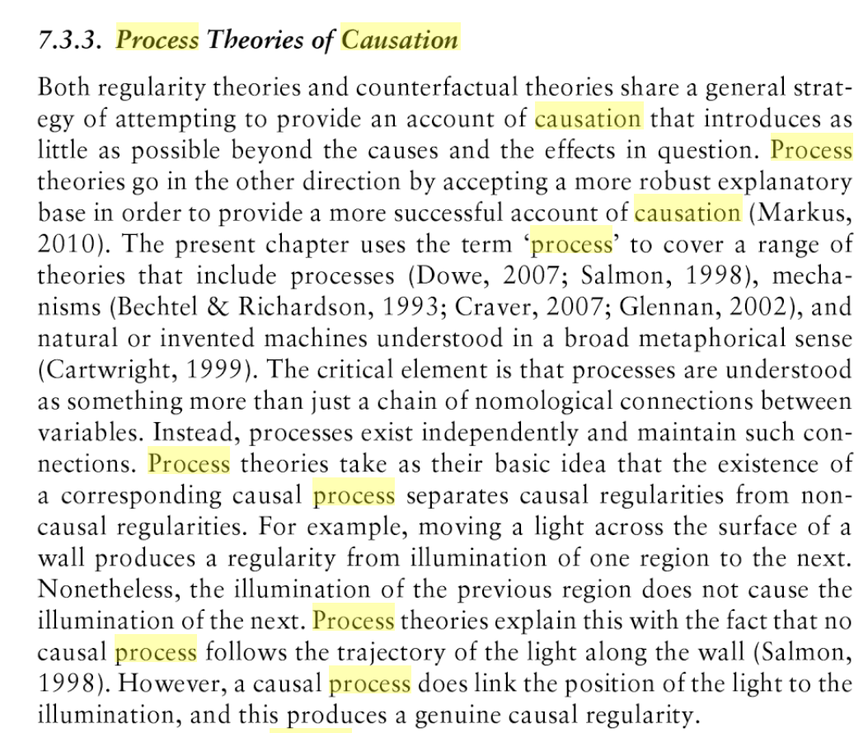
Markus and Borsboom 2013

Slide 63
Summary (and practical advice)
Appreciate that assessment of validity is not simple and requires time and multiple steps
Understand the caveats of classical validity theory
For building your own tests, think content validity
For judging externally prepared tests/instruments, start with a clear definition of what’s to be covered
For criterion-related validity, take into account group variability; and think about validity of the criterion
For your own assessments, try to eliminate the influence of any factors not related to what you want to measure
To better understand the overall research questions, think about consequential validity while developing your instrument (questionnaire)

