Slide 1
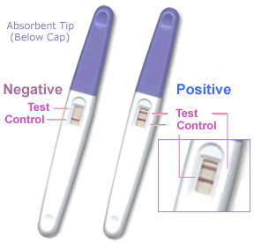
Dichotomous Tests
Tom Newman, MD, MPH
September 27, 2018
Open a browser window to PollEv.com/ebmdoc

Slide 2
Overview
Announcements, clarifications, chapter 1 and 5 material
Definitions: sensitivity, specificity, prior and posterior probability, predictive value, accuracy
2 x 2 table method
Likelihood ratios - WOWO
Probability and odds
False-negative and false-positive confusion
Treatment and testing thresholds and regret graphs (web demonstration)
Likelihood ratios in action: the $10,000 case of conjunctivitis (time permitting)

Slide 3
Announcements and clarifications
Problem writing assignment new due date: 11/15/18
EBD-1 rather than EBD-2 is OK
Send me suggestions about chapters or problems for EBD-2
Most CLE postings should have a 2018 date
Questions about Chapters 1 or 2?
Take a slide rule

Slide 4
Definitions: Sensitivity and Specificity
 |  | Disease status
 |  | Has disease | No disease | Total
Test Result | Positive | A | B | A + B
 | Negative | C | D | C + D
 | Total | A + C | B + D | A + B + C + D
Sensitivity =
A/ (A+C)
Specificity =
D/ (B+D)
P.I.D. = Positive in Disease
N.I.H.= Negative in Health

Slide 5
Definitions: Pretest (prior) and post-test (posterior) probability
 |  | Disease status
 |  | Has disease | No disease | Total
Test Result | Positive | A | B | A + B
 | Negative | C | D | C + D
 | Total | A + C | B + D | A + B + C + D
Pretest probability =
(A+C)/(A+B+C+D)
Posttest probability =
A/(A+B) or C/(C+D)
ONLY IF SAMPLING IS “CROSS-SECTIONAL”!

Slide 6
“Cross-sectional” sampling
 |  | Disease status
 |  | Has disease | No disease | Total
Test Result | Positive | A | B | A + B
 | Negative | C | D | C + D
 | Total | A + C | B + D | A + B + C + D
Subjects are sampled randomly or consecutively, so that the proportion with disease (pretest probability, prevalence) is clinically meaningful

Slide 7
Definitions: Positive and Negative Predictive value, Accuracy
 |  | Disease status
 |  | Has disease | No disease | Total
Test Result | Positive | A | B | A + B
 | Negative | C | D | C + D
 | Total | A + C | B + D | A + B + C + D
Accuracy = (A + D)/(A + B + C + D)
= (A+D)/N
Demonstration: screening for brain tumors with >99.9% accuracy
PPV=A/(A+B)
NPV=D/(C+D)

Slide 8
“Case-control” sampling
 |  | Disease status
 |  | Has disease | No disease | Total
Test Result | Positive | A | B | A + B
 | Negative | C | D | C + D
 | Total | A + C | B + D | A + B + C + D
 |  | Disease status
 |  | Has disease | No disease | Total
Test Result | Positive | A | B | A + B
 | Negative | C | D | C + D
 | Total | A + C | B + D | A + B + C + D
Pretest probability =
(A+C)/(A+B+C+D)
PPV=A/(A+B)
NPV=D/(C+D)
Subjects with and without disease are sampled separately
Proportion with disease is determined by investigator

Slide 9
Prevalence vs. Pretest probability
Prevalence= proportion with the disease at one point in time
  Typically measured in populations
Pretest probability is the more general term
  For screening tests, pretest probability = prevalence
  For diagnostic tests, pretest probability incorporates history and physical exam items

Slide 10
Post-test probability vs. Predictive value
Post-test probability after a + test is the same as positive predictive value
Post-test probability after a − test is
1− negative predictive value
Any questions about definitions?

Slide 11
2 × 2 table method: screening mammography for 45 year old woman
 |  | Disease status
 |  | Breast Cancer | No Breast cancer | Total
Mammography | Positive
 | Negative
 | Total
Pretest probability 2.8/1000
Sensitivity 75%
Specificity 93%

Slide 12
Audience Response
Given these parameters, if her mammogram is “positive,” what is the (“post-test”) probability that she has invasive breast cancer?
  Pretest probability 2.8/1000
  Sensitivity 75%
  Specificity 93%
          < 5%
          5 to <20%
          20 to <50%
          50 to <80%
          ≥ 80%.

Slide 13

Notes:
What is the probability of invasive breast cancer?
https://www.polleverywhere.com/multiple_choice_polls/gKAaSJ33KgtuBUh

Slide 14
2x2 table method: screening mammography for 45 year old woman. 1. Draw a table
 |  | Disease status
 |  | Breast Cancer | No Breast cancer | Total
Mammography | Positive
 | Negative
 | Total
Pretest probability 2.8/1000
Sensitivity 75%
Specificity 93%

Slide 15
2x2 table method: screening mammography for 45 year old woman. 2. Put a big number in the corner
 |  | Disease status
 |  | Breast Cancer | No Breast cancer | Total
Mammography | Positive
 | Negative
 | Total |  |  | 10,000
Pretest probability 2.8/1000
Sensitivity 75%
Specificity 93%

Slide 16
2x2 table method: screening mammography for 45 year old woman. 3. Get the total N with disease
 |  | Disease status
 |  | Breast Cancer | No Breast cancer | Total
Mammography | Positive
 | Negative
 | Total | 28 |  | 10,000
Pretest probability 2.8/1000
Sensitivity 75%
Specificity 93%

Slide 17
2x2 table method: screening mammography for 45 year old woman. 4. Use sensitivity to get true +
 |  | Disease status
 |  | Breast Cancer | No Breast cancer | Total
Mammography | Positive | 21
 | Negative
 | Total | 28 |  | 10,000
Pretest probability 2.8/1000
Sensitivity 75%
Specificity 93%

Slide 18
2x2 table method: screening mammography for 45 year old woman. 5. Subtract to get false −
 |  | Disease status
 |  | Breast Cancer | No Breast cancer | Total
Mammography | Positive | 21
 | Negative | 7
 | Total | 28 |  | 10,000
Pretest probability 2.8/1000
Sensitivity 75%
Specificity 93%

Slide 19
2x2 table method: screening mammography for 45 year old woman. 6. Get N without disease
 |  | Disease status
 |  | Breast Cancer | No Breast cancer | Total
Mammography | Positive | 21
 | Negative | 7
 | Total | 28 | 9,972 | 10,000
Pretest probability 2.8/1000
Sensitivity 75%
Specificity 93%

Slide 20
2x2 table method: screening mammography for 45 year old woman. 7. Use (1-specificity) for false +
 |  | Disease status
 |  | Breast Cancer | No Breast cancer | Total
Mammography | Positive | 21 | 698
 | Negative | 7
 | Total | 28 | 9,972 | 10,000
Pretest probability 2.8/1000
Sensitivity 75%
Specificity 93%

Slide 21
2x2 table method: screening mammography for 45 year old woman. 8. Subtract for true −
 |  | Disease status
 |  | Breast Cancer | No Breast cancer | Total
Mammography | Positive | 21 | 698
 | Negative | 7 | 9,274
 | Total | 28 | 9,972 | 10,000
Pretest probability 2.8/1000
Sensitivity 75%
Specificity 93%

Slide 22
2x2 table method: screening mammography for 45 year old woman. 9. Get row totals
 |  | Disease status
 |  | Breast Cancer | No Breast cancer | Total
Mammography | Positive | 21 | 698 | 719
 | Negative | 7 | 9,274 | 9,281
 | Total | 28 | 9,972 | 10,000
Pretest probability 2.8/1000
Post-test probability if mammo + = (PPV+) = ?
Post-test probability if mammo – = (1−NPV) = ?

Slide 23
2x2 table method: screening mammography for 45 year old woman. 10. Calculate post-test prob.
 |  | Disease status
 |  | Breast Cancer | No Breast cancer | Total
Mammography | Positive | 21 | 698 | 719
 | Negative | 7 | 9,274 | 9,281
 | Total | 28 | 9,972 | 10,000
Post-test probability if mammo + = (PPV+)= 21/719 = 2.9%
Post-test probability if mammo – = (1−NPV) = 7/9281= 0.75 per 1000.

Slide 24
Likelihood Ratios

Slide 25
Likelihood ratios
A ratio of likelihoods:
P(Result|Disease)
P(Result|No Disease)
WOWO = With Over WithOut
https://www.youtube.com/watch?v=oQUL4bfVqxE start at 20 sec
Pretest odds × LR = Posttest odds
(Alternate terminology:
Prior odds × LR = Posterior odds)

Slide 26
What Tests Do
Their results change our estimate of the probability of disease
HIV−
HIV+
0%
Negative test
Positive test
100%
Reasurance
Order a Test
Treatment
A good test changes estimates a lot.

Slide 27
Post-test Probability of Disease Depends on 2 Things
Where you started from (low, medium, high risk)
Result of the test, visualized as length and direction of the result arrow
Basic paradigm:
  What we thought before + test result = What we think now

Slide 28
Likelihood ratio Effect of test result
LR very low (0.01) Greatly decreases P(disease)
LR < 1 (eg, 0.5) Decreases P(disease)
LR = 1 No effect on P(disease)
LR >1 (eg, 2) Increases P(disease)
LR Very high (100) Greatly increases P(disease)

Slide 29
Likelihood Ratios
Advantages
  Simplify calculation of post-test probability (especially when disease is rare)
  Capture information for multi-level and continuous tests (next week)
Disadvantages
  If either pretest or posttest probability is high > ~10%) you need to use odds (or a slide rule or calculator)

Slide 30
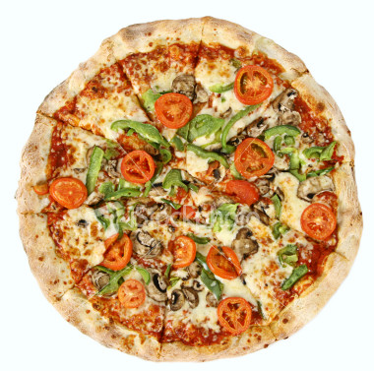
Digression: understanding odds with pizzas
Michael and I share a small pizza while we grade exams.
My share is 3 times as big as his (ratio 3:1).
What PROPORTION of the pizza do I get?
3/4 (75%)
Tom’s share
Notes:
http://www.istockphoto.com/stock-photo-1513646-vegetarian-pizza-whole-3.php

Slide 31
Digression: understanding odds with pizzas -2
Tom’s share
I only eat 1/5 (20%) of the pizza.
What is the RATIO of the size of what I eat to what I don’t eat?
1:4
Odds = P/(1−P)
P=odds/(1+odds)
If odds are a/b, probability = a/(a+b)
Remember for slide 46
Notes:
http://www.istockphoto.com/stock-photo-1513646-vegetarian-pizza-whole-3.php

Slide 32
LR for mammography
LR = P(Result|Disease) (WOWO)
P(Result|No Disease)
LR+ = P(+ Mammogram|Breast Cancer)
P(+ Mammogram|No Breast Cancer)
LR+ = Sensitivity
1-Specificity
LR+ = 75% = 10.7
7%
Pretest odds × LR = Posttest odds
Can ignore odds step when P’s are low
2.8/1000 × 10.7 = 30/1000 = 3%

Slide 33
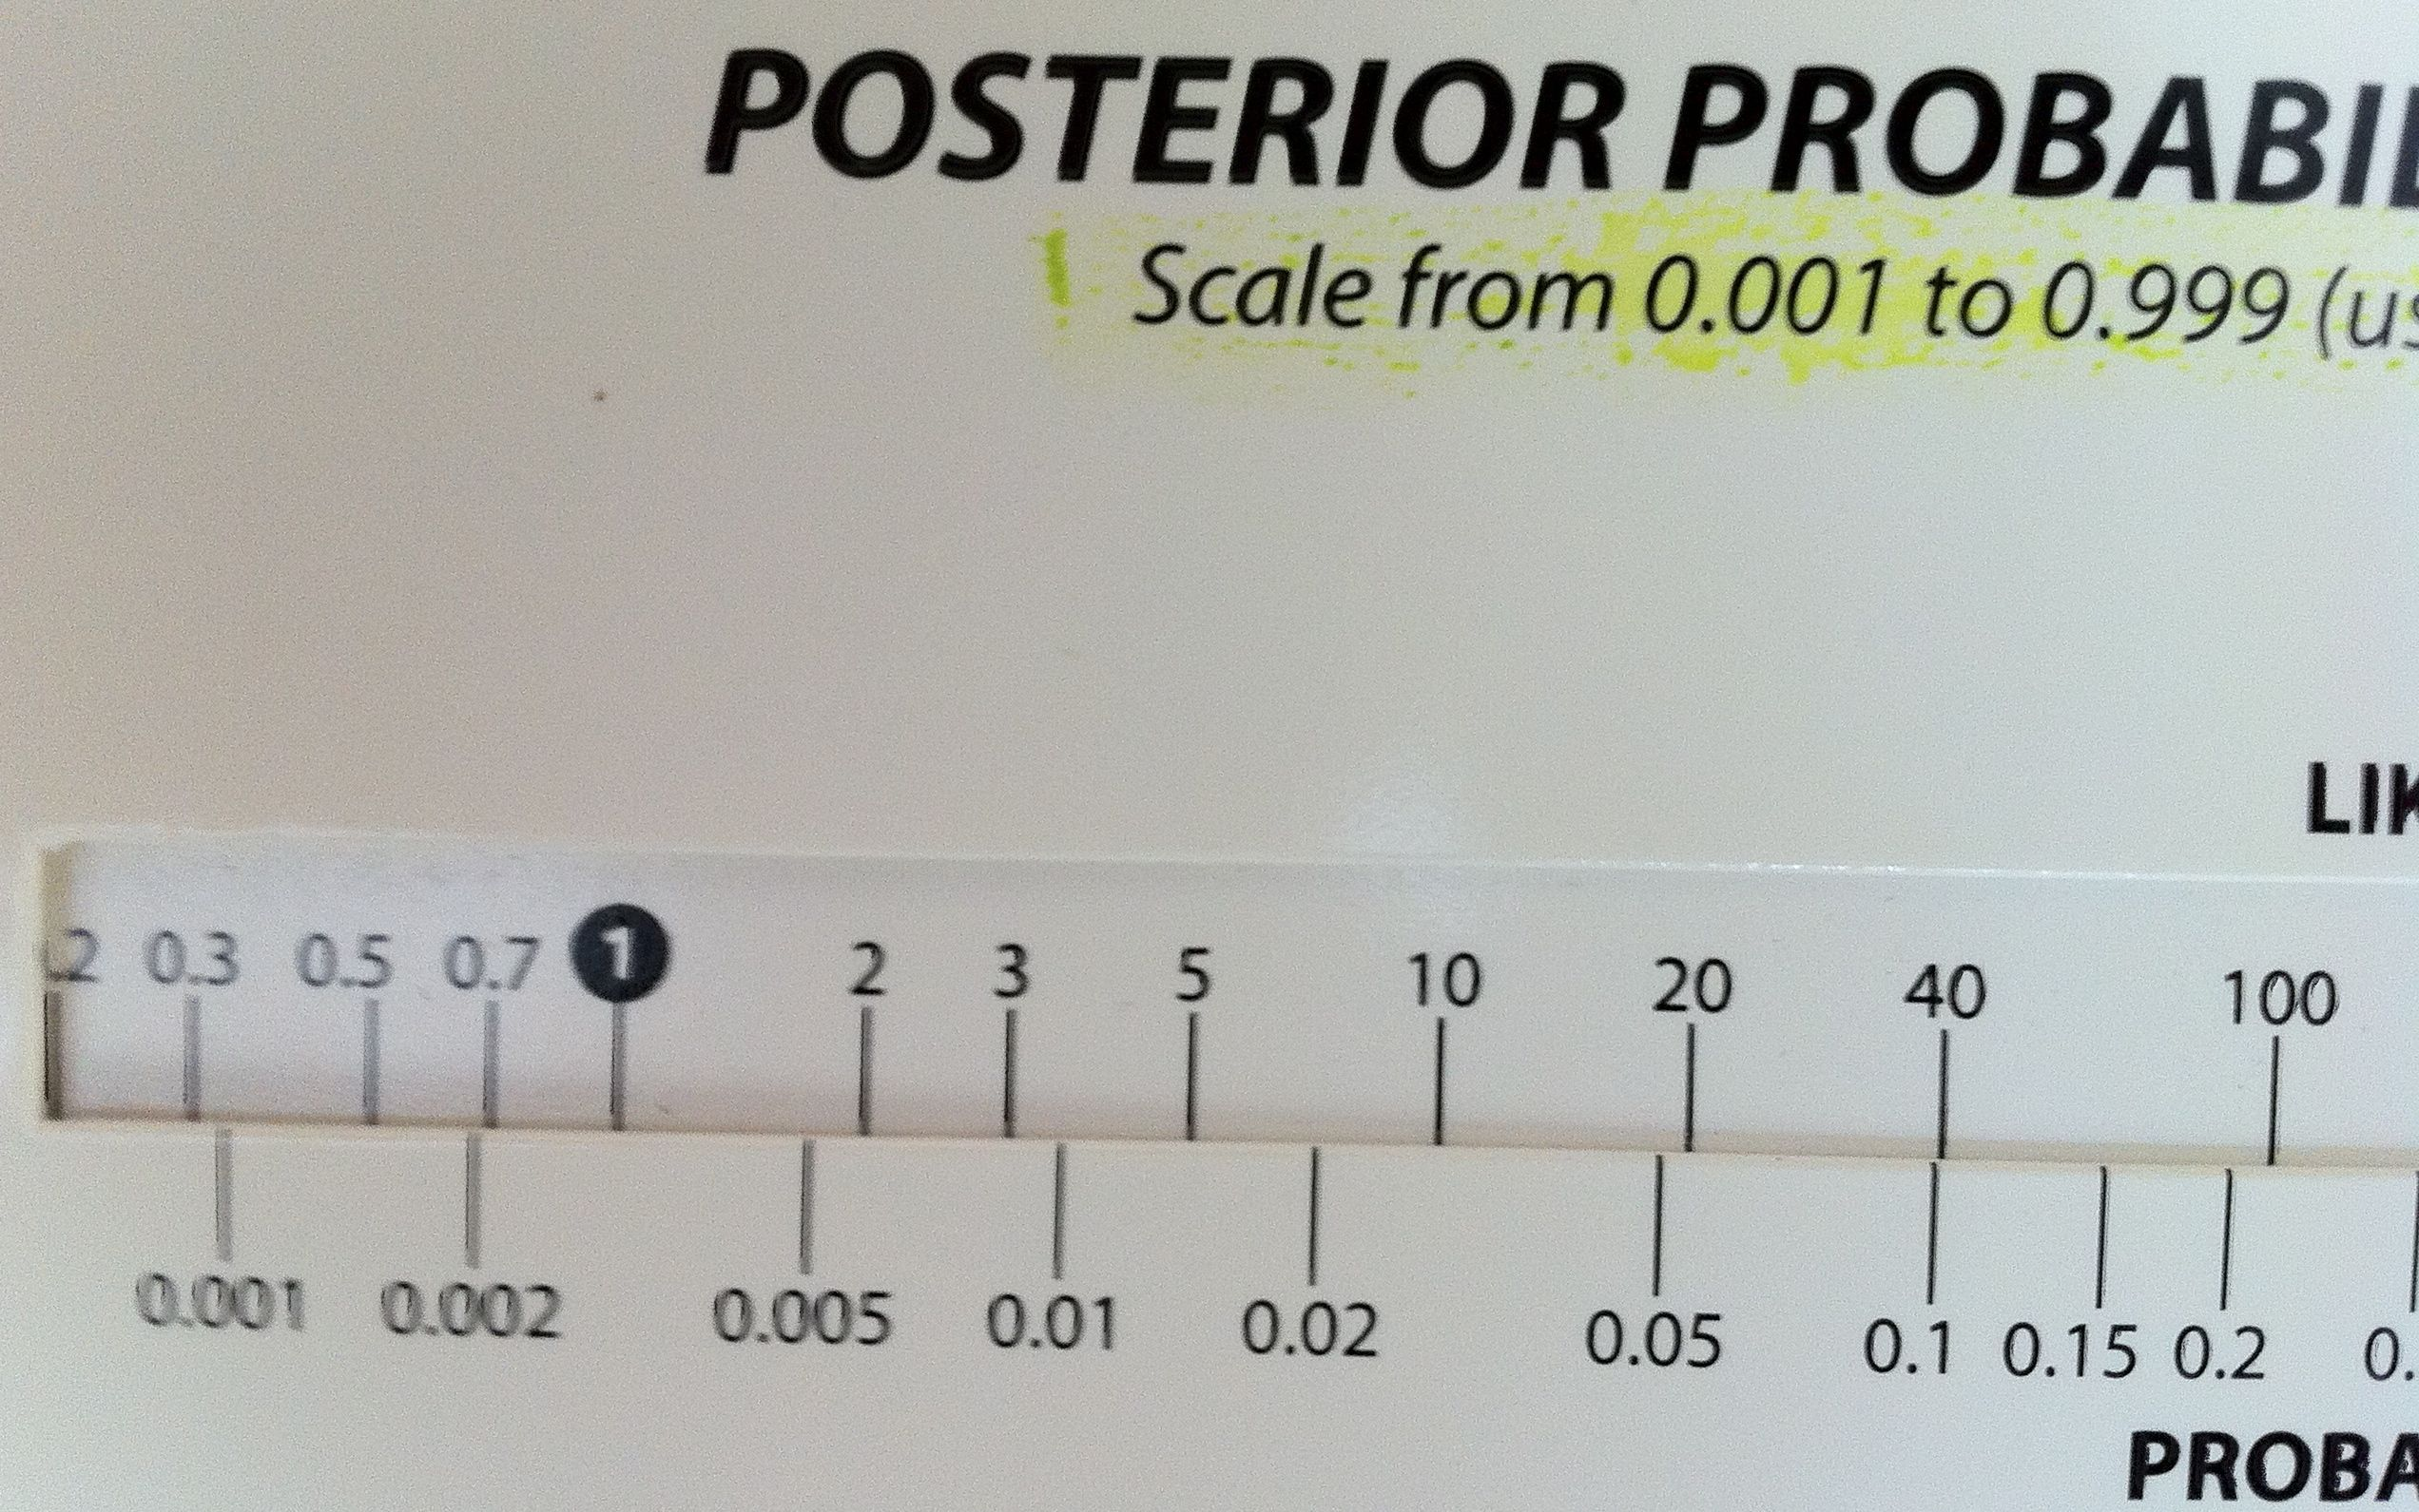
Can Use Slide Rule

Slide 34
False-negative confusion
Sensitivity of rapid strep test is 85%
Therefore, the false negative rate is 15%
A 15% probability of missing strep is too high, so I should always culture if the rapid strep is negative

Slide 35
What's wrong?
Strep
No Strep
Total
Rapid Test +
TP
FP
TP+FP
Rapid Test −
FN
TN
TN+FN
TP+FN
FP+TN
2 definitions of “false negative rate”
Vertical: 1− sensitivity = FN/(TP+FN). This one is easier because it’s (assumed to be) constant.
Horizontal: 1 − negative predictive value = FN/(FN+TN). This one is harder because it depends on prior probability, but it is the one that should determine clinical decisions.

Slide 36
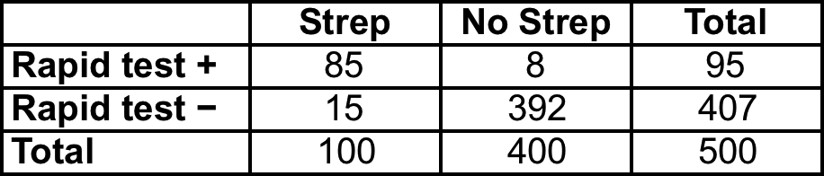
If prior probability of strep = 20% and specificity is 98%
False negative rate (def #2) = 15/407 = 3.7%
NNC (number needed to culture) = 1/.037 = 27 to identify 1 false-negative rapid test (if pre-test probability = 20%).
At some prior probability of strep, culture after negative rapid test is not indicated.
Notes:
Ask: what is sens? What is spec?

Slide 37
Audience response: Which is closest to the UCSF Medical Center charge for a Rapid Strep test (as of 9/20/18)?
$29
$63
$151
$272
$348

Slide 38
Notes:
Which is closest to the UCSF Medical Center charge for a Rapid Strep test (as of 9/15/15)?
https://www.polleverywhere.com/multiple_choice_polls/00NDDsFaBNlAffP

Slide 39
Strep test charges at UCSF
From: Blesilda Kozlowski <Blesilda.Kozlowski@ucsf.edu>
Date: Friday, September 21, 2018 at 7:23 AM
To: Thomas Newman <Newman@epi.ucsf.edu>
Subject: RE: Lab test prices
Hi Tom,
Below are FY19 List prices.
Rapid Group A Strep: $272
Group A Strep Culture: $216
If culture is positive for Group A, C, or G Strep, there is an additional charge of $129

Slide 40
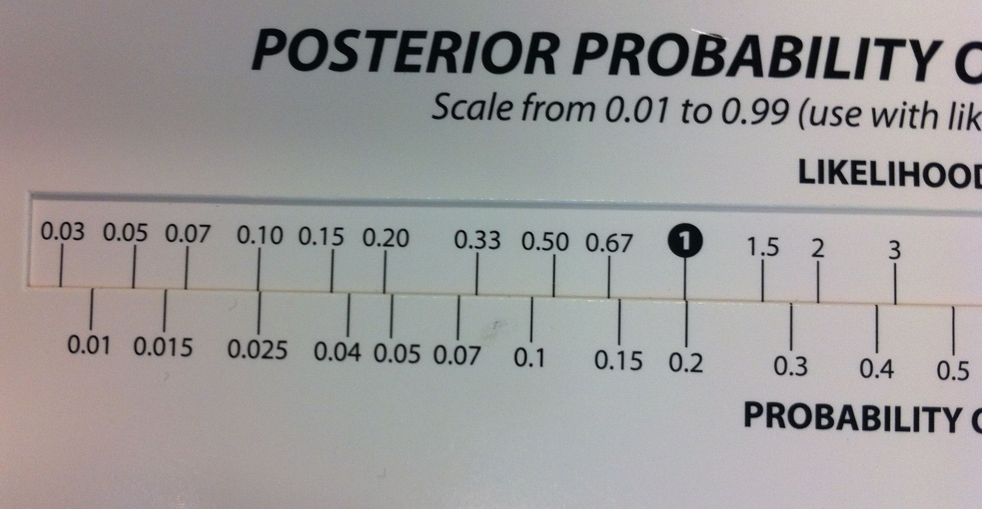
Try it with slide rule!
Sensitivity 85%
Specificity 98%
Prior probability = 20%
Rapid test is NEGATIVE. What is LR?
LR = (1-sens)/spec = .15/.98 = 0.15
3.7%

Slide 41
STRETCH BREAK!

Slide 42
Similar examples:
Sensitivity of urinalysis (UA) for urinary tract infection is only 85%, therefore always culture after a negative UA
Sensitivity of CT scan for subarachnoid hemorrhage is only 90%, therefore always do a lumbar puncture after a negative CT
False positive confusion is similar: 1−specificity ≠ 1−positive predictive value
  More on this in Chapter 11

Slide 43
Treatment Thresholds
No treat
Treat
P_{TT}
Recall Clinical Scenario #2 from Chapter 1, in which we were considering a white blood cell count (WBC) to help decide whether to treat a newborn with antibiotics.
The WBC will help us estimate the probability of infection, but we still need a Treatment Threshold to decide what to do.

Slide 44
Treatment threshold
Lowest probability of disease at which the expected benefits of an empiric treatment exceed its expected risks and costs
Depends on relative badness* of 2 types of errors
  How bad it is to treat someone who does not have the disease? (=C)
  How bad it is not to treat someone who does have the disease? (=B)
  To simplify, all costs are the costs compared with making the right decision
*Sometimes abbreviated as "cost," but it includes everything bad, not just financial cost

Slide 45
Decision Analytic Framework
P(D)
☺
Yes
Treated infection
No
Yes
Infected?
😐 = C
Treated, no infection.
No
Start antibiotics?
Yes
Untreated infection
☹ = B
No
Infected?
Untreated, no infection
☺

Slide 46
X-Graph: Concept of expected cost (utility)
Expected "cost"
B
Treat: C(1−P)
C
No Treat: BP
0
Probability of Disease
1

Slide 47
Treatment threshold = P where the lines cross:
C(1−P) = BP, so C/B=P/(1−P)
If odds are a/b, probability = a/(a+b)
So if treatment threshold ODDS = C/B, the treatment threshold probability = C/(C+B)
Treatment threshold odds
Expected cost
B
Treat: C(1−P)
C
No Treat: BP
0
0.5
1
47
Probability of Disease

Slide 48
Test/Treat Thresholds
No treat
Treat
P_{TT}
If we know the treatment threshold (P_{TT}), we can use LRs to get testing thresholds
48

Slide 49
Test/Treat Thresholds
LR+
LR−
No treat
Test
Treat
P_{TT}
Use LR+ to find P below which, even if the test is +, you won’t exceed P_{TT}
Use LR− to find P above which, even if the test is −, you won’t go lower than P_{TT}
This defines the testing zone (for a costless test)
49

Slide 50
Test/Treat Thresholds
LR+
LR−
No treat
Test
Treat
P_{TT}
Algebra is very simple
  No treat/test threshold odds = Treatment threshold odds/LR+
  Test/Treat threshold odds = Treatment threshold odds /LR−
Things get only a little more complicated when you factor in the cost of the test
50

Slide 51
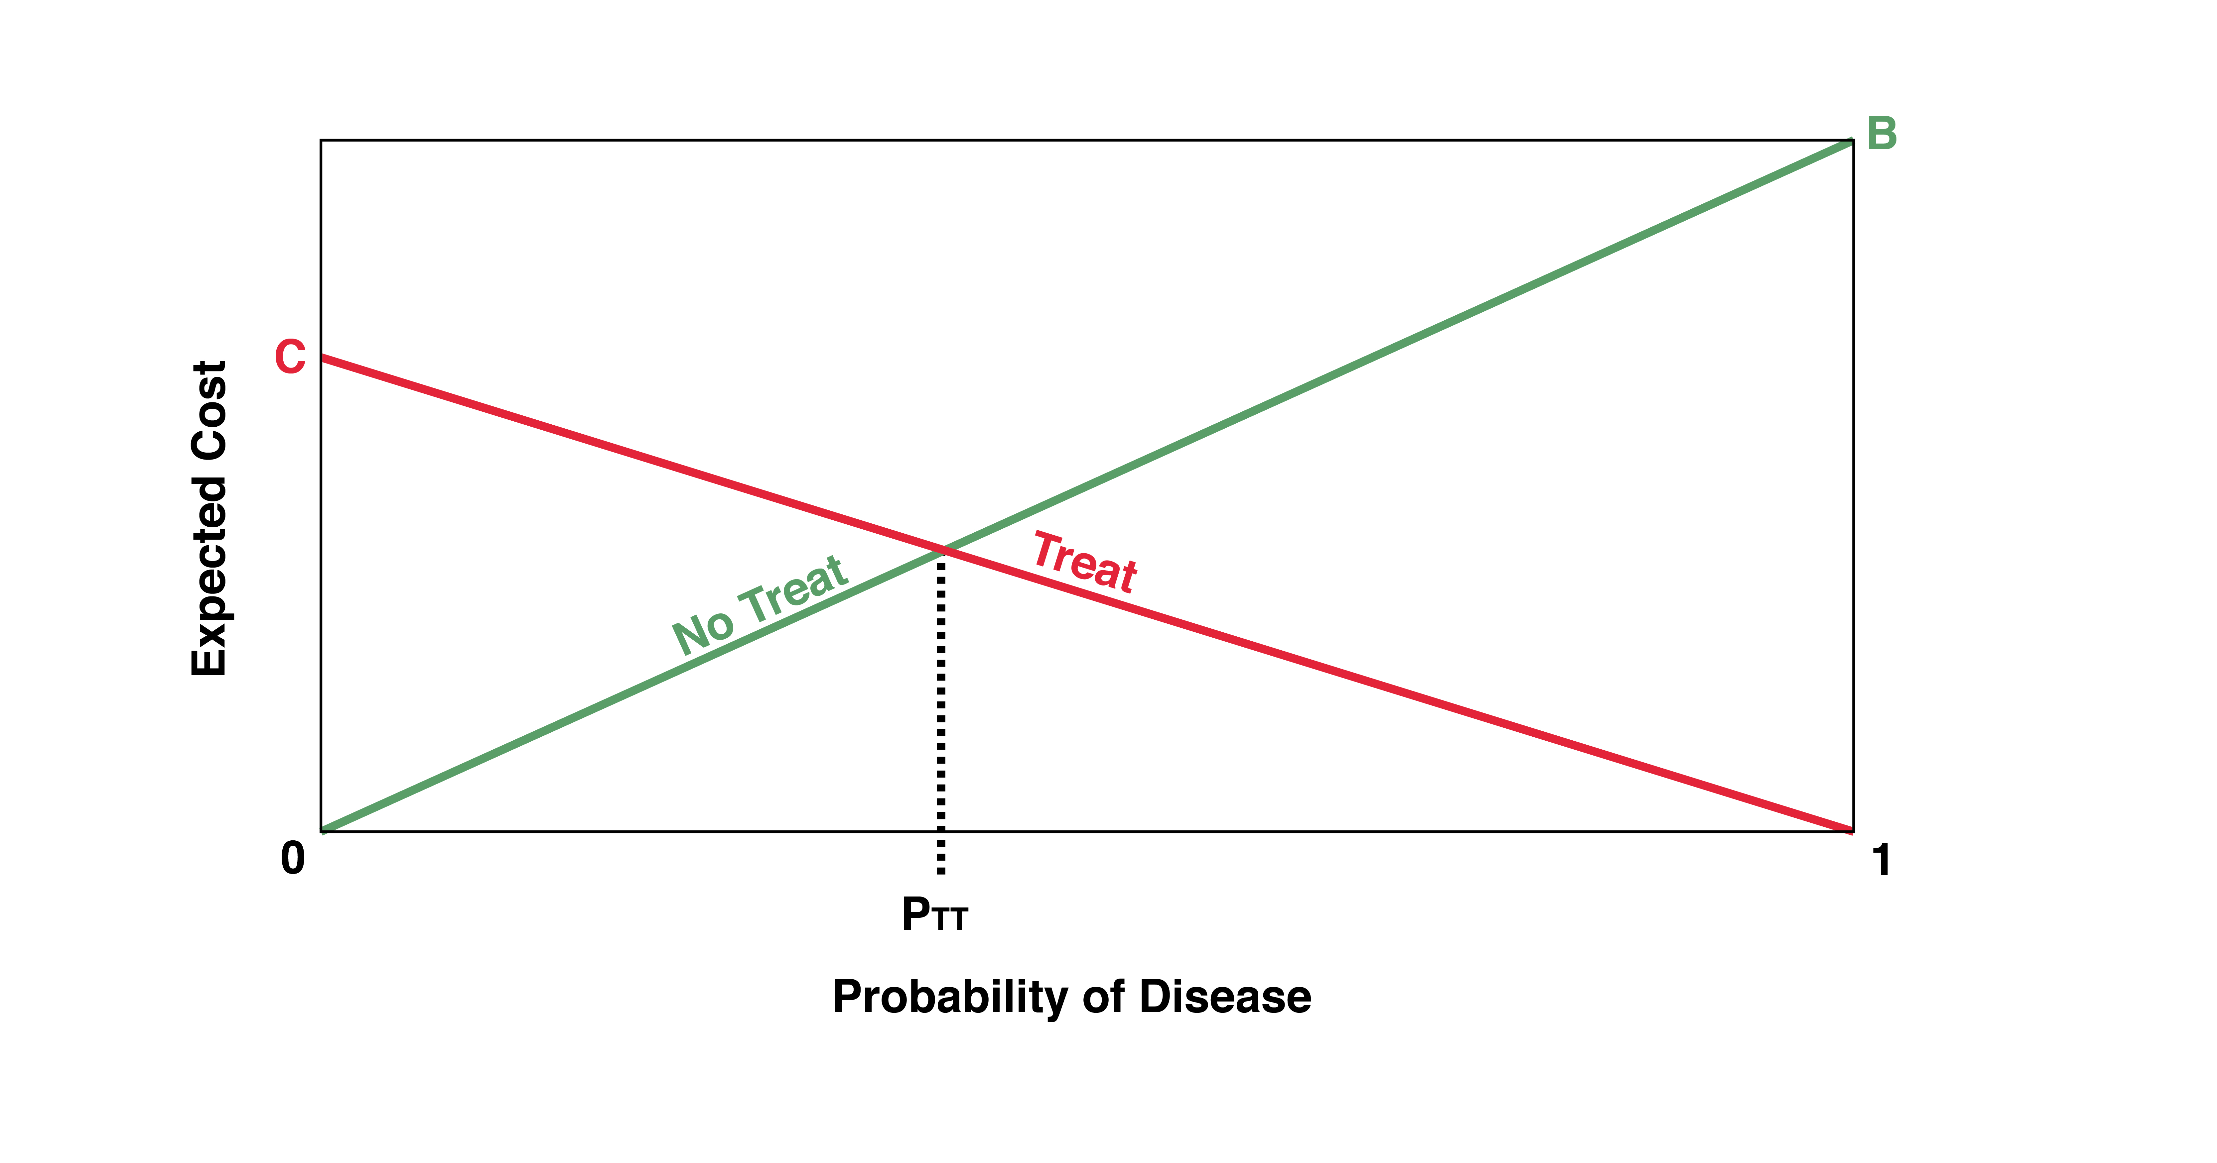
Details in Chapter 2
Figure 2.2 Expected costs of not treating and treating by probability of disease. For probabilities from 0 to P_{TT}, “No Treat” has the lower expected cost. For probabilities from P_{TT} to 1, “Treat” has the lower expected cost.

Slide 52
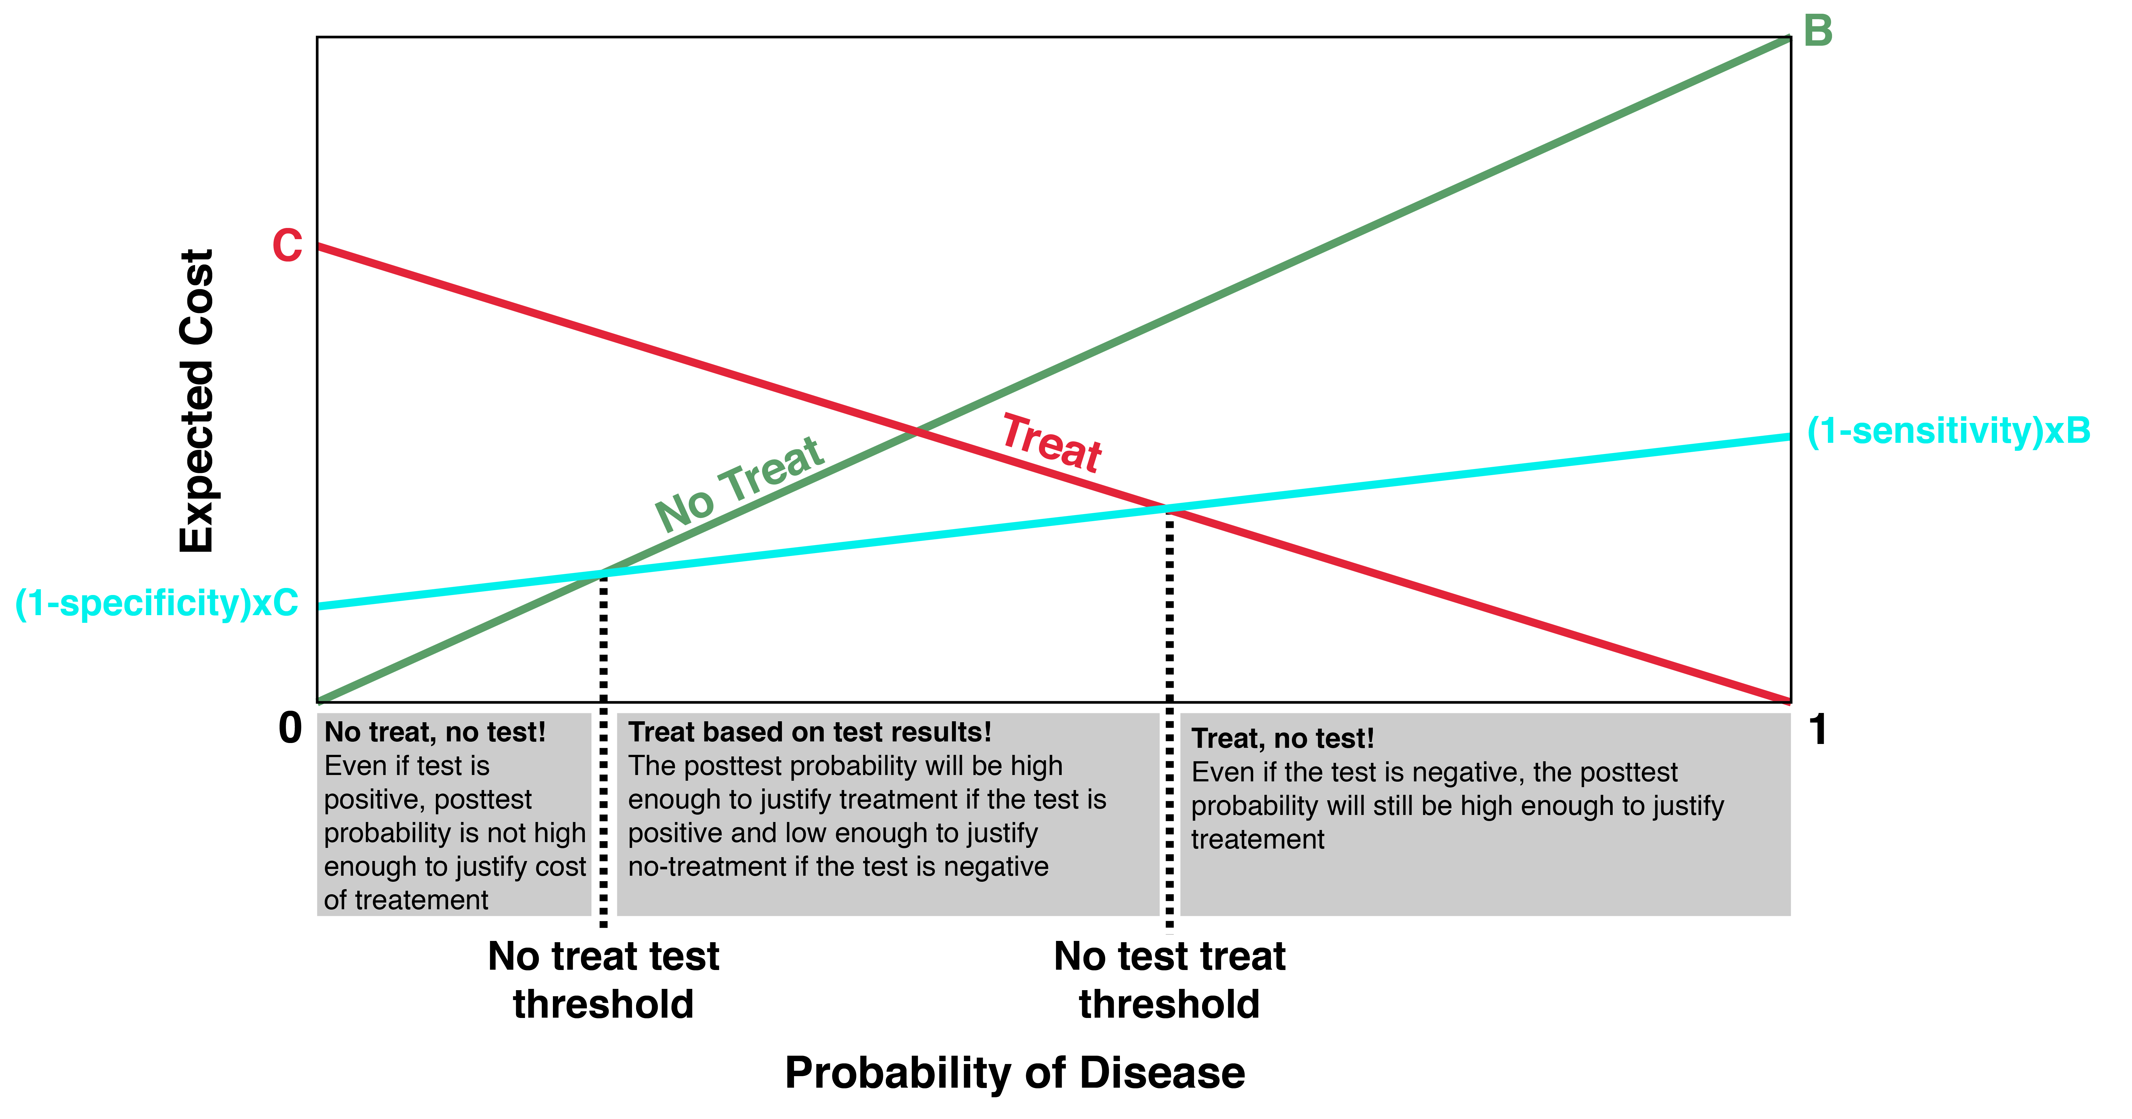
Imperfect but costless test
Figure 2.5 Imperfect but costless test. The expected cost of the “Test” option is higher than the cost of “No Treat” below the No Treat–Test threshold, and higher than the cost of “Treat” above the Test–Treat threshold.

Slide 53
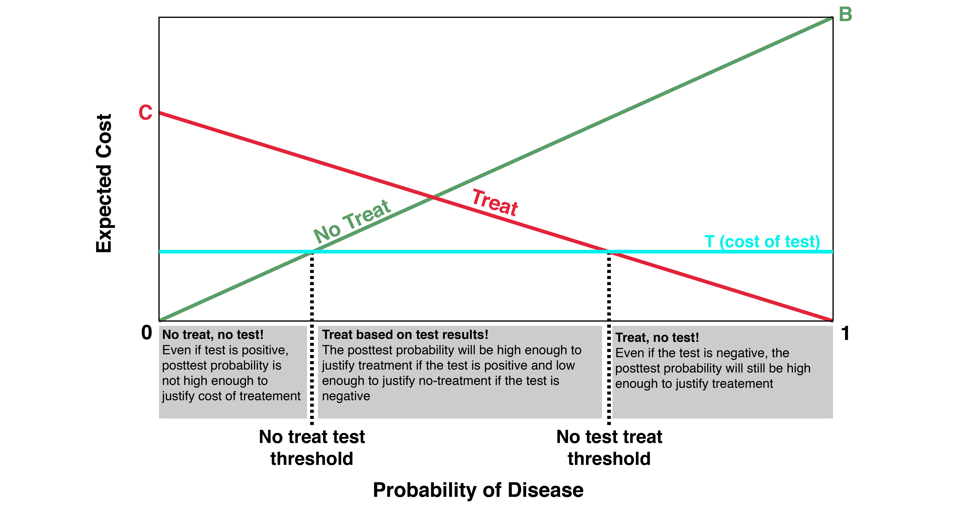
Perfect but costly test
Figure 2.6 “No Treat–Test” and “Test–Treat” thresholds for a perfect but costly test.
.

Slide 54
Excel spreadsheet/EBD-2.net demonstration

Slide 55
How can you not?
Understand likelihood ratios!

Slide 56
Likelihood Ratios in Action: Real Case
6 week old previously well baby seen the day before for conjunctivitis and fussiness (no fever)
Blood culture drawn at that time is now positive for “Staph species.”
  Staph epi: common contaminant, ~3% of blood cultures.
  Staph aureus: nasty bug, but uncommon cause of bacteremia at 6 wks, especially if no skin findings (<3% of true bacteremias)
Meanwhile, baby is no longer fussy, now feeding and acting well.

Slide 57
Likelihood Ratios in Action: Management options
Observation by mother at home; return to clinic if he acts sick
Bring child to ED for some combination of
  Repeat blood culture
  Lumbar puncture to rule out meningitis
  Admission to the hospital
  IV antibiotics
Quote from pediatric resident “How can you not?”

Slide 58
Likelihood Ratios in Action: Quantifying new information
The blood culture is a test for pathogenic bacteremia (bad bacteria in the blood; D+)
The result is “staph species.”
P(result|D+) < 3%
P(result|D-) ~ 3%
LR = <3%/~3%, <1!
Similar process for test “Did he get better without systemic antibiotics?” (LR < 0.2?)
Conclude: his probability of serious infection is now LOWER than the day before when he was sent home.

Slide 59
Likelihood Ratios in Action: What happened?
ED staff had parents bring child to ED for
  Repeat blood culture, IV
  Lumbar puncture to rule out meningitis
Ward full, TN asked to admit baby to NICU at 3:30 AM
TN unable to persuade ED attending to send child home
Mother had a cold, would not have been allowed to see baby in NICU
Baby stayed in ED until organism identified as S. epi 6 hours later
Case presented at joint ED/Pediatrics conference
  All involved ED attendings were out of town

Slide 60
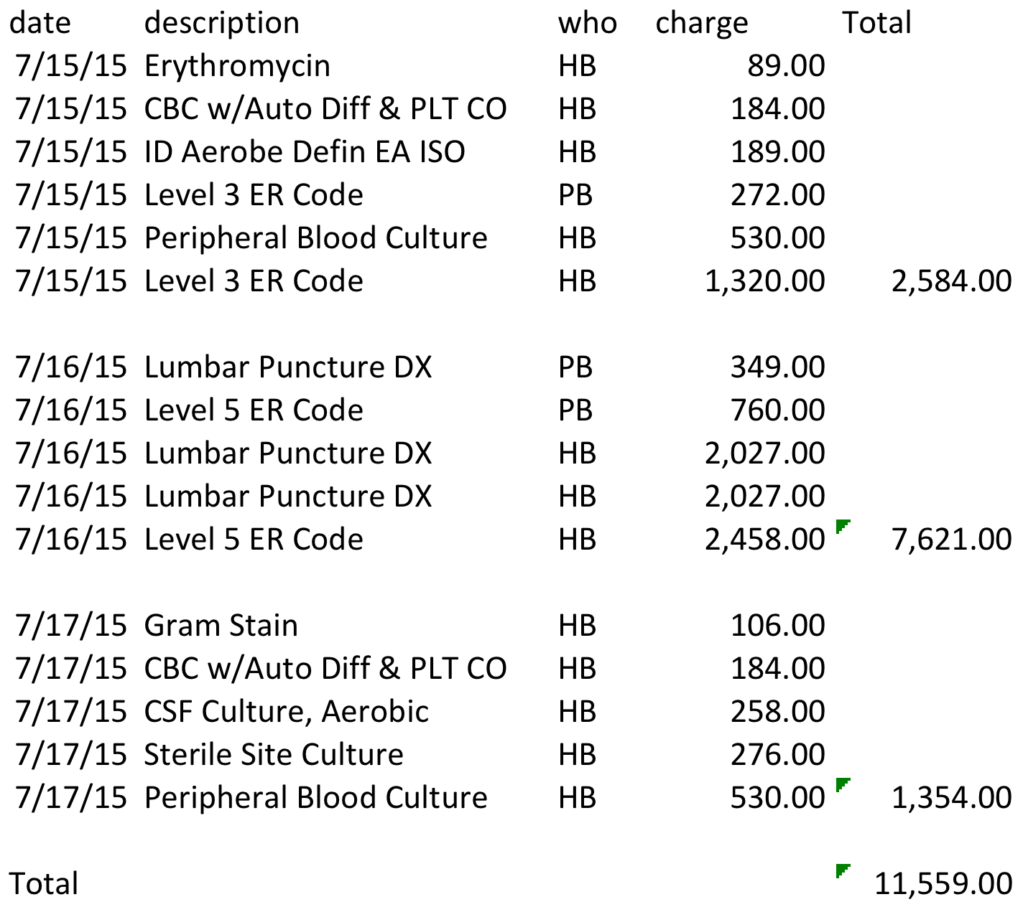
Total UCSF BCH charges
Notes:
PB= professional billing
HB= Hospital billing

Slide 61
Questions?
Definitions: sensitivity, specificity, prior and posterior probability, predictive value, accuracy
2 x 2 table method
Likelihood ratios - WOWO
Probability and odds
False-negative and false-positive confusion
Treatment and testing thresholds and regret graphs (web demonstration)
Likelihood ratios in action: the $10,000 case of conjunctivitis (time permitting)

