Slide 1
Mortality

Slide 2
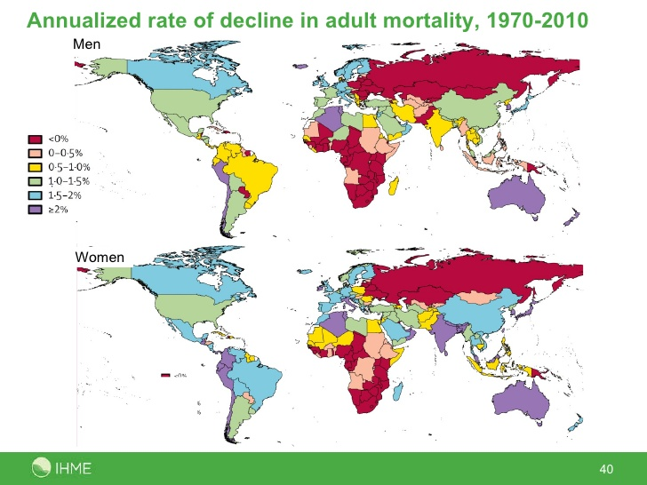
Adult Mortality Decline

Slide 3
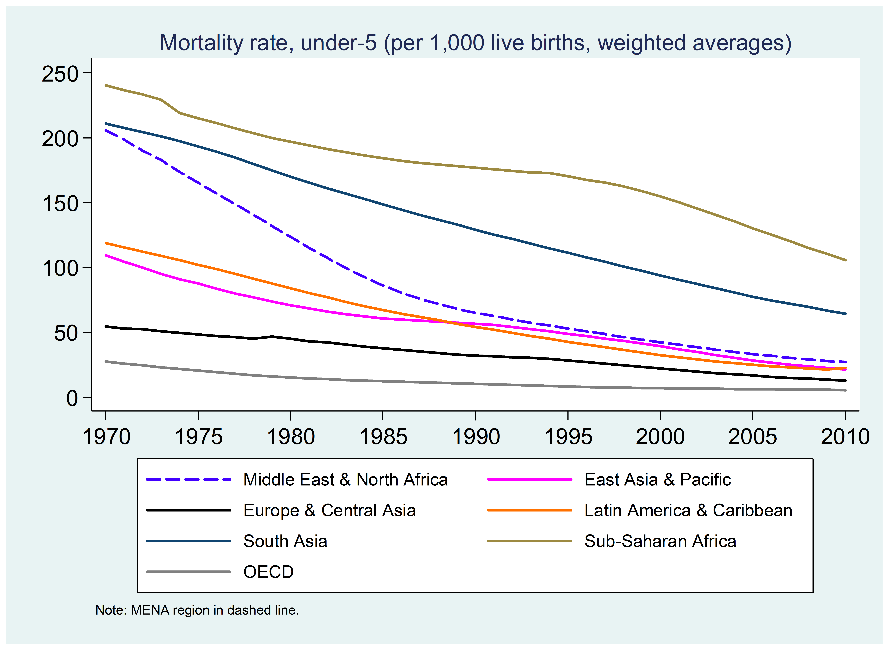
Under 5 mortality rate

Slide 4
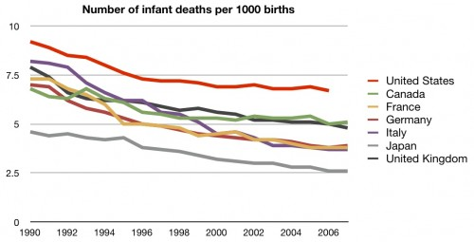
Neonatal mortality

Slide 5
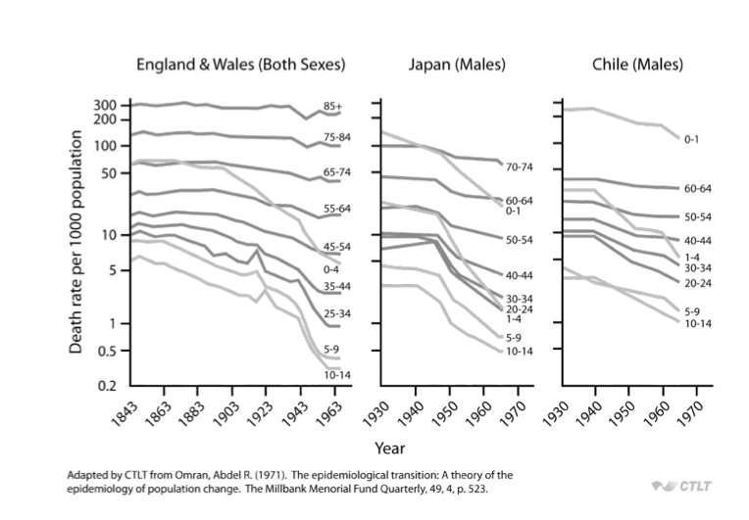
How does mortality differ by age group over time?

Slide 6
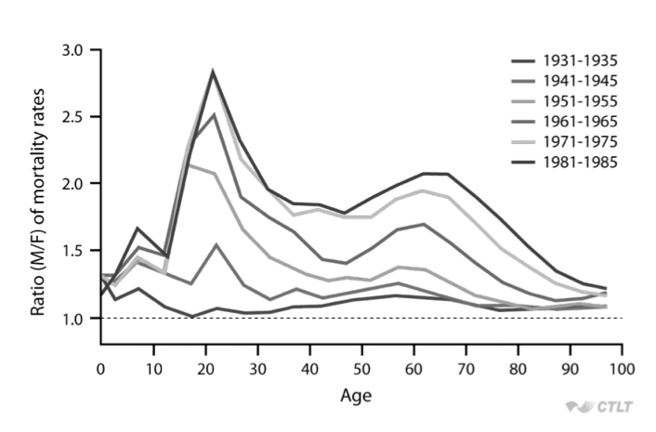
How does mortality differ by sex and age over time? (Sweden)

Slide 7
India: Age contribution to the sex gap in mortality (M/F)

Slide 8
India: Cause contribution to sex gap in mortality (M/F)

Slide 9
Measures

Slide 10
Measuring Mortality
Crude Death Rate=
  Number of deaths in year X, in country Y
  ___________________________________________________________________________________ X 1000
  Mid-year population in year X, country Y
Age specific death rate=
  Number of deaths at age Z, in country Y
  ________________________________________________________________________________________ X 1000
  Number of people age Z, in country Y

Slide 11
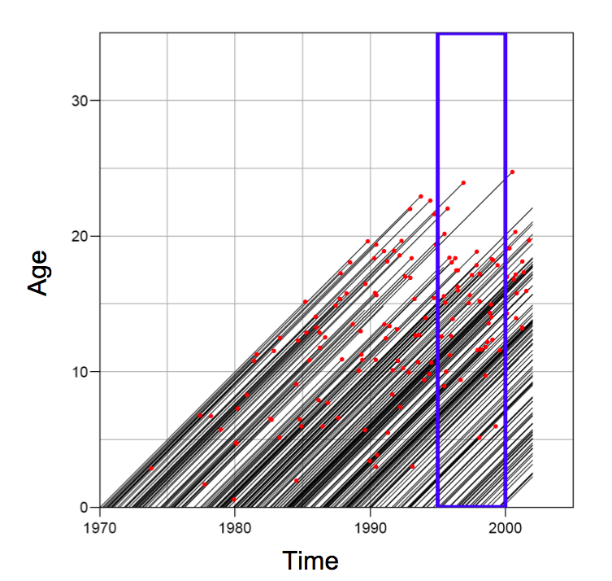
Crude death rate: why is it problematic?
Think about lexis diagrams from the other day

Slide 12
Rate vs probability
Rate:
  Measure of the frequency with which an event occurs in a defined population during a given length of time
  Numerator: Count of events that occur during a period
  Denominator: Midpoint population, or person-years, or other person-time units of exposure for the same period as the numerator
Probability:
  In demography, indicates the likelihood that some event will (or will not) occur to some group of exposed persons during the course of some period of time
  Similar to rates except that they consider the number of people exposed to risk at the start of a time interval

Slide 13
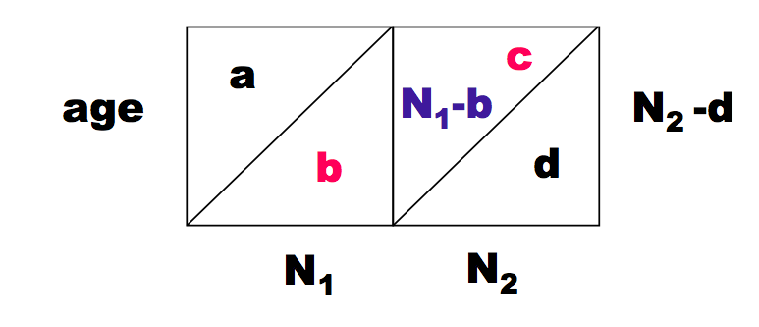
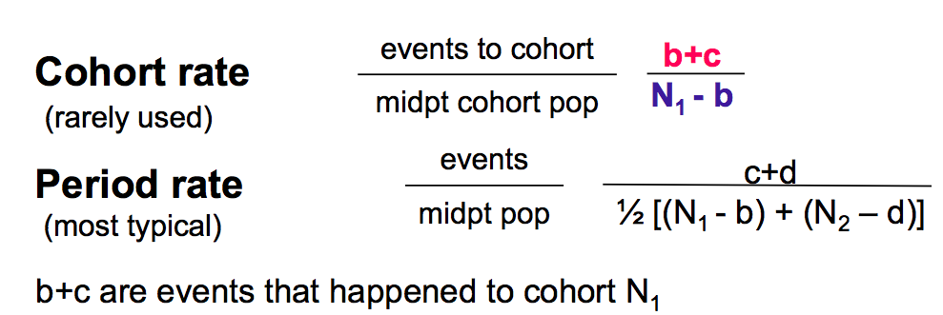
Cohort vs period rates

Slide 14
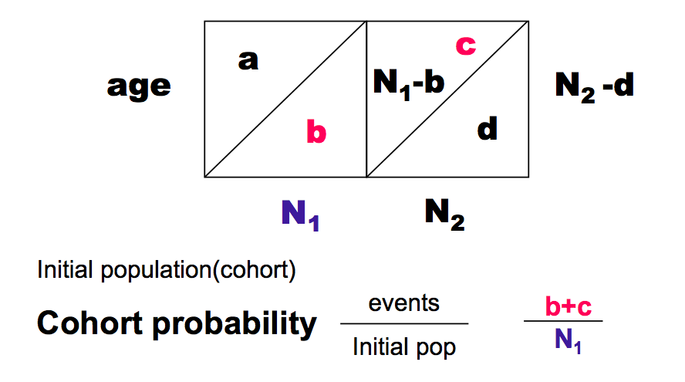
Rates vs probabilities
We often think in terms of probabilities in demography (the probability of dying)
  Life tables next week

Slide 15
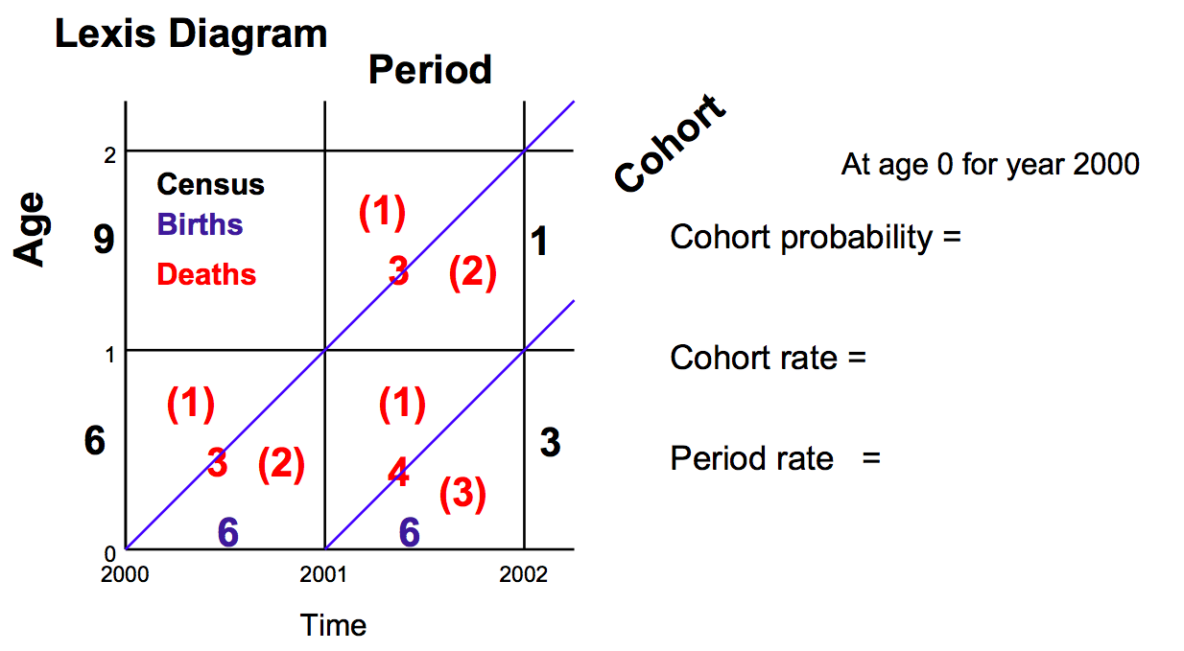
Try to calculate!

Slide 16
Try to calculate!

Slide 17
Try to calculate!
3/6
3/4
3/5

Slide 18
Problem with crude death rates
Populations differ in terms of age distribution
  Cannot really compare
Need to remove the effects of the population distribution on crude death rates to compare

Slide 19
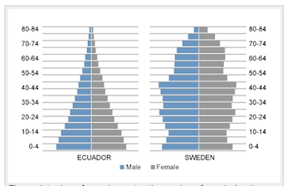
Ecuador vs Sweden
Crude death rate
Ecuador: 5.6/1000
Sweden 10.5/1000
Why?
Age Structure:
More old people in Sweden

Slide 20
How to address: Standardization
Direct
Apply age specific death rates of both countries to a standard population age distribution
Problem: what population to choose?
  Can get very different results depending on the population
  Some options
    Middle between the two populations
    Region specific fake populations (Africa, European, etc.)
    WHO in 2001 made a “world” population

Slide 21
Standardization: Direct continued
Usually calculate the Comparative Mortality Figure (CMR), which is the ratio of the age adjusted rate to the rate of the other country

Slide 22
How to address: Standardization
Indirect
Calculate the expected number of deaths if each country had real age structure, but apply a standard set of death rates
Usually calculate a Standardized Mortality Ratio (SMR)
Can use one countries death rates and apply to the other country
Only need to know # deaths, and age structure, not rates, so sometimes more feasible to calculate
Preferable when small numbers in some cells

Slide 23
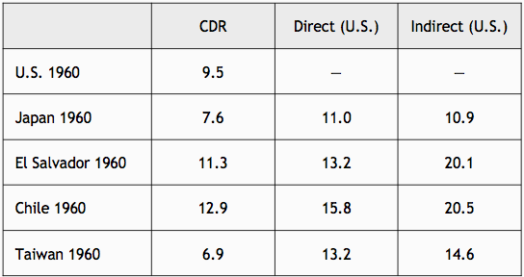
Comparison

Slide 24
Theories of mortality decline
(Acknowledgement to Dr. Magali Barbieri for some of these slides)

Slide 25
Theories of mortality change
Malthus
The demographic transition theory
The epidemiologic transition theory
The health transition theory
  Initial formulation
  The 4th stage of the health transition
  Convergence/divergence cycles
Drivers of mortality change

Slide 26
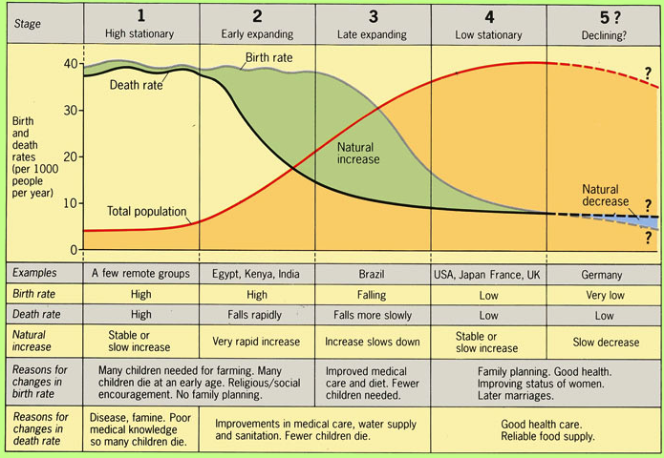
Changes in Fertility + Changes in Mortality: Demographic and Epidemiologic Transition Theory

Slide 27
Basic concepts of [mortality] transition theories
”A transition is not just any change but change that follows an identifiable pattern and which occurs over a relatively long time” (Frenk)

Slide 28
What is the epidemiologic transition theory?
Abdel Omran’s seminal article published in The Milbank Memorial Fund Quarterly in 1971
Describes and explains the profound shift in mortality that has taken place around the world
Change in mortality pattern
  By age
  By cause of death

Slide 29
Three stages
High and fluctuating mortality => until the mid-18th century for the most advanced countries = The Age of Pestilence and Famine
Mortality declines =
The Age of Receding Pandemics
Mortality reaches its lowest level (implicit concept of a biological limit to life) =
The Age of Degenerative and Man-Made diseases

Slide 30
The Age of Pestilence and Famine
Mortality patterns of pre-modern societies characterized by frequent and violent fluctuations
The average length of life oscillated between 20 and 40 years
  18 in ancient Greece
  22 in Rome
  17-35 in medieval Britain
  22, 26, and 34 in 16th , 17th , 18th c. Geneva
Predominance of infectious diseases
No sustained population growth
Notes:
Two components of mortality : “normal” and “epidemics” (often related to natural catastrophes or wars)
Death rates fluctuate at very high levels between peaks and troughs in response to epidemics that periodically ravage the population
Major killers = influenza, pneumonia, diarrhea, smallpox, tuberculosis and the plague
Main victims of “normal” mortality = infants and children as well as women of reproductive ages => unusually high risks related to complications of pregnancy and delivery
Women probably had a lower expectation of life at birth than men in many pre-transitional societies (especially where they were severely discriminated – e.g. East and South Asia) but not the case any longer
Hence median age at death skewed toward younger ages

Slide 31
The Age of Receding Pandemics
Transitional phase
Mortality declines progressively
First, mortality crises recede
Then, “normal” mortality falls
Population growth is sustained and begins its exponential growth (as the birth rates remain high)

Slide 32
The Age of Degenerative and Man-Made Diseases
Mortality has fallen to a low level
Infectious diseases have been replaced by non-communicable diseases (cardiovascular diseases and cancer) as the leading causes of death => spectacular change in the epidemiologic profile of modern populations
The age structure of mortality has shifted from children to older adults => change in epidemiologic pattern associated to changes in age pattern of mortality
Notes:
Described basically as a plateau phase in our epidemiologic history where we reach again a level of equilibrium in mortality but lower than during the pre-transitional stage
In this stage, the pace of the declines in mortality rates slows as the theoretical limits to mortality declines are approached
Improvements in survivorship that occurred with the recession of pandemics were especially beneficial to children (1-4 years old) of both sexes and to women in the reproductive age period
Shift in the structure of mortality by cause is a major characteristic of the transition => the epidemiologic transition
Two main components of the epidemiologic transition = shifts in the cause-of-death pattern and change in the age structure of mortality

Slide 33
The three types of transition
The Classical (Western) model
  Gradual, progressive transition
  Mainly determined by socioeconomic factors
  Slow population growth (=> fertility decline)
The Accelerated model
  Rapid modernization lead to rapid mortality drop in the 20th century
  Epidemiologic transition driven by a combination of sanitary and medical advances as well as by general social improvements (also bringing a decline in fertility)
The Contemporary model
  Relatively recent transition of most developing countries
  Rapid and substantial declines in death rates after WWII
  Public health and primary health care measures determinants
  Explosive population growth as fertility remained high for a long time

Slide 34
Limits to the epidemiologic transition theory
Concept of a biological limit to life
Linear process
Overlapping patterns (“double burden of diseases”)
Determinants of change
Revisions to the initial theory
  The fourth stage of the epidemiologic transition
  The health transition theory
  The concept of convergence/divergence cycles
Notes:
In the 1960s and early 1970s, scientific consensus on 3 propositions :
The century long decline in mortality rates in industrialized countries over the period from 1850 to 1950 was unique and could not be repeated because virtually all of the gains made through the limination of death from contagious diseases below age 60 had been made.
Deaths, now concentrated at older ages, were due to degenerative diseases that were unrelated to the contagious diseases they superseded. The degenerative diseases were caused by accelerated organ losses that were part of the natural process of aging.
There was an upper limit to life expectancy that was genetaically determined. One influential paper put that limit at 85, plus or minus 7 (Fries 1980, 1989).

Slide 35
The fourth stage of the epidemiologic transition
Proposed by Olshansky and Ault (1986)
Context of renewed mortality decline (c.1970)
  Due to medical advances
  And improved access to health care (Medicare and Medicaid in the 1960s)
  [Change in individual behavior = smoking]
Timing and magnitude significant and distinct from the first 3 stages
  qualifies as a 4th stage
Notes:
Cardiovascular revolution of the 1970s and 1980s: US mortality from heart diseases, the leading cause of death at the time, declined by 25% between 1968 and 1978

Slide 36
Characteristics of the 4th stage
Rapidly declining death rates concentrated in advanced ages
Occurred for both men and women
Cause-of-death structure relatively similar to 3rd stage BUT
Age distribution of deaths from degenerative causes shifting to older ages
Notes:
Olshansky believes in a biological limit to life (to about 85 years at the time) => consequence of this new stage of the mortality transition = rectangularization of the survival curve

Slide 37
The health transition theory
Concept developed by Frenk and al. to describe the transition from a high to a low level of mortality
Built on the epidemiologic transition theory, itself an offspring of the demographic transition theory
Not a dispute of the main characteristic of the epidemiologic transition theory but more encompassing => both
The health conditions in a population
The response to those conditions
Strong focus on the determinants of mortality change
Notes:
Frenk’s main critic to Omran = not only should the theory describe the characteristics/process of mortality change but it should also aim at understanding its determinants and consequences

Slide 38
Theoretical framework
Four element model driven by
The population
  Size
  Growth rate
  Age structure
  Geographic distribution
The environment
  Altitude
  Climate
  Natural resources
  Type of pathogens (parasites, vectors…)
Linked by two “bridges”
Social organization
The genome
Notes:
Organized into a very complex framework presented in the paper
Multiple attempts to provide a valid and functional theoretical framework to analyze mortality factors but not highly successful so far
Starting point in the determinants of health = population and the environment, which interactions are determined by social organization and the population genome
Social organization = a society’s structures and process to transform nature
The genome = transforms the deepest constitution of human populations in response to changes in the environment (evolution)

Slide 39
Social organization
Economic structure (production system)
Political institutions
Science and technology
Culture and ideology
Total level of wealth
Distribution of wealth within the population
  Occupational structure
  Redistribution mechanisms
Notes:
Four major dimensions on the social determinants
Redistribution mechanisms = used by the community or the government to spread wealth within the population, notably through taxes and subsidies
Social organization determines in turn the proximate determinants of health

Slide 40
Proximate determinants
Occupational hazards
Living conditions
Lifestyles
The health care system
  Health policy
  Health care (prevention and treatment)
Notes:
Living conditions include market-based elements (food, housing..), education and assistance programs (social security), public health (water and sanitation systems) => objective material situation in which the different social groups live
Lifestyles = the manner in which social groups translate their objective material situation into patterns of behavior (determined in turn by living conditions, culture and ideology, laws and regulations, taxes and subsidies, and the pressures of commercial enterprises)

Slide 41
Levels of operation
Individual
Household/family
Institutional
Societal
Systemic
Notes:
All of these factors operate at five different levels

Slide 42
Divergence-convergence cycles theory
Developed by France Meslé and Jacques Vallin (INED, Paris) (2004 Demographic Research)
To explain the lack of convergence postulated by the health transition theory (Eastern Europe, sub-Saharan Africa…)
Notes:
Seek to explain the wide diversity of mortality situations throughout the world and within MDCs
The idea that the social response to epidemiologic patterns is as important as the pattern itself (e.g. predominance of infectious vs. chronic diseases), that is emphasized by the health transition concept – by contrast with the epidemiologic transition theory – is also emphasized by others scholars and has led to other developments of the theory

Slide 43
Basic theory
Each new stage of the health transition is associated with major changes in health technologies and/or strategies
Some societies/populations are better prepared than others to take advantage of the advances => divergence
Progress diffuses from population to population => convergence
Hence the successive cycles of divergence/convergence as e0 increases

Slide 44
Why did mortality decline?

Slide 45
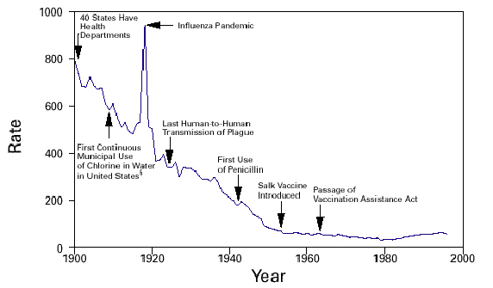
Mortality decline in the US

Slide 46
Why did mortality decline?
Improved therapeutic medical interventions
Improved water and sanitation (Preston and van de Walle, 1978)
Improved preventive medical interventions (Razzell)
Increased living standards, nutrition, hygiene (McKeown, 1976)
Spread of knowledge to public concerning disease prevention (Preston and Haines, 1991)
  Evidence in differences in child mortality by mother’s education level, etc.

Slide 47
Thomas McKeown’s thesis
4 seminal articles published in Population Studies between 1955 and 1975
2 popular books published in 1976
  The Modern Rise of Population
  The Role of Medicine: Dream, Mirage, or Nemesis?
His work generated considerable controversies and continues to stimulate support, criticism, and commentary
Idea: The growth in population in the industrialized world from the late 1700s to the present was due not to life-saving advancements in the field of medicine or public health, but instead to improvements in overall standards of living, especially diet and nutritional status, resulting from better economic conditions

Slide 48
McKeown’s Main postulate
Dramatic population growth in industrialized countries that started in the last quarter of the 18th century
Due to a decline in mortality from infectious diseases
Driven by improved economic conditions
  Rising standards of living
  Improved nutrition
  Better natural resistance to diseases
Notes:
Discussion of whether the population increase could have been driven by a fertility increase but McKeown argues against it =>
could only have been achieved by lower age at first marriage (=> natural fertility)
but little influence on the growth rate => high mortality = high infant and child mortality => higher fertility = increasing mortality (especially because adding children to existing families in a context of high infectious disease might have led to increasing mortality)
Considers three groups of factors = 1) specific preventive and curative therapy, 2) improvements in the environment, 3) change in the balance between the virulence of the infective organisms and the resistance of the host => rule out the first and third of these factors

Slide 49
McKeown’s Rebuttal of other theories
Medical treatment:
  Ruled out (except for smallpox) because became effective long after a downward mortality trend had begun
Public health advances
  Small role at best because influenced water-borne illnesses such as cholera, which were responsible for just a small portion of the mortality decline
  Did not influence airborne diseases, such as tuberculosis, which made up a large share of mortality
Notes:
McKeown acknowledges that experience of the pre-registration period in terms of TB mortality is uncertain but he claims that « there is no serious doubt that mortality from tuberculosis was very high during the previous three centuries » = one of the critics of his opponents is that TB seems in fact to have increased with urbanization in the first third of the 19th century

Slide 50
McKeown’s Conclusion
“The rise in population was due less to human agency in the form of health-enhancing measures than to largely invisible economic forces that changed broad social conditions”
By elimination, mortality decline must have been brought about by a change in the environment associated with the substantial rise in the standard of living that occurred in the 1840s
Increased food supplies during the 18th-19th centuries is particularly well documented (“impressive evidence”)

Slide 51
Influential thesis
In spite of flawed data, analysis, interpretation and conclusions (as showed in the 1980s)
Major influence on demography, public health research and policy
Asked fundamental questions that remain relevant (especially in a context of scarce resources and rising health care costs) =
What are the most important determinants of a society's patterns of morbidity and mortality? and How should public health practitioners most effectively focus their efforts?
Also because of the demographic context
as the mortality decline of the previous period had stalled (1960s) in spite of large expenditures on sophisticated medical techniques
⬄ optimism and faith in medicine that had characterized the 1940s and 1950s

Slide 52
Conclusions: Determinants of mortality decline—debate still open
Ecological => complex balance between
  disease agents
  The level of hostility in the environment
  The resistance of the host
Socio-economic, political and cultural determinants
  Standards of living (nutrition)
  Health habits (hygiene)
Medical and public health determinants
  Improved public sanitation (sewage and water systems)
  Immunization (smallpox)
  Therapies (surgery and treatment)
Notes:
Much debate over the respective impact of these various factors on mortality change, especially as regards historical Europe
Variations in the role of these different determinants over time and across space (e.g. Western countries = role of social factors most important ⬄ role of medical technology predominates in LDCs) => determine different models of the epidemiologic transition

Slide 53
Thank you!
Questions?
Notes:
Final boiler plate language: 2 versions
Through its singular focus on health, UCSF is leading revolutions in health.
UCSF is driven by the idea that great breakthroughs are achieved when the best research, the best education and the best patient care converge.

