Slide 1
Fertility

Slide 2
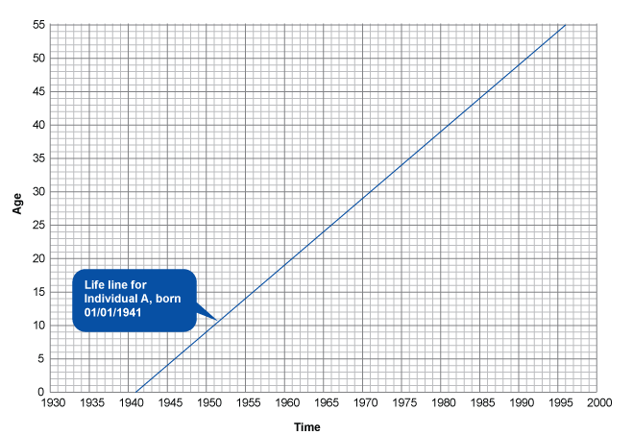
Lexis Diagrams: An individual

Slide 3
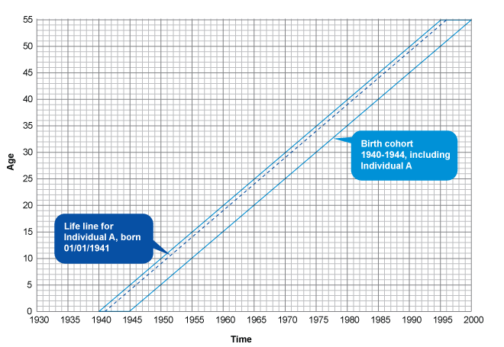
Cohort

Slide 4
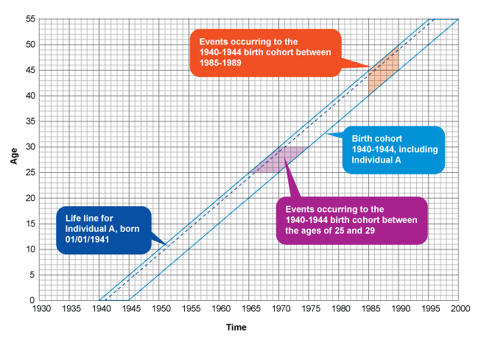
Cohort experiences

Slide 5
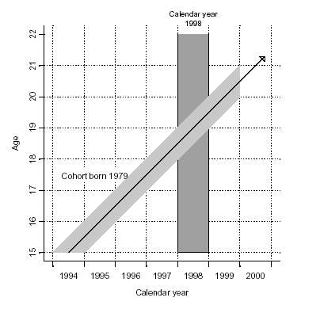
Lexis Diagram: Period vs Cohort

Slide 6
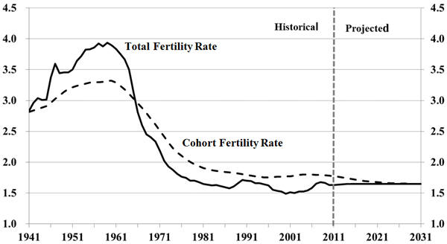
Cohort vs. Period fertility: Canada

Slide 7
Cohort vs. Period fertility: Why?
What might make this difference?
Hint: mean age at childbirth

Slide 8
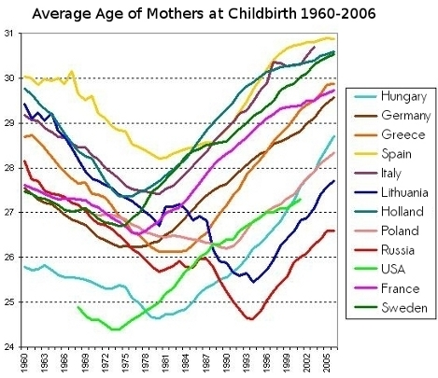
Average age of mothers over time

Slide 9
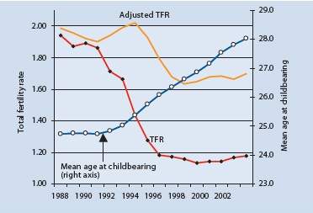
Tempo effect: Czech Republic

Slide 10
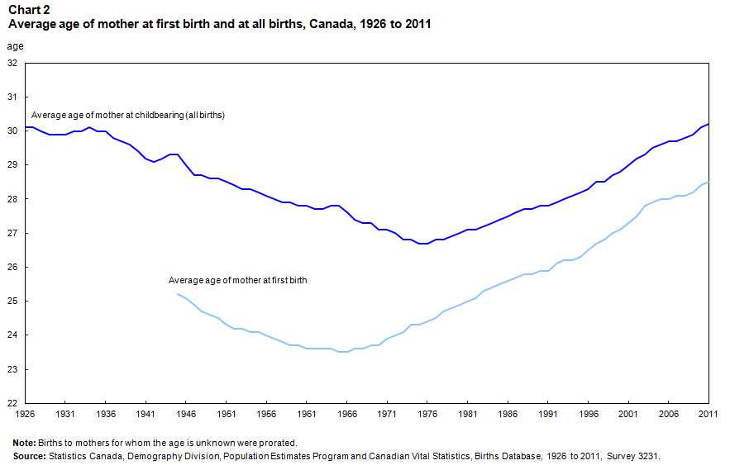
Mean age at childbirth: need to look at parity

Slide 11
Parity Progression Ratios
Cohort measures, free of tempo effects
Proportion of women with n children who go on to have n+1 children

Slide 12
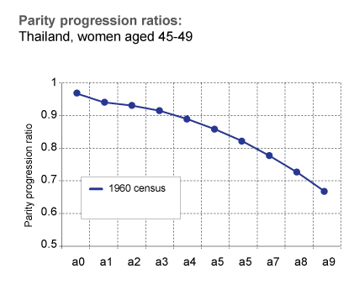
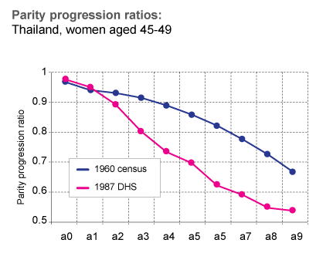
Parity Progression ratios
a0 = proportion of women with 0 children who go on to have 1
a1 = proportion of women with 1 child who go on to have 2
a2 = proportion of women with 2 children who go on to have 3
Etc….
UNFPA)

Slide 13
Period vs Cohort
Period
  Easy to collect
  Use up to date info
  Rapid changes
  CONs
    Does not reflect real life life experiences of individuals
    Tempo effects
Cohort
  Tells us about real lived experiences
  CONS
    Takes decades to collect

Slide 14
Thank you!
Questions?
Notes:
Final boiler plate language: 2 versions
Through its singular focus on health, UCSF is leading revolutions in health.
UCSF is driven by the idea that great breakthroughs are achieved when the best research, the best education and the best patient care converge.

