Slide 1
Aging and life tables
Nadia Diamond-Smith, PhD, MSc

Slide 2
Aging:
Demographic study of older populations
  Their size and composition
  Their mortality and morbidity
  The causes of demographic change among older populations
  The consequences of demographic change among older populations

Slide 3
Global Average Annual Growth Rates

Slide 4
But, There is Great Variation by Age

Slide 5
Population aging
Older persons are continually making up a larger proportion of the population
This is occurring in every world region and in nearly every country

Slide 7
Possible implications of global population aging for public health
RETOOLING HEALTH CARE SYSTEMS
In most of the world, health care systems have been designed around a particular set of needs, e.g.:
child and maternal health
infectious and communicable disease
An aging world requires a change in health care philosophy toward
degenerative disease
long-term care
Expenditure studies show costs of health care in old age to be significantly greater than costs at any other age.

Slide 8
Implications for public health
- Goal of medical science to reduce the gap between life span and longevity.
- Increasing one may not mean increasing the other.
- Rectangularization of mortality: Life span remains
the same but variation in age at death declines.

Slide 9
Rectangularization of mortality
0
55
110

Slide 10
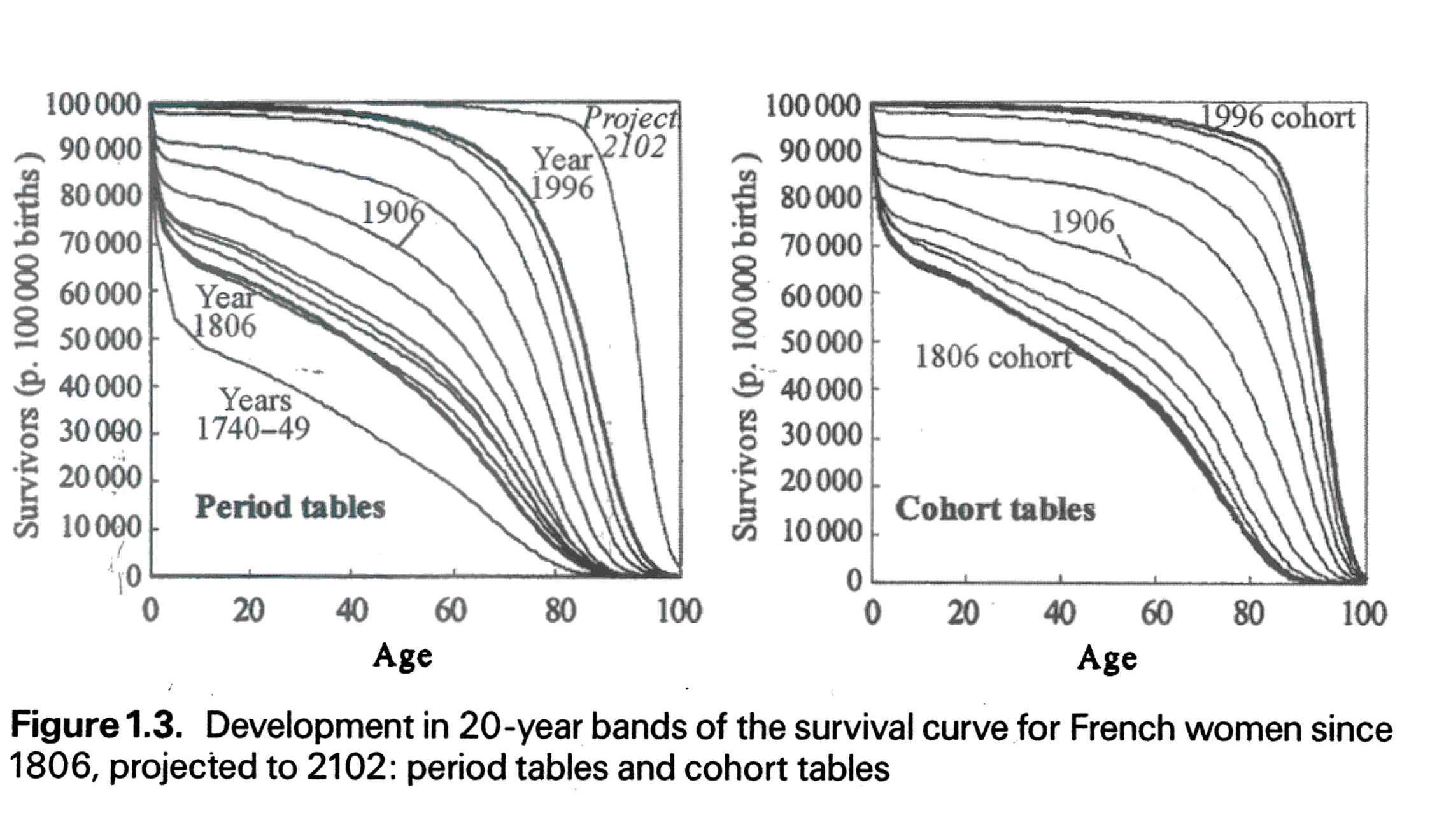
Rectangularization is evident in places where data is available
Page 21 fig 1.3

Slide 11
QUANTITY VERSUS QUALITY OF LIFE
Are the extra years of life healthy years, or are we extending our years lived in poor health?
.
Optimistic view: There has been a compression of morbidity into the final years of life.
Pessimistic view: Modern medicine extends life but it does so by saving people from dying without giving them years of healthy life.

Slide 12
Standardized survival, disability, and morbidity curves
Proportion surviving
Surviving healthy
Surviving
unhealthy

Slide 13
Standardized survival, disability, and morbidity curves
Proportion surviving

Slide 14
Expansion of morbidity – longer life worsening health
Proportion surviving
Surviving healthy
Surviving
unhealthy

Slide 15
Compression of morbidity – longer life better health
Proportion surviving
Surviving healthy
Surviving
unhealthy

Slide 16
Dynamic equilibrium – healthy years to increase proportionately to total years
Proportion surviving
Surviving
unhealthy
Surviving healthy

Slide 17
Dependency Ratio
Ratio describing the number of people of working age compared to older and/or younger people of non-working age in a population
Way to describe the burden of aging populations and/or growing populations on the working age population
  Burden in care giving, financial support, government resources
Can also calculate the youth and elderly dependency ratios on their own

Slide 18
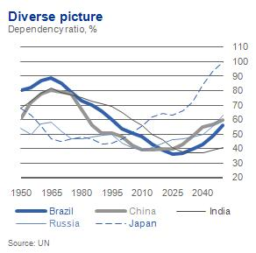
Dependency Ratios by Country

Slide 19
Demographic Dividend
A transitional period that countries go through while fertility is falling and mortality is falling
Idea that falling fertility will lead to a small youth population, while there is still a relatively small old age population
So the working aged population will grow more than the elderly or young population for a few years
Should lead to a time of increasing productivity because labor force population is growing more than the dependent population
A short period in time, lasts maybe 5 decades
  Then population aging begins
Much interest in capitalizing on the demographic dividend in Africa especially where fertility is just beginning to fall

Slide 20
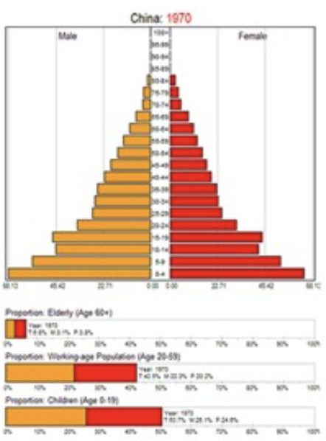
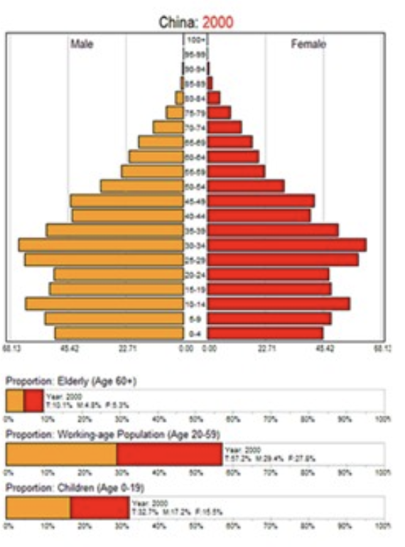
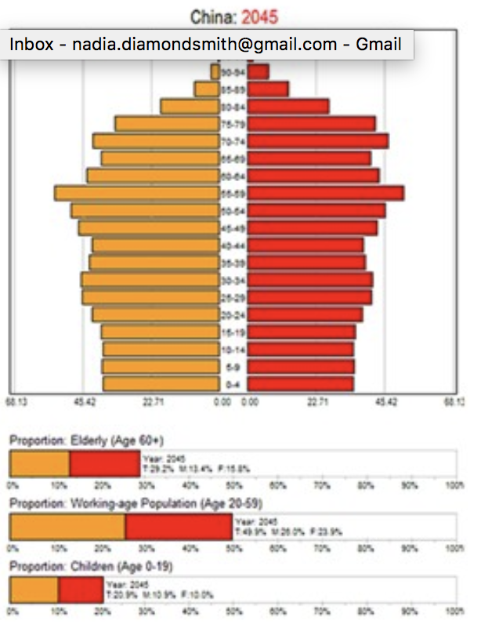
Example: China

Slide 21
Life tables

Slide 22
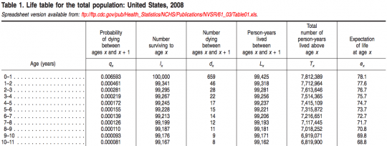
Life table: US mortality

Slide 23
Life Tables
The life table conceptually traces a cohort of newborn babies through their entire life under the assumption that they are subject to the current observed schedule of age- specific mortality rates
The life table records the passage of a cohort from birth to extinction, or when the last member has died, according to a set of fixed age specific probabilities of death/failure
As age increases, the number of survivors of the original group declines
Life Tables looks at the likelihood of an event occurring in the next time period (day, week, year) given survival to the beginning of the time period

Slide 24
Why do we use life tables?
Any question that concerns the probability of an event
To analyze any measurable process that involves a time pattern of exit from or entry into a particular state (e.g., births and deaths)
Estimate age/time specific risks
Examine changes in rates
Population growth and change (generate projections of the size and characteristics of future populations based on some initial base population.)
Compare health levels across two populations or one population over time

Slide 25
Not just life and death!
Mortality/Survival (people, cars, appliances)
Recidivism
Disability (Active Life Expectancy)
Marriage/cohabitation
Working Life (retirement, unemployment)
Contraceptive Use (effectiveness, discontinuation, switching)
Fertility (1st and higher order births, spacing, time to first sex)
Breastfeeding
Cancer survival

Slide 26
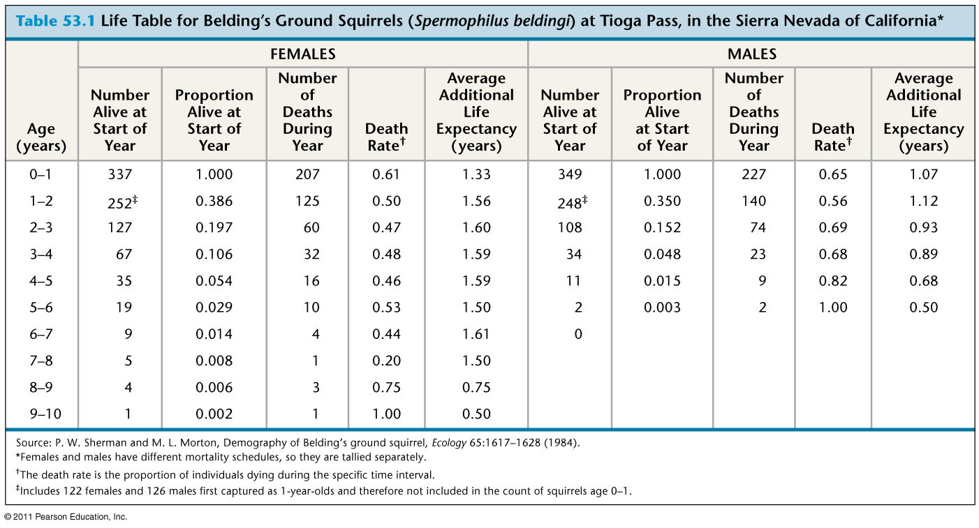
Squirrels!

Slide 27
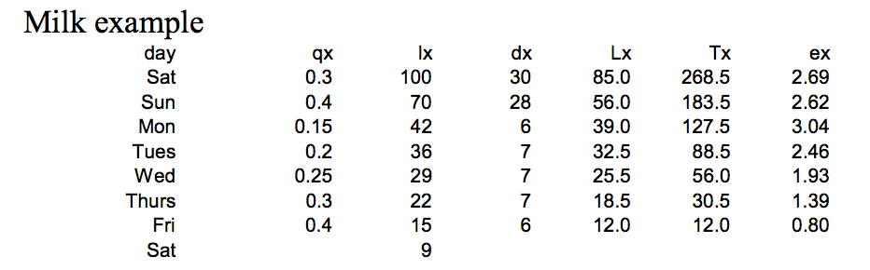
Milk being sold

Slide 28
Simplest form
Single decrement= people only go one way
Closed population
  Population growth constant
  No migration in or out

Slide 29
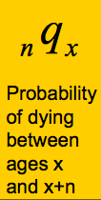
Life table notation:
The subscript before a symbol defines the width of the interval
The subscript after the symbol defines the starting point of the interval
lx, Tx and ex never have a left subscript as they refer to exact age x

Slide 30
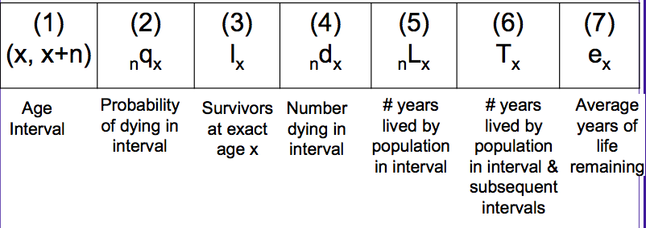
Life table

Slide 31
Practice
probability of dying between age 0 and 1
  ₁q₀
Number of deaths between age 40 and 45
  ₅d₄₀

Slide 32
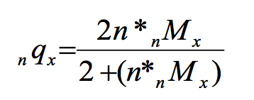
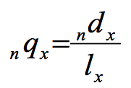
Usually start with age specific death rates (_{n}M_{x})
Can convert _{n}M_{x} to _{n}q_{x}
1)
Where n is the length of the interval (usually 5 years)
2)

Slide 33
lx= Survivors
l₀ =who are the survivors to age 0?
  Everyone born!
  The radix population, could choose anything, usually start with 100,000
l₁ = Survivors at the start of year 1?
l₁ = l₀- (l₀* ₀q₁)
Say ₀q₁ = 0.0582, how many people die in year 1?
582
How many people are alive at the start of year 1?
100,000-582= 99,418 = l₁
582 is _{n}d_{x} =deaths between age n and n+x

Slide 34
0-1 | 0.0582 | 100,000 | 582
1-2 |  | 99,418

Slide 35
L_{x}
L_{x} = The total number of person-years lived in each interval, or # in age group of stationary population
It is the sum of:
Persons who survived the interval, equivalent to the number alive at the beginning of the next interval or l_{x}+1
  They each contribute the number of years in the interval.
b. Persons who died during the interval (d_{x}) who contribute a part of the interval, depending on when they died. For most purposes, we simply assume they contributed 1⁄2 a year.

Slide 36
Lx calculations
Generally we assume linearity:
  unabridged: Lx = 0.5*(lx + lx+n)
    Every year from birth to death
  abridged: Lx = (n*0.5)*(lx + lx+n)
    Can have age groups

Slide 37
Infant/early childhood and oldest age
Because infant and early childhood deaths are closer to birth, we use:
  L₀ = 0.3*l₀ + 0.7*l₁
For the terminal category, we do not have length of interval, so we use :
∞L_{x} =l_{x}/ ∞m_{x}
for example
L₁₀₀₊ = l₁₀₀₊ / M₁₀₀₊
where ∞M_{x} substitutes for ∞m_{x} in abridged tables

Slide 38
  L₀ = 0.3*l₀ + 0.7*l₁
What is L₀ ?
0.3*100,000 + 0.7*99418
L₀=99592.6
Age group | _{n}q_{x} | l_{x} | _{n}d_{x} | L_{x} | T_{x} | e_{x}
0-1 | 0.0582 | 100,000 | 582
1-2 |  | 99,418

Slide 39
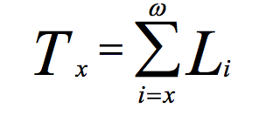
T_{x}
T_{x} is the total number of years of life lived by all members of the cohort. It is obtained by summing up all values of Lx from that age forward

Slide 40
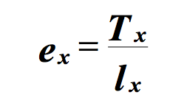
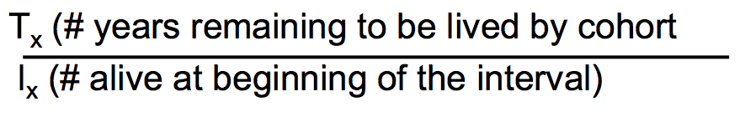
Life expectancy e_{x}
Whereas Tx provides the number of years remaining to be lived by the entire cohort, ex represents the number of years lived on average by any individual in the cohort.
Remember:

Slide 41
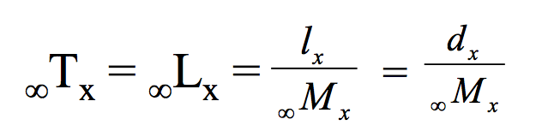
Different life expectancies
Life expectancy at birth (e₀) is the number of years that a baby born now will live if that baby experiences all the age-specific mortality rates currently operating in the population
Terminal Age Category= Because the final age category in the life table is an open ended interval, and all individuals in our cohort must die, we have variations on the usual formulas for this interval
where ∞M_{x} is the observed ASDR for the terminal age group, assumed to be equivalent to ∞m_{x}
Because everybody dies: ∞qx = 1.0

Slide 42
Single vs. Multi – state life tables
2 states: Alive and Dead
1 “absorbing” state: Death
Alive
Dead

Slide 43
More advanced forms: multistate
Multiple states
Still need one “absorbing” state: Death
Called Multiple Decrement Table
Lets try to model marriage

Slide 44
Single vs. Multi – state life tables
Single
Married
Divorced
Widowed
Dead

Slide 45
Complexities of a Multi-State life table
Censoring:
  Right-censoring: have we observed them at the beginning of their “lives”?
  Left-censoring: do we observe them until “death?”
Calculating transition probabilities
  Logit models with predicted probabilities
  Markov simulations
  SPACE (Hayward et al., 2009), etc

Slide 46
Questions one can ask with MSLT (contraception example)
Probabilities of Moving States: What is the probability that a cohort of women who began with a specific method (at Month 1) will be using other methods (or no methods) at the end of 6, 12, or 24 months, or that they will be pregnant unintentionally at these time points?
Duration in State: What is the expected length of time that women who began with a specific method will use it versus each of the other methods (or non-use), or be in the state of unintended pregnancy, during the first 24 months?
Movement of State Switching: What is the expected number of switches that women who began with a specific method will make to other contraceptive methods (or nonuse) or to unintended pregnancy during the first 24 months?

Slide 47
Thank you!
Questions?
Notes:
Final boiler plate language: 2 versions
Through its singular focus on health, UCSF is leading revolutions in health.
UCSF is driven by the idea that great breakthroughs are achieved when the best research, the best education and the best patient care converge.

