Slide 1
Racial Demography and its Discontents
Robert Pickett
October 22, 2018

Slide 2
Racial Demography
“race and ethnicity are among the most commonly used variables in public health research; their use is on the rise; and they tend to be used uncritically and without definition.” (Dressler et al. 2005:234)
Racial identification is collected in most of our data by default – often without much justification as to why.
  NLSY, CPS, HRS, SIPP, …
  It’s hard to think of an example of an American data product that doesn’t collect data on race.
It is often added to our analyses by default.
  e.g. ‘we control for demographic characteristics’
Racial demography is important but under theorized.

Slide 3
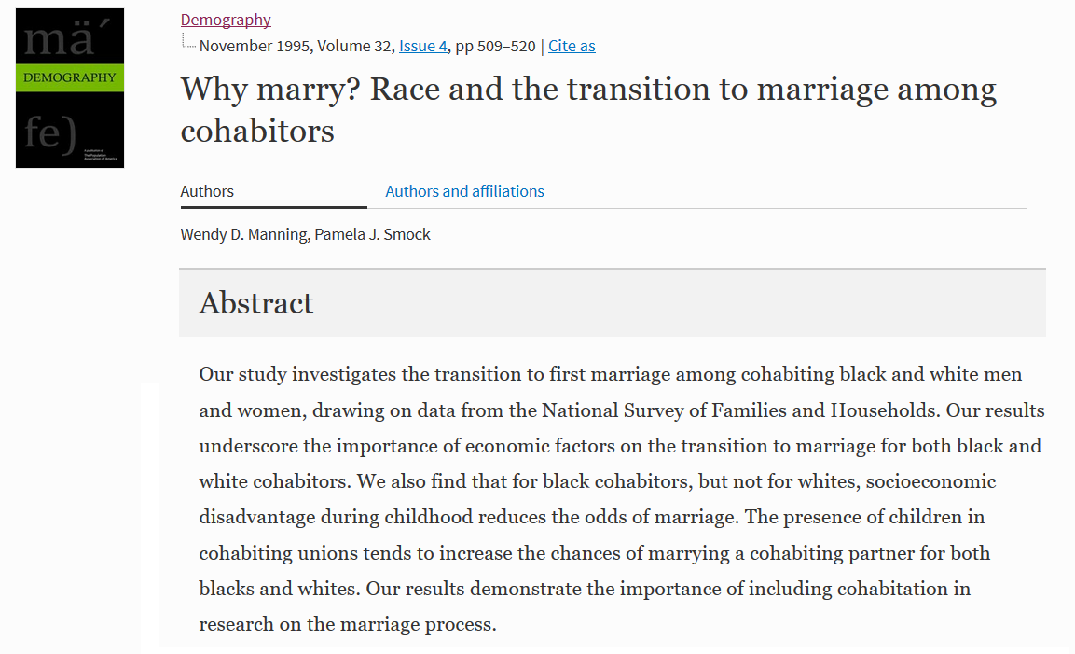

Slide 4
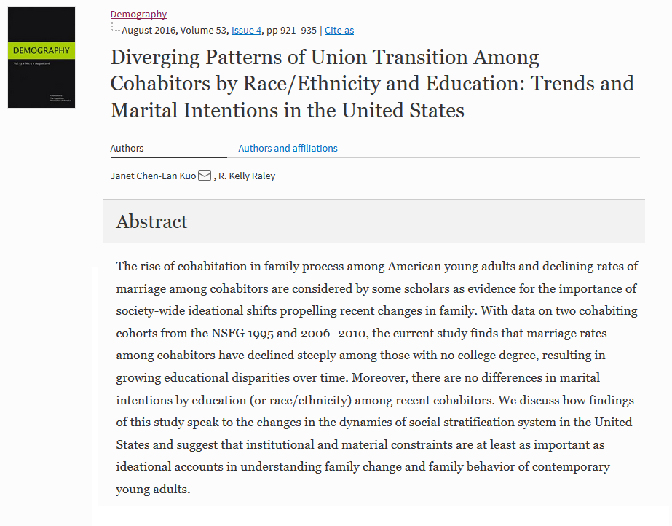

Slide 5
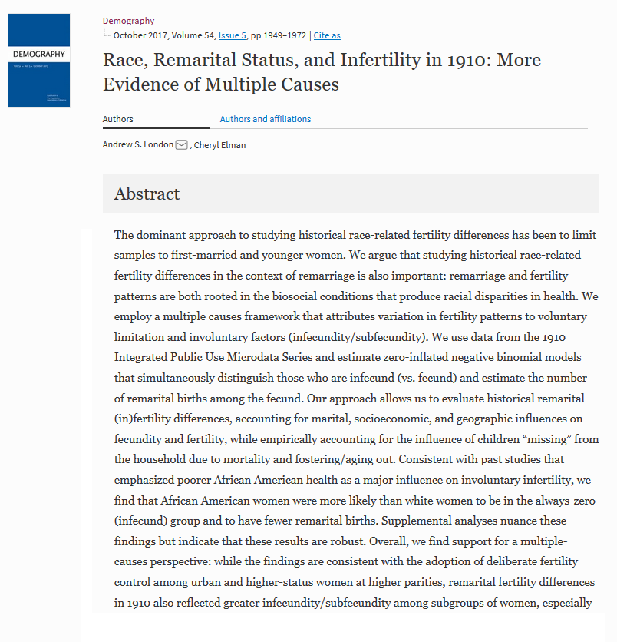

Slide 6
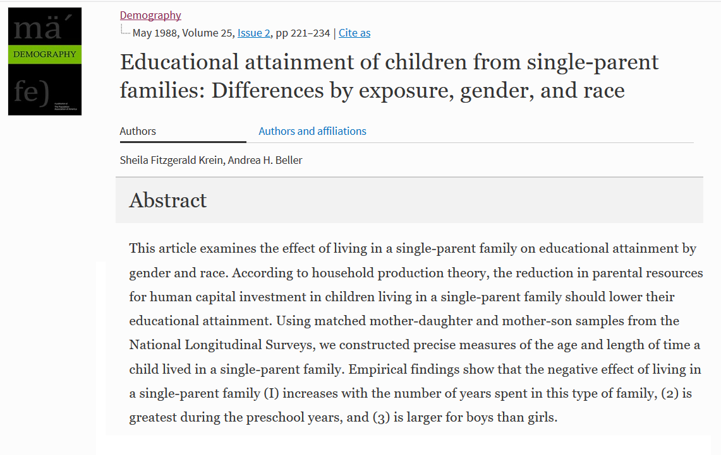

Slide 7
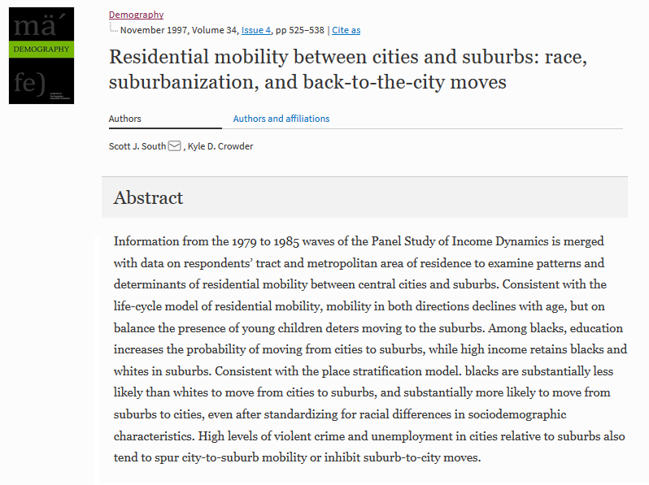

Slide 8


Slide 9
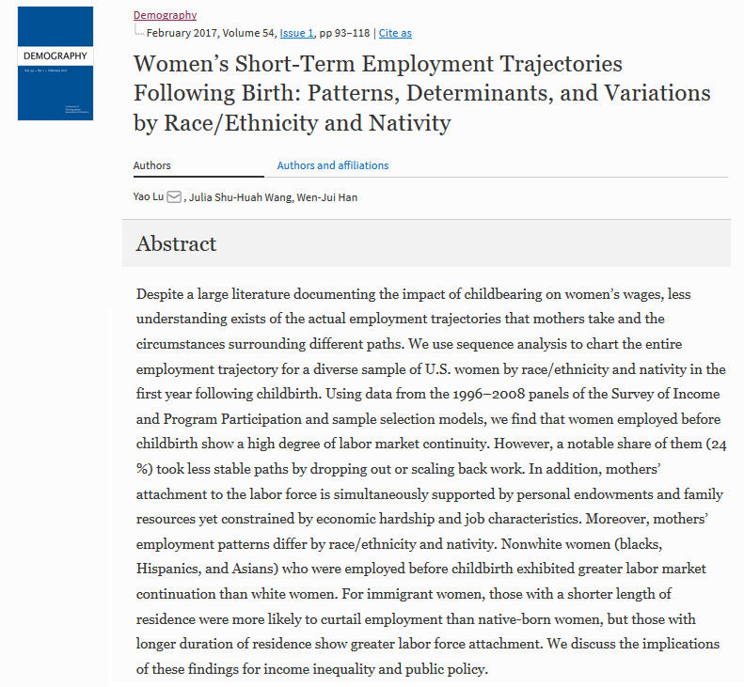

Slide 10
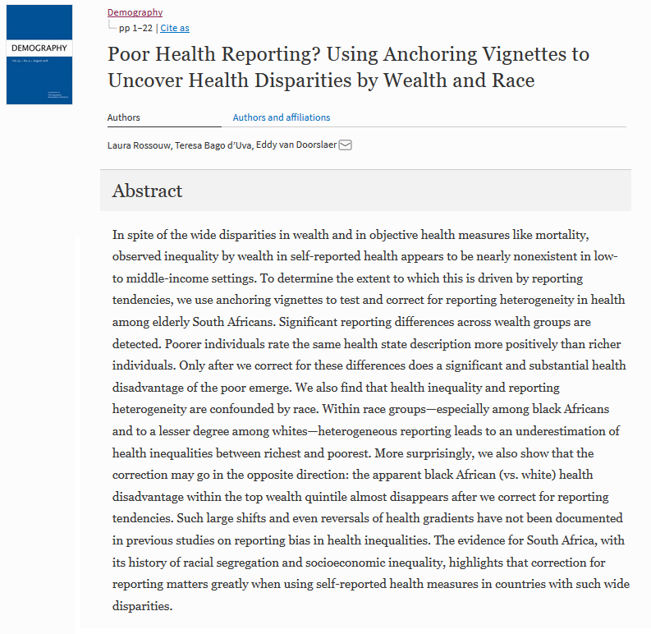

Slide 11
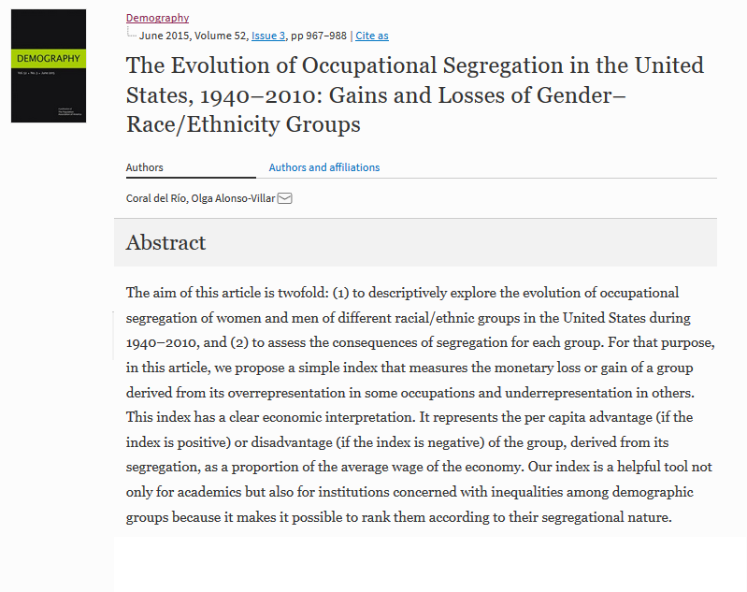

Slide 12
Three Issues
How is race generally used in demography?
What does it mean when we find a ‘race effect’?
  It’s worth noting – there are huge disparities by race.
  We ‘find’ these effects often.
What do we mean by ‘race’ and how do we collect data on it?

Slide 13
Ways of dealing with race
Two major ways demographic work deals with race.
Control
  I fit a regression model to my data, and control for race – thus, I assume all my relationships are the same across race groups, but racial identification changes the intercept.
Sub-group
  I fit my models separately by group, allowing both the level and trend to change by race.

Slide 14

Examples: Control
Standard OLS regression.
I fit the model: $income=β_{0}+β_{1}∗age+ε$ and get the following results¹:
 | Income
Intercept | 13487*** (1579.12)
Age | 306.58*** (37.39)

Slide 15

Examples: Control
A reviewer critiques my paper for not taking race into account, so I add a control to my model¹: $income=β_{0}+β_{1}∗age+β_{2}∗black+β_{3}∗other+ε$
 | Income | Income
Intercept | 13,487*** (1579.12) | 14,314.51*** (1603.46)
Age | 306.58*** (37.39) | 302.08*** (37.38)
Race
Black | ---------- | -5,155.58*** (1422.51)
Other | ---------- | -498.54 (2214.78)

Slide 16
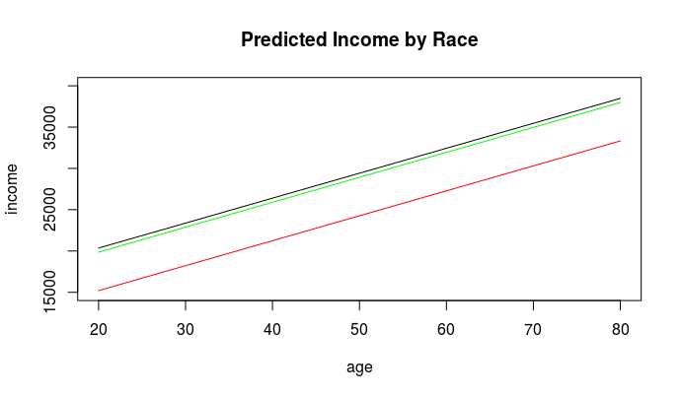
Examples: Control

Slide 17
Examples: Control
As age increases income goes up by ~300 dollars.
White people make more money then Black people on average.
The lines are parallel – everyone gets the same ~300 dollars per year of age.
  Black people start out 5 thousand dollars behind White people, and stay there throughout.
The effects of race, then, are assumed to change the level, but not the slope.

Slide 18
Examples: Control
I’ve shown the very simple example of linear regression, but this applies broadly to methods that ‘control’ for race.
E.g.:
    All the flavors of regression
    Hazard models

Slide 19

Examples: Sub-Groups
General logic: run your models separately by race.
  $income=β_{0}+β_{1}∗age$ for White people
  $income=β_{0}+β_{1}∗age$ for Black people, etc.

Slide 20
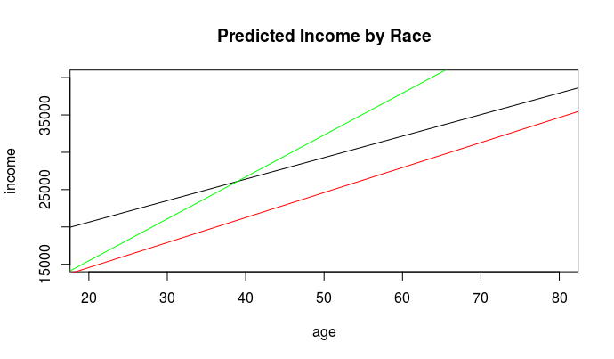
Examples: Sub-Groups

Slide 21
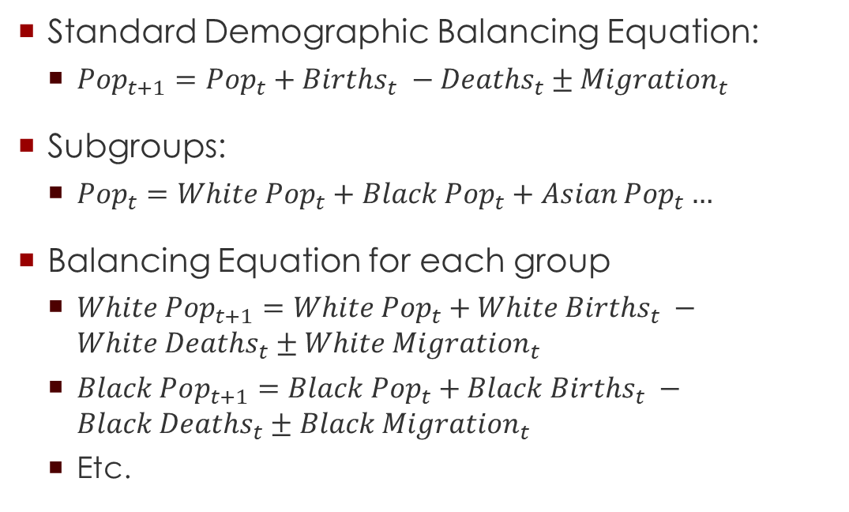
Examples: Sub-Groups
Standard Demographic Balancing Equation:
  $Pop_{t+1}=Pop_{t}+Births_{t} −Deaths_{t}±Migration_{t}$
Subgroups:
  $Pop_{t}=White Pop_{t}+Black Pop_{t}+Asian Pop_{t}…$
Balancing Equation for each group
  $White Pop_{t+1}=White Pop_{t}+White Births_{t} −White Deaths_{t}±White Migration_{t}$
  $Black Pop_{t+1}=Black Pop_{t}+Black Births_{t} −Black Deaths_{t}±Black Migration_{t}$
  Etc.

Slide 22
What do these effects mean?
In all of the above, we have some relationship that changes by race (the intercept changes in ‘control’ methods, and both the intercept and slope change in the ‘sub-group’ methods).
How do we make sense of those racial differences?

Slide 23
Essential Differences
One of the more common explanations for race effects (though often implicit) is that there are some essential/fundamental differences between racial groups.
E.g.
  Biological
  Genetic
  Tastes or Values
Often Critiqued as being unfounded.

Slide 24
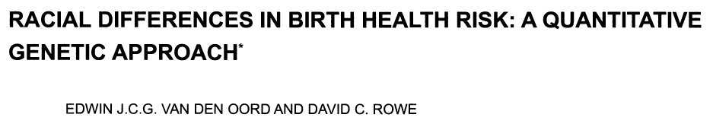
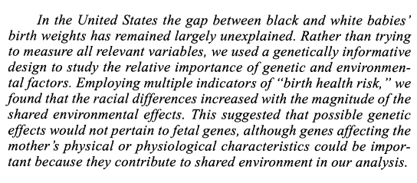

Slide 25
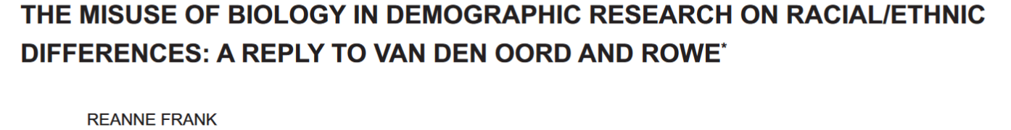
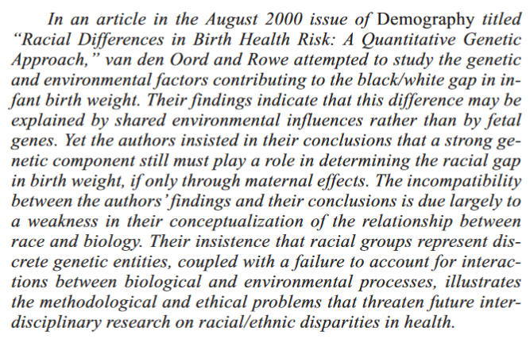

Slide 26
“human biological variation is not racially patterned.”
“the biological nature of a widely distributed population cannot be understood sufficiently if racial categories are used as the starting point.”
“This means, at the very best, that in health research, the use of racial categories as genetic markers is equivalent to basing fine-grained statistical analysis on an imprecise, constantly changing, contextually loaded categorization.”

Slide 27
Three flavors of biological approaches to race:
  “The most malignant are the ‘true believers,’ who subscribe to the typological distinctions that imply hierarchical rankings of worth across different races.”
  “At the opposite extreme are those who believe that biology has nothing to do with race-as-lived-experience”
  “Between these two extremes falls a third group, by far the largest […] the ‘confused category,’ in which racial biology is perceived as an issue of political correctness, and in which race continues to be applied in quasi-genetic manner”

Slide 28
If not biology then what?
Dressler, Oths, and Gravlee suggest 4 others:
  Health-behavior model
  Socioeconomic status model
  Psychosocial stress model
  Structural-constructivist model

Slide 29
Health-behavior model
“hypotheses that account for health disparities on the basis of discrete behaviors voluntarily adopted by individuals.”
  i.e. different race groups have different behaviors have different health outcomes.
In conclusion: “health behaviors can be potent contributors to disease risk; there is little evidence, however, that alone or in combination health behaviors can explain racial and ethnic health disparities.”

Slide 30
Socioeconomic status model
“The socioeconomic status (SES) model subsumes research that sees racial and ethnic health disparities confounded with SES disparities in health.”
  i.e. race groups are differently disadvantaged which leads to health disparities.
“In general, controlling for SES fails to account completely for racial and ethnic disparities, despite leading to a reduction in the magnitude of group differences.”

Slide 31
Psychosocial stress model
“reasoned speculation led to a consideration of the stresses associated with institutional and interpersonal racism as a cause of these disparities.”
  i.e. discrimination causes stress causes health disparities.
An advance because it represents an “explicit attempt to integrate […] what is unique about the experience of the African American community in the United States”
But
  Causes are complicated, results are hard to interpret
  Focus on individual responses rather than social causes

Slide 32
Structural-constructivist model
The world is socially constructed, but encountered as real.
  E.g. money’s value is socially defined, but you can still use it to buy a hotdog.
“the study of how racial and ethnic categories are constructed, and the implication for health of those constructions, is rarely attempted.”
Should try to understand:
  How race is constructed
  How those constructions have real world implications
  How those implications are related to health disparities

Slide 33
Structural-constructivist model
Often nodded to, but not often taken seriously.
  “Thus, although we accept that ‘race’ is a social and demographic concept, in part it is also a biological concept.” (van den Oord and Rowe 2001:573)
  You will often see acknowledgements of the social construction of race, followed by analyses that apply race without definition or plausible mechanism for why it matters.

Slide 34
Measurement
We’ve covered how race is often used as a variable, and debates about how racial effects should be interpreted, but where do the data come from in the first place?
Far and away the most common is self-identification.
  E.g. in the Census: “What is [your] race?” with various options plus a write-in field.
Someone’s ‘race’ is effectively whatever they say it is (or however else the data was collected).

Slide 35
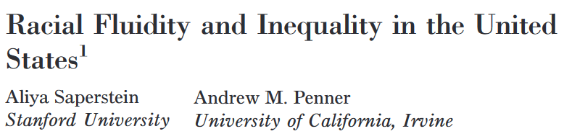
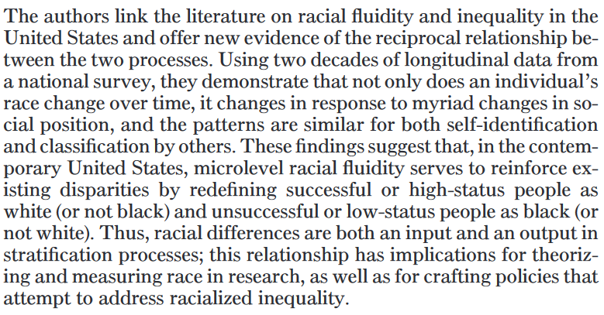

Slide 36
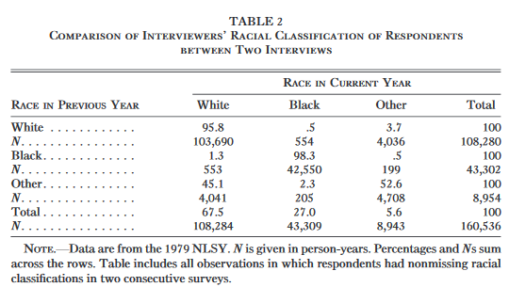
Who changes in how people see them?

Slide 37
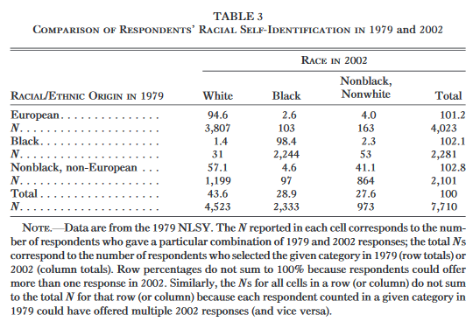
Who changes in how they identify?

Slide 38
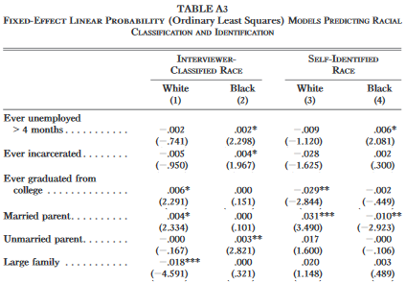
What kinds of people change?

Slide 39
Boundary Crossing
A fairly large number of people change in their racial identification and/or classification by others.
The changes reflect cultural notions about what kinds of people are in each category.
  Ever being unemployed or incarcerated increases the chances that you’re seen as Black.
  Being married with kids increases the chances you’re seen as White.
Race may not only produce inequalities, but inequalities may produce race.

Slide 40
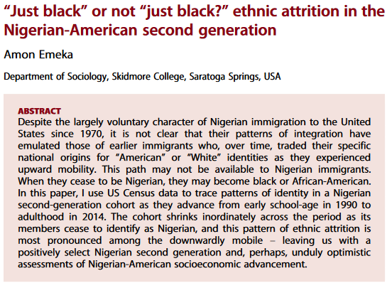
Empirical Example: Ethnic Attrition

Slide 41
Conclusions
Racial demography is important.
  We live in a fundamentally unequal society, and efforts to correct these injustices are commendable.
That said, care should be taken when interpreting racial difference.
  Often researchers fall back on faulty conceptions of fundamental or biological differences.
  This limits their scope and the kinds of questions they ask.
Further, what we know about race comes predominantly from people telling us what their race is.
  We cannot separate ‘racial facts’ from the process of racial identification.

Slide 42
Questions?

