Slide 1
Analysis Workshop #1
Reliability indices
Lydia B. Zablotska, MD, PhD
Professor, Department of Epidemiology and Biostatistics

Slide 2
3. Inter-Rater Reliability
Intraclass Correlation Coefficient
The intraclass correlation coefficient (ICC) is an excellent measure of agreement in virtually all situations.
ICC can be thought of as an "average" correlation between several sets of ratings. The Pearson correlation coefficient is an interclass correlation.
The ICC is appropriate for both nominal and ordinal data, but is especially good for continuous rating (interval scale). In the latter case, the Repeated Measures ANOVA can be used to compute the ICC.
ICC compares the variability of different ratings of the same subject to the total variation across all ratings and all subjects.
Also called the intracluster correlation coefficient (ICC), or the reliability coefficient (r or rho).

Slide 3
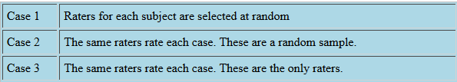
3. Inter-Rater Reliability
Intraclass Correlation Coefficient
Major advantages:
Computation of the ICC, unlike most other interrater reliability coefficients, does not require a complete set of ratings for each subject. This is a major advantage.
presumes that one has the results of a Repeated Measures ANOVA (Analysis of Variance)
One-way random ANOVA
Two-way random ANOVA
Two-way fixed-way ANOVA
Notes:
ANOVA - analysis of variance, a statistical method in which the variation in a set of observations is divided into distinct components.

Slide 4



ANOVA
MODELS
One-way random ANOVA
Two-way random ANOVA
Two-way fixed-way ANOVA
One-Way Random
  Raters are not consistent for all cases
  No attempt to look at separate effects of raters and cases – examines only one effect
  Assumes raters are randomly drawn from a population of possible raters
  Also called ICC-1, usually the smallest of ICCS
The patient is treated as a random effect and observer as a fixed effect. Thus, we are making an inference to the population of all patients, but only to these specific observers.
The interpretation is that x% of the variance in the observations was the result of “true” background variability among patients, or patient-to-patient differences, rather than due to lack of agreement among the raters or measurement error. It is a round-about way of describing the agreement among the raters.

Slide 5
ANOVA
MODELS
One-way random ANOVA
Two-way random ANOVA
Two-way fixed-way ANOVA
One-Way Random
Two-Way Random
  Raters are the same for all cases
  Models a separate effect for raters and for cases (2- Way)
  Assumes raters are randomly drawn from a population of possible raters
  Treats the rater and rate effects as random
  Also called ICC-2

Slide 6

ANOVA
MODELS
One-way random ANOVA
Two-way random ANOVA
Two-way fixed-way ANOVA
One-Way Random
Two-Way Random
Two-Way Fixed (Mixed)
  Raters are the same for all cases
  Models a separate effect for raters and for cases (2 Way)
    The only raters of interest (fixed)
  Also called ICC-3, usually the largest of ICCs
Assumes that raters are not random but are fixed, i.e., the raters are the only raters anyone would be interested in. (This is uncommon in coding, because theoretically your research assistants are only a few of an unlimited number of people that could make these ratings. This means ICC(3) will also always be larger than ICC(1) and typically larger than ICC(2), because 1) it models both an effect of rater and of ratee (i.e. two effects) and 2) assumes a random effect of ratee but a fixed effect of rater (i.e. a mixed effects model).
the only raters of interest (fixed)

Slide 7
3. Inter-rater Reliability
Intraclass Correlation Coefficient
Determining which ICC you need:
Do you have consistent raters for all ratees? For example, do the exact same 8 raters make ratings on every ratee?
No – ICC-1, Yes →Q2
Do you have a sample or population of raters?
Sample – ICC-2, Population – ICC-3 (i.e., we took ALL available raters)
Do you need a measure of absolute agreement or consistency?
Example: Variable 1 with values 1, 2, 3 and Variable 2 with values 7, 8, 9. Even though these scores are very different, the correlation between them is 1 – so they are highly consistent but don’t agree.
Are you interested in the reliability of a single rater, or of their mean?
Agreement between the averages of ratings over several raters (average ICC) are typically used when individual ratings are deemed unreliable.

Slide 8

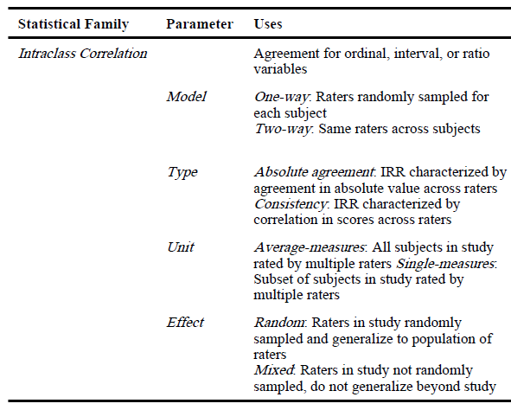
Summary of ICC statistic parameters

Slide 9
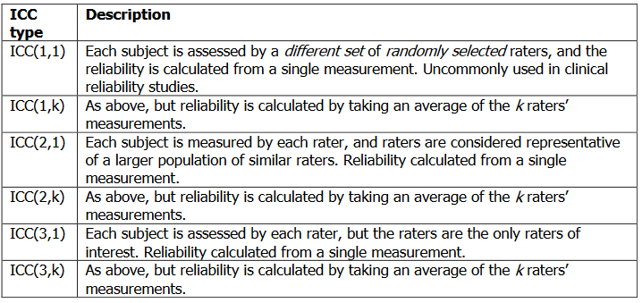
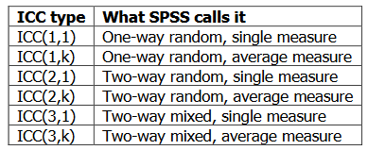
ICC types

Slide 10
3. Inter-rater Reliability
Intraclass Correlation Coefficient
Cicchetti and Sparrow (1981) suggested the following guideline for the evaluation of ICC used to measure inter-rater agreement:
ICC | interpretation
<0.40 | Poor agreement
0.40 - 0.59 | fair to moderate agreement
0.60 - 0.74 | good agreement
0.75 - 1.00 | excellent agreement

Slide 11

Equivalence of Kappa and ICC
Unweighted Kappa
For dichotomous ratings, kappa and ICC are equivalent.
Weighted Kappa
For order categorical (ordinal scale) ratings, the weighted kappa and ICC are equivalent, provided the weights are taken as

Slide 12
3. Inter-Rater Reliability
Limitations of ICCs
The ICC is strongly influenced by the variance of the trait in the sample/population in which it is assessed. ICCs measured for different populations might not be comparable.
  For example, suppose one has a depression rating scale. When applied to a random sample of the adult population the scale might have a high ICC. However, if the scale is applied to a very homogeneous population--such as patients hospitalized for acute depression--it might have a low ICC.
Assumes equal spacing between categories
Association vs. bias
  The ICC combines, or some might say, confounds, two ways in which raters differ: (1) association, which concerns whether the raters understand the meaning of the trait in the same way, and (2) bias, which concerns whether some raters' mean ratings are higher or lower than others.

