Slide 1
What Kinds of Questions Does Epidemiology Answer? “Big 6”
Description
  How frequent/common are risk factors/exposures/conditions/diseases? How often does Y occur?
Causation
  The science of establishing causal relationships among biological, behavioral, environmental (etc.) factors among humans
  Does X cause Y?
Attribution
  What fraction of disease Y can be eliminated if a causal exposure X is eliminated?
Mediation
  Understanding the mechanisms of causation
  How does X cause Y?
Interaction
  When and for whom does X cause Y?
Prediction
  Do A, B, and C predict occurrence of Y? (e.g., diagnosis or prognosis)
Notes:
Before we get started with today’s material, we should review the kinds of questions that epidemiology answers?
First, is description….
Lastly, is prediction. Can we identify a factor or set of factors that predicts the occurrence of disease or some outcome in a diseased person. Doing this prediction concurrently is basically diagnosis. Using prediction to predict the future is prognosis.
I’m guessing that each of you is working at least one of these questions. If true, then this course is for you.

Slide 2
Research Studies Based on Humans
Unit of observation
Group (e.g., geographic area)
Individual
Observational
Experimental
Experimental
Ecologic Studies
Randomized
Non-randomized
Observational
Randomized
Non-randomized
Between-subject
Cohort
Cross-sectional
Case-Control
Within-subject
Case-crossover
Case only
Self-controlled case series
Notes:
While it is important to know about group-level studies, this course will focus on study designs in which individuals are the unit of observation. In particular, we will focus on observational studies, although we will occasionally mention experimental designs (such as randomized trials). We have an entire course on experimental trials, called Clinical Trials (EPI 205), in Winter Quarter. However, experimental designs should be thought of as cohorts where the investigator assigns the exposure, and thus much of what we teach regarding cohort studies in the observational context can be applied to experimental designs. In addition, the design of an observational study is strengthened by attempting to emulate an experimental design, a topic addressed in the Hernan & Robins optional reading.
Today, we’ll provide an overview of the different designs and the key concepts underlying the design of observational studies. We won’t say much about experimental designs other than that experimental trials are essentially cohort studies in which the exposure is intentionally assigned by the investigator rather than just observed as it occurs in nature. Some clinical trials may have a very short time interval between the intervention and measurement of the outcome, but there is always some element of time with the intervention preceding the outcome measurement.
In the realm of observational designs at the individual level, we will discuss cohort and cross-sectional studies briefly and then spend more time on case-control studies. We’ll show how case-control studies, if properly designed, can give results that are as valid as cohort studies.
Finally, in the Extra Slides we look at the “within-subject” designs, describing case-crossover studies, a design that uses only cases, but can provide valid results in specific situations. Another “within-subject” design, called a “self-controlled case series” will be discussed in one of our course’s Journal Clubs.

Slide 3

3 Ways to Sample An Underlying Fixed Cohort
= event = loss to follow-up CE = competing event
CE
CE
Cohort study
Cross-sectional study
Time since enrollment
= Case-control study
Notes:
The two other ways to sample a fixed cohort are:
Cross-sectional sampling -- sample everyone at one point in time
Case-control sampling -- a strategic sampling scheme limited to just those who developed your outcome of interest and a reference group.

Slide 4
= Case-control
study
Sampling a Dynamic Cohort
New Members
= event
CE
= leave
CE
CE = competing
event
Cross-sectional study
Cohort study
Observation begins
Observation ends
Time (calendar)
Notes:
Just like there are at least 3 main different ways to sample a fixed cohort, there are also 3 main different ways to sample a dynamic cohort. Here we add the cross-sectional and case-cohort design options. It is important to be conscious of which type of underlying cohort (fixed vs dynamic) you are sampling and which type of study design (cohort, cross-sectional, case-cohort) is being utilized.

Slide 5
Cohort Study Design: Fixed Cohort
= event = loss to follow-up CE = competing event
CE
CE
Cohort study
Initial Study Cohort
(e.g., N = 1000)
Cohort at the end
of Follow-Up
(e.g., N = 987)
Time since enrollment
Notes:
Let’s start with a fixed cohort study. A fixed cohort study is the classic observational study, meaning what most people think of when they think of a cohort study. A fixed cohort study begins with a group of individuals whom at time zero have some defined set of characteristics. If the goal is to study a particular event or outcome, we would typically include in the defined set of characteristics that none of the individuals have the event or outcome of interest. These individuals are then observed over time for the occurrence of the event of interest. The time of observation is usually the “time since enrollment” in a fixed cohort, as identified on the x-axis in this schematic. The time element could be other things, however, such as age. The event could be anything, a disease, death, cessation of smoking, attending a primary care visit for the first time, etc.
In a fixed cohort study of some event (e.g., heart attack), the four possible outcomes for a participant in the fixed cohort study are: loss to follow-up, having the event of interest, a competing event (e.g., death from something other than a heart attack), or being followed without an event to the end of the study.

Slide 6
Threat to Validity in a Cohort Study:
Losses to follow-up
What bias do those lost introduce? Missed disease diagnoses?
Are those with particular exposures more or less likely to leave?
?
?
CE
?
?
?
CE
?
?
Time
Notes:
The entire last half of the course is going to discuss threats to validity (also known as “bias”) in research, but one very important threat that we will introduce now is losses to follow-up.
What is the effect of participants who are lost to follow-up on the inferences generated by a cohort study? This is a key element to consider when trying to make valid inferences when using a cohort study or an experimental trial. The answer is that it depends upon the research question. However, in general, these losses to follow-up are a source of concern. Because participants are “lost” and we do not know their outcomes, we cannot tell about the effect of these losses on the study inferences. Do those who are lost have a different rate of the outcome than those who remain? Do they represent a different association between the exposure and outcome? In practice, it is often impossible to answer these questions for the simple reason that participants who are lost or refuse to participate further are not available to supply the answers.
It is possible to assume worst case scenarios for those lost to follow-up and assess the range of possible effects on the study findings. You will have a chance to try this in one of the homework problems. This is known as a sensitivity analysis. Such an analysis asks how sensitive our findings are to the different assumptions about the lost.
Losses to follow-up are usually carefully reported in clinical trials, at least in more recent years in the better journals, but it is surprising how many articles from cohort studies give little or no attention to this crucial element.
At a minimum, results of a cohort study should include an enumeration of those lost to follow-up and a comparison of the characteristics of those leaving the cohort with those retained. At a minimum, this is a comparison of baseline characteristics, but, if data are available, a comparison should be made of the characteristics at the time of loss (i.e., using the last available measurements on the lost participants). Time of loss is more relevant than baseline because things change in a given participant. This would be the fullest disclosure of the lostness without making any assumptions about the lost. This should be done in research articles much more often than it is done. There are other more advanced techniques that can be used to make a guess at the effects of the lost on the truth of a study’s findings; we will discuss these later in the course.
There are, of course, other threats to validity in a cohort study including measurement bias, confounding, or selection bias at entry that we will take up later in the course.

Slide 7
Competing Events
Important concept but missed in most introductory coverages
Different than losses to follow-up
  Lost to follow-up: may still have outcome of interest but it won’t be observed by the investigators.
  Competing event: participant no longer able to have the outcome of interest (or has a markedly decreased risk).
Examples:
  If outcome is not mortality, death is always a competing event.
  If outcome is hip fracture, bilateral hip replacement is competing event.
Any outcome other than all-cause mortality is subject to competing events
Implications for estimating incidence in next 2 lectures.
Notes:
We earlier mentioned the term “competing event”. It typically does not receive adequate attention in introductory coverages of cohort studies, but it should. One cannot think about cohort studies without keeping in mind competing events. A competing event is an event that precludes the occurrence of the outcome of interest. At the point when a competing event occurs, follow-up ends since it’s no longer possible to have the outcome of interest.
Competing events are different than losses to follow-up. Persons who are lost may still have your outcome of interest. However, you as the investigator, are not able to observe it. With a competing event, the participant simply is no longer able to have the outcome of interest (or the chance of the outcome has been markedly altered). For example, if the study outcome is not mortality, then death is always a competing event. For example, in a study of the incidence of heart attack, death from cancer prior to occurrence of a heart attach is a competing event. Another example of a competing event would be a bilateral leg amputation (i.e., both legs amputated) in a study of knee replacement. Or, bilateral hip replacement would be a competing event for the outcome of hip fracture.
One fine point is that an event need not entirely preclude the occurrence of an outcome of interest for the investigator to handle it as a competing event. For example, in a study where ovarian cancer is the outcome, having one’s ovaries removed substantially reduces but does not entirely preclude the occurrence of ovarian cancer. Investigators may nonetheless typically choose to handle ovarian removal as a competing event.
Any study where the outcome is not inevitable has the potential for competing events. This means that any study other than one that looks at all-cause mortality is subject to the possibility of competing events.
We will discuss competing events in more detail in later lectures.
Advanced technical note: There is sometimes confusion about what to call or how to handle events that markedly alter but do not entirely preclude the probability of another event, such as the removal of ovaries mentioned above, and for after which participants continue to be alive. For example, the choice to the investigator is whether to call the occurrence of ovary removal a competing event and cease analysis/observation of the participant at that point or to keep the participant in the analysis, follow her course and incidence of ovarian cancer, and keep track of the ovary removal in other ways. The answer rests in the desired research objective. Among descriptive objectives, one question of interest is what is the cumulative incidence of ovarian cancer in women as long as they still have ovaries. In this instance, one would want to call the occurrence of ovary removal a competing event, and it will require the investigator to remember to use a special analytic tool (the Aalen-Johansen estimator, which we will discuss later in the course) in order to get the right answer. The investigator would also want to concurrently report the incidence of women who developed the competing event, such as to be able to interpret the cumulative incidence of ovarian cancer among women with intact ovaries in proper context. On the other hand, if the desire is to estimate the actual cumulative incidence of ovarian cancer among all women who started off in a fixed cohort, then the more commonly understood cumulative incidence estimators (e.g., Kaplan-Meier) can be used. Interpretation of this incidence, however, needs to keep in mind that some (possibly important fraction) of women had their ovaries removed over the course of observation and drastically changed their probability of outcome. Other nuances in censoring also come into play. Both approaches are valid but they have very different interpretations. If the investigator is estimating rates, he/she will need to be cognizant about the interpretation of the rate if ovarian removal is considered a competing event and removed from the analysis (“the rate of ovarian cancer in those who have not had ovarian removal”) versus if the participant is not removed (“the rate of ovarian cancer in the entire population, some of whom have had ovarian removal”). Both estimates are valid; they just have different interpretations.
For analytic objectives, it is clear that a competing event that results in a participant remaining to be alive but at markedly altered risk for the outcome is essentially a form of (marked) interaction. Hence, an event such as ovarian removal can be handled as a competing event (with cessation of observation) or by keeping the participant in the analysis and considering ovary removal an effect modifier. Handling ovary removal as an effect modifier has the advantage of being able to derive some marginal measure of association, averaged over all participants. It also forces the investigator to be conscious in reporting about the presence of very different stratum-specific estimates depending upon the presence or absence of ovary removal. On the other hand, handling ovary removal as a competing event essentially means that we are just evaluating the stratum-specific estimate in which ovary removal did not occur. As long as the investigator remembers this and does not confuse the competing event-derived measure of association with the marginal measure of association (i.e., for the entire starting population), there is equivalency between the two approaches (i.e., the competing event-derived approach estimate is the same as the effect modification approach-based stratum-specific estimate of the non-ovarian-removal stratum). If somehow the investigator forgets this and leads readers to believe that the competing event approach-derived estimate is the estimate for entire population, then the competing event approach-derived estimate is going to be wrong (biased) in comparison to the truth in the entire population in certain situations. One such situation is when risk differences are calculated under non-null association between exposure and outcome, and in which exposure is not related to the competing event. That is, when only participants remain in the analysis who have not had ovary removal, this leaves a group that has a higher incidence of ovarian cancer than the entire starting population – the absolute incidences in both exposed and unexposed groups who remain are falsely elevated compared to the starting exposed and unexposed populations. If there is truly no association between exposure and disease, then this will not result in bias in either the absolute or ratio measure of association. The difference between two falsely elevated incidences which are identical is still zero. On the other hand, if there is a true association between exposure and outcome (what we call the non-null scenario), then the falsely elevated incidences in the exposed and unexposed groups will result in a biased risk difference; the risk ratio should not be biased, however, as long as exposure is not causally related to the competing event. This scenario is identical to Diagram 2 of Figure 1 in Howe et al. Epidemiology 2016 except for replacing Howe’s D (lost to follow-up) with “Selection” and L with the competing event. If exposure is related to occurrence of the competing event, then this is a set up for collider bias and needs to be handled with caution.
This discussion reminds us that there is a fundamental difference between competing events that still result in a person being alive (and thus theoretically at risk for outcomes) and competing events such as death for which it does not make sense to consider the occurrence of new incident conditions.

Slide 8
Cross-Sectional Study: From a Dynamic Cohort Study Base
New Members
CE
CE
Cross-sectional study
Calendar Time
Time of the Study
Notes:
A cross-sectional study is a sample of a population at one point in time, a cross-section of that population. What is perhaps not so well appreciated is that this is a cross-sectional sample from an underlying cohort. This slide shows a cross-sectional study in an explicit dynamic cohort, e.g. the residents of SF County.
It demonstrates what we call the “prevalent” nature of the cross-sectional sample. In other words, only those individuals who were present at the time of the cross-sectional sample have a chance to be included. So, for example, in the illustration there are two members of the cohort who were diagnosed with the disease outcome who did not survive to the time of the cross-sectional sample. Cross-sectional sampling, then, will only capture prevalent cases of disease, which means that the probability of inclusion is related to the length of disease duration or survival. It will over-represent those cases of the disease with longer disease duration or survival times.
Likewise, those without disease are also “prevalent”, meaning that persons with certain characteristics that influence presence in the population may be more or less likely to be represented in the cross-sectional sample. These characteristics may influence entry into the population or removal via departure or competing event. This could especially occur if the dynamic cohort was not in steady state but also could occur if the dynamic cohort was in steady state. We will discuss this at length later in the course when we describe selection bias. For now, it is sufficient to recognize that a cross-sectional sample is not necessarily a random sample of disease and not necessarily a random sample of people who gave rise to disease.
A cross-sectional study can be conducted in a dynamic cohort, as illustrated here. A survey of Kaiser members is an example of a cross-sectional study in a dynamic cohort. In contrast, a survey of all patients presenting at a particular emergency room at a public hospital (which can be theortically attended by anyone) is a cross-sectional study with an underlying dynamic cohort that can be conceptually/hypothetically described but would be difficult to specifically delineate.

Slide 9
Cross-Sectional Design:
Weaknesses for Analytic Objectives
Often cannot determine whether putative cause (exposure) preceded the disease outcome
  Examples of exceptions: Genetic exposure; Childhood exposure and adult disease.
Cannot distinguish factors associated with disease (incidence) from factors associated with survival with disease
Notes:
Whereas cross-sectional studies are terrific for descriptive objectives, they often attempt to tackle analytic objectives (i.e., relating exposures to outcomes), and this is when they have several major weaknesses. In a cross-sectional study, you might see an association, for example, between depression and pain, but it would be hard to know which caused the other unless you could also determine (with accuracy) when each condition started. You won’t be able to know temporality (i.e.., what came first) for many of the associations that might be discovered in cross-sectional data. (Genetic exposures are one notable exception as are exposures that can clearly, by logic, known to come first, such as something that happened in childhood.)
Another weakness of the cross-sectional design also stems from the use of prevalent rather than incident cases. As noted on the previous slides, prevalent cases will over-represent those cases with longer disease duration or survival times when compared with new instances of the cases. Thus, the prevalent cases are the end result of forces that caused disease to occur (incidence) in the first place and forces that caused cases to survive/continue longer. For example, prevalent stroke cases would include those with a higher risk of having a stroke and those with lower risk of having a rapidly fatal stroke. Factors contributing to a rapidly fatal stroke might appear to be “protective” (i.e., confer lower risk) against stroke in a study of prevalent stroke cases. Thus, any association you might uncover between an exposure and a disease may alternatively be an association between exposure and survival with the disease. That this alternative association makes you think there is an association between exposure and disease incidence is a form of selection bias. Later in the course, we will provide two other graphical ways to think about this. One uses theoretical populations and provides a visual approach (boxes and sticks) to show how the components of the study base (e.g., exposed and diseased) are either over- or underrepresented in the study sample. The other uses directed acyclic graphs (DAGs) to show how if both exposure and disease are causally related to survival (and hence inclusion in a cross-sectional study) and if there is multiplicative interaction between the two, then there will a spurious association between exposure and disease.

Slide 10
Case-Control Study Design

Slide 11
Primary & Secondary Study Bases
Case-control studies can be thought of as evolving from one of two types of study bases (i.e., underlying cohorts):
  Primary study base vs. Secondary study base
A primary study base is one where the underlying cohort is readily defined, either because it is:
  previously assembled for research (e.g., Framingham)
  administratively defined (e.g., Kaiser members in 2016)
  or geographically defined (e.g., SF residents in 2010)
A secondary study base is more elusive. It starts with the cases and then works backwards.
Notes:
“Primary” and “secondary” study bases are a central concept in case-control design. In general, a primary study base is the preferred design for a case-control study, for reasons which will become apparent soon. Examples of primary study bases include a research cohort study, like the Framingham cohort study or the Nurses Health Study, that has been assembled specifically for research; an administratively defined cohort like the Kaiser membership (all persons who participate in the Kaiser insurance plan); or a geographically defined cohort like San Francisco residents in a particular time period. We call them “primary” study bases because they exist (you can put your hands on them) prior to a case-control study ever being conducted.
However, some case-control studies are proposed (or actually performed) without being sampled from an existing explicit cohort. In some situations, the investigator would like to start with a set of cases, e.g., cases of hip fracture treated at UCSF during 2012, and then attempt to identify appropriate controls. This would be an example of a case-control study with a “secondary” study base. For reasons that will become apparent soon, it is a more problematic approach.
In the next slides, we will give you examples of case-control designs that use a primary study base. Then we will return to secondary study bases and then provide a more formal definition and example. You will get a chance to identify primary and secondary study bases in the first homework problem set.

Slide 12
Incidence density vs case-cohort sampling (from an underlying fixed cohort)
Design | Unique Advantages
Incidence density | If exposures change over time (“time-varying” exposures) and resources allow for only one reasonably near but preceding exposure timepoint to be measured, this design (choosing, say, one year prior to event) could accommodate these constraints while a case-cohort design could not.
Case-cohort | One control group can be used for any number of outcomes, thereby increasing efficiency and also building up a well-phenotyped control group in terms of measurements (covariates). Especially useful for time-invariant exposures (e.g., genotype).
Notes:
We have discussed two approaches: the sampling of controls in a fixed cohort can be done with incidence density sampling or a case-cohort approach. How should one choose between them? One way to think about this is to consider the unique advantages of each. One advantage of incidence density sampling occurs when exposure measurement change over time (this is called a “time-varying exposure”). For example, the exposure in the last slide, plasma level of C-reactive protein (CRP), typically changes over time in a given individual. If you are interested in studying a time-varying exposure and if you have limited financial resources, you will not be able to measure the exposure on a large number of timepoints in given participants. With very limited resources, you will probably only be able to measure it at one time point. If this is the case, you will probably want to choose a timepoint that temporally precedes the event in question but not by a long period of time. Choosing a time point that is one year prior to the event is logically a good approach, unless you have some justification for an even earlier measurement (some “hit and run” mechanism). Incidence density sampling allows for measurement of one slice of person-time in a given participant. For case-cohort sampling, the only instance when a single timepoint can be used is when you are willing to make the measurement on the time zero (baseline) timepoint. If you seek to evaluate subsequent timepoints (such as 1 year prior to the event), you will need to make a measurement at both time zero, the subsequent time point in question (e.g., 1 year), and assuming you believe that the exposure might change in a given individual, all of the time points between baseline and 1 year prior to the event (for all cases and controls). In other words, there is no way to just evaluate a single time point after time zero in case-cohort design, as can be done with incidence density sampling.
The case-cohort study design has the advantage of allowing the control group (the random subset of the cohort) to be used for multiple outcomes. This increases the usefulness of each exposure measurement and the overall efficiency of the cohort. In addition, with the accumulation of different measurements, the control group becomes very well characterized allowing control for potentially more confounders and assessment of interaction (topics we will cover later in the course). Case-cohort designs are especially useful for time-invariant exposures (such as genotype).

Slide 13
Summary: Sampling Controls from a Dynamic Cohort Primary Study Base
Method of Sampling | Mechanics/Assumptions
Incidence density | Random sample at time each case diagnosed; i.e., match on calendar time. No assumptions needed.
Midpoint of risk period | Random sample at midpoint in follow-up. Assumes linear change in exposure and covariate prevalence.
Any single time point (e.g., end of risk period) | Random sample at one timepoint, usually end of follow-up. Assumes steady state exposure and covariate prevalence.
Notes:
This is a summary of the approaches. Incidence density sampling has no assumptions, is most commonly used, and is typically the preferred approach.
See the optional reading Vandenbroucke 2012 for additional discussion of these approaches.

Slide 14
Secondary Study Base
Example: Incident glioma (brain tumor) cases seen at UCSF Medical Center
The secondary study base is: Persons whom, if they had developed incident glioma, would have been seen at UCSF.
Can we identify this secondary study base in practice? Patients come to UCSF from many areas and for different reasons
Common approaches raise considerable concerns. Examples:
  UCSF patients with a different neurologic disease
  UCSF patients from a similar tertiary referral clinic but other rare disease
  Residents of the neighborhood of the case
Notes:
Since UCSF is a major referral center for brain tumors, it is impossible to determine a geographic catchment area, i.e. a primary study base that gives rise to all of the cases of brain tumors seen at UCSF. Thus, it is a secondary study base that gave rise to the glioma cases, but how are we going to identify and sample this secondary study base in practice to identify controls for our case-control study?
Some approaches researchers have commonly used in the past raise considerable concerns. How about using UCSF patients with a different neurologic disease as controls? If patients with a different neurologic disease for which UCSF is also a referral center are patients who would also have come to UCSF had they been diagnosed with a glioma instead, they may represent a representative sample of the study base population that gave rise to the gliomas. But what if the exposure under study was also a cause of the different neurologic disease? This will result in a biased measure of disease association between the exposure and glioma. The same problem exists for another disease in another disease domain. Later in the course, we will learn how to formally think about this with directed acyclic graphs.
Another approach that has been used often for hospital-based case-control studies is to select neighborhood controls for the cases. This approach uses geography to identify possible controls, but it chooses a very narrow boundary for each case, such as the block across the street from the case’s address from which a random address is chosen. The assumption is that someone else with a glioma in that immediate neighborhood would also have come to UCSF. This may or may not be valid assumption. Not everyone in a given neighborhood has the same attitude, beliefs, behavior or knowledge.
While it is relatively easy to describe a secondary study base in words (“all individuals who would have come to UCSF for care if they had developed and been diagnosed with brain cancer”), it is quite difficult in practice to enumerate this population and then sample it. Thus, it is difficult to design a sound case-control study using a secondary study base. You’ll appreciate this even more after working on this week’s problem set.

Slide 15
New
Members
Case-Control Study with Prevalent Cases and Controls
in a Dynamic Cohort
CE
cases
CE
:Survival Time
controls
Common case-control design –
and most susceptible to bias.
Calendar Time
Time of the Study
Notes:
A design that illustrates these distinctions and is unfortunately all too common is one which uses prevalent cases and prevalent controls. By prevalent cases, we mean that investigator finds all of the cases, at one point in time, that are accessible to him/her at that time. This is essentially like the cross-sectional study we explained before. This is sometimes referred to as a case-based case-control study carried out “cross-sectionally”: cases with long survival after diagnosis (best prognosis) are more likely to be included in the case group. In this example, the dashed horizontal lines originating from the cases represent survival times; note that only three of the five cases are included in the study. The other cases have either died or left the underlying cohort.
Use of prevalent cases is a flawed design that cannot be rescued through analytic methods. It has the same weaknesses as a cross-sectional study.
As we noted earlier in our discussion of sampling controls from a dynamic cohort at one timepoint, we can theoretically use controls sampled at the end of the study to represent exposure prevalence in the cohort. We can again informally call this “prevalent control” sampling in the context of a dynamic cohort. However, as we also noted earlier, for this to be an unbiased estimate of exposed and unexposed person-time in this dynamic cohort, the exposure prevalence in the population has to be in “steady state” during the study period. In addition, prevalence of covariates has to be in a “steady state.” These assumptions are difficult to meet.
What makes this situation even worse is that it is often done in the context of medical center-based case ascertainment, i.e., a secondary study base. This makes for 3 strikes: prevalent cases, prevalent controls, and a secondary study base.
It is easy to see how this would be an easy study to perform. Grab all of the alive cases you can find in your clinic and then grab all of the controls (persons without the disease under study) you can find at your medical center. This explains why this approach is so common. However, “you get what you pay” for in that this approach is very susceptible to producing invalid answers.

Slide 16
Also Ambiguous: Prospective & Retrospective
There are at least 3 different meanings to the dichotomy of the terms: prospective vs retrospective
  See optional reading by Vandenbroucke, BMJ 1991
  given this confusion, “words prospective and retrospective have lost all meaning. From spotting them in the abstract, the reader gains no insight into the type of research that was performed.”
The key issues for the strength of the study design are:
  Timing of measurements: best to obtain measurement (or specimen) of exposure prior to outcome
  And more broadly, the accuracy of measurements, the absence of selection bias and the absence of confounding
We don’t recommend labeling studies as prospective or retrospective, although journals will sometimes insist
Notes:
One of the major criticisms of the case-control design is that it is “retrospective.” This is correct in that the study is carried out after the disease experience of the study base has already occurred. But cohorts can also be retrospective. Looking back in time, a group of individuals is identified as a cohort (a typical example is a group of workers, such as shipyard workers in WWII) and then their disease experience over a period of time is investigated. In terms of study validity, though, the key question is not when is the study being carried out, but when were the measurements made and how good are they?
The weakness in measuring exposure variables in a case-control study comes when participant recall is relied on to make the measurement. The strongest case-control studies look for measurements that were made in the past before the disease diagnosis; for example, measurements captured in medical records in an HMO. Retrospective cohort studies always depend on measurements made in the past. This is not a limitation if the measurements were made before the outcome was known. Or, if the measurement is of a biological specimen, if biological samples acquired before the outcome have been stored and can be accessed.
Although “prospective” is often thought to be a stronger design than “retrospective,” this is not the key distinction. Rather, the timing of the measurement of exposure relative to outcome is the key issue. It’s also worth noting that the term “prospective” may be used quite loosely, including to describe a cross-sectional study.
You may also see the term “ambidirectional” used to describe studies that have both prospective and retrospective features. This term, too, is fraught with confusion and lacks specificity.
We suggest to avoid use of retrospective, prospective or ambidirectional when describing study designs. They are empty terms that give no reproducible meaning. Instead, use your space limitations to better describe the mechanics of what you have done. Unfortunately, naïve journal editors sometimes insist that you label your study as retrospective or prospective, and you may have no choice but to comply. You should ask editors not to insist on these terms, but often they hold all of the cards.

Slide 17
Emulating Experimental Studies
Emulating a target trial in observational work has advantages
  Promotes clarity in the research question
  Avoids common biases in observational research
  Better chance of influencing public health/clinical practice
As an example, consider the choice of exposure categories for assessing a particular treatment.
  In a RCT, participants are usually treatment naïve upon entry.
  In an observational study, participants are often identified as exposed to a treatment if they are currently using it.
    But, this may include participants with a wide range of duration of treatment exposure prior to baseline, including those who have fully tolerated the treatment (and are past period of highest incidence of side effects)
      Could result in overly favorable estimate of the treatment’s effect
Notes:
As an example of how this approach can highlight issues in study design in an observational study, consider the choice of exposure categories for assessing medication use. In a RCT, participants are usually chosen who are treatment naïve, and exposure to the treatment (or placebo) is initiated with the start of the RCT. In an observational study, participants are often identified as exposed to a medication if they are currently using it. With this definition, “exposed” may include participants with a wide range of duration of exposure. This has the potential to generate erroneous results. Having identified this discrepancy in the design of an observational study compared with the “target” trial, the investigators can consider various approaches to bring the observational study more in line with the target trial.

Slide 18
Prevalence versus Incidence
Prevalence counts existing diseases/conditions, usually at a single point in time
Incidence counts new disease diagnoses/ occurrences occurring over time
Fundamental distinction in epidemiology
Notes:
The difference between incidence and prevalence is a fundamental distinction in epidemiology. Prevalence counts existing disease/conditions, typically at a single point in time. Incidence counts new disease occurrence over time.
In some instances, prevalence may look numerically similar to incidence and in others the two measures will be very different. They are, however, very different entities.

Slide 19
Two Types of Prevalence
Point prevalence - number of persons with a specific disease/condition at one point in time divided by total number of persons in the study population
Period prevalence - number of persons with disease/condition in a time interval (e.g., one year) divided by number of persons in the study population
  Prevalence at beginning of interval + any incident cases
Note: Prevalence is not just for disease (outcomes).
  Exposure prevalence (sometimes called “risk factor” prevalence) is also important
    e.g., smoking prevalence
Notes:
There are two types of prevalence: point prevalence and period prevalence. Point prevalence is defined as the number of persons with a particular disease or condition at one point in time divided by the total number of persons of interest in the study population. Period prevalence is the number of persons with who have experienced or are experiencing the disease/condition at any time during some prior period of time, which typically includes up to the moment of inquiry. A way to think about period prevalence is as the point prevalence at the beginning of a defined time interval plus whatever incident cases occur during that interval. However, this is taken only from persons who have survived the interval, and is not the same counting disease in a cohort moving forward (in which case you know you have everyone accounted for). The distinction between point and period prevalence is often not made because most prevalence estimates that you will encounter in the literature are point prevalences. Period prevalence has its uses, however. Although it is not exactly the same as measuring disease in a cohort moving forward, it is, for example, helpful for planning the delivery of health services to know how many persons in a given time period may need services for the disease. It is especially useful for short-lived conditions (e.g., common cold) for which point prevalence might be somewhat deceiving regarding burden of disease.
The concept of prevalence is not unique to disease. The prevalence of a risk factor (or “exposure”, as we will generically refer to this throughout the course) is also important from a public health perspective. For example, a risk factor (exposure) may have a modest association with a disease outcome (say, a risk ratio less than 2), but it may be a very common exposure. In that instance, even a small risk ratio may have great public health importance because a large proportion of the population is exposed. A good example is the risk associated with second hand smoking. We will cover this subject in more detail later in the course when we discuss measures of disease association and attribution, but, in general, the size of the measure of association relating an exposure to disease can be useful as a gauge of the potential role of the exposure in the etiology of a particular disease, but the prevalence of the exposure in the population will determine how large its attributable risk on the disease – and on public health - will be. We have also already discussed the concept of “exposure prevalence” last week when we mentioned assumptions for exposure prevalence in case-control designs.

Slide 20
Two Measures of Incidence
Proportion of at-risk individuals who experience the event in a defined time period (E/N during time T). This is unitless. Varies between 0 and 1.
  = cumulative incidence
  = incidence proportion
  = risk
Number of events divided by the amount of at-risk person-time observed (E/NT). Importantly, this is not a proportion. (More next week.) “person-time incidence”
= incidence rate
= incidence density
= rate
Notes:
There are two different measures of incidence. Both are perfectly valid measures of incidence as both account for E, N, and T. We will be exploring the properties of these two measures, the assumptions they make, and how they are used in research. Both measures account for the element of time and the variation in individual participant observation time that often occurs in research, but they do so in different ways.
The first measure is the proportion of individuals at risk at time 0 who subsequently experience an event in a defined time period. It is E/N within a specified time period T. Note that this measure of incidence does not have units. There are many terms for this measure, but we prefer “cumulative incidence” for this construct as it is the most descriptive (an accumulation of incident events). The terms “incidence proportion” and “risk” are also acceptable. Even our preferred term “cumulative incidence” has some ambiguity. The term has also been used, for example, by Breslow and Day (1980), two famous statisticians, to describe what is more commonly known as the cumulative hazard. Once again, the reader of any research needs to be very aware of what is being presented by the authors and not just assume a common interpretation of these terms for incidence.
The second measure describes the number of events that arise from some person-time of at-risk observation. Sometimes, it is informally called “person-time incidence”, and we like this term but it is not very commonly used. More commonly, one will see the terms incidence rate, incidence density, or rate. The formula is E/NT. Please note that this is not a proportion. This measure does have units – which will be discussed in the next lecture. This measure is somewhat less intuitive to naïve observers. We prefer the term “incidence rate” to describe this construct but “incidence density” and “rate” are also fine.

Slide 21
Two Ways Censoring Occurs
Loss to follow-up
  Also known as “drop-out”
  Participants might inform investigators of intentions
    no longer interested in participating, or
    moving away and can no longer practically participate
  Or, they may not inform investigators
    Simply stop coming to study visits and cannot be found
  Or, in some real-world underlying cohorts, people just leave the context and no more data about them are available
  Although all above mechanisms are handled the same analytically, it is important to record the mechanism
2) Administrative Censoring = Study ends and participant has not yet experienced outcome
Notes:
Therefore, there are two ways that censoring can occur in a study without competing events.
The first is called lost to follow-up or drop-out. In dedicated prospective research efforts, participants might volitionally inform investigators of their intent to drop out (e.g., they lose interest or they move out of the area and cannot practically continue in the study) or they may not (they just stop showing up and don’t respond to contact efforts). In settings in which researchers are using previously collected administrative data, such as electronic medical records, sometimes the trail of data simply ends, when, for example, people leave the context (e.g., leave the Kaiser Health Insurance Plan).
The second is called administrative censoring. Follow-up ends when the investigators call it quits, and the people who are still being followed at that time but have not been diagnosed with the outcome are said to be administratively censored as of the last date of follow-up. They therefore contribute the entire amount of their time in the study as disease-free follow-up time. This time may not be exactly the same for all administratively censored subjects because they may not all have been enrolled on the same date. In the previous figure, there are actually 3 persons who are administratively censored, subjects 5, 7, and 9. Subject 7 only has 1 month of follow-up because he or she was enrolled late in the cohort.
Thus, there are two ways of being censored in a study without competing events: a) loss to follow-up (aka drop-out); and b) administrative censoring.

Slide 22
Calculating Cumulative Incidence with Kaplan-Meier Approach
Time (mos) | Individuals at Risk | Number of Events | Conditional Probability of the Event | Conditional Probability of Survival | Cumulative Probability of Survival
 | n | d | q = d/n | p = 1-q | S(t)
1 | 10 | 1 | 1/10=0.100 | 0.900 | 0.900
3 | 8 | 1 | 1/8=0.125 | 0.875 | 0.788
9 | 7 | 1 | 1/7 = 0.143 | 0.857 | 0.675
13 | 5 | 1 | 1/5 = 0.200 | 0.800 | 0.540
17 | 3 | 1 | 1/3 = 0.333 | 0.667 | 0.360
20 | 2 | 1 | 1/2 = 0.500 | 0.500 | 0.180
24 | 1 | 0 | 0 | 1 | 0.180
Cumulative probability of survival = S(24) = 0.9 x 0.875 x 0.857 x 0.8 x 0.667 x 0.500 x 1 = 0.180
But, we want cumulative incidence, the cumulative probability of the event = 1- S(24) = 1 – 0.180 = 0.820
Notes:
We continue this process, calculating conditional probability of event and of survival at each time an event occurs until we have included all events (6 in this example) and include the last person observed, who in this case was censored. The cumulative probability of survival (0.180) is the product of the individual conditional probabilities of survival, as shown on the slide.
Now, we have the cumulative probability of survival, but what we really want is the cumulative probability of the outcome. We obtain that by subtracting S(t) from 1. In this example, 1 – 0.180 = 0.820 is the cumulative probability of the event by 24 months.
22

Slide 23
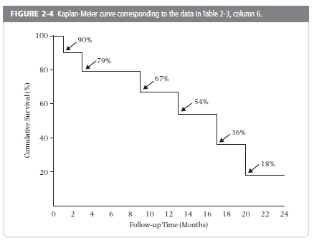
The Iconic “Kaplan-Meier Plot” (or “Curve”):
Typically shows cumulative survival
Step Function
Notes:
The results of these calculations for the S +N textbook example can be displayed in what is known as a Kaplan-Meier plot or Kaplan-Meier curve. Everyone in biomedicine has surely seen such a plot, which is why we call it iconic. What we show here is probably the most typical plot, showing the cumulative survival (not having the event).
Note that the K-M plot is a step function. It is not correct to connect the dots with straight lines. K-M curves that appear smoother are, in fact, still step functions, just like this one, but with events occurring more frequently relative to the time scale so the curve appears smooth.
While classically K-M plots show survival (i.e., falling curve), they can just as easily show incidence (i.e., climbing curve). In fact, we prefer the climbing curves in that they are more intuitive to most observers. In other words, K-M natively estimates probability of no event, but we are typically interested in probability of event, and we can estimate and plot either one.
23

Slide 24
Cumulative Incidence:
Underlying Assumption #1
For cumulative incidence to be unbiased (i.e. valid), censoring must be unrelated to the probability of experiencing the outcome.
  Censoring must be “non-informative”
i.e., the outcome experience of those who are censored (particularly those who are lost to follow-up/drop out) must be the same as those who remain in the study.
Notes:
This concept takes us back to the point made in the first lecture on study design about the threat to validity of a cohort study coming from losses to follow-up. (There are other threats to validity in a cohort study such as measurement bias and confounding, which we will cover later, but losses to follow-up are a substantial concern which are part and parcel of their longitudinal essence). As we set forth to perform survival analysis on a fixed cohort study, those persons lost to follow-up are said to be censored. If members of the cohort who are leaving are either more or less likely to experience the outcome than those remaining, the resulting incidence estimate (which can only be calculated using the persons who remain) will be either too high or too low relative to the entire study population who began at time zero.
We will give formal definitions for “valid” and “unbiased” later in the course, but for now it is clear that we seek unbiased and valid answers for our cumulative incidence estimation.

Slide 25
Cumulative Incidence Assumption #2
For K-M Estimation
No competing events; or
Independent competing events + a world in which you can envision preventing such competing events
Notes:
Another assumption we must make to get a valid and interpretable Kaplan-Meier estimate has to do with competing events. To get a valid K-M estimate, we must either have no competing events OR we must assume that there is a reality where competing events can be eliminated/prevented and that these competing events are independent of the outcome in question.

Slide 26
Incidence Rate
Our focus this week is incidence rate
The number of events per amount of person-time observed (E/NT) = incidence rate
Two flavors of incidence rates
  Average incidence rate (“incidence rate”)
  Instantaneous incidence rate (“hazard”)
Notes:
Incidence rates come in two types: average incidence rate (often just called an “incidence rate”), which we discuss first, and an instantaneous incidence rate (often just called a “hazard”), which we will discuss later.

Slide 27
What is person-time?
Person-time refers to the amount of time, in aggregate, any single person or group of persons has been observed.
For one person, person-time is simply the amount of time the person has been observed.
For a group of persons, it is the sum of the individual amounts of time each person has been observed.
A different kind of time than we are used to:
  Not a stretch of continuous time (e.g., 5 consecutive years)
  Instead, an aggregation (or collection) of individual blocks of time contributed by each person in the cohort
This sum can be expressed in any time unit: Person-years, person-months, person-days, etc.
Notes:
An incidence rate also has the number of incident events (E) as the numerator, but its denominator is different: person-time. Person-time refers to the amount of time, in aggregate, any single person or group of persons has been observed. For one person, person-time is simply the amount of time the person has been observed. For a group of persons, it is the sum of the individual amounts of time each person has been followed. The duration of time each person has been followed may be different or it may be the same. If the duration is the same, then person-time for a group of persons is simply the product of the number of persons x the number of time units they were observed (N*T).
Person-time is a different kind of time than we are used to in everyday life. It is not a stretch of continuous time (e.g., 5 consecutive years). Instead, it is an aggregation (or collection) of individual blocks of time contributed by each person in the cohort who was observed for the event of interest. This sum of person-time can expressed in any unit, such as person-years, person-months, person-days, etc.

Slide 28
Calculating an Average Incidence Rate:
Obtaining the Denominator
Incidence rate = E/NT
E= 6 deaths (events)
NT = 115 person-months
Person Number | Months of follow-up
1 | 1
2 | 17
3 | 20
4 | 9
5 | 24
6 | 16
7 | 2
8 | 13
9 | 10
10 | 3
Total | 115 person-months
6/115 person-months
6/9.583 person-years
= 0.626 per person-year
= 6.26 per 10 person-years
= 62.6 per 100 person-years
“Person-time” sometimes a source of confusion, but it need not be.
Why “person-time” instead of just “time”?
To distinguish it from more common meaning of time – a continuous duration, e.g., 115 months in a row
Notes:
Here are the calculations from the S+N text’s example using individual-level data to calculate a person-time incidence (“average” incidence rate). Note that the person-time in months is just the sum of the number of months from the previous graphic showing how long each person was observed in the study prior to getting the event of interest, drop-out, administrative censoring, or a competing event. Shifting to the left is not necessary for the calculation of average incidence rates. The S+N text calculates incidence rates separately for the first year of follow-up and then for the second year of follow-up, but this is not necessary if the rate is constant over time. One might want to show the rates separately by year if the year distinction was something special like calendar year, but this is not necessary.
The numerator is, as always, just the number of events; here, 6 deaths. We could express the rate per unit person-month or as any person-time unit. What is most conventional, however, in most fields is person-years. It is also most conventional to present rates that have integers greater than 1 to the left of the decimal point. We achieve this in this example when we converted from per person-year to per 10 person-years. The decimal point is then moved for the fraction 6/9.583 to give the rate per 10 person-year or per 100 person-years.
The concept of person-time is sometimes a source of confusion but it need not be. Think of person-time as a collection of bits of observation time contributed by different people/participants. Not all people contribute the same amount of time. In this example, we just add up time of observation from each participant to get our sum of 115 person-months. We have this construct person-time to distinguish it from the more common meaning of time, which is some continuous duration or stretch of time, for example here, 115 months in a row (as in calendar time; time from time 0/enrollment; or age (which is time from birth)). In our example, we cannot say that our rate has any meaning over 115 months in a row in any single person or group of persons. Person-time is a collection of time as opposed to a string or run of time.

Slide 29
Average Incidence Rate - Examples
  Magnitude of incidence rates are not immediately (or perhaps ever) intuitive, but you can develop a feel for them in context
Condition | Incidence rate
Prostate Cancer (men) (most common cancer in US) | 140 per 100,000 person-years
Breast cancer (women) (most common cancer in women) | 120 per 100,000 person-years
Heart Attack (men) | 50 per 10,000 person-years
Heart Attack (women) | 25 per 10,000 person-years
Acute Respiratory Infection (children) | 160 per 100 person-years
Notes:
The magnitude of these rate values are not immediately (or perhaps ever) intuitive, like a percentage is, but after you work with them for a while you can begin to develop a feeling for them. You can begin to get a feeling of the magnitude of incidence rates when looking at actual values for diseases for which you already have a feeling for their relative frequency. Cancer is less common than heart disease which is less common than HIV infection in men who have sex with men. With this relative context in mind, you can now begin to get a feeling of the incidence rates of these conditions.
Cancers are per “100,000 person-years” type of illness. However, because there are so many different forms of cancer, they begin to add up to have major public health importance. Heart disease, of which there are fewer forms, are a per “10,000 person-years” type of illness. In contrast, HIV infection in men who have sex with men is between 1 and 4 cases per 100 person-years. Acute respiratory infection in children less than 5 years old is said have an incidence of 159.5 cases 100 person-years (Benson V, Marano MA. Current estimates from the National Health Interview Survey 1995. Vital Health Stat. 1998;10:1–
428) although this actually may be too low.
It is not easy for most humans to develop intuition for these absolute rate values in isolation. For many people, thinking about the values in comparison to some of these landmark values in the chart gives a rate a meaning. For example, a rate of 25 per 100,000 person-years is less common than the most common cancers. It is basically the rate of an middle-level incidence cancer such as melanoma (~23 cases per 100,000 person-years in the U.S.)

Slide 30
A given patient can contribute exposed and unexposed follow-up time
No NSAID use
NSAID use
Notes:
Instead, calculating incidence rates by putting times of NSAID use and non-use into the appropriate person-time bins account for person-time experienced in the time-varying exposure. This is the solution to deal with the problem of changing exposure over time. There is an assumption, however, and it is that whatever effect NSAID use has on CAD risk will occur during NSAID usage but that this effect will “wash out” when use is stopped. If the “wash out” is not thought to be immediate, a time period that approximates whatever the wash out time is thought to occur can be added to avoid attributing time to non-exposure person-time before the exposure effect has been removed.
Here is a graphical representation of how an individual patient can contribute person-time as unexposed (no NSAID use), then exposed (using NSAIDs), and then (after a wash-out period) as unexposed again.

Slide 31
Average Incidence Rate:
Most Useful if Rate is Constant
So far, we have considered the “average” incidence rate
  calculated over a discrete period of time (be it calendar time or observation time)
  Has greatest relevance and interpretation if the rate is constant over that period of time
However, constant rate may not be present
Notes:
Average incidence rates have the most meaning and relevance if they represent a constant rate over the period in which they were derived.

Slide 32
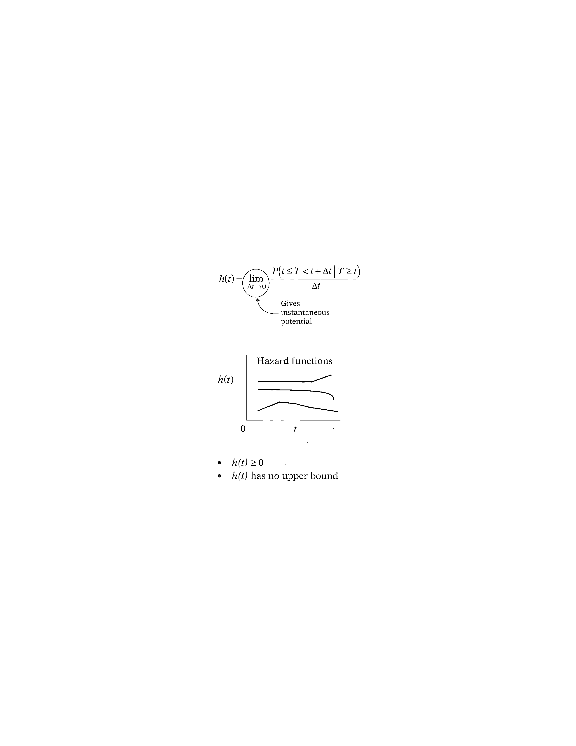
Hazard Function
(Instantaneous probability of some event)
Calculated as the duration of the time period approaches 0. This is what makes it “instantaneous”.
Average rates are macroscopic in that they are directly calculated over time durations that humans can understand with simple math
Instantaneous rates cannot be directly calculated with simple math; they can only be derived mathematically with techniques of calculus
Notes:
When we take the limit of the right-side expression as the time interval approaches zero, we are getting an expression for the instantaneous probability of failing at time t per unit time. Another way of saying this is that the conditional failure rate or hazard function h(t) gives the instantaneous potential for failing at time t per unit time, given survival up to time t. As you can see from this formula, estimating the hazard rate at a given point in time requires calculus and cannot be hand calculated directly from the data with simple math — as we did for the average incidence rate. We will not, however, be doing any calculus ourselves in this course, Instead, we will allow the statistical software to do this for us.

Slide 33
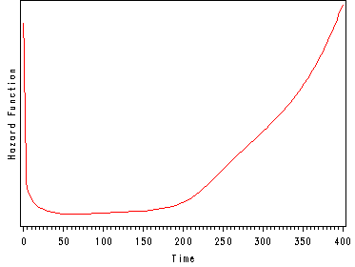
Hazard function for mortality in general U.S. population
Hazard
0 Age (years) 100
Compare information provided here versus depicting this with an average incidence rate. The average is not wrong; just less useful.
Notes:
This graph illustrates a hazard function with a 'bathtub shape'. This graph is depicting the hazard function for death in the general U.S. population over the lifespan. Notice that here age is the time on x axis. Hazard is high shortly after birth but drops rapidly and remains at a relatively low level during youth and middle age. Hazard starts to rise later in life and increases steadily.
Other metrics of interest, such as the survival function, can be derived from the hazard. Once we have modeled the hazard, we can easily obtain these other functions of interest. The hazard function is the basis for proportional hazards regression model. It is useful to be able to see the shape of a hazard function.
Note how much more this plot tells you than can be understood from an average incidence rate when incidence is not constant. An average incidence rate gives you one number — by definition. Does one number adequately depict what is going on in this plot? No. This one number is not wrong; it is just that it is not very useful. This illustrates how when the underlying hazard function is not constant, the average incidence rate falls short of being informative.

Slide 34
Relationship between hazard function and survival function with a constant hazard
where h(t) = λ
Assumes no competing events. In the presence of competing events, this direct relationship between hazard and cumulative incidence no longer holds. More on this in later slides.
Notes:
Here is the relationship between the hazard function and survival function, shown again, when the hazard is constant. If the hazard function is constant, i.e., h(t) = λ, for some specific value λ, then it can be shown that the corresponding survival function is given by the following formula: S(t) equals e to the power minus λ times t.
Of note, this also assumes no competing events. If we think of this constant hazard rate being applied to a population to produce cumulative incidence, then those who experience a competing event are removed from the population and this rate is no longer being applied to everyone. In other words, if there are competing events, the relationship no longer holds because there is no where in the formula where these losses are being accounted for. By not accounting for competing events, cumulative incidence is going to be overestimated.
With this formula, you can take an average incidence rate from an article and turn it into a cumulative incidence (which is typically more understandable by readers). Two examples follow.

Slide 35
Rates: What to do about
Drop-out and Competing Events
In the calculation of rates, people contribute person-time until they either have the event of interest (E) or:
  drop out (aka lost to follow-up)
  are administratively censored (i.e., study ends)
  have a competing event
Thus, without any special assumptions, rates have a specific interpretation:
  “Rate of the event E given that something else (drop-out; admin censoring, or competing event) has not happened first”
  i.e. “Rate of event E among those still at risk (i.e. without those who dropped out, are admin censored, or had CE)”
  This interpretation is inherently accommodating (i.e. specifically recognizing and allowing for) presence of drop-out; admin censoring; and competing events
Notes:
We spent a lot of time last week during the discussion of cumulative incidence about what to do about drop out (i.e., losses to follow-up) and administrative censoring. We also talked about what we needed regarding competing events in order to perform the Kaplan-Meier and life table estimations. What should we do about drop out, administrative censoring, and competing events in the context of rates?
If we step back for a moment, remember that in our calculation of rates thus far, persons contribute person-time until they either have the event of interest or they drop out, are administratively censored (i.e., the study ends) or they have a competing event. Thus, without making any special assumptions, rates have a specific interpretation. That is, the interpretation is: “Rate of the event (E) given that something else (drop-out; administrative censoring, or the competing event) has not happened first.
We say that this interpretation is inherently accommodating for drop out, administrative censoring, and competing events. That is, this interpretation recognizes that these events occur and allows for them.

Slide 36
Disease occurrence
Prevalence
Point
Period
Incidence
Cumulative incidence
Incidence rate
Simple proportion
Kaplan-Meier
Life-table
Aalen-Johansen
Average incidence rate
Instantaneous (hazard) rate
Notes:
This inability to appropriately deal with competing events in Kaplan-Meier analysis brings us to our last estimator for incidence, which is the last one on our list for cumulative incidence. This is one we said we would be getting to this week, and finally we have.

Slide 37
Solution for Competing Events in Cumulative Incidence Estimation
Key technical computation is simple. In successive time intervals:
  calculate joint probability of:
    a) experiencing none of the events (either event of interest or any of competing events) up through beginning of interval and
    b) experiencing event of interest during the time interval
  add up these joint probabilities within successive time intervals to get cumulative incidence of the event of interest
An argument could be made that this technique is all you need for cumulative incidence. It does everything that K-M can do & more.
Explained in detail in Satagopan et al. Brit. J. Cancer 2004
Notes:
Generally, the technique involves calculating, in successive time intervals throughout the course of follow-up, the joint probability of a) experiencing none of the events (either the event of interest or any of the competing events) up through the beginning of the time interval and b) experiencing the event of interest during the time interval. Then, one adds up the joint probabilities within the successive time intervals to get the cumulative incidence of the event of interest. This is explained in more detail in the Satagopan article, which is recommended reading for this week. We will now walk through one of the examples from the article.

Slide 38
Competing Events in Incidence Estimation
Type of incidence estimate desired | Philosophy: Accommodate or eliminate competing event? | What estimator to use?
Cumulative incidence | Eliminate | If no CE, or if CE independent of primary event: Conventional K-M If CE not independent: K-M with inverse probability of censoring weighting (or other advanced methods)
Cumulative incidence | Accommodate | Aalen-Johansen
Incidence rate/hazard | Accommodate | Usual rate/hazard calculation (in the face of competing events, it is called “cause-specific” rate/hazard)
Notes:
Here is a summary of how to handle competing events (CE) when calculating incidence, depending upon whether our goal is cumulative incidence estimation or rate estimation and our philosophy regarding accommodation or elimination. In regards to cumulative incidence, some of the best examples of wanting to eliminate competing events are studies of the longevity of heart valves, hip replacements, and other devices placed into human. The goal in these studies is to compare longevity between devices. The Grunkemeier et al. article in the Optional Reading section illustrates these situations. In these contexts, events like death in the human host are a nuisance that we would seek to eliminate. If our goal is cumulative incidence and we do indeed seek to eliminate competing events (i.e., pretend that competing events don’t occur), then we can use conventional Kaplan-Meier estimation if the CE is independent of the primary event under study. There are not too many examples of this. Getting struck dead by lightening is one such example. If the CE is not independent (as is the case with most studies of devices, such as heart valves or joint), then conventional K-M will be biased. Instead, other techniques such as K-M with inverse probability of censoring weighting or other more advanced techniques are needed. We will not cover these advanced techniques in this class. They are rarely seen in practice.
If we seek to accommodate for CE’s (accept their occurrence), we use the Aalen-Johansen estimator when we seek to estimate cumulative incidence. Note: this is a different mathematical technique than K-M estimation, where natively we are calculating cumulative survival and take the complement to get cumulative incidence. In the A-J estimator, we work directly with calculation of incidence.
When the goal is to estimate incidence rate, there is actually nothing special to do from what we have already learned. This is because rates inherently accommodate competing events. We just perform our usual rate calculation. In the face of competing events, these rates are sometimes given the special name of “cause-specific” rates or hazards.
For completeness: what we do not show in this table is the scenario in which we are interested in rates and in eliminating competing events. This is not very common in descriptive work but it follows the same solution, in general, as for cumulative incidence. That is, if the competing events can be assumed to be independent, then the usual rate calculation will provide unbiased results. This is because those who remain in the rate calculation will have the same event rate as those who were removed by the competing event. If the competing event is not independent, then this will require more sophisticated methodologic approaches that reweight the remaining individuals in an attempt to create what the population would like if those with competing events were not removed. This is beyond the scope of this course.

Slide 39
Disease occurrence
Prevalence
Point
Period
Incidence
Cumulative incidence
Incidence rate
Simple proportion
Kaplan-Meier
Life-table
Aalen-Johansen
Average incidence rate
Instantaneous (hazard) rate
Notes:
Here is a flowchart of the material covered in the lectures on Disease Occurrence, including topics that we’ll cover today (in red).

Slide 40
Disease Association I
Main points to be covered
Measures of association compare measures of disease occurrence between levels of an exposure
  Study design dictates the applicable measures of association
Cross-sectional study
  Introducing: 2 X 2 table
  Prevalence ratio
  Prevalence odds ratio
Cohort study
  Risk ratio (cumulative incidence ratio)
  Rate ratio (incidence rate ratio and hazard ratio)
  Risk difference
  Rate difference

Slide 41
2 x 2 table for association of exposure and disease
Disease
Emphasizes left to right or causal thinking
No
Yes
Yes
a
b
a + b
Exposure
No
c
d
c + d
a + c
b + d
N = a+b+c+d
Note: data/tables may not always come to you arranged as above.
e.g., Stata puts exposure across the top, disease on the side
Notes:
This is a conventional schematic of a what is called in epidemiology a 2 x 2 table or a contingency table. We will illustrate basic measures of association using this table. Of course, exposures might have more than two levels and thus more than just yes/no categories, but the same principles would apply. This 2 x 2 schematic is widely used, but exposure and disease can switch position in other formulations as can the yes and no columns and rows so it is important to notice how the table you are looking at has been arranged. Our arrangement is the same as in the Szklo and Nieto text and in many other basic epidemiology textbooks. We like it because it emphasizes what we consider “forward” or causal thinking from exposure to disease. It also emphasizes cohort-like thinking, which is what we have depicted with the green arrows. Because we read from left to right, we also think of causal sequence as happening from left to right. In other words, when we use our natural instincts and read this table from left to right, it reminds us of forward or causal thinking, which is what we want it to do. Even if this is a cross-sectional study design (which is where we are starting our discussion), we are still typically trying to make the same inferences that a cohort study can. Writing exposure on the left and following exposure to outcome reminds us of the goal of our work which is to relate exposure to outcome (either in the form of causation or prediction).
Stata regrettably puts the exposure variable across the top and the outcome variable on the side. So the format we will be using in lecture for a 2x2 table would read differently than data displayed in Stata.

Slide 42
Prevalence ratio of disease in exposed vs unexposed:
A ratio measure of association
Disease
Yes
No
a
Yes
a
b
a + b
PR =
Exposure
c
No
c
d
c + d
A prevalence ratio (PR) is a point estimate of the association between exposure and disease in a cross-sectional design.
  there is a confidence interval as well (not our course’s main focus)
Notes:
To estimate a measure of association in a cross-sectional study, the proportion of the persons with disease is calculated in the group with the exposure and separately in the group without the exposure. Hence, a/a+b is the prevalence of disease among the exposed persons and c/c+d is the prevalence of disease among the non-exposed. Since this is a cross-sectional study, both are prevalences. To compare these two prevalences, we can form a ratio with one over the other to get a prevalence ratio of disease in the exposed and unexposed. If the prevalence is the same, the ratio will equal 1.0. If disease prevalence is higher in those with the exposure (placed on top in the ratio), the ratio will be greater than 1.0 and if the prevalence is lower in those with the exposure, the ratio will be less than 1.0. How much greater or less than 1.0 is a measure of the strength of the association between the exposure and the disease. This kind of relative measure of association is known as a ratio measure. A different kind of measure could have been formed by subtracting one prevalence from the other instead of forming a ratio, but it turns out this is rarely done in a cross-sectional study. We will discuss that additive scale or absolute difference scale type of measure later.
The prevalence ratio that we get from our particular study sample is an estimate of the association between the exposure and outcome of interest in the larger accessible population from which we sampled our data. We call the estimate we derive in our study sample a point estimate. A confidence interval around this point estimate provides information about sampling error or chance. By convention, 95% confidence intervals are the most common. In this course, we are focused on calculating and understanding the point estimates. We won’t be focusing much on the mechanics of calculating confidence intervals as this is in the purview of our biostatistics series, although we will expect you to know how to derive confidence intervals in Stata and how to interpret confidence intervals.

Slide 43
Odds
Odds are another way to express occurrence (prevalence or incidence) of an event
As a measure of occurrence per se, odds are used in:
  Betting in sports (e.g., horse racing: Secretariat had 3 to 2 odds in the Kentucky Derby)
  lotteries (although “odds of winning” presented are really probabilities)
  but rarely in biomedical research
Where odds are used in research, it is in the form of a ratio of odds
  The “odds ratio”
Notes:
Odds are an alternative way to express the occurrence of an event. Although odds are a way to measure disease occurrence, we did not introduce odds in our previous lectures on measures of disease occurrence because odds per se are rarely used. As a measure of occurrence per se, odds are used in sports, for example horse racing (where the terminology is correct). In this context, they are useful to identify the “pay out” of a bet on the race outcome. For example, with 3:2 odds (1.5 odds) on Secretariat, a bet of $1 would cash in for $2.50, giving a net gain of $1.50. More about odds and gambling in Notes on next slide.
The terminology is also used in lotteries (e.g. “odds of winning lottery 1 in 100,000”) but in this situation what is really being described is probability. While odds per se as a measure disease occurrence is rarely used in biomedical research, odds are used in biomedical research in the form of odds ratios.

Slide 44
Odds and Human Intuition
Less intuitive than probability (wouldn’t say “my odds of dying are 1 to 4”)
  unless you are a professional gambler
No less legitimate mathematically, just not easily understood
This lack of intuitive interpretation, however, is sizeable and, as we will see, one of the 3 critical reasons to avoid odds ratios if possible

Slide 45
a
b
c
d
Odds ratio of disease in exposed and unexposed
ad
bc
OR =
=
The OR is the ratio of the odds of the outcome in the exposed over the odds of the outcome in the unexposed, as presented on previous slide.
OR is also often described as “cross-product” of the cells in a 2x2 table.
Instead of cross-product, it is better to calculate based on first principles:
odds of disease in exposed / odds of disease in unexposed
Notes:
Doing a little algebra to show how these four fractions reduce down to what is called the “cross-product” of the 2x2 table, the ratio of the products of the two diagonals. Notice that this result would not be affected by whether we arrange disease across the top of the table and exposure down the side or the other way around (as in Stata). However, it would be affected if we switching the order of yes vs no in the columns. For this reason, we don’t recommend calculating the odds ratio with a cross product. We do not understand the origins of “cross-product” approach and we do not see how it all lends to better understanding of the concepts, but we do know that it is pervasive.
Instead, we suggest to calculate odds ratios based on first principles: odds of disease among exposed divided by odds of disease among unexposed. If you use first principles to make the calculation, you will never go wrong.

Slide 46
Odds Ratio is Non-Collapsible
Crude/Unadjusted
= 3.3
OR _{crude}
PR _{crude}
Stratified/Adjusted
= 1.9
Young
Old
OR _{young} = 4.5
OR _{old} = 4.5
PR _{young} = 3.1
PR _{old} = 1.6
PR is said to be “collapsible.”
OR is “non-collapsible”
Notes:
In this slide, the behavior of the odds ratio has been added. Unlike the PR, for the OR, the average of the two stratum-specific odds ratios (in this case, 4.5) is not equal to the crude odds ratio (3.3). Again, there is no confounding present here, which could explain why a crude measure of association changes after adjustment for confounding factors.
This terminology will be much easier to understand later in the course when we formally cover confounding but suffice it say now that controlling for age produced a bizarre in the OR.
This property of the odds ratio is not exactly one we can call favorable. It is called non-collapsibility, and the problem is that it could mislead you during data analysis to think this is confounding. In other words, the stratified odds ratio looks considerably different than the unadjusted despite the fact there is no confounding. This is an unfavorable property.
The same problem is not seen when using a prevalence ratio, where the crude estimate is a weighted average of the two stratum-specific prevalence ratios. Prevalence ratios and risk ratios are collapsible, which is a good thing. Again, we are getting a bit ahead of ourselves in the terminology by attempting to explain collapsibility, but for now it is enough to understand that this is an unfavorable mathematical property of some measures of association (like the odds ratio), at least in terms of ability of humans to understand them.

Slide 47
Measures of Association – Cohort Studies
Metric | Ratio (often easiest to assess strength of association) | Difference (best to depict public health impact)
Cumulative incidence | Risk ratio | Risk difference
Average incidence rate | Rate ratio | Rate difference
Instantaneous incidence rate | Hazard ratio | Hazard difference
Scale
Notes:
This schematic shows the ratio and difference measures that can be calculated from cohort studies. All of the ratios are commonly used in practice, but the difference measures are typically limited to the risk difference and, less commonly, the rate difference. We list hazard difference for completeness but it is very rarely used. We will first discuss ratio measures of association and then difference measures.

Slide 48
Describing a Rate Ratio > 1 (e.g., rate ratio = 1.5)
* “Those who are exposed have 1.5 times the rate of the outcome as those who are not exposed.”
* “Rate of the outcome in the exposed is 1.5 times as high as the unexposed.”
“There is a 1.5-fold higher rate of the outcome among exposed compared to unexposed.”
“Being exposed is associated with a higher rate of the outcome compared with being unexposed (Rate Ratio = 1.5).”
“Those who are exposed have a 50% higher rate of the outcome than those who are not exposed.” - With rates, not likely to misinterpret a % as the difference in rate between the two groups. This is unless reader does not understand rates.
Avoid: “Those who are exposed are 1.5 times more likely to get the outcome than those who are unexposed.” (this sounds like a risk)
Notes:
We provide two preferred descriptions for a rate ratio greater than one. The description in the third bullet is acceptable although some my object that it is not clearly describing rate ratio rather than rate difference. Note that the description should not include “more likely” or similar terms that imply a comparison of risks rather than rates.

Slide 49
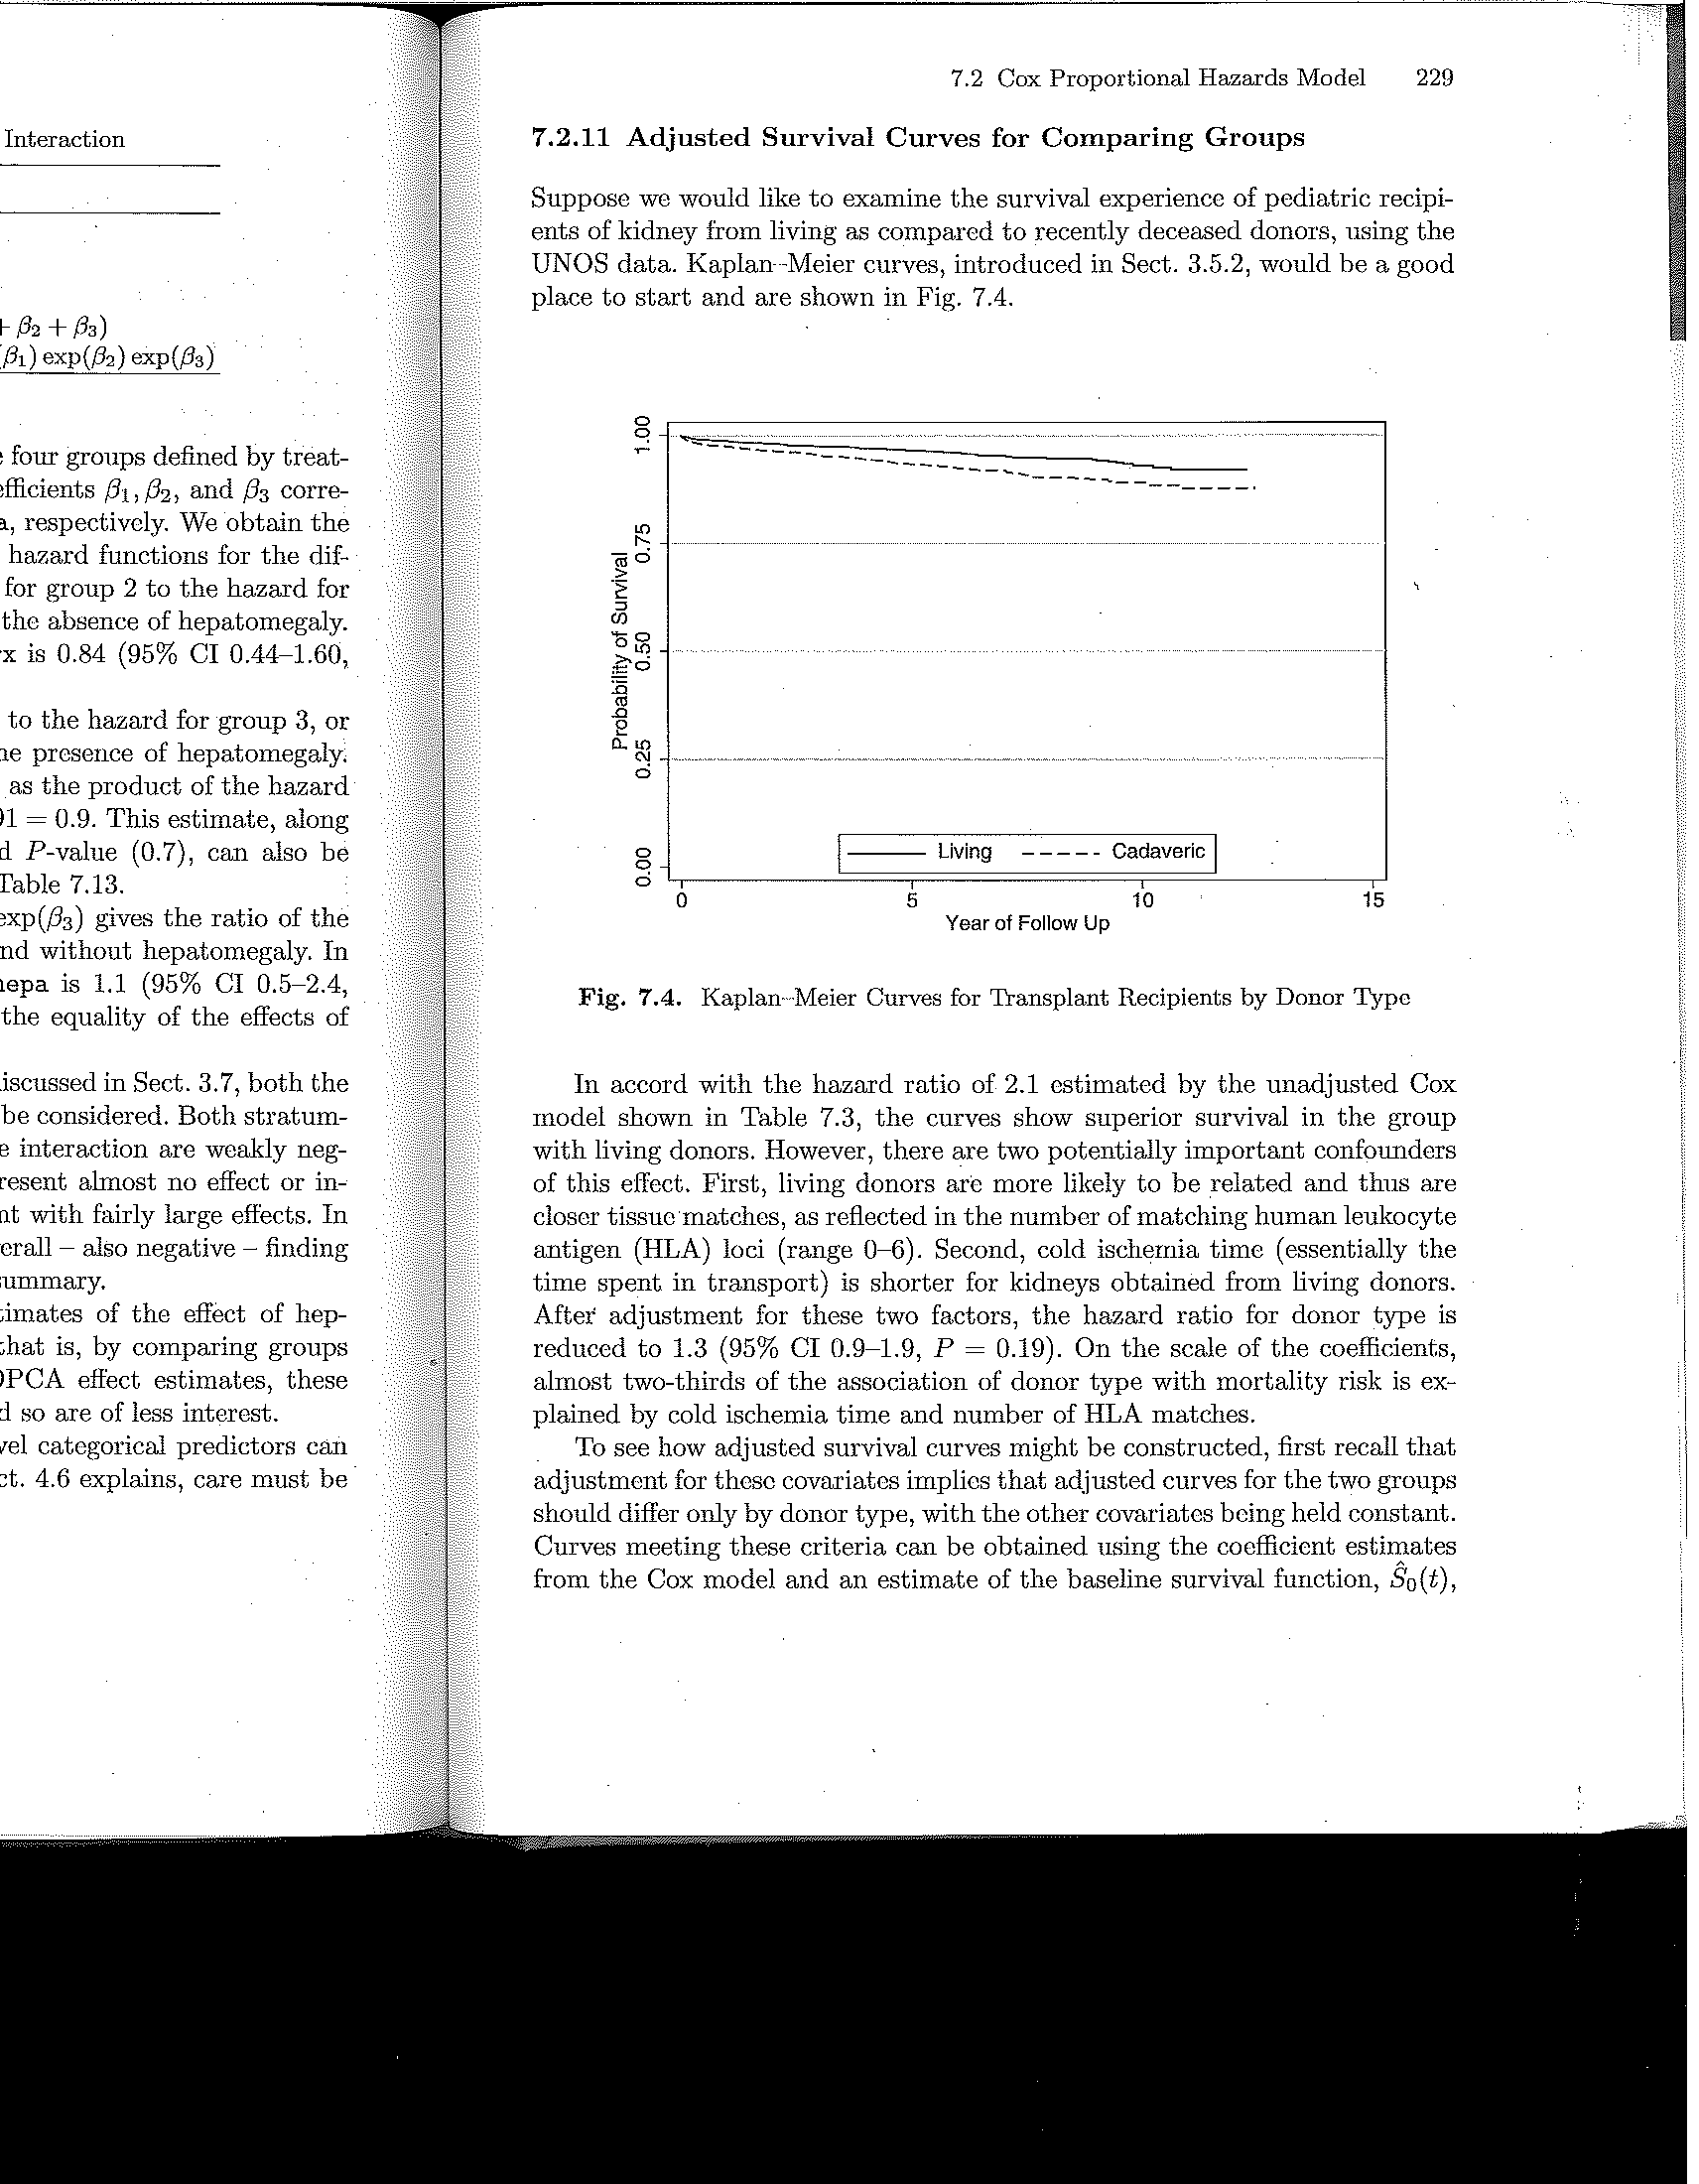
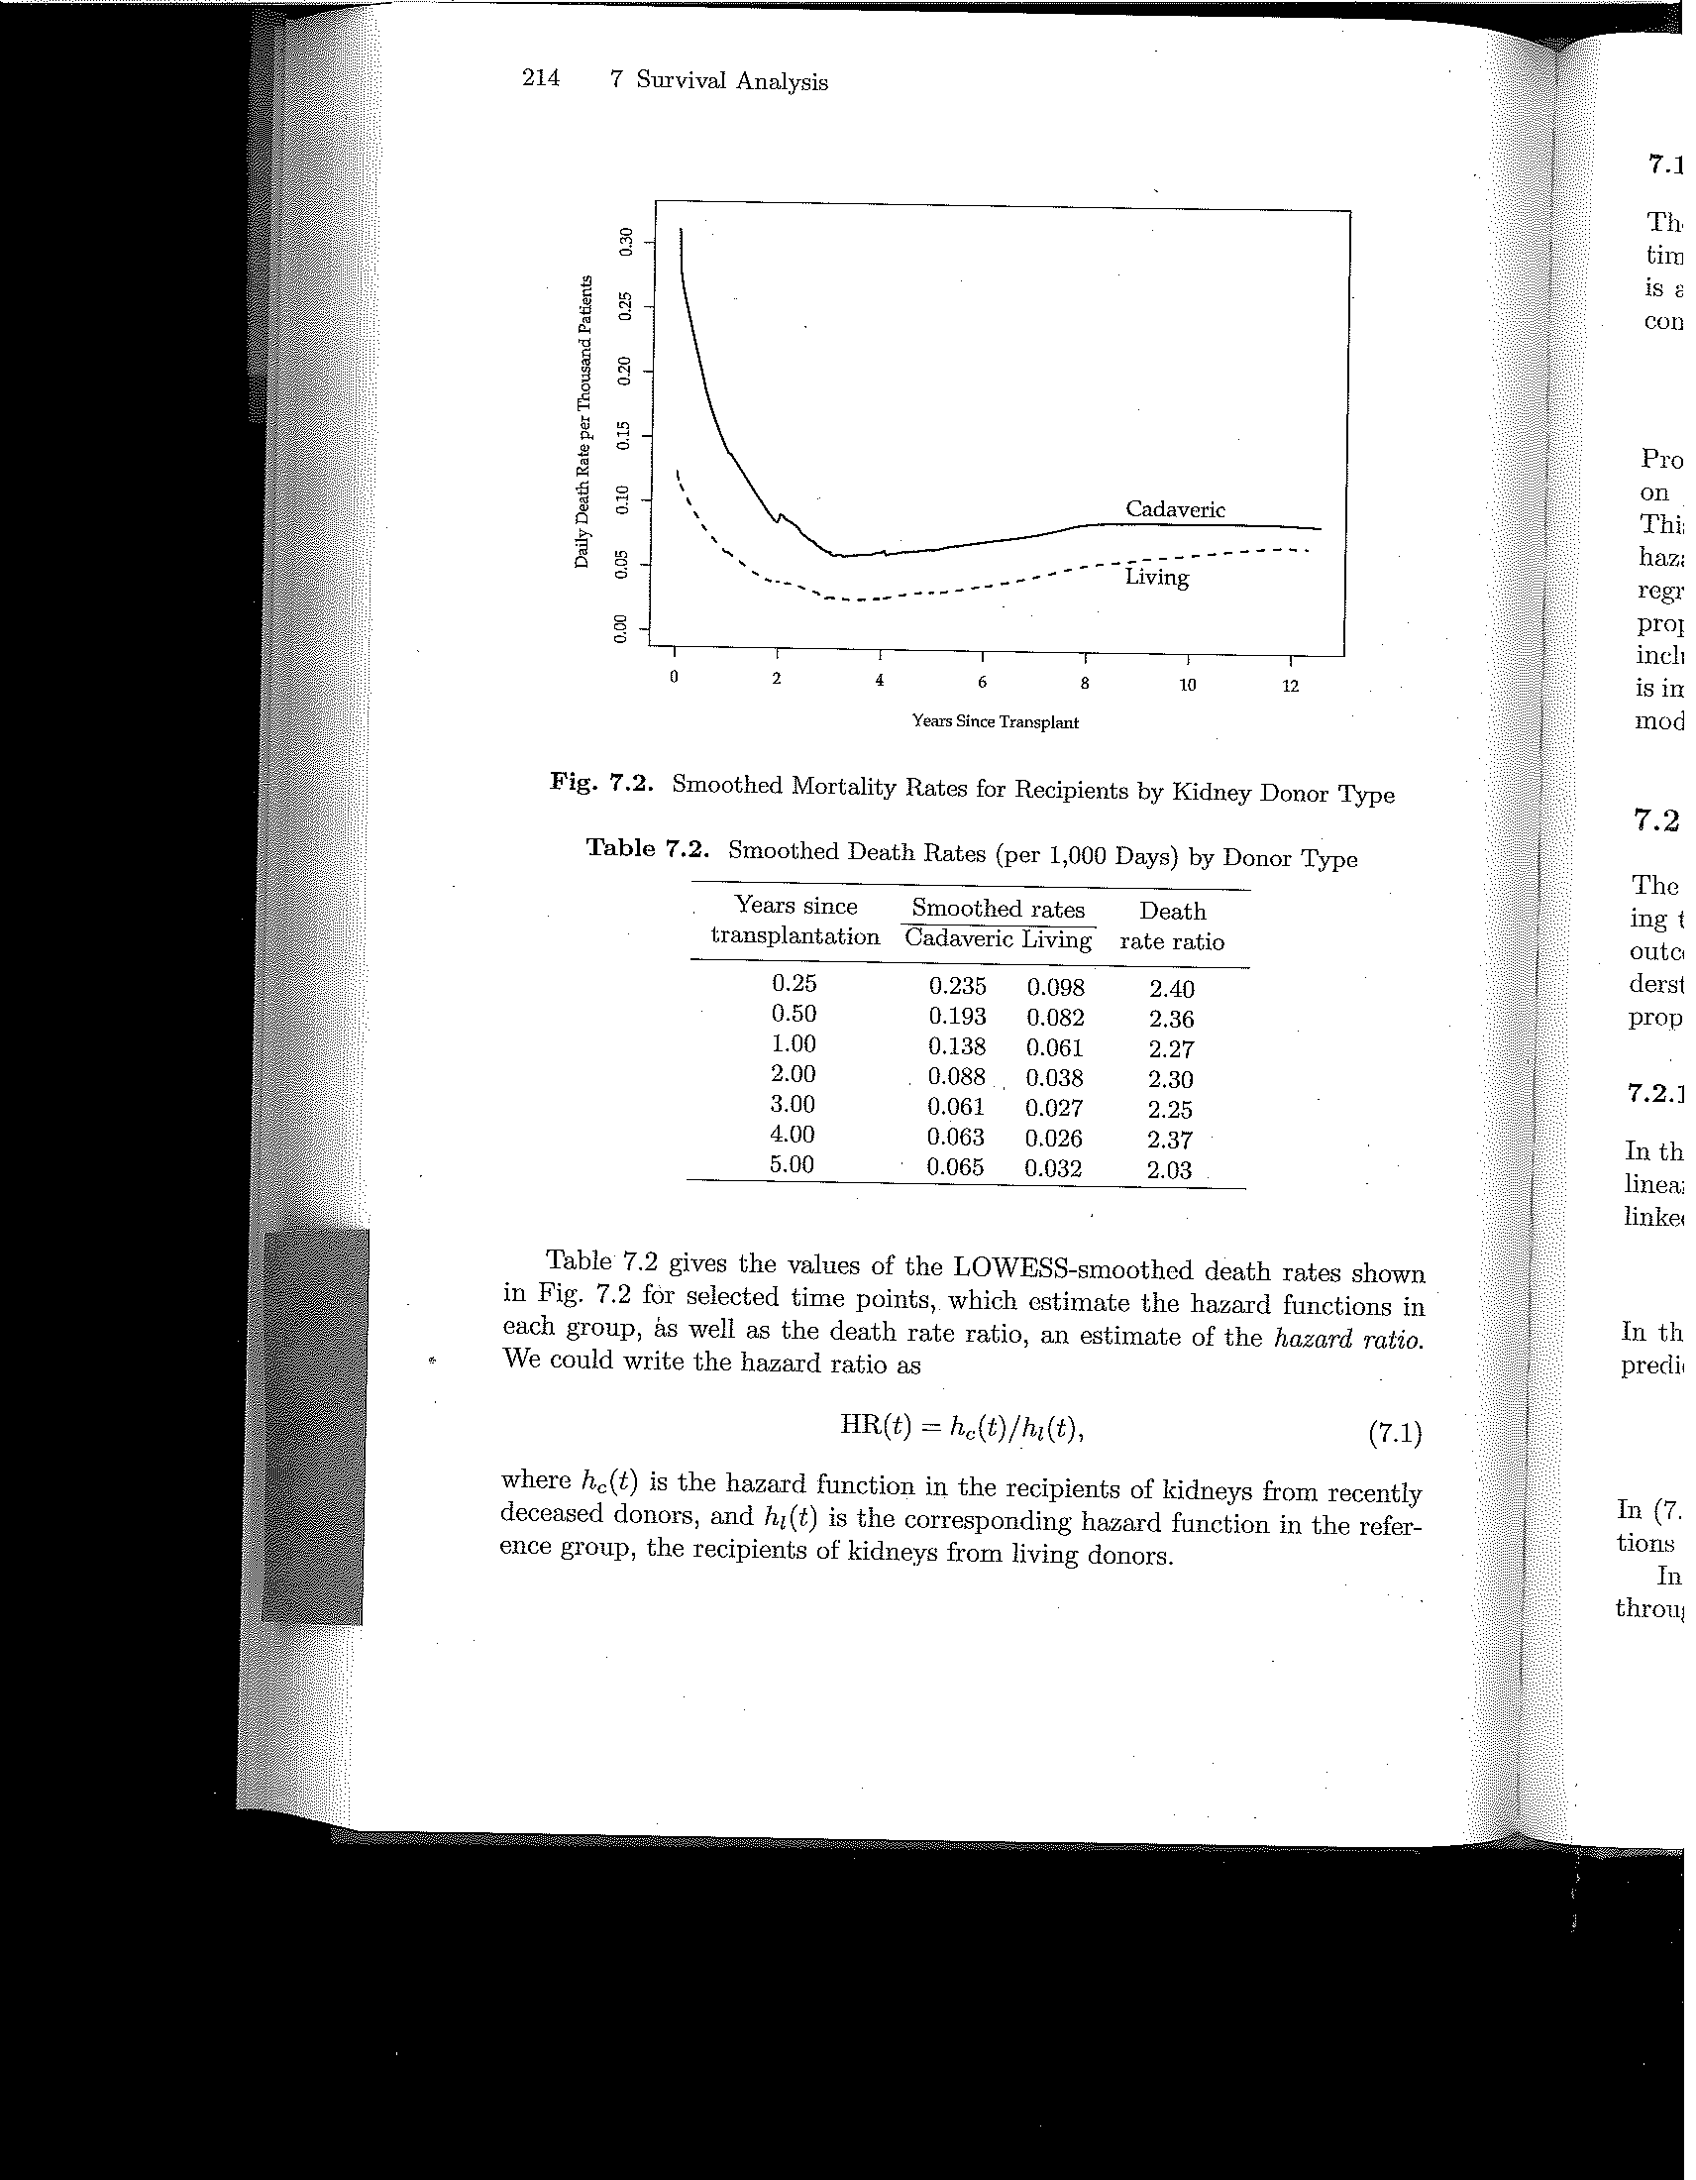
Example: Mortality after pediatric kidney transplant, stratified by donor type
How to compare hazards in 2 groups?
Survival curves
Hazard functions
From proportional hazards regression: hazard ratio = 2.06
Requires extensive math and computer calculation – averages ratio of hazards at many points in time
Vittinghoff et al. Regression Methods in Biostatistics 2012
Notes:
Here is an example from a study of mortality after pediatric kidney transplant, comparing survival in children who received a kidney from a living versus a recently deceased donor. As we saw in the lecture on disease occurrence, we can generate a smoothed hazard function from a dataset with survival data (or “time to event” data). This slide shows the survival curves and smoothed hazard functions for the two exposure levels in this study (living versus cadaveric donor). From the graphs, we can see that the survival is better in the group that received a kidney from a living donor. We have 2 broad ways to measure disease occurrence in this cohort study: cumulative incidence and incidence rate. With cumulative incidence we could calculate a risk ratio for living vs cadaveric donor. But, how would we calculate a ratio of hazards? We could use the average incidence rate for the time period of the study, but we can see from the smoothed hazard function that the rate changes over time. The ratio of average incidence rates might be misleading. So, it is better to compare the hazards (the collection of instantaneous incidence rates) at each point in time, such as each red line on the graph (but you would do this for all points in time with sophisticated math). This can be done with the proportional hazards mathematical regression model, which, in brief, forms a weighted average of the ratio of hazards over time. You cannot do this manually. You need some mathematical shortcuts and a computer to assist. This regression model is currently the “workhorse” for analysis of longitudinal studies that have individual-level “time to event” data. We do not go into any detail about this (or other) statistical models in this course, but you will learn more about proportional hazards in your Biostatistics courses. Our goal here is for you to be aware that this mathematical model provides a type of rate ratio – a hazard ratio - for analysis of disease associations in cohort studies.

Slide 50
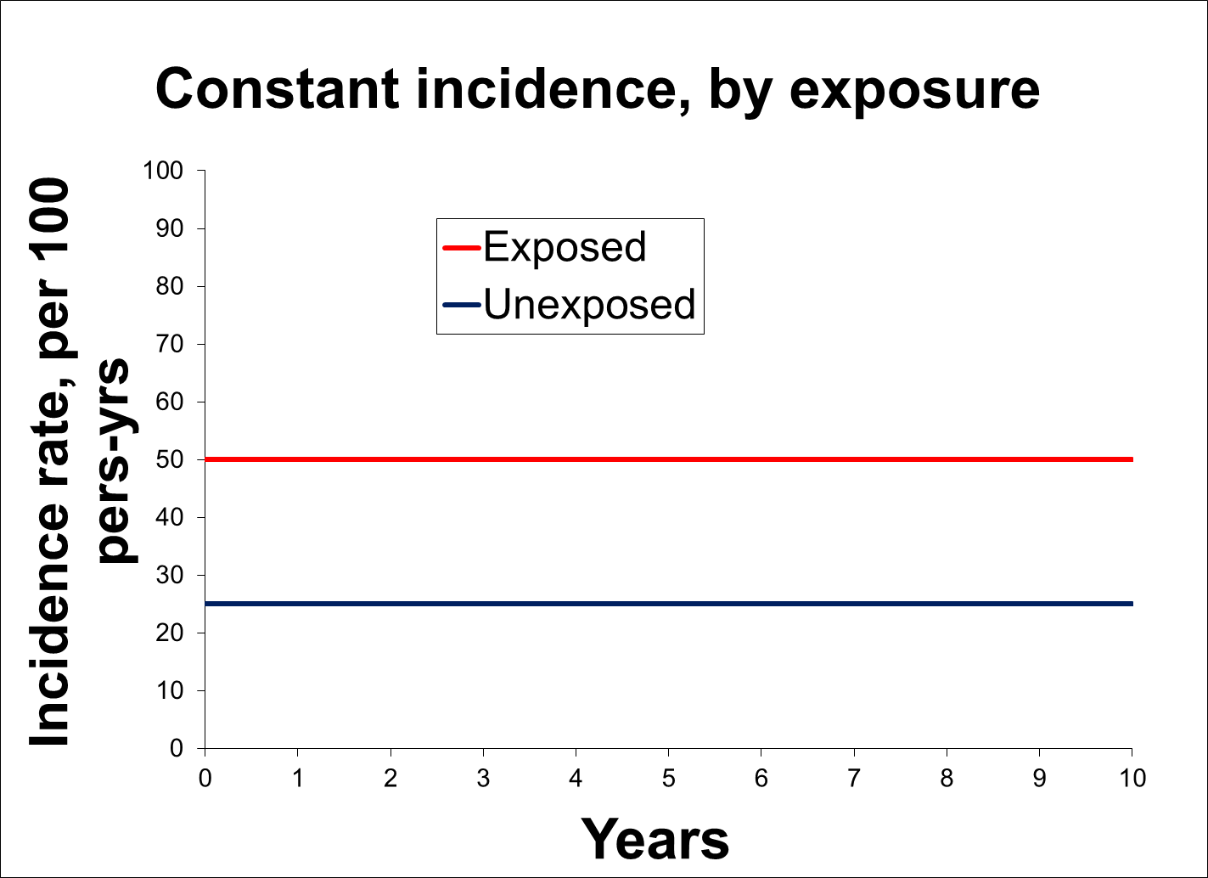
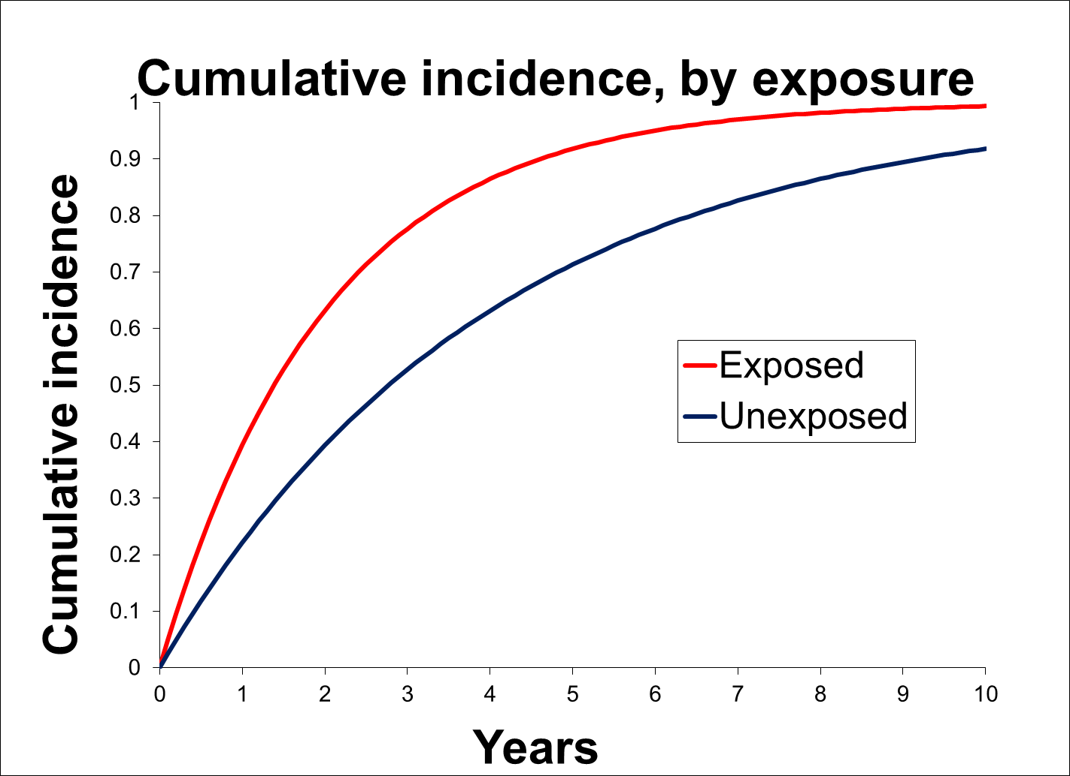
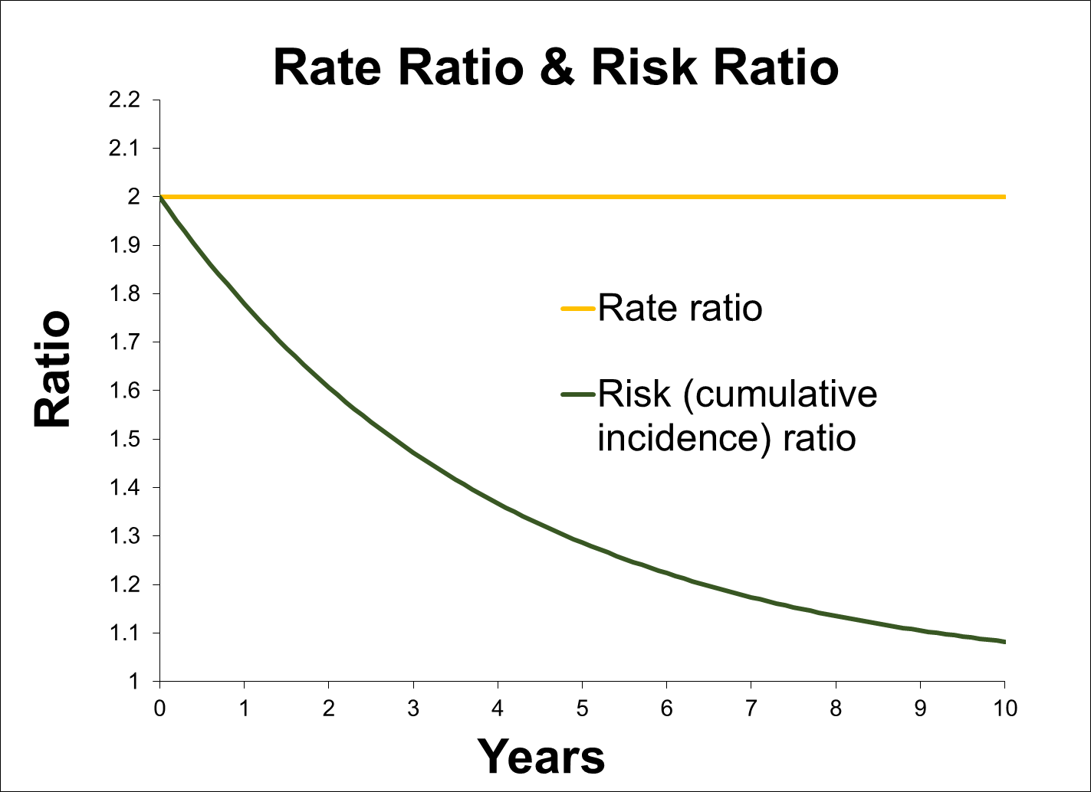
Risk Ratio vs Rate Ratio
Limitation of Risk Ratio Because of Ceiling Effect
Assume being exposed influencing (“causing”) occurrence of event
Rate ratio -- taken at any time -- shows this, but, in latter years, risk ratio shows only very small effect
But, if goal is simply to predict who gets the event by 10 years, then risk ratio is more telling than rate ratio
Notes:
This illustration shows an exposure that we can assume is clearly influencing or “causing” the occurrence of the outcome of interest. The incidence rate of the outcome is consistently higher in the exposed, shown in upper left. The rate ratio reflects this throughout the follow-up time of 10 years. At every time point, it is 2.0. In contrast, the cumulative incidence curves start to converge in the latter years of follow-up (lower left), and the resulting risk ratio shows only a small effect of the exposure in latter years as the risk ratio becomes close to 1.0. Therefore, at 10 years, because of the ceiling effect, the risk ratio is going to be misleading as a measure of causation.
However, if the goal is to predict who will get the event by 10 years, then the risk ratio is more useful than the rate ratio. The risk ratio gives the bottom line, just focusing on the fraction who have developed the event by 10 years.

Slide 51
If regression-based adjustment for confounding (etc.) is needed
Cohort design: Some commonly used regression techniques
 | Competing Events Present |  | Competing Events Absent
 | Goal |  | Goal
 | Causation | Prediction | Causation | Prediction
Not all persons have complete follow-up | Proportional hazards (PH) -> HR; Poisson or negative binomial -> IRR; Pooled logistic -> IOR | Fine-Gray modification of PH -> sub-distribution HR | PH -> HR; Poisson or negative binomial -> IRR; Pooled logistic -> IOR | PH -> risk ratio (after some manipulation)
Everyone has complete follow-up | PH -> HR; Poisson or negative binomial -> IRR; Pooled logistic -> IOR | Log-binomial-> risk ratio; Poisson -> risk ratio; Logistic -> IOR | PH -> HR; Poisson or negative binomial -> IRR; Pooled logistic -> IOR | Log-binomial-> risk ratio; Poisson -> risk ratio; Logistic -> IOR
HR = hazard ratio; IRR = incidence rate ratio; IOR = incidence odds ratio
Notes:
For your reference, here is the list for measures of association that can be cohort studies with various regression techniques. Here, things get more complicated, but this should not be surprising because a lot more is going on with cohort studies in terms of censoring (either by drop-out or administrative censoring) and competing events.
Our main point with this slide is that you now have the tools to consider which regression model you want to use for analysis of study results. You likely do not know how to perform the regression technique, but this will come later in other courses. The factors to take into account are study design, goal of the research question (causation versus prediction), the measures of association you want to get, whether you have competing events, and complete versus differing follow-up times.
A key element to remember here is to be sure what your research question is. Is it one of etiology/causation or is it one of prediction? One common error in the literature is that when competing events are present researchers often reflexively grab for the Fine and Gray modification of the proportional hazards regression technique. We want to emphasize that Fine and Gray is appropriate for when prediction (did the event happen or not but not how fast or by what mechanism) is the goal. If competing events are present and etiologic questions are being asked, the conventional proportional hazards model, which will produce cause-specific hazard ratios, is the one to use. Note: there will be issues of potential selection bias caused by the competing events, but these need to be dealt with by techniques other than a different regression model.

Slide 52
Difference/Absolute/Additive Scale
Measures of Association
 |  | Measure of association
Cross-sectional |  | prevalence difference*
 |  | prevalence odds difference*
Cohort |  | risk difference
 |  | rate difference
 |  | hazard difference* incidence odds difference*
Case-control |  | Next week: none available
*rarely used
Notes:
Difference measures are also sometimes called absolute scale or additive scale measures. Again, the type of study design limits the kind of difference measure that can be calculated. This table formally shows which difference measures can be derived from the different study designs. While this is the formal list, the measures with asterisks are rarely used. Difference measures are primarily used for risks and rates and in the context of cohort studies.
Note also that cohort studies can yield all of the prevalence measures (could be done at time zero or at any later time) in addition to the incidence measures. It is most common to see prevalence measures taken at time 0 of a fixed cohort.

Slide 53
The reciprocal (1/risk difference) is a powerful way to express a difference measure of association
Depending on context, the reciprocal of risk difference is construct of “number needed to”:
  Number needed to treat to prevent 1 case of disease
  Number needed to treat to harm 1 person (a side effect)
  Number needed to protect from exposure (or change from exposed to unexposed)to prevent 1 case of disease
TB rifampin example:
  1/0.026 = 38, means that you have to treat 38 persons for >6 months to prevent one additional case of TB recurrence as compared to treating the same 38 persons for <3 months
Notes:
Taking the reciprocal of the difference measure is one of the most useful applications of the absolute difference measure. It creates the construct of “number needed to”, the most well known of which is the “number needed to treat”. Depending on the scenario, you can calculate the number needed to treat to prevent one more case of disease (e.g., “We need to treat 10 persons with new drug X to prevent 1 additional heart attack over a 10 year period of time”), number needed to treat to harm one additional person (e.g., “For every 1000 patients treated with drug Z for 5 years, one additional side effect of bone marrow suppression occurred”), or number needed to protect from an exposure to prevent one case of disease (e.g. “For every 7 patients with exposure A whom we could change to being unexposed for 10 years, we could prevent 1 additional case of lung cancer”). This is all done by taking the reciprocal of the risk difference. Note that the time horizon must always be included, just as it always must be when expressing cumulative incidences.
Creating this “number needed to” metric now presents the measure of association in terms of actual number of people. An NNT of 10 is a stronger effect than an NNT of 100, for example. For many observers, this has more meaning than a ratio measure of association or an absolute difference, but this is by no means is a universal finding.
We can see some immediate uses of the NNT. For example, we can easily see how the absolute difference can be used in cost effectiveness analysis. For example, we might ask what are the cost implications of treating 38.5 persons an extra 3 months to prevent one case of TB. The answer will depend on the comparative cost of treating the 38.5 persons with rifampin versus the cost of managing and treating one case of TB. Those costs can be compiled and compared. Of course, the two costs may not be the only the consideration. In this example TB is a contagious disease and allowing one case of recurrence by under-treating could lead to additional infections and other cases of TB.
The number needed to treat concept is generally attributed to the Clinical Epidemiology Unit at McMaster University in Canada. A sentinel reference is Laupacis A, Sackett DL, Roberts RS. An assessment of clinically useful measures of the consequences of
treatment. N Engl J Med 1988;318:1728–33. Because it is such a simple calculation, it origins may be even further back in time but are uncredited.

Slide 54
Measures of Disease Association II and Measures of Attribution
Measures of association in case-control studies
  If/how the OR estimates other ratio measures depends on type of control sampling & nature of underlying cohort
Strengths and weaknesses of case-control studies
Interpreting the magnitude of a measure of association
  What we can learn from the “sufficient-component cause” model of human disease
Measures of attribution
  Attribution among the exposed
  Attribution among the entire population

Slide 55
What can we estimate in a case-control study?
Case-control study of TZD use & fracture in diabetes
If we try to estimate probability or odds of fracture in either exposure group, the result is nonsense. It depends on whether the study selected 4 controls per case, or 2 controls per case, etc.
We can, however, work down the table.
 | Fracture | No fracture
TZD use | 65 | 198
No TZD use | 955 | 3530
 | 1020 | 3728
X
X
Meier et al. Arch Intern Med 2008
Notes:
Since a case-control design selects participants according to outcome status (case and non-case) and fixes the ratio of the cases and non-cases by selecting one or more controls per case, the investigator cannot assess disease occurrence (probability, rate or odds) within the different exposure groups. The investigator cannot work “across” the table, as we usually like to do. All the investigator can do is to work “down” the table.

Slide 56
a
c
b
d
c
b
c
b
a
b
c
d
Important characteristic of an odds ratio
ORexp =
= OR_{dis}
=
X
OR for exposure = OR for disease
Notes:
Some algebra demonstrates that we can get the odds ratio for disease from the odds ratio for exposure. This is an important property of the odds ratio and its use in case-control studies.
As mentioned earlier, note that measuring the prevalence of exposure (rather than odds) in cases and controls does not give you a prevalence ratio that has any meaningful interpretation. In other words, it does not give you a prevalence ratio comparing prevalence of disease in exposed vs unexposed.

Slide 57
Favorable property of odds ratio #3:
OR is a lifesaver in case-control studies
…but can we do even better?
We can get OR of disease in a case-control study
Yet, we spoke earlier about some of the problems with ORs (e.g., interpretation, non-collapsibility)
Can we get OR in case-control design to represent/estimate even more interpretable measures of association (e.g., risk ratio, hazard ratio)?
Notes:
We can get the odds ratio of disease from a case-control study, but last week we spoke of some of the problems with odds ratios such as their not being able to be interpreted as probabilities (which is how most humans think) and the “odd” entity known as non-collapsibility. Hence, the question is whether we can do better than just deriving an odds ratio of disease from case-controls studies? Can we derive even more interpretable measures of association such as risk ratios or hazard ratios?

Slide 58
What the OR in a case-control study estimates
Depends on underlying cohort and control sampling
Type of Cohort | Control Sampling Scheme | Interpretation of OR
Fixed | Random sample of everyone at time zero (baseline) “case-cohort” | Consistent estimate of risk ratio (Can also estimate hazard ratio)
 | Random sample of person-time at risk each time a case occurs “incidence density” | Consistent estimate of hazard ratio
 | Random sample of non-cases after cases have been identified “prevalent control”, “cumulative”, “epidemic”, “exclusive”, “traditional” | If disease incidence low in all exposure groups: Approximation of risk ratio
Notes:
The answer is “yes” and these tables (on this slide and the next) give a summary of just what useful measures of association the OR from a case-control study can estimate.
For a long time, it was generally accepted that the OR in a case-control study in a fixed underlying cohort could be thought of as approximating the risk ratio if “the disease was rare.” This is known as the “rare disease assumption”. This idea stems from the properties of odds we discussed in the last lecture; i.e., the odds approximates the probability when the probability is low (say, less than 10%) and therefore a ratio of odds approximates a ratio of probabilities when the probabilities are low. We will illustrate this again later in the lecture.
Current epidemiologic theory has demonstrated that we don’t need the outcome to be rare in order for the odds ratio to estimate meaningful measures of association. Depending on the sampling design, the odds ratio can give estimates of risk and hazard ratios measures without this “rare disease” assumption.
Specifically, what the OR in a case-control study estimates depends upon the nature of the underlying cohort and the control sampling. This slide focuses on case-control studies in the context of a fixed cohort, and the next slide focuses on dynamic cohorts. In a fixed cohort, we can take a random sample of the cohort at baseline for our control group (case-cohort design). We could also use incidence density sampling, identifying control(s) each time a case occurs.
Or, as we have been discouraging, we can take a random sample of non-cases after all cases have been identified.

Slide 59
What the OR in a case-control study estimates
Depends on underlying cohort and control sampling
Type of Cohort | Control Sampling | Assumptions | Interpretation of OR
Dynamic | Each time a case occurs “incidence density” | None | Consistent estimate of hazard ratio
 | At midpoint of study period | Exposure prevalence is at steady state or changing linearly over time; and hazard ratio is constant | Consistent estimate of hazard ratio
 | At any point, including after all cases identified | a) Exposure prevalence is at steady state; and hazard ratio constant b) Neither exposure nor hazard ratio constant | Consistent estimate of hazard ratio Hard to interpret odds ratio
Notes:
In a dynamic cohort, we can also use incidence density sampling by identifying control(s) at each moment that a case occurs. It requires no assumptions about exposure prevalence. This is the cadillac approach for an underlying dynamic cohort. As with a fixed cohort, the resulting odds ratio will be a consistent estimate of the hazard ratio.
However, if we are willing to assume that the dynamic cohort is in “steady state” in terms of the exposure prevalence over time and that hazard ratio is constant, the we can also use a random sample of the dynamic cohort taken at one time point, such as the midpoint or after all cases have been identified. This will provide a consistent estimate of the hazard ratio. These are assumptions that are often hard to justify, and so these approaches are not the common.
If exposure is not a steady state, then we can still have a consistent estimate of the hazard ratio as long as we assume that the exposure is changing linearly over time and we doing our sampling at the mid-point of the period. This linear change in exposure prevalence is also often a hard assumption to swallow.
If we are unable to make these assumptions, but nonetheless do go ahead and take controls at one point in time (such as at the end), all we have is an odds ratio which is very difficult to interpret. The odds ratio does not estimate a risk ratio or a hazard ratio.

Slide 60
Notation in a 2 x 2 table for fixed cohort
1 = exposed; 0 = not exposed
Disease
Over some time T
Yes
No
No. of events (cases) in exposed group
No. of persons in exposed group (baseline)
Yes
E₁
N₁
Exposure
No. of events (cases) in unexposed group
No. of persons in unexposed group (baseline)
E₀
N₀
No
Notes:
This graphic puts our notation for a cohort study in a 2 x 2 table.
1 = exposed and 0 = not exposed
E₁ = No. of events (cases) in exposed group
E₀ = No. of events (cases) in unexposed group
N₁ = No. of persons in exposed group (baseline)
N₀ = No. of persons in unexposed group (baseline)
This fixed cohort is being followed over some time T. This is the same notation we used previously in illustrating the measures of disease occurrence (E, N, T) with the addition of a 1 or 0 subscript to distinguish exposed from unexposed persons.

Slide 61
Risk ratio in a cohort study
Risk ratio =
In a fixed cohort study with complete and equal follow-up T
We now have a ratio of 2 odds: Odds of exposure in those with event (E₁/E₀) and odds of exposure in the cohort at baseline (N₁/N₀).
How can we estimate these two odds with a case-control design?
Notes:
To simplify the presentation, we assume a fixed cohort with complete and equal follow-up on everyone in both exposed and unexposed groups (e.g., the diarrhea outbreak example we have talked about). In this situation, the risk ratio is calculated simply as shown above with simple proportions. In the situation of the typical cohort with censoring, it is a bit more complicated, but one can see that if the assumption of no informative censoring is met, then our demonstration that the OR is an estimate of the risk ratio will also hold true in a situation with varying lengths of follow-up (i.e., censoring). Note the meaning of no informative censoring is that the censoring is not related to the event nor to exposure so the four numbers above retain their original proportions.
The algebra just rearranges the risk ratio such that we can focus on two separate ratios. The first is the ratio of exposed cases to unexposed cases; this is the odds of exposure amongst cases. The second is the ratio of exposed participants at baseline to unexposed participants at baseline; this is odds of exposure amongst the cohort at baseline. We emphasize that these two ratios are both odds.
Also remember that when the risk ratio is reported it has to be reported for some time period (e.g., the risk ratio at 12 months of follow-up), but that time period does not affect the algebra we are illustrating.

Slide 62
Rate ratio in cohort where = exposed
and = unexposed person-time
Odds of exposure in cases
Rate Ratio =
Odds of exposed person-time in cohort
So analogous to estimating risk ratio, we need to
estimate the ratio (odds)
If we can estimate this ratio in a case-
control study, we can estimate a hazard ratio
Notes:
The first concept is to remember that when we talk about rates, we are talking about person-time, and when we talk about measures of association, we are talking about looking at incidence rates within the groups of exposed and unexposed persons. To calculate the risk ratio in a case-control setting we needed to get an estimate of the ratio of persons with and without the exposure at cohort baseline. For the rate ratio, we need an analogous estimate of exposed and unexposed person-time.
The hazard ratio is a particular type of rate ratio that compares the instantaneous incidence rates. In this example, although we are depicting NxT, which is remindful of the denominator of the average incidence rate, we are estimating this at multiple individual slices of time, which allows it to serve as part of the instantaneous rate (or hazard) ratio calculation. This is ultimately how the use of incidence density sampling yields a consistent estimate of a hazard ratio.
To estimate the hazard ratio, we need to isolate the ratio of person-time in the exposed to the person-time in the unexposed.

Slide 63
Incidence Density Sampling In Dynamic Cohort (e.g., SF County residents)
New
Residents
cases
CE
Sampling in a dynamic cohort gives consistent estimate of ratio of exposed to unexposed person-time in the same way as sampling in a fixed cohort
controls
Notes:
This is incidence density sampling in a dynamic cohort. The odds ratio here again is a consistent estimate of the hazard ratio.

Slide 64
What the OR in a case-control study estimates
Depends on underlying cohort and control sampling
Type of Cohort | Control Sampling Scheme | Interpretation of OR
Fixed | Random sample of everyone at time zero (baseline) “case-cohort” | Consistent estimate of risk ratio (and hazard ratio)
 | Random sample of non-cases each time a case occurs “incidence density” | Consistent estimate of hazard ratio
 | Random sample of non-cases after cases have been identified “prevalent control”, “cumulative”, “epidemic”, “exclusive”, “traditional” | If disease incidence low: Approximation of risk ratio
Notes:
This gets us to the last scenario on the fixed cohort table we showed earlier. By sampling incident cases and prevalent non-cases in a fixed cohort, the OR is a close approximation of the risk ratio if the disease incidence is low in all exposure groups.

Slide 65
Even if rare disease assumption holds, there are other problems with this design
cases
CE
Over time, all participants are subject to drop-out and competing events
Non-cases who are left at the time controls are selected are “battle-tested” in that they have not dropped out or developed a competing event
Controls thus may not represent study base at time 0 (Result = bias)
controls
Time
Time of the Study
Notes:
Whether or not the rare disease assumption holds in one’s study (i.e., the assumption is true), there are other problems with this design. Over time, the cohort is subject to losses to follow-up and competing events. Thus, by the end, the non-cases who are still available to be selected as controls can be said to be “battle-tested”; they have not dropped out or had a competing event. They may not be representative of people who actually started the cohort at time 0. The result of using such persons as your controls is that the N1-E1/N0-E0 ratio may be systematically different than the N1-E1/N0-E0 of the entire population. This results in an odds ratio that is “biased” compared to the true odds ratio. We will formally define what bias is next week.
This is not to say that drop-out and competing events do not cause problems of bias for the other case-control designs. The issue is that this potential bias is exacerbated in the “prevalent control” design. This is because the controls are not selected until the end after all of the forces of drop out and competing events have had a lot of time to act. Cases, on the other hand, are selected as they occur. In contrast, in the incidence density sampling design, controls are taken at the same as cases such that the forces of drop out and competing events are acting equally upon the case exposed/unexposed ratio as they are on the control exposed/unexposed ratio. We will discuss this more in the weeks ahead.

Slide 66
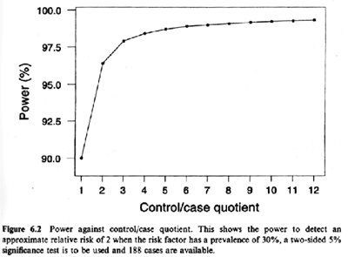
How many controls per case?
Biggest gain from 1 to 2 controls. In general, >4 controls per case not cost effective.
Power to detect OR of 2 in study with 188 cases; exposure prevalence of 30%; 2-sided alpha 5%
Notes:
The key determinant of power to detect an association in a case-control study is the number of cases. However, if the number of available cases is limited, it is possible to increase the power of a study by including additional controls. The gain in power has to be balanced against the extra effort and expense of identifying controls and measuring exposure and covariates on them. As can be seen on this graph, the gain in power for each additional control diminishes progressively with more controls. The biggest gain is in going from 1 to 2 controls per case.
The exact power with additional controls per case depends on the prevalence of the exposure and the strength of the disease association desired to be detected, but, in general, more than 4 controls per case is not cost effective.
This is shown in Ury HK. Efficiency of case-control studies with multiple controls per case: continuous and dichotomous data. Biometrics 1975, 31:643-649, 1975.

Slide 67
Case-control design recommendations
Look for a primary study base that can be clearly defined and has complete case ascertainment
  Know research study bases available in your field
  Use incidence density or case-cohort sampling in fixed cohort
  In dynamic cohort, use incidence density sampling if feasible. Know if one time sampling makes sense in your field
Use measurements recorded prior to the diagnosis when possible (medical records, etc.) or perform measurements on stored specimens/records
Notes:
Historically, the two chief weaknesses of case-control studies have been inappropriate selection of a control group and poor measurement of exposure. The former has usually occurred in the setting of hospital-based studies with secondary study bases where it is very difficult to determine the study base that gave rise to the cases. This difficulty has been exacerbated by the lack of awareness on the part of many investigators of the study base concept. Poor measurement often occurs from using questionnaire-based recall of exposures after the event has already happened. The accuracy of exposures measured in this way may then differ between cases and controls. If those weaknesses can be avoided, the case-control approach can be a valid study design, equally valid as cohort studies.
As we will define in the weeks to come, these two weaknesses address issues of selection bias and measurement bias. If they can eliminated, then all that is left is confounding, a problem that is a threat to any observational study design.

Slide 68
What does the magnitude of a measure of association tell you?
Larger magnitude values referred to as “strong” associations
What does “large” or “strong” actually mean?
For both ratio & difference measures, the larger the value the less apt the association is the result of occult bias
  Reasoning: if bias was responsible, it would have to be large and researchers would presumably have noticed it
For difference measures, strong associations translate to smaller numbers needed to treat/harm/protect
  Strong translates directly to public health/clinical impact
But for neither difference nor ratio measures does “strong” translate into any particular intrinsic biologic strength
Notes:
We have spent two sessions on calculating measures of association. There is one additional deeper topic, which is what does the magnitude of a measure of association actually tell you.
In particular, larger magnitude values of measures of association are commonly referred to as “strong” associations. But, what exactly does strong mean? What is true is that for both ratio and difference measures, the larger the value the less apt the association is the result of some occult bias. That is, assuming we are interested in etiology/causation (does an exposure cause an outcome), the larger the value the more likely — all else being equal — that the causal association is true rather than the result of some bias. The reasoning behind this is that if bias was responsible for the nominal large magnitude association, then it would have to be large (fulminant or obvious) in its own right. If so large or obvious, then the reasoning is that researchers would have been aware of it and precluded it. Thus, large associations are believed to have a higher likelihood of being unbiased. In this sense, “strong” is good in that it helps you gauge validity in the qualitative sense. (Note: while generally true, the soundness of this logic is not absolute. It is not a given that researchers will always be aware of the presence of large sources of bias. There are many limits to our knowledge in science.)
One other virtue of “strong” applies to difference measures in that strong association do translate into smaller numbers to treat, harm, or protect. This means the exposure (or treatment) doesn’t have to affect too many people to have an impact.
However, for neither difference nor ratio measures does “strong” translate into anything with actual biologic meaning.

Slide 69
Why does “strong” not translate into biologic meaning?
“Sufficient-component cause” model of human disease
  Popularized by Rothman (1976 – see website reading) in health research but originated earlier by philosophers
  Occurrence of a disease in a given person is because some set of culprit exposures comes together
    A minimal set of culprit exposures is called a “sufficient cause”
    Each individual culprit exposure is called a “component cause”
  For most diseases, there are several “sufficient causes”
Rothman & Greenland, AJPH 2005
A “sufficient cause”
Notes:
To understand this, we need to introduce a very simple but extremely useful model of human disease, which is called the “sufficient-component cause” model. It was first described by Ken Rothman, while he was at Harvard, in 1976, but, in truth, its origins were described by philosophers much earlier, particularly JL Mackie (Mackie JL. Causes and conditions. Am Philos Q. 2(4): 245–255, 1965). The theory basically says that any time an instance of disease occurs, it is because multiple “component” causes came together. The minimal set of component causes is known as a “sufficient cause”. For each “component” cause within a “sufficient” cause, the rest of the necessary causes are collectively known as complementary causes. Thus, for virtually all diseases, there are multiple sufficient causes that can result in the disease. This is another way of saying that virtually all disease is “multifactorial” in its causes, a theory that almost no one disputes, and that there are many different ways to arrive at a disease event. It is a simple concept, but it has far ranging implications.

Slide 70
Measures of Attribution
So far, we have introduced measures of association that compare occurrence of an outcome by exposure status, using ratio or absolute difference.
We can also ask how relevant the exposure is in causing the outcome, especially in comparison to other exposures causing the outcome.
  i.e., how much would the outcome be reduced if exposure was removed?
Concept known as “attribution” of outcome to exposure
Notes:
We will now transition to discussing measures of attribution.

Slide 71
Prerequisites & Introductory Comments
Don’t bother to consider measure of attribution until:
  Pretty sure that exposure is “causally” related to outcome
  Measure of association free of bias (e.g., no selection, measurement or confounding bias) (i.e., the number is right)
Measures of attribution can be expressed in the context of risks or rates
All of the terminology boils down to 2 concepts:
  Attribution of outcome to exposure among the exposed
  Attribution of outcome to exposure in a wider population
    Stata will automatically calculate both in epitab command
      even if not justified
Notes:
There are 3 important introductory points to make before explaining these measures of attribution.

Slide 72
Measures of Attribution:
Terminology we like in context of cumulative incidence (“risk”)**
Scale | Among the exposed | Among a population (exposed and unexposed)
Absolute | “Attributable risk in the exposed” AR_{exp}* | “Attributable risk in the population” or “Population attributable risk” AR_{pop} or Pop AR
Percentage | “Percent attributable risk in the exposed” %AR_{exp} | “Percent attributable risk in the population” or “Percent population attributable risk” % AR_{pop} or %Pop AR
*We earlier called this “risk difference” ** analogous terms should be used in context of rates
Notes:
This is the terminology that we endorse in the context of cumulative incidence (i.e., risk). Analogous terminology is available in the context of rates.

Slide 73
Attributable Risk in the Exposed
ARexp
Notes:
In this example, risk of the outcome is 0.10 in the unexposed and 0.20 in the exposed. Let us say the time frame is 5 years. The difference – which we have already termed the risk difference - is also called the “attributable risk in the exposed”. As it is, it is not that interesting. As we show in the next slide, this can also be expressed in a more interesting way as a percent of the risk in the exposed, called the percent attributable risk in the exposed.
Expressing the attributable risk in the exposed assumes that the exposed would experience the same risk of outcome as the unexposed if the exposure were removed.

Slide 74
Population Attributable Risk
Pop AR
Notes:
As in previous graphic example, risk is 0.10 in the unexposed and 0.20 in the exposed. In the total population, including exposed and unexposed, the risk is 0.14, between 0.10 and 0.20. The population AR is the difference between the risk in the total population and the unexposed.

Slide 75
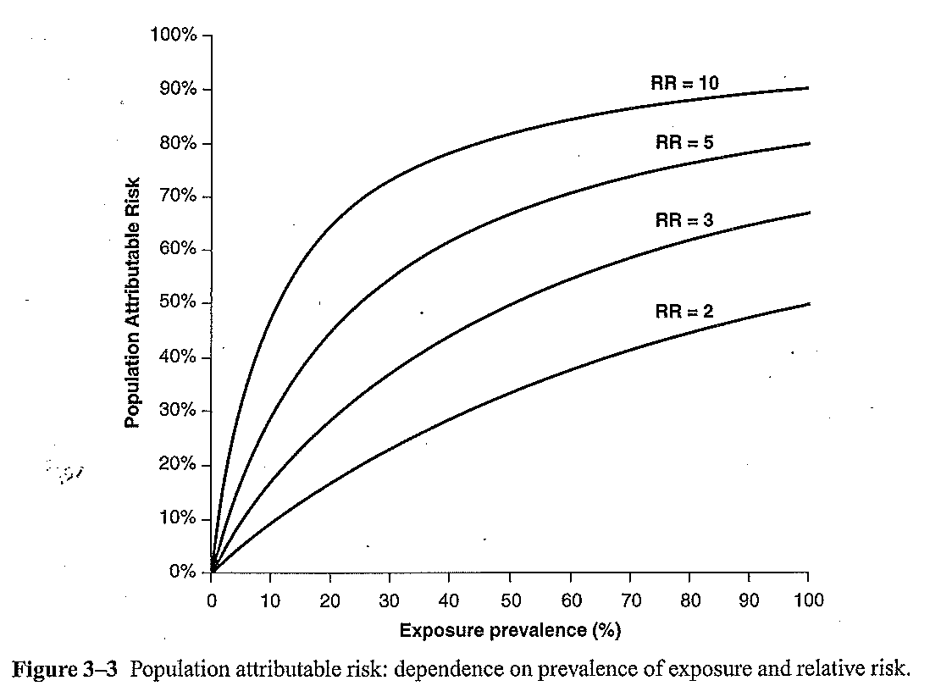
% Population Attributable Risk depends on exposure prevalence and risk ratio
Notes:
% Population AR depends on the risk ratio as well as the prevalence of exposure. This figure shows % Population AR for different combinations of exposure prevalence in a population (x-axis) and different risk ratios, ranging from 2 to 10 (over a fixed time horizon, say, 5 years).

Slide 76
Theme for Rest of Course
Anyone can get a numeric answer in research
The challenge is to tell if it is correct
Notes:
Stated another way, the theme for the rest of the course is that anyone can derive a numeric answer in a research study (i.e., push the buttons in Stata).
The challenge is to tell if the number is correct. This is the highest art form in our field.
It turns out that getting the right answer in clinical/epidemiologic research is difficult, and, as a consequence, many research results are wrong. This is important. Because if you are a knowledge generator, you obviously want to learn how to decrease frequency of being wrong. If you are a consumer of the research, either as a clinical practitioner (or even as a patient), you will need to be able to make some judgement on your own regarding right vs wrong. This is, again, why learning epidemiology and biostatistics is relevant for everyone.

Slide 77
? EXTERNAL VALIDITY (generalizability; transportability)
OTHER POPULATIONS
Inference
Disease
+ -
+
-
Inference
Exposure
? INTERNAL VALIDITY
TARGET/
REFERENCE/
SOURCE POPULATION
Two Types of Inferences
Correspond to Two Types of Validity
STUDY SAMPLE
Notes:
Remember, earlier we talked about two kinds of inferences, the first (in red) is making an inference from the study sample to the target population and the second (in green) is from the study sample to other external populations. Accordingly, there are two flavors of validity: internal and external. Here is what internal and external validity look like schematically. Internal validity is a measure of how accurately our study sample represents our target population. But remember there are usually many other populations outside of the target population that we are interested in. For example, if our study looked at 20 to 65 years old in California, we would naturally also want to know if the results also pertained to older persons living in other parts of the US or elsewhere. External validity, also called generalizability, is what this is called. A relatively new term, transportability, is also used in this regard. Transportability refers to an emerging set of formal processes to determine how to transport the results from a study to an external population.
Again, there is much confusion in textbooks and the literature about these terms (and concepts). One intelligent solution to the panoply of names has been offered by Daniel Westreich at the University of North Carolina who believes we should simply call this whole construct “target validity”. In other words, the goal of this process is to determine if the findings from a study sample pertain to some larger population. Westreich believes we should simply be clear about which larger population we want to make an inference. How well the study sample makes an unbiased inference is “target validity”.

Slide 78
Error in Clinical and Epidemiologic Research
The goal of any study is to make an accurate (true) inference, i.e.:
  measure of disease occurrence in a descriptive study
  measure of association between exposure and disease in an analytic study
Ways of getting the wrong answer:
  systematic error; aka “threat to validity” or “bias”
    any systematic process in nature or in the conduct of a study that causes a distortion from the truth in a predictable direction
    captured in the validity of the inference
  random error; aka “chance” or “sampling error”
    occurs because we cannot study everyone (we must sample)
    related to sample size; direction is random and not predictable
    captured in the precision of the inference (e.g., SE and CI)
Notes:
So, if the goal of any study sample is to find the truth about the source population (for a descriptive study, this would be the measure of disease occurrence (or exposure occurrence), and for an analytic study this would be the measure of association between the exposure and disease), then what are the ways of missing the truth (i.e., getting the wrong answer)? There are two ways.
One is systematic error and the other is random error. Systematic error is also known by the more commonly used terms “threat to validity” or “bias”. Bias is the most common term used. It is any systematic process in nature (i.e., occurring naturally, not created by the investigators) or in the conduct of a study (some of which are in the control of the investigator and some are not) that results in the incorrect estimate of a measure of disease occurrence or measure of association. Because it is a systematic process, it will cause a distortion from the truth in a predictable (not random) direction. We say that the amount of systematic error is captured in the validity of the inference. Systematic error is not influenced or ameliorated by sample size. In other words, large sample sizes will not reduce systematic error. Note that is a big misconception of the “Big Data” error. All of the big data in the world is not going to overcome systematic error. Also, just because the error occurs in a predictable direction does not mean it is easy to accommodate. This is because we typically cannot predict the quantitative degree of error; errors may in opposite directions and tend to cancel each other out; and, finally, some of the errors occur unbeknownst to us (we simply do not recognize them).
In contrast to systematic error, random error occurs because we cannot sample everyone in our studies; we are always forced to just sample a fraction of the target population. Just by chance alone we might draw a sample that is not representative of the target population and get an answer that is different than the truth in the target population. This is why random error is synonymous with the term “chance”, and the direction of the error is random and not predictable. We say that random error is captured in the precision of the estimate and is usually numerically described in the standard error or confidence interval of our estimate. Random error is in the realm of biostatistics, and we will not in this course be describing the theory about how to generate standard errors or confidence intervals for the various point estimates we will derive. We will essentially just be pointing out how to generate confidence intervals in Stata. Random error can cause either over or underestimation in descriptive studies and can cause you to either declare an association in an analytic study when one does not really occur (this is a type I error) or miss an association when one truly does occur (this is a type II error). Increasing sample size will, on average, decrease the amount of random error that is present.

Slide 79
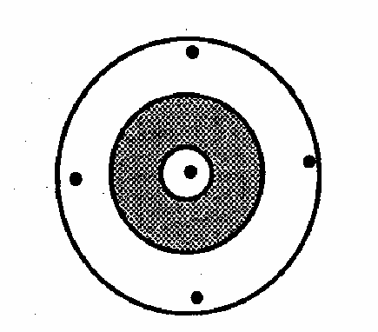
So Far, Just Theory. When Performing an Actual Study:
You Only Have One Shot
Only judgment can tell you about systematic error (validity)
Field of “statistics” can tell you the random error (precision) with formulae for confidence intervals
Judgment requires subject matter and methodologic knowledge
(i.e., you)
Notes:
The past several slides represented theory; in other words, we talked about would happen if you had many attempts at performing a study. In reality, when you perform a study you almost always have just have one shot, as shown here in red, and you don’t know where the center of the target is. The field of statistics remarkably can tell you the random error of your one shot, with definite formulae for confidence intervals, but it cannot tell you anything about how close you are to the center.
It is really only your judgment and the judgment of other scientists who review your work that can help you guess about systematic error. It is really only the person who has both subject matter knowledge of the clinical, biological, or behavioral problem as well as methodological knowledge of clinical and epidemiologic research who can make the best guess about systematic error.
The person who has the joint requisite knowledge in both subject matter and methodologic realms is you. Recall the overlapping circles shown during the Course Introduction video of how the clinical researcher/epidemiologist is the person who understands the subject matter and the research methods.

Slide 80

One More Big Picture Framework Item:
Classification Schemes for Overall Error and Bias
Common Approach (which we will use)
  Bias (Systematic error)
    Selection Bias
    Measurement (Information) Bias
    Confounding Bias
  Chance (Random error)
Szklo and Nieto (and some others)
  Bias (Systematic error)
    Selection Bias
    Measurement (Information) Bias
  Confounding
  Chance (Random error)
Think of the “BIG 4” in all of your work
Rationale: confounded associations are not erroneous; they are just not causal
Retort: The only time confounding actually comes up is causation-related research
Notes:
Before we go on, there is one more big picture framework item to describe, and this is the major classification schemes for overall error and bias.
In what is the most common approach, bias is split into 3 types: selection bias, measurement/information bias, and confounding bias. We are discussing selection bias today, measurement bias for the next 2 weeks, and then confounding for the 3 weeks after that. These three can be distinguished by their causes (or origins), consequences, and solutions (aka cures or fixes). There is, however, not absolute clarity about the distinctions between these three by different investigators, normative bodies, and textbooks. This ambiguity is explained well in Schwartz et al. Towards clarification in the taxonomy of bias…Epidemiology 26:216, 2015. In practice, it is not critical that all forms of bias be reproducibly classified into one of these three bins. Instead, it is more important that they are all recognized and acted upon.
Of course, in addition to systematic error, there is chance (aka random error).
Every time you think about your own work or read someone else’s work, you should run down this list and ask yourself: is there selection bias present, measurement bias present, or confounding present and what is the role of chance? If you can remember these four things, you should be able to cover all of the bases. These are what we call the BIG 4. Think of the BIG 4 in all of your work.
We should point out, however, that the Szklo and Nieto textbook considers selection bias and measurement/information bias to be the major forms of bias and considers confounding to be a separate process. We do not agree with this approach, but in any case, it is semantics, and we simply want to point this out to you to avoid confusion. The rationale for this approach is that confounded associations are technically not numerically wrong; they are simply not causal. The rebuttal to this, however, is that the only time confounding ever comes up is during research that is related to figuring out causation. In causation research, confounding is always a source of bias. This is why we consider confounding as one of the 3 forms of bias: selection bias, measurement bias, and confounding.

Slide 81
Selection Bias
Definition: When study sample (the people or person-time) is systematically not representative of target population
In a Descriptive Study
  Bias caused when persons in target population have different (unequal) probabilities of being selected for/retained in study sample
  Occurs when the participants/follow-up in the study sample are not representative of the persons/follow-up in the target population
In an Analytic Study (Where most of the attention goes)
  Bias caused when persons in target population have different (unequal) probabilities of being selected for/retained in study sample
    Especially, but not exclusively, when differing (unequal) probabilities are influenced by (or associated with) both exposure and outcome of interest
  Occurs when participants in study sample have different relationship between exposure & outcome than persons in target population
Notes:
So, with that introduction, let’s move on to discussing selection bias, which is defined as what happens when the study sample (either the people per se or the person-time) is not representative of the target population. We will return again and again to this basic definition.
The more detailed definition of selection bias depends upon whether you are referring to a descriptive or analytic study. In a descriptive study, selection bias is the bias that is caused when persons in the target population have different (unequal) probabilities of being selected for initially or, subsequently, retained in the study sample. If people in the target population don’t all have the same chance of landing in the study population, then most likely will happen is the study sample will not reflect the target population. In other words, this bias occurs because the participants or their follow-up that we observe in the study sample are NOT representative of the persons/follow-up in the source population. What I mean by not representative is in terms of the entity under descriptive study, be it of an exposure or an outcome.
In an analytic study — and I will say that this is where most of the attention rests for selection because it is considerably more complicated than descriptive studies — the definition is that selection bias is the bias that is caused when persons in the source population have different (unequal) probabilities of being selected for/retained in the study sample. A critical aspect of these different probabilities of being selected for study inclusion that results in bias is especially, but not exclusively, apparent when the probabilities are influenced by both the person’s exposure and outcome of interest. By influence, we mean either that selection is caused by the exposure and outcome or caused by something that also influences exposure and outcome (and thus exposure and outcome are associated with being selected for the study). Selection bias occurs when people in the target population don’t all have the same chance of landing in the study sample or, in a longitudinal study, being retained in the study sample. It occurs when the people who do land in the study sample have a different relationship between exposure and outcome than all people in the source population. By “not exclusively”, we mean that there are some situations when just influence by outcome alone is sufficient to result in selection bias; we will cover this later in the slides.
Hence, the overarching issue in selection bias is that it occurs when we are not able to get a study sample that is representative of our source population. It is important to point out that the reason for a non-representative sample is not chance; it is some systematic problem.
Foreshadowing note: When we say “especially apparent when the probabilities are influenced by both the person’s exposure and outcome of interest”, we do not mean that selection probabilities always have to be influenced by both exposure or outcome of interest in order for selection bias to occur. Influence by exposure and outcome is needed for selection bias to occur under the null, but only influence by outcome is needed under the non-null (“off the null”).

Slide 82
Descriptive Study:
“Box and Arrows” Depiction of No Selection Bias (Unbiased Sampling)
Arrow (or stick) is the probability of someone in study population participating in study sample
Equal weighting of arrows = Equal selection probabilities
TARGET POPULATION
STUDY SAMPLE
Notes:
Here is a schematic representation, with boxes and arrows (or you might call them sticks), that depicts what we hope to do when sampling in a descriptive study in terms of having no selection bias. In the upper left, we depict the target (or reference or source) population (remember this from the previous slide about validity) and on the lower right is our study sample. Our goal is to have the study sample validly represent the target population; we show this here by an equal weighting of arrows stemming from the source population to the study sample. Everyone in the source population has the same chance as ending up in the study sample.

Slide 83
Analytic Study:
Depiction of No Selection Bias (Unbiased Sampling)
Disease
+ -
Given that a person resides in one of the 4 cells in the target population, the selection probability is the probability he/she will be represented in that cell in the study sample.
+
-
Exposure
Selection probability includes process of selection and, in cohort studies, process of retention
TARGET POPULATION
Equal weighted arrows = Equal selection probability = No selection bias
STUDY SAMPLE
Notes:
In analytic studies, we are looking for the association between exposures (or interventions/treatments in the case of experimental studies) and diseases (more generally, outcomes). We depict an analytic study by the presence of the familiar 2 x 2 table with exposure (present or absent) along the rows and disease (present or absent) over the columns. This is what the schematic looks like in the presence of unbiased sampling and, thus, no selection bias. The arrows represent the selection probability, which for each cell is the percentage of persons in the cell in the target population that is found in the study sample. Here, the arrows all have the same weight, and therefore there is an equal probability of being selected into the study no matter which of the 4 cells you occupy in the target population. In such a situation, no selection bias can ensue.
These selection probabilities include both the process of selection of participants into the study, and, in cohort studies, the process of retention. In other words, the arrows are meant to depict everything about whether someone in the target population ends up in your study sample and evaluable at the end of the study.

Slide 84
Guesses are informed by remembering basic rules for selection bias
For selection bias to occur “under the null”: A person’s selection/retention must be influenced/associated with BOTH his/her exposure and outcome
Selection/retention
Exposure
Disease
Other factors
Other factors
Selection/ retention
Selection/ retention
Exposure
Disease
Exposure
Disease
Other factors
Other factors
Selection/retention
Exposure
Disease
Notes:
These guesses can be made keeping the requirements for selection bias in mind and how the study sample was identified and retained. To summarize, for selection bias to occur under the null (when there truly is no association), we need to know that people’s selection into a study or retention in the study must be influenced by (or associated with) both his/her exposure and outcomes.
This top figure is a way to remember what is needed. It shows how both exposure status and disease status are directly influencing selection and/or retention.
Actually, exposure need not be directly responsible for selection. Exposure might just be associated with selection. This means that another factor is responsible for exposure and for selection/retention. And, disease status need not be directly associated but rather it can just be associated with selection. These are shown in the second row of figures.
Or, as shown in the bottom panel, both exposure and disease may only be associated with selection/retention via another “other factors”; exposure and disease are not directly responsible for selection/retention into the study.
As we mentioned, there is one other condition that must be met regarding the influence of exposure and disease on selection or retention probability. This is called multiplicative interaction, and it means that there must be “something special” about the a person’s joint exposure and disease status that influences selection. This will be explained in much more detail later in our sessions on interaction.
We are going to return to these diagrams, which we will later call directed acyclic graphs (DAGs), later in the course. They turn out to be very handy in understanding selection bias. You can also read about them in the optional reading for this week (Hernan et al., 2004) if you want to get started now.

Slide 85
Why does selection that is influenced by exposure and outcome induce bias?
Example
Study: Does family wealth affect academic performance in young adults?
Study sample: Undergraduates at Harvard
Widely rumored/appreciated that admission to Harvard is related to:
  Academic performance
  Family wealth
Participant | Family wealth | Academic Performance
1 | Rich | Low
2 | Poor | High
3 | Rich | Low-medium
4 | Poor | Very high
Data not surprising because the more a participant has of one attribute that got him into the sample, the less he will need of the another
Or, if participant has none of one attribute, he/she must have a lot of the other
Data, in aggregate, will show family wealth and acad. performance to be inversely related.
This is not the case in target population (all young adults); the problem is selection bias
Notes:
Here is another way to understand why selection into a study sample in ways that are related to both exposure and outcome can induce bias.
As an example, let us say that we want to study the relationship between family wealth (exposure) and academic performance (let’s say GPA; the outcome) in young adults.
And, let us say that we are going to do this study among undergraduates at Harvard, a university where it is widely rumored/appreciated that admission is related to academic performance and family wealth.
Here are the data.
These data are not surprising because, among these undergraduates at Harvard, the more a participant has of one attribute that got him into the sample, the less he/she will need of the another. If you don’t believe that, you will certainly believe that if a participant has none of one attribute, he/she must have a lot of the other. Otherwise, he/she would not be at Harvard.
In the end, the data, when viewed in aggregate (as in a 2 x 2 table) will show a relationship between academic performance and family wealth in the study sample. This will be an inverse or indirect relationship. Higher family wealth will be related to lower academic performance. We know, of course, that this not true in the true target population of all young adults. If a relationship does exist, it is not an inverse one. This wrong inference is the result/manifestation of selection bias.
The example illustrates that anytime you investigate whether or not two factors are related to each other in a study population whose existence was influenced by these two factors (at least in part), you will often obtain a biased measure of association. While this may today seem like common sense to us, this was not always appreciated in clinical and epidemiologic research. Recognition of the phenomenon was recognized at least as far back as the 1940’s by Berkson (1946) but more recently has been popularized with the term collider-stratification bias. Hernan (2004) has written the current sentinel description of this.
(Note: These are fictitious data and are not meant to reflect on any particular university in any way.)

Slide 86
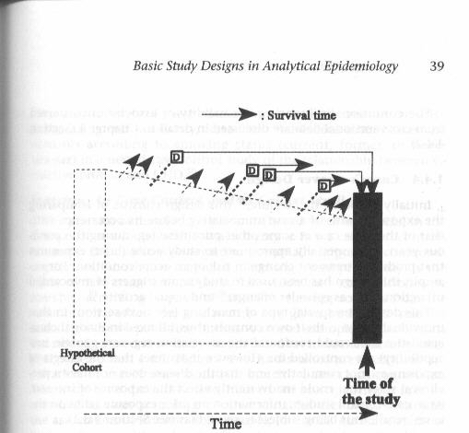
Mechanisms of Unequal Selection Probabilities in Cross-Sectional Studies
Assuming that the goal is to identify determinants of disease development (causal research)
CE
Unwise choice of a study sample as representative of target population.
  Study sample influenced by both exposure and outcome (e.g., Harvard study)
Non-participation amongst eligibles whom you have approached
  “Non-response” (eligible subjects in accessible population decline participation according to exposure & outcome)
Some people whom you would like to sample never become available to ask
  Drop out, competing events, and/or death from disease influenced by/associated with both exposure & outcome
Notes:
That said, let us think about the general mechanisms that can lead to unequal selection probabilities in cross-sectional studies. Let us do this by remembering our schematic which is that all cross-sectional studies are sampled from an underlying cohort. In this case, we have depicted a fixed cohort, but it could also be a dynamic one. With this in mind, and assuming that the goal is to identify determinants of disease development (etiologic/causal research and not survival after disease), what are the mechanisms of how unequal selection probabilities – which are related to exposure and disease -- might occur in cross-sectional studies? In other words, how does selection bias occur? (Note: Our careful preface regarding the goal of the research question is because bias always needs to be defined relative to some desired truth in a target population. In other words, there can be no discussion of bias unless we are all clear what the true parameter is that we are trying to estimate.)
There are three basic mechanisms, and they can be inferred by looking at the figure. The first is making an unwise choice of a study sample. For example, if it was your goal to study the relationship between family wealth and academic performance, it would be an unwise choice by the investigators to choose a sample of Harvard students for the study for the reasons we explained earlier.
The second mechanism is because of non-participation among those who are appropriately eligible and that you do actually have a chance to access. This non-participation is also called “non-response” or “refusal”, which means that of the persons who are eligible to be in the study (i.e. they are alive and accessible at the time you conduct the study), some might refuse to participate. If they do refuse according to their exposure and outcome status, then unequal selection probabilities and selection bias ensue. This is depicted here in item 2.
The third mechanism comes from recalling that there is a lot going on in cross-sectional studies that influences if people are around at the time of your study. In other words, in the underlying cohort, some people may never become accessible to ask to see if they want to participate. This is because of drop out, a competing event, or death among those with the disease in question. If these mechanisms of leaving the available study population are influenced by/associated with both exposure and outcome, then selection bias will ensue.
Note: these scenarios are all assumed to be under the null.

Slide 87
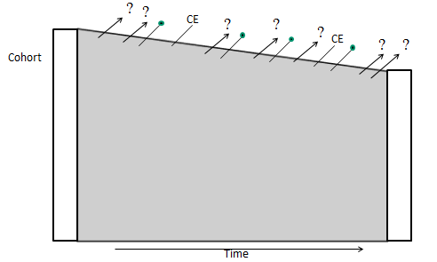
Mechanisms of Unequal Selection Probabilities in Cohort Studies: Mechanism #2: Retention During Follow-up
  Forces that determine length of participation (i.e., who ultimately stays in the analysis) are a cause of selection bias in cohorts
  Failure to complete participation comes in one of two ways:
    Drop-outs (loss to follow-up)
    Competing events (if relevant to your outcome)
Notes:
The other major mechanism of selection bias in cohort studies comes in the form of retention during follow-up. We have already spoken a lot about this in the course. This is a common mechanism of selection bias; it can create substantial bias and it may be very hard, if not impossible, to remedy. The mechanisms for this are the forces that determine length of participation (i.e., who ultimately stays in the analysis). The failure to complete participation comes in 1 or 2 ways, either drop-outs (also known as losses to follow-up) or competing events (which may or may not be relevant depending upon the outcome).
In this mechanism of selection bias, it is not whom you start with; it is whom you end up with.

Slide 88
Summary: Conditions for, Direct Evidence of, and Manifestations of Selection Bias
Conditions that could give rise to selection bias
Front: Any time your study sample is anything other than a random sample of the general population (i.e., anything other than everyone in general population having same selection probability); and/or
Back: Any time original study sample loses people from drop out/competing events
Direct evidence for selection bias: We rarely have it
Because we typically don’t have our hands on those outside of our study sample
  cannot prove (with our data) if our sample is representative of source population
  best we can do is speculate based on subject matter considerations and the rules for what is needed to create selection bias
    Rules differ depending upon whether there is (“under the non-null”) or is not (“under the null”) a true association between exposure and outcome
Manifestations
Selection Bias can result in:
  “Under the null”: specious numerical association between exposure & outcome when one truly is not present
  “Under non-null”: distortion of the association between exposure & outcome
Notes:
This is a summary of the conditions needed for, direct evidence of, and manifestations of selection bias.
Regarding the conditions that could give rise to selection bias, at study outset (what we have called the “front end”), any time your study sample is anything other than a random sample of the general population, you need to begin to worry about selection bias. In other words, if you do not have a random sample, what are the selection forces that influenced who was chosen to participate. Even with a random sample of the general population, you need to be concerned, especially in cross-sectional studies, with reasons why people may have left the underlying cohort. On the back end, any time the original study sample loses participants via drop out or competing events, there needs to be a concern about selection bias.
We believe that selection bias is the least obvious amongst the biases. This is primarily because we typically do not have any direct data we can evaluate. This is especially the case for selection bias on the front end. On the back end, at least the presence of drop out and competing events triggers a concern about selection bias. On the front end, the investigator truly needs to think hard about the possible selection forces. The best we can do in these situations is to think hard about what may influence selection and remember the rules regarding what is needed for selection bias. These rules differ according to whether there is truly no association between exposure and outcome (“under the null”) or whether there is (“off the null”). Remember, when under the null, the presence of selection bias can create a specious numerical association between exposure and outcome. Under the non-null, the presence of selection bias can cause a distortion between exposure and outcome.
Fortunately, there has been a surge of methodologic development around selection bias in the 15 years and the underlying theory of selection bias has now been worked out, which we are explaining today. This theory will become even more apparent when we explain directed acyclic graphs. Interestingly, a better understanding of selection bias has now allowed for selection bias to be recognized as the cause of many long standing “paradoxical” findings/associations in the clinical and epidemiologic literature. These include the obesity paradox (Banack and Kaufman Epidemiology 2013) and the low birthweight paradox (Whitcomb et al. Pediatric and Perinatal Epidemiology 2009).

Slide 89
“Causal Inference”
Goal: Identify causal relationships
6 ways a statistical association can occur
  Chance
  Selection bias
  Measurement bias
  Confounding
  Reverse causation
  True causal relationship
Process of causal inference: rule out/refute first 5
Notes:
Causal inference refers to the process undertaken to identify causal relationships (objective number 2 on our Big 6 list). This is one of the central goals of epidemiology and clinical research. What we do initially do in any of our studies is to determine a statistical (or “numerical”) association between a given exposure/treatment and disease. We know that there are 6 different ways that a statistical association can occur. If we can find evidence that 1 through 5 can explain the statistical association, then we cannot accept #6. If we try to find evidence for alternative explanations 1 through 5 but cannot find such evidence, eventually we can conclude that 6 is true. In other words, if we can refute all of the alternative explanations, then we feel comfortable accepting the causal explanation as being true. This is acceptance of causality by means of refutation.

