Slide 1
Randomized Trials & Quantifying Treatment Effects
Shabnam Peyvandi, MD MAS
11/1/18
With appreciation to:
Tom Newman & Michael Kohn

Slide 2
Randomization: Basic Principles
Study participants are randomly assigned to treatment groups
Groups are compared to estimate the effect of the intervention/treatment
Seems hard and expensive!

Slide 3
Why Randomize?
Minimizes Confounding
C
Treatment
Outcome
Notes:
A factor associated with the reciept of the treatment and also causally related to the outcome- may be referred to as selection bias in other courses

Slide 4
Why Randomize?
Minimizes confounding
Healthier?
Exercise
Coronary Heart Disease
May make treatment appear better than it is!
Notes:
Can also make the treatment look worse too if sicker patients take the treatement more often

Slide 5
Design & Conduct of RCT
Blinding
  Three levels
RCT Issues

Slide 6
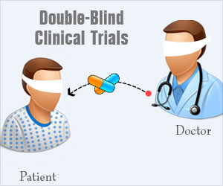
Blinding: The patient
Patient
  Prevents differences due to placebo effect
  Very important for subjective measures
  Getting study drug outside of the trial (controls)
Notes:
Subjective outcomes like pain

Slide 7
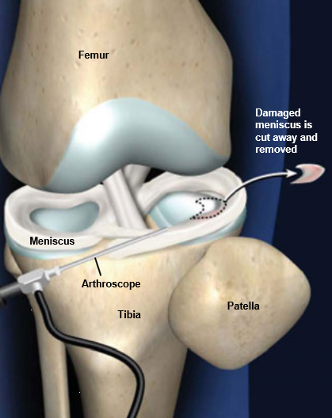
Blinding: The Patient
Arthroscopic partial meniscectomy
  Removing torn meniscus (relieves knee pain)
  RCT: Blinded patient to treatment vs. sham surgery (replicated exact sensation and sounds)
  No difference in outcomes (both groups had relief of knee pain!)

Slide 8
Blinding: The provider
The Provider
  Helps avoid co-interventions
    Other interventions or changes in management

Slide 9
Blinding: Assessing Outcome
Person assessing outcome
  Prevents observer bias
  More important for subjective measures
  Not so important for objective measures like mortality
Notes:
But cause specific mortality would need blinding

Slide 10
Blinding: Assessing Outcome
Canadian Multiple Sclerosis Trial
  Cyclophosphamide/plasma exchange vs. placebo
  Outcome: Neuro exam
    Subjects examined by both blinded and unblinded neurologist
  Unblinded neurologist group: treatment benefit (effect was not seen in blinded group)
Noseworthy et al. Neurology. 1994 Jan;44(1):16-20

Slide 11
Issues with Blinding
Patients may be able to tell they are on drug
  i.e. side effects like drowsiness/dry mouth with antidepressants
Part of the causal effect of treatment may be related to knowing you are on treatment
  Statins- if you know you are on statins you may exercise less or eat a less healthy diet

Slide 12
RCT Issues
Can be designed to maximize chances of a desired result
  Subjects
  Predictor Variables
  Outcome Variables

Slide 13
RCT Issues: Subjects
Select patient most likely to benefit from treatment and least likely to have adverse effects
Groups under-represented
  Children
  Elderly
  Women
  Comorbid conditions
  On other meds
* Significantly more likely to be excluded from industry-sponsored trials than from other trials . (Van Spall HGC et al. JAMA 2007;297:1233)

Slide 14
RCT Issues: Surrogate Outcomes
Surrogate outcome
  Presumed to be associated with the outcome of interest
  More easily measured, occurs sooner
Ex- looking at risk factors rather than disease
  Blood pressure instead of stroke
Ex- markers of disease severity rather than morbidity/mortality from disease
  Viral load, HbA1C

Slide 15
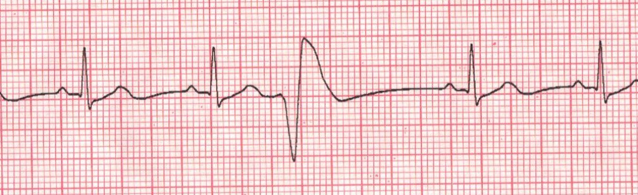
Surrogate Outcomes:
CAST Trial
Asymptomatic premature ventricular contractions after MI increase risk of sudden death
Clinical trial of Encainide/Flecainide vs. placebo
Surrogate outcome: PVC burden
Had to be terminated early due to excess death in treatment group! (8.3% vs. 3.5%, p<0.0001)
Echt DS et al. N Engl J Med. 1991;324:781-8
Moore TJ. Deadly Medicine. NY: Simon and Schuster, 1995

Slide 16
RCT Issues: Composite Outcome
Several bad outcomes grouped into one composite outcome
Can lead to combining outcomes of varying importance
  Death vs. multiple hospital re-admissions
Can be misleading if individual components of composite outcomes are not reported

Slide 17

ACCORD Trial
Aggressive control of blood glucose in adults with diabetes
  Intervention: frequent blood tests, injections to target HbA1C < 6% vs. 7-7.9%
  Pre-specified primary composite outcome
    Nonfatal MI
    Nonfatal stroke
    Cardiovascular death

Slide 18
ACCORD Study
After 3.5 years…
  Non-significant reduction in the risk of the primary composite outcome
But…..
  1% decrease in the risk of nonfatal MI (3.6% vs. 4.6%; p= 0.004)
  1% increase in risk of cardiovascular death!! (5% vs. 4%, p= 0.04)
Masked an increase in total mortality!
ACCORD Study Group. NEJM 2008;358:2545-59 ; NEJM 2011;364:818-28

Slide 19
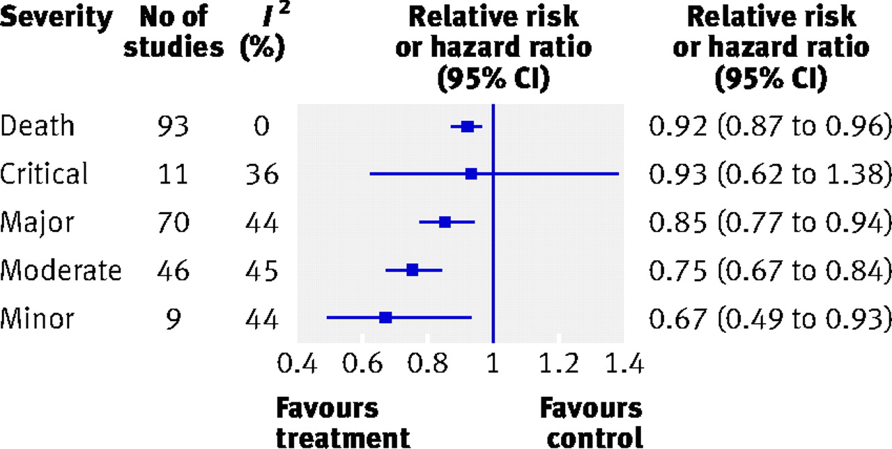
Composite Outcomes:
A common problem
Systematic Review of 114 randomized trials of cardiovascular interventions
68% of the studies reported results for each component of the composite outcome
Ferreira-Gonzalez, 2007
Notes:
Outcomes of greater importance such as death were associated with smaller relative treatment effects than less important outcomes.

Slide 20
Composite Outcomes
Important to ‘decompose’
Can mask important effects of therapy
  No effect on important outcomes
  Negative effect on important outcomes

Slide 21
Analysis in RCTs
Analysis Plan
  Intention to treat
  As-treated
  Per-protocol
Problem– subjects don’t always stay in the group they were assigned to

Slide 22
Analysis in RCTs
Intention to Treat vs. As Treated
  Based on treatment assigned rather than treatment received
  Minimizes bias that result from cross-over between groups
    Patients who complete treatment are often healthier than those that don’t (may make treatment look better than it is!)

Slide 23
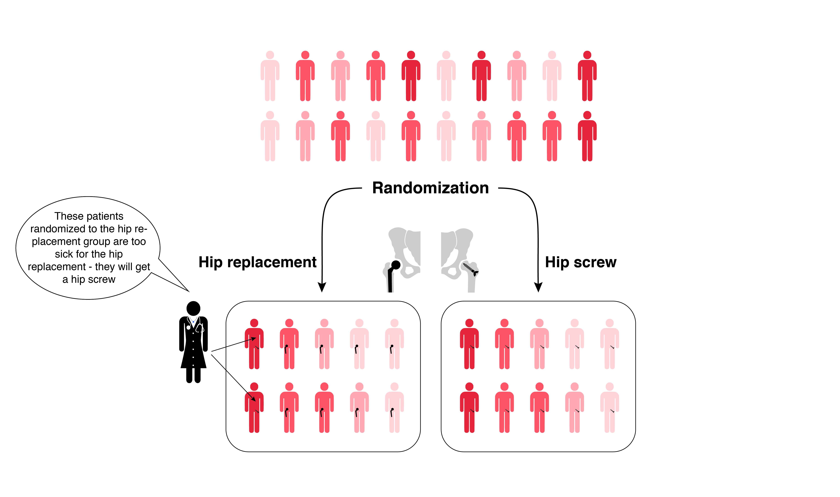
ITT vs. as-treated
Hip replacement vs. Hip screw for a broken hip in the elderly
Illustration courtesy of Martina Steurer, MD MAS

Slide 24
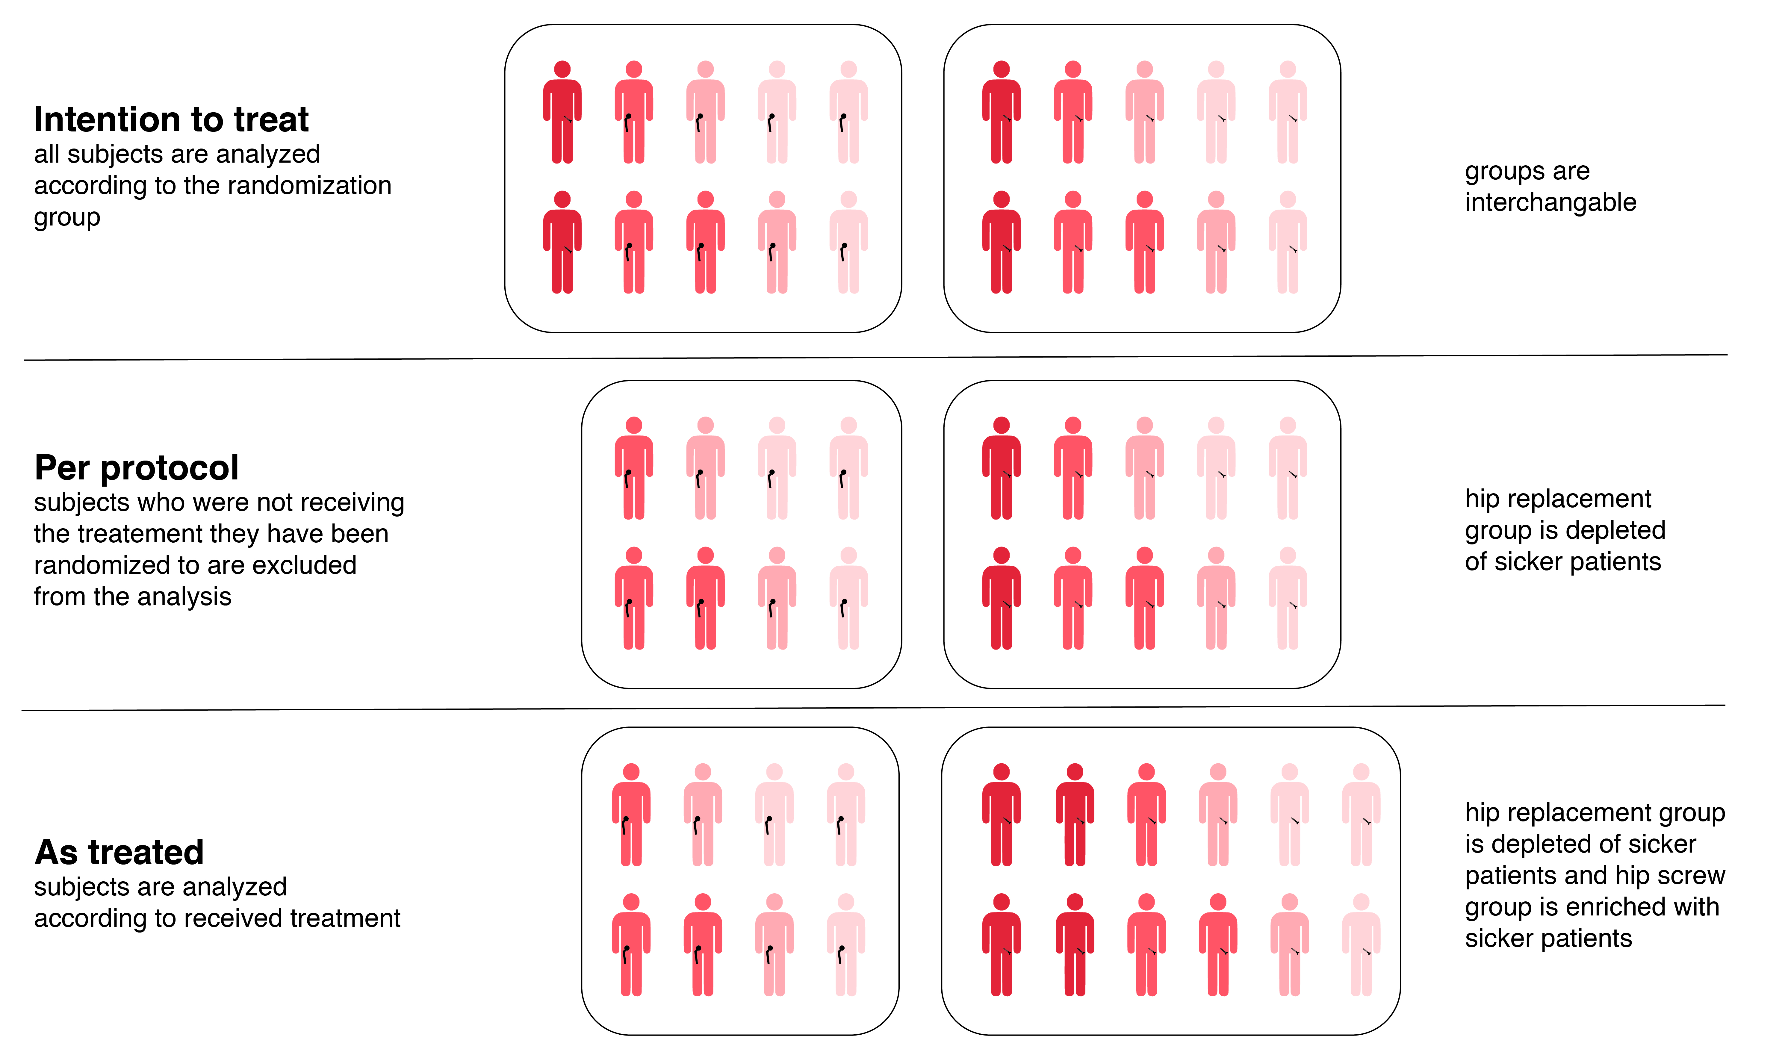
Biases results in favor of hip replacement
Illustration courtesy of Martina Steurer, MD MAS

Slide 25
Per-Protocol
Somewhere in between
Only analyze those who were treated according to the protocol
Susceptible to bias– patients treated according to protocol are likely different from those who are not

Slide 26
Per-protocol
Still biased towards hip replacement group since sick patients that moved treatment groups were excluded (but similar patients stayed in hip screw group)
Illustration courtesy of Martina Steurer, MD MAS

Slide 27
RCT Analysis: Pitfalls
Sub-group analysis
Multiple Comparisons
Between- vs. within-group comparisons

Slide 28
Pitfall #1: Subgroup Analyses
Primary Aim of RCT→ comparison of overall groups to which subjects were randomized (i.e. treatment vs. control)
Subgroup analyses: Presenting results within a particular subgroup of subjects (bound to find something interesting)

Slide 29
Pitfall #2: Multiple Comparisons
Typically false positive results in RCTs due to chance are low (if done properly)
Unless…. Look at multiple different outcomes in multiple different groups in multiple different ways (need to adjust for this)

Slide 30
Pitfall#2: Multiple Comparisons
Glaxo-Smith Kline funded study
Depression in adolescents
  Paroxetine vs. placebo
  “generally well-tolerated and effective for major depression in adolescents”
Keller MB et al, J Am Acad Child Adolesc Psychiatry 2001

Slide 31
Pitfall #2: Multiple Comparisons
Independent analysis:
  20 outcome measures had been added to the 8 original outcomes
Only highlighted those that were favorable!
GSK paid a fine of $3 billion (which was a fraction of the sales from this drug– $27.9 billion)
Notes:
Need to clarify this

Slide 32
Pitfall #3: Within group comparisons
Correct approach: compare groups according to group assignment (between groups)
Within-group comparisons-- > misleading

Slide 33
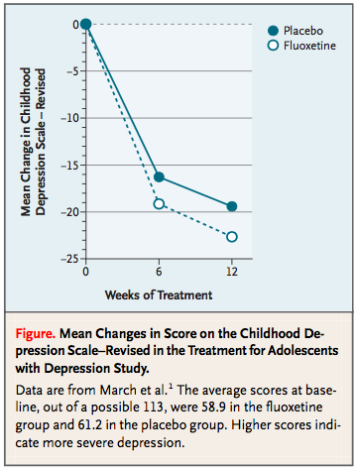
Pitfall #3 example
Fluoxetine vs. Placebo effect on depression in adolescents
Looking at mean change in depression scale in each group over time (not comparing placebo vs. fluoxetine). Looks like placebo group did pretty good!

Slide 34
Pitfall #3 Example
Percent Atheroma Volume in the Target Coronary Segment
 |  | N |  | Baseline |  | Follow-Up | Change |  | P Value*
Placebo |  | 11 |  | 34.8 |  | 34.9 | 0.1 |  | 0.97
ApoA-I Milano
 | 15 mg/kg | 21 |  | 39.7 |  | 38.4 | -1.3 |  | 0.03
 | 45 mg/kg | 15 |  | 37.9 |  | 37.2 | -0.7 |  | 0.45
 | Combined | 36 |  | 39.0 |  | 37.9 | -1.1 |  | 0.02
*P values for within-group comparison from Wilcoxon signed rank test. For between-group comparison, P = 0.29

Slide 35
Biases in RCTs
Loss to Follow-up
  Reduce power
  Introduce bias
Bias in favor of Tx: sicker patients in tx group are lost and/or healthier patients in control group are lost

Slide 36
Loss to follow-up
Solution: Sensitivity Analysis
Worst case scenario analysis (extreme)
Poor outcomes for all losses in Tx group & good outcomes for all losses in control group
Alternative: Compare subjects that remained in the study vs. lost to follow up (similar or different?)

Slide 37
Biases in RCTs
If done correctly, bias typically towards the null (false negative result)
  Poor adherence
  Random error in measurement
Problematic for equivalency trials
  Goal: study drug is similar to a known drug
Notes:
Demonstrate equivalence so may do a sloppy job because goal is not to find that study drug is different from known drug

Slide 38
Quantifying Treatment Effects
Dichotomous outcome:
 | Bad Outcome | No Bad Outcome
Treatment | a | b
Control | c | d
R_{T}= Risk in Treatment Group= a/a+b
R_{c}= Risk in Control Group = c/c+d
RR= R_{t}/R_{c}= a/(a+b)/c/(c+b)
RRR= 1- RR
Notes:
It’s helpful to put outcome in columns and interventions in rows with bad outcome column on the left and treatement rown on top. RR<1= tx beneficial abd RR>1= tx is harmful (like when bad outcome is a side effect)

Slide 39
Quantifying Treatment Effects
Dichotomous outcome:
 | Bad Outcome | No Bad Outcome
Treatment | a | b
Control | c | d
ARR= - Risk Difference= - (R_{T}- R_{C})= R_{c}-R_{T}= c/(c+d) – a/(a+b)
NNT= 1/ARR
OR= ad/bc

Slide 40
Efficacy of Salmeterol+ Fluticasone vs. Fluticasone alone
 | Exacerbation | No Exacerbation | Total
Fluticasone + Salmeterol | 480 | 5354 | 5834
Fluticasone Alone | 597 | 5248 | 5845
Risk (Fluticasone + Salmeterol)= 480/5834= 8.2%
Risk (Fluticasone alone)= 597/5845= 10.2%
RR= 8.2%/10.2%= 0.81
RRR= 1- RR= 1-0.81= 19%
ARR= -(8.2%-10.2%)= 2.0% (over 6 months)
NNT= 1/ARR= 1/0.02= 50 for 6 months– what does this mean?
“We need to treat 50 asthma patients with fluticasone + Salmeterol vs. Fluticasone alone for 6 months to prevent one asthma exacerbation requiring systemic steroid”
Notes:
Outcome= asthma exacerbation
Time- 6 months

Slide 41
NNT
Number needed to treat to prevent one bad outcome
Lower the # the better
Specify the follow-up time, the bad outcome being prevented and the characteristics of the people being treated
Round to the nearest integer (since talking about people)
Notes:
If everybody in control group dies and everybody in treatment group survives the NNT to prevent one death is 1

Slide 42
Relative vs. Absolute Risk
Relative risk will always appear more impressive than absolute risk
Absolute risk takes into account baseline risk (of control group)

Slide 43
Relative vs. Absolute Risk:
Bad Press
RCT: Evolocumab vs. Placebo
Key secondary endpoint: death, MI, stroke
USA Today:
  “[Evolocumab] cut the combined risk of heart attack, stroke and cardiovascular death in patients with heart disease by 20%”
Notes:
Cholesterol lowering agent

Slide 44
Relative vs. Absolute Risk:
Bad Press
RCT: Evolocumab vs. Placebo
USA Today:
  “[Evolocumab] cut the combined risk of heart attack, stroke and cardiovascular death in patients with heart disease by 20%”
RRR= 19.5%
ARR= 1.4%
Is that quote from USA Today correct?
Notes:
RR always seems more impressive so that is what is usually presented by the press.

Slide 45
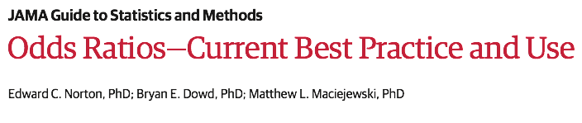
Odds Ratios
OR not necessary to report in clinical trials
Desirable to report since always further from 1 than the RR
Inflates the apparent effect size
July 2018; 320 (1): 84-85
Notes:
Good for case control or cohort studies

Slide 46
Incorporating Cost
NNT= # needed to treat to prevent one bad outcome
C= cost to treat one patient
NNT x C= treatment cost to prevent one bad outcome

Slide 47
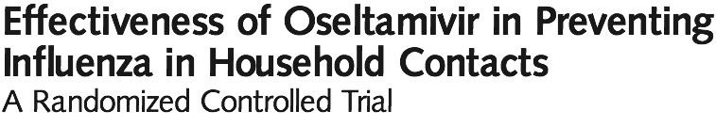
Tamiflu or not?
RCT oseltamivir vs. placebo to prevent influenza in household contacts of patients with flu-like symptoms
Stratified by whether index case had lab proved flu
Minimal loss to f/u, ITT analysis

Slide 48
Tamiflu Prophylaxis
Index case Proven Flu +
Index case not Proven Flu +
 | Flu + Contact | Flu – Contact | Totals
Tamiflu | 3 | 206 | 209
Placebo | 26 | 180 | 206
 | Flu + Contact | Flu – Contact | Totals
Tamiflu | 1 | 283 | 284
Placebo | 8 | 248 | 256
Risk_{T}= 3/209 = 1.4%
Risk_{C}= 26/206= 12.6%
RR= 1.4%/12.6%= 11%
RRR= 1-11%= 89%
Risk_{T}= 1/284 = 0.35%
Risk_{C}= 8/256= 3.1%
RR= 0.35%/3.1%= 11%
RRR= 1-11%= 89%
ARR= 12.6%-1.4%= 11.2%
ARR= 3.1%-0.35%= 2.7%
Why is ARR different between the two groups?
Notes:
Because the index flu- group has a much lower baseline risk of flu in household contacts (3.1% vs. 12.6%)– this is how RRR can be misleading. Important to know the baseline risk!

Slide 49
Tamiflu prophylaxis ~ $40
Index case Proven Flu +
Index case not Proven Flu +
 | Flu + Contact | Flu – Contact | Totals
Tamiflu | 3 | 206 | 209
Placebo | 26 | 180 | 206
 | Flu + Contact | Flu – Contact | Totals
Tamiflu | 1 | 283 | 284
Placebo | 8 | 248 | 256
ARR= 12.6%-1.4%= 11.2%
NNT= 1/11.2%= 9
Cost= 9*$40= $360
It costs about $360 to prevent a case of flu in household contacts
ARR= 3.1%-0.35%= 2.7%
NNT= 1/ 2.7%= 37
Cost= 37*$40
It costs about $1480 to prevent a case of flu in household contacts
Cost per bad outcome prevented= CBOP
Notes:
The baseline risk of contracting influenca is 4 times lower in the flu negative group so the absolute benefit is 4 times lower and the cost per flu case prevented is 4 times higher

Slide 50
CBOP: Is it worth it?
Depends on BBOP= Benefit per Bad Outcome Prevented
BBOP= $1080
BBOP>CBOP= treat!

Slide 51
Treatment Thresholds
If BBOP>CBOP, at what probability of disease would benefits outweigh costs?
  What is the treatment threshold (P_{TT})?
P_{TT}= C/C+B
We know C ($40), but what is B?

Slide 52
What is B?
B= expected benefit of treatment
B= BBOP X ARR - C
Benefit of preventing a bad outcome
Absolute Risk Reduction (how much does treatment reduce the risk)
Cost

Slide 53
Getting to P_{TT}= C/(C+B)
B= BBOP X ARR – C
ARR= 1/NNT
B= BBOP/NNT- C
P_{TT}= C/(C+ BBOP/NNT-C)= C/(BBOP/NNT)
P_{TT}= C X NNT/BBOP
P_{TT}= CBOP/BBOP

Slide 54
Back to the Flu example
Treatment cost = $40
BBOP = $1080
NNT= 9
P_{TT}= 9*40/1080= 0.33
* If you treat household contacts when the index cases’s probability of the flu is 33% or higher, you will not spend more than the BBOP of $1080 to prevent a case of flu

Slide 55
Number needed to Harm
Adverse effects of treatment
Trade-off between side effects and outcome prevention

Slide 56
Plecanatide (Trulance) to treat chronic constipation
  Unintended side effect: Diarrhea

Slide 57
Setting up for NNH
 | Diarrhea | No Diarrhea | Total | Risk
Plecanatide | 28 | 446 | 474 | 5.9%
Placebo | 6 | 452 | 458 | 1.3%
RR= 5.9%/1.3%= 4.5
ARR= 1.3%-5.9%= -4.6%
ARI= 5.9%-1.3%= 4.6%
NNH= 1/ARI= 21.7
For every 22 patients treated , we will cause one additional case of diarrhea
Notes:
Set up table same way as your usual 2x2 table but now adverse event is the outcome you are interested in.

Slide 58
The trade-off
Trade-off between side effects and primary outcome prevention
Harms/Bad outcome prevented= ARI/ARR
NNT/NNH
Trulance example:
  NNT for primary outcome 9.3
  NNH: 22
NNT/NNH= 9.3/21.7= 0.43= We cause 0.43 cases of diarrhea for each durable responder

Slide 59
RCT Conclusions
Pay close attention to study methodology (blinding, outcome variable) and analytic plan (ITT?)
ARR takes baseline risk into account
Practical results:
  NNT
  CBOP, BBOP
  ARI and NNH

