Slide 1
Classical and modern measurement theories:
Introduction to Generalizability Theory
Lydia B. Zablotska, MD, PhD
Professor, Department of Epidemiology and Biostatistics

Slide 2
Highlights from week #6
Reviewed types of measurement frameworks:
  norm-referenced vs. criterion-referenced
Defined standards, norms and methods of standardization
  Standardization is the process of development of norms for interpreting scores
Discussed 4 steps in the development of standardized measures:
  Develop an instrument
  Rigorously test the instrument before general use
  Use standardized protocol to consistently administer and score the instrument
  Use established norms to interpret data collected by the instrument (judgment vs. empirical)

Slide 3
Highlights from week #6
Standardized measures are usually norm-referenced measures
Constructed, administered and scored in a prescribed and consistent manner
Interpreted with reference to established norms
Standardized measures are best for stable concepts which are common across many domains

Slide 4
Intraclass Correlation Coefficient (ICC) to assess inter-rater reliability
Highlights from week #6
Determining which ICC you need:
Do you have consistent raters for all ratees? For example, do the exact same 8 raters make ratings on every ratee?
No – ICC-1, Yes →Q2
Do you have a sample or population of raters?
Sample – ICC-2, Population – ICC-3 (i.e., we took ALL available raters)
Do you need a measure of absolute agreement or consistency?
"Absolute agreement” option is a default for 2-way random-effects model while “Consistency” is a default option for 2-way mixed-effects model.
Are you interested in the reliability of a single rater, or of their mean?
Agreement between the averages of ratings over several raters (average ICC) are typically used when individual ratings are deemed unreliable.

Slide 5
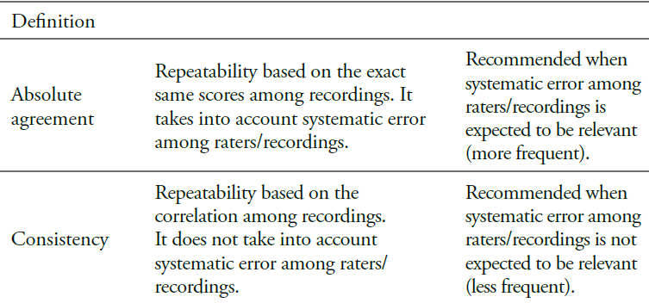
Highlights from week #6
The difference between “consistency” and “absolute agreement” measures is defined in terms of how the systematic variability due to raters or measures is treated.

Slide 6
Highlights from week #6
Cicchetti and Sparrow (1981) suggested the following guideline for the evaluation of ICC used to measure inter-rater agreement:
ICC | interpretation
<0.40 | Poor agreement
0.40 - 0.59 | fair to moderate agreement
0.60 - 0.74 | good agreement
0.75 - 1.00 | excellent agreement
The ICC is calculated as the ratio of the sums of various variance component estimates and defined to be within the interval [0, 1].
In some statistical packages negative variance estimates are not prevented – this can lead to out of range ICC estimates.
Typically this happens when the between-subject variation is relatively small compared to the within-subject variation, e.g. due to different raters. If that is the case the negative ICC estimate produced by the software should not be quoted but you can say that the scale is not reliable.

Slide 7
Learning Objectives
Classical measurement theory: its advantages and limitations.
Modern measurement theories (Generalizability theory (GT) and Item Response theory).
Basic principles of GT and its use in measurement frameworks.
Basic principles of estimation of g-coefficient using ANOVA.
Steps for making decisions about measurement scheme using g-coefficient.

Slide 8
Sources of Error
Random
  Fluctuations in the measurement based purely on chance
  Scoring, rater drift, subject state, administration of measure, environment
  Primarily affects reliability (consistency or stability of measures)
Systematic
  Measurement error that affect a score because of some particular characteristic of the person or the test that has nothing to due with the construct being measured
  Characteristics of subject, measurement tool, measuring process, proxy response
  Primarily affects validity

Slide 9
Classical measurement theory
(‘classical test theory’)
Provides a model for assessing random measurement error
Describes ways in which errors of measurement (due to fallible measures) can influence observed scores
Describes unsystematic, or random, deviation of an individual’s observed score from a theoretically expected or “true” score
Effects of random error in the model are thought to cancel one another out if sample size is large

Slide 10
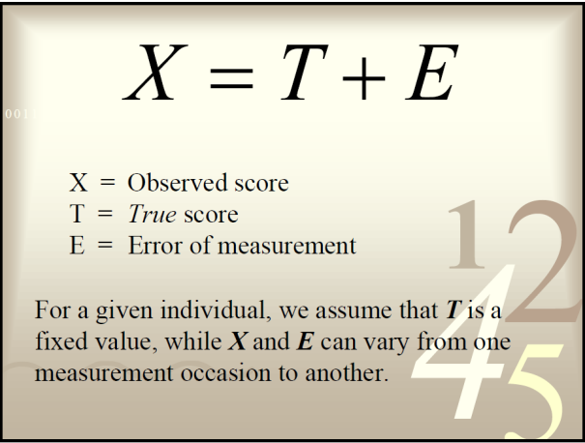
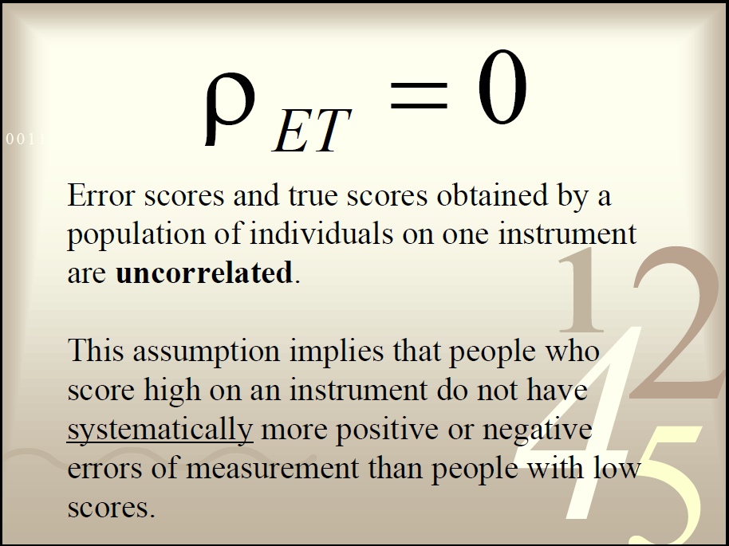
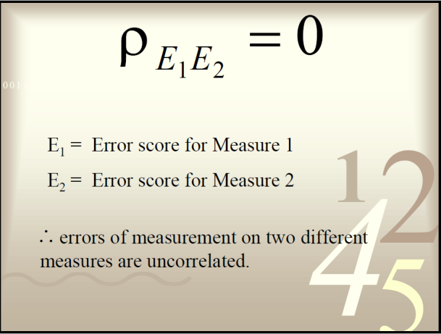
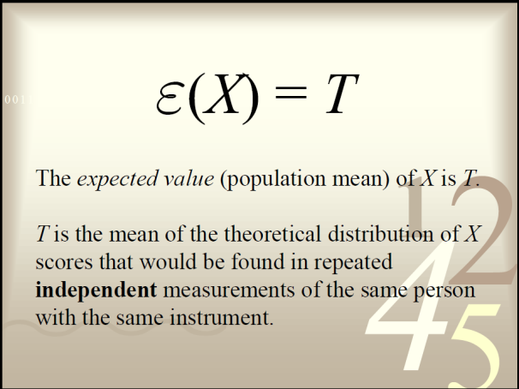
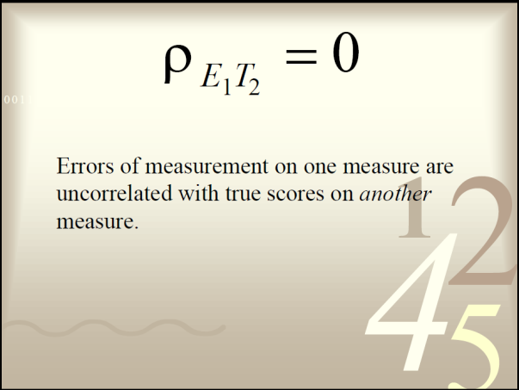
Classical measurement theory:
Assumptions

Slide 11
CTT’s limitations
X = T + E
Although E could represent many different types of error, CTT only permits the estimation of one general error term, which incorporates all sources of error but emphasizes certain types of error over others depending on the reliability study conducted:
Inter–rater reliability focusing on rater error
Test–retest reliability focusing on temporal error (occasion facet)
Internal consistency reliability focusing on how well items fit together to measure the phenomenon consistently
Recognizes only two sources of variance
    Test -retest (stability over time)
    Parallel/ alternate forms (equivalence in item sampling)
Cannot adequately estimate individual sources of error influencing a measurement
Notes:
Clearly, the assumption that all variance in scores can be neatly divided into true and error variance is simplistic. Instead, for each person we have measured there are, in addition to the ‘true’ score of that individual, multiple potential sources of error.
Each of the multiple forms of reliability that we discussed (test-retest, inter-rater, etc.) identifies and quantifies only one source of error variance.
In most situations, we need to assess more than source of error, e.g., we want to evaluate internal consistency at the same time as test-retest reliability.

Slide 12
CTT goals and measures
Determine the degree to which variations in the conditions of measurement (e.g., different raters and different measurement occasions) affect the consistency with which a construct is measured
CTT reliability coefficients are computed using the Pearson product–moment correlation; only useful where we can identify the X and Y scores in the pair (X and Y).

Slide 13
GT vs. CTT
CTT – the major concern with reliability is how well observed scores reflect corresponding true scores
GT – attention focuses on dependability, or how well observed scores allow generalization about behavior in a defined universe of situations

Slide 14
Examples of modern measurement theories
Generalizability theory – acknowledges the multiple sources of measurement error by deriving estimates of each source separately
Item response theory – in contrast to classical measurement theory, which focuses on test performance, this theory focuses on item’s performance and the examinee’s ability; eg., examinee’s performance could be predicted based on a set of factors referred to as traits, latent traits, abilities or proficiencies

Slide 15
Generalizability Theory (GT)
Cronbach, 1972
Classical true score model considers only persons and items/scales
GT takes into account the various sources of error that affect measurement
  assumes that an observed score is a linear combination of true score and error
  error is multi-faceted and can be systematic
  Examples of error: Population, Time, Setting
Acknowledges, but also accounts for, the differences in measurement conditions that one is likely to encounter in applied measurement contexts

Slide 16
GT
Rather than attempting to estimate a true score, as in CTT, the focus of GT is on the universe score, or the average score, that would be expected across all possible variations in the measurement procedure (e.g., different raters, forms, or items).
Because no single obtained score is likely to perfectly match the universe score, some degree of error exists when generalizing from a particular sample of behavior to the universe score.
The quantification of this error is a central focus of GT and is represented through the calculation of generalizability coefficients and dependability coefficients along with consideration of variances attributable to various predefined sources (e.g., persons, occasions, and raters).

Slide 17
GT steps
Determine the individual sources of variance (and their interactions) of interest for your study.
Conduct a G-study using a repeated measures design and collect the data on sources of variance of interest.
Incorporate all plausible sources of variance into a single ANOVA (of Generalized Linear Model).
Compute generalizability coefficients (g-coefficients, another form of reliability).
Use the data from steps 1-4 to do calculations for D-study (dependability) and calculate dependability coefficients (d-coefficients).
Notes:
D coefficients examine various combinations of error sources and allow us to see exactly which combination maximizes the overall reliability, keeping the number of observations fixed.
Both g and d coefficients are interpreted as reliability indices.

Slide 18
Design Considerations (1)
“Object of measurement” – every observation of this object is subject to error, derived from various sources.
Facets - factors other than the “object of measurement,” which contribute to the variance in scored between subjects and within subjects.
  Could be differences between persons using the instrument; relevant conditions that could be potential sources of systematic measurement error, etc.
Error term =
Eperson + Eitem + E(person*item) + residual error
Notes:
Sample size in G-studies is determined by the number of objects being rated, not by the number of raters.
E.g., 100 students rate one professor, so sample size here is =1.
E.g., one professor grades 100 students, so sample size is =100. variance components: student’s scores could vary due to educational and other characteristics and professor who graded them.
Facets – sources of variation or variance.
In other literature:
Object of measurement is called Facet of Determination
usually people, but can vary (e.g. raters)
Facet is called Facet of Generalization
raters, trials, days, clinics, therapists

Slide 19
Simple example
The final examination in a class of 10 students, consists of three essay questions, each rated by course director and teaching assistant.
  Object of observation – students.
  Sample size – 10.
  Facets of generalization – two raters.
  Design: 6 repeated observations on each student – three essay questions x two raters
Could add a few more facets:
  If raters were asked to not only score the essays but also to judge neatness, logical thought, scientific writing style, knowledge, etc.
G-study answers questions:
Inter-rater reliability: To what extent can we generalize from a rating made by one rater to a second rater on the same question?
Internal consistency: To what extent can I generalize from one essay question to another with the same rater?

Slide 20
Design Considerations (2)
Nested design
  Two raters rate the first essay question, a different two raters rate the second essay question, and another pair of raters rate the third essay question.
  Raters ‘nested’ in questions.
Crossed design
  The same two raters rate all three essay questions.
  Raters are ‘crossed’ with questions (each rater occurs at all levels of question).
Notes:
The distinction matters because if rater is nested in question, we cannot ask about interaction of rater and question. Also, one question could be rated by two raters and another by three raters which complicates the analysis.

Slide 21
Two Facet Fully Crossed Design
Variance Components
We have two facets:
  Raters
  observations
Seven sources of variance are estimated:
  Subjects (10 students)
  Raters (2 raters)
  Observations (3 essay questions)
  Sxr (interaction between Subjects and Raters)
  sxo
  rxo
  sxrxo, e – random error (residual error)

Slide 22
One Facet Design
Variance Components
4 Sources of Variability
  systematic differences among subjects
    (object of measurement)
  systematic differences among
  raters (occasions, items)
  subjects*raters interaction
  random error
confounded

Slide 23
Variance Components
(s*o)
Subjects (s)
Observations (o)
(s*r*o)
+
Error
(s*r)
(o*r)
Raters (r)

Slide 24
Design Considerations (3)
Fixed Facets
When the levels of the facet exhaust all possible conditions in the universe to which the investigator wants to generalize.
When the level of the facet represent a convenient sub-sample of all possible conditions in the universe.
Similar to mixed model for ICC
Random Facets
When it is assumed that the levels of the facet represent a random sample of all possible levels described by the facet.
If you are willing to EXCHANGE the conditions (levels) under study for any other set of conditions of the same size from the universe.
Similar to random model for ICC
  G-theory determines how exchangeable observations are and identifies the major obstacles to exchangeability
Notes:
If we apply this to an earlier example of two raters for 3 essay questions on the final exam for 10 students, we could choose the facets to be fixed if we want to restrict ourselves to just these questions and these raters. Therefore, we don’t need to correct for rater systematic bias as it applies equally to all students.

Slide 25
Relative Error
Facet of Determination: Subjects
Subjects (s)
(s*o)
Observations (o)
(s*r*o)
+
Error
(s*r)
(o*r)
Raters (r)
Notes:
In fixed facets design, we ignore rater systematic bias.
Fixed facets design could be thought of as accepting that each subjects score is meaningful only relative to other students who wrote the same essays which were scored by the same raters. We thus omit any bias emerging from systematic differences between questions or raters.

Slide 26
Absolute Error
Facet of Determination: Subjects
Subjects (s)
(s*o)
Observations (o)
(s*r*o)
+
Error
(s*r)
(o*r)
Raters (r)
Notes:
Alternatively, we could correct each score taking into account the stringency of the rater and the difficulty of the essay question. We are using a random facets approach and essentially acting as if the raters were a random sample of all raters, and all questions were a random sample of possible questions. Because of this, we need to include main effects (biases) of rater and question as error terms.
Caution: could only treat all facets either as relative or as absolute, which in reality is often not the case.

Slide 27
Types of Decisions
Relative – similar to norm-referenced reliability
  establish a rank order of individuals (or groups).
  the comparison of a subject’s performance against others in the group.
Absolute - similar to criterion-referenced reliability
  to index an individual’s (or group’s) absolute level of measurement.
  measurement results are to be made independent from the performance of others in the group.

Slide 28
Generalizability Theory
Quantitative Approach
ICC partitions variance due to between subjects and within subjects
  assesses rating reliability by comparing the variability of different ratings of the same subject to the total variation across all ratings and all subjects
  Has some ability to accommodate multiple sources of variance
  Does not provide an integrated approach to estimating reliability under multiple conditions (e.g., only 1- and 2-way ANOVA)
ANOVA for GT
  just as ANOVA partitions a dependent variable into effects for the independent variable (main effects & interactions), G-theory uses ANOVA to partition an individual’s measurement score into an effect for the universe-score and an effect for each source of error and their interactions in the design.

Slide 29
Generalizability Theory
Quantitative Approach
In ANOVA we were driven to test specific hypotheses about our independent variables and thus sought out the F statistic and p-value.
In G-theory we use ANOVA to partition the different sources of variance and then to estimate their amount (Variance Component).

Slide 30
Sources of variation
Between-subject sources:
  examples: Gender, Ethnicity, Ability, Person
Within-subject sources
  examples: Item, Time, Rater

Slide 31
Types of GT Studies
Generalizability Study (G-Study)
  When researchers are primarily concerned with the extent to which a sample of measurements generalizes to a universe of measurements.
  For instrument development.
  To plan a D-study to have adequate generalizability.
Decision Study (D-Study)
  For design of a measurement that minimizes error for a particular purpose.
Notes:
Example: randomly select 2,000 children from public schools and 2,000 from parochial schools in the same region and use the same standardized achievement test. If we want to determine reliability of the test for students from both types of schools, this is a g-study. If we want to compare mean achievement scores from both types of schools and draw conclusions about possible differences in the adequacy of the two educational systems, this would be a d-study.

Slide 32
G-Study
Purpose is to anticipate the multiple uses of a measurement.
To provide as much information as possible about the sources of variation in the measurement.
The G-Study should attempt to identify and incorporate into its design as many potential sources of variation as possible.

Slide 33
D-Study
Makes use of the information provided by the G-Study to design the best possible application of the measurement for a particular purpose.
Error is suppressed by adding more levels of a facet (like adding more items to a questionnaire).
  akin to the use of the Spearman-Brown formula in CTT
Planning a D-Study:
  defines the Universe of Generalization
  specifies the proposed interpretation of the measurement.
  uses G-Study information to evaluate the effectiveness of alternative designs for minimizing error and maximizing reliability.
  The accuracy of generalizing from a person’s observed score on a measure to the average score that person would have received under all possible testing conditions the tester would be willing to accept.

Slide 34
D-studies and coefficients
Change number of facet levels to do “what if” studies
Select specific subsets for specific levels (eg. specific raters, subsets of raters)
  May be random or fixed factors, depending on if the raters have a particular characteristic (random) or those specific raters will be used (fixed)

Slide 35
D-Study: consider raters as fixed, no generalization made to other raters
Variation in s is no longer affected by raters:
sxo
Subjects (s)
Observations (o)
a) average over the levels the fixed effect
sxoxr,e
b) analyze the fixed effect levels separately
sxr
oxr
Raters (r)

Slide 36
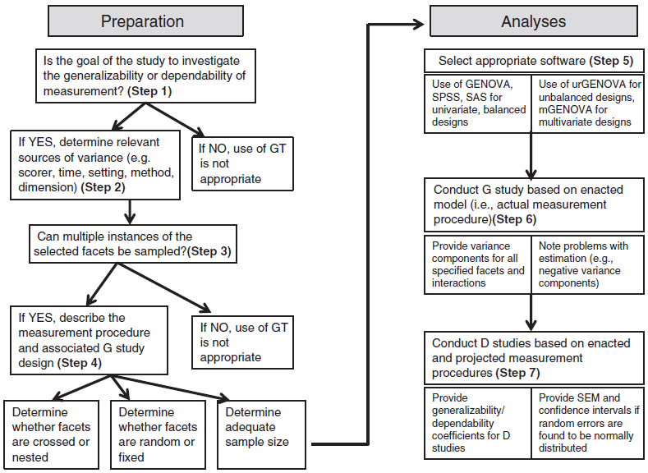
A suggested process for decision-making regarding GT

Slide 37
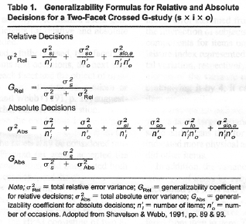
generalizability coefficient (ρ²)
dependability coefficient (Φ)

Slide 38
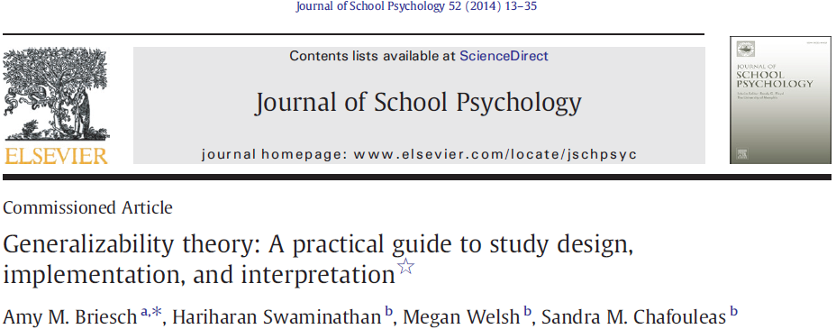
Example:
Step 1: The goal is to determine how many teacher ratings would be needed in order to obtain a dependable estimate of student engagement during whole-group math instruction
Step 2: Important facets are teacher-raters, occasion (stability of ratings), but not setting facet (because looking only at math instruction)
Step 3: Two teachers must be included and ratings should be collected over multiple days in order to investigate fluctuations across occasions. In order to ensure a fully-crossed design, all students should be rated on all occasions by all participating teachers. Because we wish to generalize findings beyond the specific teachers and occasions utilized, both facets should be treated as random.
Step 4: A total of two teachers were ultimately utilized; both agreed to conduct ratings for 2 full school-weeks. Each day, both teachers rated the proportion of time (0 to 100%) that each of 10 students spent engaged in whole-group math instruction. At the end of the 2 weeks, a total of 200 data points had been collected (i.e., 10 students × 10 occasions × 2 raters).
Step 5: ANOVA analysis.
Step 6: G-study.

Slide 39
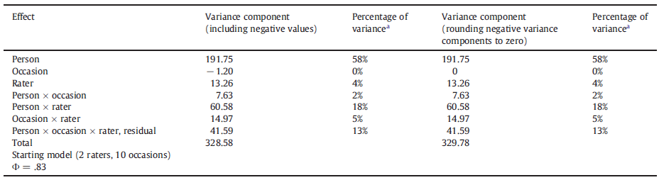
The greatest percentage of variance (58%) is due to person – teachers were able to discriminate between students' levels of academic engagement.
The small percentage of variance (4%) attributable to the facet of rater –teachers' ratings did not vary substantially overall (i.e., averaged across students and occasions).
Interaction person*rater is 18% of the observed variance - teachers' assessments of particular students did vary to a notable extent.
Rater and occasion*rater are ≤5%, i.e. (a) the rank order of students did not change dramatically across occasions and (b) there were small changes in rating behavior across occasions.

Slide 40
Do we need to move to a D-study?
Generalizability coefficients or dependability coefficients, or both types? Depends on how the data will be used:
generalizability coefficient (ρ²) should be calculated when one is interested in making decisions about an individual's performance relative to his or her peers
a dependability coefficient (Φ) should be calculated when one is interested in an individual's performance irrespective of his or her peers
  the goal of this case study was to determine the number of ratings needed to obtain a dependable estimate of a student's behavior (i.e., engagement) independent of the performance of his or her peers → the calculation of dependability coefficients
  The model has 2 raters and 10 occasions
  dependability coefficient =0.83 – adequate

Slide 41
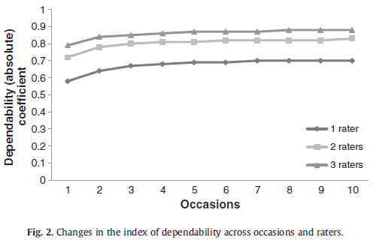
Step 7: D-study
Flattening in the rate of improvement suggests a point of diminishing returns beyond which additional data collection may not be valuable

Slide 42
Conclusions:
A dependable estimate of student engagement may be obtained in as few as three occasions if two teachers are able to provide concurrent ratings. In typical classroom settings, however, it is unlikely that more than one classroom teacher will be present at a time.
Unfortunately, the D study results seem to indicate that adequate levels of dependability (i.e., .80) will not be achieved given a single rater.
It is necessary to re-examine the rating context and determine what training and supports can be put into place in order to improve rating reliability.

Slide 43
Summary
Generalizability is broadly understood as representativeness of a specific sample of the traits and characteristics in the entire population
Generalizability Theory (GT) offers increased utility for assessment research given the ability to concurrently examine multiple sources of variance, inform both relative and absolute decision making, and determine both the consistency and generalizability of results.

Slide 44
Summary
GT represents a significant advance over traditional approaches to reliability because it could simultaneously consider multiple sources of error variance.
GT could be used to optimize reliability (increase sample size, number of raters, other facets, etc.)

