Slide 1
Graphics to tell a story: Oakland A’s*
2004: Moneyball published by Michael Lewis
2011: The film ‘Moneyball’ released
  The film ends with the A’s winning their 20th consecutive game in 2002.
  It’s now 2018:
Did Moneyball continue to work for the Oakland A’s?
Was Moneyball a sustainable practice?
How far did Oakland go this year?
*“Fair or Foul? The innovative Moneyball management approach can make a difference—up to a point,” Julia E. Seaman & I. Elaine Allen, Journal of Quality Progress, April, 2012.

Slide 2
Moneyball & the Oakland A’s: Background*
*Excel plot

Slide 3
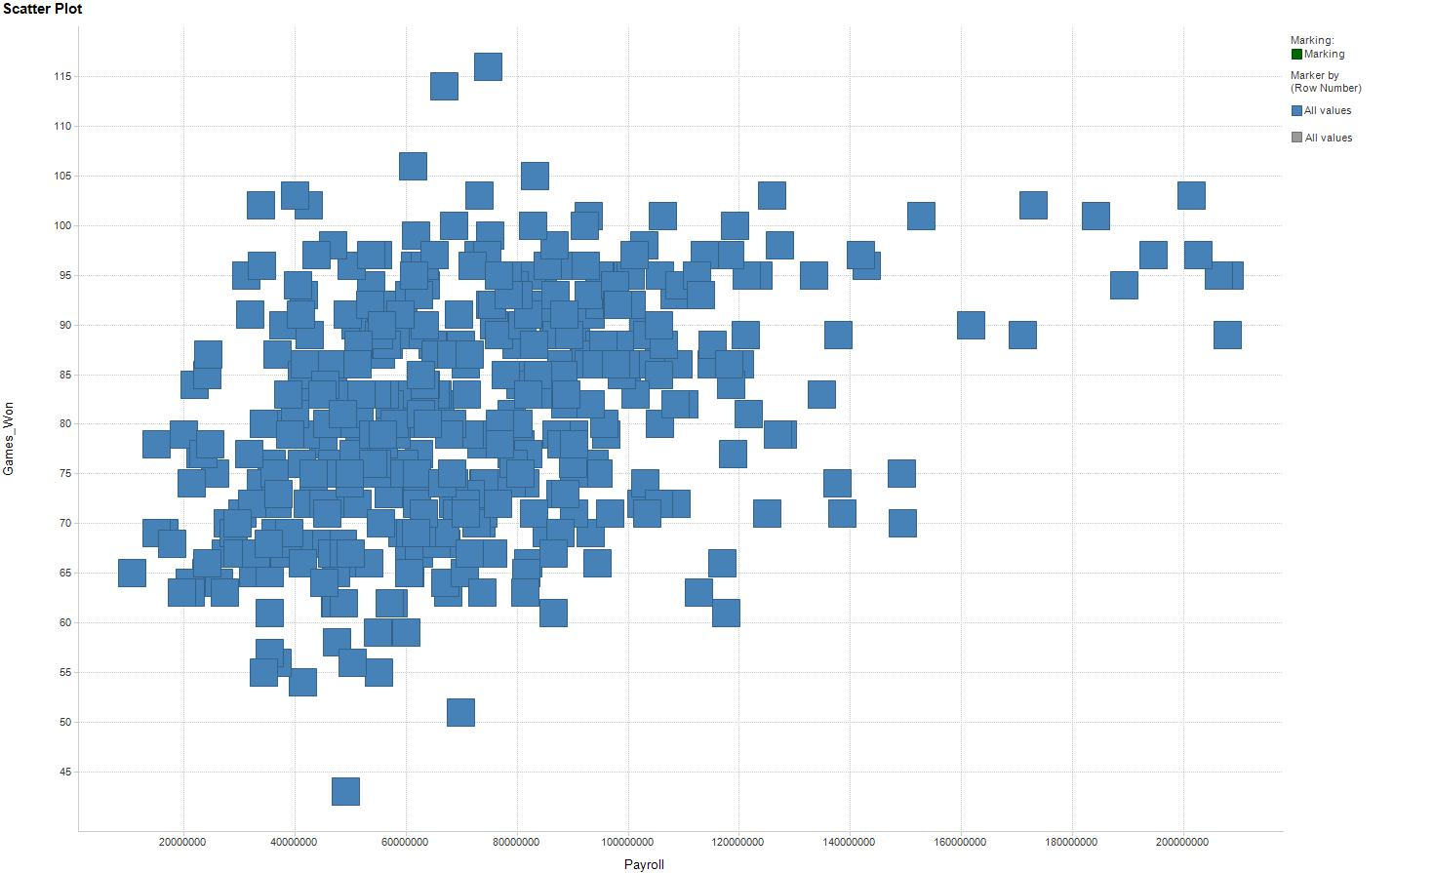
Payroll vs. Games Won*
*analysis & graphics completed with Excel & Spotfire

Slide 4
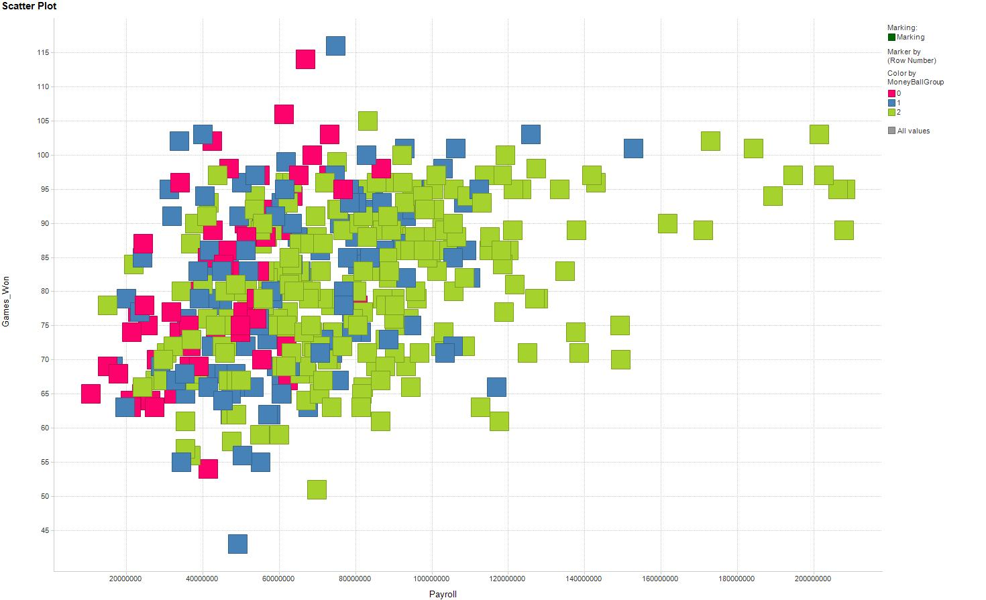
Overlay colors where Red = Pre-MoneyBall, Blue = MoneyBall, and Green is Post-MoneyBall

Slide 5
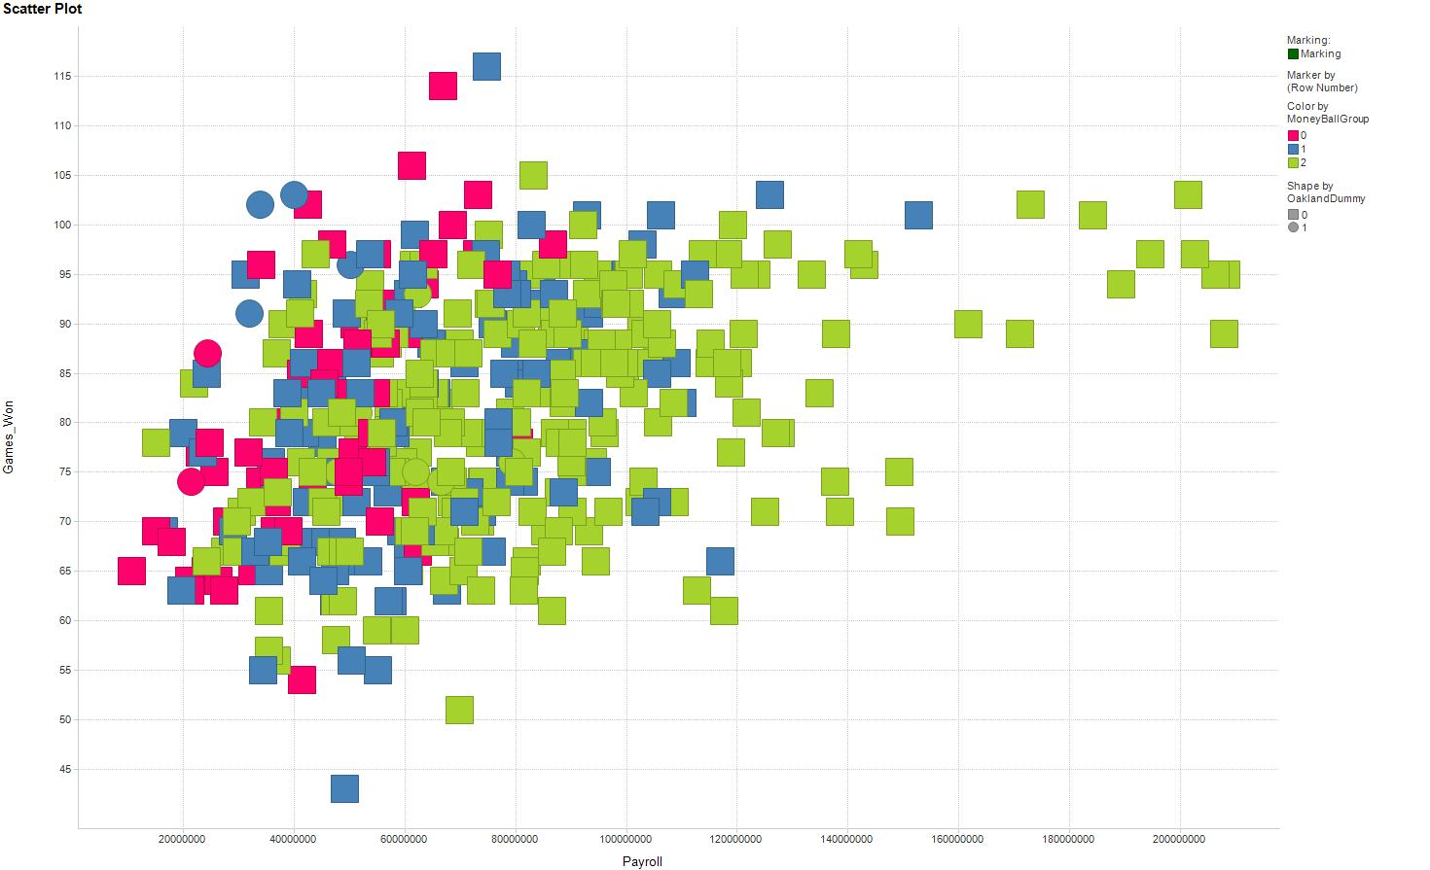
Add Circles for Oakland so BLUE Circles = Oakland & MoneyBall

Slide 6
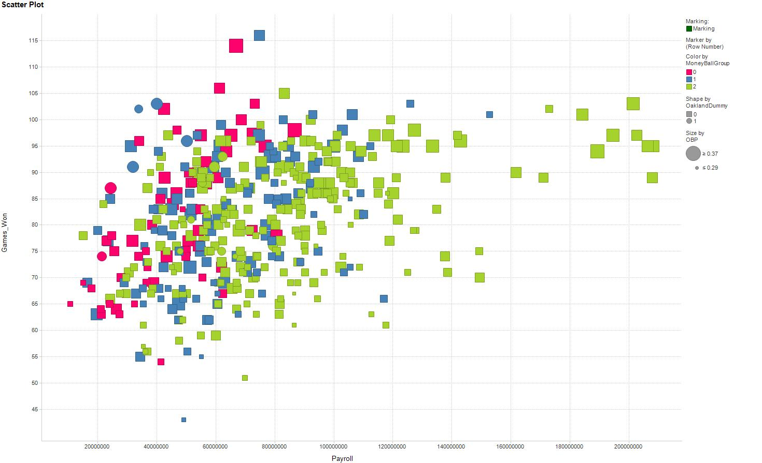
Add size to indicate the OBP for a team . . . Oakland looking good!
But did it help them get to the Post Season?

Slide 7
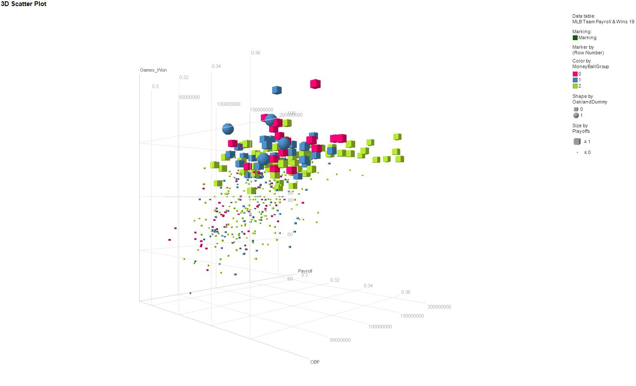
Now in 3D – Look at Oakland during the MoneyBall era getting into the playoffs…but does using only one metric (OBP) = success?

Slide 8
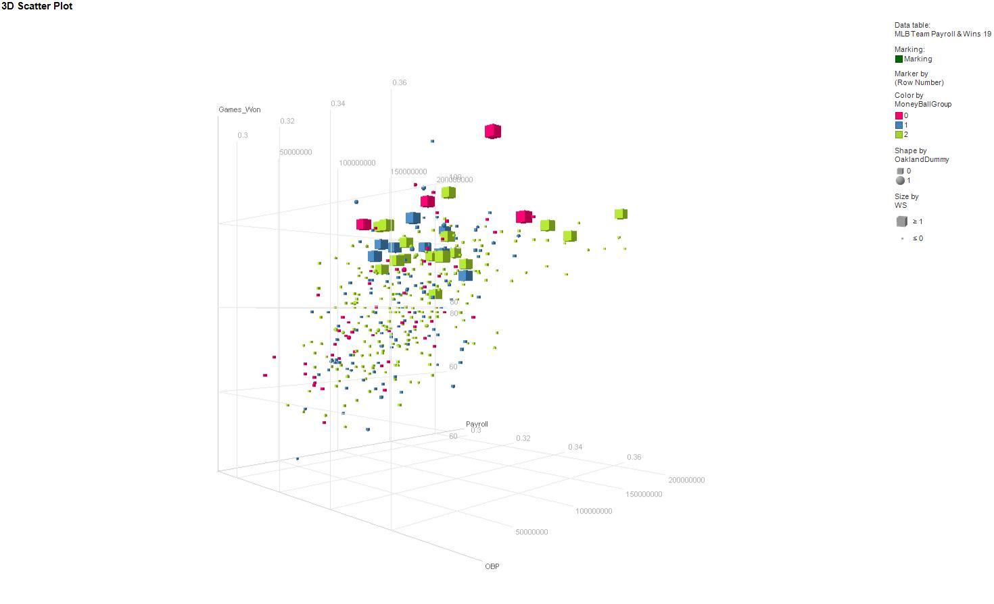
Sadly no, analytics can get you to the party but maximizing only one metric (offense) will not win you everything. In 2018 Oakland made the playoffs but lost in the 1st round.

Slide 9
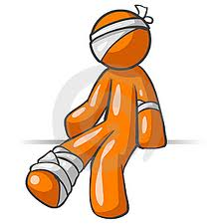
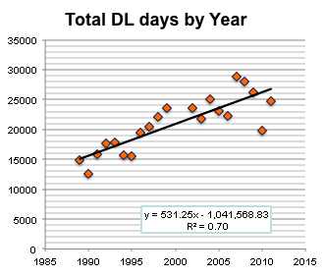
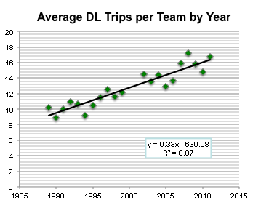
MLB & the LA Dodgers: The Injury Project
Increasing number of players injured per year
Increasing cost of injuries
Negative correlation to training

Slide 10
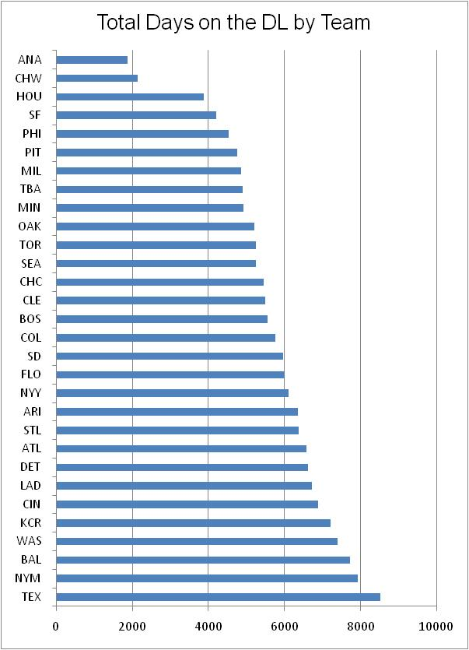
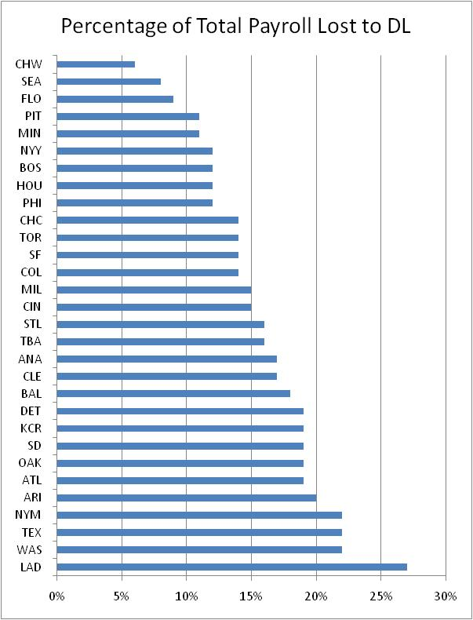
MLB & the LA Dodgers: The Injury Project

Slide 11
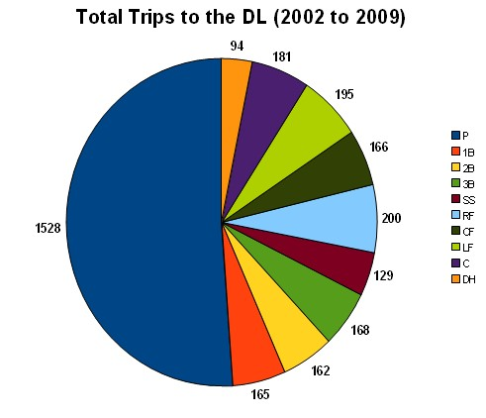
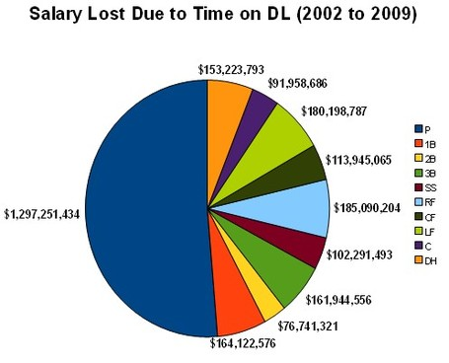
MLB & the LA Dodgers: The Injury Project
It’s all about the pitchers
Need more detailed information about injuries by position …

Slide 12
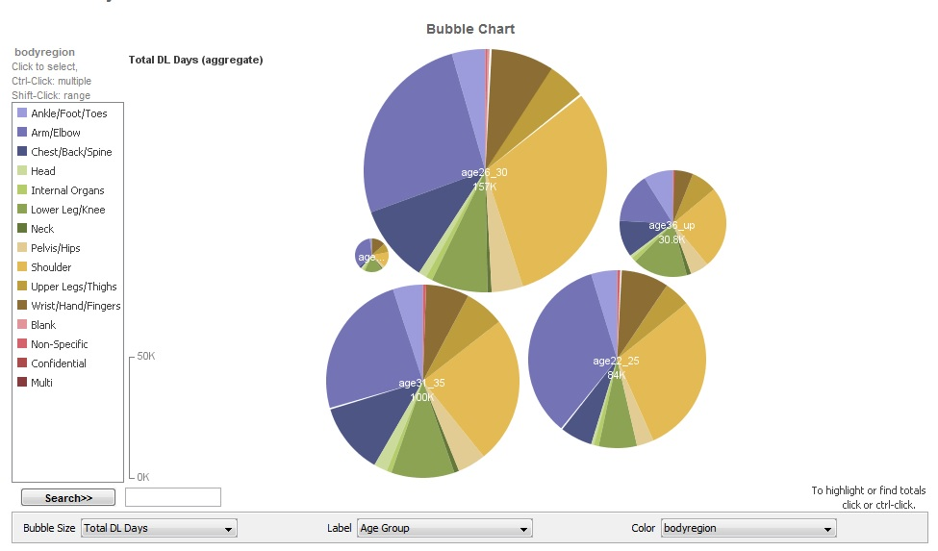
What about Age & Position:
http://www-958.ibm.com/software/analytics/labs/manyeyes/#home
http://www-958.ibm.com/software/analytics/labs/manyeyes/#vis=501453

Slide 13
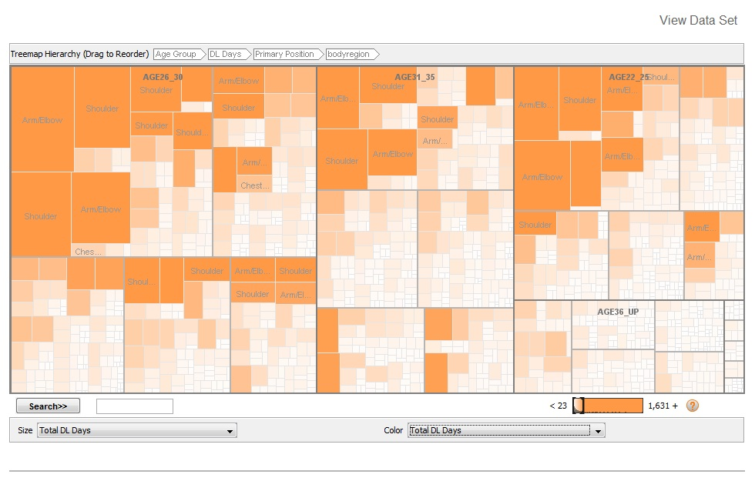
What about Age & Position:
http://www-958.ibm.com/software/analytics/labs/manyeyes/#home
http://www-958.ibm.com/software/analytics/labs/manyeyes/#vis=501453

Slide 14
How to Estimate the Impact of being on the DL
Examine the team performance pre & post the time that the player is on the DL (W/L ratio). Calculate the difference with the player on the field and on the DL*
Example:
  Damian Rolls, 2004 TB: Chest contusion
  DL May 24- July 2, 39 days
  TB’s record during DL time: 25-10 (0.714)
  TB’s season 2004 record: 70-91 (0.435)
  Rolls’ DL W/L difference is -0.2795
    Tampa Bay winning percentage was almost 30% higher without Rolls
*”Better Training, Better Analytics, & More Players on the DL,” Julia E. Seaman & I. Elaine Allen, Presented at the AmerStatAsso, Montreal, 2015

Slide 15
Pitchers
Chart showing the difference between the W/L% of the team’s season and while the player was on the DL against total DL days, for pitchers.
Rank | Player | Team | Year | Pos | Date on DL | Date off DL | Total Days | WL% Dif | Injury
1 | Joey Devine | OAK | 2011 | P | 27-Sep-2011 | 2-Nov-2011 | 1 | -0.5432 | rhomboid strain
2 | Felix Doubront | BOS | 2011 | P | 22-Mar-2011 | 8-Apr-2011 | 8 | 0.4127 | forearm inflammation
3 | Jon Lieber | PHI | 2007 | P | 25-Mar-2007 | 9-Apr-2007 | 15 | 0.4065 | Strained right oblique
4 | Hector Ambriz | CLE | 2010 | P | 23-Sep-2010 | 3-Oct-2010 | 10 | -0.3519 | Right elbow inflammation
5 | Armando Benitez | SF | 2006 | P | 14-Sep-2006 | 2-Oct-2006 | 18 | 0.3387 | Right knee inflammation
6 | Yorkis Perez | BAL | 2002 | P | 16-Sep-2002 | 30-Sep-2002 | 14 | 0.3367 | Appendectomy
7 | Dennis Sarfate | BAL | 2008 | P | 17-Sep-2008 | 30-Sep-2008 | 13 | 0.3315 | Fractured clavicle
8 | Joaquin Benoit | TEX | 2003 | P | 1-Jun-2003 | 22-Jun-2003 | 21 | 0.3272 | Tendinitis in right shoulder
9 | Brad Penny | LAD | 2005 | P | 5-Apr-2005 | 24-Apr-2005 | 19 | -0.3264 | Nerve irritation - right arm
10 | Terry Mulholland | ARZ | 2006 | P | 6-Jun-2006 | 21-Jun-2006 | 15 | 0.3263 | Inner ear infection
11 | Brad Lidge | PHI | 2009 | P | 7-Jun-2009 | 26-Jun-2009 | 19 | 0.3241 | Sprained right knee
12 | Matt Ginter | CLE | 2008 | P | 7-Aug-2008 | 25-Aug-2008 | 18 | -0.3235 | Strained right forearm
13 | Dan Miceli | HOU | 2004 | P | 22-Aug-2004 | 9-Sep-2004 | 18 | -0.3210 | Conjunctivitis
14 | Mike Remlinger | CHC | 2005 | P | 21-May-2005 | 5-Jun-2005 | 15 | -0.3123 | Fractured finger - left hand
15 | Daniel Cabrera | BAL | 2008 | P | 19-Sep-2008 | 30-Sep-2008 | 11 | 0.3112 | Sprained pitching elbow

Slide 16
Position Players
Chart showing the difference between the W/L% of the team’s season and while the player was on the DL against total DL days, colored by position
Rank | Player | Team | Year | Pos | Date on DL | Date off DL | Total Days | WL% Dif | Injury
1 | Denard Span | MIN | 2011 | OF | 10-Jun-2011 | 23-Jun-2011 | 13 | -0.4111 | head concussion
2 | Jeff Kent | SF | 2002 | 2B | 21-Mar-2002 | 6-Apr-2002 | 15 | -0.4099 | Fractured left wrist
3 | Yuniesky Betancourt | KC | 2009 | SS | 11-Jul-2009 | 16-Jul-2009 | 5 | 0.4012 | Strained right hamstring
4 | Jacque Jones | MIN | 2003 | OF | 1-Jul-2003 | 17-Jul-2003 | 16 | 0.3889 | Strained left groin
5 | Chris Coste | PHI | 2007 | C | 24-Mar-2007 | 8-Apr-2007 | 15 | 0.3827 | Strained hamstring
6 | Anderson Hernandez | WAS | 2009 | 2B | 5-Apr-2009 | 13-Apr-2009 | 8 | 0.3642 | Strained left hamstring
7 | Josh Willingham | FLA | 2006 | OF | 7-Jun-2006 | 22-Jun-2006 | 15 | -0.3519 | Strained ligament - left hand
8 | Jim Thome | MIN | 2011 | DH | 2-Jun-2011 | 24-Jun-2011 | 22 | -0.3480 | quadriceps strain
9 | Gary Matthews Jr. | BAL | 2002 | OF | 25-Aug-2002 | 11-Sep-2002 | 17 | 0.3469 | Right wrist tendinitis
10 | Juan Encarnacion | LAD | 2004 | OF | 4-Jul-2004 | 19-Jul-2004 | 15 | -0.3426 | Left shoulder tendinitis
11 | Dean Palmer | DET | 2002 | DH | 24-Mar-2002 | 7-Apr-2002 | 15 | 0.3416 | Shoulder stiffness
12 | Brandon Inge | DET | 2002 | C | 12-May-2002 | 27-May-2002 | 15 | -0.3251 | Dislocated left shoulder
13 | Kevin Youkilis | BOS | 2004 | 3B | 16-Aug-2004 | 1-Sep-2004 | 16 | -0.3236 | Bruised right ankle
14 | Geoff Blum | SD | 2005 | 3B | 30-Apr-2005 | 18-May-2005 | 18 | -0.3174 | Left chest contusion
15 | Clete Thomas | DET | 2008 | OF | 4-Jun-2008 | 19-Jun-2008 | 15 | -0.3124 | Sprained right ankle

Slide 17
Team Effects?
Rank | Pos | Trips | Ave Dif WL%
1 | C | 284 | 0.0110
2 | 3B | 242 | 0.0070
3 | 2B | 248 | 0.0037
4 | SS | 206 | 0.0031
5 | OF | 804 | 0.0029
6 | P | 2443 | 0.0021
7 | DH | 60 | -0.0023
8 | 1B | 198 | -0.0046
Team | Direction | R2
ARZ | - | 0.16568
ATL | - | 0.54194
BAL | + | 0.01572
BOS | - | 0.0226
CHC | + | 0.00052
CIN | - | 0.73704
CLE | - | 0.13732
COL | - | 0.00114
CWS | - | 0.20728
DET | - | 0.00667
FLA | + | 0.00113
HOU | - | 0.63405
KC | - | 0.18294
LAA | + | 0.05581
LAD | - | 0.25082
MIN | - | 0.16924
MLW | - | 0.06054
NYM | + | 0.0149
NYY | - | 0.18393
OAK | - | 0.64791
PIT | + | 0.04208
SD | - | 0.57971
SEA | - | 0.00057
SF | - | 0.20632
STL | - | 0.32249
TB | - | 0.08225
PHI | + | 0.24191
TEX | - | 0.01923
TOR | - | 0.08326
WAS | - | 0.04226
This is a summary table of linear regressions of total DL Days and season WL%, 2002-2011 for each team. A few teams show a larger direct correlation (always negative) but most teams are very loosely affected.
Overall, teams did slightly worse while players were on DL
  Mean DifWL%= 0.003 (not significantly different)
  Teams lost most without catchers and won most without 1st Basemen.
Infield players hurt a team more than outfielders

Slide 18
Motivating Example: UCSF Project Studying Pedestrians Hit by Cars in San Francisco
Adjusting the traffic-related injury by age, gender, occupation, # of dependents and ethnicity. Map the injuries and use DALYs for San Francisco for comparisons to global, regional, state, and city trends.
  Overall Mean Disability weight for an ankle sprain = 0.064 YLD or 14 days
  A 38 year old male with a life expectancy of 77 years who sprains his ankle has a DALY of 0.03 years or 11 days
  A 66 year old male with the same injury has a DALY or 0.06 years or 22 days
Question for SF: Where are traffic lights needed?
SHORT QUIZ on San Francisco auto/pedestrian accidents:
  When do most pedestrians get hit by cars?
  What neighborhood or area are they most likely to get hit?
  What is the most likely confounding variable in getting hit by a car?
  What gender and age group(s) are most likely hit by a car?

Slide 19
Creating Disability Adjusted Player Days (DAPD)
  Disability Adjusted Player Days (DAPD) adjusted for:
    Average time lost for an injury
    Previous injuries
    Position the player plays
    Age of the player
    Expected future playing years in the MLB
    Years in position in MLB
    Years in a contract
    Team you play for
    Others?

Slide 20
Example: Creating the DAPD for a Catcher with an Ankle Sprain
  DAPD $= −\left[\frac{DCe^{−βa}}{{\left(β+r\right)}^{2}}\right]\left[e^{−\left(β+r\right)(L)}\left(1+(β+r)(L+a)\right)−(1+\left(β+r\right)a)\right]$
L = Adjust for average time lost for an injury
  mean = 44 days, median = 40 days [15 to 140]*
C = age of the player = 33 years old in this example
r = Standard discounted lifespan of 3% per year
DW = Disability weight for an ankle sprain = 0.064
Calculate β for adjustment factors:
K₁ = Adjust for expected future years the player will play this catcher reached the MLB at age 25, & probably has at most 4 more active years
K₂ = Adjust for time already played in MLB = 8 years
K₃ = Adjust for Catcher DL days mean = 49 days, median = 29 days
*based on 14 years of DL data including MLB EMR data

Slide 21
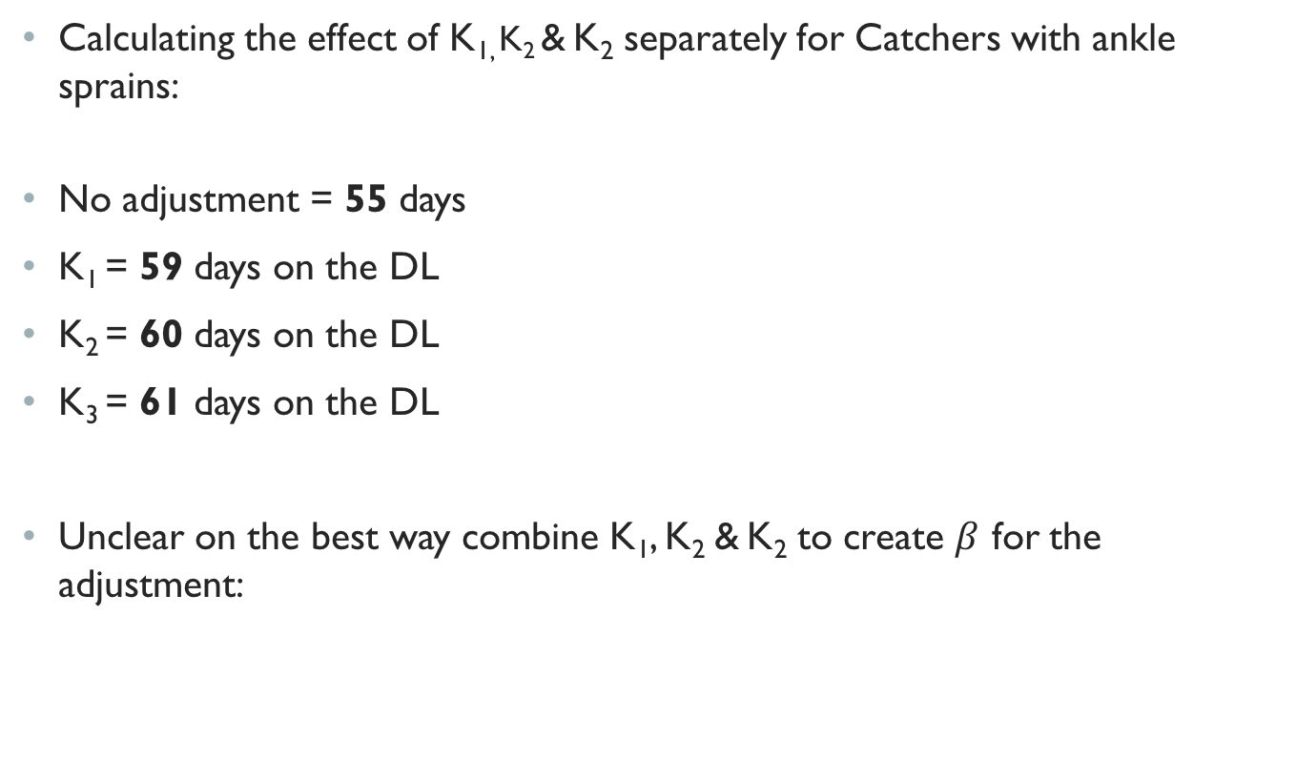
Example: Creating the DAPD for a Catcher with an Ankle Sprain
Calculating the effect of K_{1,} K₂ & K₂ separately for Catchers with ankle sprains:
No adjustment = 55 days
K₁ = 59 days on the DL
K₂ = 60 days on the DL
K₃ = 61 days on the DL
Unclear on the best way combine K₁, K₂ & K₂ to create $β$ for the adjustment:

Slide 22
Example: Sensitivity of Adjustments
Given you are a catcher, as age changes from 25 to 35, the DL days for an ankle sprain increase by .25 per year
Given you are 35 years old, as position changes, DL days change:
Given you are a Catcher, as time in the majors changes (as % of overall expected playing time):
AGE | 25 | 26 | 27 | 28 | 29 | 30 | 31 | 32 | 33 | 34 | 35
DL Days | 45.95 | 46.18 | 46.39 | 46.60 | 46.80 | 46.99 | 47.16 | 47.33 | 47.48 | 47.63 | 47.77
Position | 1B | 2B | 3B | C | DH | LHR | LHS | OF | RHR | RHS | SS
DL Days | 51 | 52 | 53 | 57 | 66 | 71 | 80 | 60 | 80 | 86 | 71
Fraction of expected MLB time | 90% | 85% | 80% | 75% | 70% | 65% | 60% | 55% | 50%
DL Days | 70.96 | 67.88 | 65.34 | 63.22 | 61.42 | 59.89 | 58.57 | 57.43 | 56.43
(DL years 1998 – 2012):
  Only one player was on the DL because of a bullet wound
  Only one player was on the DL because of insomnia
  Troy O’Leary, Russ Johnson, & Trip Cromer are the only 3 players to
  go on the DL for this.

