Slide 1
Methods of Test Development I:
Item Response Theory, Item Analysis, Scaling
Lydia B. Zablotska, MD, PhD
Professor, Department of Epidemiology and Biostatistics

Slide 2
Highlights from Week #8
Data collection methods (‘field methods’):
  Quality assurance and Quality controls in epi studies
  Procedures for developing study protocols
  Protocols for interview administration
  Operations Manuals: staff training and re-training, certification, quality control measures: assessment of study progress
  Ways to deal with problems in subject recruitment/retention
Sources and procedures for collection of measurement information
  Sources of public health data
  Research Toolboxes
  Standardized instruments (covered during week #6 – Standardized approaches to measurement)
  Principles of new instrument development

Slide 3
Quality control and Quality assurance in epi study design
Highlights from Week #8
 | Activity | QA /QC | Comments
1 | Formulation of study’s main hypothesis | QA | Including confounders and effect modifiers
2 | A priori specification of confounders | QA | Based on lit review, data analysis from pilot
3 | Definition of the characteristics of the study sample for generalizability | QA | To allow application to target population
4 | Definition of the study design and selection procedures for internal validity | QA | To prevent selection bias
5 | Definition of the design strategy for studies of reliability and validity | QA/ QC | Selectin of samples for validity and reliability studies
6 | Specification of the study power to detect hypothesized association at significance level | QA | Should take into account confounders and eff modifiers
7 | Standardization of procedures | QA | Written manuals for sample selection, data collection, staff training and certification
8 | Activities during data collection, incl analysis of QC data and remedial actions | QC | Data collection monitoring, validation studies during data collection
9 | Data analysis |  | According to the pre-established plan
10 | Reporting of data |  | As soon as possible to avoid publication bias. Study instruments, databases and QC data available upon request

Slide 4
Learning Objectives
Discuss and review various methods of test development:
  Principles of instrument development
    Standardized instruments
    → Discussed in Week #6
  Item analysis (based on the Classical Test Theory (CTT))
  Computer-assisted testing (CAT)
  Item response theory (IRT)
    Connection to the classical test theory (CTT)
    Advantages and limitations

Slide 5
Item analysis
The examination of any statistical property of examinees’ responses to an individual test item.
Used to assess the quality of these items and of the test as a whole
Three general categories for item analysis
  Indices that describe the distribution of responses to a singular item (mean, SD)
  Indices that describe the degree of relationship between response to the item and some other criterion (item difficulty)
  Indices that are a function of both item variance and relationship to a criterion (item discrimination)
Notes:
In test construction, a general goal is to arrive at a test of minimum length that will yield scores with the necessary degree of reliability and validity for the intended uses.
In constructing a new test (or shortening or otherwise revising an existing one), the final set of items is usually identified through a process known as item analysis.
Item analysis is broadly defined as the computation and examination of any statistical property of examinee’s responses to an individual test item.

Slide 6
CTT statistics for test development
  item difficulty (for dichotomously scored items equivalent to proportion of correct responses)
  item discrimination (corrected item-total correlation)
  reliability is the same regardless of patient ability
    contingent on the sample of respondents to whom the questions were administered → that’s why we always need to pre-test instruments!

Slide 7
Item difficulty
Item difficulty (p): the proportion of participants who answer an item correctly.
  P0 = 0.50 + 0.50/m
    m = number of choices

Slide 8
Item discrimination
Refers to the ability of an item to differentiate among students on the basis of how well they know the material being tested
  To identify items for which high scoring participants have a high probability of answering correctly and low-scoring participant have a low probability of answering correctly.

Slide 9
Index of Discrimination (D)
For dichotomously scored items.
Designating cut scores to identify upper and lower groups (50%, 33%, 27%)
  D= Pμ - Pl
Pμ - proportion in the upper group who answered the item correctly
Pl– proportion in the lower group who answered the item correctly.
Range from -1.00 to 1.00
Notes:
Positive D indicates that the item discriminates in favor of the upper group
Negative D indicates that the item is a reverse discriminator, favoring the lower-scoring group.
Limitation: sampling distribution of D is unknown.

Slide 10
Interpretation of D value
Ebel (1965) provided the following guidelines:
  D ≥ .40 Satisfactory
  0.30 ≥ D ≤ .39 Little or no revision
  0.20 ≥ D ≤ .29 Marginal and needs revision
  D ≤ .19 Eliminated or completely revised

Slide 11
Typical item analysis plan
Decide what properties of the test score are of greatest importance.
Identify the item parameters most relevant to those properties.
Administer the items to a sample representative of those for whom the test is intended.
Estimate for each item the parameters from #2 above.
Establish a plan for selection of items (or identification and revision of malfunctioning items).
Select the final subset of items.
Assess whether the desired results have been achieved by conducting a cross-validation study.

Slide 12
Sample size considerations
Most item parameters could be estimated with a sample of about ~200
Rule-of-thumb proposed by Nunnally in 1967: have 5-10 times as many subjects as items.

Slide 13
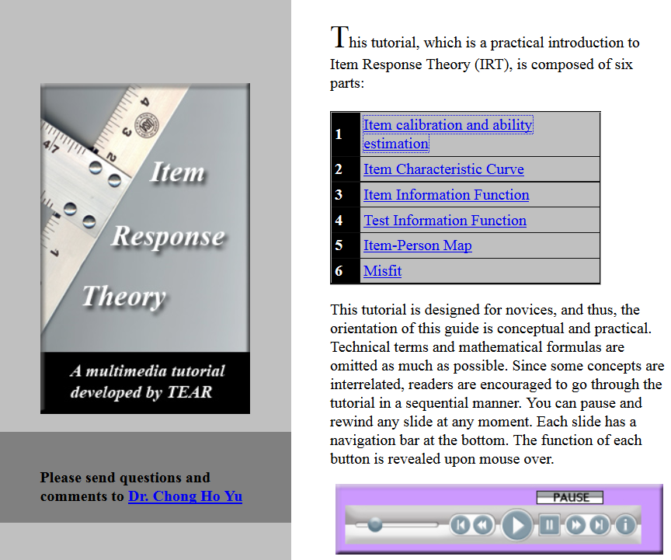
http://www.creative-wisdom.com/multimedia/IRTTHA.htm

Slide 14
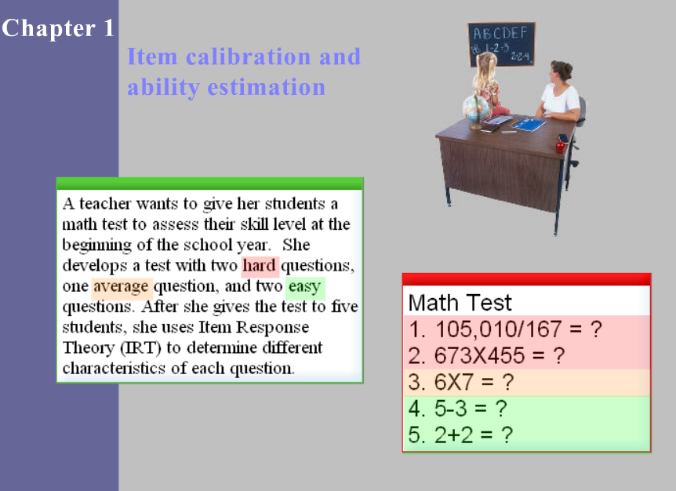
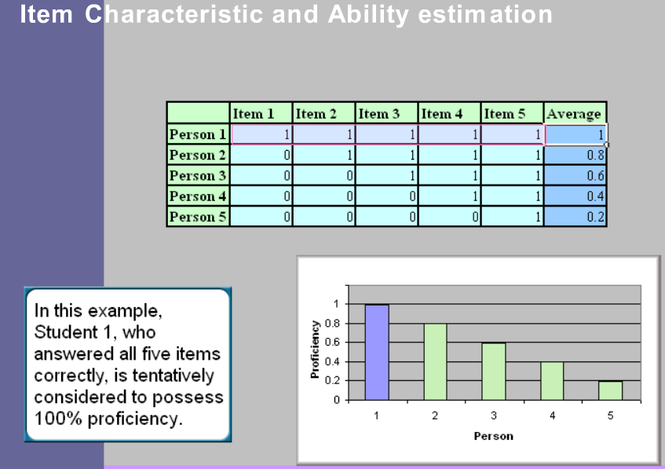
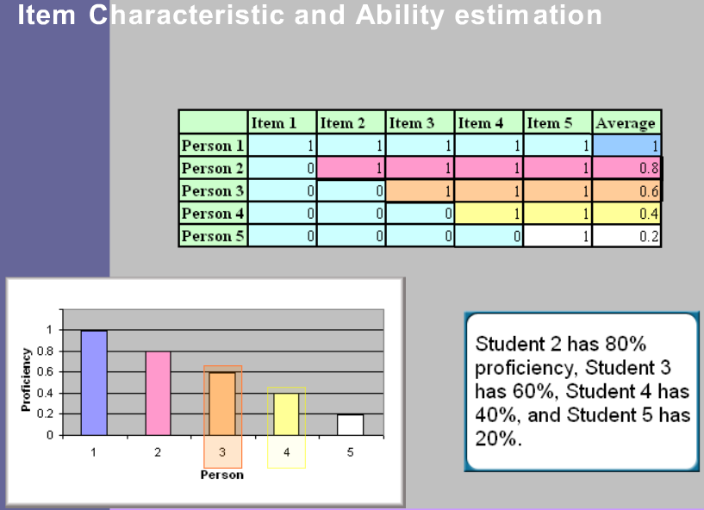
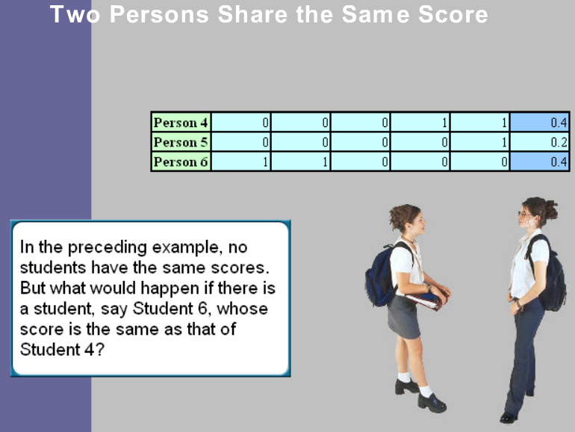

Slide 15
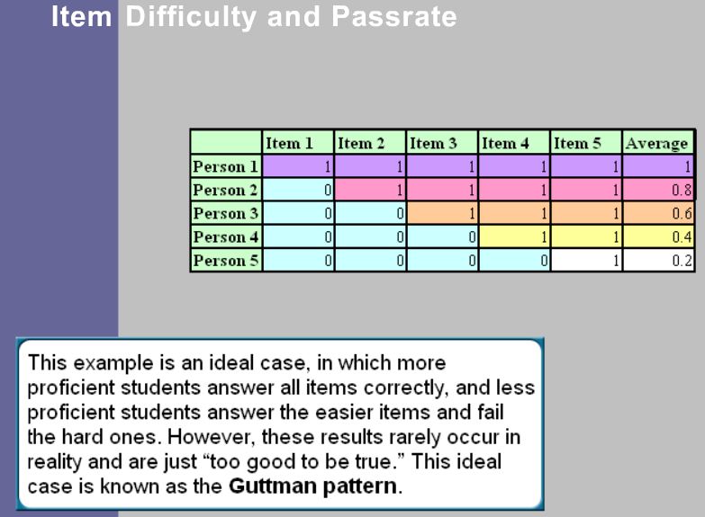
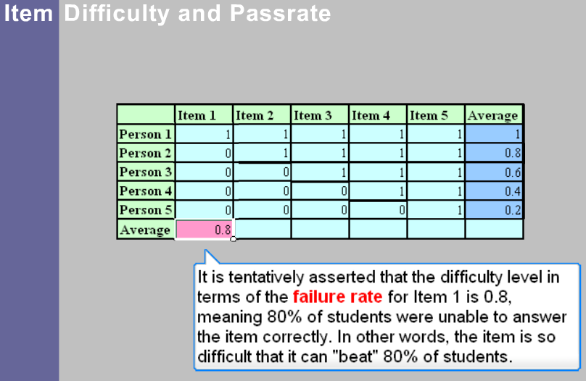
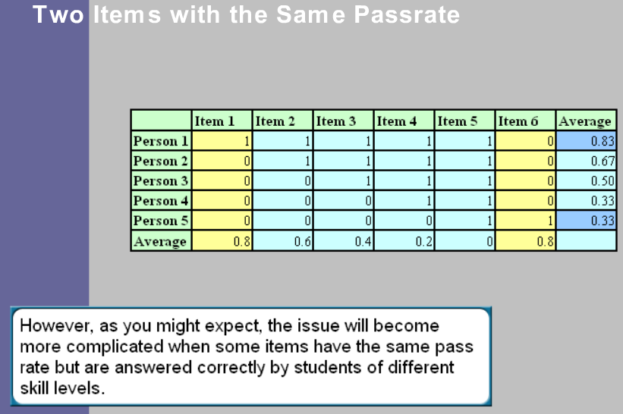
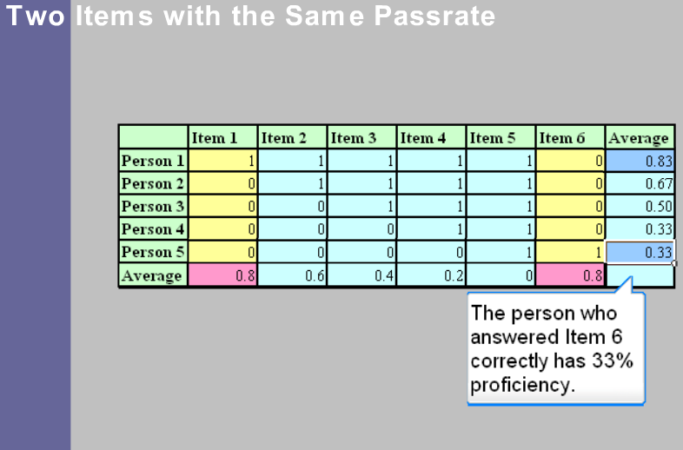

Slide 16
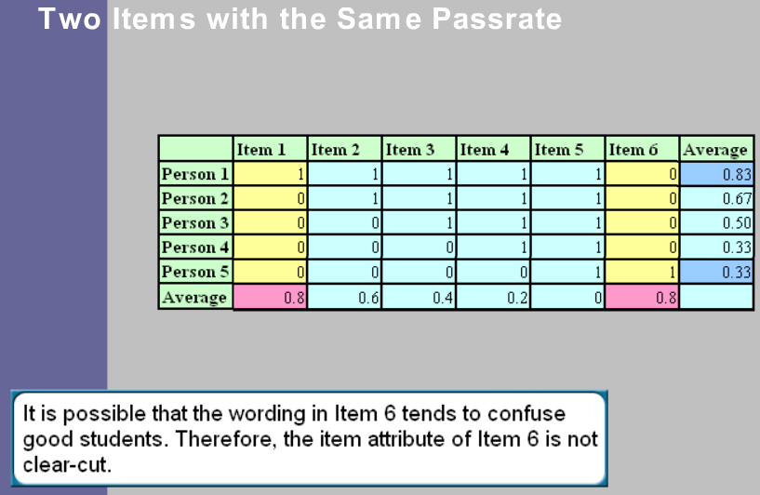
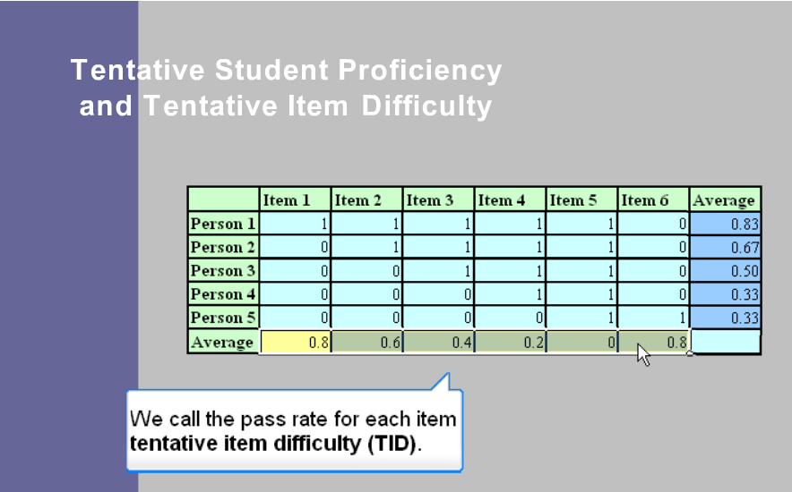
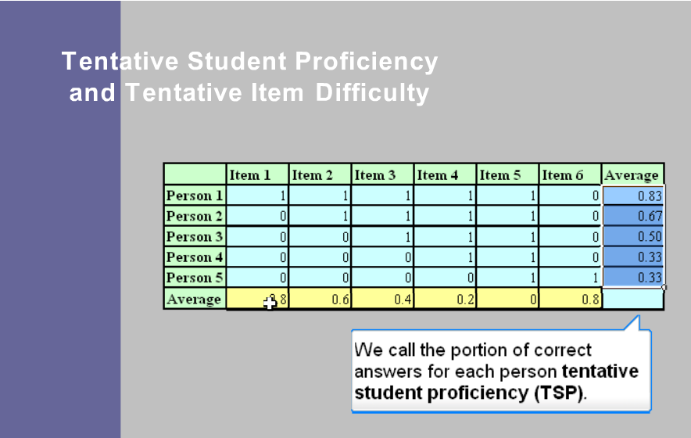
We need a theory which will integrate the data on item difficulty with student’s proficiency → Item Response Theory

Slide 17
item response theory

Slide 18
Item Response Theory (IRT)
IRT is the study of test AND item scores
  IRT is a model-based measurement in which trait level estimates (e.g., level of physical functioning or level of depression) depend on both persons’ responses AND on the properties of the questions that were administered
Assumptions are based on the mathematical relationship between abilities (or other hypothesized traits) and item responses
Other names and subsets include: Item Characteristic Curve Theory, Latent Trait Theory, Rasch Model, 2PL Model, 3PL model and the Birnbaum model
Notes:
IRT methods model how persons with given trait levels will respond to items that have specified characteristics. The “specified characteristics” may include item difficulty, item discrimination, and item “guessing.”
CTT does not provide information about how subjects at different ability levels on the trait have performed on the item.

Slide 19
IRT-based instruments
Because the expected participant's scale score is computed from their responses to each item (that is characterized by a set of properties), the IRT estimated score is sensitive to differences among individual response patterns and is a better estimate of the individual's true level on the trait continuum than CTT's summed scale score

Slide 20
Assumptions of Item Response Theory Models
the items are measuring a single continuous latent variable θ ranging from -∞ to +∞
the item responses are assumed to be independent of one another: the assumption of local independence (the only relationship among the items is explained by the conditional relationship with the latent variable θ)

Slide 21
IRT basics
IRT is a model for expressing the association between an individual's response to an item AND the underlying latent variable (often called "ability" or "trait") being measured by the instrument.
The underlying latent variable in health research may be any measurable construct such as physical functioning, risk for cancer, or depression. The latent variable, expressed as theta (θ), is a continuous unidimensional construct that explains the covariance among item responses (Steinberg & Thissen, 1995).
People at higher levels of θ have a higher probability of responding correctly or endorsing an item.

Slide 22
IRT basic premises:
An examinees test performance can be predicted or explained by a set of factors referred to as traits, latent traits, abilities, or proficiencies
The relationship between the examinee’s item performance and the set of abilities underlying item performance can be described by a monotonically increasing function, item characteristic curve (ICC)
The probability of a person correctly answering a test item:
  Person’s attributes: abilities, aptitude
  Item attributes: difficulty level

Slide 23
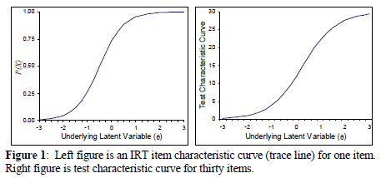
IRT basics
TCC (the test characteristic curve): the sum of the probabilities of the correct response of the item trace lines yields the test characteristic curve
ICC for one item
TCC based on 30 items
The higher a person’s trait level (moving from left to right along the θ scale), the greater the probability that the person will endorse the item.
  E.g., “Are you unhappy most of the day?”, then the left graph of Figure 1 shows that people with higher levels of depression (θ) will have higher probabilities for answering yes to the question.

Slide 24
IRT uses in test development
IRT provides direction for a method of test construction that takes into account item analysis and selection, and a measurement scale for reporting scores
For dichotomous item and response data:
  1 parameter model →assesses item difficulty
  2 parameter model →>assesses item difficulty and discrimination
  3 parameter model → assesses item difficulty, discrimination and guessing
For polytomous item and response data (e.g., never/sometimes/always):
  More complicated models
Notes:
Only option for small sample size
Conduct a logistic regression and choose a model that fits the data better than other models and with fewer parameters

Slide 25
IRT basics
The item difficulty, or threshold, parameter b is the point on the latent scale θ where a person has a 50% chance of responding positively to the scale item (question).
Items with high thresholds are less often endorsed (Steinberg & Thissen, 1995).
The slope, or discrimination, parameter a describes the strength of an item's discrimination between people with trait levels (θ) below and above the threshold b.
The a parameter may also be interpreted as describing how an item may be related to the trait measured by the scale and is directly related, under the assumption of a normal θ distribution, to the biserial item-test correlation ρ

Slide 26
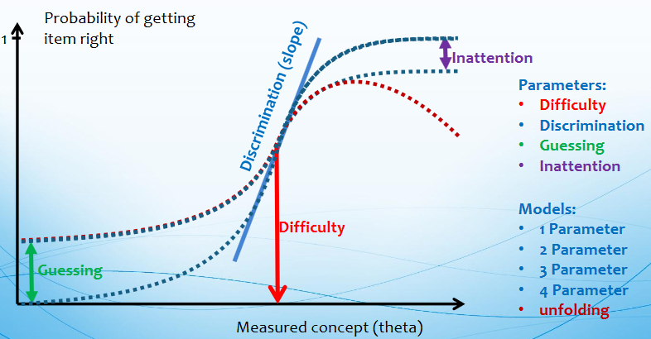
Item Response Function
Binary items

Slide 27
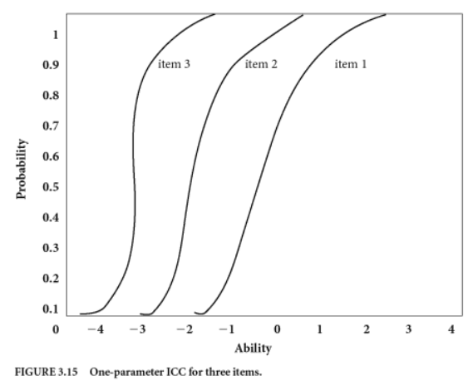
One parameter logistic model (1PL)
One parameter → item difficulty
assumes that all items have the same discrimination
3 items of varying difficulty
Difficulty: item #1 is the hardest
Notes:
Only option for small sample size

Slide 28
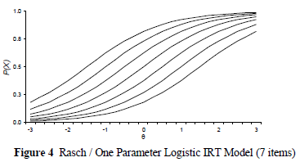
1PL model (The Rasch Simple Logistic Model)
This model shows the dependent variable, the probability of endorsing an item, as a function of the difference between two independent variables, the person’s level on the underlying trait θ and the item threshold b (difficulty).

Slide 29
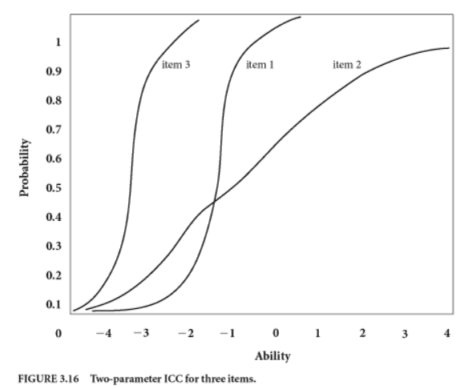
2PL model
Two parameters → item difficulty and discrimination
Item discrimination is defined by the slope of the ICC
It is proportional to the steepness (tilt) of an ICC in its central part. Determines the capability of the item to differentiate well between persons with trait or ability.
Difficulty: item #3 is the easiest, item #2 is the hardest
  Discrimination: items #1 and #3 are better able to discriminate among examinees compared to item #2
Notes:
We could see from the graph that item 3 is the easiest in the analyzed dataset. If we add a black horizontal line at prob=0.5, ICC for item 1 would be the first to cross it (even subjects with very low ability, correctly answer it in high proportions), indicating that it is the easiest item.
In the same fashion, item 2 seems to be the hardest item (even subjects with very high abilities answer it incorrectly sometimes).

Slide 30
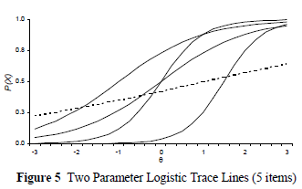
The two-parameter logistic model (2PL; Birnbaum, 1968)
allows the slope or discrimination parameter a to vary across items instead of being constrained to be equal as in the one-parameter logistic or Rasch model. The relative importance of the difference between a person’s trait level and item threshold is determined by the magnitude of the discriminating power of the item

Slide 31
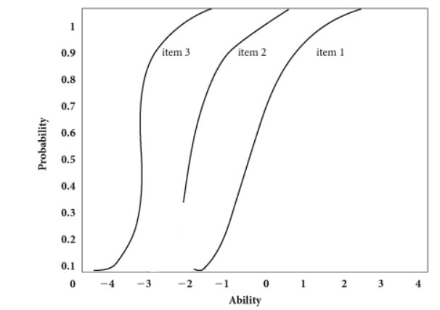
3PL model
Thee parameters → item difficulty, discrimination and proneness to guessing the item
Item discrimination is defined by the slope of the ICC
Guessing: item #2 is guessed correctly by examinees with low abilities
Notes:
‘guessing’ by some studied persons on one or more items. Such individuals may tend to possess low ability levels and elect to ‘guess’ the correct answers on them. To respond to this challenge, the 3PL model includes a third parameter for any item on which guessing is suspected.

Slide 32
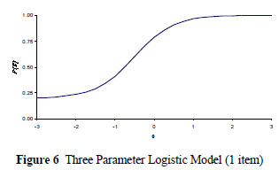
The three-parameter logistic model (3PL; Lord, 1980)
developed in educational testing to extend the application of item response theory to multiple choice items that may elicit guessing.

Slide 33
Sample size considerations
Sample sizes required for parameter estimation based on IRT are higher than for CTT
Vary from 200 to 1,000 subjects, depending on the particular model chosen
Larger if cross-validation substudies are being planned
  Cross-validation study:
    Choose items which have been selected based on IRT
    Administer to an independent sample
    Compare reliability and validity in the independent sample to the estimates from the original sample

Slide 34
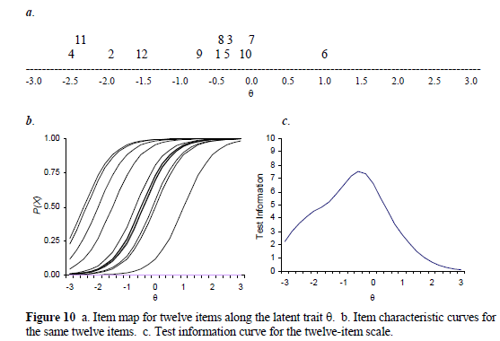
Example
Rasch or 1PL IRT model
a. presents an item map
for twelve items. Except for
item #6, the items are
located at the lower end of
the latent scale, meaning
that the items are measuring
low levels of the trait θ being
measured by the instrument.
Items # 1, 3, 5, and 8
measure people at similar
trait levels, suggesting that an instrument developer may wish to remove one or two of the items because they provide redundant information.
b. displays the item characteristic curves (trace lines) for the same set of twelve items. Items # 1, 3, 5, and 8 are bunched together around theta θ levels of –0.47.
c. displays the precision of measurement of respondents at different levels of the underlying latent construct θ.
Conclusion: The instrument lacks information for measuring
respondents with high levels of the trait θ.
Notes:
Information is a function of the discrimination parameter of the item, as well as the conditional variance and pseudoguessing parameter (if used).

Slide 35
IRT vs. CTT
Under the CTT, an attribute is assessed on the basis of responses of a sample of subjects or examinees to the set of items on a measure → focus on test performance
Under the IRT, a set of attributes are assessed to understand how well an examinee or a group of examinees might perform when presented with a given item from the measure → focus on item performance and on the examinee’s ability
Notes:
For IRT, each individual item can be used for comparison purposes
Person endorses better rating on “hard items”-The person is higher on the trait
Person endorses worse rating on “easy items” -The person is lower on the trait
Items that measure the same construct can be aggregated into longer assessment

Slide 36
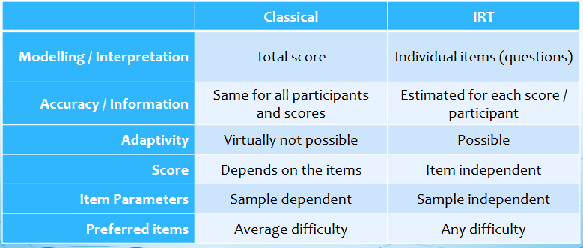
IRT vs. CTT
Notes:
IRT item parameters are not dependent on the sample used to generate the parameters, and are assumed to be invariant across divergent groups within a research population and across populations.

Slide 37
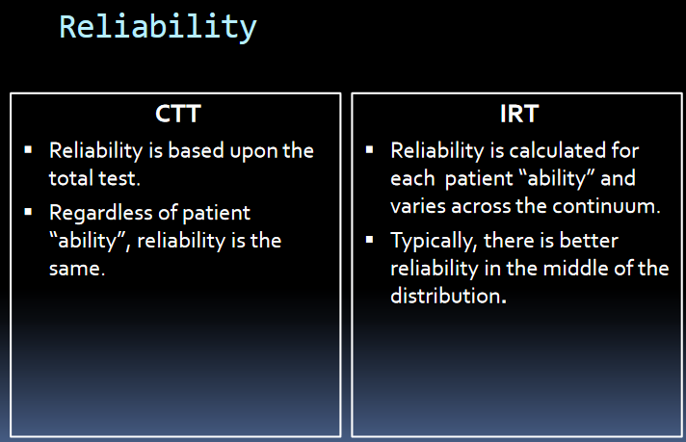
Notes:
CTT requires that participants respond to every item of a measure. If a person skips an item or chooses not to answer an item, the missing response must be imputed. Persons' trait levels are estimated by manipulating item scores mathematically. In most cases, the mathematics is the simple summing of item scores.
With an IRT model, imputation of missing responses is unnecessary.

Slide 38
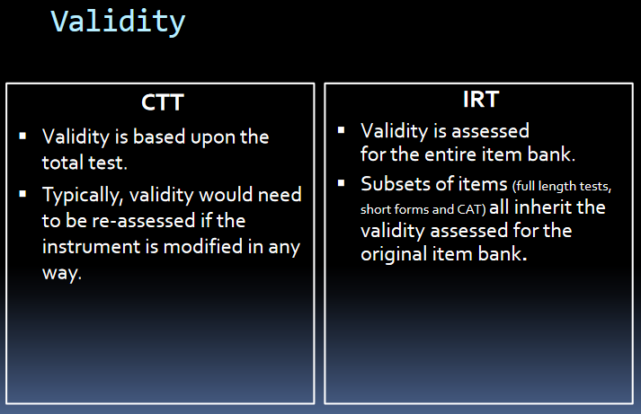

Slide 39
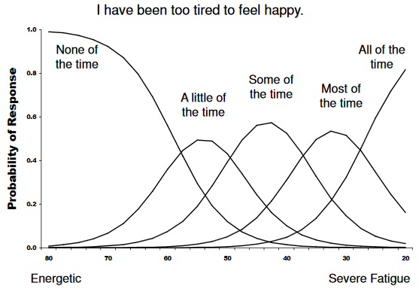
Examples of IRT Polytomous Responses

Slide 40
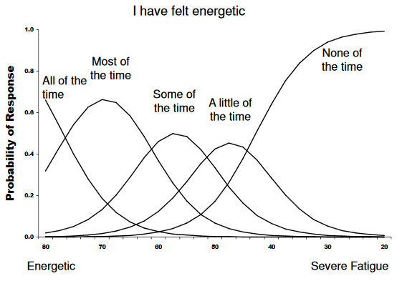
Examples of IRT Polytomous Responses

Slide 41
Summary: CTT vs. GE. vs. IRT
CTT is used for assessment of random measurement error
GE is an extension of the CTT and takes into account multiple sources of error. G-coefficient indicates how accurately one can generalize the results of measurement to a specified universe
IRT is an approach to constructing cognitive and psychological measures, which focuses on item performance and examinee’s ability, unlike CTT, which focuses on test performance
A wonderful feature of IRT models are the graphical descriptions of item functioning and test functioning

Slide 42
Advantages of IRT
Test-takers and items are represented on the same scale
Item calibrations are independent of the test-takers used for calibration
Candidate ability estimates are independent of the particular set of items used for estimation
Measurement precision is estimated for each item and test taker
Good for tests where a core of items is administered, but different groups get different subsets (i.e., cross-cultural testing, computer adapted testing)
Notes:
for example, can develop a criterion-referenced test that has most precision around the cut-off score, and good for tests where a core of items is administered, but different groups get different subsets (i.e., cross-cultural testing, computer adapted testing). Some disadvantages of IRT are strict assumptions, large sample size (minimum 200; 1000 for complex models), more difficult to use than CTT: computer programs not readily available and models are complex and difficult to understand.

Slide 43
Limitations of IRT
Many generic concepts are not unidimensional
Items must be scorable in real time if a new item is to be selected instantaneously.
Time and complexity required in test development
Large sample size required for modeling of the test (typically hundreds of examinees)
Large item pool is required
Expensive

Slide 44
Computerized adaptive testing (CAT)
A form of computer-based test that adapts to the examinee's ability level. Also called tailored testing.
A form of computer-administered test in which the next item or set of items selected to be administered depends on the correctness of the test taker's responses to the most recent items administered.
As a result of adaptive administration, different examinees receive quite different tests.
The psychometric technology that allows equitable scores to be computed across different sets of items is item response theory (IRT).
IRT is also the preferred methodology for selecting optimal items which are typically selected on the basis of information rather than difficulty.

Slide 45
CAT principles
Calibrated item pool – requires IRT
Starting point or entry level
Item selection algorithm – requires IRT
Scoring procedure
Termination criterion

Slide 46
Advantages of CAT
Reduce burden of responding
Make room for measuring more domains
Notes:
A measure that is computer administered only is not computer adaptive. In the former, the patient responds by computer to an exact equivalent of the measure's paper-and-pencil counterpart. Only the delivery mode changes. Persons respond to each item, and their scores are computed exactly as they would have been in the paper-and-pencil version. A measure is adaptive only when the selection of items is adapted to prior estimates of the respondent's level of the construct being measured.

Slide 47

Created by NIH in 2004
Develops computer-adapted testing (CATs) for various concepts across various chronic illnesses
System for gathering and analyzing data
The Domain framework has 3 sections: Physical Health, Mental Health and Social Health

Slide 48

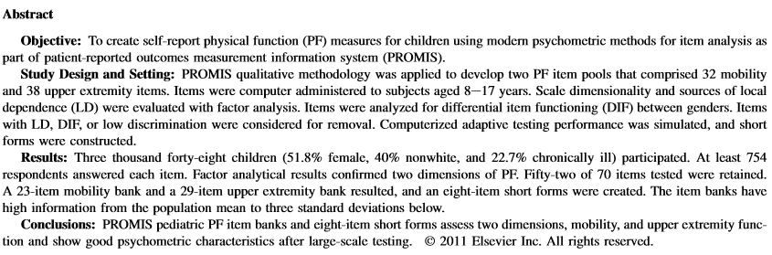
Example of using IRT for developing a CAT:

