Slide 1
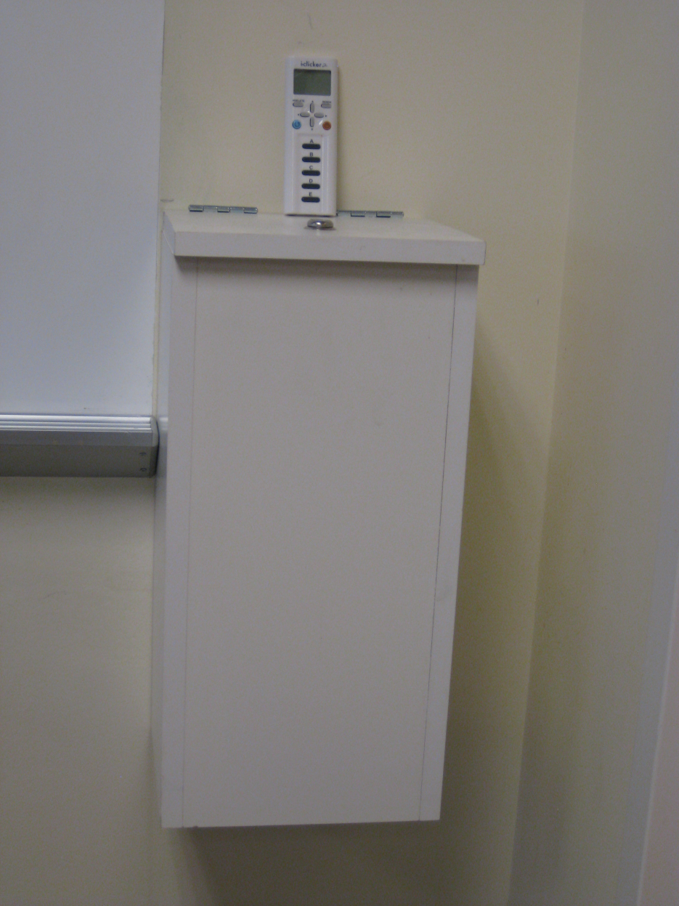
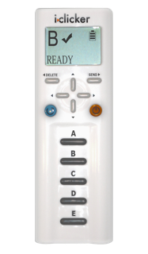
Please take an i>clicker from the box in front of the room

Slide 2
Classification Schemes for Error
Szklo and Nieto
  Bias (Systematic error)
    Selection Bias
    Information/Measurement Bias
  Confounding
  Chance (Random error)
Other Common Approach
  Bias (Systematic error)
    Selection Bias
    Information/Measurement Bias
    Confounding Bias
  Chance (Random error)
Think of the “BIG 4” in all of your work
Notes:
Let’s remind ourselves where we are in the discussion of threats to validity in clinical research. Remember, we emphasized the Big 4: Selection Bias, Measurement Bias, and Confounding Bias, as the three forms of bias and then, the fourth, chance. We have talked about selection bias two weeks ago. Last week, we introduced how we characterize measurements, in terms of reproducibility and validity. Today, we are moving on to explore more about how imperfect measurements can result in measurement bias.

Slide 3
Bias in Clinical Research:
Measurement Bias
Refined description of measurement error types (nomenclature)
Bias from misclassification of dichotomous variables
  In descriptive studies
  In analytic studies
    Misclassification of dichotomous exposure & outcome variables
      non-differential and differential misclassification
      independent and dependent misclassification
      magnitude and direction of bias
Bias from mis-measurement of interval scale variables
Advanced topics (brief mention only)
  Misclassification of multi-level categorical variables
  Misclassification of confounding variables
  Back-calculating to the truth (“quantitative bias analysis”)
Notes:
Here is our roadmap for today. We will first give a refined description of measurement error types extending upon what we discussed last week. This will be additional important nomenclature. We will then discuss the bias that ensues from misclassification of dichotomous variables (the simplest kinds of variables). We will first discuss it in the context of descriptive studies and then, where we will spend the bulk of the session, in analytic studies. We will discuss what happens with non-differential misclassification of dichotomous exposures and outcomes and then what happens with differential misclassification of exposure and outcome. We will also introduce the concept of independent and dependent error. In particular, we will focus on the magnitude and directions of these biases. We will then spend a little bit of time on the bias that occurs with mis-measurement of interval scale variables. Finally, we will briefly mention, but not describe in detail, some advanced topics such as misclassification of multi-level categorical variables and misclassification of confounding variables. We will also mention how what we know about the imperfections in our measurements can be used to back calculate to the expected truth, a topic called quantitative bias analysis.

Slide 4
Measurement Bias
Definition
  bias that is caused when any measurement collected about or from subjects is not completely reproducible or valid (accurate)
    any type of variable: exposure, outcome, confounder, or other
Synonyms
  aka: misclassification bias; information bias (S&N text); identification bias
    misclassification is what happens when there is error in measurement of a categorical variable, for which everyone is “classified”
Notes:
How do we define measurement bias? It is the bias, in other words deviation from the truth, that it is caused when any measurement collected about or from subjects is not completely reproducible or valid (i.e., not completely accurate). We are referring to any kind of variable, be it an exposure variable, an outcome variable, an effect modifier, a mediator, or a confounder variable. Problems in any of these variables can lead to measurement bias.
What are the other terms you might find for measurement bias? Measurement bias is also known as misclassification bias, information bias (the text uses that term) or identification bias. Misclassification bias is a good term, and I will often use measurement bias and misclassification bias synonymously, although I prefer the more general term measurement bias. Where does the term misclassification come from? Misclassification is what happens when there is an error in the measurement of a categorical variable. When people are characterized with a categorical variable, they are said to be classified.

Slide 5
Measurement Bias is the Result of Measurement Error:
A Refined Description of Measurement Error
Random error
  Presence and direction of error is unrelated to:
    true value of the entity under study,
    true values of other variables, or
    whether other variables are measured in error
Systematic error
  Presence and direction of error is predictable, often related to actual true values and may be related to two other processes
Is error related to: | Terminology
1. True values of other variables in the analysis? | If no: “non-differential” or If yes: “differential”
2. Whether other variables in the analysis are measured in error? | If no: “independent” or If yes: “non-independent (dependent)”
Notes:
Measurement bias is therefore the result of measurement error.
Let’s spend a moment giving a more refined description of measurement error compared to last week. Last week, we broke down measurement error into either random error or systematic error. Although we did not use this description per se, it should be evident that random error means that the presence and direction of error is unrelated to the actual true value of what you are trying to measure, true values of other variables in the same subject, or whether the other variables in the analysis are measured in error. In contrast, with systematic error, the presence and direction of error is predictable, often related to the actual true values, and importantly may be related to two other processes. The first process is whether error is related to true values of other variables in the analysis. If no, we call the error non-differential, but, if yes, we call the error differential. The second process is whether error in the variable is related to whether other variables in the same subject are measured in error. If no, we call this independent. If yes, we call this non-independent or dependent error. We will be giving examples of this throughout.

Slide 6
Causes of Measurement Error
Questionnaire problems
  inaccurate recall
  socially desirable responses
  ambiguous questions
  under or overzealous interviewers
Biological specimen collection
  problems in specimen collection or processing or storage
Biological specimen testing
  inherent limits of detection
  faulty instruments
Data management problems in coding
Study design or analytic problems (See Problem Set)
  incorrect time period assessed, particularly for exposure
  lumping of outcome variables (composite variables)
Notes:
Today is mainly about the consequences of measurement error, but we should remind ourselves of the causes.
We won’t have the time to go over in a lot of detail all of the possible reasons for misclassification in measurement because the list is long. For things that are measured by questionnaire, problems include inaccurate recall by participants, ambiguously worded questions, and problems caused by under or overzealous interviewers. For entities measured in biological specimens, problems start with specimen collection or processing or storage and extend into issues with inherent limits of detection of our instruments as well as faulty instruments.
Completing the list, we have potential problems in data management, and issues that occur in study design or analysis that you will get to deal with in the Problem Set for this week, that being what happens when the incorrect time period is assessed for a particular measurement (i.e., the measurement per se is correct but the wrong time period was assessed) or when there is lumping together of variables to form a composite variable.

Slide 7
Bias in Clinical Research:
Measurement Bias
Refined description of measurement error types (nomenclature)
Bias from misclassification of dichotomous variables
  In descriptive studies
  In analytic studies
    Misclassification of dichotomous exposure & outcome variables
      non-differential and differential misclassification
      independent and dependent misclassification
      magnitude and direction of bias
Bias from mis-measurement of interval scale variables
Advanced topics (brief mention only)
  Misclassification of multi-level categorical variables
  Misclassification of confounding variables
  Back-calculating to the truth (“quantitative bias analysis”)
Notes:
We’ll first talk about what happens – in other words, what is the bias that results in our inferences – with misclassification of dichotomous variables, the simplest kinds of variables.

Slide 8
Characterizing the Measurement of a Dichotomous Variable (e.g., present vs absent)
What does d/(b+d) refer to?
Sensitivity - A
Specificity - B
Positive predictive value - C
Negative predictive value - D
None of the above - E
Notes:
8
To discuss the bias that ensues from a misclassified dichotomous variable, we first need to characterize the measurement of a dichotomous variable.
Here is a warm-up question.

Slide 9
Characterizing the Measurement of a Dichotomous Variable (Present vs Absent)
What does d/(b+d) refer to?
Specificity - B
Sensitivity - A
Positive predictive value - C
Negative predictive value - D
None of the above - E
Notes:
9
The answer is specificity.

Slide 10
Terms Used to Characterize Classification of
Dichotomous Variables (Terms for Validity)
Positive predictive value = a/(a+b)
Negative predictive value = d/(c+d)
Sensitivity
  the ability of a measurement to identify correctly those who HAVE the characteristic (disease or exposure) of interest.
Specificity
  the ability of a measurement to identify correctly those who do NOT have the characteristic of interest
Applies to any dichotomous variable, not just diagnoses
Notes:
How do we characterize misclassification? What terms do we use?
This is review for most people.
For dichotomous variables, we describe the validity of measurement in terms of two parameters - sensitivity and specificity. We did not explicitly discuss this last week when we discussed describing the reproducibility and validity of a measurement, but you know these terms inside and out by your work in our Clinical Epidemiology course. Sensitivity is the ability of a measurement to identify correctly those who have the characteristic (disease or exposure) of interest. Specificity is the ability of a measurement to correctly identify those persons who do not have the characteristic of interest.
In the Clinical Epidemiology course and most of your previous work, you likely learned these words in terms of diagnostic tests (i.e., looking for diseases), but, in fact, the terms can be used for assessing the accuracy of the measurement of any kind of dichotomous variable, be it predictor, outcome, or confounding variable.

Slide 11
Descriptive Study: Measurement Bias from Measurement Error in Dichotomous Variable
1982 California Governor Election
Bradley +7%
SOURCE POPULATION = CALIFORNIA
Deukmejian
STUDY SAMPLE = PRE-ELECTION POLL
(Field Poll)
Notes:
Let’s start with measurement bias in a descriptive study, and like we did for selection bias, a famous example comes from the world of politics. In the 1982 California Governor election, Tom Bradley, an African-American, led George Deukmejian, a white candidate, in most pre-election polls. In the Field poll (one of the largest surveys), just before the election, he led by 7 percentage points.

Slide 12
Descriptive Study: Measurement Bias
1982 California Governor Election
Bradley 48%
“Bradley Effect” = Respondents who favored Deukmejian sought to avoid appearing racist and hence did not state true choice in pre-election survey
Deukmejian 49%
Bradley +7%
SOURCE POPULATION = CALIFORNIA
Deukmejian
STUDY SAMPLE = PRE-ELECTION POLL
(Field Poll, one of the largest pre-election surveys)
Notes:
Again, the reason we like these pre-election polls is that they are one of the few instances where we can later see the answer in the source population. Much to the surprise of the polls, when the votes were counted, Deukmejian won. What the pundits believe happened is known as the “Bradley effect”, where respondents who truly favored Deukmejian sought to avoid appearing racist when questioned and hence did not state their true choice. Hence, in the poll (the pre-election survey) their true choice was misclassified as the arrow shows giving the spurious appearance that Bradley was going to win.
A more recent example of a potential Bradley Effect was seen in Prop. 19, the vote to legalize marijuana in California. Many polls taken before the election found that the majority of likely voters would vote yes. However, the final vote favored no and it is reasoned that when approached by pollsters many persons wanted to be appear liberal, but then when they voted they voted “no”.

Slide 13
Contrast with Selection Bias
Unequal weighting of arrows
SOURCE POPULATION
e.g., Dewey backers were over-represented
STUDY SAMPLE
Notes:
Note that this is different than the selection bias that occurred with Dewey-Truman pre-election surveys, where there it was felt that the pre-election surveys simply were not representative of the source population. In the Bradley effect, there is not thought to be anything non-representative about the people in the polls. Instead, the problem is that they did not answer the question truthfully.

Slide 14
Descriptive Biomedical Studies: Measurement Bias
e.g., Prevalence of:
  Flossing
  Condom use
  Exercise
  etc.
Caused by a common mechanism of measurement error
  “Social desirability bias”
  Humans tend to give socially desirable responses
Notes:
What are some examples of measurement bias in descriptive biomedical studies? There are a lot of them. For example, any time you depend upon self-report from humans, there is a chance of measurement bias. This includes things like prevalence of flossing, condom use, exercise, etc. Humans will tend to give socially desirable responses and hence sometimes will give biased responses. Although I don’t like naming all of these individual biases, this one is sometimes known as social desirability bias.
This is all we will say about measurement bias in descriptive studies. The direction of the bias is clear depending upon the circumstance.

Slide 15
Bias in Clinical Research:
Measurement Bias
Refined description of measurement error types (nomenclature)
Bias from misclassification of dichotomous variables
  In descriptive studies
  In analytic studies
    Misclassification of dichotomous exposure & outcome variables
      non-differential and differential misclassification
      independent and dependent misclassification
      magnitude and direction of bias
Bias from mis-measurement of interval scale variables
Advanced topics (brief mention only)
  Misclassification of multi-level categorical variables
  Misclassification of confounding variables
  Back-calculating to the truth (“quantitative bias analysis”)
Notes:
Let’s move on to bias from misclassification of dichotomous variables in analytic studies.

Slide 16
Non-Differential Misclassification of Exposure:
Imperfect Sensitivity
Diseased
+ -
Problems with sensitivity in measurement of exposure – unrelated to disease status
+
-
Exposed
SOURCE POPULATION
Evenly weighted arrows = non-differential
e.g., case-control study
exposure = alcohol abuse (self-report)
STUDY SAMPLE
Notes:
Remember our familiar schema where we have the source population here and our study sample here. We use our study sample to make inferences about the source population. We’ll talk about the simplest example of a dichotomous exposure and dichotomous outcome, and we depict this with a 2 x 2 table. As we talk about misclassification of dichotomous variables, let’s first discuss misclassification of exposure. Consider as an example of a case-control study of some disease and the exposure under study is alcohol abuse. Let’s consider that among all true alcohol abusers our measurement, which is self-report, is only able to identify some fraction. In other words, we aren’t able to get some alcohol abusers to admit that they are abusers. Hence, our measurement of alcohol use is insensitive. We depict this by showing an arrow going from the exposure cell to the unexposed cell. This is lack of complete sensitivity; in other words, we are misclassifying some alcohol users as non-users. This is called misclassification of exposure. Because the misclassification of exposure is occurring equally among the cases and controls, we call this non-differential with respect to disease. Overall, this is called non-differential misclassification of exposure.
Again, some truly exposed persons are misclassified as unexposed. Because this happens equally among diseased and non-diseased persons, it is called non-differential misclassification of exposure.

Slide 17
Non-differential Misclassification of Exposure
Truth: No misclassification (100% sensitivity/specificity)
Exposure Cases Controls
Yes 50 20
No 50 80
OR= (50/50)/(20/80) = 4.0
Presence of 70% sensitivity in exposure classification
Exposure Cases Controls
Yes 50-15=35 20-6=14
No 50+15=65 80+6=86
OR= (35/65)/(14/86) = 3.3
Effect of non-differential misclassification of dichotomous exposures:
Bias “toward the null” value of 1.0
Notes:
Let’s work through a numeric example of non-differential misclassification of exposure.
In the top panel is the truth where there is no misclassification of exposure; in other words, 100% sensitivity and specificity in the classification of exposure. The true odds ratio is 4.
What happens in the presence of 70% non-differential sensitivity in exposure classification. That means that 30% of truly exposed cases or 15 of 50 are instead classified as unexposed. Also, 30% of the 20 exposed controls are falsely classified as unexposed, or 6 persons. The bottom panel therefore shows what happens and you can see that the OR is now attenuated to 3.3.
This illustrates the effect of non-differential misclassification of exposure in the presence of 2 exposure categories - the bias is towards the null hypothesis, in other words, towards 1.0.

Slide 18
Non-Differential Misclassification of Exposure:
Imperfect Specificity
Diseased
e.g., exposure = self-reported second-hand smoke exposure
+ -
+
-
Exposed
SOURCE POPULATION
Problems with specificity of exposure measurement – unrelated to disease status
STUDY SAMPLE
Notes:
Here is the schematic representation of misclassification of exposure but when we have imperfect specificity. Let’s say we are doing a case-control study where our exposure is self-report of second hand cigarette smoke and where it is possible that some people may over report their exposure.
Persons who are truly unexposed but who are classified as exposed (because of faulty self-report) are shown with this arrow. This is a problem of specificity. This is happening to the same degree in the diseased individuals as it is in the non-diseased individuals. The arrows are evenly shaded and are meant to depict that misclassification is occurring to the same degree in the diseased and non-diseased persons. If the degree of misclassification of exposure is equivalent in the diseased vs non-diseased groups, i.e., unrelated to true disease status, this again is known as non-differential misclassification of exposure.

Slide 19
Non-differential Misclassification of Exposure
Truth: No misclassification (100% sensitivity/specificity)
Exposure Cases Controls
Yes 50 20
No 50 80
OR= (50/50)/(20/80) = 4.0
Presence of 70% specificity in exposure classification
Exposure Cases Controls
Yes 50+15=65 20+24=44
No 50-15=35 80-24=56
OR= (65/35)/(44/56) = 2.4
Effect of non-differential misclassification of dichotomous exposures:
Bias toward the null value of 1.0
Notes:
Here is what non-differential misclassification of exposure because of problems of specificity looks like numerically. On the top panel we have the truth, in other words, perfect classification of exposure (100% sensitivity and 100% specificity). The true odds ratio is 4.
What happens in the presence of 70% specificity in exposure classification. That means that 30% of truly unexposed cases or 15 of 50 are instead misclassified as exposed. Also, 30% of the 80 unexposed controls are falsely classified as exposed, or 24 persons. The bottom panel therefore shows what happens and you can see that the OR is now attenuated to 2.4.
This illustrates the effect of non-differential misclassification of exposure because of imperfect specificity in the presence of 2 exposure categories - the bias is towards the null hypothesis, towards 1.0

Slide 20
No misclassification
Diseased
e.g., exposure = self-reported second-hand smoke exposure
+ -
+
-
Exposed
SOURCE POPULATION
50
20
50
80
OR = 4.0
STUDY SAMPLE
Notes:
For viewers who need a more visual approach, here is what the study sample would look like with no misclassification. We show which cell has the most subjects by a darker cell.

Slide 21
Non-Differential Misclassification of Exposure:
Imperfect Specificity
Diseased
e.g., exposure = self-reported second-hand smoke exposure
+ -
+
-
Exposed
SOURCE POPULATION
differences become blurred
65
44
35
80
56
50
OR = 2.4
STUDY SAMPLE
Notes:
Here is what happens when misclassification occurs. Among the cases, some unexposed migrate to the exposed cell, causing the exposed cell to become slightly darker. Among the controls, even a greater number of unexposed go to the exposed cell. The big disparity between exposed and unexposed has now evened out, it has become blurred, and hence the odds ratio has diminished.

Slide 22
Non-Differential Misclassification of Exposure:
Imperfect Specificity and Sensitivity
Diseased
+ -
Problems with sensitivity – unrelated to disease status
+
-
Exposed
SOURCE POPULATION
Problems with specificity – unrelated to disease status
STUDY SAMPLE
Notes:
Isolated problems with sensitivity or specificity are the exception rather than the rule because, in fact, measurements often suffer from both problems with sensitivity and specificity. Here we depict both imperfect sensitivity and specificity in the measurement of the exposure.

Slide 23
Exposure Cases Controls
Yes 50 20
No 50 80
True OR = (50/50) / (20/80) = 4.0
But, now assume non-differential exposure misclassification problems
with both sensitivity and specificity
Sensitivity = 70%
Specificity = 70%
Assuming no sampling error, what will the observed OR be?
OR = 3.1 - A
OR = 2.8 - B
OR = 2.4 - C
OR = 1.6 - D
OR = 4.0 - E
Notes:
23
What is the effect of misclassification in terms of both sensitivity and specificity? Let’s assume we are studying an exposure where the true odds ratio is 4.0. However, now let’s assume there are non-differential misclassification problems with both sensitivity and specificity. Let’s say that sensitivity and specificity are both 70%. Assuming no sampling error, what will the observed OR be? 3.1, 2.8, 2.4, 1.6 or perhaps these errors will cancel each other and the answer is 4.0.

Slide 24
Exposure Cases Controls
Yes 50 20
No 50 80
True OR = (50/50) / (20/80) = 4.0
But, now assume non-differential exposure misclassification problems
with both sensitivity and specificity
Sensitivity = 70%
Specificity = 70%
Assuming no sampling error, what will the observed OR be?
OR = 1.6 - D
OR = 3.1 - A
OR = 2.8 - B
OR = 2.4 - C
OR = 1.2 - E
Notes:
24
Wow. That is low!

Slide 25
Non-Differential Misclassification of Exposure:
Imperfect Sensitivity and Specificity
SOURCE POPULATION
Exposure Cases Controls
Yes 50 20
No 50 80 True OR = (50/50) / (20/80) = 4.0
True Cases Controls
Distribution exp unexp exp unexp
(gold standard) 50 50 20 80
Study distribution: Cases Controls
Exposed 35 15 50 14 24 38
Unexposed 15 35 50 6 56 62
sensitivity 0.70 0.70 0.70 0.70
or specificity
Exposure Cases Controls
Yes 50 38
No 50 62 Observed OR = (50/50) / (38/62) = 1.6
Sensitivity = 0.7
Specificity = 0.7
(Sn)
(Sp)
(Sn)
(Sp)
STUDY
SAMPLE
Notes:
Indeed, when there are problems with sensitivity and specificity, the impact is worse than when you have either alone.
The text describes a nice way to figure out the impact of non-differential misclassification when both sensitivity and specificity are imperfect.
At the top you see a 2x2 table of the source population, where the true odds ratio is 4.0.
Let’s walk through this for the controls.
Of 80 truly unexposed controls, if the specificity of the exposure measurement is 70%, then 56 will be classified as unexposed and 24 as exposed.
Among the 20 truly exposed controls, if the sensitivity is 70% we would see 14 cases classified as exposed and 6 as unexposed.
If you then add these rows up you get a net of 62 unexposed controls and 38 exposed controls. You can then do the same thing for the cases and ultimately you see what the observed 2x2 table will look like.
Now the OR is all the way down to 1.6. This again illustrates how non-differential misclassification of exposure results in attenuated measures of association.

Slide 26
Exposure Cases Controls
Yes 50 20
No 50 80
True OR = (50/50) / (20/80) = 4.0
But, now assume non-differential exposure misclassification problems
with both sensitivity and specificity
Sensitivity = 90%
Specificity = 80%
Assuming no sampling error, what will the observed OR be?
OR = 3.5 - A
OR = 3.2 - B
OR = 3.0 - C
OR = 2.8 - D
OR = 2.4 - E
Notes:
26
How about here? Now assume that things are a bit better. Sensitivity is 90% and Specificity is 80%. What will the observed OR be?

Slide 27
Exposure Cases Controls
Yes 50 20
No 50 80
True OR = (50/50) / (20/80) = 4.0
But, now assume exposure misclassification problems
with both sensitivity and specificity
Sensitivity = 90%
Specificity = 80%
Assuming no sampling error, what will the observed OR be?
OR = 2.4 - E
OR = 3.5 - A
OR = 3.2 - B
OR = 3.0 - C
OR = 2.8 - D
Notes:
27
Low again. These are some big hits in the magnitude of the association.

Slide 28
Non-Differential Misclassification of Exposure:
Imperfect Sensitivity and Specificity
Exposure Cases Controls
Yes 50 20
No 50 80 True OR = (50/50) / (20/80) = 4.0
True Cases Controls
Distribution exp unexp exp unexp
(gold standard) 50 50 20 80
Study distribution: Cases Controls
Exposed 45 10 55 18 16 34
Unexposed 5 40 45 2 64 66
sensitivity 0.90 0.80 0.90 0.80
or specificity
Exposure Cases Controls
Yes 55 34
No 45 66 Observed OR = (55/45) / (34/66) = 2.4
SOURCE POPULATION
Sensitivity = 0.9
Specificity = 0.8
Seemingly respectable Sn and Sp result in substantial bias
STUDY
SAMPLE
Notes:
Here is the math.
At the top you see a 2x2 table of the source population, where the true odds ratio is 4.0.
What happens when sensitivity of exposure measurement is 90% and specificity is 80%? We do the same math as we did before, and now the OR is all the way down to 2.4. This again illustrates how non-differential misclassification of exposure results in attenuated measures of association. And, it illustrates how seemingly respectable figures for sensitivity and specificity, 90 and 80%, can result in a substantial bias, from an OR of 4 down to 2.4. What if you had assembled your sample size to have 80% power to detect on effect size of an odds ratio = 4.0? What would the effect of this measurement bias be for your study? Suddenly, your power to detect a statistically significant effect size is much lower.

Slide 29
Non-Differential Misclassification of Exposure:
Imperfect Sensitivity & Specificity and Uncommon Exposure
e.g., radon exposure
Exposure Cases Controls
Yes 50 20
No 500 800 True OR = (50/500) / (20/800) = 4.0
True Cases Controls
Distribution exp unexp exp unexp
(gold standard) 50 500 20 800
Study distribution: Cases Controls
Exposed 45 100 145 18 160 178
Unexposed 5 400 405 2 640 642
sensitivity 0.90 0.80 0.90 0.80
or specificity
Exposure Cases Controls
Yes 145 178
No 405 642 Observed OR = (145/405) / (178/642) = 1.3
SOURCE POPULATION
Sensitivity = 0.9
Specificity = 0.8
Lower exposure prevalence is less balanced and less resilient to misclassification
STUDY
SAMPLE
Notes:
In addition to the actual sensitivity and specificity of the exposure measurement, it also turns out that the absolute prevalence of the exposure in the source population, as best seen in the controls in a case-control study, also makes a big difference in determining the extent of bias. In this example, we again have a sensitivity of 0.9 and specificity of 0.8 but now exposure is much less prevalent. The effect of non-differential misclassification of exposure, if you work out the math, is down to an odds ratio of 1.3.
Numerically you can understand this by looking back a slide and seeing that as the numbers (number exposed and number unexposed) change in the control group, when they start off more balanced they are more resilient to changes than they are when they start off imbalanced. In the prior slide, we had in the control group 50 exposed and 50 unexposed. After we moved the numbers around after accounting for misclassification, we now have 55 and 45. The odds have not changed much. Compare this to starting off with 20 and 800, as shown here, and then moving 158 more persons into the exposed control group to come up with 178 and 642; in this case, the odds of exposure in the controls have gone up by over a factor of 10. In other words, the more imbalance you start with (i.e., from lower prevalence of exposure) the more radically changed is the exposure odds in the controls and hence more radically altered is the odds ratio.

Slide 30
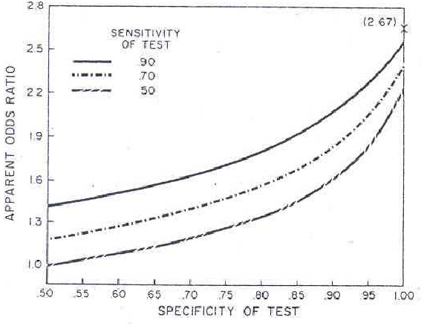
Bias as a function of non-differential imperfect sensitivity and specificity of exposure measurement
2.8
2.5
2.2
1.9
1.6
1.3
1.0
True OR = 2.67
Case-control study
Prevalence of exposure in controls = 0.2
Sensitivity of exposure measurement
0.9
0.7
0.5
Apparent Odds Ratio
Copeland et al. AJE 1977
.50 .55 .60 .65 .70 .75 .80 .85 .90 .95 1.00
Specificity of exposure measurement
Notes:
As you might imagine, the effects of all the different scenarios have been worked out. This graph assumes a case-control study where the true OR is 2.67, which is, as we have talked about, a decent sized odds ratio and one that might be common these days now that the many of the odds ratios of 10, like smoking and lung cancer, have already been found! The prevalence of exposure in the controls is 0.2. On the y axis is the observed or apparent odds ratio and the line shows what happens as specificity is varied from 50% to 100% under 3 different scenarios of sensitivity.
Note especially how there are some pretty substantial hits on the apparent odds ratio as you move away from 100% specificity and that this is accentuated, noted by the steeper slopes, as sensitivity falls. Note how the slope is steeper in the sensitivity of 50% curve.

Slide 31
Bias as a function of non-differential imperfect sensitivity and specificity of exposure measurement
2.8
2.5
2.2
1.9
1.6
1.3
1.0
True OR = 2.67
Prevalence of exposure in controls = 0.2
Sensitivity of exposure measurement
0.9
0.7
0.5
Apparent Odds Ratio
When does OR fall below 2?
Copeland et al. AJE 1977
.50 .55 .60 .65 .70 .75 .80 .85 .90 .95 1.00
Specificity of exposure measurement
Notes:
Let’s look at what scenarios will result in observed odds ratios being under 2.0 which is often the smallest odds ratio that many of our studies can pick up from a statistical power perspective, speaking very generally. If sensitivity is 90%, then specificity can be no less than about 87% before the OR drops below 2. If sensitivity is 70%, then specificity can be no lower than about 94%. If sensitivity is as low as 50%, then specificity can be no lower than about 98%.

Slide 32
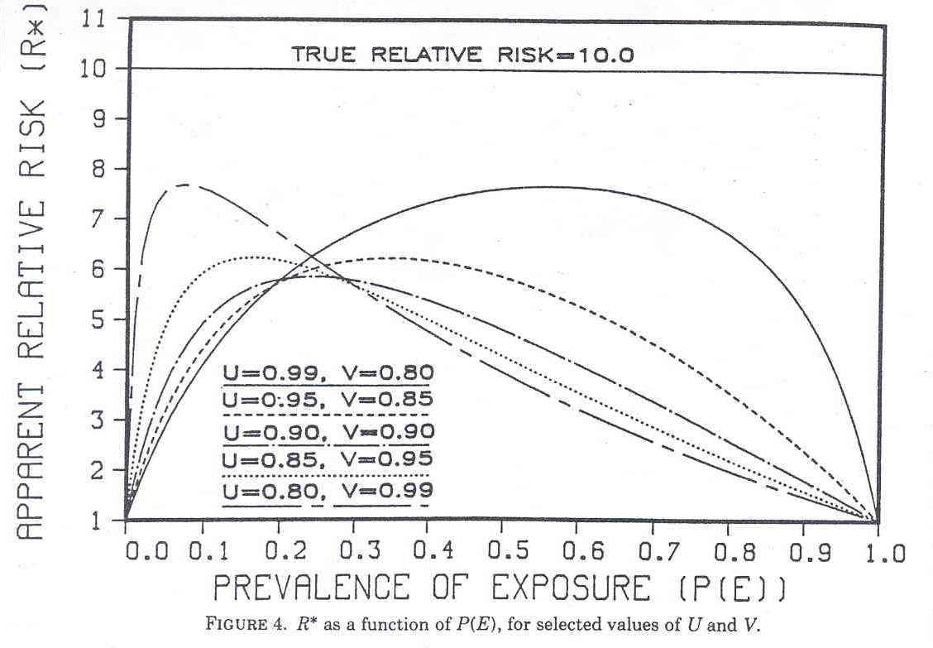
Non-Differential Misclassification of Exposure in a Cohort Study:
Effect of Sensitivity, Specificity and Prevalence of Exposure
Apparent Risk Ratio
All RR < 8
If Pe >.25, ↑ Sn. influ.
Dependence upon Prev.
True Risk Ratio = 10
U = sensitivity; V = specificity
Sn
Sp
Sn Sn Sn Sn Sn
Sp Sp Sp Sp Sp
Sn and Sp
Flegal et al. AJE 1986
Notes:
Here is a pretty interesting plot that looks at the effect of non-differential misclassification of exposure in a cohort study. Here, the true risk ratio is 10. Sn is equal to the sensitivity and Sp is equal to the specificity of the exposure measurement. The 5 lines show some representative combinations of sensitivity and specificity.
The figure points out a few things:
Even with these seemingly reassuring combinations of sensitivity and specificity, the highest risk ratio we can get is 8 or a 20% decline.
For most overall prevalences of exposure of 0.25 and higher, you see a greater influence of sensitivity than specificity. Note, for example, at a prevalence of overall exposure of 50%, near perfect sensitivity but 80% specificity gives you an apparent risk ratio of about 7.63 but a situation with near perfect specificity but 80% sensitivity gives a risk ratio of about 4. This changes, however, when you have overall prevalence of exposure below about 0.25.
3. And, again illustrating the important dependence of the prevalence of the exposure. As you get to the extremes of imbalance between exposed and unexposed, you see that the apparent (or observed) risk ratio starts to plummet.
You don’t have to commit any of this to memory, but suffice it to say that some of these relationships are complex and not easily predictable.
By the way, is it theoretically possible to have differential misclassification of exposure in a cohort study? No, because at the beginning of a cohort when measurements of exposure are made the outcome has not yet occurred.

Slide 33
In the presence of non-differential misclassification of exposure (e.g., sensitivity and specificity of 80%), what can we say in our Discussion section about any measures of association derived from the exposure?
Will, on average, underestimate truth - B
Are an underestimate of truth - A
Tend to underestimate truth - C
Are an overestimate of truth - D
Notes:
33

Slide 34
In the presence of non-differential misclassification of exposure (e.g., sensitivity and specificity of 80%), what can we say in our Discussion section about any measures of association derived from the exposure?
Will, on average, underestimate truth - B
Tend to underestimate truth - C
Are an underestimate of truth - A
Are an overestimate of truth - D
Notes:
34

Slide 35
Non-differential misclassification of exposure and “Bias towards the null”
In any single study, non-differentiality by itself does not guarantee that the observed measure of association is falsely low
Reason: in any single study, the observed results are a function of bias plus CHANCE
  Only if a study is repeated many times over and the findings averaged, can we say that the observed measure of association is biased towards the null
Don’t say: “Because we had non-differential misclassification of exposure, our findings are an underestimate of the true measure of association.” (i.e., do not be definitive)
Instead, say: “Because imperfect sensitivity and specificity of <the exposure measurement> was generally the same irrespective of outcome, our findings tend to be (or, “on average are likely to be) an underestimate of the true association.”
Jurek et al. IJE 2005

Slide 36
Non-Differential Misclassification of Exposure:
Rules of Thumb Regarding Sensitivity & Specificity
Exposure Cases Controls
Yes 50 100
No 50 300 True OR = (50/50) / (100/300) = 3.0
SOURCE POPULATION
Sens + Spec >1 but <2 gives attenuated effect
Sens + Spec = 1 gives OR = 1 (no effect)
Sens + Spec < 1 gives reversal of effect
Coding error
Notes:
The previous slides and the underlying math leave us with a few rules of thumb when it comes to non-differential misclassification of exposure.
Again, we show here a reference population where the true odds ratio is 3.0. When sensitivity and specificity add up to more than 1 but less than 2, you will have an attenuated measure of association. This is the situation you will usually be in and so the rule of thumb is that most of the time non-differential misclassification will cause a bias towards the null. When sensitivity and specificity add up to 1 exactly, you will see an apparent no effect (odds ratio is 1). When things are really bad and sensitivity and specificity add up to less than 1, then you will be to see a reversal of effect. Here an odds ratio of 0.82 means that the exposure is actually protective of the disease outcome.

Slide 37
Non-Differential Misclassification of Outcome
Diseased
+ -
Problems with outcome sensitivity –unrelated to exposure status
+
-
Exposed
SOURCE POPULATION
Evenly weighted arrows = non-differential
Problems with outcome specificity – unrelated to exposure status
STUDY SAMPLE
Notes:
The same kind of reasoning applies when we look at non-differential misclassification of outcome. Here is the schematic.
These arrows depict diseased persons misclassified as non-diseased - in other words problems with sensitivity. These arrows depict non-diseased persons who are mistakenly misclassified as diseased - in other words, problems with specificity.
When the degree of misclassification of outcome is the same in the exposed vs unexposed groups, i.e. unrelated to exposure, this is called non-differential misclassification of outcome.

Slide 38
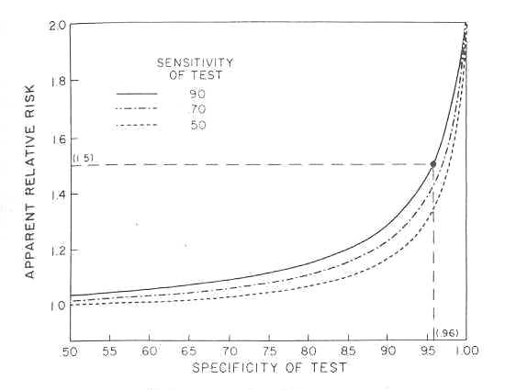
Bias as a function of non-differential imperfect sensitivity and specificity of outcome measurement in a cohort study
Apparent Risk Ratio
True risk ratio = 2.0
Cumulative incidence in unexposed = 0.05
Sensitivity of outcome measurement
0.9
0.7
0.5
Steep bias with change in specificity
Relatively less influence from sensitivity
Copeland et al. AJE 1977
Specificity of outcome measurement
Notes:
Here is a graph looking at the effects of imperfect specificity and sensitivity in the measurement of outcome. Here, we assume that the true risk ratio is 2.0 and that the cumulative incidence of disease in the unexposed is 5%. The lines show what happens when specificity is changed from 50% to 100%, under 3 different assumptions of sensitivity, 90%, 70%, and 50%.
The figure illustrates that you take a pretty big hit in the observed risk ratio with only subtle changes in specificity.
Also, there is not that much dependence on sensitivity. Note that in comparison to the graph where we looked at non-differential misclassification of exposure the three lines that vary sensitivity are pretty closely bunched together.

Slide 39
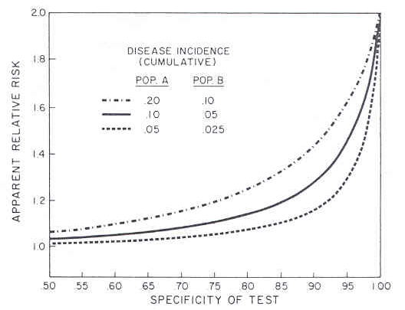
Non-Differential Misclassification of Outcome:
Effect of Incidence of Outcome
Apparent Risk Ratio
True risk ratio = 2.0
Sensitivity of outcome measurement held fixed = 0.9
Cumulative incidence of outcome
Exposed Unexposed
0.2 0.1
0.1 0.05
0.05 0.025
Copeland et al. AJE 1977
Specificity of outcome measurement
Notes:
There is, however, an important dependence upon the underlying frequency of the outcome, in other words, the cumulative incidence of outcome. Here are three scenarios of where the true risk ratio is 2.0. In the bottom curve, the incidence of outcome in the exposed group is 0.05 and in the unexposed group 0.025. Overall outcome incidence is doubled in each successive curve. The sensitivity of the outcome measurement is held fixed at a realistic 90% and the curves show you what happen as specificity falls. You can see that when you are dealing with an outcome with a cumulative incidence of around 5% in the exposed, you begin to take rapid hit as specificity falls. Just a 5% fall in specificity could leave you with an observed risk ratio of 1.2 – good luck in picking that up.
This dependence upon outcome incidence when talking about misclassification of outcome is akin to the situation of misclassification of exposure where there is a dependence upon overall prevalence of exposure. When there is a lot of imbalance between key cells, the effects of misclassification can become very large.

Slide 40
Special Situation In a Cohort or Cross-sectional Study
Misclassification of outcome
If specificity of outcome measurement is 100%
Any degree of imperfect sensitivity, if non-differential, will not bias the risk ratio or prevalence ratio
e.g.,
Risk difference, however, is changed by a factor of (1 minus sensitivity), in this example, 30% (truth=0.1; biased = 0.07)
Truth
70% sensitivity
Notes:
Now, so far I’ve said that for both non-differential misclassification of exposure and outcome there is a predictable bias towards the null hypothesis. There is, however, a special situation to know about in a cohort or cross-sectional study when it comes to misclassification of outcome.
If specificity is 100%, then any degree of imperfect sensitivity will not have any impact on the risk ratio in a cohort study or the prevalence ratio in a cross sectional study.
Here’s an example. In the true scenario, the risk or prevalence ratio is 2.0.
If specificity of the outcome measurement is 100% but there is only 70% sensitivity of the classification of the outcome, the risk (or prevalence) ratio is unaltered at 2.0. This is because all that you have done is to decrease both this cell and this cell by the same percentage. Therefore, the ratio between exposed and unexposed will not be affected.
However, the risk difference will be changed even in the face of 100% sensitivity, in fact, by a factor or ‘1 minus the sensitivity’
Odds ratios and rate ratios remain biased even with 100% specificity but the magnitude is very small when the cumulative incidence is low, say, less than 10% in all exposure groups.

Slide 41
When specificity of outcome is 100% in a cohort or cross-sectional study
Apparent Risk Ratio
True risk ratio = 2.0
Cumulative incidence in unexposed = 0.05
Sensitivity of outcome measurement
0.9
0.7
0.5
Copeland et al. AJE 1977
Specificity of outcome measurement
Notes:
Here is this special situation of 100% specificity of outcome measurement. We actually saw this a few slides ago. When specificity is 100%, you can actually get an unbiased risk ratio regardless of the sensitivity of the outcome measurement. Here the true risk ratio is 2.0 and when specificity is 100% you can get a risk ratio of 2.0 regardless of the sensitivity.

Slide 42
When specificity of outcome measurement is 100% in a cohort or cross sectional study
Worth knowing about when defining outcomes, such as choosing cutoffs for continuous variables on ROC curves
Choosing most specific cutoff (preferably, the 100% specificity cutoff) will lead to least biased ratio measures of association
Example of ROC curve
Notes:
This fact about how 100% specificity in the outcome measurement can preserve unbiased risk ratios even in the face of less than perfect sensitivity is worth knowing when you are considering which outcomes to use or where to make cutoffs for certain outcome variables that are measured in their most raw form with a continuous variable. Choosing the most specific cutoff, the cutoff associated with 100% specificity, will lead to least biased ratio measures of effect. I show an ROC curve to remind you when you have a diagnostic test for outcome, say an antibody test for an infectious disease, you have many choices in terms of where you can make your cutoff for positivity.

Slide 43
Efficacy of a pertussis (whooping cough) vaccine in adults
RCT of: Previously approved (in kids) pertussis vaccine vs. comparator vaccine for the prevention of pertussis in adults
What should you choose as your primary outcome variable?
Microbiologic diagnosis of pertussis - B
>5 days of cough + microbiologic diagnosis of pertussis - D
>5 days of cough - A
Abnormal chest x-ray - C
Ward et al. NEJM 2005
Notes:
43
Let’s look at a related question. A few years ago, investigators sought to look at the efficacy of a vaccine for pertussis, which is also known as whooping cough, in adults. To do this, they performed an RCT in adults comparing the approved pertussis vaccine in kids vs a comparator vaccine (one that is not known to have any effect on pertussis). They randomized nearly 1400 adults to each group and followed them for about 1.5 years. What should you choose as your primary outcome variable?

Slide 44
Efficacy of a pertussis (whooping cough) vaccine in adults
RCT of: Pertussis vaccine vs. comparator vaccine for the prevention of pertussis in adults
What should you choose as your primary outcome variable?
Microbiologic diagnosis of pertussis - B
>5 days of cough + microbiologic diagnosis of pertussis - D
>5 days of cough - A
Abnormal chest x-ray - C
Ward et al. NEJM 2005
Notes:
44
Answer: When in doubt, choose the most specific outcome, especially when the study sample size is ample. Cough plus the microbiologic diagnosis.

Slide 45
Efficacy of a pertussis (whooping cough) vaccine in adults
Pertussis vaccine vs. comparator vaccine for the prevention of pertussis in adults (Ward et al. NEJM 2005)
Outcome: Cough > 5 days
  No. of events: 2672 (and lots of statistical power)
  Result: No significant difference between groups
Outcome: Cough + microbiologic pertussis confirmation
  No. of events: 10
  Result: rate ratio = 0.08 (92% vaccine efficacy) (95% CI = 0.01 to 0.68)
Notes:
This is not just an academic issue, and here is how this played out.
This is a study of the use of a pertussis vaccine in adults. Pertussis is whooping cough, a disease characterized by an unrelenting cough. As you know, we do get vaccinated as children, but this immunity is now known to wane. The question is whether vaccination in adults is efficacious. This study randomly assigned pertussis vaccine or a control vaccine (in this case, hepatitis A vaccine was used) to over 2600 adults and adolescents who were followed for nearly 5000 person years.
One of the outcomes looked at was clinical disease defined as cough of 5 or more days of duration. With this outcome, there were a whopping 2672 events. Plenty of statistical power with this, right? Well, despite this power, there was no significant difference between groups. (Note: original article does not give the numeric association or statistics, perhaps indicating that it was not even close)
When the authors looked at a different outcome, cough plus microbiologic confirmation of pertussis, there were only 10 total events. However, virtually all of these were in the non-pertussis vaccine group, resulting in a rate ratio of 0.08, in other words 92% vaccine efficacy.
What happened here: cough alone is a very non-specific way to capture pertussis. When the authors tightened up the specificity of their outcome measurement to 100% specificity they were able to show the efficacy of the vaccine. If they had not done this, the vaccine would have been discarded as non-useful. Might they have missed some true pertussis events because their measurement tool lacked sensitivity? They probably did but it did not matter. With full specificity of the outcome measurement, they were able to prevent bias – and get the right answer.

Slide 46
Pervasiveness of Non-Differential Misclassification
Direction of this bias is typically towards the null
  Other than the aforementioned special situation
Therefore, called a “conservative” bias
Goal, however, is to get the truth
Consider how much underestimation of effects must be occurring in research
How many “negative” studies are truly “positive”?
Notes:
Let’s conclude our discussion of non-differential misclassification by considering how common it must be. In other words, whenever you start to measure something with less than 100% sensitivity and 100% specificity you begin to get biased measures of association towards the null. In fact, they will always be towards 1.0 unless the sens and specificity are atrocious in which case you will begin to reverse direction. Because this bias is typically towards the null, it has been called a conservative bias. But what does conservative really mean? After all, the goal in our work is to get at the truth. Consider how much underestimation of effects must be occurring in research. Or, how many “negative” studies are truly “positive”. How much does non-differential misclassification add to the confusion in given fields where some studies have positive results and others are negative?

Slide 47
Bias in Clinical Research:
Measurement Bias
Refined description of measurement error types (nomenclature)
Bias from misclassification of dichotomous variables
  In descriptive studies
  In analytic studies
    Misclassification of dichotomous exposure & outcome variables
      non-differential and differential misclassification
      independent and dependent misclassification
      magnitude and direction of bias
Bias from mis-measurement of interval scale variables
Advanced topics (brief mention only)
  Misclassification of multi-level categorical variables
  Misclassification of confounding variables
  Back-calculating to the truth (“quantitative bias analysis”)
Notes:
Let’s regroup to see where we are. We’ve talked about non-differential misclassification. Now, let’s talk about differential misclassification.

Slide 48
Differential Misclassification of Exposure
Weinstock et al. AJE 1991
Nested case-control study in Nurses Health Study cohort
Cases: women with new melanoma diagnoses
Controls: women w/out melanoma - by incidence density sampling
Measurement of exposure: questionnaire about self-reported “tanning ability”; administered shortly after melanoma development
Notes:
So, that’s non-differential misclassification. What about differential misclassification? A good verified example of this can be seen in a nested case-control study within the Nurses Health Study that looked at the association between a woman’s self-reported tanning ability and melanoma. Here, the cases were women with new melanoma diagnoses and controls were women without melanoma, sampled by incidence density sampling in this fixed cohort, a primary study base. The measurement was a question about tanning ability on a questionnaire that was administered shortly after the melanoma diagnosis. The responses to the tanning question were: no tan; light tan; medium tan, and dark tan. These 4 responses were dichotomized into No tan or light tan vs medium tan or dark tan, which was the reference category.
Here is what they found. The reference group is women who report medium to dark tanning ability. Compared to this reference group, women with no tan to light tan had a 1.6-fold greater odds of developing melanoma. Is there any reason to be suspicious about this?

Slide 49
Question asked after diagnosis
Question asked before diagnosis (NHS baseline)
Virtually unchanged
Substantially changed
Notes:
Well, it is conceivable that when questioned after the diagnosis of melanoma, some participants may have exaggerated their lack of tanning ability especially if they were concerned that sun exposure was a reason they got melanoma.
Actually, because the study base was a research-level cohort study, the investigators had the ability to look at responses to the tanning ability question was answered at the baseline of the study - long before the melanoma diagnosis. Of course, tanning ability should not change over time.
When they looked at the question answered at the Nurses Health Study baseline, they found no evidence of an association between tanning ability and melanoma. You can see what happened. In the controls, things were virtually unchanged. It is among the cases that things changed.
Much of what we have been talking about so far is hypothetical in terms of what will happen with various misclassifications of exposure or outcome but this is an outstanding example because it actually gives direct proof right within a given study.

Slide 50
“Tanning Ability” and Melanoma:
Differential Misclassification of Exposure
Melanoma
+ -
Imperfect specificity of exposure measurement - mostly in cases
No
Yes
Tanning
ability
Bias away from the null leading to spurious association
SOURCE POPULATION
STUDY SAMPLE
Notes:
What apparently occurred is shown schematically here. If we consider the responses given at baseline to be the gold standard (and these responses were, of course, given prior to any occurrence of melanoma and hence they are most believable), then what we have in this example is a problem in the specificity in the tanning ability measurement. This was mostly if not solely in the cases who are most likely over exaggerating of their inability to tan. This is an example of DIFFERENTIAL misclassification of exposure, and the bias is away from the null. In non-differential exposure, all we ever see, if anything, is bias towards the null. With differential misclassification, it can go either way. The gray shading indicates which cell gets enriched, which in this case is the poor tanners with melanoma which would result in overestimating the association between poor tanning and melanoma.

Slide 51
Differential Misclassification of Exposure: Magnitude of Bias e.g., True OR=3.9
See Extra Slides for example of differential misclassification of outcome
Notes:
Here’s a table showing some examples of what can happen in the presence of differential misclassification of exposure.
Assume that we are looking at an odds ratio in a case-control study and that the true odds ratio is 3.9 and that the prevalence of exposure in the controls is 10%. (A base-case OR could be (200/466)/(100/900)). If specificity of the exposure measurement is perfect, we will get entirely different patterns of bias depending upon the pattern of differential sensitivity in the exposure measurement. If measurement of the exposure in controls is less sensitive than in the cases, you can see how this will result in an overestimate of the association under study. In contrast, if the exposure measurement is more sensitive in the controls, this will lead to a underestimate of the odds ratio, here 2.2.
The bottom line is that unlike non-differential misclassification where the bias is predictably towards the null hypothesis, in the presence of differential misclassification anything can happen with biases both towards and away from the null hypothesis. It all depends upon the individual situation.
For example, in one instance, the bias is away from the null and in another situation the bias is towards the null.

Slide 52
Misclassification of Dichotomous Exposure or Outcome: Summary of Bias
Notes:
Here is a summary of the effects of misclassification of either dichotomous exposure or dichotomous outcome measurements:
As we have said, the effect of non-differential misclassification is predictably always towards the null hypothesis, in other words an attenuation of the measure of association. The exception to this comes when specificity is 100%, there is no bias incurred with imperfect sensitivity of the outcome measurement when risk ratios or prevalence ratios are being estimated. The other exception is that if misclassification is severe enough, it can even cause a reversal of effect, but fortunately in practice this is very uncommon. The bias from non-differential misclassification of exposure is greatest when the prevalence of exposure is low. The bias from non-differential misclassification of outcome is greatest when outcome prevalence or incidence is low.
The effects of differential misclassification can go in either direction and depend very much on the individual circumstances of the problem. The bias can either be away from or towards the null hypothesis.

Slide 53
Independence versus Dependence of Errors
Prior rules on direction of bias caused by non-differential vs differential misclassification assume that errors are independent of errors in all other variables
  e.g., for non-differential misclassification to result in bias towards the null:
    errors in exposure must be independent of errors in outcome or any other variable in the analysis
Notes:
All of the rules we just described in the last slide regarding the direction of the bias caused by non-differential vs differential misclassification assume that errors in one variable are independent of errors in all other variables.
For example, for non-differential misclassification of exposure to cause a bias towards the null, errors in exposure ascertainment have to be independent of errors in other variables, especially outcome.

Slide 54
Bias in Clinical Research:
Measurement Bias
Refined description of measurement error types (nomenclature)
Bias from misclassification of dichotomous variables
  In descriptive studies
  In analytic studies
    Misclassification of dichotomous exposure & outcome variables
      non-differential and differential misclassification
      independent and dependent misclassification
      magnitude and direction of bias
Bias from mis-measurement of interval scale variables
Advanced topics (brief mention only)
  Misclassification of multi-level categorical variables
  Misclassification of confounding variables
  Back-calculating to the truth (“quantitative bias analysis”)
Notes:
This brings to this point in the outline.

Slide 55
Measurement Bias is the Result of Measurement Error:
A Refined Description of Measurement Error
Random error
  Presence and direction of error is unrelated to:
    true value of the entity under study,
    true values of other variables, or
    whether other variables are measured in error
Systematic error
  Presence and direction of error is predictable, often related to actual true values and may be related to two other processes
Is error related to: | Terminology
1. True values of other variables in the analysis? | If no: “non-differential” or If yes: “differential”
2. Whether other variables in the analysis are measured in error? | If no: “independent” or If yes: “non-independent (dependent)”
Notes:
And let me remind you of this nomenclature point that we made at the beginning. Remember that we said that within the realm of systematic error, we need to pay attention to two processes. The first process is whether error is related to true values of other variables in the analysis. This is what we have just been discussing. If no, we call the error non-differential, but, if yes, we call the error differential. In general, this axis is called differentiality. The second process is whether error in the variable is related to whether other variables in the same subject are measured in error. If no, we call this independent. If yes, we call this non-independent or dependent error. This axis is called “dependency”.

Slide 56
When Might Errors in One Variable Be Related to Errors in Other Variables?
When two or more variables (e.g., exposure and outcome) are measured by the same process, such as:
  Same questionnaire
    e.g., some subjects less literate/motivated, or have lower reporting thresholds
    e.g., some interviewers may be less probing or less motivated
  Same biological specimen
    e.g., some specimens lose viability causing either false-negative (analyte no longer detectable) or false-positive results (formation of cross-reactive entities)
Especially prominent (but not limited to) in cross-sectional studies when exposure and outcome are measured at same time
If occurrence of errors in one variable are related to errors in other variables, the errors are said to be non-independent (or dependent)
  (Math) Joint Prob. of errors in both variable_1 and variable_2 ≠
                (Prob. of error in variable_1)(Prob. of error in variable_2)
Notes:
When might non-independence occur? In other words, when might errors in one variable be related to errors in other variables?
This can occur when two or more variables (such as exposure and outcome) are measured by the same process, such as by the same questionnaire or via the same biological specimen.
This is especially prominent in study designs where exposure and outcome are being simultaneously measured, such as a cross-sectional study.
Some people see this better if expressed mathematically. In mathematical terms, if the joint probability of errors in both variable 1 and variable 2 is not equal to the probability of error in variable 1 times the probability of error in variable 2, then we say the errors are non-independent. This follows simple probability theory. Likewise, if the joint probability of errors in both variable 1 and variable 2 is equal the probability of error in variable_1 times the probability of error in variable_2, then we say that the errors are independent.

Slide 57
Pesticide Exposure and Physical Symptoms in Siskiyou County, California
Design: cross-sectional
Exposure: Average intensity of pesticide odor
Outcome: Self-reported physical health symptoms
Procedure: Self-administered questionnaire
Findings: Intensity of pesticide odor positively associated with several different physical health symptoms
However, a more objective measure of pesticide (geographic proximity of residence to pesticide-treated fields) showed no association
Mechanism: Subjects differ in threshold in perception and hence reporting of various subjective sensations, including, e.g., odor & health symptoms
Termed “Dependent non-differential misclassification”
Notes:
This example comes from Ames et al. Archives of Environmental Health 46: 213-217, 1991 and Kristensen Epidemiology 3:210-215, 1992.

Slide 58
Measurement Bias is the Result of Measurement Error:
Refined Terminology for Measurement Error
 |  | Is error related to whether other variables in the analysis are measured in error? (“Dependence”)
 |  | Independent | Dependent
Is error related to true values of other variables in the analysis? (“Differentiality”) | Non-differential | Independent Non-differential Misclassification | Dependent Non-differential Misclassification
 | Differential | Independent Differential Misclassification | Dependent Differential Misclassification
Uniformly predictable: Bias towards the null (if at all)
Predictable, but context-specific; bias can go in either direction
VComplicated and hard to predict: bias can go in either direction
Notes:
So, this gets us to more refined terminology for measurement error. We have talked about two axes. The first is whether error is related the true values of other variables in the analysis. This axis is called differentiality. If no, we said this is called non-differential. If yes, then it is called differential. The other axis concerns whether error is related to the occurrence of other errors in in other variables in the same subjects. This is called “dependence”. If errors on one variable are not related to errors on other variables, this is called “independent”. If errors on one variable are related to errors on other variables, we call the errors dependent. Putting these two axes together, we have this table.
Errors in the green box have a uniformly predictable direction, which is towards the null, if they occur at all (remembering that independent non-differential misclassification of outcome in the face of 100% specificity will not bias a risk or prevalence ratio). Errors in the blue box will also go in the predictable direction that is context specific. Importantly, the bias can go in either direction, either toward or away from the null. These two orange boxes are the most complicated. They are not simple to predict because there are two processes going on. Of note, dependent non-differential misclassification can result in bias away from the null.

Slide 59
Bias in Clinical Research:
Measurement Bias
Refined description of measurement error types (nomenclature)
Bias from misclassification of dichotomous variables
  In descriptive studies
  In analytic studies
    Misclassification of dichotomous exposure & outcome variables
      non-differential and differential misclassification
      independent and dependent misclassification
      magnitude and direction of bias
Bias from mis-measurement of interval scale variables
Advanced topics (brief mention only)
  Misclassification of multi-level categorical variables
  Misclassification of confounding variables
  Back-calculating to the truth (“quantitative bias analysis”)
Notes:
Let’s move on from dichotomous variables and let’s finish up and spend a little time on what happens with mismeasurement of interval scale measurements.

Slide 60
Effect of Lack of Validity and Reproducibility in Interval Scale Measurements
Lack of Validity (Systematic Error)
  Measurements systematically off truth by some multiplicative factor or absolute difference
x
x
truth
observed
Lack of Reproducibility
  Measurements off truth by some random factor or difference
x
x
x
x
x
x
x
observed
truth
observed
Notes:
Schematically, this is what mismeasurement of interval scale measurements looks like. Lack of validity of an interval scale measurement is synonymous with systematic error. This means that the observed measurement is systematically off the truth by some multiplicative factor or absolute difference. We depict this by a shift from the true value to the observed value.
Lack of reproducibility means that the measurements are systematically off the truth by some random factor or difference. We depict that by showing that the observed values could be anywhere in reference to the truth.

Slide 61
Relating the Validity and Reproducibility of Measurements to Measurement Bias in Analytic Studies – Interval Scale Variables
Validity (Systematic error)
Result moves systematically up or down scale by given factor or absolute difference
e.g., systematic error in an interval scale outcome variable
Mean Ratio of Means Difference in Means
Bias depending upon measure of association
Notes:
We won’t have time to discuss all of the scenarios regarding mismeasurement of interval scale variables, but we can discuss a few. Remember with an interval scale variable, such as a continuous variable, there aren’t broad categories, but rather a continuum of responses. Hence, systematic error in a continuous variable just results in everyone being systematically shifted up or down the scale. Let’s look at what happens in the face of systematic error in an outcome variable. Let’s say that this scenario is the truth and we are measuring the mean of something in an exposed and unexposed group. The truth is that the mean is 100 in the exposed group and 50 in the unexposed group. Therefore the ratio of the means is 2 and the difference in means is 50. What happens if the measurement is off by a multiplicative factor of 10? You can see that the exposed group now has a mean of 1000 and the unexposed has a mean of 500. The ratio, however, is the same – no bias compared to the truth. If your goal, however, is to look at the difference in means, then the difference is 500, as opposed to 50. This is a biased result. What happens if the measurement is off by an absolute difference of 10 units. Here, you can see that the exposed group has a mean value of 110 and the unexposed group has a value of 60. The ratio in this case is 1.83, which is biased compared to the truth. The absolute difference, however, is still 50 and unbiased. So, in the face of systematic error in an interval scale measurement of an outcome variable, whether or not there is bias depends upon the measure of association in question. Usually, this does not turn out to be much of a problem.

Slide 62
Relating the Reproducibility and Validity of Measurements to Measurement Bias in Analytic Studies – Interval Scale Variables
Truth and Error
Truth
Reproducibility (Random error)
e.g., random error in an exposure variable
Assuming:
Exposure is normally distributed with variance, σ²_{True}
Random error is normally distributed with variance, σ²_{E}
Then, the observed regression coefficient is equal to the true regression coefficient times:
i.e., the greater the measurement error, the greater the attenuation (bias) towards the null (e.g., if ICC is 0.5, the measure of association is halved)
(i.e. reproducibility, the intraclass correlation coefficient)
Regression Dilution Bias
Notes:
How about problems in reproducibility, the result of random error? Let’s talk about the case of random error in an exposure variable. This turns out to be a classic scenario. We talked a bit about this last week, but let’s formalize it now. Let’s assume that the exposure is normally distributed with some variance sigma squared subscript T, shown here on the graph, using the nomenclature we used last week. If there is also some random error with variance of sigma sub E squared, then this is what the spread of observed values, truth plus error, looks like. When you have continuous exposure variables, you cannot use 2x2 table but instead you use mathematical regression equations to get measures of association. Suffice it to say that when you do this, the observed regression coefficient, which is the measure of association between the exposure variable and the outcome variable, will be attenuated (ie smaller) by some factor. This factor is the reproducibility expressed as the intraclass correlation coefficient. Remember this formula from last week? For example, if the ICC is 0.5 then your measure of association will be halved.
This phenomenon of how an imperfectly reproducible exposure attenuates the measure of association is known as “regression dilution bias”.

Slide 63
Relating the Reproducibility and Validity of Measurements to Measurement Bias in Analytic Studies – Interval Scale Variables
See Extra Slides for Additional Examples
Notes:
For additional examples of how problems in the validity and reproducibility of interval scale measurements cause measurement bias, I invite you to look at the Extra Slides.

Slide 64
Advanced Topics
Misclassification of multi-level categorical exposure variables
  some of the rules change regarding direction of bias
  See Extra Slides for examples
Notes:
We also don’t have time to explore a few other advanced topics in much detail. One is what happens when you have misclassification of multi-level categorical variables, variables that are more complex than dichotomous ones. Today, we just talked about dichotomous categorical variables and what happens when you have misclassification. When you have even non-differential misclassification of exposure variables some of the rules change in the presence of multi-level exposures. The text gives a few examples of this, which are repeated in the Extra Slides.

Slide 65
Advanced Topics
Mis-measurement of confounding variables
  When confounding variables are mis-measured, the net result is failure to fully control (adjust) for that variable
    You are left with “residual confounding”
    “Adjusted” measures of association may be over or under-estimated
    One rule: independent non-differential misclassification of a dichotomous confounder will result in an adjusted estimate somewhere between the unadjusted estimate and the true adjusted estimate
      Other forms of mis-measurement of the confounder do not have easily predicted direction
  Very common problem
    Researchers focus mainly on optimal measurement of exposure & outcome
    By the time confounders surface, everyone is too exhausted
      e.g., when controlling for smoking, does classification of people into smokers and non-smokers based on current smoking capture the essence of the exposure?
Notes:
Another advanced topic is the misclassification of confounding variables. Next week we will begin our discussion of confounding. In general, all variables can be classified as either the primary predictor variable, the outcome variable, a confounding variable, an effect modifier, or a mediator. So far, we’ve just talked about measurement bias incurred by mis-measurement of primary exposure variables or outcome variables. How about mis-measurement of confounding variables? The net result of misclassification of confounding variables is that you will fail to do what you attempted to do, adjust for the effect of that variable. Adjusting with a mis-measured confounding variable is essentially only an incomplete job. You are left with unfinished work; you are left with what is called residual confounding. Depending upon a number of factors, this will result in either an over or underestimation of the association between the primary predictor and the outcome variable. One rule is that independent non-differential misclassification of a dichotomous confounder will result in an adjusted estimate somewhere between the unadjusted (crude) estimate and the true adjusted estimate. This has been lore for some time and has been recently proved by Ogburn and VanderWeele (Epidemiology 2012).
This turns out to be a very common problem. This is because researchers typically focus their efforts of optimal measurement of exposure and outcome. By the time confounders come up for discussion, everyone is too exhausted to think too hard. So, confounding variables often get short shrift in measurement. As an example, we often want to control for, say, smoking. But what does this actually mean? Does the all too often classification of people dichotomously into smoker and non-smokers based upon their current smoking really capture the essence of smoking, which is a cumulative exposure and highly quantitative in nature?

Slide 66
Advanced Topics
Back-calculating to unbiased results
  thus far, truth about measurement quality and the relationships between exposure/outcome variables have been assumed
    We have then predicted what the bias will be in observed results
  In practice, we have observed results and sometimes a guess about the measurement quality, but we seek the truth
  when extent of classification errors (e.g., PPV, NPV, sensitivity & specificity, ICC) are known, it is possible to back-calculate to truth
  if exact classification errors are not known, it is possible to perform sensitivity analyses to estimate a range of study results given a range of possible classification errors
  “Quantitative bias analysis”– growing field as software evolves
Notes:
A final topic is one you may have thought about yourself is that thus far we’ve been presenting scenarios where we know the truth about the relationship between a given exposure variable and outcome variable and something about the quality (validity and reproducibility) of the measurements. We’ve then been showing you what happens to the observed results, in other words, the extent of bias that will ensue. In fact, in real practice, we just have observed results and some guess about measurement quality. But, we would like to get back to the truth. Can this be done? Yes! If you know the extent of classification errors (e.g., the sensitivity and specificity or positive predictive value and negative predictive value of dichotomous variables) there are developed mathematical techniques to back calculate to the truth. I will say that currently we don’t see this type of quantitative bias analysis calculation often in the literature primarily because the available software for this is not readily available, often we don’t really know the sensitivity and specificity of our measurements, and because the whole field is not well enough appreciated. This is, however, changing. I predict that over the next 5 to 10 years that this will become more common and hence it is wise to become familiar with it conceptually.
Even if the exact classification errors are not known, it is possible to perform sensitivity analyses to estimate a range of study results given a range of possible classification errors in your exposure and outcome variables.
This type of thinking is one form of what is known as quantitative bias analysis.

Slide 67
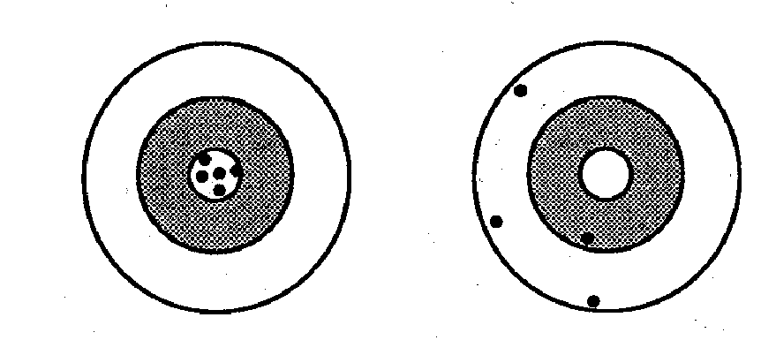
Measurement Bias
Small imperfections in measurement can induce substantial bias
Prevention and avoidance of measurement error are critical
  study design phase merits most emphasis
  use state-of-the-art techniques, blinding, SOPs, and replicates
Not simple to correct after study (but back-correction possible)
Become an expert in the measurement of your primary variables
For the other variables, seek out the advice of experts (teams)
Optimize the reproducibility/validity of your measurements!
Good Reproducibility
Good Validity
Poor Reproducibility
Poor Validity
Notes:
Let me end by saying that we have illustrated that small imperfections in measurement can induce substantial bias. Just as was the case with selection bias, prevention and avoidance of measurement bias are key. In short, in the design of a study, you need to use the best measurements possible, you need to perform them in a blinded way, and you need to perform them in a standard fashion using SOPs. In some cases, if warranted, consider making replicate measurements to enhance reproducibility. After the study is over, there the fixes are not simple and not currently well understood by readers. While there are some ways to back-calculate to the truth, many readers won’t understand and will be skeptical about these methods. Hence, just as was the case with selection bias, it is so important in the study design phase to get the measurements straight!
What this means is that you need to become an expert in the measurement of your primary variables. You need to understand them inside out. If you are working with a biological measurement, this means that you need to go into the lab and understand the nuances of the technique. This is not to say that you need to own and operate a lab to make these measurements, but rather that you must understand the measurement thoroughly.
Of course, you probably cannot do this for all of the variables you work with, such as all of your potential confounding variables. For these, you should work with multidisciplinary teams that include experts in these fields.
The goal of all of this knowledge is to optimize the reproducibility and validity of your measurements before you use them in a study and this brings us full circle back to where we were in the first lecture. This is where you want to be and this is where you want to avoid.

Slide 68
Extra slides

Slide 69
Descriptive studies
  Objective: Estimate measures of disease occurrence (e.g., prevalence or incidence)
Analytic studies
  Objective: Estimate measures of association between exposure (predictors) and outcome (e.g., disease)
Notes:
But before we do this, I want to re-emphasize what we meant by descriptive and analytic studies.

Slide 70
Differential Misclassification of Exposure:
Exposures During Pregnancy and Congenital Malformations
Congenital Malformation
+ -
+
-
Cases more likely than controls to remember a variety of exposures
Exposed
SOURCE POPULATION
Uneven weighting of arrows = differential
Cases might be more likely than controls to falsely state a variety of exposures
STUDY SAMPLE
Notes:
Another example of differential misclassification of exposure.
One of the classic examples of differential misclassification of exposure is the study of exposures during pregnancy and congenital malformations. These are commonly done as case-control studies because of the rarity of the outcomes.
First, we may have differential recall of various exposures during pregnancy, with cases less apt to forget things, i.e. differential sensitivity of the exposure measurement.
Second, we may have differential specificity. The cases may tend to recall things that truly did not happen. The result of all of this is that there is overestimation of the association between the exposure and the outcome.
The gray shading indicates which cells end up getting enriched, both of them in this case resulting in overestimation between exposure and outcome.

Slide 71
Differential Misclassification of Outcome:
Smoking and Emphysema
Emphysema
Smokers more likely than non-smokers to be receiving medical attention and to be undergoing diagnostic testing
+ -
+
-
Smoking
SOURCE POPULATION
Uneven weighting of arrows = differential
Emphysema features non-specific symptoms and requires specialized procedures to make definitive diagnosis
STUDY SAMPLE
Notes:
This is an example of differential misclassification of outcome. It is a cohort study of whether smoking causes emphysema. We know that emphysema features non-specific clinical symptoms (shortness of breath, for example, which can sometimes be mild and well compensated by a patient). Diagnosis of emphysema requires specialized procedures such as x-rays and pulmonary function tests. Smokers are more likely than non-smokers to receive medical attention because of the other problems they usually have. Because of this extra medical attention that smokers receive, they are more likely to be tested for emphysema. Consequently, there is differential sensitivity of the diagnosis of emphysema according to exposure. This results in an overestimation of the association between smoking and emphysema.

Slide 72
Relating Last Week to This Week:
Relating Validity / Reproducibility of Individual Dichotomous Measurements to Measurement Bias in Inferences in Analytic Studies
Validity
  How sensitivity and specificity of a measurement results in measurement bias covered in discussion of non-differential vs differential error
Reproducibility
  Recall that a measurement with imperfect reproducibility will typically lack perfect validity when used in practice -- (unless it is repeated many many times)
Notes:
Let’s see how we can relate the material from last week on the reproducibility and validity of specific measurements to how we end up with measurement bias in our inferences. Let’s start with categorical variables, particularly dichotomous variables.
It should be clear from today’s lecture exactly how the validity of a dichotomous variable (as described by the sensitivity and specificity) results in measurement bias. However, it may be less clear how the reproducibility of a measurement results in bias. To understand this, recall that a measurement with imperfect reproducibility will typically lack perfect validity when used in practice unless it repeated many many times.

Slide 73
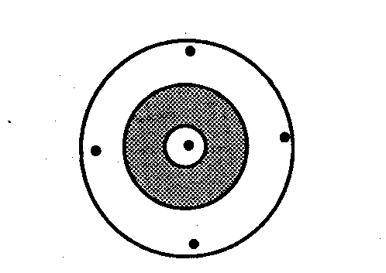
Reproducibility and Validity of a Measurement
With only one shot at the measurement, most of the time you will be off the center of the target
Notes:
Remember this panel on the right which we said depicted poor reproducibility. It is only if you had the ability to take many many replicates and average them would you be left with good validity. If you only take one shot at the measurement, most of the time you will be off the center of the target. The result of being off the center of the target is a measurement which lacks validity.

Slide 74
Imperfect reproducibility leads effectively to 90% sensitivity and 90% specificity of height measurement –non-differential with respect to outcome
Notes:
Remember this slide where we described how random errors in measuring height resulted in a bias in the prevalence ratio. We can now better mechanically understand this. At the time, we said there was 10% misclassification in the measurement of height. Now, we can see how imperfect reproducibility led effectively to 90% sensitivity and 90% specificity in the height measurement – a misclassification of the exposure measurement that was non-differential with respect to outcome. It led to what we now know is the predictable result of a bias towards the null hypothesis.

Slide 75
Validity of Analytic Inferences Derived from Measurement
“Measurement Bias”
Reproducibility of Measurement
Validity of Measurement in Practice
Systematic Error of Measurement
Notes:
This summarizes what we have been discussing. Two general properties of a measurement, its reproducibility and systematic error, can influence the validity of a measurement taken in practice. The validity of a measurement then influences the validity of the analytical inferences derived from the measurement, in other words, measurement bias.

Slide 76
Mismeasurement of Interval Scale Variables:
Summary of Bias When Relating to Perfectly Measured Variables
Notes:
As mentioned, we don’t have time to delve deeply into the effects of mismeasurement of interval scale variables, but here is a broad summary of the bias that can result. First, for the issue of imperfect validity in the measurement, ie systematic error. Whether bias ensues, depends the nature of error, an absolute difference or a ratio difference and how the measure of association is defined. If you are working all of the arithmetic scale, such as in linear regression, then absolute systematic error will result in no bias in measure of association. Systematic error is usually not a big problem.
Imperfect reproducibility is a bigger problem. With imperfect reproducibility of exposure variables, we have bias towards the null. This is called regression dilution. Fortunately, when there is imperfect reproducibility of the outcome variable, there is no bias, but there is an effect on precision.

Slide 77
Relating the Reproducibility of Measurements to Measurement Bias in Analytic Studies – Interval Scale Variables
Correlating one interval scale measurement to another
  e.g., weight and cholesterol
Correlation is attenuated directly proportional to ICC of measurements (r = correlation coefficient)
  e.g., If ICC of both weight and cholesterol is 0.80
  20% attenuation

Slide 78
Non-differential Misclassification of Multi-level Exposure
Misclassification between adjacent exposure categories
Truth
Exposure
Bias away from the null
Dosemeci et al. AJE 1990
Notes:
All of our comments so far were in the context of a dichotomous exposure and dichotomous outcome.
Unfortunately, things are more complicated and less predictable with multi-level exposures. With dichotomous exposure or outcome variables, we were pretty much assured that non-differential misclassification would lead to a bias towards the null. However, consider a multi-level exposure, say something like “no cigarette use”, “some cigarette use”, and “a lot of cigarette use”. If we performed a case-control study, for example, we aren’t limited to dichotomous exposure variables; we can have as many levels of exposure as we like, and we had an example of this in the previous problem sets. When you do this, you need to assign one of the levels as the reference category, and you then compare each of the other exposure categories to the reference category.
On the left panel is the truth in the source population. Here you can see that we have an exposure with three categories, none, low, and high. Compared to the none group, the odds ratio for the disease outcome is 2.0 for the low exposure group and 6.0 for the high exposure group. However, what happens if there is non-differential misclassification between the low and high exposure groups, and assume it is fairly high. What you end up with is a bias away from the null when comparing the “low” exposure group to the no exposure group, an odds ratio of 3.1.

Slide 79
Misclassification of Multi-level Exposure
Misclassification between adjacent and non-adjacent exposure categories
Truth
Exposure
Appearance of J-shaped relationship
Dosemeci et al. AJE 1990
Notes:
Although somewhat less plausible, if misclassification occurs between non-adjacent exposure categories, for example, between the high exposure group and the no exposure group, then some wild behavior can occur. Here, you can see how a J-shaped relationship could occur if persons in both the high exposure group and low exposure group are misclassified into the no exposure group.
The overall point is that in the presence of multi-level exposures, there are not simple rules as to how even non-differential exposure will alter the truth.

