Slide 1
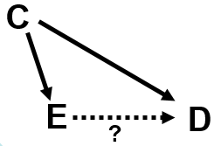
Notes:
Who has been dreaming of DAGs this week?

Slide 2
Confounding and Interaction: Part II
Methods to reduce/eliminate confounding
  during study design:
    Randomization
    Restriction
    Matching
    Instrumental variables
  during study analysis:
    Stratification
    (Mathematical regression)
    (Propensity scores)
    (Inverse probability weighting)
    (g-estimation)
Interaction
  What is it?
  Additive vs. multiplicative interaction
  How to detect it?
  Different types of interaction
  Statistical testing for interaction
  Implementation in Stata
  How DAGs help identify candidates?
  Comparison with confounding
Notes:
Here is our roadmap for today. Last session, we defined and discussed what confounding can do. Today, we will spend a large part of the session discussing ways we can prevent or manage confounding. We will divide the methods into what can be done in the design phase, before we start officially enrolling participants and completing measurements, and in the analysis phase, after all of the data have been collected. In the design phase, we will talk about randomization, restriction, matching, and instrumental variables. In the analysis phase, we will talk about stratified analysis. We will not be talking about mathematical regression, propensity scores, or inverse probability weighting in this course (or other advanced techniques, such as g-estimation), but I have listed them here for completeness. Mathematical regression is the topic for our BIOSTAT 2, 3, and 4 courses, and inverse probability weighting and propensity scores are covered in our spring course on advanced approaches to the analysis of observational data.
We will then use the remainder of the session to discuss a concept that comes up during the process of managing confounding. This concept is known as interaction. We will define it, how to detect it, and describe the two different scales we use to evaluate for interaction: additive and multiplicative. We will compare and contrast interaction with confounding and also describe how to do statistical testing for interaction, including how to implement this in Stata. Finally, we will discuss how DAGs can help with interaction by identifying potential effect modifiers. We note, however, that DAGs do not definitively show interaction on a given scale of association.

Slide 3
Confounding
Confounding occurs if there is a factor C that is a “Common Cause” of both E and D
C
C is part of an open undirected (non-causal) path from E to D
Specifically, this is a “backdoor path” from E to D
E
D
?
Notes:
Remember from last week how we used a causal diagram, or DAG (directed acyclic graph), to describe confounding in a very specific way. The research context is whether some exposure, E, causes an outcome/disease, D. Remember that confounding occurs when there is some factor C, which is a “common cause” of both E, the exposure in question, and D, the disease. When evaluating a causal role of E on the occurrence of D, we want to make sure that we have precluded any “other influences” which we are showing as C, a third variable, a confounding variable. That is why confounding is often called a mixing of effects.
Confounding, if not controlled for, might act to overestimate the effect of E on D (i.e., positive confounding) or it could serve to underestimate the effect (i.e., negative confounding). This is the case if there is truly an association present (under non-null conditions) or if there is truly no association (under null conditions).
In the parlance of DAGs, confounding is a “backdoor path” between exposure and disease. It is called backdoor path because of the edge that points toward the exposure. As you can see, some of these names (“collider” and “backdoor”) seem to have been created simply because of graphical appearance, but they have nonetheless become firmly entrenched in formal scientific vocabulary.

Slide 4
Elimination of Confounding
Adjusting/controlling for C closes the backdoor path; eliminates confounding
C
Confounder Present
Confounder Absent
E
D
?
Last session:
Stratification is one approach
But there are also other approaches to eliminate confounding
Notes:
Last week we also talked about how adjusting or controlling for the confounding variable factor C will block the backdoor path and eliminate confounding. Last week, we described one approach to do this, called stratification. Stratification holds the value of C constant in each stratum when you analyze the association between E and D. Since C is constant, there can be no association between C and E, or between C and D. Another way to consider this is that because C is constant, it is the same in the exposed as in the unexposed. Hence, neither exposed or unexposed have any special degree of “other influences” upon them.
It turns out that stratification is not the only way to accomplish elimination of confounding.

Slide 5
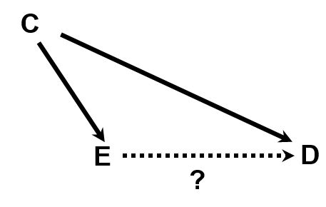
Methods to Eliminate or Reduce Confounding
By closing at least one edge of the exposure – confounder – disease
backdoor path, confounding is precluded
is not conventional depiction of path closure, but we will use it in class for illustration/emphasis.
Notes:
Indeed, there are several ways to effectively achieve control of confounding. One of the main reasons to draw this causal diagram is that it reminds us of the ways to prevent or manage confounding. Virtually all the methods I am going to describe for managing confounding work by blocking or precluding one of the two edges. These methods to manage confounding either block or interrupt the association between the confounder and the exposure or the association between the confounder and the disease. Or, the method could block both edges.
One note: these two red lines that we will use to show a blocked path are not a conventional depiction of closure but we will use them in class for emphasis and illustration. A more typical depiction of closure of a path is to simply eliminate the edge altogether.

Slide 6
Confounding and Interaction: Part II
Methods to reduce/eliminate confounding
  during study design:
    Randomization
    Restriction
    Matching
    Instrumental variables
  during study analysis:
    Stratification
    (Mathematical regression)
    (Propensity scores)
    (Inverse probability weighting)
    (g-estimation)
Interaction
  What is it?
  Additive vs. multiplicative interaction
  How to detect it?
  Different types of interaction
  Statistical testing for interaction
  Implementation in Stata
  How DAGs help identify candidates?
  Comparison with confounding
Notes:
So, to introduce the various methods to prevent or reduce confounding, let us now go to the top of the list in the study design phase. The first method that we will discuss is randomization.

Slide 7
Randomization to Eliminate/Reduce Confounding
Definition: random assignment of participants to exposure (e.g., treatment) categories
Exposed (treatment)
All participants → Randomize
Unexposed (no treatment or a different treatment)
Distribution of any other variable is theoretically the same in the exposed group as the unexposed
  Theoretically, can be no association between exposure and any other variable
Comes closest to goal of “exchangeability” (although still can fall short)
One of most important inventions of 20th Century
Notes:
Of the methods to deal with confounding, randomization is the cadillac. If one is able to implement it, randomization is the optimal strategy to reduce confounding.
As you know, in randomization, all study participants are randomly allocated to two or more exposure (or “treatment”) groups. This is most commonly some form of therapy or device or therapeutic strategy but can also be an exposure in the sense of a diet or other behavioral modification. As usual, we are using the word “exposure” very generally here. The randomization can be to an active treatment vs placebo; to two or more active treatments; or some combination of placebo and active interventions.
Since the exposure groups are created by a random process, the distribution of any variable you can think of is theoretically the same in the exposed group and the unexposed group. Therefore, there should be, in theory, no association between exposure and any other variable. If you think about it, randomization comes closest to the goal we described last week of exchangeability or the counterfactual ideal, although it does not guarantee exchangeability.
Note: one need not randomize an equal number of participants to each randomization group (i.e., a 1:1 randomization). Instead, an investigator may choose to randomize 2 participants to a given group for every 1 participant assigned to another group (or some other ratio). All that matters, and what defines the approach, is random assignment of persons to groups, meaning that assignment is done without regard to any other characteristic (nothing influences group assignment).
We have a lot more to say about randomization in our course on clinical trials in the winter, but randomization is truly one of the most important inventions of the 20th century.

Slide 8
Randomization to Eliminate/Reduce Confounding
Blocking the path between any would-be confounder & exposure is main reason for the exulted role of randomization
Notes:
Using DAGs, you can see that randomization theoretically precludes any association between any would-be confounder and the exposure. Therefore, confounding cannot occur. This is the main reason why randomization holds its exulted place in clinical and epidemiologic research. Its primary purpose is to prevent confounding.
Of course, earlier, we learned that randomization also helps to prevent selection bias on the “front end” of a study. With DAGs, we can now understand this better. By precluding any association between C and E, we eliminate one of the ways that collider stratification (i.e., selection bias) can occur (via an “M” DAG). We also learned that the act of randomization precludes dependent misclassification of exposure and any other variable. This is because if the investigator allocates the exposure, then there will not be error in exposure measurement related to outcome.
Note: randomization is not a so-called “conditioning” approach. We are not holding C constant. Instead, randomization is forcing the distribution of C to be the same across each level of the exposure.

Slide 9
Randomization to Eliminate/Reduce Confounding
All participants → Randomize
Exposed (treatment)
Unexposed (no treatment)
Applicable only for ethically assignable exposures (i.e., ethical interventions, experiments)
  Typically not for naturally occurring exposures (e.g., height, air pollution)
Special strength of randomization is its ability to control for the effect of confounding variables about which the investigator is unaware (and unmeasured)
  This is because distribution of any variable is theoretically same across randomization groups
Yet, it is not a guarantee to eliminate confounding
  By chance alone, there can be imbalance
  Less of a problem in large studies
  Techniques exist to ensure balance of certain variables (e.g., blocked or stratified randomization)
Notes:
Obviously, randomization is only relevant when the investigator has control over the exposure such as when we are studying drugs or other interventions, and it is ethical to assign it to a participant. In other words, it is only relevant when you are able to ethically assign things to people or you are instructing them to do things to themselves. There are practical or ethical limitations to this in that we cannot, for example, randomize people to smoking or air pollution or unprotected sexual behavior. Of note, there is no gold standard for what is ethical or not. This must always be decided by the investigators (personal ethics) and external ethics boards (professional ethics).
When randomization is feasible, the special strength of randomization, which makes it the cadillac approach, is that not only does it protect against confounding by known confounding, but it also eliminates/reduces confounding by unknown and hence unmeasured confounding., i.e., common causes (aka “other influences”) that the investigator does not even know about or had not thought of. Remember, the distribution of any variable you can think of is theoretically the same in the exposed and unexposed groups.
One note: randomization, especially in small studies, may not lead to perfect balance of confounding factors in the different exposure arms (in the case of a drug trial, treatment and placebo, for example). Just by chance alone, there can be imbalance. (And, it is also possible that things like fraudulent randomization could occur — after all, research is being done by humans on humans.) What is interesting is that the magnitude of potential bias from confounding is contained in the confidence interval you get for sampling error. Because sampling error is the root of confounding in a properly conducted randomized trial (i.e., a trial in which there is no attempt to game the trial by researchers, providers, or patients), the confidence interval gives you some boundaries of what your estimate might be under different circumstances of sampling.
The bigger the study, the less of a problem chance imbalance is. In smaller studies, investigators will want to pay attention to the possibility of chance imbalance and know that there are also certain specialized randomization techniques that help to guarantee perfect balance of particular confounders. You will learn more about these in our Clinical Trials course. There is no way, however, to guarantee perfect balance of all variables.

Slide 10
Another Example of Confounding and Another Solution
RQ: Does practice of commercial sex cause acquisition of HHV-8 (a herpesvirus) infection?
Bias: Confounding by unmeasured behavioral factors as mediated by injection drug use
Behavioral factors (unmeasured)
Injection
drug use
Commercial
sex
HHV-8
infection
?
  Solution: control for injection drug use to block path
Notes:
Let us consider another problem of confounding and another solution. Consider, for example, the research question of whether the practice of commercial sex causes the acquisition of a particular herpesvirus infection, human herpesvirus 8 (HHV-8). When thinking about this system, you recognize that certain behavioral factors, which you cannot measure directly, cause both commercial sex and injection drug use, and injection drug use is known to cause acquisition of HHV-8 infection. Although we cannot measure the common cause of “behavioral factors” and control for them directly, we can block this backdoor path by controlling for injection drug use.

Slide 11
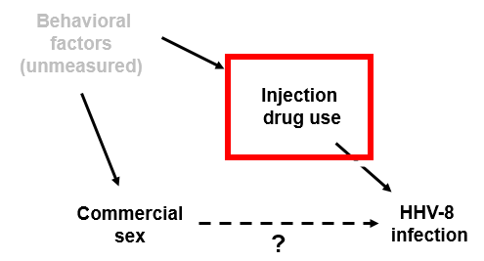
RQ: Does practice of commercial sex result in acquisition of HHV-8 infection?
Issue: Confounding by unmeasured behavioral factors as mediated by injection drug use
  Solution: deal with injection drug use to block path
  When controlling for injection drug use,
  how should it be measured?
Lifetime needlesharing days - B
Some other answer - E
Lifetime needlesharing partners - A
Years of injection drug use - C
Frequency of use of bleach - D
Notes:
So, the question for you is, when controlling for the construct of injection drug use, how should its use be measured, in other words operationalized? Let us say that this is a cross-sectional study. Should you measure number of lifetime needlesharing partners that a study participant reports to you, number of lifetime needlesharing days that a participant reports, years of injection drug use, frequency of the use of bleach, or some other answer?

Slide 12
  When controlling for injection drug use, how should it be measured?
  Answer: injection drug use very difficult to quantitate; instead, restrict to those without injection drug use
  When controlling for injection drug use,
  how should it be measured?
Lifetime needlesharing days - B
Some other answer - E
Lifetime needlesharing partners - A
Years of injection drug use - C
Frequency of use of bleach - D
Notes:
The answer is some other answer, and that is because it is very difficult to quantitate the practice of injection drug use. It is a very complex phenomenon/construct that depends upon the frequency of its performance as well as the types of drug-sharing partners a person has. How will you possibly get injection drug users to remember all of this across their lifetime? We think it is essentially impossible to accurately quantitate injection drug use exposure. Instead, the answer is to restrict to those without injection drug use.

Slide 13
Restriction to Prevent Confounding
Particularly useful when confounder is quantitative in scale but difficult to measure
e.g., Does practice of commercial sex result in acquisition of HHV-8 infection?
  Issue: Confounding by unmeasured behavioral factors as mediated by injection drug use
  Problem: degree of injection drug use difficult to measure
  Solution: restrict to subjects with no injection drug use, thereby preclude need to measure degree of injection use
  .
  Cannon et al. NEJM 2001
    Restricted to persons denying injection drug use
Notes:
The solution is to restrict the study sample to persons who do not inject drugs and therefore you do not have to worry about measuring the magnitude of injection drug use in those who do. This is very clever. In fact, it was done in this NEJM article where the study sample was restricted to persons denying injection use. After doing so, the authors showed data that persons who were commercial sex workers had a 2.2-fold greater prevalence of HHV-8 infection than women who were not commercial sex workers, suggestive that HHV-8 infection can be spread via sexual contact in women.
In another example where we used restriction, we were interested in knowing whether there was a causal role of HIV infection in the occurrence of pulmonary hypertension. The participants were from the San Francisco General Hospital (SFGH). The concern was again over confounding by injection drug use which is known to cause both HIV infection and pulmonary hypertension. Quantitating just how much injection drug use patients at SFGH experience is really not possible. Instead, we restricted the analysis to just those without any self-reported history of injection drug use (and who were also negative for hepatitis C virus infection, a biological surrogate for injection drug use). Note: a restriction approach will not prevent people from not telling the truth. It is recognized that some people might falsely deny ever using injection drugs. This is why the addition of a biological surrogate for injection drug use, hepatitis C virus, served as useful further evidence in this study.

Slide 14
Confounding and Interaction: Part II
Methods to reduce/eliminate confounding
  during study design:
    Randomization
    Restriction
    Matching
    Instrumental variables
  during study analysis:
    Stratification
    (Mathematical regression)
    (Propensity scores)
    (Inverse probability weighting)
    (g-estimation)
Interaction
  What is it?
  Additive vs. multiplicative interaction
  How to detect it?
  Different types of interaction
  Statistical testing for interaction
  Implementation in Stata
  How DAGs help identify candidates?
  Comparison with confounding
Notes:
This technique is known as restriction and is the first of techniques that we will discuss if we cannot randomize and have to, instead, live by our wits.

Slide 15
Restriction to Prevent Confounding
AKA Specification
Definition: Restrict enrollment to those participants who have specific value/range of the confounding variable
e.g., when diet is a confounder, restrict to persons with a certain diet
Notes:
Restriction, also known as specification, is the most blunt method we can use if we cannot randomize. Restriction is where we restrict enrollment in a study just to those participants who have a specific value of the confounding variable in question. For example, when diet is confounder, we would restrict enrollment to persons with a certain diet.
Graphically, what restriction does is to hold the confounding variable fixed and thereby eliminate any possible association between the exposure and the confounder and between the disease and confounder. This is because there is no variability in the values of the confounding variable. It is constant (i.e., fixed) in everyone.

Slide 16
Restriction to Reduce Confounding
Advantages:
  conceptually straightforward
  handles difficult to quantitate variables
  can also be used in analysis phase
Notes:
Let us summarize the advantages and disadvantages of restriction. First, the advantages. One advantage of restriction is that it is very straightforward, and straightforward is good — especially when you trying to convince people who review your grants and manuscripts.
It is also the best approach, without question, for difficult to quantitate variables, like injection drug use in the prior example. Restriction is also advantageous in that decisions about individual participants can be made without having to consider other participants (as is the case with matching, which will be discussed a bit later). This is especially important in studies which prospectively recruit participants in that the investigator can just make an enroll or not enroll decision on each participant during screening without regard to anything that is happening with other participants.
Finally, restriction can also be used in the analysis phase of studies. In other words, you can limit an analysis to a restricted subset even if your study subjects had a broader range of values for the confounding variable. Investigators do this quite commonly, as an “added note of proof” when analyzing their data.

Slide 17
Restriction to Reduce Confounding
Disadvantages:
  may limit number of eligible subjects
  cost-inefficient to screen subjects, then not enroll
  “residual confounding” may persist if restriction categories not sufficiently narrow (e.g., “20 to 30 years old” age restriction might be too broad)
  limits generalizability, but
    “Validity before generalizabilty”
  not possible to evaluate how relationship of interest differs according to the level of the restricted variable (i.e., cannot assess statistical interaction)
    Not a bias; just a less rich study
Bottom Line
  Restriction not used as much as it could be (particularly with difficult to quantitate variables)
Notes:
There are, however, a few disadvantages. One is that restriction reduces the number of persons who are eligible. In the prior example in which commercial sex was the primary exposure, it might be difficult — in some contexts — to find many participants who do not use injection drugs. Depending upon how narrow you limit the restriction, you may become harder and harder to find enough participants. It may also take a lot of work to sift through persons to find those with the level of the confounder you are looking for. It is also cost inefficient to have to screen a lot of subjects and only use some of them.
Another issue is that if you do not restrict the values of the would-be confounder narrowly enough, you may not accomplish what you thought you did. In other words, you may be left with what we call “residual confounding”, in other words, left over confounding. We introduced this term earlier when we referred to the consequences of a mismeasured confounding variables or unmeasured confounding. For example, if you are studying the association between birth order of a child (1st, 2nd, 3rd, etc.) and Down syndrome, you would need to be concerned about confounding by mother’s age. Let’s say you restricted your study population to those mothers who are 20 to 30 years old. This may not be enough to preclude confounding because the older women in this age range (the 30 year olds) may be very different than the youngest persons (20 year olds) in terms of relationship with a) birth order (the exposure under study) and b) Down syndrome incidence (the outcome under study). We will return to this term “residual confounding” later.
Another drawback with restriction is that by limiting the study population to only a specific group of participants with a certain value/range of a confounder, you limit the generalizability of the study (for example, if you restrict to younger persons, you might have a tough sell generalizing to older persons). This is an issue of external validity. Sometimes researchers worry a lot about external validity or generalizability, but, as we have discussed before, the first order of business in determining causality of a relationship is internal validity. In other words, do whatever it takes to determine a valid association, and this might mean you need to study restricted study population. Validity before generalizability is a mantra of causality-oriented research. If you show an association in a narrowly defined population, then go on to do the next study looking for the association in other populations. Even though investigators might think they are enhancing generalizability by studying a diverse group of participants, including small numbers of persons from uncommon strata, such as in the case of race, is not tantamount to comprehensively studying these individuals. Just because you find an overall effect does not mean that this applies to all strata of a confounder if they are small in number. In other words, it is specious to think that your results apply or generalize to all persons in your study who just contributed a little bit of data to your study, such as uncommon race strata. To really understand whether a given exposure is operative in a given racial group or socioeconomic group, you need to include, as an important fraction of your overall study, members of this group in your study or perform a dedicated study of that group. The first order of business is internal validity. Generalizability can follow later. An interesting discussion on the whether study populations should be “representative” can be found in Rothman KJ. Why representativeness should be avoided. International Journal of Epidemiology 42:1012–1014, 2013.
Related to this idea of lack of generalizability is that if you restrict to only one level of the confounding extraneous variable, you cannot evaluate the relationship of interest at different levels of the confounding variable (i.e., you cannot assess statistical interaction — a topic we will discuss later today). A simple example from the field of cancer is that if you were evaluating in an observational study the association between obesity and a specific cancer, the presence and degree of smoking might be an important effect modifier. If you limit your study population to just those participants who had never smoked, you might be missing a very interesting part of the story. This is not an issue of validity; the answer from the study using non-smokers is not wrong. It is just a less rich study if you restrict participants to a certain level of the confounding factor.
The bottom line is that restriction is a good technique that is not used as much as it could be, especially when you have difficult to quantitate confounders that have a discernible null state.

Slide 18
Confounding and Interaction: Part II
Methods to reduce/eliminate confounding
  during study design:
    Randomization
    Restriction
    Matching
    Instrumental variables
  during study analysis:
    Stratification
    (Mathematical regression)
    (Propensity scores)
    (Inverse probability weighting)
    (g-estimation)
Interaction
  What is it?
  Additive vs. multiplicative interaction
  How to detect it?
  Different types of interaction
  Statistical testing for interaction
  Implementation in Stata
  How DAGs help identify candidates?
  Comparison with confounding
Notes:
Let us move to matching, another method which can be used in the design phase to reduce confounding.

Slide 19
Matching to Reduce Confounding
Definition: unexposed/non-case participants are enrolled who match those of the comparison group (either exposed or cases) in terms of the confounder in question
Mechanics depends upon study design:
  e.g., cohort/cross-sectional study: unexposed participants are “matched” to exposed participants according to their values for the confounder.
    e.g. matching on race
  e.g., case-control study: non-diseased controls are “matched” to diseased cases
    e.g. matching on age
Operationally, performed by “individual matching” (one-by-one) or frequency matching (e.g., select control group at the end to match distribution of confounding factor in case group)
One unexposed_{latino} enrolled for each exposed_{latino}
One unexposed_{asian} enrolled for each exposed_{asian}
One control_{age} ₅₀ enrolled for each case_{age} ₅₀
One control_{age} ₇₀ enrolled for each case_{age} ₇₀
can be age ranges, e.g., +/- 2.5 years
Notes:
We will point out at the outset that matching is a complex topic, about which we will only scratch the surface today. What we do in matching is to choose participants (either unexposed persons in cohort/cross-sectional designs or non-cases in case-control studies) who match those of the comparison group (either the exposed group in cohort/cross-sectional studies or the cases in case-control studies) in terms of the confounding factor in question.
The mechanics of matching depend upon the study design. For example, in a cohort study or a cross-sectional study, if you were concerned about race as a confounder, you might match on race. For each white exposed person, you would choose one (or more) white unexposed person. For each Asian exposed person, you would choose one (or more) Asian unexposed. Note: if the unexposed group was rarer in prevalence than the exposed group, one could start with the unexposed and then identify exposed persons who match the characteristics of the unexposed.
Similarly, in a case-control study, if, for example, we performed a study of, say, diet and cancer and were worried about age as a confounder, we might match on age. For each case who was 50 years old, we would choose one (or more) controls who was 50 years old. For each 70 year old case, we would select one (or more) 70 year old controls. We do not have to match exact age (which is an example of an interval scale measurement), e.g. 50 to 50. Instead, we can match to a range, e.g., within plus or minus 2.5 years. The larger the age range, the more likely one begins to get into problems of residual confounding.
Incidence density sampling in case-control studies matches on calendar time when conducted within a dynamic underlying cohort. Density sampling matches on time under observation when conducted within a fixed underlying cohort.
Note: In a cross-sectional study, if the sampling was performed according outcome status (e.g., akin to a prevalent case-control study), matching could also occur between the diseased and non-diseased.
Operationally, matching is performed by either “individual matching” where, for example in the situation of a case-control study, for each case you would find one or more controls who had the same value of the potential confounder as the case. In what is called “frequency matching”, the investigator determines what the distribution of the confounder is in the case group, for example, and then selects participants in the control group to match the distribution of the confounder in the case group.

Slide 20
Matching to Reduce/Eliminate Confounding
Cross-sectional/cohort study
Uncommon in large cohort studies typically because there is not just one exposure of interest
More common and can be valuable in smaller studies with a single focused exposure
Case-control study
More common use of matching
Can be relevant for a variety of exposures
Notes:
So, back to our DAG, this is what matching does. For a cross-sectional or cohort study, matching results in prohibiting any association between the exposure and the confounder, as seen in the top panel. (We could have also removed the edge between C and E.)
You will not commonly see matching in large “classic” cohort studies or cross-sectional studies. This is because there is typically not just one exposure of interest and so there is not any single exposed and unexposed grouping to match. Instead, matching can be useful in smaller more focused cohort or cross-sectional studies with just a single exposure of interest.
In a case-control study, matching precludes any association between the disease and the confounder as shown in the right panel. Matching is most commonly performed in case-control studies. Investigators think of it because there are clearly two distinct groups to match on ― the cases and the controls. In case-control studies, matching on a given confounding factor can be relevant for a variety of exposure variables of interest.
Note: we have not placed a box around C but this is not strictly a conditioning technique. Instead, you are guaranteeing the same distribution of the confounder between comparator groups, just like randomization. You are not holding anything fixed; you are just balancing the distributions of a confounder. However, many matching methods require conditioning upon the matching variable in the analysis. Without this conditioning, the measures of association will be biased.

Slide 21
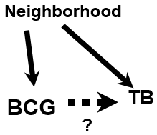
Advantages of Matching
1. Useful in preventing confounding by factors which might be impossible, or, at a minimum, statistically inefficient to manage in analysis phase. We call them “complex nominal variables”.
  e.g., “neighborhood” is a nominal variable with multiple values (complex nominal variable)
  e.g., Case-control study of the effect of a BCG vaccine in preventing TB (Int J Tub Lung Dis. 2006)
    Cases: newly diagnosed TB in Brazil
    Controls: persons without TB
    Exposure: receipt of a BCG vaccine
    Confounder: neighborhood (village) of residence; causally related to
    ambient TB incidence and practices regarding BCG vaccine
    Control sampling: Relying upon random sampling without attention to neighborhood may result in (especially in a small study) choosing no controls from some of the neighborhoods seen in the case group
      i.e., cases and controls would lack overlap in neighborhood
      Matching on neighborhood would ensure overlap
    Even if all neighborhoods seen in the case group were represented in the control group, adjusting for neighborhood with “analysis phase” strategies is less statistically efficient
Matching is most efficient approach for control of complex nominal variables
Notes:
Matching does have several advantages. It is the one of the best ways to manage certain confounding variables. For example, “neighborhood” is a nominal variable with multiple values; we call this a complex or multi-level nominal variable. Think of all the neighborhoods in San Francisco (there are officially 36) as an example of a complex nominal variable. Other cities may even have more neighborhoods.
A nice literature example examined the effect of a second BCG vaccine in preventing the occurrence of tuberculosis (TB). In this study in Brazil, cases were defined as persons with newly diagnosed tuberculosis. Controls were individuals without TB. The principal exposure under study was receipt of a second BCG vaccination. Here, a confounder is neighborhood of residence. This is because neighborhood is causally related with risk for TB by virtue of the ambient levels of transmissible TB in the neighborhood and it is also causally related to local practices as to whether second BCG vaccination is routinely given (because residents of a neighborhood tend to get a certain type of care).
If one had to rely upon random sampling of controls from throughout Brazil, one might end up choosing no controls from some of the neighborhoods seen in the case group. This is especially true in a small study. If you have persons in the case group for whom there are no persons in the control group with the same value of the neighborhood, you are not going to be able to use any adjustment techniques to adjust for this confounder in the analysis phase. In other words, the cases and controls will lack complete overlap on neighborhood. More formally, having lack of overlap is called a violation in the positivity assumption. The positivity assumption is one of the formal assumptions of what is needed to derive a valid causal inferences. By matching on neighborhood, you are assured that for every case with a given neighborhood there will be at least one control with the same neighborhood. Cases and controls will completely overlap in terms of their distributions of neighborhood.
Even if you did manage to find in your random sampling of controls enough controls to make sure that all the neighborhoods in the case group were represented (by finding at least one control with that neighborhood), the actual mechanics of adjusting for these in the analysis phase is problematic because the neighborhood variable has so many multiple possible values. You likely would have a hard time handling these multiple values of the confounder with conventional stratification or mathematical regression techniques. This is because such techniques cannot tolerate a large number of values for exposure variables without some type of penalty to your analysis. To accommodate this, you would need to use the same “matched analysis” or “conditional” techniques that are used in conjunction with matching in the design phase. However, using these techniques solely in the analysis phase without matching upfront is less efficient than if you had matched in the design phase.
In summary, matching is the most efficient approach for complex nominal variables.

Slide 22
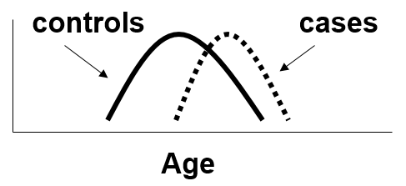
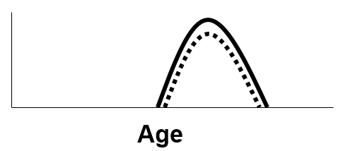
Advantages of Matching:
Extends to Continuous & Ordinal Variables
2. Provides a way to ensure overlap between comparator groups (e.g., cases/controls) in the distribution of confounders other than complex nominal variables (i.e., ensures overlap for all variable types)
e.g., Case-control study of prostate cancer and diet
  Concern regarding confounding by age
  Cases will have many old individuals
  Random sampling of controls, especially in smaller studies, apt not to contain oldest individuals
  Matching age distribution of controls to age distribution of cases ensures complete overlap in age between cases and controls
Notes:
This assurance of complete overlap in the potential confounder provided by matching extends beyond complex nominal variables. It also applies to interval scale (e.g., continuous) or ordered categorical variables. Consider a case-control study of prostate cancer in which the exposure is diet. In such a study, there is concern for confounding by age. Certainly, the case group will contain many older individuals. If one just randomly sampled a control group from the general population, it is possible, especially in a small study, not to contain men as old as in the cases, and it may contain many younger men. This is shown here in the two distributions of age in cases and controls. In a situation like this, there is no way to completely adjust for age in the analysis phase. (Again, this is formally called a violation of the positivity assumption.) Both stratification and regression techniques need there to be overlap between the cases and controls in the distribution for the confounding variable. In other words, for each level of a confounding variable for which a case has this value, there needs to be a non-zero probability of the controls having this value or level as well. If there is not, then the cases without a comparable control need to be discarded from the analysis.
In the schematic we have drawn, there are no controls to use to compare against the older cases. Matching provides a solution for this because it ensures that the distribution of age in the controls will completely overlap the age distribution in the cases. Now, in the analysis phase, you can adjust for age completely.

Slide 23
Advantages of Matching
3. By ensuring a balanced number of cases and controls (in a case-control study) or exposed/unexposed (in a cohort study) within the various strata of the confounding variable, statistical precision of a study’s inference may be increased
Notes:
A third advantage is that matching may provide you with increased statistical precision in your inferences (i.e., smaller standard errors and narrower confidence intervals). This is especially true in case-control studies by ensuring a balanced number of cases and controls within the various strata of the confounder. This balance means tighter precision.

Slide 24
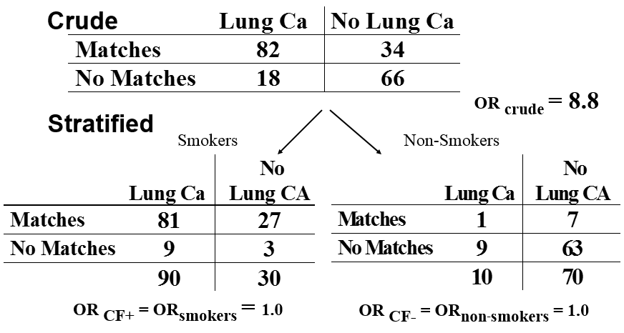
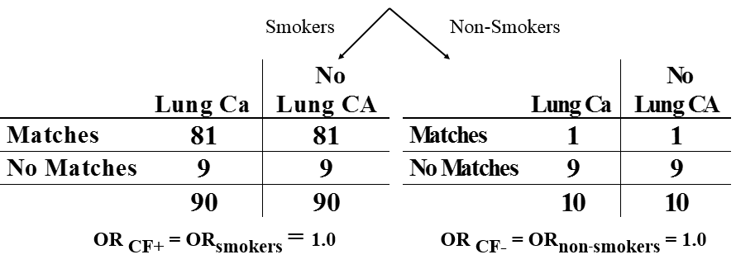
Smoking, Matches, and Lung Cancer
A. Random Sample of Controls
B. Controls matched on smoking
  OR_{adj} = 1.0 (0.31 to 3.2)
  OR_{adj} = 1.0
  (0.40 to 2.5)
Matching facilitates statistically efficient stratification
Underappreciated benefit of matching: Improved precision
Notes:
An example of this is our familiar smoking, matches, and lung cancer analysis.
Recall from last week that if one performs a case-control study and randomly samples controls from the general population, you will get the following: a crude or unadjusted odds ratio of 8.8 evaluating the association between matches and lung cancer. After adjustment for smoking, the two smoking-specific strata now feature OR’s of 1.0. When we pool these 2 strata, using a method we have not yet described, we get an OR of 1.0 with the 95% confidence interval (CI) you see. But what if we instead matched on smoking when we sampled the controls. Again, we can choose the controls from the population at large but for every lung cancer case that is a smoker we identify a control who is a smoker. For every lung cancer case that is a non-smoker, we randomly select a control who is not a smoker.
In the matching scheme, we end up with better balance in the smoking strata. Notice, in the smokers, we see 90 cases and 90 controls, in the non-smokers, we see 10 cases and 10 controls. When we pool the 2 stratum-specific OR’s to get the overall adjusted OR, we get the same point estimate as when we sampled controls randomly from the population, but now notice that the CI is narrower, i.e. increased statistical precision, even though the overall sample size is the same. This is all because better balance has been achieved in the comparisons: 90 cases vs 90 controls in the smoking stratum and 10 vs 10 in the non-smoking stratum. This is the point that few realize about matching; it can sometimes improve statistical precision. It can be thought of as doing this by setting up, or facilitating, a statistically efficient stratification. This is also a reminder that in case-control studies, all matching in the analysis must be followed by a stratified analysis or regression in the analysis phase.
Advanced topic: 1:K matching

Slide 25
Advantages of Matching
4. People find matching easy to understand; there is a natural appeal
  If one group is matched to another group on one or more factors, groups begin to look “exchangeable”
  So intuitive that matching often the first choice among the uninitiated (“let’s match on x, y, and z”)
    This is both good and potentially bad
Notes:
The last advantage is that people, laypersons and scientists alike, find matching easy to understand. We have surmised that this is because matching appears very close to fulfilling the exchangeability objective that we discussed last week, which strives to have the two populations under study exchangeable in terms of the “other influences” on them. Matching is an obvious deliberate attempt to make two or more groups comparable; everyone understands this. Of course, matching only results in the two groups being exchangeable in terms of the matching factors and hence they may be, in reality, far from exchangeable.
Matching is indeed so intuitive that it is often the first choice that comes to mind among the uninitiated. I cannot tell you how often I here “let’s match on x, y, and z” when planning a study. This is both a good thing — matching is easy understood — and a bad thing, in that matching in the hands of the uninitiated can sometimes cause more problems than it is worth.

Slide 26
Disadvantages of Matching
1. Finding appropriate matches may be difficult and expensive. Thus, the gains in statistical efficiency can be offset by increases in overall costs.
  As long as can ensure overlap, may be better just to enroll more subjects and stratify
  Exacerbated when matching > 1 factors jointly
In a case-control study, factor used to match cannot be itself evaluated as a causal determinant for the disease. In general, matching decreases robustness to address secondary questions.
In a case-control study, must still account for matching in the analysis phase of study
  i.e., must still perform either stratification (McNemar’s test) or regression (conditional logistic) in the analysis phase
  This is because matching artifactually induces cases and controls to look more similar regarding exposure
  If this extra step is forgotten (out of ignorance or the matching aspect simply gets lost over time) the crude OR is biased
Notes:
We say that matching is potentially “bad” because there are disadvantages. First of all, it may be time- and resource-consuming to sift through participants to find appropriate matches. As long as you believe you will have overlap in confounder distribution between comparator groups, the inefficiencies of having to find specific matches may outweigh the benefits gained in statistical precision. In other words, it may have been better (easier and cheaper) just to enroll more participants and deal with confounding in the analysis phase (via stratification or regression). Although less efficient (in terms of statistical value per participant), the latter approach could achieve just as narrow (or even narrower) precision at the same or lower cost. This problem is exacerbated when matching > 1 variables jointly. It gets harder and harder to find people who are, for example, Asian/female/60 years old.
Second, in a case-control study, because you have artificially precluded any association between the confounder and the outcome, you cannot directly assess in the study whether this factor is indeed causally related to the outcome. This illustrates how matching, in general, works toward reducing the robustness of a study for secondary research questions.
Third, as mentioned earlier, in a case-control study, you must still also perform stratification or regression in the analysis phase to avoid bias. This is because the matching process has artifactually made the cases and controls like more alike for the exposure (see DAG in the Additional Material slides that depicts this). If this step of needing to do something in the adjustment phase is forgotten (either out of ignorance or because the data gets old and no one can remember if it was derived by matching), then any resulting crude odds ratios will be biased (typically toward the null).

Slide 27
More Disadvantages of Matching
4. Decisions are irrevocable
If you happened to match on a mediator (an intermediary factor) of a directed (causal path), you have lost ability to evaluate role of exposure in question via that pathway
    e.g., study of effect of exercise on coronary artery disease. Matching on HDL cholesterol precludes ability to assess total effect of exercise
Inadvertently matching on a collider also permanently induces bias
If factor matched on really isn’t a confounder, bias and statistical precision can be worse than no matching.
Particularly a problem for factors strongly associated with exposure but not with outcome (“instrument variable – IV’s” – see next section)
Bottomline:
Matching very useful in certain situations but should not be done indiscriminately.
Think carefully before you match & seek advice
Notes:
The list of disadvantages continues. Fourth, the decisions you make about matching are irrevocable. For example, let us say you did not understand last week’s lecture and matched upon a mediator (an intermediary variable) in a directed (causal) path. You then will have lost the ability to look for an effect of your exposure through that pathway. An example of this is if you were studying the effect of sexual activity on cervical cancer. If you happened to match on HPV status of cervical specimens, you would have precluded your ability to detect an effect of sexual activity and there would be no ability to undo this. Or, in a study of the effect of exercise on coronary artery disease, matching on HDL cholesterol precludes ability to look at the total effect of cholesterol. In other words, you cannot undo matching that has already occurred. The other way you could get irrevocably into trouble is if you matched on a collider (and there was nothing else — a non-collider — in the path you could adjust for to undo the opening of the path).
Fifth, if the variable you are concerned about causing confounding really is not a confounder than you will actually, in some instances, suffer losses, not gains, in both bias and/or statistical precision compared to a situation where you did not match. In other words, you may do more harm than good. This is particularly true for factors that are causally related to exposure but not to outcome; such factors are called “instrumental variables” and they are actually the topic of the next section. The problem is especially true for strong instruments, variables that are strongly associated with exposure but not associated with outcome. The problem regarding worsening bias caused by matching on an instrument is known as “bias amplification”, and it will be covered in the next lecture. It is called bias amplification because the mechanism is an amplification of some other confounding pathway that is not being managed fully, an entity which is called “residual confounding”. In other words, matching on an instrument does not directly cause bias itself if no other unmanaged confounding is present. The problem in worsening precision can occur when you match on a factor that is solely related to exposure, solely related to outcome but in a weak way, or related to neither exposure nor outcome. These issues are not unique to matching but, in fact, also occur with stratification and mathematical regression as well.
What is the bottom line? Matching can be very useful in certain situations, especially when in order to ensure complete overlap of the confounder. However, it should not be done indiscriminately. Think carefully before you match and seek advice.

Slide 28
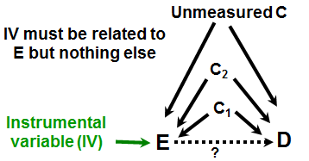
Confounding and Interaction: Part II
Methods to reduce/eliminate confounding
  during study design:
    Randomization
    Restriction
    Matching
    Instrumental variables
See Additional Material Slides
Notes:
The last technique to consider in the design phase is the most recently developed but also among least common because it can only sometimes be used. The technique is called an instrumental variable or “IV”. This is explained in the Additional Material Slides. It turns out that DAGs make IV’s easy to understand. IVs, as noted on the last slide, are variables associated with exposure but not with outcome (other than via exposure). In some situations, IVs exist but for others, they do not.
Of note, choosing an IV is something that needs to be done in the design phase, but there is also some math to be done in the analysis phase to be able calculate what we want, which is an unbiased association between E and D.

Slide 29
Design Phase Techniques to Manage Confounding
Technique | Advantages | Disadvantages
Randomization | Manages all known and unknown confounders | None, other than it cannot always be done
Restriction | Good for difficult-to-quantitate variables with a discernible null state | Limits eligible subjects Limits generalizability
Matching | Handles complex nominal variables Assures overlap in confounder Enhances precision | Limits eligible subjects May backfire if factor truly not a confounder Must also be dealt with in design phase
Instrumental variables | Manages all known and unknown confounders | None, other than often cannot find an “instrument”
Notes:
Here is a summary of the techniques we have just discussed for managing confounding in the design phase.

Slide 30
Confounding and Interaction: Part II
Methods to reduce/eliminate confounding
  during study design:
    Randomization
    Restriction
    Matching
    Instrumental variables
  during study analysis:
    Stratification
    (Mathematical regression)
    (Propensity scores)
    (Inverse probability weighting)
    (g-estimation)
Interaction
  What is it?
  Additive vs. multiplicative interaction
  How to detect it?
  Different types of interaction
  Statistical testing for interaction
  Implementation in Stata
  How DAGs help identify candidates?
  Comparison with confounding
Notes:
So, that is all for approaches we can use in the design phase. How about the analysis phase, meaning once the measurements are already made and we are ready to analyze the data? Indeed, we have already introduced the first strategy, stratification, when we introduced confounding last week. Stratification was the first technique we discussed.

Slide 31
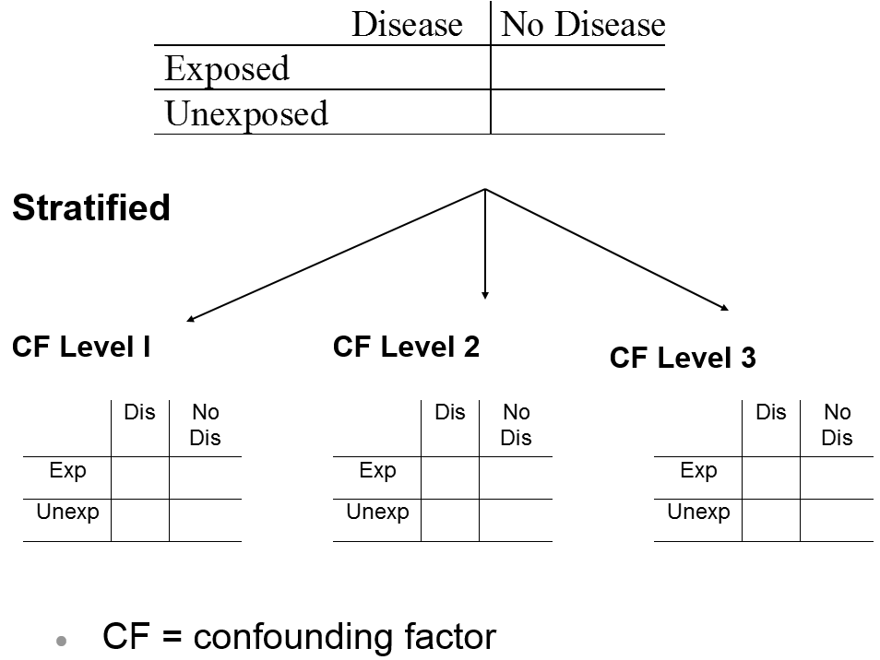
Stratification to Reduce/ Eliminate Confounding
Strategies in the analysis phase
Crude/Unadjusted/Marginal
Goal: evaluate the relationship between the exposure and outcome in strata homogeneous with respect to confounding variables
Each stratum is a mini-example of restriction!
CF = confounding factor
Notes:
Remember, that in stratification we create strata that are homogeneous with respect to the different values or levels of the confounder. In doing so, we have in each stratum created a mini-example of restriction. Everyone in the stratum nominally has the same level (value) of the confounder variable, and, therefore, confounding theoretically cannot occur in that stratum. Without variability in the confounder, there can be no association with exposure or outcome. Both exposed and unexposed participants in each stratum have the same degree/amount of the confounder in question.

Slide 32
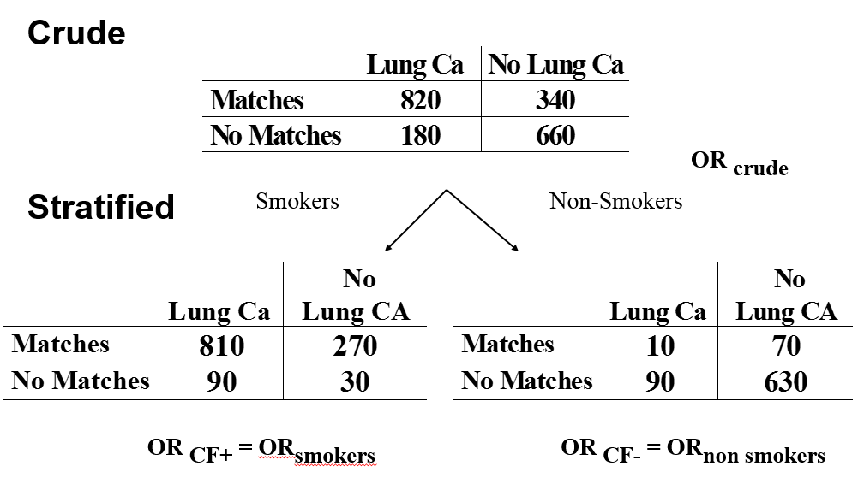
Smoking, Matches, and Lung Cancer
OR_{crude} = 8.8
Each stratum is unconfounded with respect to smoking
OR_{smokers} = 1.0
OR_{non-smoker} = 1.0
Notes:
Recall, in our initial example, when we were concerned about the confounding effect of smoking on the relationship between matches and lung cancer, we stratified on the two values of smoking: smoking present and smoking absent. Each of these strata is now unconfounded with respect to smoking status. After we create these strata, we observed that each smoking specific-stratum odds ratios has became one. The difference between the crude and adjusted measure of association represents bias due to confounding.

Slide 33
Obtaining Adjusted Estimate from the Stratified Analyses
After the strata have been formed, what next?
Process: Summarize the unconfounded estimates from the two (or more) strata to form a single overall unconfounded “adjusted” (aka “conditional”) estimate
  e.g., for matches-lung cancer example, summarize the odds ratios from the smoking stratum and non-smoking stratum into one odds ratio
Notes:
Now that we have formed our strata and gotten rid of confounding in each stratum, what is the next step in the process? The next step is to summarize the unconfounded estimates from the two or more strata into one single overall unconfounded “adjusted” estimate. This is also known as a “conditional” estimate. It is called this because it is a product of conditioning upon (i.e., holding fixed) a third variable (in this case, smoking status).

Slide 34
Smoking, Matches, and Lung Cancer
OR_{crude} = 8.8
OR_{smokers} = 1.0
OR_{non-smoker} = 1.0
OR_{adjusted} = 1.0
Notes:
In the smoking, matches, and lung cancer example, the measures of association from the different strata were identical; they are both equal to 1. Here the summary of these two strata is easy: the summary, or adjusted, measure of association is 1. However, in real life it is seldom the case that the estimates from the various strata are identical.

Slide 35
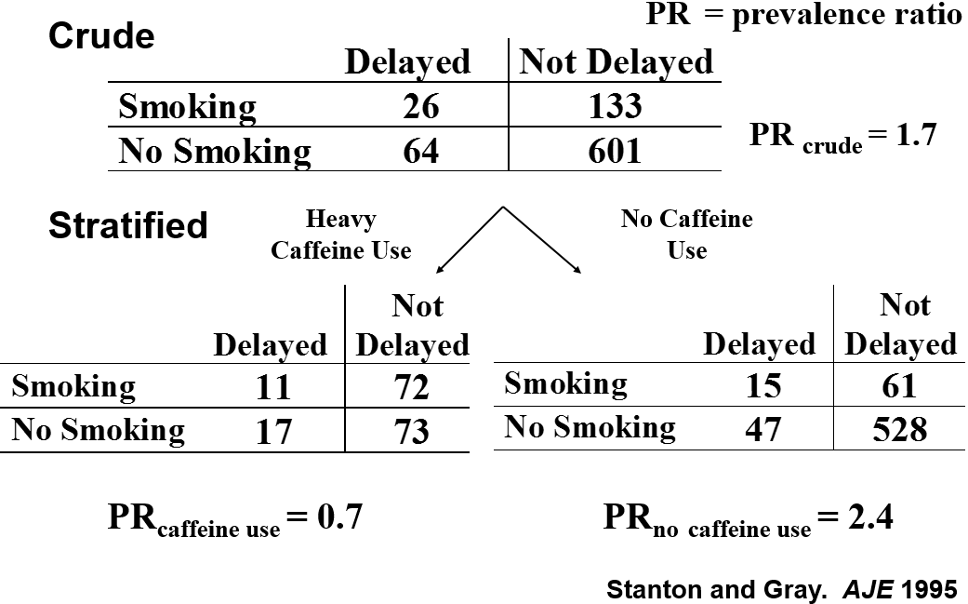
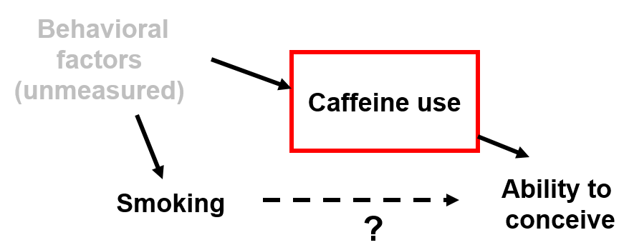
Smoking, Caffeine Use and Delayed Conception
Cross-sectional study in reproductive age women: effect of smoking on ability to conceive a child (i.e., become pregnant/give birth; delayed conception vs non-delayed)
Stanton and Gray. AJE 1995
Notes:
Consider this example from a cross-sectional study of the effects of smoking in the occurrence of delayed pregnancies (called “delayed conception”) among women of reproductive age who were hoping to conceive. The outcome is having had experienced a delay in conception versus having not experienced such a delay. The principal exposure in question is smoking, but, say, we are concerned about the confounding effects of unmeasured behavioral factors that both cause people to smoke and also to ingest large amounts of caffeine. Let us say we know that ingestion of large amounts of caffeine influences ability to conceive. The DAG is shown.
Look what happens after we stratify by caffeine use. In those women who do not use caffeine, smoking is associated with over a two-fold occurrence of delayed conception. But in women who use lots of caffeine the prevalence ratio is 0.7, if anything a protective effect.

Slide 36
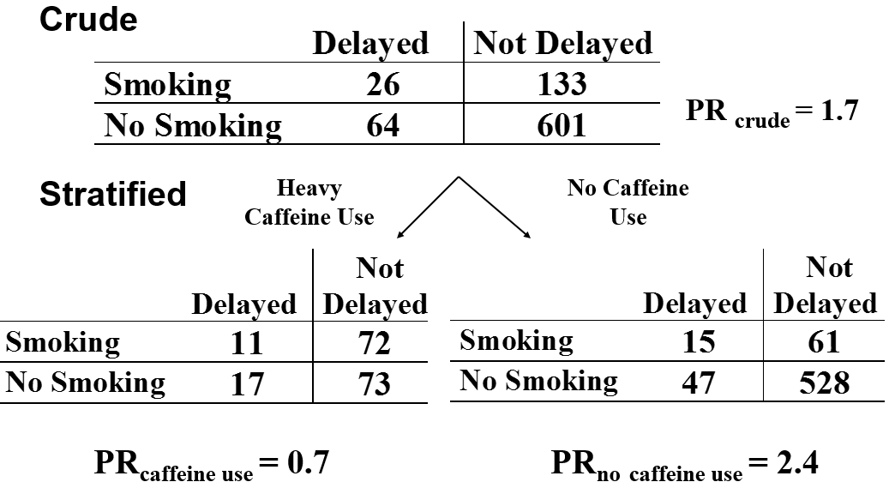
Smoking, Caffeine Use and Delayed Conception
What is the unconfounded “adjusted” estimate of the prevalence ratio?
Prevalence Ratio = 1.1 - B
Prevalence ratio = 0.9 - A
Some other better answer - D
Prevalence Ratio = 2.0 - C
Notes:
What do you think is the unconfounded “adjusted” estimate of the prevalence ratio? Is it 0.9, 1.1, 2.0, or some other answer?

Slide 37
Smoking, Caffeine Use and Delayed Conception
What is the unconfounded “adjusted” estimate of the prevalence ratio?
Prevalence Ratio = 1.1 - B
Prevalence ratio = 0.9 - A
Some other better answer - D
Prevalence Ratio = 2.0 - C
Notes:
The correct answer is “some other answer” and that other answer is that it is not appropriate to form this adjusted estimate.

Slide 38
Underlying Assumption Needed to Form a Summary/Adjusted Estimate of the Unconfounded Stratum-Specific Estimates
If the relationship between the exposure and the outcome varies meaningfully in a clinical/biologic sense and statistically across strata of a third variable:
  it is not usually appropriate to create a single summary estimate across strata
To create one single summary estimate, the assumption is that the different strata are basically all estimating the same number/entity
  they only differ because of sampling error
i.e., When you summarize across strata to get one single estimate, the assumption is that no “statistical interaction” is present
Notes:
If we look at these two stratum-specific estimates more closely, I think most of us would agree that it does not make much sense to try to summarize these two very different numbers into one. If we did, we are very much missing an important aspect of the system under study. This illustrates the one assumption that is needed before one embarks upon attempting to form a summary adjusted estimate between the different strata in stratified analyses. The assumption is that the different strata are basically all estimating the same number (i.e., same thing or entity). If the relationship between the exposure and disease/outcome under study differs “meaningfully” in a clinical/biologic sense (and we will talk about what we mean by “meaningful” later) according to the level of a third variable, as well as statistically (we will describe what kind of threshold to consider later), then it is typically not appropriate to form an overall summary estimate across the strata.
More precisely in the jargon of epidemiology, the assumption you need before you estimate one overall measure of association by combining two or more stratum-specific estimates is that “statistical interaction” is not present across the strata.

Slide 39
Confounding and Interaction: Part II
Methods to reduce/eliminate confounding
  during study design:
    Randomization
    Restriction
    Matching
    Instrumental variables
  during study analysis:
    Stratification
    (Mathematical regression)
    (Propensity scores)
    (Inverse probability weighting)
    (g-estimation)
Interaction
  What is it?
  Additive vs. multiplicative interaction
  How to detect it?
  Different types of interaction
  Statistical testing for interaction
  Implementation in Stata
  How DAGs help identify candidates?
  Comparison with confounding
Notes:
This means that we are here in our outline. We will now discuss interaction.

Slide 40
Statistical Interaction
Definition
  when the magnitude of a measure of association (between exposure & disease) meaningfully/statistically differs according to value of a 3rd variable
Synonyms
  Effect-measure modification*
  Effect modification
  Heterogeneity of effect
  Heterogeneity of measure
  Non-uniformity of effect
  Effect variation
  “When one influences another”
Proper terminology
  e.g., Smoking, caffeine use, delayed conception
    Caffeine use modifies the effect of smoking on the occurrence of delayed conception.
    There is interaction between caffeine use and smoking in the occurrence of delayed conception.
    Caffeine is an effect modifier in the relationship between smoking and delayed conception.
* preferred
Notes:
The example using smoking, caffeine use, and delayed conception illustrates what we call “statistical interaction”, which is what we call the situation when a particular measure of association (between an exposure and disease; for example, a risk ratio or a prevalence ratio) meaningfully differs according to the level of some third variable.
Synonyms for statistical interaction include effect-measure modification, effect modification, heterogeneity of effect, heterogeneity of measure, non-uniformity of effect, and effect variation. You will hear interaction and effect modification most commonly, but the preferred term on this list is effect-measure modification, and the reason for this will be clear in a few minutes. A more poetic synonym is “when one influences another”.
What’s the proper terminology in this situation? For example, we would say:
Caffeine use modifies the effect of smoking on the occurrence of delayed conception.
There is interaction between caffeine use and smoking in the occurrence of delayed conception.
Caffeine is an effect modifier in the relationship between smoking and delayed conception.

Slide 41
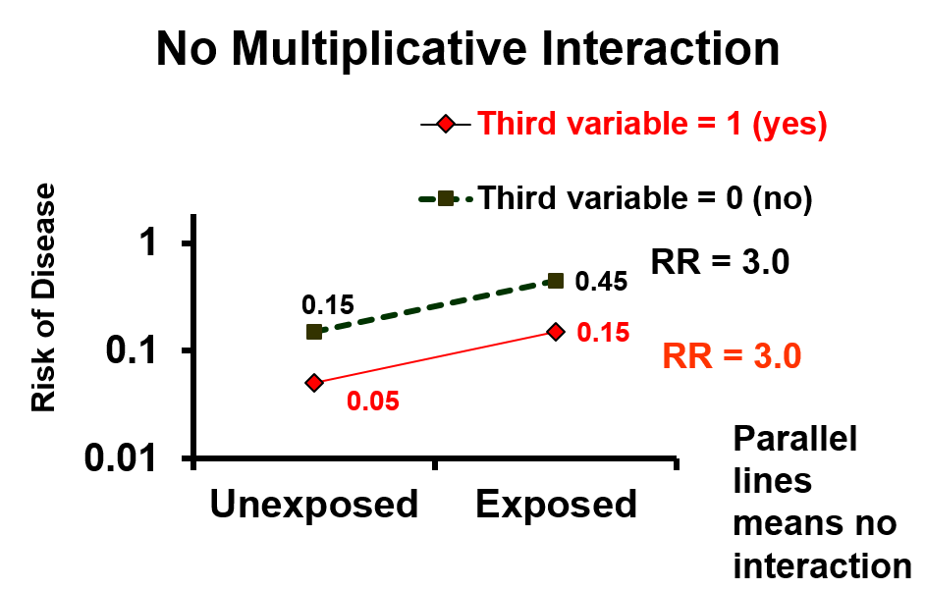
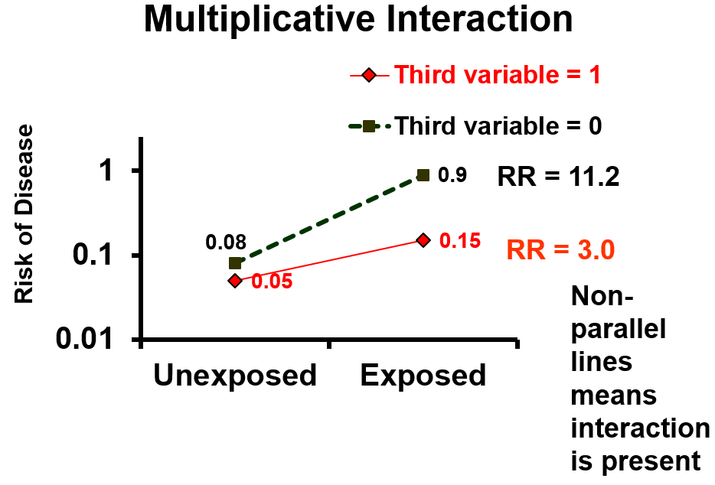
0
1
Notes:
The S+N text, like many others, uses a graphical approach to depict interaction. These graphs show the findings from a simple situation with a dichotomous exposure (exposed vs unexposed), dichotomous outcome and dichotomous third variable, as shown in the generic stratification schematic at the top of the panel. In this schematic, we are stratifying into two strata, one in which the value of the third variable is set to (held fixed at) 0 and another stratum in which the value is set to 1.
Let us look at the graph on the left first. Risk of disease (in a log base 10 scale which remember defines it as a multiplicative scale) is shown on the y axis; exposure status (exposed vs unexposed) is on the x axis. Let us look at the line with the red symbols first; it is for persons who have the value of some third variable (perhaps a confounder but not necessarily) equal to “present”, “yes” or 1. When the third variable is “yes” (or 1), the risk of disease in the unexposed group is 0.05 and it goes up three fold to 0.15 in the exposed group. When the third variable is equal to “no” or 0 or “absent” (the black line), risk in unexposed is 0.15 which goes up to 0.45 in the exposed group, again a 3 fold increase. In other words, the risk ratio does not change according to the third variable. The lines are parallel; parallel lines means that there is not statistical interaction in terms of the risk ratio. Because we are working on the multiplicative scale, we say that there is not interaction on the multiplicative scale or “no multiplicative interaction”.
In the bottom graph, you can see that the risk ratio of disease does change according to the level of the third variable. With the third variable equal to “present”/”yes”/”1”, the risk ratio is 3.0. When the third variable is equal to absent/no/0, the risk ratio is 11.2. Non-parallel lines means statistical interaction is present.

Slide 42
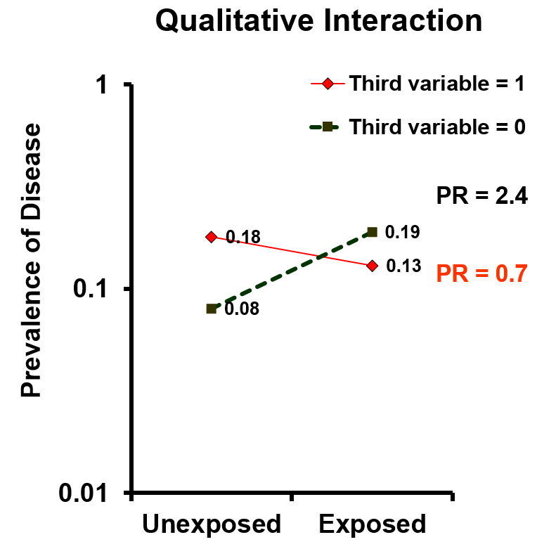
Third variable = 1
Heavy caffeine use
No caffeine use
Prevalence of delayed conception
No smoking
Smoking
Notes:
These are the data from the smoking, caffeine use, and delayed contraception example. What is going on here? In the presence of heavy caffeine use, exposed persons (smokers) appear to be protected relative to unexposed (non-exposed), but in the absence of caffeine use (black), exposed persons (smokers) are at have over two-fold increased prevalence of delayed conception. The effects in the two levels of the third variable are on the opposite sides of 1.0. This is what we call qualitative interaction; in other words, the interaction is substantial.

Slide 43
Interaction is everywhere
Susceptibility to infectious diseases; e.g.,
    exposure: sexual activity with HIV-infected partner
    disease: HIV infection
    effect modifier: human chemokine receptor genotype and phenotype
Susceptibility to non-infectious diseases; e.g.,
    exposure: smoking
    disease: esophageal cancer
    effect modifier: alcohol use
Susceptibility to drugs (efficacy and side effects)
    effect modifier: genetic susceptibility to drug
      e.g., VKORC1 / CYP2C9 and warfarin
    “personalized/precision medicine” is an expression of interaction
Genetic factors featured here as root of interaction but they are not the only such factors
Although we believe that interaction is everywhere, it is not so easy to convincingly prove
Notes:
If you think about it for a moment, I think you will agree that interaction is everywhere around us.
As an example from infectious diseases, if the exposure is sexual activity with an HIV-infected partner and the outcome is HIV infection, we know that certain persons are more apt to become infected with HIV given sexual activity than others. One such effect modifier that has been discovered is the presence of a particular human host chemokine receptor phenotype (CCR5 -- the cellular receptor for HIV), which is the product of a particular genetic deletion. Another example is Zika virus infection and the occurrence of neurologic defects in newborns. Of all pregnant women who get infected with Zika virus, only a fraction will go on to have newborns with neurologic defects. The effect modifier of Zika virus infection is a topic of intense investigation.
Among non-infectious diseases, we have the classic example of smoking and alcohol use in the occurrence of esophageal cancer. Smoking and alcohol use modify each other’s effect on the occurrence of esophageal cancer. Another example is smoking and lung cancer. There are host genetic factors that modify the effect of smoking on lung cancer.
How about the effectiveness of drugs? We all know there is substantial heterogeneity in terms of how people respond both in terms of therapeutic efficacy and toxicity and that some of this is due to various genetically coded susceptibilities. One example is the response to the blood thinner drug called warfarin. We know that polymorphisms in two genes influence susceptibility to warfarin. The first is CYP2C9 (pronounced “sip two see nine”), which is responsible for the breakdown of warfarin into its inactive form. The second gene encodes the enzyme that is responsible for activating vitamin K. This enzyme is called vitamin K epoxide reductase complex subtype 1 (VKORC1, pronounced “vee cor see one”). Examples like these form the basis what is being called personalized medicine or precision medicine. Indeed, precision medicine — the new slogan for this university — is an expression of interaction. A methodologic understanding of interaction is what we use to prove the evidence base for personalized medicine.
Although we have featured genetic factors on this slide as some of the prominent source of interaction, they are certainly not the only factors.
Although we all believe that interaction is likely everywhere around us, it has been — to date — in practice actually relatively difficult to document these factors. This may be changing as measurement science gets better and as appreciation grows for the additive scale. In particular, there is hope that with the genomics revolution we will be able to find these more of these different host susceptibility factors — factors that are responsible for interaction.

Slide 44
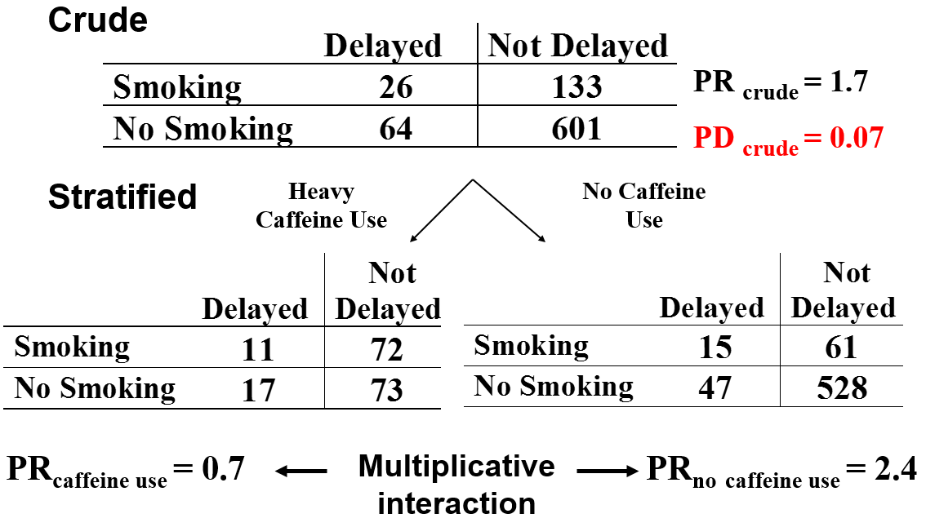
A Ratio is Not the Only Measure of Association: Additive vs Multiplicative Interaction
PD = Prevalence Difference
= Prevalence _{exposed} - Prevalence _{unexposed}
Notes:
Getting back to our example, you know that the ratio measure is not the only measure of association we have to choose from when characterizing the association between an exposure and outcome. The other measure is an absolute difference between exposed and unexposed, which is called a prevalence difference in a cross-sectional study, shown here (in red) as PD, or a risk difference in a cohort study. In these 2x2 tables, this is simply the prevalence in the exposed minus the prevalence in the unexposed.
When there is interaction in terms of the ratio measure of association (in this case, the prevalence ratio), we call this multiplicative interaction. So, just as there could be interaction in the ratio measure there might also be interaction in the difference measure. In fact, here, in this example, there is. Among caffeine users, the prevalence difference is -0.06. Smokers have 0.06 less prevalence than non-smokers. Among non-caffeine users, smokers have +0.12 absolute prevalence. Statistical interaction in the risk difference is called additive interaction.

Slide 45
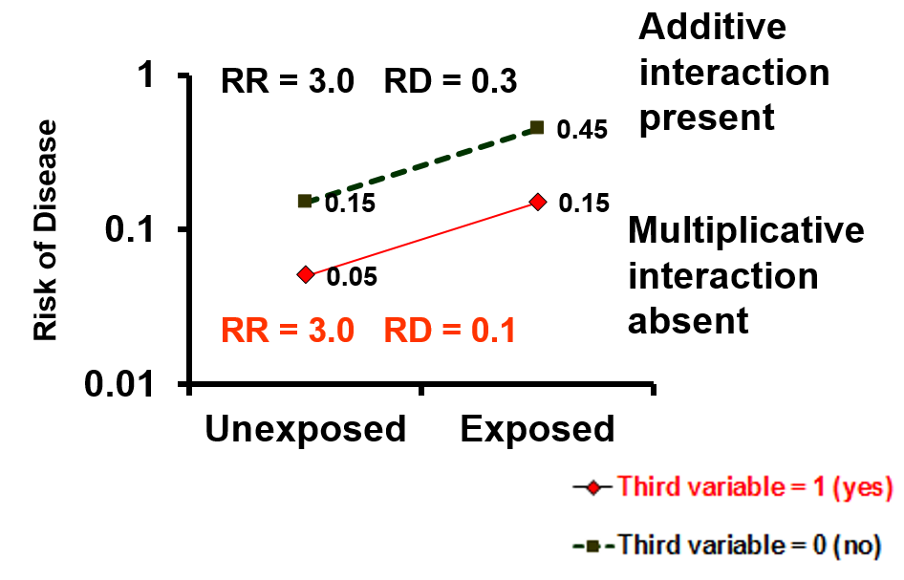
Additive vs Multiplicative Interaction
Assessment of whether interaction is present depends upon the measure of association
  ratio measure (multiplicative interaction) or difference measure (additive interaction)
  Hence, the term:
    effect-measure modification
Absence of multiplicative interaction implies presence of additive interaction (exception: no association for one or both factors)
“it’s just the math”
Notes:
So, when talking about statistical interaction, we have to be specific about whether we are referring to interaction in the context of ratio measures (i.e., multiplicative interaction) or interaction in the context of difference measures (i.e., additive interaction) or both. That is why the concept is sometimes termed “effect-measure modification”, because whether or not interaction is occurring depends upon the specific measure of association in question.
Let us go thru a few scenarios and pay attention to multiplicative vs additive interaction.
True absence of multiplicative interaction implies presence of additive interaction, unless there is no association whatsoever. As you can see here, although there is no interaction for the ratio of risks, there is interaction in the risk differences. There is no obvious heuristic explanation of why the absence of interaction on one scale implies presence of interaction on the other scale (at least that we can think of); it is just a manifestation of the math. When the third variable is present, the risk difference is 0.1, but when the third variable is absent the risk difference is 0.3.
What this illustrates is that when we talk about interaction, we must link it to the measure of association (additive or multiplicative).

Slide 46
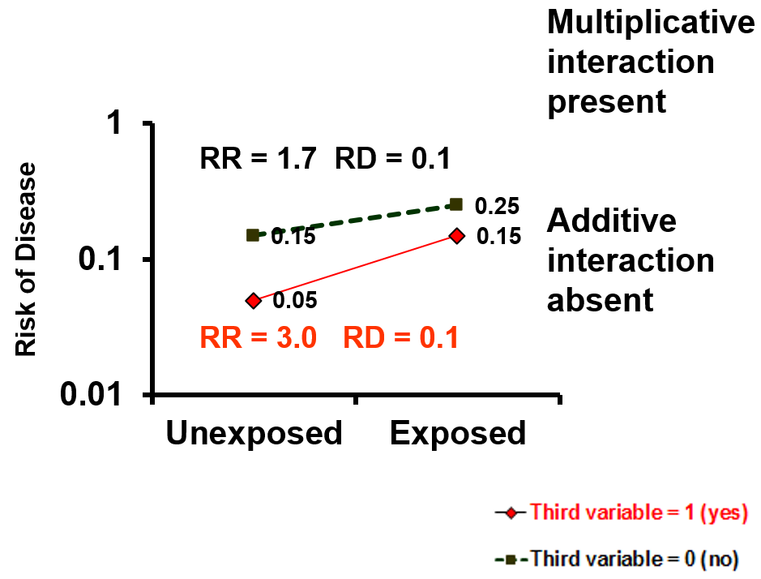
Additive vs Multiplicative Interaction
Absence of additive interaction implies presence of multiplicative interaction (exception: no association for one or both factors)
“it’s just the math”
Notes:
Absence of additive interaction (when an effect is truly present) implies presence of multiplicative interaction. Here, the risk difference is 0.1 in both strata of the third variable, but the risk ratio differs between two strata (red and black ones) — multiplicative interaction is present. Again, there is no obvious heuristic explanation for this; it is just the math.

Slide 47
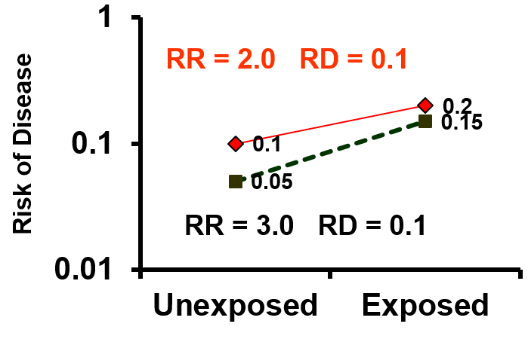
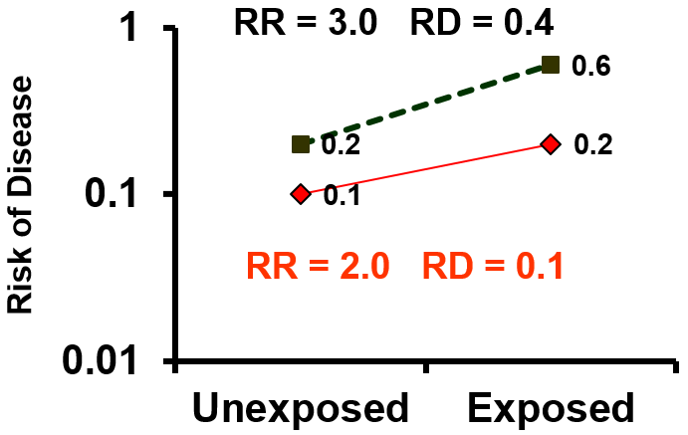

Additive vs Multiplicative Interaction
Presence of multiplicative interaction may or may not be accompanied by additive interaction
No additive interaction
Additive interaction present
Notes:
The presence of multiplicative interaction may or may not be accompanied by additive interaction. In the left panel, we see that despite the presence of multiplicative interaction, the risk difference is 0.1 in both strata of the third variable – i.e., no additive interaction. In the right panel, there is again multiplicative interactive, but this time the risk difference in one stratum is 0.1 and 0.4 in another; i.e., additive interaction is present.

Slide 48
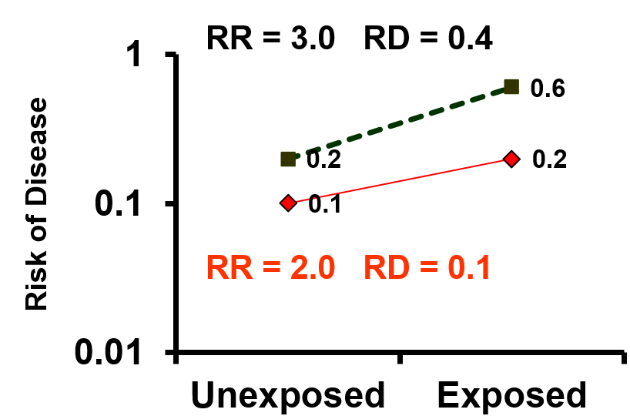
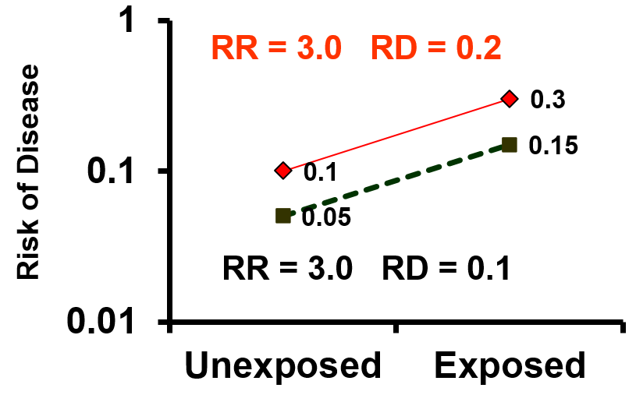
Additive vs Multiplicative Interaction
Presence of additive interaction may or may not be accompanied by multiplicative interaction
Multiplicative interaction present
Multiplicative interaction absent
Notes:
Likewise, the presence of additive interaction may or may not be accompanied by multiplicative interaction.
In the left panel, we see additive interaction and multiplicative interaction. In the right panel, we see additive interaction but no multiplicative interaction.

Slide 49
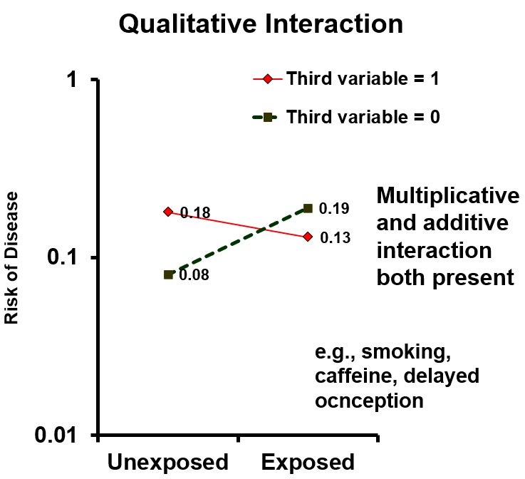
Additive vs Multiplicative Interaction
Presence of qualitative multiplicative interaction is always accompanied by qualitative additive interaction
Notes:
One thing that you can count on is that the presence of qualitative multiplicative interaction is always accompanied by qualitative additive interaction. We saw this in our example of smoking, caffeine, and delayed conception.

Slide 50
Additive vs Multiplicative Interaction: The Essence
A
Absence of multiplicative interaction implies presence of additive interaction (exception: no association with outcome for one or both factors)
Absence of additive interaction implies presence of multiplicative interaction (exception: no association with outcome for one or both factors)
Therefore:
  If both of the exposures in question are “causes” of the outcome, then there must be interaction on at least one scale.
E
D
There must be interaction between A and E on the occurrence of D on at least one additive or multiplicative scale (or possibly both)
Notes:
At first glance, these different scenarios appear numerous and confusing, but there is one very important point to remember, the essence of interaction. It stems from these two observation. First, we said that absence of multiplicative interaction will necessarily imply presence of additive interaction. The only exception is if there is no association with outcome for one of both factors. And, second, absence of additive interaction will necessarily imply presence of multiplicative interaction. Again, the only exception is lack of association for one or both factors. Therefore, as long as both of the exposures in question have an effect on the outcome (i.e., they are “causes” of the outcome), then there must be interaction on at least one scale (additive or multiplicative).
In terms of a DAG, if both A and E are causes of D as they are in this DAG, then there must be interaction between A and E on the occurrence of D on at least one scale (additive or multiplicative), if not both.

Slide 51
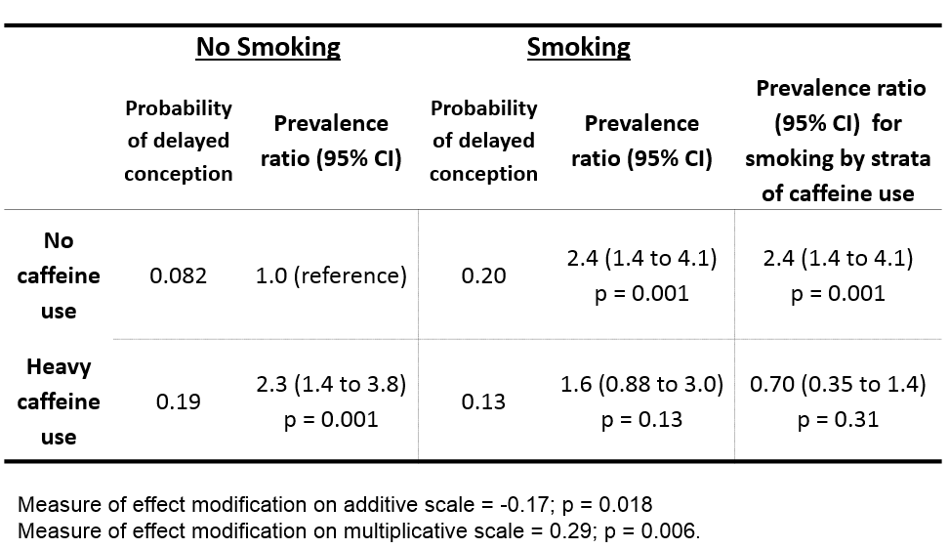
When You Find Interaction, Give it a Full Description
Show stratum-specific measures of association for main exposure (smoking), by strata of other variable
Show outcome (here, probability) and measure of association amongst joint strata of both exposures with common reference category
Even if one is primarily interested in one scale (here, multiplicative), should provide enough information for reader to evaluate other scale
Further recommendations:
  Knol and VanderWeele IJE 2012 (Optional Reading)
Notes:
Finding interaction is interesting and when you do find it, you should give it a full description. Standards and guidelines for presenting interaction are evolving and they now published in several places. For example, they can be found in the STROBE guidelines (general guidelines for publication of observational research) as well as the Knol and VanderWeele 2012 article in IJE (Optional Reading section on our website).
Specifically, these guidelines recommend showing much more data than has been shown in the past. In the past, perhaps just the two stratum-specific estimates, here 2.4 and 0.7 would be shown, but it is now recommended to provide enough data to allow the reader to also calculate the other scale of association (in this case, the additive scale).
The table shown is an optimal approach for presenting interaction when working with dichotomous variables. On the far right, we show the two caffeine use-specific estimates for the effect of the main exposure (smoking) on delayed conception. (Note: the main exposure could have just as easily been conceived of as caffeine use and smoking could be called the effect modifier. In truth, both smoking and caffeine use modify the effect of the other variable.) Here, we have shown ratio measure, but we could have chosen to show the absolute difference measures (if that measure was more relevant to us).
The table also illustrates how it is recommended to show more raw-level data (prevalence, in this example) by classifying participants according to the joint distribution of the two exposures. Persons who are unexposed for both variables are the reference group, as shown here in the red (absolute prevalence of 0.082 for delayed conception) in the upper left hand corner. Outcome prevalences for the 3 other classifications of the two exposures are shown in the other 3 cells surrounding the reference group. Then, show also the measure of associations in relation to the reference group (participants jointly classified as unexposed). For example, the prevalence ratio comparing participants who are “exposed” for both caffeine use and smoking (whose absolute prevalence is 0.13) to those who have neither exposure for delayed conception is 1.6. Showing the data in this way will give the reader the ability to explore interaction on both additive and multiplicative scale even if you as the author might only be interested in the multiplicative measure of association.

Slide 52
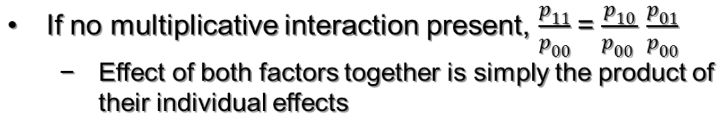
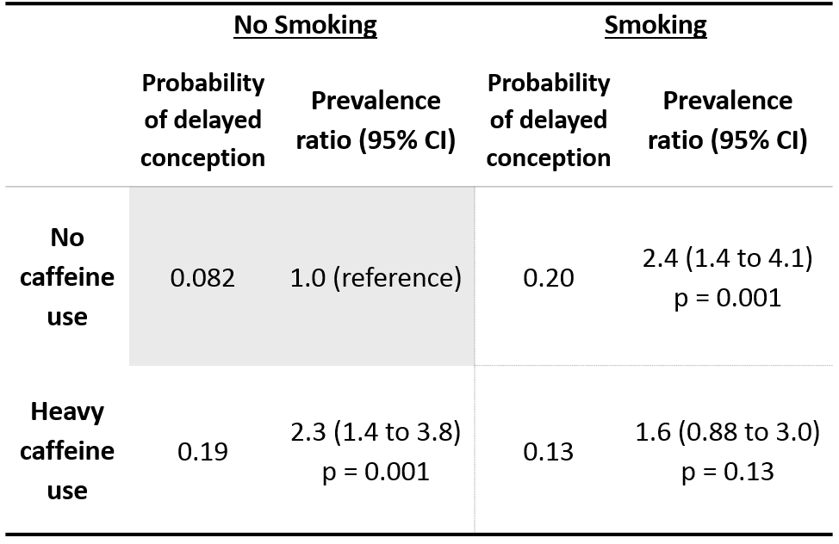
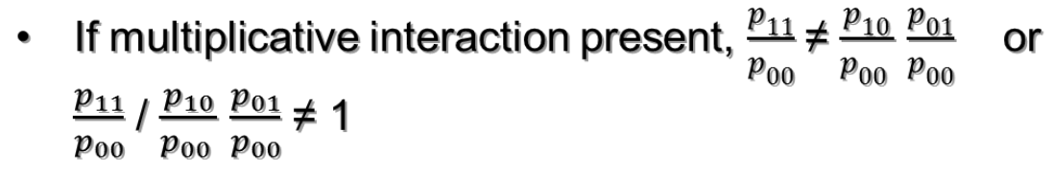
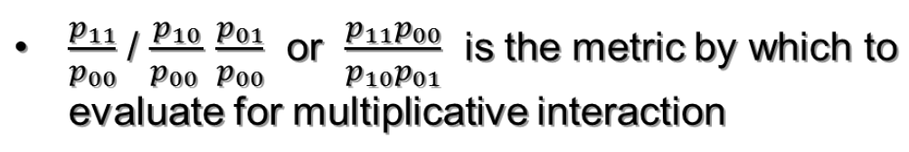
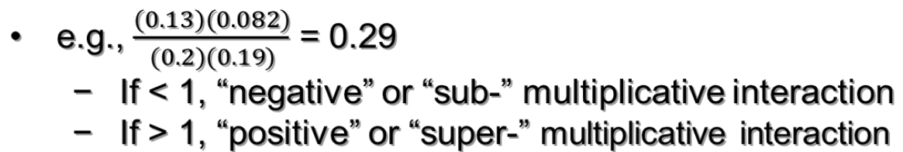
This Presentation Provides Another Way to Think About Interaction
p₀₀
p₁₀
0 (no) smoking
0 (no) caffeine
p₀₁
p₁₁
If = 1, no multiplicative interaction
If ≠ 1, multiplicative interaction is present
Joint exposure classification
Notes:
Presenting interaction in this way, with joint exposure classification (i.e., place each participant into one of four categories), provides us another way to think about interaction. The process starts by considering this group, “no caffeine use” and “no smoking” as the reference. This is the joint “no exposure” group. We can look at raw probabilities in this cell and the other 3 cells. Each of the 4 probabilities is denoted with this notation, 𝑝₀₀, 𝑝₁₀, 𝑝₀₁, and 𝑝₁₁. The first number in the subscript refers to smoking status (0 = no smoking; 1 = smoking) and the second number refers to caffeine use (0 = no caffeine use; 1 = heavy caffeine use).
Let us then consider how we can think about interaction in this context. Interaction is when the effect of one cause alters the effect of another cause. If no multiplicative interaction is present, we would naturally just expect that the effect of both factors together, which is p₁₁/p₀₀, would be the product of their individual effects. In other words, if no multiplicative interaction is present, we expect the two causes to operate independently. This means we expect that their joint effect is just the product of one effect times the other effect. In contrast, if multiplicative interaction is present, we would expect effect of both factors to be different than the product of the individual factors. After a bit of mathematical rearrangement, we can see that the entity (𝑝₁₁ 𝑝₀₀)/(𝑝₁₀ 𝑝₀₁ ) is therefore a convenient metric by which to evaluate for multiplicative interaction. If it is 1, then there is no multiplicative interaction. If < 1, we call it negative or sub-multiplicative interaction. If > 1, we call it positive or super-multiplicative interaction. In this case, the value is 0.29; this is negative or sub-multiplicative interaction. This makes sense when we look at the raw probabilities. If we go from 0.082 to 0.2 with smoking in the absence of caffeine and then from 0.082 to 0.19 from heavy caffeine use in the absence of smoking, but then only have 0.13 with both heavy caffeine use and smoking. There is something about having both causes that is really driving down the prevalence. That is why it is called negative interaction on the multiplicative scale.
This entity (𝑝₁₁ 𝑝₀₀)/(𝑝₁₀ 𝑝₀₁ ) is exactly the same as the regression coefficient for the interaction term in multiplicative regression models such as logistic regression and proportional hazards regression.
Or, you can look at the two prevalence ratios, 2.4 and 2.3. If the two exposures had no interaction, we would expect persons who had both factors to be 2.4 x 2.3 = 5.52 fold greater prevalence of the outcome than persons with neither. However, we see that the prevalence ratio is 1.6, indicating that when together there is negative interaction.

Slide 53
This Presentation Provides Another Way to Think About Interaction
If no additive interaction present,
  (p₁₁ – p₀₀) = (p₁₀– p₀₀) + (p₀₁ – p₀₀)
  p₁₁ = p₁₀ + p₀₁ – p₀₀
  Effect of both factors together simply the sum of their individual effects
If additive interaction present,
  (p₁₁ – p₀₀) ≠ (p₁₀– p₀₀) + (p₀₁ – p₀₀)
  p₁₁ ≠ p₁₀ + p₀₁ – p₀₀
  p₁₁ - p₁₀ - p₀₁ + p₀₀ ≠ 0
p₀₀
p₁₀
0 (no) smoking
0 (no) caffeine
  p₁₁ - p₁₀ - p₀₁ + p₀₀ is the metric by which to evaluate for additive interaction
p₀₁
p₁₁
Joint exposure classification
If = 0, no additive interaction
If ≠ 0, additive interaction is present
e.g., 0.13 – 0.2 – 0.19 + 0.082 = -0.17
  If < 0, “negative” or “sub-” additive interaction
  If > 0, “positive”, or “super-” additive interaction
Notes:
We can also look at the same schema to evaluate additive interaction. If no additive interaction is present, we would naturally expect that the effect of both factors jointly present compared to the reference category (which is p₁₁ – p₀₀) would be simply equal to the sum of the individual effects of both smoking (p₁₀– p₀₀) and caffeine use (p₀₁ – p₀₀) in isolation. In other words, the effect of both factors together is simply the sum of their individual effects. Therefore, if additive interaction is present, we would expect that the effect of both factors together is NOT equal to the sum of the individual effects. In other words, after some mathematical rearrangement, this quantity, p₁₁ - p₁₀ - p₀₁ + p₀₀ , is not equal to zero. This quantity, p₁₁ - p₁₀ - p₀₁ + p₀₀, is therefore a convenient metric by which to evaluate for additive interaction. If it is zero, then there is no additive interaction present. If this quantity is < 0, we call this negative or sub-additive interaction. If this quantity is > 0, we call this positive or super-additive interaction.
This entity , p₁₁ - p₁₀ - p₀₁ + p₀₀, is exactly the same as the regression coefficient for the interaction term in additive regression models such as ordinary least squares linear egression.

Slide 54
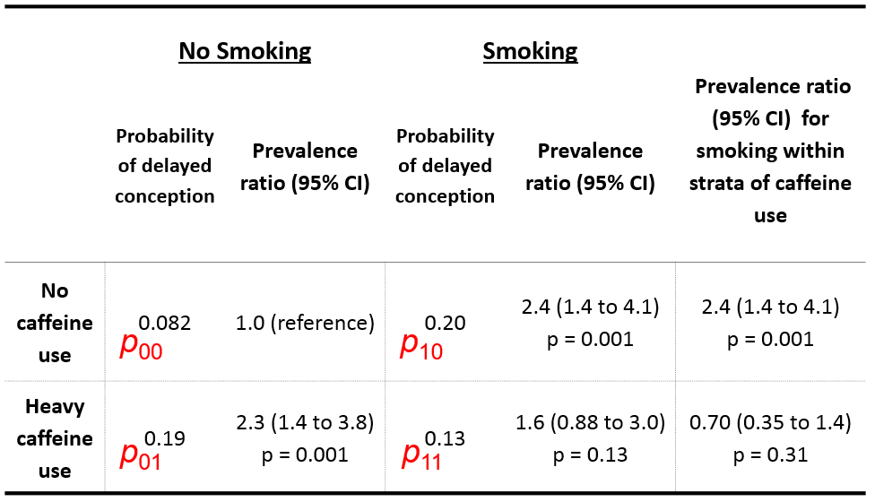
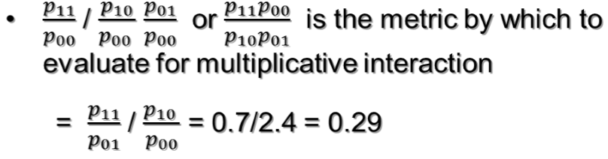
What about case-control studies where p of outcome is not available?
Therefore, we don’t need the individual p’s
  Can just use stratum-specific ORs if they estimate risk (prevalence ratios) or rate ratios
Notes:
What if this was a case-control study, and we did not have the raw probabilities of outcome (either prevalence or incidence of outcome)? In other words, we do not have measures of disease occurrence; we just have a measure of disease association. If we do a little bit of algebra on our metric to evaluate multiplicative interaction, we come up with 𝑝₁₁/𝑝₀₁ divided by 𝑝₁₀/𝑝₀₀ . It turns out that we have these two entities even, as in the case of a case-control study, when we don’t have the raw probabilities. These are just the stratum-specific prevalence ratios looking at the effect of smoking compared to no smoking, first in the absence of caffeine use and in the presence of caffeine use. When we do the math, we get 0.29, which is we got two slides ago.
Therefore, we do not need the individual probabilities of disease occurrence. We can just use the stratum-specific ORs, from a case-control study, if they estimate risk (or prevalence) or rate ratios. This is yet another reason to use case-cohort or incidence density-based case-control studies.
Note: our example here (smoking, caffeine use, and delayed conception) is not a case-control study (it is a cross-sectional study) but we use it to illustrate how a ratio of the two stratum-specific measures of association is equal to the metric by which to evaluate multiplicative interaction. This just illustrates that you can quickly evaluate for the presence of interaction without looking at the raw level individual p’s.

Slide 55
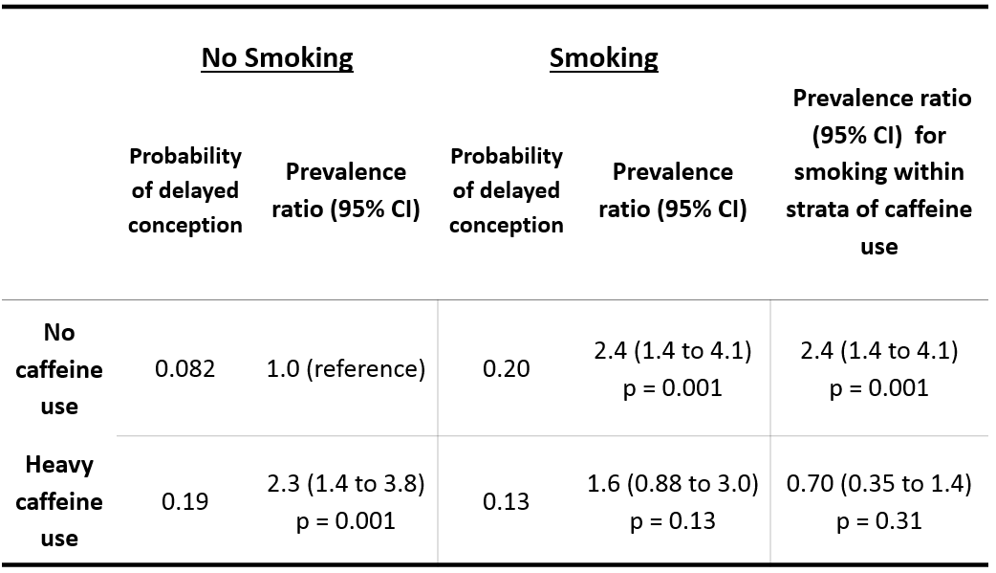
What about case-control studies? Determining Additive Interaction
p₁₁ - p₁₀ - p₀₁ + p₀₀ is the metric for additive interaction
Divide by p₀₀
  = (p₁₁/p₀₀) – (p₁₀ / p₀₀)- (p₀₁ /p₀₀) + (p₀₀ / p₀₀)
  = RR₁₁ – RR₁₀ – RR₀₁ + 1
  = 1.6 – 2.4 – 2.3 + 1 = -2.1
“Relative excess risk due to interaction”; “RERI”
If RERI = 0, no additive interaction;
  > 0, positive or super-additive interaction
  < 0, negative or sub-additive interaction
The math dictates that sign of “RERI” matches the sign of p₁₁ - p₁₀ - p₀₁ + p₀₀
See Notes and Additional Slides
for Stata code
Don’t need the individual p’s
  use OR’s if they estimate risk/prevalence/rate ratio
Notes:
Likewise, we can also look at additive interaction even when we do not have the raw probabilities, as is the case in case-control studies. Recall that p₁₁ - p₁₀ - p₀₁ + p₀₀ is the metric by which to evaluate for the presence of additive interaction. If we divide this by p₀₀, we come up with the quantity of = (p₁₁/p₀₀) – (p₁₀ /p₀₀)- (p₀₁ /p₀₀) + (p₀₀ / p₀₀). This now describes the entities in the quantities in terms of ratio measures of association. p₁₁/p₀₀ is simply the ratio measure comparing participants who have both exposures to the reference category (which is “no” for smoking and caffeine use in our example). The other two entities similarly correspond to ratio measures of either heavy caffeine use to the reference category or the smokers to the reference category. When we divide the metric for additive interaction by p₀₀, it is been termed the “relative excess risk due to interaction” or RERI. It is not the most intuitive term, but you can remember it by thinking about “interaction”, “excess risk” pertaining to the additive scale, and “relative” pertaining to the use of ratio measures of association to derive a metric for additive interaction. The term RERI is also used when we are talking about prevalences (i.e., it is not just for risk per se). (RERI was apparently first derived in the first edition of the Modern Epidemiology textbook: Rothman, K. J. (1986). Modern Epidemiology. 1st Edition. Boston, MA: Little, Brown and Company. We are not aware of any earlier publication.)
If RERI is 0, then our original metric, p₁₁ - p₁₀ - p₀₁ + p₀₀, must also be zero. If RERI is > 0, this is positive or super-additive interaction. If RERI is < 0, this is negative or sub-additive interaction. So, we can just look at the sign of RERI to tell us about additive interaction. This is just a clever mathematical trick. We can get RERI when we think of the problem as having a common reference group and forming exposure categories based on having one of the exposures or both. Therefore, again, we don’t need the individual p’s. We can use the ORs from case-control studies if they appropriately estimate risk, prevalence, or rate ratios.
The associated statistical inferences (standard errors, confidence intervals) regarding RERI can be derived from either logistic regression in case-control studies or from the type of regression models we discussed earlier in the course for direct estimate of risk/prevalence ratios (e.g., glm or poisson regression).
To obtain RERI in a case-control study, use the following code in Stata. We will assume, for purposes of illustration, that the smoking, caffeine, delayed conception example is a case-control study.
First, create what is known as an “interaction term” for the two exposures, smoking and caffeine use:
. generate smokingXcaffeine = smoking*caffeine
Then, create the logistic regression model:
.logistic delayed smoking caffeine smokingXcaffeine
This produces the following output:
Logistic regression Number of obs = 824
LR chi2(3) = 15.26
Prob > chi2 = 0.0016
Log likelihood = -276.55634 Pseudo R2 = 0.0269
--------------------------------------------------------------------------------
delay | Odds Ratio Std. Err. z P>|z| [95% Conf. Interval]
---------------+----------------------------------------------------------------
smoke | 2.762469 .9003729 3.12 0.002 1.458361 5.23275
caffeine | 2.616147 .8092851 3.11 0.002 1.426755 4.797056
smokeXcaffeine | .2374852 .1264597 -2.70 0.007 .0836327 .6743682
_cons | .0890152 .0135498 -15.89 0.000 .0660534 .119959
--------------------------------------------------------------------------------
Then, run the following post-estimation command to derive RERI:
. nlcom exp(_b[smoke] + _b[caffeine] + _b[ smokeXcaffeine]) - exp(_b[smoke]) - exp(_b[caffeine]) + 1
_nl_1: exp(_b[smoke] + _b[caffeine] + _b[ smokeXcaffeine]) - exp(_b[smoke]) - exp(_b[caffeine]) + 1
------------------------------------------------------------------------------
delay | Coef. Std. Err. z P>|z| [95% Conf. Interval]
-------------+----------------------------------------------------------------
_nl_1 | -2.662304 1.322758 -2.01 0.044 -5.254863 -.0697455
------------------------------------------------------------------------------
_n1_1 is RERI. It is -2.6 and hence the sign is negative, just as was the case for when we calculated the metric for additive interaction earlier (p₁₁ - p₁₀ - p₀₁ + p₀₀ ). The p value is 0.044.
----------------------------------------------------------------------------------------------------------------------------------------------
To calculate RERI from a regression model that directly produces prevalence ratios, we would do the following:
First, create what is known as an “interaction term” for the two exposures, smoking and caffeine use:
. generate smokingXcaffeine = smoking*caffeine
Then, create a log-binomial regression model, which derives risk or prevalence ratios directly (This was covered in our earlier Measures of Association lecture)
. glm delayed smoking caffeine smokeXcaffeine, family(binomial) link(log) eform difficult
Iteration 0: log likelihood = -384.90955
Iteration 1: log likelihood = -278.31514
Iteration 2: log likelihood = -276.55757
Iteration 3: log likelihood = -276.55634
Iteration 4: log likelihood = -276.55634
Generalized linear models No. of obs = 824
Optimization : ML Residual df = 820
Scale parameter = 1
Deviance = 553.1126793 (1/df) Deviance = .6745277
Pearson = 823.9999999 (1/df) Pearson = 1.004878
Variance function: V(u) = u*(1-u) [Bernoulli]
Link function : g(u) = ln(u) [Log]
AIC = .680962
Log likelihood = -276.5563397 BIC = -4952.507
------------------------------------------------------------------------------
| OIM
delay | Risk Ratio Std. Err. z P>|z| [95% Conf. Interval]
-------------+----------------------------------------------------------------
smoke | 2.414614 .6525993 3.26 0.001 1.42165 4.10112
caffeine | 2.310875 .5992695 3.23 0.001 1.390074 3.841625
smokeXcaff~e | .2905765 .1298261 -2.77 0.006 .121047 .6975369
------------------------------------------------------------------------------
The regression coefficient for the interaction term is the multiplicative interaction metric.
Then, use the post-estimation command for RERI:
. nlcom exp(_b[smoke] + _b[caffeine] + _b[ smokeXcaffeine]) - exp(_b[smoke]) - exp(_b[caffeine]) + 1
_nl_1: exp(_b[smoke] + _b[caffeine] + _b[ smokeXcaffeine]) - exp(_b[smoke]) - exp(_b[caffeine]) + 1
------------------------------------------------------------------------------
delay | Coef. Std. Err. z P>|z| [95% Conf. Interval]
-------------+----------------------------------------------------------------
_nl_1 | -2.104109 .9809866 -2.14 0.032 -4.026808 -.1814109
------------------------------------------------------------------------------
------------------------------------------------------------------------------
_n1_1 is RERI. It is -2.1 and hence the sign is negative, just as was the case for when we calculated the metric for additive interaction earlier (p₁₁ - p₁₀ - p₀₁ + p₀₀ ). The p value is 0.032.

Slide 56
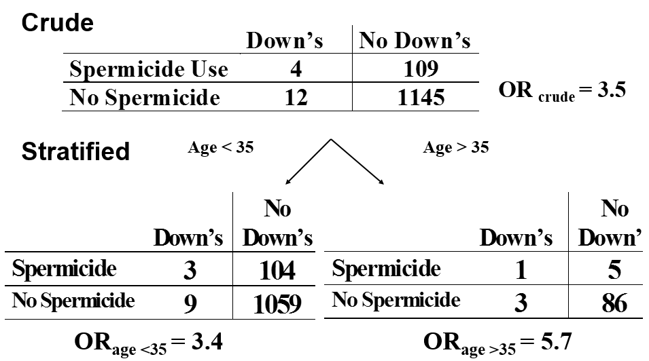
Chance as a Cause of Interaction?
Are all Non-identical Stratum-specific Estimates Indicative of Interaction?
Should we report statistical interaction here?
Notes:
Does every time the stratum-specific estimates differ numerically, to any extent, indicate that we have interaction occurring? In other words, does every time (p₁₁ - p₁₀ - p₀₁ + p₀₀, the additive interaction metric) not equal 0, RERI not equal 0, or (𝑝₁₁ 𝑝₀₀)/(𝑝₁₀ 𝑝₀₁), the multiplicative interaction metric, not equal 1, is interaction present? If interaction is present, we have just learned that we should not form a single summary estimate adjusted for the third variable but instead we should report all the stratum-specific estimates separately. This could get messy especially with many different factors to contend with. We could have dozens of different measures of association to report.
Here is an example, from a case-control study, looking at the association between spermicide use (exposure) and Down syndrome (outcome), and we are wondering about the influence of age on this association. There is a reasonable difference in the ORs in the two strata, but look at the sample sizes. Some of the cells are very small, and therefore we know these numbers are not very statistically precise. Somehow, we need to take this possibility of random variation (i.e., sampling error or chance) into account when we assess the presence of interaction.

Slide 57
Statistical Tests of Interaction: Test of Homogeneity (Heterogeneity)
Null hypothesis: The individual stratum-specific estimates of the measure of association differ only by random variation (chance or sampling error)
  i.e., the strength of association is homogeneous across all strata
  i.e., there is no interaction
Alternative: there is heterogeneity (i.e. no homogeneity); there is interaction
If test of homogeneity is “significant” (small p value), reject null in favor of alternative hypothesis
Variety of formal tests available with the same general format, following a chi-square distribution:
where:
  effect_{i} = stratum-specific measure of association
  var(effect_{i}) = variance of stratum-specific measures of association
  summary effect = summary adjusted effect
  N = no. of strata of third variable
The test statistic has a chi-square distribution with degrees of freedom of one less than the number of strata. We won’t dwell on derivation, but instead on interpretation
Notes:
Fortunately, there are statistical tests available to assess the role of chance or random variation in causing the appearance of interaction when it truly does not exist. The null hypothesis of these tests is that there is no difference between the strata — and that any apparent difference is only because of random sampling error. In other words, the null hypothesis is that the strength/magnitude of association is homogenous across strata; there is no statistical interaction. The alternative hypothesis of these tests is that there is heterogeneity (i.e., no homogeneity); there is interaction. If the test is significant (small p value), we reject the null in favor of the alternative and state that interaction is present. We will not dwell on the mechanics of deriving these tests only to say that they follow a chi-square distribution with the degrees of freedom equal to the number of strata minus one. Instead, we will dwell on interpretation.

Slide 58
Tests of Homogeneity with Stata in the Context of Stratification
1. Determine crude measure of association
e.g., for a cohort study
command:
cs outcome_variable exposure_variable
for smoking, caffeine, delayed conception:
-exposure variable = “smoking”
-outcome variable = “delayed”
-third variable = “caffeine”
command:
cs delayed smoking
2. Determine stratum-specific estimates by levels of third variable
command:
cs outcome_var exposure_var, by(third_variable)
e.g.,
cs delayed smoking, by(caffeine)
Notes:
Let us implement this test in Stata. To do this for dichotomous outcomes, exposures and third variables, we use the epitab set of commands that you have already used.
First, let us look at the crude association. You already know this command. For a cross-sectional study, it is: cs outcome exposure.
Then, to look at the stratum-specific estimates, we add a “by” command after the comma: cs delayed smoking, by(caffeine)

Slide 59
. cs delayed smoking
      | smoking |
| Exposed Unexposed | Total
-----------------+------------------------+----------
Cases | 26 64 | 90
Noncases | 133 601 | 734
-----------------+------------------------+----------
Total | 159 665 | 824
| |
Risk | .163522 .0962406 | .1092233
| Point estimate | [95% Conf. Interval]
|------------------------+----------------------
Risk difference | .0672814 | .0055795 .1289833
Risk ratio | 1.699096 | 1.114485 2.590369
        +----------------------------------------
chi2(1) = 5.97 Pr>chi2 = 0.0145
. cs delayed smoking, by(caffeine)
caffeine | RR [95% Conf. Interval] M-H Weight
-----------------+-------------------------------------------------
no caffeine | 2.414614 1.42165 4.10112 5.486943
heavy caffeine | .70163 .3493615 1.409099 8.156069
-----------------+-------------------------------------------------
Crude | 1.699096 1.114485 2.590369
M-H combined | 1.390557 .9246598 2.091201
-----------------+-------------------------------------------------
Test of homogeneity (M-H) chi2(1) = 7.866 Pr>chi2 = 0.0050
See Notes and Additional Slides for test of homogeneity of risk differences
Notes:
Here’s what the output looks like for the smoking, caffeine, and delayed conception example. First the crude association, and then the stratum-specific measures of association.
When looking at the crude association, note the 2x2 table and the output of both the risk ratio and the risk difference. The chi square statistic for the table follows as does the p value.
When looking at the stratum-specific estimates, the “by( )” option is used. You do not get two separate two by two tables, but instead you get the prevalence ratio for the primary exposure under study stratified by values of the third variable. Here is the prevalence ratio (2.4) when no caffeine is used and here is the prevalence ratio 0.7 when caffeine is used. (Note that Stata is calling these RR because it does not know if it is a cohort study or cross-sectional study.) In Stata, the test for homogeneity is automatically calculated as part of epitab command that you already familiar with. Here it is. The p value is: 0.005. What does this p value mean?
[Answer: By chance alone, we can see differences this large or larger between strata just by chance alone 5 out of 1000 times we conducted a study of this sample size, assuming there is, in truth, no difference between strata.)
This low p value reinforces your initial instinct that these two strata are not telling you the same thing and you do not want to report them pooled together into one summary adjusted estimate of the measure of association.
Of note, the only test of homogeneity that Stata provides in the context of stratification is for multiplicative interaction. Stata does not automatically provide this for the additive scale. This is regrettable, but it again indicates the general level of poor understanding in the scientific community of the value of the additive scale. Fortunately, in the setting of a binary outcome and two binary exposures, it is easy to create a generalized linear regression model that produces the metric for additive interaction and the p value. The code is as follows
First, create what is known as an “interaction term” for the two exposures, smoking and caffeine use:
. generate smokingXcaffeine = smoking*caffeine
Then, create generalized linear regression model:
.glm delayed smoking caffeine smokingXcaffeine, family(binomial) link(identity) difficult
This produces the following output:
Iteration 0: log likelihood = -276.55634
Iteration 1: log likelihood = -276.55634
Generalized linear models No. of obs = 824
Optimization : ML Residual df = 820
Scale parameter = 1
Deviance = 553.1126793 (1/df) Deviance = .6745277
Pearson = 824 (1/df) Pearson = 1.004878
Variance function: V(u) = u*(1-u) [Bernoulli]
Link function : g(u) = u [Identity]
AIC = .680962
Log likelihood = -276.5563397 BIC = -4952.507
--------------------------------------------------------------------------------
| OIM
delay | Coef. Std. Err. z P>|z| [95% Conf. Interval]
---------------+----------------------------------------------------------------
smoke | .1156293 .0470631 2.46 0.014 .0233874 .2078712
caffeine | .1071498 .042812 2.50 0.012 .0232398 .1910597
smokeXcaffeine | -.1719881 .0728175 -2.36 0.018 -.3147078 -.0292683
_cons | .0817391 .0114252 7.15 0.000 .0593461 .1041321
--------------------------------------------------------------------------------
Coefficients are the risk differences.
----------------------
The coefficient for the interaction term, which is -0.17, is the metric for additive interaction. This metric is p₁₁ - p₁₀ - p₀₁ + p₀₀ .
The p value for the interaction term, which is 0.018, is the p value for the test of homogeneity comparing stratum-specific risk differences. Here, the small p value is statistically significant at an alpha of 0.05. Note that the p value here, 0.018, is not the exact p value as we derived for RERI before (p = 0.032), when using generalized linear model to directly derive prevalence ratio. This is because the magnitude of RERI is not a surrogate of p₁₁ - p₁₀ - p₀₁ + p₀₀ . It is only the case that sign of RERI is guaranteed to be the sign of p₁₁ - p₁₀ - p₀₁ + p₀₀ . In this case, the sign is negative. The p values, however, are quite close.

Slide 60
. cs delayed smoking, by(caffeine)
caffeine | RR [95% Conf. Interval] M-H Weight
-----------------+-------------------------------------------------
no caffeine | 2.414614 1.42165 4.10112 5.486943
heavy caffeine | .70163 .3493615 1.409099 8.156069
-----------------+-------------------------------------------------
Crude | 1.699096 1.114485 2.590369
M-H combined | 1.390557 .9246598 2.091201
-----------------+-------------------------------------------------
Test of homogeneity (M-H) chi2(1) = 7.866 Pr>chi2 = 0.0050
If there truly is no interaction present, we would see differences between the strata of this magnitude (0.7 and 2.4) or greater, 0.5% of the time, by chance alone. - B
There is 0.5% probability that the differences between strata (0.7 and 2.4) are caused by chance. - C
What does the p value mean?
There is a 0.5% chance that interaction is present . - A
Notes:
What does this p value mean? Is it interpretation A, B, or C?

Slide 61
. cs delayed smoking, by(caffeine)
caffeine | RR [95% Conf. Interval] M-H Weight
-----------------+-------------------------------------------------
no caffeine | 2.414614 1.42165 4.10112 5.486943
heavy caffeine | .70163 .3493615 1.409099 8.156069
-----------------+-------------------------------------------------
Crude | 1.699096 1.114485 2.590369
M-H combined | 1.390557 .9246598 2.091201
-----------------+-------------------------------------------------
Test of homogeneity (M-H) chi2(1) = 7.866 Pr>chi2 = 0.0050
If there truly is no interaction present, we would see differences between the strata of this magnitude (0.7 and 2.4) or greater, 0.5% of the time, by chance alone. - B
There is 0.5% probability that the differences between strata (0.7 and 2.4) are caused by chance. - C
What does the p value mean?
There is a 0.5% chance that interaction is present . - A
Notes:
What does this p value mean?
[Answer: By chance alone, we can see differences this large or larger between strata, assuming there is in truth no difference between strata, 5 out of 1000 times we conducted a study of this sample size.)
This low p value reinforces your initial instinct that these two strata are not telling you the same thing and you don’t want to report them pooled together.

Slide 62
When to Report or Ignore Interaction?
When to report or ignore interaction to your readers needs to keep several considerations in mind
  A complex substantive, statistical, and practical decision
  Substantive (i.e., clinical, biologic, behavioral):
    Is the magnitude of stratum-specific differences substantively (e.g., clinically) important?
    Is there prior evidence for the heterogeneity?
  Statistical
    Most studies were not planned to have sufficient power to examine interaction
    Only relatively large between-strata effect sizes or large sample size can achieve p < 0.05
    One approach is to report interaction for p < 0.10 if the magnitude of differences is clinically meaningful (liberalize the “threshold to report”)
    However, meaning of p value is not different than other contexts
  Practical: How complicated is the story?
    i.e., if it is not too complicated to report stratum-specific estimates, it is often more revealing to report potential interaction than to ignore it.
Notes:
We talked earlier about how to report interaction, but how about when to report it? When to report or ignore interaction is not always clear cut and we can give no absolute rules for this. When to report or ignore is a complex substantive (i.e., clinical, biologic, or behavioral), statistical, and practical decision.
By clinical, we mean that we have to look at the magnitude of the stratum-specific differences. Differences that are so small to be of very little relevance from a clinical or biologic perspective are typically not worth reporting. In contrast, very large differences might well be telling us something clinically or biologically/behaviorally and we should want to report these. We should also keep in mind the prior probability of the interaction being true based on prior data. The more prior data there are suggesting an interaction, the more we will likely believe that interaction we see is true and will want to report it. Using the same line of reasoning, it is also the case that we likely only want to look for interaction among factors for which there is some reasonable a priori belief. Again, we can use our well formulated DAG to guide us.
By statistical, we mean that we need to look at the p value for tests of interaction, as we just discussed, but what p value threshold should we use? There are limitations in the statistical power of tests of homogeneity in most of our work. This is because the sample size of the original analysis in most studies which seek to look at the effect of some exposure E on outcome D was based on very different parameters than ones which compare stratum-specific estimates. Comparing exposed to unexposed in the entire population is different than having to compare multiple strata, each will have smaller sample sizes than the overall study population. Therefore, only a relatively large magnitude of difference between stratum-specific estimates or large sample sizes can achieve p values of less than 0.05 in most of our studies. Hence, it may be worthwhile to use a higher threshold — not for declaring statistical significance of interaction — but for when deciding when to report stratum-specific estimates as opposed to pooling them. Some have advocated going up to p of 0.10, or higher. It should be emphasized that we are not condoning a different cut off of statistical significance for tests of interaction as if to say that they are fundamentally different than any other hypothesis testing. They are indeed interpreted just like any other p value. In other words, when we say “report” interaction, we do not necessarily mean that we are reporting statistical significance. We just mean whether we are going to report stratum-specific estimates to our readers rather than a single summary adjusted estimate.
Finally, from a practical perspective, the question is just how complicated is it to report stratum-specific estimates individually instead of just one number which would apply for all strata. If there are 10 different strata to report on, this could make for a complicated message for some audiences or contexts. On the hand, if there are just two strata, then it is not that much more complicated to report than one single measure of association.

Slide 63
Report vs Ignore Effect-Measure Modification?
Some Guidelines
Will you report or ignore multiplicative interaction?
Notes:
Let us go through several examples to get a feeling for when we should report to our readers, rather than ignore interaction. You will see that this requires consideration of both substantive and statistical significance. (Note: in these scenarios in which there are only two strata, there really is not a practical consideration as to whether to report interaction. This is because reporting two stratum-specific estimates is really not much more complicated than one adjusted estimate. It is when we have multiple strata and multiple factors that interaction can become very complicated and practical considerations become paramount.)
Let us say we are looking at the association between a given exposure and a given disease, and we have to then look at the effect of a potential effect modifier that has two levels: present (=1) and absent (=0). We are working on the multiplicative scale and we are interested in multiplicative interaction. In the two leftward columns you see the stratum-specific measures of association; in this example, we are using risk ratios. In the more rightward column is the p value for the test of homogeneity (or heterogeneity), and here, in the far rightward column, is our recommendation in terms of whether to report or ignore interaction.
If the two strata give results of 2.3 and 2.6 and a p-value for the test of heterogeneity of 0.45, what should we do with it? We should ignore this difference and not report the presence of interaction. What if the p value is 0.001? This is an example of where we should still ignore it because this difference really is pretty small from a clinical or biologic perspective — not substantively meaningful. What if we got 2.0 in one stratum and 20 in another and a p value of 0.001? Here, this is worth reporting. However, if we saw a difference of 2 and 20 and a p value of 0.1, we still would want to report or show this interaction rather than ignoring it. As the p value gets higher, I would be less and less interested in reporting and more and more interested in just lumping the strata together. How about a difference between 3 and 4.5? This is not that big a difference in clinical or biological terms. Hence I would probably ignore it if the p value was 0.3 and be on the fence about it even if the p value was very small. Finally, how about in the presence of what appears to be qualitative interaction. We would have a lower threshold to report it, perhaps even up to a p value of 0.15. Again, the p value does not have any different meaning here than in other contexts and we are not saying that a p of 0.2 is “statistically significant”. We are just stating that it is reasonable to report stratum-specific differences of large magnitude, even if the p value is up to 0.15. Such a report still requires dedicated confirmation in other studies, hopefully studies that have adequate statistical power.

Slide 64
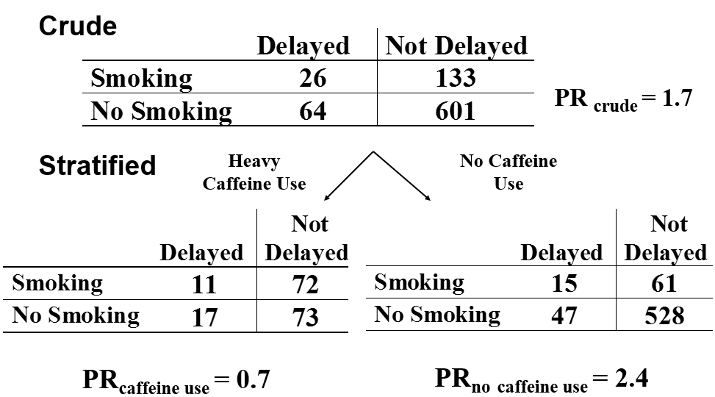
Why Should We Bother to Look for Statistical Interaction?
Because it is good analytic practice
What if we had ignored the notion of statistical interaction entirely and reported a summary adjusted estimate?
  PR_{adj} =
  1.4 (95% CI 0.92 to 2.1);
  p = 0.14
Using just one number could obscure an effect entirely
Because sometimes summarizing a measure of association with just ONE number is misleading or uninformative
Notes:
Let us regroup for a moment and summarize why should we bother to look for statistical interaction. Here are the data again that motivated this discussion. The reason we should bother to look for statistical interaction is that because sometimes summarizing the measure of association with just one number is misleading or uninformative. What if we had gone ahead and summarized these two stratum-specific estimates with one summary adjusted estimate, using a technique we have not yet explained to you. We will tell you that the adjusted prevalence ratio (PR_{adj}) would be 1.4 with the confidence interval shown and a p value of 0.14. It is not surprising that the summary estimate is somewhere in between the two stratum-specific estimates of 0.7 and 2.4.
The interpretation of this summary estimate and confidence interval is that there is no strong evidence of an association between smoking and delayed conception. Is this the correct inference? Certainly not! Nothing could be farther than the truth. Instead, we see a very interesting story with smoking being protective in the presence of heavy caffeine use and directly associated in the absence of caffeine use. If we had used just one number to summarize this, we would have entirely obscured this interesting effect. Some methodologists refer to what happens if you summarize this situation with one number as a form of bias, which they call effect modification bias. Indeed, in this example, the conclusion if we had used summarized this analysis with one number would have been “no evidence of an effect”. This is not an accurate conclusion; this is why this can be considered a form of bias.
Thus, sometimes summarizing a measure of association with just one number is misleading or uninformative.

Slide 65
It is good analytic practice to always look for statistical interaction
Are there are other forms of interaction that are of interest to us?
Notes:
Everyone probably now agrees that we want to be looking out for statistical interaction. It is simply good analytic practice. But, are there other forms, or concepts, of interaction that are of interest to us?

Slide 66
Statistical Interaction is Just One Type of Interaction:
The Four Distinct Concepts of Interaction
Type of Interaction | Why look for it?
Statistical Interaction | “Just the numbers” Because summarizing disparate measures of association with just ONE number is usually misleading or uninformative.
Public Health Interaction | To determine in which groups of individuals, if any, would deployment of given exposure/removal of exposure/intervention result in impact on greatest absolute number of individuals. Quantitated via NNT/NNH.
Mechanistic Interaction | To determine if two exposures are operating synergistically in causing the outcome. In other words, to determine if there are persons for whom the outcome would occur if both exposures are present but not if only one or the other exposure was present.
Biologic/ Physical Interaction | To determine if there is physical interaction between two or more exposures in causing outcome, i.e., physical entities actually physically interacting with/touching each other.
Notes:
You will have noted that we have been careful to call the prior discussion “statistical interaction”. This is because it just one of the 4 different types, forms, or concepts, of interaction.
This topic is poorly understood in that most scientists are just vaguely familiar with interaction, in general terms. And, what most scientists are familiar with is what we have been calling statistical interaction, meaning that the numerical measures of association for a given exposure are different according to levels of a third variable. Most are not familiar with this distinction of 4 different concepts. Let’s go through these 4 different concepts.
Statistical interaction is what we have been discussing in the last set of slides. We should look for it because summarizing disparate measures of association with just ONE number is usually misleading or uninformative.
Public health interaction is what we are interested in when we want to determine in which groups of individuals, if any, would deployment of a given modification of exposure, prevention of exposure, or intervention result in the greatest impact — greater than other groups in terms of absolute number of individuals benefitted. We use this concept of public health interaction when looking for groups of patients to target or prioritize. Earlier in the course, we discussed public health impact using actual counts of people. We discussed how this is quantified via metrics like NNT and NNH.
Mechanistic interaction is what you are interested in evaluating when you are interested in knowing whether two exposures are operating synergistically in causing an outcome. Stated another way, this is the case if there are persons for whom the outcome would occur if both exposures are present but not if only one or the other exposure was present. This is the definition of synergism in the sense of the sufficient-component cause model of causation. As such, it is also called “sufficient cause interaction”. It means that there must be at least one sufficient cause for the outcome in question which has both exposures under study as components. There is an even narrower definition of mechanistic interaction, which is called “epistatic interaction”, in which there are persons for whom the outcome would occur if and only if both exposures are present but not if only one or the other exposure was present. Of note, the only way disease is caused in this setting is if both exposures are component causes in the sufficient cause. Without the two exposures, a sufficient cause cannot form. There are rules that can be applied to evaluating RERI which can help to distinguish when epistatic interaction is present.
Finally, biologic or physical interaction asks if there is physical interaction between two or more exposures. This means actual physical entities actually touching each other. It turns out, as we explain later, that we can directly evaluate this form of interaction with our typical data in human subjects research. Only data from the wet laboratory can prove this.

Slide 67
What Scale (Additive or Multiplicative) Should be Used to Look for Different Forms of Interaction?
Type of Interaction | Which Scale to Use?
Statistical Interaction | Whatever scale you are interested in for other reasons. Looking for statistical interaction is simply a good analytical practice, but it does not inform which scale to use.
Public Health Interaction | Additive (i.e.. difference measures).
Mechanistic Interaction | Additive (i.e., difference measures). Proof is beyond scope of course; involves counterfactual theory. Magnitude of RERI is key metric.
Biologic/ Physical Interaction | Our typical analyses cannot address this issue; this is the realm of physical laboratory science.
Notes:
We have talked about two scales we might use to express measures of association, additive and multiplicative. Which of these should we use to evaluate each of these 4 concepts of interaction?
For statistical interaction, the decision about which scale to use should be dictated by other reasons. In other words, looking for statistical interaction is just a good analytic practice, but it does not inform which scale to use. For example, if we are committed to working on the ratio scale (for whatever reason), then our evaluation of statistical interaction should be on the multiplicative scale.
For public health interaction, you will not be surprised to hear that it should be evaluated on the additive scale.
For mechanistic interaction, you might be surprised to hear that the additive scale is also the one to use. The proof of this is beyond the scope of this course but can be found in the Rothman, Greenland, and Lash Modern Epidemiology text, edition 3. It involves use of counterfactual theory. Of note, it is in the evaluation of mechanistic interaction that RERI has its greatest utility, even more so than the aforementioned native metric of additive interaction. That is, there are actually two forms of mechanistic interaction, one called “sufficient-cause interaction” and the other called “epistatic interaction” (as indicated on the prior slide). They can be understood either from the perspective of the sufficient-component cause model (of Rothman, 1976) or the counterfactual model of causality. In short, sufficient-cause interaction means that there exist some persons for whom a particular outcome will occur if both exposures in question are present but not if only one or the other is present. This is akin to having at least one causal pie containing both exposures; in at least one person, the two exposures are “working together” towards the outcome. The other exposures can be part of other causal pies but they will need other component causes (other background causes) to complete the pie. Also, the same background plus other causes can also cause disease. In epistatic interaction, there exist at least some persons for whom outcome will occur only in situations in which both exposures are present. In other words, all causal pies in persons of this background must have both exposures. Other persons with different background causes can form other causal pies. Evaluating the presence or absence of sufficient-cause and epistatic interaction requires certain assumptions about the relationship of the exposure to outcome (remember both exposures have to be “causes”) and the size of RERI, specifically whether it is greater than 0, greater than 1, or greater than 2. One easy rule to remember is that with no assumptions about the exposures, a RERI whose lower end of the 95% confidence interval is greater than 1 is specific (albeit not sensitive) for the presence of sufficient-cause interaction. More detail on this can be found in the VanderWeele and Knol 2014 tutorial in the optional reading. Table 7 in the tutorial gives all of the rules.
Finally, while very interesting, we cannot typically evaluate biologic or physical interaction. The type of data we collect typically does not allow us to do this. This is in the realm of laboratory science.
The above makes some people to question the intrinsic value of multiplicative interaction given that all of the action appears to be in the additive scale.

Slide 68
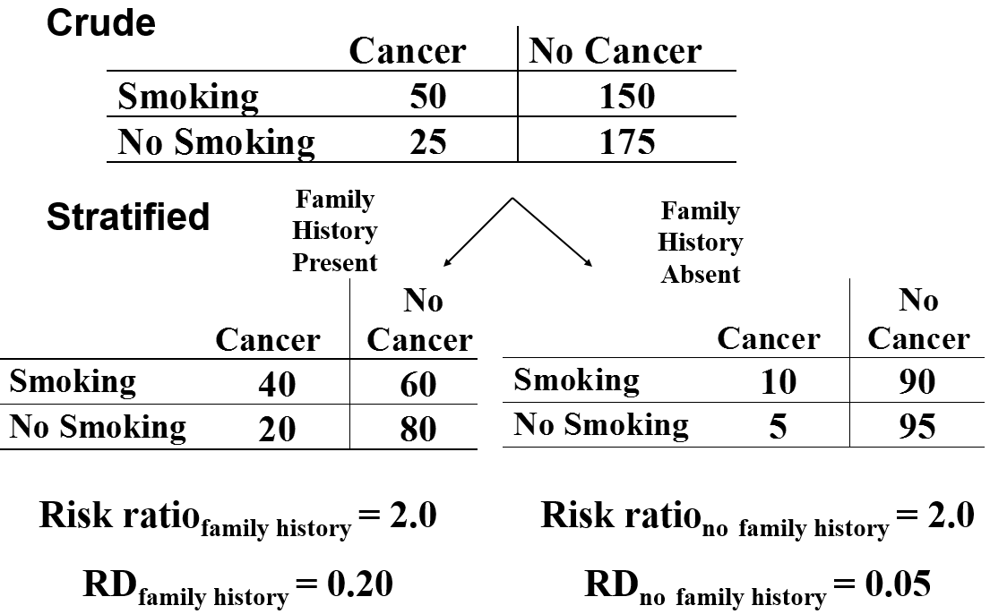
Smoking, Family History and Cancer:
Additive vs Multiplicative Scales
If causal inference re: smoking sole goal:
  Risk ratio is sufficient (no interaction)
  If goal is to define sub-groups of persons to target smoking cessation/prevention intervention or mechanistic interaction between smoking and family history
  Rather than ignoring interaction, worth reporting additive
Public health interaction: only 5 persons with FH have to be prevented from smoking to avert 1 case of cancer (group to target)
No multiplicative but presence of additive interaction
Notes:
Here is another example showing the types of interaction we might be looking for and which scales to use. Here, smoking is the exposure of interest, cancer (say, one specific type of cancer) is the outcome of interest, and family history of that cancer is the third variable in question. We stratify for family history because it is known to be causally related to the outcome (and it could also be a confounder). We see that there is not multiplicative interaction present; the risk ratio’s are the same in both strata. However, there is additive interaction, which is no surprise to us after we saw an effect of smoking. If both smoking and family history are causes of the cancer, then there must be interaction on at least one scale. The risk difference is 0.2 among those with a family history and 0.05 among those without a family history. If your goal was simply to assess whether smoking was causally related to smoking and nothing else, you would probably go with the risk ratio of 2 and not bother to report the additive interaction to your readers. There would be no interaction reported. After all, it is a bit easier to report just one number instead of two. If we were just interested in the big picture causal/etiologic research goal, then it would be reasonable just to use the multiplicative scale and report one number.
But say you already had a pretty good sense that smoking was a causal determinant of the cancer and now your goal is to see where you can have the most impact in terms of getting persons to stop smoking. So, if your goal is to identify subgroups of persons to target with an intervention (say a smoking cessation intervention), then you should use the additive scale when assessing for interaction. In the prior slide, we called this a public health impact goal. The impact of an intervention would differ depending upon the third variable, family history. In the stratum with a family history present, you just need to eliminate smoking in 5 persons to avert one case of cancer. In the family history absent stratum, you need to eliminate smoking in 20 persons to avert one case of cancer. Hence, the most efficient group to intervene upon is those with a family history (assuming you could identify them at equal cost as those with no family history). Hence, it is well worth to report the presence of additive interaction based upon family history. This is the mathematical basis of choosing high risk groups when searching for the targets for such interventions.
If your goal was a mechanistic one (does smoking and family history ever work together to cause cancer?), you would also choose the additive scale.

Slide 69
Summary: Confounding vs Interaction
We discovered interaction by performing stratification as a means to contend with confounding
  This is where the similarities between confounding and interaction end!
Confounding
  A non-causal path (bias) that we seek to prevent
Interaction
  A more detailed description of the relationship between the exposure and disease
  A richer description of the biologic or behavioral system under study
  A finding to be reported if we have a good evidence, not a bias to be eliminated
  Presence depends upon scale
    Multiplicative (ratio) vs additive (difference)
  Statistical interaction simply refers to numerical differences in effect across strata of a 3rd variable
    Usually, we are interested in something more: public health interaction; mechanistic interaction
        These require presence of additive interaction
    We cannot measure biologic interaction
Next Week: Return to stratification and formation of adjusted summary estimates.
Notes:
In summary, how did we get to where we are in our discussion of confounding? How did we happen to start talking about interaction? Recall, it was in an attempt to prevent confounding of an association between an exposure and a given disease by some third variable that we initially performed stratification. When we did this, we saw in one of our earliest examples that the measure of associations in the different strata were very different. We termed this the concept of statistical interaction or effect-measure modification.
Sometimes there is a lot of confusion about the differences between confounding and interaction, but there really need not be.
How do confounding and interaction differ?
Confounding is a backdoor or non-causal path that we want to preclude (i.e., eliminate) when looking at the causal association between our exposure in question and the disease under study. Interaction, however, when present, is a more detailed description of the biological or behavioral system under study. It is not extraneous but rather a richer description of the system. When we have good enough evidence to suggest that it is real, interaction is not a bias we are seeking to eliminate but rather a new finding we should report.
We also discussed how the presence of interaction depends upon the scale you are working, the multiplicative scale of measures of association or the additive scale of measures of association. This is why it is most properly called “effect-measure modification”. Whether it is present depends upon the specific scale. We gave one important rule in this regard. Whenever two exposures both cause an outcome, there will be interaction on at least one scale (additive or multiplicative).
There are 4 types of interaction. Statistical interaction just means that the numbers (measures of association) are different; there is no additional meaning. Usually, however, we are interested in a specific interpretation, either public health or mechanistic interaction. Both of these require presence of additive interaction. Finally, we cannot directly measure biologic interaction with our usual data in epidemiology or clinical research. This is in the realm of laboratory science.
Next week, we will get back to discussing stratification and forming adjusted summary estimates as we complete our tour of ways to reduce or eliminate confounding.

Slide 70
Additional Material Slides

Slide 71
Last Week
Gave intuitive understanding of confounding
Introduced DAGs, which
  provide definitive & visual explanation of confounding
  also demonstrate selection bias (“collider” bias)
Any statistical (numerical) association in your data between E and D might be due to:
C
C
1. Confounding
2. Selection Bias
E
D
E
D
E Meas. error
E
D
3. Measurement Bias
4. Reverse Causality
E_{obs}
D_{obs}
E_{true}
D_{true}
E
E
D
D
6. True Causation
5. Chance
Notes:
As a review, last week we first gave an intuitive understanding of how confounding occurs.
We then introduced DAGs, which provide a definitive and visual explanation of confounding. Interestingly, DAGs also demonstrate selection bias.
Ultimately, we saw, via DAGs the six different explanations that any statistical association in your data might represent. Any statistical (numerical) association in your data between two variables (say, exposure and outcome) might be due to confounding, conditioning on a collider (i.e., selection bias), measurement bias (either dependent misclassification or differential independent misclassification), reverse causality, or truth (causal effect). Of course, it may also be due to chance but DAGs do not encode chance; they just encode so-called structural issues (i.e., bias).
There is also another form of bias that some call effect modification bias, which is what occurs when one inappropriately ignores the presence of effect modification. This was shown in the smoking, caffeine, and delayed conception example. It is also the source of selection bias without colliders, which we explained last session. Recall the situation when outcome was associated retention in a cohort study and we only analyze those who remain in the study. Effect modification can entirely obscure a true effect or either accentuate or attenuate an effect.

Slide 72
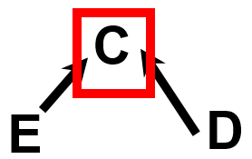
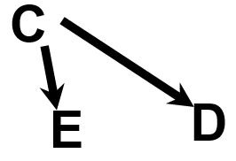
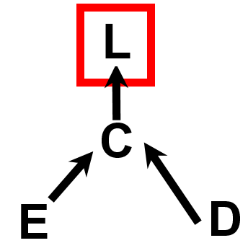
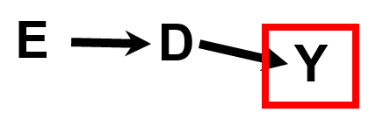
Reading and Working with DAGs
Two Basics
1. Confounding
Selection
aka “collider-stratification” bias
Two Nuances
Once you commit these to memory pattern recognition, it opens up a very efficient means for thought and communication
4. Conditioning on descendant of outcome under non-null
Conditioning on descendant of a collider
- also results in collider-stratification bias (induces spurious relationship between E & D)
- also results in collider-stratification bias (induces spurious relationship between E & D)
Notes:
Some course participants were looking for a simplified guide to DAGs.
Reading and working with DAGs comes down to understanding two basic patterns and two more nuanced patterns. The first basic pattern is confounding. By now, hopefully everyone has this iconic pattern firmly emblazoned in their brains. Confounding occurs when exposure is influenced by factor — a common cause — which also influences outcome. The second basic pattern is selection bias. It is also known as collider-stratification bias because it occurs when we evaluate the relationship between two factors (E and D) at fixed levels of another factor (C), called a common effect, which is caused by both of the factors. Selection bias induces a spurious relationship between E and D. These two compact notation drawings are not necessarily intuitive to the naked eye. I have shown these to laypersons many times only to be met with quizzical looks. In other words, they need some explanation before one understands them. If you use them for a while, however, their appearance will become second nature to you as representing the basic constructs of confounding and selection bias. Once they do become second nature to you, they become a very efficient way to organize your thinking and communication to other scientists.
Evenly slightly less intuitive are these two more nuanced patterns, which in essence are just one pattern. The first is conditioning upon a descendant (L) of a collider (C). It also results in collider-stratification bias and it induces a spurious relationship between E and D. The second more nuanced pattern is also a form of selection bias (collider-stratification bias). It occurs when we condition upon a descendant on an outcome variable under non-null conditions. It will also induce a spurious relationship between E and D. A trick to remember this is that we know that there are other causal influences on D. We just do not usually need to show them on a DAG. For example, think of a factor, A, that has an edge coming into D. This means that Y is actually a descendant of a collider (D). When we condition upon Y, we are conditioning upon a descendant of a collider. This is yet another reason to avoid indiscriminate adjustment out of the spirit of “controlling for everything”.

Slide 73
Lessons Learned from DAGs for Management of Confounding
Adjustment for any non-collider on a confounding path will block confounding
Avoid controlling for (aka conditioning upon) colliders, if at all possible
Importance of distinguishing confounding from nuisance indirect causal paths
Beware special issues of direct effect estimation
Adjust only for factors with a priori probability of confounding as evidenced by being at least considered on your DAG
  Doing so decreases probability of accepting chance as explanation for apparent confounding
DAGs focus attention on what must be known to evaluate causality for particular exposure
If how you draw DAG influences the causal effect of exposure, future research needs to determine which DAG is correct (i.e., focuses attention on which other relationships need deciphering).
Notes:
A few other highlights from last week regarding how DAGs provide valuable lessons for the management of confounding and identification of collider bias:
Adjustment for any non-collider on a confounding (backdoor) path will close the path and block confounding.
Avoid controlling for colliders if at all possible, although note that anything other than random sampling of the general population is equivalent to conditioning upon (controlling for) a selection node.
It is important to distinguish confounding from nuisance indirect causal paths. While it is often necessary to adjust for factors that are mediating indirect causal paths to estimate direct effects, we need to be aware of what we are doing because doing so brings up special issues in direct effect estimation. These special issues involve the potential for inducing collider bias if there is a unconditioned common cause of the mediator in question and the outcome.
Adjust only for factors that have a priori probability of confounding as evidenced by being on, or at least being considered to be on, your DAG. Doing so decreases probability of accepting chance as explanation for apparent confounding. The gum chewing and melanoma example showed this. We do not have to adjust for any factor that results in there being a difference between the crude and adjusted result (i.e., anything that induces data-based confounding); this is because some of these things may simply be chance and the differences we observe are spurious ones.
Importantly, DAGs focus attention on what else you might need to know to evaluate causality for a particular exposure. Specifically, if how you draw the DAG (meaning what you decide to put as additional nodes and edges outside of exposure and outcome) influences your final estimate for a particular exposure–disease relationship, this means you need to figure out which DAG is correct. You can start off studying one relationship, but you might find out that you really need to know more about the surrounding system.
Finally, and this is an esoteric point, DAG’s help with non-collapsibility issues. Recall earlier that we discussed the non-collapsibility of the odds ratio. Non-collapsibility of the odds ratio means even when confounding is not present, stratum-specific OR’s will numerically differ than crude OR when outcome is common. This would typically lead you to accept the stratum-specific estimates if you let the data dictate to you what confounding is. DAGs will decrease the chances of this happening because they inform you to adjust only for factors that you have substantive evidence for being confounders.

Slide 74
What Makes Bias Detection Hard?
Most of the action/thinking is outside of the readily observable data in your single study
  selection bias: which persons are represented NOT in the study data? why do some people choose not to participate? why do some drop out?
  measurement bias: how reproducible / valid are the measurements?
    You just have one measurement per person
  confounding bias:
    What are the common causes of the primary exposure under study and the primary outcome?
    What are the colliders? Have you avoided conditioning upon them?
Answers not always found by simply interpreting available data (which is what we usually do in science)
  one needs to be a deep subject-matter and methodologic expert
Notes:
Some students have commented that the last several weeks of exploring bias have been hard. One explanation is that when evaluating bias, most of the action or thinking is done outside of the readily observable data.
In selection bias, we have think about the people NOT in the dataset. Why did some people decide not to participate in the first place? Or, why did some people drop out?
How about measurement bias? Here, the questions are just how reproducible and valid are the data? Well, that is often hard to know because we typically have only one measurement, we may not have our own available gold standards, or they may not be gold standards all. We may not have made the measurements ourselves if we are using pre-existing data (so-called “found data”), especially health care system-derived data. Hence, in any one study, we typically cannot tell directly how far our one measurement per participant is off from the truth.
How about confounding? Well, the DAG approach puts a premium on exquisite understanding of the relationships outside of the exposure--disease you are studying. To get the right answer in terms of managing confounding and avoiding colliders, one needs to understand all of the causal determinants of your primary exposure and outcome. Sometimes these are simply not yet studied, and you do not have the data. In other words, the DAG needs to be correct. Even if we do have the data ourselves to investigate a particular relationship in the periphery of a DAG, the data from our single study is not as valuable as the collective body of literature to date on the topic.
In sum, the answers to these questions will not typically be found in simply doing a few analyses and interpreting available data from a single study, which is what we usually think of in science. Instead, we need to be thinking outside the available data. To do this, you need to be a deep subject matter expert in addition to being a methodologic expert.

Slide 75
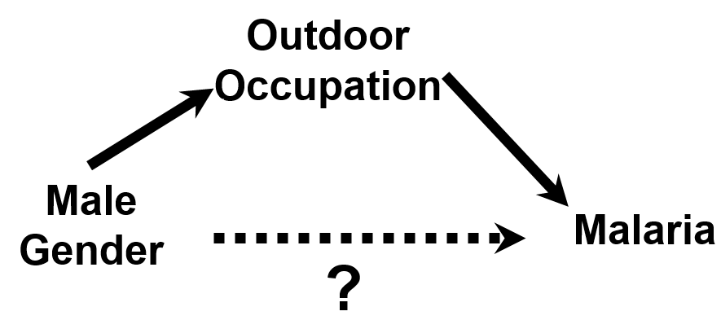
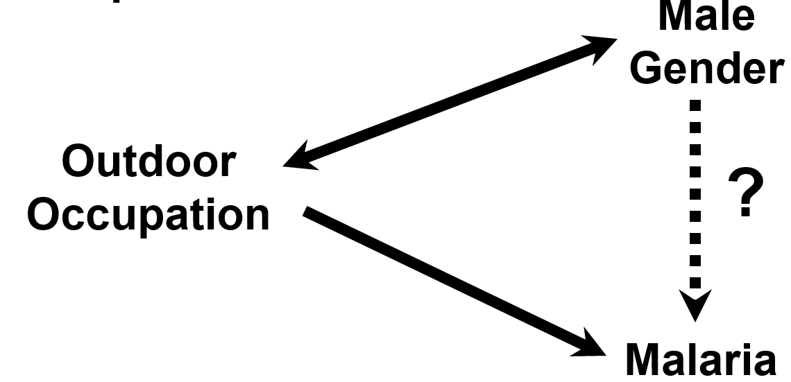
Discrepancies with the S & N Text
Text: Uses vertical orientation; Class: horizontal
Text: Occupation is a confounder
Class: Occupation mediates a causal indirect pathway to malaria. We are interested in the direct effect of gender on malaria not mediated by occupation.
U
Need to contend with occupation in either case
Notes:
We want to remind everyone of the discrepancies regarding what we are teaching in class and what the Szklo and Nieto textbook presents for confounding. First, the orientation of the diagrams that we use differs. The text uses a vertical orientation of exposure situated above disease. We will use a horizontal orientation that is read from left to right. This left to right approach is also the way most of the methodologic inventors also depict DAGs. Second, most of the diagrams that the text uses are not formally DAGs. Hence, you will see many ambiguous double-headed arrows.
The text explains an example in which occupation is said to be a confounder in the relationship between male gender and malaria. In our more contemporary view on confounding, outdoor occupation is not a confounder, for it does not cause male gender to occur. Instead, we view occupation as a mediator on a nuisance indirect causal pathway, one we are not primarily interested in studying. Instead, we are interested in studying the direct effect of gender on malaria that is not mediated by occupation (“direct effect of gender on malaria apart from gender’s effect on occupation”).
You might say that the semantics do not matter because we need to contend with occupation in either case, no matter if you call it a confounder or mediating an extraneous causal pathway. You need to control for it in any case. While this is true, clearly distinguishing the two scenarios enables us to more clearly see the potential problems that occur when we seek to estimate direct effects, which is what we need to do in this example. Recall last week how the presence of unknown confounders, U, in the DAG, can lead to collider bias, if you control for occupation. U is a common cause of the mediator of the indirect path and the outcome. This mediator-outcome confounding is a largely unrecognized by researchers.

Slide 76
Overmatching
Often used term, not well understood and non-reproducibly interpreted
  May refer to any form of conditioning: matching, stratification, or regression
Two types of “overmatching” manifestations
  Overmatching resulting in precision losses
    Conditioning on factors which are not related to exposure or outcome
    Conditioning on factors solely related to exposure
    Conditioning on factors solely related to outcome (in some circumstances)
    Conditioning on true confounders very strongly related to exposure
      results in “collinearity”
      e.g., cohort study of effect of income on CHD; attempt to match on education
      Not a mistake but instead inevitable consequence of trying to tease apart very closely related constructs
  Overmatching resulting in bias
    Conditioning on mediators; colliders; or instruments in face of unmeasured confounding
Notes:
It is worth discussing the term “overmatching” because you will hear it a lot and it has a lot of different meanings. Overmatching could refer to one of two possible manifestations of a mistake in adjustment, either in terms of precision or bias. Also, it may refer to any form of conditioning, be it by matching, stratification, or regression. When first coined, the term referred to some specific aspects of the adjustment process but it seems to us that now it may (and is) refer to any unwanted manifestation of adjustment. As such, it is a non-specific and essentially empty term. Instead, depicting the specific problem with a DAG seems much more informative. Nonetheless, you will continue to see the term used.
Regarding precision losses, conditioning on factors which are not related to exposure or outcome will cause precision losses. This makes sense when we think about a DAG. Adjusting for a factor that has nothing to do with the system is just going to cause unneeded noise. The same is true when conditioning on factors solely related to exposure. Adjusting for factors solely related to outcome is more complicated. Depending upon the measure of association and the strength of the association between the factor and outcome, adjustment can either improve or lessen precision. For example, adjusting for factors strongly related to outcome in linear regression is well appreciated to improve precision.
The above situations feature adjustment for factors that do not have to be controlled for to manage confounding. One could have avoided the problems by not conditioning at all. A more vexing situation is what to do with confounding factors that are closely related to exposure. For example, in a cohort study of the effect on income on coronary heart disease, there might be an attempt to control for education. Yet, education is very closely to income, and hence adjusting for education will inflate the standard errors for the income effect. This issue is called “collinearity”, in the sense that income and education are collinear (i.e., highly related). Adjusting for education is not a mistake per se but it comes with a price. This is referred to as the “bias-variance tradeoff”. Achieving a less biased estimate by adjusting for education comes with a tradeoff of increasing variance, and there is no best established answer for what to do. Historically, many workers have often done everything they can to avoid bias (and have sided with “bias” in the bias-variance tradeoff), but not all (for more see:
Kaufman JS. Commentary: Why are we biased against bias? International Journal of Epidemiology 37: 624–626, 2008.)
The second manifestation of a mistake in adjustment, bias, has been covered earlier when we discussed DAGs. As we have discussed, conditioning on a mediator (e.g., when you are estimating a total effect) or a collider can result in bias. In addition, conditioning upon a factor solely related to exposure can also cause bias if there is coincident unmeasured confounding. This is known as bias amplification.

Slide 77
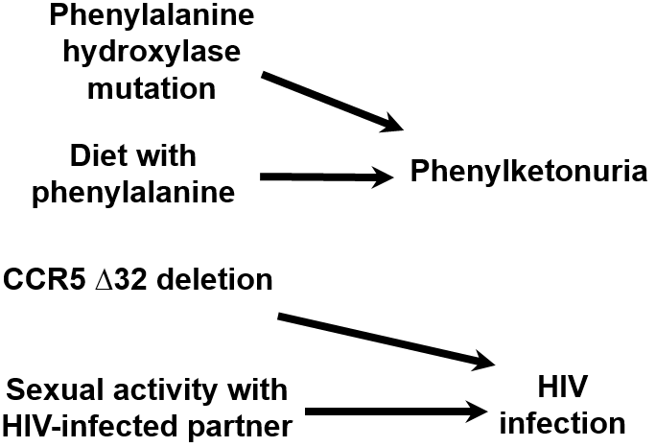
Pure Interaction
Term used for when the causal effect of one exposure is only seen depending upon the presence of another
Explains how exposures sometimes not appreciated as causes (e.g., a genetic factor in an infectious disease) are indeed formal causes
  They contribute to sufficient causes in at least some people (people who have other causes)
Examples
Notes:
The term “pure interaction” is used when the causal effect of one exposure is only seen depending upon the presence of another. It helps to explain how exposures sometimes not appreciated as being causes of certain diseases are indeed causes in the formal sense. For example, some people would balk at calling a genetic mutation such as the CCR5 deletion a “cause” of HIV infection. You might, for example, hear: How can a genetic mutation be a cause of an infectious disease? Only microorganisms are causes of infections, right?
A more general framework for causation defines a cause as any exposure for which there is at least one person who will get the disease in question in the presence of the exposure but not in the absence. This person or persons may well need other causes to develop the disease. If the effect of one exposure only contributes to disease in the presence of another exposure, we call this pure interaction. For example, the phenylalanine hydroxylase mutation will not on its own cause the disease phenylketonuria. It needs the presence of a diet containing phenylalanine. Or, an intact CCR5 receptor will not on its own cause HIV infection. It needs the presence of exposure to HIV, the virus. However, both the CCR5 receptor and HIV, the virus, are legitimately called “causes”.

Slide 78
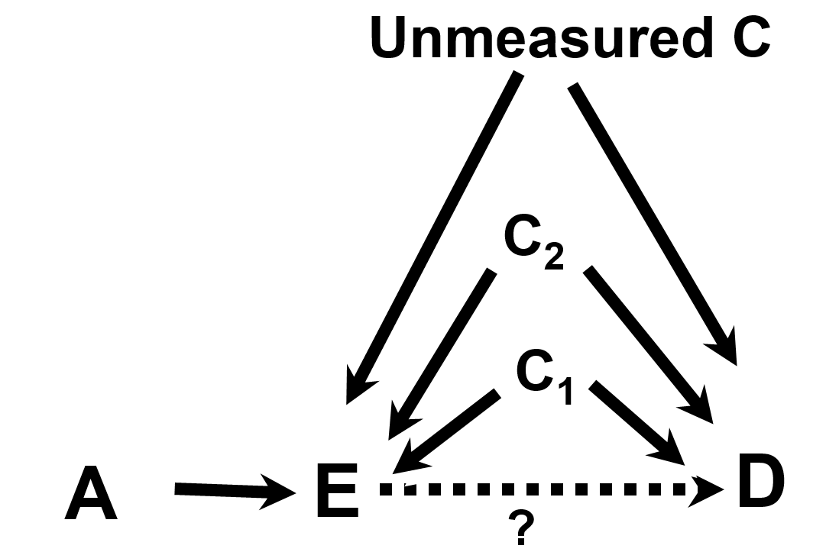
Variable A is referred to as an instrumental variable (IV) or “instrument”.
Notes:
Variable A is referred to as an instrumental variable or “instrument”. An instrument is defined to as a factor related to exposure but to nothing else.

Slide 79
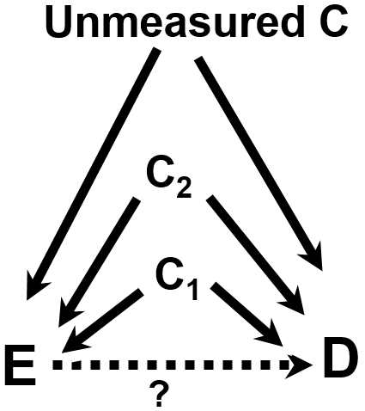
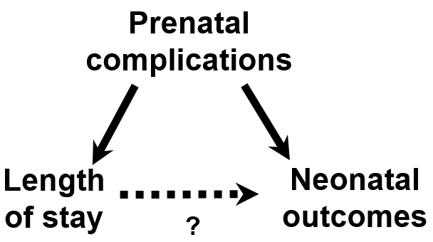
Instrumental Variables to Manage Confounding
RQ: Does length of stay influence neonatal outcomes?
IV must be related to E but nothing else
Instrumental variable (IV)
Hour of birth
Use IV—D and IV—E associations to estimate unconfounded E—D
Malkin et al. Heath Serv. Res., 2000
Notes:
Here is our typical situation when we are trying to estimate the causal relationship between E and D. We have some known confounders, C1 and C2, that may or may not be easy to measure. We also have some unmeasured confounders that we are worried about, shown here. Is there any other way out of this mess other than randomization, which, as we know, is not always possible?
What if we had a variable that was related to E but nothing else in the system? If that variable exists, we call it an instrumental variable or an “instrument”.
If that variable exists, we can then mathematically manipulate two observable associations, between IV and E, and between IV and D, to estimate the unconfounded relationship between E and D (which is what we are truly interested in knowing). A way to think about this is that if we know the magnitude of the long path between IV and D and one part of this path (between IV and E), then we must be able to figure out the magnitude of the rest of the path (from E to D). DAGs are an easy way to visualize how instrumental variables work.
An example of this was a study which sought to determine whether length of stay in the hospital after childbirth was associated with adverse neonatal outcomes. There are arguments that stays that are too short or too long can be deleterious. In this system, there are clearly many confounders, some easily measurable and some not. An instrumental variable here is the hour of birth because it is related to how long you stay in the hospital but it is not related to anything else.
The challenge with IVs is to find them. They do not necessarily exist for all situations. One must train one’s mind to think about them, and it helps to be imaginative (and to use DAGs).
Note: The requirements of instrumental variables can be loosened a bit by allowing for common causes between IV and D, as long as these are well measured and can be controlled for. However, as soon as one allows for some confounding of the IV and D relationship, concerns are raised as to whether additional unmeasured confounding exists.

Slide 80
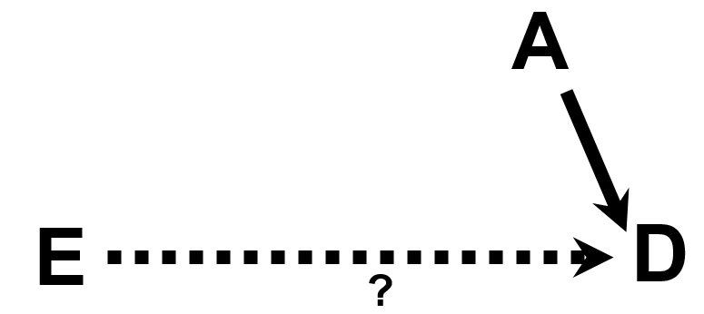
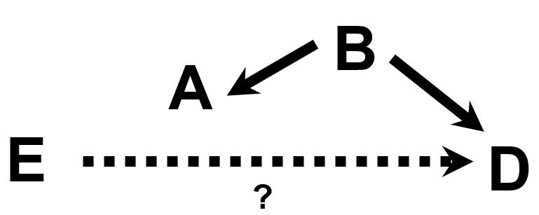
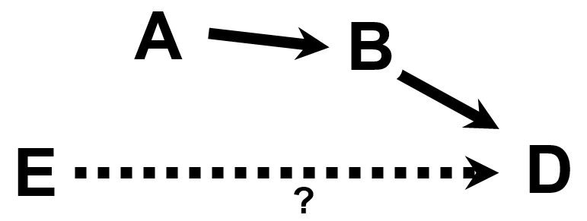

What variables can be effect modifiers?
Direct effect modification
Effect modification by proxy
Indirect effect modification
Effect modification by common cause
VanderWeele Epidemiology 2007
Notes:
Because we have seen that chance might be a reason for apparent effect-measure modification, one needs to be careful which factors you consider. Besides chance there are also other imposter reasons for how something can appear to be an effect modifier, such as a factor which is a descendant of the outcome.
How should you decide what to consider for evaluation as an effect modifier? It stands to reason that since effect modification has to do with one variable altering the influence of a second variable on some outcome, the effect modifier itself must influence the outcome. By influence, we mean that the effect modifier much either be a cause of the outcome or associated with a factor that is cause. DAGs can help us visualize this.
These 4 DAGs show the 4 different scenarios for how variables can be effect modifiers. In each scenario, the variable A is the variable that is a candidate to be an effect modifier. These 4 scenarios are called direct effect modification, indirect effect modification, effect modification by proxy, and effect modification by common cause. These 4 scenarios are descriptive narratives for how A is associated with D. This is new terminology and not commonly used, but it is nonetheless a good way to keep things straight.
Note how if A does show mechanistic interaction with E for the occurrence of D in our empiric data analysis (by finding presence of additive interaction), altering A will not necessarily influence the occurrence of D in all scenarios. In two of the scenarios on the slide (direct effect modification and indirect effect modification), it will, but it will not on the other two.

Slide 81
DAGs Do Not/Cannot Specifically Show Effect Measure-Specific Modification
The “A” variables could be effect modifiers, on a given scale, but only the data will tell us if they are
DAGs can find the effect-measure modification candidates but DAGs, using current conventions, cannot predict scale-specific effect measure modification
  This is not surprising because DAGs are qualitative, not quantitative, and not dependent upon scale
  Effect-measure modification depends upon the scale (additive or multiplicative)
Once an analysis has determined presence of effect-measure modification, there are some ways to show it on a DAG but these not universally accepted
Notes:
Hence, DAGs show us variables (i.e., the A variables in the prior slide) that could be effect modifiers, but only the data will tell us if they ARE effect modifiers on a specific scale (i.e., additive or multiplicative). In other words, DAGs can find the candidates for effect-measure modification, but DAGs themselves cannot predict when effect-measure modification on a particular scale will be present. It is not surprising that one cannot show this quantitative complexity with just qualitative edges. Effect-measure modification is a very quantitative phenomenon. For example, you can have effect modification on the additive scale but not on the multiplicative scale.
DAGs, with their current conventions, do not depict effect-measure modification even if have demonstrated effect-measure modification in your data analysis. That is, the current theoretical underpinnings do not have a way for effect-measure modification to be universally depicted in a DAG. Some authors have offered a few solutions but these are not universally accepted. Again, this is not surprising because DAGs are fundamentally qualitative, not quantitative.
We do not believe that the current inability of DAGs to depict interaction as a major limitation.

Slide 82
Effect modifiers may also be confounders
Direct effect modification
Effect modification by proxy
Indirect effect modification
Effect modification by common cause
VanderWeele Epidemiology 2007
Notes:
There is one other thing to clarify about the 4 scenarios we showed earlier regarding which variables you might want to consider as candidates for effect modification. When we showed these, this was not to say that these same variables might also simultaneously meet the definition of confounders. Sometimes there is a confusion about whether a factor can be an effect modifier and a confounder. The answer is “yes”; a variable can be considered both a confounder and an effect modifier. However, this is not a question that we have to answer in our routine applied work. In other words, the goal above is to evaluate whether E causes D. The goal is not to give a name (e.g., a confounder or effect modifier) to each of the surrounding variables; such naming of variables is merely an academic process.
Another thing to note is that when we report on the presence of interaction, we do so by showing stratum-specific estimate of the effect of E on D. By doing this, we are also covering ourselves for the possibility of confounding. The stratum-specific estimates are unconfounded. If we look for and find that A modifies the effect of E on D and report stratum-specific estimate of E on D, then we are still managing confounding.

Slide 83
Additive vs Multiplicative Scales
Review
Which do you want to use?
Multiplicative measures (e.g., risk ratio)
  commonly used in causal/etiologic research but is not only scale that can be used for this
  not dependent upon background incidence of disease
  all that is available in some designs (case-control)
Additive measures (e.g., risk difference):
  readily translated into impact of an exposure (or intervention) in terms of absolute number of outcomes prevented
    e.g. 1/risk difference = no. needed to treat to prevent (or avert) one case of disease
      - or no. of exposed persons one needs to revert exposure to avert one case of disease
  very dependent upon background incidence of disease
  gives “public health impact” of the exposure
  metric for public health interaction and mechanistic interaction
Notes:
For a review of which scale to use (multiplicative or additive) for your work, this is a review that reminds us that it depends upon your research question. We covered this earlier in the course.
Multiplicative measures (like the risk ratio) are commonly used when looking for causal relationships, in other words, etiologic research. However, the multiplicative scale is not the only scale that could be used for this. The additive scale (e.g., risk differences) could also be used, but for historical reasons it has not been. These relative measures do not depend upon the background incidence of a disease in unexposed persons. Use of additive scale measures are, however, gaining in popularity, particularly in the causal inference field. Arguments can be made it is the purest measure of association.
Additive measures (like the risk difference) are most readily translated into the impact an exposure (or intervention) has in terms of actual number of actual people with disease. For example, as you all know, 1/risk difference is the number of exposed persons in whom you would have to eliminate exposure in order to avert one case of disease. Or, when the exposure is a drug, 1/risk difference is the number of persons you would to treat to avert one case of disease. In clinical trials, this is known as the number needed to treat. The background incidence of disease in the unexposed group is an important component of this. Use of the additive scale gives you the public health impact of the exposure. Finally, as we have seen, additive measures are the metrics for the evaluation of both public health interaction and mechanistic interaction.

Slide 84
Additive vs Multiplicative Scales
Causally related but minor public health importance
  Risk ratio = 2
  Risk difference = 0.0001 - 0.00005 = 0.00005
  Need to eliminate exposure in 20,000 persons to avert one case of disease
Causally related and major public health implications
  RR = 2
  RD = 0.2 - 0.1 = 0.1
  Need to eliminate exposure in 10 persons to avert one case of disease
Notes:
This is a simple example of the utility of additive vs multiplicative scales. In the upper panel, we are working with a disease that is very rare and the exposure in question is associated with a two fold risk of disease. Assuming no bias, this is evidence for a causal relationship. The risk difference between exposed and unexposed is very small, just 0.00005. That means you have to eliminate exposure in 20,000 persons just to avert one case of disease. A simple way to infer this is if you took 100,000 exposed persons and then took away their exposure, you would end up with 5 cases of disease (the background) and 5 cases of disease averted. In other words, take away exposure from 100,000 and avert 5 cases, translates into take away exposure in 20,000 to avert 1 case.
Contrast that with the lower panel. Here, the disease is more common in unexposed but the relative risk of the exposure is still 2, just like above. In this case, the risk difference is 0.1 which translates into only needing to eliminate exposure in 10 persons to avert one case of disease. You could achieve much more bang for your buck if you went after this exposure as opposed to the exposure in the top panel.

Slide 85
What Scale (Additive or Multiplicative)
Should You Be Using for Interaction? It Depends Upon Your Goal
Goal | Which Scale to Use for Interaction?
Public Health Impact* | Additive (RERI can assist when base analysis is on multiplicative scale)
Causal/Etiologic Inference
Big picture/Total effect | Evaluate for interaction as a matter of good analytic practice in order not to miss an effect, but finding interaction is not main focus
Mechanistic interaction between exposures | Additive (RERI can assist when base analysis is on multiplicative scale)
Prediction | Evaluate for interaction as a matter of good analytic practice in order to improve fit of model to data, but finding interaction is not main focus
*maximizing efficiency of resource allocation
Notes:
What scale should you be using to look for interaction? As usual, it depends upon the goal of your work. If your goal is to have the most public health impact, and by this we mean maximizing efficiency of resource allocation by finding groups of individuals for whom the smallest number is needed to intervene upon to have an effect, then you should be evaluating additive interaction. An example is if you wish to apply an intervention to prevent disease or to improve prognosis in those who are diseased. We have already said this for the main analysis when we described the concepts of NNT and NNH earlier in the course. Now, when we introduce potential effect modifiers (i.e., 3rd variables), you would want to identify the subgroup for which there is the smallest number needed to treat. Note, however, that for some types of analysis, you will need to use regression models that are based on the multiplicative scale (such as logistic regression in a case-control study), but you can still within these models evaluate additive interaction (such as with RERI).
If your goal is causal or etiologic inference, there are still two sub-goals. You might be interested in just the big picture or the total effect, i.e., if a given exposure or set of exposures is causally related to an outcome. If this is the case, you will want to look for interaction as a matter of good analytic practice and especially to be sure that you are not missing an effect (e.g., the smoking, caffeine use, and delayed conception example), but looking for interaction is not your main goal. On other hand, if your goal is causal or etiologic inference and you want to drill down into mechanisms involving other causal exposures, then this requires assessment of additive interaction. There are some rules which can be used when interpreting the magnitude of multiplicative interaction terms that can tell you about additive interaction. And, as we discussed one can use RERI to assist you to look for additive interaction when you are working on the multiplicative scale. There are several rules (and needed assumptions) which can be used to interpret RERI to identify sufficient cause interaction and epistatic interaction. This is the point that is understood by very few — additive interaction can be evaluated even with inherently multiplicative regression models such as logistic regression and proportional hazards regression. These rules are explained in the VanderWeele tutorial on interaction.
Finally, if prediction is your goal, your reason to look for interaction is a matter of good analytic practice. You will look for interaction in order to improve the fit of the model to your data. In other words, we are evaluating for statistical interaction in the setting of prediction to try to make the statistical model better fit the observed data. Hence, the scale of interaction will reflect the scale of the main analysis. With binary or time-to-event outcomes, the scale is typically multiplicative.

Slide 86
Reciprocity of Interaction
Caffeine use modifies the effect of smoking on delayed conception
or
Smoking modifies the effect of caffeine use on delayed conception
Crude
No Smoking
PR _{crude} = 1.7
Smoking
Stratified
PR_{caffeine use} = 0.7
PR_{no} _{caffeine use} = 2.3
Notes:
Another interesting but not surprising aspect of interaction is the reciprocity it features. If we re-frame the smoking, caffeine use, and delayed conception question in terms of looking at caffeine use as the primary exposure, we see the following. If we stratify by smoking, we again see qualitative effect-measure modification. The prevalence ratio is 0.7 among smokers and 2.3 in non-smokers. In other words, this could be interpreted as either caffeine use modifies the effect of smoking on delayed conception or as smoking modifies the effect of caffeine use on delayed conception. Either is correct. This type of reciprocity will always be seen with both additive and multiplicative interaction, regardless if qualitative or not. Interaction is always reciprocal between the two causes.

Slide 87
Interaction: What’s Being Done in Practice?
Interaction is likely one of the least understood concepts in everyday practice
While most analysts aware of the concept in general and look for interaction in their data, few recognize the explicit reason why (statistical vs mechanistic vs public health)
Knol et al. (Epidemiology 2009) reviewed 138 papers which “addressed” interaction
  42% reported at least one scale of interaction with adequate detail
  11% provided sufficient detail to allow readers to calculate interaction on both additive and multiplicative scales
  3 (2.1%) focused on additive scale
Given that most researchers are interested in either mechanistic or public health concepts, the absence of reporting of additive interaction is a major loss for the field
  Popularity of multiplicative regression models (e.g., logistic) is one root cause, but can be overcome by calculating RERI
Notes:
Unfortunately, interaction is one of the least understood aspects of clinical and epidemiologic research in everyday practice. Most of you are familiar with biomedical literature in one or more areas, and you should ask yourself how often you have seen the practices we have just described in this lecture.
While most data analysts are aware of the concept of interaction in general and will (occasionally) look for interaction (typically multiplicative) in their data, few recognize the explicit reason why they are looking (statistical vs mechanistic vs public health).
A few years ago, some authors (Knol et al.) reviewed 138 recent papers which purported to address interaction. They found that only 42% reported data on at least one scale of interaction (additive or multiplicative) with adequate detail. Only 11% gave readers enough detail to evaluate data on the additive and multiplicative scale. Only 2% made additive interaction the focus of their work. This is surprising because, indeed, if you asked most researchers, we suspect they would say that they are interested in mechanistic interaction (the biologically-oriented researchers) or public health interaction (the clinical or public health-oriented researchers). Given these interests, they should be reporting on additive interaction. Not doing so is a major loss for science.
A big problem in looking for additive interaction is the enormous popularity of regression models which inherently work on the multiplicative scale, such as logistic regression. Their native output spits out information solely on multiplicative interaction. We now know, however, that even with inherently multiplicative models we can derive information on additive interaction by calculating RERI.

Slide 88
A Note on Vocabulary
Like other aspects of epidemiologic research, there is inconsistency in the language surrounding interaction
Different authors give different meaning to the concepts of interaction, statistical interaction, mechanistic interaction, effect modification, biologic interaction, and public health interaction
  See Rothman, Greenland, and Lash. Modern Epidemiology. 3rd Edition. Lippincott Williams & Wilkins. 2008 for more details.
Much of the differences relate to:
  what can be observed with real data vs theoretical concepts
  whether the interacting causes refer to interventions that can be feasibly manipulated vs. other factors
As usual, we, as readers, need to search for details to understand what others are doing
  We cannot rely upon brief descriptions
  We also need to spell out the details in our work

Slide 89
Last Session: 3 Reasons to Adjust for a Variable
Close a non-causal path generated by a non-collider (confounding) or by a conditioned-upon collider (selection bias)
Close a indirect causal path which is a nuisance to our primary research interest
To enhance statistical precision by adjusting for strong causal determinants of outcome
Notes:
Last week we gave 3 reasons why you might want to adjust for a variable, say via stratification.

Slide 90

This Week: A Fourth Reason to Adjust –
To Evaluate for Effect-Measure Modification
Notes:
This week, we have learned of a fourth reason to adjust, which is to evaluate for the presence of effect-measure modification.

Slide 91

Stata Code for Determining P Values for Statistical Tests for Interaction
Notes:
With this DAG in mind, the Stata code on the following pages can be used to assess for additive and multiplicative interaction between E and G.

Slide 92
Notation: D = outcome; E = primary exposure of interest; G = additional exposure for which interaction with E is being tested. C1 &C2 = confounders of E – D relationship.
Cross-sectional/cohort with complete follow-up (including randomized trial)
Nature of data | Interaction scale | Code
Binary outcome (D); two binary exposures (E & G) | Multiplicative | cs D E, by(G)
 | Additive | First, create what is known as an “interaction term”: generate EXG = E*G Then, create a generalized linear regression model: glm D E G EXG, family(binomial) link(identity) difficult The coefficient for EXG is the additive interaction metric, and its p value and confidence interval are shown.
 | Additive via RERI | First, create what is known as an “interaction term”: generate EXG = E*G Then, create a log binomial regression model: glm D E G EXG, family(binomial) link(log) eform difficult Then, run the following post-estimation command to derive RERI: . nlcom exp(_b[E] + _b[G] + _b[EXG]) – exp(_b[E]) – exp(_b[G]) + 1 _n1_1 is RERI, and its p value and confidence interval are shown.
Notes:
These tables are organized by study design and then nature of the available data. In this first block is the Stata code to use for when we have a cross-sectional study (i.e., working with prevalences) or a cohort study with complete follow-up ((i.e., working with risks), and we have a binary outcome and two binary exposures in question. Obtaining the p value for multiplicative interaction can be obtained via the cs command. Unfortunately, the cs command does not calculate any metric for additive interaction. Therefore, we can either create a regression model on the additive scale to evaluate the p value for additive interaction or we can derive RERI from a multiplicative interaction model using a post-estimation nlcom command.

Slide 93
Notation: D = outcome; E = primary exposure of interest; G = additional exposure for which interaction with E is being tested. C1 &C2 = confounders of E – D relationship.
Cross-sectional/cohort with complete follow-up (including randomized trial)
Nature of data | Interaction scale | Code
Binary outcome (D); two binary exposures (E & G); 1 or more additional covariates (C1, C2) | Multiplicative | First, create what is known as an “interaction term”: generate EXG = E* G Then, create a log binomial regression model: glm D E G EXG C1 C2, family(binomial) link(log) eform difficult The exponentiated coefficient for EXG is the multiplicative interaction metric. Note: other models that directly estimate risk/prevalence ratios can be used.
 | Additive via RERI | First, create what is known as an “interaction term”: generate EXG = E* G Then, create a log binomial regression model: glm D E G EXG C1 C2, family(binomial) link(log) eform difficult Then, run the following post-estimation command to derive RERI: . nlcom exp(_b[E] + _b[G] + _b[EXG]) – exp(_b[E]) – exp(_b[G]) + 1 _n1_1 is RERI, and its p value and confidence interval are shown.
Notes:
In this first block is the Stata code to use for when we have a cross-sectional study or a cohort study with complete follow-up and we have binary outcome, two binary exposures, and two confounders of the exposure—outcome relationship. The confounders can be categorical or continuous variables. Because of the complexity of the system and the presence of confounders that can be categorical or continuous, we use mathematical regression as the conditioning technique (instead of, for example, stratification). Here, we show natively multiplicative models (we know this because of log link function) because they can more reliably be fit. We can obtain the statistics for the metric for multiplicative interaction directly by creating a multiplicative interaction term (shown in the first row). To get the statistics for additive interaction, we can use a post-estimation nlcom command to calculate RERI.

Slide 94
Notation: D = outcome; E = primary exposure of interest; G = additional exposure for which interaction with E is being tested.
C1 & C2 = confounders of E – D relationship.
Case-control study
Nature of data | Interaction scale | Code
Binary outcome (D); two binary exposures (E & G) | Multiplicative | cc D E, by(G)
 | Additive via RERI | First, create what is known as an “interaction term”: generate EXG = E*G Then, create a logistic regression model: logistic D E G EXG Then, run the following post-estimation command to derive RERI: nlcom exp(_b[E] + _b[G] + _b[EXG]) – exp(_b[E]) – exp(_b[G]) + 1 _n1_1 is RERI, and its p value will also be shown.
Binary outcome (D); two binary exposures (E & G); 1 or more additional covariates (C1, C2) | Multiplicative | First, create what is known as an “interaction term”: generate EXG = E*G Then, create the logistic regression model: logistic D E G C1 C2 EXG The exponentiated coefficient for EXG is the multiplicative interaction metric.
 | Additive via RERI | First, create what is known as an “interaction term”: generate EXG = E*G Then, create a logistic regression model: logistic D E G C1 C2 EXG Then, run the following post-estimation command to derive RERI: nlcom exp(_b[E] + _b[G] + _b[EXG]) – exp(_b[E]) – exp(_b[G]) + 1 _n1_1 is RERI, and its p value will also be shown.
Notes:
In this first block is the Stata code to use for when we have a case-control study which, by definition, has a binary outcome. In the first two rows, we have two binary exposures. In the last two rows, we add two confounders of the exposure — outcome relationship.
In the scenario in the first row, we can use simple stratification to derive the statistics for multiplicative interaction. As we know, additive scale measures of association are not derived directly from case-control studies, but we can use RERI as a way to evaluate for additive interaction.
When we make the situation more complex in the last two rows, we work entirely with regression models and not stratification. Because we are working with a natively multiplicative regression model (here, logistic regression), we can directly derive the metric for multiplicative interaction from the regression model (shown in the 3rd row). To get an estimand for additive interaction, we can calculate RERI as a post-estimation nlcom command.

Slide 95
Advanced Topics in Interaction
(which we won’t cover)
Interaction between more than 2 variables (“3 way interaction” or higher)
How much you should control for the confounding influences on each of the two “interacting” variables depends upon the goal of the research question.
  simply knowing that exposure A acts differently across levels of variable B
  or
  whether there is true mechanistic interaction where you might try to intervene upon either of the two interacting variables.
Notes:
There are several advanced topics in interaction that we won’t have time to cover in our course.

Slide 96




Depicting Adjustment on DAGs
Methods to Reduce/Eliminate Confounding
Randomization or
inverse probability weighting
Matching, as in a case-control study
Notes:
A growing movement in conventions (albeit not universal) in DAG depicts various means of adjustment as shown. Importantly, randomization and inverse probability weighting are not “conditioning” techniques. Rather than holding confounders fixed, these methods work to balance the distribution of a confounder across levels of exposure. We depict this by taking the edge off the DAG from C to E.
In contrast, we use a box to depict conditioning in the techniques of restriction, stratification, and conventional regression.
The matching scenario reminds us that when we match in case-control study, we are conditioning on a collider and inducing bias. This is why we must also adjust for the matching variable in the analysis phase in order to close the non-causal path.
The DAG for the technique which uses an instrumental variable was shown earlier in this slide set.

Slide 97

Dependent error
Generic measurement error
Differential
error
E Meas. error
E Meas. error
D Meas. error
E_{obs}
D_{obs}
E_{obs}
D_{obs}
E_{true}
D_{true}
E_{true}
D_{true}
Notes:
This DAG depicts measurement bias, specifically differential misclassification of exposure and dependent misclassification of exposure and outcome. Some of you have already read about, in our optional reading by Hernan and Cole, how DAGs can be used to depict measurement bias. We won’t be discussing this in class in any detail, but we wanted to make you aware of this. Measurement bias looks like confounding on DAGs. Indeed, it has the structure of confounding but it is mediated through an artificial, investigator-driven process — the measurement process — rather than a naturally occurring process which was the source of the first type of confounding that we introduced last week.
It can be messy and crowded to show all measurement bias on your DAG for all variables, but you might want to do it for certain variables such as your primary exposure and outcome. At a minimum, if you are not showing measurement bias on your DAGS, you certainly need to be thinking about measurement bias outside of DAGs.
Selection bias, on the other hand, needs to be incorporated in all DAGs because inadvertent conditioning upon colliders causes what is known as collider bias (or collider-stratification bias). It you don’t depict colliders on your DAG, you will never think about them.

