Slide 1
Epi 213 Decision and Cost-Effectiveness Analysis (DCEA)
Introduction & Overview
10 Jan 2019

Slide 2
Today
Introductions (15 min)
  Course staff
  Students
Course overview (30 min)
Lecture - Decision Trees (60 min)
Discussion (15 min)

Slide 3
DCEA 2019 Staff
Course Director | Elliot Marseille, DrPH, MPP Health Strategies International
Mentors | James G. Kahn, MD, MPH UCSF – IHPS, DEB, GHS Elliot Marseille, DrPH, MPP Health Strategies International Harinder Chahal, PharmD, MSc Food and Drug Administration
 | Joanne Spetz, PhD (?) UCSF – IHPS, MTM, Health Workforce Center
Teaching Assistant | Ammar Asban UCSF

Slide 4
Elliot Marseille, DrPH MPP
Home
  Independent consutant (Health Strategies International).
Mission
  How can we best spend health care dollars to improve health?
  Thus – projects on efficiency in intervention choice & service delivery
  Secondarily – Improve CEA theory and practice

Slide 5
Scaling up integrated prevention campaigns for global health: costs and cost-effectiveness in 70 countries (BMJ, 2014)
Cost-effectiveness (net integrated prevention campaign (IPC) cost per disability-adjusted
life-year (DALY) averted) and Opportunity Index (DALYs per capita; n=70).
Notes:
Objective: This study estimated the health impact,
cost and cost-effectiveness of an integrated prevention
campaign (IPC) focused on diarrhoea, malaria and HIV
in 70 countries ranked by per capita disability-adjusted
life-year (DALY) burden for the three diseases.
Methods: We constructed a deterministic costeffectiveness
model portraying an IPC combining
counselling and testing, cotrimoxazole prophylaxis,
referral to treatment and condom distribution for HIV
prevention; bed nets for malaria prevention; and
provision of household water filters for diarrhoea
prevention. We developed a mix of empirical and
modelled cost and health impact estimates applied to
all 70 countries. One-way, multiway and scenario
sensitivity analyses were conducted to document the
strength of our findings. We used a healthcare payer’s
perspective, discounted costs and DALYs at 3% per
year and denominated cost in 2012 US dollars.
Primary and secondary outcomes: The primary
outcome was cost-effectiveness expressed as net cost
per DALY averted. Other outcomes included cost of the
IPC; net IPC costs adjusted for averted and additional
medical costs and DALYs averted.
Results: Implementation of the IPC in the 10 most
cost-effective countries at 15% population coverage
would cost US$583 million over 3 years (adjusted
costs of US$398 million), averting 8.0 million DALYs.
Extending IPC programmes to all 70 of the identified
high-burden countries at 15% coverage would cost an
adjusted US$51.3 billion and avert 78.7 million DALYs.
Incremental cost-effectiveness ranged from US$49 per
DALY averted for the 10 countries with the most
favourable cost-effectiveness to US$119, US$181, US
$335, US$1692 and US$8340 per DALY averted as
each successive group of 10 countries is added
ordered by decreasing cost-effectiveness.
Conclusions: IPC appears cost-effective in many
settings, and has the potential to substantially reduce
the burden of disease in resource-poor countries. This
study increases confidence that IPC can be an
important new approach for enhancing global health

Slide 6
Taking ART to Scale: Determinants of the Cost and Cost-
Effectiveness of Antiretroviral Therapy in 45 Clinical Sites in Zambia (Plos One 2012)
Notes:
Abstract
Background: We estimated the unit costs and cost-effectiveness of a government ART program in 45 sites in Zambia
supported by the Centre for Infectious Disease Research Zambia (CIDRZ).
Methods: We estimated per person-year costs at the facility level, and support costs incurred above the facility level and
used multiple regression to estimate variation in these costs. To estimate ART effectiveness, we compared mortality in this
Zambian population to that of a cohort of rural Ugandan HIV patients receiving co-trimoxazole (CTX) prophylaxis. We used
micro-costing techniques to estimate incremental unit costs, and calculated cost-effectiveness ratios with a computer
model which projected results to 10 years.
Results: The program cost $69.7 million for 125,436 person-years of ART, or $556 per ART-year. Compared to CTX
prophylaxis alone, the program averted 33.3 deaths or 244.5 disability adjusted life-years (DALYs) per 100 person-years of
ART. In the base-case analysis, the net cost per DALY averted was $833 compared to CTX alone. More than two-thirds of the
variation in average incremental total and on-site cost per patient-year of treatment is explained by eight determinants,
including the complexity of the patient-case load, the degree of adherence among the patients, and institutional
characteristics including, experience, scale, scope, setting and sector.
Conclusions and Significance: The 45 sites exhibited substantial variation in unit costs and cost-effectiveness and are in the
mid-range of cost-effectiveness when compared to other ART programs studied in southern Africa. Early treatment
initiation, large scale, and hospital setting, are associated with statistically significantly lower costs, while others (rural
location, private sector) are associated with shifting cost from on- to off-site. This study shows that ART programs can be
significantly less costly or more cost-effective when they exploit economies of scale and scope, and initiate patients at
higher CD4 counts.

Slide 7
HIV prevention costs and program scale: data from the PANCEA project in five low and middle-income countries (BMC 2007)
Notes:
Abstract
Background: Economic theory and limited empirical data suggest that costs per unit of HIV
prevention program output (unit costs) will initially decrease as small programs expand. Unit costs
may then reach a nadir and start to increase if expansion continues beyond the economically
optimal size. Information on the relationship between scale and unit costs is critical to project the
cost of global HIV prevention efforts and to allocate prevention resources efficiently.
Methods: The "Prevent AIDS: Network for Cost-Effectiveness Analysis" (PANCEA) project
collected 2003 and 2004 cost and output data from 206 HIV prevention programs of six types in
five countries. The association between scale and efficiency for each intervention type was
examined for each country. Our team characterized the direction, shape, and strength of this
association by fitting bivariate regression lines to scatter plots of output levels and unit costs. We
chose the regression forms with the highest explanatory power (R2).
Results: Efficiency increased with scale, across all countries and interventions. This association
varied within intervention and within country, in terms of the range in scale and efficiency, the best
fitting regression form, and the slope of the regression. The fraction of variation in efficiency
explained by scale ranged from 26% – 96%. Doubling in scale resulted in reductions in unit costs
averaging 34.2% (ranging from 2.4% to 58.0%). Two regression trends, in India, suggested an
inflection point beyond which unit costs increased.
Conclusion: Unit costs decrease with scale across a wide range of service types and volumes.
These country and intervention-specific findings can inform projections of the global cost of scaling
up HIV prevention efforts.

Slide 8
Effectiveness of School-Based Teen Pregnancy Prevention Programs in the USA: a Systematic Review and Meta-Analysis (Prev. Science, 2018)
Notes:
Abstract
School-based programs have been a mainstay of youth pregnancy prevention efforts in the USA. We conducted a
systematic review and meta-analysis to assess their effectiveness. Eligible studies evaluated the effect on pregnancy
rates of programs delivered in elementary, middle, or high schools in the USA and Canada, published between January
1985 and September 2016. The primary outcome was pregnancy; secondary outcomes were delay in sexual initiation,
condom use, and oral contraception use. Randomized controlled trials (RCTs) and non-RCTs with comparator groups
were eligible. We developed a comprehensive search strategy, applied to major bibliographic databases, article bibliographies,
gray literature, and contact with authors. We calculated risk ratios (RR) with 95% confidence intervals (CI) for
each outcome and pooled data in random effects meta-analysis. We used Grading of Recommendations Assessment,
Development and Evaluation (GRADE) to assess evidence quality. Ten RCTs and 11 non-RCTs conducted from 1984 to
2016 yielded 30 unique pooled comparisons for pregnancy, of which 24 were not statistically significant. Six showed
statistically significant changes in pregnancy rates: two with increased risk (RR 1.30, 95% CI 1.02–1.65; and RR 1.39,
95% CI 1.10–1.75) and four with decreased risk ranging from RR 0.56, 95% CI 0.41–0.77, to RR 0.75, 95% CI 0.58–
0.96. All studies were at high risk of bias, and the quality of evidence was low or very low. Identified evidence indicated
no consistent difference in rates of pregnancies between intervention recipients and controls.

Slide 9
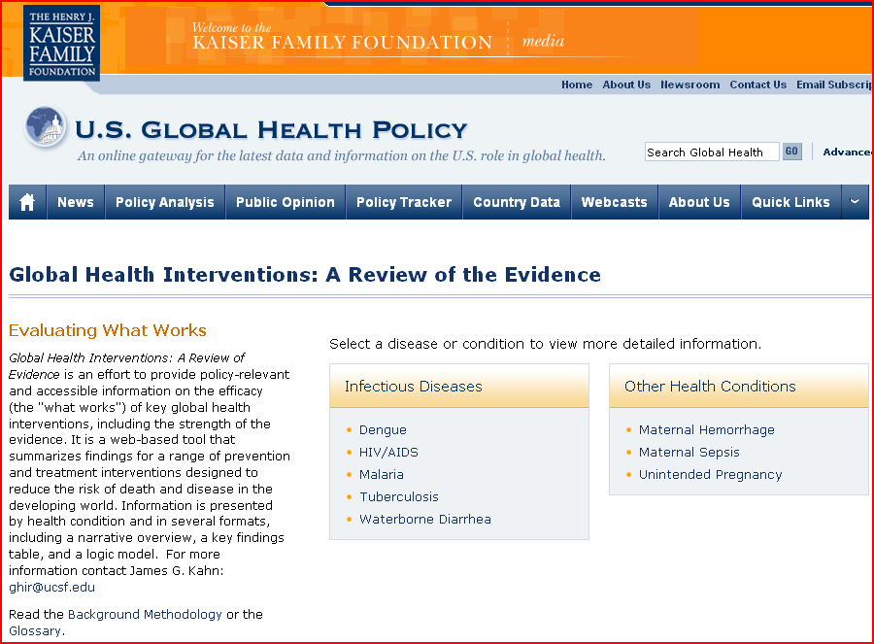
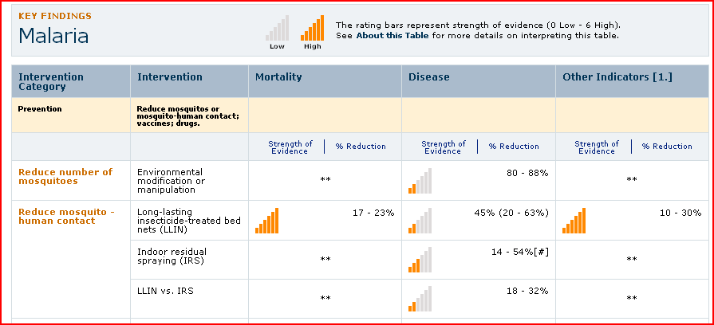

Slide 10


Cost-effectiveness of psychedelics-assisted therapy for PTSD, treatment-resistadnt depression, addiction, autism (etc.)

Slide 11
Other DCEA team introductions

Slide 12
DCEA students
TICR – MCR / ATCR: 8
Global Health Masters: 1
Other (PhD, fellows, MTM): 5
… and quick introductions

Slide 13
DCEA structure
Six cycles of lecture + section:
  Decision trees
  Valuing health: QALYs/DALYs
  Adding costs: Cost-effectiveness
  Markov disease-state modeling
  Data inputs
  Sensitivity analyses
Sections:
  Review HW (10 min)
  Review student projects – ~10 min each - structured summary / critique / discussion
Special topics:
  Excel and TreeAge tutorials
  HIV program cost-effectiveness
  Ethical foundations of CEA
  CEA thresholds
  Iron CEA America!

Slide 14
DCEA student work & grading
Readings – prioritize lecture notes, PPTs, videios over articles
Own project – DA / CEA
  Design & implement simple CEA.
  Start with Excel templates, or TreeAge
  Each cycle, add new element (and update), feedback from mentor
  Ongoing development of structured summary (~800 words)
  By end, have complete simple DA/CEA & structured summary
  Often solo; but can work in pairs if prefer
  Given preliminary score and chance to refine
  Value: 40 points
Homework / problem sets (5)
  Mainly on mammography
  First is open-ended, then 3 programmed (excel)
  One on CEA article review
  Skip cycle 5 (data inputs)
  Value: 100 or 60 points (depending on track 1 or track 2) – late downgraded.
Final exam
  Optional, if needed due to missed HW(s)

Slide 15
DCEA Mentors
Mentor | Area(s) of focus
Elliot Marseille | HIV, TB, diabetes, hepatitis
James G Kahn | HIV, hepatitis, diabetes, & varied other
Joanne Spetz | MTM students; Labor economics
Ammar Asban | Epidemiology and biostats
Harinder Chahal | Diabetes, pharaceuticals
Others as approp. | Repro. health, ortho, global health, etc.

