Slide 1
The Problem with Thresholds in Evaluating the Cost-Effectiveness of Global Health Programs
Elliot Marseille, DrPH, MPP – Health Strategies International
DCEA – Epi 213
February 7, 2019
Notes:
JGK – changed MPP to MPH

Slide 2
Presentation based on:
Marseille E, Larson B, Kazi DS, Kahn JG, Rosen S. Thresholds for the cost-effectiveness of interventions: alternative approaches. Bull World Health Organ. 2015;93(2):118-24.

Slide 3
The Basics:
Obvious but important
Cost-effectiveness is a relative concept.
If analysts or decision makers are unwilling or unable to say that an intervention is, or is not, CE compared to another option, CEAs cannot help decide how $$ should be spent.
Thus – some standard method of determining CE is indispensable
CE is not the only criterion for guiding resource allocation . . .

Slide 4
The problem
Many CEAs in global public health define cost-effectiveness by a standard which is theoretically hard to justify, and leads to severe practical problems in the application of CEA as a guide to resource allocation.

Slide 5
The WHO CE Threshold
Promoted by WHO’s Choosing Interventions that are Cost–Effective (WHO-CHOICE) project.
Definition: an intervention that, per DALY avoided, costs less than:
  3 x the annual GDP per capita is CE,
  1 x annual GDP per capita is considered highly CE.
Notes:
(http://www.who.int/choice/en/)
The most widely used of these thresholds was advanced by the Commission on Macroeconomics and Health which links per capita gross domestic income (GDI) and returns on investments in health. This framework was adopted by WHO in its 2002 World Health Report and by WHO-CHOICE, and modified to reflect the pc-GDP cost-effective standard.

Slide 6
This standard has become ubiquitous
“According to World Health Organization guidelines these strategies are all highly cost-effective because they cost less than [the country’s] per-capita GDP” (Alistair, 2011)
“(The intervention) for adolescents is slightly less than one GDP/ per-capita/life year gained and therefore highly cost-effective, while for adults it is less than two GDP/per-capita/life year gained and therefore potentially cost-effective. (Binagwaho, 2010)
“We compared the estimates to a benchmark for cost-effectiveness of one times the gross domestic product per-capita (GDP/capita) per DALY averted, per QALY gained, or per life-year saved…” (Gomez 2013)

Slide 7
What’s the problem with the WHO threshold approach?
Important comparisons among locally relevant options are ignored
Threshold is too easily attained.
Weak theoretical basis
Affordability not addressed
Result:
CEA far less helpful as a guide to policy than it could be. When used, potential for error.

Slide 8
Important comparisons are obscured
Interventions are lumped together as “CE” or “very CE” regardless of their incremental CE ratio (ICER)
Means that options with huge differences in CE will be treated the same.
Relevant question: “Is Option ‘A’ a better use of limited budget than Option ‘B’?
Tends to suggest that finer distinctions cannot be support by existing data and methods; subtly undermines credibility of CEA enterprise.
Notes:
Simply stating that an intervention is CE by WHO’s standards masks the trade-offs among competing strategies.
Even among activities with ICERs below a national-income threshold, trade-offs are real and consequential.

Slide 9
WHO threshold is easily attained if effective, cost-effective: an example
In SSA, annual child risk of death from diarrhea ~1%
Death = 28 DALYs; ignore morbidity.
Annual DALY burden = 28 * 0.01 = ~0.3 per HH w/1 child.
Clean water -- I$37 per year
Well-powered trials detect risk drop of 20%, or 10% at best
At 20%, intervention averts 0.06 (0.2 × 0.3) DALYs, ICER = I$37 / 0.06 = I$614 per DALY averted. At 10%, I$1228 PDA
Both ICERs << I$5211, WHO CHOICE threshold for “cost-effective” in Kenya. Even if effectiveness at 5%, still CE.
Thus, effective implies cost-effective. Better to de-link.

Slide 10
Weak theoretical basis
Justification for per-capita GDP metric is not stated by WHO CHOICE or the Commission on Macroeconomics and Health.
Tacit assumption that people are WTP up to the threshold.
Assumes that WTP for healthcare increases linearly with national income; whereas reason to believe that health care is a ‘superior good’.
Was the WHO threshold chosen in part to ensure that ART for HIV would be considered CE?
Notes:
Using GDP/capita to establish cost-effectiveness implies a willingness to pay that is not borne out by existing evidence

Slide 11
Thresholds are unrelated to budgets; fail to address affordability
  Trade-offs and opportunity costs are at the heart of CEA
  These only have meaning in the context of finite budgets.
  Imagine a drug that adds 1 year of life to everyone and costs 1x pc-GDP.
    “Highly CE”
    Would require HC budget = entire GDP
Like a teenager at a shopping mall, it’s possible to go broke saving money.
Notes:
Fact that CE recommendations are usually oblivious to budgetary context may be part of reason they aren't adopted more often.
Consider a miracle drug that adds one year to everyone’s life and costs one GDP per capita per person. Such a drug would earn a “highly cost-effective” label using WHO thresholds. Paying for the drug for all eligible patients—in this case the entire population—would require the healthcare budget to increase by an amount equal to the entire GDP of the country, however, which is clearly unfeasible.

Slide 12
The temptation is great
Very easy to use.
Has imprimatur of premier standards-setting body in global health (WHO).
Everyone else uses it.
For journals, having a globally accepted standard reassures editors and reviewers that the methods and results meet international norms.
Encourages authors and reviewers to choose convenience over a more nuanced, and setting-relevant examination of a complex issue.
Notes:
Journal editors / reviewers won’t find fault.
For journals, particularly the medical journals in which many public health cost-effectiveness analyses are published and which often lack health economics expertise, having a globally accepted standard reassures editors and reviewers that the methods and results in a paper under consideration meet international norms. The standard thus allows authors and reviewers to choose convenience over a more nuanced, and setting-relevant examination of a complex issue.
Full disclosure: even us; though working hard to break the habit.

Slide 13
Possible solutions
Increase the link to local context, revealed or stated WTP and budgets
Benchmark interventions
League tables
Notes:
Easier to diagnose than to treat, but we believe the solution may lie in the area of League Tables.

Slide 14
Benchmark interventions
Uses ICER of intervention already widely adopted
Thus (may) reveal actual WTP.
More closely linked to local context but otherwise several drawbacks.
  Does it really represent WTP? May be outlier.
  Needs updating
  Shares other shortcomings of threshold approach b/c it is a threshold approach.

Slide 15
League tables
Given a budget, health benefit maximized if the most CE options are selected; moving down the list (‘league table’) to successively less CE options until budget is exhausted.
Notes:
Though league table analysts also has shortcomings, we believe that this represents the most promising replacement of the WHO threshold approach.

Slide 16
League Tables: Pros and Cons
‘Pros’
Budget and affordability are front and center
No one cut-off; rather reflects relative CE of many interventions
Least CE option that can be funded more likely to represent societal WTP than is a threshold or benchmark

Slide 17
League Tables: ‘Cons’ and solutions
ICERs in local context may be unavailable for any relevant options
‘Bare’ league table that just gives ICERs will not provide needed context for policy makers.
Solutions / mitigating techniques:
1. ‘Borrow’ CE information from similar settings; program contexts;
2. Develop “Extended League Table” in which ICERs are accompanied by information that helps situate each entry in relation to the policy question at hand.
Notes:
A bare league table omits much of the information that decision-makers might want to consider when choosing among
options – e.g. the size of the affected population, whether the intervention is scalable, the health benefit per recipient
and the degree of uncertainty around the ICERs.
Perhaps, given these, we need an extended league table approach in which a list of ICERs is complemented by information on context-sensitive costs and benefits of competing options.

Slide 18
WHO threshold is a demand-side concept
WHO threshold or any threshold unrelated to budgets cannot guide decisions about allocation of a constrained budget
Simplified and erroneous formulation:
“ICER below WHO threshold ➔ CE ➔ Should be implemented”
Notes:
Aspirational WTP estimate
Purpose is rehabilitate CEA’s ability to contribute to UHC benefits package.

Slide 19
Thresholds if unrelated to budgets, fail to address affordability
  Trade-offs and opportunity costs are at the heart of CEA
  These only have meaning in the context of finite budgets
  Thought Experiment
  Imagine a drug that adds 1 year of life to everyone and costs 1x pc-GDP thus,
    “Highly CE”
    Would require that health care budget = entire GDP
Marseille E, Larson B, Kazi DS, Kahn JG, Rosen S. Thresholds for the cost-effectiveness of interventions: alternative approaches. Bull World Health Organ. 2015;93(2):118-24.
Notes:
Fact that CE recommendations are usually oblivious to budgetary context may be part of reason they aren't adopted more often.
Consider a miracle drug that adds one year to everyone’s life and costs one GDP per capita per person. Such a drug would earn a “highly cost-effective” label using WHO thresholds. Paying for the drug for all eligible patients—in this case the entire population—would require the healthcare budget to increase by an amount equal to the entire GDP of the country, however, which is clearly unfeasible.

Slide 20
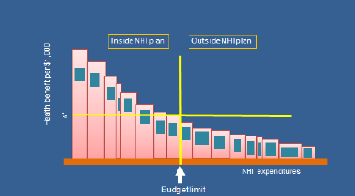
Alternative, supply-side concept of CE threshold
Anthony J Culyer, “Cost-effectiveness thresholds in health care: a bookshelf guide to their meaning and use”, Universities of Toronto and York, 2015
Notes:
Supply-side concept.

Slide 21
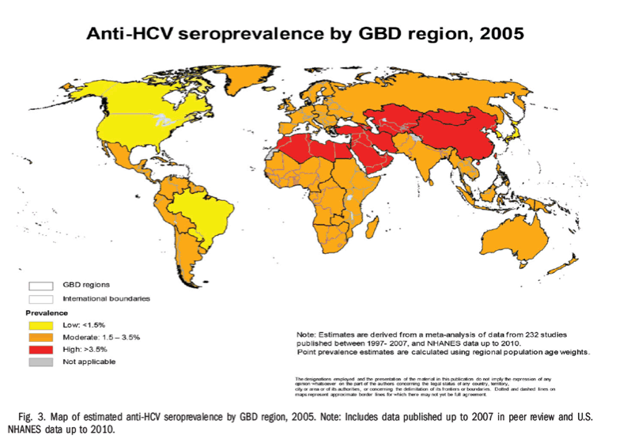
Background – Hepatitis C
Clinical:
Progresses slowly
Causes liver damage, cancer, death
World epi:
  170 million living with CHC
  350,000 deaths per year
  6 genotypes
United States epi:
  2.3 million living with CHC
  16,500 new cases per year
  16,600 deaths per year
  Genotype 1 accounts for 70%
HCV is curable!

Slide 22
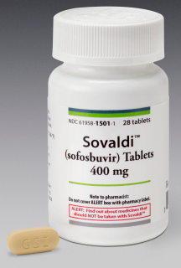
Background – Therapy
New drugs & new regimens including interferon-sparing
  Ledipasvir/sofosbuvir (October 2014)
  Simeprevir/sofosbuvir (November 2014)
Advantages
  Less toxic
  Shorter duration
    12 weeks vs 48 weeks
  Easy to dose/lower pill burden
  Highly effective: 50% SVR for old vs > 90% SVR for new therapies
Disadvantage
  Very expensive

Slide 23
Cost and cost-effectiveness results by treatment initiation timing
Common criterion for evaluating incremental cost-effectiveness:
$50,000 - $150,000 per QALY gained
Chahal HS, Marseille E, Tice JA, Pearson SD, Ollendorf DA, Fox R, Kahn JG. Cost-effectiveness of Early Treatment of Hepatitis C Virus Genotype 1 by Stage of Liver Fibrosis in a US Treatment-Naive Population. JAMA Intern Med, 2015.
Notes:
a Sixty-seven percent of the patients with fibrosis stages F0 to F3 received 8 weeks of treatment and33%received 12 weeks; all patients with stage F4 received 12 weeks.
b Generated by comparing each policy with the one above (next least expensive).
c Indicates wait and treat only when patients reach stages F3 and F4.
d Indicates treat all patients as soon as they are identified with HCV in any fibrosis stage.
Liver transplant is ~ $205,000 / QALY (Chambers et al, Med. Dec. Making, 2010)

Slide 24
Effect of adding a costly and cost-effectiveness new technology
HCV therapy
Really ?
Notes:
Our model suggests that full uptake of new HCV treatments among known-infected patients would increase costs by approximately $1.6 billion, $545 million, and $901 million for genotypes 1, 2, and 3 respectively (see Figure ES2 on page ES8), resulting in a total increase of $3 billion, or $33 PMPM. This represents a 5% increase over the base per-member per-month (PMPM) Medi-Cal costs of $611.179
Cost offsets after five years would total $254 million, reducing net expenditures modestly to $2.8 billion. More substantial offsets after 20 years ($1.2 billion) would reduce net expenditures further to $1.8 billion (see section 7 of the report for sensitivity analyses).

Slide 25
When care value collides with health system value
For MediCal system, any increase above ~1.0%
PMPM problematic.
New HCV Rx would entail 5% increase in PMPM
Comparative clinical effectiveness and CE
Tice JA, Ollendorf DA, Chahal HS, Kahn JG, Marseille E, Weissberg J, Shore KK, Pearson SD. The Comparative Clinical Effectiveness and Value of Novel Combination Therapies for the Treatment of Patients with Genotype 1 Chronic Hepatitis C Infection: A Technology Assessment, Institute for Clinical and Economic Review, January 30, 2015
Notes:
Care Value: 1. Comparative clinical effectiveness of each regimen vs. alternatives (considering both clinical benefits and harm)
2. Any additional “non-clinical” benefits (e.g., reduced caregiver burden)
3. Contextual considerations (no other acceptable treatment, vulnerable populations)
4. Cost-effectiveness (incremental cost to achieve important patient outcomes vs. alternatives)
• Health System Value: 1. Care value of the regimen of interest (as above): and
2. Potential effects of short-term budgetary impact from each regimen on other patients in the health care system
Usually, the care value and the health care system value of an intervention or approach to care will align, whether it is “high,” “reasonable,” or “low.” But health system value also takes into consideration the short-term effects of the potential budget impact of a change in care across the entire population of patients. Rarely, when the additional per-patient costs for a new care option are multiplied by the number of potential patients treated, the short-term budget impact of a new intervention of reasonable or even high care value could be so substantial that the intervention would be “unaffordable” unless the health system severely restricts its use, delays or cancels other valuable care programs, or undermines access to affordable health insurance for all patients by sharply increasing health care premiums. Under these circumstances, unmanaged change to a new care option could cause significant harm across the entire health system, in the short-term possibly even outweighing the good provided by use of the new care option itself.

Slide 26
Policy options for affordability
Target to most CE sub-populations
Negotiate price-volume agreements with manufacturers (exercise market power)
Amortize cost of treatment over several years to reduce immediate budget impact
Accelerated pathways for approval of competing drugs
Engage stakeholders and the public in a broad discussion of manufacturer pricing
Notes:
Payment
• Pay for outcomes rather than for the treatment (e.g., if a patient doesn’t achieve the desired clinical benefit, the manufacturer refunds the payment; alternatively, the manufacturer receives payment only when a patient achieves the desired clinical outcome)
• Negotiate price volume agreements with manufacturers so that prices continue to decrease with increasing volume
• Mortgage/amortize the cost of treatment over several years to reduce the immediate budget impact (this was described by payers as unrealistic since they have 1- or 2-year budget windows, and since there will be other new/innovative therapies to pay for in the future)
• Use mechanisms such as reinsurance or risk corridors to help manage unexpectedly high costs
Policy
• Target federal funding to provide access to care for those who need it but do not have health insurance coverage or other financial resources to obtain care (akin to Ryan White Act for HIV/AIDS)
• Guide the FDA to provide accelerated pathways for approval for competing drugs in order to maximize market forces that can stimulate price competition
• Engage stakeholders and the public in a broad discussion of manufacturer pricing
• Establish a prize or award fund for a cure that provides a financial reward for innovation and allows treatments to be spread widely and quickly (e.g., the government could buy the patent for a cure and make the product available to everyone at very low cost)
• Explore the existing public health emergency powers of the states, along with their purchasing power, to create statewide plans to identify and treat all infected individuals
• Mandate at the federal level that important drugs not priced reasonably be placed in the public domain so other manufacturers can make generics, as is done in India
• Identify a mechanism that would allow more anticipatory, collaborative policymaking between manufacturers, payers, and other stakeholders as drugs with large budget impacts are coming through the system so there can be earlier conversations with policy options identified and implemented
Care Redesign
• Use data to collaboratively identify opportunities to disinvest from low value care and eliminate waste in the health care system, so that the savings can be redirected to higher value options now and in the future
3

Slide 27
Cost and cost-effectiveness results by treatment initiation timing
Chahal HS, Marseille E, Tice JA, Pearson SD, Ollendorf DA, Fox R, Kahn JG. Cost-effectiveness of Early Treatment of Hepatitis C Virus Genotype 1 by Stage of Liver Fibrosis in a US Treatment-Naive Population. JAMA Intern Med, 2015.
Notes:
a Sixty-seven percent of the patients with fibrosis stages F0 to F3 received 8 weeks of treatment and33%received 12 weeks; all patients with stage F4 received 12 weeks.
b Generated by comparing each policy with the one above (next least expensive).
c Indicates wait and treat only when patients reach stages F3 and F4.
d Indicates treat all patients as soon as they are identified with HCV in any fibrosis stage.

Slide 28
More policy options for affordability
Establish prize or award fund for innovation; (e.g., government buys patent for a cure and make available to at low cost)
Use data to identify opportunities to disinvest from low value care, so that the savings can be redirected to higher value options

Slide 29
Conclusions - 1
The current WHO threshold approach for determining CE needs to be replaced by methods which account for budgets, permit multiple comparisons, and more closely approximate WTP.
An ‘extended league table’ approach may be promising.
The BMGF and NICE (UK) are
concerned with this issue.

