Slide 1
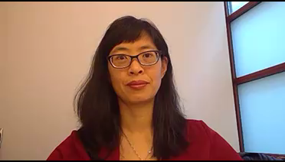
Welcome!
Epidemiology 207 - Epidemiologic Methods II
June M. Chan, ScD
Professor, Epidemiology & Biostatistics and Urology
Steven & Christine Burd-Safeway Distinguished Professor

Slide 2
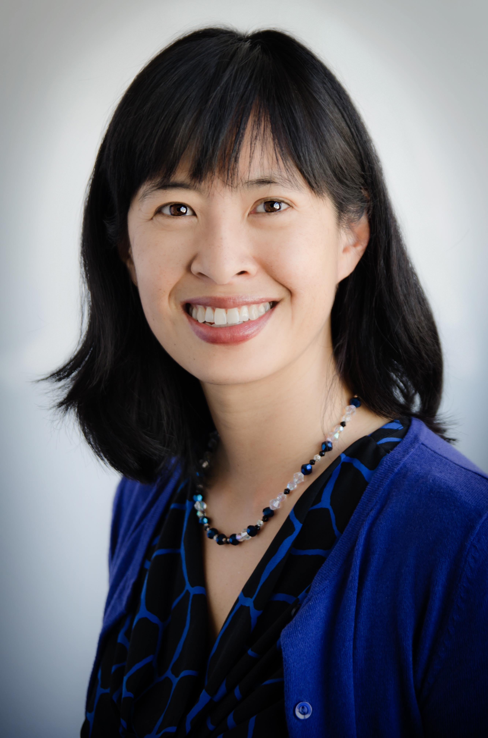
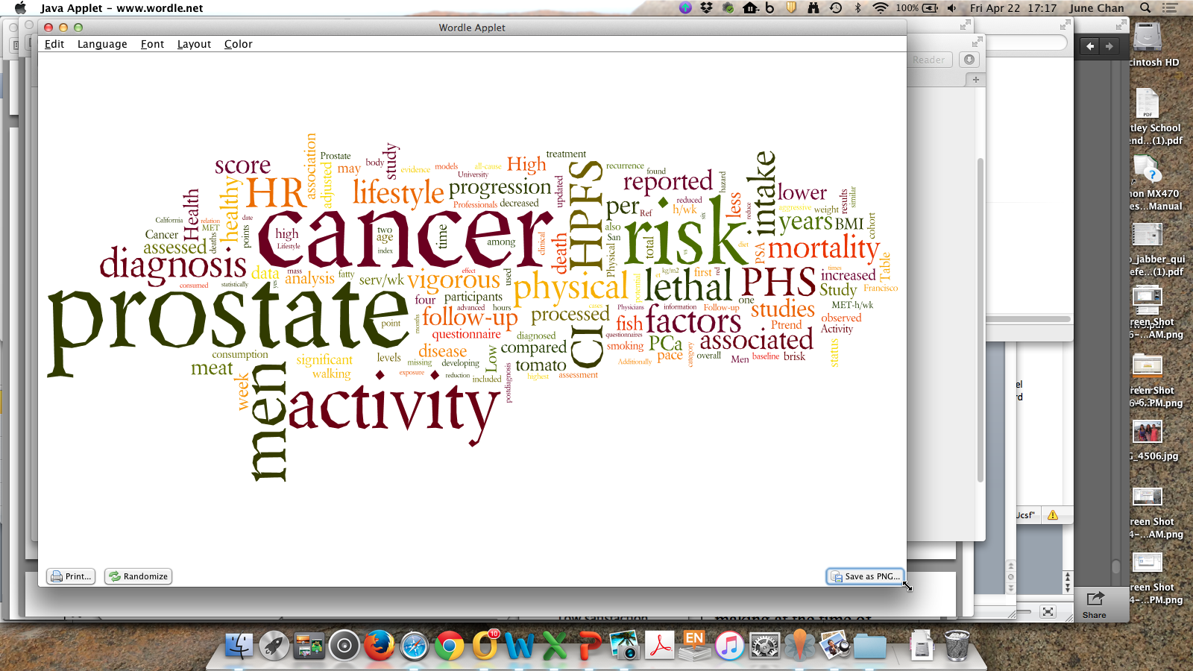
June M. Chan, ScD
Professor, Epidemiology & Biostatistics and Urology
Steven & Christine Burd-Safeway Distinguished Professor
Associate Chair, Clinical Research, Urology
Vice Chair, Education, Epidemiology & Biostatistics
Cancer Epidemiologist
Educator & Mentor
diet

Slide 3
Disclosures
Research:
  Individual: Collaborations with GenomeDx, federally funded grants
  Dept. of Urology collaborates with Genomic Health Inc., Genome Dx, and Myriad Genetics Lab
Husband: full-time employee for GRAIL; previously Myriad Genetics Lab

Slide 4
Introduction to the Course
EPI 207, Epidemiologic Methods II

Slide 5
Outline
Course Learning Objectives
Schedule of Topics & Format
Resources
Assessment & Grades
Tips for learning in this course

Slide 6
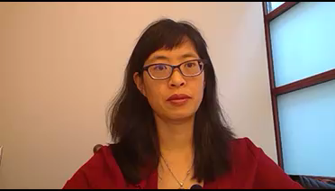
Learning Objectives
Main objective – help you build skills in the design, conduct, analysis, and interpretation of epidemiologic & translational research.
Specific objectives:
  Understand common study designs used in observational research
  Identify sources of bias (including confounding) in observational epidemiologic studies
  Understand and practice applying methods to address bias in observational epidemiologic studies
  Identify effect modification (interaction) and how to present this in results
  Gain experience in interpreting data and critiquing results from observational epidemiologic studies

Slide 7

What Kinds of Questions Does Epidemiology Answer? “Big 6”
Recap of Epid Methods I
Description
  How frequent/common are risk factors or exposures & conditions or diseases? How often does Y occur?
Causation
  The science of establishing causal relationships among biological, behavioral, environmental (etc.) factors among humans
  Does X cause Y?
Attribution
  What fraction of disease Y can be eliminated if a causal exposure X is eliminated?
Mediation
  Understanding the mechanisms of causation
  How does X cause Y?
Interaction
  When and for whom does X cause Y?
Prediction
  Do A, B, and C predict occurrence of Y? (e.g., diagnosis or prognosis)

Slide 8
How does this build upon Epidemiologic Methods I?
Delve deeper into how to design rigorous, valid, observational epidemiologic studies
Provide a practical framework for integrating and applying concepts taught in Epid Methods I by thinking through the research process - from hypothesis development, to study design, analysis, and interpretation; & practical tips on implementation.
Gain further practice in interpretation of observational epidemiologic & translational research by reading and critiquing papers.

Slide 9

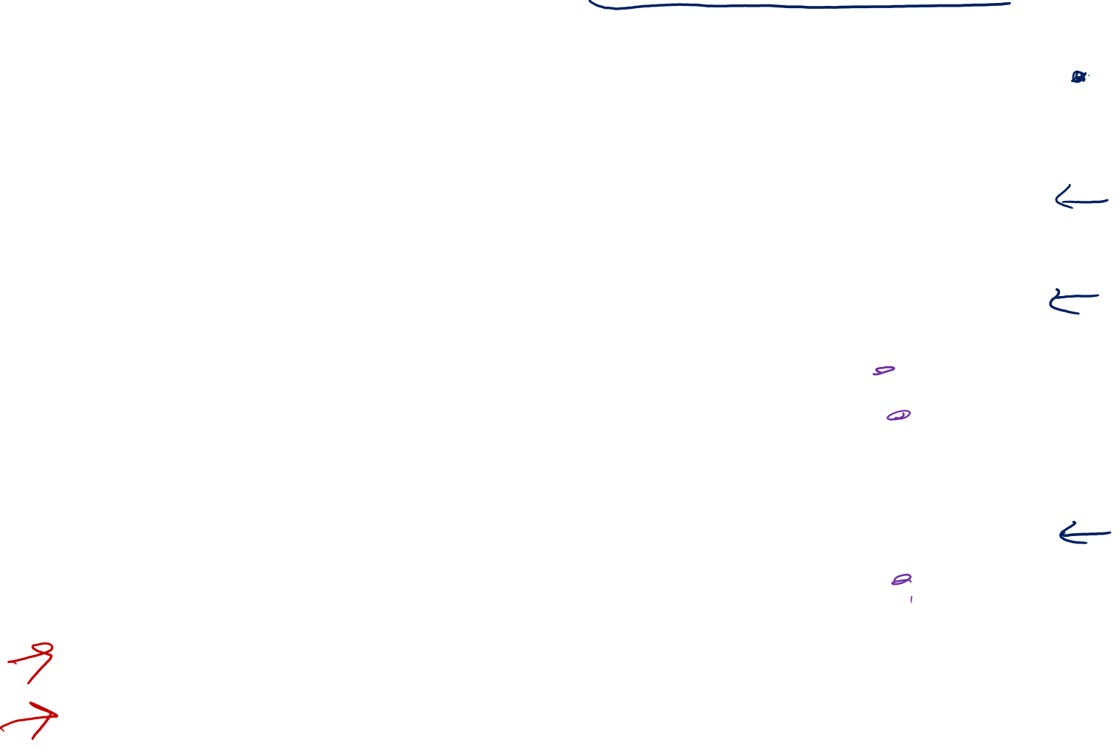
EPI 207 Schedule – 2019 Thursday, 1:15-3:00 pm
Date | Topic | Instructor(s) | Mode
Pre-Jan 10 | Lec: Intro to the Course | Chan | Recorded
Jan. 10 | Lec: Intro, Study Design (COH & RCT) | Chan | In-Class
Jan. 17 | Small Group: Cohort | Ospina, (Chan) | In-Class
Jan. 17 | Lec: Person-time & Bias in Cohorts | Chan | Recorded
Jan. 24 | Small Group: Bias | Ospina, (Chan) | In-Class
Jan. 24 | Lec: Causal Inference | Chan | Recorded
Jan. 31 | Small Group: Causal Inference | Rerolle, (Chan) | In-Class
Feb. 7 | Lec: DAGS | Maria Glymour | In-Class
Feb. 14 | Lec: QBA | Elizabeth Mayeda | In-Class
Feb. 21 | Small Group: DAGS | Rerolle, (Glymour) | In-Class
Feb. 28 | Small Group: QBA | Rerolle, (Chan) | In-Class
Feb. 28 | Tutorial (reading + short Lec): Effect Modification | Chan | Recorded
Mar. 7 | Lecture: Matching | Erin Van Blarigan | In-Class
Mar. 14 | Small Group: Matching & Eff. Mod | Ospina, (Chan) | In-Class
Mar. 14 | Assigned: Final Exam |  | Online
Mar. 21 | Final Exam DUE |  | Online
Notes:
Overall schedule for 2019
Class day/time
Mix of live lecs and small groups
Special guest lecs from glymour, mayeda, and van blarigan
Recorded lectures available on CLE, highlighted in grey
Final is assigned March 14 and due online march 21

Slide 10

EPI 207 Schedule – 2019 Homework Schedule
Date Posted | Homework Topics | DUE DATE (by 1:15 PM)
Jan. 10 | Intro to Study Design & Cohort (live lec, RGL Ch. 6, HW) | Jan. 17
Jan. 17 | Person-time, Bias/Confounding in Cohorts (recorded lec, RGL Ch. 7, Hernán et al J Clin Epid 2016, HW) | Jan. 24
Jan. 24 | Causal Inference (recorded lec, RGL Ch 2, (optional Hernán & Robins Ch 1), HW) | Jan. 31
Feb. 7 | DAGS (live lec, reading TBD, HW) (due in TWO weeks) | Feb. 21
Feb. 14 | Quantitative Bias Analysis (live lec; reading TBD, HW) (due in TWO weeks) | Feb. 28
Feb. 28 | Effect Modification (recorded lec, Vanderweele Epid 2014, RGL Ch. 5, HW) (due in TWO weeks) | March 14
March 7 | Case-Control / Matching (live lec, RGL Ch. 8, articles TBD, HW) | March 14
March 14 | FINAL TAKE HOME EXAM | March 21
HW is generally a chapter from Rothman/Greenland/Lash (RGL), 1-2 articles, & problem set

Slide 11
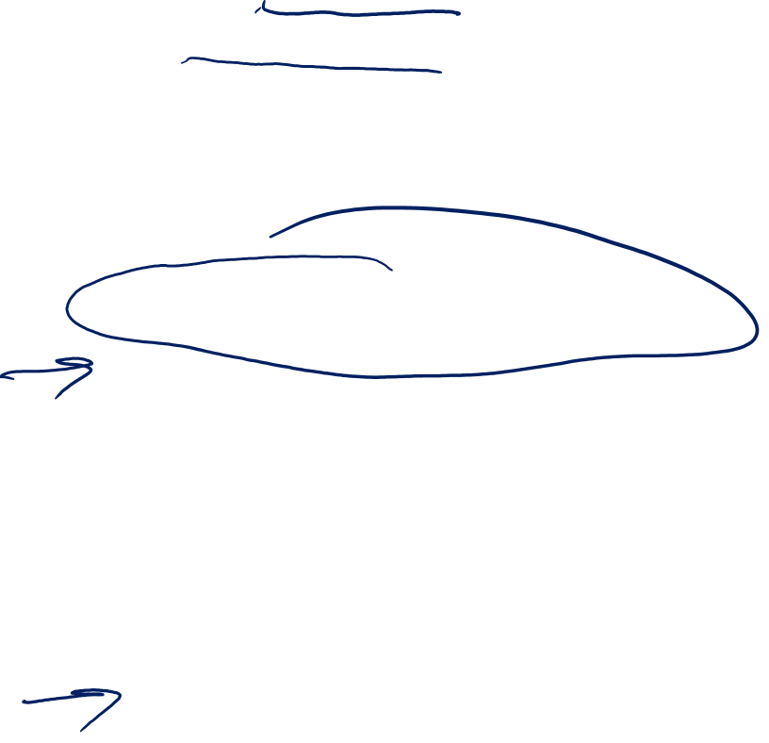
Course Format
Lectures: 4 live lectures, 3 recorded lectures
  3 guest live lecturers
  Recordings and slides posted ~ 1 week+ prior to due date of HW
  Live Lecs (also recorded/posted): Jan 10, Feb 7 & 14, March 7
  Recorded Lecs assigned: Jan 17, Jan 24, Feb 28
Small Groups: 6 In-person sessions
  HW assignment posted on CLE ~1 week before
  HW due at 1:15pm, CLE will not accept assignments after the due date/time
  In-Person Small Groups: Jan 17, 24, & 31, Feb 21 & 28, & March 14
Instructors
  Course Director: June M. Chan ScD june.chan@ucsf.edu
  Teaching Assistants: Monica.ospina@ucsf.edu & Francois.rerolle@ucsf.edu

Slide 12
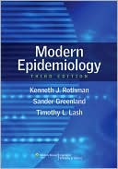
Study Resources
Lectures, Slides, & Notes
Assigned Readings
  Rothman/Greenland/Lash (3rd Edition, 2008) (RGL)
  Selected articles and other chapters
Problem Sets, Small Groups, & Answer Keys
Software Resources that may be used
  Statistical software: STATA
  dagitty.net – free web-based software for DAGs
  MS Office Excel

Slide 13
Text Books
Rothman K, Greenland S, Lash T(2008), Modern Epidemiology (3rd edition). Philadelphia: Lippincott-Raven.
    UCSF users can access an electronic version of the book online at the UCSF library through OvidSP
Hernán M A, James M. Robins J A (2019), Causal Inference. Boca Raton: Chapman & Hall/CRC, forthcoming
    PDF of the book could be accessed here: http://www.hsph.harvard.edu/miguel-hernan/causal-inference-book/

Slide 14

Assessment & Grading Policies
  Overall Grade
    70% 7 Homework assignments (drop 1 lowest score)
    30% Take Home Final Exam
  Homework Assignments
    Late assignments NOT accepted (key posted after SG on due date)
    Files will be posted on website ~1 week prior to due date
    Type responses (OK to handwrite some equations)
    Due at 1:15 pm day of SG; CLE will not accept assignments after 1:15
    Any issues: e-mail teaching assistant before 1:15pm on due date
  Attendance
    Lectures & Small Group: Not required, but highly recommended.

Slide 15

What is the best way to learn in this course?
Watch the lectures & review the slides, do assigned readings
Do the Problem Sets, engage in the small groups, review answer keys
Study with a partner or in a group
Ask questions

Slide 16
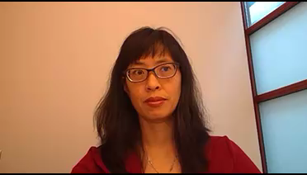
See you in class on January 10th!

