Slide 1
Information Content of a Magnetic Resonance Spectra
A. Chemical Shift and Structure
1. Origins of chemical shift
2. Chemical shift and functional groups
3. Effects of molecular interactions on chemical shift
a) magnetic susceptability
b) pH
c) metal binding
4. Chemical shift equivalence/Chemical Exchange
B. Spin-Spin Coupling and Structure
1. Simple coupling and identification of adjacent protons
2. Typical proton coupling constants
3. Magnetic Equivalence
4. Levels of unsaturation and identification of a organic compound
5. More complex coupling
6. Strong coupling
C. T1 and T2 relaxation times
D. Identification of compounds in NMR spectra using chemical shift and j- coupling information.

Slide 2
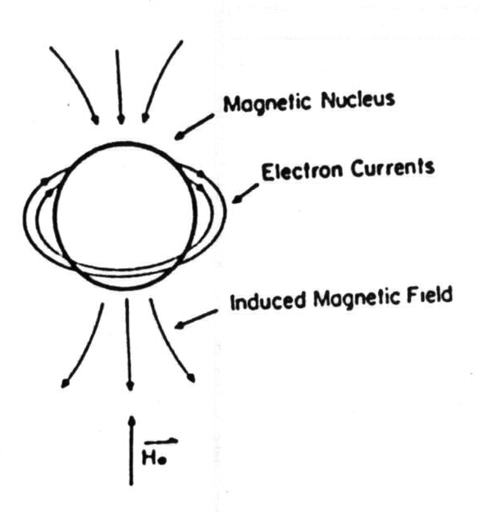
Chemical Shift and Structure
The presence of electrons around a nucleus causes the nucleus to be “shielded” to a certain extent from the applied field magnetic field. The applied field induces electronic currents, setting up local magnetic fields around the nucleus that oppose the applied field.
Magnetic Nucleus
Electron Currents
Induced magnetic field
Applied magnetic field

Slide 3
Chemical Shielding
Chemical shielding (σ) arises from magnetic fields generated by electrons within molecules that oppose the applied B_{o}.
Each type of molecule experiences a different magnetic field and frequency.
The molecule corresponding to a given frequency is referred to by its chemical shift (δ_{i}) which is expressed in parts-per-million (ppm) and is independent of B_{o}.
Shielded magnetic field: B_{i} = B_{o} (1 - σ_{i})
Shielded frequency: υ_{i} = γB_{o} (1 - σ_{i})
Chemical Shift: δ_{i} = (υ_{i} - υ_{ref}) / ω_{ref}
ref = standard molecule (eg TMS)

Slide 4
Precession of spins in the presence of a magnetic field (B_{o})
z
υ₁ = γB₁
B₁
M
υ₂ = γB₂
B₀
B₂
x
υ₃ = γB₃
y
B₃
Protons on different molecules experience slightly different B
fields due to chemical shielding

Slide 5
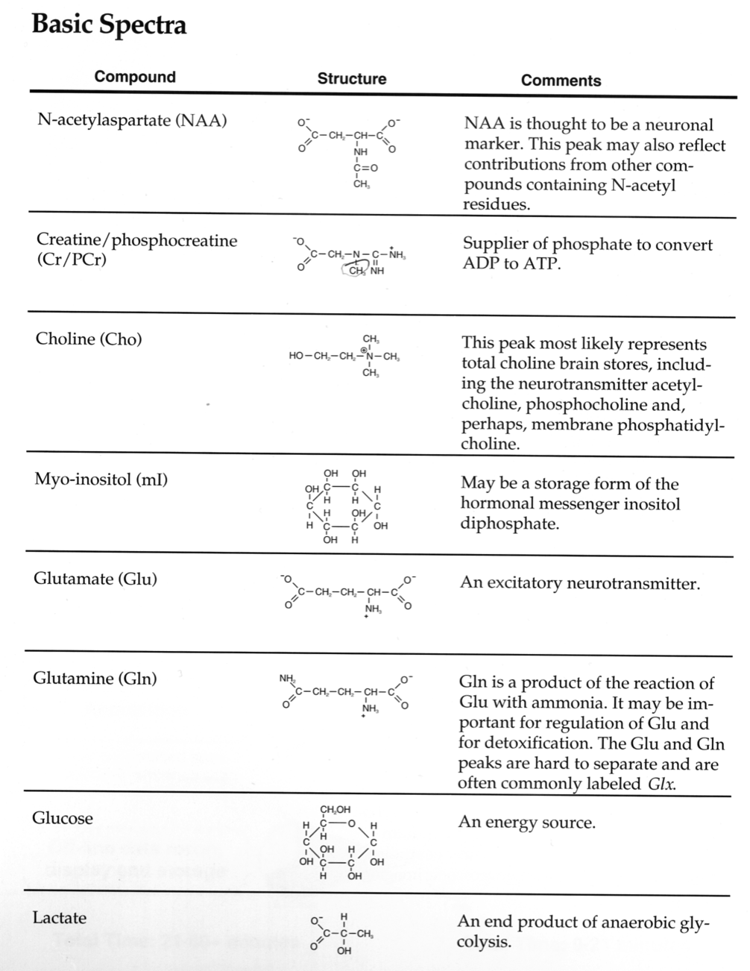
Chemical Shift (PPM)
N-Acetyl Aspartate
Creatine
Choline
ppm = Shift from TMS (Hz)
Spectrometer (MHz)
Frequency in Hz or “Parts per million” ppm.
The PPM scale provides a way to report chemical shifts that doesn’t depend on magnetic field strength.
Notes:
In vivo brain spectra

Slide 6
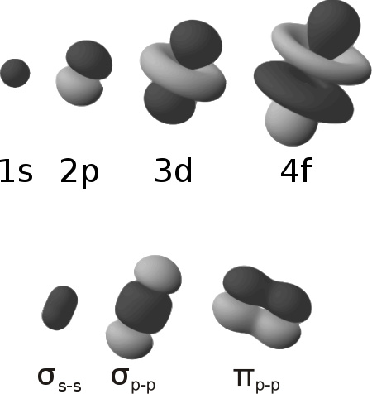
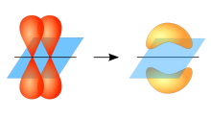
Molecular Orbitals and Chemical Bonds
Sigma bonds (σ bonds) are the strongest type of covalent chemical bond. They are formed by head-on overlapping between atomic orbitals.
Pi bonds (π bonds) are covalent chemical bonds where two lobes of one involved atomic orbital overlap two lobes of the other involved atomic orbital. Each of these atomic orbitals is zero at a shared nodal plane, passing through the two bonded nuclei.

Slide 7
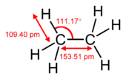
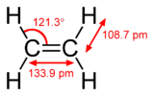

Multiple Bonds
A typical double bond consists of one sigma bond and one pi bond; for example, the C=C double bond in ethylene. A typical triple bond, for example in acetylene, consists of one sigma bond and two pi bonds in two mutually perpendicular planes containing the bond axis.
A pi bond is weaker than a sigma bond, but the combination of pi and sigma bond is stronger than either bond by itself. The enhanced strength of a multiple bond versus a single (sigma bond) is indicated in many ways, but most obviously by a contraction in bond lengths and molecular geometry.
Ethylene 1- σ bond
+ 1-π bond
Trigonal planar
Ethane 1- σ bond
+ 2-π bonds
linear
Ethane 1- σ bond
tetrahedral
Notes:
Geometry impacts chemical shift and coupling constant

Slide 8
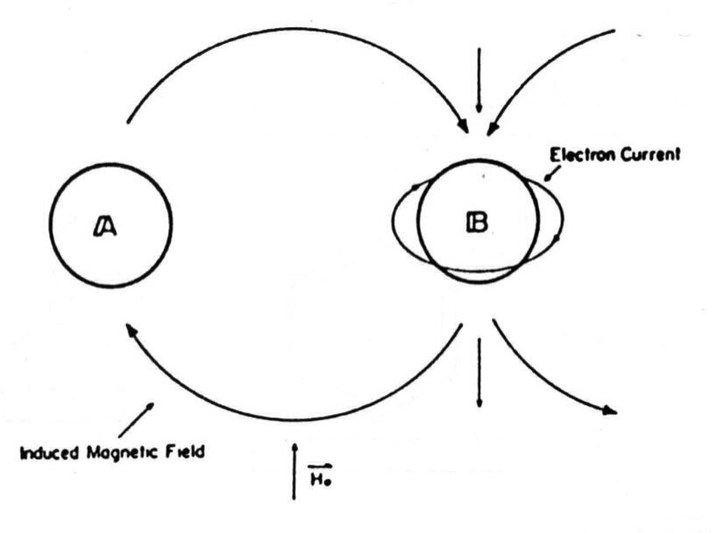
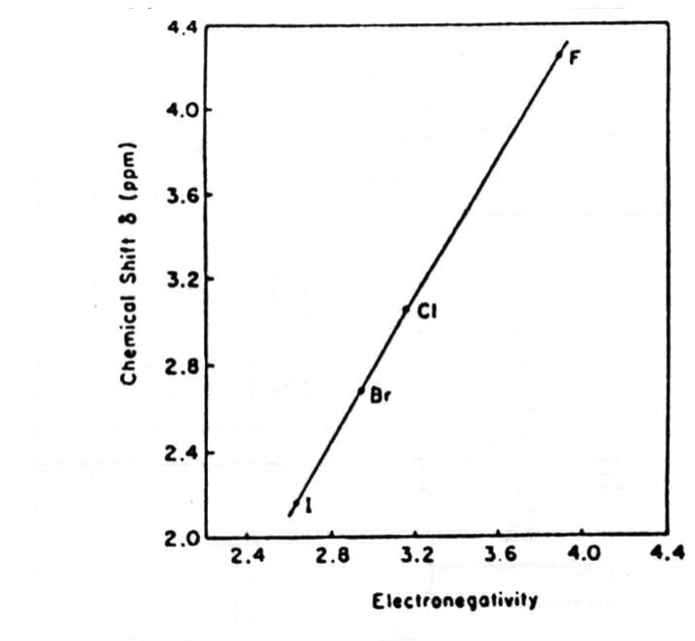
Chemical Shift and Structure
The shielding that a nucleus experiences is derived from several types of electronic circulations.
1. Local diamagnetic effects or diamagnetic and paramagnetic effects of neighboring atoms.
The magnitude of the induced field depends on:
  The type of bonds containing the electrons.
The electronegativity of the atoms involved.
Electron Current
Chemical bond between atoms A and B.
Induced magnetic field
Applied magnetic field

Slide 9
Common Chemical Structures
carboxylic acid
ketone
ester
anhydride
amide
alcohol
alkene
secondary alkane
tertiary alcohol
nitrile
primary alkane
quantenary alkane
O
H
3
C
O
H
N
H
2
phenyl
phenol
napthalene
amino acid

Slide 10
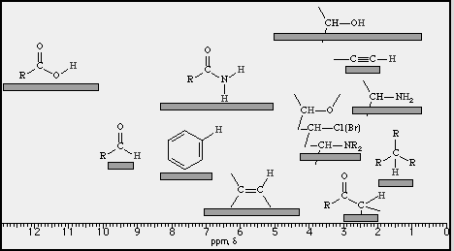
¹H Chemical Shifts for Common Chemical Structures
Electronegative groups are "deshielding" and tend to move NMR signals from neighboring protons further "downfield" (to higher ppm values) relative to simple alkanes.
Protons on oxygen or nitrogen have highly variable chemical shifts which are sensitive to concentration, solvent, temperature, etc.

Slide 11
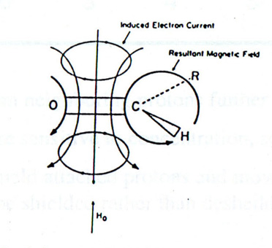
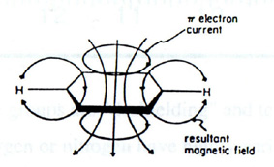
Chemical Shift and Structure
2. Effects from interatomic currents - anistropic sheilding and ring effects.
a. Anisotrophic desheilding of aldehydic protons.
Induced electronic current
Resultant magnetic field
Applied
field
b. The current effect causing desheilding of benzene ring protons.
Applied
field
Resultant magnetic field

Slide 12
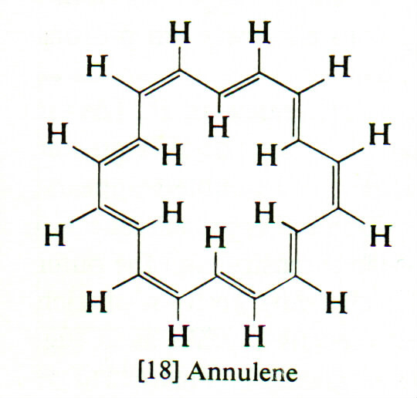
¹H Chemical Shifts for Common Chemical Structures
Outside protons -8.9 ppm
Inside protons -I.8 ppm ppm
The Pi-system of alkenes, aromatic compounds and carbonyls strongly deshield attached protons and move them "downfield" to higher ppm values.
Protons located above and below the Pi-system like the protons inside the ring structure of annulene and the protons of acetylene will actually be very shielded (shifted upfield) rather than desheilded.

Slide 13
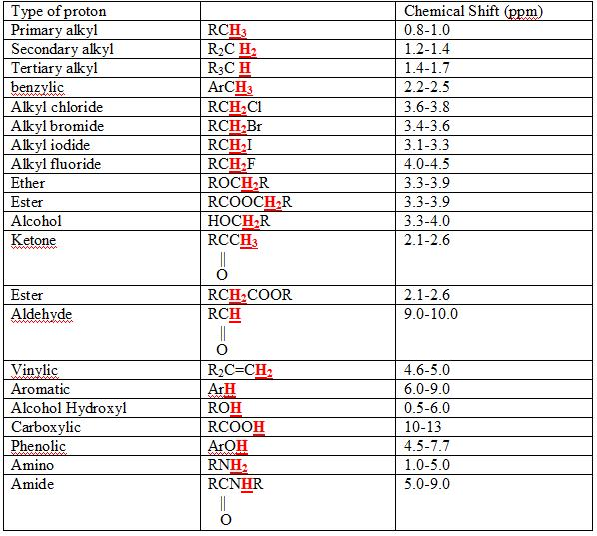
¹H Chemical Shifts for Common Chemical Structures
Notes:
Different programs to predict chemcial shifts

Slide 14
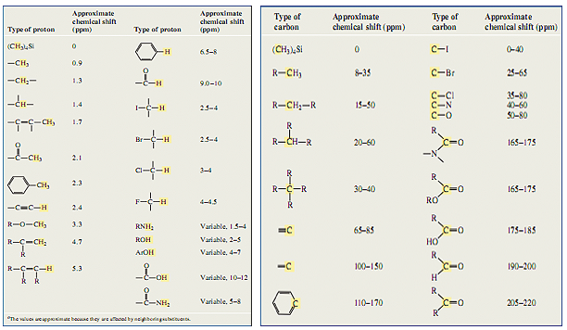
¹H Chemical Shifts for Common Chemical Structures

Slide 15
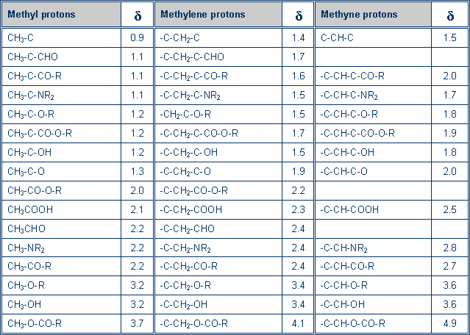
¹H Chemical Shifts for Common Chemical Structures

Slide 16
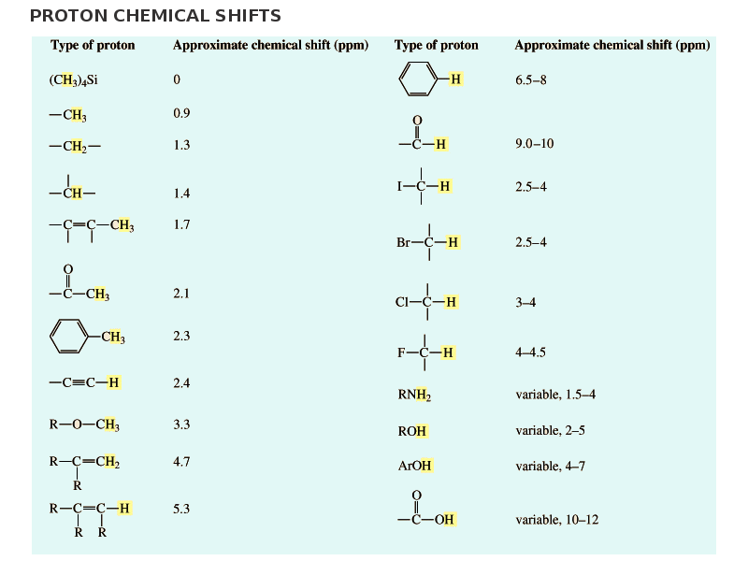

Slide 17
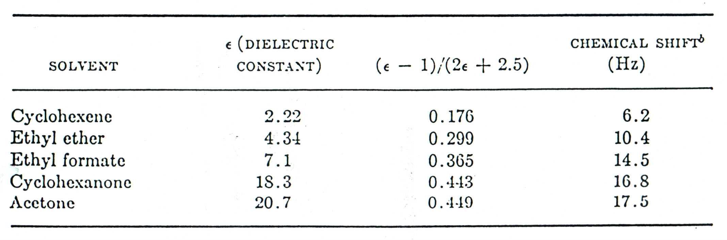
Effects of Molecular Interactions on Chemical Shift
There are several specific interactions of surrounding molecules with the molecule of interest that have profound effects on chemical shift.
Bulk Magnetic Susceptibility - a dimensionless proportionality constant that indicates the degree of magnetization of a material in response to an applied magnetic field.
Bulk magnetic susceptibility changes can dramatically change the resonant frequency of NMR active nuclei. In solution, bulk magnetic susceptibility changes with the solvent’s dielectric constant (a measure of the solvents polarity). For example, the CH₃ protons of the molecule CH₃CN shift downfield with increasing dielectric constant.

Slide 18
Bulk Magnetic Susceptibility (χ) Induced Chemical Shifts in the Body
Differences in χ in the body can cause shifts as large as a few ppm.
The amount of filed inhomogeneity depends on differences in χ within a tissue or at the interface of different tissues. The amount of field inhomogeneity depends on the susceptibility difference and the geometry.
The resultant in homogeneity is most severe near the boundaries between two materials with different susceptibilities such as air and tissue (water is slightly diamagnetic, χ < 0, χ = − 0.719 x 10⁻⁶) and air is slightly paramagnetic (χ > 0), while only a vacuum is non-magnetic (χ = 0).
Magnetic susceptibility induced chemical shifts increase with field strength and with decreasingly symmetric shapes.
Examples of areas of the body that are subject to these effects are the abdomen (intestinal gases), rectum, lungs, and head (sinuses).
Notes:
Similarity of orbitals and shim coils. Spherical symmetry and symmetric shapes (say phantoms)

Slide 19
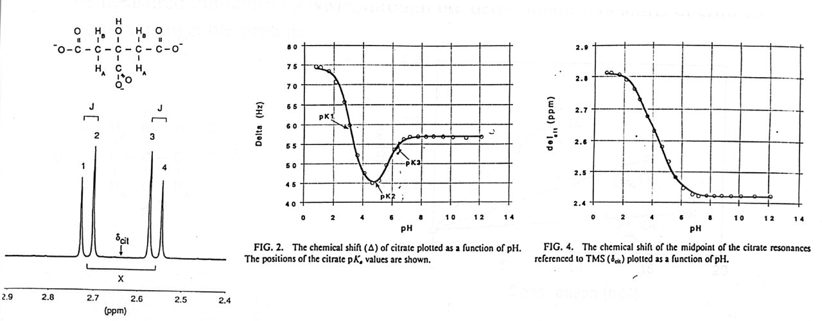
Effects of Molecular Interactions on Chemical Shift - pH Effects
When a proton is added to RCOO-, RNH₂, RS- to form RCOOH, RNH₃⁺, RSH, respectively, the chemical shifts of non-exchanging proton resonances on R moiety are shifted downfield, with the deshielding effect attenuating with increasing distance between the non-exchangeable proton and the site of protonation.
For this reason, the particular chemical shift of nuclei in many compounds of biological interest, such as citric acid in the prostate, are be pH dependent.
Delta
Protonation also effects the difference in chemical shift between the A and B protons. This will have an impact on J-modulation as well.

Slide 20
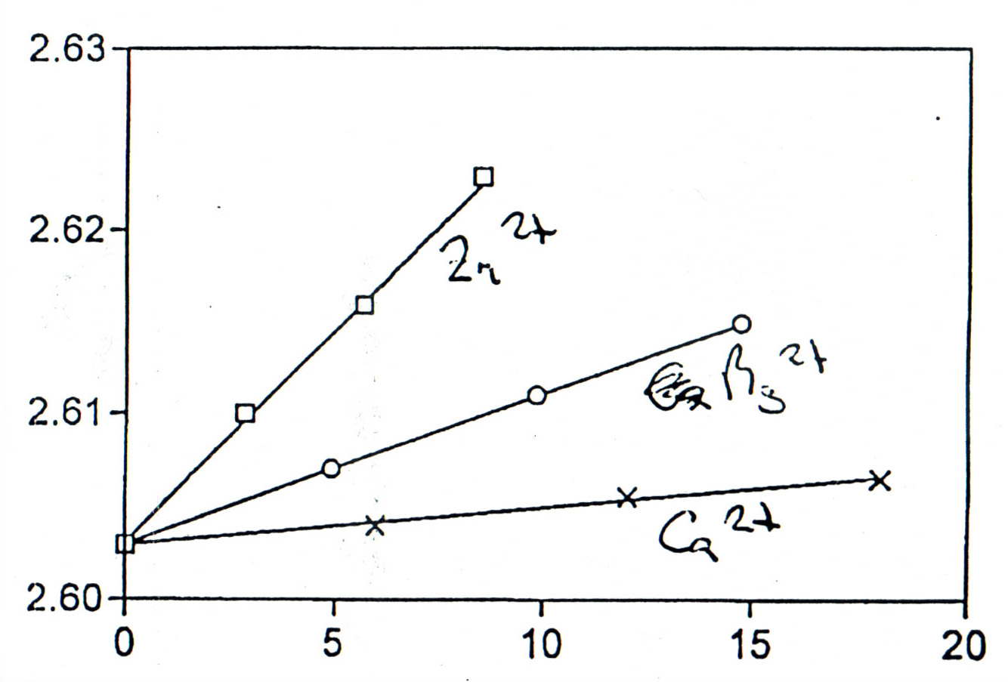
Effects of Molecular Interactions on Chemical Shift - Metal Binding
Metal binding - Just as protonation leads to movement of NMR peaks down-field, complex formation with diamagnetic metal ions will give chemical shifts at lower fields for protons on the ligand.
An example of this phenomenon is the shift in the proton resonances of citrate with increasing cation concentration. Of biochemical interest is that changes in levels of the cation Zn in the prostate have been associated with the evolution of prostate cancer. Zn cannot be monitored by NMR directly, but could potentially be measured indirectly by NMR through the determination of shifts of citrates non-exchangeable protons.
Zn²⁺
Mg²⁺
Chemical Shift of Citrate (ppm)
Ca²⁺
Concentration of Cation (mM)
Notes:
If paramagnetic – line broadening
HW: how will you estimate a probe that binds all these metal ions? Linear function – can quantify the metal ion concentraiton – why is that important? Biological application.

Slide 21
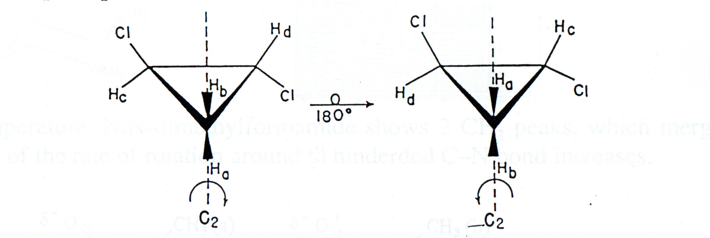
Chemical Shift and Structure - Chemical Shift Equivalence
If nuclei are interchangeable by a symmetry operation or a rapid process, they are chemical shift equivalent. Nuclei are interchangeable if the structures before and after the operation are indistinguishable. The symmetry operations are: rotation about a symmetry axis; inversion at a center of symmetry; reflection at a plane of symmetry, or higher orders of rotation about an axis followed by reflection in a plane normal to the axis.
For example. Protons a and b in trans-1,2-dichlorocylopropane are chemical shift equivalent, as are protons c and d. The molecule has an axis of symmetry passing through C3 and bisecting the C1-C2 bond. Rotation of the molecule by 180º around the axis of symmetry interchanges proton Ha for Hb and Hc for Hd. If the protons were not labeled, it would not be possible to tell if the symmetry operation has been performed, i.e. the structures are superimposable.
1
2
1
2
3
3
Notes:
Add spectra

Slide 22
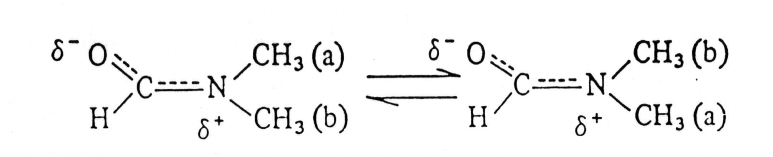
Chemical Shift and Structure - Chemical Shift Equivalence
Moreover, protons that appear to be chemically equivalent due to the symmetry of the molecule may not be due to hindered rotation about a bond. For example, at room temperature, N,N-dimethylformamide shows 2 CH₃ peaks, because of the rate of rotation around the hinderded C–N bond is slow on the NMR time scale. However, as one raises the temperature the barrier to rotation is overcome and the two CH₃ peaks merge into a single peak at ≈ 123ºc.
Another example is citric acid where hydrogen bonding between the carboxy and hydroxy groups cause restricted rotation about the C2 -C3 and C4-C3 bonds, resulting in the A and B protons to be chemically different.
O
H
O ⁻
H
O ⁻
B
H
B
O
⁻ O
C
C
C
C
C
1
2
3
4
5
H
A
H
A
C
O
O ⁻
Notes:
How fast does it rotate – going from 23 to 123? No rotation to xx seconds?

Slide 23
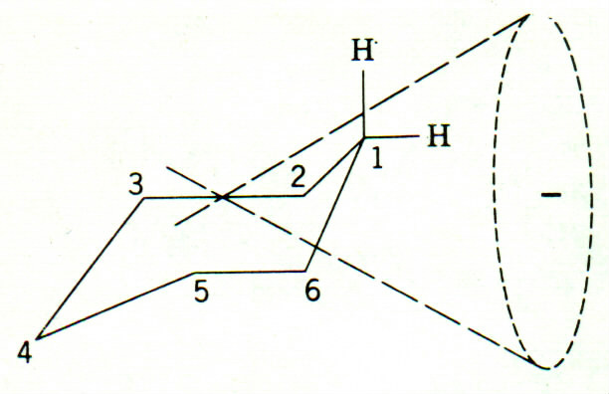
Chemical Shift and Structure - Chemical Shift Equivalence
Chemical shift equivalence is also caused by rapid exchange mechanisms (faster than once in 10⁻³ sec.). For example, the chemical shift of the cyclohexane protons is an average of the shifts of the axial and equatorial protons. The chemical shift equivalence of the cylohexane protons results from rapid interchange of the axial and equatorial protons as the molecule flips between chair forms.
axial
The equatorial protons would be more deshielded than the axial protons if there was not a rapid exchange of these two positions. At room temperature, the spectrum consists of a singlet at 1.42 ppm.
equatorial
However, if the chemical exchange rate is faster than the time scale of the NMR experiment, the exchanging protons will not be observed. This is the case for the hydroxy and carboxylic acid protons of citric acid in aqueous solution. These protons exchange with water so fast that they are not NMR visible.
H
O
H
O
H
O
B
B
HO
C
C
C
C
C
OH
NMR invisible.
H
H
A
NMR invisible due to exchange with water.
A
C
O
OH
Notes:
Add spectra of cyclohexane, and one when its hindered with a t-but group. Goes from singlet to 2 peaks for the 12 protons
HW: when will you see the –OH groups?

Slide 24
Example of Fast Chemical Exchange
Citrate
B
A
O
H
O ⁻
H
O ⁻
B
H
B
O
⁻ O
C
C
C
C
C
1
2
3
4
5
H
A
H
A
C
O
O ⁻
No Resonances due to the hydroxy or carboxy protons.
Residual Water
Citrate
9
8
7
6
5
4
3
2
1
0
Chemical Shift (ppm)

Slide 25
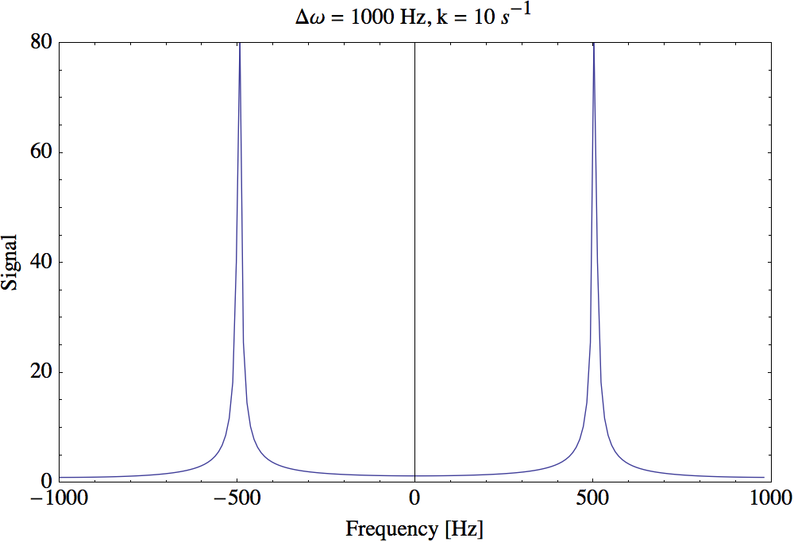
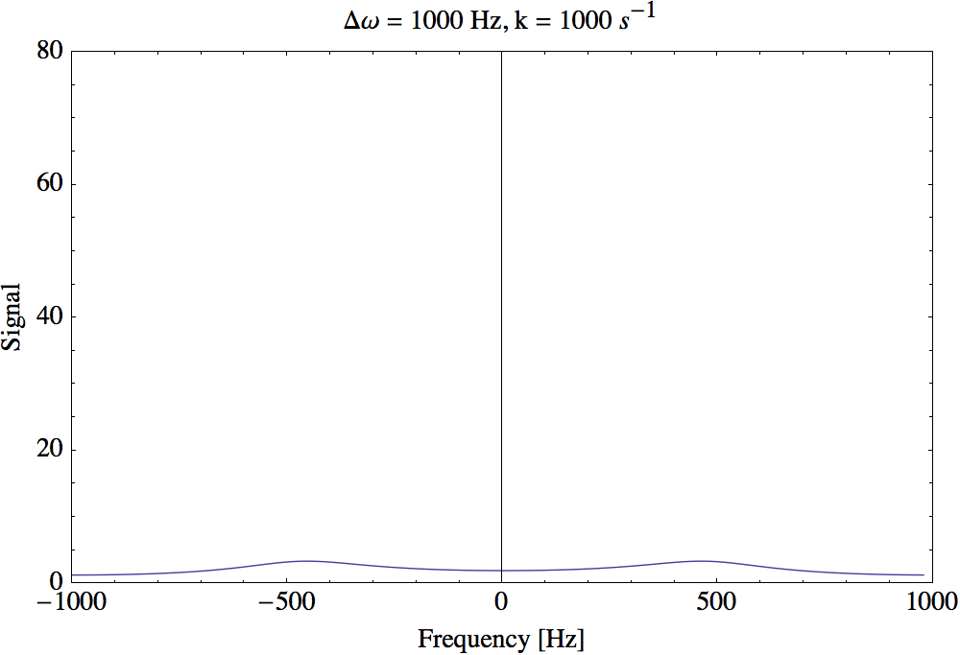
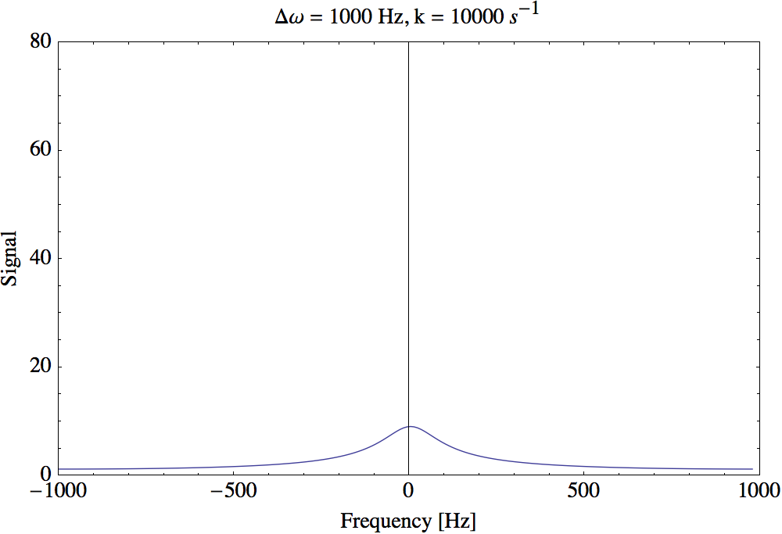
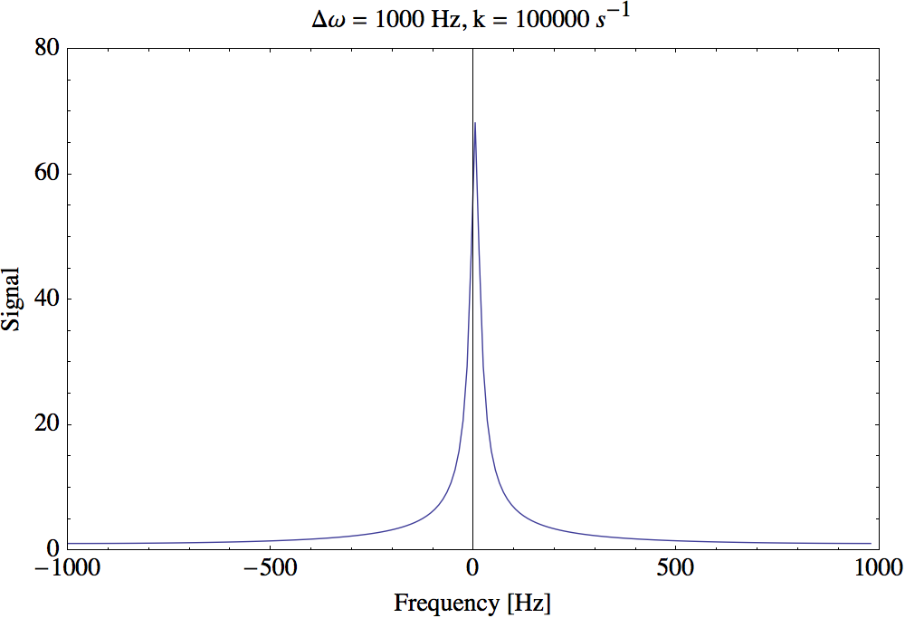
Rate Chemical Exchange and Difference in Chemical Shift
Notes:
Add equation for chemical exchange vs shift

Slide 26
Information Content of a Magnetic Resonance Spectra
A. Chemical Shift and Structure
1. Origins of chemical shift
2. Chemical shift and functional groups
3. Effects of molecular interactions on chemical shift
a) magnetic susceptability
b) pH
c) metal binding
4. Chemical shift equivalence/Chemical Exchange
B. Spin-Spin Coupling and Structure
1. Simple coupling and identification of adjacent protons
2. Typical proton coupling constants
3. Magnetic Equivalence
4. Levels of unsaturation and identification of a organic compound
5. More complex coupling
6. Strong coupling
C. T1 and T2 relaxation times
D. Identification of compounds in NMR spectra using chemical shift and j- coupling information.

Slide 27
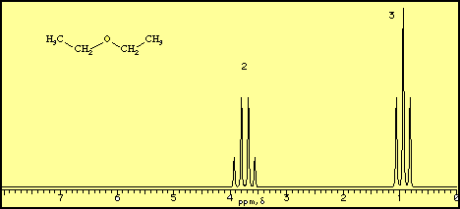
Spin - Spin Coupling - Identification of Adjacent Protons
For a molecule such as diethyl ether, CH3CH2OCH2CH3, two chemically different types of protons would be predicted to appear in the NMR spectrum; a 'simple' CH3 in the area of 1 ppm, and a CH2 shifted down to about 4 ppm by the adjacent electronegative oxygen. The NMR spectrum of diethyl ether, however, displays seven peaks, as shown below.
This multiplicity is due to the phenomena known as spin coupling and arises because of interaction of the proton magnetic field with bonding electrons. In essence, each proton can have one of two possible spin orientations in the applied field, so that the magnetic field sensed by adjacent protons can have one of two possible values. The result is that n protons will split adjacent protons into (n + 1) peaks. The intensities of these peaks are simply a result of the possible spin orientations.
Notes:
Pop up chemical shift table?

Slide 28
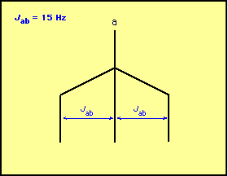
Spin - Spin Coupling - Identification of Adjacent Protons
The protons of a CH2 group can have the following possible spin states:
The middle pair have degenerate energies, therefore a proton adjacent to a CH2 group will be split into three separate peaks in the ratio 1:2:1.
The separation between these peaks is referred to as the coupling constant, J which is measured in Hz; typical values for J for protons seldom exceed 20 Hz and it is important to note that sets of coupled protons will display exactly the same coupling constant. This is known as simple or first order coupling since the difference in chemical shift is much greater than the magnitude of the coupling constant.
1
2
1
Notes:
HW: Probability distribution map for spin 1 like deuterium
Illustrate one proton from ch3 looking at metyhlene protons

Slide 29
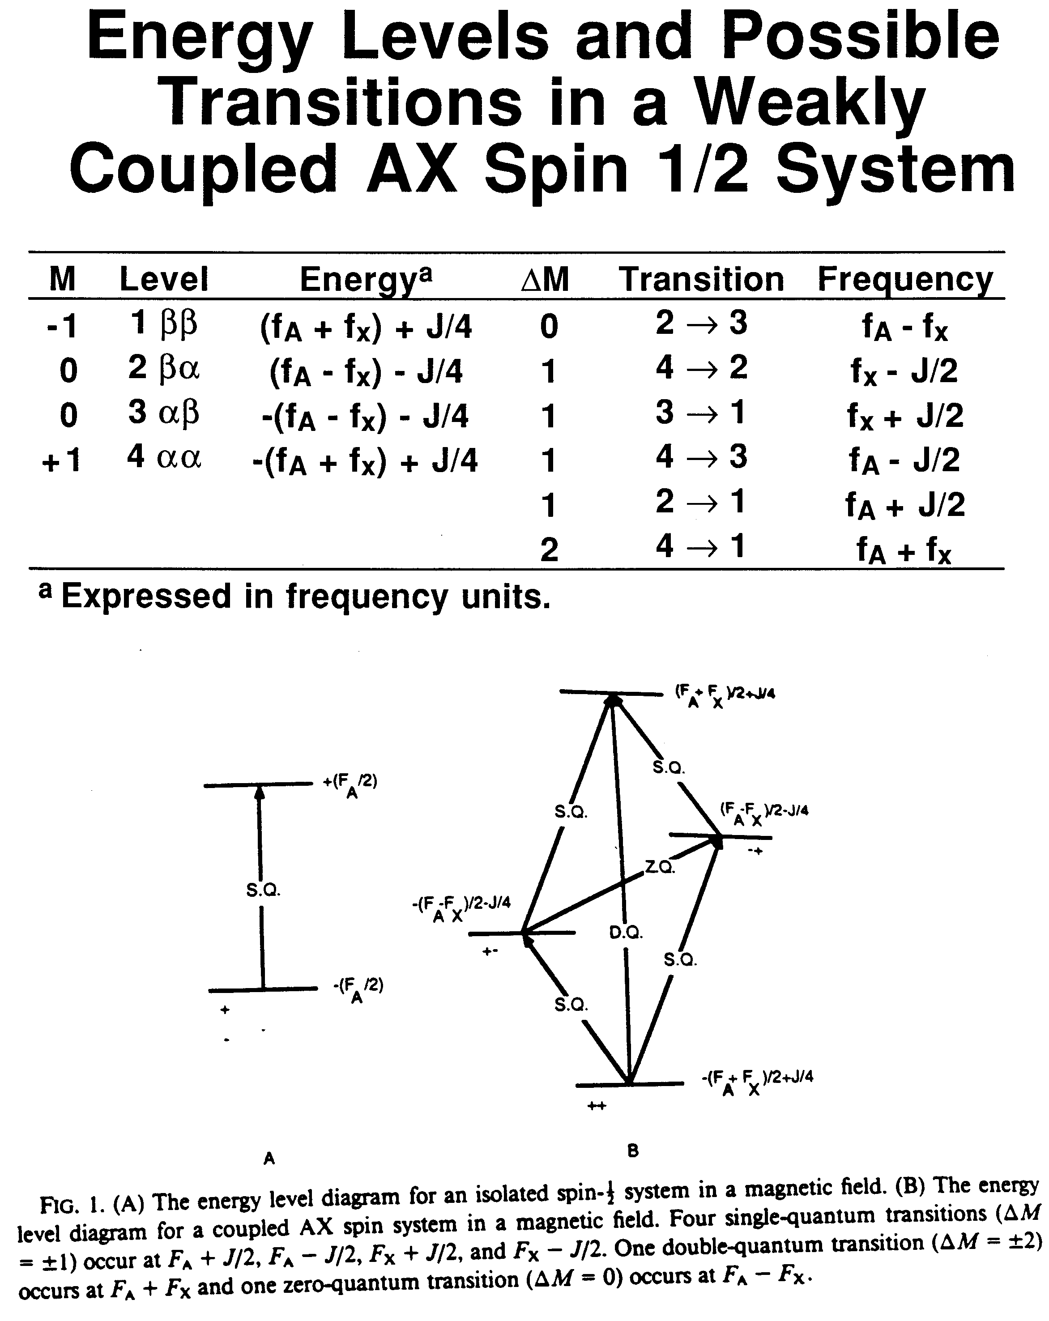

Slide 30
Spin - Spin Coupling - AX Spin System
Energy level diagram demonstrating the spin states of a weakly coupled AX spin system and the transitions producing the peaks in the corresponding NMR spectrum.
4
Example
b
d
Cl
0H
O
3
2
Cl
C
C
C
OH
c
a
H_{X}
H
A
1
splitting by A
splitting by X
d
c
b
a
J_{AX}
J_{AX}
x
A

Slide 31
Spin - Spin Coupling - AX₂ Spin System
The effects of splitting are often described using a splitting tree which depicts the original absorbance being split by a coupling constant J into (n + 1) peaks.
Example
H_{A}
0H
O
NH₂
C
C
C
OH
splitting by A₁
splitting by X
H_{A}
H
x
splitting by A₂
J_{AX}
J_{AX}
x
A₂

Slide 32
Spin - Spin Coupling - AX₃ Spin System
Example -Lactate
H_{A}
0H
O
H_{A}
C
C
C
OH
splitting by A₁
H_{A}
splitting by X
H
x
splitting by A₂
splitting by A₃
J_{AX}
J_{AX}
x
A₃

Slide 33
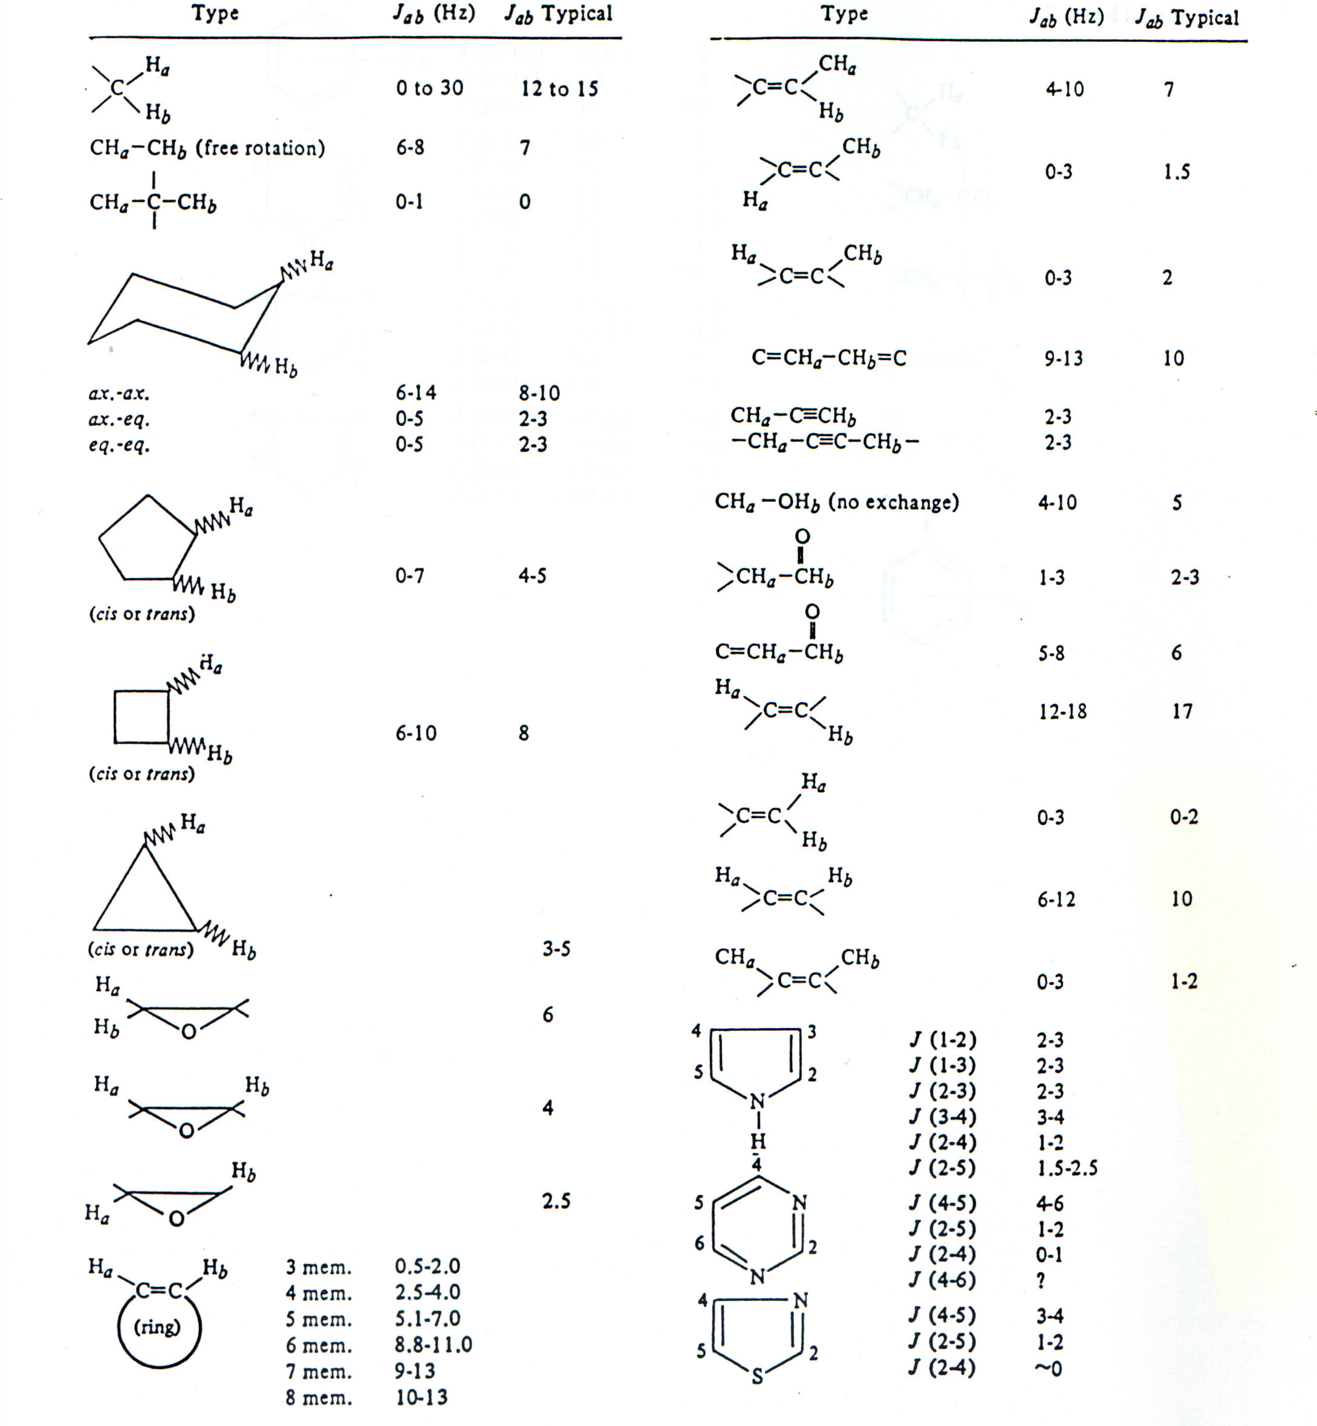
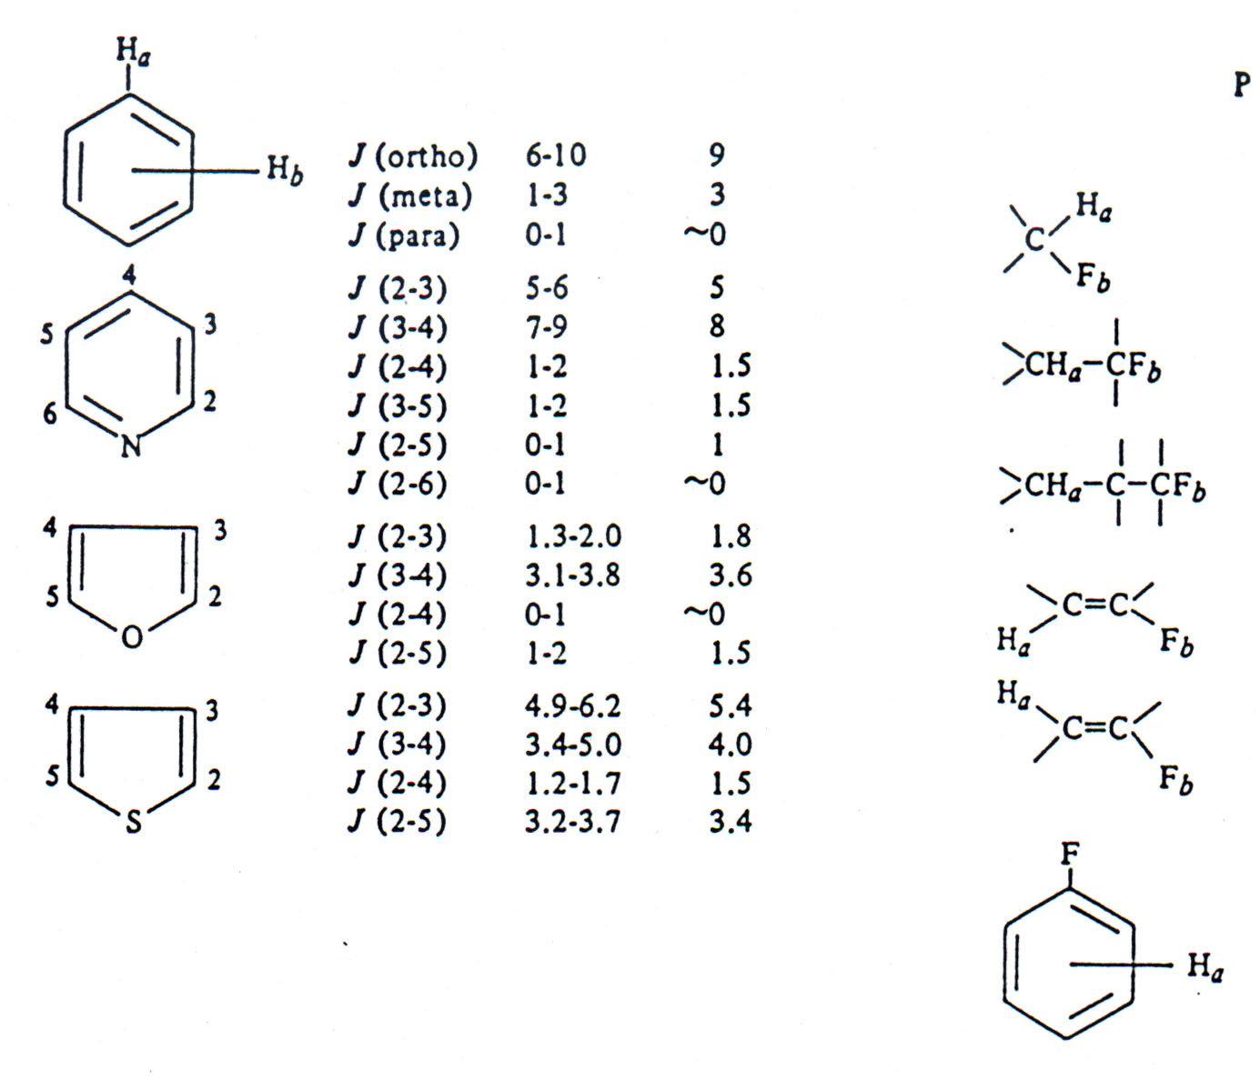
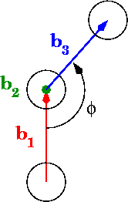
Spin - Spin Coupling - Magnitude of Typical Proton Coupling Constants
Coupling constants between protons on adjacent carbons in rigid molecules are dependent on the dihedral angle θ. Maximum at 0º and 180º and minimum at 90º.
Notes:
Used to identify metabolite, protein structure

Slide 34
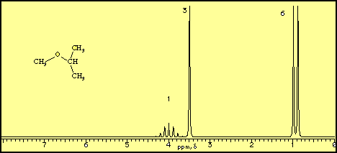
Spin - Spin Coupling - Magnetic Equivalence
If chemical shift equivalent nuclei are also coupled to same adjacent nuclei, they are said to magnetically equivalent.
An example of this is the NMR spectrum of methyl isopropyl ether.
The spectrum demonstrates three types of protons; the methyl group bonded to the oxygen (4 ppm), a methyne proton (the CH), also shifted to the same region, and the isopropyl methyl protons, at 1 ppm. The CH3 bonded to the oxygen should appear as a single peak (a singlet) since it is not immediately adjacent to any protons. The CH should be split into seven peaks since it is adjacent to six equivalent hydrogens (the two CH3 groups) and the peak for the two (magnetically equivalent) CH3 groups should be split into two peaks (a doublet) by the adjacent CH. Integration of the peaks indicates the appropriate number of protons for each group.

Slide 35
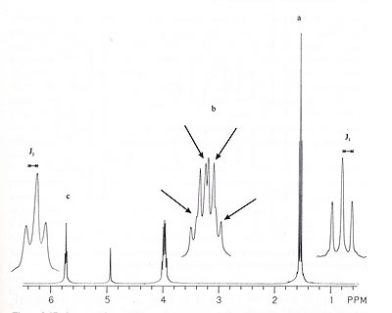
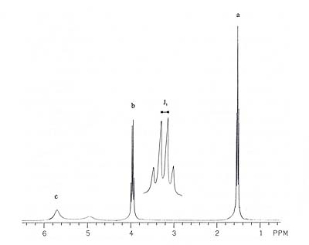
Chemical Exchange - Chemical Shift, J-coupling and Linewidth
Chemical exchange is a term that embraces both conformational changes and chemical reactions.
Chemical exchange affects both chemical shift and line-width depending on the rate of chemical exchange relative to the frequency separation of the resonances. Two spins undergoing slow exchange have two distinct resonances that approach each other and line widths that broaden as the exchange rate and chemical shift difference Δν increases.
Two spins undergoing fast exchange demonstrate a single frequency which is the mean of the two frequencies weighted by the concentrations of the spins. The faster the exchange the sharper the line.
For NMR spectroscopy, if the difference in absorption frequency expressed in hertz is Δν, then the transition form slow to fast exchange occurs when
K_{ex}= πΔν/√2
95 % ethanol in water + acid
95 % ethanol in water

Slide 36

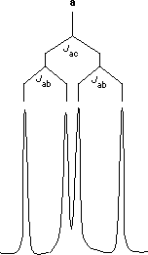
Spin - Spin Coupling - More Complex Coupling
Many terminal alkenes exhibit splitting patterns in which there is no element of symmetry to the coupling constants and a complex coupling pattern is observed. For many terminal alkenes, this pattern can be predicted and described in terms of the coupling constants for the cis, trans and geminal protons. The coupling constants for these protons are generally 10, 15 and 2 Hz, respectively, as shown below.
The proton on carbon a is split by c with J = 15 Hz into a doublet (n + 1 peaks). These peak are further split by b with J = 10 Hz into a doublet of doublets, as shown below.

Slide 37
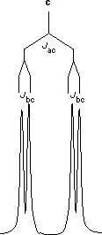
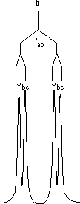
Spin - Spin Coupling - More Complex Coupling
The proton on carbon b is split by a with J = 10 Hz into a doublet (n + 1 peaks). These peak are further split by c with J = 2 Hz into a doublet of tiny doublets. The proton on carbon c is likewise split by a with J = 15 Hz into a doublet, and these peaks are again split by b with J = 2 Hz into another doublet of tiny doublets.
For many terminal alkenes, a predictable pattern is observed. If, however, the chemical shifts of a, b and c are similar so that J is the same order of magnitude as the difference in chemical shift, second-order coupling occurs and the spectrum becomes non-trivial. Higher resolution spectrometers (i.e., 600 MHz) are useful at resolving fine structure in the spectrum such as this.

Slide 38
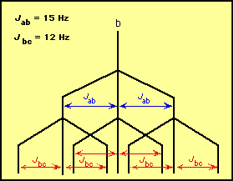
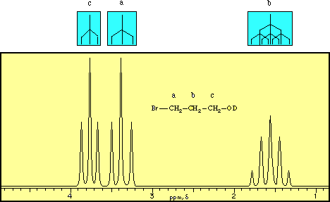
Spin - Spin Coupling - Multiply Coupled Spin Systems
Tree diagrams become even more useful when you have multiply coupled spins with different coupling constants.
a
c
b

Slide 39
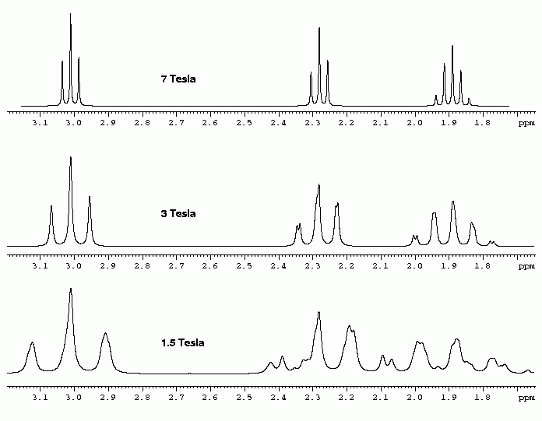
More Complex Coupling- Multiply Coupled Spin System and the Effect of Field Strength (A₂M₂X₂)
A₂
X₂
M₂
7 Tesla
3 Tesla
1.5 Tesla

Slide 40
Progression from a Weakly Coupled AX Spin System to Strongly Coupled AB Spin System
Strong Coupling - When the coupling constants and chemical shifts are of the same order of magnitude, complex splitting patterns can result that bear little resemblance to the predicted first-order spectrum. Second-order splittings and drastic changes in line intensities and peak positions result.
AX
υ_{A}−υ_{B} >> J
J
J
υ_{B}
υ_{A}
υ_{A}−υ_{B} = 3J
υ_{B}
υ_{A}
AB
υ_{A}−υ_{B} = J
υ_{B}
υ_{A}

Slide 41
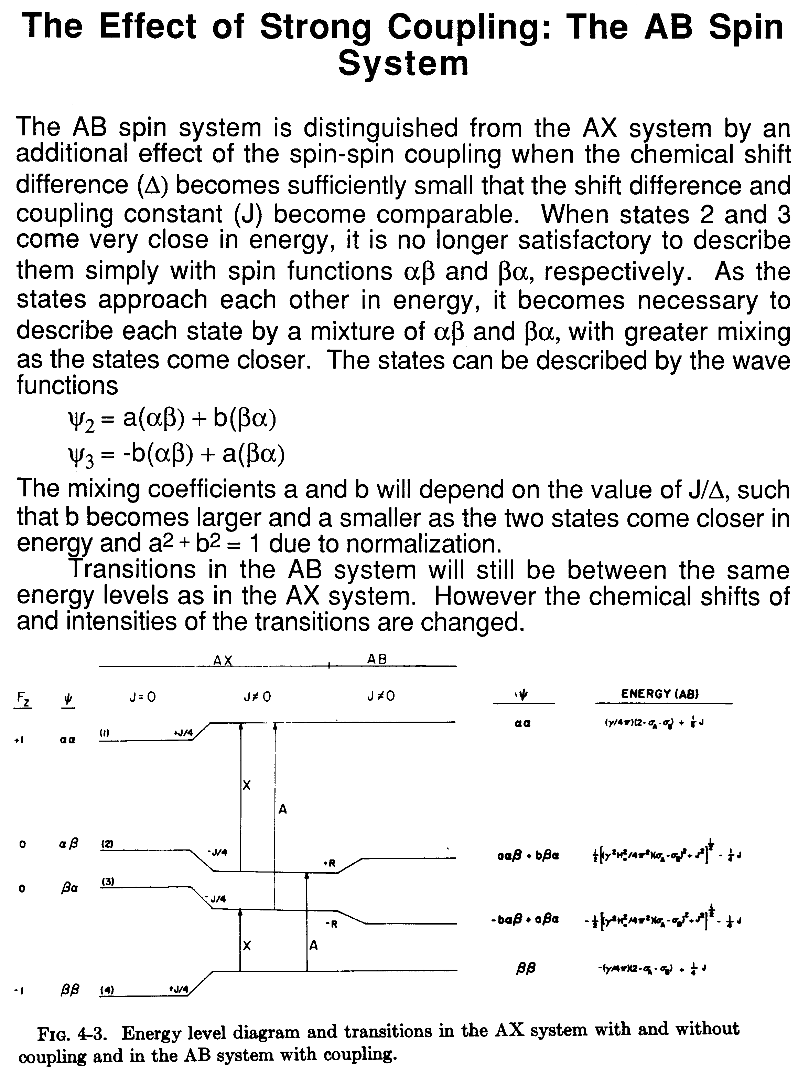
Notes:
Mixing of energy levels causing newer lines….

Slide 43
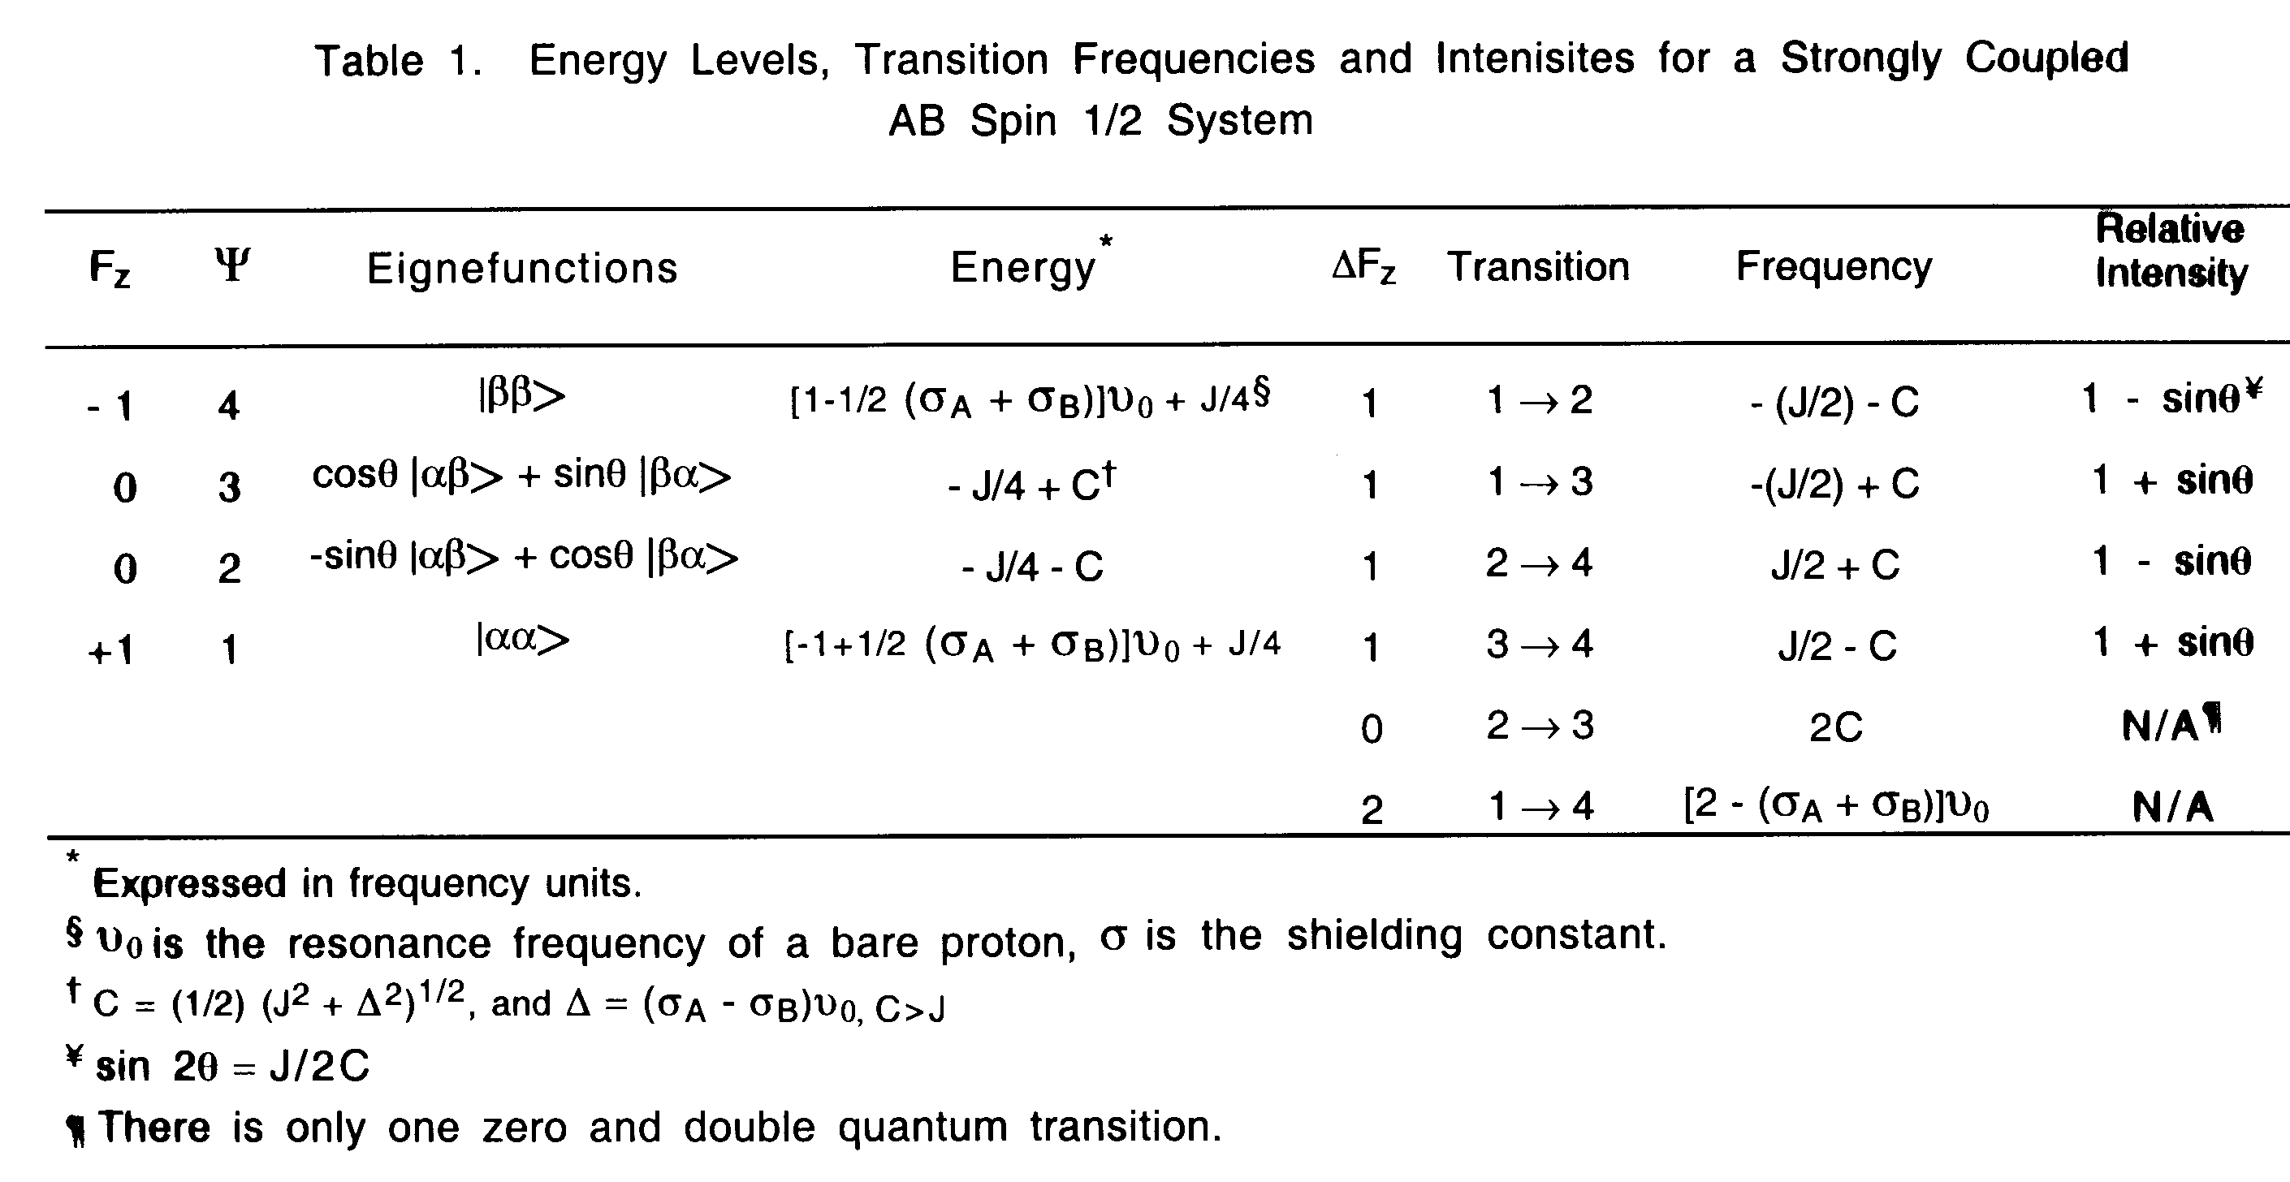

Slide 44
Strongly Coupled Spin Systems and the Effect of Field Strength (AB)
AB Spin
System
H
Magnetic
Calculated Citrate
Citrate Phantom
O
H
B
O
H
O
Field
Line Spectra
Spectra
B
HO
C
C
C
C
C
OH
Strength
A
B
Citrate
δ
H
A
C
H
A
A
= 2.65 ppm
O
7 Tesla
J
2C
δ
= 2.50 ppm
J
B
= 15.39 Hz
OH
AB
2−4
1−3
3−4
1−2
A
X
Hz
40
20
0
-20
-40
A
B
Citrate becomes a AX spin system at around 18 Tesla - 800 Mhz.
4.7 Tesla
40
20
0
-20
-40
Hz
A
B
1.5 Tesla
J
J
3−4
1−3
2−4
1−3
3−4
1−2
2−4
1−2
40
20
0
20
40
Hz
40
20
0
-20
-40
Hz

Slide 45
Information Content of a Magnetic Resonance Spectra
A. Chemical Shift and Structure
1. Origins of chemical shift
2. Chemical shift and functional groups
3. Effects of molecular interactions on chemical shift
a) magnetic susceptability
b) pH
c) metal binding
4. Chemical shift equivalence/Chemical Exchange
B. Spin-Spin Coupling and Structure
1. Simple coupling and identification of adjacent protons
2. Typical proton coupling constants
3. Magnetic Equivalence
4. Levels of unsaturation and identification of a organic compound
5. More complex coupling
6. Strong coupling
C. T1 and T2 relaxation times
D. Identification of compounds in NMR spectra using chemical shift and j- coupling information.

Slide 46
T₁ Relaxation Time
The name spin-lattice relaxation refers to the time it takes for the spins to give the energy they obtained from the RF pulse back to the surrounding lattice in order to restore their equilibrium state.
The sample in which the nuclei are held is called the lattice. Nuclei in the lattice are in vibrational and rotational motion, which creates a complex magnetic field.
The magnetic field caused by motion of nuclei within the lattice is called the lattice (solution, tissue) field. The components of the lattice field can interact with nuclei in the higher energy state, and cause them to lose energy (returning to the lower state).
The energy that a nucleus loses increases the amount of vibration and rotation within the lattice (resulting in a tiny rise in the temperature of the sample).

Slide 47
T₁ Relaxation Time
The relaxation time, T1 (the average lifetime of nuclei in the higher energy state) is dependent on the magnetogyric ratio of the nucleus and the mobility of the lattice.
As mobility increases, the vibrational and rotational frequencies increase, making it more likely for a component of the lattice field to be able to interact with excited nuclei.
Only frequencies at the Larmor frequency affect T₁. Since the Larmor frequency is proportional to B_{o}, T₁ will vary as a function of B_{o}. In general, T1’s get longer as B_{o} increases because there are fewer relaxation-causing frequency components present in the random motions of the molecules at higher frequencies.
The rotation frequency distribution also depends on the temperature and viscosity of the solution. Therefore T₁ will vary as a function of temperature, with T₁ (280 K ) < T₁ (340 K).

Slide 48
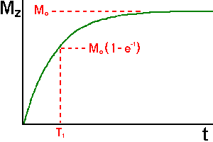
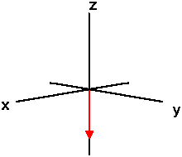
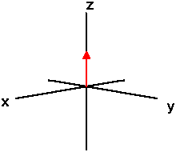
T₁ Relaxation Time
The time (rate) constant which describes how MZ returns to its equilibrium value is called the spin lattice relaxation time (T₁). The equation governing this behavior as a function of the time t after its displacement is:
M_{z} = M₀(1 - e^{-t/T1})
T₁ is the time to reduce the difference between the longitudinal magnetization (MZ) and its equilibrium value by a factor of e (63%).
Measured with the inversion recovery experiment:
π - τ - π/2 - acquire

Slide 49
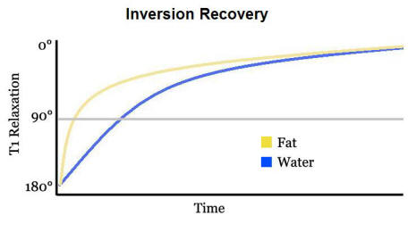
Inversion recovery
180
τ
90
M₀
M_{z}(0+)
M_{z}(t)
B₁(t)
B₁(t)
B₁(t)
Run a series of experiments with different τ values, fit the data to an exponential equation:
M_{z} = M₀(1 – e^{-τ/T1})
water based tissues - 400-1200 msec
fat based tissues - 100-150 msec range.

Slide 50
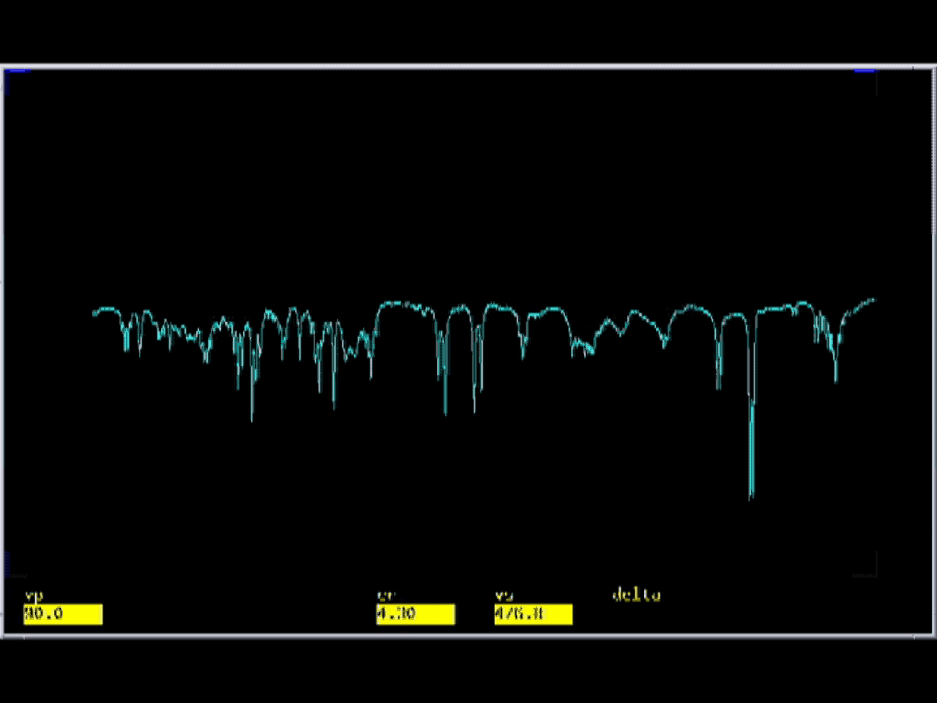
T₁ Relaxation of In Vivo Metabolites @ 11.5T

Slide 51
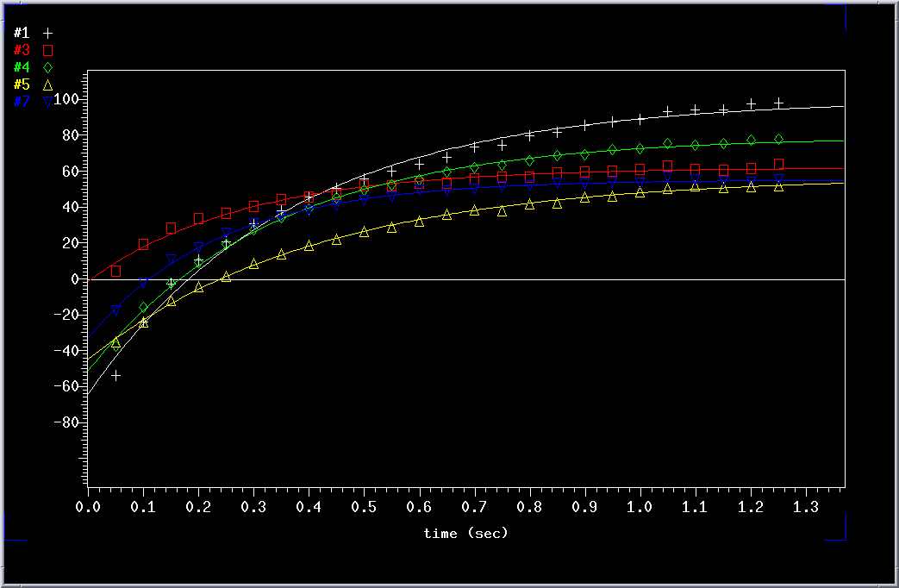
Measurement of T1
T1 - fit the data to an exponential equation: M_{z} = M₀(1 - e^{-t/T1})

Slide 52
T₁ Relaxation Times of Prostate Metabolites @ 11.7T
1400
1ºC
1200
20ºC
37ºC
1000
T1, ms
800
600
400
200
0
Spermine
Citrate
Creatine
Choline
GPC
Myo-
S-Inositol
Taurine
Lactate
TSP
Inositol

Slide 53
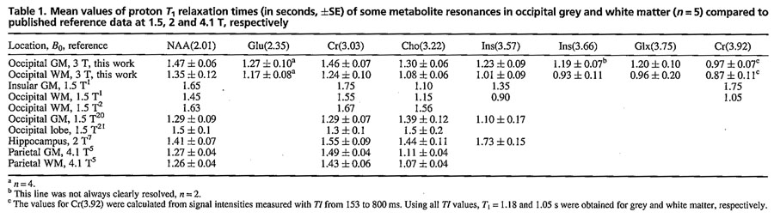
In Vivo Brain Metabolite T1’s
Mlynarik, NMR in Biomed, 2001;14:325–331
In vivo brain metabolite T1’s at 3T are ≈ between 1 and 2 seconds.
What is the consequence of pulsing (90º pulse) and acquiring a brain ¹H NMR spectra every second?

Slide 54

Impact of Acquisition Parameters (TR and TE)
TR - 2 sec
Choline
Creatine
Impact of Repetition Time (TR)
Differential Saturation – depending on the T1 of the nuclei and the repetition time TR.
TR - 1 sec
M_{z} = M₀(1 – e^{TR/T1})
TR - 0.75 sec

Slide 55
NMR - Ernst angle
The Ernst angle is the flip angle for a particular spin that gives the maximal signal in the least amount of time, when signal averaging over many transients. This relationship was developed by Richard R. Ernst, winner of the 1991 Nobel Prize in Chemistry.
The following equation relates the Ernst angle, theta_{E}, to the repetition time which is equal to experimental interpulse delay and the acquisition time and the T₁:
For example, if one wishes to get the best signal from a resonance with T₁=3 sec, and one wishes to use d₁= 1sec and a_{t}=2 sec (TR-3 sec.), the optimal tip angle is 68 degrees.

Slide 56
T₂ Relaxation Time
T₂ relaxation is a complex phenomenon, but at its most fundamental level, it corresponds to a decoherence of the transverse nuclear spin magnetization.
Random fluctuations of the local magnetic field lead to random variations in the instantaneous NMR precession frequency of different spins. As a result, the initial phase coherence of the nuclear spins is lost, until eventually the phases are disordered and there is no net xy magnetization.
Because T₂ relaxation involves only the phases of other nuclear spins it is often called "spin-spin" relaxation.T₂ values are generally much less dependent on field strength, B, than T₁ values.
Notes:
Video for T2 dephasing?

Slide 57






T₂ Relaxation Time
The time constant which describes the return to equilibrium of the transverse magnetization, M_{XY}, is called the spin-spin relaxation time, T₂.
M_{XY} = M_{XYo} e^{-t/T2}
T₂ is always less than or equal to T₁. The net magnetization in the XY plane goes to zero and then the longitudinal magnetization grows in until we have M_{o} along Z.

Slide 58


T₂ Relaxation – Hahn Spin Echo

Slide 59

Impact of Acquisition Parameters (TR and TE)
Short versus Long Echo Times - Differential Saturation – depending on the T2 of the nuclei and the echo time TE.
M_{XY} = M_{XYo} e^{-TE/T2}

Slide 60
MR spectra from human brain:
Effect of T₂ (Echo Time - TE)
TE = 272ms
TE = 144ms
NAA
Cr / PCr
Cho
Cre
TE = 65ms
TE = 40ms
Myo-I
What happens with coupled spins with increasing echo time?

Slide 61

Spin echo – J- Modulation with TE?
Citrate
T₂* is refocused – yielding the natural T₂
Lactate
J-modulation may or may not be completely refocused depending on the echo time
This J-modulation results in a inverted doublet at TE = 1/2 * 1/(J/2) = 1/J = 1/7Hz = 144 ms, and returning to a positive doublet at TE= 1/(J/2) = 2/J = 288 ms.
Will get relaxation based signal losses with increasing echo time

Slide 62

Impact of TE On A Strongly Coupled Spin System
J - Modulation
Of Glutamate

Slide 63

CPMG Pulse Sequence – T2 measurement of Spin Coupled Nuclei
π/2 - (τ - π - τ)_{n} – acquire, τ << T_{E}
T₂ relaxation: Time it takes for 63% of transverse magnetization to decay to zero. Measured with Carr-Purcell-Meiboom-Gill (CPMG) sequence is based on a spin echo sequence:
Run a series of experiments with different n values to get the desired echo time, fixed very short τ to refocus J-Modulation, fit the data to an exponential equation:
M_{z} = M₀e^{-TE/T2}

Slide 64

T₂ Relaxation of Prostate Metabolites @ 11.7T
Notes:
No phase modulation due ot CPMG

Slide 65

Measurement and T2
T2 - fit the data to an exponential equation: M_{z} = M₀e^{-t/T2}

Slide 66
T₂ Relaxation Times of Prostate Metabolites @ 11.5T
700
1ºC
600
20ºC
37ºC
500
T2, ms
400
300
200
100
0
Spermine
Citrate
Creatine
Choline
GPC
Myo-
S-Inositol
Taurine
Lactate
TSP
Inositol

Slide 67




Simultaneous T₁ and T₂ Relaxation Time
In the previous sequence, T₂ and T₁ processes are shown separately for clarity. That is, the magnetization vectors are shown filling the XY plane completely before growing back up along the Z axis. Actually, both processes occur simultaneously with the only restriction being that T₂ is less than or equal to T₁.
2T1 ≥ T2, T2* < T2
Bloch equations are used to calculate the nuclear magnetization M = (Mx, My, Mz) as a function of time when relaxation times T₁ and T₂ are present.
Where γ is the gyromagnetic ratio and B(t) = (Bx(t), By(t), B0 + Bz(t)) is the magnetic flux density experienced by the nuclei.
M(t) × B(t) is the cross product of these two vectors.

Slide 68
Impact of Acquisition Parameters (TR and TE)
Metabolite and water T1 and T2 relaxation times are different for different metabolites and change with pathology.
A. Healthy Young Volunteers (@ 1.5T)
Metabolite T1, ms T2, ms concentration
Citrate* 339+42ª N/A N/A
838+76^{c} 116+28ª, 141+18^{b} 21+6ª, 45+20^{b} μmol/g
N/A 198+55^{c} N/A
Choline 837+89ª 227+61ª 3.1+0.7ª mM
Creatine 864+98ª 209+97ª 4.4+0.8ª mM
Water 1481+109ª 98+9ª N/A
Water N/A 71+10ª, 114+30^{b} 39.4+5.4^{c} mmol/g
B. Water T2 Values and Citrate Concentrations in Patients with BPH and/or Cancer
Pathology T2, ms concentration, μmol/g
Normal 96.2+15.2^{b} 64.5+13.6ª, 42.4+19.5^{b}
BPH 127.9+38.9^{c} 64.5+13.6^{c}
Cancer 64.7+6.2^{c} 5.9+5.8^{c}

Slide 69

In Vivo Brain Metabolite T₂’s
In vivo brain metabolite T2’s at 3T are ≈ between 150 and 500 milliseconds.
What is the consequence of pulsing acquiring a brain ¹H NMR spectra with increasing echo time in a spin echo acquisition.

Slide 70
T₂* Relaxation Time and NMR linewidth
Two factors contribute to the decay of transverse magnetization.
1) molecular interactions (said to lead to a pure T₂ molecular effect)
2) variations in Bo (said to lead to an inhomogeneous T₂ effect)
The combination of these two factors is what actually results in the decay of transverse magnetization. The combined time constant is called T₂ star and is given the symbol T₂*. The relationship between the T₂ from molecular processes and that from inhomogeneities in the magnetic field is as follows.
1/T₂* = 1/T₂ + 1/T₂inhomo
The spectral linewidth (Δν) at half peak height (Δν_{1/2}) is described by the following equation.
Δν_{1/2} = 1/π Τ₂ , where π = 3.146

Slide 71

Impact of Magnetic Field Homogeneity
T₂* - relaxation from magnetic field inhomogeneity
  In an ideal system line-widths represent pure T₂, effectively the decay of the FID
  Observed T₂ is a convolution
  Shimming – homogenize the magnetic field using external coils
  Other ways to get rid of T₂* - pulse sequences ?
Poor Magnetic Field Homogeneity
Good Magnetic Field Homogeneity
Δν_{1/2}
Δν_{0.11%}
X₀
X (Hertz)

Slide 72

Magnetic Susceptibility – B_{o} inhomogeneity
Lipid that has been frequency shifted to overlap the NAA peak due to magnetic susceptibility at the air-tissue interfacev(water is slightly diamagnetic,  < 0,     x 10-6) and air is slightly paramagnetic ( > 0).
υ_{i} = γB_{o} (1 - σ_{i})
NAA
lipid

Slide 73
Information Content of a Magnetic Resonance Spectra
A. Chemical Shift and Structure
1. Origins of chemical shift
2. Chemical shift and functional groups
3. Effects of molecular interactions on chemical shift
a) magnetic susceptability
b) pH
c) metal binding
4. Chemical shift equivalence/Chemical Exchange
B. Spin-Spin Coupling and Structure
1. Simple coupling and identification of adjacent protons
2. Typical proton coupling constants
3. Magnetic Equivalence
4. Levels of unsaturation and identification of a organic compound
5. More complex coupling
6. Strong coupling
C. T1 and T2 relaxation times
D. Identification of compounds in NMR spectra using chemical shift and j- coupling information.

Slide 74
NMR Identification of Chemical Structure
Calculating Degrees of Unsaturation
Because of the presence of a double bond, alkenes have two fewer hydrogens than the corresponding parent hydrocarbon. For example, ethene (H2C=CH2) has the molecular formula C2H4 and ethane (CH3CH3) has the formula C2H6 (following the 2n + 2 rule). Cycloalkanes, likewise, have two fewer hydrogens than the parent hydrocarbon since two of the valences are utilized to close the ring: cyclohexane is C6H12, while hexane is C6H14.
Knowing this relationship, it is possible to take a molecular formula and calculate the degree of unsaturation; that is, the total number of multiple bonds or rings in a molecule. This information can then be utilized in the conversion of NMR data into structural possibilities.`
For hydrocarbons, the process is simple:
1) take the parent hydrocarbon and calculate the number of hydrogens using the 2n + 2 rule,
2) every two hydrogens that are "missing" in the analysis of the unknown represents one degree of unsaturation.

Slide 75

Calculating Degrees of Unsaturation - Examples
NMR Identification of Chemical Structure

Slide 76
NMR Identification of Chemical Structure - Pure Compounds
Calculating Degrees of Unsaturation
For compounds containing elements other than carbon and hydrogen, degrees of unsaturation can be calculated as follows:
Organohalogen compounds: since a halogen is simply a replacement for a hydrogen in an organic molecule (a valence of one), you simply add the total number of halogens to the carbon-hydrogen analysis, and calculate the unsaturation number as described above.
Organooxygen compounds: since oxygen is divalent, it has no effect on the calculation for the degree of unsaturation, and can be simply ignored. This can be demonstrated by considering ethanol (CH3CH2OH); removing the oxygen produces ethane (CH3CH2-H). The calculation for ethanol (ignoring the oxygen) therefore gives no degrees of unsaturation. For a carbonyl, (i.e., acetone, CH3COCH3), ignoring the oxygen gives C3H6, two hydrogens short of (2n + 2), and one degree of unsaturation. The carbonyl is therefore equivalent to one degree of unsaturation.
Organonitrogen compounds: since nitrogen is trivalent, on organonitrogen compound has one more hydrogen than an equivalent hydrocarbon has, and therefore you should subtract the number of nitrogens from the total number of hydrogens and calculate as described above.

Slide 77

Calculating Degrees of Unsaturation -Examples
NMR Identification of Chemical Structure

Slide 78


Example - NMR identification of a pure compound
C₁₀H₁₄O - Levels of unsaturation
From the molecular formula (22 H’s -14 = 8/2 =4), the compound has "4 degrees of unsaturation" (four double bonds or rings),suggesting the presence of an aromatic compound (benzene has four degrees of unsaturation).
The proton NMR has four sets of peaks; a singlet at 3.6 (3H), two sets of doublets centered around 6.9 (4H), a septet at 2.7 (1H) and a doublet at 1.6. The singlet at 3.6 is consistent with an isolated
CH3 adjacent to an electronegative center, such as an oxygen. The septet and doublet strongly suggest an isopropyl group CH(CH3) 2 in which the carbon is bonded to something mildly electronegative and the two doublets centered at 6.9 strongly suggest a 1,4-disubstituted aromatic compound.

Slide 79
Identification of In Vivo Metabolites
O
Alanine
H
C
3
O
H
N
H
2
How many chemically different protons?
Where would they resonate?
What is their multiplicity?
3.5
3.0
2.5
2.0
1.5
Chemical Shift (ppm)

Slide 80
Identification of In Vivo Metabolites
Taurine
How many chemically different protons?
Where would they resonate?
What is their multiplicity?
H
C
2
O
S
C
H
3
2
N
H
3
3.60
3.55
3.50
3.45
3.40
3.35
3.30
3.25
3.20
3.15
3.10
3.05
Chemical Shift (ppm)
Notes:
Which set of peak is the one on SO3 (UPFIELD?) versus NH3 (downfield?)

Slide 81

Phospholipid Metabolites
CH₃
CH₃
N⁺
CH₃
CH₂
CH₂
OR
H
N
H
CH₂
CH₂
OR
R = OH, Phosphate, glycerol phosphate, or glycerol phospho-lipid
Notes:
Kennedy cycle
Mechanism of trapping things inside the cell is by phophorylation

Slide 82

Phospholipid Metabolites

Slide 83

Phospholipid Metabolites

Slide 84
Identification of In Vivo Metabolites
choline
CH₃
CH₃
N⁺
CH₃
How many chemically different protons?
Where would they resonate?
What is their multiplicity?
CH₂
CH₂
OH
4.1
4.0
3.9
3.8
3.7
3.6
3.5
3.4
3.3
3.2
3.1
Chemical Shift (ppm)
Notes:
@ 11.7T,
Strongly coupled spin system The protons on the CH2 is not identical
CH2-OH is the peak @ 4.1ppm?

Slide 85
CH₃
GPC
CH₃
N⁺
CH₃
CH₂
4.3
4.2
4.1
4.0
3.9
3.8
3.7
3.6
3.5
3.4
3.3
3.2
CH₂
PC
OR
4.3
4.2
4.1
4.0
3.9
3.8
3.7
3.6
3.5
3.4
3.3
3.2
R = OH - Cho
R = OPO₃ - PC
R = OPO₃CH₂CHOHCH₂OH
Cho
4.3
4.2
4.1
4.0
3.9
3.8
3.7
3.6
3.5
3.4
3.3
3.2
Chemical Shift (ppm)

Slide 86
Polyamine Synthesis Pathway
Arginine
Ornithine
Arginase
Ornithine
decarboxylase
H₂N-CH₂-CH₂-CH₂-CH₂-NH₂
Putrescine
Spermidine
synthase
Decarboxylated
S-adenosyl-
methionine
(aminopropyl
donor)
H₂N-(CH₂)₃-HN-CH₂-CH₂-CH₂-CH₂-NH₂
Spermidine
Spermine
synthase
H₂N-(CH₂)₃-HN-CH₂-CH₂-CH₂-CH₂-NH-(CH₂)₃-NH₂
Spermine

Slide 87
putrescine
H₂N-CH₂-CH₂-CH₂-CH₂-NH₂
3.0
2.5
2.0
1.5
H₂N-(CH₂)₃-HN-CH₂-CH₂-CH₂-CH₂-NH₂
spermidine
3.0
2.5
2.0
1.5
H₂N-(CH₂)₃-HN-CH₂-CH₂-CH₂-CH₂-NH-(CH₂)₃-NH₂
spermine
3.0
2.5
2.0
1.5
Chemical Shift (ppm)

Slide 88
Identification of In Vivo Metabolites
How many chemically different protons? 3
Where would they resonate? β proton most upfield,
α proton most downfield
What is their multiplicity? β - multiplet, α − triplet, γ − triplet
Glutamine
(Gln)
N
H
H
O
2
H
H
O
H
α
O
H
H
N
H
2
γ
β
3.5
3.0
2.5
2.0
Chemical Shift (ppm)

Slide 89

Identification of In Vivo Metabolites
Trans coupling constant = 10 Hz
Cis coupling constant = 3 Hz
6
Myo-Inositol
5
4
1
3
2
How many different kinds of protons - Hint - is there a plane of symmetry?
4.2
4.0
3.8
3.6
3.4
3.2
PPM

Slide 90

Identification of In Vivo Metabolites
Things get even more complicated!!!
Glucose
4.5
4.0
3.5
3.0
Chemical Shift (ppm)

