Slide 1
Housekeeping - units
1 or 2 units:
students to decide how many units will be completed before the 3rd week of term.
If the decision gets made later, a Study List Change petition needs to be submitted ($5 fee).
change period ends in the 7th week of the term.
Timing of section to be held on Wednesday
1-2pm
3:15-4:15pm
Notes:
People can switch from 1 unit to 2 unit – by 3rd week of course
What are we struggling with in the field? Challenges that we don’t know a lot of things are causal
Job strain is controversial – mixed whether it’s causal or not – quasi experimental – plant changes and how they organize the plant
This is where the science is
These are the challenges and we take them seriously.
How do we move from associational studies to causal studies
We are at different places with research on these different factors. We are regularly challenged when we can’t do RCT’s with these.
MPO example

Slide 2
Multi-level Etiologies of Health Disparities:
Pt 1. social determinants
Salma Shariff-Marco, PhD, MPH
Associate Professor
Department of Epidemiology & Biostatistics

Slide 3
Objectives
Social determinants of health (SDOH)
  Socioeconomic status, socioeconomic position
  Racism
  Incarceration
  Neighborhood
Research with SDOH
  Multilevel conceptual approaches/frameworks
  Measurement and methodological considerations

Slide 4
Social determinants of health
The conditions in which people are born, live, work and age.
Neighborhood and Built Environment
Health and Health Care
Social and Community Context
Education
Economic Stability
SDOH

Slide 5
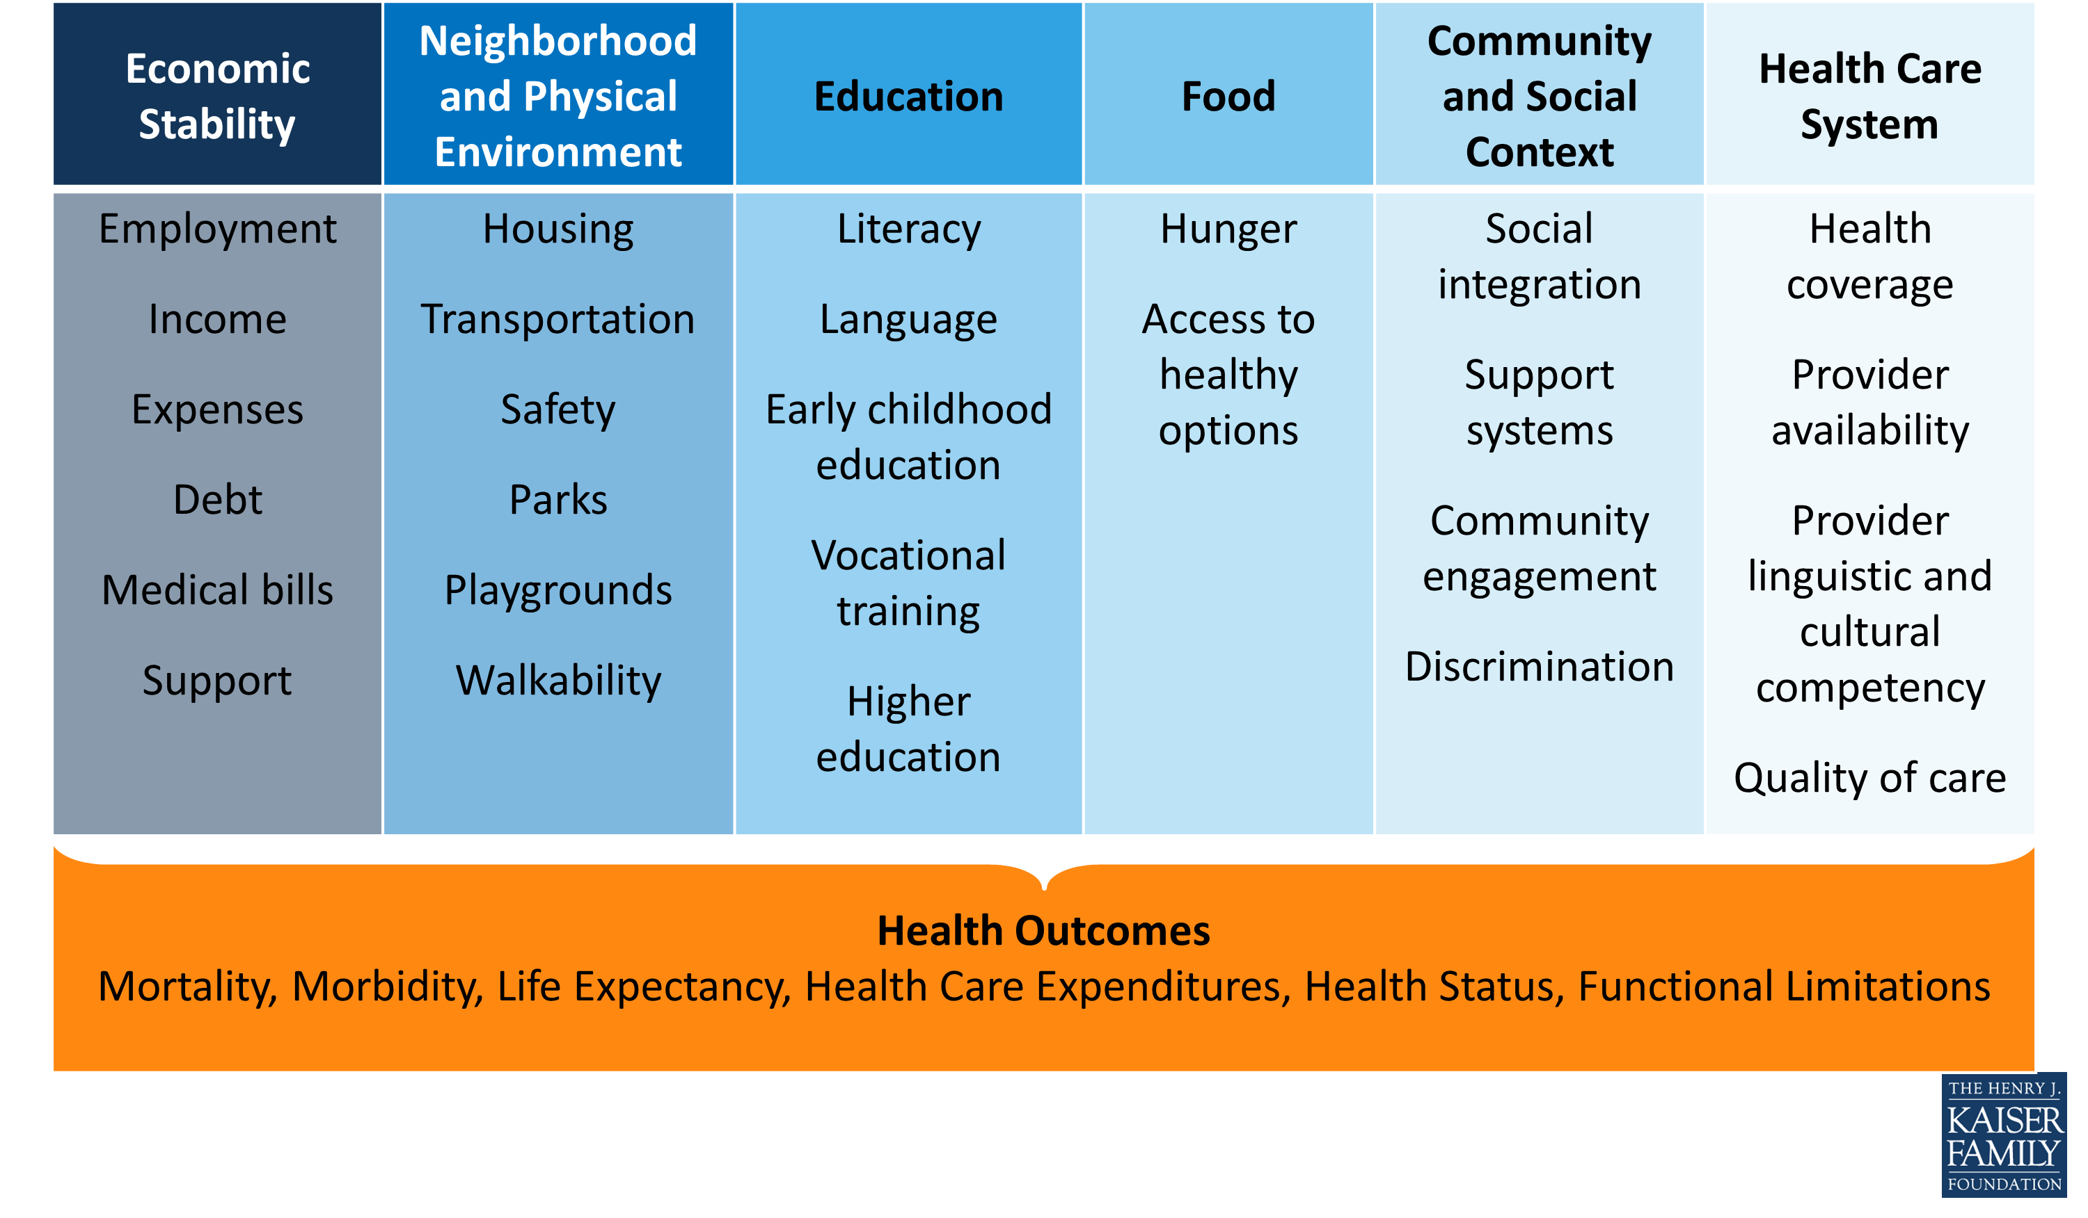
Social Determinants of Health
Beyond Health Care: The Role of Social Determinants in Promoting Health and Health Equity
http://www.kff.org/disparities-policy/issue-brief/beyond-health-care-the-role-of-social-determinants-in-promoting-health-and-health-equity/

Slide 6
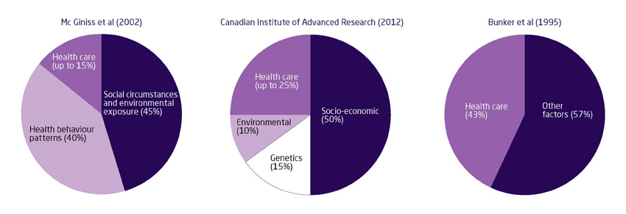
Importance of social factors
in any research
Notes:
FRAME - Why should we care if we’re not doing health disparities research?
Having the big picture matters.
Make methodological pts – if you’re collecting your own data or working on data collected by someone else vs setting out to collect your own

Slide 7
Biology:
Reproductive factors 5%
Viruses 8%
Medication 5%
Social (behavioral)
Diet 5%
Tobacco 30%
Alcohol 4%
Physical Environment:
Sun/radiation 2%
Obesity 20%
Sedentary Lifestyle 5%
Environment 4%
From: Colditz and Wei, Annu Rev Public Health, 2012, 33:137-56 (p. 148—Figure 1)

Slide 8
Improving health & reducing disparities by addressing the role of social factors
Economic & Social
Opportunities and Resources
Living & Working Conditions
in Homes and Communities
Behaviors
Medical Care
Interaction with genetic/other biological factors
HEALTH
Adapted from Braveman et al., for Robert Wood Johnson Foundation Commission to Build a Healthier America | www.commissiononhealth.org
Notes:
stress is cross cutting and is a mechanism, more than a social determinant itself. I think making that point would be great, and you could tie that into the RWJ model of SDH if you want by making a big picture point of how SDHs can impact health:
SDHs can directly lead to poor health outcomes through physical deprivation, toxic exposures, etc.
SDH can lead to lead to health outcomes through physical and emotional stress (allostatic load etc)
SDH can lead to health outcomes through modifications of behavior (i.e. smoking, exercise diet), that result in poor health outcomes (obviously say that Scarlett will touch on that in more detail)
And then also mention how this can be mediated by biological changes (which Maria will talk about) and be multigenerational as well.

Slide 9
Fundamental Cause
Influences multiple disease outcomes;
Affects disease thru multiple risk factors;
Involves access to resources that can assist in minimizing risk once the disease occurs;
Reproduced over time

Slide 10
Race/Ethnicity + SES as Fundamental Causes: Framework for social disparities in health
Diez Roux, Annual Review of Public Health 2012

Slide 11
Social status
“the relative rank that an individual holds, with attendant rights, duties, and lifestyle, in a social hierarchy based upon honor or prestige.”
www.brittannica.com
“relations of ownership or control over productive resources (i.e. physical, financial and organizational).”
WHO Social Determinants of Health

Slide 12
Dimensions of social status
Race/ethnicity
Socioeconomic status/position
Sex
Gender
Sexual orientation
Marital status
Religion
Immigration

Slide 13
Socioeconomic position/status
“… the social and economic factors that influence what positions individuals or groups hold within the structure of a society”
Galobardes et al 2006
SES and health
Multidimensional, multilevel construct
Life course perspective
Multiple causal pathways
Interacts with other social status measures (race/ethnicity)
Notes:
Pathways for education (not only economic)
--material resources
--general and health-related knowledge
--literacy
--problem-solving skills
--prestige
--influence over others and one’s own life
--social ties?
Wealth:
--buffer effects of temporarily low income (unemployment/illness)
--power/influence over others
Occupation
--psychosocial characteristics of one’s occupation (control over one’s work)

Slide 14
Measures of SES
Education
  years of formal education completed
  ordinal categories
Income
  annual household and factor number of dependents
Occupation
  laborer, technical, professional, business
  manual/non-manual
Neighborhood SES
  % poverty, composite indices

Slide 15
Additional SES Measures
Wealth
  Assets
  Debt
  Ownership (home, car)
Childhood SES
  Parental occupation and education
  Household income, wealth
Self-perceived ‘standing’ on a ladder ranging from 1 to 10

Slide 16
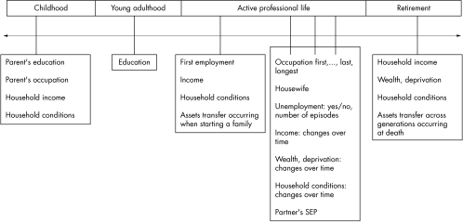
SES across the Life Course
Galobardes et al 2006
Notes:
Talk about research using cross-sectional measures, cumulative measures and then measures across the life course (more specific to research questions/outcomes)

Slide 17
SES across the Life Course
Latency/critical period model:
Exposure during sensitive window puts one at risk for development of disease later in life. Exposures encountered after the critical window closes do not influence risk. Focus on early life experiences that do not have a cumulative effect.
Galobardes et al 2006
Notes:
Example is cognitive and socioemotional development

Slide 18
SES across the Life Course
Social trajectory model:
Social disadvantage increases risk of future disadvantage later in life. The initial insult does not necessarily have a harmful effect on the outcome – but the first exposure leads to subsequent exposures that then directly cause the outcome.
Galobardes et al 2006
Notes:
Cumulative effects
Accumulation of risk model

Slide 19
Childhood SES is associated with adult health
Nurses Health Study:
Parental education is associated with the self-rated health of their adult children, after taking into consideration current SES (highest year of schooling, total household income, total net worth)
[Moody-Ayers, et al. 2007]
Health and Retirement Survey:
Parental occupation is associated with cardiovascular disease in middle age, after taking into consideration current SES (highest year of schooling)
[Gliksman et al. 1995]

Slide 20
Stressors
Job insecurity
Job strain (High demands / Low control)
Housing insecurity/homelessness
Food insecurity
Adequate health care coverage
Notes:
Can go even further and talk about food policy, corn syrup etc.
http://www.ncbi.nlm.nih.gov/pubmed/24392603
http://www.ncbi.nlm.nih.gov/pubmed/15622689
http://www.ncbi.nlm.nih.gov/pubmed/18366535/
Perceived discrimination/racism has been shown to play a role in unhealthy behaviors such cigarette smoking, alcohol/substance use, improper nutrition, and refusal to seek medical services (Lee, Ayers, & Kronenfeld, 2009; Peek et al, 2011).

Slide 21
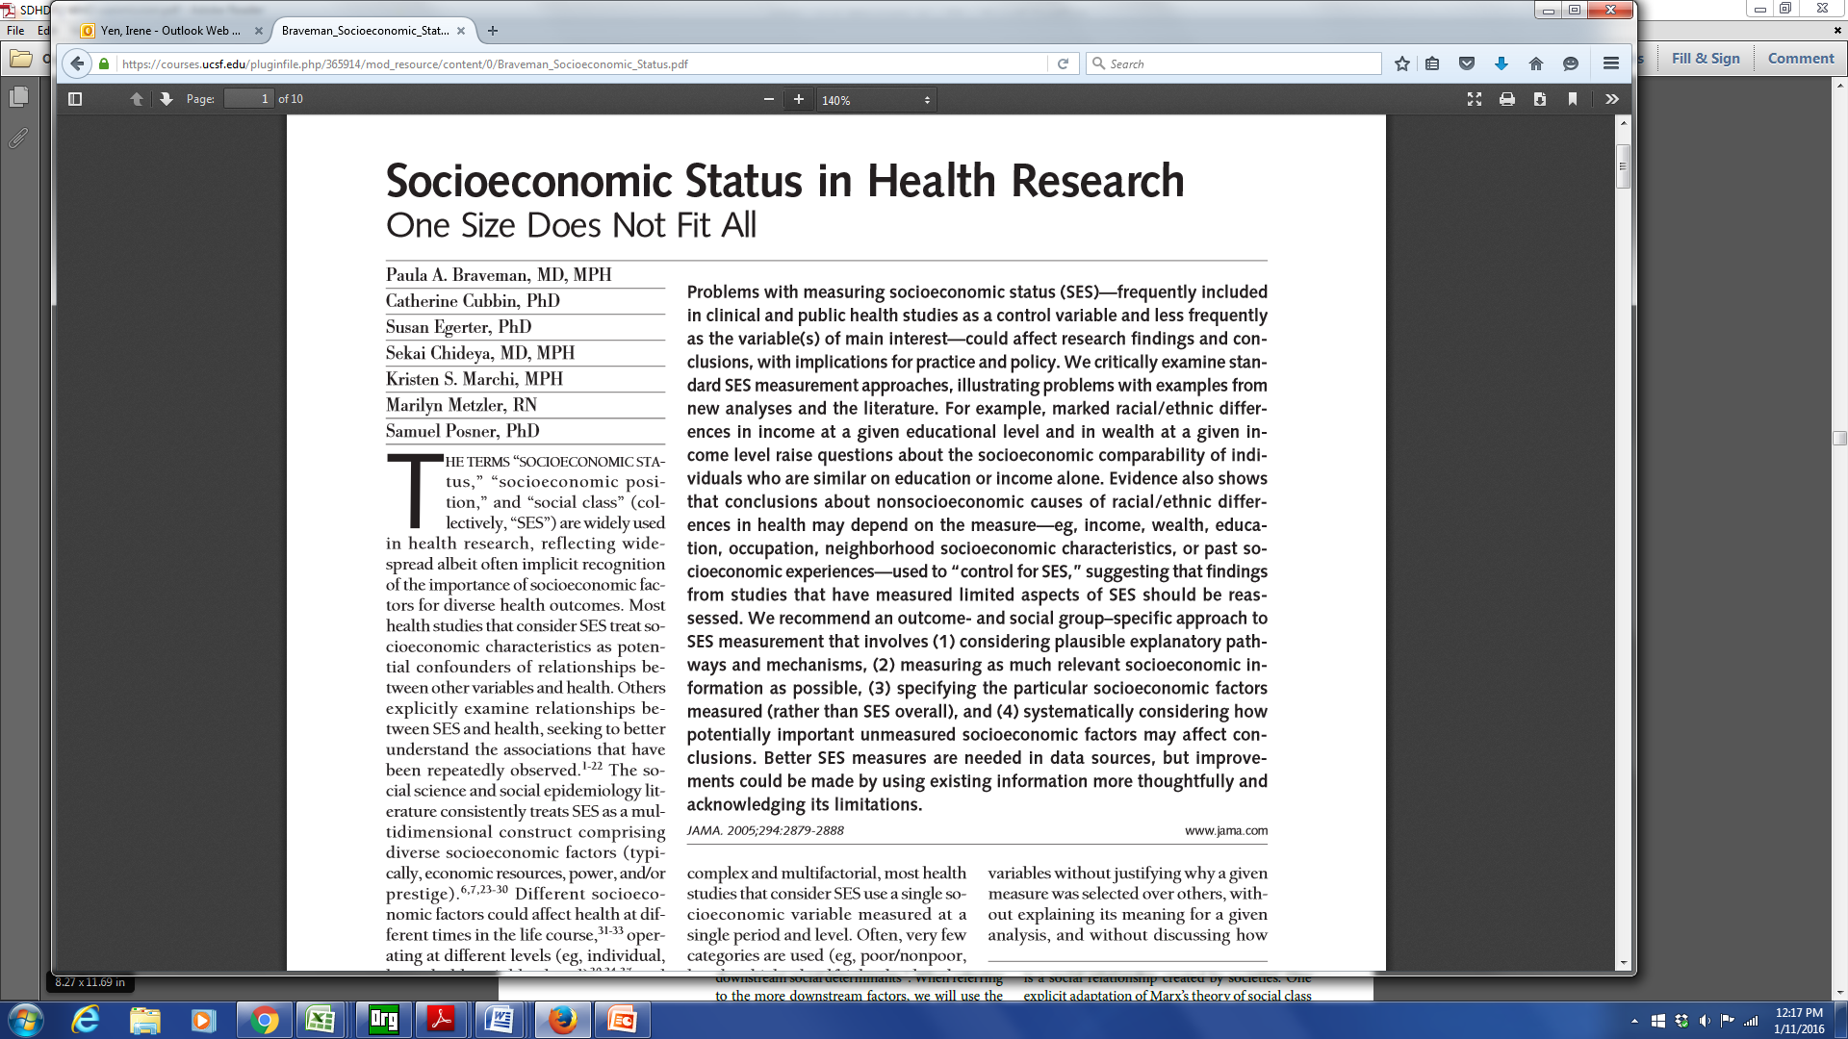

Slide 22
Braveman et al article –
a few of the take home points
Education and income are not interchangeable – earnings can vary at similar educ levels.
Income is not a proxy for wealth
Importance
  past socioeconomic experiences
  neighborhood socioeconomic conditions
Outcome and social-group specific approach

Slide 23
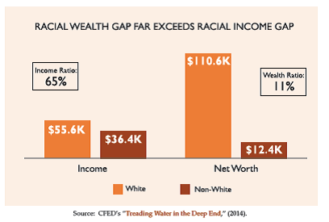
Notes:
African-Americans are twice as likely to be liquid asset poor as white households. This lack of savings corresponds with overall lower wealth and assets. Corporation for Enterprise Development (CFED) found that households of color have approximately one-tenth the median net worth (assets minus debt) of white households ($12,377 and $110,637, respectively).
The racial wealth gap is growing. According to research by the Urban Institute, the wealth gap has doubled in the past few decades. In 1983, the average wealth of white families was $230,000 higher than the average wealth of African-American and Hispanic families; in 2010, it has increased to over $500,000.

Slide 24
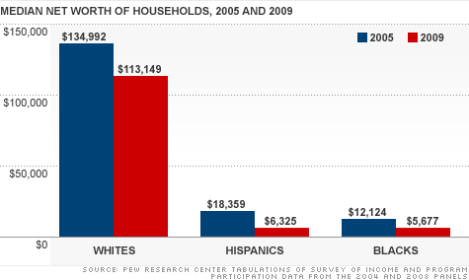
-16%
-66%
-53%

Slide 25
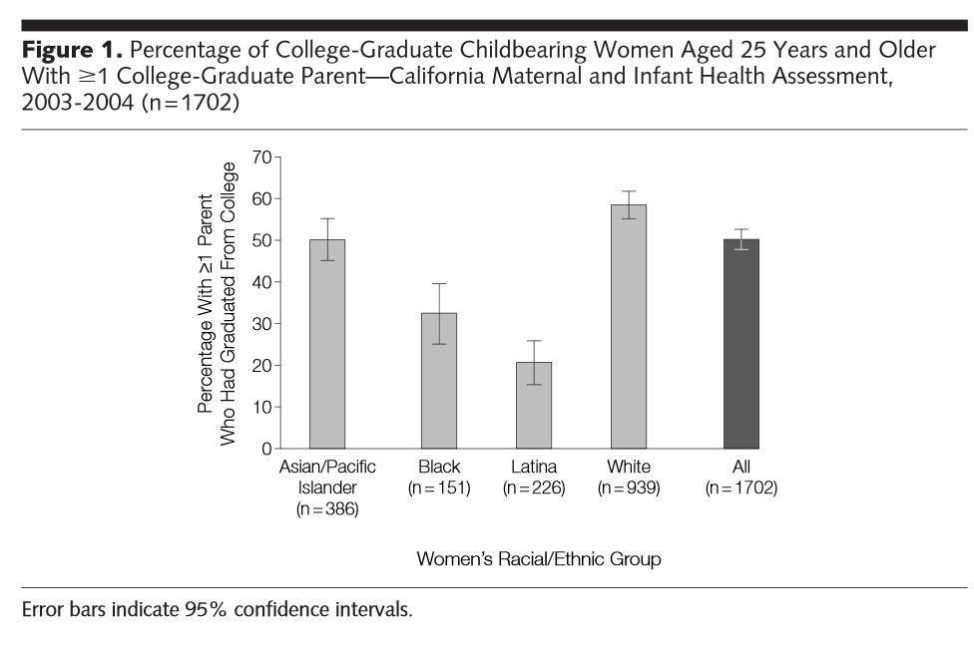

Slide 26
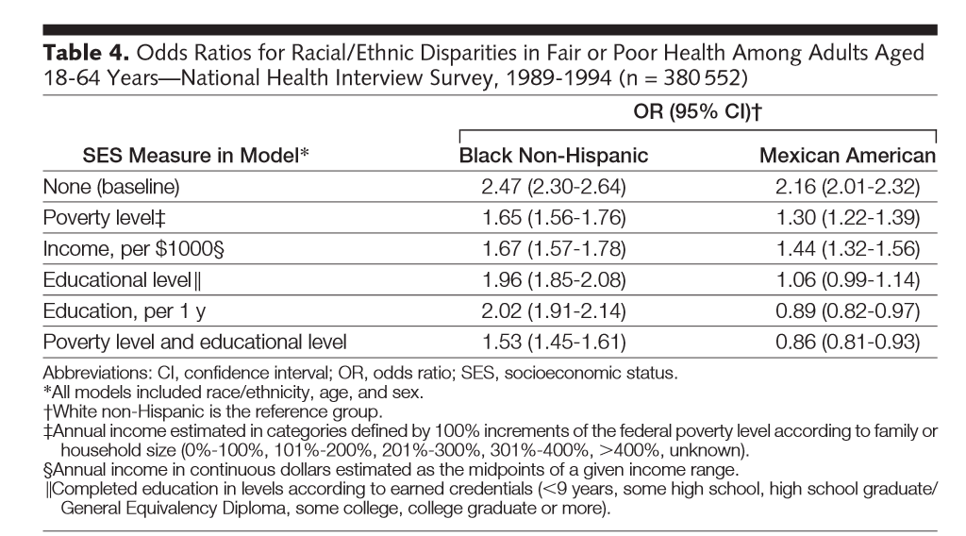
Income not a proxy for wealth
Income not a proxy for wealth
Notes:
Models differed by whether and how income and education were included.
When income was used to adjust for SES, Mexicans had increased risk for fair/poor health compared to Whites
If use education, risk appear similar

Slide 27
Intersectional Framework & Approach
Social identities and categories should not be viewed as independent variables that capture individual characteristics; instead, they are markers of institutional processes
Intersecting inequalities & multiple vulnerabilities
  Multiple dimensions of social status impact health
Williams et al, Health Services Research 2012

Slide 28
Education by Race/Ethnicity, CBCSC
Shariff-Marco et al, Journal of Community Health 2015

Slide 29
NSES by Race/Ethnicity, CBCSC
Shariff-Marco et al, Journal of Community Health 2015

Slide 30
Race/ethnicity/SES disparities in mortality after breast cancer in California
Shariff-Marco et al, Journal of Community Health 2015

Slide 31
Measurement of SES
Think about measures that have most relevance to your research question
  May need multiple measures
  Results may depend on what measures you use
Use validated measures
Consider life course perspective
Consider other social status dimensions (e.g., race/ethnicity) as jointly impacting health

Slide 32
Racism, United Nations
“any distinction, exclusion, restriction or preference based on race, color, descent, or national or ethnic origin which has the purpose or effect of nullifying or impairing the recognition, enjoyment or exercise, on an equal footing, of human rights and fundamental freedoms in the political, economic, social, cultural or any other field of public life.”

Slide 33
Racism
Racism
  an organized system that categorizes population groups into ‘races’, and uses this ranking to preferentially allocate societal goods and resources to groups regarded as superior (Bonilla-Silva 1996)
  ideology of inferiority that ranks some racial groups as inherently or culturally superior to others and supports the social norms and institutions that implement this ideology (Jones 1997)
Williams and Mohammed, J Behav Med 2009
Notes:
Race/ethnicity as a social construct
social classification
impacts of racism

Slide 34
Multilevel, multiple dimensions of racism
Institutionalized racism (e.g., residential segregation)
  differential access to goods, services, opportunities and power
  structural, systemic (codified in customs, practices, laws)
Personally mediated racism (e.g., prejudice and discrimination)
  differential assumptions about abilities, motives, and intentions of others by race/ethnicity
  differential actions towards others by race/ethnicity
Jones, APJH 2000

Slide 35
Multilevel, multiple dimensions of racism
Internalized racism
  acceptance by members of stigmatized race/ethnicity of negative messages about their own abilities and intrinsic worth
Jones, APJH 2000

Slide 36
Lessons from the Gardener’s Tale
Interventions at 3-levels of racism
  internalized: Pink is beautiful
  personally mediated: Change gardener’s attitudes/behavior towards pink flowers
  institutionalized: improve the conditions in which the pink flowers born, grow and live
  Addressing the SDOH/fundamental causes will yield the biggest impact
Jones, APJH 2000

Slide 37
Racism and Health
Multiple pathways (direct)
  economic deprivation, including poor housing and educational opportunities, exposure to dangerous neighborhoods, lack of access to healthy food, riskier work, and a lack of health insurance
  excess exposure to toxins, hazards, pathogens
  social trauma
  targeted marketing of harmful commodities
Muennig & Murphy, Journal of Health, Politics, & Law, 2011
Krieger, AJPH 2012
Notes:
economic and social deprivation;
excess exposure to toxins, hazards,
and pathogens; social trauma;
health-harming responses to discrimination;
targeted marketing
of harmful commodities; inadequate
medical care; and, especially
(but not only) for indigenous peoples,
ecosystem degradation and
alienation from the land.

Slide 38
Racism and Health
Multiple pathways (indirect)
  effectively “stressing” the individual, leading to neuroendocrine disruptions that affect one’s physical and mental health (racism as a stressor)
  health-harming responses (coping via alcohol, smoking, poor diet)
Muennig & Murphy, Journal of Health, Politics, & Law, 2011
Krieger, AJPH 2012

Slide 39
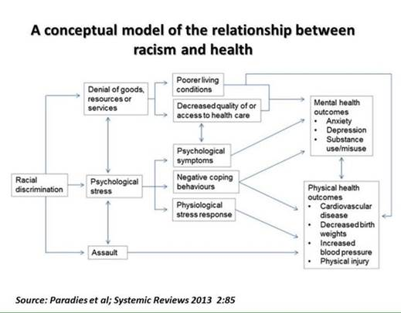

Slide 40
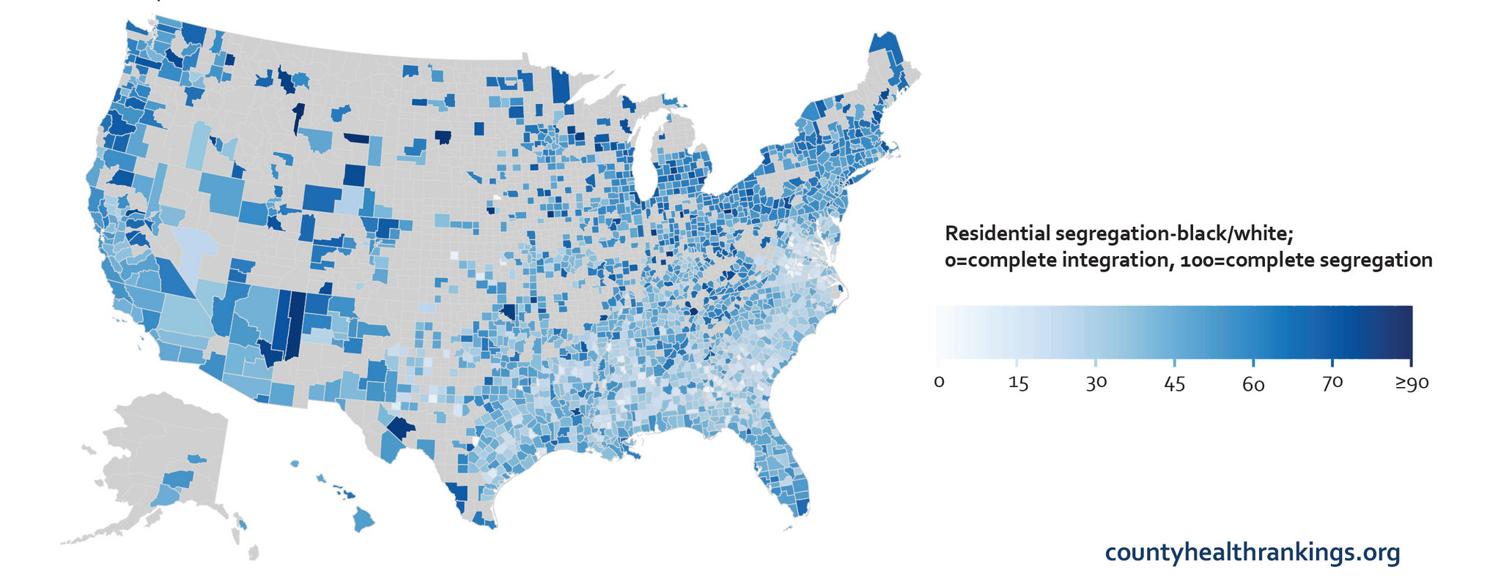
Residential segregation in the US

Slide 42
Hypersegregation
Segregation highest for African Americans
Characterized by not only by racial segregation, but also socioeconomic segregation
Socioeconomic segregation does not account for racial/ethnic segregation
Related to discrimination in housing/ mortgage markets

Slide 43
Residential Segregation & Cancer
17 studies of segregation and cancer outcome
70% of studies showed associations between segregation and adverse cancer outcomes (late stage diagnosis, higher mortality, lower survival, higher risks)
  while many used validated measures (isolation index, dissimilarity index), several did use less validated measures (% African American)
  did not test mediators
Landrine et al, J Racial and Ethnic Health Disparities, 2017

Slide 44
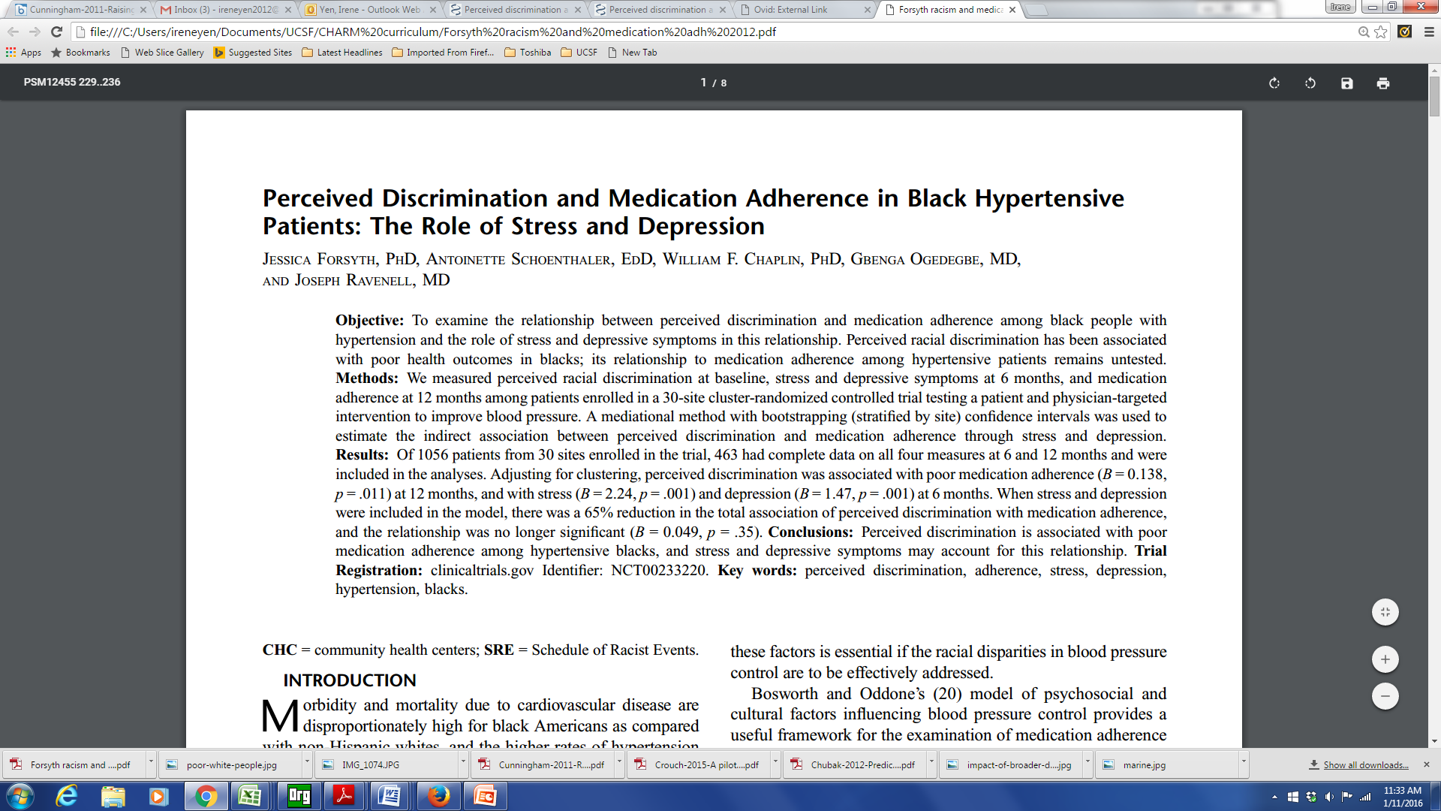
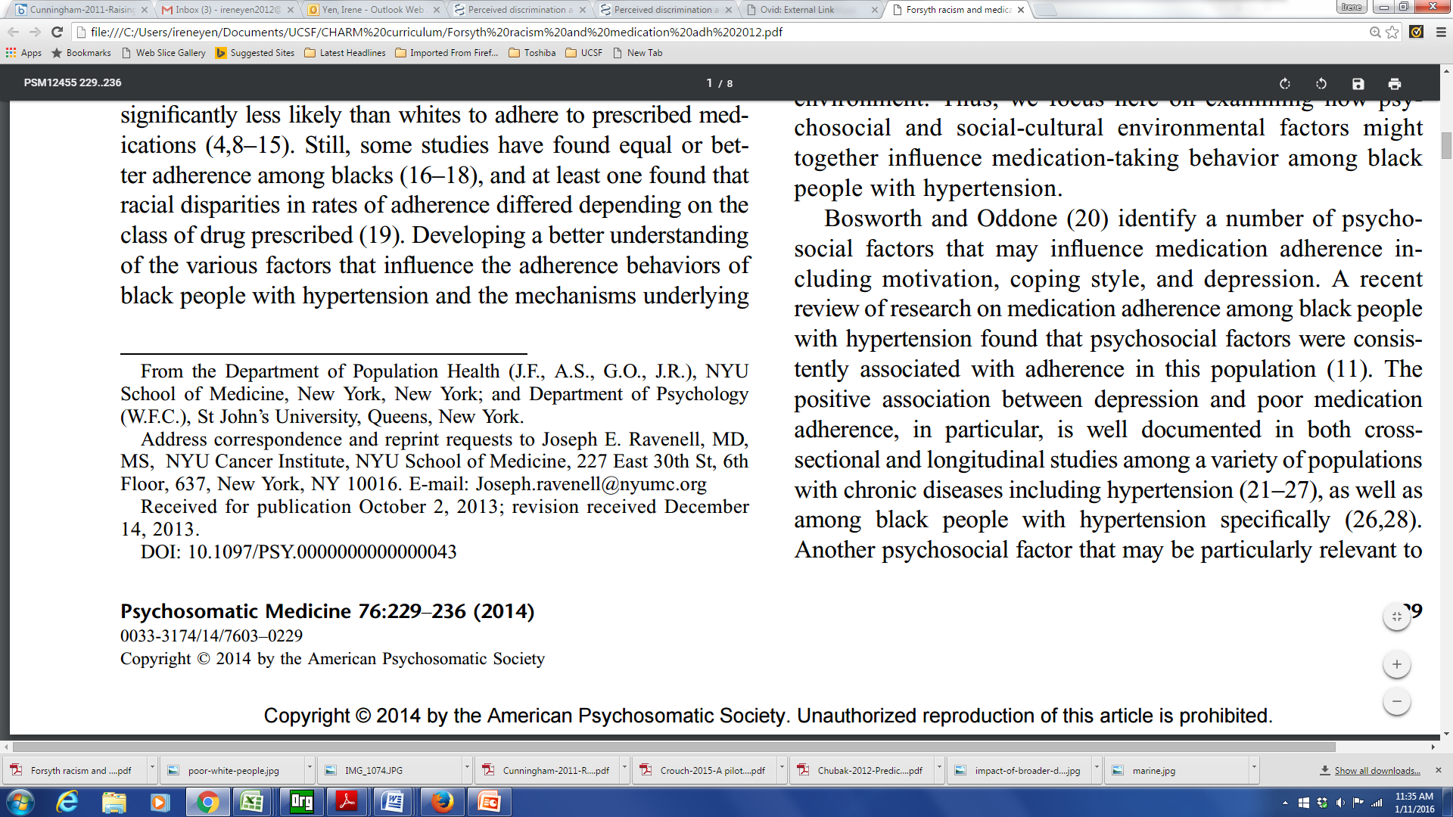

Slide 45
Discrimination and Medication Adherence
Perceived racial discrimination measured among patients enrolled in a 30-site cluster-randomized controlled trial
A mediational method was used to estimate the indirect association between perceived discrimination and medication adherence through stress and depression
Perceived discrimination was associated with poor medication adherence, and was mediated by stress and depression
Notes:
Racism
Pt’s experience racism
Medical mistrust
Research on the outcomes / prognosis of people with a condition – as contrasted with the incidence

Slide 46
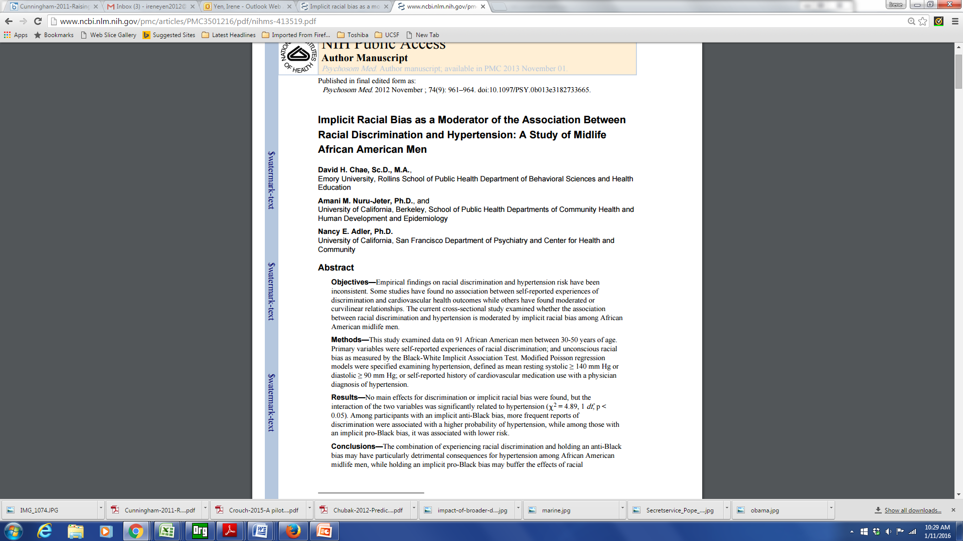
Internalized Racism

Slide 47
Internalized Racism
Implicit association test used to measure implicit (unconscious) racial bias
Among black men with anti-black bias, experiences of discrimination associated with hypertension
  Those with a pro-black bias had lower dx of hypertension

Slide 48
Life course perspective & racism
Gee et al, AJPH 2012

Slide 49
Additional dimensions of racism
Intergenerational impacts
  Historical trauma
  Wealth and inheritance
Discrimination in health care (medical discrimination)
  Institutional policies, practices
  Interpersonal interactions (providers/staff)

Slide 50
Considerations for research on racism
In the US, fundamental cause underlying racial/ethnic disparities in health
Relevant measures
  levels/dimensions
  exposure period
Validated instruments for study population
  measurement approach
  immigration

Slide 51
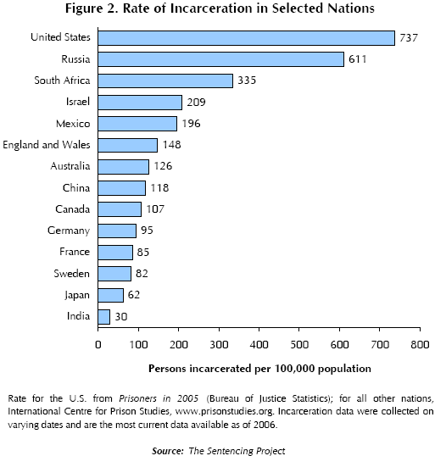
Incarceration

Slide 52
Incarceration
As of 2004, there were approximately six times more inmates and ex-inmates than in the mid-1970s.
Presently, there are more than 16 million felons and ex-felons in the United States (Uggen et al. 2006)

Slide 53
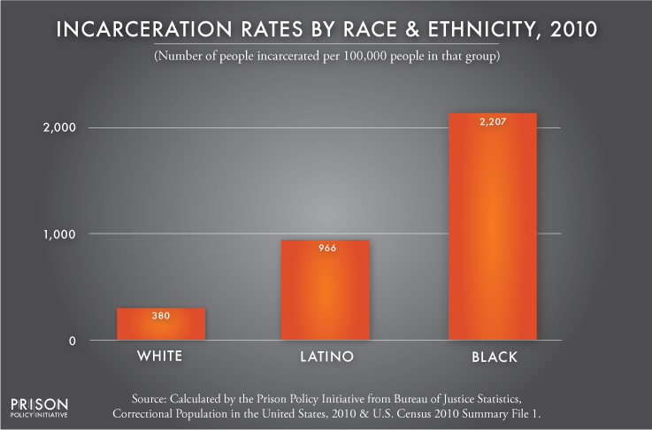
Incarceration

Slide 54
Incarceration
The lifetime cumulative risk (measured to age 34) of imprisonment for all African American males > 20 % (Pettit & Western 2004).
African American males without a high school diploma, the lifetime risk of incarceration is 59 % (5x the rates of comparable whites).
Correctional policies have caused the emergence of a new ‘‘felon class’’ in society.
  8 % of the adult population
  22% of the black adult population
  33% percent of the black adult male population

Slide 55
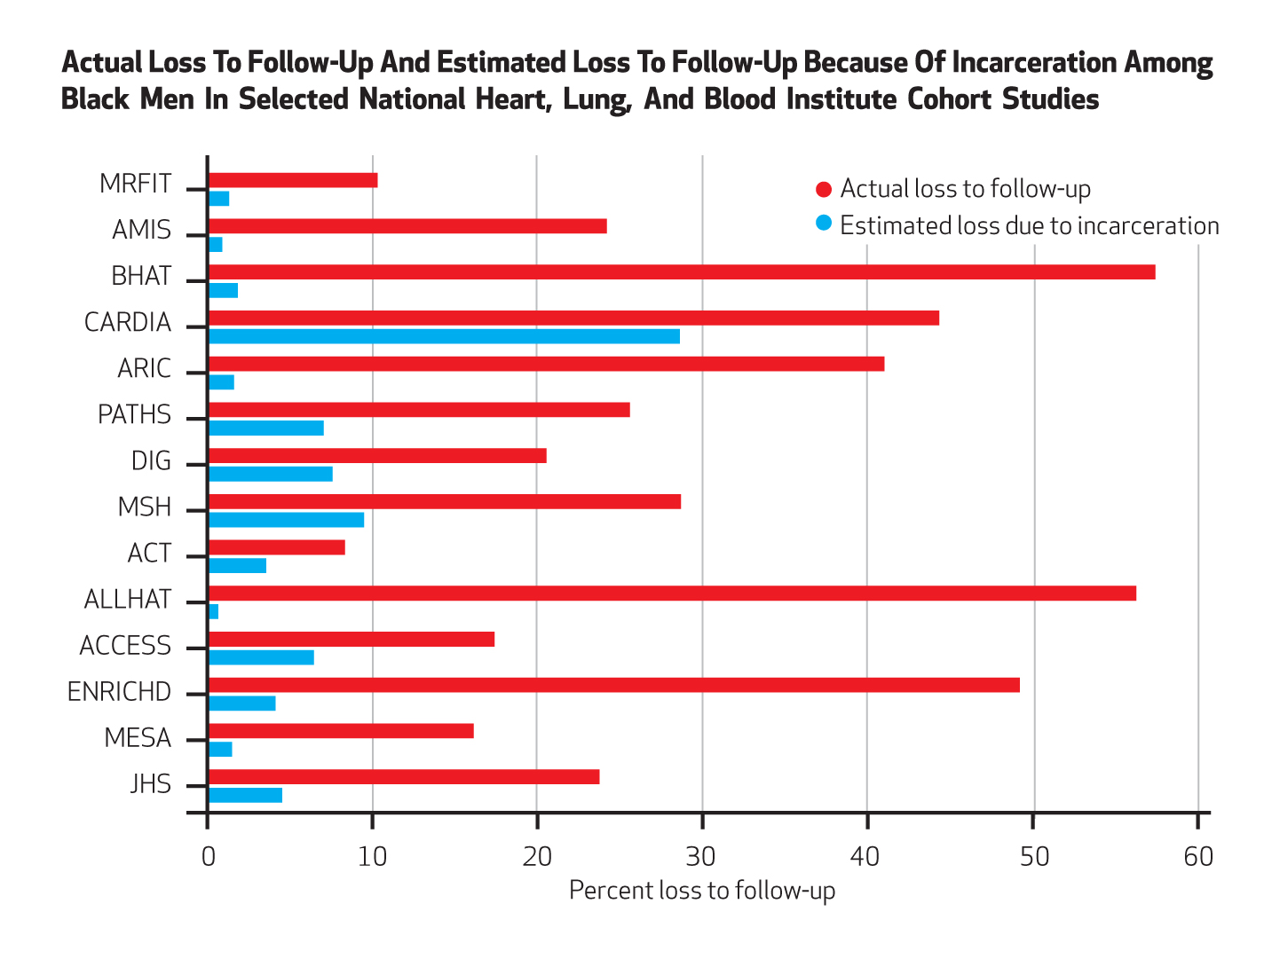
Incarceration
Notes:
Health Affairs 2014

Slide 56
Neighborhood
Pubmed Articles “Neighborhood” in title: 1970 - 2012
56

Slide 57
Place and health
Where you live, work and play impacts your health
  Environmental exposures
  Material deprivation
  Psychosocial mechanisms (stress, social support)
  Lifestyle behaviors (physical activity, diet, smoking & alcohol use)

Slide 58
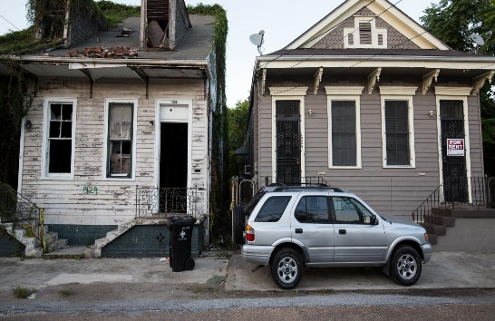
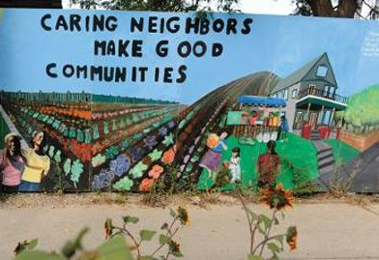

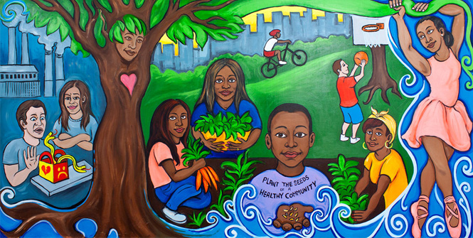
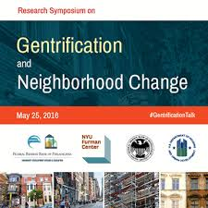
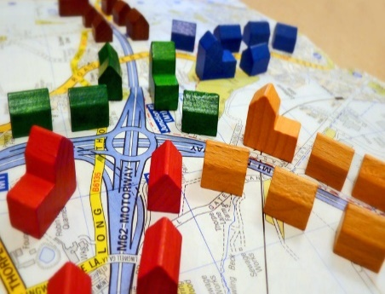

Social Environment Attributes
Social Environment
Socioeconomic status
Crime
Gentrification/ displacement
Ethnic enclave
Segregation
Racial/ ethnic composition
Social cohesion
Socioeconomic Status
Crime
Social Capital/
Social Cohesion
Racial/Ethnic Composition
Gentrification/
Displacement
Ethnic Enclave
Segregation

Slide 59
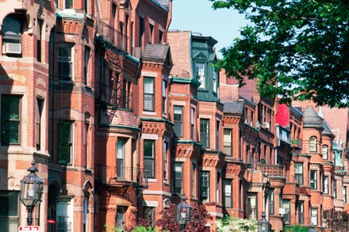
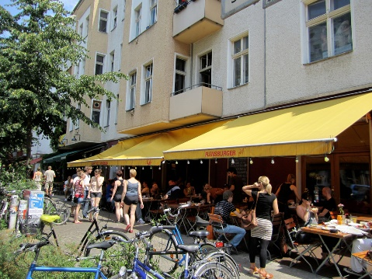
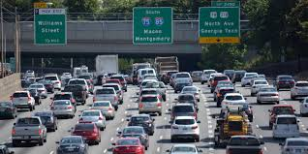
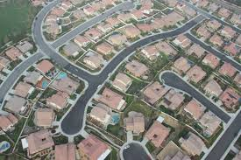
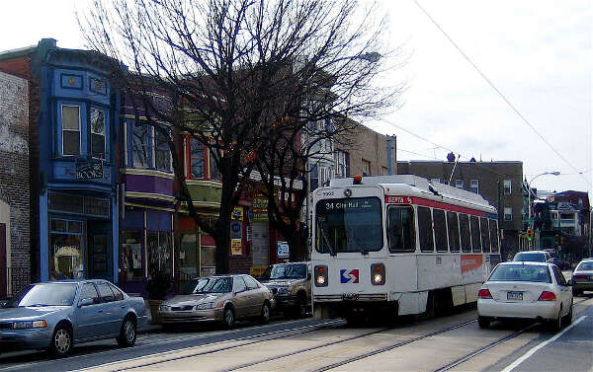

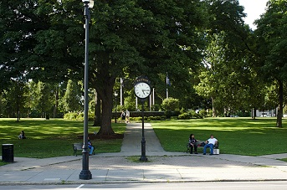

Built Environment Attributes
Population Density
Built Environment
Population density
Housing characteristics
Commuting patterns
Parks/green space
Recreational facilities
Food environment (retail food outlets, restaurants)
Street connectivity
Traffic density
Housing Characteristics
Traffic Density
Street Connectivity
Commuting Patterns
Food Environment
Parks/Green Space
Recreational Facilities

Slide 60
Gomez, Shariff-Marco, et al. Cancer 2015.

Slide 61
Additional neighborhood environments
Physical environment
  Air pollution
  Noise pollution
  Light pollution
  Toxic waste sites
Healthcare Context
  Resources: density of providers, facilities
  % insured/uninsured
  Distance to facilities

Slide 62
Diez Roux et al, Global Heart 2016

Slide 63
Neighborhood / Place research concepts and methods
definitions of neighborhood / geographic unit (scale)
  census block group
  census tract
  zip code
  buffers
measure to characterize the place
  composition
  context
types of measures
  census data
  counts
  density
  distance to
  time / space

Slide 64
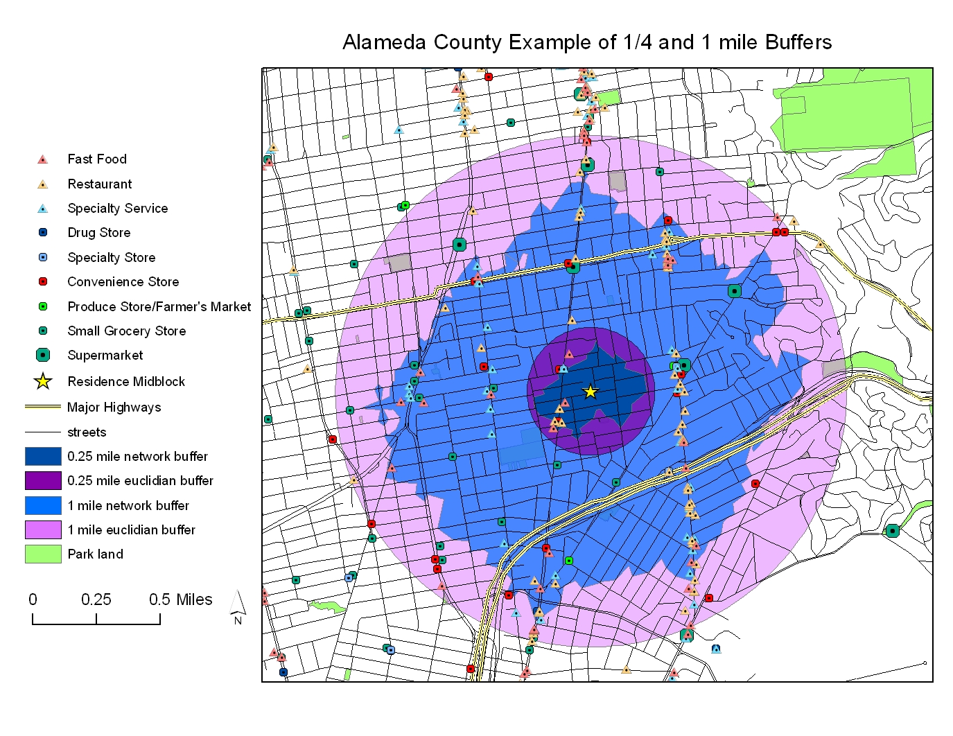

Slide 65
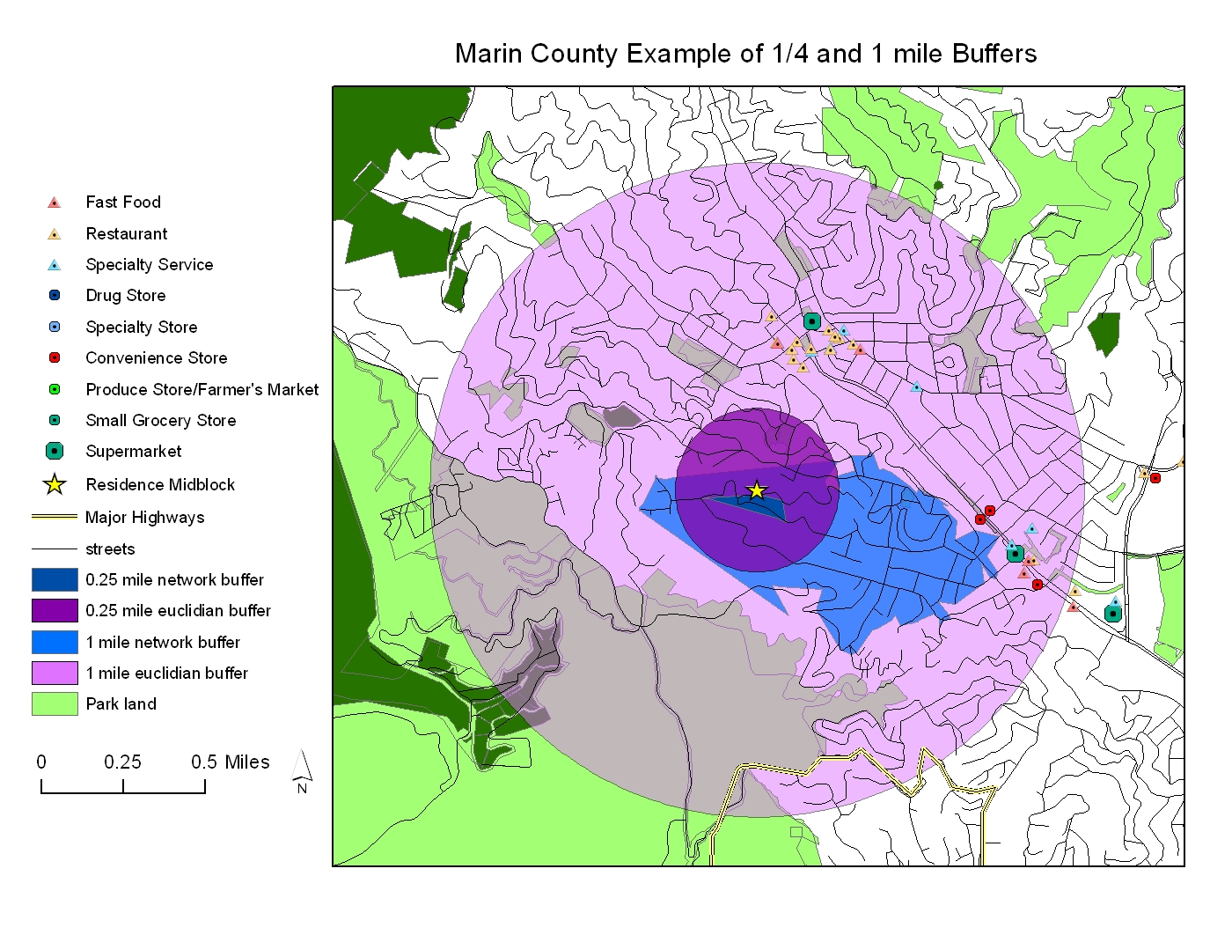

Slide 66
Arcaya et al, Social Science & Medicine 2016

Slide 67
Arcaya et al, Social Science & Medicine 2016

Slide 68
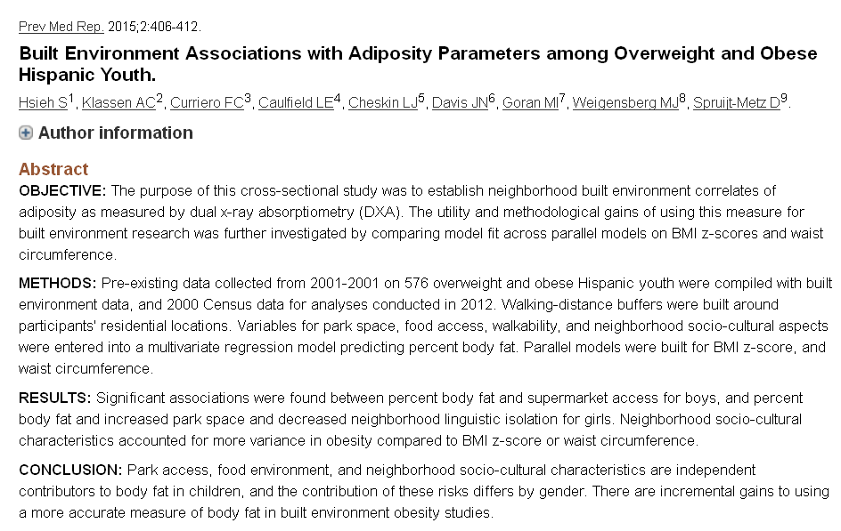

Slide 69
Moving to Opportunity
1994 – 4600 families with children living in public housing – RCT to move to lower poverty neighborhoods
  Vouchers (<10% poverty)
  Section 8
  control
2008-2010 – evaluation studies
http://www.nber.org/mtopublic/

Slide 70
Moving to Opportunity
adults offered housing vouchers
  a lower prevalence of severe obesity and diabetes compared to controls
  fewer physical limitations
  improved mental health in areas such as depression and psychological distress
self-reported health status and rates of hypertension and health-related risk behaviors are similar across groups
little or no effect on economic self-sufficiency

Slide 71
Recommendations for research on neighborhood + health
Consider the complex and dynamic relationships
A life-course perspective
  capture neighborhood environment factors during relevant time periods and account for changes in neighborhood characteristics
Consider neighborhood environments at work
Integration of secondary (objective) and self-report (perception) data
Engage communities in solutions/interventions
Develop analytical approaches and tools
Causal inference
  apply (develop) causal inference methods to allow for calculation of less biased estimates of associations between neighborhood environments and cancer outcomes

Slide 72
Map of First Four Weeks
Week 2
Week 5
Economic & Social
Opportunities and Resources
Week 3
Living & Working Conditions
in Homes and Communities
Week 4
Behaviors
Medical Care
Interaction with genetic/other biological factors
HEALTH
Adapted from Braveman et al., for RWJ Foundation
Commission to Build a Healthier America | www.commissiononhealth.org

Slide 73
Questions? Comments?
Salma Shariff-Marco, PhD, MPH
sshariff@psg.ucsf.edu

