Slide 1
Multi-level Etiologies of Health Disparities:
Pt 3. Behavioral
January 22, 2019
Scarlett Lin Gomez, PhD, MPH
Department of Epidemiology & Biostatistics
Helen Diller Family Comprehensive Cancer Center

Slide 2
Map of First Four Weeks
Week 2
Week 5
Economic & Social
Opportunities and Resources
Week 3
Living & Working Conditions
in Homes and Communities
Week 4
Behaviors
Medical Care
Interaction with genetic/other biological factors
HEALTH
Adapted from Braveman et al., for RWJ Foundation
Commission to Build a Healthier America | www.commissiononhealth.org

Slide 3
Outline
Health behaviors - patterned by social determinants, ex:
  Tobacco
  Diet
  Physical activity
  Alcohol / drugs
  Healthcare utilization
Conceptual models of health behaviors
Explanatory concepts/potential mechanisms connecting social determinants with health behaviors
  Putting it into practice → research & clinical practice

Slide 4

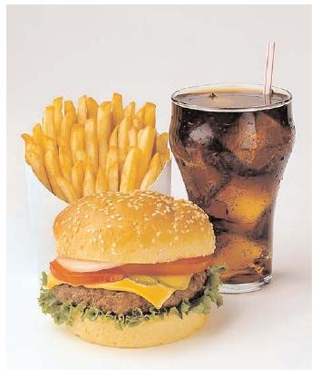
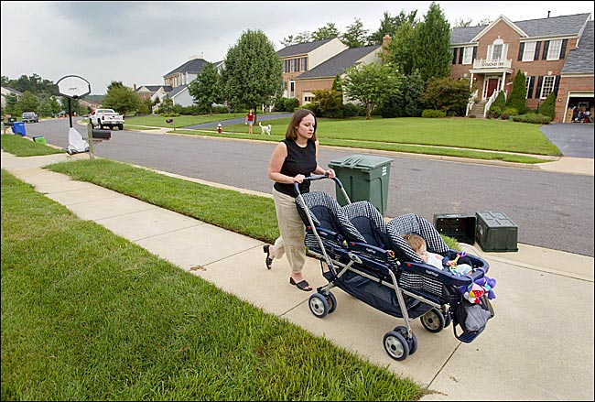
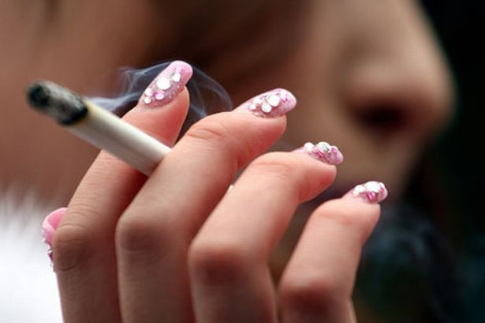
Health behaviors are patterned by social determinants

Slide 5
Health behaviors vary by SES
In representative US sample (Lantz, JAMA 1998)
Health Behavior | < High school education | College education
Smoking | 42% | 20%
Excessive alcohol intake | 4.4% | 3.7%
Physical inactivity | 37% | 14%
Obesity | 28% | 11%

Slide 6
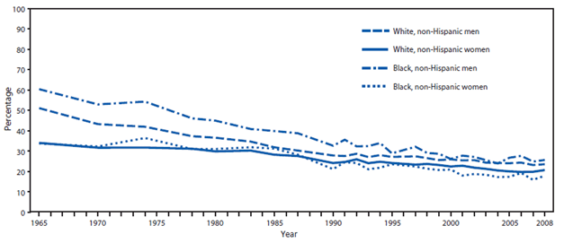
Tobacco trends by race/ethnicity and sex

Slide 7
Tobacco trends by education

Slide 8
Health behaviors by race/ethnicity,
California Health Interview Survey 2015-2016

Slide 9
Health behaviors by race/ethnicity,
California Health Interview Survey 2015-2016

Slide 10
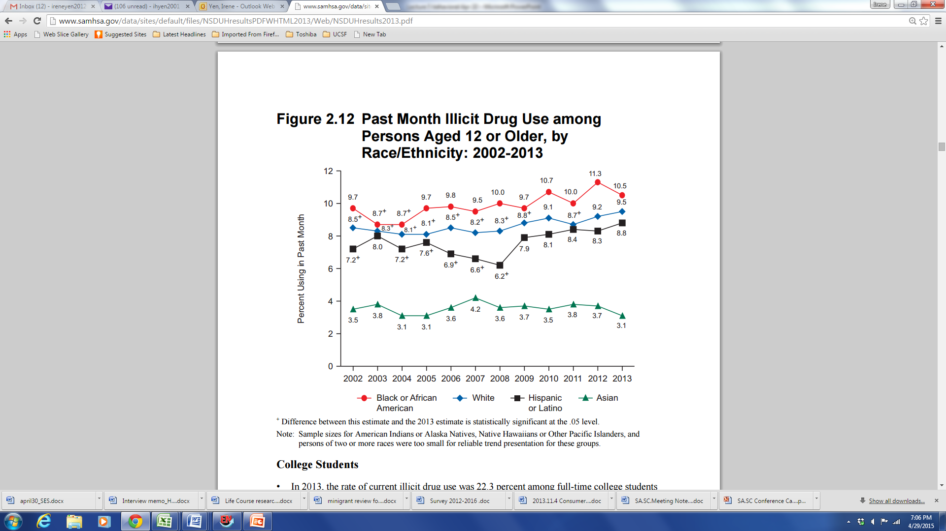
Drugs and Alcohol
2013 National Survey on Drug Use and Health

Slide 11
Illicit drug dependence or abuse by education
2013 National Survey on Drug Use and Health (aged 26+)
College graduates: 0.9%
Some college education: 2.1%
High school graduate: 1.9%
Did not graduate from high school: 2.5%

Slide 12
Conceptual models of health behaviors

Slide 13
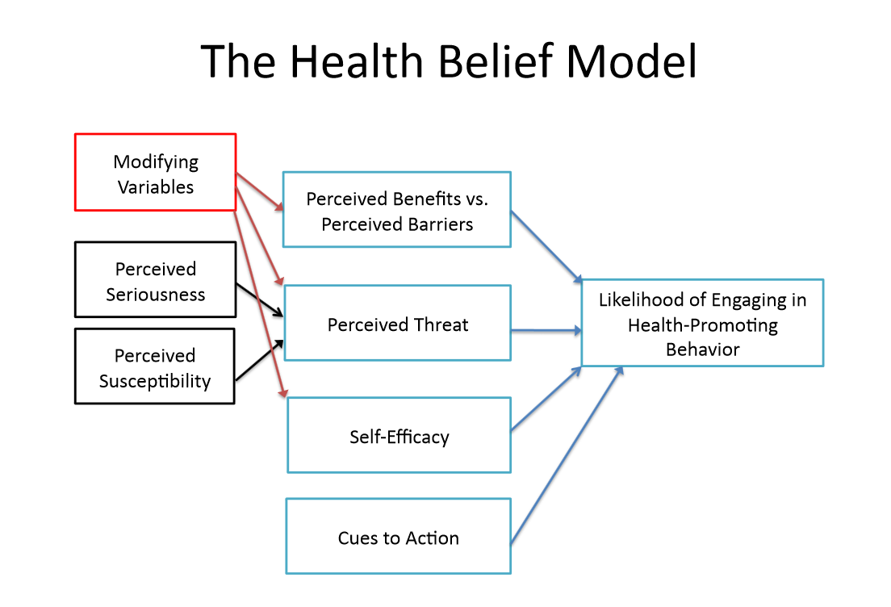
Psychological models of motivation and behavioral change

Slide 14
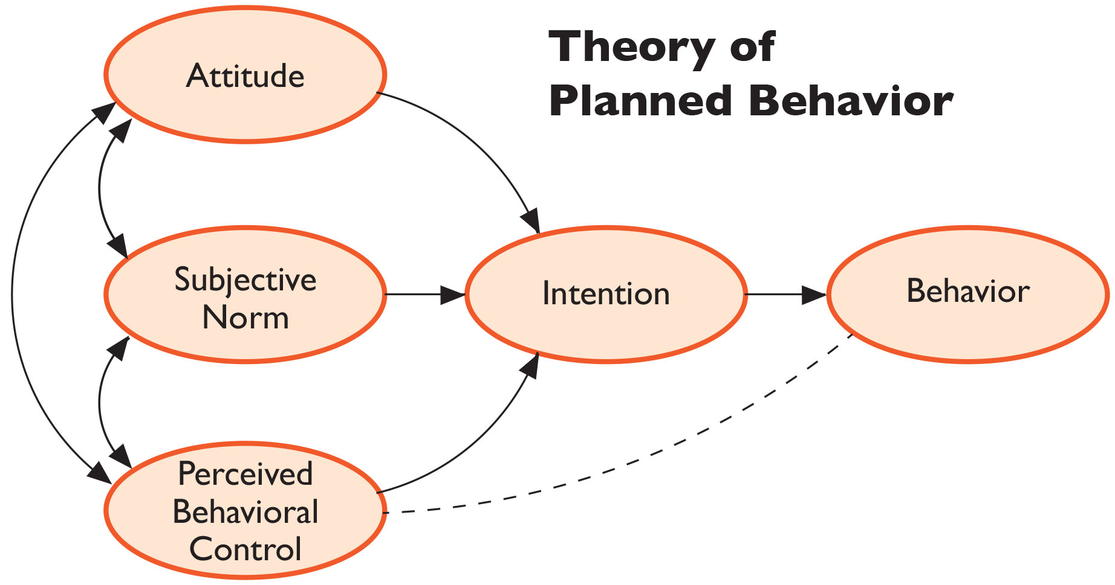
Psychological models of motivation and behavioral change

Slide 15
RWJ Foundation Framework
Economic & Social
Opportunities and Resources
Living & Working Conditions
in Homes and Communities
Behaviors
Medical Care
Interaction with genetic/other biological factors
HEALTH
Adapted from Braveman et al., for RWJ Foundation
Commission to Build a Healthier America | www.commissiononhealth.org

Slide 16

Putting it in Context: World Health Organization’s Commission on Social Determinants of Health Framework
Socioeconomic & political context
Governance
Policy (Macroeconomic, Social, Health)
Cultural and societal norms and values
Social Position
Material circumstances
Social cohesion
Psychosocial factors
Behaviors
Biological factors
Distribution of health and
well-being
Education
Occupation
Income
Gender
Ethnicity/Race
Health-Care System
SOCIAL DETERMINANTS OF HEALTH INEQUITIES
SOURCE: Amended from Solar & Irwin, 2007
http://www.who.int/social_determinants/thecommission/finalreport/graphs/en/

Slide 17
“Unnatural Causes. Place Matters” (PBS 2008)
Why is your street address…such a good predictor of your health?
“When we think about health, we usually think about health care and access to health care and the quality of care. But what research clearly shows is that health is embedded in the larger conditions in which we live and work.…
Sometimes, we naively think of improving health by simply changing behaviors. But the choices of individuals are often limited by the environments in which they live.”
(David Williams)

Slide 18
1. How would you design a research project based on these models?
2. How would you design an intervention based on these models?
3. How would you incorporate these models into clinical care?
Putting it into Practice: 3 Questions

Slide 19
Explanatory concepts/POTENTIAL PATHWAYS connecting social determinants with behaviors

Slide 20
Potential pathways
Access to resources: neighborhood/environmental context
Economic deprivation, financial constraints
Social and cultural norms, culturally-driven health beliefs
Stress & social support
Medical mistrust & healthcare utilization

Slide 21
Potential pathways – sociological perspectives
(Pampel Annu Rev Sociol 2010)
Fewer benefits of health behaviors for longevity
Latent traits
Class distinctions
Knowledge and access to information
Efficacy and agency

Slide 22
Potential pathways
Access to resources: neighborhood/environmental context
Economic deprivation, financial constraints
Social and cultural norms, culturally-driven health beliefs
Stress & social support
Medical mistrust & healthcare utilization

Slide 23
Access to resources: neighborhood/environmental context
“Unnatural Causes. Place Matters” (PBS 2008)
Why is your street address…such a good predictor of your health?
“When we think about health, we usually think about health care and access to health care and the quality of care. But what research clearly shows is that health is embedded in the larger conditions in which we live and work.…
Sometimes, we naively think of improving health by simply changing behaviors. But the choices of individuals are often limited by the environments in which they live.”
(David Williams)

Slide 24
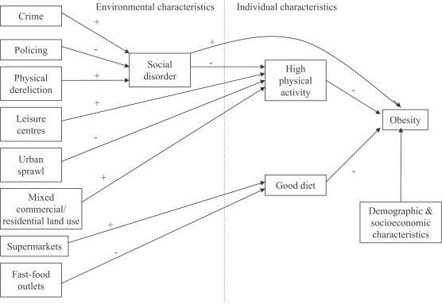
Model linking social and physical environmental characteristics to obesity
Pathways to obesity: Identifying local, modifiable determinants of physical activity and diet
Mai Stafford , Steven Cummins , Anne Ellaway , Amanda Sacker , Richard D. Wiggins , Sally Macintyre
Social Science & Medicine, Volume 65, Issue 9, 2007, 1882 - 1897

Slide 25
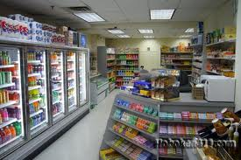
Food environment
Galvez et al 2009:
Children (ages 6-8) living on a block with 1 + convenience stores (range, 1–6) were more likely to have a BMI percentile in the top tertile (OR 1.90, 95% CI, 1.15–3.15) compared with children having no convenience stores
Oreskovic et al 2009:
Distance to nearest fast-food restaurant was inversely associated with BMI
Chen et al 2016:
Food environment incl. living in food desert associated with obesity after adjusting for home food environment factors

Slide 26
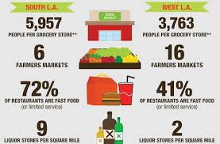
Diet / Food
“Food Desert” - low-income census tract where a large number of residents are more than a mile from a grocery store.

Slide 27
Potential pathways
Access to resources: neighborhood/environmental context
Economic deprivation, financial constraints
Social and cultural norms, culturally-driven health beliefs
Stress & social support
Medical mistrust & healthcare utilization

Slide 28
Economic deprivation/
Financial constraints
Meta-analysis of 27 studies - healthy eating costs $1.48 more per day per adult than eating a low-quality diet ($550 more annually per person).
Aids for healthy behavior (Pampel 2010)
  Costs required for resources to quit smoking/reduce alcohol dependency, physical activities

Slide 29
Potential pathways
Access to resources: neighborhood/environmental context
Economic deprivation, financial constraints
Social and cultural norms, culturally-driven health beliefs
Stress & social support
Medical mistrust & healthcare utilization

Slide 30
Social and cultural norms, culturally-driven health beliefs
Some negative health behaviors are more common among certain social groups
  Culturally acceptable? E.g., alternative forms of smoking among South Asians, esp. women
  Less stigmatized? E.g., overweight/obesity among immigrant/2nd gen Latinos and Asians
  Targeted advertising? E.g., menthol cigarettes among African-American communities
  Greater availability? E.g., betel-nut chewing in East Asia
  Perceived necessity of preventive health in absence of symptoms

Slide 31
Potential pathways
Access to resources: neighborhood/environmental context
Economic deprivation, financial constraints
Social and cultural norms, culturally-driven health beliefs
Stress & social support
Medical mistrust & healthcare utilization

Slide 32
Stress & social support
Socioeconomic disadvantage → increased adversity, drain on capacity to cope (Pampel 2010)
Affordances model:
  Poor health behaviors → regulate mood → ability to cope
Environmental affordances:
  Relationships between people and their environments that can have an effect on human activity whether or not they are visible, known, or desirable.

Slide 33
Affordances Model (Jackson)
Over the life course, Blacks (and other underserved populations) are more likely to engage in coping strategies (i.e., adverse health behaviors) that “preserve” mental health
However, over time, in concert with social, economic, and environmental stressors, these coping strategies lead to poor physical health in middle age and older life
Jackson et al. AJPH 2010

Slide 34
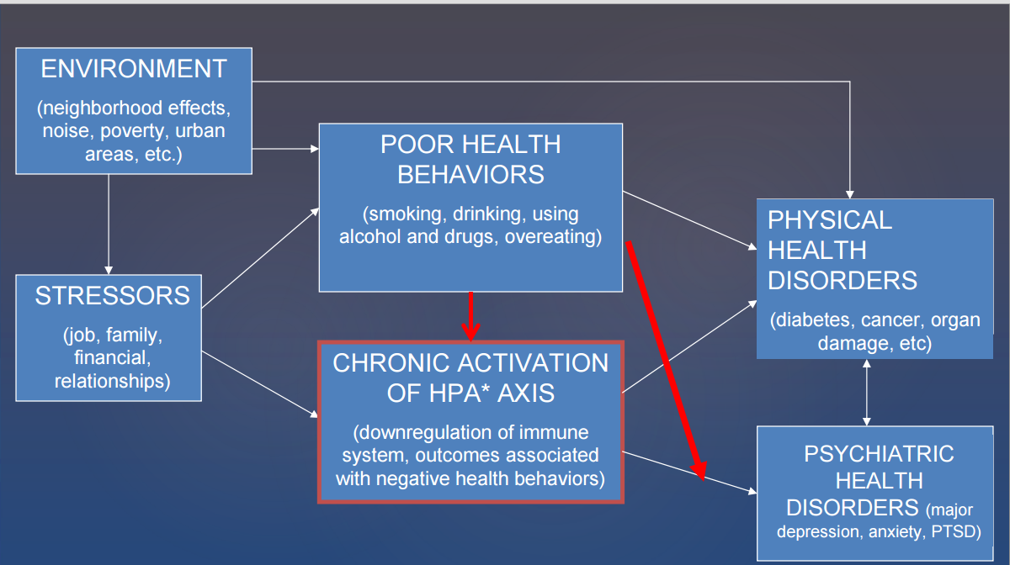
Affordances Framework: Inter-relationships among environment, stressors, negative health behaviors, and physical and mental health
Jackson & Knight, 2006; Jackson, Knight, & Rafferty, 2010, AJPH

Slide 35
Adverse Childhood Experiences (ACEs) - CDC
Before the age of 18:
Live with
  depressed or mentally ill person
  alcoholic
  drug user
  anyone sentenced to prison time
Parents separated or divorced
Exposed to domestic violence
Physical abuse
Sexual abuse

Slide 36
Adverse Childhood Experiences and adult health behaviors, UK
Bellis et al. AJPH 2013

Slide 37
Potential pathways
Access to resources: neighborhood/environmental context
Economic deprivation, financial constraints
Social and cultural norms, culturally-driven health beliefs
Stress & social support
Medical mistrust & healthcare utilization

Slide 38
Medical mistrust and healthcare utilization
Institutional and personal experiences with adverse medical experiences may result in mistrust of the medical care system and providers, leading to avoidance of medical care
Medical mistrust index (of healthcare organizations) associated with measures of underutilization of health care (LaVeist et al. Health Serv Res 2009)
Review of 27 studies showed greater medical mistrust associated (in most studies) with lower use of colorectal cancer screening (Adams et al. J Comm Health 2017)

Slide 39
Potential pathways
(Pampel Annu Rev Sociol 2010)
Fewer benefits of health behaviors for longevity
Latent traits
Class distinctions
Knowledge and access to information
Efficacy and agency

Slide 40
Fewer benefits of health behaviors for longevity
Persons of low SES have less to gain from healthy behaviors
Less reason to invest in future longevity and more reason to focus on present when making decisions about health behaviors
Lower SES groups feel fatalistic about ability to act in ways that extend longevity, reduce disease risk
Strong concern with future consequences of health decisions partially mediates relationship between SES and body weight
High SES groups quit smoking because of future health concerns, while low SES groups are motivated by cost and current health problems
Pampel Annu Rev Sociol 2010

Slide 41
Potential pathways
(Pampel Annu Rev Sociol 2010)
Fewer benefits of health behaviors for longevity
Latent traits
Class distinctions
Knowledge and access to information
Efficacy and agency

Slide 42
Latent traits
Personal characteristic with propensity to engage in risky and/or unhealthy behaviors
Crime literature – low self-control, attraction to risk, choose short-term gain in the face of long-term harm
Pampel Annu Rev Sociol 2010

Slide 43
Potential pathways
(Pampel Annu Rev Sociol 2010)
Fewer benefits of health behaviors for longevity
Latent traits
Class distinctions
Knowledge and access to information
Efficacy and agency

Slide 44
Class distinctions
Engage in healthy behaviors and lifestyles to set themselves apart from lower SES groups
Classical theory: lifestyle as source of social differentiation, adoption of innovative fashion to reinforce differences
Pampel Annu Rev Sociol 2010

Slide 45
Potential pathways
(Pampel Annu Rev Sociol 2010)
Fewer benefits of health behaviors for longevity
Latent traits
Class distinctions
Knowledge and access to information
Efficacy and agency

Slide 46
Knowledge and access to information
Lower SES groups have less access to and opportunities for learning about harms of unhealthy behaviors
Some groups may also be exposed to more advertising
Persons with college degree 3.6 x more likely to report that they pay attention to nutritional information from scientific experts, compared to those with less than high school degree
Pampel Annu Rev Sociol 2010

Slide 47
Potential pathways
(Pampel Annu Rev Sociol 2010)
Fewer benefits of health behaviors for longevity
Latent traits
Class distinctions
Knowledge and access to information
Efficacy and agency

Slide 48
Efficacy and agency
Education provides human capital, effective agency, and sense of personal control
Education trains individuals to evaluate and use information
High SES groups are quickest to use new medical technologies
Education increases use of aids to quit smoking, and responsiveness to antismoking ads
Pampel Annu Rev Sociol 2010

Slide 49
1. How would you design a research project based on these models?
2. How would you design an intervention based on these models?
3. How would you incorporate these models into clinical care?
Putting it into Practice: 3 Questions

Slide 50
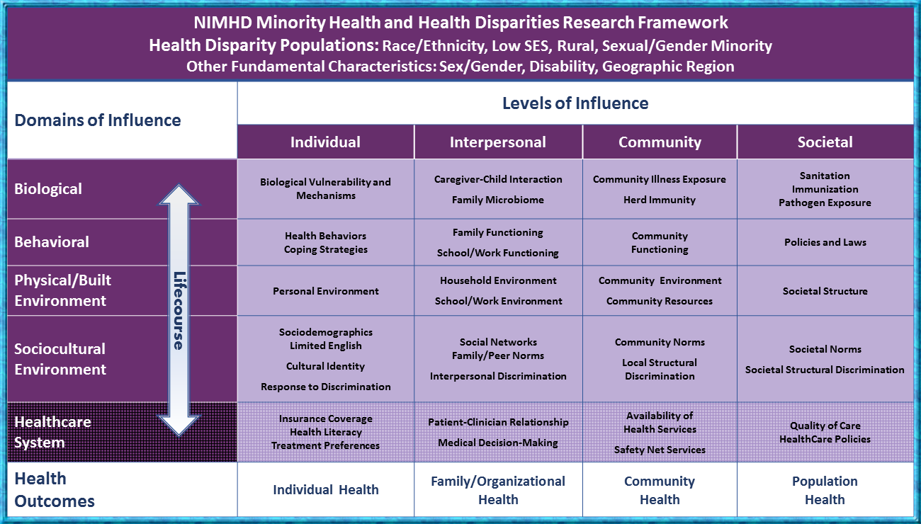
Capturing social determinants of health

Slide 51
Capturing social determinants of health

Slide 52
Social and built environment associations with body size among breast cancer survivors
Pathways breast cancer survivor cohort (N=4,312), Northern CA Kaiser, racially/ethnically diverse
Higher odds of overweight associated with:
  Lower neighborhood SES, ethnic minority composition, more commuters, higher traffic density, higher ratio of fast food to non fast food, higher ratio of unhealthy to healthy food outlets
Higher odds of obesity associated with:
  Lower neighborhood SES (OR=2.3 Q1 vs. Q5), ethnic minority composition, more commuters, higher traffic density, higher ratio of fast food to non fast food, higher ratio of unhealthy to healthy food outlets, fewer total businesses, fewer recreational facilities
Shariff-Marco et al. CEBP 2017

Slide 53
Social and built environment associations with body size among breast cancer survivors
Adjusting for neighborhood SES greatly attenuated increased odds of overweight and obesity among African Americans and obesity among US-born Hispanics, relative to non-Hispanic whites.
Further adjustment for other neighborhood attributes slightly attenuated increased odds of overweight and obesity among African Americans, but not among US-born Asians, relative to non-Hispanic whites.
Shariff-Marco et al. CEBP 2017

Slide 54

Effect of neighborhood scales on the likelihood of development of obesity in the CYGNET Study, 2007-2012 (n=601 observations from 174 girls)
 | Model 1 |  | Model 2
Neighborhood Scale | OR | 95% CI | OR | 95% CI
Food and Service Retail | 2.40*** | 1.44, 4.02 | 2.27*** | 1.42, 3.61
Recreation | 0.97 | 0.55,1.69 | 0.84 | 0.50,1.40
Walkability | 1.02 | 0.63, 1.67 | 0.85 | 0.53, 1.36
Physical Disorder | 2.53** | 1.28, 5.01 | 2.41** | 1.31, 4.44
*** p < .001; ** p < .01; * p < .05
Hoyt Pediatrics 2014
Notes:
When controlling for baseline BMI z score, pubertal development stage, race/ethnicity, number of street segments observed per girl, and year of outcome measure, results indicated food and service retail scale (OR=2.40; P<.001) and physical disorder scale (OR=2.53; P=.008) were predictors of increased odds of obesity during the 4-year transition from late childhood to early adolescence.

Slide 55
Intersectionality: “intersecting inequalities” & “multiple vulnerabilities”
Intersectionality theory originated from Black feminist scholarship
Upstream social determinants (racism, sexism, classism) that shape life experiences and restrict opportunities for upward mobility for individuals as a consequence of their multi-dimensional social statuses
Social status/identity is a marker of institutional policies
In health inequalities research:
  “inter-categorical intersectionality” → interactions between dimensions of social statuses/identities
Green, Evans, Subramanian. Social Sci Med 2017
Williams et al. Health Services Research 2012

Slide 56
Breast cancer survival: intersection of race/ethnicity, education, & neighborhood SES
California Breast Cancer Survivorship Consortium
(ref)
Hazard ratio
Shariff-Marco et al.
J Comm Health 2015

Slide 57
Breast cancer survival: intersection of race/ethnicity, education, & neighborhood SES
California Breast Cancer Survivorship Consortium
Relative to non-Latina Whites in high SES neighborhoods:
Non-Latina Whites and African Americans living in low SES neighborhoods had worse survival, regardless of education.
(ref)
Hazard ratio
Shariff-Marco et al.
J Comm Health 2015

Slide 58
Breast cancer survival: intersection of race/ethnicity, education, & neighborhood SES
California Breast Cancer Survivorship Consortium
Relative to non-Latina Whites in high SES neighborhoods:
African Americans with low education, living in high SES neighborhoods, also had worse survival.
(ref)
Hazard ratio
Shariff-Marco et al.
J Comm Health 2015

Slide 59
Breast cancer survival: intersection of race/ethnicity, education, & neighborhood SES
California Breast Cancer Survivorship Consortium
Relative to non-Latina Whites in high SES neighborhoods:
Latinas with low education, living in high SES neighborhoods, was the only group to have better survival.
(ref)
Hazard ratio
Shariff-Marco et al.
J Comm Health 2015

Slide 60
Multilevel Research: built environment and physical activity
California Teachers Study: population cohort study of ~130,000 teachers and teaching administrators
Analysis included 117,367 women who resided in California at the time of the 1995 baseline survey and for whom residential address could be geocoded
Recursive partitioning was used to identify unique combinations of predictors of physical inactivity (< 25 hrs/wk)
Keegan et al. Am J Public Health, 2012

Slide 61
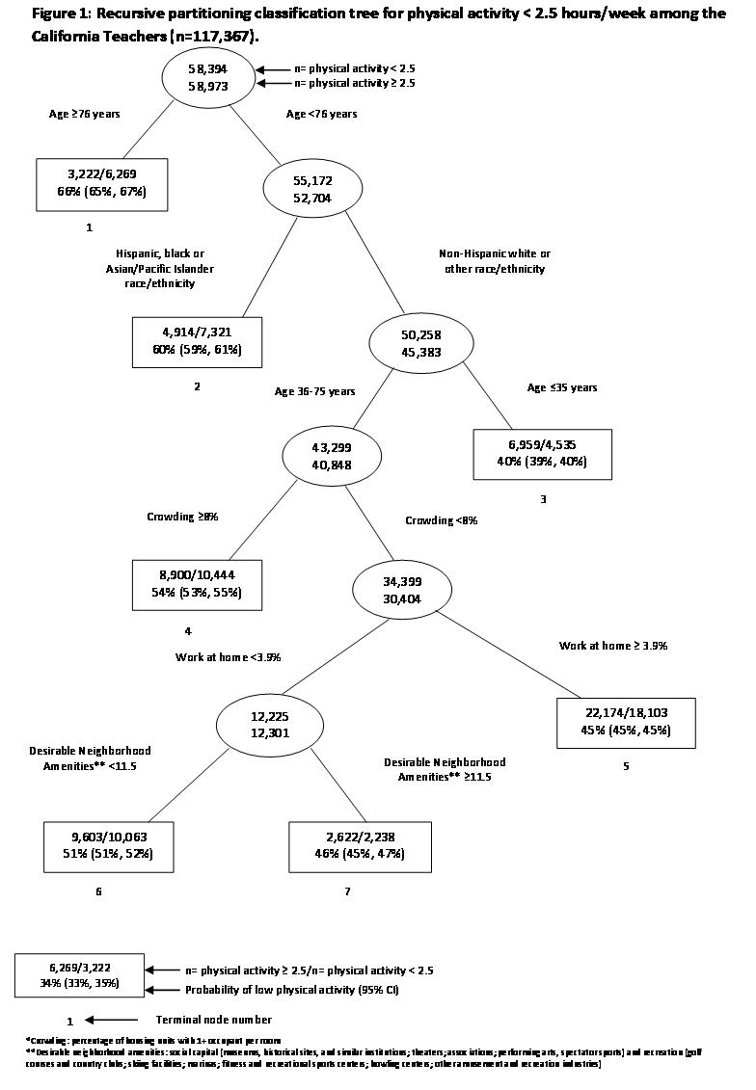

Slide 62
Multilevel Research: built environment and physical activity
Built environment variables associated with physical activity
  Household crowding
  % of population work at home
  N of desirable amenities
But built environment effects seen only among non-Hispanic Whites and “other” race/ethnicity, aged 36-75
Minority groups have low physical activity regardless of built environment in this educated population of educators

Slide 63
1. How would you design a research project based on these models?
2. How would you design an intervention based on these models?
3. How would you incorporate these models into clinical care?
Putting it into Practice: 3 Questions

Slide 64
Colorectal cancer screening guideline adherence among Asian Americans & Pacific Islanders,
CHIS 2001-2005 (Lee, Ethnicity & Health 2011)

Slide 65
Interventions addressing social and cultural norms, culturally-driven health beliefs
Factors associated with lower colorectal cancer screening in AAPIs (Lee Ethnicty & Health 2011)
Female
Never married
Lower education
Poverty
No health insurance
No usual source of care
Fewer years in US
Speak English + another language at home
Fewer doctor visits
Fewer chronic diseases
Smoker

Slide 66
Social and cultural norms,
culturally-driven health beliefs
Ex: Colorectal cancer screening in South Asian Americans → preventive health beliefs
While immigration and language determinants were important, the factors most strongly associated with screening were being obese and having had a flu shot in the past year
Findings triangulate with qualitative data showing health beliefs, esp in preventive care, is important in this population (Ivey J Health Care Poor Underserv 2018)

Slide 67
Applying conceptual models of health behaviors to intervention studies
Study #1: Colorectal cancer screening in Chinese Americans (Nguyen AJPM 2017)
  In-language print materials
  Randomize to print materials vs. lay health worker
  Lay health worker outreach more effective than print materials alone

Slide 68
Applying conceptual models of health behaviors to intervention studies
Study #2: FLU-FIT program (Potter AJPH 2013)
  Randomized flu clinics in an integrated healthcare system to offering FIT vs. no FIT
  Offering FIT increased FIT completion within 90 days of flu clinic, OR = 2.75

Slide 69
Applying conceptual models of health behaviors to intervention studies
Study #3: A physician-initiated intervention to increase colorectal cancer screening (Sun Cancer 2018)
  Physicians from local independent practice association serving Chinese Americans
  Early intervention group: CME + patient intervention mailer w/FOBT kit
  Delayed intervention group: patient intervention mailer only
  No effect of CME → both arms saw equal increase in FOBT

Slide 70
1. How would you design a research project based on these models?
2. How would you design an intervention based on these models?
3. How would you incorporate these models into clinical care?
Putting it into Practice: 3 Questions

Slide 71
Biopsychosocial approach to behavior change: integrating sociocultural context into patient care
Enhance knowledge of social context factors influencing health
  Social and political structures
  Economic conditions
  Cultural values
  Epidemiology of health behaviors
Build advocacy skills
  E.g., work with healthcare provider to identify resources to improve health outcomes of low-income patient
Chin et al. Education for Health 2000

Slide 72
Biopsychosocial approach to behavior change: integrating sociocultural context into patient care
Implement motivational strategies with patients from diverse backgrounds – learning from the patient
  Use motivational interviewing principles to build rapport
  Interaction discussion with patients to assess readiness to change (Prochaska model)
  Build provider-patient partnership – learn about patients’ previous experiences with healthcare system and preferences for care
Reinforce counseling skills through role-plays
  Include social and cultural information that is relevant to health behavior
Chin et al. Education for Health 2000

Slide 73
Health promotion efforts that … simultaneously
prevent initiation or promote cessation of harmful behaviors,
mitigate sources of stress (e.g., financial strain, exposure to trauma and violence) or reinforce positive resources (e.g., positive social networks), and
act on structural forces (e.g., high concentrations of fast food restaurants or alcohol outlets) that encourage engagement in these behaviors
are more likely to succeed than efforts to modify any of these factors in isolation.

Slide 74
Questions / Discussion?
Notes:
Key points: it is not the individual woman’s job to solve public health problem of unintended pregnancy on her own time
It is about informed preferences
Comparison to maternal mortality – our job is to give women the information they need and to think about how it relates to their preferences. In the visit, s not to solve public health problem.
Contraception as preference sensitive – maybe elucidate this a bit more
Challenges around “Shared” – from a feminist perspective
Importance of question “what is important to you about your method”
The public health question – some people really felt like it was okay to have the public health hat on during a visit. I think it is important to say that while affecting public health outcomes may be secondary outcome of your clinical care, it should never be what you are primarily focusing on – it should be about influencing the individual women’s outcome – and this is why the public health level outcome around IUD use goes along with getting women to use IUDs regardless of their preferences.
Really, you should never really have the public heatlh in mind – it should be the individual patient’s goals that matter – i.e. avoiding diabetes related foot amputations.

