Slide 1
Clustered Data Arising from Cluster Randomized Trials and Geographically Clustered Observational Data
Catie Oldenburg, ScD MPH
April 12, 2019

Slide 2
Outline
Sources of clustering: place, time, people, sampling
Methods for cluster randomized trials
Sample size calculations for cluster randomized trials
Analytic considerations for cluster randomized trials
Spatial clustering in observational data

Slide 3
Examples of sources of clustering

Slide 4
Examples of sources of clustering
Sampling in places: neighborhoods, schools, hospitals, clinics, families, siblings
Repeated measures over time
Two eyes in the same person
Multiple measures of related constructs in the same person (math, verbal scores)

Slide 5
Features of clustering
Clusters may have equal numbers of observations (balanced) or unequal
Items within a cluster may be ordered with respect to one another (e.g., time creates an ordering)
Assume that conditional on cluster, observations are independent

Slide 6
Hierarchy
Convenient to represent the measurements with an index to distinguish when you are referring to characteristics of the place versus the person. Y_{ij}= Value of the variable “Y” for person i in place j
Could also talk about X_{ij} or X_{j,} a feature of place j that has the same value for every person i in place j.

Slide 7
Hierarchy
Convenient to represent the measurements with an index to distinguish when you are referring to characteristics of the place versus the person. Y_{ij}= Value of the variable “Y” for person i in place j
Could also talk about X_{ij} or X_{j,} a feature of place j that has the same value for every person i in place j.

Slide 8
Hierarchy
Convenient to represent the measurements with an index to distinguish when you are referring to characteristics of the place versus the person. Y_{ij}= Value of the variable “Y” for person i in place j
Could also talk about X_{ij} or X_{j,} a feature of place j that has the same value for every person i in place j.

Slide 9
Sources of clustering
Three level hierarchy:
  Diabetic people nested in clinics
  Each patient measured repeatedly
Cross-classified hierarchy:
  Diabetics within a clinic
  Some live in the same neighborhoods
Multivariate response
  Two outcome measures of the same latent variable

Slide 10
Three-level hierarchy
Y_{ijk}= Value of the variable “Y” for person i in household j in place k

Slide 11
Repeated cross-sectional design
Repeated cross-sectional design is drawing a random sample of a target population repeatedly, with the selection probability of each individual at one wave unrelated to his/her selection in the previous wave, e.g, NHANES, BRFSS
Time is level 2 because People are sampled within Waves in each Place
Y_{itk}= Value of the variable “Y” for person i at time t in place k

Slide 12
With a repeated measures design
Repeated measures design: select a representative sample of individuals and measure them repeatedly.
Time is level 1 because annual observations are sampled within People in each Place
Y_{tik}= Value of the variable “Y” for at time t for person i in place k

Slide 13
Multivariate responses
e.g., Y1=walking speed, Y2=balance measure, Y3=grip strength and Y4=lung function
Y_{ijk}= Value of the measurement i for person j in place k

Slide 14
Cross-classified models
People are nested within neighborhoods and also within worksites.
Some people who live in the same neighborhood work at the same place, others do not.

Slide 15
Sampling design creates clustering

Slide 16
Outline
Sources of clustering: place, time, people, sampling
Methods for cluster randomized trials
Sample size calculations for cluster randomized trials
Analytic considerations for cluster randomized trials
Spatial clustering in observational data

Slide 17
Why cluster randomize?
Intervention by nature applies to an entire community
Avoid contamination that would arise from randomizing individuals
Evaluate population-level effects of an intervention

Slide 18
Examples?

Slide 19
Examples?
Azithromycin versus placebo for child mortality
WASH intervention for trachoma control
Immediate versus delayed ART initiation for preventing HIV transmission

Slide 20
Key issue
Observations within a cluster are correlated
Can’t use standard methods for design and analysis that assume observations are statistically independent

Slide 21
Measures of Variability
Coefficient of variation (k) – between cluster
Intracluster correlation coefficient (ρ) – within cluster

Slide 22
Coefficient of variation
k = σ_{B}/μ
where σ_{B} is the between-cluster standard deviation and μ is the mean
A standardized measure of dispersion of a probability distribution

Slide 23
Intracluster correlation coefficient (ICC)
How much more similar measures of individuals from the same cluster are than those from different clusters
Ratio of between-cluster variance to the total variance (between + within)
ρ = σ²_{B}/(σ²_{B} + σ²_{W})
Basically, the proportion of the variance that is explained by what group you’re in
ICC=0: individuals within clusters are no more similar to each other than those in different clusters (no between-cluster variability)
ICC=1: individuals in the same cluster have identical outcomes (no within-cluster variability)

Slide 24
Design Effect
A cluster randomized trial is analogous to collected data from a cluster sample rather than a simple random sample
Design effect = Variance for cluster sampling/Variance for simple random sampling
Effective sample size = Actual sample size/Design effect
What implications does a design effect of 2 have for effective sample size?

Slide 25
Design Effect
Can estimate the effective sample size and the standard error accounting for clustering using the design effect:
DEff = 1 + ICC*(m-1)
where m=number of individuals per cluster
Effective sample size = actual sample size/DEff
Variance correcting for clustering = variance*DEff

Slide 26
Sources of within-cluster correlation
Clustering of population characteristics
  Urban versus rural
  Socioeconomic status
  Environment
Variations in response to treatment
  More effective peer educators in a social network cluster
  Interaction between the intervention and a population characteristic
Interaction between individuals
  Infectious disease transmission
  Shared behavioral characteristics

Slide 27
Effects in cluster randomized trials
Direct effects
Indirect effect
Population effects

Slide 28
Direct effects
Individually randomized trials designed to estimate direct effect

Slide 29
Indirect effects
An intervention may have an effect on transmission of an infection
Interventions may have mass effects when a large proportion of the population is treated that leads to effects in untreated individuals
House et al, Lancet, 2009

Slide 30
Population effects
Estimate overall effect in the entire population
With 80% coverage (target for trachoma studies), effect includes both people who received and did not receive treatment
Keenan et al, PLOS Medicine, 2018

Slide 31
Threats to validity
Imbalance in clusters (small sample size)
Lack of masking
Lack of allocation concealment
Non-random sample monitored or loss to follow-up

Slide 32
Contamination
Occurs when individuals receive the opposite intervention to which they were randomized
Leads to an underestimate of treatment effects
Leads to underpowered studies
“Fried egg design”

Slide 33
Outline
Sources of clustering: place, time, people, sampling
Methods for cluster randomized trials
Sample size calculations for cluster randomized trials
Analytic considerations for cluster randomized trials
Spatial clustering in observational data

Slide 34
Unit of inference
Individual?
A defined cluster of individuals (e.g., a geographic unit)?
If the unit of inference is the cluster, no consideration is needed for the ICC
Sample size estimation, analysis are similar to those used in an individually randomized trial (the cluster = the individual)

Slide 35
Design effect and effective sample size
Standard sample size approaches leads to an underpowered study
Effective Sample Size = km/DEff,
Where DEff = 1+ICC*(m-1)
k=number of clusters
m=population per cluster

Slide 36
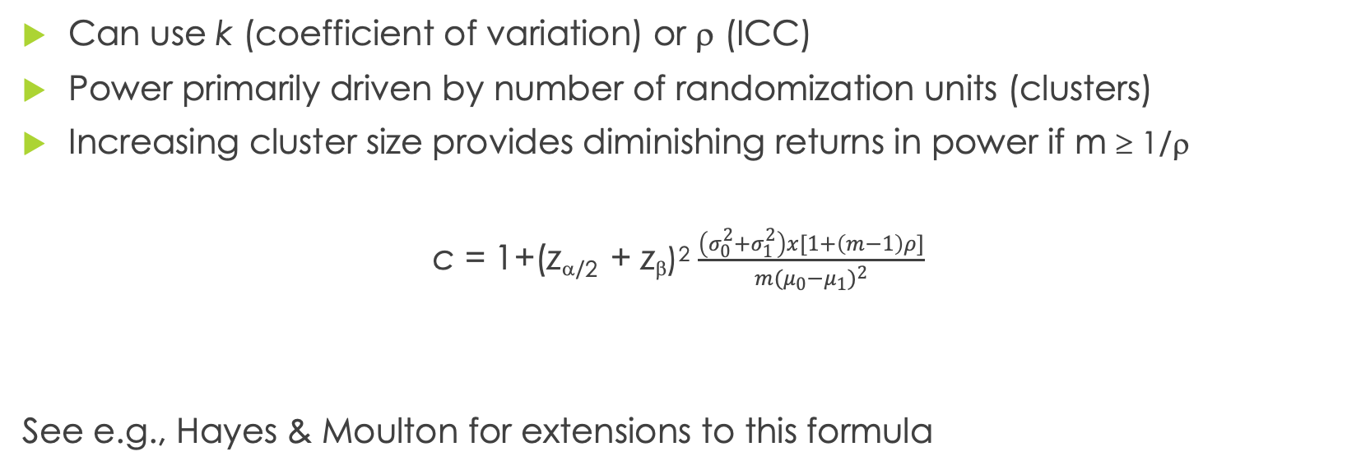
Sample size estimation
Can use k (coefficient of variation) or ρ (ICC)
Power primarily driven by number of randomization units (clusters)
Increasing cluster size provides diminishing returns in power if m ≥ 1/ρ
c = 1+(z_{α/2} + z_{β})² $\frac{\left(σ_{0}^{2}+σ_{1}^{2}\right)x[1+\left(m−1\right)ρ]}{m({μ_{0}−μ_{1})}^{2}}$
See e.g., Hayes & Moulton for extensions to this formula

Slide 37
Outline
Sources of clustering: place, time, people, sampling
Methods for cluster randomized trials
Sample size calculations for cluster randomized trials
Analytic considerations for cluster randomized trials
Spatial clustering in observational data

Slide 38
Unit of randomization vs unit of analysis
May randomize at the community level but be interested in individual-level inference
Must take lack of independence within clusters into account in the analysis
Failure to account for clustering generally leads to underestimated variances

Slide 39
What happens if you ignore clustering?
Trial A |  | Trial B
Control | Intervention | Control | Intervention
8/100 (8%) | 4/100 (4%) | 4/100 (4%) | 0/100 (0%)
9/100 (9%) | 5/100 (5%) | 7/100 (7%) | 3/100 (3%)
10/100 (10%) | 6/100 (6%) | 10/100 (10%) | 6/100 (6%)
11/100 (11%) | 7/100 (7%) | 13/100 (13%) | 9/100 (9%)
12/100 (12%) | 8/100 (8%) | 16/100 (16%) | 12/100 (12%)
50/500 (10%) | 30/500 (6%) | 50/500 (10%) | 30/500 (6%)
Standard analysis: χ²=5.43, P=0.02 for both trials
Example from Hayes and Moulton

Slide 40
What happens if you ignore clustering?
Trial A |  | Trial B
Control | Intervention | Control | Intervention
8/100 (8%) | 4/100 (4%) | 4/100 (4%) | 0/100 (0%)
9/100 (9%) | 5/100 (5%) | 7/100 (7%) | 3/100 (3%)
10/100 (10%) | 6/100 (6%) | 10/100 (10%) | 6/100 (6%)
11/100 (11%) | 7/100 (7%) | 13/100 (13%) | 9/100 (9%)
12/100 (12%) | 8/100 (8%) | 16/100 (16%) | 12/100 (12%)
50/500 (10%) | 30/500 (6%) | 50/500 (10%) | 30/500 (6%)
Standard analysis: χ²=5.43, P=0.02 for both trials
Example from Hayes and Moulton

Slide 41
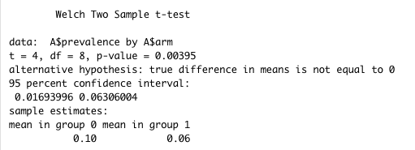
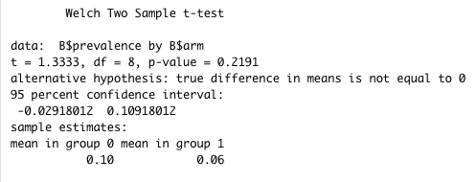
What happens if you ignore clustering?
Trial A |  | Trial B
Control | Intervention | Control | Intervention
8/100 (8%) | 4/100 (4%) | 4/100 (4%) | 0/100 (0%)
9/100 (9%) | 5/100 (5%) | 7/100 (7%) | 3/100 (3%)
10/100 (10%) | 6/100 (6%) | 10/100 (10%) | 6/100 (6%)
11/100 (11%) | 7/100 (7%) | 13/100 (13%) | 9/100 (9%)
12/100 (12%) | 8/100 (8%) | 16/100 (16%) | 12/100 (12%)
50/500 (10%) | 30/500 (6%) | 50/500 (10%) | 30/500 (6%)
Example from Hayes and Moulton

Slide 42
What happens if you ignore clustering?
Trial A |  | Trial B
Control | Intervention | Control | Intervention
8/100 (8%) | 4/100 (4%) | 4/100 (4%) | 0/100 (0%)
9/100 (9%) | 5/100 (5%) | 7/100 (7%) | 3/100 (3%)
10/100 (10%) | 6/100 (6%) | 10/100 (10%) | 6/100 (6%)
11/100 (11%) | 7/100 (7%) | 13/100 (13%) | 9/100 (9%)
12/100 (12%) | 8/100 (8%) | 16/100 (16%) | 12/100 (12%)
50/500 (10%) | 30/500 (6%) | 50/500 (10%) | 30/500 (6%)
The amount of between-cluster variability greatly affects inferences
Example from Hayes and Moulton

Slide 43
Analytic options for handling clustering

Slide 44
Analytic options for handling clustering
Analyze at the cluster level
GEE
Random effects model
Clustered bootstrap

Slide 45
Cluster-level analysis
Obtain a summary measure for each cluster (e.g., prevalence in each community from a simple random sample from within the community)
Compare the cluster-specific measures using an appropriate statistic (e.g., a t-test comparing prevalences in communities randomized to intervention or control)
Generally assuming the clusters are the same size

Slide 46
Individual-level analysis (random intercept)
Linear regression model with no allowance for clustering:
μ_{ijk} = α + β_{i} + Σγ_{l}z_{ijkl}
Linear regression model allowing for clustering
μ_{ijk} = α + β_{i} + Σγ_{l}z_{ijkl} + u_{ij}
μ_{ijk} = mean for kth individual in jth cluster in ith treatment arm
β_{i} = intervention effect
Σγ_{l}z_{ijkl} = covariates
u_{ij} = random effect corresponding to jth cluster in ith treatment arm

Slide 47
Individual-level analysis (random intercept)
μ_{ijk} = α + β_{i} + Σγ_{l}z_{ijkl} + u_{ij}
Assume u_{ij} is normally distributed with u_{ij} ~ N(0, σ²_{Bi})
Random intercept coefficient is given by:
α = α + v_{ijk}

Slide 48
Comparison of 3 methods
Effect of biannual azithromycin vs placebo distribution on weight in kg in children under 5
 | Mean Difference (95% CI) | P-value
Linear regression, ignoring clustering | 0.38 (0.15 to 0.63) | 0.001
Linear mixed effects model
Linear regression at level of cluster

Slide 49
Comparison of 3 methods
Effect of biannual azithromycin vs placebo distribution on weight in kg in children under 5
 | Mean Difference (95% CI) | P-value
Linear regression, ignoring clustering | 0.38 (0.15 to 0.63) | 0.001
Linear mixed effects model | 0.38 (-0.11 to 0.88) | 0.14
Linear regression at level of cluster

Slide 50
Comparison of 3 methods
Effect of biannual azithromycin vs placebo distribution on weight in kg in children under 5
 | Mean Difference (95% CI) | P-value
Linear regression, ignoring clustering | 0.38 (0.15 to 0.63) | 0.001
Linear mixed effects model | 0.38 (-0.11 to 0.88) | 0.14
Linear regression at level of cluster | 0.38 (-0.14 to 0.89) | 0.14

Slide 51
Outline
Sources of clustering: place, time, people, sampling
Methods for cluster randomized trials
Sample size calculations for cluster randomized trials
Analytic considerations for cluster randomized trials
Spatial clustering in observational data

Slide 52
Clustering in observational studies
Communities
Neighborhoods
Streets
Households
Etc
Nunn et al, AJPH, 2014

Slide 53
Clustering in observational studies
Many overlapping issues with cluster randomized trials
Standard statistical methods will lead to incorrect standard errors
Loss of efficiency in estimators
Can miss scientific questions
  Individualistic fallacy: assuming that individual-level outcomes can be explained exclusively in terms of individual-level characteristics
Nunn et al, AJPH, 2014

Slide 54
Incorrect SEs and Loss of Efficiency
Ignoring clustered data generally leads to SEs for individual-level exposures that are too small
  Variance of estimate of mean value Y = variance of Y/N
  Clustered data: effect N is < actual N
Same problem if you draw a clustered sample, people within the cluster are not independent, and you do not learn as much new information from each person
  Must correct standard errors
  Must anticipate this in the study design and inflate the sample size
  The ratio of the clustered sample size needed to the simple random sample is the design effect

Slide 55
Intracluster correlation coefficient
Measure of homogeneity, same as in a cluster randomized trial
Rho of 1: extreme homogeneity (e.g., household income of all 6 children in one household)
Rho of -1: extreme heterogeneity (e.g., gender w/in a two person heterosexual cluster)
Small Rho of 0.05 or less common for many characteristics in neighborhoods and schools

Slide 56
Spatial clustering
Spatial heterogeneity
  A spatial process that varies from point to point
Spatial dependence
  A functional relationship between what happens at one point in space and what happens elsewhere
Spatial patterns can be either or both
Results in autocorrelation and requires accounting for clustering

Slide 57
Statistical methods for clustering in observational studies

Slide 58
Statistical methods for clustering in observational studies
Mixed models
GEE

