Slide 1
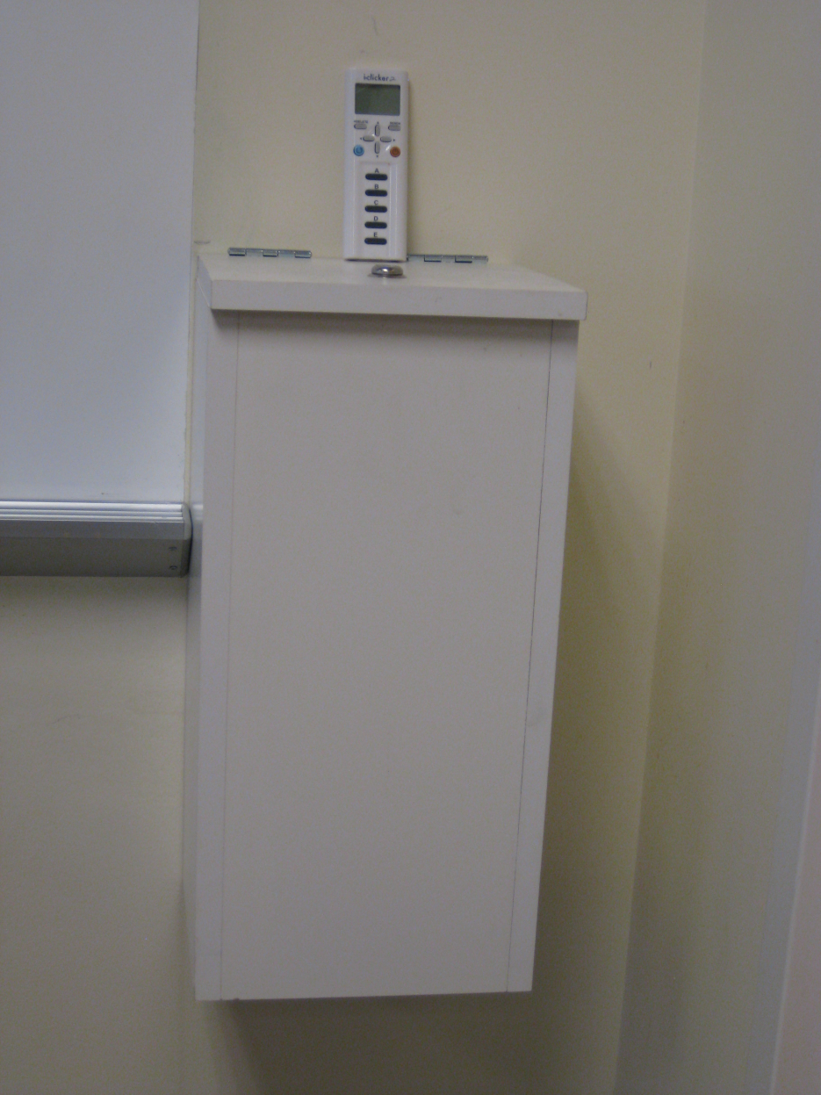

Please take an i>clicker from the box in front of the room

Slide 2
Do you agree with the authors’ conclusion?
Strongly agree - A
Somewhat agree - B
Not sure - C
Somewhat disagree - D
Strongly disagree - E
Notes:
2
Here is the conclusion of today’s article, that you all know. Do you agree with the author’s conclusion? This is a 5 point scale.

Slide 3
Mother’s Education
Calendar time
Sex
Birth weight
SES
Gestational age
Age
MMR
Autism
?
Unknown Confounders
Notes:
What is the research question, at least the way the authors are depicting it? We now know that depicting the research question in a DAG is the clearest way to communicate. I was impressed the other day in Small Group Section when I heard one of you say that you don’t want to hear someone’s research question in words; you would much rather see the DAG. Did anyone draw the DAG for this research question?
Here is a quick version of how I see the authors envisioning the system. There might be edges in between these variables but I don’t think they are critical to show. Of course, there is the obligatory unknown confounders that are worth showing.

Slide 4
Populations
Target Population
  Children in resource-rich regions, 1991-99
Accessible Population
  Entire child population of Denmark w/ID number, 1991-99
Study Population
  Entire child population of Denmark w/ID number, 1991-99
Notes:
What are the populations for this study?

Slide 5

Does the population-based aspect of the study enhance internal validity?
Yes - A
No - B
Notes:
5
The authors emphasized the population-based aspect of their design both in the title and in the narrative. Does the ….

Slide 6
Does the population-based aspect of the study enhance internal validity?
Yes - A
Why?
No - B
Notes:
6
Why is the answer yes? Don’t get this confused with external validity or generalizability. Population-based studies are great to enhance generalizability because they, in fact, cover the entire population. However, this is not what we are asking. We are asking about internal validity. What is internal validity enhanced?

Slide 7
For Selection Bias to occur at the front end of a cohort
Selection into study
MMR
Autism
Other factors
Other factors
Selection
Selection
MMR
Autism
MMR
Autism
Selection
Other factors
Other factors
MMR
Autism
Notes:
You have actually seen the answer before. Remember this slide from the Selection Bias lecture? We said that for selection bias to occur, a person’s selection into a study or his retention must be influenced by/ associated with BOTH his/her exposure and outcome (e.g., disease). In a population-based study, ie when people are selected from the general population with no restrictions, none of these DAGS can occur. Therefore, there can be no selection on the front end of the cohort. In this Denmark study, the only restriction is that you needed to have a civil registration number. There may be some illegal births in the country but we cannot see that could result in either of these 3 DAGs.

Slide 8
Selection Bias in a Cohort Study
1. Problems with initial sample?
Autism
+ -
No
+
-
MMR
SOURCE POPULATION
STUDY SAMPLE
Notes:
Thus, for our tally of selection bias, we do not think that there are problems with the initial sample

Slide 9
Selection Bias in a Cohort Study
2. Losses to follow-up
Autism
+ -
+
-
MMR
?
?
SOURCE POPULATION
?
?
STUDY SAMPLE
Notes:
What is another potential mechanism for selection bias? As usual, we have to consider losses to follow-up. We are not actually told how many losses to follow there are. The losses, which are emigration, are bundled together with the deaths, and we are told that there are 5028 of these. We probably could get the national death rates and figure out how many of these were deaths, but the point is that there is some emigration or losses. So, the question is: do we think that losses to follow-up are creating selection bias?

Slide 10
For Losses to Follow-up to Create Selection Bias
Retention in study
MMR
Autism
Other factors
Other factors
Retention
Retention
MMR
Autism
MMR
Autism
Retention
Other factors
Other factors
MMR
Autism
Notes:
For losses to follow-up to create selection bias, one of these 3 DAGs would need to be operative. Do we think this is the case?

Slide 11
Selection Bias in a Cohort Study
2. Losses to follow-up
Autism
SES
+ -
Retention
+
-
MMR
MMR
Autism
Not likely
SOURCE POPULATION
STUDY SAMPLE
Notes:
The only scenario we might think of is that kids persons with particular SES might be more apt to both leave the country and to get/not get the vaccine. We have depicted these relationships here. We cannot, however, see how there would be a connection between autism and retention. While perhaps kids with an autism diagnosis might be more apt to leave the country, because this is after the autism diagnosis is not operative. Once autism is diagnosed their follow-up is over. The only way we could make this connection is if those kids who were developing symptoms but who were not yet diagnosed are selectively moving out of the country to get treatment. We don’t think this is likely. It is hard to imagine people leaving the country for treatment if they did not have a diagnosis.
Hence, we don’t think that a DAG of selection bias related to losses to follow-up is likely. We continue to also show the box and stick figure with equally shaded arrows. Now, you can see the equivalence of these two approaches of thinking about selection bias.

Slide 12
Selection Bias in a Cohort Study
3. Competing Events
Autism
Autism
MMR
Death/other disorders (Competing Events)
+ -
+
-
Genetic Factors
MMR
Retained in observation
Not likely
SOURCE POPULATION
STUDY SAMPLE
Notes:
Is there a third mechanism?
How about the deaths or the development of a short list of disorders, for example, tuberous sclerosis, which are associated with autism.? These are competing events. It is conceivable that some underlying host factor, like genetic factors, is responsible for both autism and death, which are competing events. The deaths then take the kids out of observation. When we condition upon those in the analysis, it is conditioning upon a descendant of a collider, which actually produces the same effect as conditioning on a collider. Is this structure possible? Well, probably not, because we are not aware of how MMR is causing deaths. MMR has been accused of a lot of things but not overt mortality. One might say that MMR is actually supposed to prevent infectious disease and hence it must be associated with death. However, given the high penetrance of vaccination these days, there is a lot of herd immunity where even non-vaccinated persons are protected against getting the vaccine-targeted diseases. In other words, it is hard to see how MMR is causally associated with death.
Hence, we would have to make this edge disappear and conclude that the competing events are not causing selection bias. Again, equal selection probabilities means no selection bias using the box and stick paradigm.

Slide 13
Misclassification of Exposure:
Imperfect Sensitivity
Autism
Problems with sensitivity in measurement of exposure - independent of disease status
+ -
+
-
MMR
Independent and non-differential
SOURCE POPULATION
Mechanism: administrative mistakes in vaccination capture
Manifestation?
Bias towards null
STUDY SAMPLE
Notes:
How about the measurements? Let’s start with exposure. If there is a problem, it is likely in the realm of sensitivity. Prior to 1996, the recording of vaccination in the kids was done through linkage with their adult caregiver. Seems to me that this may result in missing the recording of some vaccinations. How often did this happen but pediatricians are busy and we have to believe that this occurred to some extent. Hard to know. If it did happen, we believe this would be independent and non-differential with respect to outcome, which is has to be since outcome has not yet occurred. what would have been the manifestation or direction of the bias? Towards the null.

Slide 14
Misclassification of Exposure:
Imperfect Specificity
Autism
Problems with specificity in measurement of exposure - independent of disease status
+ -
+
-
MMR
Independent and non-differential
SOURCE POPULATION
Mechanism: administrative mistakes in vaccination linkage
How should authors feel about biases to the null?
Manifestation?
Bias towards null
STUDY SAMPLE
Notes:
We also cannot rule out problems in specificity, again caused by administrative mistakes in vaccination linkage. Perhaps the linkage was done incorrectly in some cases. We would term this independent with respect to other measurements and non-differential. Again, the manifestation would be bias towards the null.
It is hard to know the magnitude of this, but we don’t expect that it is large.
What could have been to evaluate this? It would have been nice to do a small validation study of the measurement by doing a chart review and comparison with the computer database.
What about these biases to the null? This is not what the authors want to see when they are trying to prove the null. The answer is that they should feel nervous.

Slide 15
Accuracy of Outcome Measurement
Assume prevalence is 1 in 100
Specificity = 531906/531930 = 0.99995
Sensitivity = 292/5373 = 0.054
Notes:
How about the outcome measurement? The authors used the Danish Psychiatric Central Register. How did diagnoses get in this register?
What was done by the authors to get some sense of the accuracy of the autism diagnoses?
What is this, 37 divided by 40? This is positive predictive value.
What if we scaled this up to the entire study population?
Now, let’s say that the true prevalence of autism is as high as 1 in 100, a number claimed in some studies. Here is the 2x2 table. Anytime you have so few cases diagnosed, you know the specificity must be very high.
The other issue with outcome is that autism may be several different diseases. Given that there is no single diagnostic, this could be considered as a composite outcome. Hence, for the real autism that is caused by vaccine, the outcome as currently constituted could be considered non-specific (with attendant bias towards the null).

Slide 16
Misclassification of Outcome:
If Non-Differential
Extremely minimal bias towards null
Autism
Manifestation?
+ -
Problems with outcome sensitivity -independent of exposure status
+
-
MMR
SOURCE POPULATION
Problems with outcome specificity - independent of exposure status
STUDY SAMPLE
Notes:
How was outcome ascertained? If the misclassification is non-differential….
Because of the very high specificity, the degree of bias is extremely minimal.

Slide 17
Misclassification of Outcome:
If Differential
Autism
Our speculation: Specificity not affected
+ -
Less sensitive diagnosis among non-vaccinated perhaps because they are not “in care” as much as vaccinated or because psychiatrists were aware of vaccine-autism hypothesis
+
-
MMR
SOURCE POPULATION
Bias away from null, towards effect of MMR
Manifestation?
STUDY SAMPLE
Notes:
However, what if misclassification was differential? What would the mechanism be?
Our guess is that specificity is not affected. If there is differential misclassification of outcome, we think it would affect sensitivity. That is, we might expect less sensitive diagnosis among the non-vaccinated perhaps because they are not “in care” as much as the vaccinated kids or perhaps because psychiatrists were more likely to diagnose clinically borderline, but yet true, cases in the vaccinated as compared to unvaccinated if they were aware of the vaccine hypothesis. Were they aware of the vaccine autism hypothesis? The first paper regarding MMR and autism came out in 1998 but even before this there was general suspicion about vaccines. If this was operative, what would the manifestation be? It would be a bias away from the null, towards a positive effect of MMR on autism. Because ultimately the analysis did not show this result, it does not threaten the final inference.

Slide 18
Possible manifestation of omitting family history:
Mother’s education
Calendar time
Non-vaccinated enriched for highest risk children
Underestimate risk of vaccine (neg CF)
Sex
Birth weight
SES
Gestational age
B list
Age
MMR
Autism
?
Family Hx of Autism (unmeas’d)
Unknown Confounders
Notes:
How about confounding? Here is a simplified DAG again. On the top are the measured factors. Red means that I am unsure about the causal relationships existing; these are factors that I might place on the B list. The child’s age is the only factor I feel sure about. We know that age affects when you get vaccinated and it also affects when you will get diagnosed with autism.
Is there any downside for adjusting for all of these? There might be a loss of precision. This is an issue when we are trying to show no effect because the width of the confidence interval is critical. We wonder what the confidence interval would have been without adjusting for all of this stuff (other than age).
On the bottom are unmeasured factors. Here I have placed the generic “unknown confounders”, which can almost always be listed. Yet, there is one unmeasured confounder that we do know about and should be concerned about? What is the chief and most concerning unmeasured confounder? It is family history. Why might this be the case? Family history is causally related to autism. That much is easy. The other axis is that a family who has a family history of autism, perhaps in a sibling of the index child, might be less apt to get their next child vaccinated – if they bought into the vaccine-autism hypothesis. In other words, the unvaccinated might become enriched for the highest risk children.
What is the manifestation of omitting family history? It will underestimate the risk of the vaccine. Negative confounding.
Is there any data we can examine to evaluate whether parents with a family history were withholding MMR for the index children. The data at the bottom of Table2 shows that if those with family history were withholding MMR, then they should have been doing this the most when the news of the Wakefield article broke in 1998. If this were the case, the vaccinated should have been depleted of the highest risk and thus we would have expected to a lower rate ratio in that latter period, but we don’t. In other words, we would have expected to see an elevated IRR in the early time period (early 1990’s) which would then become attenuated in 1998. This did not happened. This leads us to believe that this was not a substantial confounder.
However, what if there was general concern about vaccines throughout the study period and was causing negative confounding throughout, and that last datapoint at the bottom of page 2 is just a random blip. We will never know.

Slide 19
If FH confounding operative, would have expected progressive attenuation of IRR with time as more high risk children went unvaccinated
Notes:
Omiting family history if it were an important confounder should have resulted in seeing a progressive attentuation of the IRR over time and in particular in the last time period, of 1997 to 1999 but we really don’t see this. Therefore, we are not convinced that this was occurring.

Slide 20
What if general concern by autism-affected families about vaccines throughout the study period?
Would mean that all measures suffer from negative confounding
Notes:
One caveat: perhaps negative confounding by FH was occurring throughout the time period, in which case all of the measures suffer from negative confounding.

Slide 21
Was the unadjusted (crude) measure of association reported?
Yes - A
No - B
Notes:
21
Let’s move to the results. Was the unadjusted measure of association reported?

Slide 22
Was the unadjusted (crude) measure of association reported?
No - B
Yes - A
Notes:
22
No

Slide 23
What was the unadjusted measure of association?
1.45 - B
0.85 - A
1.02 - C
Not enough information to tell- D
Notes:
23
What is the unadjusted measure of association?

Slide 24
iri 263 53 1647504 482360
| Exposed Unexposed | Total
-----------------+------------------------+------------
Cases | 263 53 | 316
Person-time | 1647504 482360 | 2129864
-----------------+------------------------+------------
| |
Incidence Rate | .0001596 .0001099 | .0001484
| |
| Point estimate | [95% Conf. Interval]
|------------------------+------------------------
Inc. rate diff. | .0000498 | .0000144 .0000851
Inc. rate ratio | 1.452863 | 1.078099 1.99046 (exact)
Attr. frac. ex. | .3117039 | .072441 .4976036 (exact)
Attr. frac. pop | .2594244 |
+-------------------------------------------------
(midp) Pr(k>=263) = 0.0052 (exact)
(midp) 2*Pr(k>=263) = 0.0104 (exact)
Notes:
This is the unadjusted analysis looking at the effect of vaccine.

Slide 25
Should the unadjusted measure of association have been reported?
No - B
Yes - A
Notes:
25
Should the unadjusted measure of association been reported? (There is no correct answer. However, I am sure this was not just an oversight from the authors or the editors. This was an intentional omission.)

Slide 26
Explain it in words
Any way to make the confidence interval smaller?
Notes:
Here are “final” adjusted estimates. Let’s walk through. What is it in words?
The main result is in the 4th row. Rate ratio = 0.92. Who can interpret in words? What is the range of measures of association that are compatible with the observed data?
The blip at IRR of 1.38 merits mention at 6 to 11 months following vaccination.

Slide 27
Do you agree with the authors’ conclusion?
Strongly agree - A
Somewhat agree - B
Not sure - C
Somewhat disagree - D
Strongly disagree - E
Notes:
27
How about a post test?

Slide 28
Summary
Type of Bias | No Bias | Away from Null: Protective effect of MMR |  | Towards the Null | Away from Null: Causative Effect of MMR
Selection
Measurement
Confounding
×
×
Magnitude unclear; likely small
×
Magnitude unclear
If you are trying to show no positive association, these are not the biases you want to see
Notes:
Here is our score card.
We don’t think there is any appreciable selection bias.
Effect of measurement error for exposure and outcome, if present, are opposite, and we suggest that they cancel out. Or perhaps all of the bias is in the exposure, which results in bias towards the null. In either case, we think this is pointing towards the null.
Threat of confounding is by unmeasured family history which serves to underestimate effect of vaccine.

Slide 29
Conclusions
In general, well conducted
No obvious substantial threats to validity
Not easy to prove the null hypothesis
Biases toward the null are not always “reassuring”
If you seek to convincingly show no association, optimizing measurements (including confounders) even more important than usual

Slide 30
Some Other Issues
Just how specific is the outcome?
  Autism may be many different diseases (each with similar clinical phenotype)
  Perhaps MMR causes just one of them?
    Hence measure of association for the one specific disease caused by MMR is drowned out by non-specificity of the current composite outcome

Slide 31
Some Other Issues
What would be a better measure of association?

Slide 32
Some Other Issues
What would be a better measure of association?
  Risk difference and a number needed to harm
Notes:
Risk difference and a number needed to harm

Slide 33
Could there have been a better design?
Case-control
  Would have limited sample size to a manageable number for whom there could have been:
    Chart review and interviews
    More accurate measurements
    Measurement of family history

Slide 34
Questions?

Slide 35
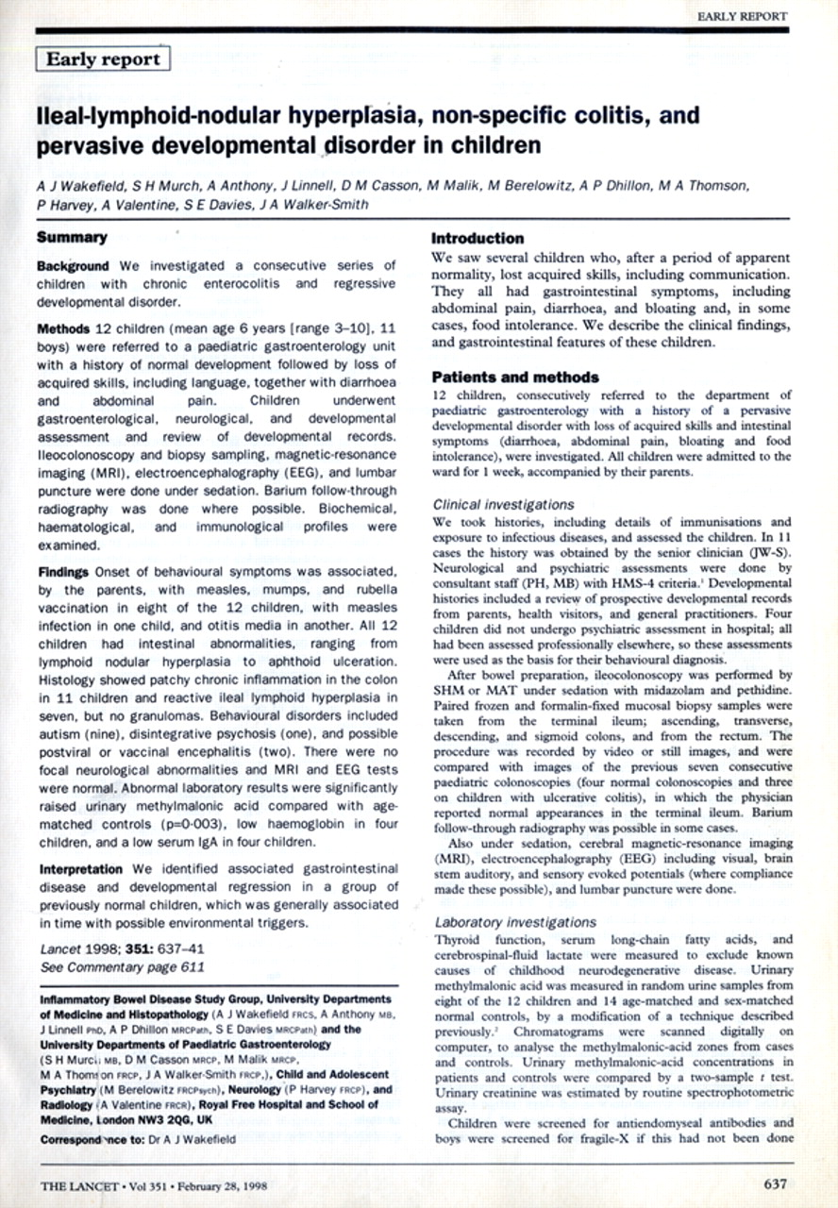
Feb. 1998
Why was this study in Denmark done in the first place?
Notes:
Why was this study in Denmark done in the first place? While the anti-vaccine movement has been around for as long as vaccines have been, the anti-vaccine movement reached a fever pitch with the article published by Wakefield and colleagues in 1998. This was a case series of kids, mainly with autism, who developed symptoms shortly after MMR vaccination and had intestinal findings suggestive of measles involvement.
This paper got an unusual amount of press attention and was really latched on to by the anti-vaccine groups.
It did spur on a lot of epidemiologic research, like this Madsen article, which failed to show an association.

Slide 36
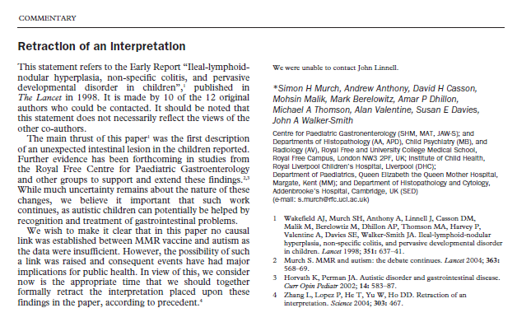
Partial Retraction – March 2004
Notes:
The world began to sense that something funny was going on when 10 out of the 12 authors offered what they called a “partial retraction”. While they did not deny the validity of the data, they did retract the nominal interpretation, which is that MMR vaccine was causally related to autism.

Slide 37
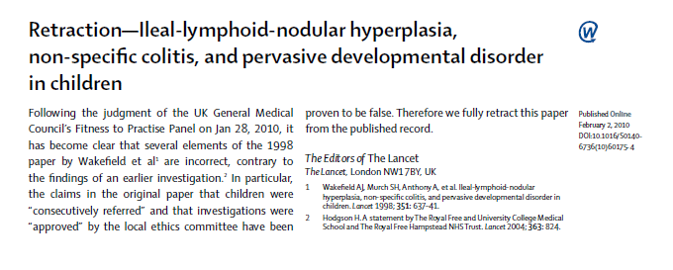
Full RetractionFeb. 2010
Notes:
The epidemiologic data continued to pile up against the hypothesis, and then an investigative reporter in London, Brian Deer, became involved who dug up many undisclosed financial conflicts for the first author, Wakefield. This led to a thorough review by the UK General Medical Council who found several procedural flaws with the original article.
This led, in Feb. 2010, to the full retraction of the article by the Lancet editors. In fact, if you try to find the article today on-line, you will see a big red “retracted” across it.

Slide 38

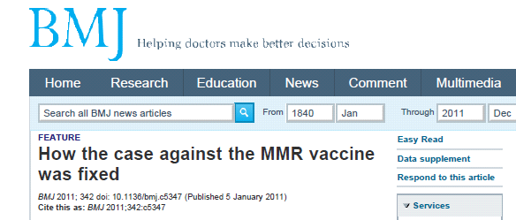
Jan. 2011
Fiona Godlee, editor of the BMJ:
  "The original paper has received so much media attention, with such potential to damage public health, that it is hard to find a parallel in the history of medical science. Many other medical frauds have been exposed but usually more quickly after publication and on less important health issues.”
Notes:
This all came to a head in January of 2011 when the BMJ published a series of 3 articles by the investigative reporter, Brian Deer, where they concluded the Wakefield’s work was indeed fraudulent, all motivated by, they claim, a desire to make money in lawsuits, by developing new a diagnostic test, and by developing an alternative vaccine.
The BMJ editor called this one of the most damaging frauds in the history of medical science.
Given this, we can be pretty sure that there is no association between MMR and autism. Hence, the Madsen paper inference is correct.

