Slide 1
Lectures
Assuming that you are in town and physically able to attend, which do you prefer?
Attending Live Lectures - A
Watching Recorded Lectures - B
Notes:
1

Slide 2
Alternative activities
If all lectures were only recorded and we eliminated live lectures, how interested would you instead be in attending weekly 90 minute open discussion (question-and-answer) sessions about the lecture topics?
Very interested - C
Not interested - A
Somewhat interested- B
Notes:
2

Slide 3
Prize Winners
Systematic Performance
  Highest % score on Problem Sets
    Robert Hayward
    Tu My To
Chance
  Pick name out of a hat
    Lindsay Hampson (who also had a very % !!)
Runners up: everyone else
Notes:
This year’s prize winners.
Sometimes it is just as good to be lucky as it is to be good and to show you that we respect the role of chance we also are awarding a prize on the basis of chance. We picked a name out of hat and drew Lindsay who also happened to have a very high % on her problem sets.

Slide 4
Notes:
In the Optional Reading for this week, we have included recently published guidelines for reporting observational research. Who has heard of the CONSORT statement for reporting randomized trials.
Interestingly, it is not the trials who really need these guidelines. The beauty of the randomized study design is typically very robust to making mistakes.

Slide 5
Instead, where more help is needed is in the wild west of observational studies.
Notes:
Instead, where more help is needed is in the wild wild west of observational studies.

Slide 6
Optional Reading for this week
Notes:
To tame the massive heterogeneity that is currently the case in observational research, the new STROBE guidelines for reporting observational studies were published a few years ago. These are slowly catching on and will likely become the standard within the next 5 to 10 years.

Slide 7
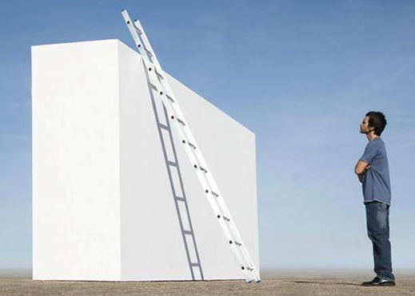




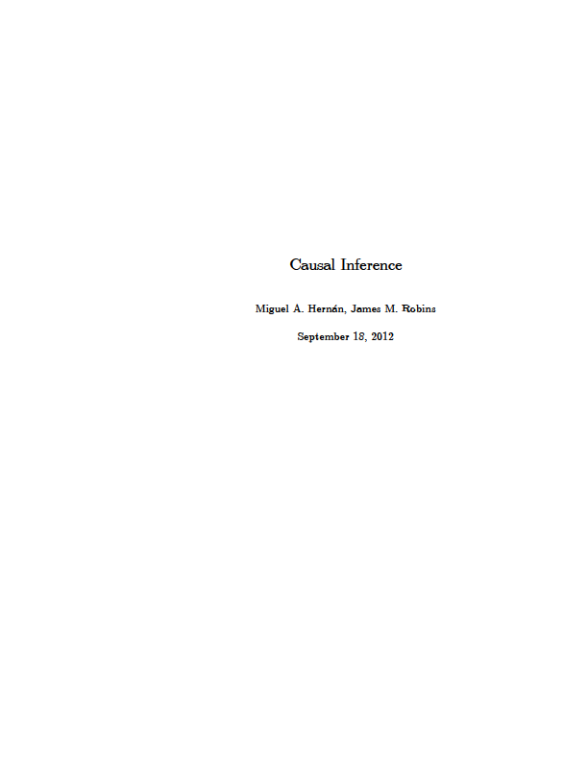
Where We Stand on the Ladder of Methodologic Sophistication
Causal Inference
Hernan & Robins
End of EPI 203
Beginning of EPI 203
Notes:
Finally, we want to leave you with where we think you stand in your methodologic knowledge. This is what I call the ladder of methodological sophistication. It begins with introductory textbooks like the one by Gordis. It then goes to intermediate level, and as a reminder, we do view this course as an intermediate level course in epidemiologic methods. Our primary text, by Szklo and Nieto, is indeed pitched as such and distinguishes itself from other introductory texts, like that by Gordis, the prototype. As an intermediate level course, we had a lot to cover and everyone should feel a great sense of accomplishment for getting this far. I did want to mention to everyone, however, that there is a world beyond our text in the form of some advanced specialized material. Our discussion of DAG’s, for example began to take us a bit into this world. You can see what the world is like in the Rothman, Greenland, and Lash text (the blue text) as well as the to be released in 2014 text on causal inference by the Harvard faculty. Finally, because there is always something at the top of the ladder, there a very sophisticated text on causality by Judea Pearl.

Slide 8
Epidemiologic Methods II
Winter Quarter
Course Director: Lydia Zablotska
Notes:
For those of you who want more formal instruction, we encourage you

Slide 9
Observational Research
Getting it right can be a challenge
Replete with uncertainty
  Unknown selection forces
  Unknown degree of misclassification
  Unmeasured confounders
  Unbeknownst colliders
We need the most skillful researchers performing observational research
Notes:
Now that the course is drawing to an end, we hope that we have convinced you that observational research is not simple. Getting it right can be a challenge. It is replete with uncertainty from unknown forces of differential selection, to unknown degree of misclassification, to unmeasured confounders, to unbeknownst colliders.
Given this degree of difficulty and degree of uncertainty, we hope that we have convinced you that we need the most skillful and most knowledgeable people to be doing observational research.

Slide 10
  1:30 to 3:00 pm: Last Section
    Web-based course evaluation
    Bring laptop
  Distribute Final Exam (on website)
    Due Dec. 10 in hands of Olivia by 4 pm by email (olivia@epi.ucsf.edu) or China Basin 5700
    Please work independently
Notes:
Here is the rest of the day’s schedule.

