Slide 1
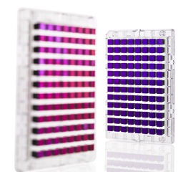

Genome-wide association studies (GWAS) – still continued!

Slide 2
Outline for GWAS
Following up on hits
eQTLs & Transcriptome-wide association studies (TWAS)
Limitations, heritability, and “missing heritability”, Genetic risk scores
Enriching weak signals?: Gene/pathways/polygenic models

Slide 3

What after we’ve discovered (and replicated) a novel variant?
Recall that we may not have the true causal locus
Fine mapping vs. imputed genotypes
  UKB paper you read on # of variants to follow-up on…
Tie-in to biology
A lot of work has been done to characterize SNPs and prioritize what should be followed up on
Functional studies

Slide 4
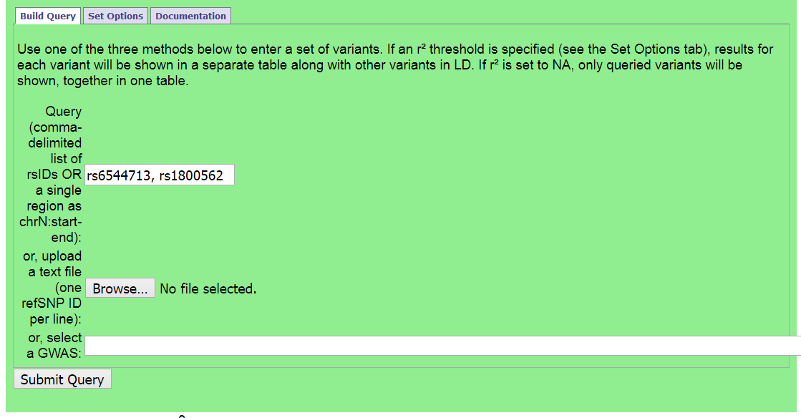
Refining GWAS SNPs: Haploreg
http://archive.broadinstitute.org/mammals/haploreg/haploreg.php

Slide 5
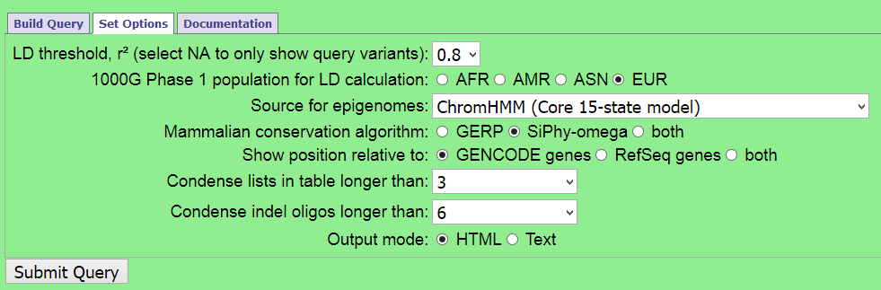
Haploreg further options
(r², 1000 Genomes population)

Slide 6
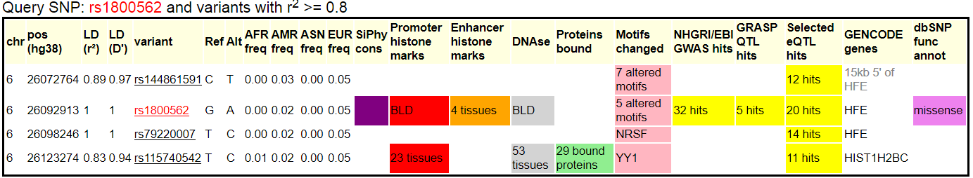
Which one is causal / biological mechanism?
(Talk about eQTLs later today)
Don’t know for certain, can do some exploration:
Likely will not know for certain, may prioritize for functional work

Slide 7
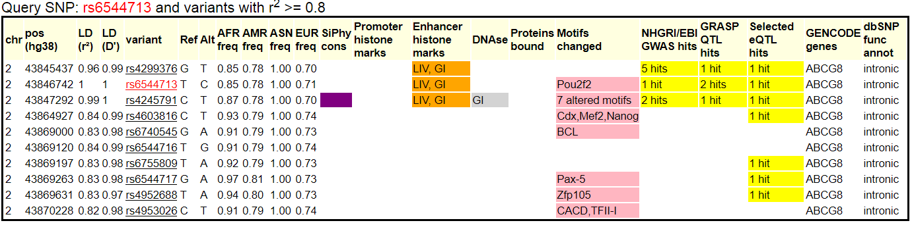
Which one is causal / biological mechanism?
?

Slide 8
Outline for GWAS
Following up on hits
eQTLs & Transcriptome-wide association studies (TWAS)
Limitations, heritability, and “missing heritability”, Genetic risk scores
Enriching weak signals?: Gene/pathways/polygenic models

Slide 9
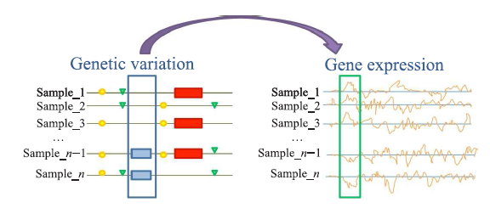
What is an eQTL?
Tian Lu et al., Tsinghua Science and Technology, 2014, 19(6): 624-634.

Slide 10
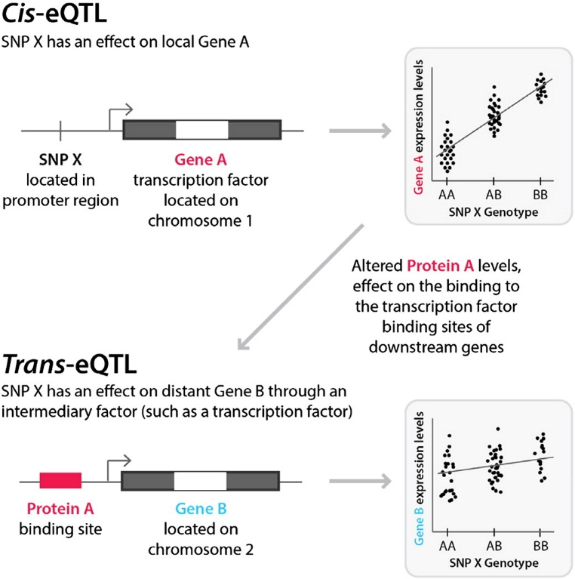
What is an eQTL?
Harm-Jan Westra & Lude Franke, Bichimica et Biophysica Acta – Molecular Basis of Disease 1842(10):1892-1902

Slide 11
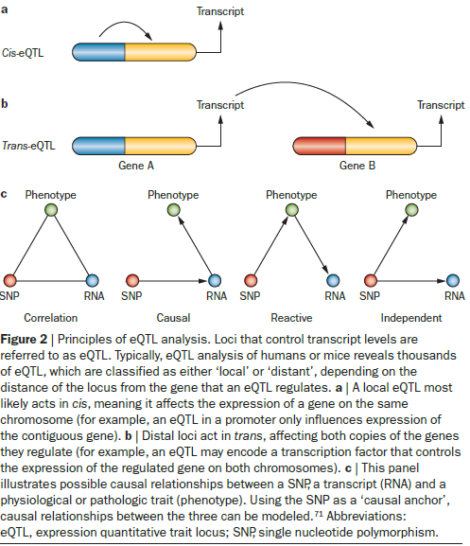
What is an eQTL?
E.g. of cis-eQTL – transcription factor
W. Robb MacLellan et al, Nature Reviews Cardiology, 9:172-184

Slide 12
What is an eQTL?
CLASS EXERCISE
Design an eQTL study!
(Assume that the expression of each gene has been quantified. Or sort of. This is expensive.)
Harm-Jan Westra & Lude Franke, Bichimica et Biophysica Acta – Molecular Basis of Disease 1842(10):1892-1902

Slide 13
What is an eQTL?
CLASS EXERCISE
Design an eQTL study!
(Assume that the expression of each gene has been quantified. Or sort of. This is expensive.)
What kind of genotyping method? LD?
Advantages / Disadvantages to testing only cis, only trans, both? How many tests?
How far up/downstream of each gene?
Harm-Jan Westra & Lude Franke, Bichimica et Biophysica Acta – Molecular Basis of Disease 1842(10):1892-1902

Slide 14
What is an eQTL?
The expression of a gene can be viewed as a quantitative trait.
Test the SNPs around the gene for association with the expression of the gene.
Does the SNP affect expression?
The same problem still applies, don’t know causal locus!
Might differentiate between which gene is being expressed, if between or amongst more than one.

Slide 15
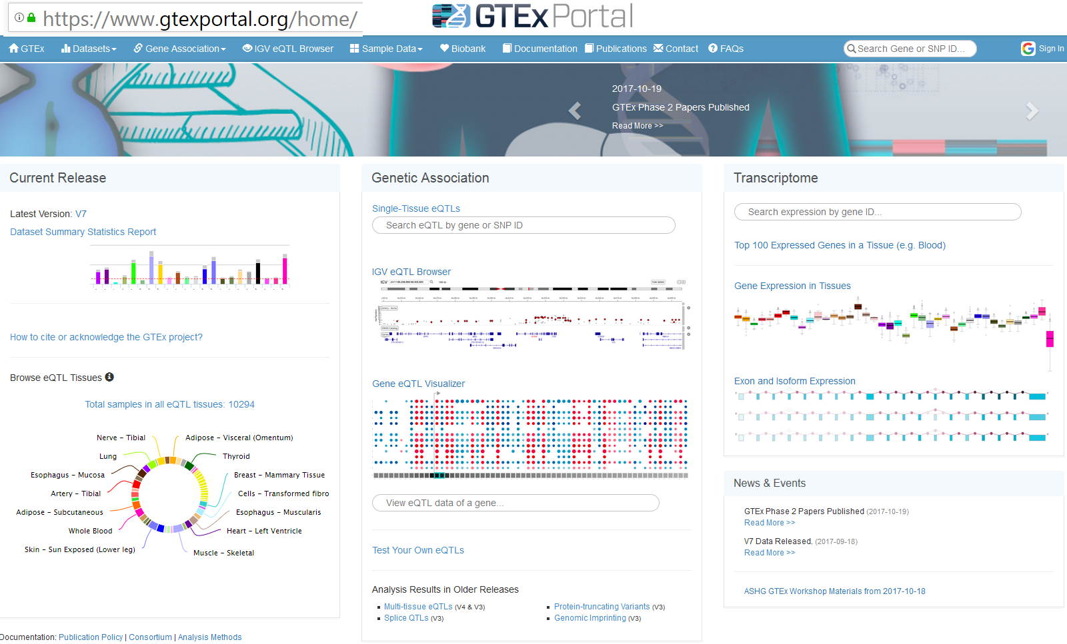
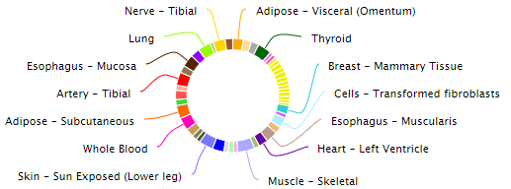
cis eQTLs: GTeX
Database of SNP associations with gene expression in humans

Slide 16
Transcriptome-Wide Association Studies (TWAS)
We have used reference panel sequence data to fill in missing genotypes.
We have talked about eQTLs, testing for correlation between SNPs and the genotype expression
  But what about predicting/imputing what the expression data was based on the genotypes?
    And then test that for correlation with the trait instead?
    Guided gene-based test, if you will

Slide 17
Class Exercise!: Express yourself (or at least someone else)!
SNP 1
SNP 2
SNP 3
SNP 4
SNP 5
Expression
Reference population
How is this similar/different to genotype imputation?
Person
Ref-001
Ref-002
Ref-003
Ref-004
Ref-005
AA AA TT TT TT 0.98
AA AA TC TG TG 0.90
GG GG TC TG TG 0.10
GG GG CC TT TG 0.12
GG GG CC TT GG 0.05
SNP 1
SNP 2
SNP 3
SNP 4
SNP 5
Expression
Target population
Person
Target-001
Target-002
AA AA TT TT TT ?
GG GC CC CC GG ?

Slide 18
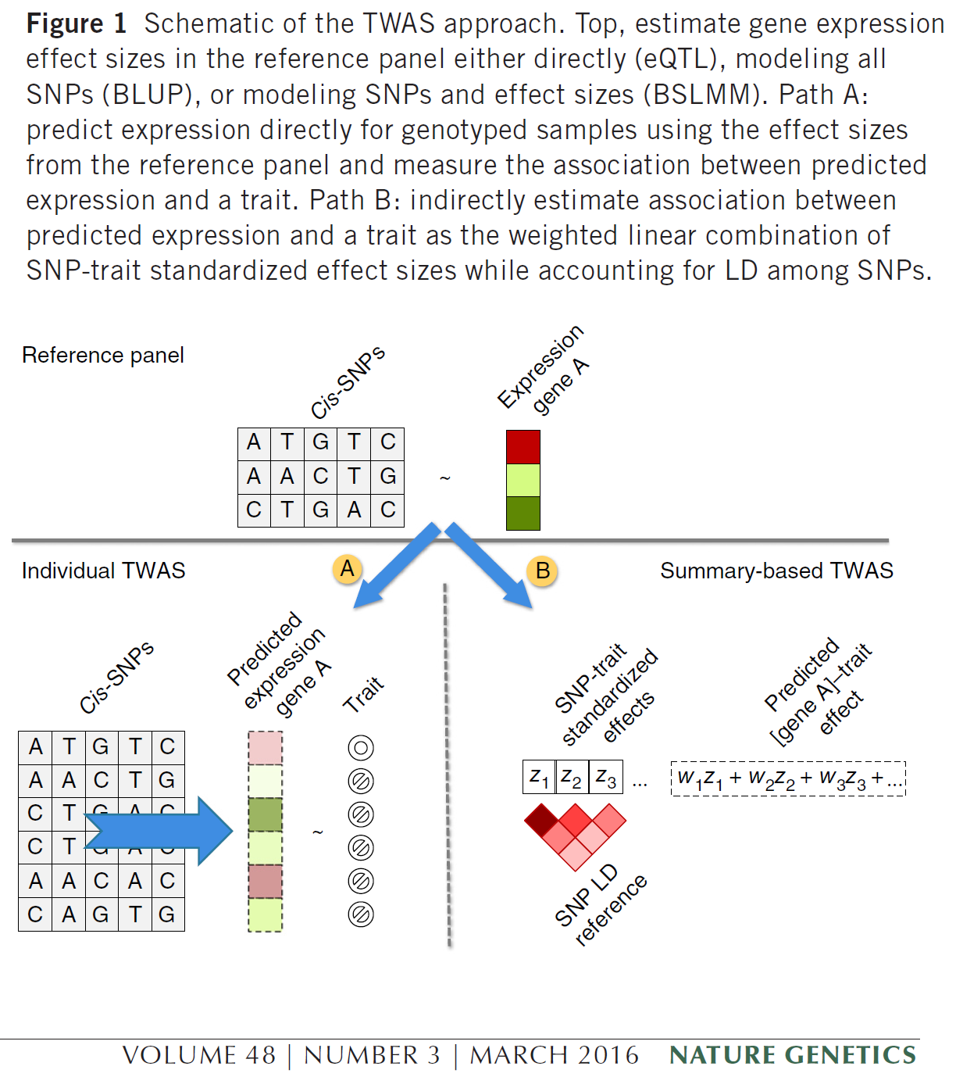
TWAS – cis expression
GTEx eQTL data
Model that predicts expression data using the GWAS SNPs (instead of testing for association between those SNPs and expression)
Test that expression for association with trait
Repeat for each of the 44 GTEx tissues
Software Predixcan

Slide 19
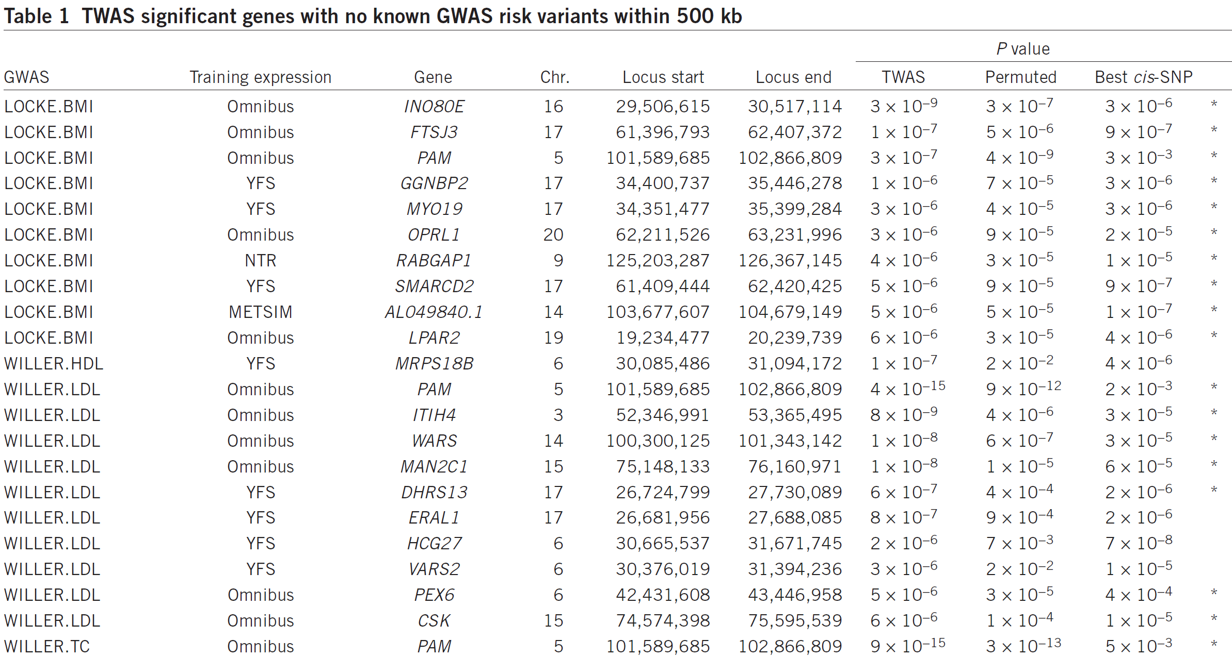
TWAS results

Slide 20
Outline for GWAS
Following up on hits
eQTLs & Transcriptome-wide association studies (TWAS)
Limitations, heritability, and “missing heritability”, Genetic risk scores
Enriching weak signals?: Gene/pathways/polygenic models

Slide 21
Limitations of GWAS
Not very predictive
Explain little heritability, generally, but improving
Focus on common variation, but getting rarer
Many associated variants are not causal

Slide 22
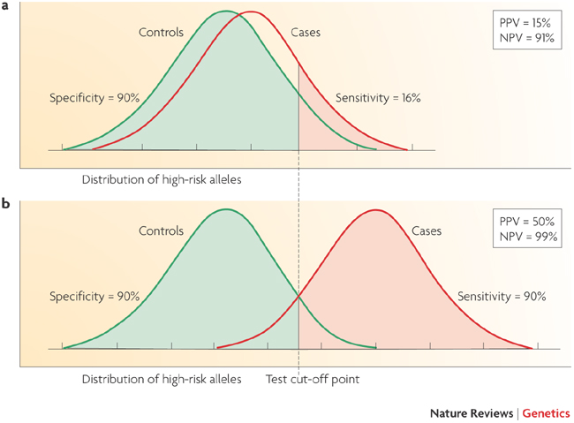
Limitations of GWAS
Example:
AUC for Breast Cancer Risk
58%: Gail model (# first degree relatives w bc, age menarche, age first live birth, number of previous biopsies) + age, study, entry year
58.9%: SNPs
61.8%: Combined
Wacholder et al., NEJM 2010
Not very predictive
Witte, Nat Rev Genet 2009
Notes:
22

Slide 23
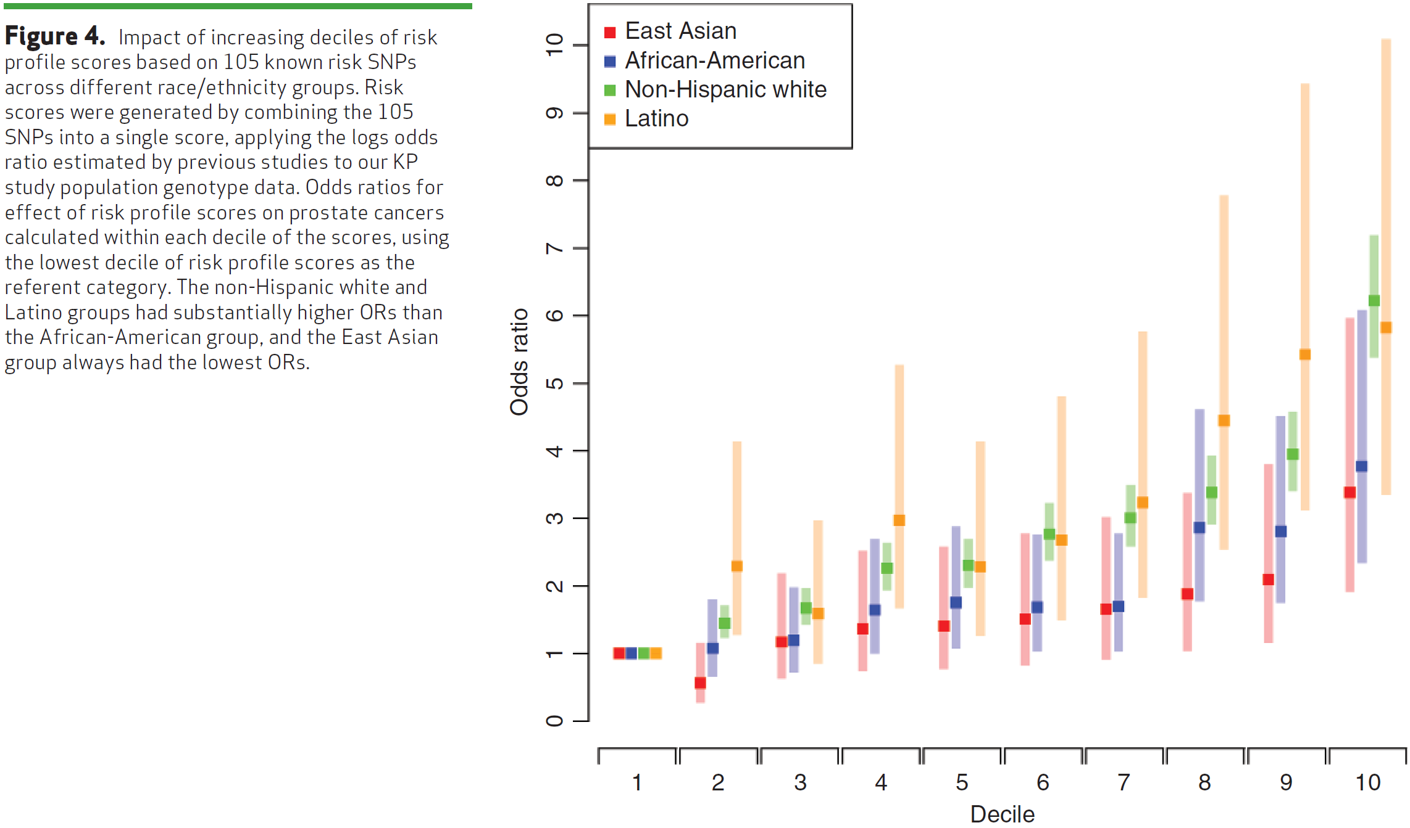
Genetic Risk Score (GRS) – Overall genetic risk; tails show more sep.?
i.e., β_{j}
GRS_{j}
Be careful of SNPs in LD… e.g., don’t want to include same SNP effectively twice if reported in two studies.
Hoffmann et. Al, Cancer Discovery 2015

Slide 24
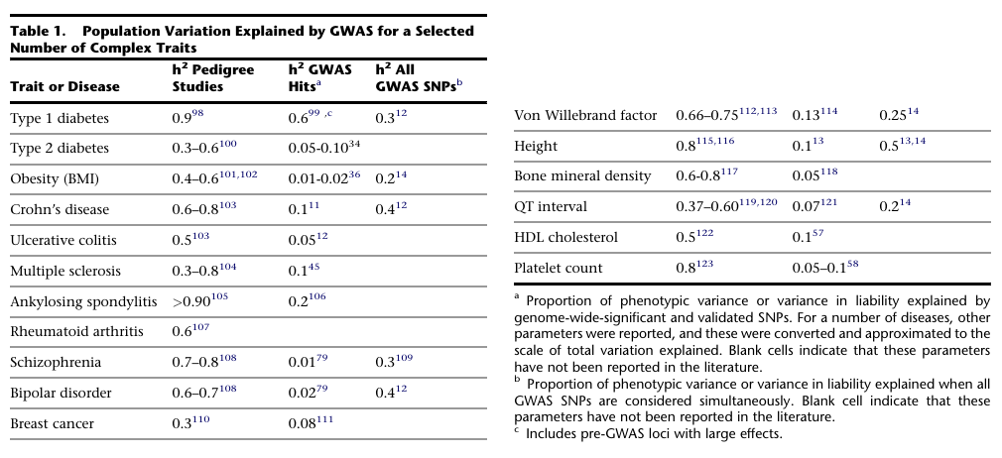
What does it mean to explain little of the heritability, and where is it?
Visccher, AJHG 2011

Slide 25
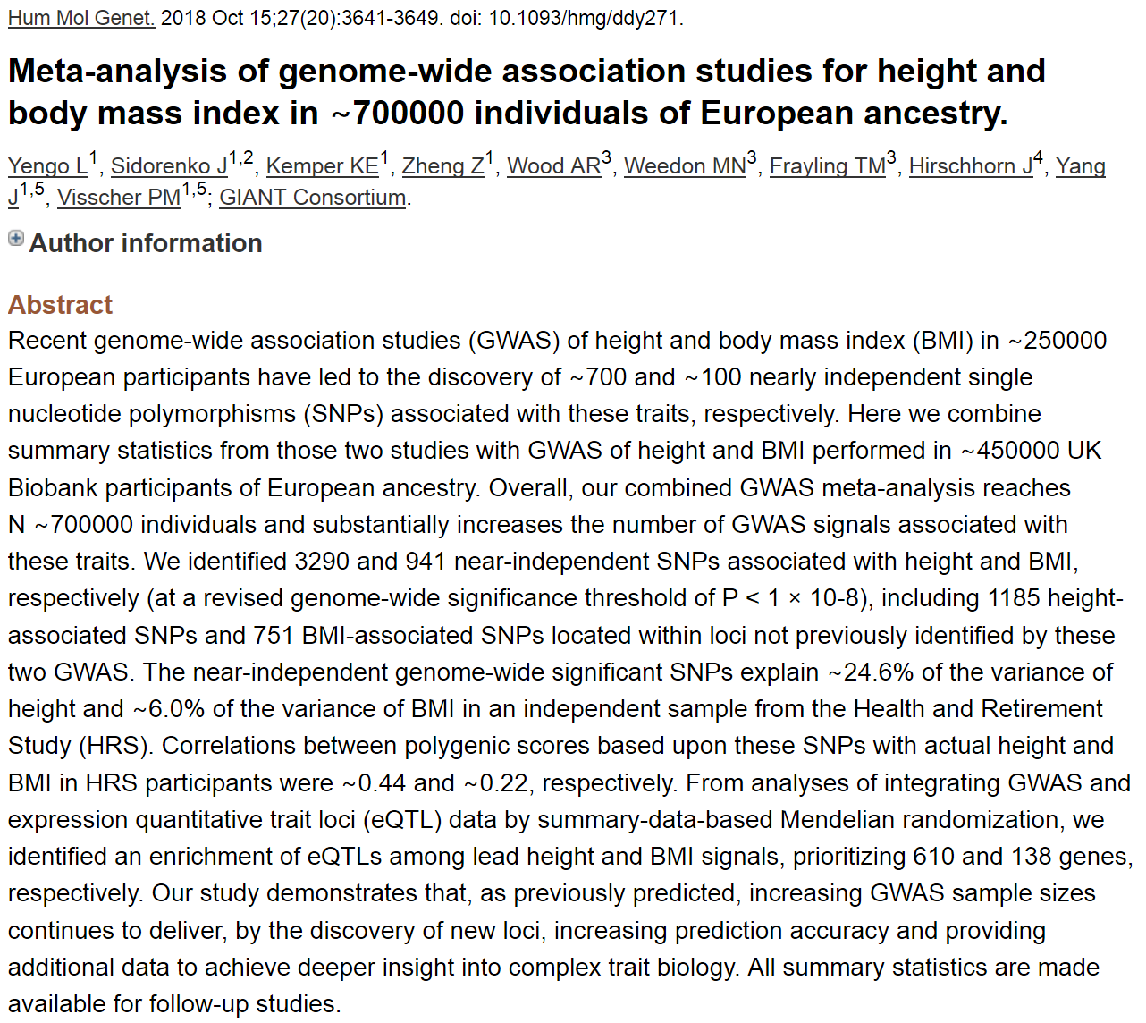
Revised height variance explained
(really not very predictive, or?)

Slide 26
Class exercise: Where is it?
Can GWAS find more?
Are our analysis methods not creative enough?
Are we missing genetic things?

Slide 27
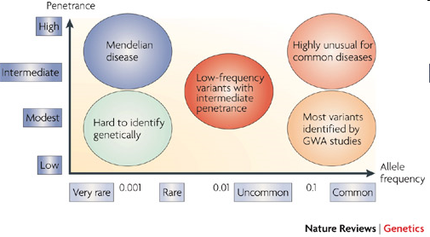
Where’s the heritability?
Common disease rare variant (CDRV) hypothesis: diseases due to
multiple rare variants with intermediate penetrances (allelic heterogeneity)
Many more
of these?
See: NEJM, April 30, 2009
McCarthy et al., 2008

Slide 28
Will GWAS results explain
more heritability?
Possibly, if…
Causal SNPs not yet detected due to power issues – weak effects
  Previous GWAS designed/powered for MAF>0.05/0.10; lower MAFs for newer arrays and larger reference panels
More complicated modeling necessary, e.g. gene-gene interaction (epistasis), gene-environment interaction, etc.
Notes:
28

Slide 29
How much is left to discover?
“Array” heritability
Compute heritability using all SNPs
  Be careful with QC, esp. case-control
If you adjust for the known hits, how much remains yet to be found?
Restricted to narrow sense heritability
E.g.,
Lecture 2:
“Broad sense”: H²=σ²_{G}/σ²_{P}=(σ²_{A} + σ²_{D})/σ²_{P}
“Narrow sense”: h² = σ²_{A} /σ²_{P}
GCTA: http://www.complextraitgenomics.com/software/gcta/
LD Score (can use summary statistics!): https://github.com/bulik/ldsc

Slide 30
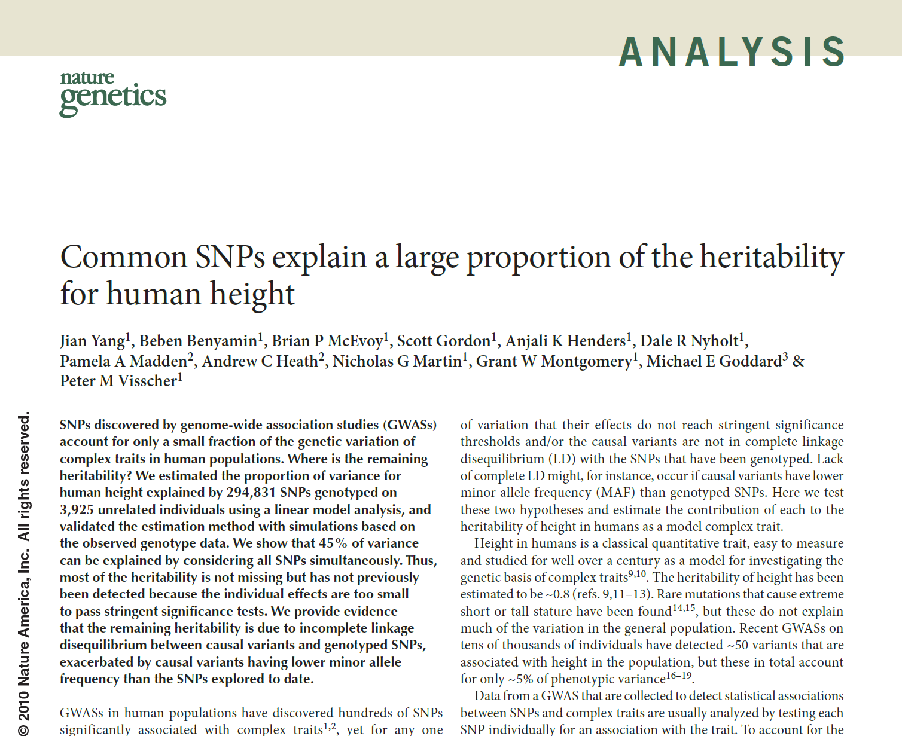

Slide 31
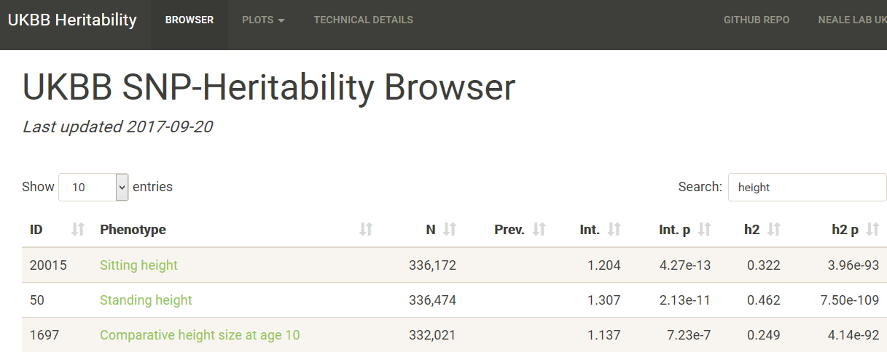
UK Biobank h² for height
https://nealelab.github.io/UKBB_ldsc/

Slide 32
But, what about more complicated modeling? Epistasis
Epistasis – snp x snp, or gene x gene interactions
Very difficult to do genome-wide
  Much less power to detect an interaction than a main effect in general
  Multiple testing burden: Correct for 10⁶ tests before? Now 10¹² tests!!!
Some argue not worth testing for an interaction unless a main effect…
Notes:
. The SNP in ABO is *not* blood type.

Slide 33
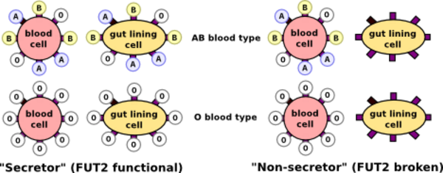
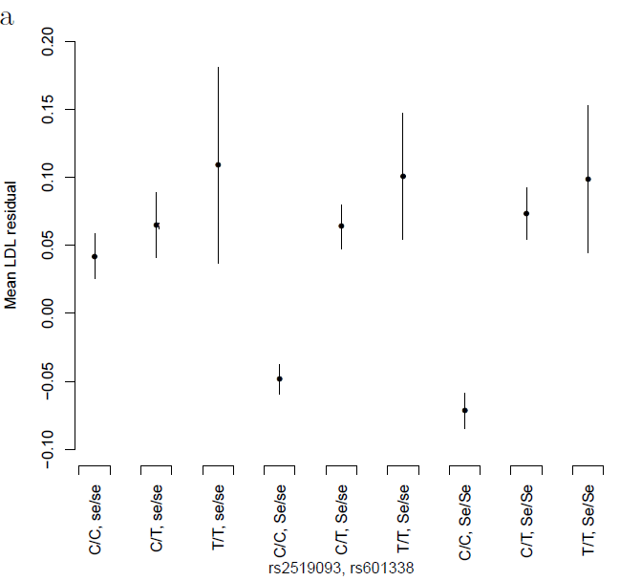
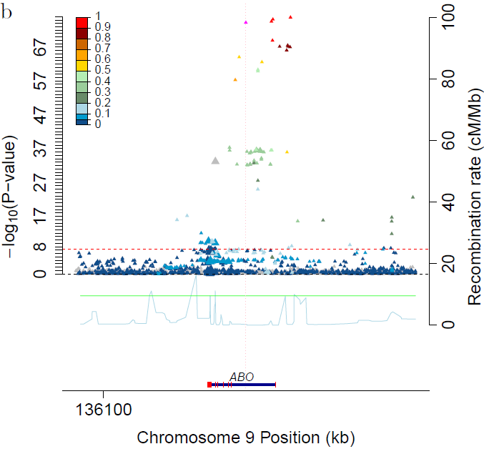
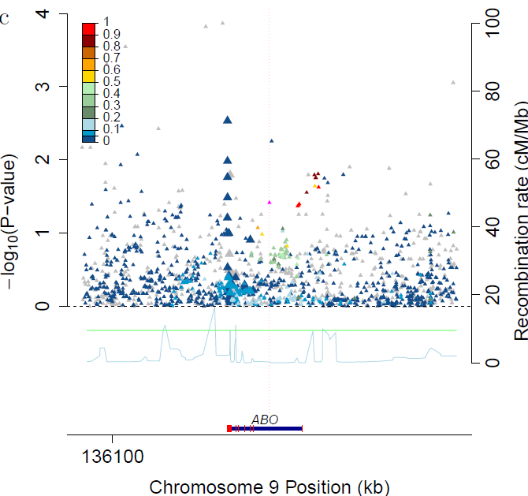
Epistasis in serum lipids
Serum lipids example
  Tested all pairs of known GWAS hit variants
  Rs2519093 (ABO) x rs492602 (FUT2): Interaction P_{LDL}=8.1x10⁻¹⁰
    Rs492602 has r²=0.992 with rs601338, a nonsense dominant variant determining FUT2 non-secretor status
http://genos.hr/en/laboratories/analytical-dna-laboratory-1/human-dna-analysis-1/secretor-status-dna-test-1/
Residual LDL by genotype ABO locus for secretors (Se/Se or Se/se) ABO locus plot for non-secretors
Notes:
. The SNP in ABO is *not* blood type.

Slide 34
Other things than SNPs
Copy number variants (CNVs)
Epigenetics, e.g., methylation, histone modification
Gene expression (RNA levels) [eQTLs! we covered these]
Proteomics (measures of proteins in cells)
...

Slide 35
Outline for GWAS
Following up on hits
eQTLs & Transcriptome-wide association studies (TWAS)
Limitations, heritability, and “missing heritability”, Genetic risk scores
Enriching weak signals?: Gene/pathways/polygenic models

Slide 36
Ways to enrich weak signals?:
Gene/pathway-based tests
Various ways of collapsing the genotype information in multiple genes
  Less multiple comparison adjustment
logit (Prob(y=1| x, c)) = α + βx + γc
e.g.=α+β₁x₁+…+β₁₂x₁₂+{PC’s, other covariates}
  y: disease status)
  x is a vector of genotypes (e.g., a gene, or a pathway)
  c is a vector of covariates
H₀: β=0
Rare variant “burden” tests are along these lines
  Make a lot of assumptions

Slide 37
Pathways - how to define?
Many websites / companies provide ‘dynamic’ graphic models of molecular and biochemical pathways.
Examples: GO (Gene Ontology), KEGG, BioCarta, Reactome
May be interested in potential joint and/or interaction effects of multiple genes in one pathway.

Slide 38
Other Extreme: Polygenic Models
Many weak associations combine to risk?
Score model (use all GWAS SNPs):
where
  ln(ORi ) = ‘score’ for SNPi from ‘discovery’ sample
  SNPij = # of alleles (0,1,2) for SNPi, person j in ‘validation’ sample.
  Large number of SNPs (m)
xj associated with disease?
ASIDE: Genetic risk score same idea, but only on known hits
ISC / Purcell et al. Nature 2009

Slide 39
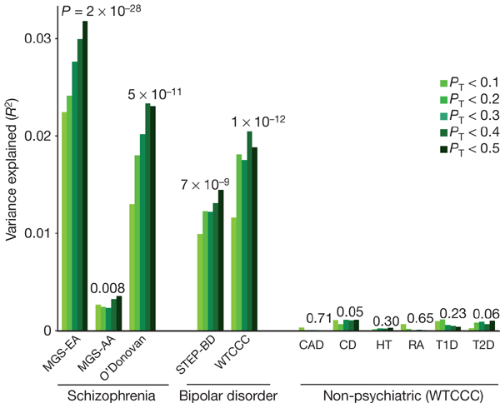
Application of Model
Purcell / ISC et al. Nature 2009

Slide 40
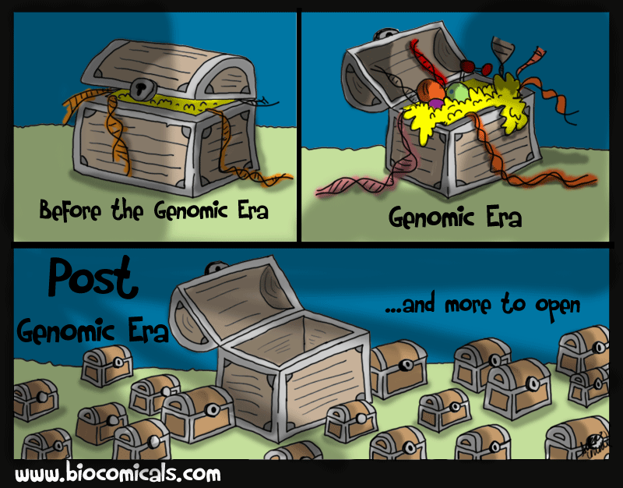
Thanks!

