Slide 1
UCSF Epi Tools Workshop
Quantitative Bias Analysis
Elizabeth Rose Mayeda, PhD, MPH
UCSF Epi Tools Workshop
Quantitative Bias Analysis
February 14, 2019
ermayeda@ph.ucla.edu
@er_mayeda

Slide 2
Outline
Part 1: Introduction to quantitative bias analysis (QBA) (1:10-3pm)
Motivation and key concepts
What is quantitative bias analysis?
Deterministic bias analysis:
  Selection bias
  Unmeasured confounders
  Misclassification
Multidimensional bias analysis
Probabilistic bias analysis

Slide 3
Outline
Part 2: Monte Carlo simulations for quantifying confounding bias and collider-stratification bias (3:15-4:30pm)
  Why simulate?
  Simulation steps
  Simulation exercise: confounding bias
  Simulation exercise: collider-stratification bias
  Briefly: extension to simulating information bias

Slide 4
Part 1: Introduction to Quantitative Bias analysis
Elizabeth Rose Mayeda, PhD, MPH
UCSF Epi Tools Workshop
Quantitative Bias Analysis
February 14, 2019
ermayeda@ph.ucla.edu
@er_mayeda

Slide 5
Acknowledgements
Hailey Banack, University of Buffalo
Maria Glymour, UCSF
June Chan, UCSF
Francois Rerolle, UCSF

Slide 6
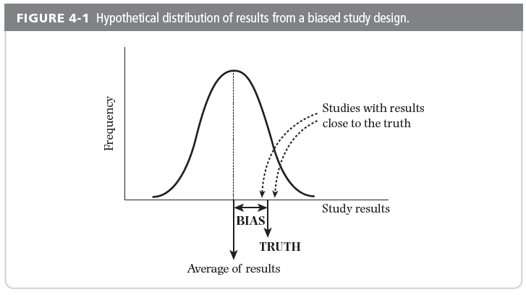
Key Terms: what is bias?
“Systematic deviation of results or inferences from the truth”
Porta, 2008; Szklo & Nieto,2012

Slide 7
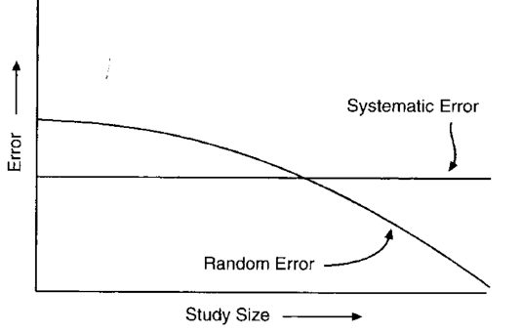
Key Terms: random error vs. systematic error
Random error = lack of precision
  Decreases as sample size increases
Systematic error = bias/lack of validity
  Present regardless of sample size, even in an infinitely large study
Validity and precision are both
components of accuracy
Notes:
Systematic error is present regardless of study size, even in an infinitely large study
Random error decreases as study size increases

Slide 8
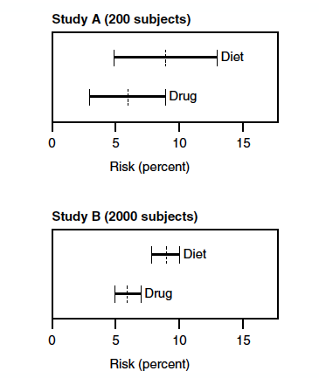
Random error
Two hypothetical RCTs
  Cholesterol-lowering drug vs. dietary intervention
In both studies, risk of myocardial infarction (MI) was 9% for the diet group and 6% for the drug group
Study A: “No difference between treatments”
Study B: “Drug is more effective for reducing risk of MI”

Slide 9
Error
Random Error
Systematic error
Confounding
Selection bias
Information bias
Precision
Relative lack of random error
Internal Validity
Relative absence of systematic error

Slide 10
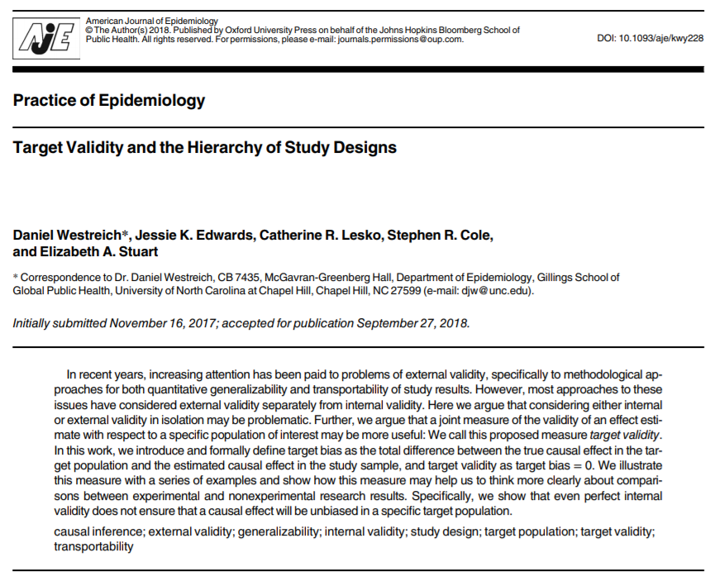
https://www.ncbi.nlm.nih.gov/pubmed/30299451

Slide 11
Internal validity, external validity, and target validity
Internal validity: a result is internally valid when the effect estimated in the study sample is unbiased for the true effect in that sample
External validity: a result is externally valid if the true effect in the study sample is unbiased for the true effect in the target population
Target bias = [true causal effect in the target population] – [estimated causal effect in the study sample]
  Target validity is defined as target bias = 0
The focus of today’s lecture is on internal validity (and QBA for internal validity
Westreich, AJE 2018

Slide 12
Threats to internal validity
Confounding:
  Unmeasured confounder (or mismeasured confounder)
  Unknown confounder
Selection Bias (collider-stratification bias):
  Baseline
  Losses to follow-up
Information Bias:
  Misclassification of categorical variables, measurement error of continuous variables
  Differential vs. non-differential

Slide 13
Confounding
Confounding: Estimate of effect of exposure on outcome is ‘mixed with’ the effect of uncontrolled/unmeasured covariate on outcome
  Unmeasured confounder (or mismeasured confounder)
  Unknown confounder
Confounding bias: Bias arising from the existence of a common cause of exposure and outcome
⇨Lack of exchangeability of treated and untreated
U
?
A
Y
Notes:
In a causal framework, we think of confounding as bias arising from the existence of a common cases of exposure and outcome.

Slide 14
Selection bias
Estimate of association is different in study population than in the source/target population
Can refer to threat to internal validity or external validity

Slide 15
Structure of collider-stratification bias
Bias arising from conditioning on a common effect (collider) of exposure (or cause of exposure) and outcome (or cause of outcome)
Conditioning on a common effect of exposure and outcome results in two sources of association between exposure and outcome:
  Causal effect of A on Y: A→Y
  Spurious association between A and Y
  induced by conditioning on collider C: A→C ← Y
⇨Lack of exchangeability of treated and untreated
C
?
A
Y

Slide 16
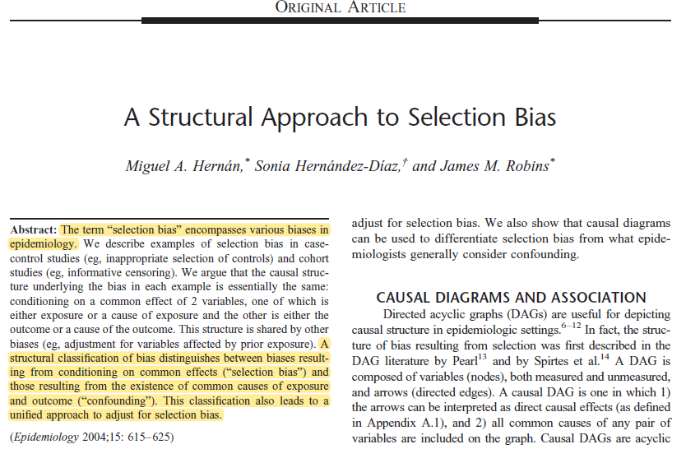
https://www.ncbi.nlm.nih.gov/pubmed/15308962

Slide 17
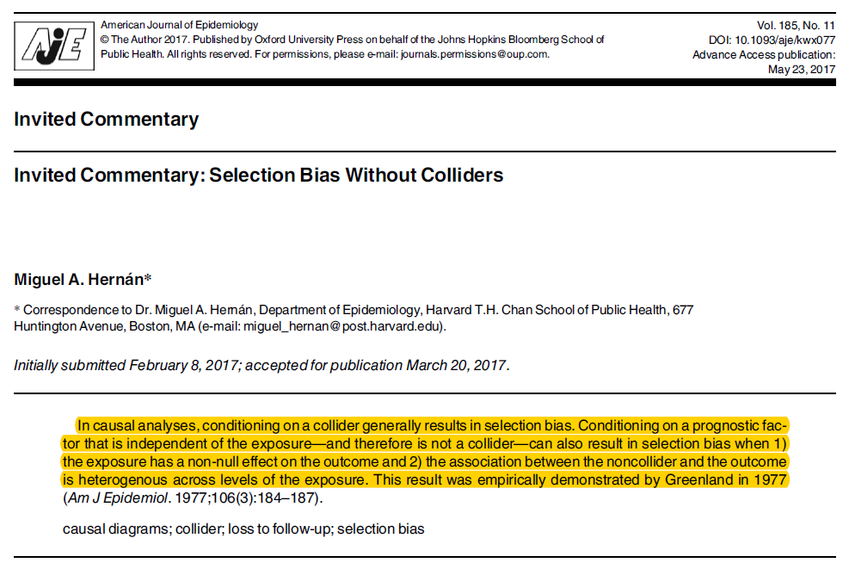
https://www.ncbi.nlm.nih.gov/pubmed/28535177

Slide 18
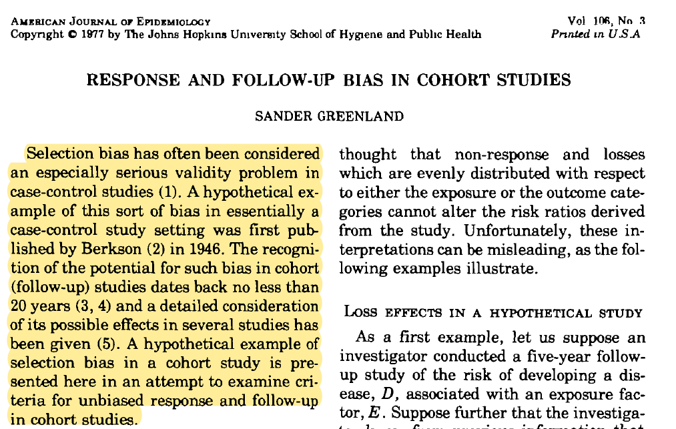
https://www.ncbi.nlm.nih.gov/pubmed/900117

Slide 19
DAGs for selection bias
Example: A = treatment, Y = health outcome, S=1 = selection into the study sample, and Z = sociodemographic and health factors
Exposure and determinants of outcome influence selection (collider-stratification bias): threat to internal validity
Determinants of the health outcome, but not the exposure, influence selection: threat to external validity
Z
Z
S=1
S=1
A
Y
A
Y

Slide 20
Information Bias
The estimate of association is distorted by inaccurate measurement or classification of the exposure, outcome, or a covariate
Misclassification of categorical variables (exposure, outcome, covariate)
Measurement error (continuous variables)

Slide 21
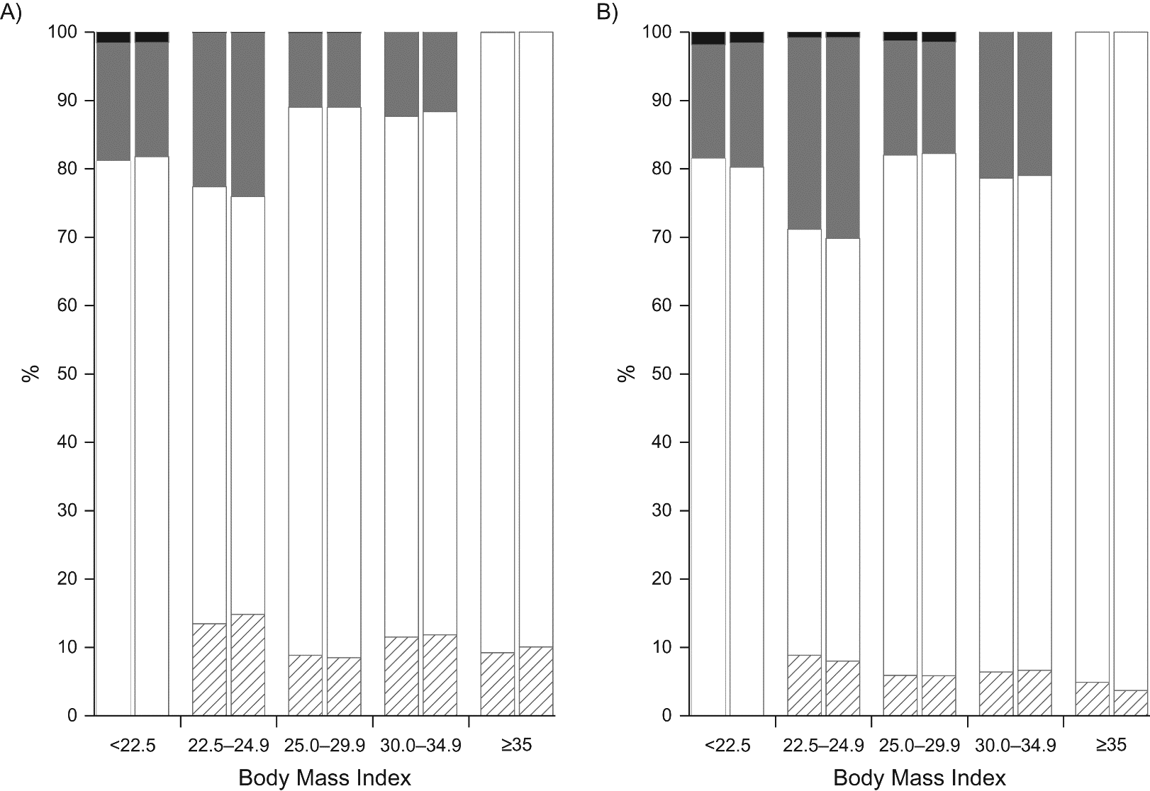
Percentage of sample within categories of self-reported BMI that were classified into the same, higher, or lower categories of measured BMI (NHANES)
White: BMI category_{measured} = BMI category_{self-reported}
Striped: BMI category_{measured} < BMI category_{self-reported}
Gray: BMI category_{measured} 1 category higher than BMI category_{self-reported}
Black: BMI category_{measured} was 2 categories higher than BMI category_{self-reported}
Men
Women
(self-report)
(self-report)
Flegal, Am J Epi, 2017
Notes:
Percentage of sample within categories of self-reported body mass index (BMI) that were classified into the same, higher, or lower categories of measured BMI, National Health and Nutrition Examination Survey (NHANES) II (1976–1980), NHANES III (1988–1994), and Continuous NHANES (1999–2010), United States. A) Men. B) Women. Measured BMI was calculated from measured height and weight. Self-reported BMI was calculated from self-reported weight and height. The x-axis BMI categories are according to self-report. Within BMI categories, the first bar is for the full sample, and the second bar for the restricted sample. White: measured BMI category was the same as self-reported BMI category; striped: measured BMI category was lower than self-reported BMI category; gray: measured BMI category was 1 category higher than self-reported BMI category; black: measured BMI category was 2 categories higher than self-reported BMI category.

Slide 22
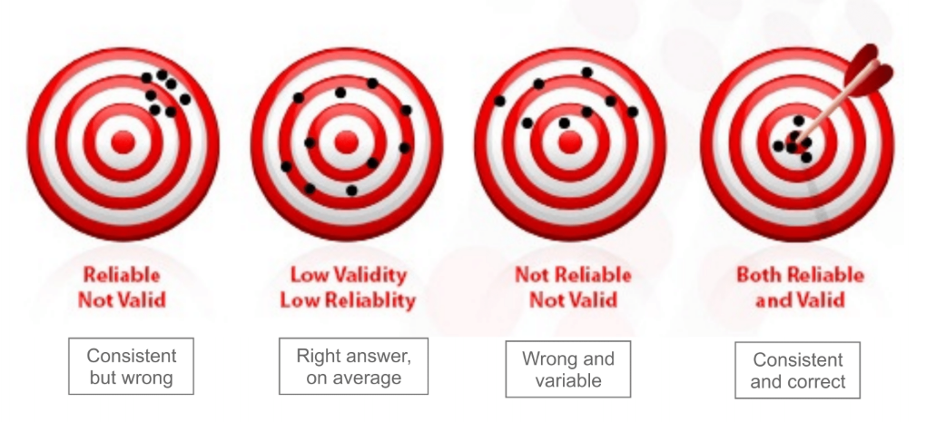
Reliability vs. Validity
Reliable
Not Valid
Valid
Low Reliability
Not Reliable
Not Valid
Both Reliable
and Valid

Slide 23
Limitations of meta-analysis
If there is a systematic bias affecting study results, a meta analysis will not solve this problem
More precise, but still biased effect estimate
Stovitz, Banack & Kaufman, 2018

Slide 24
Why QBA?
As epidemiologists, we all try to design quality studies and reduce the amount of systematic error affecting an effect estimate
Problem: It’s not always possible!
Incumbent upon investigators to quantify how far an estimate is from the “truth” (an estimate that is free of bias)

Slide 25
When QBA?
When the effect estimate is reasonably precise
  Narrow 95% CI reflects a small amount of random error
  With a wider CI, it is already difficult to make inferences because of the amount of random error, regardless of whether you try to account for systematic error
When you believe the effect estimate is affected by a limited number of systematic errors
  With multiple systematic errors, total error may be too large to reliably quantify
  QBA may not be productive; perhaps data should be used for generating ideas for future studies
When you have a way of realistically estimating bias parameters
  Required to complete QBA
  Could come from internal or external validation data or literature review

Slide 26
Bias parameters
In QBA, equations are used to adjust an effect estimate to see the impact of potential bias
The parameters in these equations are called ‘bias parameters’
Used to determine the direction and magnitude of bias adjustment
Confounding bias
  Hypothesized strength of relationship between unmeasured confounder and exposure and unmeasured confounder and outcome
Selection bias (collider-stratification bias)
  Sampling fractions: proportion of all eligible subjects who participate in your study
Misclassification
  Sensitivity and specificity of exposure/outcome/confounder classification

Slide 27
Confounding

Slide 28
Identifying confounding
Confounding refers to a theoretical concept
  Risk of disease in the reference population equals the risk the index population would have had, if they had not been exposed
  Reference group intended to be a substitute for index group in every way (“exchangeable” groups)
  When they are not exchangeable, there is confounding present
Methods for accounting for confounding
  Stratification, Mantel-Haenszel (MH) adjustments, regression modeling

Slide 29
Crude vs. adjusted estimates
In practice, confounding typically identified when crude estimate of association does not equal the adjusted estimate (‘change in estimate’)
Some problems:
Only can adjust for variables you have collected information on
  Can not adjust for:
    Unknown confounding (variables you can’t identify, theoretical concepts)
    Unmeasured confounding (variables you did not measure)
    Residual confounding (variables measured poorly or by proxy)

Slide 30
Bias analysis for unmeasured confounding
Requires:
  Crude estimate of the exposure-outcome association
  Association between confounder and disease
  Association between confounder and exposure (or exposure specific prevalence of confounder)
Assumption: Unmeasured confounder is independent of measured confounders
Result: Overestimate magnitude of bias
Confounder
3
2
Exposure
Disease
1

Slide 31

Question of interest
What estimate of association between EXPOSURE and DISEASE would have been observed in the study had the authors collected data on CONFOUNDER and adjusted for it in the analysis?
Prevalence of confounder among unexposed (E=0)
Observed RR without adjustment for confounder
Confounder-disease RR
Prevalence of confounder among exposed(E=1)

Slide 32
Example: HDL cholesterol, exercise & CVD risk
What estimate of association between HDL and CVD would have been observed in the study had the authors collected data on EXERCISE and adjusted for it in the analysis?
Exercise
HDL
CVD

Slide 33
Crude association HDL CVD
| |
| Exposed Unexposed | Total
-----------------+------------------------+------------
Cases | 515 4357 | 4872
Noncases | 1894 10222 | 12116
-----------------+------------------------+------------
Total | 2409 14579 | 16988
| |
Risk | .2137817 .2988545 | .2867907
| |
| Point estimate | [95% Conf. Interval]
|------------------------+------------------------
Risk difference | -.0850729 | -.1030516 -.0670941
Risk ratio | .7153369 | .659999 .7753145
Prev. frac. ex. | .2846631 | .2246855 .340001
Prev. frac. pop | .0403669 |
+-------------------------------------------------
chi2(1) = 73.15 Pr>chi2 = 0.0000

Slide 34
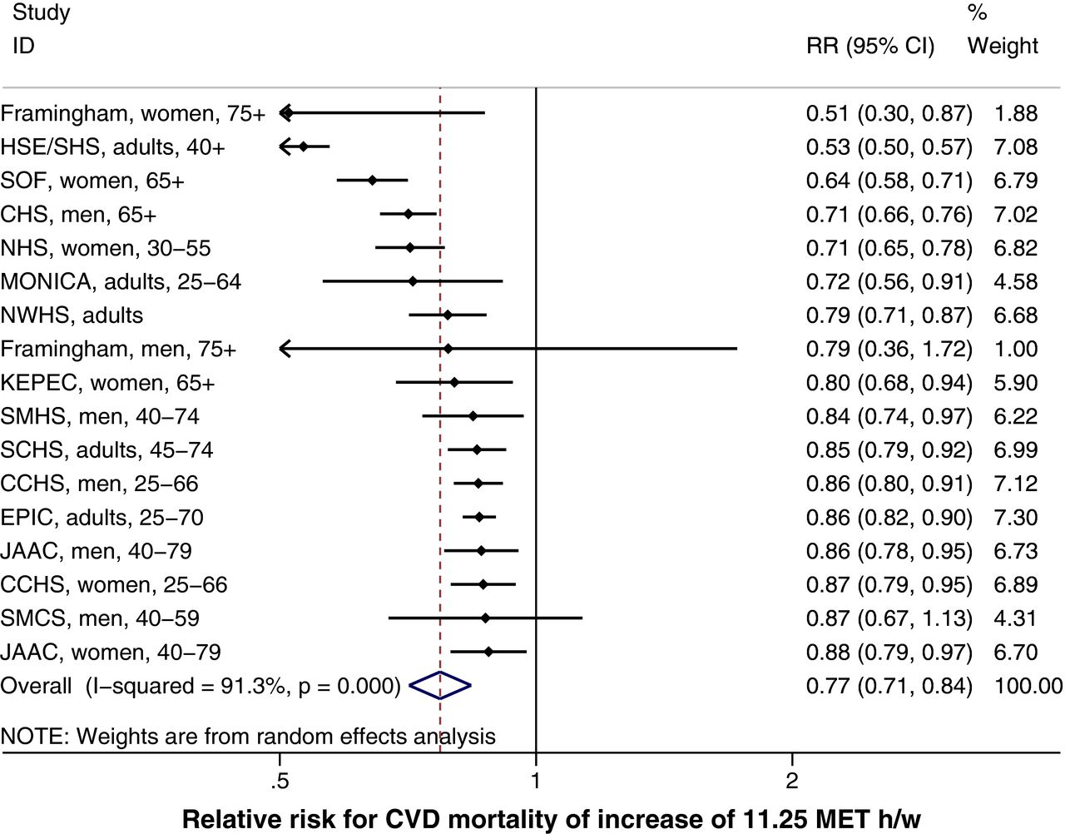
Exercise CVD
?
Notes:
http://jaha.ahajournals.org/content/5/9/e002495

Slide 35
Bias parameters
Bias Parameter | Description | Value Assigned
RR_{CD} | Association between exercise and CVD | 0.77
p₁ | Prevalence of exercisers among high HDL | 0.80
p₀ | Prevalence of exercisers among low HDL | 0.05

Slide 36
Observed Data
| |
| Exposed Unexposed | Total
-----------------+------------------------+------------
Cases | 515 4357 | 4872
Noncases | 1894 10222 | 12116
-----------------+------------------------+------------
Total | 2409 14579 | 16988

Slide 37
Deterministic bias analysis
|
| Exposed Unexposed
-----------------+-------------------
Cases | 515 4357 |
Noncases | 1894 10222 |
-----------------+--------------------
Total | 2409 14579 |
1927.2
728.9
481.8
13850.1
1. Solve for M₁ and N₁ using prevalence of confounder in exposed and unexposed:
M₁= m*p1 = 2409 * 0.80 = 1927.2
N₁= n*p0 = 14579 * 0.05 = 728.9
2. Solve for M₀ and N₀ by subtraction:
M₀= m – M1 = 2409 - 1927.2 = 481.8
N₀= n – N1 = 14579 - 728.9 = 13850.1

Slide 38




Deterministic bias analysis
|
| Exposed Unexposed
-----------------+-------------------
Cases | 515 4357 |
Noncases | 1894 10222 |
-----------------+--------------------
Total | 2409 14579 |
1927.2
728.9
481.8
13850.1
3. Use estimated relationship between exercise and CVD (RR_{CD}=0.77) to fill in the remaining cells:
$$= \frac{0.77 ∗1927.2 ∗515 }{0.77∗1927.2+2409 −1927.2}$$
= 388.8
$$= \frac{0.77 ∗728.9 ∗4357 }{0.77∗728.9+14579 −728.9}$$
= 169.7

Slide 39
Deterministic bias analysis
4. Fill in remaining cells of the table and calculate effect estimate:
 | Total |  | C1 |  | C0
 | E1 | E0 | E1 | E0 | E1 | E0
D+ | 515 | 4357 | 388.8 | 169.7 | 126.2 | 4187.3
D- | 1894 | 10222 | 1538.4 | 559.3 | 355.6 | 9662.7
 | 2409 | 14579 | 1927.2 | 729.9 | 481.8 | 13850.1
Estimated MH RR = 0.87

Slide 40
Excel option
Tim Lash et al., have spreadsheets to correct for bias available online as an adjunct to their bias analysis textbook:
https://sites.google.com/site/biasanalysis/

Slide 41
-episens- or -episensi-
To use -episens- for analysis of unmeasured confounding, need estimates of the bias parameters as previously described:
dpexp: define the prevalence of the confounder among E+
dpunexp: define the prevalence of the confounder among E-
drrcd: define the confounder-disease relative risk
dorce: define the confounder-exposure odds ratio
Orsini et al. The Stata Journal 2008

Slide 42
-episens- or -episensi-
episensi 515 4357 1894 10222, st(cs) dpexp(c.(0.8)) dpunexp(c.(0.05)) drrcd(c(0.77))
Pr(c=1|e=1): Constant(.8)
Pr(c=1|e=0): Constant(.05)
RR_cd : Constant(.77)
Observed Risk Ratio [95% Conf. Interval]= 0.72 [0.66, 0.78]
Deterministic sensitivity analysis for unmeasured confounding
External adjusted Risk Ratio = 0.82
Percent bias = -13%

Slide 43
Selection bias (collider-stratification bias)

Slide 44

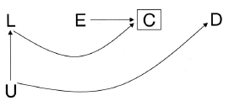

Structural approach to collider-stratification bias
Case Control Study Inappropriate control selection
Cohort Study Differential loss to follow-up
Cohort Study Adjustment for variables affected by previous exposure
E=coffee
D=pancreatic cancer, C=selection into study
F=ulcer patients
E=HAART, D=AIDS , U=immunosupression, C=censoring L= symptoms (fever, weight loss etc.)
E=obesity
L=CVD
U= genetic factors
D=mortality

Slide 45
Selection vs. selection bias
| final mortality
| status
hbp | Alive Deceased | Total
-------------+----------------------+----------
normotensive | 6,526 246 | 6,772
hypertensive | 2,656 531 | 3,187
-------------+----------------------+----------
Total | 9,182 777 | 9,959
OR=5.3
If we select 50% of cases and 20% of controls- no selection bias:
| final mortality
| status
hbp | Alive Deceased | Total
-------------+----------------------+----------
normotensive | 3,263 49 | 3,312
hypertensive | 1,328 106 | 1,434
-------------+----------------------+----------
Total | 4,591 155 | 4,746
OR=5.3

Slide 46
When does selection bias occur?
| final mortality
| status
hbp | Alive Deceased | Total
-------------+----------------------+----------
normotensive | 6,526 246 | 6,772
hypertensive | 2,656 531 | 3,187
-------------+----------------------+----------
Total | 9,182 777 | 9,959
OR=5.3
If we select 50% of unexposed cases, 80% of exposed cases, 20% of unexposed controls, and 10% of exposed controls:
| final mortality
| status
hbp | Alive Deceased | Total
-------------+----------------------+----------
normotensive | 3,263 49 | 3,312
hypertensive | 2,125 53 | 2,178
-------------+----------------------+----------
Total | 5,388 102 | 4,746
OR=1.6

Slide 47
Calculate the cross product
If we select 50% of cases and 20% of controls- no selection bias:
 | Cases | Controls
Exposed | 0.5 | 0.2
Unexposed | 0.5 | 0.2
(0.5*0.2) / (0.5*0.2) = 1.0
If we select 50% of unexposed cases, 80% of exposed cases, 20% of unexposed controls, and 10% of exposed controls:
 | Cases | Controls
Exposed | 0.8 | 0.1
Unexposed | 0.5 | 0.2
(0.8*0.2)/(0.5*0.1) = 0.31

Slide 48
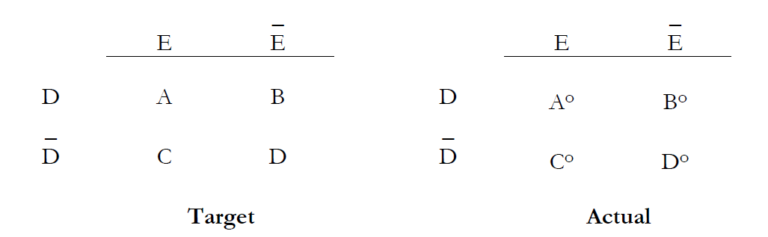
Sampling Fractions (selection probabilities)
Target
Selected Sample
α= A°/ A | β=B°/ B
γ=C°/ C | δ=D°/ D

Slide 49
Bias Analysis for Selection Bias
In the previous exercise with high blood pressure and mortality, we had the “master” 2x2 table and applied sampling fractions to get a biased table (and biased effect estimate)
In general, for bias analysis we need to work backwards, we have the biased table (and biased effect estimate), and need to get back to the master 2x2

Slide 50
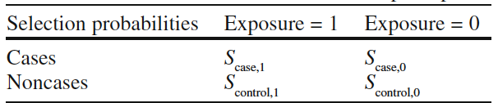
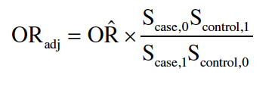
Bias analysis for selection bias
Need estimate of sampling fractions
Use sampling fractions to adjust the biased estimates

Slide 51
Example
From a study examining the relationship between obesity and mortality in HF patients:
You suspect there is collider stratification bias due to conditioning on a variable affected by exposure (HF) and sharing common causes with the outcome
Proportion
| Exposed Unexposed | Total Exposed
-----------------+------------------------+------------------------
Dead | 998 977 | 1975 0.5053
Alive | 2086 1606 | 3692 0.5650
-----------------+------------------------+------------------------
Total | 3084 2583 | 5667 0.5442
| |
| Point estimate | [95% Conf. Interval]
|------------------------+------------------------
Odds ratio | .7864429 | .7037068 .8789046

Slide 52
Where to get estimates of sampling fractions?
Need population representative data to estimate selection probabilities
Use data from the 1999-2000 and 2001-2002 US National Health and Nutrition Examination Survey (NHANES)
 | 25.5-29.9 | 18.5-24.9
Dead | 258 | 256
Alive | 3270 | 3096
Total NHANES cohort
α= A°/ A | β=B°/ B
γ=C°/ C | δ=D°/ D
 | 25.5-29.9 | 18.5-24.9
Dead | 34 | 29
Alive | 68 | 23
NHANES HF=1
 | 25.5-29.9 | 18.5-24.9
Dead
Alive
Sampling fractions

Slide 53
Calculations
 | 25.5-29.9 | 18.5-24.9
Dead | 34/258 = 0.132 | 29/256 = 0.113
Alive | 68/3270 = 0.021 | 23/3096 = 0.007
Sampling fractions
 | 25.5-29.9 | 18.5-24.9
Dead | 998 | 977
Alive | 2086 | 1606
Biased 2x2 table

Slide 54
Stata -episens-
Nicola Orsini and colleagues created a Stata package for bias analysis called -episens-
Add on to Stata (type: findit episens)
http://www.stata-journal.com/article.html?article=st0138
Can be used with data or as an immediate command (-episensi-)
episensi #a #b #c #d [, options]
Selection bias options
dpscex define the selection probability among cases exposed
dpscun define the selection probability among cases unexposed
dpsnex define the selection probability among noncases exposed
dpsnun define the selection probability among noncases unexposed

Slide 55
-episensi-
. episensi 998 977 2086 1606, dpscex(c(.132)) dpscun(c(.113)) dpsnex(c(.0208)) dpsnun(c(.00743))
Pr Case Selection Exposed: Constant(.132)
Pr Case Selection No-Exposed: Constant(.113)
Pr No-Case Selection Exposed: Constant(.0208)
Pr No-Case Selection No-Exposed: Constant(.00743)
Observed Odds Ratio [95% CI]= 0.79 [0.70, 0.88]
Deterministic sensitivity analysis for selection bias
External adjusted Odds Ratio = 1.88
Percent bias = -58%

Slide 56
Excel option
Tim Lash et al., have spreadsheets to correct for bias available online as an adjunct to their bias analysis textbook:
https://sites.google.com/site/biasanalysis/

Slide 57
Misclassification

Slide 58
Two types of misclassification
Incorrect measurement and recording of values:
  Instruments not calibrated correctly
  Participants not answering questions accurately
  Incorrect data entry
2. Discordance between definition of variable used in the study and the ‘truth’
Result: When dividing participants into exposed/unexposed and diseased/non-diseased some people will be classified into the wrong group (=misclassification)

Slide 59
Terminology
Sensitivity= Probability someone is truly exposed is classified as exposed
Specificity= Probability someone is truly unexposed is classified as unexposed
PPV= Probability of truly being exposed if classified as exposed
NPV= Probability of truly being unexposed if classified as unexposed
Predictive values are highly dependent on the true prevalence of exposure in the population in which the predictive value is measured

Slide 60
Other key terms
Non-differential misclassification: Assignment of exposure is independent of disease status (e.g., cohort study where disease hasn’t occurred, blinded ascertainment) OR assignment of disease is independent of exposure status
Differential misclassification: Sensitivity and/or specificity for disease classification depends on exposure status OR sensitivity and/or specificity for exposure classification depends on disease status
Dependent misclassification: When individuals who are misclassified on one variable (e.g., exposure status) are more likely than individuals correctly classified on that variable to also be misclassified on a second variable (e.g., disease status)
Independent misclassification: When individuals who are misclassified on one variable are no more likely to be misclassified on a second variable
Notes:
When misclassification of the outcome is dependent on misclassification of the
exposure, this dependent misclassification can cause a strong bias away from the
null even when the overall misclassification mechanism for both exposure and
disease are nondifferential (Kristensen, 1992 ).

Slide 61
Where to obtain bias parameters?
Internal validation study
External sources (i.e., literature review, expert collaboration, educated guesses)
 | Strategy | Parameters
1 | Select individuals based on misclassified exposure measurement | PPV, NPV
2 | Select individuals based on true exposure status | SE, SP
3 | Select a random sample of individuals | PPV, NPV, SE, SP

Slide 62
Example: Self-report vs. measured BMI
bmi_mcat | Freq. Percent Cum.
------------+-----------------------------------
<18.5 | 646 2.01 2.01
18.5-24.9 | 10,140 31.55 33.56
25-29.9 | 11,136 34.65 68.22
30-34.9 | 6,345 19.74 87.96
35-39.9 | 2,758 8.58 96.55
>40 | 1,110 3.45 100.00
------------+-----------------------------------
Total | 32,135 100.00
Measured BMI
bmi_srcat | Freq. Percent Cum.
------------+-----------------------------------
<18.5 | 579 1.81 1.81
18.5-24.9 | 11,345 35.50 37.32
25-29.9 | 11,129 34.83 72.14
30-34.9 | 5,838 18.27 90.41
35-39.9 | 2,204 6.90 97.31
>40 | 859 2.69 100.00
------------+-----------------------------------
Total | 31,954 100.00
Self-report BMI

Slide 63
Comparing self-report and measured BMI
| bmi_srcat
bmi_mcat | <18.5 18.5-24.9 25-29.9 30-34.9 35-39.9 >40 |
-----------+------------------------------------------------------------------+
<18.5 | 346 273 0 0 0 0 |
18.5-24.9 | 194 8,758 862 15 0 3 |
25-29.9 | 8 1,923 8,206 579 20 2 |
30-34.9 | 0 92 1,730 4,047 222 12 |
35-39.9 | 0 6 102 988 1,449 93 |
>40 | 0 2 7 68 413 524 |
-----------+------------------------------------------------------------------+
There doesn’t even appear to be a consistent direction to the misclassification, people are just bad at self-reporting their BMI accurately

Slide 64
https://academic.oup.com/aje/article/187/1/125/3860095

Slide 65
Using observed data to calculate the “truth”

Slide 66
Example: Race and obesity
You’re conducting a study to explore the relationship between black race (black=exposed, white=unexposed) and obesity (obese=cases, non-obese=non-cases)
All that is available in the dataset is self-report BMI.
| |
| Exposed Unexposed | Total
-----------------+------------------------+------------
Cases | 2670 7957 | 10627
Noncases | 4357 18710 | 23067
-----------------+------------------------+------------
Total | 7027 26667 | 33694
| |
Risk | .379963 .2983838 | .3153974
| |
| Point estimate | [95% Conf. Interval]
|------------------------+------------------------
Risk ratio | 1.273404 | 1.229504 1.318871

Slide 67
Validation Study
After taking a QBA workshop, you decide to conduct a validation study to examine potential non-differential misclassification of the outcome in your study (self-report BMI):
Calculate sensitivity, specificity, PPV, and NPV from this table
| ob_m
ob_sr | 1 0 |
1 | 9,279 1,348 |
0 | 2,486 20,581 |
-----------+----------------------+

Slide 68
-Diagt- command to calculate sensitivity, specificity, PPV, and NPV
Report summary statistics for diagnostic tests compared to true disease status
----------------------------------------------------------------
diagt diagvar testvar [weight] [if exp] [in range] [, prev(#) level(#)
diagti #a #b #c #d [, prev(#) level(#)
diagvar is the variable which contains the real status of the patient, and testvar is the variable which identifies the result of the diagnostic test.

Slide 69
-Diagt- command
. diagt obm obsr
| obsr
obm | Pos. Neg. | Total
-----------+----------------------+----------
Abnormal | 9,279 2,486 | 11,765
Normal | 1,348 20,581 | 21,929
-----------+----------------------+----------
Total | 10,627 23,067 | 33,694
True abnormal diagnosis defined as obm = 1
[95% Confidence Interval]
---------------------------------------------------------------------------
Prevalence Pr(A) 35% 34% 35.4%
---------------------------------------------------------------------------
Sensitivity Pr(+|A) 78.9% 78.1% 79.6%
Specificity Pr(-|N) 93.9% 93.5% 94.2%
ROC area (Sens. + Spec.)/2 .864 .86 .868
---------------------------------------------------------------------------
Likelihood ratio (+) Pr(+|A)/Pr(+|N) 12.8 12.2 13.5
Likelihood ratio (-) Pr(-|A)/Pr(-|N) .225 .217 .233
Odds ratio LR(+)/LR(-) 57 53.1 61.2
Positive predictive value Pr(A|+) 87.3% 86.7% 87.9%
Negative predictive value Pr(N|-) 89.2% 88.8% 89.6%
---------------------------------------------------------------------------

Slide 70
Excel option
Tim Lash et al., have spreadsheets to correct for bias available online as an adjunct to their bias analysis textbook:
https://sites.google.com/site/biasanalysis/

Slide 71
Using the spreadsheet….
What would the corrected RR be if the sensitivity was 50% and specificity was 80%?
Upon further examination, it appears as though the misclassification of obesity status is differential by exposure status. Using the following parameters, what is the corrected RR?
  Sensitivity among obese black people= 64%
  Sensitivity among non-obese non-black people= 83%
  Specificity among obese black people= 95%
  Specificity among non-obese non-black people= 90%

Slide 72
-episensi- for misclassification
episensi 2670 7957 4357 18710, st(cc) dseca(c(.64)) dspca(c(.83)) dsenc(c(.95)) dspnc(c(.90))
Se|Cases : Constant(.64)
Sp|Cases : Constant(.83)
Se|No-Cases: Constant(.95)
Sp|No-Cases: Constant(.9)
Observed Odds Ratio [95% Conf. Interval]= 1.44 [1.36, 1.52]
Deterministic sensitivity analysis for misclassification of the exposure
External adjusted Odds Ratio = 1.79
Percent bias = -19%

Slide 73
Using PPV and NPV
When PPV and NPV data are available, can use those values in place of sensitivity and specificity:

Slide 74
Biggest misconception
Non-differential misclassification does not always lead to a bias toward the null!
The simulations by Jurek et al. demonstrate that on average, results may be biased toward the null, but for some individual iterations, the result was biased away from the null
Jurek et al., 2005
Notes:
Figure 2 Distribution of , by IPRT, incidence proportion in unexposed subjects, sensitivity and specificity where exposure prevalence = 0.1.
, misclassified incidence-proportion ratio; IPRT, true incidence-proportion ratio; Se, sensitivity; Sp, specificity; 10 000 simulation trials. Total
number of exposed subjects = 1000, total number of unexposed subjects = 9000
Because our simulation experiments satisfied the conditions for
the non-differential misclassification rule, they all resulted in bias
towards the null. With no misclassification (i.e. sensitivity and
specificity = 1), a correctly classified estimate would exceed the
true value in roughly half of the repetitions. When bias towards
the null is added, it does become less probable that the estimate
will exceed the true value, as long as any resulting increase in
standard error does not exceed the bias. But it does not in general
guarantee that the observed estimate will be an underestimate; in
particular, non-differential exposure misclassification does not
always result in an observed relative-risk estimate between the
null and true value, even when it produces bias towards the null.
Random error alone can cause an observed relative-risk estimate
to be less than one or greater than the true value.
In summary, the belief that non-differential exposure
misclassification always produces an underestimate of the true
value is incorrect. One reason for this incorrect belief is a failure
to understand that bias is not the only, or even necessarily,
the main, source of error in an estimate. Bias is not the ratio
of the observed estimate from one study to the true value,
because the observed estimate also incorporates random
errors. The latter errors diminish with sample size but remain
substantial in most epidemiological studies, as revealed by the
width of the confidence interval.
Another reason for the incorrect belief is the failure to
recognize that non-differentiality is insufficient to guarantee the
bias is towards the null; other conditions must be satisfied,
especially independence of errors.10,11,18,19 Furthermore, even
small departures from non-differentiality can produce bias away
from the null.12 Finally, even when bias due to exposure
misclassification is towards the null, other biases (such as
confounding, selection bias, and mismeasurement of covariates)
can cause the total bias to be away from the null. The combined
effect from all biases must be considered when interpreting
study results.2
See tim p. 103

Slide 75
It’s not always true!
When an exposure has more than 2 categories, misclassification of exposure can bias estimates of effect in middle categories away from the null
Validation study demonstrated BRFSS underestimated overweight and obesity
Sp=100%
Se_{over}= 91%
Sp_{over}= 68.2%

Slide 76
Multidimensional bias analysis

Slide 77
Concept
Conceptually, multidimensional bias analysis is no different than the three ‘simple’ types we have already discussed
There is one important distinction:
  Rather than assuming you know the exact value of the bias parameters, you explore several different options for the values of the bias parameters
Repeat the simple bias analysis several times with different values of the bias parameters

Slide 78
Probabilistic bias analysis

Slide 79
Concept
Probabilistic bias analysis is an extension of simple bias analysis in which the analyst assigns probability distributions to the bias parameters, rather than single values
Repeatedly sampling from the probability distributions using Monte Carlo Sampling techniques and correcting for the bias, the result is a frequency distribution of revised estimates of association

Slide 80
Probabilistic bias analysis
1. Specify a probability distribution for the bias parameters
2. Use Monte Carlo sampling techniques to select bias parameter values from the probability distributions
3. Use the sampled bias parameter values to correct the ‘naive’ effect estimate
4. Repeat steps 2 and 3 (many times)
5. Generate a frequency distribution of corrected effect estimates
  50th percentile of this distribution = bias-corrected risk ratio
  2.5 and 97.5 percentiles = upper and lower limits of 95% CI

Slide 81
Probability Distributions: Uniform
Uniform
  Min and max
  Not very realistic (sharp drop on sides plummeting to 0)

Slide 82
Probability Distributions: Triangular
Triangular
  Min, mode and max
  More realistic, but rarely is one point known to be superior to others so strongly

Slide 83
Probability Distributions: Trapezoidal
Trapezoidal
  Min, lower mode, upper mode, max
  More realistic, has a zone of confidence (plateau at the top)

Slide 84
Probability Distributions: Normal
Truncated normal
  Mean, std
  Truncated so that cannot draw outside range 0-1
  Can allow for empirical truncation

Slide 85
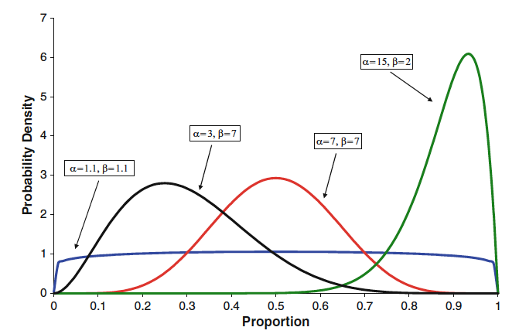
Probability Distributions: Beta
Beta
  Alpha and beta shape parameters
  Works well for proportions and validation data (and a lot of the data we use are proportions)
  For sensitivity, among true positives, set
    Alpha = N test positives + 1
    Beta = N test negatives + 1
Notes:
Beta distribution allows us to represent different shapes, just by changing alpha and beta

Slide 86
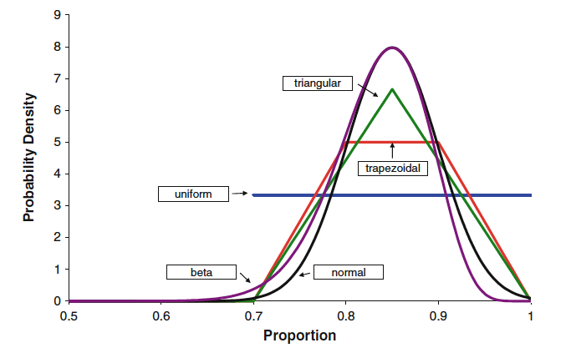
Comparing distributions
All of the distributions here are centered around 0.85
Majority of the density lies between 0.7 and 0.1
⇨Choice of distribution not likely to have a major effect on the results of the bias analysis

Slide 87
Software options
Stata:
  rbeta
  runiform
  episens has several probability density functions built-in
SAS:
  standard uniform: ranuni(seed)
  quantile(‘uniform’,u,{l,r})
  rannor(seed) ← standard normal
  quantile(‘normal’,u, μ,σ)
  quantile(‘beta’,u,α,β,l,r)

Slide 88
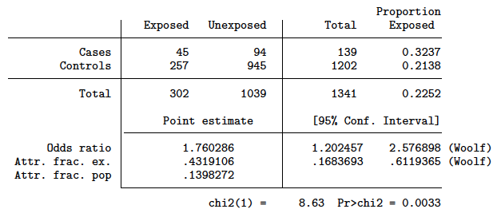
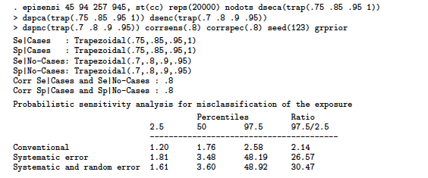
-episens- for probabilistic bias analysis
Case Control study: Exposure to resins & lung cancer cases
(Greenland et al., 1994)

Slide 89
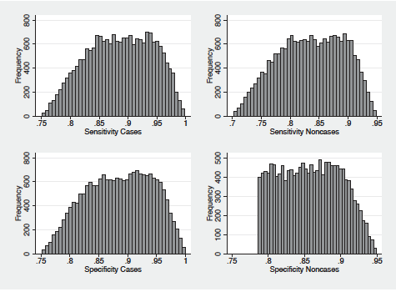
Exposure misclassification histograms
Histograms of 20,000 draws from trapezoidal prior distributions for the sensitivity and specificity among cases and non-cases

Slide 90
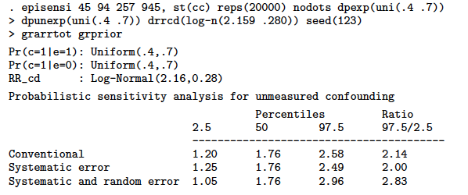
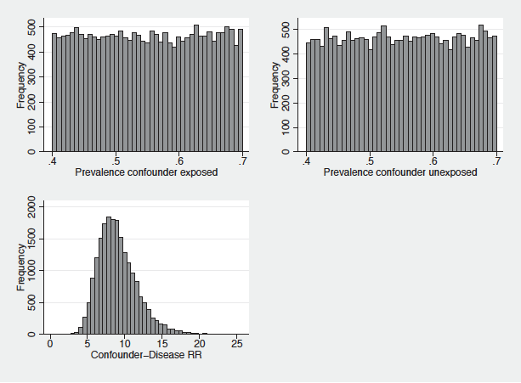
Unmeasured confounder (smoking)

Slide 91
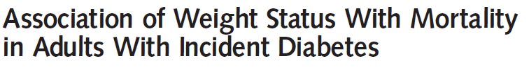

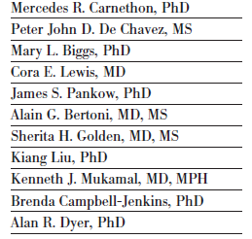
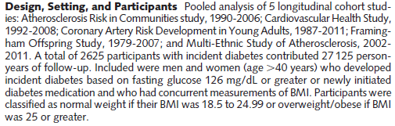

Collider-stratification bias example: the obesity paradox

Slide 92
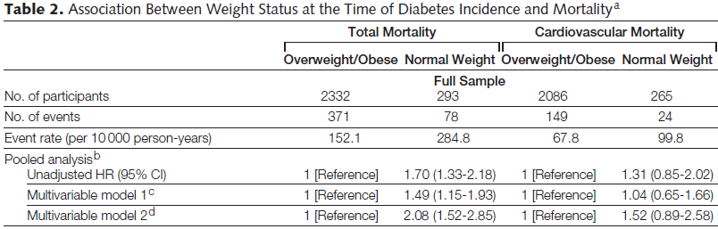
Analytic cohort comprised of 2625 men and women with incident diabetes (based on fasting glucose or newly initiated medication for diabetes)

Slide 93
 | Normal weight | Overweight/obese
Dead | 78 | 371
Alive | 215 | 1961
Carnethon paper
 | Normal weight | Overweight/obese
Dead | 1835 | 2735
Alive | 5705 | 7812
NHANES III
Complete cohort
 | Normal weight | Overweight/obese
Dead | 203 | 612
Alive | 99 | 521
NHANES III
Diabetics
 | Normal weight | Overweight/obese
Dead | 0.11 | 0.22
Alive | 0.02 | 0.07
Sampling Fractions

Slide 94
 | HR Estimate from article | Crude OR Estimate | Selection bias corrected OR estimate
Normal weight | 1.70 (1.33, 2.18) | 1.92 (1.45, 2.54) | 1.13 (0.82, 1.57)
*Overweight-obese (BMI>25) used as referent group

Slide 95
Wrap up

Slide 96
Review of what we’ve covered today:
Key concepts about bias and different types of bias
  Deterministic and probabilistic bias analysis techniques
  Selection bias
  Misclassification
  Unmeasured confounding
Hand calculations, Stata commands, Excel worksheets
Didn’t cover Bayesian bias analysis, multiple bias analysis, more complex scenarios (e.g., polytomous unmeasured confounders, effect measure modification with unmeasured confounding)

Slide 97
Link to BOX with simulation tutorial files: https://bit.ly/2SOJer8

