Slide 1
Part 2: Monte Carlo Simulations for quantifying confounding bias and Collider-Stratification bias
Elizabeth Rose Mayeda, PhD, MPH
UCSF Epi Tools Workshop
Quantitative Bias Analysis
February 14, 2019
ermayeda@ph.ucla.edu
@er_mayeda

Slide 2
Link to BOX with simulation tutorial files: https://bit.ly/2SOJer8

Slide 3
Outline
Part 2: Monte Carlo simulations for quantifying confounding bias and collider-stratification bias
  Why simulate?
  Simulation steps
  Simulation exercise: confounding bias
  Simulation exercise: collider-stratification bias
  Briefly: extension to simulating information bias

Slide 4
Why simulate?
Simulation studies provide a means for quantifying expected magnitude of bias
Why might you simulate vs. use bias equations for quantitative bias analysis?
  Flexible
  Complex data-generating processes
  One tool that can be used for quantifying multiple sources of bias in your study (i.e., confounding, selection bias, information bias)
  Allows for comparison of alternative analytic tools

Slide 5
Steps for using Monte Carlo simulations for quantitative bias analysis from a simulated data set

Slide 6
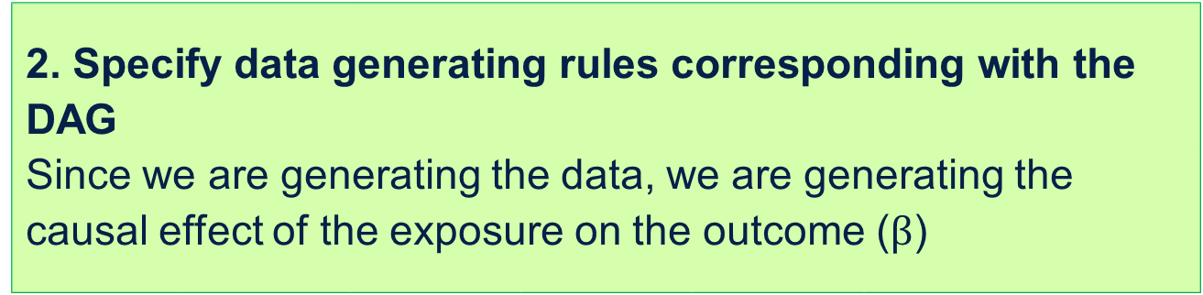
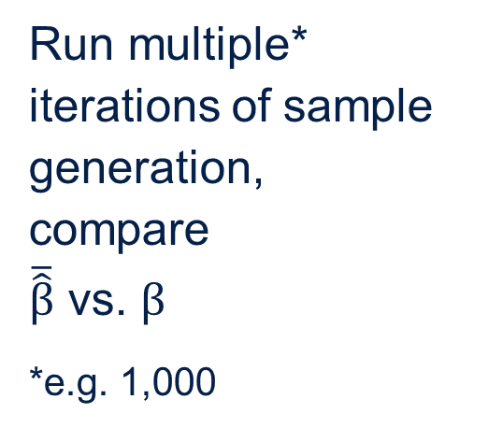
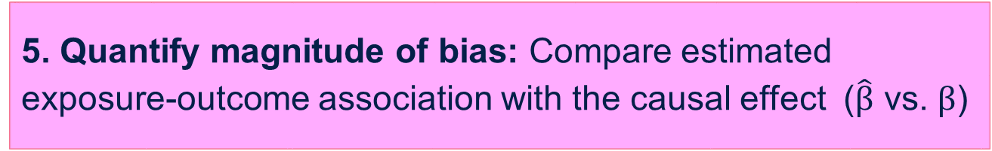
1. Express causal structure as a DAG
2. Specify data generating rules corresponding with the DAG
Since we are generating the data, we are generating the causal effect of the exposure on the outcome ($β$)
Repeat!
Varying causal structure and parameterizations
3. Generate data according to specified rules
Run multiple* iterations of sample generation,
compare
$\overline{\hat{β}}$ vs. $β$
*e.g. 1,000
4. Estimate exposure-outcome association ($\hat{β}$)
5. Quantify magnitude of bias: Compare estimated exposure-outcome association with the causal effect ($\hat{β}$ vs. $β$)
Notes:
These steps are for one causal structure and one set of parameterizations. ..Different causal structures or different parameterizations, so often it’s useful to look across multiple scenarios
How many samples do you generate? A large number of samples so we get a stable sample of estimates from our simulated world.
Look at average beta hat and look at distribution of beta hats, other metrics.

Slide 7
Simulation tips
K-I-S-S
Start simple, gradually add complexity
Sanity checks:
  Check distributions of data: Did you generate the data you thought you did?
  Consider a base scenario with no bias anticipated
Check work in one iteration of sample generation (with large n)
Check work by running a few iterations of sample generation (with desired n) prior to running desired # iterations of sample generation
Make sure to set random number seeds so your results are reproducible

Slide 8
For today’s simulations involving data generation from scratch, we have three Stata do files (with parallel files in R)
Preamble file: Sets parameters
  Why set parameters in a separate file?: You can have separate preamble files for different sets of parameter inputs for alternative causal structures, but one data generation and analysis file
Data generation and analysis file: Generates one data set, analyzes the data set, and stores results as scalars
Run simulation file (runs Monte Carlo simulations): Calls the data generation and analysis file to generate and analyze B iterations of sample generation, stores the results from each sample, summarizes the results across the B samples, and stores the summarized results

Slide 9

R simulation tutorial code courtesy of Crystal Shaw
Crystal Shaw, MS, Doctoral Student, UCLA Department of Statistics

Slide 10
Macro variables in Stata: Variables you are storing in Stata memory that you don’t see in your data set
Local macro variables
  local x 1 //creates a local macro variable named x with value = 1
  To call the local macro variable, surrounded variable by a specific set of quotation marks: `x’
  A local macro variable is temporarily defined and only exists within the program in which it is defined
Global macro variables
  global x 1 //creates a global macro variable named x with value = 1
  To call the global macro variable, put a “$” before the variable name: $x
  A global macro variable is available to all programs in your Stata session
Notes:
Stata documentation on macros: “A macro is a string of characters, called the macroname, that stands for another string of characters, called the macro contents.” http://www.stata.com/manuals13/u18.pdf#u18.3Macros
Stata documentation on global macros: ………………….
Stata documentation on local macros: “Local macros exist solely within the program or do-file in which they are defined. If that program or do-file calls another program or do-file, the local macros previously defined temporarily cease to exist, and their existence is reestablished when the calling program regains control. When a program or do-file ends, its local macros are permanently deleted.”
http://www.stata.com/manuals13/pmacro.pdf

Slide 11
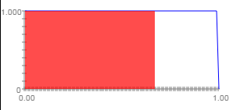
Generating continuous and binary variables in Stata
Generating continuous variables:
*Generate A, where A~N(0,1)
gen A = rnormal()
Generating binary variables:
  *Specify Probability(C)
    Gen P_C = 0.67
    *Generate C
    gen C = runiform()> P_C
runiform() produces random
numbers over [0,1)
0.67
Documentation on Stata’s random number generators: http://blog.stata.com/2012/07/18/using-statas-random-number-generators-part-1/

Slide 12
Simulation exercise: Confounding bias

Slide 13
Example: Hypothetical cohort study with an unmeasured confounder
Causal question: Does “exposure” cause “outcome”?
Hypothetical cohort study of 5,000 people
Binary exposure
Binary outcome
Unmeasured continuous confounder U
Estimand of interest: odds ratio for the effect of exposure on the outcome
For simplicity, we will simulate under the sharp null in this exercise (no effect of exposure on the outcome for any individual in the population) and assume no other sources of bias
U
Exposure
Outcome

Slide 14
1. Express causal structure as a DAG
Draw a DAG representing the exposure, the outcome, and confounder
U
Exposure
Outcome

Slide 15
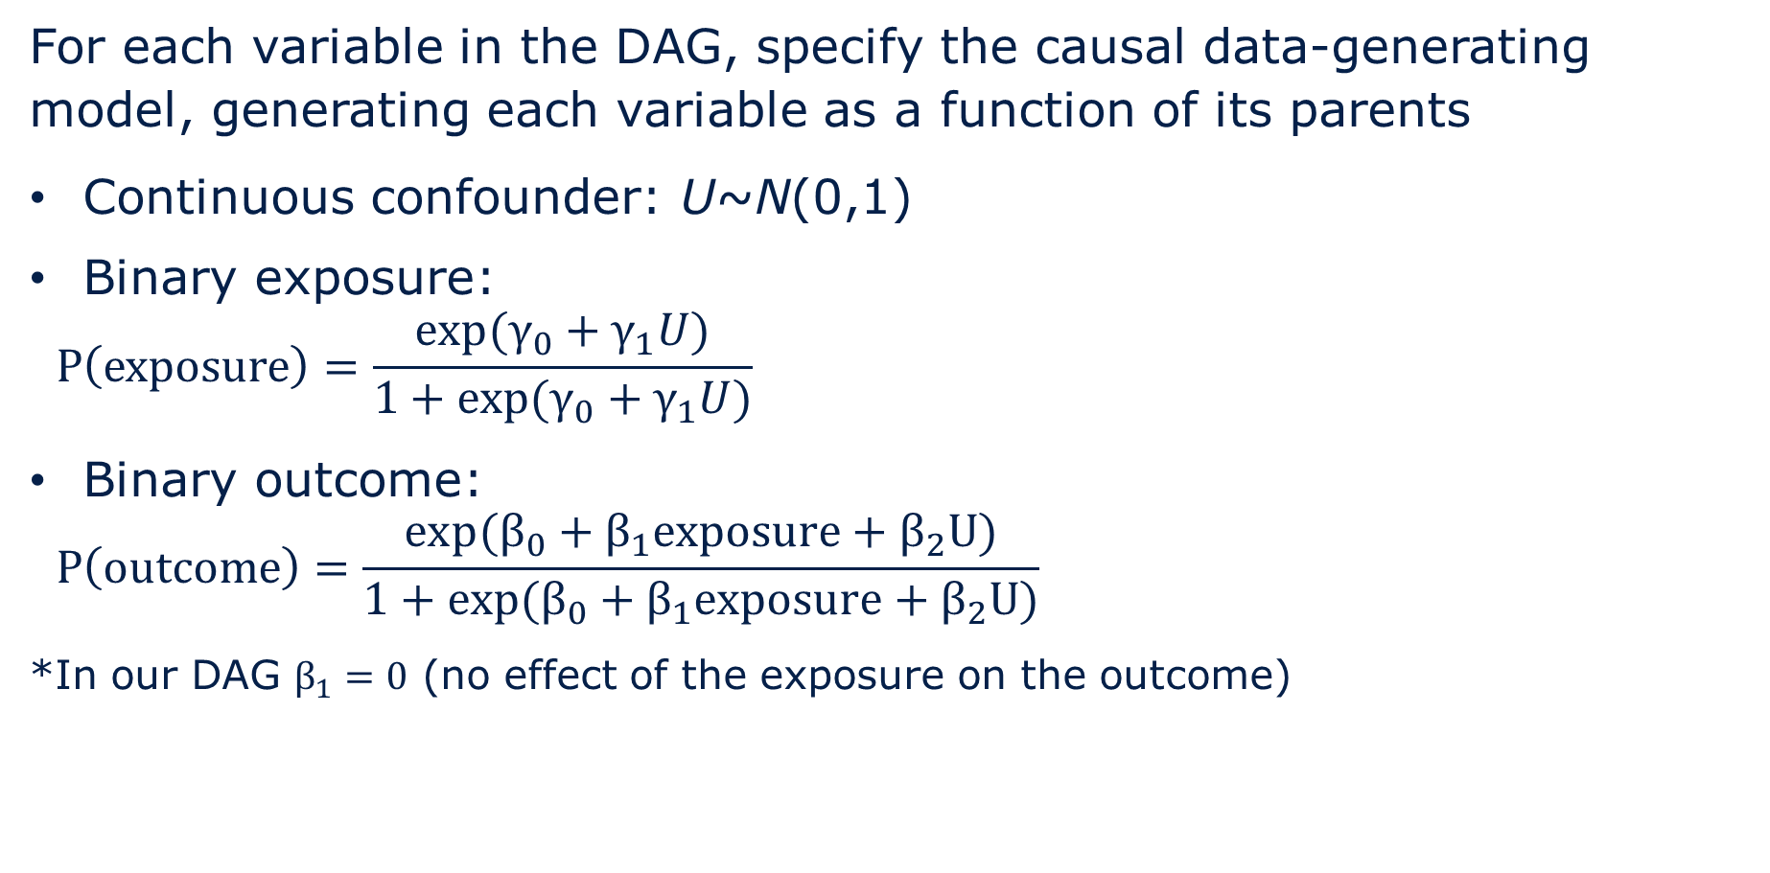


2. Specify data generating rules corresponding with the DAG
For each variable in the DAG, specify the causal data-generating model, generating each variable as a function of its parents
Continuous confounder: U~N(0,1)
Binary exposure:
$$P\left(exposure\right)=\frac{exp(γ_{0}+γ_{1}U)}{1+exp(γ_{0}+γ_{1}U)}$$
Binary outcome:
$$P\left(outcome\right)=\frac{exp(β_{0}+β_{1}exposure+β_{2}U)}{1+exp(β_{0}+β_{1}exposure+β_{2}U)}$$
*In our DAG $β_{1}=0$ (no effect of the exposure on the outcome)
U~N(0,1)
$$γ_{1}$$
$$β_{2}$$
Exposure
Bernoulli(P(exposure))
Outcome
Bernoulli(P(outcome))
Notes:
Our data-generating model for exposure is a logit link between U and exposure, and then we generate probability of exposure from this data-generating model.
Same thing for the binary outcome

Slide 16
3. Generate data according to specified rules
Download folder: “<your file path>\Confounding_simulation_tutorial”
Open Stata file: 2_simulation_workshop_confounding_data_gen_analysis.do

Slide 17
3. Generate data according to specified rules
Generate a blank data set with n=5,000 observations
Apply the data-generating rules sequentially to the data set, starting with the exogenous variables and then for each of their children
id | U | P(Exposure) | Exposure | P(Outcome) | Outcome
1 | 1.829 | 0.470 | 1 | 0.283 | 1
2 | -0.487 | 0.151 | 0 | 0.073 | 0
3 | 0.391 | 0.247 | 0 | 0.127 | 1
…
5,000 | -2.345 | 0.047 | 0 | 0.021 | 0
Notes:
For exogenous variables, generate the actual values for each person
For each of the children, generate actual values for each person based on the probabilities specified in the data-generating rules

Slide 18
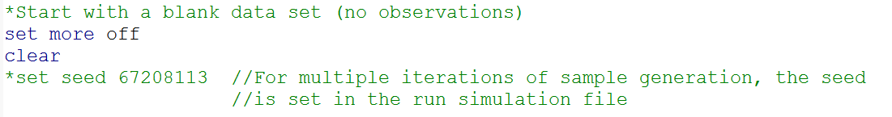
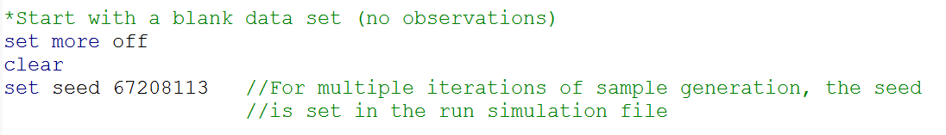
3. Generate data according to specified rules
Start with a blank data set (no observations)
We will set a seed for one iteration of sample generation so we can check our work. Before we run multiple iterations of sample generation, we’ll need to comment this line of code back out.

Slide 19
3. Generate data according to specified rules
Generate a data set with n=5,000 observations
*call preamble file
do 1_simulation_workshop_confounding_preamble.do
/************************************************************/
/******** Step A. Create blank data set ********/
/************************************************************/
set obs 5000 //creates blank dataset with desired # observations
gen id = _n

Slide 20
3. Generate data according to specified rules
Set parameters
/************************************************************/
/******** Step B. Set parameters ********/
/************************************************************/
*Parameters for odds of exposure
local g0 = $g0 //log odds [p/(1-p)] of exposure for ref group (U=0)
local g1 = $g1 //effect of one-unit higher U on log odds of exposure
*Parameters for odds of outcome
local b0 = $b0 //log odds [p/(1-p)] of outcome for ref group (U=0,exp=0)
local b1 = $b1 //effect of exposure on log odds of outcome
local b2 = $b2 //effect of one-unit higher U on log odds of outcome
Notes:
Take a look at the preamble file to see the parameter inputs

Slide 21
3. Generate data according to specified rules
View parameter inputs:
  1_simulation_workshop_confounding_preamble.do

Slide 22


3. Generate data according to specified rules
Generate continuous confounder U, where U~N(0,1)
/************************************************************/
/******** Step C. Generate data ********/
/************************************************************/
*Generate U, where U~N(0,1)
gen U = rnormal()
U~N(0,1)
$$γ_{1}$$
$$β_{2}$$
Exposure
Bernoulli(P(exposure))
Outcome
Bernoulli(P(outcome))
Notes:
Start with exogenous variables
Documentation on Stata’s random number generators: http://blog.stata.com/2012/07/18/using-statas-random-number-generators-part-1/
For exogenous variables, generate the actual values for each person
For each of the children, generate actual values for each person based on the probabilities specified in the data-generating rules

Slide 23
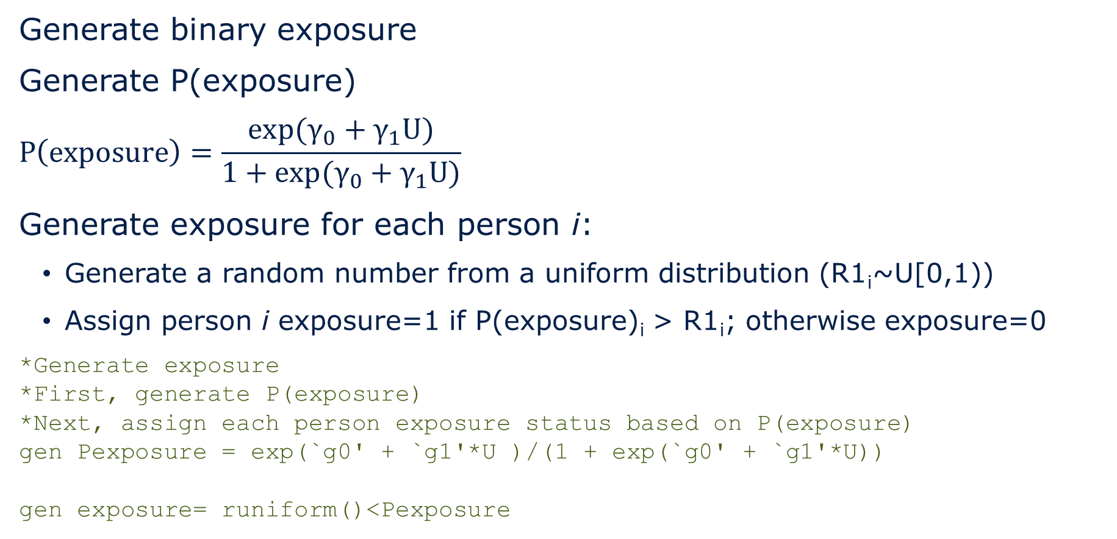


3. Generate data according to specified rules
U~N(0,1)
Generate binary exposure
Generate P(exposure)
$$P\left(exposure\right)=\frac{exp(γ_{0}+γ_{1}U)}{1+exp(γ_{0}+γ_{1}U)}$$
Generate exposure for each person i:
  Generate a random number from a uniform distribution (R1_{i}~U[0,1))
  Assign person i exposure=1 if P(exposure)_{i} > R1_{i}; otherwise exposure=0
*Generate exposure
*First, generate P(exposure)
*Next, assign each person exposure status based on P(exposure)
gen Pexposure = exp(`g0' + `g1'*U )/(1 + exp(`g0' + `g1'*U))
gen exposure= runiform()<Pexposure
$$γ_{1}$$
$$β_{2}$$
Exposure
Bernoulli(P(exposure))
Outcome
Bernoulli(P(outcome))
Notes:
For each of the children, generate actual values for each person based on the probabilities specified in the data-generating rules
Generate P(exposure) from a logistic model.
Generate exposure for each person i in the simulated sample by generating a random number from a uniform distribution (R1_{i}~U[0,1)) and assign person i to exposure=1 if P(exposure> R1_{i}; otherwise exposure=0
Documentation on Stata’s random number generators: http://blog.stata.com/2012/07/18/using-statas-random-number-generators-part-1/

Slide 24
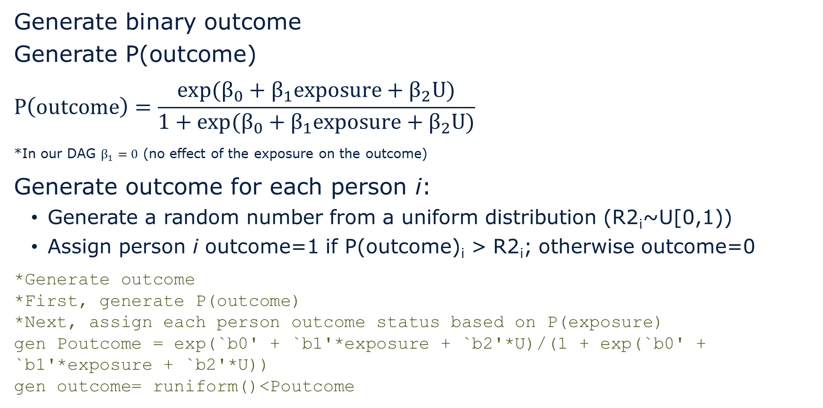
3. Generate data according to specified rules
Generate binary outcome
Generate P(outcome)
$$P\left(outcome\right)=\frac{exp(β_{0}+β_{1}exposure+β_{2}U)}{1+exp(β_{0}+β_{1}exposure+β_{2}U)}$$
*In our DAG $β_{1}=0$ (no effect of the exposure on the outcome)
Generate outcome for each person i:
  Generate a random number from a uniform distribution (R2_{i}~U[0,1))
  Assign person i outcome=1 if P(outcome)_{i} > R2_{i}; otherwise outcome=0
*Generate outcome
*First, generate P(outcome)
*Next, assign each person outcome status based on P(exposure)
gen Poutcome = exp(`b0' + `b1'*exposure + `b2'*U)/(1 + exp(`b0' + `b1'*exposure + `b2'*U))
gen outcome= runiform()<Poutcome
U~N(0,1)
$$γ_{1}$$
$$β_{2}$$
Exposure
Bernoulli(P(exposure))
Outcome
Bernoulli(P(outcome))
Notes:
For each of the children, generate actual values for each person based on the probabilities specified in the data-generating rules
Generate P(outcome) from a logistic model.
Generate outcome for each person i in the simulated sample by generating a random number from a uniform distribution (R2_{i}~U[0,1)) and assign person i to outcome=1 if P(outcome> R2_{i}; otherwise outcome=0
Documentation on Stata’s random number generators: http://blog.stata.com/2012/07/18/using-statas-random-number-generators-part-1/

Slide 25
3. Generate data according to specified rules
Take a look at the data you generated!
id | U | P(Exposure) | Exposure | P(Outcome) | Outcome
1 | 1.829 | 0.470 | 1 | 0.283 | 1
2 | -0.487 | 0.151 | 0 | 0.073 | 0
3 | 0.391 | 0.247 | 0 | 0.127 | 1
…
5,000 | -2.345 | 0.047 | 0 | 0.021 | 0

Slide 26
4. Estimate exposure-outcome association ($\hat{β}$)
Before estimating exposure-outcome association, check out your results: Did you generate the data you intended to?
/*************************************************************/
/******** Step D. Analyze data & store results ********/
/*************************************************************/
*Store results as scalar variables
*Scalar variables store single numbers or stings, not variables in the dataset
/**** Check distributions and store results ***/
*Check mean value of U and proportion of people with exposure=1 and outcome=1
foreach x in U exposure outcome {
summarize `x'
scalar p_`x' = round(r(mean),0.001)
}
scalar mean_U = p_U
scalar drop p_U

Slide 27
4. Estimate exposure-outcome association ($\hat{β}$)
Before estimating exposure-outcome association, check out your results: Did you generate the data you intended to?
Variable | Obs Mean Std. Dev. Min Max
-------------+---------------------------------------------------------
U | 5,000 .0097761 1.014481 -4.06433 3.791389
Variable | Obs Mean Std. Dev. Min Max
-------------+---------------------------------------------------------
exposure | 5,000 .2344 .4236656 0 1
Variable | Obs Mean Std. Dev. Min Max
-------------+---------------------------------------------------------
outcome | 5,000 .1112 .3144111 0 1

Slide 28
4. Estimate exposure-outcome association ($\hat{β}$)
/*** Look at associations and store results ***/
*Estimated OR & 95% CI for exposure-outcome association
*Adjusting for U (confounder)
logistic outcome i.exposure c.U
matrix list r(table)
matrix logit1 = r(table)
scalar OR_exposure_Uyes = logit1[1,2]
scalar lb_OR_exposure_Uyes = logit1[5,2]
scalar ub_OR_exposure_Uyes = logit1[6,2]
*Estimated OR & 95% CI for exposure-outcome association
*Without adjusting for U (confounder)
logistic outcome i.exposure
matrix list r(table)
matrix logit2 = r(table)
scalar OR_exposure_Uno = logit2[1,2]
scalar lb_OR_exposure_Uno = logit2[5,2]
scalar ub_OR_exposure_Uno = logit2[6,2]
*Look at stored results
scalar list
Notes:
We are storing results as scalars (behind the scenes variables)

Slide 29
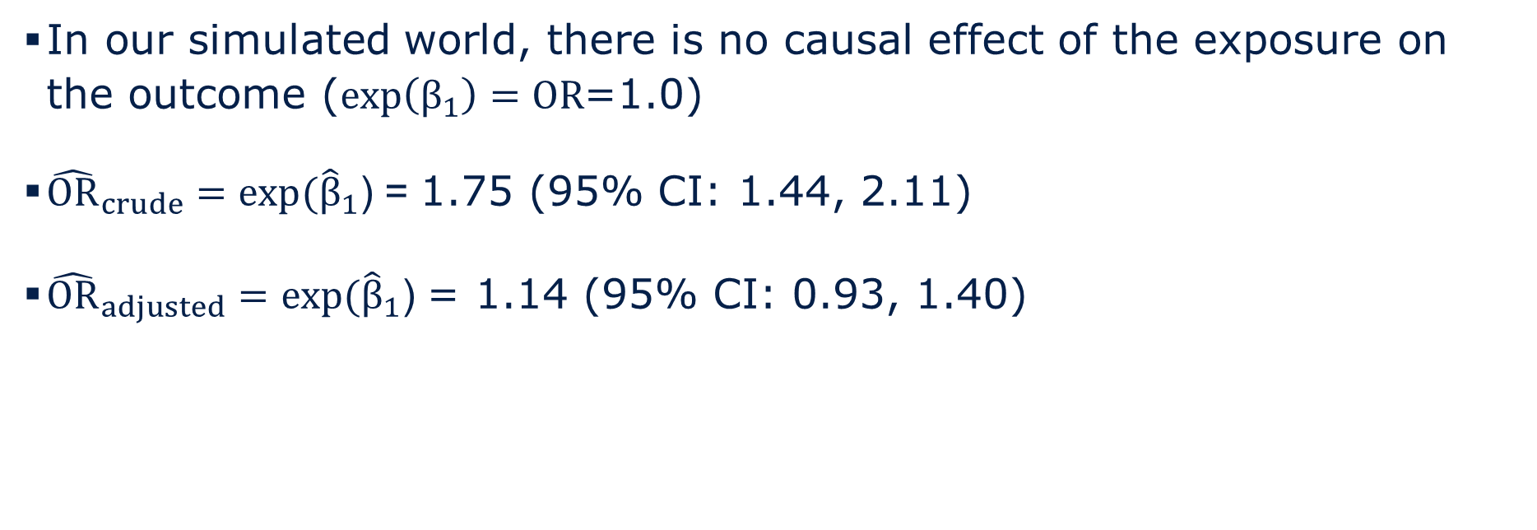
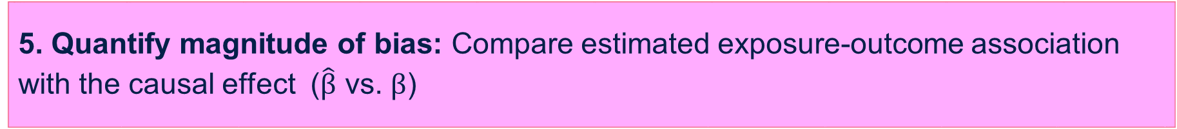
5. Quantify magnitude of bias: Compare estimated exposure-outcome association with the causal effect ($\hat{β}$ vs. $β$)
In our simulated world, there is no causal effect of the exposure on the outcome ($exp\left(β_{1}\right)=OR$=1.0)
${\hat{OR}}_{crude}={exp⁡(\hat{β}}_{1}$) = 1.75 (95% CI: 1.44, 2.11)
${\hat{OR}}_{adjusted}={exp⁡(\hat{β}}_{1}$) = 1.14 (95% CI: 0.93, 1.40)

Slide 30

Run multiple iterations of sample generation
Run multiple (several hundred to several thousand) iterations of sample generation, compare $\overline{\hat{β}}$ vs. $β$
Don’t forget to comment out the seed in the data generation and analysis file or else you will generate the same data set over and over again!

Slide 31
Run simulation file
File name: 3_simulation_workshop_confounding_run.do
Call the data generation and analysis file B times to generate and analyze B data sets
Summarize results across the B replications
Stores the results from the B replications (one replication = one row in the file)

Slide 32
Run simulation file
The simulate command performs Monte Carlo-type simulations
Basic form of the code is:
  simulate [list of scalars stored from each replication], reps(B) seed(#): do [data generation and analysis do file]
  This will replicate B data sets using the data generating code and perform the analyses in the do file. Then it will pull the results from each replication we stored as scalars so we can summarize results across all B repetitions.
  "reps(B)" specifies the number of replications
  "seed(#)" specifies the random number seed
  Simulate documentation: http://www.stata.com/manuals13/rsimulate.pdf
Notes:
Note that the first lines of code call in and assign the value from each scalar to a variable with the same name.

Slide 33
Simulation results
Sample | MeanU | Prev exposure | Prev outcome | OR_{adj} | OR_{crude} | Lower CL OR_{adj} | Upper CL OR_{adj} | Lower CL OR_{crude} | Upper CL OR_{crude} | 95% CI covers truth OR_{adj} | 95% CI covers truth OR_{crude}
1 | 0.010 | 0.234 | 0.111 | 1.14 | 1.75 | 0.93 | 1.40 | 1.44 | 2.11 | 1 | 0
2 | -0.006 | 0.208 | 0.115 | 1.15 | 1.70 | 0.94 | 1.41 | 1.40 | 2.06 | 1 | 0
3 | -0.003 | 0.219 | 0.118 | 1.03 | 1.57 | 0.84 | 1.26 | 1.30 | 1.90 | 1 | 0
…
1,000 | -0.026 | 0.216 | 0.115 | 0.99 | 1.44 | 0.80 | 1.22 | 1.19 | 1.76 | 1 | 0

Slide 34
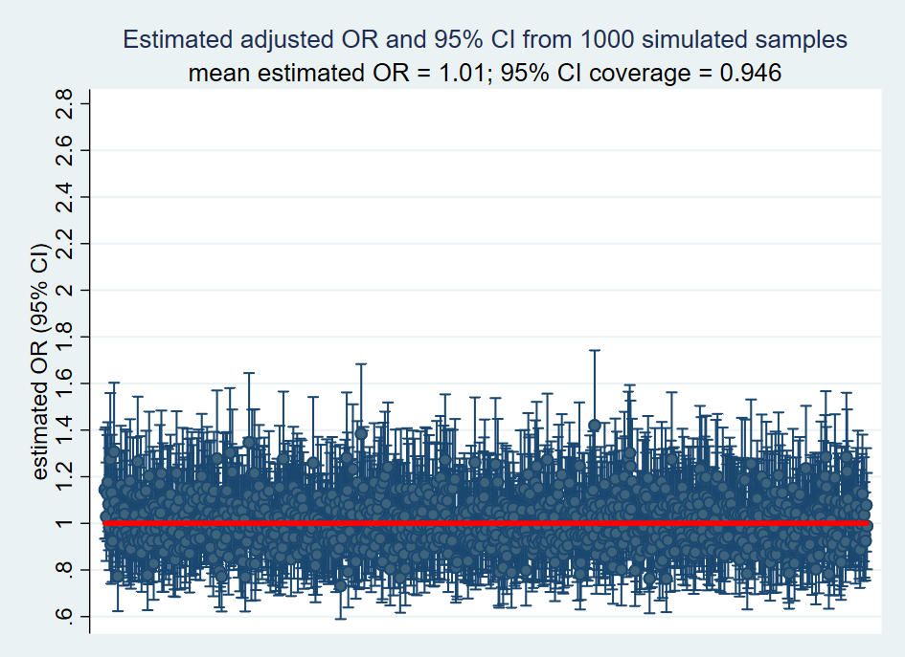

Simulation results: Adjusted $\hat{OR}$and 95 % CI
${\overline{\hat{OR}}}_{adjusted}$= 1.01, 95% CI coverage = 0.946
Notes:
. scalar list mean_mean_U mean_p_exposure mean_p_outcome
mean_mean_U = 0
mean_p_exposure = .22
mean_p_outcome = .12
.
. *Across B replications, average estimated OR for exposure on outcome, adjusting for U
. scalar list mean_OR_exposure_Uyes
mean_OR_exposure_Uyes = 1.01
.
. *Across B replications, average estimated OR for exposure on outcome, not adjusting for U
. scalar list mean_OR_exposure_Uno
mean_OR_exposure_Uno = 1.53
.
. *Proportion of 95% CIs for OR for exposure on outcome that include the causal/true OR
. scalar list P_covg_OR_exposure_Uyes P_covg_OR_exposure_Uno
P_covg_OR_exposure_Uyes = .946
P_covg_OR_exposure_Uno = .008

Slide 35
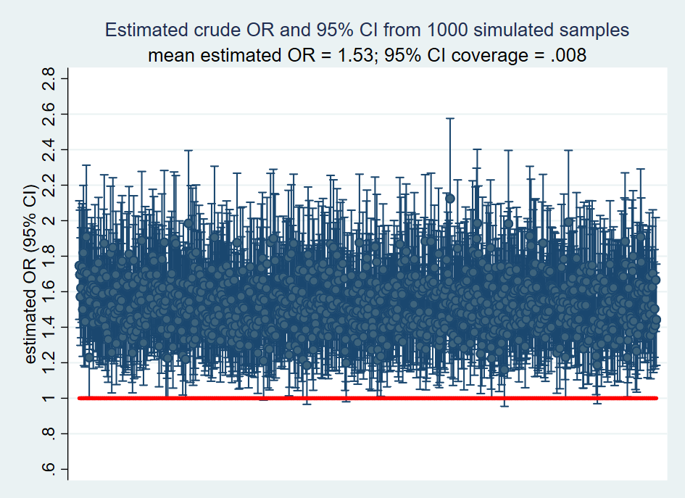

Simulation results: Crude $\hat{OR}$and 95 % CI
${\overline{\hat{OR}}}_{crude}$= 1.53, 95% CI coverage = 0.008
Notes:
. scalar list mean_mean_U mean_p_exposure mean_p_outcome
mean_mean_U = 0
mean_p_exposure = .22
mean_p_outcome = .12
.
. *Across B replications, average estimated OR for exposure on outcome, adjusting for U
. scalar list mean_OR_exposure_Uyes
mean_OR_exposure_Uyes = 1.01
.
. *Across B replications, average estimated OR for exposure on outcome, not adjusting for U
. scalar list mean_OR_exposure_Uno
mean_OR_exposure_Uno = 1.53
.
. *Proportion of 95% CIs for OR for exposure on outcome that include the causal/true OR
. scalar list P_covg_OR_exposure_Uyes P_covg_OR_exposure_Uno
P_covg_OR_exposure_Uyes = .946
P_covg_OR_exposure_Uno = .008

Slide 36
Simulation exercise:
Collider-stratification bias

Slide 37
Example
Causal question: Does anxiety influence risk of stroke?
    Study: Cohort study of adults with memory complaints
    Exposure: Anxiety
    Outcome: Acute stroke during the next 5 years
    Selection factor/Collider: Memory complaints
    U: Underlying cerebrovascular disease
Anxiety
Memory complaints
Acute stroke
Cerebrovascular disease

Slide 38
1. Express causal structure as a DAG
Anxiety
Memory complaints
Acute stroke
Cerebrovascular disease
Notes:
Pr[Y=1|A=1,C=0]/Pr[Y=1|A=0,C=0] ≠ Pr[Y^{a=1}=1]/Pr[Y^{a=0}=1]
Figures 8.1 and 8.2 from Hernan and Robins

Slide 39



2. Specify data generating rules corresponding with the DAG
For each variable in the DAG, specify the causal data-generating model, generating each variable as a function of its parents
Binary exposure: Anxiety ~ Bernoulli(0.2)
Continuous common cause of selection and outcome: Cerebrovascular disease ~ N(0,1)
Anxiety
$$γ_{1}$$
Memory complaints
$$γ_{2}$$
Acute stroke
Cerebrovascular disease
$$β_{2}$$

Slide 40

2. Specify data generating rules corresponding with the DAG
Binary selection factor: Memory complaints
P(memory complaints)$=\frac{exp(γ_{0}+γ_{1}anxiety+γ_{2}cerebrovascular disease)}{1+exp(γ_{0}+γ_{1}anxiety+γ_{2}cerebrovascular disease)}$
Binary outcome: Acute stroke
P(acute stroke) $=\frac{exp(β_{0}+β_{1}anxiety+β_{2}cerebrovascular disease)}{\begin{aligned}1+exp(β_{0}+β_{1}anxiety+β_{2}cerebrovascular disease) \\ \end{aligned}}$
*In our DAG $β_{1}=0$ (no effect of the exposure on the outcome)
Anxiety
$$γ_{1}$$
Memory complaints
$$γ_{2}$$
Acute stroke
Cerebrovascular disease
$$β_{2}$$
Notes:
Our data-generating model for memory is a logit link between anxiety and cerebrovascular disease and memory complaints, and then we generate probability of mem complaints from this data-generating model.

Slide 41
3. Generate data according to specified rules
Download folder: “<your file path>\Collider_bias_simulation_tutorial”
Open Stata file: 2_simulation_workshop_collider_bias_data_gen_analysis.do

Slide 42
3. Generate data according to specified rules
Generate a data set with n=5,000 observations
Apply the data-generating rules sequentially to the data set, starting with the exogenous variables and then for each of their children
id | anxiety | cerebrovascular disease | P(memory complaints) | memory complaints | P(acute stroke) | acute stroke
1 | 0 | -0.630 | 0.039 | 0 | 0.019 | 0
2 | 1 | -1.018 | 0.097 | 0 | 0.010 | 0
3 | 0 | -0.147 | 0.081 | 0 | 0.040 | 0
…
5,000 | 1 | -1.420 | 0.054 | 0 | 0.005 | 0
Notes:
Generate memory complaints for each person i in the simulated sample by generating a random number from a uniform distribution (U1_{i}~U[0,1)) and assign person i to Memory complaints=1 if P(Memory complaints)_{i} > U1_{i}; otherwise Memory complaints=0

Slide 43
3. Generate data according to specified rules
Start with a blank data set (no observations)
We will set a seed for one iteration of sample generation so we can check our work. Before we run multiple iterations of sample generation, we’ll need to comment this line of code back out.

Slide 44
3. Generate data according to specified rules
Generate a data set with n=5,000 observations
*call preamble file
do 1_simulation_workshop_collider_bias_preamble.do
/************************************************************/
/******** Step A. Create blank data set ********/
/************************************************************/
set obs 5000 //creates blank dataset with desired # observations
gen id = _n

Slide 45
3. Generate data according to specified rules
Set parameters
/*******************************************************/
/******** Step B. Set parameters ********/
/*******************************************************/
*Specify prevalence of A (exposure)
local P_A = $P_A
*Parameters for odds of S (selection)
local g0 = $g0 //log odds of S for ref group (A=0 and U=0)
local g1 = $g1 //log OR for effect of A on log odds of selection (OR=5.0)
local g2 = $g2 //log OR for effect of U on log odds of selection (OR=5.0)
local g3 = $g3 //log OR for interaction between A and U on (OR=1.0)
*Parameters for odds of Y (outcome)
local b0 = $b0 //log odds of Y for ref group (A=0, U=0, and S=0)
local b1 = $b1 //log OR for effect of A on log odds of Y (OR=1.0)
local b2 = $b2 //log OR for effect of U on log odds of Y (OR=5.0)
Notes:
Take a look at the preamble file to see the parameter inputs

Slide 46
3. Generate data according to specified rules
View parameter inputs:
  1_simulation_workshop_collider_bias_preamble.do

Slide 47
3. Generate data according to specified rules
Generate binary Anxiety (A), where A~Bernoulli(Probability(A))
/*******************************************************/
/******** Step C. Generate data ********/
/*******************************************************/
*Generate A
gen A = 0
replace A = runiform()<`P_A'
Anxiety (A)
$$γ_{1}$$
Memory complaints (S)
$$γ_{2}$$
Acute stroke (Y)
Cerebrovascular disease (U)
$$β_{2}$$
Notes:
Documentation on Stata’s random number generators: http://blog.stata.com/2012/07/18/using-statas-random-number-generators-part-1/

Slide 48
3. Generate data according to specified rules
Generate continuous Cerebrovascular disease (U), where U~N(0,1)
*Generate U, where U~N(0,1)
gen U = rnormal()
Anxiety (A)
$$γ_{1}$$
Memory complaints (S)
$$γ_{2}$$
Acute stroke (Y)
Cerebrovascular disease (U)
$$β_{2}$$
Notes:
Documentation on Stata’s random number generators: http://blog.stata.com/2012/07/18/using-statas-random-number-generators-part-1/

Slide 49
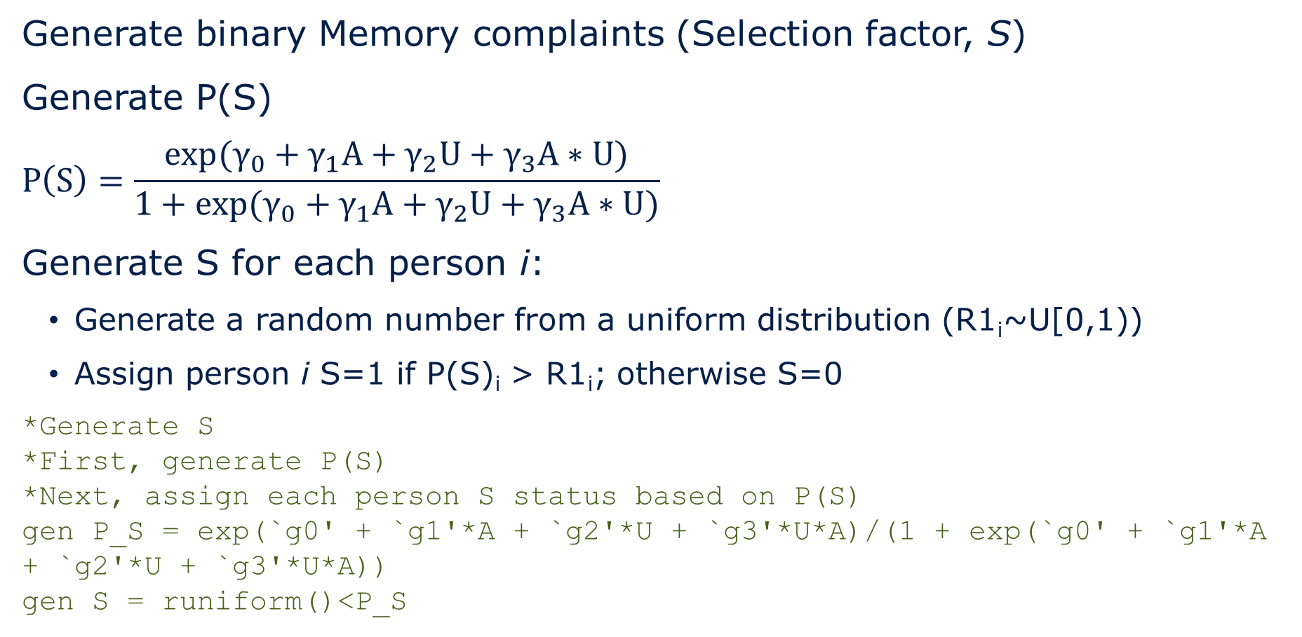
3. Generate data according to specified rules
Generate binary Memory complaints (Selection factor, S)
Generate P(S)
$$P\left(S\right)=\frac{exp(γ_{0}+γ_{1}A+γ_{2}U+γ_{3}A∗U)}{1+exp(γ_{0}+γ_{1}A+γ_{2}U+γ_{3}A∗U)}$$
Generate S for each person i:
  Generate a random number from a uniform distribution (R1_{i}~U[0,1))
  Assign person i S=1 if P(S)_{i} > R1_{i}; otherwise S=0
*Generate S
*First, generate P(S)
*Next, assign each person S status based on P(S)
gen P_S = exp(`g0' + `g1'*A + `g2'*U + `g3'*U*A)/(1 + exp(`g0' + `g1'*A + `g2'*U + `g3'*U*A))
gen S = runiform()<P_S
Anxiety (A)
$$γ_{1}$$
Memory complaints (S)
$$γ_{2}$$
Acute stroke (Y)
Cerebrovascular disease (U)
$$β_{2}$$
Notes:
Generate memory complaints for each person i in the simulated sample by generating a random number from a uniform distribution (R1_{i}~U[0,1)) and assign person i to Memory complaints=1 if P(Memory complaints)_{i} > R1_{i}; otherwise Memory complaints=0
Documentation on Stata’s random number generators: http://blog.stata.com/2012/07/18/using-statas-random-number-generators-part-1/

Slide 50
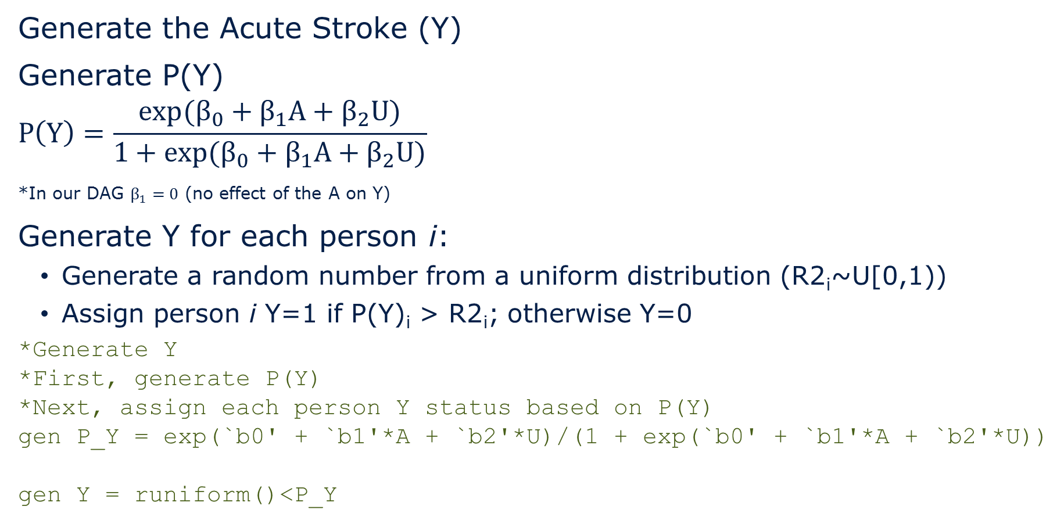
3. Generate data according to specified rules
Generate the Acute Stroke (Y)
Generate P(Y)
$$P\left(Y\right)=\frac{exp(β_{0}+β_{1}A+β_{2}U)}{1+exp(β_{0}+β_{1}A+β_{2}U)}$$
*In our DAG $β_{1}=0$ (no effect of the A on Y)
Generate Y for each person i:
  Generate a random number from a uniform distribution (R2_{i}~U[0,1))
  Assign person i Y=1 if P(Y)_{i} > R2_{i}; otherwise Y=0
*Generate Y
*First, generate P(Y)
*Next, assign each person Y status based on P(Y)
gen P_Y = exp(`b0' + `b1'*A + `b2'*U)/(1 + exp(`b0' + `b1'*A + `b2'*U))
gen Y = runiform()<P_Y
Anxiety (A)
$$γ_{1}$$
Memory complaints (S)
$$γ_{2}$$
Acute stroke (Y)
Cerebrovascular disease (U)
$$β_{2}$$
Notes:
Generate Y for each person i in the simulated sample by generating a random number from a uniform distribution (R2_{i}~U[0,1)) and assign person i to Y=1 if P(Y)_{i} > R2_{i}; otherwise Y=0
Documentation on Stata’s random number generators: http://blog.stata.com/2012/07/18/using-statas-random-number-generators-part-1/

Slide 51
3. Generate data according to specified rules
Take a look at the data you generated!
id | anxiety | cerebrovascular disease | P(memory complaints) | memory complaints | P(acute stroke) | acute stroke
1 | 0 | -0.630 | 0.039 | 0 | 0.019 | 0
2 | 1 | -1.018 | 0.097 | 0 | 0.010 | 0
3 | 0 | -0.147 | 0.081 | 0 | 0.040 | 0
…
5,000 | 1 | -1.420 | 0.054 | 0 | 0.005 | 0
Notes:
For exogenous variables, generate the actual values for each person
For each of the children, generate actual values for each person based on the probabilities specified in the data-generating rules

Slide 52
4. Estimate exposure-outcome association ($\hat{β}$)
Before estimating exposure-outcome association, check out your results: Did you generate the data you intended to?
/*******************************************************/
/******** Step D. Look at data ********/
/*******************************************************/
/********Check distributions of variables and store results********/
*Check proportions of people with: exposure (A) = 1, selection (S) = 1, outcome (Y) = 1
*Check mean U
foreach x in A U S Y {
summarize `x', meanonly
scalar p_`x' = round(r(mean),0.001)
}
scalar mean_U = p_U
scalar drop p_U
Notes:
Note: There is more code for this section in the do file, but for now, let’s just look at the means to make sure we all generated the same data.
Variable | Obs Mean Std. Dev. Min Max
-------------+---------------------------------------------------------
A | 5,000 .2028 .402125 0 1
Variable | Obs Mean Std. Dev. Min Max
-------------+---------------------------------------------------------
U | 5,000 .0119757 1.017345 -4.06433 3.239829
Variable | Obs Mean Std. Dev. Min Max
-------------+---------------------------------------------------------
S | 5,000 .2238 .4168313 0 1
Variable | Obs Mean Std. Dev. Min Max
-------------+---------------------------------------------------------
Y | 5,000 .0988 .2984231 0 1

Slide 53
4. Estimate exposure-outcome association ($\hat{β}$)
Variable | Obs Mean Std. Dev. Min Max
-------------+---------------------------------------------------------
A | 5,000 .2028 .402125 0 1
Variable | Obs Mean Std. Dev. Min Max
-------------+---------------------------------------------------------
U | 5,000 .0119757 1.017345 -4.06433 3.239829
Variable | Obs Mean Std. Dev. Min Max
-------------+---------------------------------------------------------
S | 5,000 .2238 .4168313 0 1
Variable | Obs Mean Std. Dev. Min Max
-------------+---------------------------------------------------------
Y | 5,000 .0988 .2984231 0 1
Notes:
Note: There is more code for this section in the do file, but for now, let’s just look at the means to make sure we all generated the same data.
Variable | Obs Mean Std. Dev. Min Max
-------------+---------------------------------------------------------
A | 5,000 .2028 .402125 0 1
Variable | Obs Mean Std. Dev. Min Max
-------------+---------------------------------------------------------
U | 5,000 .0119757 1.017345 -4.06433 3.239829
Variable | Obs Mean Std. Dev. Min Max
-------------+---------------------------------------------------------
S | 5,000 .2238 .4168313 0 1
Variable | Obs Mean Std. Dev. Min Max
-------------+---------------------------------------------------------
Y | 5,000 .0988 .2984231 0 1

Slide 54
4. Estimate exposure-outcome association ($\hat{β}$)
/********Look at associations and store results********/
*Check ORs for A and Y (whole population). No bias anticipated
logistic Y A
matrix list r(table)
matrix matrix2 = r(table)
scalar OR_AY_all = matrix2[1,1]
scalar lb_OR_AY_all = matrix2[5,1]
scalar ub_OR_AY_all = matrix2[6,1]
*Estimates of primary interest: Estimated ORs for A and Y among S=1 (store ORs and 95% CI limits)
logistic Y A if (S==1)
matrix list r(table)
matrix matrix3 = r(table)
scalar OR_AY_S1 = matrix3[1,1]
scalar lb_OR_AY_S1 = matrix3[5,1]
scalar ub_OR_AY_S1 = matrix3[6,1]
*Look at stored results
scalar list

Slide 55
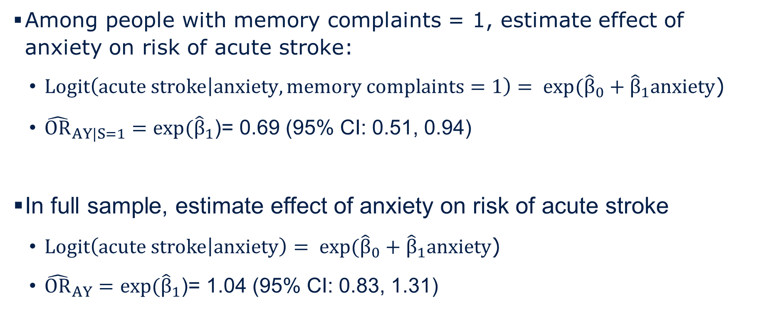
4. Estimate exposure-outcome association ($\hat{β}$)
Among people with memory complaints = 1, estimate effect of anxiety on risk of acute stroke:
  $Logit\left(acute stroke | anxiety, memory complaints=1\right)= exp({\hat{β}}_{0}+{\hat{β}}_{1}anxiety$)
  ${\hat{OR}}_{AY|S=1}={exp⁡(\hat{β}}_{1}$)= 0.69 (95% CI: 0.51, 0.94)
In full sample, estimate effect of anxiety on risk of acute stroke
  $Logit\left(acute stroke | anxiety\right)= exp({\hat{β}}_{0}+{\hat{β}}_{1}anxiety$)
  ${\hat{OR}}_{AY}={exp⁡(\hat{β}}_{1}$)= 1.04 (95% CI: 0.83, 1.31)
Notes:
. *Look at stored results
. scalar list
ub_OR_AY_all = 1.3069561
lb_OR_AY_all = .82683915
ub_OR_AY_S1 = .93670888
lb_OR_AY_S1 = .51057748
OR_AY_S1 = .69156523
OR_AY_all = 1.0395395
mean_U_A1_S1 = .70132251
mean_U_A0_S1 = 1.0340965
mean_U_A1_all = .04079575
mean_U_A0_all = .00464417
p_Y_A0_S1 = .238
p_Y_A1_S1 = .178
p_Y_A0 = .098
p_Y_A1 = .102
p_S_A1 = .421
p_S_A0 = .174
mean_U = .012
p_Y = .099
p_S = .224
p_A = .203

Slide 56

5. Quantify magnitude of bias: Compare estimated exposure-outcome association with the causal effect ($\hat{β}$ vs. $β$)
${\hat{OR}}_{AY|S=1}={exp⁡(\hat{β}}_{1}$) = 0.69 vs. $ORAY=exp(β_{1})$ = 1.00
In our simulated world, there is no causal effect of anxiety on acute stroke ($ORAY$=1.00)
In our hypothetical cohort of people with memory complaints, people with anxiety are less likely to have underlying cerebrovascular disease, inducing a spurious protective association between anxiety and acute stroke (${\hat{OR}}_{AY|S=1}$<1.0)
Anxiety (A)
Memory complaints (S)
Acute stroke (Y)
Cerebrovascular disease (U)
Notes:
People who volunteered for the study tended to take daily multivitamins or have a family history of heart disease
Among study participants, people who take vitamins are less likely to have a family history of heart disease

Slide 57
Run multiple iterations of sample generation
Run multiple (several hundred to several thousand) iterations of sample generation, compare $\overline{\hat{β}}$ vs. $β$
Don’t forget to comment out the seed in the data generation and analysis file or else you will generate the same data set over and over again!

Slide 58
Run simulation file
File name: 3_SER_simulation_workshop_2018_collider_bias_run.do
Call the data generation and analysis file B times to generate and analyze B data sets
Summarize results across the B replications
Stores the results from the B replications (one replication = one row in the file)

Slide 59
Run simulation file
The simulate command performs Monte Carlo-type simulations
Basic form of the code is:
  simulate [list of scalars stored from each replication], reps(B) seed(#): do [data generation and analysis do file]
  This will replicate B data sets using the data generating code and perform the analyses in the do file. Then it will pull the results from each replication we stored as scalars so we can summarize results across all B repetitions.
  "reps(B)" specifies the number of replications
  "seed(#)" specifies the random number seed
  Simulate documentation: http://www.stata.com/manuals13/rsimulate.pdf
Notes:
Note that the first lines of code call in and assign the value from each scalar to a variable with the same name.

Slide 60
Simulation results
Sample | OR_{S1} | Upper CL OR_{S1} | Lower CL OR_{S1} | OR_{all} | Upper CL OR_{all} | Lower CL OR_{all} | Mean U | …
1 | 0.63 | 0.84 | 0.47 | 1.06 | 1.32 | 0.85 | 0.02
2 | 0.64 | 0.86 | 0.48 | 0.95 | 1.19 | 0.76 | -0.01
3 | 0.60 | 0.82 | 0.43 | 0.91 | 1.14 | 0.72 | 0.01
…
1,000 | 0.59 | 0.79 | 0.44 | 0.99 | 1.23 | 0.80 | 0.02

Slide 61
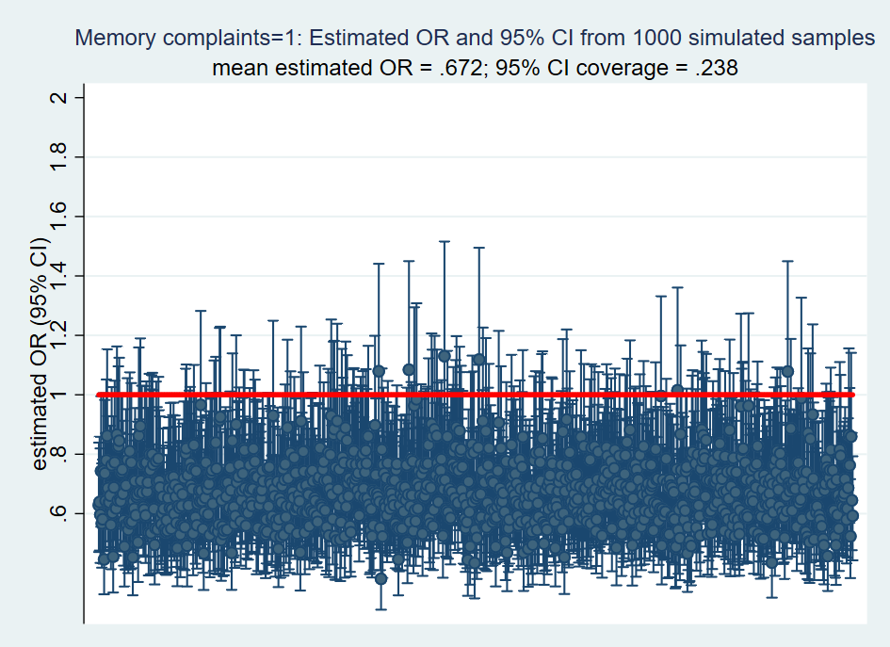


Simulation results: $\hat{OR}$and 95% CI among Memory complaints = 1
${\overline{\hat{OR}}}_{AY|S=1}$ = 0.672; 23.8% of 95% CI’s include $ORAY$ = 1.0
Notes:
. /***List results across the B iterations of sample generation***/
.
. *Check proportions of people with:
. *exposure (A) = 1
. *selection (S) = 1
. *outcome (Y) = 1
. *outcome (Y) = 1 by exposure (A)
. scalar list mean_p_A mean_p_S mean_p_Y mean_p_Y_A1 mean_p_Y_A0 mean_mean_U
mean_p_A = .2
mean_p_S = .221
mean_p_Y = .108
mean_p_Y_A1 = .108
mean_p_Y_A0 = .108
mean_mean_U = 0
.
. *Check proportion of people with outcome (Y) = 1 by exposure (A) among S=1
. scalar list mean_p_Y_A1_S1 mean_p_Y_A0_S1
mean_p_Y_A1_S1 = .193
mean_p_Y_A0_S1 = .265
.
. *Check distribution of U by A among S=1
. scalar list mean_mean_U_A1_S1 mean_mean_U_A0_S1
mean_mean_U_A1_S1 = .666
mean_mean_U_A0_S1 = .984
.
. *Check distribution of U by A among full sample
. scalar list mean_U_A1_all mean_U_A0_all
mean_U_A1_all = .02375461
mean_U_A0_all = .01667605
.
. *Check ORs and 95% CI coverage in whole population (no bias anticipated)
. scalar list mean_OR_AY_all
mean_OR_AY_all = 1.008
. scalar list P_covg_OR_AY_all
P_covg_OR_AY_all = .94
.
. *Estimate of primary interest: Estimated ORs among S=1
. scalar list mean_OR_AY_S1
mean_OR_AY_S1 = .672
.
. *Proportion of 95% CIs that include the causal/true OR 95% CI coverage)
. scalar list P_covg_OR_AY_S1
P_covg_OR_AY_S1 = .238

Slide 62
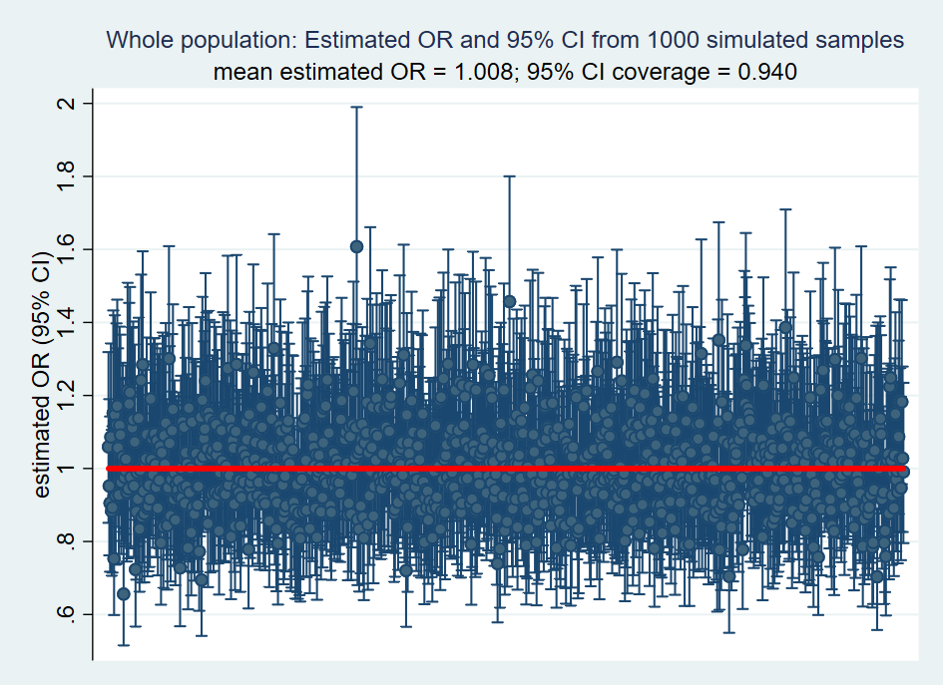

Simulation results: $\hat{OR}$and 95% CI in whole sample
${\overline{\hat{OR}}}_{AY}$ = 1.008; 94.0% of 95% CI’s include $ORAY$ = 1.0
Notes:
. /***List results across the B iterations of sample generation***/
.
. *Check proportions of people with:
. *exposure (A) = 1
. *selection (S) = 1
. *outcome (Y) = 1
. *outcome (Y) = 1 by exposure (A)
. scalar list mean_p_A mean_p_S mean_p_Y mean_p_Y_A1 mean_p_Y_A0 mean_mean_U
mean_p_A = .2
mean_p_S = .221
mean_p_Y = .108
mean_p_Y_A1 = .108
mean_p_Y_A0 = .108
mean_mean_U = 0
.
. *Check proportion of people with outcome (Y) = 1 by exposure (A) among S=1
. scalar list mean_p_Y_A1_S1 mean_p_Y_A0_S1
mean_p_Y_A1_S1 = .193
mean_p_Y_A0_S1 = .265
.
. *Check distribution of U by A among S=1
. scalar list mean_mean_U_A1_S1 mean_mean_U_A0_S1
mean_mean_U_A1_S1 = .666
mean_mean_U_A0_S1 = .984
.
. *Check distribution of U by A among full sample
. scalar list mean_U_A1_all mean_U_A0_all
mean_U_A1_all = .02375461
mean_U_A0_all = .01667605
.
. *Check ORs and 95% CI coverage in whole population (no bias anticipated)
. scalar list mean_OR_AY_all
mean_OR_AY_all = 1.008
. scalar list P_covg_OR_AY_all
P_covg_OR_AY_all = .94
.
. *Estimate of primary interest: Estimated ORs among S=1
. scalar list mean_OR_AY_S1
mean_OR_AY_S1 = .672
.
. *Proportion of 95% CIs that include the causal/true OR 95% CI coverage)
. scalar list P_covg_OR_AY_S1
P_covg_OR_AY_S1 = .238

Slide 63
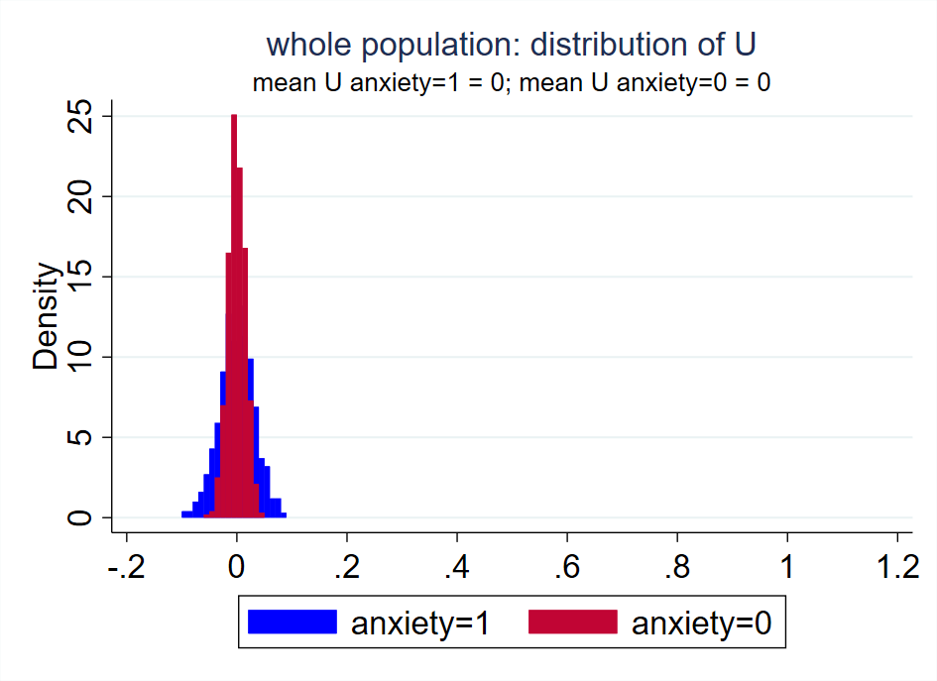
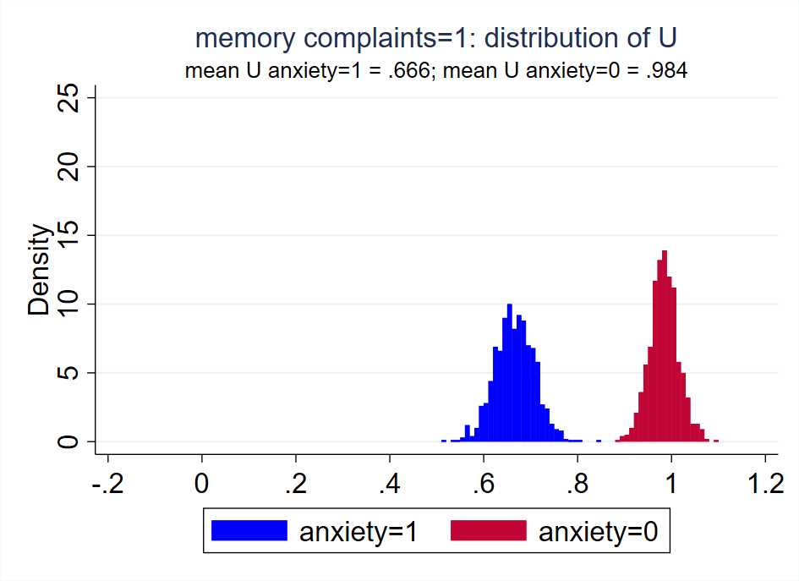
Spurious association between anxiety and stroke induced by conditioning on memory complaints
Because our hypothetical study was restricted to people with memory complaints, participants with anxiety have lower burden of underlying cerebrovascular disease….and therefore lower risk of acute stroke
Anxiety
Memory complaints
Acute stroke
Cerebrovascular disease

Slide 65
Simulating information bias (briefly)
Measurement error for continuous variable X
Generate variable that represents “true” value of X (X_true)
Generate variable that represents measurement error for X (X_error)
Generate variable that represents “measured” value of X X_measured = X_true + X_error

Slide 66
For simplicity, we only looked at a few simulation results today, but in practice, we recommend:
  Many sanity checks (did you simulate the data you intended to?)
  Simulation results: Calculate mean(estimate), bias, % bias, mean(estimated SE), empirical SE, root mean square error (RMSE), 95% CI coverage, estimate median and 2.5th and 97.5th percentiles
For simplicity, we only considered one causal structure and set of parameter inputs for each source of bias, but in practice, we recommend considering several causal structures/sets of input parameters
Notes:
empirical SE = standard deviation of estimates of interest from all iterations of sample generation.

