Slide 1
Non-Mendelian Genetics
Epidemiology 217: Lecture 8
Eric Jorgenson, PhD
February 26th, 2019
Kaiser Permanente Research

Slide 2
Epigenetics, Epistasis, and
Linking GWAS Findings to Function
Non-Mendelian Genetics
Epidemiology 217: Lecture 8
Eric Jorgenson, PhD
February 26th, 2019
Kaiser Permanente Research

Slide 3
Outline
A GWAS Example: Inguinal Hernia
Epigenetics: DNA Methylation and Histone Modification
Epistasis: Cutaneous Squamous Cell Carcinoma

Slide 4
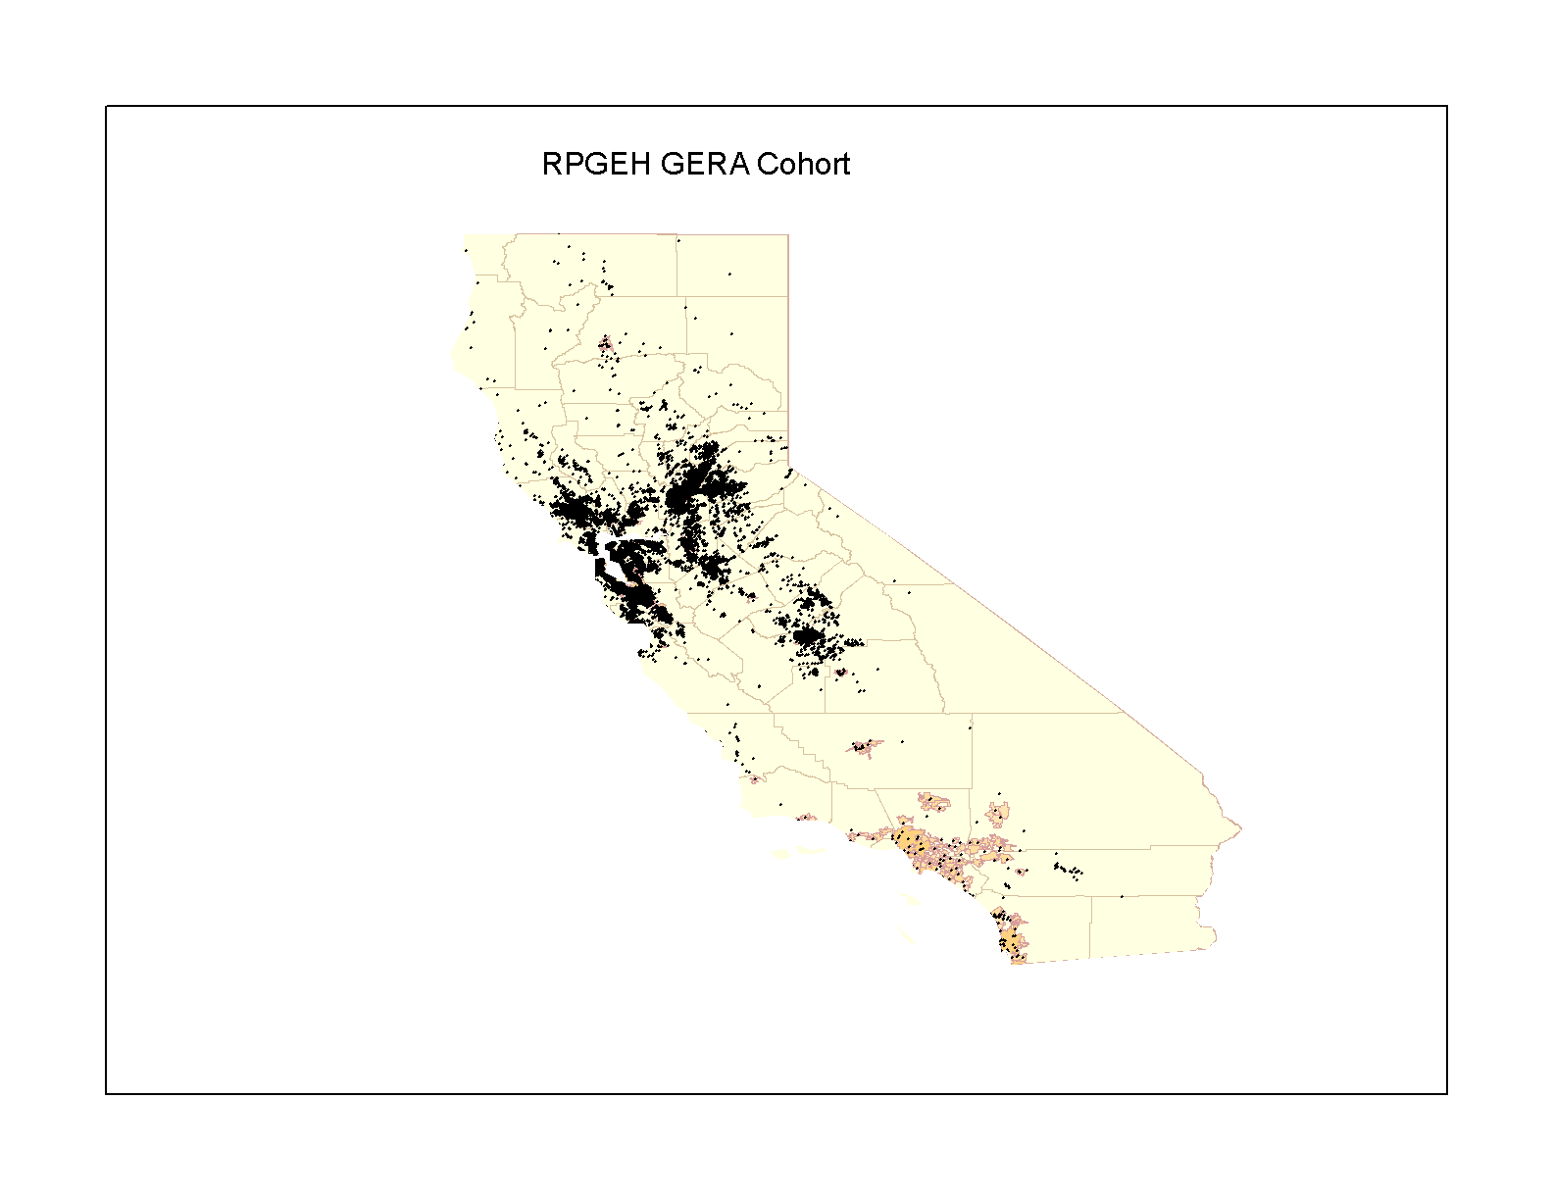
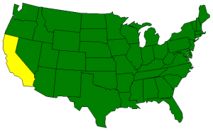
Kaiser Permanente Northern California Members
4
Notes:
GERA participants live in Northern California

Slide 5
Research Program on Genes, Environment, and Health
430,000 Adult Members of Kaiser Permanente Northern California Provided Informed Consent
Behavioral and
Demographic Data
from Surveys
Kaiser Permanente
Electronic
Health Records
RPGEH Resource
For Research
Genetic Data
from Biospecimens
Environmental
Exposure Data
Research Studies
Co-directors: Catherine Schaefer and Neil Risch
Notes:
A resource for studies of the genetic and environmental influences
on health, disease, and aging (2007)
RPGEH developed by Cathy and Neil
Build a resource
430K
Combines…
Initially funded by:
The Robert Wood Johnson Foundation
The Wayne and Gladys Valley Foundation
The Ellison Medical Foundation
Kaiser Permanente’s Community Benefit Program

Slide 6
RPGEH Survey Respondents, Biospecimens, and GERA
430,000 Survey Respondents
190,000 Biospecimens
110,266 GERA Cohort
Notes:
In total, 430K, >190K,
GERA includes 110,266

Slide 7
GERA Cohort Characteristics
 | Number of Subjects | %
Age at Specimen Donation
18-39 | 7,025 | 6.3
40-59 | 33,344 | 30.2
60-79 | 57,856 | 52.4
80+ | 12,041 | 10.9
Sex
Women | 63,883 | 57.9
Men | 46,383 | 42.1
Race/Ethnicity
African American | 3,765 | 3.4
Asian | 8,512 | 7.7
Hispanic | 7,917 | 7.2
Non-Hispanic White | 89,259 | 81.0
Total | 110,266 | 100.0
Notes:
Baseline characteristics
More women than men
Broad age range: average 62
Diverse

Slide 8
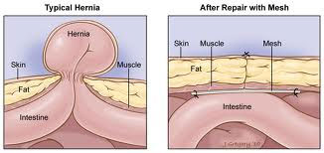
Hernia: A Common Condition
Hernia Repair Surgery

Slide 9
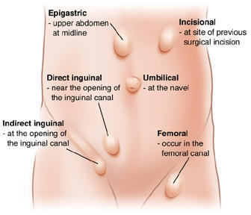
Hernias Are Classified by Anatomical Site
Hernia Repair Surgery

Slide 10
Inguinal Hernias Are Common in GERA
Hernia Repair Surgery
GERA Cohort | Inguinal Hernia Cases |  |  |  |  |  | Controls
Non-Hispanic whites | All (n=5,295) |  | Direct (n=2,335) |  | Indirect (n=2,647) |  | (n=67,510)
Men | 4,746 | 89.6% | 2,193 | 93.9% | 2,408 | 91.0% | 25,011 | 37.1%
Women | 549 | 10.4% | 142 | 6.1% | 239 | 9.0% | 42,499 | 63.0%
Jorgenson et al. Nature Communications 2015
Notes:
Hernia Type
ICD9 Diagnosis Codes
ICD9 Procedure Codes
CPT4 Codes
Inguinal Hernia
550.x
17.x, 53.0x, 53.1x
49491, 49492, 49495, 49496, 49500, 49501, 49505, 49507, 49520, 49521, 49525, 49650, 49651, 49659
Direct Inguinal
17.11, 17.21, 17.23, 53.01, 53.03, 53.11, 53.14, 53.13, 53.16, 53.17
Indirect Inguinal
17.12, 17.22, 17.23, 53.02, 53.04, 53.12, 53.15, 53.13, 53.16, 53.17

Slide 11
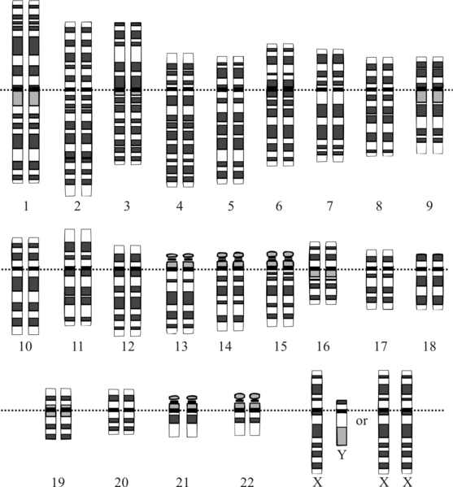
The Human Genome Is 3.2 Billion Basepairs Long

Slide 12
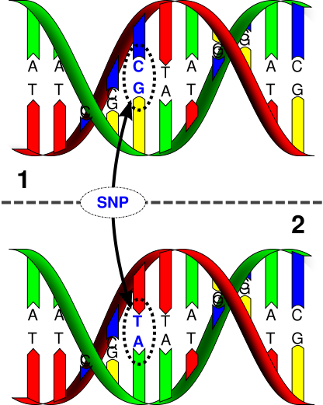
Single Nucleotide Polymorphism (SNP)

Slide 13
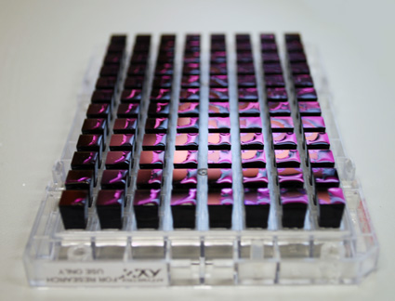
Genotyping Arrays Measure Millions of SNPs in Parallel

Slide 14
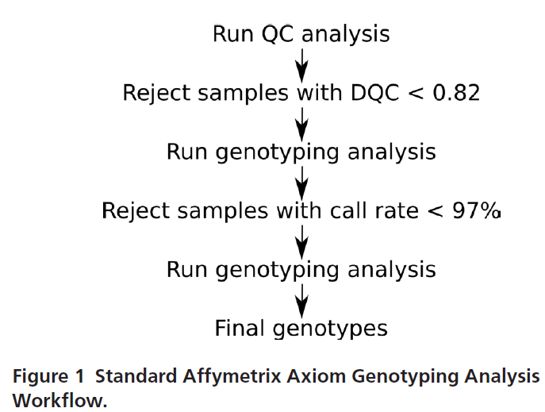
Sample QC Workflow
Kvale et al. Genetics 2015

Slide 15
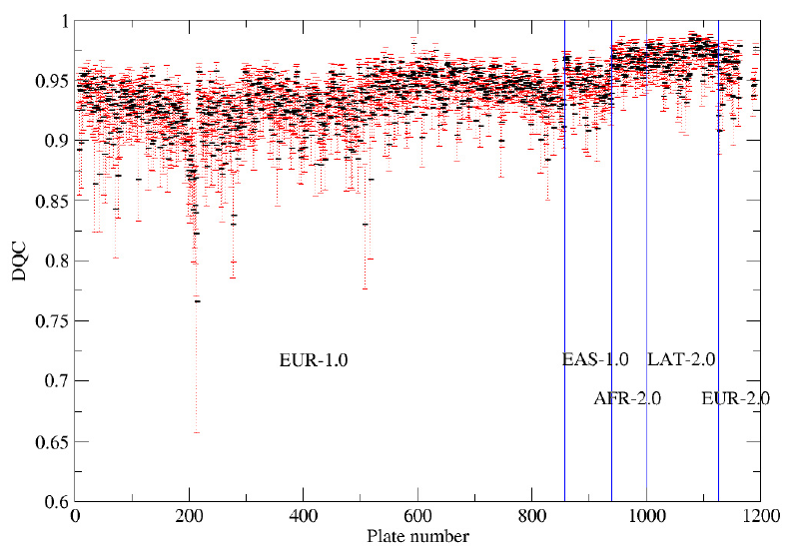
Genotyping Performance Was Tracked in Real Time
Kvale et al. Genetics 2015

Slide 16
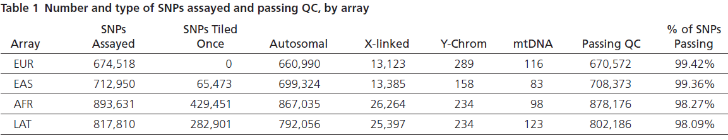
SNP Quality Control
Kvale et al. Genetics 2015

Slide 17
GWAS Can Identify Loci, Not Genes
Hernia Phenotype Development
Genetic Data
Development
Genetic Analysis of Hernia Risk
Hernia Genetic Risk Loci
Hernia Risk Alleles

Slide 18
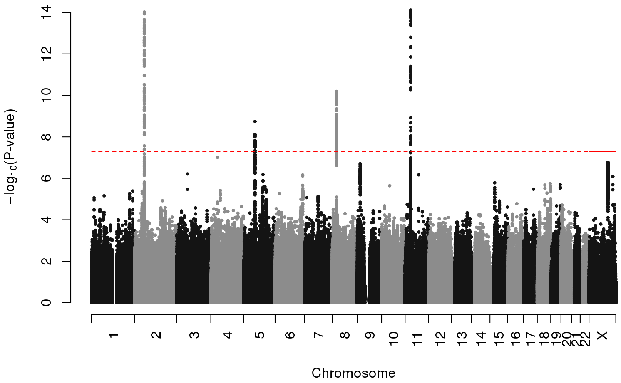
Manhattan Plot of Inguinal Hernia GWAS Results
EFEMP1
WT1
EBF2
ADAMTS6
Jorgenson et al. Nature Communications 2015
Notes:
Figure 1. Manhattan plot of GWAS findings in the GERA discovery cohort. Four novel inguinal hernia risk loci with genome-wide significant associations were identified in the regions of EFEMP1 (chromosome 2), ADAMTS6 (chromosome 5), EBF2 (chromosome 8), and WT1 (chromosome 11). The dotted red line represents a significance threshold of P=5.0x10⁻⁸.

Slide 19
Hernia Repair Replication Sample: 23&Me Subjects
“Have you ever had any of the following gastrointestinal surgeries (Hernia repair)?”
23&Me Subjects | Hernia Repair Cases (n=9,701) |  | Controls (n=82,743)
Men | 6,812 | 70.2% | 41,611 | 50.2%
<30 | 246 | 3.6% | 5,147 | 12.4%
31-45 | 1,087 | 16.0% | 14,109 | 33.9%
46-60 | 1,605 | 23.6% | 10,259 | 24.7%
>60 | 3,874 | 56.9% | 12.096 | 29.1%
Women | 1,889 | 29.8% | 41,132 | 49.8%
<30 | 63 | 3.3% | 4,252 | 10.3%
31-45 | 317 | 16.8% | 11,099 | 27.0%
46-60 | 603 | 31.9% | 11,431 | 27.8%
>60 | 906 | 48.0% | 14,350 | 34.9%
Jorgenson et al. Nature Communications 2015
Notes:
“Have you ever had any of the following gastrointestinal surgeries (Hernia repair)?”

Slide 20
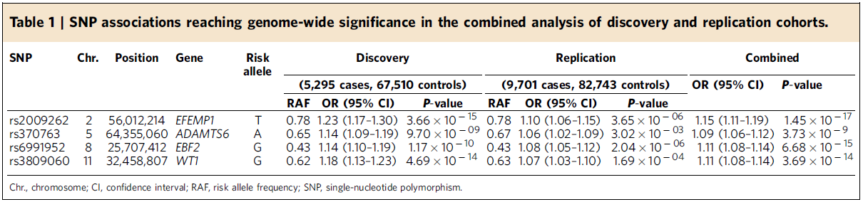
Replication of Inguinal Hernia Significant Associations
Jorgenson et al. Nature Communications 2015
Notes:
Top associated SNPs at four loci replicate in an independent sample

Slide 21
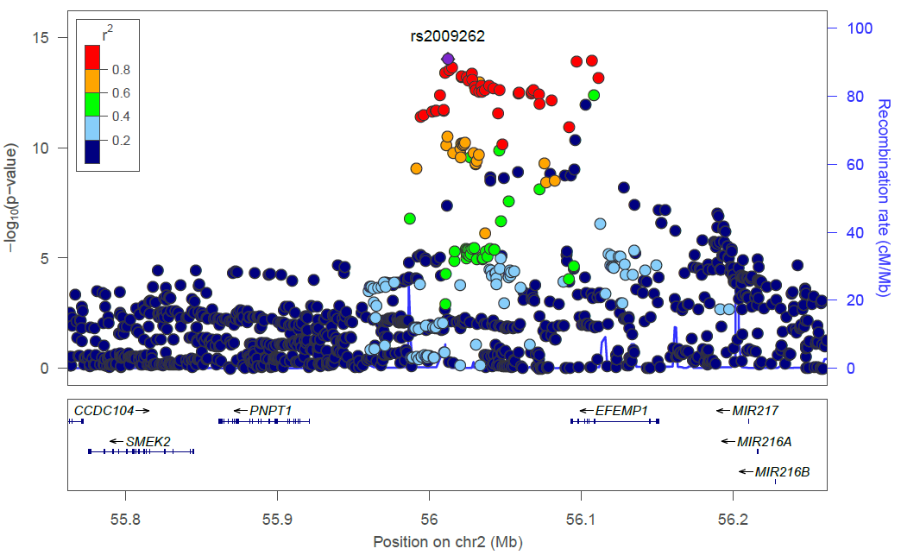
Each Inguinal Hernia Risk Locus Includes Many SNPs
Jorgenson et al. Nature Communications 2015
Notes:
Supplementary Figure 1: (A-D) Locus Zoom plots of the top four loci associated with inguinal hernia in the GERA discovery cohort. Plots show association results of SNPs in the GWAS of the GERA cohort samples and recombination rates. Each circle represents the -log₁₀ P value (y axes) and chromosomal position (x axes) of SNPs tested for association. The top associated SNP in each region is identified by its rsID. The color of each circle reflects the extent of LD with the top SNP. Physical positions are based on NCBI build 37 of the human genome. The relative position of genes and transcripts are displayed below the association plot.

Slide 22
Can We Link Hernia Risk Loci to Specific Genes?
Hernia Phenotype Development
Genetic Data
Development
Genetic Analysis of Hernia Risk
Hernia Genetic Risk Loci
Hernia Risk Alleles
qRT-PCR and RNA-seq of Genes in Hernia Risk Loci
Tissue Specific Expression of Putative Risk Genes

Slide 23
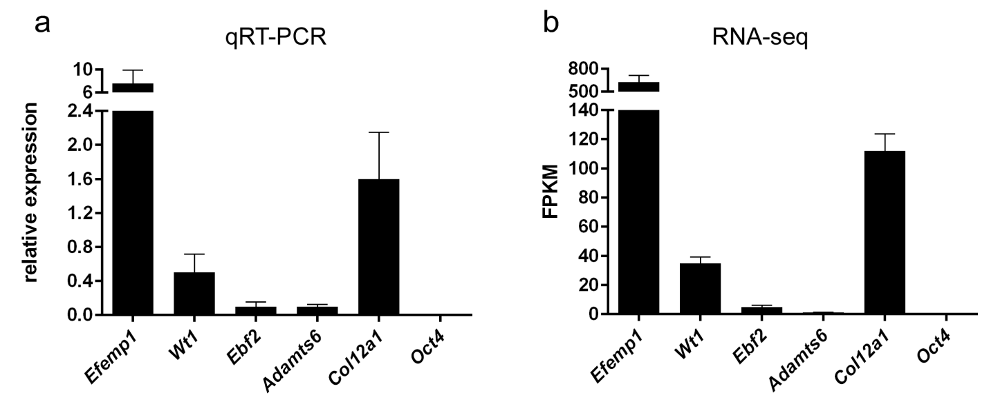
Genes at Inguinal Hernia Risk Loci are Expressed in Mouse Connective Tissue
Jorgenson et al. Nature Communications 2015
Notes:
Note that it is not proven that these are the causal genes

Slide 24
What Have We Learned about Inguinal Hernia Genetics?
4 Inguinal Hernia Risk Loci
  Confirmed through replication in an independent cohort
  Genes in the loci are expressed in equivalent mouse tissue
Hernia Loci Show Evidence of Pleiotropy
  EFEMP1: Height, Forced Vital Capacity, Multiple Cancers
  WT1: Wilms’ Tumor, Tuberculosis
  EBF2: Prostate Cancer (different area in the gene)
  ADAMTS6: Central Corneal Thickness, Osteosarcoma
Moving Toward Mechanism
  Collagen homeostasis
  Matrix metalloproteinases and their inhibitors (WT1 and ADAMTS6)
  Elastin and chronic obstructive pulmonary disease (EFEMP1)

Slide 25
What Have We Learned about Inguinal Hernia Genetics?
4 Inguinal Hernia Risk Loci
  Confirmed through replication in an independent cohort
  Genes in the loci are expressed in equivalent mouse tissue
Hernia Loci Show Evidence of Pleiotropy
  EFEMP1: Height, Forced Vital Capacity, Multiple Cancers
  WT1: Wilms’ Tumor, Tuberculosis
  EBF2: Prostate Cancer (different area in the gene)
  ADAMTS6: Central Corneal Thickness, Osteosarcoma
Moving Toward Mechanism
  Collagen homeostasis
  Matrix metalloproteinases and their inhibitors (WT1 and ADAMTS6)
  Elastin and chronic obstructive pulmonary disease (EFEMP1)

Slide 26
What Have We Learned about Inguinal Hernia Genetics?
4 Inguinal Hernia Risk Loci
  Confirmed through replication in an independent cohort
  Genes in the loci are expressed in equivalent mouse tissue
Hernia Loci Show Evidence of Pleiotropy
  EFEMP1: Height, Forced Vital Capacity, Multiple Cancers
  WT1: Wilms’ Tumor, Tuberculosis
  EBF2: Prostate Cancer (different area in the gene)
  ADAMTS6: Central Corneal Thickness, Osteosarcoma
Moving Toward Mechanism
  Collagen homeostasis
  Matrix metalloproteinases and their inhibitors
  Elastin and chronic obstructive pulmonary disease

Slide 27
What Do We Still Need to Learn about Hernia Genetics?

Slide 28
What Do We Still Need to Learn about Hernia Genetics?
Where are the Regulatory Elements in Hernia Risk Loci?

Slide 29
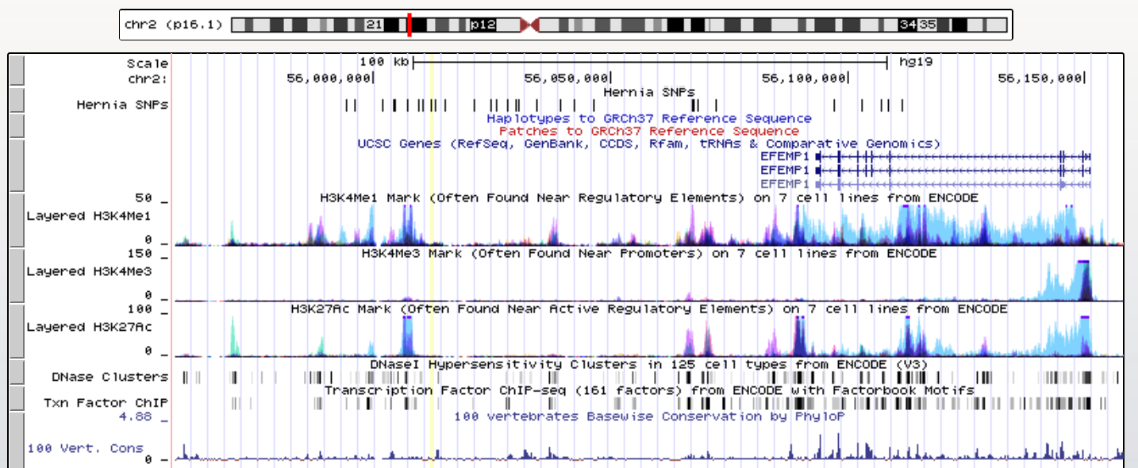
Genomic Context of Hernia SNPs in the EFEMP1 Region

Slide 30
Genomic Context of Hernia SNPs in the EFEMP1 Region

Slide 31
Genomic Context of Hernia SNPs in the EFEMP1 Region
rs2009262

Slide 32

Genes Are Like Lightbulbs
Genes

Slide 33
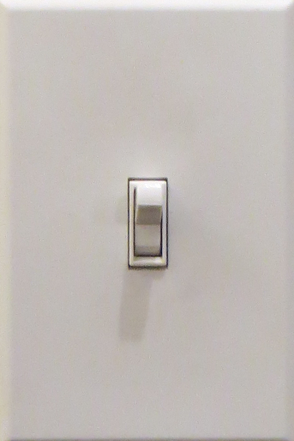
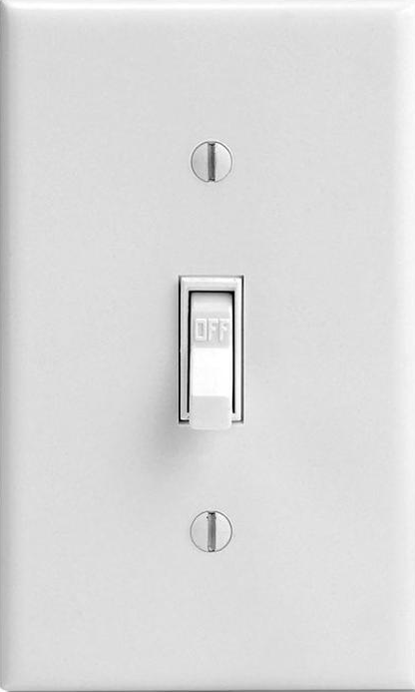
Genes Are Like Lightbulbs
Genes
Promoters

Slide 34
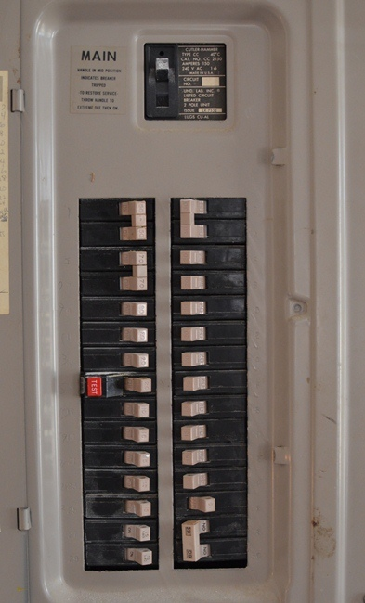
Genes Are Like Lightbulbs
Genes
Enhancer
Promoters

Slide 35
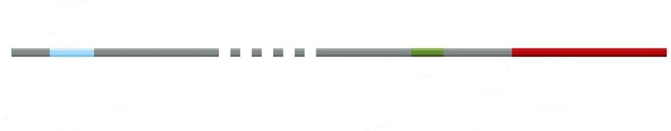
Proteins Bind Regulatory Elements
Enhancer Promoter Gene

Slide 36
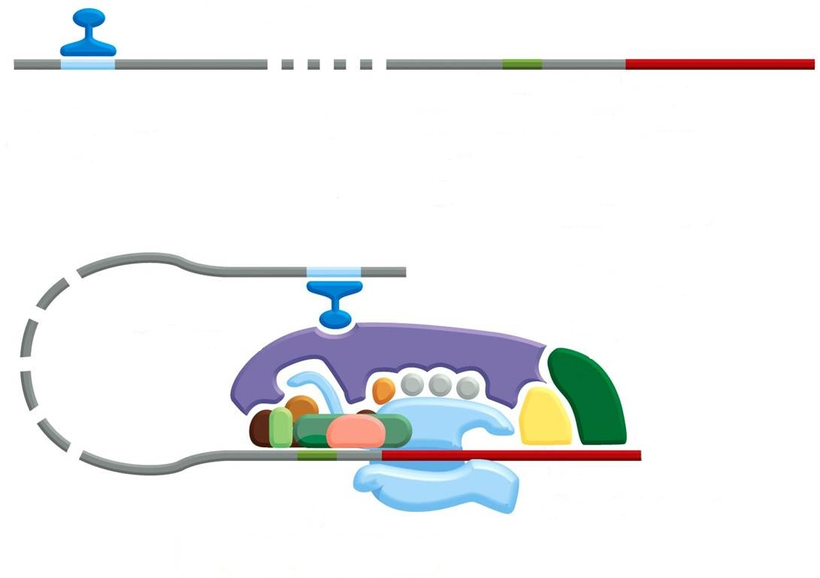
Proteins Bind Regulatory Elements
Activator
Enhancer Promoter Gene

Slide 37
Proteins Bind Regulatory Elements
Activator
Enhancer Promoter Gene

Slide 38
Outline
A GWAS Example: Inguinal Hernia
Epigenetics: DNA Methylation and Histone Modification
Epistasis: Cutaneous Squamous Cell Carcinoma

Slide 39
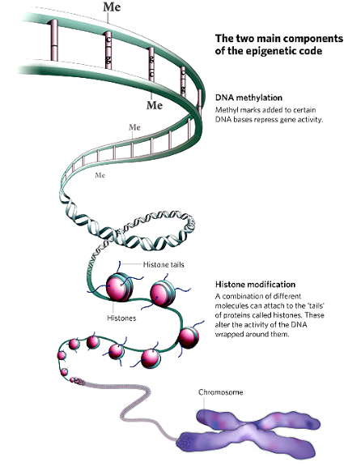
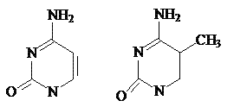
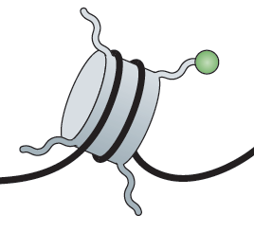
The Two Main Components of the Epigenetic Code
DNA methylation
Histone modification
Notes:
DNA Methylation occurs predominantly at CpG dinucleotides in mammals
Different molecules can attach to the tails of proteins called “histones”

Slide 40
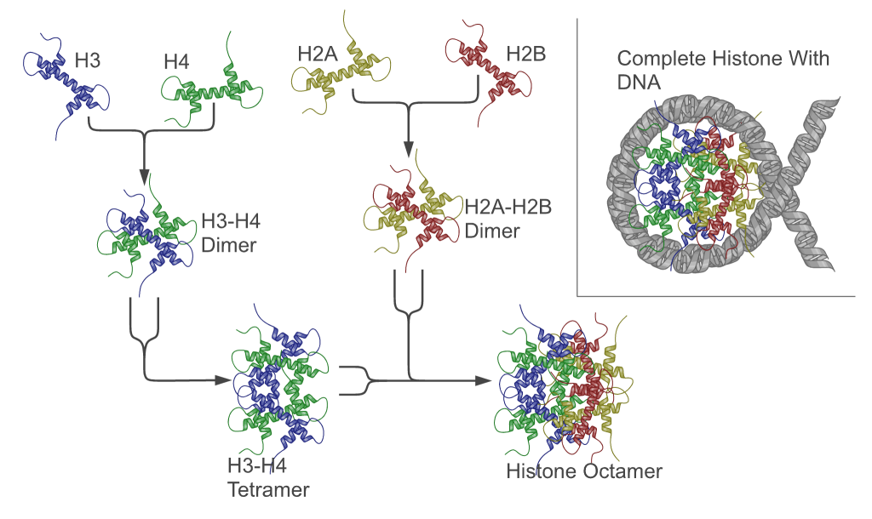
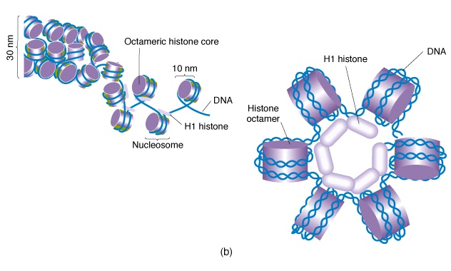
Chromatin: Histones Provide Structure to DNA
Chromatin
Notes:
Histones are proteins; they combine to form an octamer (8 subunits)
DNA wraps around the histone octamer twice to form a nucleosome
The resulting structured DNA and protein complex is called chromatin
Changes in chromatin lead to changes in gene regulation
in eukaryotes
80bp DNA = 1 turn
DNA wraps two times and 145bp DNA associates with each core
Linker DNA = 55bp
Human nucleus = 15-30 x 10⁶ nucleosomes

Slide 41
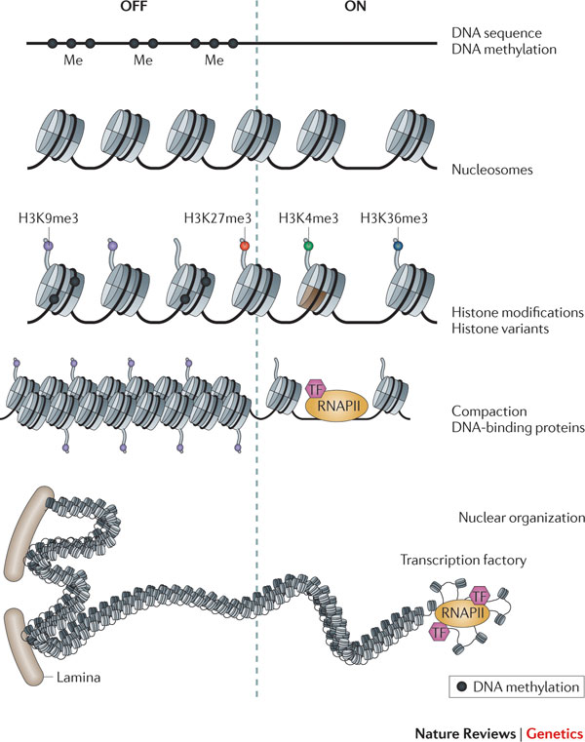
Acetylation Reduces Histone Binding to DNA
AC
Transcription factor
Transcription ON
Closed
Open
Notes:
Neutralization of positively charged lysines by acetylation reduces the strength of binding of the histones to the negatively charged DNA and thus opens DNA binding sites.

Slide 42
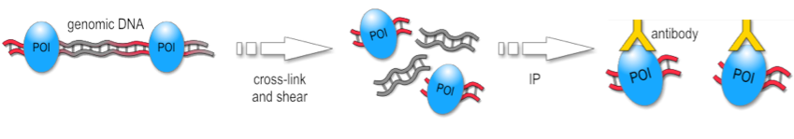
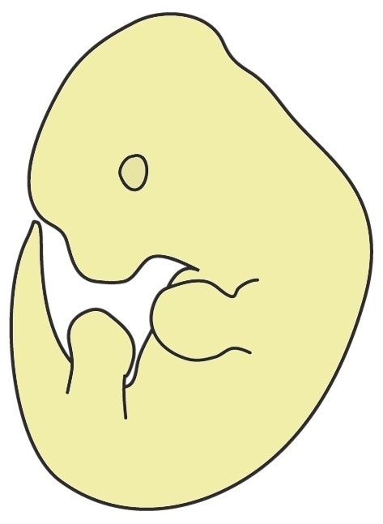
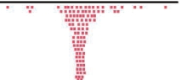
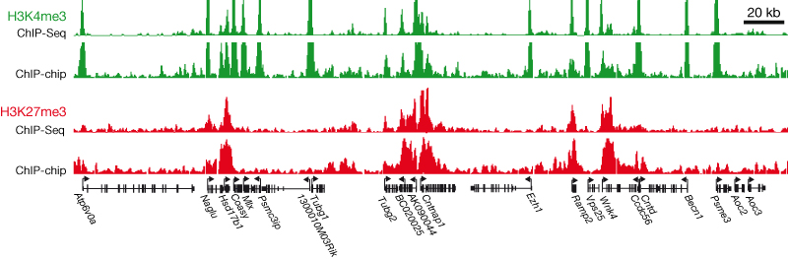
ChIP-seq Can Identify Regulatory Elements
Cross-link DNA and Proteins
Shear DNA
Isolate Tissue
Immunoprecipitate
Reverse Cross-link
Sequence and Map Reads
Determine Location

Slide 43
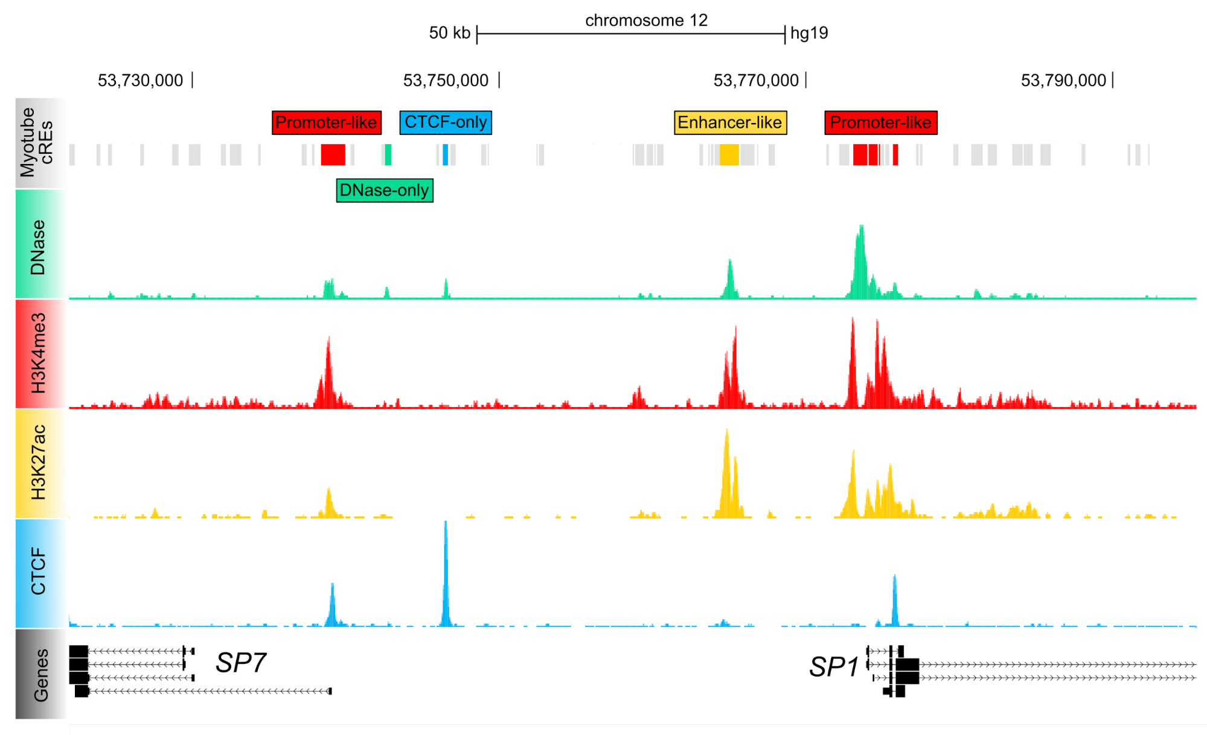
ENCODE has Cataloged Different Types of Marks
https://www.encodeproject.org/data/annotations

Slide 44
EFEMP1: rs2009262 is not in a Regulatory Element Mark
rs2009262

Slide 45
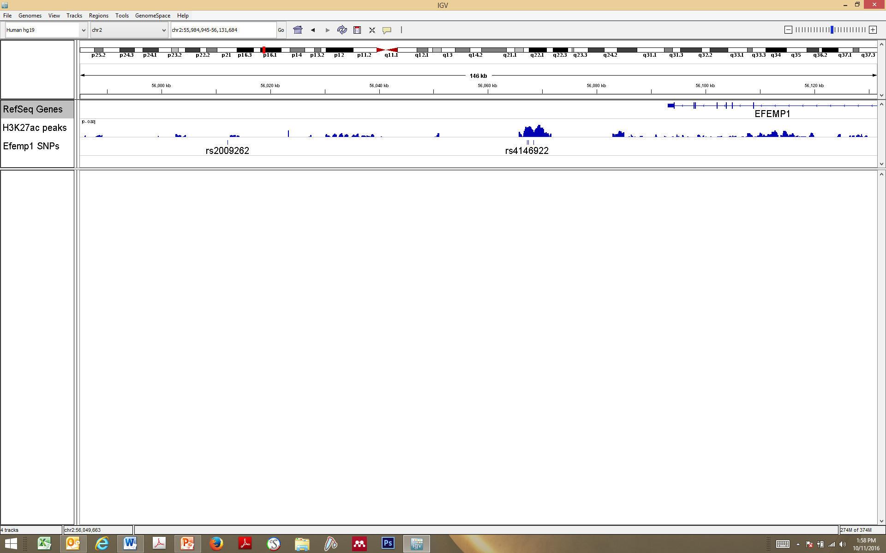
3 SNPs in Connective Tissue Enhancer Marks
l
l
l
l
l
56,100 kb
chr2
l
l
l
l
56,060 kb
l
56,020 kb
56,080 kb
l
56,040 kb
EFEMP1
H3K27ac
l
l
rs2009262
rs4146921
l
rs4146922
l
rs7563032
Notes:
We did ChIP-seq in mouse connective tissue
Blue peaks indicated potential enhancer locations
Top SNP rs2009262 not in an enhancer
3 SNPs in LD
May alter enhancer function and consequently hernia risk
Connective Tissue H3K27ac ChIP-seq

Slide 46
Identifying Causal Variants
Hernia Phenotype Development
Genetic Data
Development
Genetic Analysis of Hernia Risk
Hernia Genetic Risk Loci
Hernia Risk Alleles
qRT-PCR and RNA-seq of Genes in Hernia Risk Loci
ChIP-seq and Differential Enhancer Assays
CRISPR/Cas9 of
Associated Alleles
Tissue Specific Expression of Putative Risk Genes
Regulatory Elements in Hernia Risk Loci
Alterations in Regulatory Elements Influence Risk
Notes:
CRISPR/Cas9

Slide 47
Can We Link Risk SNPs to Specific Genes?

Slide 48
Chromosomes are Organized into
Topologically Associating Domains (TADs)
Matharu and Ahituv
PLoS Genetics 2015

Slide 49

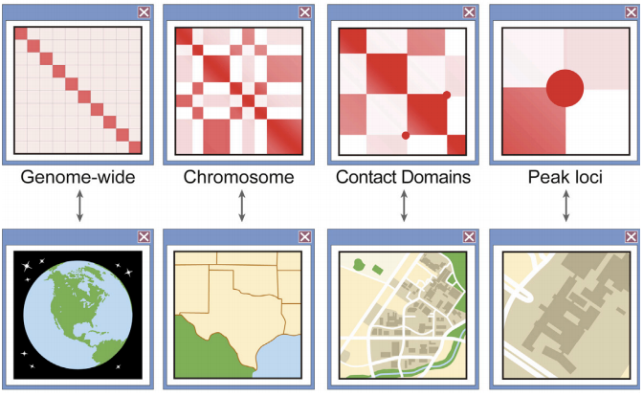
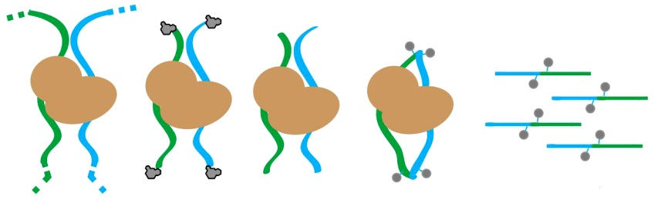
Hi-C contact map
Chromatin conformation capture (Hi-C)
Adaptor
ligation
Proximity ligation
NGS Library
Fixation
Digestion
Ramani et al. Nature Protocols 2016

Slide 50
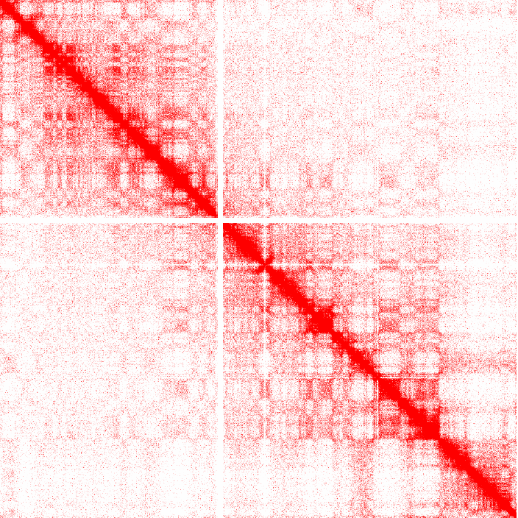
Chromosome Conformation Capture Example
Modified from Lazar et al. Genome Research 2018

Slide 51
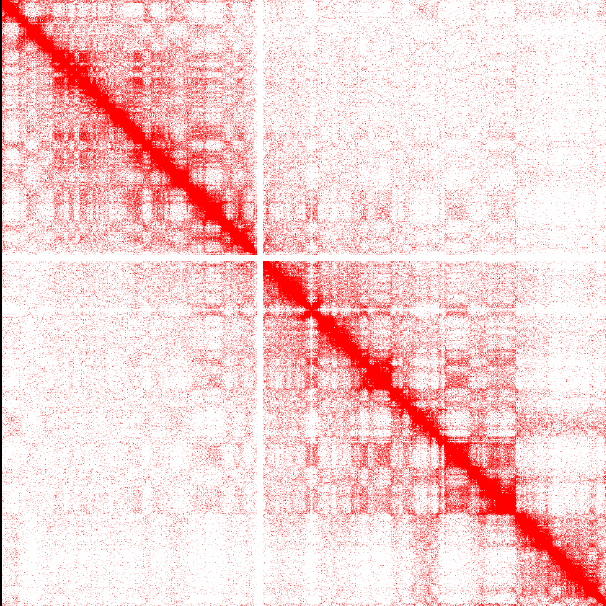
Chromosome Conformation Capture Example
12q3
Modified from Lazar et al. Genome Research 2018

Slide 52

TADs around the EFEMP1 Locus
http://promoter.bx.psu.edu/hi-c/

Slide 53
TADs around the EFEMP1 Locus
http://promoter.bx.psu.edu/hi-c/

Slide 54
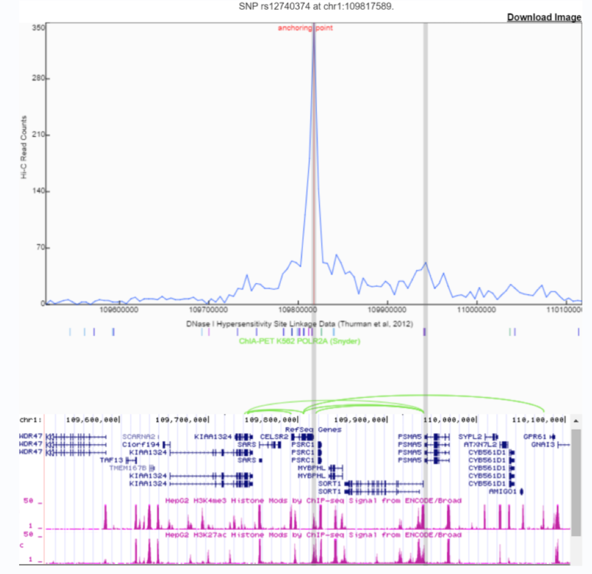
Virtual 4C Shows Interactions with rs2009262
http://promoter.bx.psu.edu/hi-c/

Slide 55
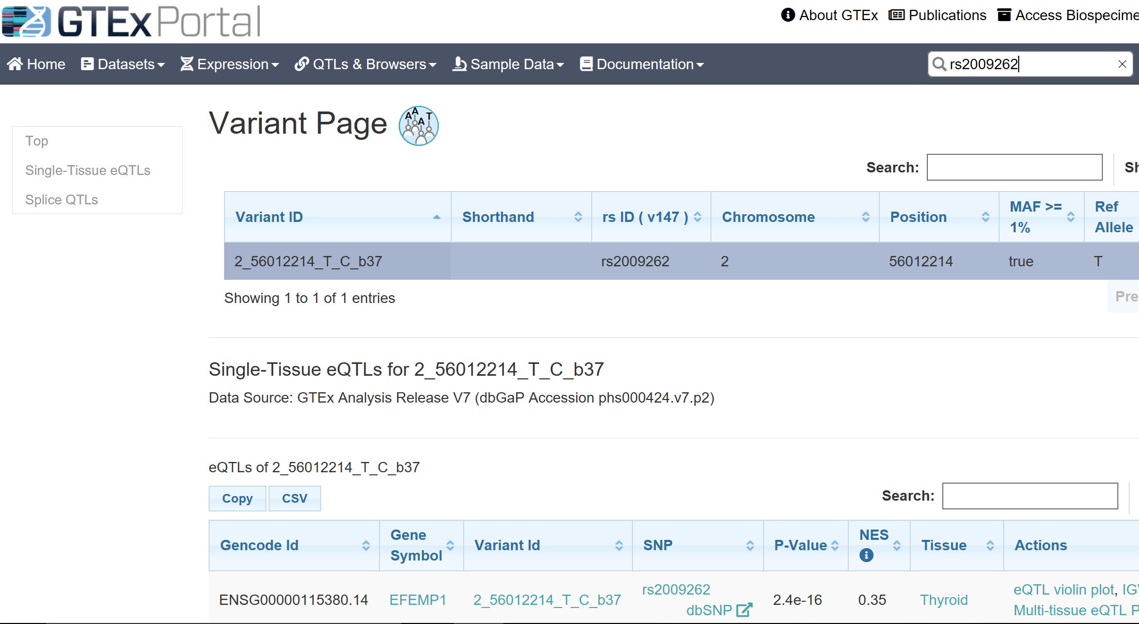
Does rs2009262 Affect EFEMP1 Gene Expression?
https://www.gtexportal.org/home

Slide 56
Outline
A GWAS Example: Inguinal Hernia
Epigenetics: DNA Methylation and Histone Modification
Epistasis: Cutaneous Squamous Cell Carcinoma

Slide 57
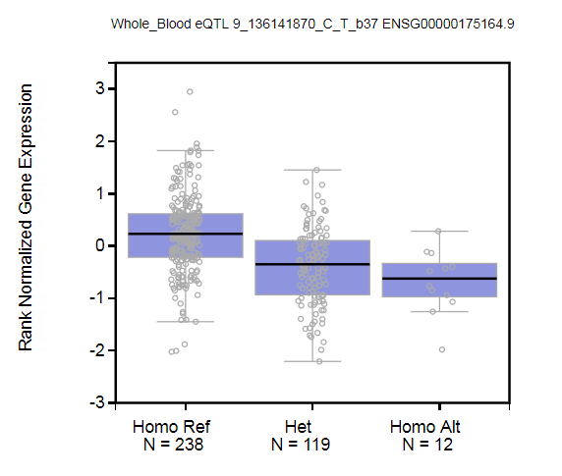
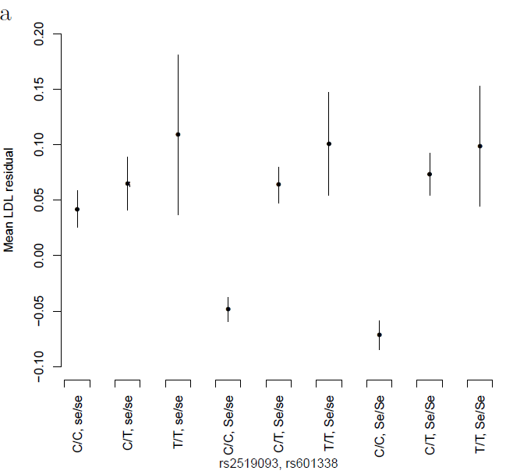
Epistasis: LDL and a FUT2 x ABO Interaction
rs492602 (FUT2) and rs2519093 (ABO) are hits in overall GWAS
Interaction P_{LDL}= 8.1x10⁻¹⁰
FUT2 secretor status and greater ABO expression lower LDL
Hoffmann et al. Nature Genetics 2018
https://gtexportal.org/home/snp/rs2519093
Notes:
. The SNP in ABO is *not* blood type.

Slide 58
Cutaneous Squamous Cell Carcinoma (cSCC)
4.3 Million cases per year of non-melanoma skin cancer
$4.8 Billion public health costs
4,000 Deaths per year
Asgari et al. JID 2016

Slide 59
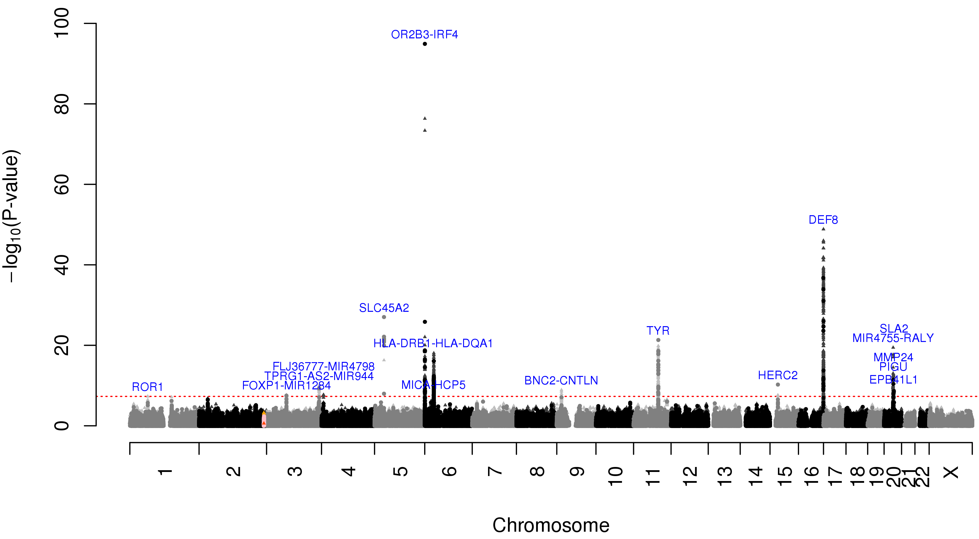
GWAS of cSCC in GERA
Asgari et al. JID 2016

Slide 60
GWAS of cSCC in 23&Me
Chahal et al. Nature Communications 2016

Slide 61
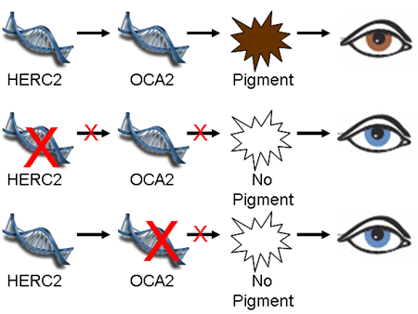
Epistasis and Eye Color
https://genetics.thetech.org/how-blue-eyed-parents-can-have-brown-eyed-children

Slide 62
cSCC Risk by HERC2 and OCA2 Genotypes
 |  | rs12916300 (HERC2)
 | OR (CI) | CC | CT | TT
rs1800407 (OCA2) | CC | 1.00 (ref) | 1.45 (1.26, 1.66) | 1.91 (1.67, 2.18)
 | CT | 1.25 (0.99, 1.57) | 2.13 (1.83, 2.48) | 1.84 (1.55, 2.19)
 | TT | 2.26 (1.40, 3.65) | 1.76 (1.12, 2.76) | 1.85 (0.83, 4.11)

Slide 63
Subjects with Blue Eyes have Similar cSCC Risk
 |  | rs12916300 (HERC2)
 | OR (CI) | CC | CT | TT
rs1800407 (OCA2) | CC | 1.00 (ref) | 1.45 (1.26, 1.66) | 1.91 (1.67, 2.18)
 | CT | 1.25 (0.99, 1.57) | 2.13 (1.83, 2.48) | 1.84 (1.55, 2.19)
 | TT | 2.26 (1.40, 3.65) | 1.76 (1.12, 2.76) | 1.85 (0.83, 4.11)

Slide 64
Interaction Coding Does Not Reflect Blue Eye Phenotype
Allele Coding
 | OR (CI) | CC | CT | TT
 | CC | 0 | 0 | 0
 | CT | 0 | 1 | 2
 | TT | 0 | 2 | 4
0 1 2
0 1 2
Interaction p > 0.05

Slide 65
Interaction Coding Does Not Reflect Blue Eye Phenotype
Allele Coding
 | OR (CI) | CC | CT | TT
 | CC | 1.00 (ref) | 1.45 (1.26, 1.66) | 1.91 (1.67, 2.18)
 | CT | 1.25 (0.99, 1.57) | 2.13 (1.83, 2.48) | 1.84 (1.55, 2.19)
 | TT | 2.26 (1.40, 3.65) | 1.76 (1.12, 2.76) | 1.85 (0.83, 4.11)
0 1 2
0 1 2
Interaction p > 0.05

Slide 66
Paper Discussion

