Slide 1
Genetic Variation in the SIM1 Locus is Associated with Erectile Dysfunction
Eric Jorgenson, PhD
Kaiser Permanente Division of Research
February 26th, 2019
Kaiser Permanente Research

Slide 2
What Is the Public Health Relevance of the Study?

Slide 3
The Prevalence of Erectile Dysfunction Increases with Age
Adapted from Reference 2: Wessells et al. Journal of Urology 2007

Slide 4
There are Different Types of ED and Risk Factors for ED
Reference 3: Lue. New England Journal of Medicine 2000
Notes:
Erectile dysfunction is a common and costly disease of men in
middle and older ages (1, 2). Its pathophysiology is tied to
psychosocial, neurological, hormonal, and vascular factors (3).
Epidemiological studies have shown that age, obesity, diabetes,
benign prostatic hyperplasia (BPH), lower urinary tract symptoms,
hyperlipidemia, cardiovascular disease, and smoking are
important risk factors in erectile dysfunction susceptibility (4).
There is also substantial evidence that genetics influence the risk
of erectile dysfunction. A twin study in middle-aged male
veterans found that about one-third of the risk is heritable,
independent of known erectile dysfunction risk factors (5).
However, subsequent association studies searching for specific
genetic contributors have been limited by small sample sizes, a
reliance on limited candidate-gene approaches, and weak phenotyping.
As a result, there are no confirmed genetic risk factors for erectile dysfunction (6).

Slide 5
What Is the Study Setting?

Slide 6
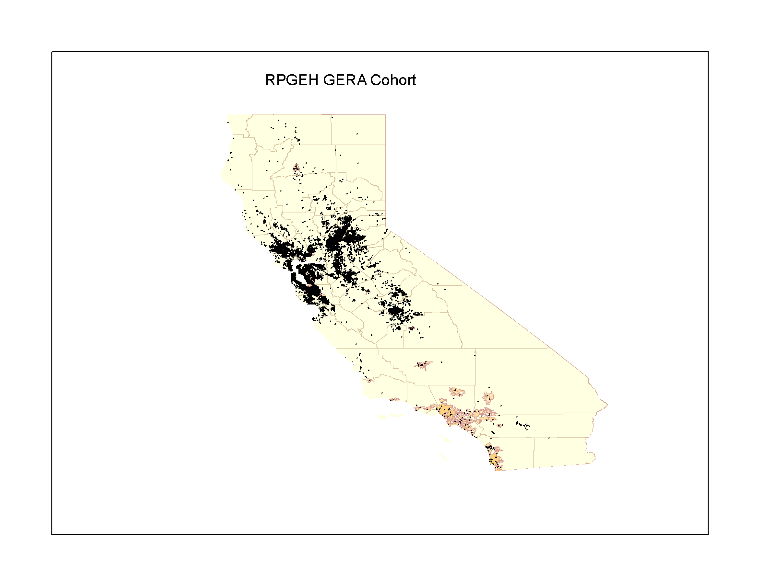
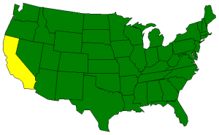
Kaiser Permanente Northern California Members

Slide 7
GERA Cohort Characteristics
 | Number of Subjects | %
Age at Specimen Donation
18-39 | 7,025 | 6.3
40-59 | 33,344 | 30.2
60-79 | 57,856 | 52.4
80+ | 12,041 | 10.9
Sex
Women | 63,883 | 57.9
Men | 46,383 | 42.1
Race/Ethnicity
African American | 3,765 | 3.4
Asian | 8,512 | 7.7
Hispanic | 7,917 | 7.2
Non-Hispanic White | 89,259 | 81.0
Total | 110,266 | 100.0
Notes:
Baseline characteristics
More women than men
Broad age range: average 62
Diverse

Slide 8
How Are Cases and Controls Defined?
Notes:
Cases were defined as men with a record of erectile dysfunction (“impotence
of organic origin”; UK Biobank record 41202) or self-reporting of any of
the following medications on the medications list (data field 20003): alprostadil,
Caverject, sildenafil, Viagra (25, 50, or 100 mg), tadalafil, Cialis (10 mg or
20 mg), vardenafil, or Levitra (5, 10, or 20 mg). The control group included
men who did not report any of these conditions or medications.

Slide 9

Erectile Dysfunction: Self-report
The Independent

Slide 10
How Are Cases and Controls Defined?

Slide 11
How Are Cases and Controls Defined?

Slide 12
How Are Cases and Controls Defined?

Slide 13
How Was the Genetic Data Produced?

Slide 14
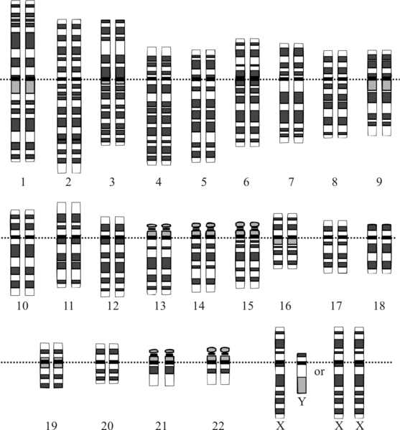
The Human Genome Is 3.2 Billion Basepairs Long

Slide 15
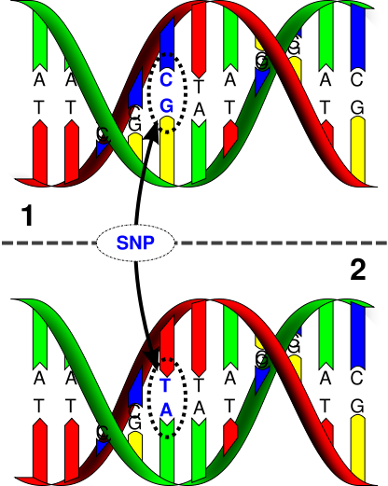
Single Nucleotide Polymorphism (SNP)

Slide 16
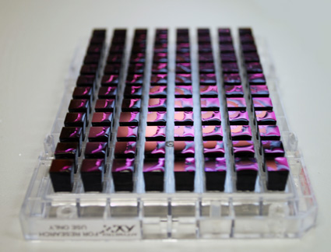
Genotyping Arrays Measure Millions of SNPs in Parallel

Slide 17
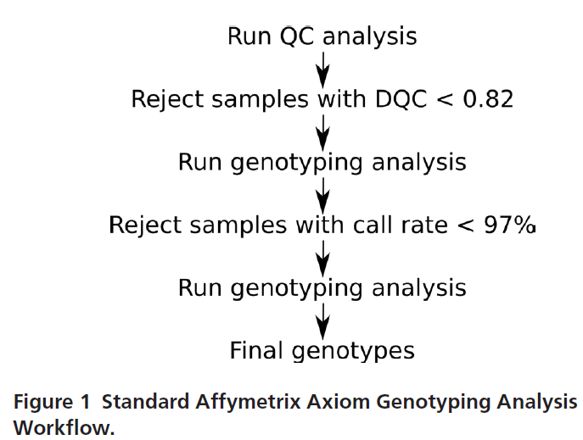
Sample QC Workflow
Reference 25: Kvale et al. Genetics 2015

Slide 18
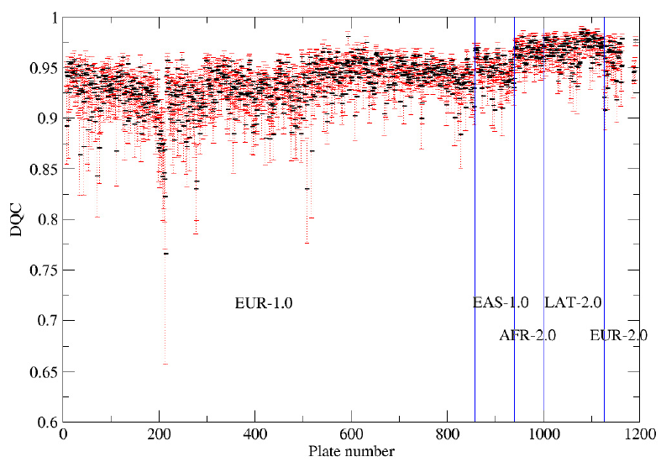
Genotyping Performance Was Tracked in Real Time
Reference 25: Kvale et al. Genetics 2015

Slide 19
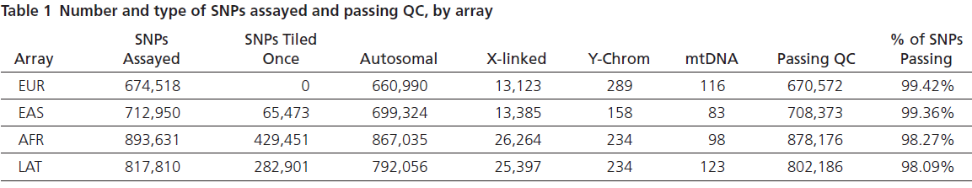
SNP Quality Control
Reference 25: Kvale et al. Genetics 2015

Slide 20
What Are the Main Association Findings?

Slide 21
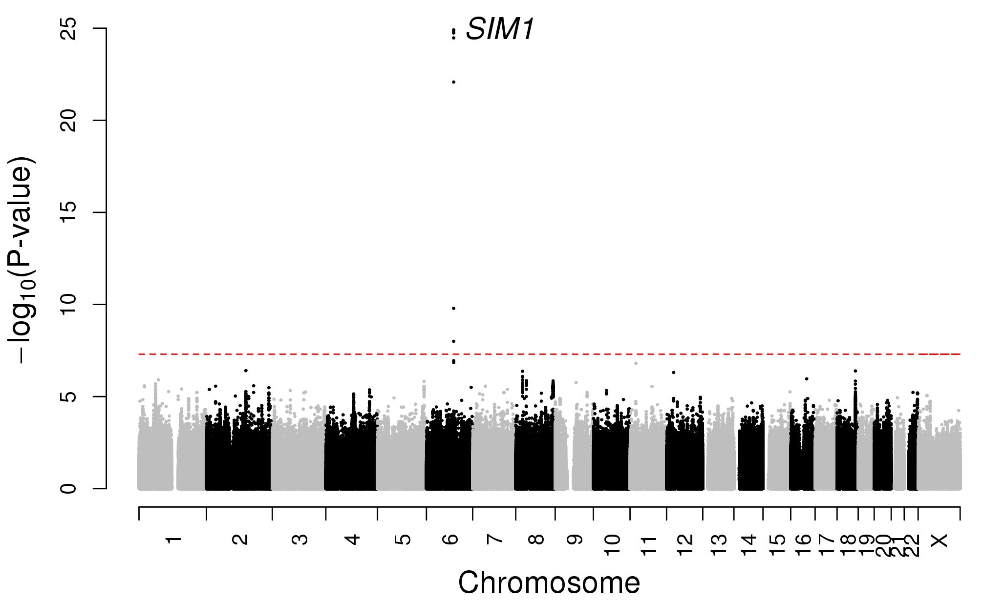
Manhattan Plot of Erectile Dysfunction GWAS Results
Notes:
Manhattan plot of GWAS findings. Manhattan plot of the GERA discovery cohort multiethnic genomewide association meta-analysis of erectile dysfunction. A GWAS of erectile dysfunction was conducted in 36,649 men (14,215 cases and 22,434 controls) from four race/ethnicity groups (non-Hispanic white, Latino, East Asian, and African American). Association results (−log10 P values) are plotted for each chromosome. The SIM1 gene name at the locus associated with erectile dysfunction is indicated.. The dotted red line represents a significance threshold of P=5.0x10⁻⁸.

Slide 22
Are the Findings Affected by Phenotype Definition?
Notes:
Cases were defined as men with a record of erectile dysfunction (“impotence
of organic origin”; UK Biobank record 41202) or self-reporting of any of
the following medications on the medications list (data field 20003): alprostadil,
Caverject, sildenafil, Viagra (25, 50, or 100 mg), tadalafil, Cialis (10 mg or
20 mg), vardenafil, or Levitra (5, 10, or 20 mg). The control group included
men who did not report any of these conditions or medications.

Slide 23
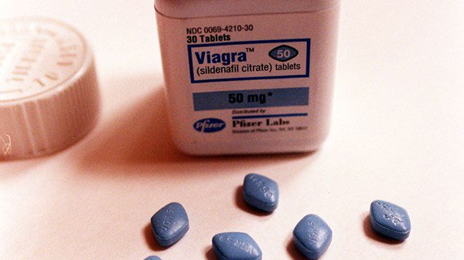
Erectile Dysfunction: Prescription Information
The Independent The Irish Examiner

Slide 24

Erectile Dysfunction: Artistic Interpretation
The Independent The Irish Examiner
Inverse.com

Slide 25
How Similar are the EHR and Prescription Definitions?

Slide 26
Self-Report vs. Electronic Health Record (EHR)

Slide 27
Self-Report vs. PDE5i Prescriptions

Slide 28
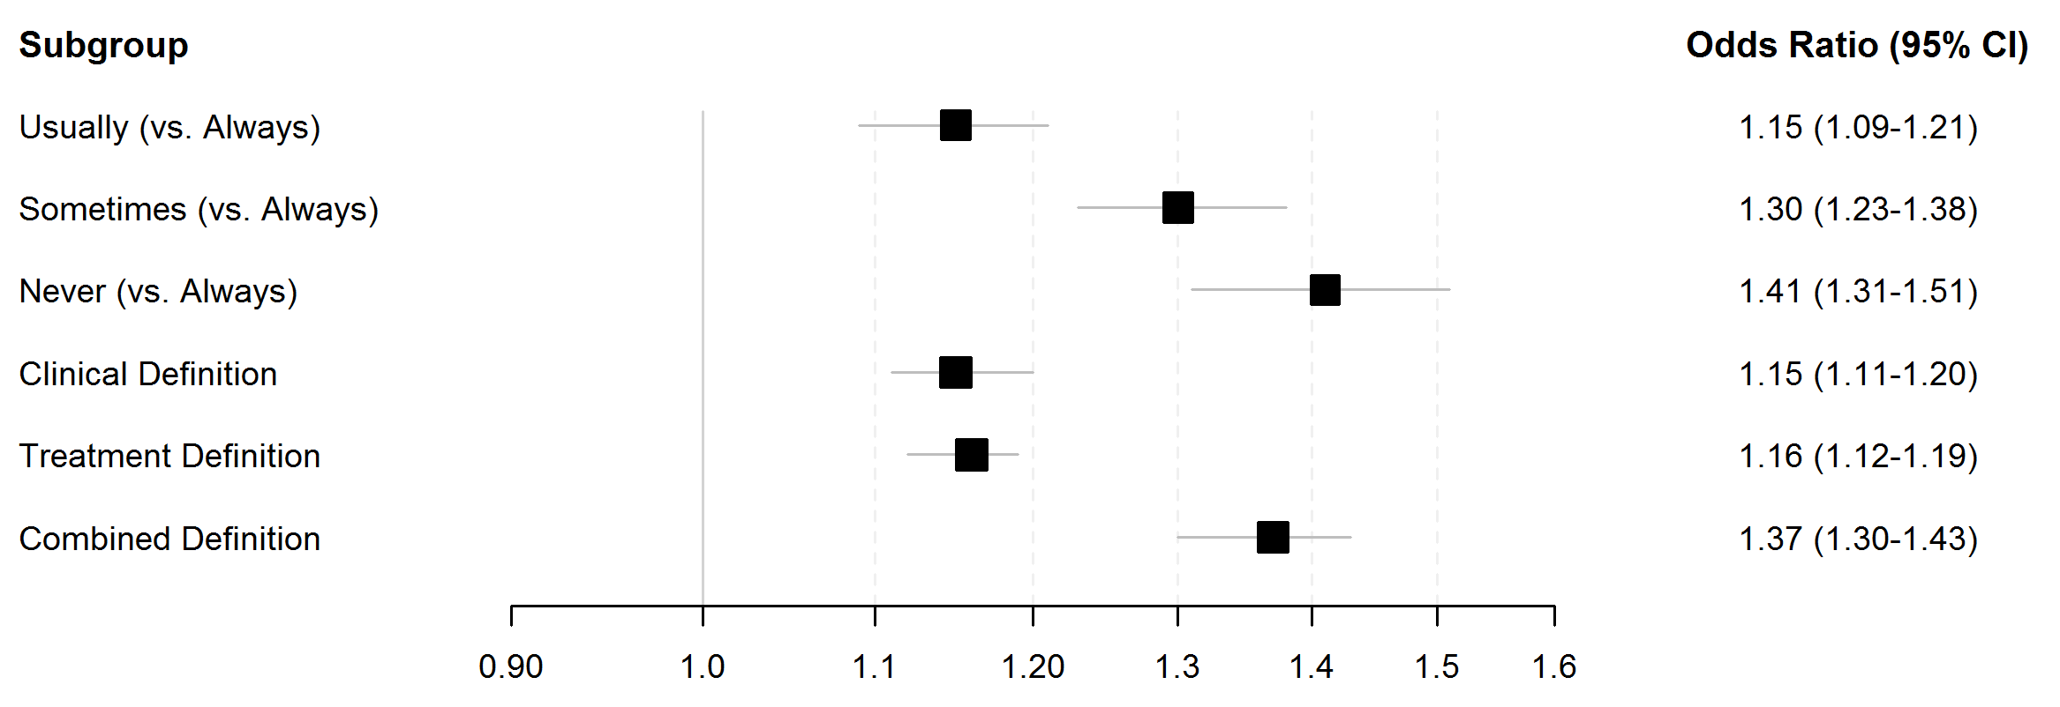
Sensitivity Analyses by Diagnostic Subgroup: rs17185536
Notes:
Supplementary Figure 1. Forest plot of the subgroup and sensitivity analyses in GERA
Odds ratios (OR) and 95% confidence interval lower (LCL) and upper (UCL) bounds for association analyses between the SNP rs17185536 and the risk of erectile dysfunction.

Slide 29
Multiple Associated SNPs in the SIM1 Region
Notes:
Locus Zoom plot of the top locus associated with erectile dysfunction. Plot shows association results of SNPs in the GWAS and recombination rates. Each circle represents the -log₁₀ P value (y axes) and chromosomal position (x axes) of SNPs tested for association. The top associated SNP in the region is identified by its rsID (rs17185536). The color of each circle reflects the extent of LD with the top SNP. Physical positions are based on NCBI build 37 of the human genome. The relative position of genes and transcripts are displayed below the association plot.

Slide 30
95% Credible Set Identifies 5 SNPs in the SIM1 Locus
CAVIAR: http://genetics.cs.ucla.edu/caviar/
Notes:
Supplementary Table 1: 95% Credible Set of SNPs in the Chromosome 6 Erectile Dysfunction Risk Region

Slide 31
U.K. Biobank Subject Characteristics
https://biobank.ctsu.ox.ac.uk/showcase
Notes:
Supplementary Table 2: U.K. Biobank Subject Characteristics

Slide 32
Replication of Credible Set SNPs
Notes:
Supplementary Table 3: GERA and UKB Meta-Analysis Results for the 95% Credible Set SNPs
Top associated SNPs at the SIM1 locus replicate in an independent sample

Slide 33
Imputation Quality Control
Notes:
Supplementary Table 6: Imputation r2 of SNPs in the Chromosome 6 Erectile Dysfunction Risk Region

Slide 34
What is the Evidence That the Locus Is Functional?

Slide 35
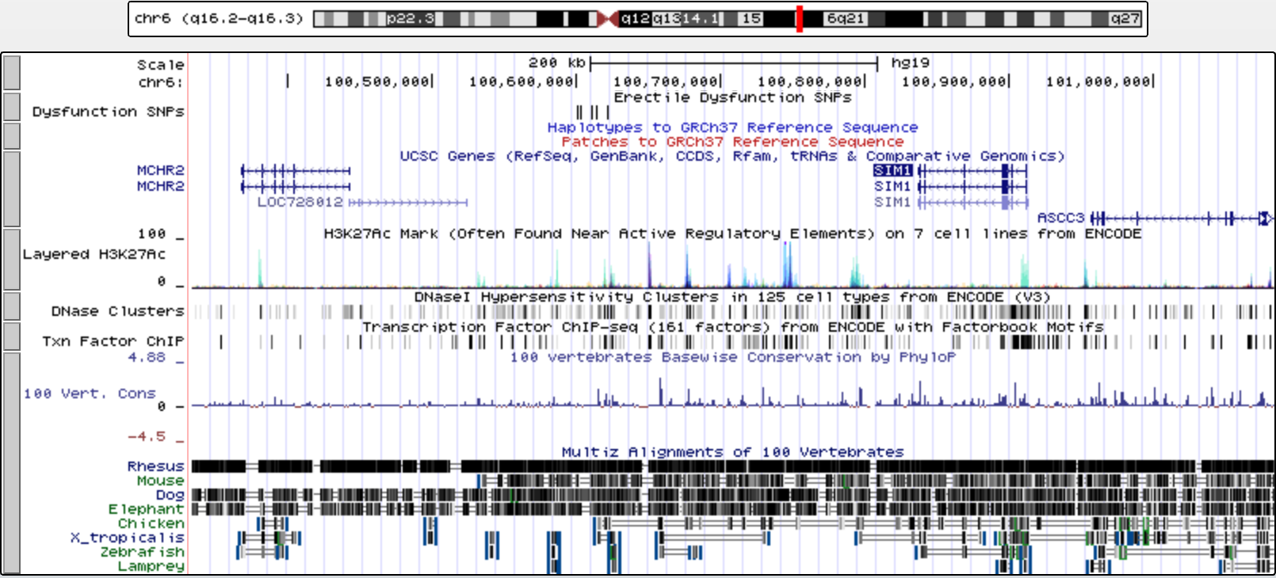
Genomic Context of Erectile Dysfunction Credible Set SNPs
https://genome.ucsc.edu/cgi-bin/hgGateway

Slide 36
5 Credible Set SNPs
https://genome.ucsc.edu/cgi-bin/hgGateway

Slide 37
Human-Mouse Synteny Breakpoint
https://genome.ucsc.edu/cgi-bin/hgGateway

Slide 38
ENCODE Enhancer Markers
https://genome.ucsc.edu/cgi-bin/hgGateway

Slide 39
Are Erectile Dysfunction Credible Set SNPs in Enhancers?
Notes:
In vitro Analyses of 95% Credible Set SNPs

Slide 40
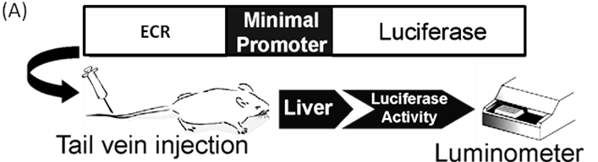
Luciferase Assays to look for Differential Enhancer Activity
Cloned Region
Notes:
In vitro Analyses of 95% Credible Set SNPs

Slide 41
3 ED Risk SNPs Show Differential Enhancer Activity
Notes:
Enhancer assay results in HEK 293T cells. Results for each allele compared with the empty vector are presented as mean ± SD. ****P < 0.0001; ns, not significant; t test.

Slide 42
3 ED Risk SNPs Show Differential Enhancer Activity
Notes:
Enhancer assay results in HEK 293T cells. Results for each allele compared with the empty vector are presented as mean ± SD. ****P < 0.0001; ns, not significant; t test.

Slide 43
Can We Link the Putative Enhancers to a Specific Gene?

Slide 44
Chromosomes are Organized into
Topologically Associating Domains (TADs)
Matharu and Ahituv
PLoS Genetics 2015

Slide 45

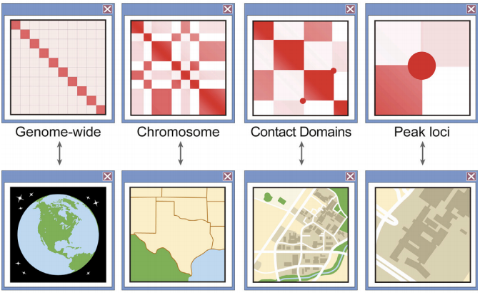
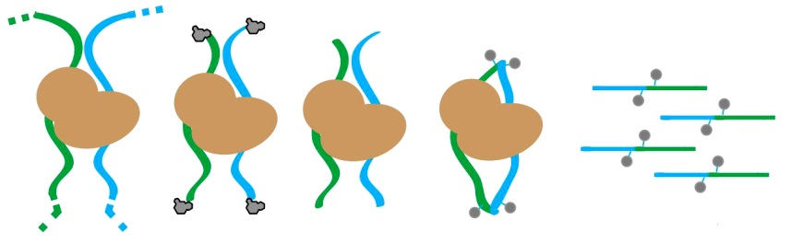
Hi-C contact map
Chromatin conformation capture (Hi-C)
Adaptor
ligation
Proximity ligation
NGS Library
Fixation
Digestion
Ramani et al. Nature Protocols 2016

Slide 46
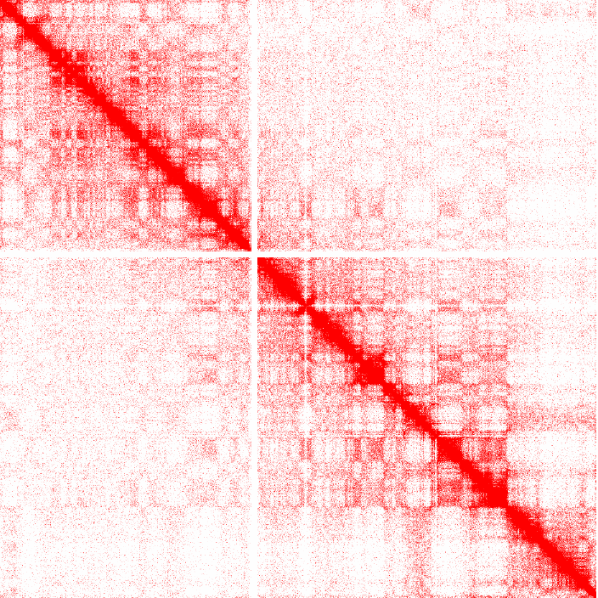
Chromosome Conformation Capture Example
Modified from Lazar et al. Genome Research 2018

Slide 47
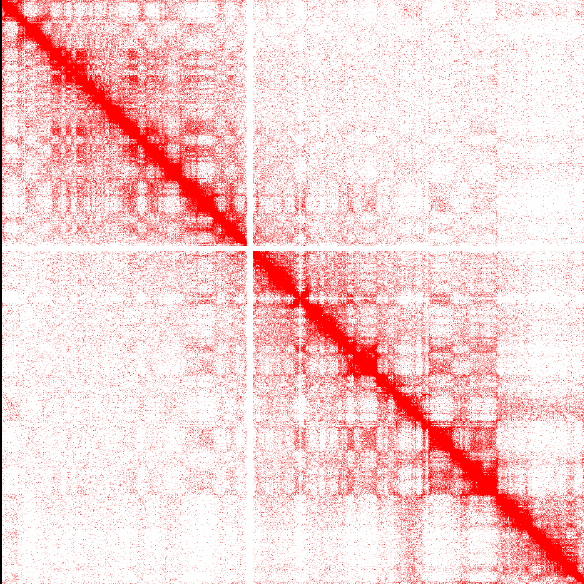
Chromosome Conformation Capture Example
12q3
Modified from Lazar et al. Genome Research 2018

Slide 48

TADs in the Region of Erectile Dysfunction Risk Locus
http://promoter.bx.psu.edu/hi-c/

Slide 49
TADs in the Region of Erectile Dysfunction Risk Locus
http://promoter.bx.psu.edu/hi-c/

Slide 50
rs17185536 Interacts with the SIM1 Promoter
http://promoter.bx.psu.edu/hi-c/
Notes:
Fig. 2. Genomic and epigenetic annotations of the SIM1 locus. (A) A University of California, Santa Cruz genome browser snapshot of the SIM1 locus showing rs17185536, the TAD in this region, the human–mouse (H–M) synteny breakpoint, and the virtual 4C (circularized chromosome conformation capture) interactions from human GM12878 cells adapted from the 3D Genome Browser (54).

Slide 51
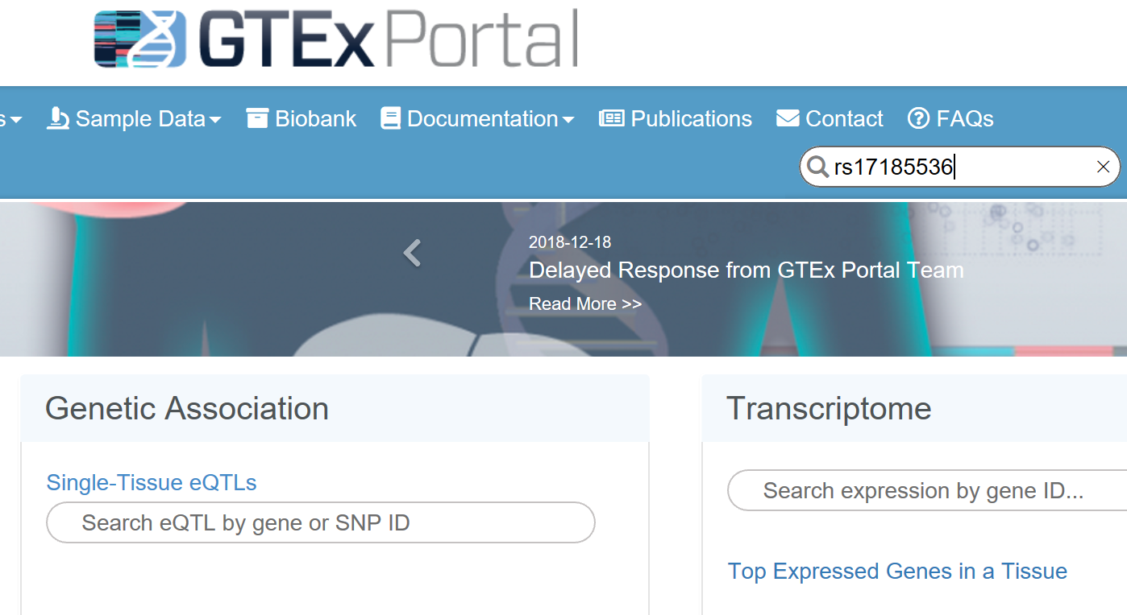
Do Credible Set SNPs Affect SIM1 Gene Expression?
https://www.gtexportal.org/home

Slide 52
The Associated SNPs are not in GTEx
https://www.gtexportal.org/home

Slide 53
SIM1 is Part of the Leptin-Melanocortin Pathway
Notes:
Several different lines of evidence suggest a biologically plausible role for SIM1 in erectile dysfunction susceptibility. SIM1 encodes a
transcription factor that is active in the leptin–melanocortin pathway, a system that plays a central role in body weight homeostasis
and sexual function (14).

Slide 54
Melanocortin Agonists Stimulate Sexual Function
Reference 15: Bertolini et al. Nature 1969
Notes:
The melanocortin peptides alpha melanocortin-stimulating hormone (α-MSH) and adrenocorticotrophic
hormone (ACTH) have long been known to stimulate penile erection in male animals (15, 16)

Slide 55
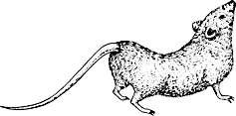
Melanocortin Agonists Stimulate Sexual Function
Reference 16: Feder and Ruf. Endocrinology 1969

Slide 56
Melanocortin Agonists Stimulate Sexual Function
Reference 17: Wessells et al. Urology 2000
Notes:
MT-II, a synthetic analog of α-MSH, has been shown to induce penile erection in men (17).

Slide 57
Melanocortin Agonists Stimulate Sexual Function
Reference 17: Wessells et al. Urology 2000

Slide 58
Melanocortin Agonists Stimulate Sexual Function
Reference 17: Wessells et al. Urology 2000

Slide 59
Cells Expressing SIM1 and MC4R May be Important
Notes:
While both MT-II and α-MSH are nonselective melanocortin
agonists, it is believed that their effect on sexual function is mediated
by the melanocortin 4 receptor (MC4R).

Slide 60
Expression of MC4R on SIM1⁺ Cells Restores Sexual Function
Reference 19: Semple and Hill. Endocrinology 2018
Notes:
Mice lacking Mc4r display impaired copulatory behavior (18), an effect that is reversed when
MC4Rs are reexpressed only on SIM1-expressing neurons (19). In the latter study, SIM1-dependent expression of MC4R was observed
in the paraventricular nucleus of the hypothalamus and medial amygdala.

Slide 61
Expression of MC4R on SIM1⁺ Cells Reduces Food Intake
Balthasar et al. Cell 2005
Notes:
Neurons coexpressing MC4R and SIM1 in the paraventricular nucleus of the hypothalamus have been shown to be both necessary and sufficient for the regulation of feeding and body weight in mice (21).
Figure 6. Body Composition and Energy Homeostasis in Sim1-Cre, loxTB Mc4r Mice
(C) Food intake was measured in 11-week-old male and female wild-type (male/female n = 12/5), loxTB Mc4r (n = 12/9), and Sim1-Cre, loxTB Mc4r (n = 9/7) for a week and is expressed here as 24 hr food intake.

Slide 62
SIM1 and MC4R Knockouts Cause Obesity in Humans
Reference 20: Ahituv et al. American Journal of Human Genetics 2005
Notes:
Rare mutations in the coding sequences of both MC4R and SIM1 cause severe forms of human obesity (20)

Slide 63
Is the Association of SIM1 and ED Driven by Obesity?

Slide 64
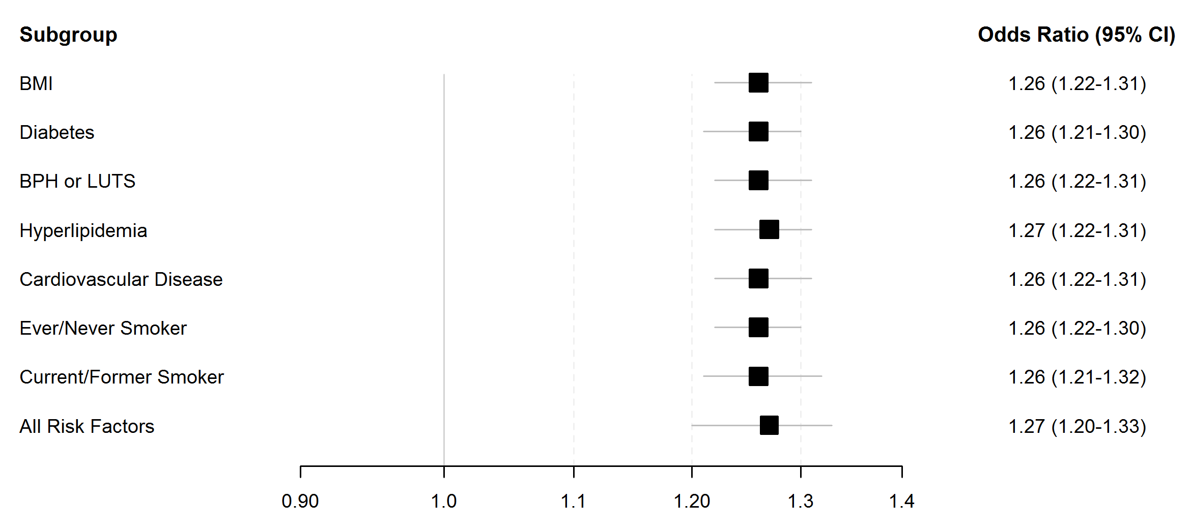
ED Association is not Driven by Body Mass Index (BMI)
Notes:
Supplementary Figure 1. Forest plot of the subgroup and sensitivity analyses in GERA
Odds ratios (OR) and 95% confidence interval lower (LCL) and upper (UCL) bounds for association analyses between the SNP rs17185536 and the risk of erectile dysfunction. B. Results adjusting for known erectile dysfunction risk factors.

Slide 65
ED Association is not Driven by Body Mass Index (BMI)
Notes:
Supplementary Figure 1. Forest plot of the subgroup and sensitivity analyses in GERA
Odds ratios (OR) and 95% confidence interval lower (LCL) and upper (UCL) bounds for association analyses between the SNP rs17185536 and the risk of erectile dysfunction. B. Results adjusting for known erectile dysfunction risk factors.

Slide 66
Conclusions

Slide 67
A Previous Melanocortin-based Treatment for ED
Hadley. Endocrinology 2005

Slide 68
A Serendipitous Side Effect
Hadley. Endocrinology 2005

Slide 69
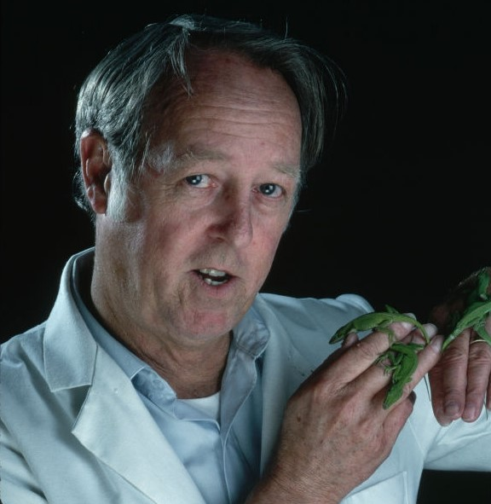

The Hadleys
Mac Hadley Gertrude Hadley

Slide 70
Acknowledgements
Kaiser Permanente UCSF
Stephen Van Den Eeden Nadav Ahituv
Jie Yin Thomas Hoffmann
Khanh K. Thai Navneet Matharu
Jun Shan Xujia Zhou
Grant Support UW
  R01 EY027004 Melody Palmer
  R01 DK090382 James Hotaling
  UM1 HG009408 Hunter Wessells
  R01 MH109907
  P01 HD084387
  R01 HL138424

Slide 71
RPGEH Acknowledgements
Kaiser Permanente UCSF Stanford
Catherine Schaefer Eric Jorgenson Neil Risch Hua Tang
Carol Somkin Marianne Sadler Elizabeth Blackburn Chiara Sabatti
Carlos Iribarren Dana Ludwig Pui Yan Kwok Sophie Candille
Stephen Van Den Eeden Stan Sciortino Thomas Hoffmann Nicholas Johnson
Rachel Whitmer Ling Shen Stephanie Hesselson Zhongyang (Thomas) Zhang
Charles Quesenberry Dilrini Ranatunga Mark Kvale
Mary Henderson Petra Liljestrand Yambazi Banda
Larry Walter Bernie McGuire Kyle Lapham Affymetrix
Sarah Rowell Chia Zau Jue Lin Andrea Finn
David Smethurst Julia Kay Eunice Wan Mike Shapero
Judith Millar Marcia Ewing Philippe Jolivalt Yiping Zahn
Sunita Miles Paul Young Jasmin Eshragh Jeremy Golub
Sheryl Connell Kathleen Sampel-Morris Jeanette Atilano Teresa Webster
Reid Wearley Gustavo Parra Yang Cao Yontau Yu
Christine Aquino Eboni Stephens Simon Wong Gangmu Mei
Maria Miranda Deborah Burman Brad Dispensa David Chan
Elaine Chung Lynn Simonson Tanu Shenoy Mohini Patel
Ivo Violich Inga Wagar Richard Lao
Sharon Matthews Marvella Villasenior Simi Mathauda
Julie Harris Terrance Chinn Chris Wen
Andrea Altschuler Jun Shan Cory Fergus
Lori Sakoda Diane Olberg Shigeshi Yamomoto

