Slide 1

Counterfactual Framework & Interaction & Overall Summary
EPI207
June M. Chan, ScD
Notes:
RGL, p. 75-76 or Hernan & Robins 5.1-5.3

Slide 2
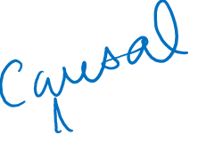
Topics
Interaction & Effect Modification – what do these terms mean in epidemiology?
Why or when do we want to study these?
Interpretation of model coefficients with an interaction term
Statistical Measures of Interaction (View on own, not recorded)
  Importance of Scale - Additive vs. Multiplicative Interaction
Presenting Effect Modification & Interaction, Examples
Interaction under Counterfactual Framework
Appendix (not recorded)
Notes:
RGL, p. 75-76 or
Hernan & Robins, 5.1-5.3
Focus here is on motivating “causal interaction” in counterfactual framework.
For more on defining “effect measure modification” in counterfactual notation, see Hernan/Robins, Ch.4.1 – 4.2 (optional)

Slide 3
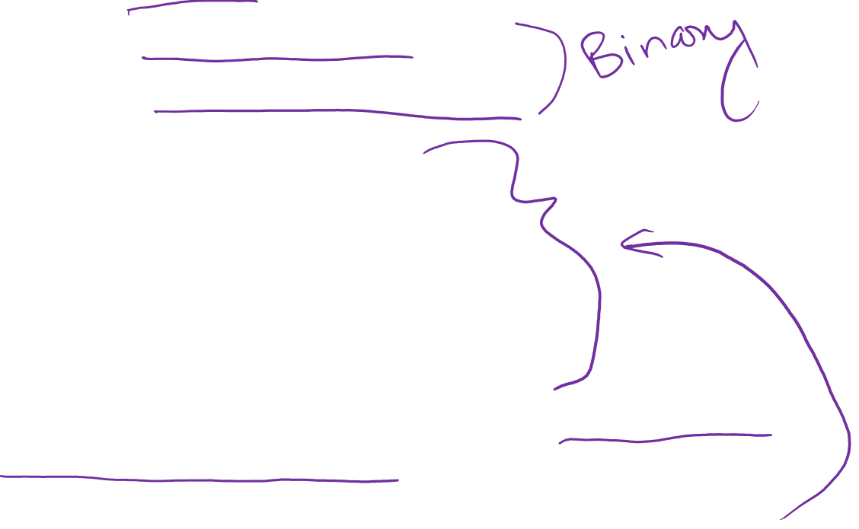
(Causal) Interaction – Ex using counterfactual framework
Consider example from Hernan and Robins, Chapter 5:
  Outcome (Y): Death
  Treatment 1 (A): Heart transplant
  Treatment 2 (E): Taking multivitamin complex
Four treatment groups:
  A = 1, E = 1: Heart transplant and vitamins
  A = 1, E = 0: Heart transplant and no vitamins
  A = 0, E = 1: No heart transplant and vitamins
  A = 0, E = 0: No heart transplant and not vitamins
For each individual, we can imagine 4 potential or counterfactual outcomes
  one under each of the 4 treatment conditions above

Slide 4
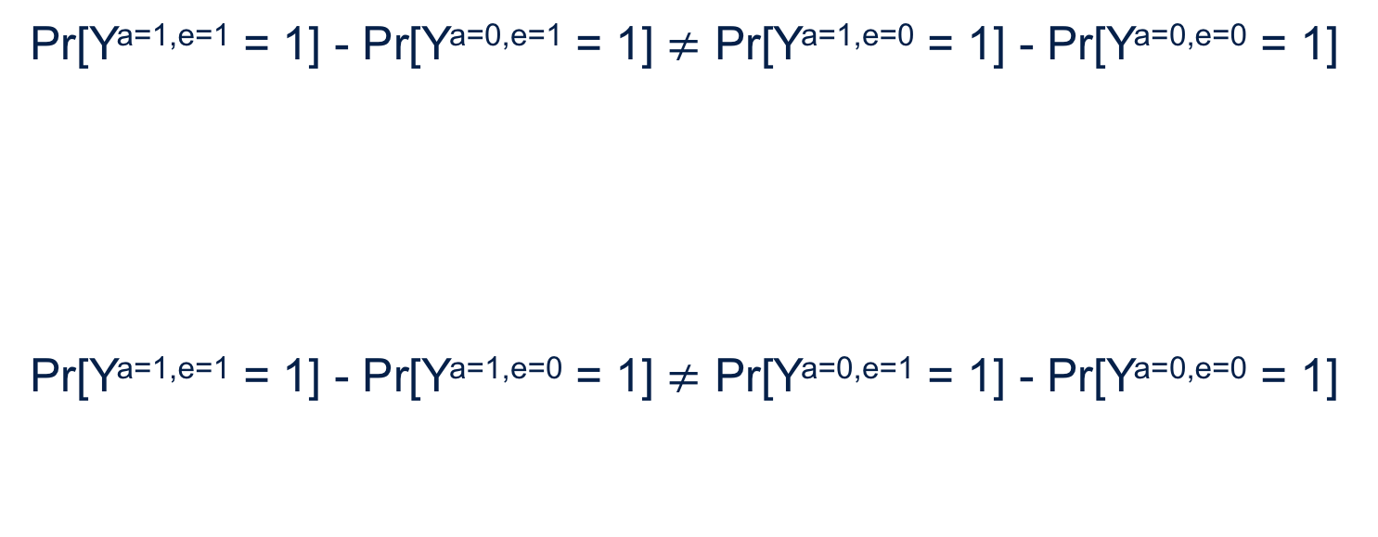
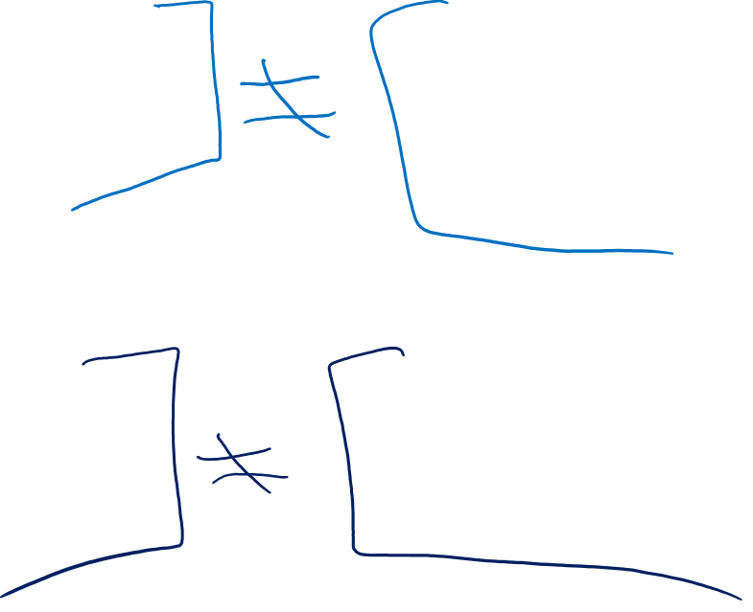
Interaction – an example
    Pr[Y^{a=1,e=1} = 1] - Pr[Y^{a=0,e=1} = 1] $≠$ Pr[Y^{a=1,e=0} = 1] - Pr[Y^{a=0,e=0} = 1]
    Pr[Y^{a=1,e=1} = 1] - Pr[Y^{a=1,e=0} = 1] $≠$ Pr[Y^{a=0,e=1} = 1] - Pr[Y^{a=0,e=0} = 1]
Causal risk difference of heart transplant on risk of death if everyone takes vitamins
Causal risk difference of heart transplant on risk of death if no one takes vitamins
Causal risk difference of vitamins on risk of death if everyone had a heart transplant
Causal risk difference of vitamins on risk of death if no one had a heart transplant
Notes:
With these two treatments or interventions, we can now provide a definition of interaction.
(click) Interaction on the additive scale exists when the causal risk difference of heart transplant on the risk of death if everyone takes vitamins (E=1) is not equal to the causal risk difference of heart transplant on the risk of death if no one takes vitamins (E=0).
This can also be written vice versa.
(click) Interaction on the additive scale exists when the causal risk difference of vitamins on the risk of death if everyone had a heart transplant (A=1) is not equal to the causal risk difference of vitamins on the risk of death if no one had a heart transplant (A=0).
In order to estimate causal effects and because we have two interventions, assumptions of exchangeability, positivity, and consistency also need to hold for both interventions

Slide 5
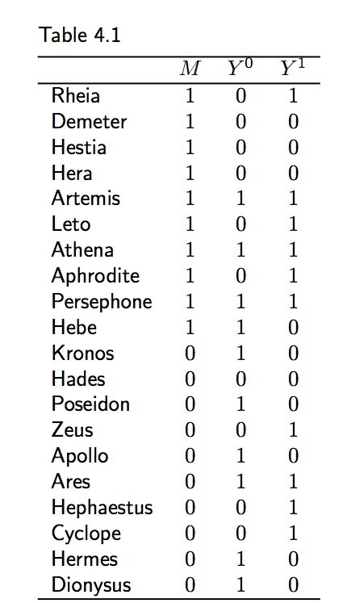
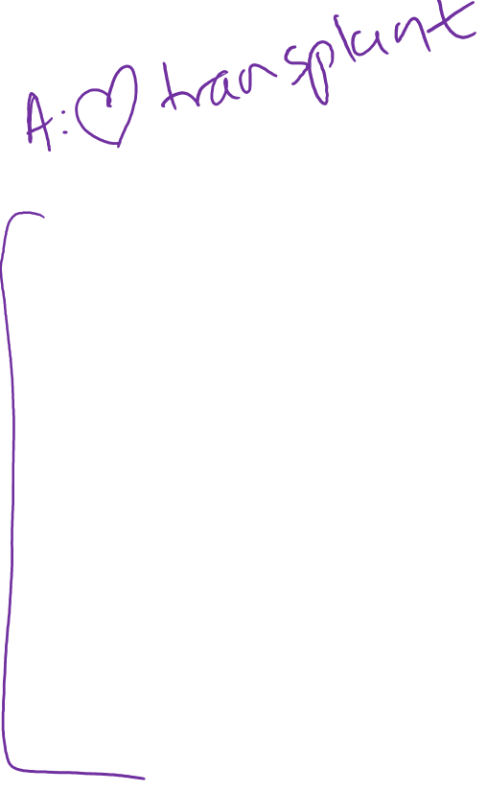
Interaction – counterfactual response types
In the case of one intervention or treatment:
 | Y^{a=0} | Y^{a=1} | Examples
Doomed | 1 | 1 | Artemis, Athena, Persephone, Ares
Preventative | 1 | 0 | Hebe, Kronos, Poseidon, Apollo, Hermes, Dionysus
Causative | 0 | 1 | Rheia, Leto, Aphrodite, Zeus, Hephaestus, Cyclope
Immune | 0 | 0 | Demeter, Hestia, Hera, Hades
Notes:
Individuals can be defined by their counterfactual responses.
In the first and simpler example with only one treatment, there are four types of people. Those who die regardless of whether or not they are given the heart transplant are classified as doomed. In the table to the right, examples include Artemis, Athena, Persephone, and Ares.
Those who die only if not given the heart transplant but survive if they are given the heart transplant are classified as preventative. In this table, examples include Hebe, Kronos, Poseidon, Apollo, Hermes, Dionysus.
Those who die only if given the heart transplant but survive if they are not given the heart transplant are classified as causative. This would include Rheia, Leto, Aphrodite, Zeus, Hephaestus, and Cyclope.
And finally, those who survive regardless of whether or not they are given the heart transplant are classified as immune. Examples from the table include Demeter, Hestia, Hera, and Hades.

Slide 6
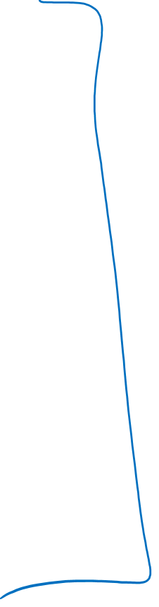
Type | Y^{a=1,e=1} | Y^{a=0,e=1} | Y^{a=1,e=0} | Y^{a=0,e=0}
1 | 1 | 1 | 1 | 1
2 | 1 | 1 | 1 | 0
3 | 1 | 1 | 0 | 1
4 | 1 | 1 | 0 | 0
5 | 1 | 0 | 1 | 1
6 | 1 | 0 | 1 | 0
7 | 1 | 0 | 0 | 1
8 | 1 | 0 | 0 | 0
9 | 0 | 1 | 1 | 1
10 | 0 | 1 | 1 | 0
11 | 0 | 1 | 0 | 1
12 | 0 | 1 | 0 | 0
13 | 0 | 0 | 1 | 1
14 | 0 | 0 | 1 | 0
15 | 0 | 0 | 0 | 1
16 | 0 | 0 | 0 | 0
Notes:
For one binary exposure, we have four potential counterfactual response types.
If we have two binary exposures, there are actually 16 possible counterfactual response types, as shown in this table.
We said earlier that with 2 binary exposures, each individual has 4 counterfactual outcomes, one under each of the four possible joint interventions or treatments. Under each treatment condition, the individual will survive or not (one actual and one counterfactual outcome), which leads to 16 distinct patterns or response types (i.e., 4 conditions, 2 outcomes possible → corresponding to 2⁴ or 16 distinct response types)

Slide 7
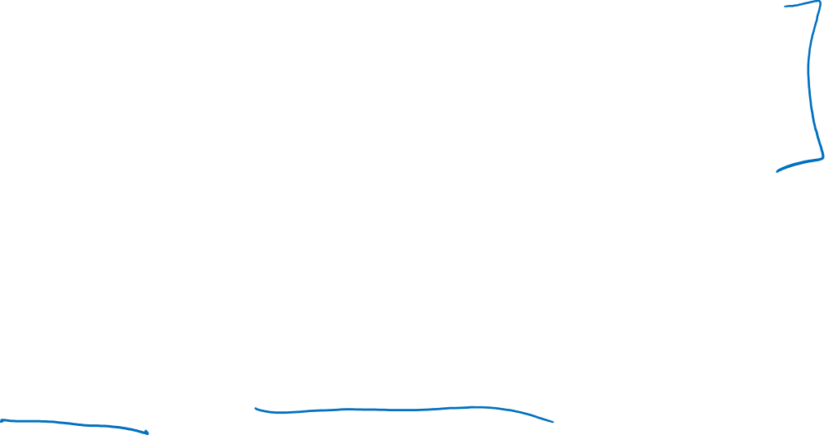
Counterfactual types
Type | Y^{a=1,e=1} | Y^{a=0,e=1} | Y^{a=1,e=0} | Y^{a=0,e=0}
1 | 1 | 1 | 1 | 1
16 | 0 | 0 | 0 | 0
For Type 1 individuals, they would die if treated or untreated with heart transplant or vitamins
For Type 16 individuals, they would survive if treated or untreated with heart transplant or vitamins
Neither A nor E had a causal effect on Y
Notes:
Let’s talk about these different types and what they mean.
(click) First, there are type 1 individuals. They would die if treated or untreated with heart transplant or vitamins. Their counterfactual outcome is 1 in every scenario.
(click) On the flip side, type 16 individuals would survive if treated or untreated with heart transplant or vitamins. Their counterfactual outcome is 0 in every scenario.
(click) For both Type 1 and Type 16 individuals, neither A nor E had a causal effect on Y.

Slide 8

Counterfactual types
Type | Y^{a=1,e=1} | Y^{a=0,e=1} | Y^{a=1,e=0} | Y^{a=0,e=0}
4 | 1 | 1 | 0 | 0
6 | 1 | 0 | 1 | 0
11 | 0 | 1 | 0 | 1
13 | 0 | 0 | 1 | 1
Type 4 individuals would die only if treated with vitamins. Heart transplant has no effect on Y.
Type 13 individuals would die only if untreated with vitamins. Heart transplant has no effect on Y.
Type 6 individuals would die only if treated with heart transplant. Vitamins have no effect on Y.
Type 11 individuals would die only if untreated with heart transplant. Vitamins have no effect on Y.
Causal effect of A on Y is independent of E.
Causal effect of E on Y is independent of A.
Notes:
Now, let’s look at individuals with types 4, 6, 11 and 13.
Type 4 individuals would die only if treated with vitamins. The heart transplant had no effect on Y because both contrasts of A=1 to A=0 for the same level of E are the same.
Type 13 individuals would die only if untreated with vitamins. Just like type 4, the heart transplant had no effect on Y because both contrasts of A=1 to A=0 for the same level of E are the same.
Type 6 individuals would die only if treated with a heart transplant. Vitamins had no effect on Y because both contrasts of E=1 to E=0 for the same level of A are the same.
And finally, Type 11 individuals would die only if untreated with a heart transplant. Vitamins had no effect on Y.
If study population was only comprised of individuals with types 4, 6, 11 and 13, we would conclude that: causal effect of A on Y is independent of E and the causal effect of E on Y is independent of A. There would be no evidence of interaction between A and E on the risk of Y.

Slide 9

Counterfactual types
Type | Y^{a=1,e=1} | Y^{a=0,e=1} | Y^{a=1,e=0} | Y^{a=0,e=0}
8 | 1 | 0 | 0 | 0
12 | 0 | 1 | 0 | 0
14 | 0 | 0 | 1 | 0
15 | 0 | 0 | 0 | 1
Type 8 individuals would die only if treated with both heart transplant and vitamins
Type 12 individuals would die only if treated with vitamins and no heart transplant
Type 14 individuals would die only if treated with heart transplant and no vitamins
Type 15 individuals would die only if treated with no heart transplant and no vitamins
Individuals would only develop outcome under one of four treatment combinations.
Notes:
Now how about types 8, 12, 14 and 15?
Type 8 individuals would die only if treated with both heart transplant and vitamins
Type 12 individuals wolud die only if treated with vitamins and no heart transplant
Type 14 individuals would die only if treated with heart transplant and no vitamins
Type 15 individuals would die only if treated with no heart transplant and no vitamins
These are examples of individuals who would develop the outcome under one of four treatment combinations.

Slide 10
Counterfactual types
Type | Y^{a=1,e=1} | Y^{a=0,e=1} | Y^{a=1,e=0} | Y^{a=0,e=0}
7 | 1 | 0 | 0 | 1
10 | 0 | 1 | 1 | 0
Type 7 individuals would die only if treated with both heart transplant and vitamins, or treated with no vitamins and no heart transplant
Type 10 individuals would die only if treated with vitamins and no heart transplant, or treated with heart transplant and no vitamins
Individuals would only develop outcome under two of four treatment combinations.
Notes:
Moving on to types 7 and 10.
Type 7 indviiduals would die only if treated with both heart transplant and vitamins, OR treated with no vitamins and no heart transplant
Type 10 individuals would die only if treated with vitamins and no heart transplant, or treated with heart transplant and no vitamins
These are examples of individuals who would only develop the outcome under two of four treatment combinations.

Slide 11
Counterfactual types
Type | Y^{a=1,e=1} | Y^{a=0,e=1} | Y^{a=1,e=0} | Y^{a=0,e=0}
2 | 1 | 1 | 1 | 0
3 | 1 | 1 | 0 | 1
5 | 1 | 0 | 1 | 1
9 | 0 | 1 | 1 | 1
Type 2 individuals would survive only if treated with no heart transplant and no vitamins
Type 3 individuals would survive only if treated with heart transplant and no vitamins
Type 5 individuals would survive only if treated with no heart transplant and vitamins
Type 9 individuals would survive only if treated with heart transplant and vitamins
Individuals would only develop outcome under three of four treatment combinations.
Notes:
And finally, we have individuals of types 2, 3, 5, and 9.
Type 2 individuals would survive only if treated with no heart transplant and no vitamins
Type 3 individuals would survive only if treated with heart transplant and no vitamins
Type 5 individuals would survive only if treated with no heart transplant and vitamins
Type 9 individuals would survive only if treated with heart transplant and vitamins
These are examples of individuals who would develop the outcome under three of four treatment combinations.

Slide 12
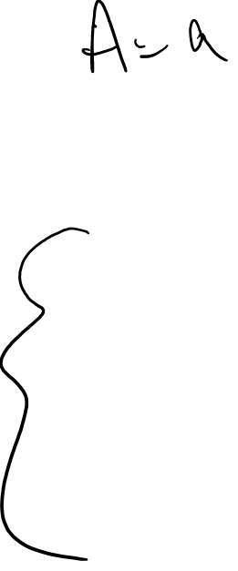
Interaction under counterfactual model
The presence of additive interaction between A and E means individuals in at least one of the three classes:
  Individuals develop disease only under one of four treatment conditions (Types 8, 12, 14, 15)
  Individuals develop disease only under two of four treatment conditions (Types 7, 10)
  Individuals develop disease only under three of four treatment conditions (Types 2, 3, 5, 9)
If no additive interaction, then no individual in the study population belongs to these classes (or in rare cases, perfect cancellation)
Notes:
Hernan & Robins, Ch 5
The presence of additive interaction between A and E implies that, for some individuals in the population, the value of their two counterfactual outcomes
under A = a cannot be determined without knowledge of the value of E, and vice versa. That is, there must be individuals in at least one of the following
three classes:
1. those who would develop the outcome under only one of the four treatment
combinations (types 8 , 12 , 14 , and 15 in Table 5.2)
2. those who would develop the outcome under two treatment combinations,
with the particularity that the eff ect of each treatment is exactly the
opposite under each level of the other treatment (types 7 and 10 )
3. those who would develop the outcome under three of the four treatment
combinations (types 2 , 3 , 5 , and 9 )
Well, if we detect there is additive interaction between A and E in our study, that means there are individuals in at least one of the three classes. Either there are individuals who develop disease under one treatment condition, two treatment conditions, or three treatment conditions.
If there is no evidence of additive interaction, then no individual in the study population belongs to these three classes. Or, in rare cases, it can result from a perfect cancellation of equal deviations from additivity of opposite signs. But again, that’s a rare scenario.

Slide 13
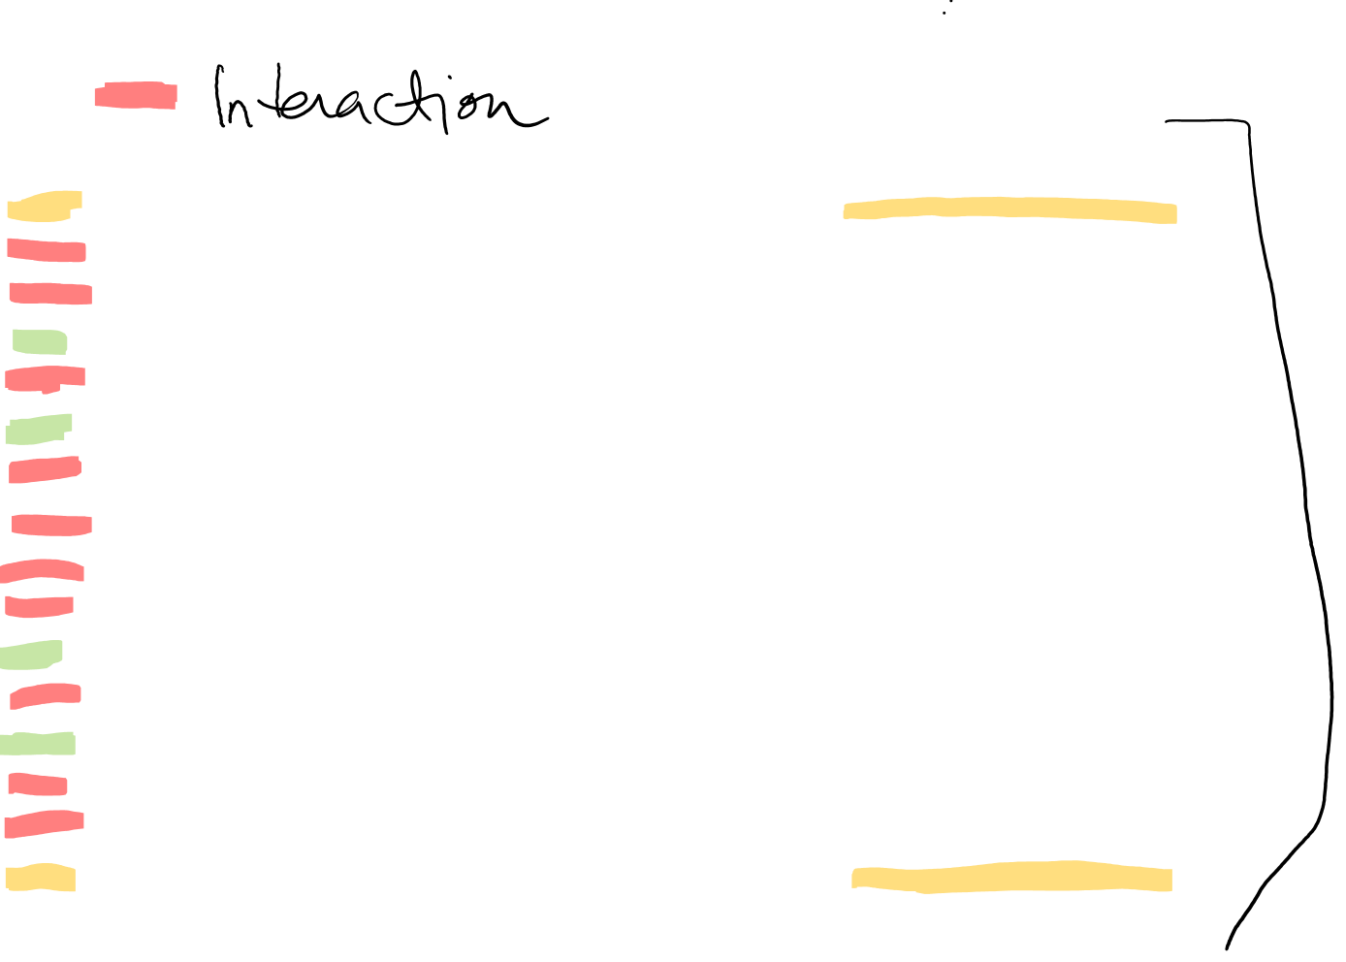
In Summary….
Type | Y^{a=1,e=1} | Y^{a=0,e=1} | Y^{a=1,e=0} | Y^{a=0,e=0} | Description of Causal Type
1 | 1 | 1 | 1 | 1 | Doomed (no effect)
2* | 1 | 1 | 1 | 0 | Single plus joint causation
3* | 1 | 1 | 0 | 1 | Preventive antagonism
4 | 1 | 1 | 0 | 0 | E has causal effect. A has no effect
5* | 1 | 0 | 1 | 1 | Preventive antagonism
6 | 1 | 0 | 1 | 0 | A has causal effect. E has no effect
7* | 1 | 0 | 0 | 1 | Preventive antagonism (mutual blockage)
8* | 1 | 0 | 0 | 0 | Causal synergism
9* | 0 | 1 | 1 | 1 | Preventive synergism
10* | 0 | 1 | 1 | 0 | Causal antagonism (mutual blockage)
11 | 0 | 1 | 0 | 1 | A has causal effect (preventive). E no effect
12* | 0 | 1 | 0 | 0 | Causal antagonism
13 | 0 | 0 | 1 | 1 | E has causal effect (preventive). A as no effect
14* | 0 | 0 | 1 | 0 | Causal antagonism
15* | 0 | 0 | 0 | 1 | Single plus joint prevention
16 | 0 | 0 | 0 | 0 | Immune (no effect)
Notes:
We can put all of this together now. Before, we discussed the 16 potential counterfactual outcomes that can happen when there are two binary exposures. Let’s go through these now and describe the causal type.
For types 1 and 16, there is no effect of A or E (click). Type 1 individuals would have died under any treatment combination. Type 16 individuals would have survived under any treatment combination.
For types 4, 6, 11, and 13, these are cases where either A had a causal effect of Y independent of E or E had a causal effect on Y independent of A. Types 4 and 13 are examples of where E has a causal effect but A has no effect. Types 6 and 11 are examples where A has a causal effect but E has no effect. Thus, for these types, there is no interaction between A and E on the effect of Y.
So, for these first 6 types, either one or both of the exposures have not effect.
For the other 10 types (indicated with *), what distinguishes them from the previous 6 we just described is that you have to know both exposures to know the response. The defining feature of these 10 other response types is that we cannot say what the effect of Z will be unless we also know the value for E; and vice versa – we can’t know the effect of E without also knowing the value for A. In other words, for these response types, the effect of one variable depends on the other, or each factor modifies the other. These response types correspond to interaction effects.

Slide 14
Overall Summary
Interaction vs. Effect Modification
Interpreting Coefficients – When you have an interaction term in model, interpreting the coefficients for the other variables change.
  Be careful, when in doubt, go back to ”basics” to appreciate what the coefficients mean
Interaction is scale-dependent (Additive & Multiplicative scales)
Summary metrics of interaction on additive and mult scales
Presenting Effect Mod and Interaction depends on your scientific question and focus.
  Good to show results in multiple ways - counts, absolute risks, relative measure with 1 reference group, summary metrics, etc
  Be aware how to interpret results when reference groups change
Counterfactual Framework & Causal Interaction

