Slide 1
Acquisition of Individual Patient Data from 53 RCTs for the FNIH Bone Quality Surrogacy Project
UCSF Symposium on Data Sharing from RCTs
UCSF Parnassus 2/25/19
Dennis Black, PhD., PI
University of California, San Francisco
For the FNIH Bone Quality Study Project Team
Gayle Lester, PhD., NIAMS, Chair

Slide 2
Foundation for NIH Bone Quality Project
New drugs are needed for osteoporosis
  Recent trials require 7 to 15k patients and no longer feasible
Project Goal:
  Qualify a biomarker as surrogate to replace hip fracture endpoint ➔
  Reduce trials from 15k/5 years to 500/2 years
Methods
  Collect IPD from all osteoporosis RCTs (1990-2019)
  ~18 drugs from ~14 sponsors (Pharma and a bit of NIH)
  50-60 trials, >150,000 patients
  Compile into standard data template for analysis and perform surrogacy analyses
  Apply for surrogate endpoint qualification for DXA BMD in new (2017) FDA biomarker process

Slide 3
Process for Obtaining IPD Data
Collaboration between UCSF and FNIH (begun 2013)
UCSF identified companies and individual contacts
  Challenging since many drugs now generic or sold/merged from original developers (2-4x!)
FNIH does heavy legal lifting to develop contracts and data use agreements with each company
  Enormous challenges
  Lots of schmoozing
  FDA helped

Slide 4
FNIH Bone Quality Project Clinical Trial IPD Data Sets at UCSF as of 2/19
Bone Quality Database (total N > 160,000)
Drug (Approved) | Type | Company | N trials | N patients | ~Year FDA approved
Alendronate | Bisphosphonate | Merck | 10 | 20,500 | 1996
Risedronate | Bisphosphonate | PG/Actavis/Allergan | 6 | 16,900 | 2000
Ibandronate | Bisphosphonate | Roche/ Genentech | 5 | 8,900 | 2002
Ibandronate | Bisphosphonate | GlaxoSmith Kline | 1 | 93 | 2002
Zoledronic Acid | Bisphosphonate (IV) | Novartis | 2 | 10,000 | 2007
Denosumab | RL inhibitor | Amgen | 1 | 7,800 | 2010
Raloxifene | SERM | Lilly | 1 | 7,700 | 1999
PTH (1-34) | Anabolic | Lilly | 4 | 2,400 | 2003
Estrogen | HT | WHI/ NHLBI | 2 | 27,500 | 1948 ?
Drug | Type | Company | N trials | N patients | ~Year FDA Approved
Lasofoxifene | SERM | Sermonix | 4 | 10,960 | Not approved
Arzoxifene | SERM | Lilly | 1 | 9,350 | Not approved
Bazedoxifene | SERM | Pfizer | 3 | 12,000 | 2016
Clodronate | BP | McCloskey | 2 | 5,300 | Not approved (US)
PTH (1-84) | Anabolic | NPS/ Shire | 4 | 3,000 | Not approved (US)
Odanacatib | Cat-K inhibitor | Merck | 2 | 17,000 | Not approved
Abaloparatide | Anabolic | Radius |  | ~ 3000 | 2018

Slide 5
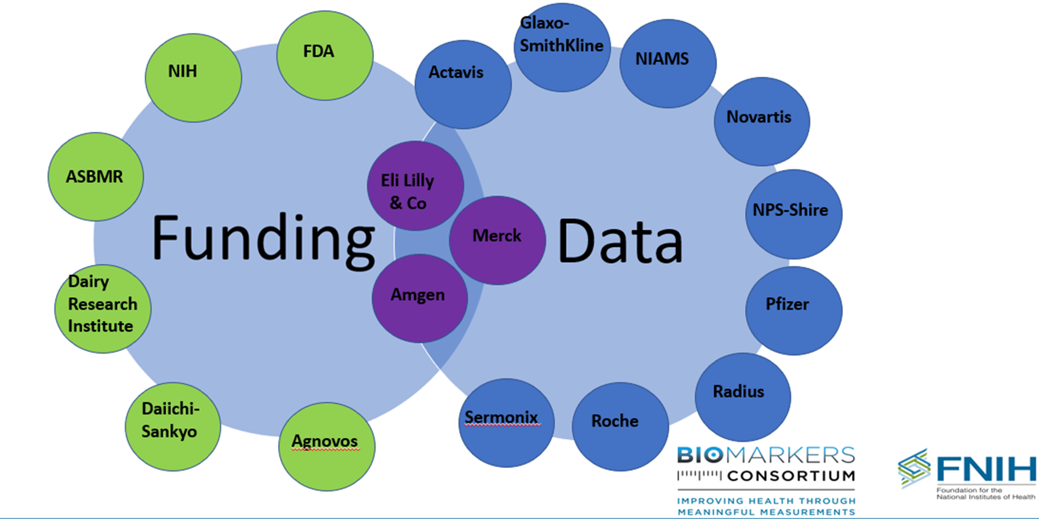
BQ Project Funding & Data Providers
Summary of Data Obtained
Data | N
Data Sources/sponsors | 14
RCTs | 53
Patients | >150,000
N with DXA BMD | ~90,000
Hip Fractures | ~2000
Non-vertebral Fractures | ~13,000
2 papers published (2018 & 2019)
Main DXA surrogacy paper to Lancet by 4/1/19

Slide 6
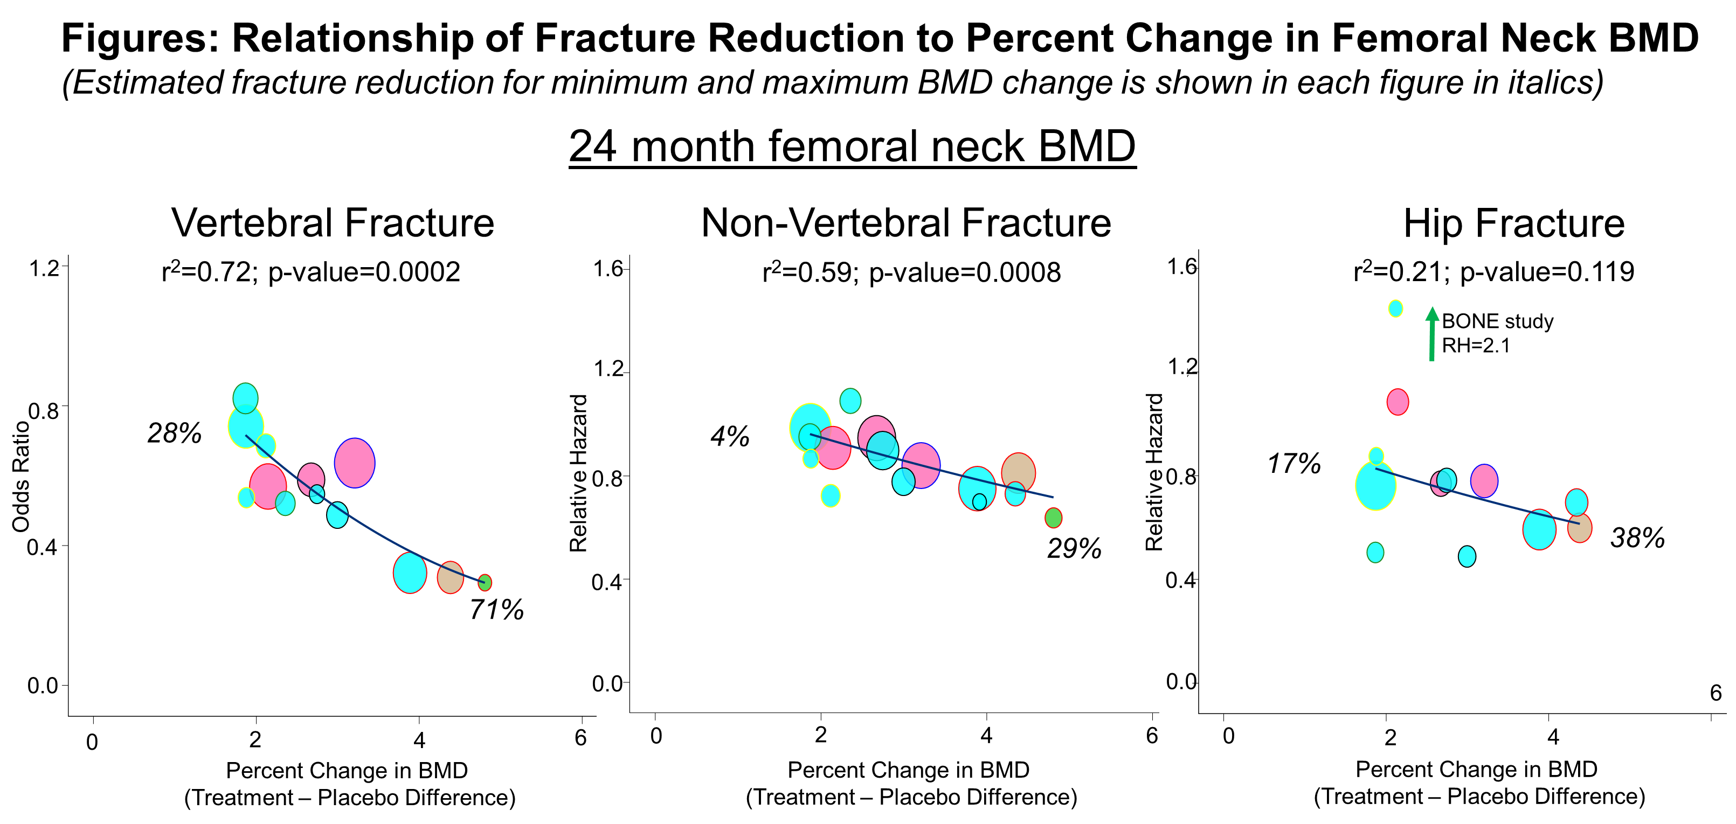


Slide 7
Status of FDA Qualification of BMD as Surrogate
FDA has accepted UCSF/FNIH application to enter into new process to qualify as surrogate.
  First surrogate in new process
Expected timeline
2019: Submission by UCSF of Qualification Plan, discussions of QP
Acceptance of final QP by FDA
2020: Submission of briefing document to FDA
2011: FDA accepts BMD as fracture surrogate for future drug approvals

