Slide 1
Next Generation Sequencing
Epidemiology 217: Lecture 9
Eric Jorgenson, PhD
March 5th, 2018
Kaiser Permanente Research

Slide 2
Outline
Technology
Exome Sequencing
  Medical Resequencing
  Population Level Exome Studies
  Exome Array Studies
Whole Genome Sequencing
De novo Mutations
  Parent-Offspring Studies
  Cancer

Slide 3
Outline
Technology
Exome Sequencing
  Medical Resequencing
  Population Level Exome Studies
  Exome Array Studies
Whole Genome Sequencing
De novo Mutations
  Parent-Offspring Studies
  Cancer

Slide 4
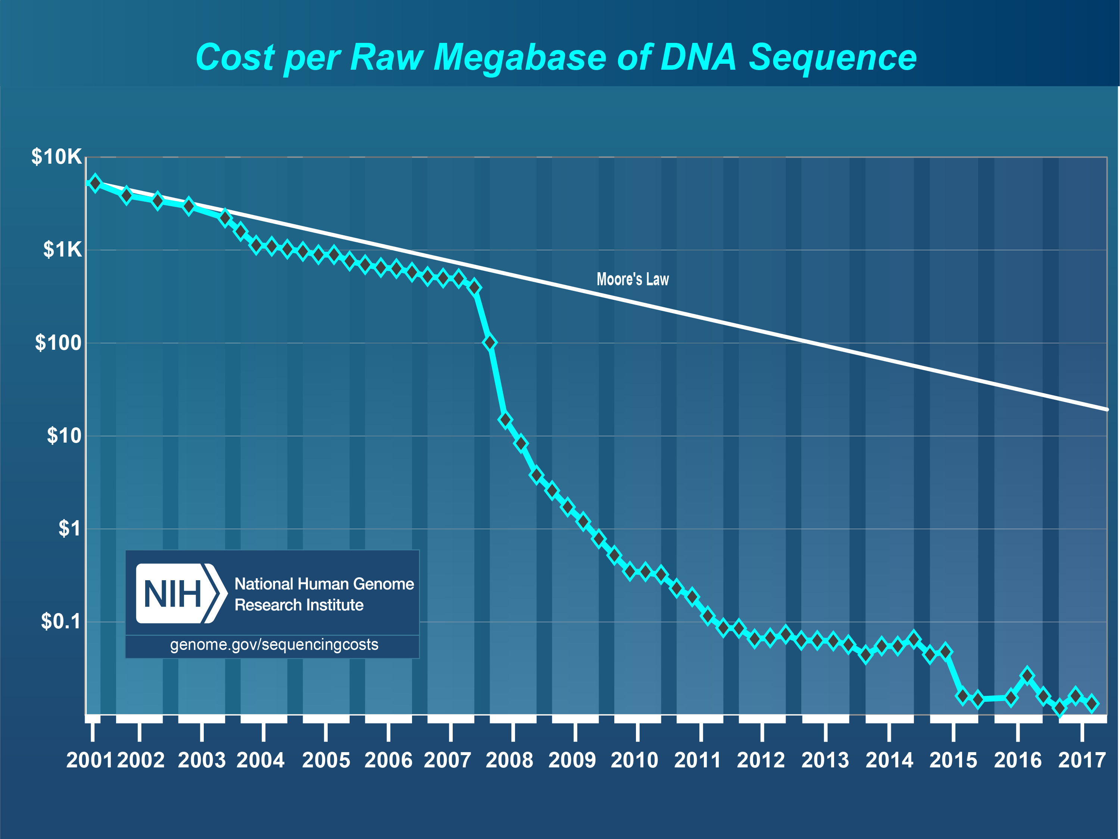
Sequencing Cost Have Fallen

Slide 5
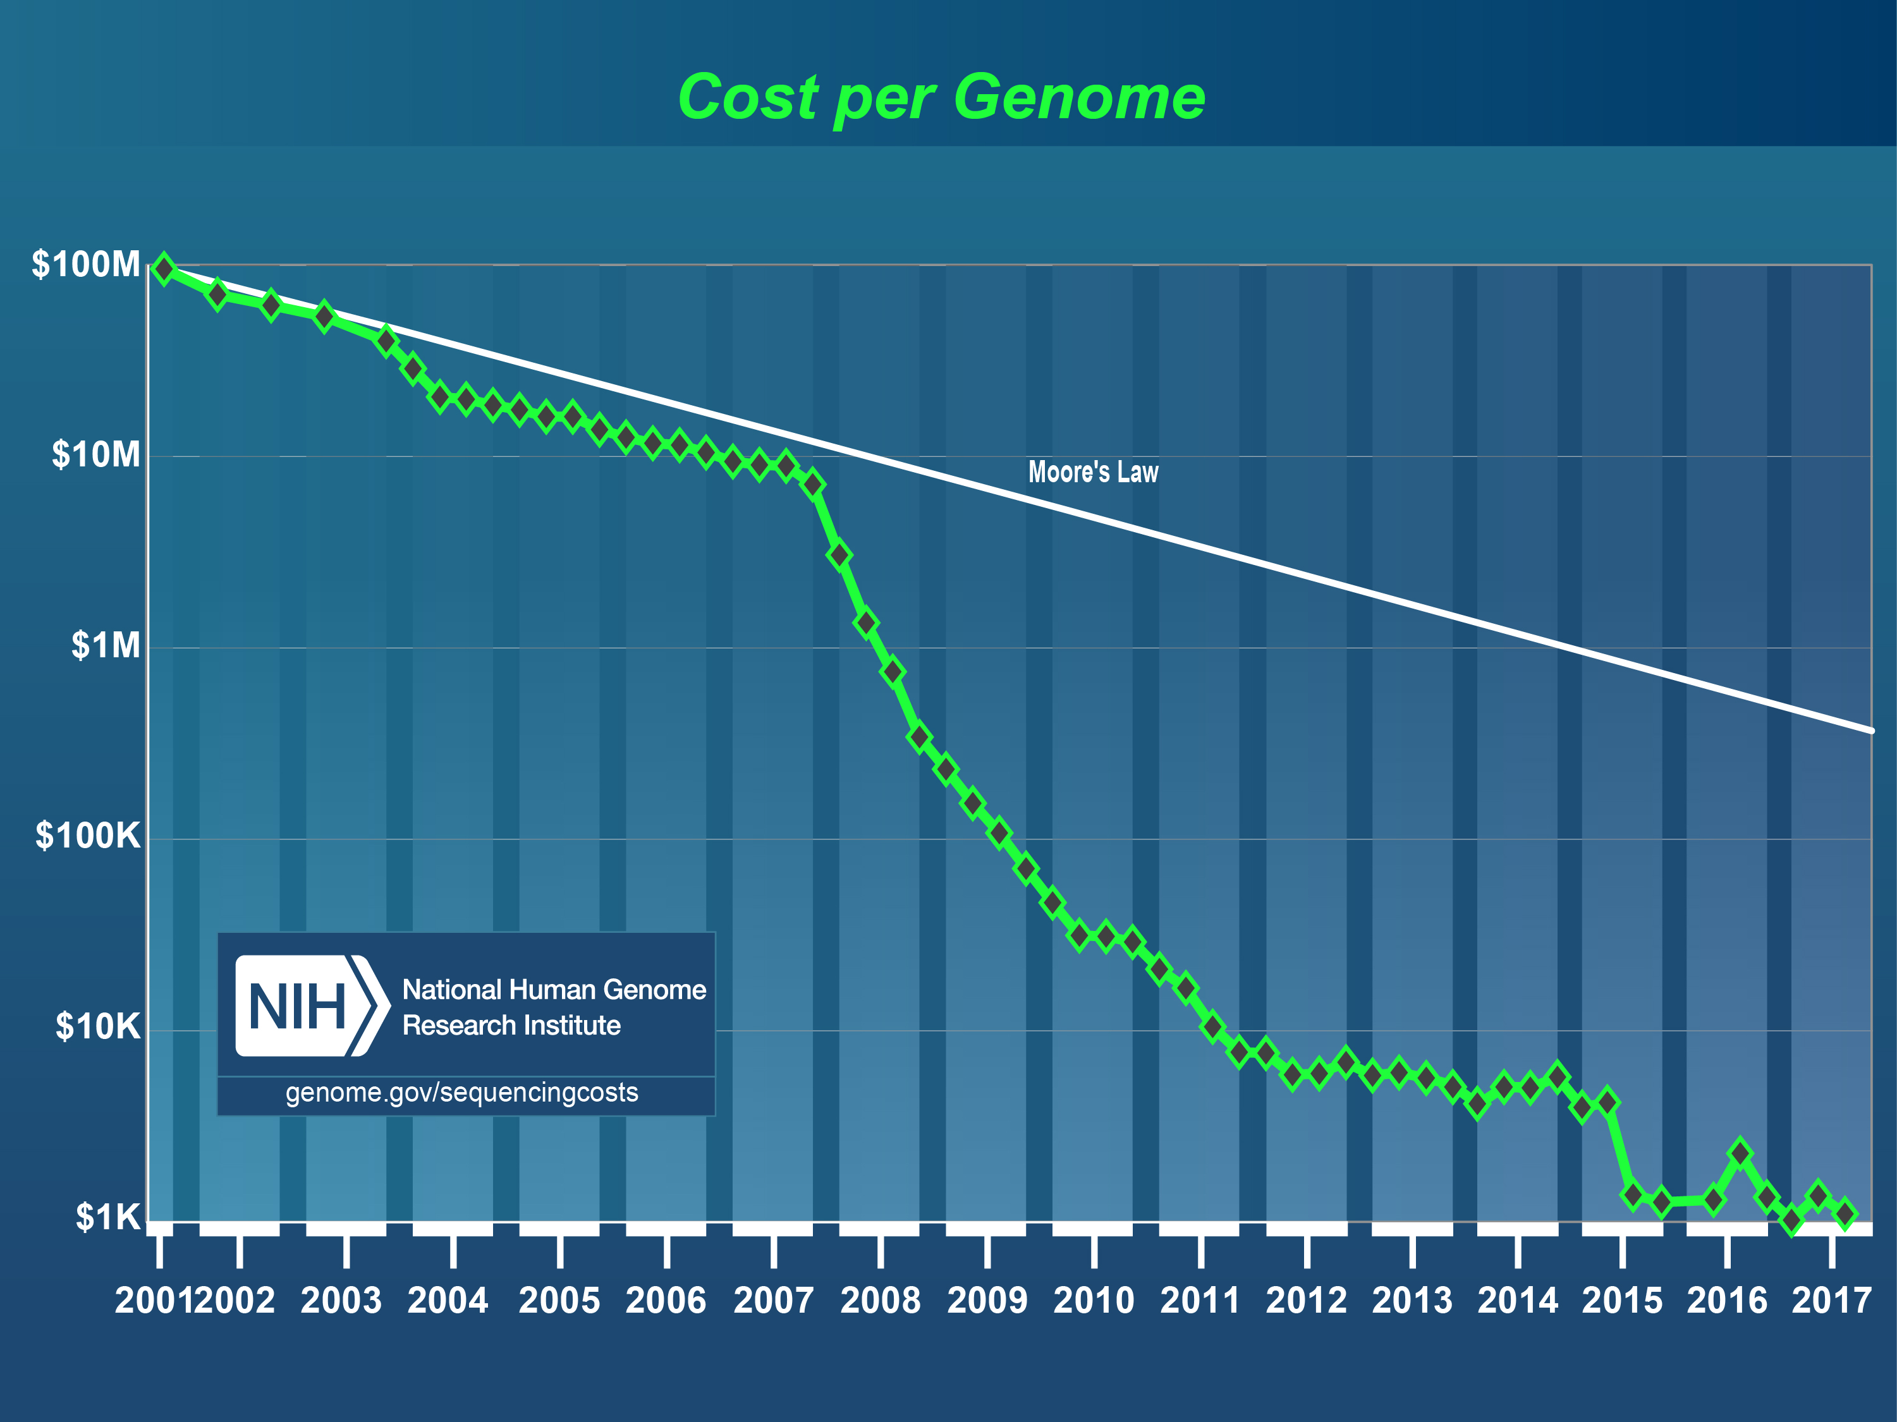
Sequencing Cost Have Fallen

Slide 6
Human Genome Sequencing

Slide 7
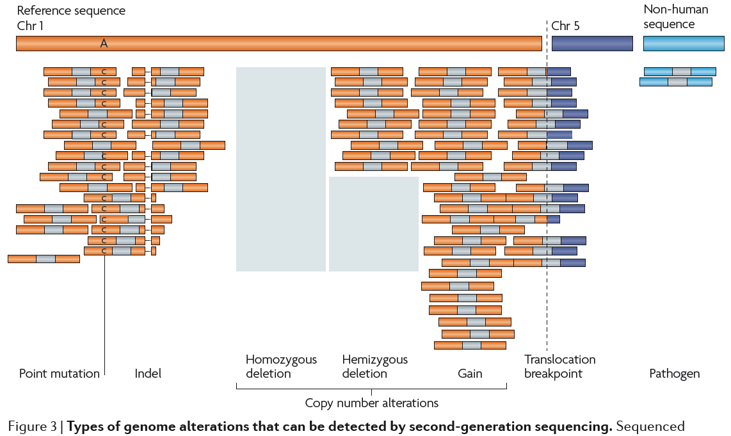
Variant Detection through Next Generation Sequencing
Meyerson et al. NRG 2010

Slide 8
Outline
Technology
Exome Sequencing
  Medical Resequencing
  Population Level Exome Studies
  Exome Array Studies
Whole Genome Sequencing
De novo Mutations
  Parent-Offspring Studies
  Cancer

Slide 9
Medical Resequencing to Detect Rare Variants
Ahituv et al. AJHG 2005

Slide 10
Medical Resequencing to Detect Rare Variants
Ahituv et al. AJHG 2005

Slide 11
Medical Resequencing to Detect Rare Variants
Ahituv et al. AJHG 2005

Slide 12
Medical Resequencing to Detect Rare Variants
Ahituv et al. AJHG 2005

Slide 13
Outline
Technology
Exome Sequencing
  Medical Resequencing
  Population Level Exome Studies
  Exome Array Studies
Whole Genome Sequencing
De novo Mutations
  Parent-Offspring Studies
  Cancer

Slide 14
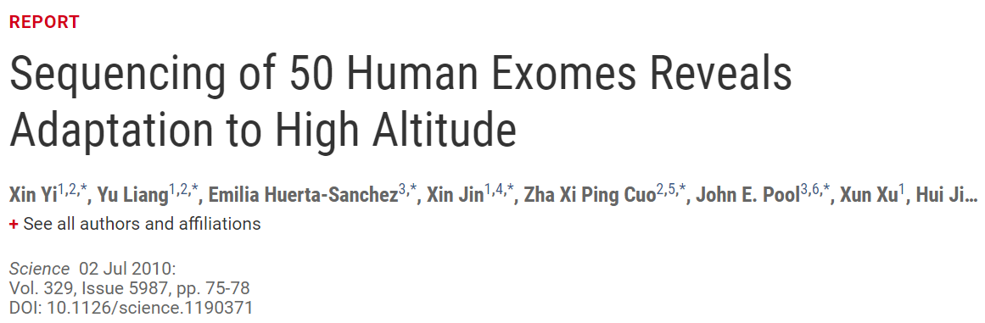
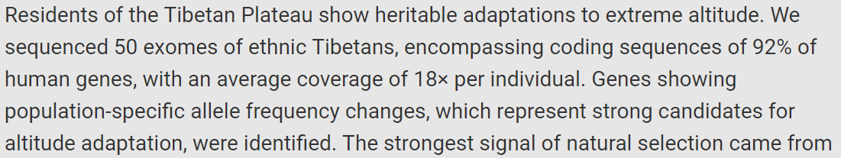
Exome Sequencing Identifies a Tibetan Adaptation
Yi et al. Science 2010, DOI: 10.1126/science.1190371

Slide 15
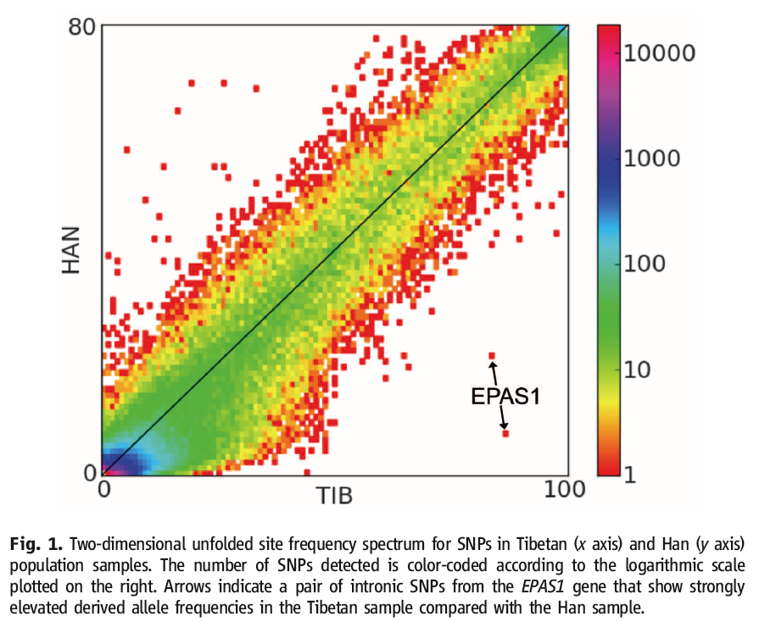
Exome Sequencing Identifies a Tibetan Adaptation
Yi et al. Science 2010, DOI: 10.1126/science.1190371

Slide 16
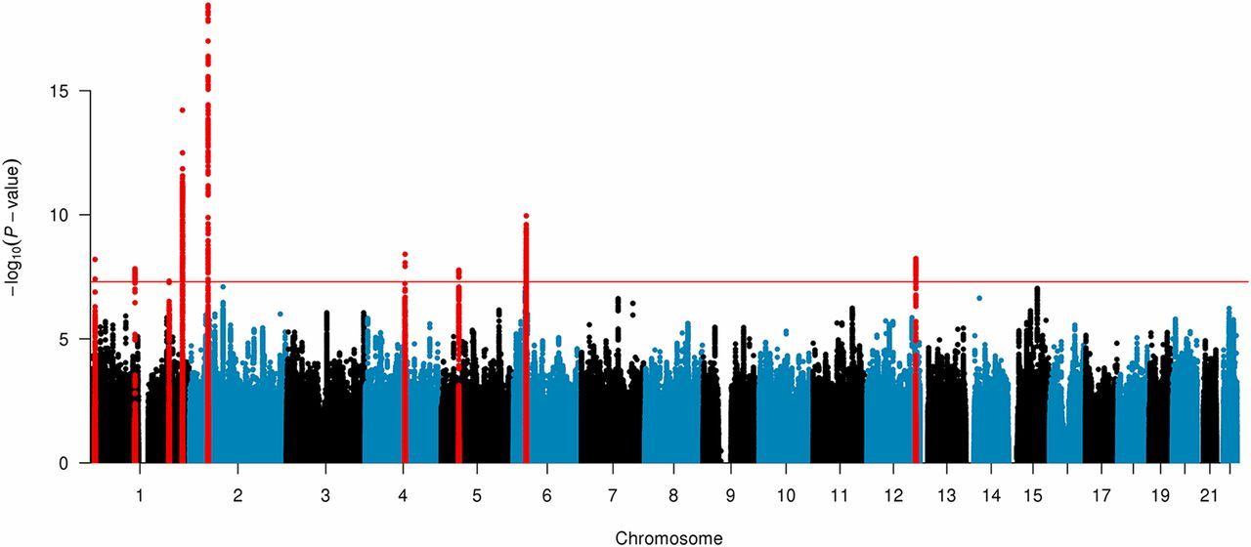
GWAS Also Identifies a Tibetan Adaptation
EPAS1
Jian Yang et al. PNAS doi:10.1073/pnas.1617042114
Notes:
Genome-wide scan for genetic signatures of adaptation. Shown on the y axis are −log10 of P values from the tests of allele frequency difference between Tibetan Chinese (n = 3,008) and EASs (n = 7,287). The analysis was performed using the MLMA-LOCO method, which tests for difference in allele frequency between populations taking into account the difference caused by random drift. SNPs at the genome-wide significant loci are highlighted in red.

Slide 17
Outline
Technology
Exome Sequencing
  Medical Resequencing
  Population Level Exome Studies
  Exome Array Studies
Whole Genome Sequencing
De novo Mutations
  Parent-Offspring Studies
  Cancer

Slide 18
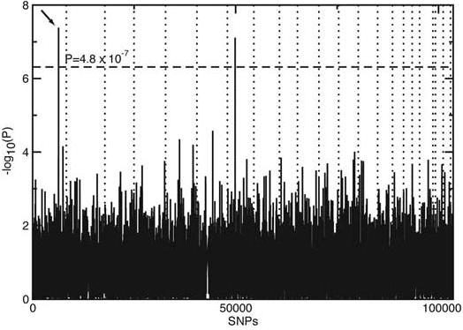
AMD GWAS Findings, 2005

Slide 19
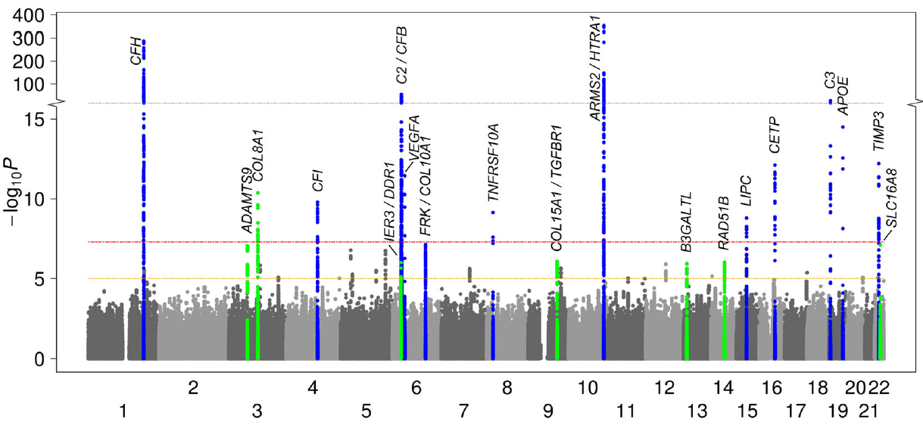
AMD GWAS Findings, 2013

Slide 20
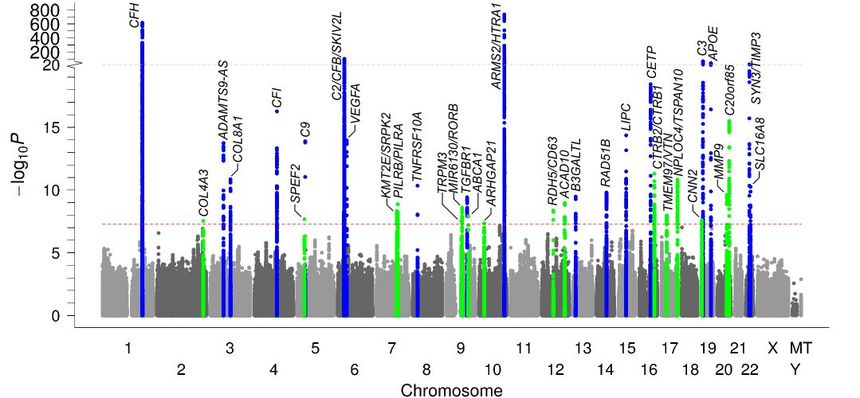
AMD GWAS Findings, 2015

Slide 21
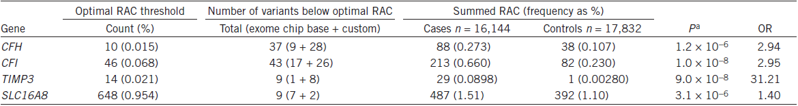
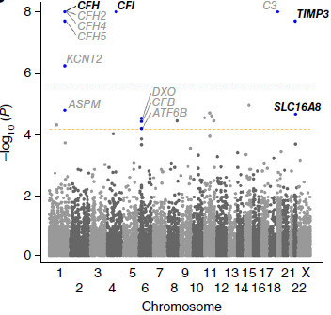
AMD Rare Variant Findings, 2015
Notes:
We computed a gene-based burden test of rare protein-altering variants comparing 16,144 advanced AMD cases and 17,832 controls. Shown are P values from the variable-threshold test (from up to 100 million permutations) and odds ratios from the collapsed burden test, both adjusted for the other variants identified in each locus (locus-wide conditioning). Four genes (among the 703 genes in the 34 AMD locus regions) showed a significant (P < 0.05/703 = 7.1 × 10−5) burden.

Slide 22
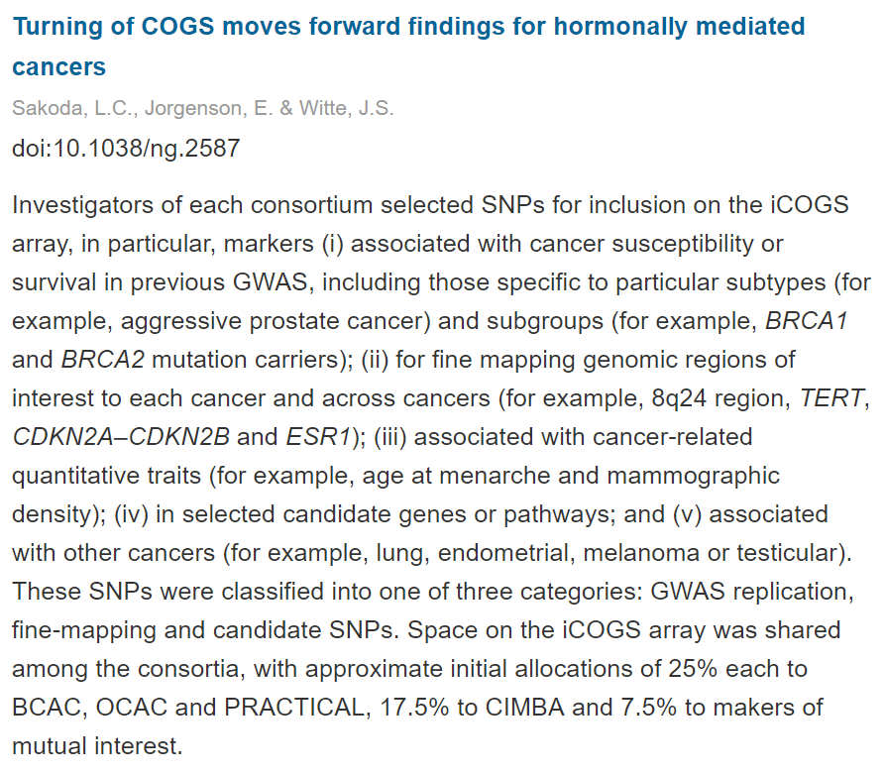
COGS Exome Array Example in Cancer
https://www.nature.com/articles/ng.2587
Notes:
We computed a gene-based burden test of rare protein-altering variants comparing 16,144 advanced AMD cases and 17,832 controls. Shown are P values from the variable-threshold test (from up to 100 million permutations) and odds ratios from the collapsed burden test, both adjusted for the other variants identified in each locus (locus-wide conditioning). Four genes (among the 703 genes in the 34 AMD locus regions) showed a significant (P < 0.05/703 = 7.1 × 10−5) burden.

Slide 23
Outline
Technology
Exome Sequencing
  Medical Resequencing
  Population Level Exome Studies
  Exome Array Studies
Whole Genome Sequencing
De novo Mutations
  Parent-Offspring Studies
  Cancer

Slide 24
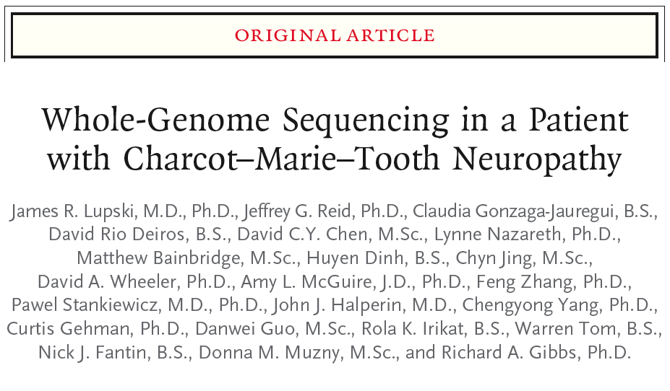
Sequencing of a Single Individual with Family Data
Lupski et al. NEJM 2010

Slide 25
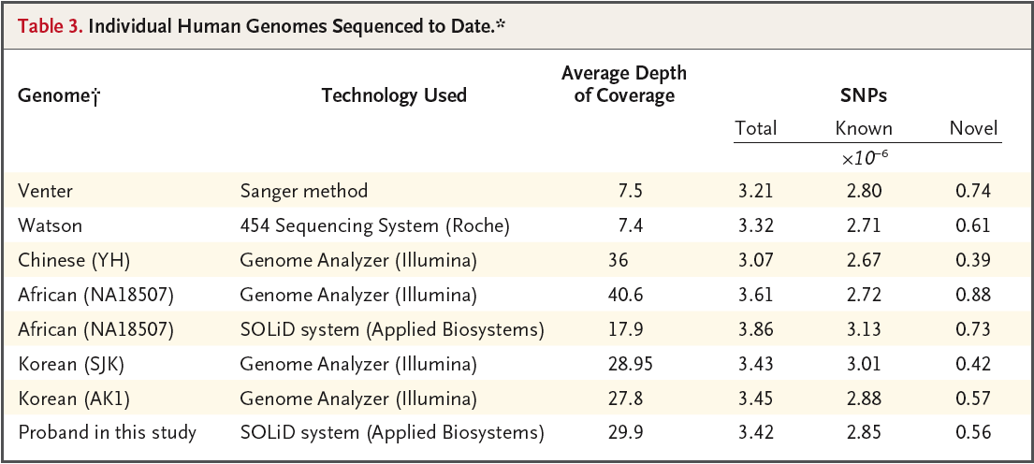
The First 8 Human Genomes
Lupski et al. NEJM 2010

Slide 26
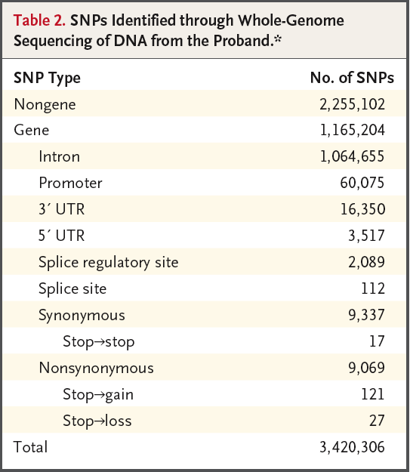
SNP Distribution in Proband
Lupski et al. NEJM 2010

Slide 27
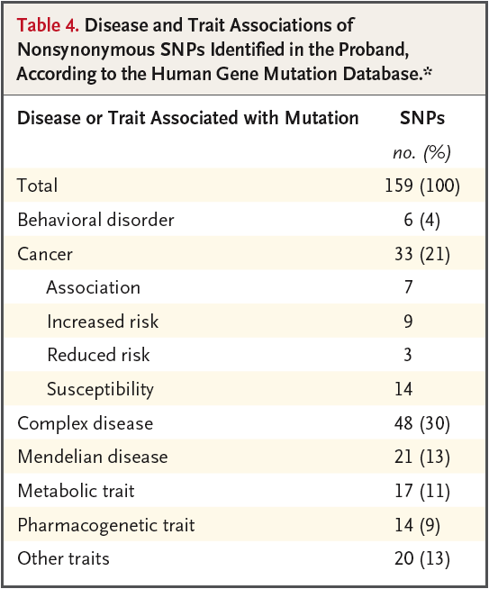
Nonsynonymous SNPs in Known Disease Genes
Lupski et al. NEJM 2010

Slide 28
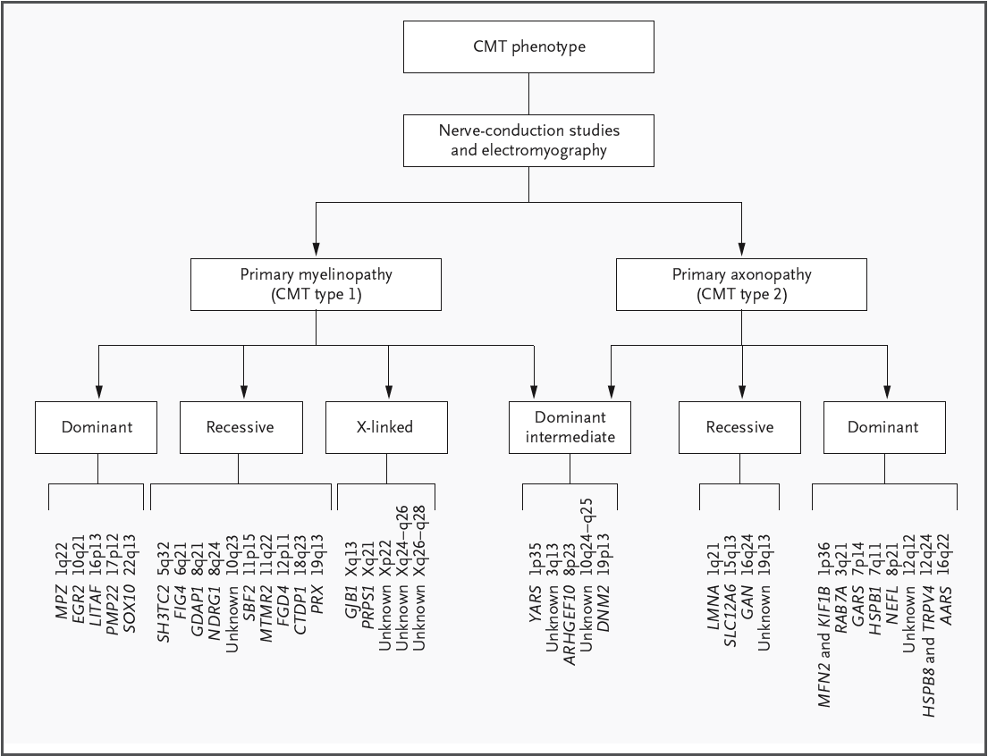
CMT Subtypes: Many Genes
Lupski et al. NEJM 2010

Slide 29
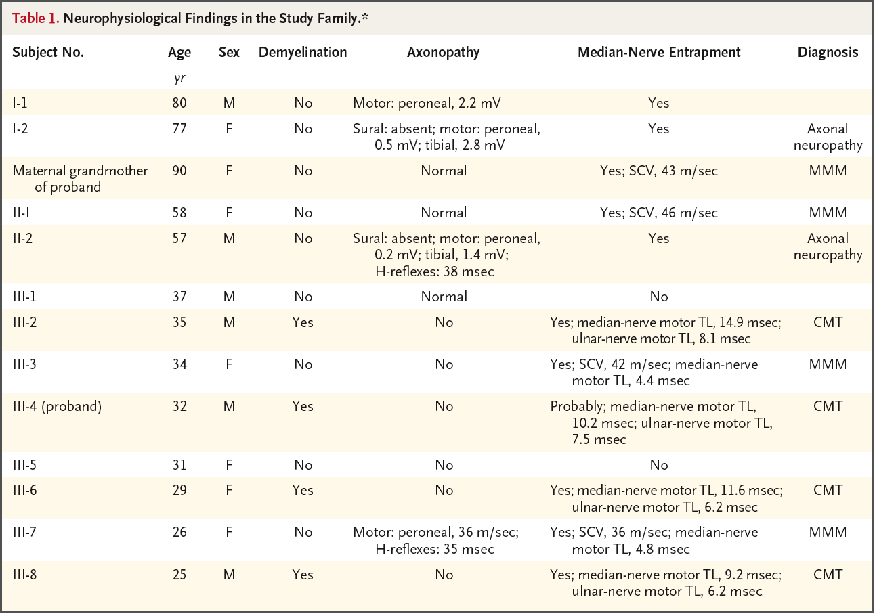
Phenotypes in Unseqeunced Family Members
Lupski et al. NEJM 2010

Slide 30
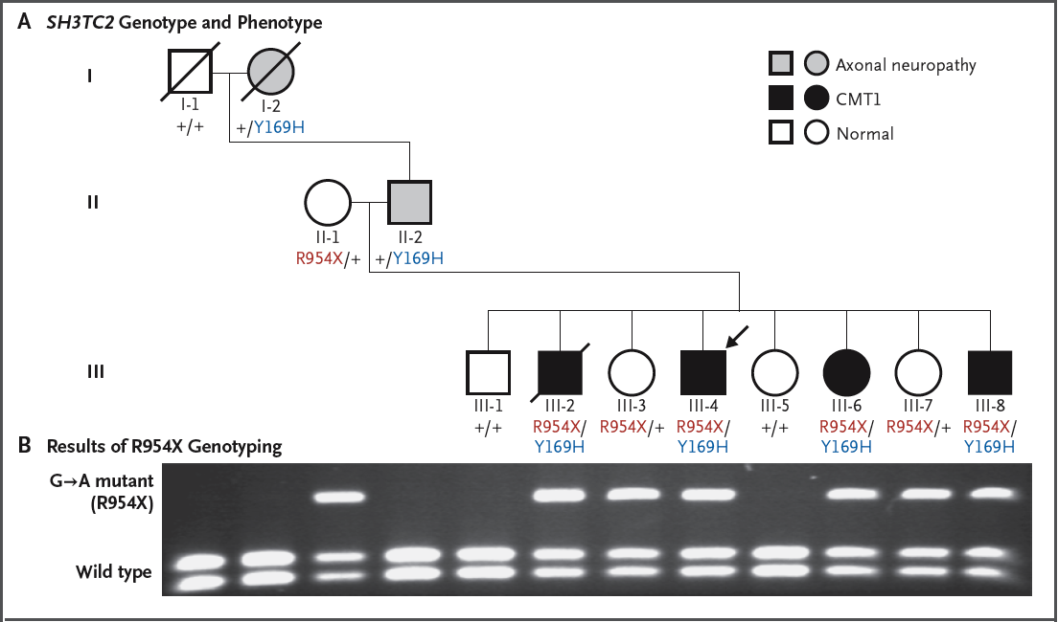
Family Pedigree
Lupski et al. NEJM 2010

Slide 31
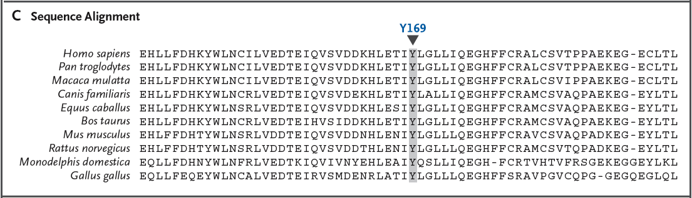
Putative Causal Variant at a Conserved Amino Acid
Lupski et al. NEJM 2010

Slide 32
Outline
Technology
Exome Sequencing
  Medical Resequencing
  Population Level Exome Studies
  Exome Array Studies
Whole Genome Sequencing
De novo Mutations
  Parent-Offspring Studies
  Cancer

Slide 33

Your De Novo Mutations
74 new SNPs
2 new Indels
Rarely a CNV

Slide 34
Sporadic Autism Exome Study and De Novo Mutations
209 Families, 677 Individuals
  Trios
  Unaffected Siblings
Exome Sequencing
248 De Novo Events
  225 SNVs (single nucleotide variants)
  17 Indels
  6 CNVs
181 nonsynonymous changes
  120 severe
O’Roak et al. Nature 2012

Slide 35
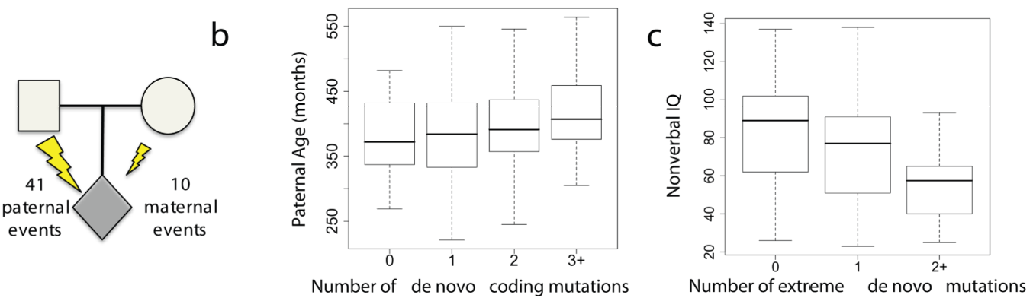
De Novo Mutations and Autism Spectrum Disorder
O’Roak et al. Nature 2012
Notes:
a Haplotype phasing using informative markers shows a strong parent-of-origin bias with
41/51 de novo events occurring on the paternally inherited haplotype.
b, The paternal estimated age at conception versus the
number of observed de novo point mutations (0, n = 53; 1, n = 65; 2, n = 44; 3+, n = 27).
c, Decreased nonverbal IQ is significantly associated with an increasing number of “extreme”
mutation events (0, n = 138; 1, n = 41; 2+, n = 10), both with and without CNVs

Slide 36
Outline
Technology
Exome Sequencing
  Medical Resequencing
  Population Level Exome Studies
  Exome Array Studies
Whole Genome Sequencing
De novo Mutations
  Parent-Offspring Studies
  Cancer

Slide 37
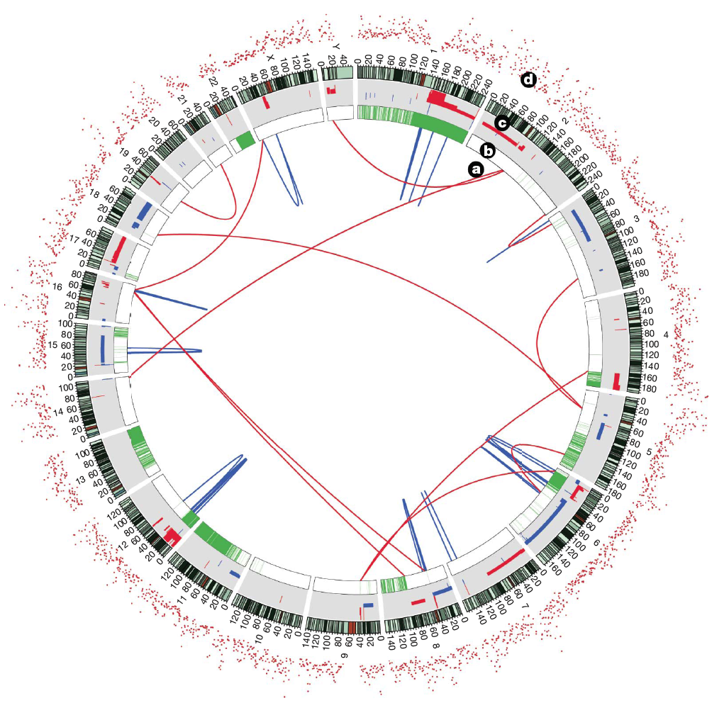
Cancer: Tumor vs. Normal
Lee et al. Nature 2010

Slide 38
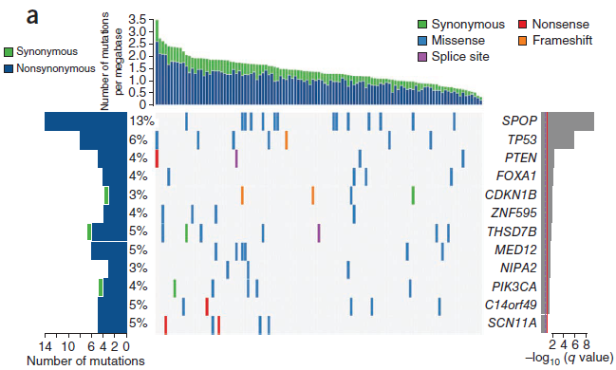
Exome Sequencing in Prostate Cancer
Barbieri et al. Nature Genetics 2012

Slide 39
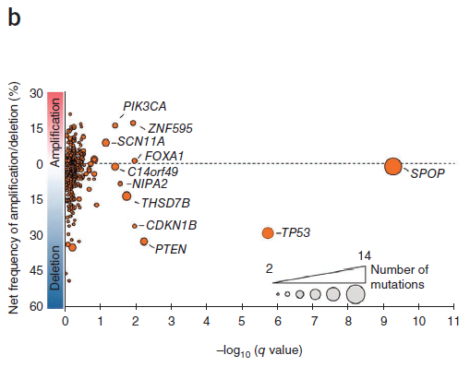
Exome Sequencing in Prostate Cancer
Barbieri et al. Nature Genetics 2012

Slide 40
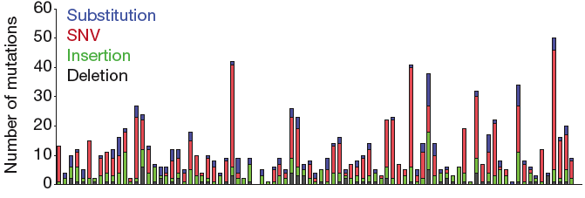
Nonsynonymous Somatic Mutations in Neuroblastoma
Molenaar et al. Nature 2012

Slide 41
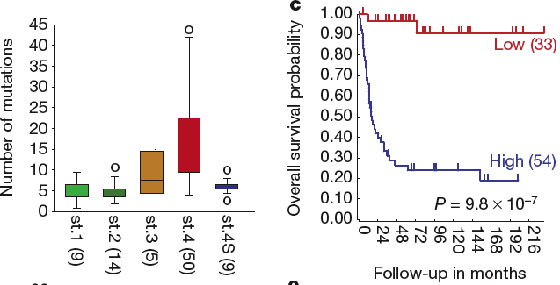
Mutation Count Associated with Age, Stage, and Survival
Molenaar et al. Nature 2012

Slide 42
Personal Genome Sequencing
https://www.youtube.com/watch?v=YGIxMYiPLOU

