Slide 1
Basic Analysis Issues for Health Disparities Research
Anusha M. Vable, ScD, MPH
Assistant Adjunct Professor
Department of Family and Community Medicine
University of California, San Francisco
anusha.vable@ucsf.edu
@AnushaVable

Slide 2
Topics covered
Confounding, mediation (Baron-Kenny) & model building
Effect modification
Multi-level analysis
Notes:
Today we’ll discuss confounding, mediation, and model building.
Then, we’ll discuss effect modification.
And, finally we’ll touch on multi-level analysis. I took a whole semester-long course on multilevel, and we’re going to go over it in about 20 minutes.
So, my goal for today is provide you with some of the intuition behind these concepts, and we’ll do a few examples by hand. After this lecture, you should to be able to read the literature more critically, and know about different analysis techniques that are important for health disparities research.
So let me start with quickly defining these concepts, and then we’ll go through them in more depth.

Slide 3
Confounding
Confounding bias occurs when there is a common (shared) prior cause of both the exposure and the outcome.
Accounting for confounders is important for getting unbiased effect estimates
?
education
cognition
mother’s education
$$E\left[cognition\right]=β_{0}+β_{1}\left(mother^{′}s education\right)+β_{2}(education)$$
$$Cognition=β_{0}+β_{1}\left(mother^{′}s education\right)+β_{2}\left(education\right)+e_{i}$$

Slide 4
Mediation
Mediation analysis allows us to decompose the total effect (a) of the exposure on the outcome into the direct effect (a’) and the indirect (or mediated effect; b*c)
Helpful for identifying mechanisms
mother’s education
a
cognition
a'
mother’s education
education
cognition
b
c

Slide 5
Effect Modification
The relationship between an exposure and an outcome depends on the level of another variable, the effect modifier
Helpful for targeting of interventions.
Example: you may expect the effect of education on cognition to be different among Black women than among White men
Notes:
So for example, you might expect that the effect of education on cognition is different among Black women than among White men since Black women’s experience of the world every day differs from than of White men.

Slide 6
Multilevel Analysis
Empirically differentiating composition (characteristics of individuals) from context (differences due to place), both of which are important for health
Examining cross-level interactions (effect modification)

Slide 7
Confounding

Slide 8
Confounding
Confounding bias occurs when there is a common (shared) prior cause of both the exposure and the outcome.
Accounting for confounders is important for getting unbiased effect estimates
?
education
cognition
mother’s education
$$E\left[cognition\right]=β_{0}+β_{1}\left(mother^{′}s education\right)+β_{2}(education)$$
$$Cognition=β_{0}+β_{1}\left(mother^{′}s education\right)+β_{2}\left(education\right)+e$$

Slide 9
Activity: Confounding
Draw a DAG for a relationship of interest
Include only one confounder for simplicity
Follow convention that time moves from left to right, so there are no arrows that point from right to left (would imply moving backwards in time)
Optional: Write the equation to determine if the exposure has an effect on the outcome after controlling for confounding

Slide 10
Empirical example of confounding
Data generating rule:
cog = 4*momedu + 2*edu + error
?
education
cognition
mother’s education
?
education
cognition
mother’s education

Slide 11
Confounders in disparities research
education
income
health
race / ethnicity

Slide 12
Additional reading on confounding: Society for Epidemiologic Research (SER) Playlist

Slide 13
How to estimate mediation

Slide 14
Mediation analysis
Mediation analysis allows us to decompose the total effect (a) of the exposure on the outcome into the direct effect (a’) and the indirect (or mediated effect; b*c)
mother’s education
a
cognition
a'
mother’s education
education
cognition
b
c
Baron & Kenny, 1986

Slide 15
Baron-Kenny Decomposition
Evaluate if a variable is a mediator
Complete or partial mediation
mother’s education
a
cognition
a'
mother’s education
education
cognition
b
c
Baron & Kenny, 1986

Slide 16
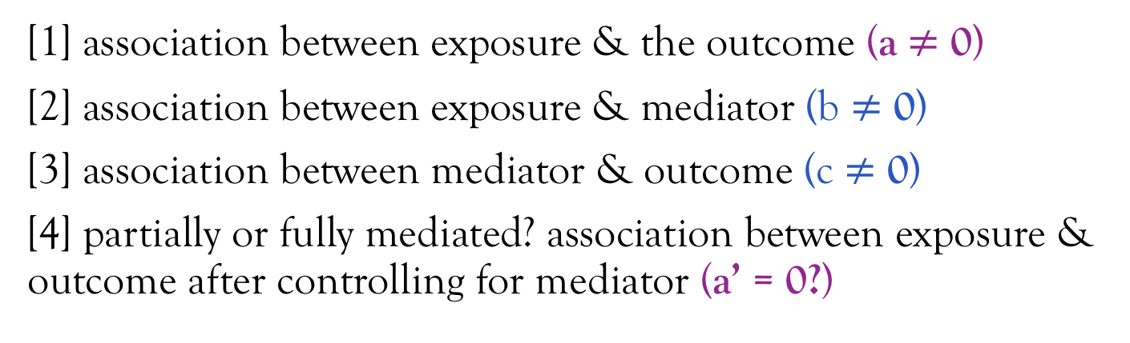
Baron-Kenny Decomposition (4 steps)
[1] association between exposure & the outcome (a $≠$ 0)
[2] association between exposure & mediator (b $≠$ 0)
[3] association between mediator & outcome (c $≠$ 0)
[4] partially or fully mediated? association between exposure & outcome after controlling for mediator (a’ = 0?)
mother’s education
a
cognition
a'
mother’s education
education
cognition
b
c
Baron & Kenny, 1986

Slide 17
Equations for the Baron-Kenny Decomposition
mother’s education
cognition
mother’s education
education
cognition
[1] association between exposure & the outcome
[2] association between exposure & mediator
[3] association between mediator & outcome
[4] partially or fully mediated? association between exposure & outcome after controlling for mediator
Baron & Kenny, 1986
Notes:
Can you add the wrap up that you interpret beta 2 as the direct effect and contrast beta1 (from model 1) and beta 2 from model 4 to evaluate the indirect effect?
Block out equations so they are serially revealed

Slide 18
Empirical example of mediation
a'
mother’s education
a
cognition
mother’s education
education
cognition
b
c
Step 1:
Step 2:
Steps 3 & 4:
Notes:
Put a and a’ in previous example

Slide 19
Activity: Mediation
Suggest following the convention that time moves from left to right
Victora et al., 1997

Slide 20
family income
sanitation
malnutrition
diarrhea
Victora et al., 1997

Slide 21
List the confounders and the mediators for the following relationships:
family income
sanitation
malnutrition
diarrhea
 | Confounders | Mediators
Family income on diarrhea
Sanitation on diarrhea
Malnutrition on diarrhea
Victora et al., 1997

Slide 22
You want to determine if the relationship between sanitation and diarrhea is mediated by malnutrition. What are the equations to assess this relationship?
family income
sanitation
malnutrition
diarrhea
Step 1: association between exposure & the outcome?
Step 2: association between exposure & mediator?
Step 3: association between mediator & outcome?
Step 4: partially or fully mediated?
Notes:
We’ll go over this together – if you view in presentation mode the boxes will go away for the equations to be revealed

Slide 23
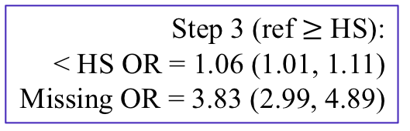
Pathways through which racial / ethnic disparities in US fetal deaths arise
Step 2:
< HS White = 11%
< HS Black = 22%
OR = 1.98 (1.81, 2.15)
Step 3 (ref $≥$ HS):
< HS OR = 1.06 (1.01, 1.11)
Missing OR = 3.83 (2.99, 4.89)
OR = 1.56 (1.42, 1.70)
OR = 1.04 (0.95, 1.14)
Step 1 (ref = Whites):
Black OR = 2.24 (2.08, 2.42)
Lorch et al., 2012

Slide 24
Additional reading on mediation
Notes:
All subsequent mediation analyses are based on the framework proposed by BK. There have been some critiques of BK and advances in mediation analysis such as, there may be an interaction between the exposure and the mediator, there may be confounders of the mediator – outcome relationship, measurement error of the mediator, etc.
The BK approach is the foundation of all subsequent mediation approaches, so now you should have a solid foundation to build on if you want to study mediation.

Slide 25
Why is it important to differentiate between confounders & mediators in disparities research?
What to adjust for – don't adjust for mediator if want total effect
Want to control for mediators to understand the mechanisms
Interpretation of models
Notes:
Want to describe effect of race on quality of care in the hospital
Walk through an example related to race
If want to look at poverty / education then you do want to control for race

Slide 26
Why adjust for SES when examining racial disparities?
education
race / ethnicity
occupation
health
income
wealth

Slide 27
Measurement of racism reduces possibility disparities misinterpreted as genetic / biologic rather than social
racism
education
race / ethnicity
occupation
health
income
wealth

Slide 28
Effect Modification

Slide 29
Effect modification is critical for health disparities research!!
In order for health disparities to be reduced by an intervention applied equally to both groups, there must be effect modification – that is, the socially vulnerable group must improve more than the socially advantaged group as a result of the intervention
Effect modification is used interchangeably with other terms:
Heterogenous treatment effects
Interactions
Differential returns

Slide 30
Effect modification & health disparities

Slide 31
Intersectionalities & Effect Modification
Intersectionality theory developed to address the non-additive effects of gender and race / ethnicity
Cannot sum the coefficients for “Black” and “male” to understand the experiences of Black men; must examine Black men independently
Bauer GR; Social Science and Medicine (2014)

Slide 32

Effect modification in linear models
The relationship between gender and systolic blood pressure does not vary by race:
The relationship between gender and systolic blood pressure does vary by race:
$$E\left[SBP\right]=β_{0}+β_{1}\left(male\right)+ β_{2}\left(Black\right)$$
$$E\left[SBP\right]=β_{0}+β_{1}\left(male\right)+ β_{2}\left(Black\right)+β_{3}\left(male\right)∗(Black)$$

Slide 33


Interpretation of coefficients without an interaction term
$$E\left[SBP\right]=β_{0}+β_{1}\left(male\right)+ β_{2}\left(Black\right)$$
$β_{0}$: mean SBP when all coefficients are zero
(that is, mean SBP for White women)
$β_{1}$: mean difference in SBP for men vs. women
$β_{2}$: mean difference in SBP for Blacks vs. Whites
Mean SBP for Black men: $β_{0}+β_{1}+β_{2}$
Notes:
Add boxes so serially revealed

Slide 34

Interpretation of coefficients with an interaction term
$$E\left[SBP\right]=β_{0}+β_{1}\left(male\right)+ β_{2}\left(Black\right)+β_{3}\left(male\right)∗(Black)$$
$β_{0}$: mean SBP when all coefficients are zero
(that is, mean SBP for White women)
$β_{1}$: mean difference in SBP for White men vs. White women
$β_{2}$: mean difference in SBP for Black women vs. White women
$β_{3}$: additional difference in SBP for Black men
Mean SBP for Black men: $β_{0}+β_{1}+β_{2}+β_{3}$
Notes:
After this slide- point out that you can do this with two binary variables or a binary and a continuous, or two continuous, and the ideas are the same it just gets slightly more complicated to interpret.
In this case, we looked at two binary variables – male and Black. You can extend this to look at the interactions between binary and continuous variables (which we’ll do now), or two continuous variables, but two continuous variables gets difficult to interpret.

Slide 35
Differential returns to education
Because different sociodemographic groups have different experiences in the social world, we thought different sociodemographic groups may differentially benefit from each year of education, that is, there may be differential returns to education
Vable et al., 2018

Slide 36
Differential returns among race - sex subgroups in predicting MCS?
Variables | Beta | (95% CI) | p-value
Constant (White men) | 54.01 | (53.51,54.50) | <0.0005
Education (yrs) | 0.44 | (-0.03,0.90) | 0.066
White women | -2.68 | (-3.35,-2.01) | <0.0005
Black men | -0.18 | (-0.96,0.61) | 0.658
Black women | -2.03 | (-2.84,-1.22) | <0.0005
Latino men | 0.58 | (-0.47,1.63) | 0.279
Latino women | -0.97 | (-2.10,0.17) | 0.095
White women * education | 0.65 | (-0.06,1.37) | 0.075
Black men * education | 0.22 | (-0.62,1.06) | 0.608
Black women * education | 0.91 | (0.19,1.64) | 0.014
Latino men * education | 0.36 | (-0.42,1.14) | 0.364
Latino women * education | -0.13 | (-0.99,0.74) | 0.775
Education is centered at 12 years
Vable et al., 2018

Slide 37

Activity: interpret regression coefficients
$$E\left[BMI\right]=β_{0}+β_{1}\left(male\right)+ β_{2}\left(Black\right)+β_{3}\left(male\right)∗(Black)$$
$β_{0}$:
$β_{1}$:
$β_{2}$:
$β_{3}$:
Mean BMI for Black men:
Notes:
Have exact text written down so I don’t forget

Slide 38
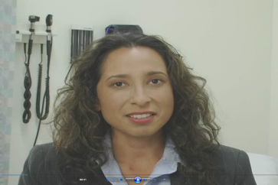
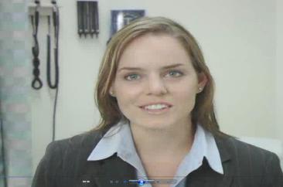

The “Patients”
Notes:
Examples of effect modification – Christine to explain

Slide 39
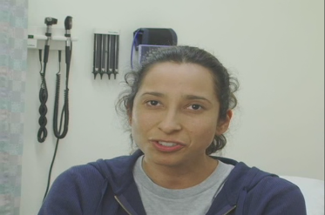
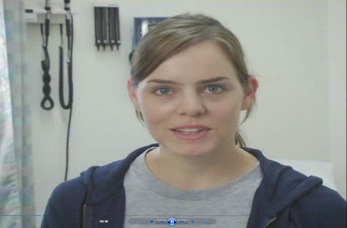
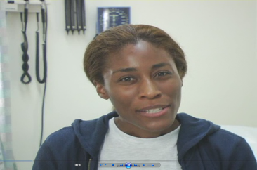
The “Patients”
Notes:
Examples of effect modification – Christine to explain

Slide 40
GI Bill eligibility predicted smaller socioeconomic disparities in memory were among veterans than non-veterans
0.04
0.07
0.08
Difference in disparities = 0.04 (0.01, 0.08); equivalent to aging 1 year
Vable AM, Eng CW, Mayeda ER, Basu S, Marden JR, Hamad R, Glymour MM; JECH 2018

Slide 41
Is there effect modification here?
Who benefits and who doesn’t?
Does this version of Paid Family Leave increase or decrease disparities?
Hamad R, Modrek S, White JS; AJPH, 2018

Slide 42
Reducing criminal petalites for drug possession in CA reduced racial / ethnic disparities in felony drug arrests
Mooney AC, et al.; AJPH, 2018

Slide 43
Homework question 1
What are 3 different ways to account for SES in a analytic models when investigating racial/ethnic health disparities?
Briefly discuss the interpretations/implications of each approach as it relates to understanding health disparities by race/ethnicity.

Slide 44
Homework question 2
Describe a potential effect modifier, mediator, or contextual variable (for definition of contextual variable, see Diez-Roux reading) for an association of interest to you and relevant to health disparities. For example, for investigating the association between education and hypertension, I might be interested in evaluating whether the association between years of education and hypertension is different for Black men than for White men. Describe how you would study whether this relationship exists.

Slide 45
Multilevel Analysis
Notes:
Multilevel Modeling is a totally different category of analysis, although it’s still regression based. And it’s particularly relevant for health disparities research.

Slide 46
Multilevel analysis useful for
Empirically differentiating composition (characteristics of individuals) from context (differences due to place), both of which are important for health
Examining cross-level interactions (effect modification)
… among other things … !
Notes:
Here’s an example where you may be interested in separating composition from context:
States in the southern US have much higher stroke rates. They also have a higher fraction of the population that is Black, and Blacks have higher stroke rates. So is the excess in the stroke belt about composition or context?
A multilevel model can help you answer this question.

Slide 47
What is a multilevel model?
🏥
We’ll discuss
Level 3
. . . .
Empirically differentiating composition from context, both of which are important for health
👩🏿‍⚕️
Examining cross-level interactions (effect modification)
👩🏾‍⚕️
👨🏿‍⚕️
. . . .
Level 2
Level 1
👩🏾 🧟‍♀️👸🏽👩🏿‍💼👰🏼🤵🏾👨🏻‍🏫👵🏾🧕🏼👩🏻👨🏼‍💼👨🏾‍🔧👳🏾‍♀️
. . . .

Slide 48
Examples of when you might use multilevel models
🏫
. . .
🌆
. . .
👨🏽‍🏫
👩🏾‍🏫
. . .
🏘
🏘
. . .
👧🏿👦🏻👦🏼👧🏾👦🏽👦🏿👧🏽👧🏻👧🏼👦🏾
. . .
👨🏾‍🎨👩🏽‍✈️🤷🏻‍♀️💆🏽‍♂️🏃🏿‍♀️👶🏾🧕🏼💇🏾‍♂️
. . .

Slide 49
Questions you might answer with multilevel models
How much of health outcomes is due to quality of care vs. the composition of the patient population?
How much of test scores is due to the SES of the student population vs. the quality of the school?
Is the effect of neighborhood social capital on individual PTSD different for individuals who report high or low trust?

Slide 50
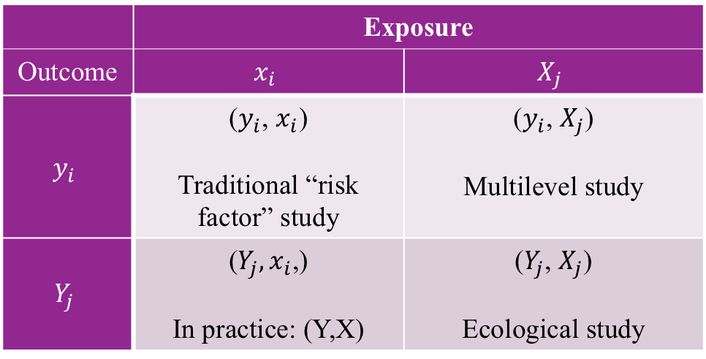


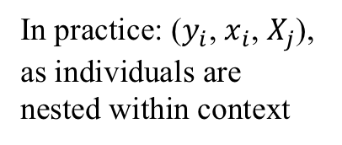
Types of studies
In practice: ($y_{i}$, $x_{i}$, $X_{j}$), as individuals are nested within context
 | Exposure
Outcome | $$x_{i}$$ | $$X_{j}$$
$$y_{i}$$ | ($y_{i}$, $x_{i}$) Traditional “risk factor” study | ($y_{i}$, $X_{j}$) Multilevel study
$$Y_{j}$$ | ($Y_{j},x_{i}\text{,}$) In practice: (Y,X) | ($Y_{j}$, $X_{j}$) Ecological study
$i$: individual-level
$j$: contextual
Adapted from Kawachi & Subramanian 2006
Notes:
Little x is an individual level exposure, big X is a contextual exposure
Little y is an individual level outcome, big Y is a contextual exposure

Slide 51
Multilevel models help you avoid the ecologic & atomistic fallacies
Ecologic fallacy: inferences about individuals are deduced from associations between groups
  Example: @ country level, higher GDP countries have lower mortality, therefore, increasing individual-level income will reduce mortality
Atomistic fallacy: inferences about groups are deduced from associations between individuals
  Example: @ individual level, higher income predicts lower mortality, therefore, increasing GDP will lower mortality
Diez Roux AJPH, 1998

Slide 52
Level 2 variables
Variables that reflect the characteristic of groups can be:
Derived / aggregate variables (aggregate of individual-level variables)
Proportion living in poverty
Proportion minority
Integral / obligatory variables (characteristics of place; no individual-level analogue)
Density of health centers
Level of air pollution
Diez Roux AJPH, 1998

Slide 53










Analytic models
For multilevel models, develop regression equation at each level of analysis, and the combine them
Level 1:
Level 2:
Combined:
$i$: each individual
$j$: each neighborhood
$$y_{ij}=β_{0j}+β_{1}x_{ij}+e_{0ij}$$
$β_{0j}$:mean of y for the jth neighborhood
$β_{1}$:mean differential in y for a change in x
$e_{0ij}$: individual level residual
$$β_{0j}=β_{0}+u_{0j}$$
$β_{0}$: mean across neighborhoods
$u_{0j}$: differential contribution of each neighborhood
Partition the total variance into the variation in the individual level (level 1) and the neighborhood level (level 2); allows you to separate composition from context
$$y_{ij}=β_{0j}+β_{1}x_{1ij}+{(u_{0j}+e}_{0ij})$$
Kawachi & Subramanian, 2006

Slide 54
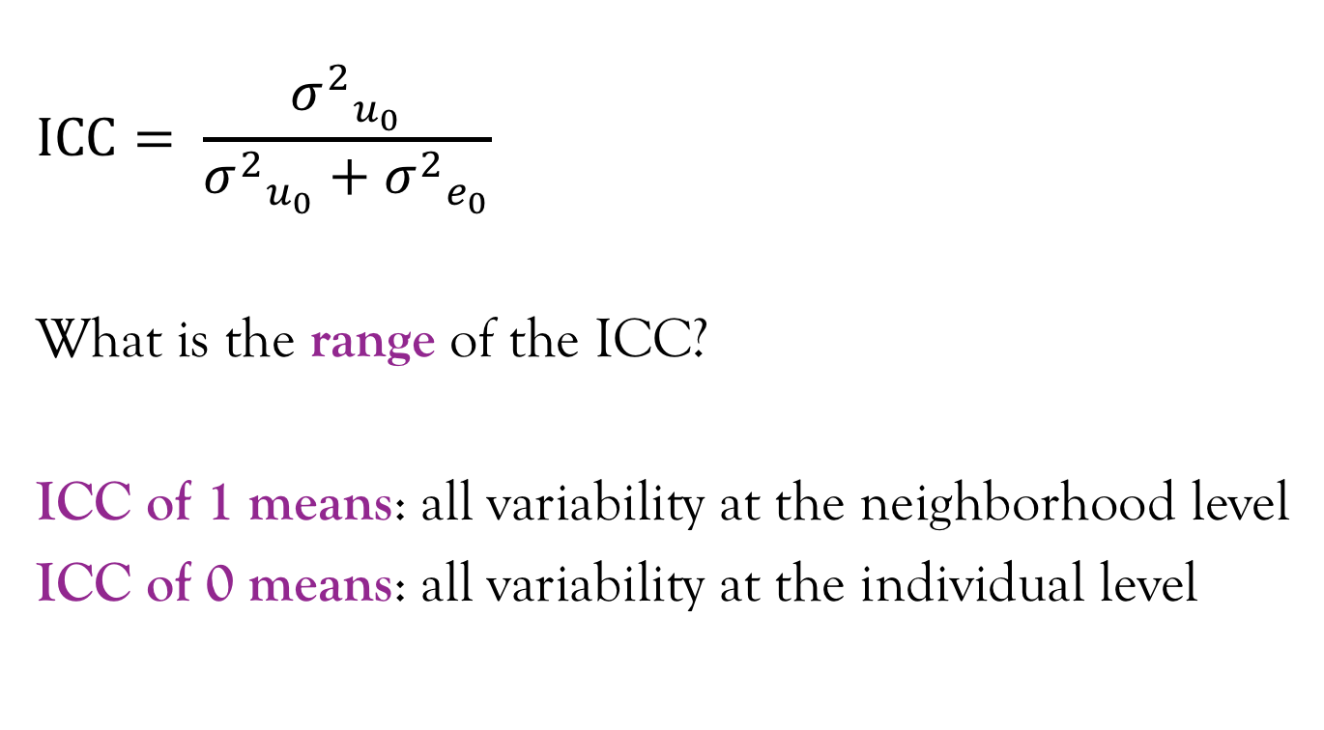
Interclass correlation separates the total variance into the individual-level and neighborhood level
$$ICC= \frac{{σ^{2}}_{u_{0}}}{{σ^{2}}_{u_{0}}+{σ^{2}}_{e_{0}}}$$
What is the range of the ICC?
ICC of 1 means: all variability at the neighborhood level
ICC of 0 means: all variability at the individual level
Kawachi & Subramanian, 2006; Merlo J, et al., 2005

Slide 55





Visual example of separating the variance
$$e_{0ij}$$
$${σ^{2}}_{e_{0j}}$$
$$u_{0j}$$
$$β_{0}$$
$${σ^{2}}_{u_{0}}$$
Merlo J, et al., 2005

Slide 56





Random intercepts & slopes
$$β_{1}$$
$$β_{1}$$
$$u_{0j}$$
$$β_{0}$$
$$β_{0}$$
Notes:
Multilevel models give you a mean intercept and slope.
We discussed the random intercepts u0j. There is also an extension to random slopes that we’re not going to discuss today, but if you’re interested in this, you should take Maria’s class.
With a random slopes model, you can answer questions about how inequalities vary across place

Slide 57
Examples of cross-level interaction questions
Does the relationship between income and pellagra (vitamin B3 deficiency) vary based on village fresh fruit and vegetable availability?
Is the relationship between income and mortality different in countries with higher income inequality vs. lower income inequality?

Slide 58
Activity: multilevel
Research question | Number of levels
Is there an association between diet and BMI?
Is there an association between neighborhood food availability, diet, and BMI?
Is there an association between neighborhood food availability, diet, and changes in BMI over time?
Is there an association between segregation within cities, neighborhood food availability, diet and BMI?

Slide 59
Additional reading on multilevel

Slide 60
Additional reading on multilevel

Slide 61
Resources for disparities / population health researchers
Society for Epidemiologic Research (SER)
#EpiTwitter (follow @epi_twit)
Population Health happy hour for Bay Area researchers; you can add yourself to the listserv here: https://bit.ly/2GlXpyX
@AnushaVable

Slide 62
Code to generate toy dataset

