Slide 1
Assessing Information from Multilevel and Continuous Tests
Likelihood Ratios for results other than “+” or “-”
Michael A. Kohn, MD, MPP
10/04/2018

Slide 2
Five Main Points
Avoid making multi-level tests dichotomous
(Do not calculate one or more LR(+) or LR(-) for a multilevel test!)
The ROC curve summarizes the ability of the test to differentiate between D+ and D- individuals.
LR(result) = P(result|D+)/P(result|D-) = slope of ROC curve.
Pre-Test Odds x LR(result) = Post-Test Odds
Threshold result to trigger treatment depends on pre-test probability of disease

Slide 3
Additional Topics
Regret graphs for multi-level tests
Walking Man (computer-created, non-parametric ROC curves)

Slide 4
Evaluating the Test
--Test Characteristics
For dichotomous tests, we discussed sensitivity P(+|D+) and specificity P(-|D-)
For multi-level and continuous tests, we will discuss the Receiver Operating Characteristic (ROC) curve

Slide 5
Using the Test Result to Make Decisions about a Patient
For dichotomous tests, we use the LR(+) if the test is positive and the LR(-) if the test is negative
For multilevel and continuous tests, we use the LR(r), where r is the result of the test

Slide 6
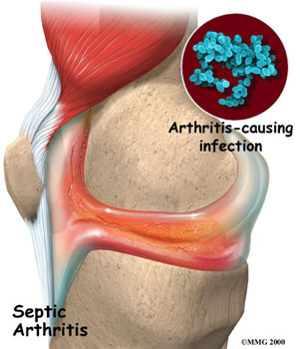
Septic Arthritis
Bacterial infection in a joint.

Slide 7
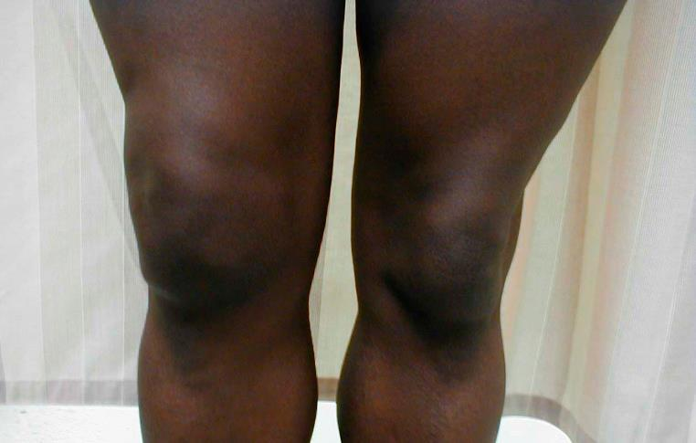
Clinical Scenario
Does this Adult Patient Have Septic Arthritis?

Slide 8
Clinical Scenario
Does this Adult Patient Have Septic Arthritis?*
A 48-year-old woman with a history of rheumatoid arthritis who has been treated with long-term, low-dose steroids presents to the emergency department with a 2-day history of a red, swollen, tender right knee.
On examination, she is afebrile and has a fluid in her right knee joint. The white blood cell count in her blood is 11 000/µL (normal). An arthrocentesis (needle in the joint) is done to obtain some joint fluid for analysis
You have the synovial fluid white blood cell (WBC) count.
8
*Margaretten, M. E., J. Kohlwes, et al. (2007). JAMA 297(13): 1478-88.
Notes:
8
She reports no prior knee swelling and no recent trauma or knee surgery, illegal drug use, rash, uveitis, or risky sexual behavior.

Slide 9
Clinical Scenario
Does this Adult Patient Have Septic Arthritis?
The authors estimated the pre-test probability of septic arthritis is 0.38.
How do you use the synovial WBC result to revise the probability of septic arthritis?
Margaretten, M. E., J. Kohlwes, et al. (2007). JAMA 297(13): 1478-88.
9
Notes:
9

Slide 10
Chapter 2 Method: Make It a Dichotomous Test
Synovial Septic Arthritis
WBC Count Yes No
>25,000 77% 27%
≤ 25,000 23% 73%
TOTAL* 100% 100%
*Note that these could have come from a study where the patients with septic arthritis (D+ patients) were sampled separately from those without (D- patients).
Margaretten, M. E., J. Kohlwes, et al. (2007). Jama 297(13): 1478-88.

Slide 11
Why Not Make It a Dichotomous Test?
Sensitivity = 77%
Specificity = 73%
LR(+) = 0.77/(1 - 0.73) = 2.9
LR(-) = (1 - 0.77)/0.73 = 0.32
“+” = > 25,000/uL
“-” = ≤ 25,000/uL

Slide 12
Clinical Scenario
Synovial WBC = 48,000/mL
Pre-test prob: 0.38
LR(+) = 2.9 (where > 25,000/mL =“+”)
Post-Test prob = ?
a) 0.16
b) 0.33
c) 0.64
d) 0.74
e) 0.95
http://www.sample-size.net/post-probability-calculator-test-new/

Slide 13
Clinical Scenario
Synovial WBC = 48,000/mL
Pre-test prob: 0.38
Pre-test odds: 0.38/0.62 = 0.61
LR(+) = 2.9
Post-Test Odds = Pre-Test Odds x LR(+) = 0.61 x 2.9 = 1.75
Post-Test prob = 1.75/(1.75+1) = 0.64
Notes:
13

Slide 14
Clinical Scenario
Synovial WBC = 128,000/mL
Pre-test prob: 0.38
Sensitivity = 77%
Specificity = 73%
Post-Test prob =?
a) 0.16
b) 0.33
c) 0.64
d) 0.74
e) 0.95

Slide 15
Clinical Scenario
Synovial WBC = 128,000/mL
Pre-test prob: 0.38
Pre-test odds: 0.38/0.62 = 0.61
LR = 2.9 (same as for WBC=48,000!)
Post-Test Odds = Pre-Test Odds x LR(+)
= 0.61 x 2.9 = 1.75
Post-Test prob = 1.75/(1.75+1) = .64

Slide 16
Why Not Make It a Dichotomous Test?
Because you lose information. The risk associated with a synovial WBC=48,000 is equated with the risk associated with WBC=128,000.
Choosing a fixed cutpoint to dichotomize a multi-level or continuous test throws away information and reduces the value of the test.

Slide 17
Main Point 1: Avoid Making Multilevel Tests Dichotomous
Dichotomizing a multi-level or continuous test by choosing a fixed cutpoint reduces the value of the test

Slide 18
WBC (/uL) Interval | % of Septic Arthritis | % of No Septic Arthritis
>100,000 | 29% | 1%
50,001-100,000 | 33% | 7%
25,001-50,000 | 15% | 19%
0 - 25,000 | 23% | 73%
TOTAL | 100% | 100%

Slide 19
Synovial Fluid WBC Count

Slide 20
Histogram
Does not reflect prevalence of D+ (Dark D+ columns add to 100%, Open D- columns add to 100%)
Sensitivity and specificity depend on the cutpoint chosen to separate “positives” from “negatives”
The ROC curve is drawn by serially lowering the cutpoint from highest (most abnormal) to lowest (least abnormal).*
* Just said that choosing a fixed cutpoint reduces the value of the test. The key issues are 1) the ROC curve is for evaluating the test, not the patient, and 2) drawing the ROC curve requires varying the cutpoint, not choosing a fixed cutpoint.

Slide 21
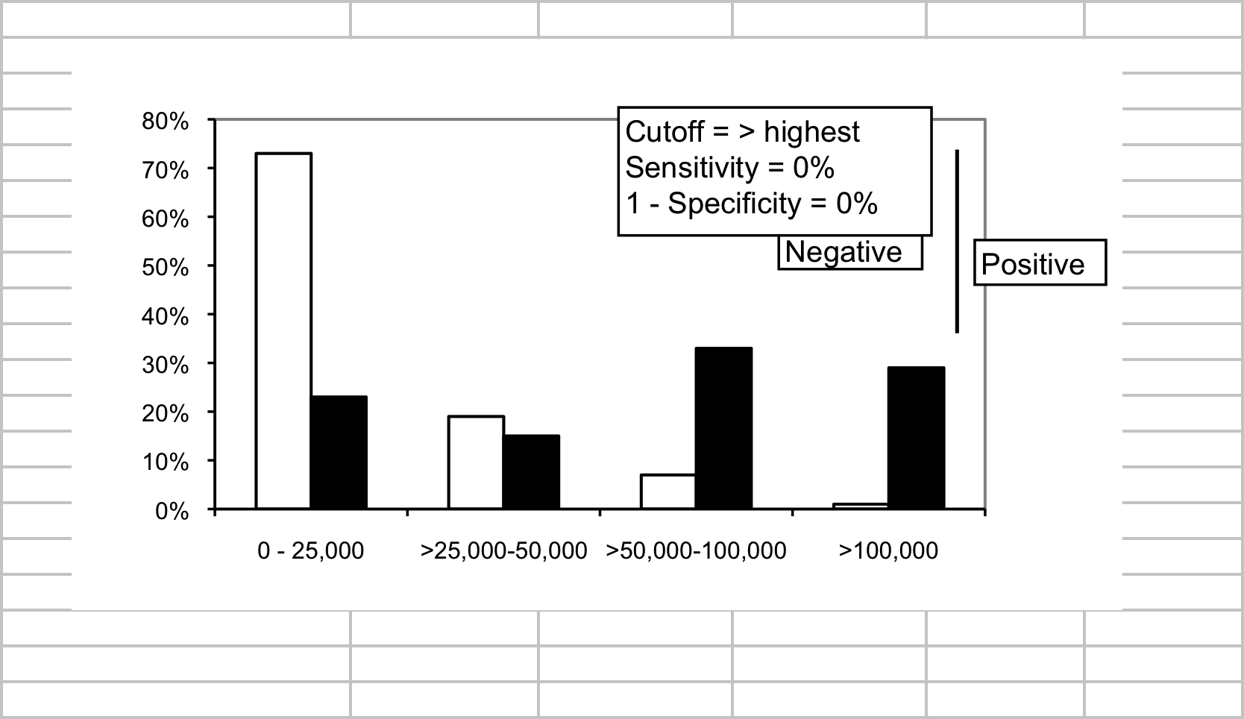
No Septic arthirtis
Septic arthirtis
21
Notes:
21

Slide 22
22
Notes:
22

Slide 23
23
Notes:
23

Slide 24
24
Notes:
24

Slide 25
25
Notes:
25

Slide 26
ROC Table
WBC Count (x1000/uL) | Sensitivity | 1 - Specificity
> highest | 0% | 0%
> 100 | 29% | 1%
> 50 | 62% | 8%
> 25 | 77% | 27%
≥ 0 | 100% | 100%
Margaretten, M. E., J. Kohlwes, et al. (2007). Jama 297(13): 1478-88.

Slide 27
ROC Table
WBC Count (x1000/uL) | Sensitivity | 1 - Specificity
> ∞ | 0% | 0%
> 100 | 29% | 1%
> 50 | 62% | 8%
> 25 | 77% | 27%
≥ 0 | 100% | 100%

Slide 28
ROC Table
WBC Count (x1000/uL) | Sensitivity | 1 - Specificity
> 100 | 29% | 1%
> 50 | 62% | 8%
> 25 | 77% | 27%
used to create an ROC curve like the one on the next slide.

Slide 29
Cutoff ≥ 0
Cutoff > 25k
WBC Count (K/uL) | Sensitivity | 1 - Specificity
> top | 0% | 0%
> 100 | 29% | 1%
> 50 | 62% | 8%
> 25 | 77% | 27%
≥ 0 | 100% | 100%
Cutoff > 50k
Cutoff > 100k
Cutoff > top value
29
Notes:
29

Slide 34
Test Discriminates Fairly Well Between D+ and D-
D+
D-
Test Result

Slide 35
Test Discriminates Well Between D+ and D-

Slide 36
Test Discriminates Poorly Between D+ and D-
D+
D-
Test Result

Slide 37
Test Discriminates Poorly Between D+ and D-

Slide 38
Area Under ROC Curve
No overlap between the D+ and D- distributions across test results*. Test discriminates perfectly. AUROC = 1.
Complete overlap between D+ and D- distributions across test results. Test doesn’t discriminate at all. AUROC = 0.5.
*The least abnormal result in the D+ population is more abnormal than the most abnormal result in the D- population.

Slide 39
MAK’s Index (until I find out the real name)
AUROC ranges from 0.5 (worst) to 1.0 (best).
Want index that ranges from 0.0 (worst) to 1.0 (best).
MAK’s Index = (AUROC – 0.5)×2
(Multilevel version of Youden’s Index for dichotomous tests; Youden’s Index = Sensitivity + Specificity -1.)

Slide 40
Area Under ROC Curve
Summary measure of test’s discriminatory ability
Probability that a randomly chosen D+ individual will have a more positive test result than a randomly chosen D- individual

Slide 41
Area Under ROC Curve
Corresponds to the Mann-Whitney U Test Statistic (same P value as Wilcoxon Rank Sum), which is the non-parametric equivalent of Student’s t test based on ranks.
Also corresponds to the “c statistic” measure of discrimination reported in logistic regression models

Slide 42
Area Under ROC Curve
Cutoff ≥ 0
Cutoff > 25k
Cutoff > 50k
Area Under Curve = 0.8114
Cutoff > 100k
Cutoff > ∞

Slide 43
Main Point 2
ROC Curve Describes the Test, Not the Patient
Describes the test’s ability to discriminate between D+ and D- individuals
Not particularly useful in interpreting a test result for a given patient

Slide 44
ROC Curve Describes the Test, Not the Patient
Clinical Scenario
Synovial WBC count = 48,000
Synovial WBC count = 128,000

Slide 45
Synovial WBC count = 48,000

Slide 46
Cutoff ≥ 0
Cutoff > 25k
Cutoff > 50k
Cutoff > 100k
Cutoff > ∞

Slide 47
Summary Sensitivity, Specificity, LR(+), and LR(-) of the Synovial Fluid WBC Count for Septic Arthritis at 3 Different Cutoffs (As presented)
WBC (/µL) | Sensitivity | Specificity |  | LR+ | LR-
>100,000 | 29% | 99% |  | a)29.0 | d) 0.7
>50,000 | 62% | 92% |  | b) 7.8 | 0.4
>25,000 | 77% | 73% |  | c) 2.9 | 0.3
Synovial WBC Count = 48,000/uL
Which LR should we use?
e) none of these
47
Margaretten, M. E., J. Kohlwes, et al. (2007). JAMA 297(13): 1478-88.
Notes:
47

Slide 48
Summary Sensitivity, Specificity, LR(+), and LR(-) of the Synovial Fluid WBC Count for Septic Arthritis at 3 Different Cutoffs
(As presented)
WBC (/µL) | Sensitivity | Specificity |  | LR+ | LR-
>100,000 | 29% | 99% |  | 29.0 | 0.7
>50,000 | 62% | 92% |  | 7.8 | 0.4
>25,000 | 77% | 73% |  | 2.9 | 0.3
Synovial WBC Count = 48,000/uL
Which LR should we use?
NONE of THESE!
48
Notes:
48

Slide 49
Do not calculate LR(+) and LR(-) for tests with more than 2 results.
Do not report LRs (or PVs) in an ROC table.
Report LRs in an LR table.

Slide 50
Problem-Writing Assignment?
Find a recent paper in your area that presents an ROC table with calculated LR(+) and LR(-) or PPV and NPV.
JAMA Pediatrics?
Write a final exam problem and maybe a letter to the editor.
(Ch 2 problem idea: find a paper that uses case-control sampling but reports ppv and npv.)

Slide 51
Likelihood Ratios
P(Result) in patients WITH disease
----------------------------------------------------
P(Result) in patients WITHOUT disease
LR(result) = P(result|D+)/P(result|D-)

Slide 52
WOWO
With Over WithOut

Slide 53
Likelihood Ratios
The ratio of the height of the D+ distribution to the height of the D- distribution
LR = 15%/19% = 0.8
19%
15%

Slide 54
> 25k
> 50k
15%
Slope = 15%/19% =0.8
19%

Slide 55
Likelihood Ratio
WBC (/uL) Interval | % of D+ | % of D- | Interval LR
>100,000 | 29% | 1% | 29.0
50,001-100,000 | 33% | 7% | 4.7
25,001-50,000 | 15% | 19% | 0.8
0 - 25,000 | 23% | 73% | 0.3

Slide 56
Common Mistake
When given an “ROC Table,” it is tempting to calculate an LR(+) or LR(-) as if the test were “dichotomized” at a particular cutoff.
Example: LR(+,25,000) = 77%/27% = 2.9
This is NOT the LR of a particular result (e.g. WBC >25,000 and ≤ 50,000); it is the LR(+) if you divide “+” from “-” at 25,000.
Notes:
Might also point out that one could use one of the negative LRs as well

Slide 57
Common Mistake
WBC (/uL) | Sensitivity | Specificity |  | LR+ | LR-
>100,000 | 29% | 99% |  | 29.0 | 0.7
>50,000 | 62% | 92% |  | 7.8 | 0.4
>25,000 | 77% | 73% |  | 2.9 | 0.3

Slide 58
Common Mistake
> 25,000
77%
27%
Notes:
By the way, Youden’s Index is the area under the dichotomous ROC curve -1/2 and then multiplied by 2.
The area under the dichotomous ROC curve is ½(Sensitivity + Specificity). Subtract ½ and multiply by 2→ Sensitivity + Specificity -1. Should range from 0 to 1.

Slide 59
Youden’s Index
> 25,000
77%
27%

Slide 60
Obtain interval LR from ROC table by subtracting adjacent rows
WBC (/uL) | Sensitivity | Specificity | 1-Specificity
>100,000 | 29% | 99% | 1%
>50,000 | 62% | 92% | 8%
>25,000 | 77% | 73% | 27%
77% of D+ > 25K
62% of D+ > 50 K
Therefore 77%-62% =15% of D+ must be >25 K and < 50K
60
Notes:
60

Slide 61
Obtain interval LR from ROC table by subtracting adjacent rows
WBC (/uL) | Sensitivity | Specificity | 1-Specificity
>100,000 | 29% | 99% | 1%
>50,000 | 62% | 92% | 8%
>25,000 | 77% | 73% | 27%
27% of D- > 25K
8% of D- > 50 K
Therefore 27%-8% =19% of D- must be >25 K and < 50K
61
Notes:
61
ROC curves are made up of POINTS – different cutoffs for sensitivity and specificity. LR are SEGMENTS- the slope between adjacent points.

Slide 62
Excel Demonstration
MultiLevelAndContinuousTestsExcelDemo.xlsx
Make sure whole spreadsheet projects
Pre-test Prob = 0.38 WBC = 48
Pre-test Prob = 0.38 WBC = 128
Assume treatment threshold prob = 0.2
What is WBC treatment threshold for Pre-test Prob = 0.38?
What is WBC treatment threshold for Pre-test Prob = 0.04?
Resume at Slide 78

Slide 63
> 25k
> 50k
15%
Slope = 15%/19% =0.8
19%
63
Notes:
63

Slide 64
Common Mistake
From JAMA paper:
“Her synovial WBC count of 48,000/µL increases the probability from 38% to 64%.” (Used LR = 2.9)
Correct calculation:
Her synovial WBC count of 48,000/µL decreases the probability from 38% to 33%.” (Used LR = 0.8)

Slide 65
Main Point 3
Likelihood Ratio
P(Result) in patients WITH disease
------------------------------------------------------
P(Result) in patients WITHOUT disease
Slope of ROC Curve
Do not calculate one or more LR(+) or LR(-) for a multilevel test!

Slide 66
Clinical Scenario
Synovial WBC = 48,000/uL*
Pre-test prob: 0.38
LR(WBC btw 25,000 and 50,000) = 0.8
Post-Test prob = ?
a) 0.16
b) 0.33
c) 0.64
d) 0.74
e) 0.95

Slide 67
Clinical Scenario
Synovial WBC = 48,000/uL*
Pre-test prob: 0.38
Pre-test odds: 0.38/0.62 = 0.61
LR(WBC btw 25,000 and 50,000) = 0.8
Post-Test Odds = Pre-Test Odds x LR(48)
= 0.61 x 0.8 = 0.49
Post-Test prob = 0.49/(0.49+1) = 0.33
*Can use slide rule, Excel, or web page

Slide 68
Clinical Scenario
Synovial WBC = 128,000/uL*
Pre-test prob: 0.38
LR(128,000/uL) = 29
Post-Test prob = ?
a) 0.16
b) 0.33
c) 0.64
d) 0.74
e) 0.95
http://www.sample-size.net/post-probability-calculator-test-new/
*

Slide 69
Clinical Scenario
Synovial WBC = 128,000/uL*
Pre-test prob: 0.38
Pre-test odds: 0.38/0.62 = 0.61
LR(128,000/uL) = 29
Post-Test Odds = Pre-Test Odds x LR(128)
= 0.61 x 29 = 17.8
Post-Test prob = 17.8/(17.8+1) = 0.95
*Can use slide rule, Excel, or web page

Slide 70
Clinical Scenario
WBC = 48,000/uL Post-Test Prob = 0.33
WBC = 128,000/uL Post-Test Prob = 0.95
(Recall that dichotomizing the WBC with a fixed cutpoint of 25,000/uL meant that WBC = 48,000/uL would be treated the same as WBC = 128,000/uL and post-test prob = 0.64)

Slide 71
Main Point 4: Bayes’s Rule
Pre-Test Odds x LR(result) = Post-Test Odds
What you knew before + What you learned = What you know now

Slide 72
What result should prompt treatment?
Need to know the relative cost of errors: treating unnecessarily (C) versus failing to treat (B)
Assume B = 4C, so P_{TT} = 0.2
Starting with P = 0.38, we need a very reassuring test result

Slide 73
What result should prompt treatment?
*Pre-test Probability = 0.38
WBC (/uL) Interval | % of D+ | % of D- | Interval LR | Post-Test Prob*
>100,000 | 29% | 1% | 29 | 0.95
50,001-100,000 | 33% | 7% | 4.7 | 0.74
25,001-50,000 | 15% | 19% | 0.8 | 0.33
0 - 25,000 | 23% | 73% | 0.3 | 0.16
TREAT
NO TREAT

Slide 74
No Treat
Cutoff ≥ 0
Treat
Cutoff > 25k
Cutoff > 50k
Cutoff > 100k
Cutoff > ∞

Slide 75
Different Pre-Test Probability
Pre-Test Probability = 0.04 , not 0.38

Slide 76
Now, what result should prompt treatment?
*Pre-test Probability = 0.04
WBC (/uL) Interval | % of D+ | % of D- | Interval LR | Post-Test Prob*
>100,000 | 29% | 1% | 29 | 0.55
50,001-100,000 | 33% | 7% | 4.7 | 0.16
25,001-50,000 | 15% | 19% | 0.8 | 0.03
0 - 25,000 | 23% | 73% | 0.3 | 0.01
TREAT
NO TREAT

Slide 77
No Treat
Cutoff ≥ 0
Treat
Cutoff > 25k
Cutoff > 50k
Cutoff > 100k
Cutoff > ∞

Slide 78
Optimal Cutoff = r*
Because the ROC curve does not provide pre-test probability of disease, it is not sufficient to identify the optimal cutoff to prompt treatment

Slide 79
Main Point 5: Optimal Cutoff r*
The test result r* that should prompt treatment depends on
the slope of the ROC curve
the relative cost of failing to treat (B) vs. the cost of treating unnecessarily (C)
the pre-test probability of disease

Slide 80
Optimal Cutoff = r*
The test result that should prompt treatment is the least abnormal result r* such that
[P/(1-P)]×LR(r*) ≥ C/B

Slide 81
Youden’s Index
WBC Count (x1000/uL) | Sensitivity | 1 - Specificity | Youden's Index
> 100 | 29% | 1% | 0.28
> 50 | 62% | 8% | 0.54
> 25 | 77% | 27% | 0.5

Slide 82
Youden’s Index
WBC Count (x1000/uL) | Sensitivity | 1 - Specificity | Youden's Index
> 100 | 29% | 1% | 0.28
> 50 | 62% | 8% | 0.54
> 25 | 77% | 27% | 0.5

Slide 83
Summary
Making multi-level test dichotomous by choosing a fixed cutpoint reduces the value of the test.
The ROC curve summarizes the discriminatory ability of the test.
LR(result) = P(result|D+)/P(result|D-) = Slope of ROC Curve
Pre-Test Odds x LR(result) = Post-Test Odds
The test result that should prompt treatment depends on the likelihood of disease

Slide 84
Additional Topics
Regret-graphs for multi-level tests
Walking Man
Youden’s Index
MAK Index

Slide 85
Regret graphs for non-dichotomous tests
Figure 4.13

Slide 86
THE WALKING MAN OR …

Slide 87
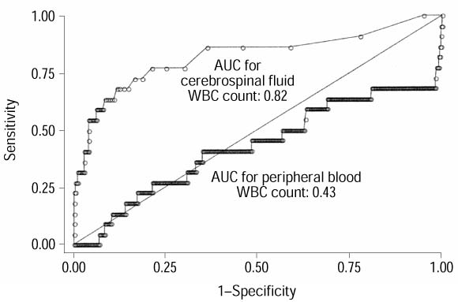
… WHAT CAN YOU LEARN FROM ROC CURVES LIKE THESE?
Bonsu, B. K. and M. B. Harper (2003). "Utility of the peripheral blood white blood cell count for identifying sick young infants who need lumbar puncture." Ann Emerg Med 41(2): 206-14.

Slide 88
“Walking Man” Approach to ROC Curves
Divide vertical axis into d steps, where d is the number of D+ individuals
Divide horizontal axis into n steps, where n is the number of D- individuals
Sort individuals from most to least abnormal test result
Moving from the first individual (with the most abnormal test result) to the last (with the least abnormal test result)…

Slide 89
“Walking Man” (continued)
…call out “D” if the individual is D+ and “N” if the individual is D-
Let the walking man know when you reach a new value of the test
The walking man takes a step up every time he hears “D” and a step to the right every time he hears “N”
When you reach a new value of the test, he drops a stone.
Notes:
Want to act this out?

Slide 90
Synovial WBC Count in 5 Patients with Septic Arthritis
Patient | WBC Count (x 1000/uL)
D1 | 128
D2 | 92
D3 | 64
D4 | 37
D5 | 24

Slide 91
Synovial WBC Count in 10 Patients Without Septic Arthritis
Patient | WBC Count (x 1000)
N1 | 71
N2 | 48
N3 | 37
N4 | 23
N5 | 12
N6 | 12
N7 | 8
N8 | 7
N9 | 6
N10 | 0

Slide 92
DDNDN(DN)DN
(NN)NNNN
Septic Arthritis | No Septic Arthritis
128
92
 | 71
64
 | 48
37 | 37
24
 | 23
 | 12
 | 12
 | 8
 | 7
 | 6
 | 0
92
Notes:
92

Slide 93



Slide 95
… WHAT CAN YOU LEARN FROM ROC CURVES LIKE THESE?

Slide 96
Peripheral WBC Count as Test for Bacterial Meningitis
Cross sectional study of test accuracy
Index test: peripheral WBC count
Reference Standard: CSF culture
Population: Infants 3-89 days old evaluated in a pediatric ED for serious bacterial infection.
Ann Emerg Med. 2003;41:206-214.

Slide 97
Ann Emerg Med. 2003;41:206-214.

Slide 98
What is the best interpretation of the circled segment of the ROC curve for the peripheral WBC count?
Infants with the highest peripheral WBC counts were at the highest risk for meningitis.
Infants with the lowest peripheral WBC counts were at the highest risk for meningitis.
Infants with intermediate peripheral WBC counts were at the highest risk for meningitis.
The peripheral WBC count is useless for diagnosing meningitis.
30% of the infants in the study sample had meningitis.

Slide 99
What can you learn besides areas under curves?
Ann Emerg Med. 2003;41:206-214.
More kids had periperhal WBC than CSF WBC
Only 22 kids had bacterial meningitis
Some peripheral WBC results strongly suggest meningitis
99
Notes:
99

Slide 100
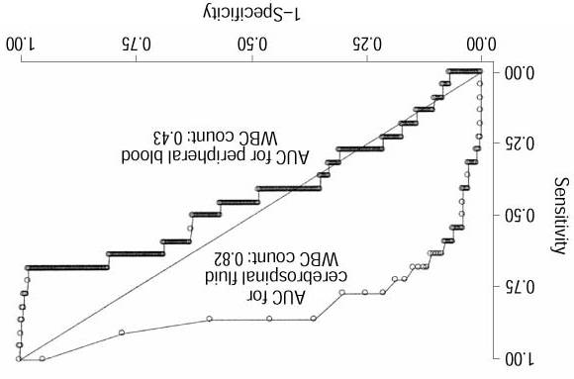

Slide 103
Overall meningitis 22/5353 = 4.1 /1000
If WBC < 4k, 5/88 = 57 /1000
LR(WBC < 4k) ≈ 15

Slide 104
Authors’ Conclusion
Decisions to perform or withhold lumbar puncture should not be based on prevailing interpretations of the total peripheral blood WBC counts to maximize detection of bacterial meningitis in young infants.
[Ann Emerg Med. 2003;41:206-214.]

Slide 105
EBD Conclusion?
While the total peripheral blood WBC count is not often helpful in identifying bacterial meningitis, young infants with very low WBC counts (e.g. < 4k) are at high risk and should definitely receive an aggressive workup including lumbar puncture.

Slide 106
Pre-Test 8: Interpret circled part of ROC curve
a) Infants with the highest peripheral WBC counts were at the highest risk for meningitis.
b) Infants with the lowest peripheral WBC counts were at the highest risk for meningitis.
c) Infants with intermediate peripheral WBC counts were at the highest risk for meningitis.
d) The peripheral WBC count is useless for diagnosing meningitis.
e) 30% of the infants in the study sample had meningitis.

Slide 107
ROC Curves for Dichotomous Tests: Fun Facts
77%
73%

Slide 108
AUROC = (Sensitivity + Specificity)/2
73%
77%
Notes:
By the way, Youden’s Index is the area under the dichotomous ROC curve -1/2 and then multiplied by 2.
The area under the dichotomous ROC curve is ½(Sensitivity + Specificity). Subtract ½ and multiply by 2→ Sensitivity + Specificity -1. Should range from 0 to 1.

Slide 109
Area Above Diagonal = (Sensitivity + Specificity)/2 – 1/2
(Sens + Spec)/2 – 1/2

Slide 110
Youden’s Index
2 × Area Above Diagonal
2 × [(Sensitivity + Specificity)/2 – ½]
Sensitivity + Specificity -1
Sensitivity + (1 – Specificity)
Ranges from 0 (Worthless Test) to 1 (Perfect Test)
If Youden’s Index < 0, reverse definitions of “positive” and “negative”.
Notes:
Youden’s Index is the area under the dichotomous ROC curve -1/2 and then multiplied by 2.
The area under the dichotomous ROC curve is ½(Sensitivity + Specificity). Subtract ½ and multiply by 2→ Sensitivity + Specificity -1. Should range from 0 to 1.

Slide 111
Youden’s Index
Youden’s Index applies to dichotomous (or dichotomized) tests
Youden’s Index = [AUROC – 1/2] × 2
AUROC = (Sensitivity + Specificity)/2 (for dichotomous test)
Youden’s Index = [(Sensitivity + Specificity)/2 – 1/2) × 2
Youden’s Index = Sensitivity + Specificity – 1
Youden’s Index = Sensitivity – (1 – Specificity)

