Slide 1
Combining Tests, Multivariate Risk Prediction
Michael A. Kohn, MD, MPP
10/24/2019

Slide 2
Outline: Combining Tests
Clarification: Brier Score and Calibration
Independence Conditional on D+/D- (Hard!)
Classification Trees
Logistic Regression
  Digression: Natural Logarithms
  Odds Ratios
Variable (Test) Selection
Validation separate from derivation
NLST Risk Model
Low-Risk Appendicitis Rule

Slide 3
Calibration Metrics: Bias, MAE, Brier Score -- Smaller is better; 0 is perfect.
r_{i} = predicted risk for individual i
o_{i} = outcome for individual i (1=yes; 0 = no)
Error = r_{i} - o_{i}
Absolute Error = |r_{i} - o_{i}|
Squared Error = (r_{i} - o_{i})²
Sum over all individuals and divide by N
Mean Error = Bias
Mean Absolute Error = MAE
Mean Squared Error = Brier Score
Notes:
TN: A couple of examples might help make these parameters more concrete. We predict r= 50% risk in everyone. The actual risk is 0%. The error, absolute error and mean error are all 0.5, but the Brier score is 0.25. If the actual risk were 1, the error would be -0.5, but the other parameters would stay the same.
Now suppose that we predict 50% in everyone and the outcome occurs in 50%. So actually we are perfectly calibrated with zero discrimination. The errors will be 0.5 and -0.5 with equal frequency. The Mean Error = Bias will be zero. But the mean absolute error will be 0.5 and the Brier score will be 0.25. In fact, if our prediction is 50%, the MAE can be no worse than 0.5 and the Brier score can be no worse than 0.25.
Now suppose we predict r=0 in everyone and the event happens 50% of the time. The mean error will =1 when the event happens and 0 when it does not, so the mean error and MAE will be 0.5. The Brier score will be 0.5.
MAK: Good idea. The 50% risk in everyone, perfectly calibrated, no discrimination, gives rise to a calibration error = 0 and a refinement lost = 0.25. This is how decomposing the Brier Score into Calibration Error and Refinement Loss separates calibration from discrimination. But I would prefer to use the square root of all of these quantities. So then SQRT(Brier) = 0.5. SQRT(Calibration Error) = 0. SQRT(Refinement Loss) = 0.5

Slide 4
Why divide the population into risk groups?
To create a calibration plot
Separate calibration from discrimination
Can evaluate discrimination without creating risk groups by generating a “walking man” ROC curve and calculating the area under it.
Can calculate a Brier score without creating risk groups, but this depends on both calibration and discrimination.

Slide 5
Calibration Metrics: Bias, MAE, Brier Score -- Based on risk groups
Divide population in risk groups
r_{k} = predicted risk in group k
p_{k} = proportion with outcome in group k
f_{k} = fraction of population in group k
Metrics are f_{k}-weighted averages; smaller is better; 0 is perfect.
Bias = r_{k} – p_{k}
Absolute Error = p_{k}| 1 - r_{k} | + (1 – p_{k})|0 – r_{k}|
Brier Score = p_{k}(1 - r_{k} )² + (1 – p_{k}) (0 – r_{k})²

Slide 6
Brier Score = Calibration Error + Refinement Loss
r_{k} = predicted risk in group k
p_{k} = proportion with outcome in group k
f_{k} = fraction of population in group k
f_{k}-weighted averages.
Brier Score = p_{k}(1 - r_{k} )² + (1 – p_{k}) (0 – r_{k})²
Calibration Error* = (r_{k} – p_{k})² (*metric has same name as concept)
Refinement Loss = p_{k}(1-p_{k}) (metric of discrimination)
Brier Score = Calibration Error + Refinement Loss
Notes:
Refinement has nothing to do with calibration, only discrimination, and is related to the AUROC. Very roughly speaking, MAK Index = SQRT(1-REF/PQ). AUROC = (MAK Index +1)/2 = (SQRT(1-REF/PQ) +1)/2. (This is very rough!!!) I’m not convinced the metrics themselves have any value, but they nicely convey the idea that model error consists of calibration error and discrimination error.

Slide 7
Brier Score = Calibration + Refinement
Model Error
Discrimination Error
Calibration Error
Notes:
This is the key point. There are 2 separate components of model error: Calibration Error and Discrimination Error.

Slide 8
Brier Score = Calibration + Refinement
√Brier Score
√Refinement Loss
Root Mean Square Group Error = √Calibration
Notes:
I’m not convinced the metrics themselves have any value, but they nicely convey the idea that model error consists of calibration error and discrimination error.

Slide 9
Meteorologist Channel 4
On 10 days, predicts 95% chance of rain. Rains on 8.
On 20 days, predicts 40% chance of rain. Rains on 2.
Fraction of Population | Predicted Risk | Proportion with Outcome | Difference | Breier | Calibration Error | Refinement Loss
0.33 | 95% | 80% | 15% | 0.18 | 0.02 | 16%
0.67 | 40% | 10% | 30% | 0.18 | 0.09 | 9%
 |  |  | Weighted Avg | 0.18 | 0.07 | 0.11
 |  |  |  | RMSE | SQRT (Calibration Error) | SQRT(Refinement Loss)
 |  |  |  | 0.43 | 0.26 | 0.34
Notes:
Not to be discussed. For reference.

Slide 10
Brier Score = Calibration + Refinement
√Brier Score = 0.43
√Refinement Loss =0.34
√Calibration Error = 0.26

Slide 11
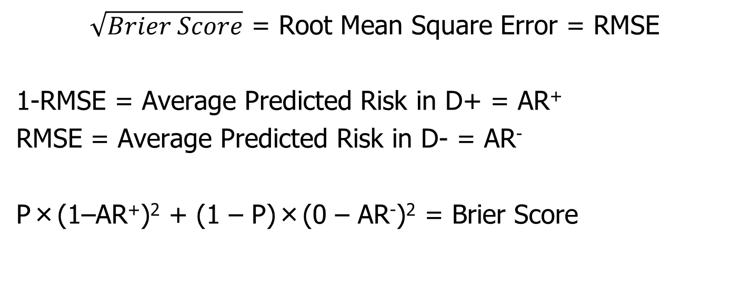
Brier Score = Mean Squared Error
$\sqrt{Brier Score}$ = Root Mean Square Error = RMSE
1-RMSE = Average Predicted Risk in D+ = AR⁺
RMSE = Average Predicted Risk in D- = AR⁻
P×(1–AR⁺)² + (1 – P)×(0 – AR⁻)² = Brier Score
Notes:
Not to be discussed. For reference.

Slide 12
Assessing/Quantifying Calibration*
Calibration Plots with Mean Bias, Mean Absolute Error, √Brier Score, √Calibration Error, √Refinement Loss
*Overall calibration of a model is always good in the “derivation” dataset. For example, mean bias is always 0 for a logistic regression model in the dataset used to derive its coefficients.
Notes:
(SD of Group Errors)^2 + (Mean Bias)^2 = Mean-Squared Group Error = “Calibration Error”
“Calibration Error” + “Refinement Loss” = Brier Score
These numbers are always < 1 and 0 is perfect. They are usually very small. I prefer using the SQRT

Slide 13
Outline: Combining Tests
Independence Conditional on D+/D- (Hard!)
Classification Trees
Logistic Regression
  Digression: Natural Logarithms
Variable (Test) Selection
Validation separate from derivation
NLST Risk Model
Low-Risk Appendicitis Rule

Slide 14
Combining Tests
Example
Prenatal sonographic Nuchal Translucency (NT) and Nasal Bone Exam as dichotomous tests for Trisomy 21*
*Cicero, S., G. Rembouskos, et al. (2004). "Likelihood ratio for trisomy 21 in fetuses with absent nasal bone at the 11-14-week scan." Ultrasound Obstet Gynecol 23(3): 218-23.

Slide 15
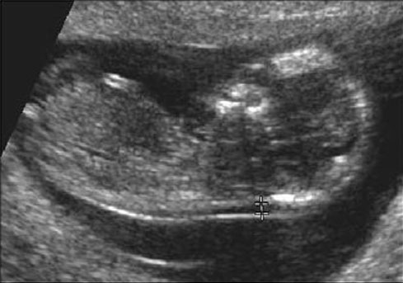
If NT ≥ 3.5 mm Positive for Trisomy 21*
*What’s wrong with this definition?

Slide 17
In general, don’t make multi-level tests like NT into dichotomous tests by choosing a fixed cutoff
I did it here to make the discussion of multiple tests easier
I arbitrarily chose to call ≥ 3.5 mm positive

Slide 18
One Dichotomous Test
(212/333)/(478/5223)
Trisomy 21
Nuchal D+ D- LR
Translucency
≥ 3.5 mm 212 478 7.0
< 3.5 mm 121 4745 0.4
Total 333 5223
Notes:
Many oversimplifications in this example. Made NT dichotomous and considered only trisomy 21. In fact, you do CVS to identify any chromosomal abnormality,, not just trisomy 21. Different chromosomal abnormalities do different things to NT.

Slide 19
NT Positive
Pre-test Prob = 0.06
LR(Result) = 7.0
Post-Test Prob = ?

Slide 20
Clinical Scenario – One Test
Pre-Test Probability of Down’s = 6%
NT Positive
Pre-test prob: 0.06
Pre-test odds: 0.06/0.94 = 0.064
LR(+) = 7.0
Post-Test Odds = Pre-Test Odds x LR(+)
= 0.064 x 7.0 = 0.44
Post-Test prob = 0.44/(0.44 + 1) = 0.31

Slide 21
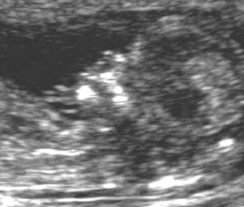
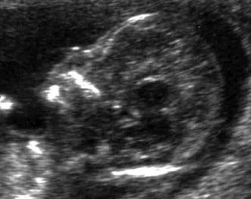
Nasal Bone Seen
NBA=“No”
Neg for Trisomy 21
Nasal Bone Absent
NBA=“Yes”
Pos for Trisomy 21

Slide 22
Second Dichotomous Test
Nasal Bone Tri21+ Tri21- LR
Absent
Yes 229 129 27.8
No 104 5094 0.32
Total 333 5223
(229/333)/(129/5223)

Slide 23
Pre-Test Probability of Trisomy 21 = 6%
NT Positive for Trisomy 21 (≥ 3.5 mm)
Post-NT Probability of Trisomy 21 = 31%
Nasal Bone Absent
LR(NBA) = 27.8
Post-NBA Probability of Trisomy 21 = ?
Clinical Scenario –Two Tests
Using Probabilities

Slide 24
Clinical Scenario – Two Tests
Using Odds
Pre-Test Odds of Tri21 = 0.064
NT Positive (LR = 7.0)
Post-Test Odds of Tri21 = 0.44
Nasal Bone Absent (LR = 27.8?)
Post-Test Odds of Tri21 = .44 x 27.8
= 12.4?
(P = 12.4/(1+12.4) = 92.5%?)

Slide 25
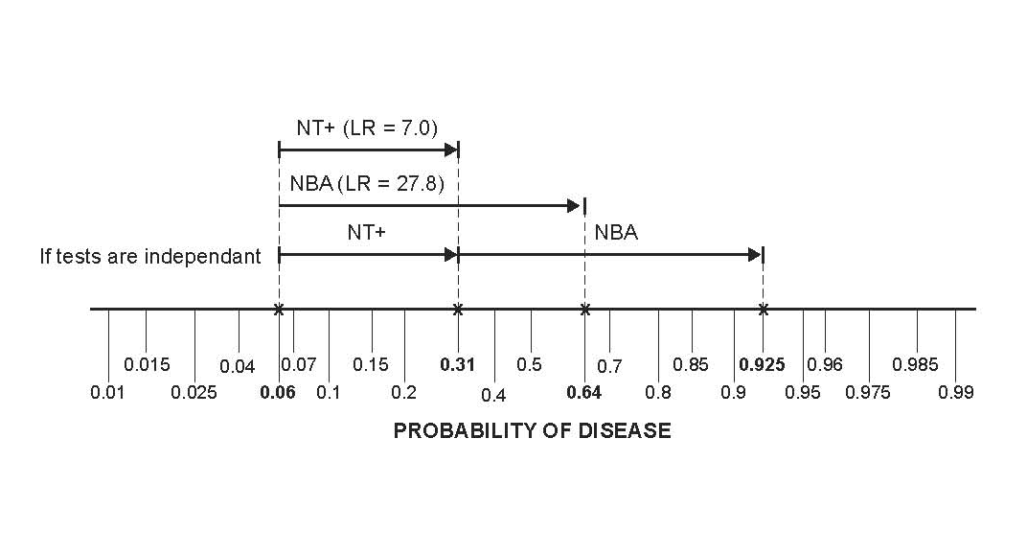
Clinical Scenario – Two Tests
Pre-Test Probability of Trisomy 21 = 6%
NT ≥ 3.5 mm AND Nasal Bone Absent

Slide 26
Question
NT “positive” and Nasal Bone Absent. What is probability of Trisomy 21?
< 92.5%
= 92.5%
> 92.5%
Cannot say

Slide 27
Answer
NT | NBA | Tri21+ | Tri21- |  | Post Test Prob*
Pos | Pos | 158 | 36 | 158/(158+36) | 81%
Pos | Neg | 54 | 442 | 54/(54+442) | 11%
Neg | Pos | 71 | 93 | 71/(71+93) | 43%
Neg | Neg | 50 | 4652 | 50/(50+4652) | 1%
Total | Total | 333 | 5223 | 333/(333+5223) | 6%
*Assumes pre-test prob = 6%

Slide 28
Question
Can we use the post-test odds after a positive Nuchal Translucency as the pre-test odds for the positive Nasal Bone Examination?
i.e., can we combine the positive results by multiplying their LRs?
LR(NT+, NBA +) = LR(NT +) x LR(NBA +) ?
= 7.0 x 27.8 ?
= 194 ?

Slide 29
Answer = No
NT | NBA | Trisomy 21 + | % | Trisomy 21 - | % | LR
Pos | Pos | 158 | 47% | 36 | 0.7% | 69
Pos | Neg | 54 | 16% | 442 | 8.5% | 1.9
Neg | Pos | 71 | 21% | 93 | 1.8% | 12
Neg | Neg | 50 | 15% | 4652 | 89% | 0.2
Total | Total | 333 | 100% | 5223 | 100%
Not 194
158/(158 + 36) = 81%, not 92.5%

Slide 30
Non-Independence
Absence of the nasal bone does not tell you as much if you already know that the nuchal translucency is ≥ 3.5 mm.

Slide 31
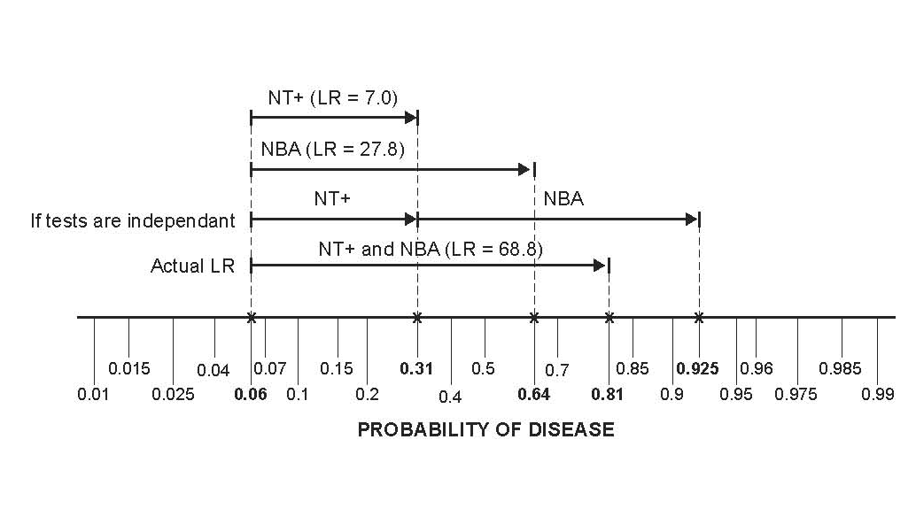
Non-Independence

Slide 32
Non-Independence of NT and NBA
In chromosomally normal (D-) fetuses, a false positive on the NT makes a false positive on the NBA more likely.
Some (but not all) of this may have to do with ethnicity. In this London study, chromosomally normal fetuses of “Afro-Caribbean” ethnicity had both larger NTs and more frequent absence of the nasal bone.
In Trisomy 21 (D+) fetuses, normal NT was associated with the presence of the nasal bone, so a false negative on the NT was associated with a false negative on the NBA.
Notes:
8-8 (d)

Slide 33
Non-Independence of NT and NBA
Of normal (D-) fetuses with NT ≥ 3.5 mm, 7.5% had nasal bone absent. Of normal (D-) fetuses with NT < 3.5 mm only 2.0% had nasal bone absent.
P(NBA+|NT+ & D-) = 0.075
P(NBA+|NT- & D-) = 0.020
Notes:
Among D- fetuses, NBA+ increases the odds of NT+ by a factor of 0.075/0.02 = 3.25.
Odds(NT+|NBA+&D-) = Odds(NT+|D-) * 3.25
They are not independent.

Slide 34
Non-Independence of NT and NBA
If independent,
P(NBA+|NT+&D-) = P(NBA+|NT-&D-) = P(NBA+|D-)
But,
P(NBA+|NT+ & D-) = 0.075
P(NBA+|NT- & D-) = 0.020
Notes:
If conditional independence, Odds(NT+|NBA+&D-) = Odds(NT+|D-), but Odds(NT+|NBA+&D-) = Odds(NT+|D-)*3.25

Slide 35
Non-Independence
Instead of looking for the nasal bone, what if the second test were just a repeat measurement of the nuchal translucency?
A second positive NT would do little to increase your certainty of Trisomy 21. If it was false positive the first time around, it is likely to be false positive the second time.

Slide 36
Reasons for Non-Independence
Tests measure the same aspect of disease.
One aspect of Down’s syndrome is slower fetal development; the NT decreases more slowly and the nasal bone ossifies later. Chromosomally NORMAL fetuses that develop slowly will tend to have false positives on BOTH the NT Exam and NBA.

Slide 37
Reasons for Non-Independence
Heterogeneity of Disease (e.g. spectrum of severity)*.
Heterogeneity of Non-Disease.
(See EBD-2 Chapter 7 first 3 pages)
*In this example, Down’s syndrome is the only chromosomal abnormality considered, so disease is fairly homogeneous. But this is actually quite unrealistic.
Notes:
Many oversimplifications in this example. Made NT dichotomous and considered only trisomy 21. In fact, you do CVS to identify any chromosomal abnormality,, not just trisomy 21. Different chromosomal abnormalities do different things to NT and NBA.

Slide 38
Unless tests are independent (conditional on D+/D-), we can’t combine results by multiplying LRs.
Notes:
“Naïve Bayes” is assuming that tests are conditionally independent, so that you can multiply LRs.

Slide 39
Independence Conditional On Disease Status
In D+ patients,
a false negative on Test 1 does not affect the probability of a false negative on Test 2.
In D- patients,
a false positive on Test 1 does not affect the probability of a false positive on Test 2.

Slide 40
Ways to Combine Multiple Tests
On a group of patients (derivation set), perform the multiple tests and (independently*) determine true disease status (apply the gold standard)
Measure LR or PV for each possible combination of results
Classification Trees
Logistic Regression
*Beware of incorporation bias

Slide 41
Determine LR for Each Result Combination
NT | NBA | Tri21+ | % | Tri21- | % | LR | Post Test Prob*
Pos | Pos | 158 | 47% | 36 | 0.7% | 69 | 81%
Pos | Neg | 54 | 16% | 442 | 8.5% | 1.9 | 11%
Neg | Pos | 71 | 21% | 93 | 1.8% | 12 | 43%
Neg | Neg | 50 | 15% | 4652 | 89.1% | 0.2 | 1%
Total | Total | 333 | 100% | 5223 | 100%
*Assumes pre-test prob = 6%

Slide 42
Sort by LR (Descending)
NT | NBA | Tri21+ | % | Tri21- | % | LR
Pos | Pos | 158 | 47% | 36 | 0.70% | 69
Neg | Pos | 71 | 21% | 93 | 1.80% | 12
Pos | Neg | 54 | 16% | 442 | 8.50% | 1.9
Neg | Neg | 50 | 15% | 4652 | 89.10% | 0.2
Notes:
8-7 (a)

Slide 43
Apply Chapter 4 – Multilevel Tests
Now you have a multilevel test (In this case, 4 levels.)
Have LR for each test result
Can create ROC curve and calculate AUROC
Given pre-test probability and treatment threshold probability (C/(B+C)), can find optimal cutoff.

Slide 44
Create ROC Table
NT | NBA | Tri21+ | Sens | Tri21- | 1 - Spec
 |  |  | 0% |  | 0%
Pos | Pos | 158 | 47% | 36 | 0.70%
Neg | Pos | 71 | 68% | 93 | 3%
Pos | Neg | 54 | 84% | 442 | 11%
Neg | Neg | 50 | 100% | 4652 | 100%

Slide 45
AUROC = 0.896

Slide 46
Optimal Cutoff
NT | NBA | LR | Post-Test Prob
Pos | Pos | 69 | 0.81
Neg | Pos | 12 | 0.43
Pos | Neg | 1.9 | 0.11
Neg | Neg | 0.2 | 0.01
Assume
Pre-test probability = 6%
Threshold for CVS is 2%
Notes:
8-7 (b)

Slide 47
Determine LR for Each Result Combination
2 dichotomous tests: 4 combinations
3 dichotomous tests: 8 combinations
4 dichotomous tests: 16 combinations
Etc.
2 3-level tests: 9 combinations
3 3-level tests: 27 combinations
Etc.

Slide 48
Determine LR for Each Result Combination
How do you handle continuous tests*?
Not always practical for groups of tests.
*Nuchal Translucency is really a continuous measurement.
Notes:
The “Curse of Dimensionality”. Common dimension reduction techniques from Machine Learning (Principal Components Analysis, Factor Analysis) do not appear to be appropriate to apply in this context.

Slide 49
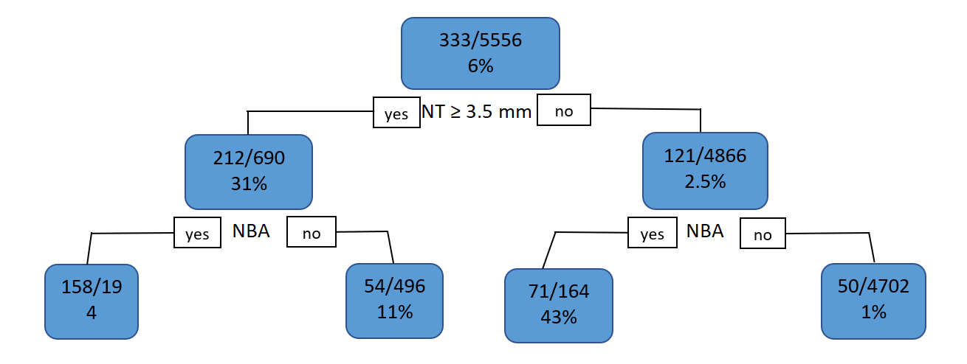
Classification Tree
Measure NT First
Notes:
Recall Net Benefit is always (TP – (C/B)*FP.)/N . NBA has both more TP (229 vs 212) and fewer FP (129 vs 478), so it is always preferred to NBA.
If treatment threshold is 20% C/B = ¼, then you would not treat initially. NT+ → Treat. NT- → No treat. NB = [212 - ¼(478)5556 = 0.0167 (For NBA was 0.035.)
If treatment threshold is 4.8% C/B = 1/20, then you would treat initially. NT+ → Treat. NT- → No treat. NB(Treat all) = [333 - (1/20)(5233) ]/ 5556 = 0.013. NB = [212 - 1/20(478)]/5556 = 0.034 (for NBA was 0.040). Diff = 0.021 (with NBA was 0.027)
At both treatment thresholds NBA is better than NT. This will be the case at any treatment threshold where NBA and changes the default decision.

Slide 50
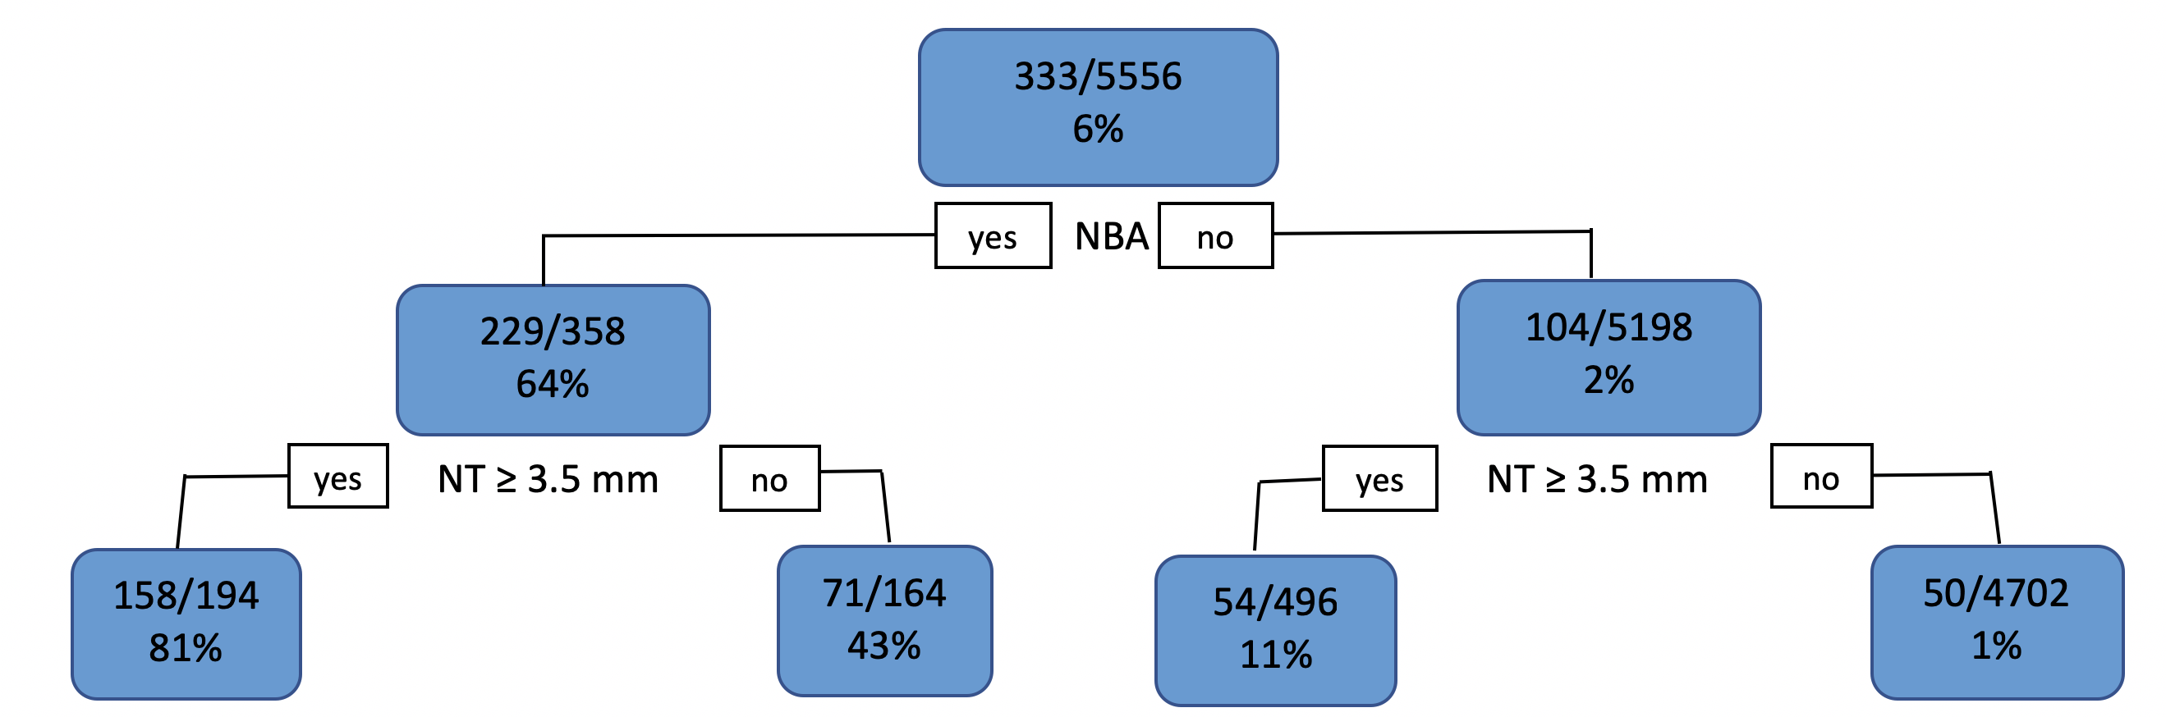
Classification Tree
Examine Nasal Bone First
Notes:
Recall Net Benefit is always TP – (C/B)*FP. NBA has both more TP (229 vs 212) and fewer FP (129 vs 478), so it is always preferred to NBA.
Note that the probabilities at the nodes are P(D+|node), not the proportion of the population that the node represents This will help with at least one of the homework problems. 7.10 (a)
If treatment threshold is 20% C/B = ¼, then you would not treat initially. NBA+ → Treat. NBA- → No treat. NB = [229 - ¼(129)]/5556 = 0.035 (with NT is 0.017)
If treatment threshold is 4.8% C/B = 1/20, then you would treat initially. NBA+ → Treat. NBA- → No treat. NB(Treat all) = [333 - (1/20)(5233) ]/ 5556 = 0.013. NB = [229 - 1/20(129)]/5556 = 0.04 (with NT is 0.034). Diff =0.027 (with NT is 0.021).
At both treatment thresholds NBA is better than NT. This will be the case at any treatment threshold where NBA changes the default decision.

Slide 51
Do Nasal Bone Exam First
NBA+ (TP = 229, FP = 129)
NT+ (TP = 212, FP = 478)
Net Benefit = TP - (C/B)×FP (all divided by N)
Net Benefit of NBA+ always > NT+
But might be < NB(Treat All) or < 0 = NB(Treat None)
Notes:
NB(Treat All) = N⁺ - (C/B) × N⁻ (all divided by N)

Slide 52
Notes:
The question being addressed: Can only do one, NBA or NT. Which one?
Ptt < 0.02. (P(D+) in NBA- group). Don’t split. Treat everybody
Ptt > 0.02. (Up to 0.81). Do NBA, not NT.

Slide 53
Do Nasal Bone Exam First
Better separates Trisomy 21 from chromosomally normal fetuses
If your threshold for CVS is between 11% and 43%, you can stop after the nasal bone exam
If your threshold is between 1% and 11%, you should do the NT exam only if NBA is negative.

Slide 54
Classification Tree
Examine Nasal Bone First
CVS (1% < Ptt < 11%)

Slide 55
Classification Trees
May not deal well with continuous test results*
Results in rules or algorithms, i.e. trees, not scores or formulas
Evaluation with calibration plots, ROC curves, net benefit calculations, and decision curves more difficult
*when there is a monotonic relationship between the test result and the probability of disease
*that have a monotonic relationship with the risk of the outcome.
Notes:
Ch07.57 a(ii)

Slide 56
Random Forests
Create of 1000s of classification trees and average the results
Bootstrap resampling of records
Random selection of candidate splitting variables
Black Box: Risk estimate with no explanation what went into it
Surprisingly accurate risk predictions
*when there is a monotonic relationship between the test result and the probability of disease
Notes:
I’m not going to discuss k-fold cross validation.

Slide 57
Logistic Regression
ln(Odds(D+)) =
a + b_{NT}NT+ b_{NBA}NBA + b_{interact}(NT)(NBA)
“+” = 1
“-” = 0

Slide 58
ln(a) = 2.3×log(a)
a | Log(a) | Ln(a)
1 | 0 | 0
2 | 0.30 | 0.69
3 | 0.48* | 1.10
4 | 0.60 | 1.38
5 | 0.70 | 1.61
6 | 0.78* | 1.79
7 | 0.85 | 1.96
8 | 0.90 | 2.07
9 | 0.95 | 2.19
10 | 1.00 | 2.3

Slide 59
ln(xy) = ln(x) + ln(y) ln(x/y) = ln(x) – ln(y)
Notes:
The logarithm of the product is the sum of the logarithms

Slide 60
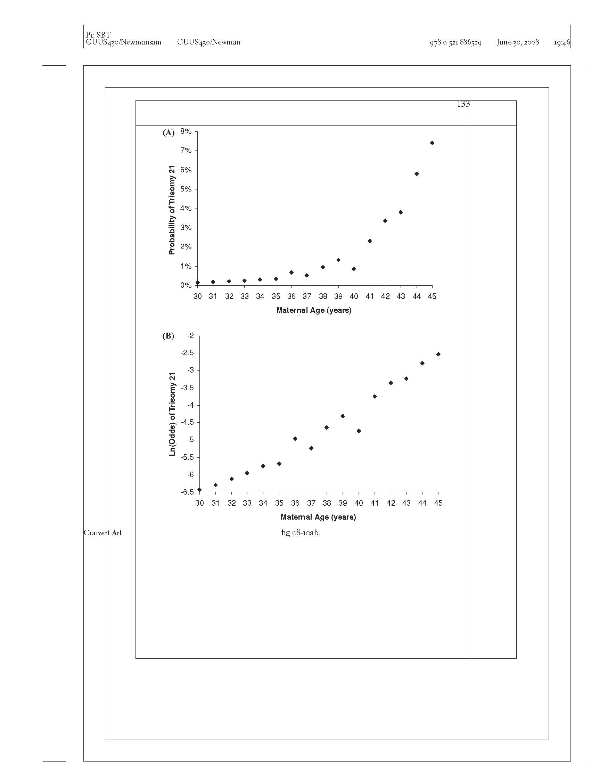
Probability of Trisomy 21 vs. Maternal Age
Data from Snijders et al. Ultrasound Obstet Gynecol. 1999;13(3):167-70. Tables 1 and 2, GA = 16)
Notes:
This is data for gestational age = 16 from the Snijders reference given.
Tables 1 and 2 give the information for Maternal ages 35-45. They didn’t report actual risks for 30-34, so I fudged and used predicted risk. Even though the study had 57,614 women, after limiting it to gestation age = 16, it was only 19968, and only 1147 with both GA=16 and Maternal Age = 40, There were only 10 with trisomy 21. 10/1147 = 0.87%.
So, the smoothness from 30-34 is artificial. The authors didn’t report actual data, so I used predicted (already smoothed). The variability 35-45 is consistent with random error. Sample size was small because I only looked at GA = 16.
There were only 25 women aged 45 (and GA = 16), and 2 of them had trisomy 21 fetuses. 2/25 = 7.4%
But isn’t this the point? That if you take log odds, you get a linear trend in data that you can fit to account for random error.

Slide 61
Ln(Odds) of Trisomy 21 vs. Maternal Age

Slide 62
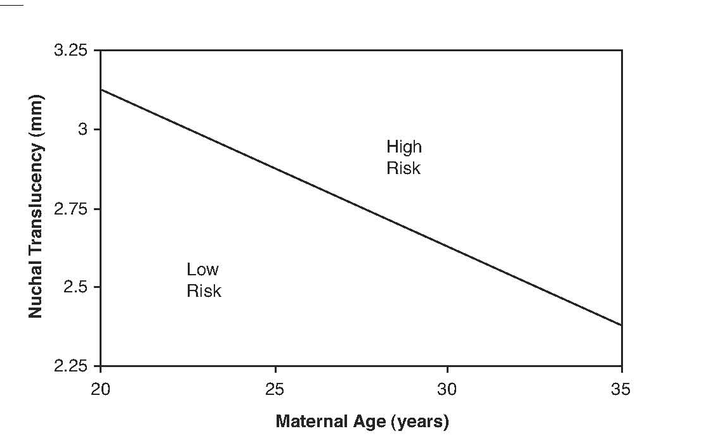
Combining 2 Continuous Tests
> 1% Probability of Trisomy 21
< 1% Probability of Trisomy 21
Notes:
Note, you couldn’t represent this with a tree.

Slide 63
Logistic Regression
ln(Odds(D+)) =
a + b_{NT}NT+ b_{NBA}NBA + b_{interact}(NT)(NBA)
Used to create risk scores, formulas,or nomograms, not trees.
Evaluation with calibration plots, ROC curves, net benefit calculations, and decision curves is natural

Slide 64
Logistic Regression Coefficients
The logistic regression coefficient for a dichotomous predictor is the ln of the multivariate odds ratio.
Notes:
Bottom line: the logistic regression coefficient for a dichotomous predictor is the ln of the multivariate odds ratio

Slide 65
Logistic Regression Coefficients
ln(Odds(D+)) =
a + b_{NT}NT+ b_{NBA}NBA + b_{interact}(NT)(NBA)
Coefficient b_{NBA}= ln(OR_{NBA})
e^{b} = OR_{NBA}
OR_{NBA} = Odds(D+|NBA+) / Odds(D+|NBA-)
Notes:
Bottom line: the logistic regression coefficient for a dichotomous predictor is the ln of the multivariate odds ratio

Slide 66
ORs vs. LRs
Odds of disease given a positive test or exposure = Odds(D+|+) = Odds(D+) × LR(+)
Odds of disease given a negative test or no exposure = Odds(D+|−) = Odds(D+) × LR(−)
OR = Odds(D +|+)/Odds(D +|−)
= [Odds(D+) × LR(+)]/[Odds(D+) × LR(−)]
= LR(+)/LR(−)

Slide 67
ORs vs. LRs
Use LRs for test results, symptoms, or findings (caused by the disease)
Use ORs for risk factors that cause the disease
  The prevalence of the risk factor will affect the prevalence (pre-test probability) of the disease
  Risk factor rare, prevalence low, and LR(+) high
  Risk factor common, prevalence high, and LR(+) low.

Slide 68
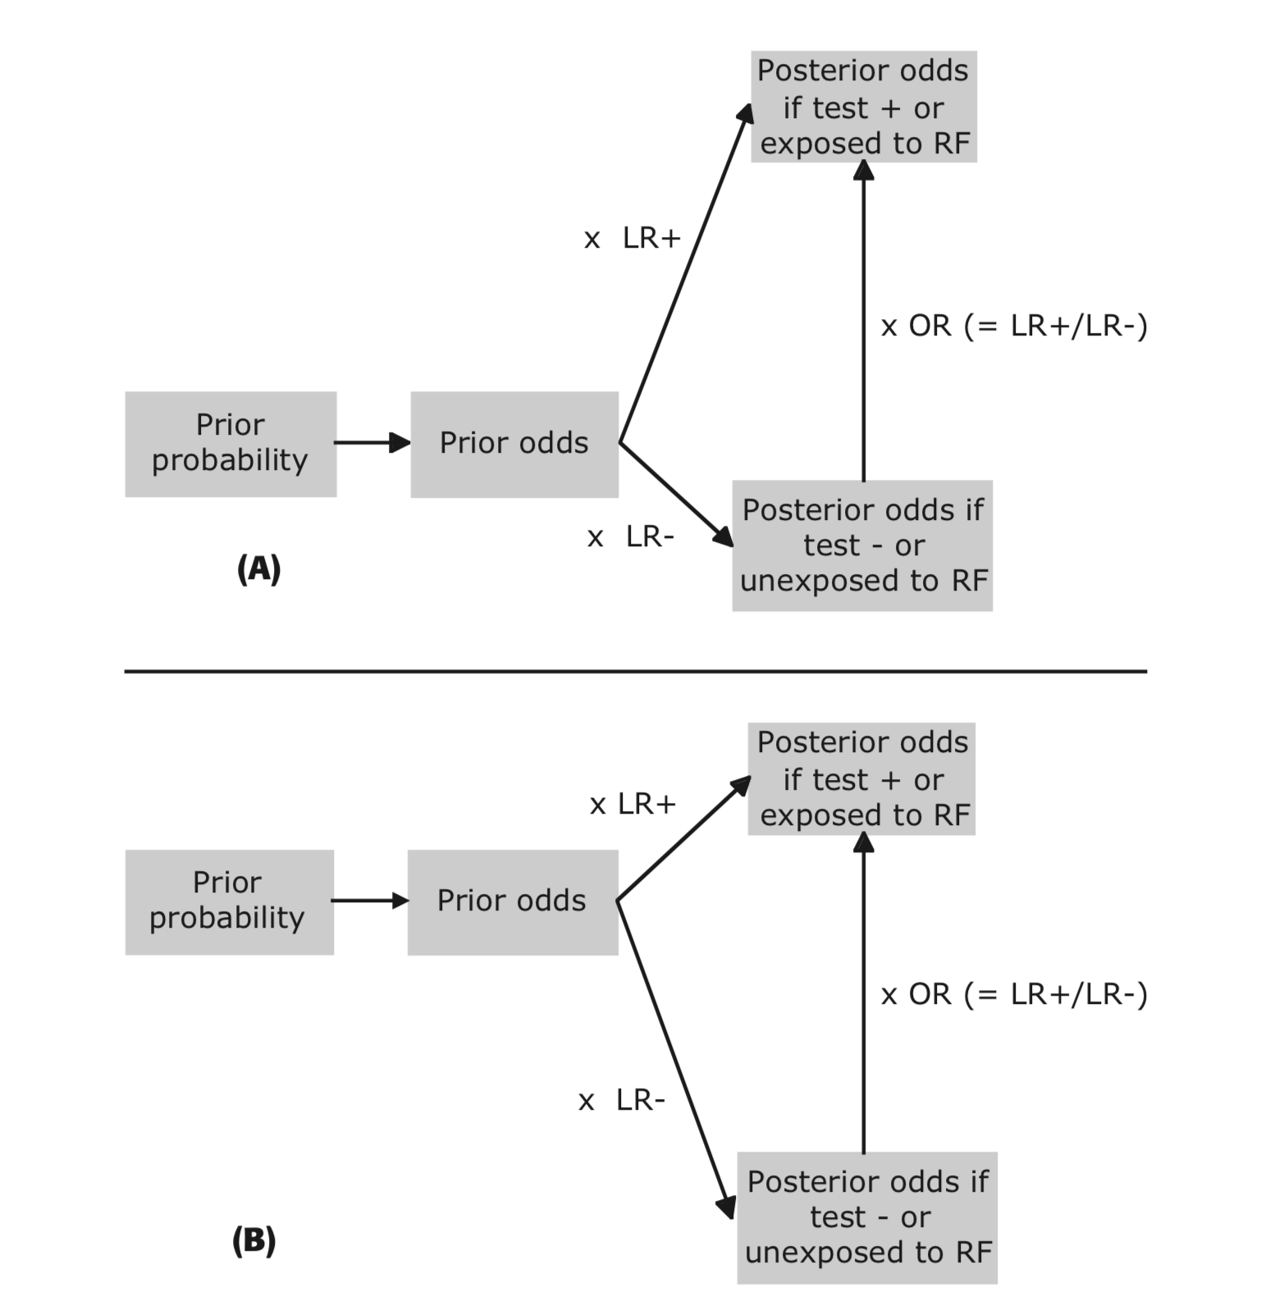

Slide 69
Choosing Which Tests to Include in the Decision Rule
“Use well-established theory, past research, clinical observations, preliminary statistical analysis, or some sensible combination of these ….”
Stoltzfus, J. C. (2011). "Logistic regression: a brief primer." Acad Emerg Med 18(10): 1099-1104.
Notes:
Machine learning algorithms tend to use the whole dataset (all variables). In random forests, variable selection is done randomly and then all the rules are combined in an ensemble. The records are also selected randomly, which is called bootstrap aggregation. Bootstrap aggregation is different from cross-validation, because it is random sampling of records with replacement.

Slide 70
Need for Validation
Develop prediction rule by choosing a few tests and findings from a large number of candidates, based on which work the best.
Takes advantage of chance variations in the data.
Predictive ability of rule will probably decrease or even disappear when you try to validate on a new dataset.
Can be referred to as “overfitting.”

Slide 71
Need to Test the Rule in a Separate Dataset
Derivation → Validation
Training → Test
Beware of Tweaking the Rule

Slide 72
Validation Dataset
Measure all the variables needed for the model.
Determine disease/outcome status (D+ or D-) on all subjects.

Slide 73
NLST Lung CA Mortality
Risk Prediction Model
Regression model converts the following variables* into a risk of lung cancer death within 5 years
Age
BMI
Family history of lung cancer
Pack-years of smoking
Years since smoking cessation
Emphysema diagnosis
*Sex and Race were not included in the model (?)

Slide 74
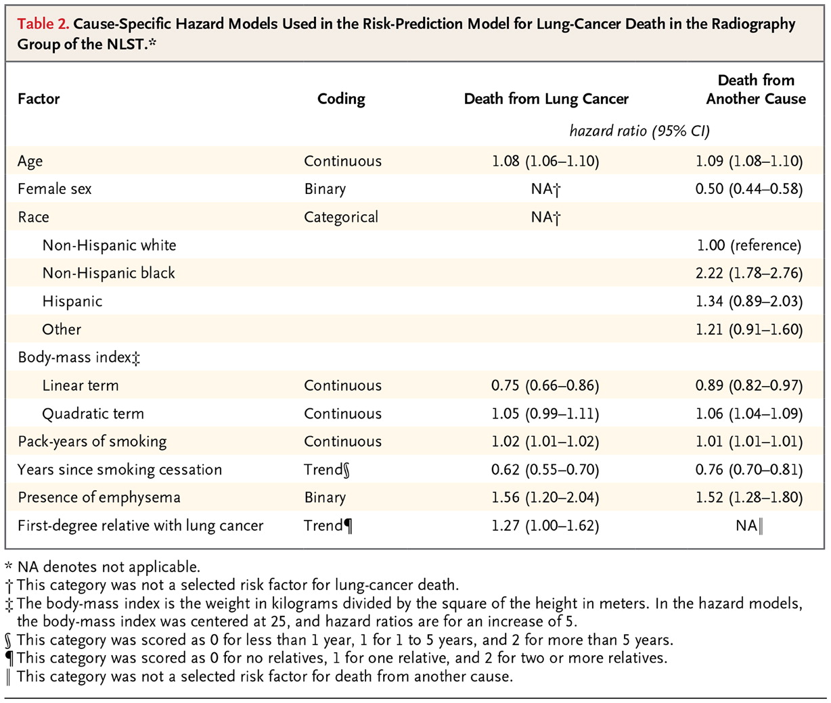

Kovalchik SA et al. N Engl J Med 2013;369:245-254.
Notes:
Hazard ratios, not odds ratios.

Slide 75
Calibration
Risk Category* | Lung Cancer Deaths within 5 years/1000
 | Predicted | Validation | Difference
5 | 34.1 | 45.3 | -11.2
4 | 13.7 | 19.5 | -5.8
3 | 8.3 | 13.2 | 4.9
2 | 6.6 | 4.6 | 2.0
1 | 3.8 | 2.0 | 1.8
*These were actually quintiles or risk, but for exposition, I will treat them as fixed risk categories.

Slide 77
RMSE = 0.128
RMSGE = 0.006
Root Refinement Loss = 0.128
Notes:
Experimenting with this type of calibration plot and Root Mean Square Error, Root Mean Square Group Error, and Root Refinement Loss. No so sure about the metrics.

Slide 78
Discrimination
Risk Category | Lung Cancer Death within 5 years
 | Predicted | Sensitivity | 1- Specificity
5 | 34.1 | 54% | 19%
4 | 13.7 | 77% | 39%
3 | 8.3 | 92% | 59%
2 | 6.6 | 98% | 80%
1 | 3.8 | 100% | 100%
Notes:
3rd column: Of all patients who die of lung cancer within 5 years, 54% are in Risk Category 5; 77% are in Risk Categories 4 & 5; 92% are in categories 3, 4, & 5; and so on.

Slide 79
AUROC = 0.744

Slide 80
Binary Decision: CT Yes/No
Assume CT scanning one who will die of lung CA in the next 5 years is worth CT scanning 100 who will not die
Threshold mortality risk =1%

Slide 81
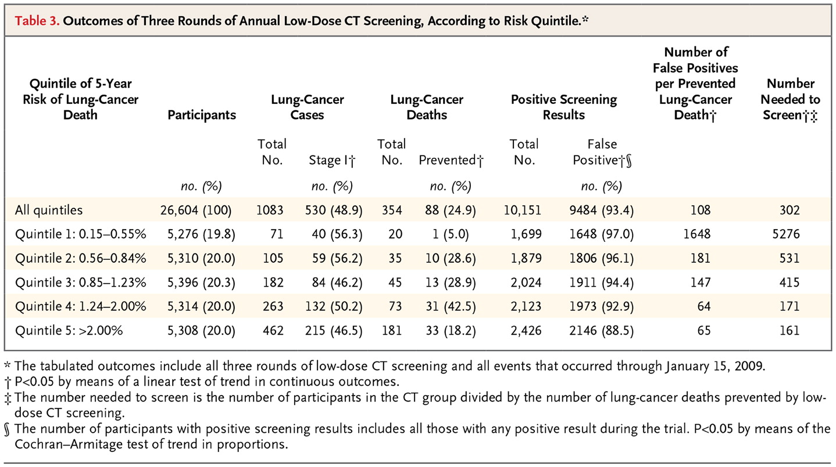
Kovalchik SA et al. N Engl J Med 2013;369:245-254.

Slide 82
Binary Decision: CT Yes/No
Assume CT scanning one who will die of lung CA in the next 5 years is worth CT scanning 100 who will not die
Threshold mortality risk =1%

Slide 83
Net Benefit of Risk Model
 | Total Scans | TP | FP | (TP - FP/100)/N
CT None | 0 | 0 | 0
CT Risk Groups 3,4,5 | 16018 | 376 | 15642 | 8.3/1000
CT w/o risk stratification | 26604 | 442 | 26162 | 6.8/1000

Slide 84
NLST Risk Model Decision Curve
Notes:
This is approximate. MAK.

Slide 85
Example of Recursive Partitioning: Kharbanda Low Risk Appendicitis Rule
Multivariable rule to determine which children to CT scan for appendicitis
Objective: Identify patients at low risk
2005: Derivation (N=425) and initial validation (N=176)
2012: Repeat validation (N=2390) and “refinement” (N=2625)

Slide 86
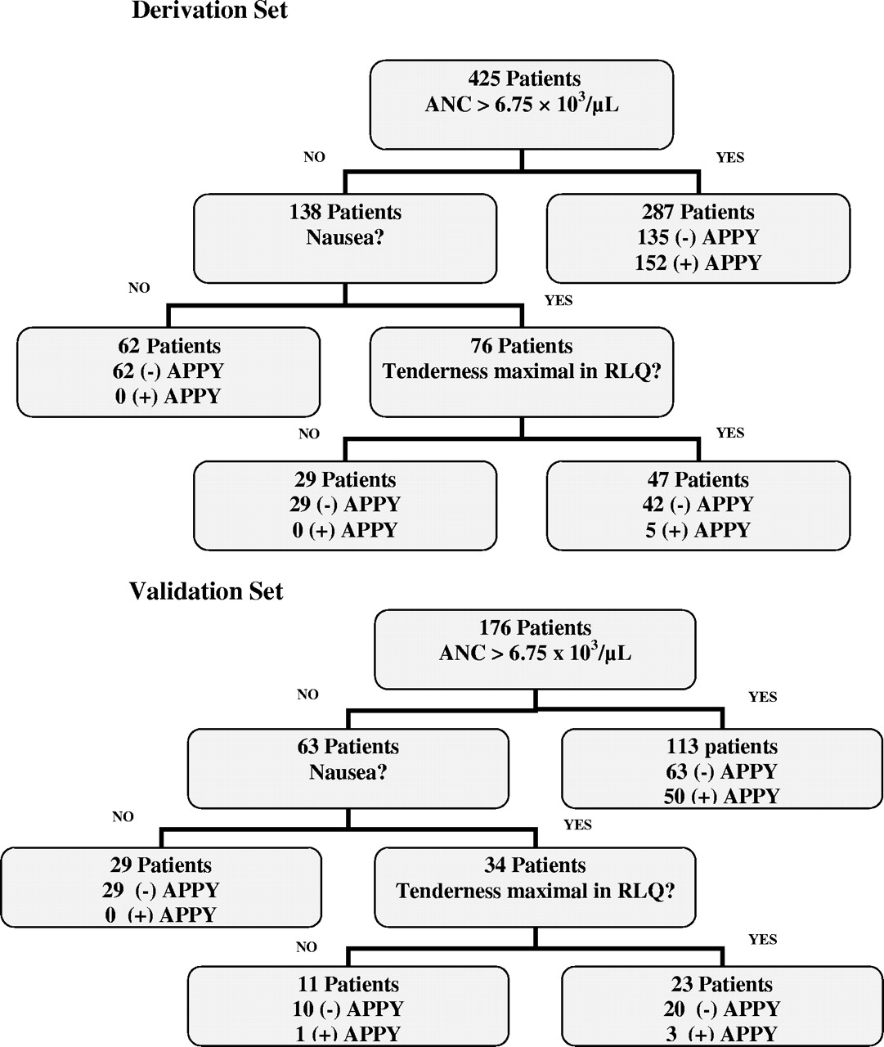
Low-risk decision tree that was created using classification trees
21% assigned to Low Risk
Low Risk Group: 0%
Higher Risk Group: 47%
Overall Risk: 37%
Anupam B. Kharbanda et al. Pediatrics 2005;116:709-716
©2005 by American Academy of Pediatrics
Notes:
Low-risk decision tree that was created using recursive partitioning. APPY indicates appendicitis.

Slide 87

Low-risk decision tree that was created using classification tree.
23% assigned to Low Risk
Low Risk Group: 1/40 = 2.5%
Higher Risk Group: 39%
Overall Risk: 31%
Anupam B. Kharbanda et al. Pediatrics 2005;116:709-716
©2005 by American Academy of Pediatrics
Notes:
Low-risk decision tree that was created using recursive partitioning. APPY indicates appendicitis.

Slide 88
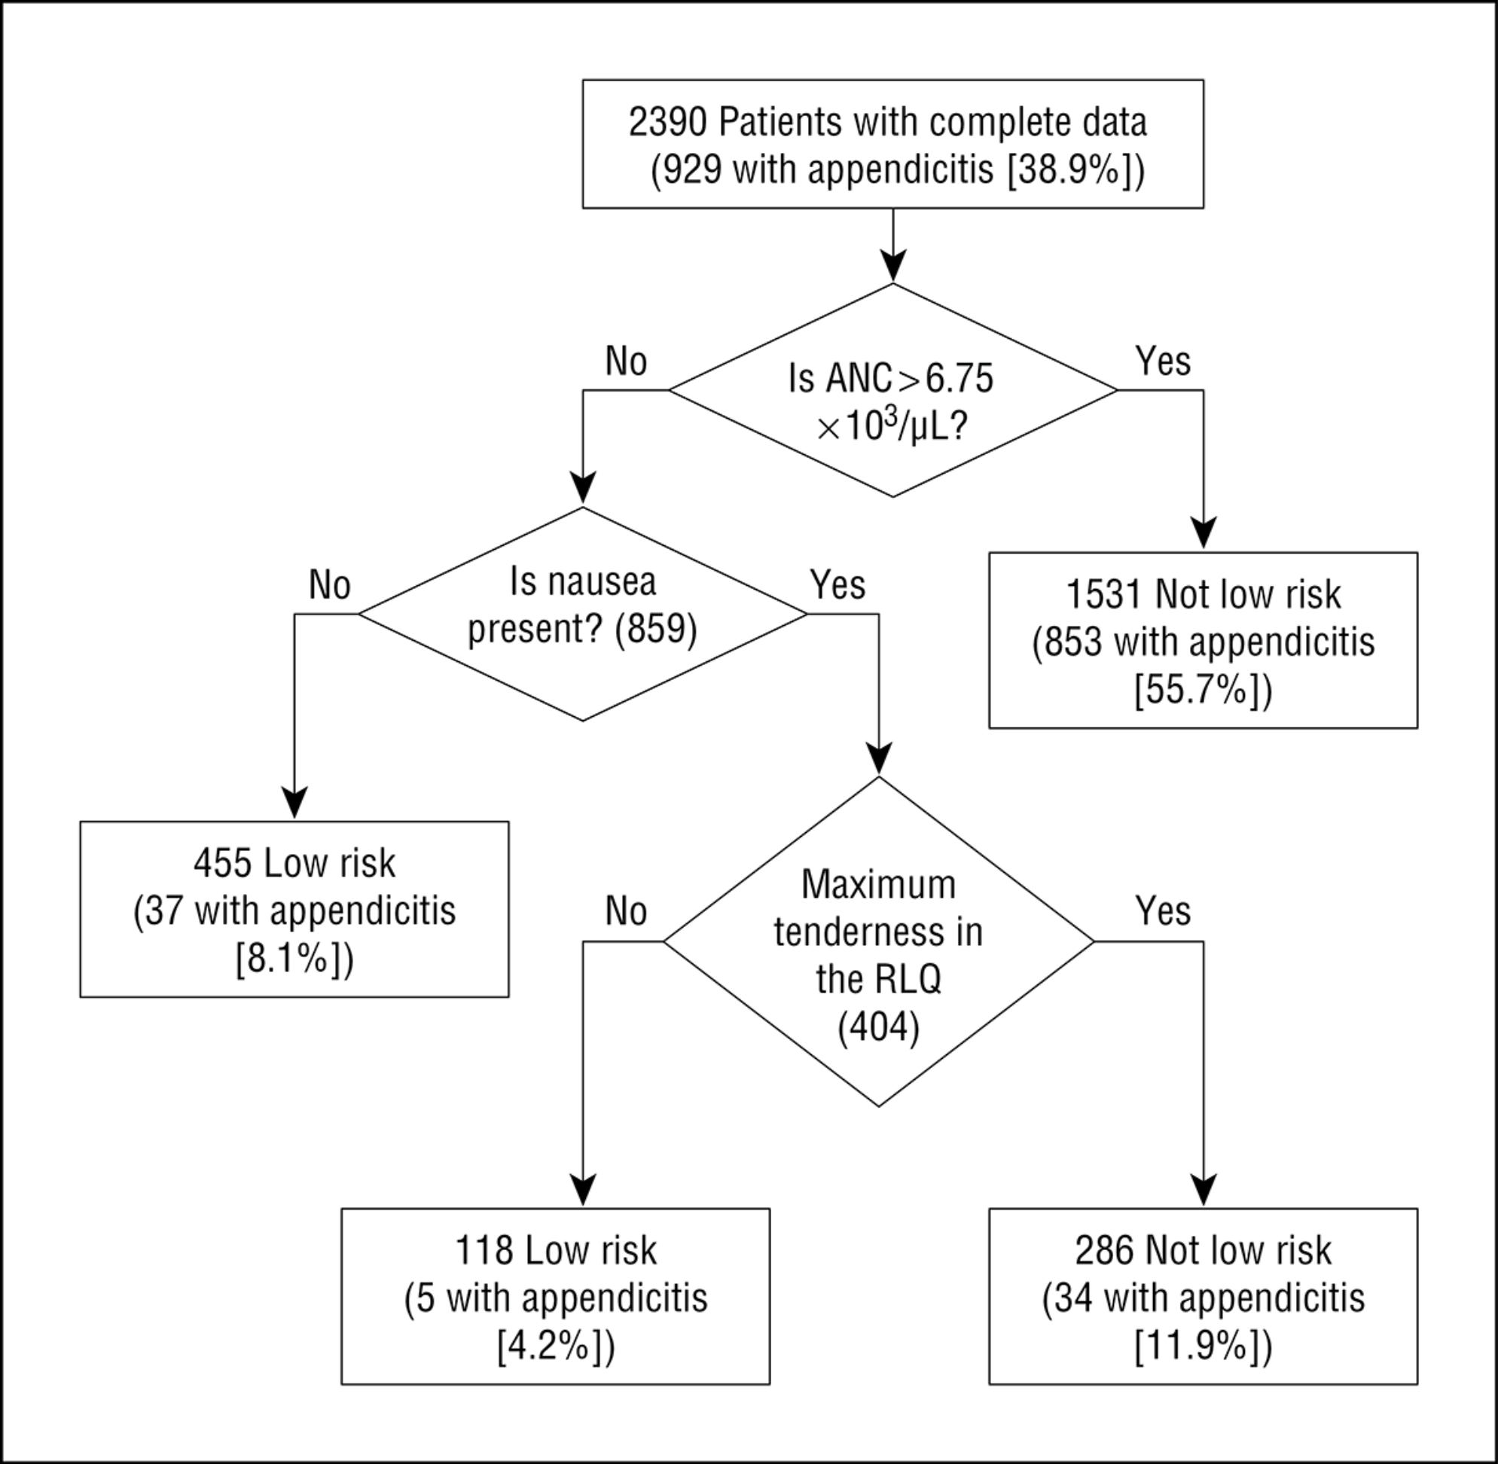
From: Validation and Refinement of a Prediction Rule to Identify Children at Low Risk for Acute Appendicitis
Arch Pediatr Adolesc Med. 2012;166(8):738-744. doi:10.1001/archpediatrics.2012.490
2012 Validation:
24% assigned to Low Risk
Low Risk Group: 42/573 = 7.3%
Higher Risk Group: 49%
Overall Risk: 39%
2005 Validation:
23% assigned to Low Risk
Low Risk Group: 1/40 = 2.5%
Higher Risk Group: 39%
Overall Risk: 31%
Figure 2. Effect of hypothetical application of the Low-Risk Appendicitis Rule. ANC indicates absolute neutrophil count (to convert count to ×10⁹ per liter, multiply by 1); RLQ, right lower quadrant.
Copyright © 2015 American Medical Association. All rights reserved.

Slide 89
Notes:
Calibration plots and ROC Curves not that useful for recursive partitioning models.
Reminder that
Points on calibration plot correspond to intervals on ROC curve
Low left on calibration plot corresponds to high right on the ROC curve

Slide 90
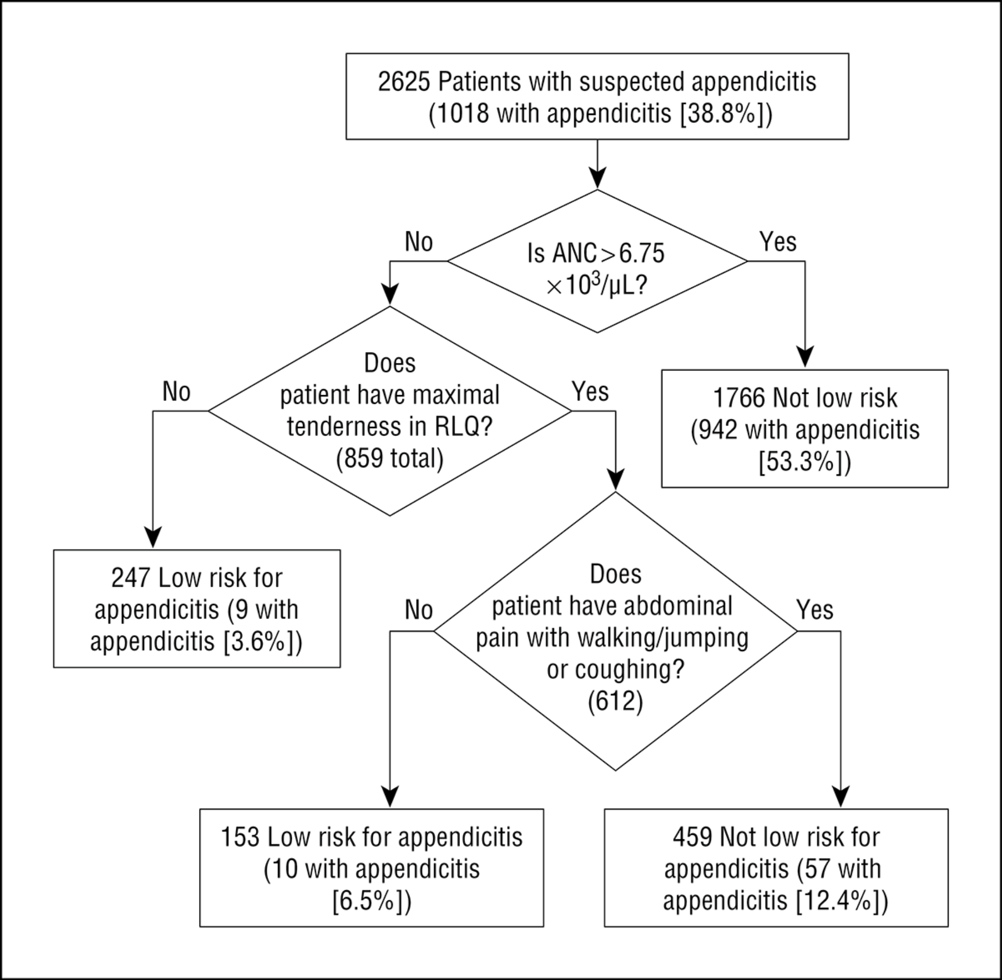
From: Validation and Refinement of a Prediction Rule to Identify Children at Low Risk for Acute Appendicitis
Arch Pediatr Adolesc Med. 2012;166(8):738-744. doi:10.1001/archpediatrics.2012.490
2012 Validation:
24% assigned to Low Risk
Low Risk Group: 42/573 = 7.3%
Higher Risk Group: 49%
Overall Risk: 39%
2012 Refinement:
15% assigned to Low Risk
Low Risk Group: 19/400 = 4.8%
Higher Risk Group: 45%
Overall Risk: 39%
Figure 3. Refined Low-Risk Appendicitis Rule and rule performance. ANC indicates absolute neutrophil count (to convert count to ×10⁹ per liter, multiply by 1); RLQ, right lower quadrant.
Copyright © 2015 American Medical Association. All rights reserved.

Slide 91
Outline: Combining Tests
Evaluating Predictions/Decision Curves Addendum
Independence Conditional on D+/D- (Hard!)
Classification Trees
Logistic Regression
  Digression: Natural Logarithms
Variable (Test) Selection
Validation separate from derivation
NLST Risk Model
Low-Risk Appendicitis Rule

