Slide 1
Machine Learning in R
Lecture 2 -- Classification, linear algebra and loss functions
John Kornak – Epidemiology and Biostatistics
john.kornak@ucsf.edu

Slide 2
Last lecture
What is Machine Learning?
Supervised vs. Unsupervised learning
Introduction to prediction techniques for supervised learning with continuous outcomes:
  Local estimation and nearest neighbors
  Loss functions and mean square error
  The training-test paradigm
  The curse of dimensionality
  Linear regression modeling (including polynomials)
  Some trade-offs

Slide 3
In this lecture:
Supervised learning methods for classification
  Logistic and multinomial regression
  Linear discriminant analysis

Slide 4
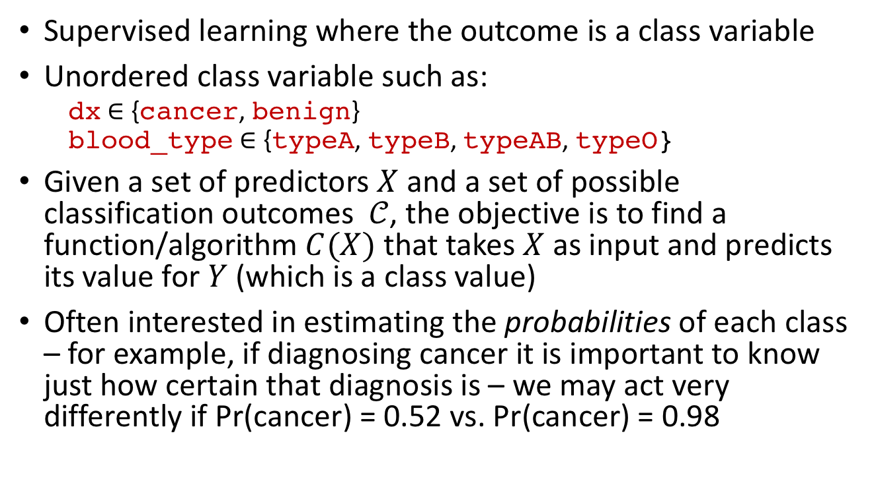
Classification
Supervised learning where the outcome is a class variable
Unordered class variable such as:
  dx $∈$ {cancer, benign}
  blood_type $∈$ {typeA, typeB, typeAB, typeO}
Given a set of predictors $X$ and a set of possible classification outcomes $𝒞$, the objective is to find a function/algorithm $C(X)$ that takes $X$ as input and predicts its value for $Y$ (which is a class value)
Often interested in estimating the probabilities of each class – for example, if diagnosing cancer it is important to know just how certain that diagnosis is – we may act very differently if Pr(cancer) = 0.52 vs. Pr(cancer) = 0.98

Slide 5
Supervised vs. unsupervised
Machine Learning
Supervised
Regression (continuous outcome)
Classification (categorical outcome)
Unsupervised
Clustering
(grouping observations)
Data Reduction (transforming variables)
Survival outcome
Outcome observed
No outcome

Slide 6
Supervised vs. unsupervised
Machine Learning
Supervised
Regression (continuous outcome)
Classification (categorical outcome)
Unsupervised
Clustering
(grouping observations)
Data Reduction (transforming variables)
Survival outcome
Outcome observed
No outcome

Slide 7
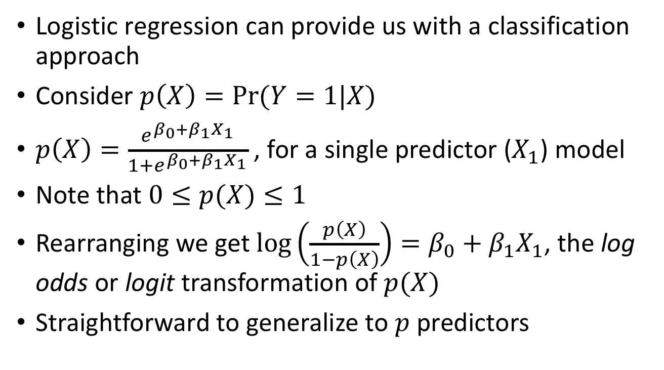
Classification with logistic regression
Logistic regression can provide us with a classification approach
Consider $p\left(X\right)=Pr⁡(Y=1|X)$
$p\left(X\right)=\frac{e^{β_{0}+β_{1}X_{1}}}{1+e^{β_{0}+β_{1}X_{1}}}$ , for a single predictor ($X_{1}$) model
Note that $0≤p(X)≤1$
Rearranging we get $\log\left(\frac{p\left(X\right)}{1−p\left(X\right)}\right)=β_{0}+β_{1}X_{1}$, the log odds or logit transformation of $p(X)$
Straightforward to generalize to $p$ predictors

Slide 8
Logistic regression example – ISPY1
Multicenter Investigation of Serial Studies to Predict Your Therapeutic Response with Imaging and moLecular Analysis (I-SPY TRIAL) breast cancer trial
A study of imaging and tissue-based biomarkers for predicting pathological complete response (pCR) and recurrence free survival (RFS)
Inclusion criteria: T3 tumors > 3cm diameter, receiving neoadjuvant chemotherapy with an anthracycline-cyclophosphamide regimen alone or followed by a taxane
Study was open to enrollment from May 2002 to March 2006. 237 patients were enrolled, of which 230 met eligibility criteria.

Slide 9
Experimental design of ISPY1 imaging
3 or 4 MRI scans
  Before treatment (T0)
  After 1 cycle AC (T1)
  Before surgery (Tfinal)
Anthracycline
Taxane
Post surgical treatment and follow up
Surgery
?
MRI_{final}
MRI₀
MRI₁
MRI₂

Slide 10
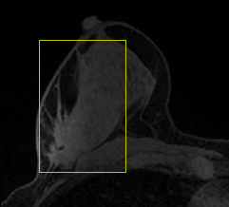
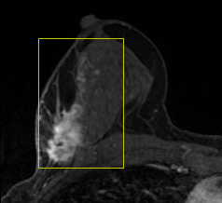
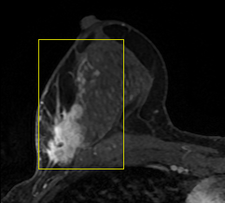
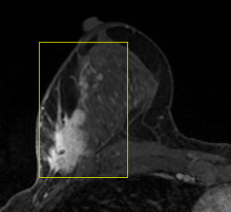
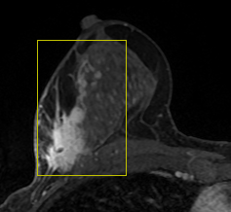

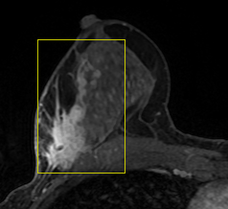
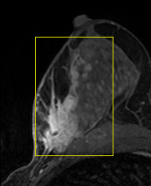
ISPY1 -- Dynamic contrast-enhanced (DCE) MRI
DCE-MRI is standard for breast cancer evaluation in high-risk patients
T1-weighted imaging performed before and after injection of gadolinium contrast agent
Used for cancer detection (screening) and evaluation of response to treatment
For evaluation of response to treatment, additional requirements include:
  Sequential MRIs performed on same (or equivalent) scanner
  All scan parameters kept constant
  Gadolinium administration kept constant (dose, rate of injection, flush volume)
contrast injection
← 80-100 second temporal resolution; 8 minute duration →
Pre-contrast
Post-contrast 1
Post-contrast 2
Post-contrast 3
Post-contrast 4
Post-contrast 5
Post-contrast 6
Post-contrast 7

Slide 11
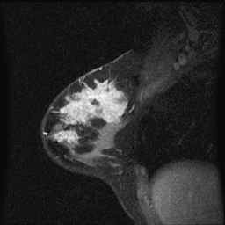
Longest diameter (LD) predictor
Measured by radiologist (in I-SPY 1 clinical trial, diameter measurements at treatment time-points were required to be along same axis as baseline)
LD
Longest diameter (LD)

Slide 12
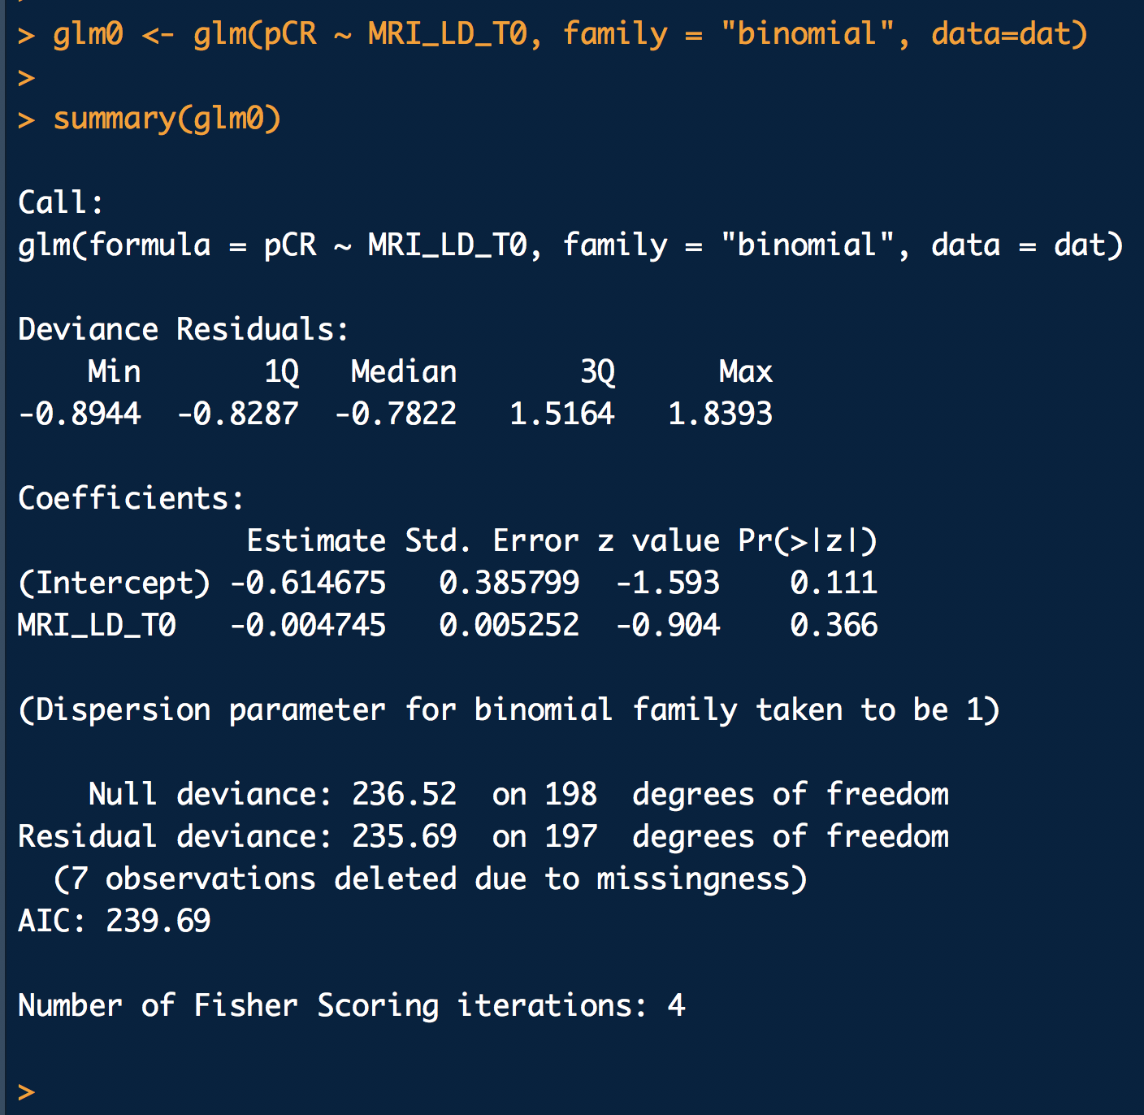
Can longest diameter @T0 predict pCR?
Fit logistic regression with pCR as outcome (1=pCR, 0=not pCR) and longest diameter on MRI at T0 as predictor

Slide 13
Can longest diameter @T0 predict pCR?
Fit logistic regression with pCR as outcome (1=pCR, 0=not pCR) and longest diameter on MRI at T0 as predictor

Slide 14
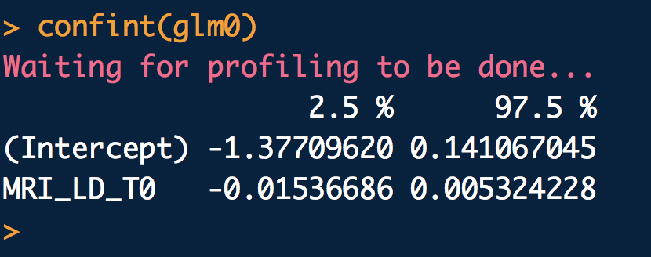
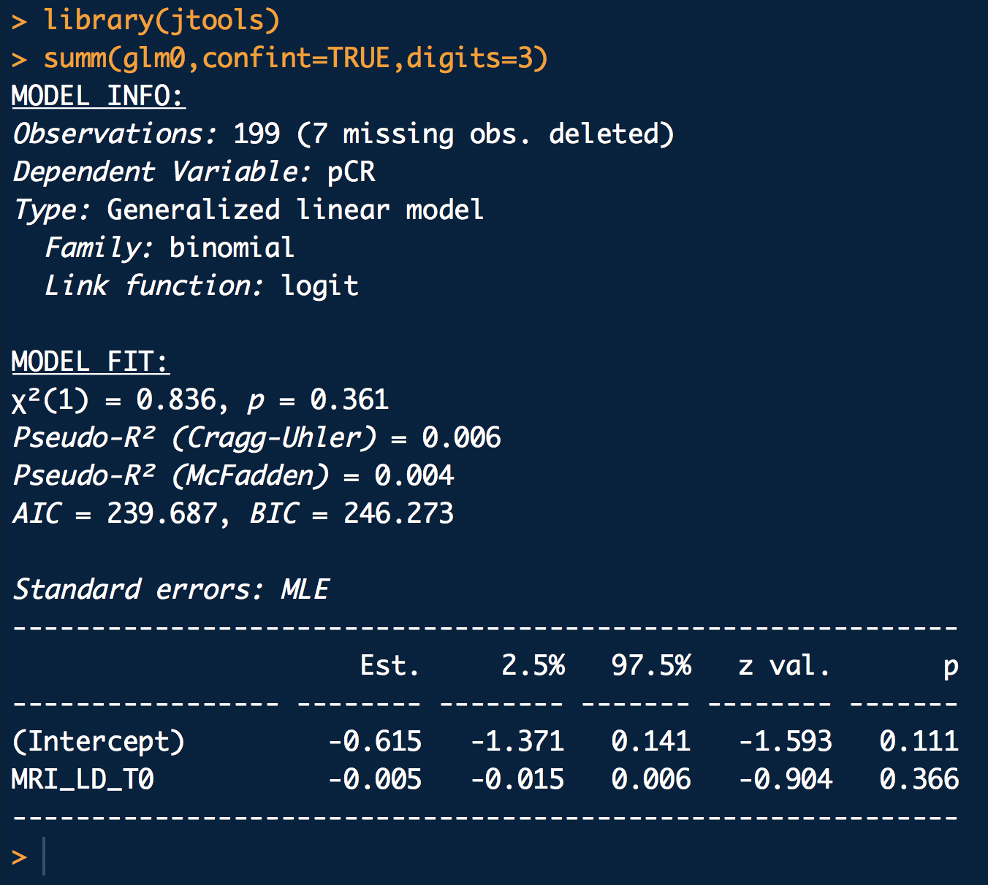
Can longest diameter @T0 predict pCR?
We can get confidence intervals too
Note that estimates and CIs are of the parameters. If you want odds-ratios then you will need to exponentiate
or

Slide 15
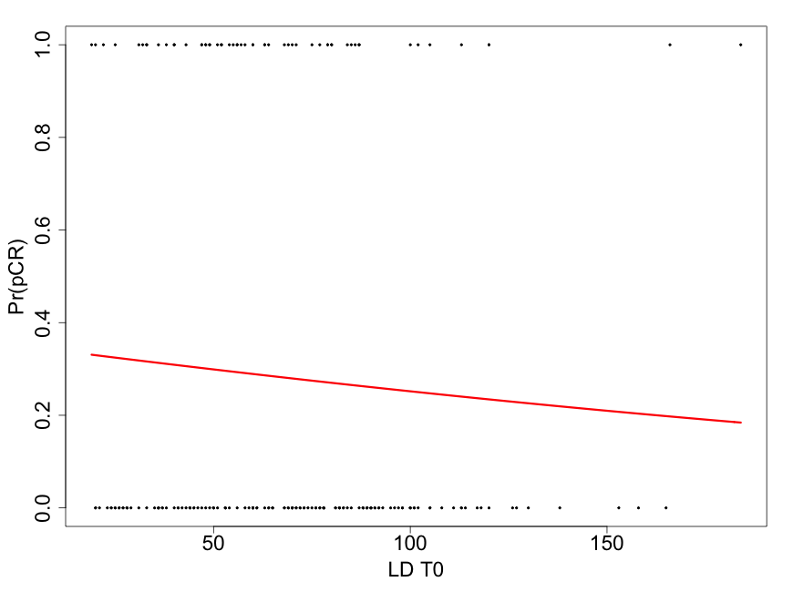
Can longest diameter @T0 predict pCR?

Slide 16
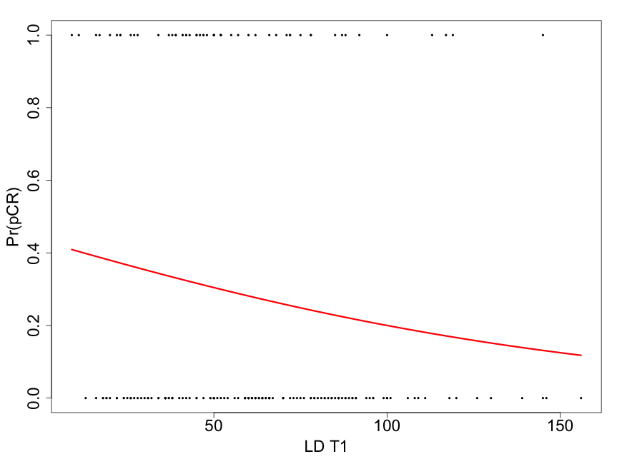
What about longest diameter @T1 predicting pCR?

Slide 17
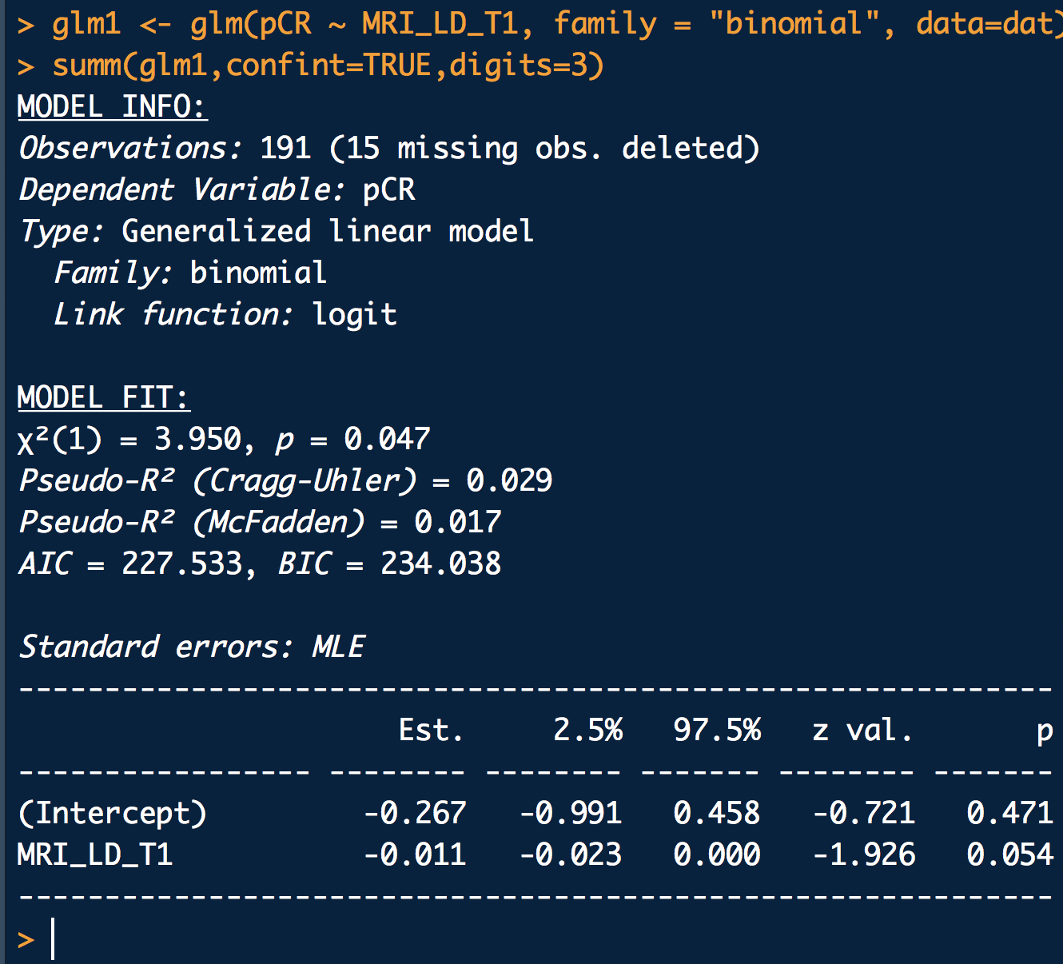
What about longest diameter @T1 predicting pCR?

Slide 18
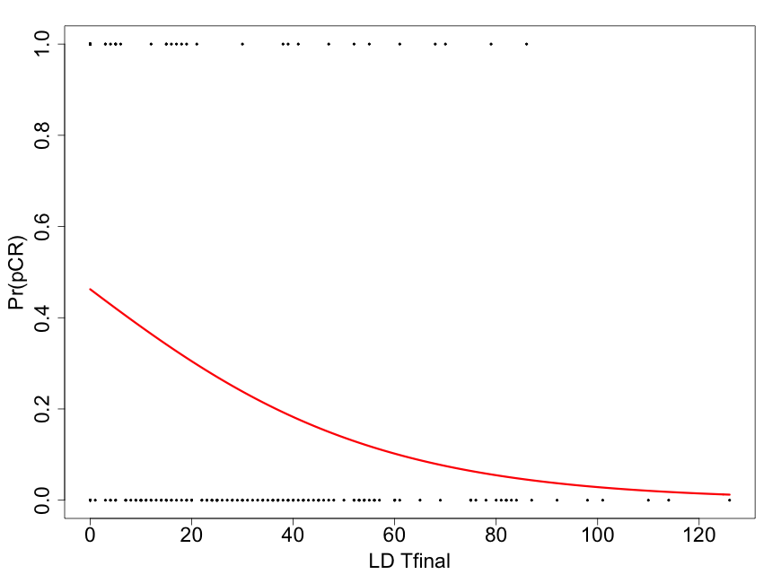
Longest diameter @Tfinal predicting pCR?

Slide 19
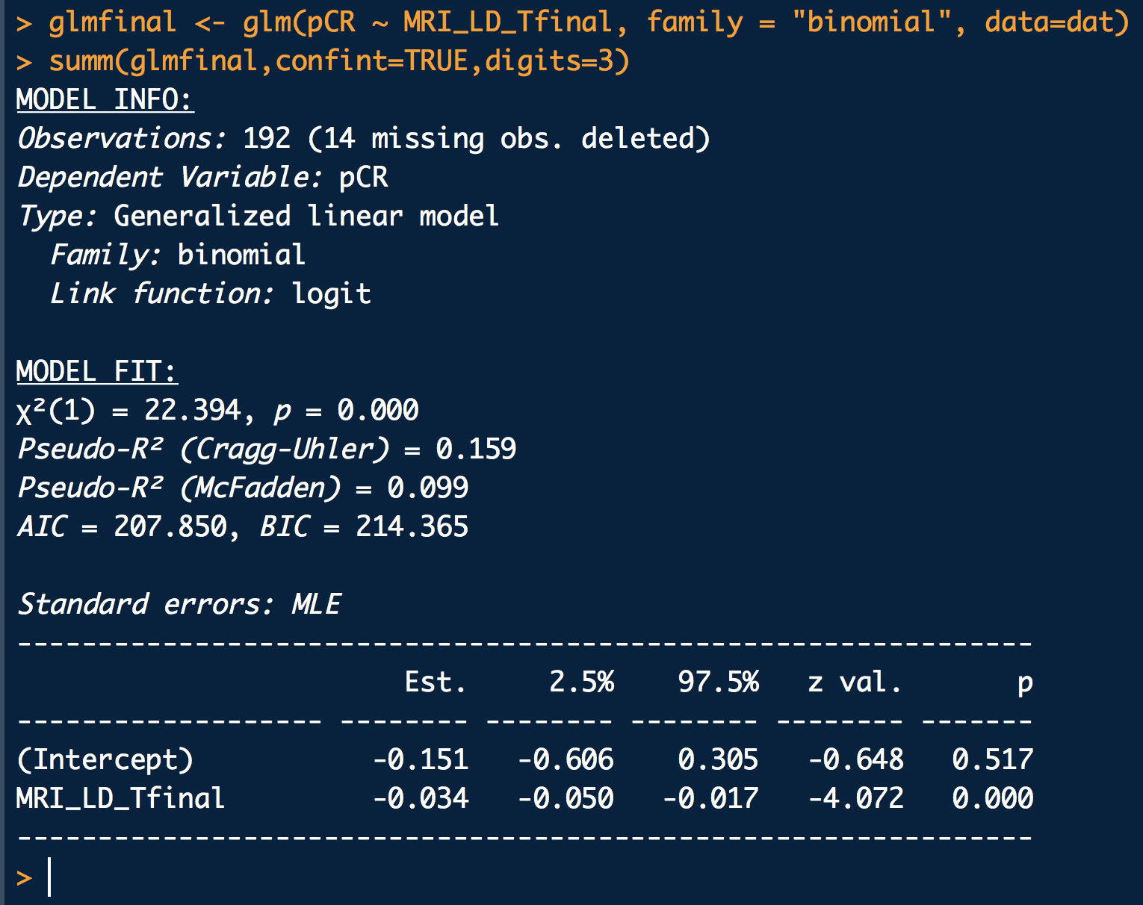
Longest diameter @Tfinal predicting pCR?

Slide 20
Longest diameter @Tfinal predicting pCR?
So how would we classify future patients based on this curve?

Slide 21
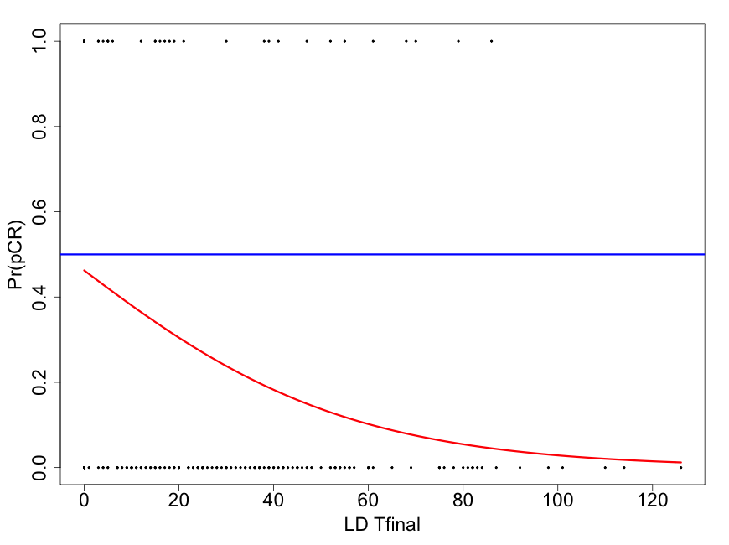
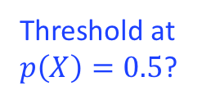
Longest diameter @Tfinal predicting pCR?
Threshold at
$p\left(X\right)=0.5$?
So how would we classify future patients based on this curve?

Slide 22
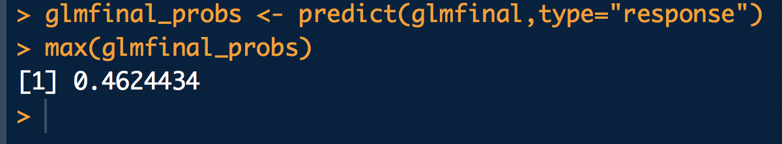
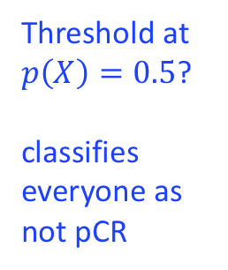
Longest diameter @Tfinal predicting pCR?
Threshold at
$p\left(X\right)=0.5$?
classifies everyone as not pCR
So how would we classify future patients based on this curve?

Slide 23
Maybe we need other or more predictors?
Threshold at
$p\left(X\right)=0.5$?
classifies everyone as not pCR
So how would we classify future patients based on this curve?
We need to make it over 0.5 in order to predict anyone as pCR = 1

Slide 24
Maybe we need other or more predictors?
Threshold at
$p\left(X\right)=0.5$?
classifies everyone as not pCR
So how would we classify future patients based on this curve?
We need to make it over 0.5 in order to predict anyone as pCR = 1 or perhaps choose a lower threshold if objective is screening?

Slide 25
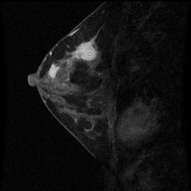
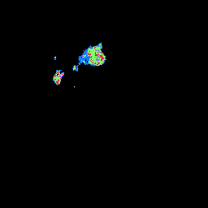
Percent Enhancement (PE), Signal Enhancement Ratio (SER), and Functional Tumor Volume (FTV)
S₁
Washout
SER>1.1
S₂
S
∆S₁
Plateau
0.9≤SER≤1.1
∆S₂
S₀
Gradual
SER<0.9
t₀
t₁
t₂
SER map
injection
ΔS₁
× 100%
S₀
Early percent enhancement (PE) =
Signal enhancement ratio (SER) =
ΔS₁
ΔS₂
Higher SER (i.e. faster washout) indicative of cancer tissue
Functional tumor volume (FTV) is the volume of tissue for which both PE and SER are both above their respective pre-specified thresholds

Slide 26
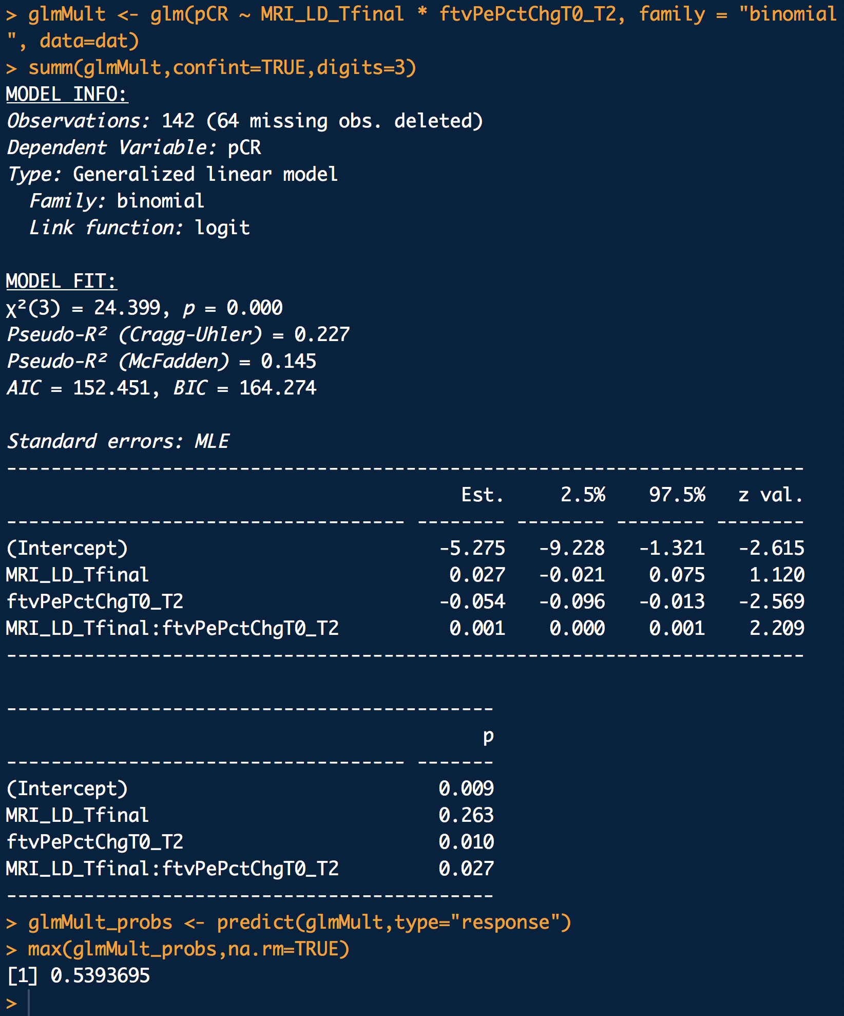
Try LD Tfinal * FTV change T0 to T2
But we would really need to perform independent validation to see if we are really getting anything extra out of using this more complex model.
In fact, is 0.5 really the right threshold value for us here?
What if it is twice as bad to misclassify pCR as not pCR than it is to misclassify not pCR as pCR?

Slide 27
Let’s think about this as a loss function
We could define the loss function as follows:
  Loss = 0 when we correctly classify either pCR or non-pCR
  Loss = 1 when we misclassify non-pCR as pCR
  Loss = 2 when we misclassify pCR as non-pCR
We would then find the probability threshold that minimizes the expected loss over all observations
This could then be evaluated with reserved data
We will not pursue this idea further with logistic regression because there are classification methods that deal with this problem more naturally – including discriminant analysis…

Slide 28
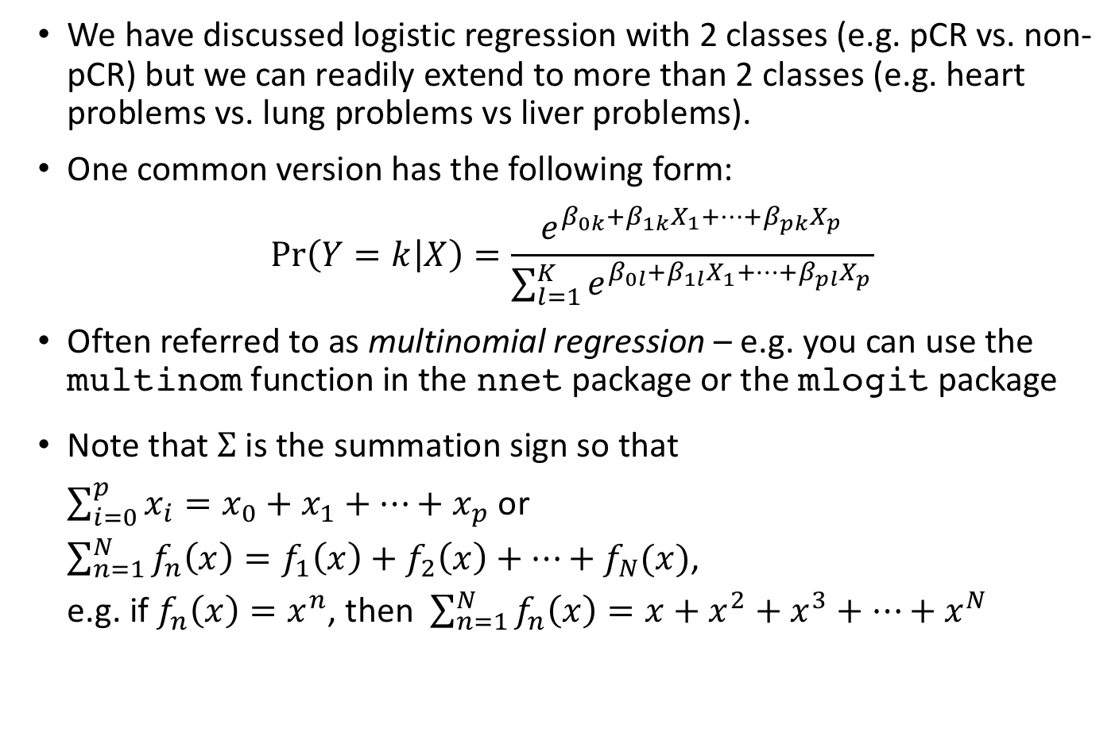
Extending logistic regression for more than 2 classes
We have discussed logistic regression with 2 classes (e.g. pCR vs. non-pCR) but we can readily extend to more than 2 classes (e.g. heart problems vs. lung problems vs liver problems).
One common version has the following form:
$$\operatorname{Pr}\left(Y=k | X\right)=\frac{e^{β_{0k}+β_{1k}X_{1}+…+β_{pk}X_{p}}}{\sum_{l=1}^{K}{e^{β_{0l}+β_{1l}X_{1}+…+β_{pl}X_{p}}}}$$
Often referred to as multinomial regression – e.g. you can use the multinom function in the nnet package or the mlogit package
Note that $Σ$ is the summation sign so that $\sum_{i=0}^{p}{x_{i}=x_{0}+x_{1}+…+x_{p}}$ or $\sum_{n=1}^{N}{f_{n}\left(x\right)=f_{1}\left(x\right)+f_{2}\left(x\right)+…+f_{N}(x)}$, e.g. if $f_{n}\left(x\right)=x^{n}$, then $\sum_{n=1}^{N}{f_{n}\left(x\right)={x+x}^{2}+x^{3}+…+x^{N}}$

Slide 29
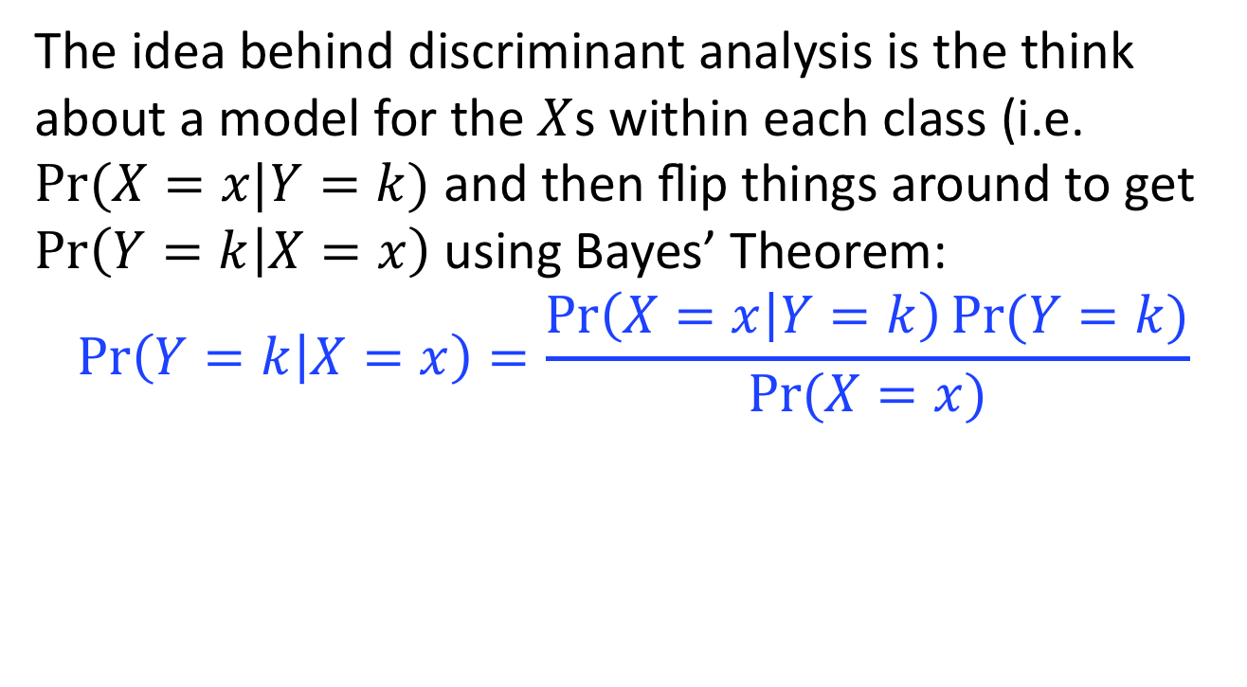
Discriminant analysis
The idea behind discriminant analysis is the think about a model for the $X$s within each class (i.e. $Pr⁡(X=x|Y=k)$ and then flip things around to get $\operatorname{Pr}\left(Y=k | X=x\right)$ using Bayes’ Theorem:
$$\operatorname{Pr}\left(Y=k | X=x\right)=\frac{\operatorname{Pr}\left(X=x | Y=k\right)Pr⁡(Y=k)}{Pr⁡(X=x)}$$
The Reverend Thomas Bayes 1701-1761
Work was published by Richard Price 1723-1791

Slide 30
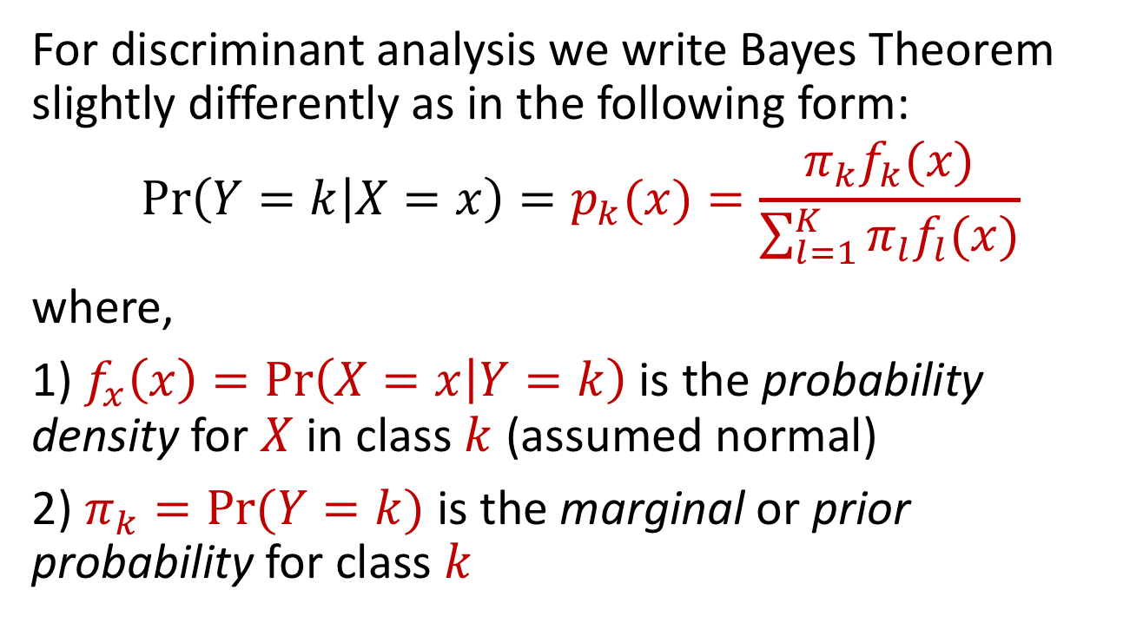
Discriminant analysis
For discriminant analysis we write Bayes Theorem slightly differently as in the following form:
$$\operatorname{Pr}\left(Y=k | X=x\right)=p_{k}(x)=\frac{π_{k}f_{k}(x)}{\sum_{l=1}^{K}{{π_{l}f}_{l}(x)}}$$
where,
1) $f_{x}\left(x\right)=\operatorname{Pr}\left(X=x | Y=k\right)$ is the probability density for $X$ in class $k$ (assumed normal)
2) $π_{k}=Pr⁡(Y=k)$ is the marginal or prior probability for class $k$

Slide 31
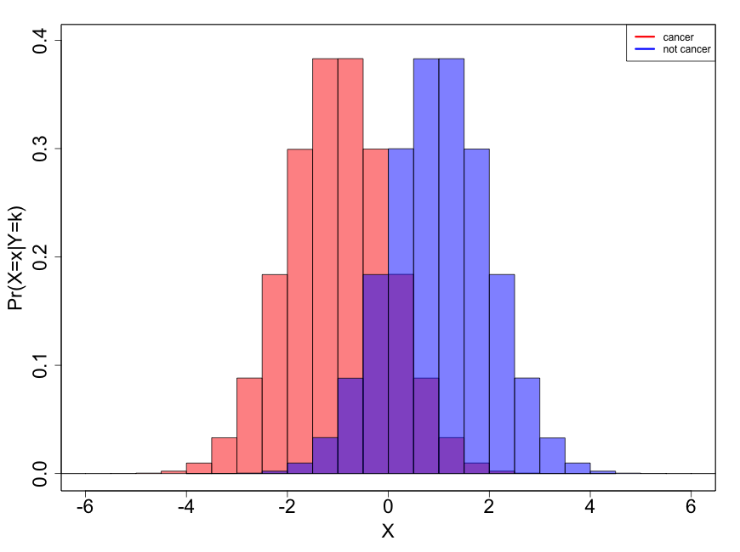
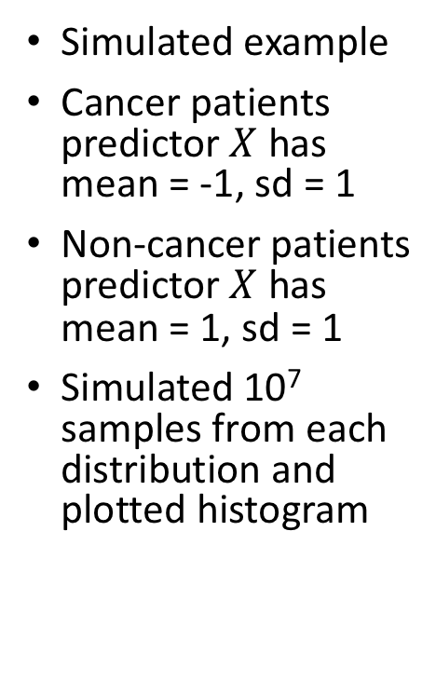
Equal prior probabilities
Simulated example
Cancer patients predictor $X$ has mean = -1, sd = 1
Non-cancer patients predictor $X$ has mean = 1, sd = 1
Simulated 10⁷ samples from each distribution and plotted histogram

Slide 32
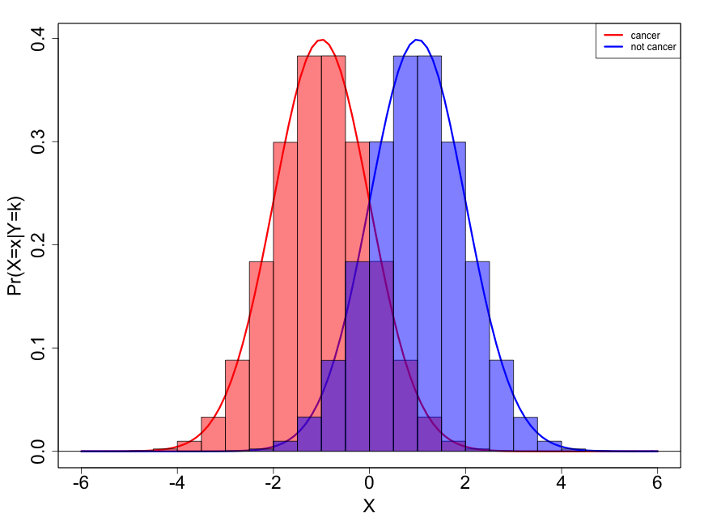
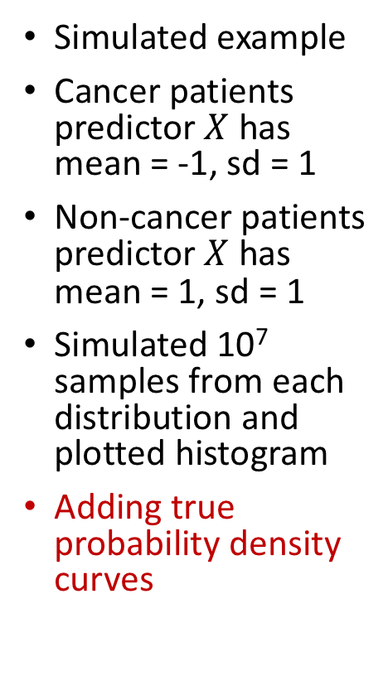
Equal prior probabilities
Simulated example
Cancer patients predictor $X$ has mean = -1, sd = 1
Non-cancer patients predictor $X$ has mean = 1, sd = 1
Simulated 10⁷ samples from each distribution and plotted histogram
Adding true probability density curves

Slide 33
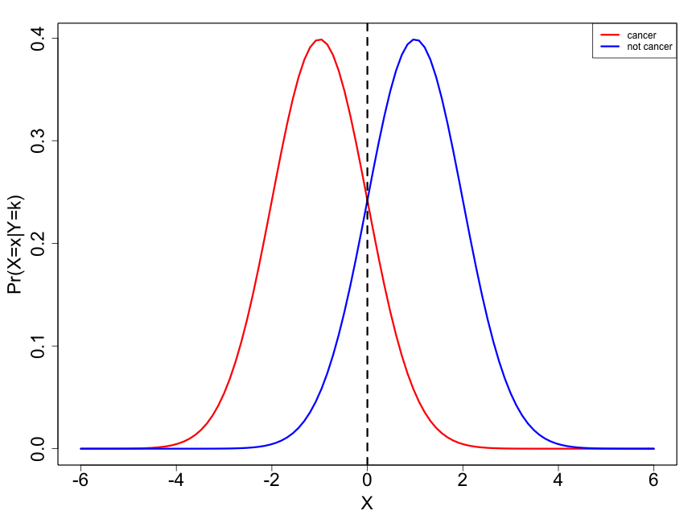
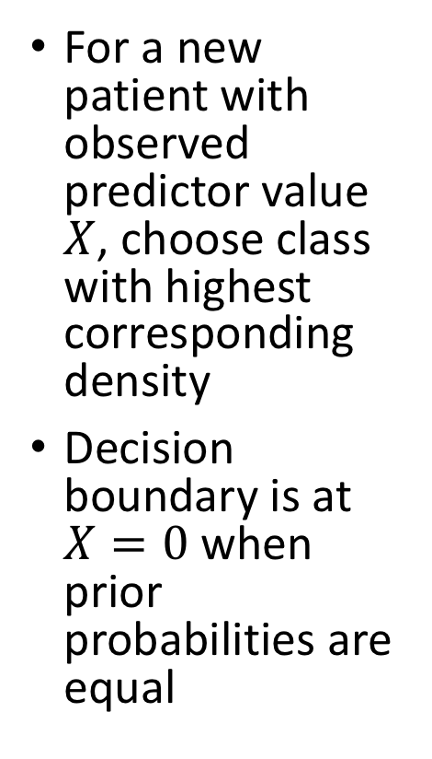
Equal prior probabilities
For a new patient with observed predictor value $X$, choose class with highest corresponding density
Decision boundary is at $X=0$ when prior probabilities are equal

Slide 34
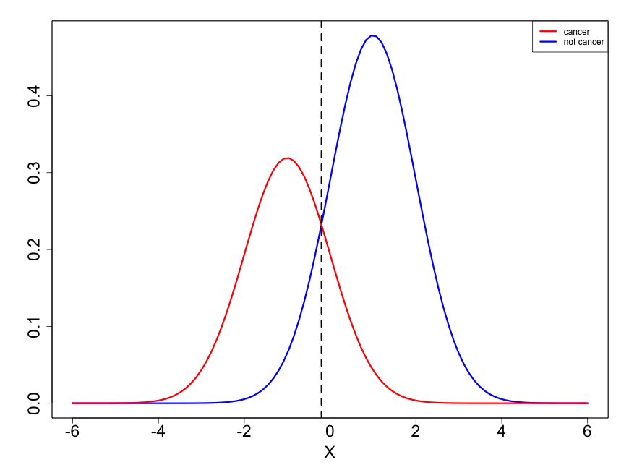
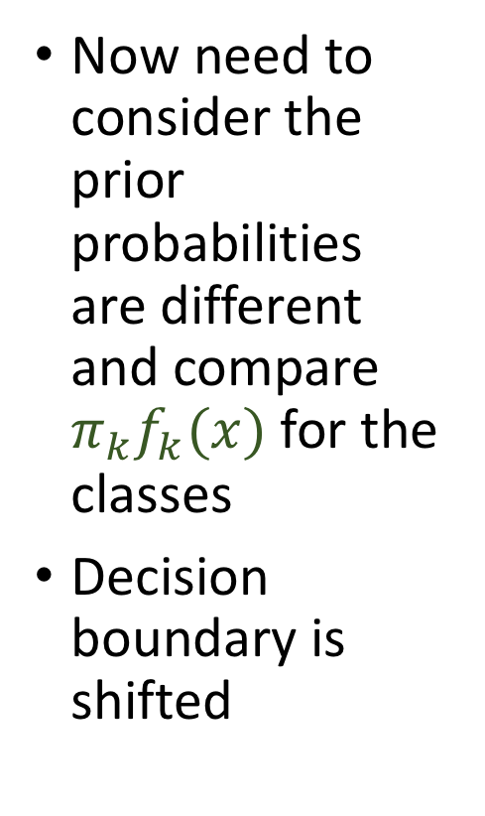

Unequal prior probabilities
Now need to consider the prior probabilities are different and compare $π_{k}f_{k}(x)$ for the classes
Decision boundary is shifted
$$π_{k}f_{k}(x)$$

Slide 35
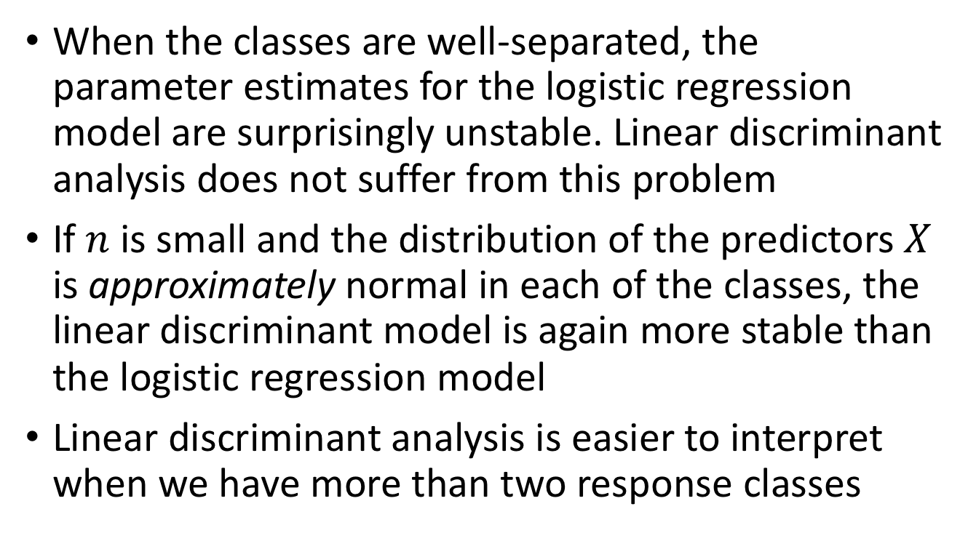
Why discriminant analysis vs. logistic regression?
When the classes are well-separated, the parameter estimates for the logistic regression model are surprisingly unstable. Linear discriminant analysis does not suffer from this problem
If $n$ is small and the distribution of the predictors $X$ is approximately normal in each of the classes, the linear discriminant model is again more stable than the logistic regression model
Linear discriminant analysis is easier to interpret when we have more than two response classes

Slide 36
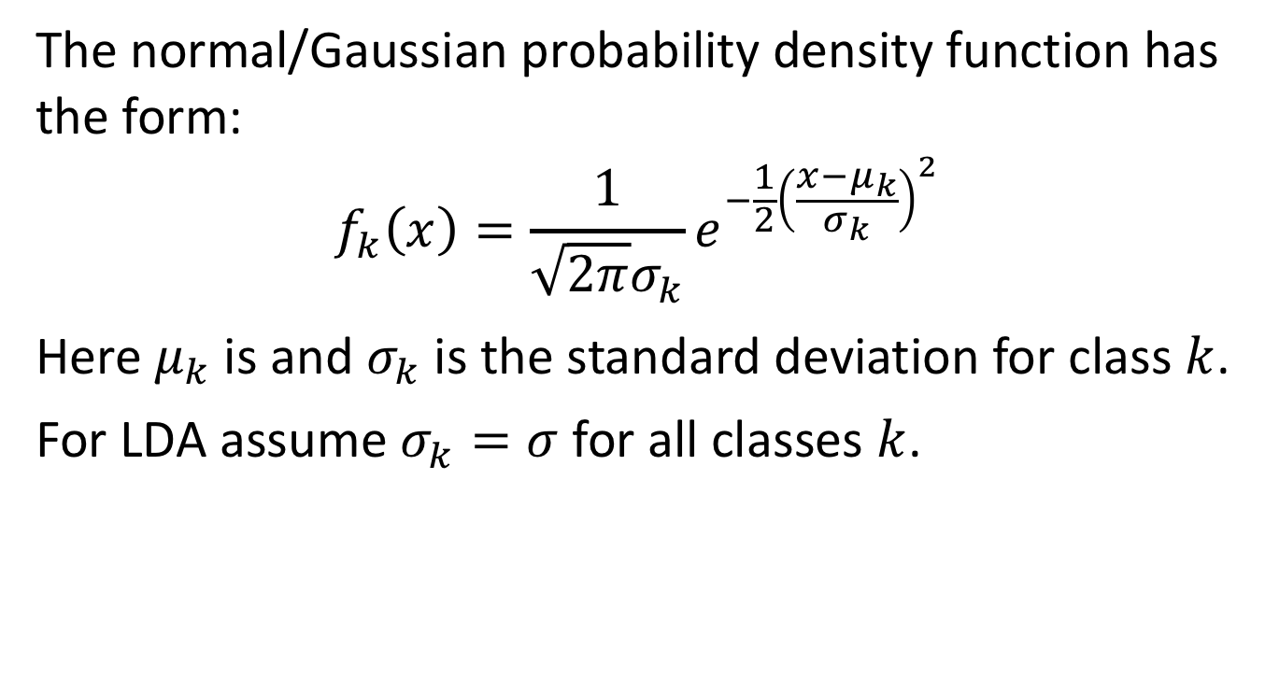

Linear discriminant analysis (LDA) with $p=1$
The normal/Gaussian probability density function has the form:
$$f_{k}\left(x\right)=\frac{1}{\sqrt{2π}σ_{k}}e^{−\frac{1}{2}{\left(\frac{x−μ_{k}}{σ_{k}}\right)}^{2}}$$
Here $μ_{k}$ is and $σ_{k}$ is the standard deviation for class $k$.
For LDA assume $σ_{k}=σ$ for all classes $k$.

Slide 37
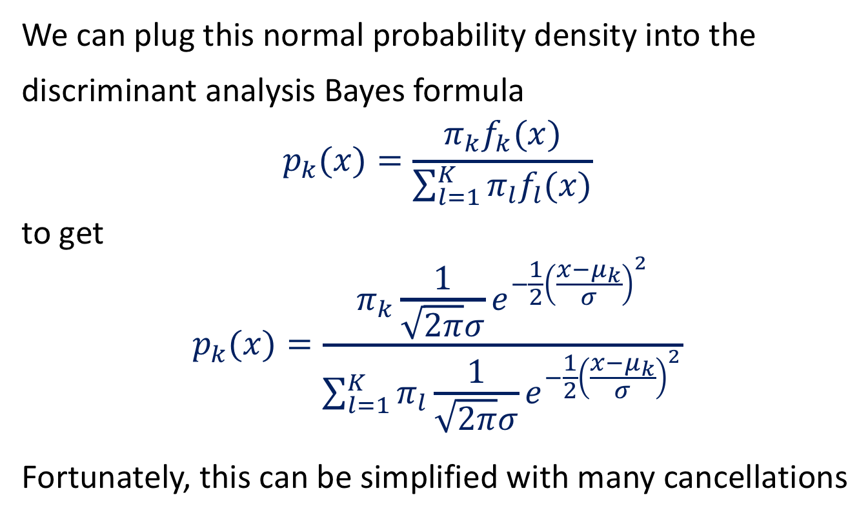

Linear discriminant analysis (LDA) with $p=1$
We can plug this normal probability density into the discriminant analysis Bayes formula
$$p_{k}(x)=\frac{π_{k}f_{k}(x)}{\sum_{l=1}^{K}{{π_{l}f}_{l}(x)}}$$
to get
$$p_{k}(x)=\frac{π_{k}\frac{1}{\sqrt{2π}σ}e^{−\frac{1}{2}{\left(\frac{x−μ_{k}}{σ}\right)}^{2}}}{\sum_{l=1}^{K}{π_{l}\frac{1}{\sqrt{2π}σ}e^{−\frac{1}{2}{\left(\frac{x−μ_{k}}{σ}\right)}^{2}}}}$$
Fortunately, this can be simplified with many cancellations

Slide 38
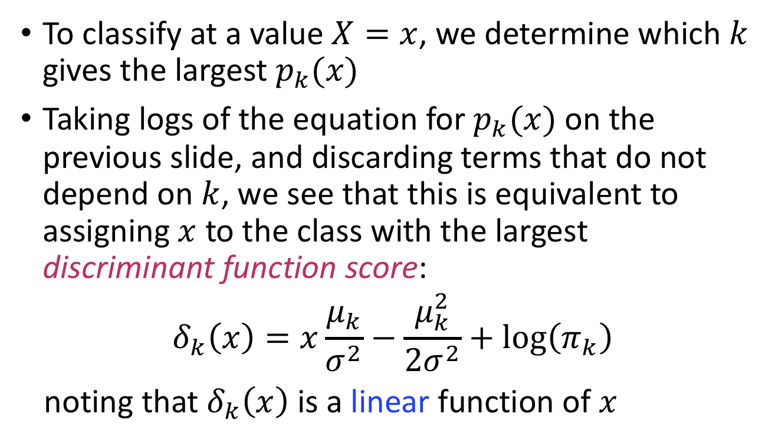
The discriminant function
To classify at a value $X=x$, we determine which $k$ gives the largest $p_{k}(x)$
Taking logs of the equation for $p_{k}(x)$ on the previous slide, and discarding terms that do not depend on $k$, we see that this is equivalent to assigning $x$ to the class with the largest discriminant function score:
$$δ_{k}\left(x\right)=x\frac{μ_{k}}{σ^{2}}−\frac{μ_{k}^{2}}{2σ^{2}}+\log\left(π_{k}\right)$$
noting that $δ_{k}\left(x\right)$ is a linear function of $x$

Slide 39
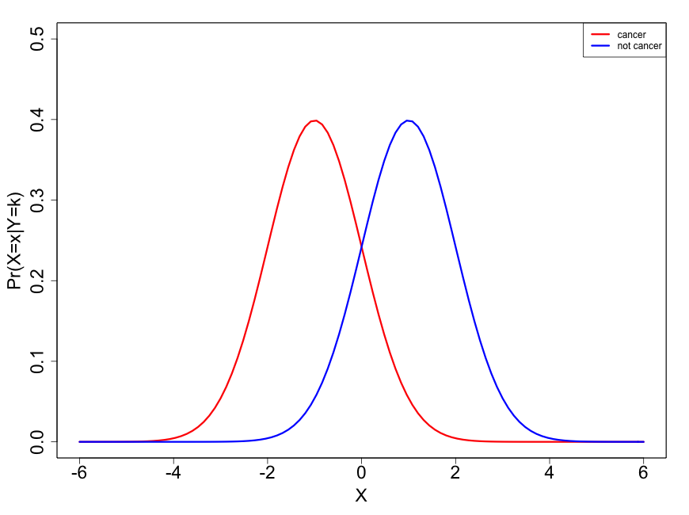
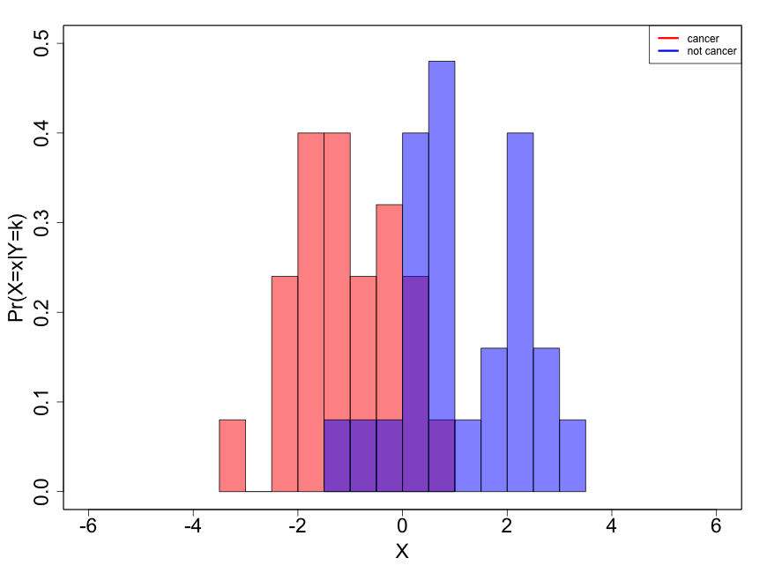

We don’t know $μ_{k}$’s or $σ$
With a sample like on the right (25 in each group) we need to get an estimate of the parameters which of course will be estimated with more error than if we have 10⁷ in each group like before

Slide 40
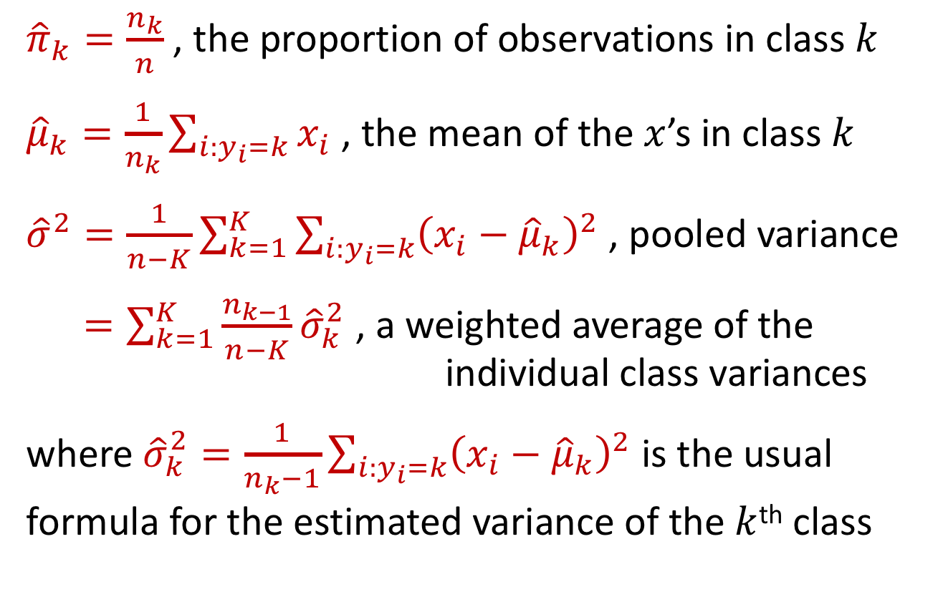

Estimating $μ_{k}$’s, $σ$, and $π_{k}$’s
${\hat{π}}_{k}=\frac{n_{k}}{n}$ , the proportion of observations in class $k$
${\hat{μ}}_{k}=\frac{1}{n_{k}}\sum_{i:y_{i}=k}{x_{i}}$ , the mean of the $x$’s in class $k$
${\hat{σ}}^{2}=\frac{1}{n−K}\sum_{k=1}^{K}{\sum_{i:y_{i}=k}{{\left(x_{i}−{\hat{μ}}_{k}\right)}^{2}}}$ , pooled variance
$=\sum_{k=1}^{K}{\frac{n_{k−1}}{n−K}{\hat{σ}}_{k}^{2}}$ , a weighted average of the
individual class variances
where ${\hat{σ}}_{k}^{2}=\frac{1}{n_{k}−1}\sum_{i:y_{i}=k}{{\left(x_{i}−{\hat{μ}}_{k}\right)}^{2}}$ is the usual formula for the estimated variance of the $k$^{th} class

Slide 41
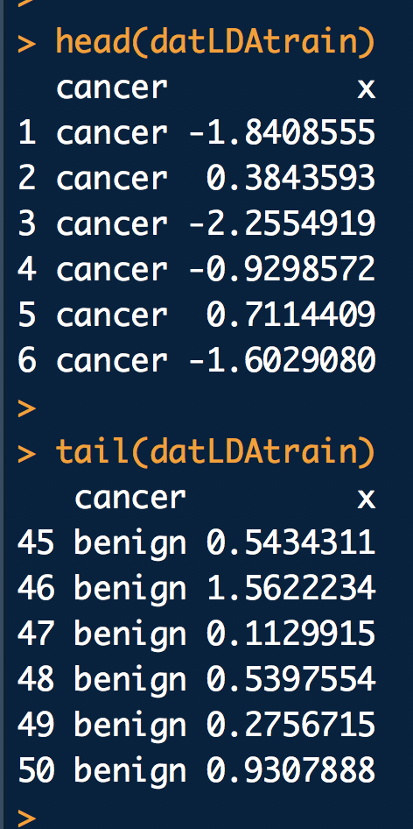
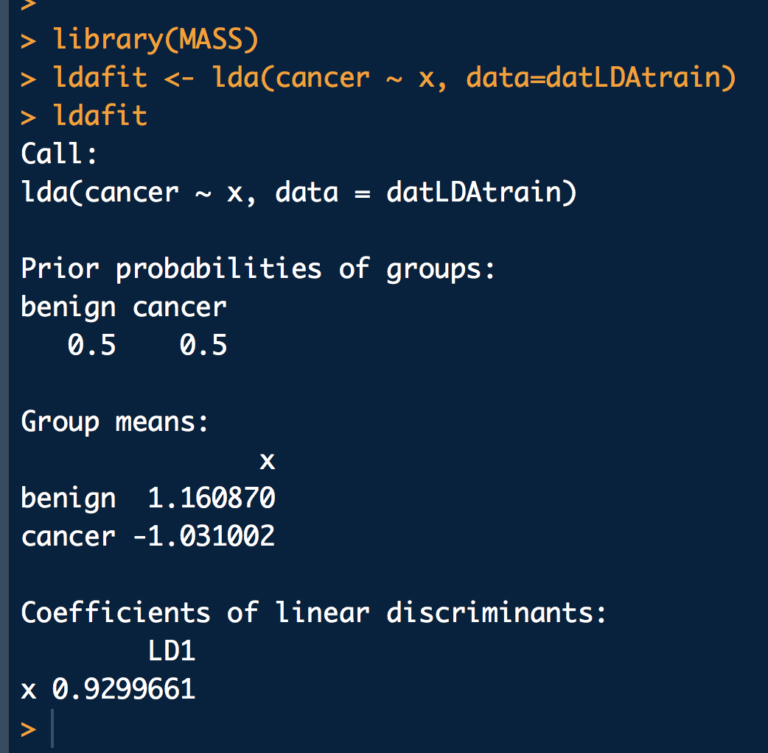
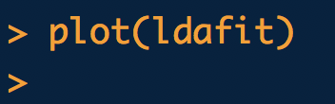
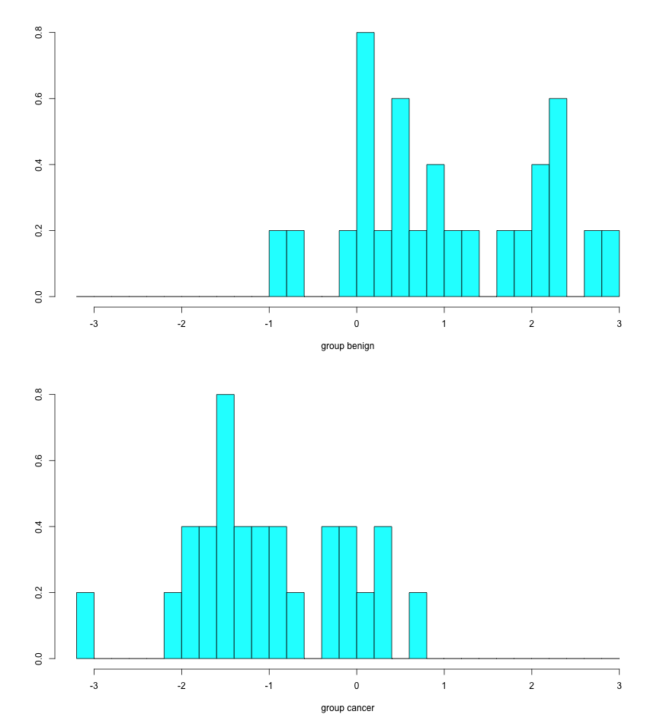
Running LDA in R
Training data
Running in R
Plotting in R

Slide 42
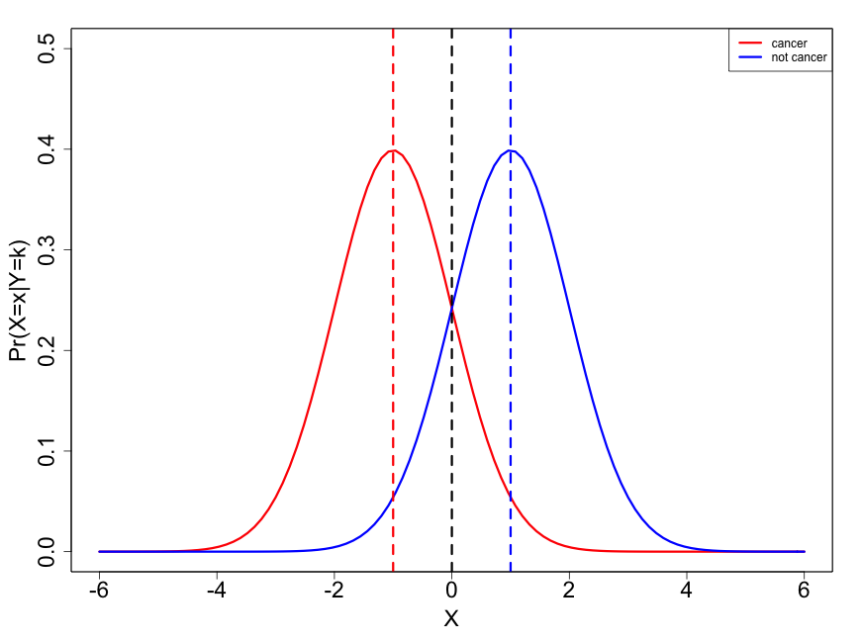

We don’t know $μ_{k}$’s or $σ$
True mean
True mean
Estimated mean
Optimal threshold
LDA estimated threshold
Optimal threshold

Slide 43
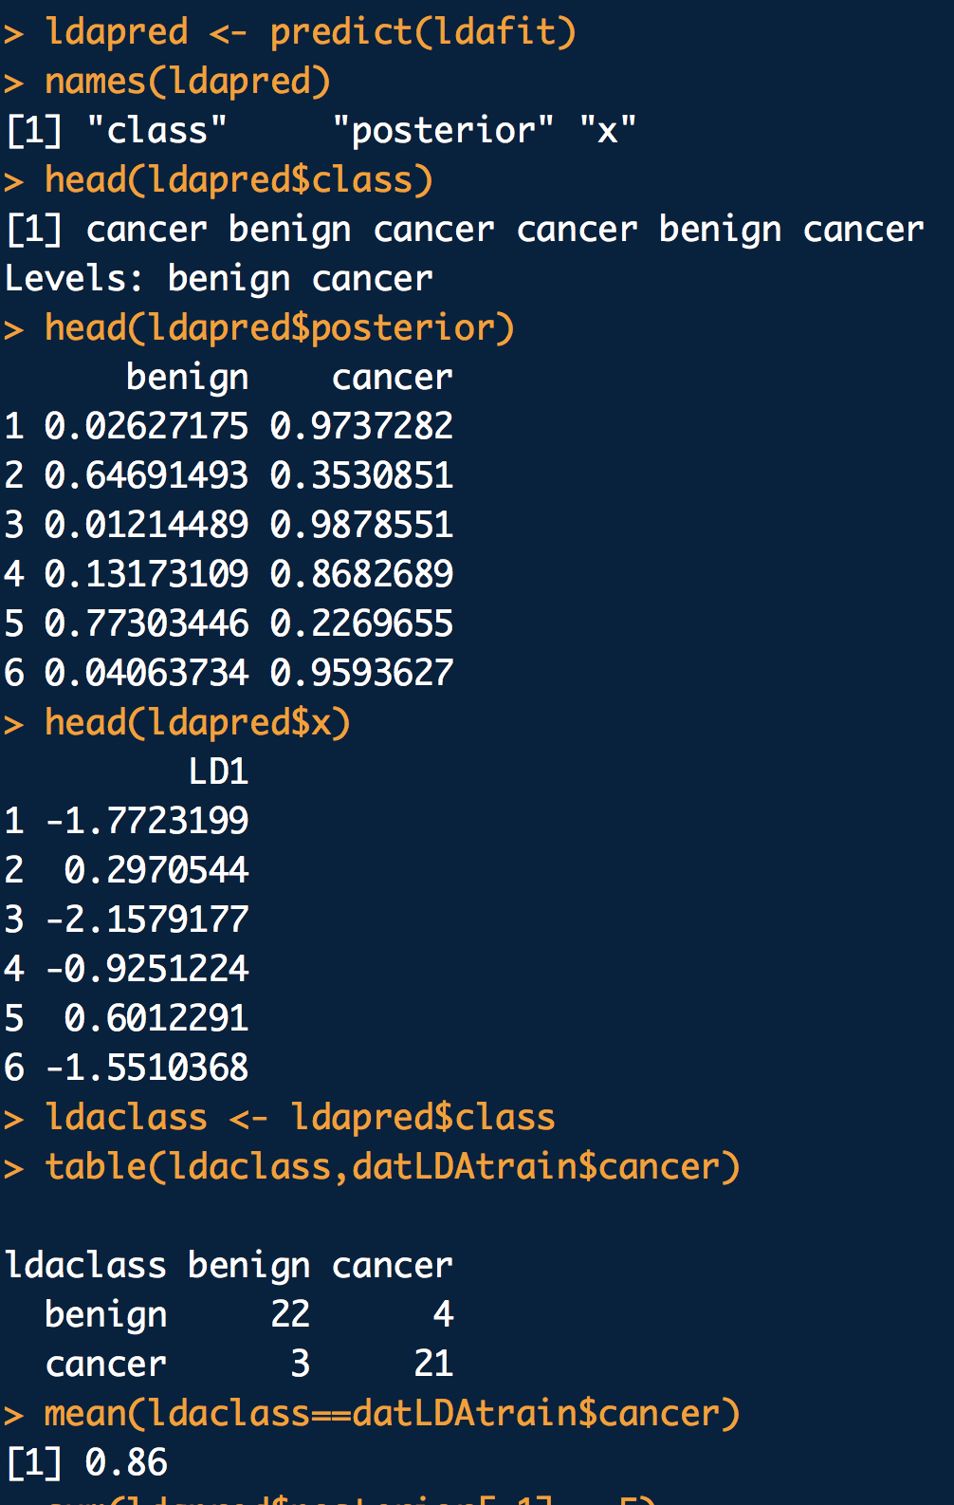
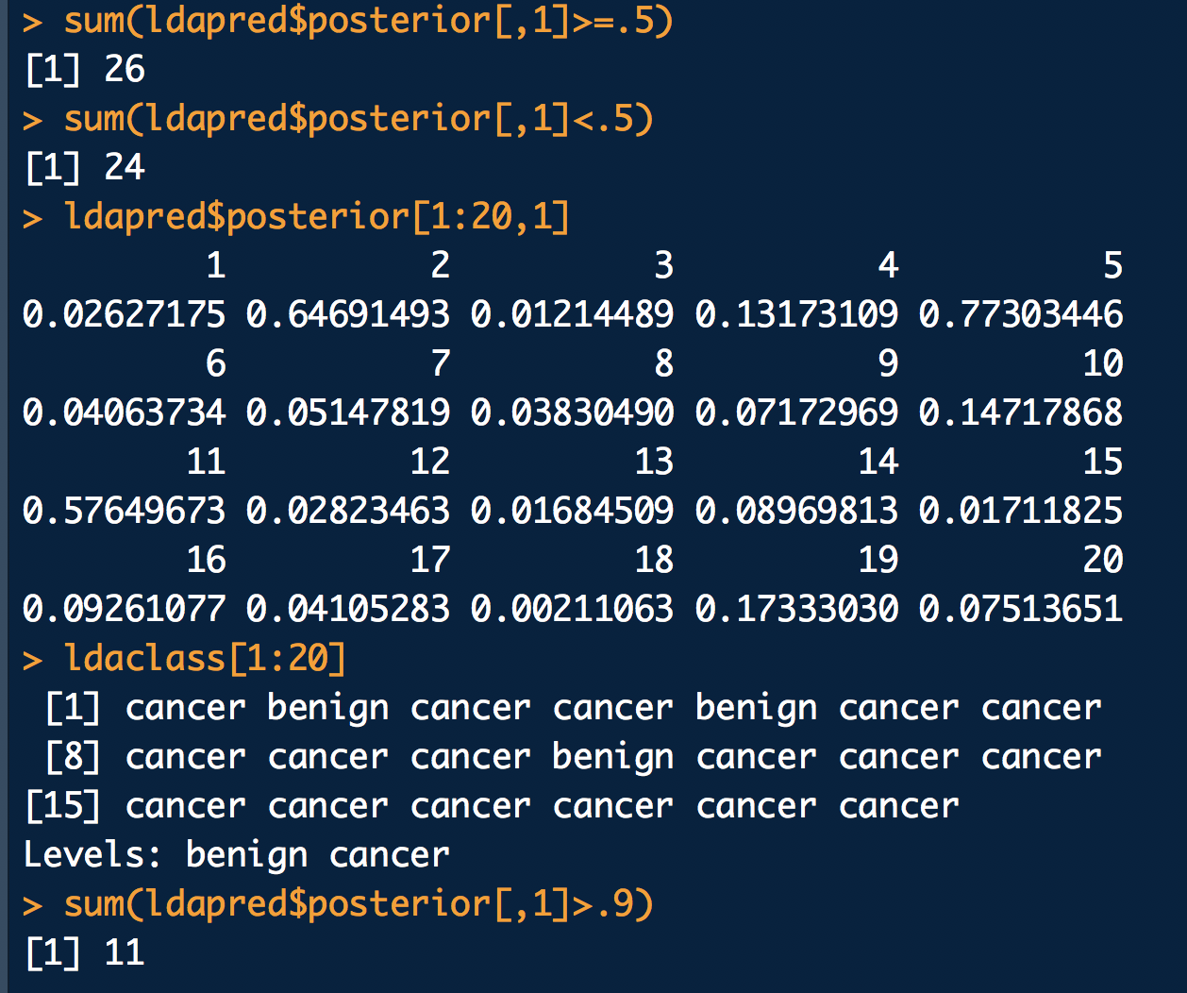
Assessing the prediction quality (training)
But this is assessing the fit on the training data. What about looking at independent test data?

Slide 44

Assessing the prediction quality (test)

Slide 45


What if we want to change the prior probabilities
What if our data was from a matched case-control study (1:1) but we know that the prior probabilities at clinic will be in the proportion 80% non-cancer to 20% cancer. We may want to adjust our decision process to optimize with respect to these proportions.

Slide 46


LDA when $p>1$
Interested reader can look at the math in ISLR Ch. 4
However, an important note here is that SD’s for each variable and correlations between them are assumed to be the same for each group – this blows up to a lot of parameter assumptions when number of predictors gets large

Slide 47



Illustration: $p=2$ and $K=3$
Here $π_{1}=π_{2}=π_{3}=1/3$
Dashed lines are the Bayes decision boundaries – if they were known then they would give fewest misclassification errors on average among all possible classifiers

Slide 48


LDA with 2 predictors in R
Go back to the breast cancer data

Slide 49


Getting probabilities from $δ_{k}(x)$
Once we have estimates ${\hat{δ}}_{k}(x)$ we can extract class probabilities
$$\hat{Pr}\left(Y=k | X=x\right)=\frac{e^{{\hat{δ}}_{k}(x)}}{\sum_{l=1}^{K}{e^{{\hat{δ}}_{l}(x)}}}$$
So classifying to largest ${\hat{δ}}_{k}(x)$ gives the same answers as classifying to the largest $\hat{Pr}\left(Y=k | X=x\right)$
E.g., if $K=2$, then classify to class 2 if $\hat{Pr}\left(Y=k | X=x\right) ≥0.5$, otherwise classify as class 1

Slide 50
Summary
Supervised learning methods for classification
  Logistic and multinomial regression
  Linear discriminant analysis

Slide 51

Announcement

Slide 52
Next Lecture
Matrix algebra
Loss functions and optimization
  Gradient descent
Cross-validation methods
Neural networks?

