Slide 1
Systematic Review Lecture 2:
Protocol, Search, Study Selection, Quality Assessment, Data Abstraction
Stephen Bent, MD
Professor of Medicine, Epidemiology & Biostatistics, Psychiatry
University of California, San Francisco

Slide 2
8 Steps of Systematic Review
1. Research Question
2. Protocol
3. Search
4. Study selection (inclusion/exclusion)
5. Quality assessment
6. Data abstraction
7. Analysis
  A) Create summary measure
  B) Assess for heterogeneity
  C) Assess for publication bias
  D) Conduct sensitivity/subgroup analyses
  E) Advanced issues/techniques
8. Interpretation

Slide 3
Protocol
PRISMA Statement: checklist, Methods, item #5: Protocol and registration: Indicate if a review protocol exists, if and where it can be accessed (e.g., Web address), and, if available, provide registration information including registration number.
PROSPERO: https://www.crd.york.ac.uk/prospero/

Slide 4
PROSPERO
Step 1 : Check the inclusion criteria to make sure that your review is eligible for inclusion in PROSPERO
Step 2: Ensure that your review protocol is in its (near) final form
Step 3: Search PROSPERO to ensure that your review has not already been registered by another member of your team
Step 4: Search PROSPERO to ensure that you are not unnecessarily duplicating a review that is being done by another team
Step 5: Start registering your review

Slide 5
PROSPERO Inclusion Criteria
PROSPERO includes details of any ongoing systematic review that has a health related outcome in the broadest sense. Reviews may be of interventions, diagnosis, service delivery, prognostic factors, risk factors, genetic associations, and epidemiological reviews relevant to health and social care, welfare, public health, education, crime, justice, and international development, as long as there is a health related outcome.

Slide 6
PROSPERO Items
1. Review title
2. Original language title
3. Anticipated or actual start date
4. Anticipated completion date
5. Stage of review at time of this submission
6. Named contact
7. Named contact email
8. Named contact address
9. Named contact phone number
10. Organisational affiliation of the review

Slide 7
PROSPERO Items
11. Review team members and their organisational affiliations
12. Funding sources/sponsors
13. Conflicts of interest
14. Collaborators
15. Review question
16. Searches
17. URL to search strategy
18. Condition or domain being studied
19. Participants/population
20. Intervention(s), exposure(s).

Slide 8
Search
Whit will cover today

Slide 9
Study Selection: Which studies to include?
Related to feasibility
For most interventions, include all RCT’s
  With target population
  The desired intervention
  The desired outcome
You may find that you have to narrow or broaden the inclusion criteria as you do your initial searches (pre-protocol investigation)

Slide 10
Step 6: Quality Assessment
Dozens of quality assessment scales available
No consensus
Jadad score (0-5 point scale)
  Was the study randomized?
  Was the randomization appropriate?
  Was the study double-blind?
  Was the double-blinding appropriate?
  Were dropouts and withdrawals accounted for?
Jadad 1996. Controlled Clinical Trials; 17:1-12.
Notes:
Some studies will perform sensitivity analyses and re-analyze the data with only the highest quality studies – this is controversial, because different scales have been shown to rate the same studies differently.
We chose not to perform quality assessments (at the time, it was not as in vogue as it is now). But we did limit to double-blind, placebo controlled RCTs

Slide 11
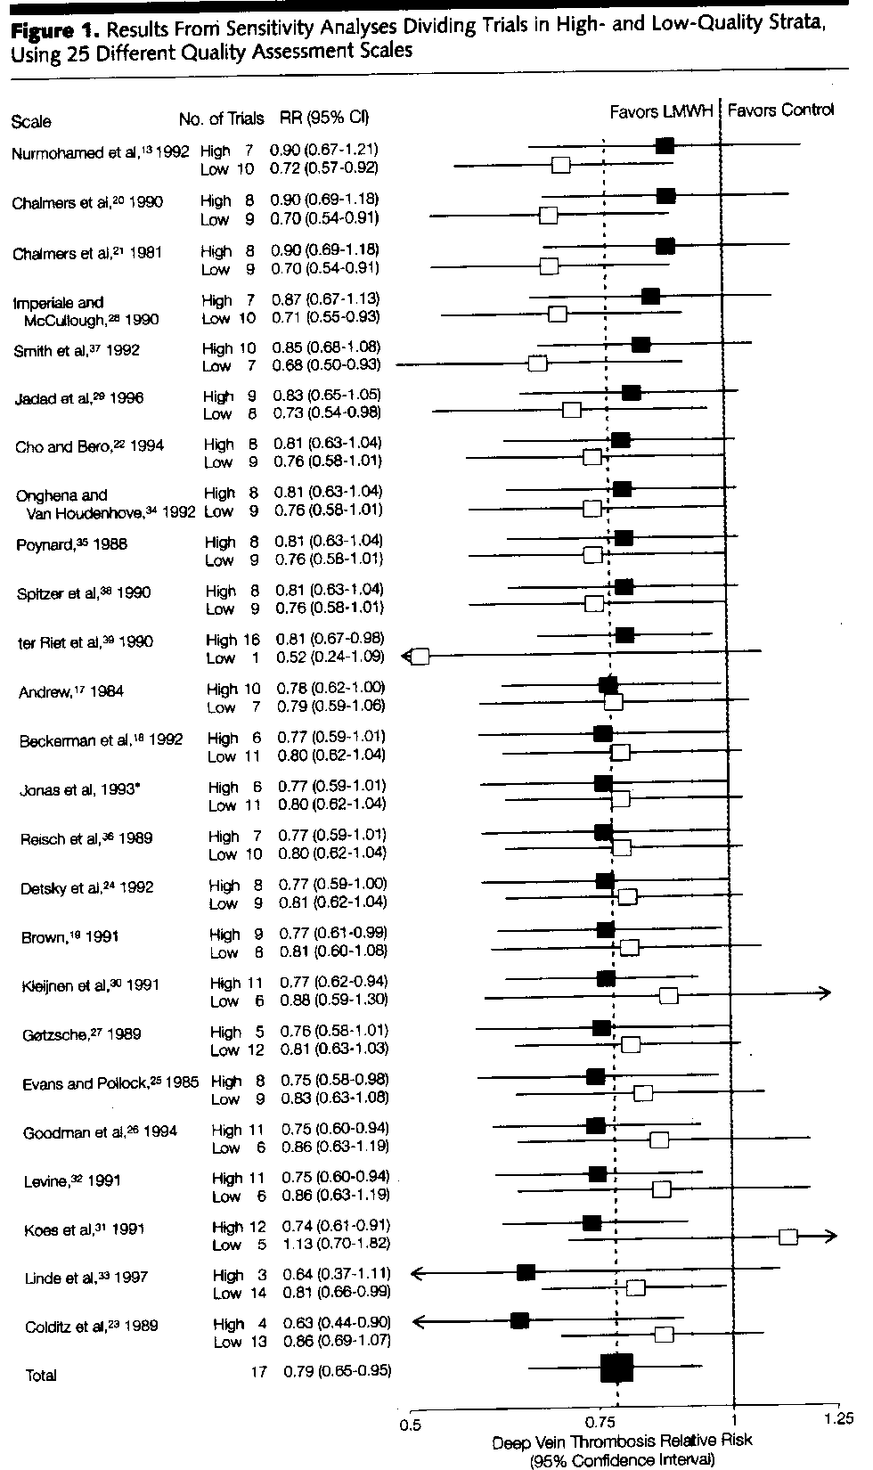
Juni et al, Hazards of
scoring the quality of
clinical trials.
JAMA. 1999;282:1054-60.
Notes:
Quality assessment scales and change in summary measure, when quality scores are used to exclude studies. Relative risks (RRs) for deep vein thrombosis with 95% confidence intervals (CIs) are shown. LMWH indicates low-molecular-weight heparin. Blacksquares indicate estimates from high-quality trials and open squares indicate estimates from low-quality trials. Arrows indicate that the values are outside the range of the x axis. Broken line indicates combined estimate from all17 trials. Solid line indicates null effect line. The scales are arranged in decreasing order of the RRs in trials deemed to be of high quality. Asterisk indicates unpublished scale.

Slide 12
Cochrane Collaboration “Risk of Bias Tool”
Random sequence generation
Allocation concealment
Blinding of participants and personnel
Blinding of outcome assessment
Incomplete outcome data
Selective reporting
Other sources of bias

Slide 13
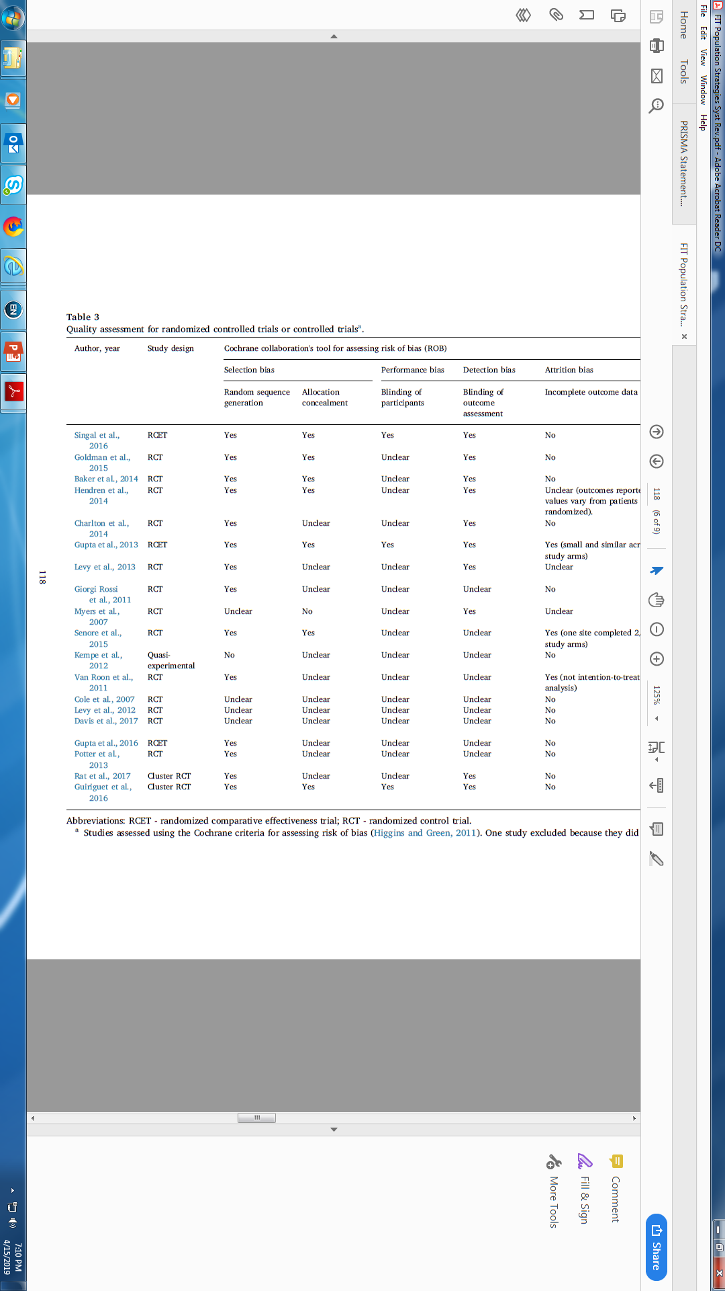

Slide 14
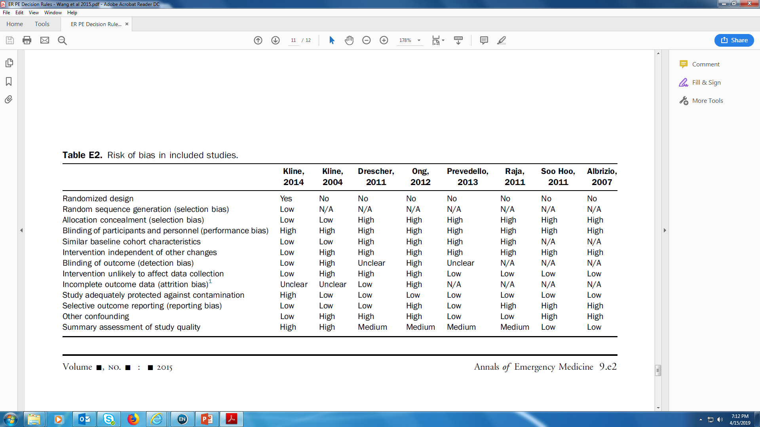

Slide 15
Data Abstraction
Excel!
Think about your Table 1 – organize accordingly

Slide 16
